Slide 1
First draft assessment of radiation classification zoning in the ECN3 cavern
Fred Aberle – HSE-RP-AS

Slide 2
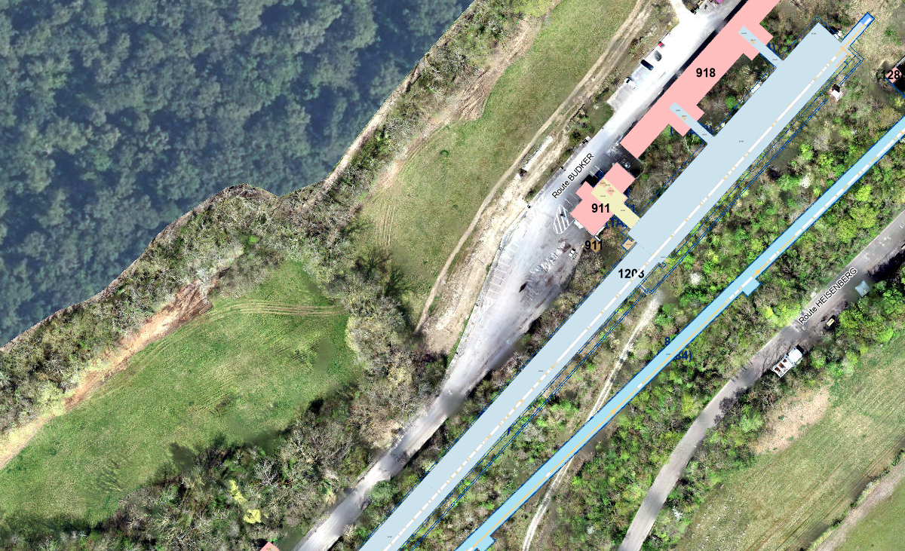
Situation

Slide 3
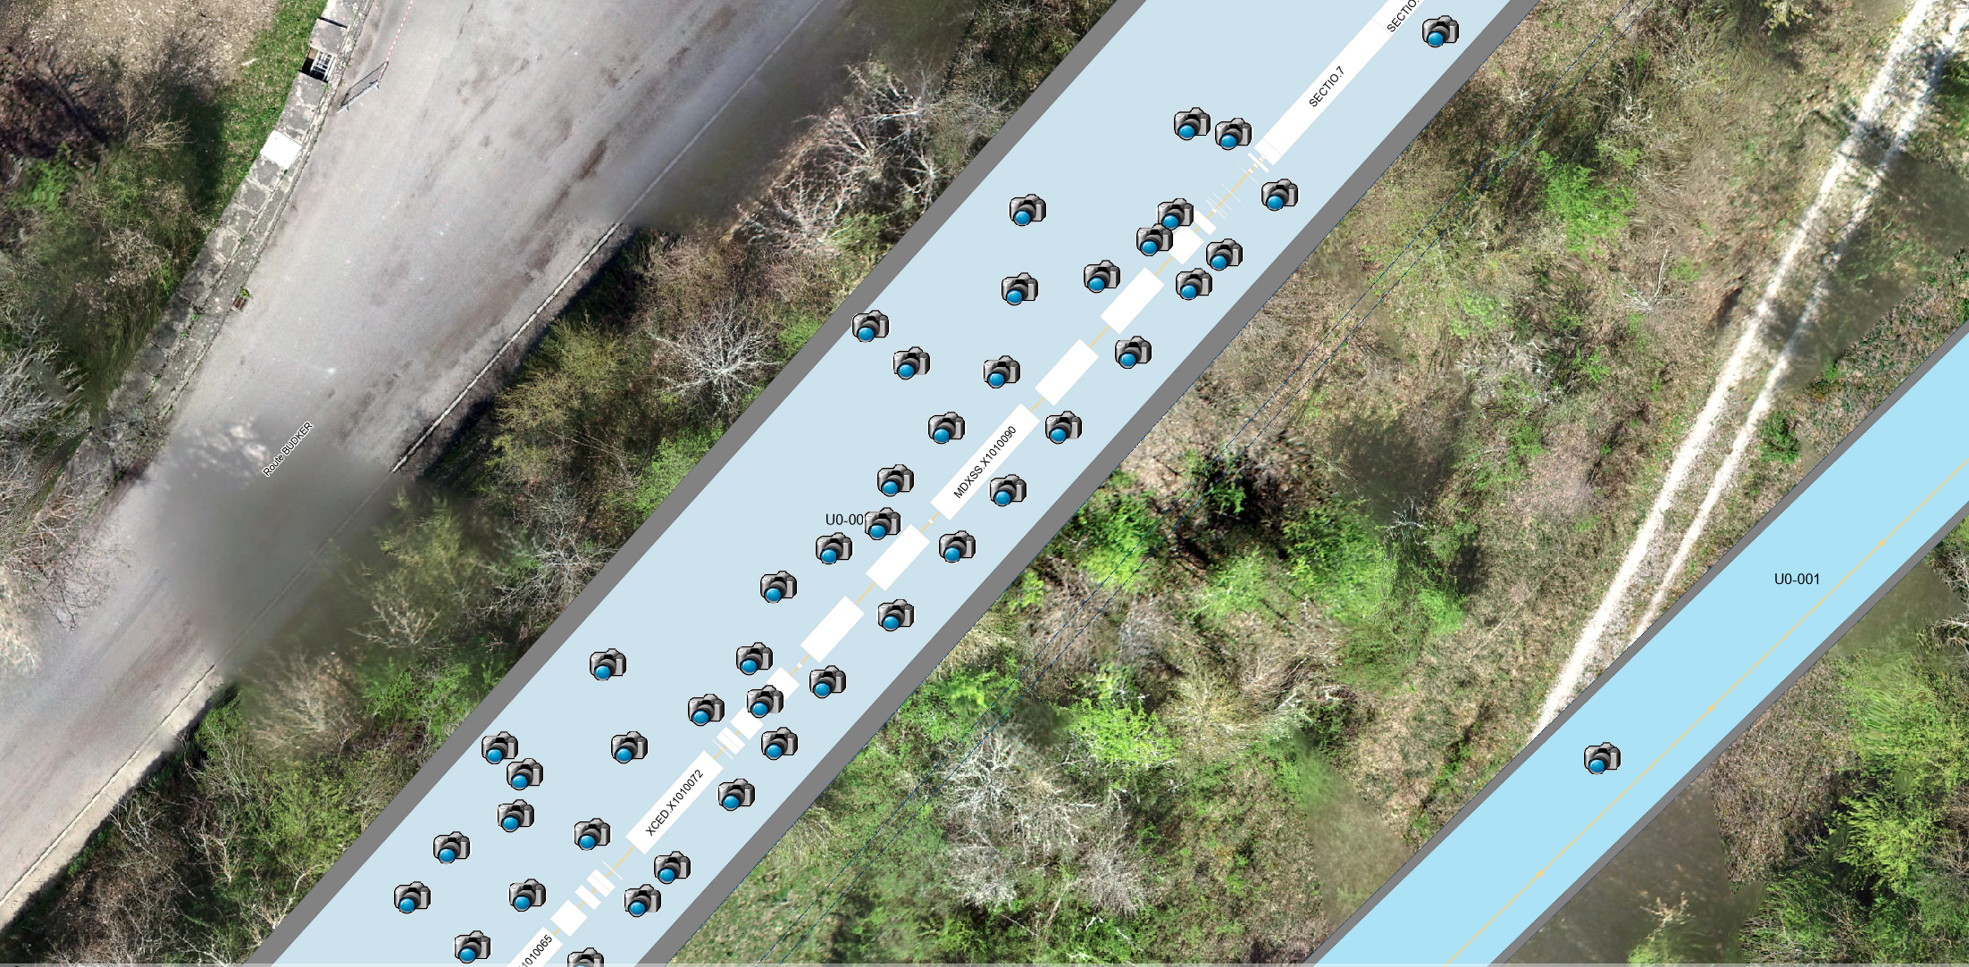
Survey done on the 10.10.24 (14h00 – 14h30)
Beam cut at 07h20: 6h40 decay
All values are raw values: background to be subtracted
340 cps
80 cps
420 cps
140 cps
150 cps
380 cps
420 cps
550 cps
4000 cps
1000 cps

Slide 4
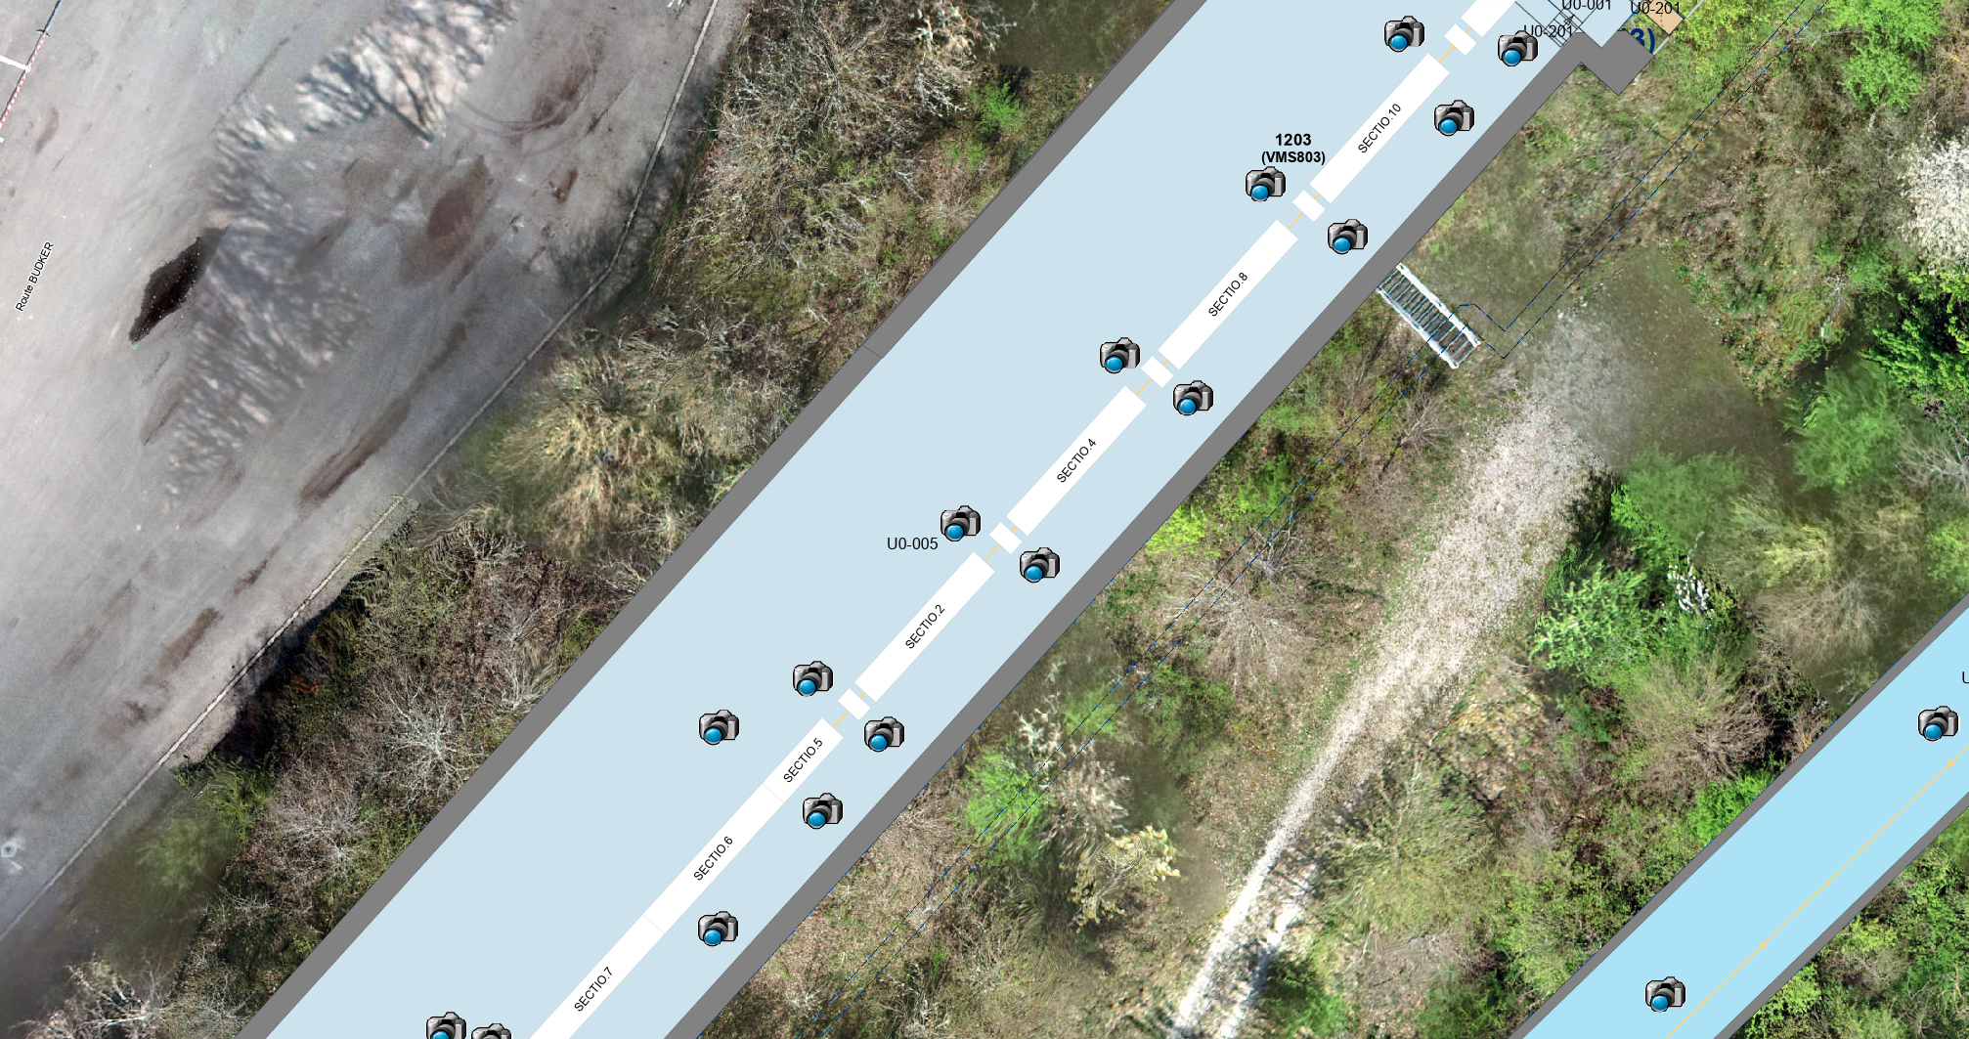
Survey done on the 10.10.24 (14h00 – 14h30)
Beam cut at 07h20: 6h40 decay
All values are raw values: background to be subtracted

Slide 5
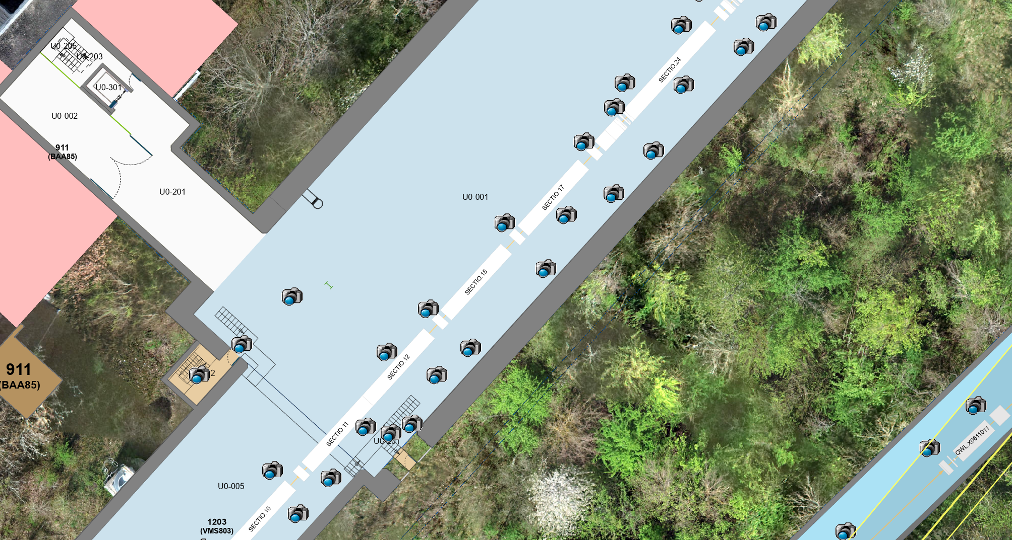
Survey done on the 02.10.24 (09h35 – 10h30)
Beam cut at 08h35: 1h decay
All values are raw values: background to be subtracted
95 cps
55 cps
75 cps
85 cps
Activated air measured in TCC8 part of ECN3. Not possible to perform BGO scan with activated air background -> second survey planned

Slide 6
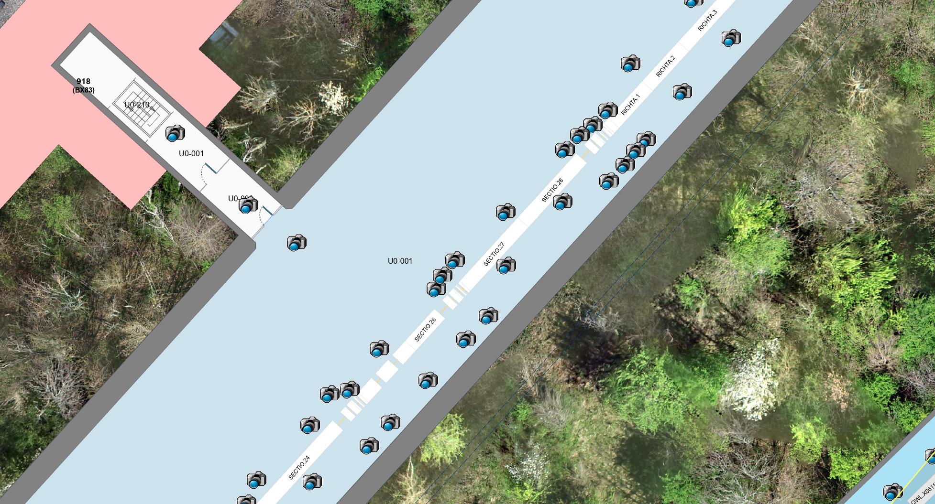
Survey done on the 02.10.24 (09h35 – 10h30)
Beam cut at 08h35: 1h decay
All values are raw values: background to be subtracted
55 – 60 cps at contact (background)

Slide 7
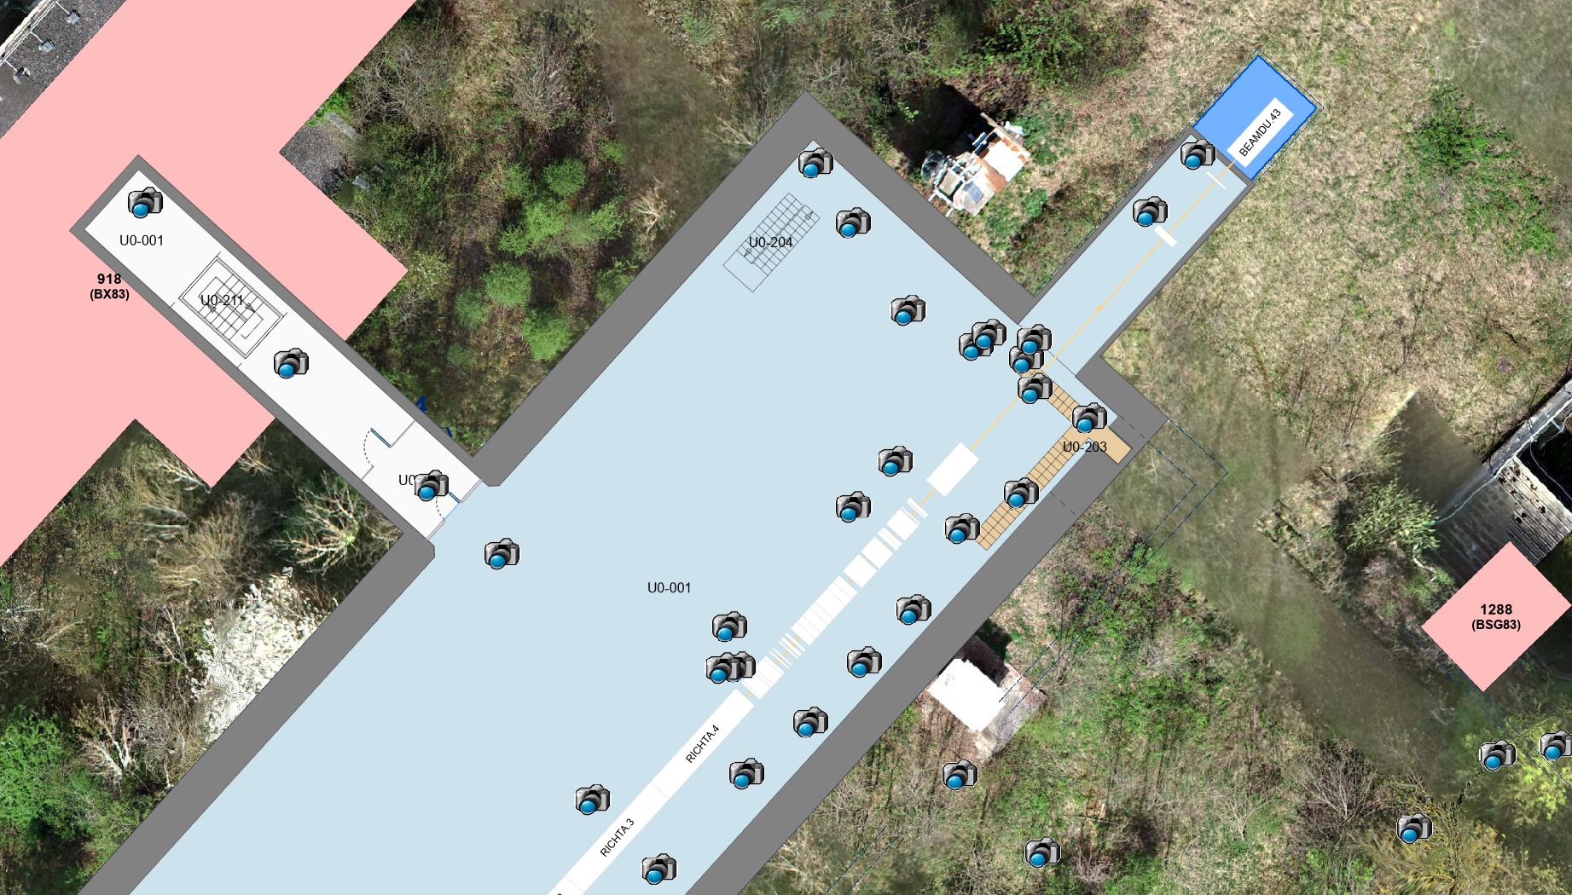
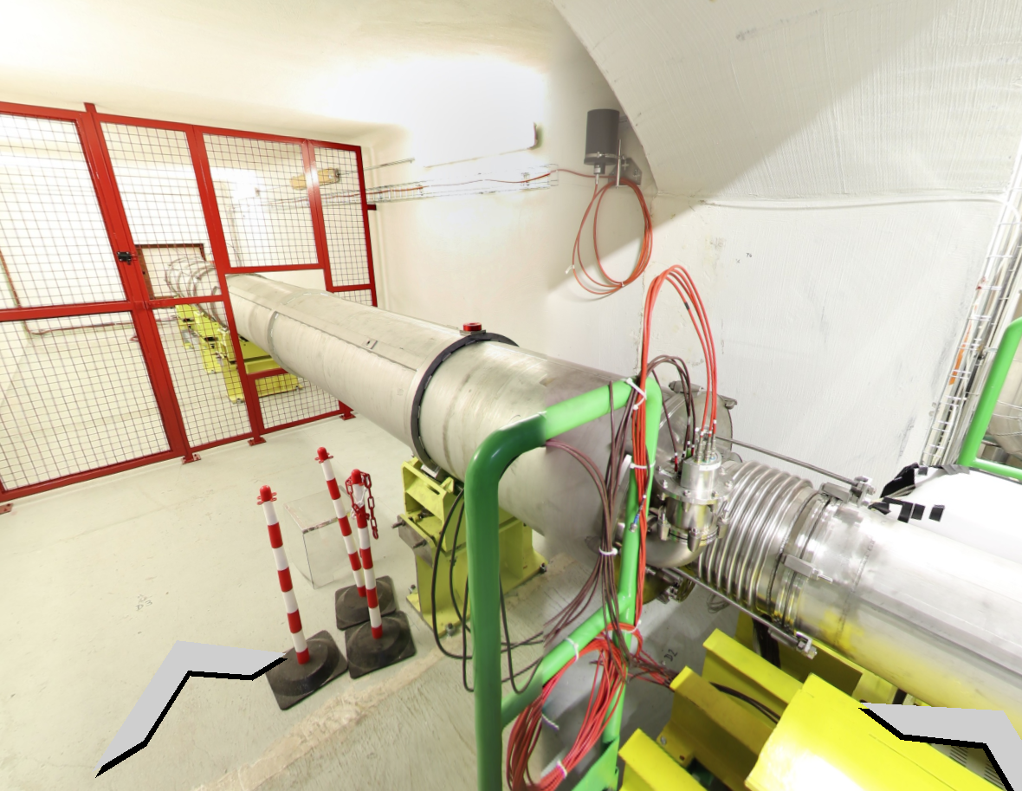
Survey done on the 02.10.24 (09h35 – 10h30)
Beam cut at 08h35: 1h decay
All values are raw values: background to be subtracted
Tube before beam dump
Sample n°20
180 cps at 1m of the beam pipe
1500 cps, 2.5 uSv/h on contact of the beam pipe
1200 cps, 2 uSv/h
200 cps, 0.3 uSv/h

Slide 8
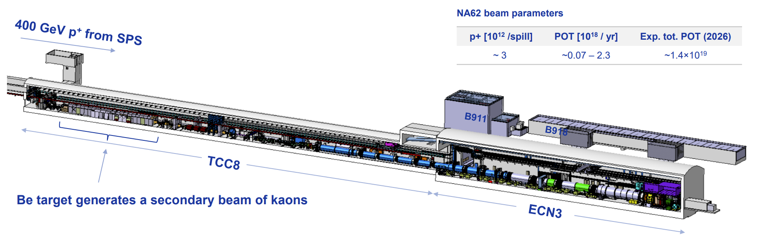
First operational clearance proposal
Red: To be considered a priori radioactive
Orange: To be studied case by case
The rest: To be considered a priori non-radioactive (except for in beam material)

Slide 9
Radiological measurements of material and waste at CERN
HSE-RP defines a zoning of Radiation Areas that implies different measurement procedures
Global control zone:
  All material is considered a priori non-radioactive (neither activation nor contamination risk)
  Verification measurement is sufficient
Individual control zone
  All material is considered potentially radioactive
    Exceptions for tools and equipment that was only in the zone without beam
  Clearance measurement must be performed individually
All measurements are traced in a database -> TREC
Certificates can be generated via TREC or specifically upon request.

