Slide 1
TCC8: Update of Decommissioning FLUKA Simulations with LS3 Shift Date
RP studies for TCC8 dismantling
August 2024
F. Luoni, C. Ahdida
EDMS 3180993

Slide 2
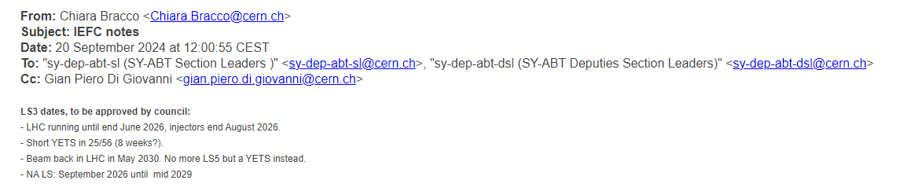
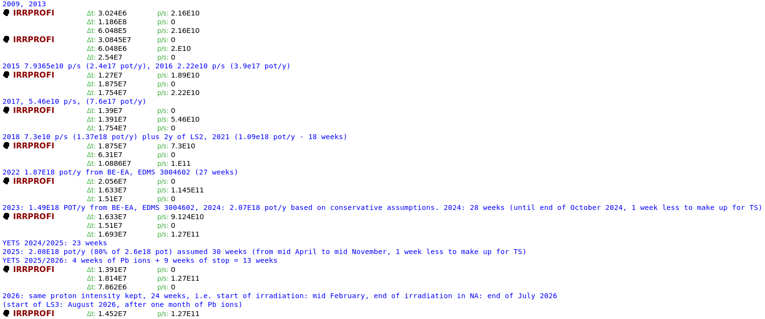
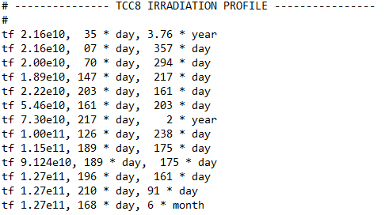
LS3 Shift : Updated Irradiation Profile
FLUKA simulations:
ActiWiz studies:
ª
ª 7.94*10¹⁰ is the value that was mistakenly used for 2015, but it was proven that it has no effect on the results

Slide 3
Other Simulation Details
TCC8 Geometry: given by BE-EA and updated as described in EDMS Document 3086822
TCC8 Tunnel and Shielding Blocks Concrete Compositions: updated as described in EDMS Document 3156461
Magnetic Fields correct, checked by BE-EA (see EDMS Document 3160904)
Dates of Interest
July 2026 = end of R3 in the NA (August 2026 is foreseen to be Pb ions at the LHC only)
January 2027 (6 months after the end of R3) = earliest date for the TCC8 dismantling
September 2027 (1 year and 2 months after the end of R3) = latest date of TCC8 dismantling with goal to minimize the overlap with NA-CONS activities

Slide 4
Residual Dose Rates Updated Maps

Slide 5
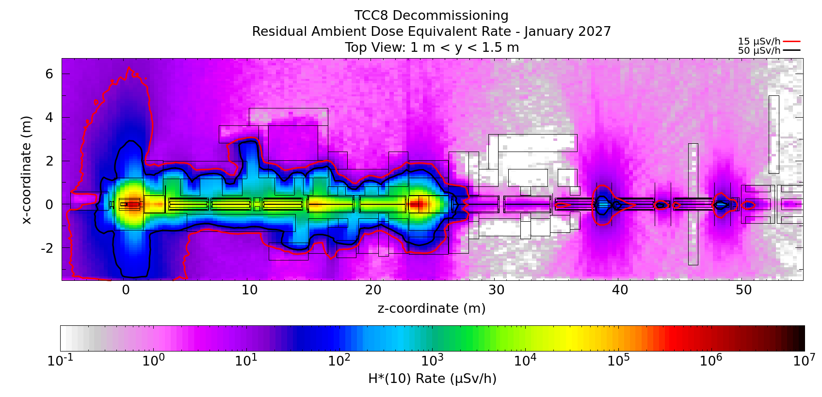
Residual Dose Rate - Top View – 6 Months of Cooldown (January 2027)
The radiation levels are high in the location of the target station and iron collimator

Slide 6
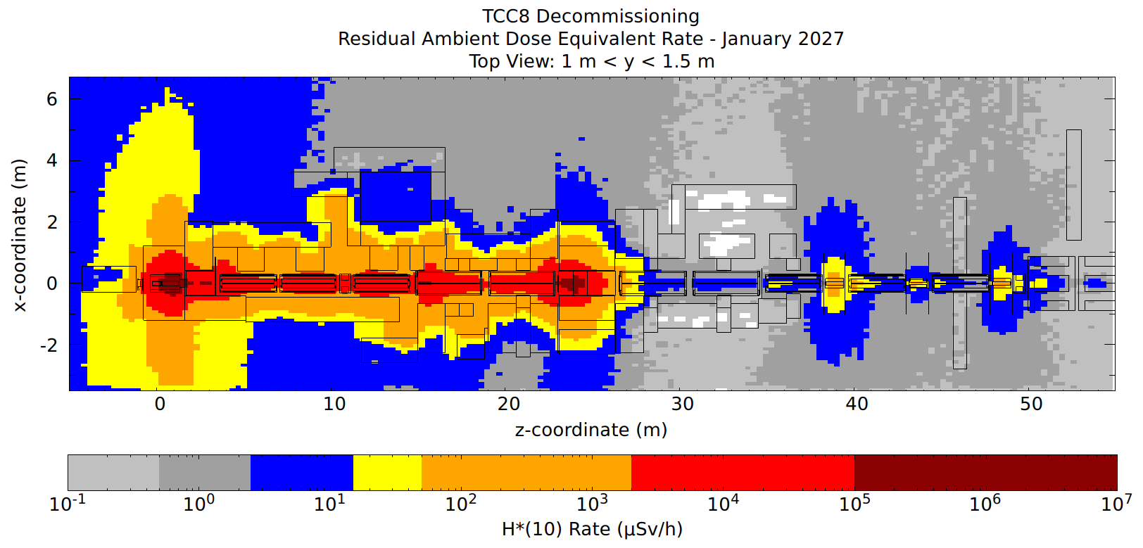
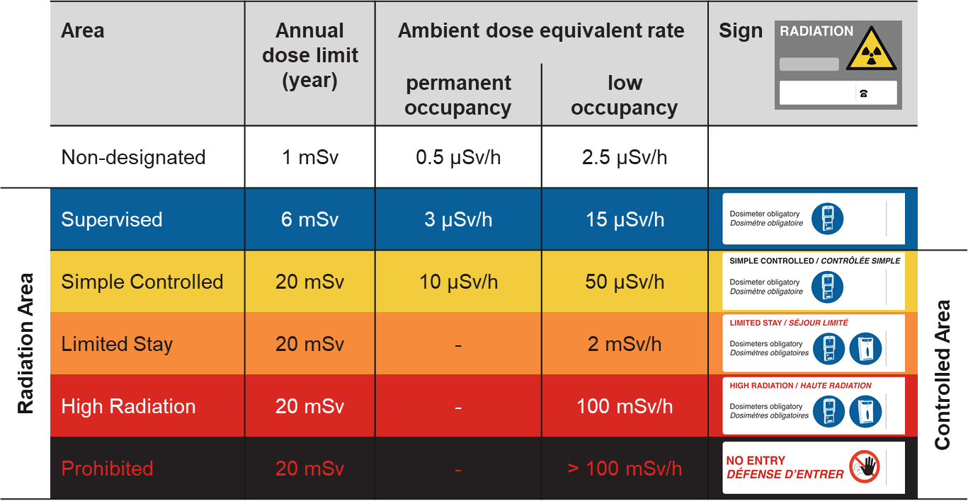
Residual Dose Rate - Top View - 6 Months of Cooldown (January 2027)
Color Code is according to the area classification:
Non-Designated Area
Supervised Radiation Area
Simple Controlled Radiation Area
Limited Stay Radiation Area
High Radiation Area
Prohibited Radiation Area
The beamline area w/ 1m distance to components is compatible with a Limited Stay Controlled Area
Outside of the shielded area, the levels are compatible with a Supervised Radiation Area, except around the target station and the iron collimator
Hot areas are also around the collimators downstream of the TAX

Slide 7
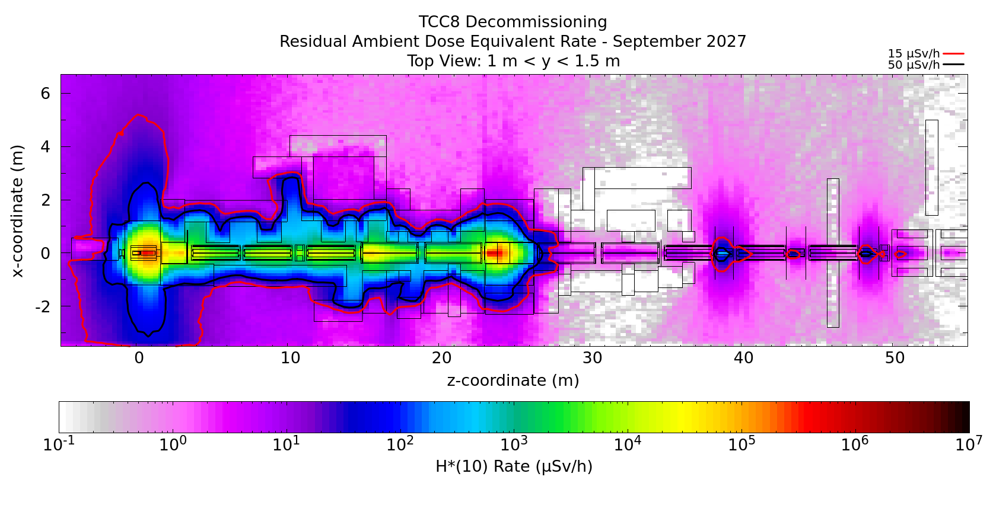
Residual Dose Rate - Top View – 1 Year and 2 Months of Cooldown (September 2027)
The radiation levels are high in the location of the target station and iron collimator

Slide 8
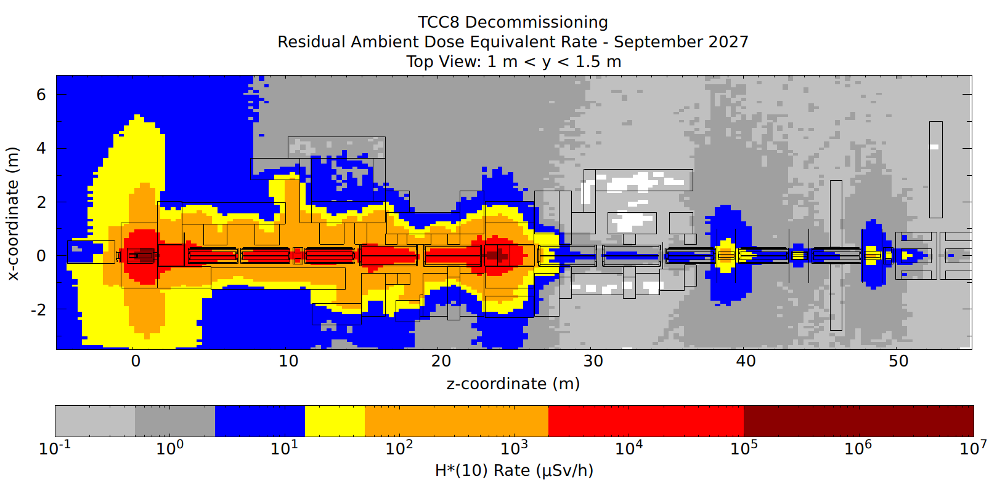
Residual Dose Rate - Top View - 1 Year and 2 Months of Cooldown (September 2027)
Color Code is according to the area classification:
Non-Designated Area
Supervised Radiation Area
Simple Controlled Radiation Area
Limited Stay Radiation Area
High Radiation Area
Prohibited Radiation Area
The beamline area w/ 1m distance to components is compatible with a Limited Stay Controlled Area
Outside of the shielded area, the levels are compatible with a Supervised Radiation Area, except around the target station and the iron collimator
Hot areas are also around the collimators downstream of the TAX

Slide 9
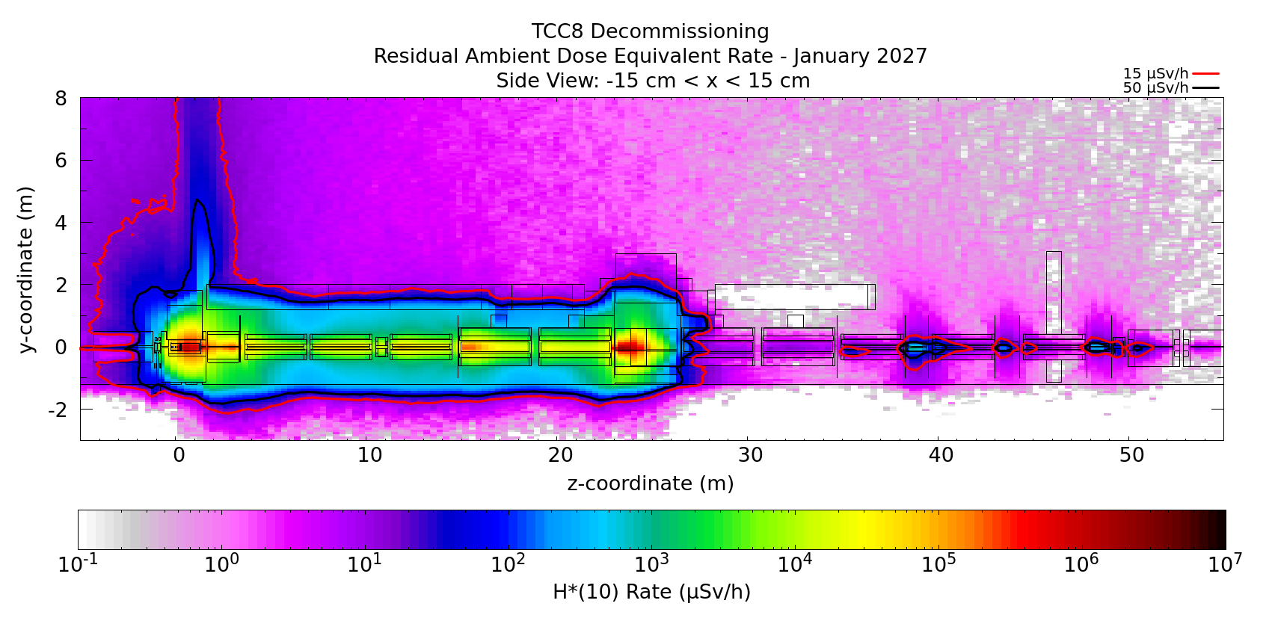
Residual Dose Rate - Side View - 6 Months of Cooldown (January 2027)
The radiation levels are high over the target station and iron collimator because of a gap in the shielding blocks
The hot area ends around the TAX
No soil activation studies were performed since no soil excavation is planned

Slide 10
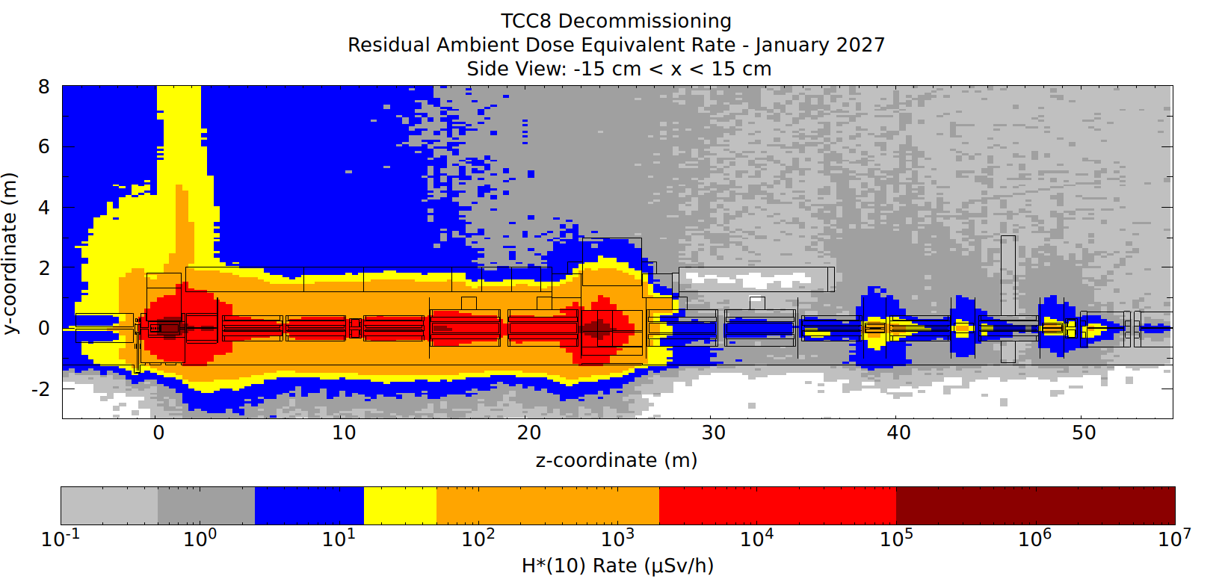
Residual Dose Rate - Side View - 6 Months of Cooldown (January 2027)
Color Code is according to the area classification:
Non-Designated Area
Supervised Radiation Area
Simple Controlled Radiation Area
Limited Stay Radiation Area
High Radiation Area
Prohibited Radiation Area

Slide 11
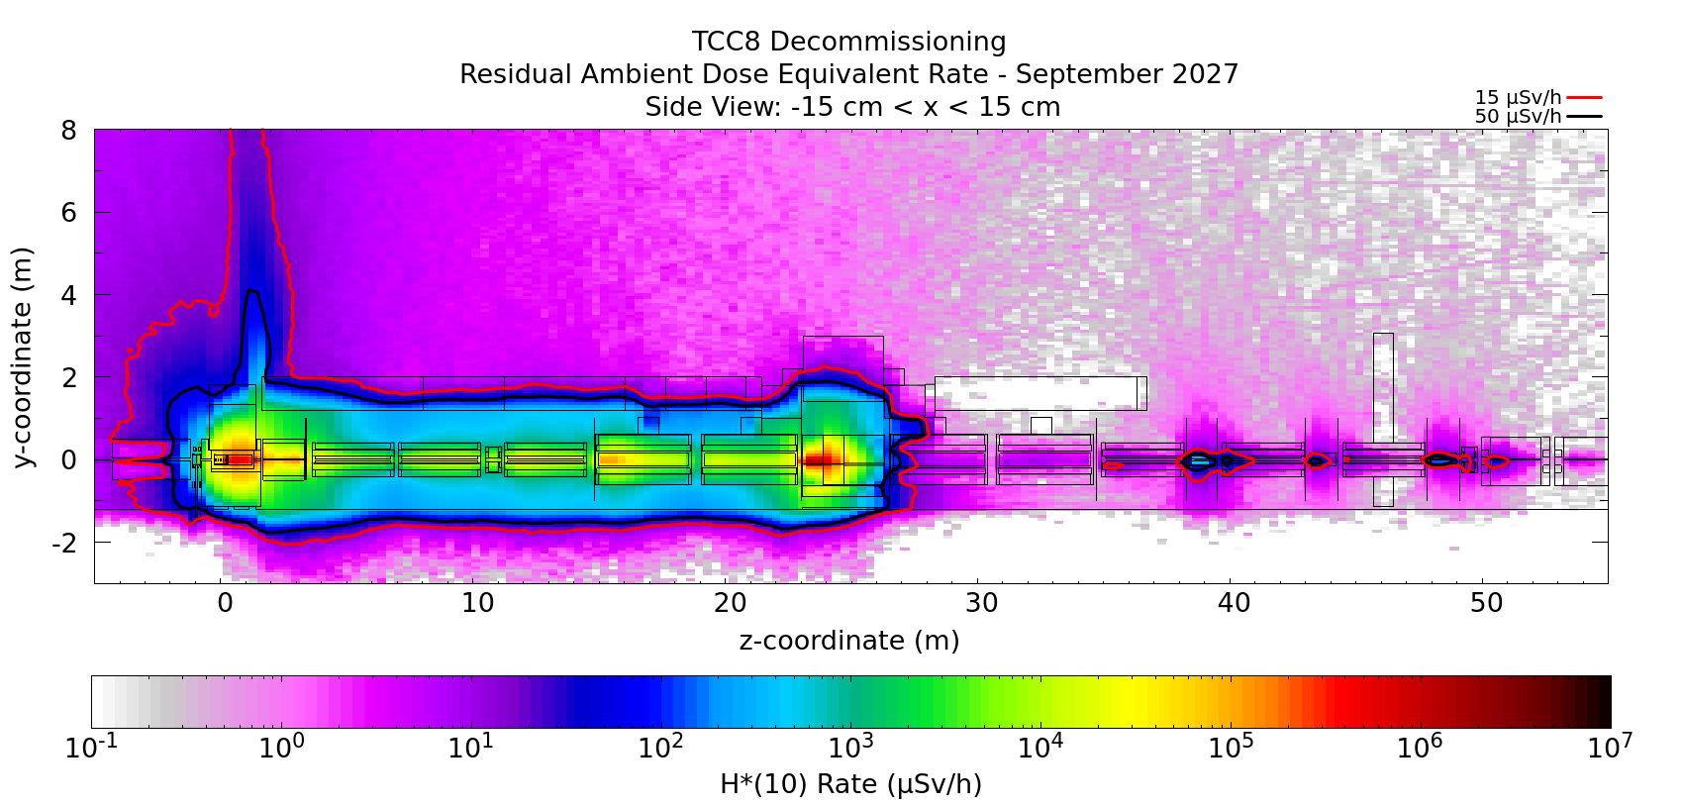
Residual Dose Rate - Side View - 1 Year and 2 Months of Cooldown (September 2027)
The radiation levels are high over the target station and iron collimator because of a gap in the shielding blocks
The hot area ends around the TAX
No soil activation studies were performed since no soil excavation is planned

Slide 12
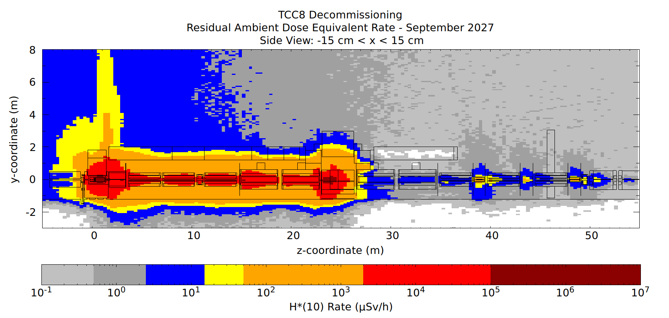
Residual Dose Rate - Side View - 1 Year and 2 Months of Cooldown (September 2027)
Color Code is according to the area classification:
Non-Designated Area
Supervised Radiation Area
Simple Controlled Radiation Area
Limited Stay Radiation Area
High Radiation Area
Prohibited Radiation Area

Slide 13
Activation of the Tunnel Walls and Floor: Simulations with Empty Tunnel

Slide 14
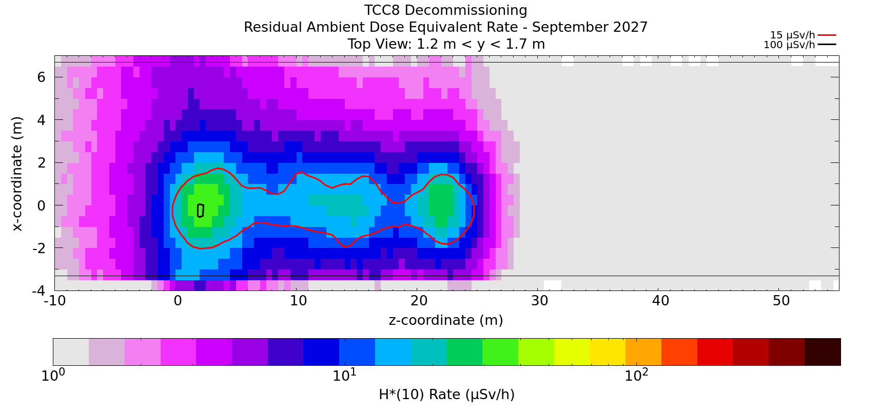

Residual Dose Rate - Top View - 1 Year and 2 Months of Cooldown (September 2027) - Body-Chest Level
No Objects
With Phantom Objects
Note that the residual dose rates are solely from the activation of the cavern floor and walls, as all the beamline elements and the shielding block regions were set to air during the decay step

Slide 15
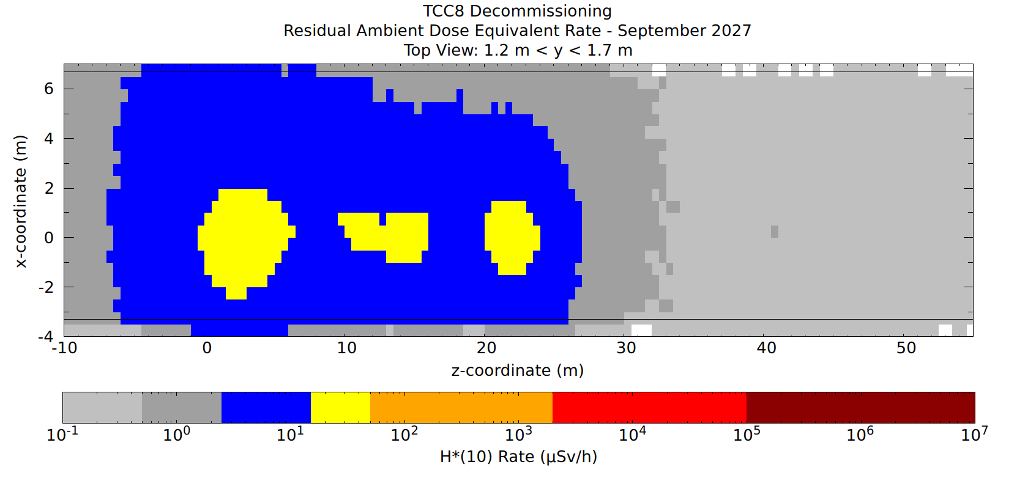
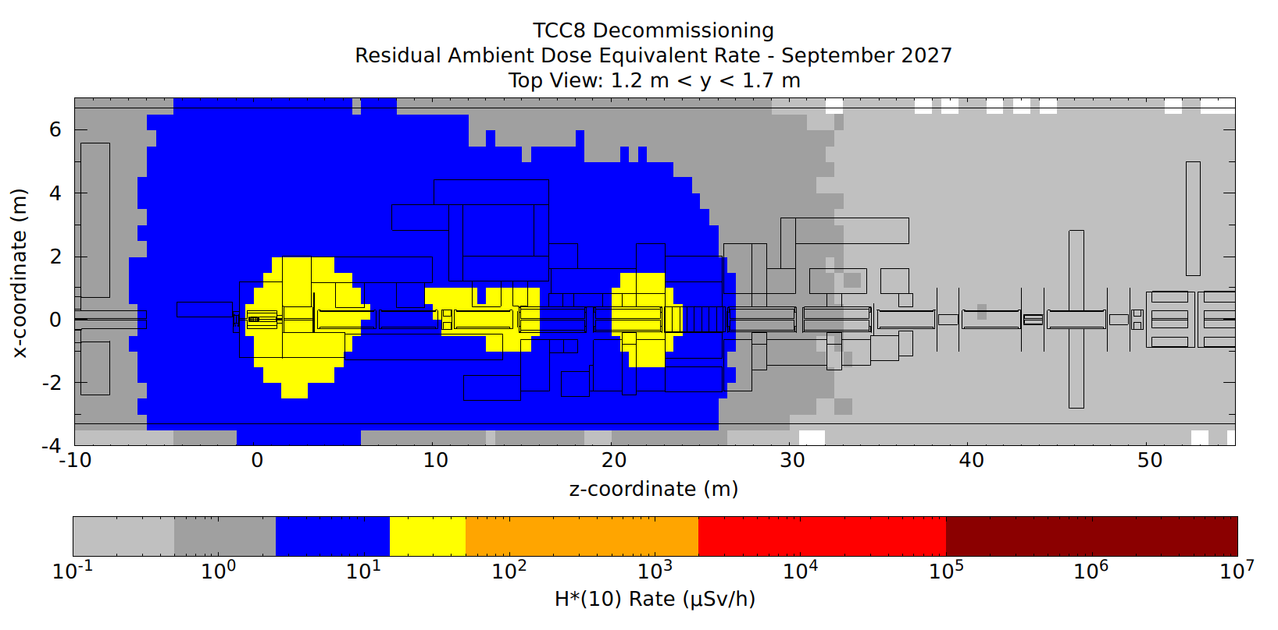
Residual Dose Rate - Top View - 1 Year and 2 Months of Cooldown (September 2027) - Body-Chest Level
The empty TCC8 tunnel between the target station and the TAX is compatible with a Simple Controlled Radiation Area classification. The rest is compatible with a Non-Designated Area.
Local shielding can be foreseen
Color Code is according to the area classification:
Non-Designated Area
Supervised Radiation Area
Simple Controlled Radiation Area
Limited Stay Radiation Area
High Radiation Area
Prohibited Radiation Area
No Objects
With Phantom Objects

Slide 16
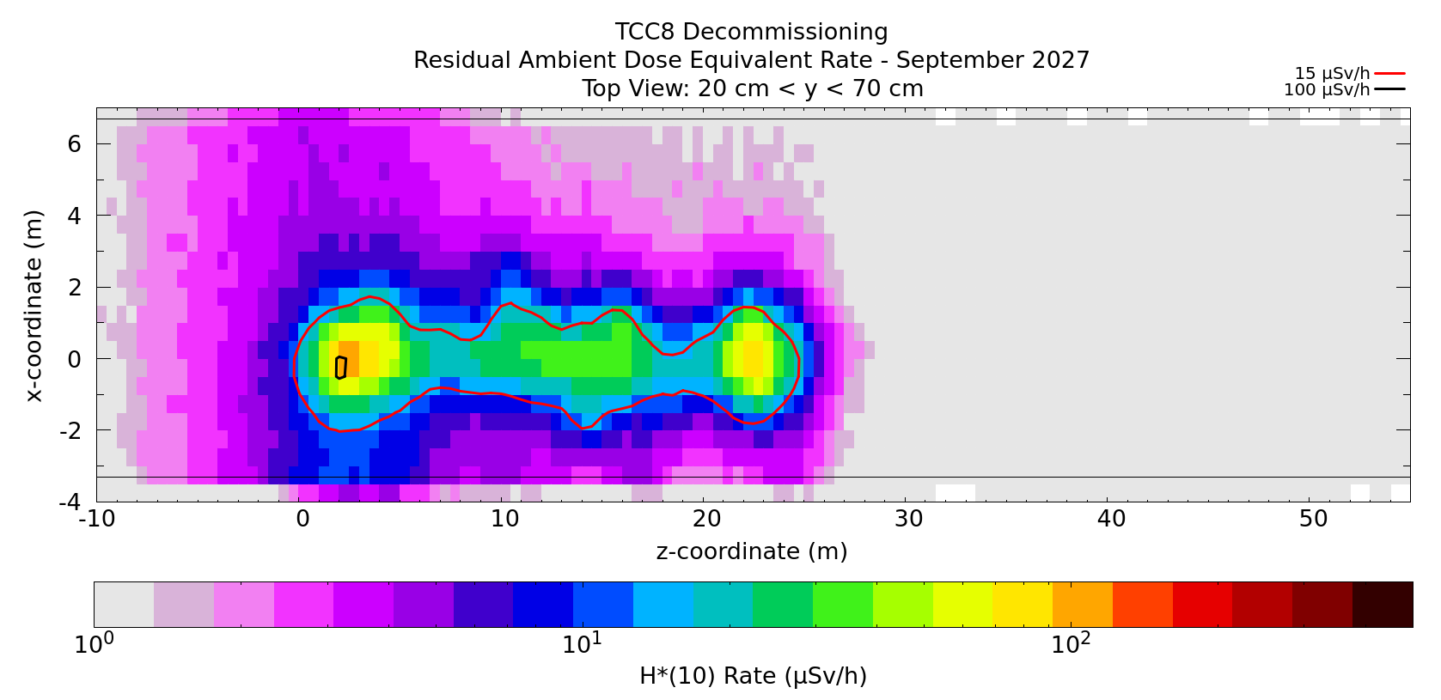
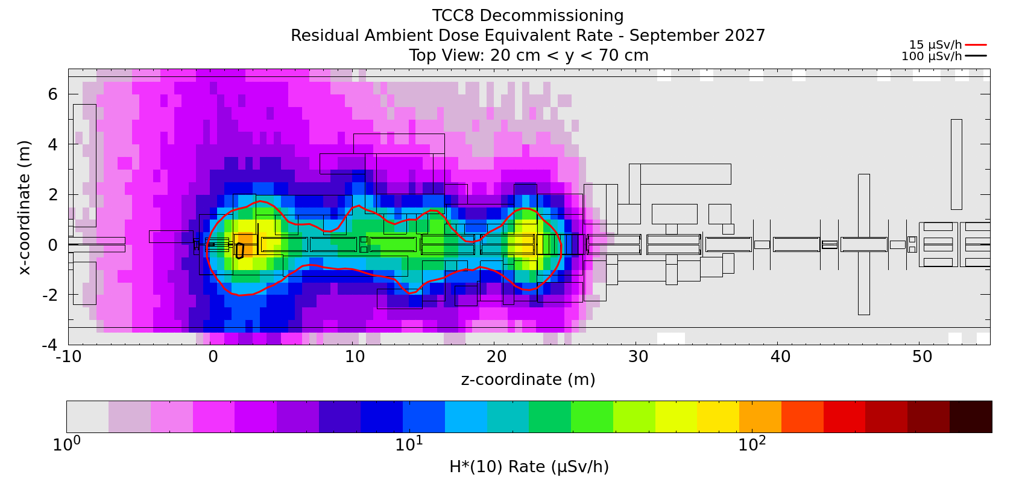
Residual Dose Rate - Top View - 1 Year and 2 Months of Cooldown (September 2027) - Floor Level
No Objects
With Phantom Objects
Note that the residual dose rates are solely from the activation of the cavern floor and walls, as all the beamline elements and the shielding block regions were set to air during the decay step

Slide 17
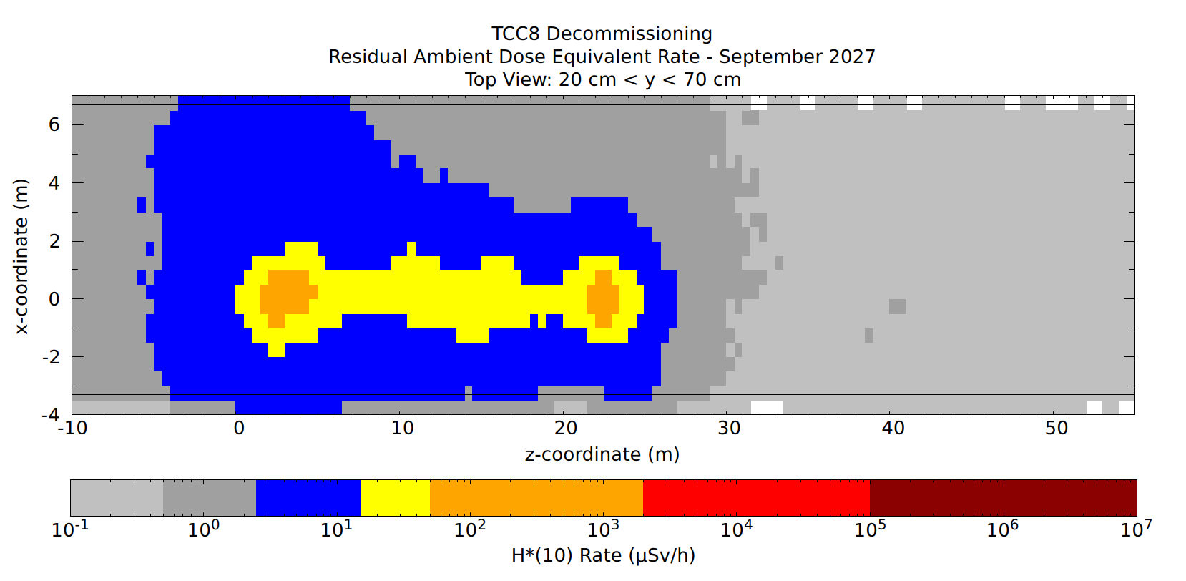
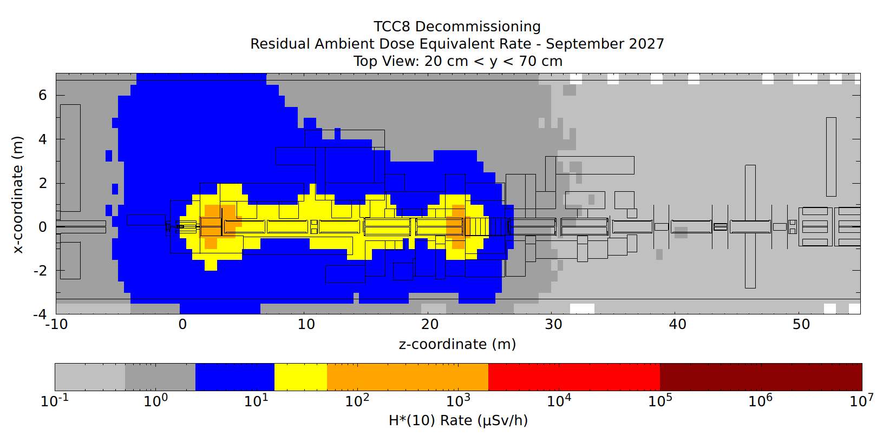
Residual Dose Rate - Top View - 1 Year and 2 Months of Cooldown (September 2027) - Floor Level
The empty TCC8 tunnel between the target station and the TAX is compatible with a Limited Stay Radiation Area classification. The rest is compatible with a Non-Designated Area.
Local shielding can be foreseen
Color Code is according to the area classification:
Non-Designated Area
Supervised Radiation Area
Simple Controlled Radiation Area
Limited Stay Radiation Area
High Radiation Area
Prohibited Radiation Area
No Objects
With Phantom Objects

Slide 18
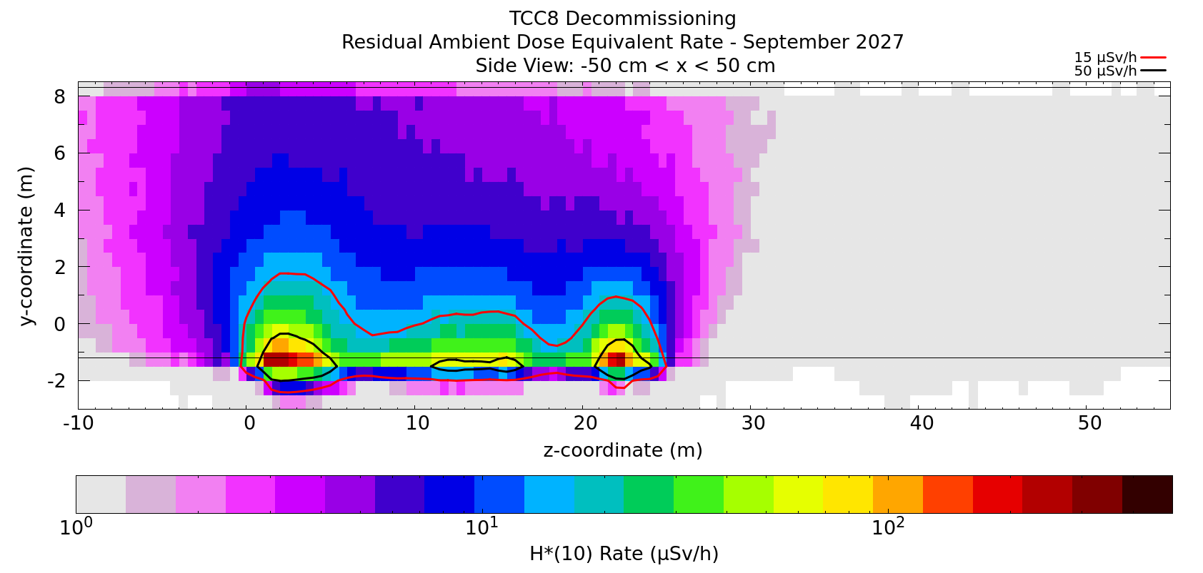
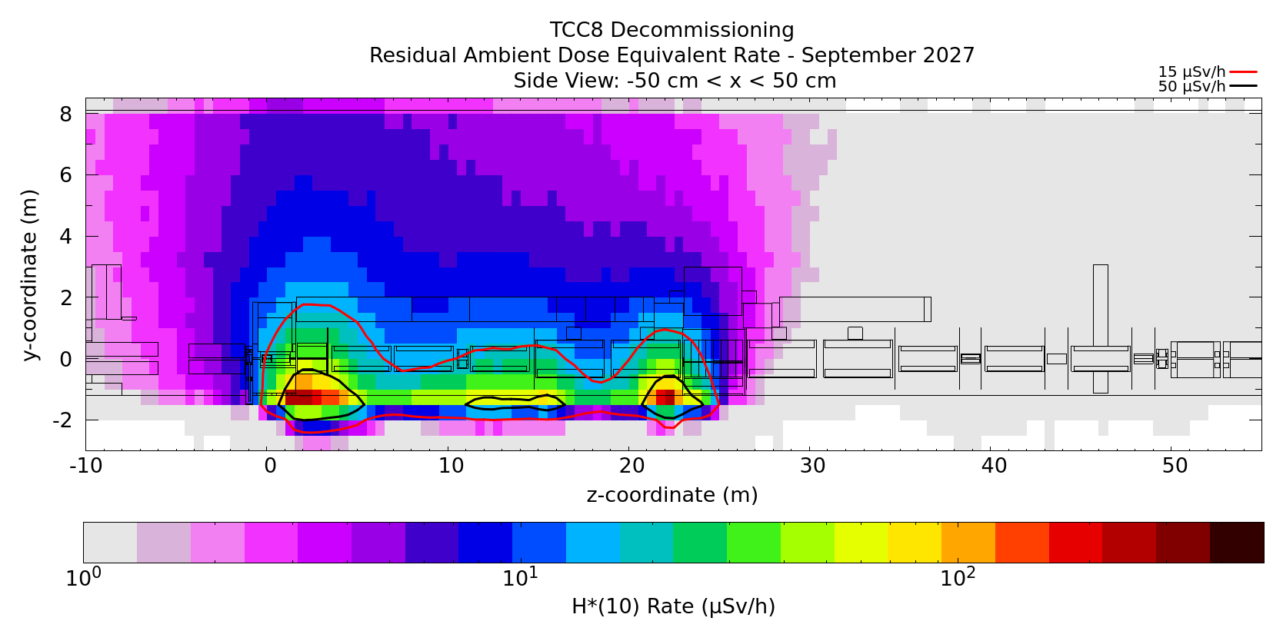
Residual Dose Rate - Side View - 1 Year and 2 Months of Cooldown (September 2027)
No Objects
With Phantom Objects
Max Dose at the floor ~ 0.3 mSv/h
Local shielding can be foreseen
Note that the residual dose rates are solely from the activation of the cavern floor and walls, as all the beamline elements and the shielding block regions were set to air during the decay step

Slide 19
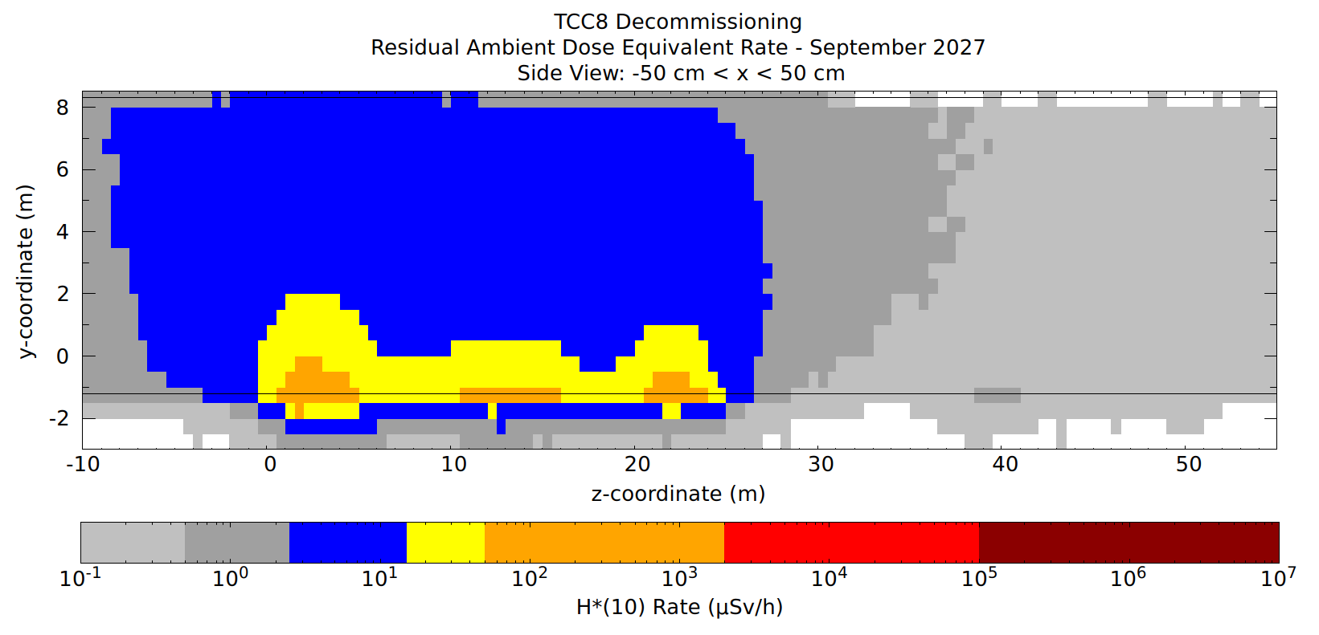
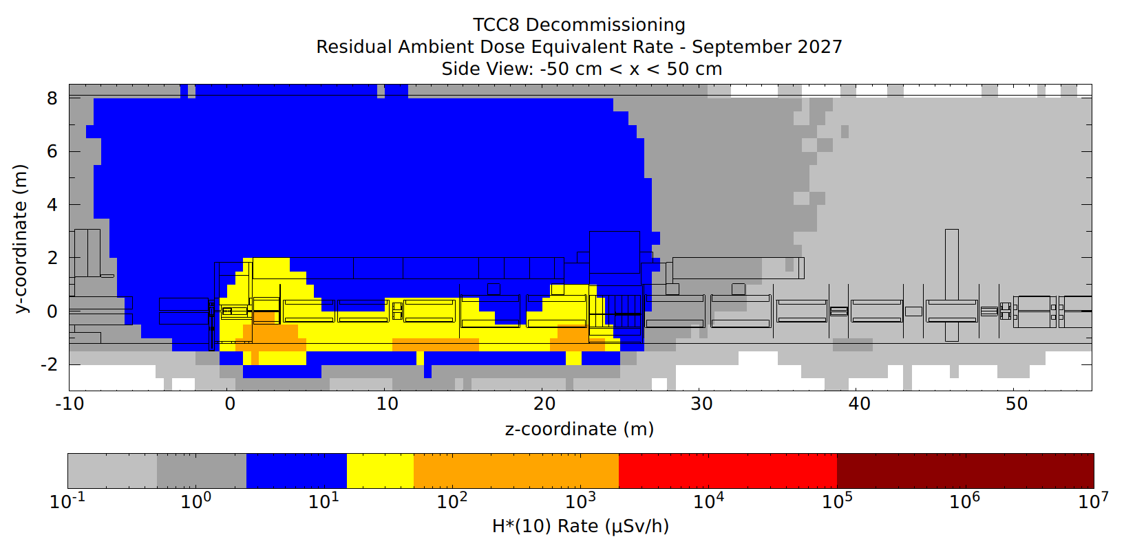
Residual Dose Rate - Side View - 1 Year and 2 Months of Cooldown (September 2027)
The empty TCC8 tunnel between the target station and the TAX is compatible with a Limited Stay Radiation Area classification. The rest is compatible with a Non-Designated Area.
Local shielding can be foreseen
Color Code is according to the area classification:
Non-Designated Area
Supervised Radiation Area
Simple Controlled Radiation Area
Limited Stay Radiation Area
High Radiation Area
Prohibited Radiation Area
No Objects
With Phantom Objects

Slide 20
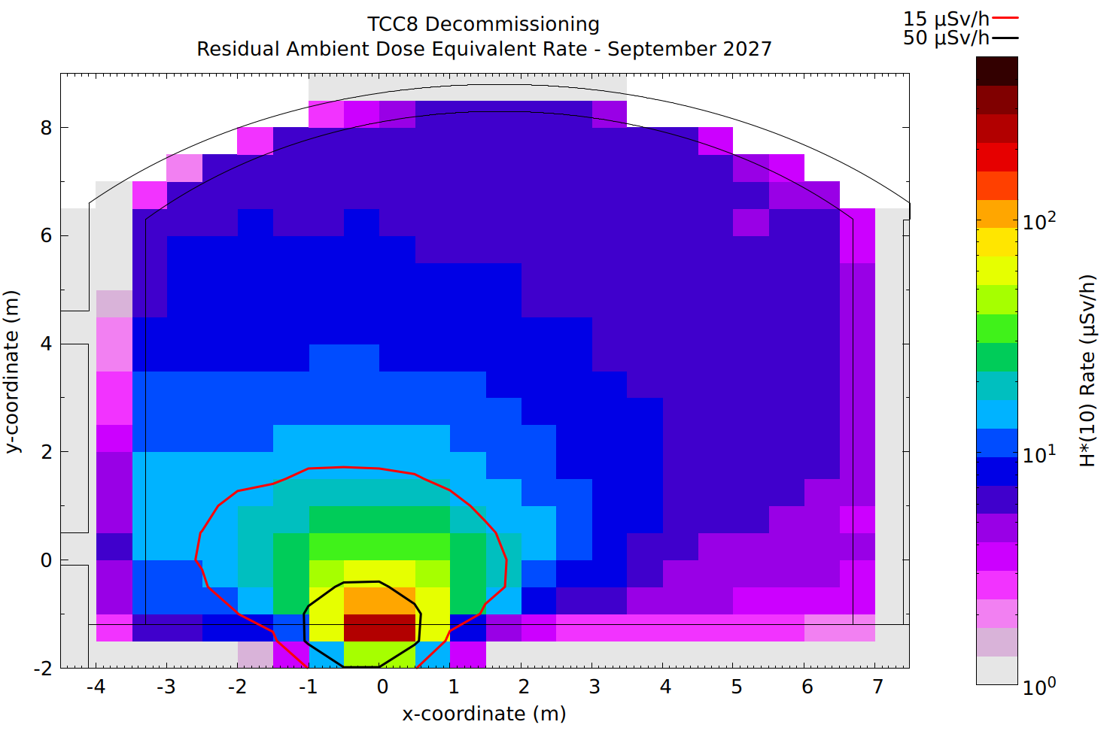
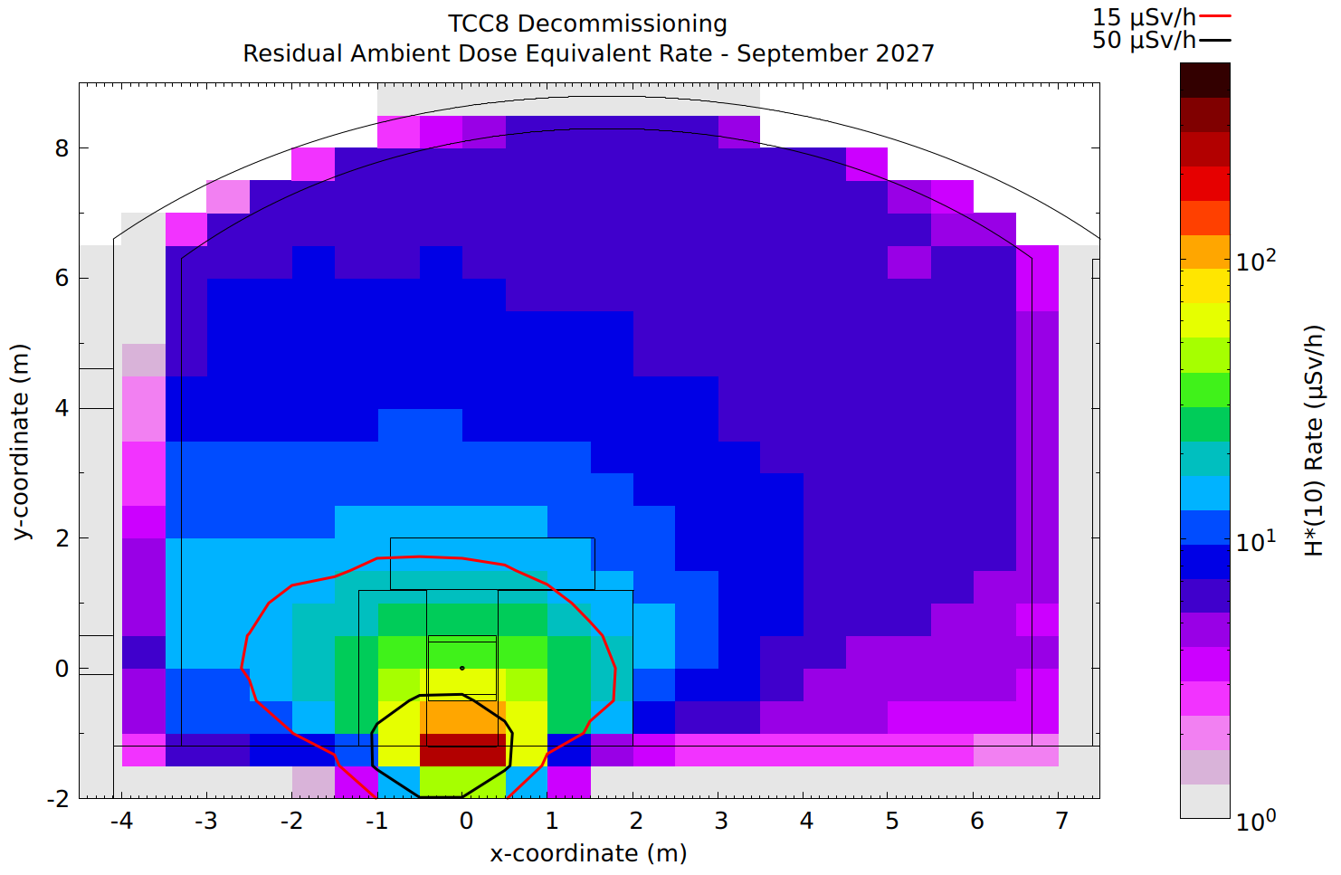
Residual Dose Rate - Cross View - 1 Year and 2 Months of Cooldown (September 2027)
No Objects
With Phantom Objects
1.5 m < z < 3 m = under the iron collimator after the target station
Note that the residual dose rates are solely from the activation of the cavern floor and walls, as all the beamline elements and the shielding block regions were set to air during the decay step

Slide 21
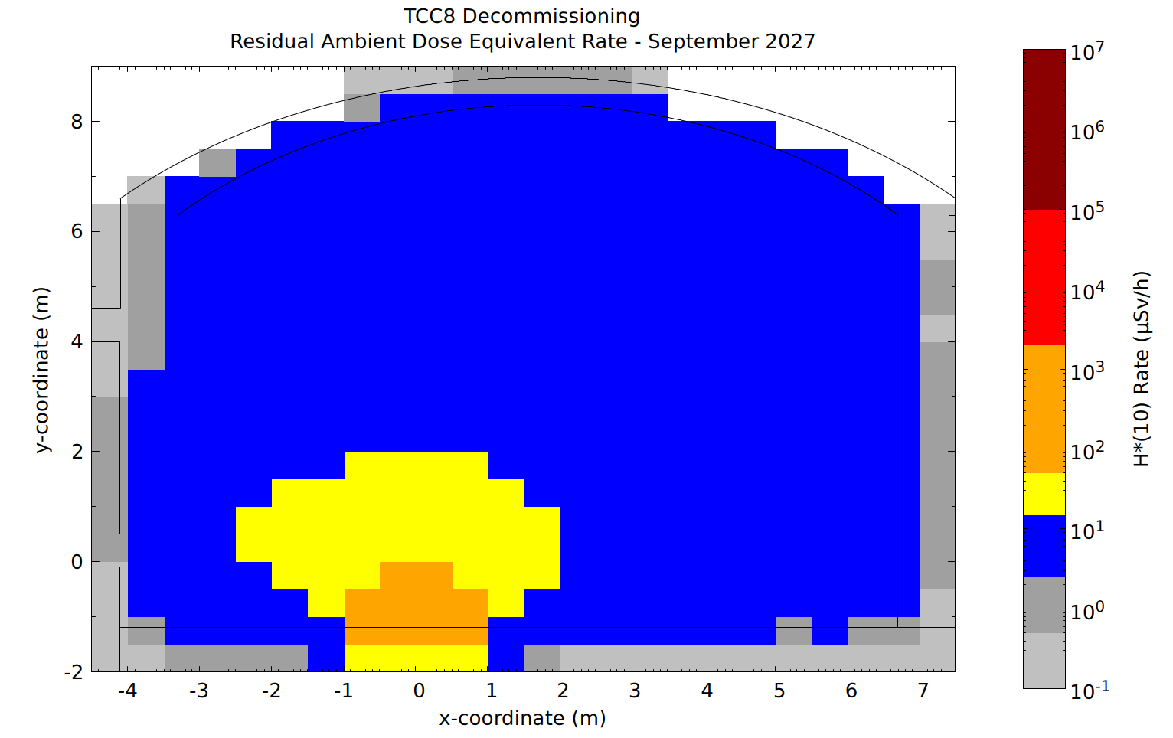

Residual Dose Rate - Cross View - 1 Year and 2 Months of Cooldown (September 2027)
1.5 m < z < 3 m = under the iron collimator after the target station
Color Code is according to the area classification:
Non-Designated Area
Supervised Radiation Area
Simple Controlled Radiation Area
Limited Stay Radiation Area
High Radiation Area
Prohibited Radiation Area
No Objects
With Phantom Objects

Slide 22
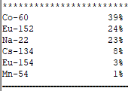
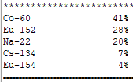
Main Contributors to the Floor Activation
Particle fluences in a floor sample under the iron collimator (right downstream of the target station) were sampled and used as AW input to evaluate the nuclide relative contributions to H*(10)
1 year and 8 months after the start of LS3
3 years after the start of LS3

Slide 23
Conclusions

Slide 24
Conclusions
The RP assessment for the TCC8 decommissioning was performed again after the LS3 shift was taken into account in the irradiation profile
New dates of interest are:
July 2026 = end of R3 in the NA (August 2026 is foreseen to be Pb ions at the LHC only)
January 2027 (6 months after the end of R3) = earliest date for the TCC8 dismantling
September 2027 (1 year and 2 months after the end of R3) = latest date of TCC8 dismantling with goal to minimize the overlap with NA-CONS activities
Residual dose rates:
The beamline area is mostly compatible with a Limited Stay Controlled Area
Outside of the shielded area, the levels are compatible with a Supervised Radiation Area, except around the target station and the iron collimator
Tunnel wall and floor activation:
Regarding the area classification, the empty TCC8 tunnel between the target station to the TAX is compatible with a Limited Stay Controlled Area classification. The rest is compatible with a Non-Designated Area.
Actions still pending:
Contact Doses and Doses at 10 cm
Activation of the Shielding Blocks

Slide 25
Thank you for your attention!

