Slide 1
14 T block-coil benchmark
HFM
High Field Magnets
Programme
HTS Modeling WG Mtg
B. Auchmann
24 October 2024

Slide 2
Block Coil Benchmark – Purpose and Design Goals
The 14 T block coil benchmark does not constitute an EM design.
Rather, it is a tool to evaluate numerical models and techniques for the simulation of ramp-induced effects (AC losses, field quality on ramp and stability on plateau, screening-current induced forces).
With a better understanding of our numerical tools, and their eventual experimental validation, we create a commonly accepted basis for design work that informs our R&D roadmaps.
  Collateral benefit: we get a feeling for ramp-induced effects as compared to an LTS 14 T magnet →
  we try not to be too pessimistic.
Benchmark design goals (all debatable for an actual design):
  14 T central field at 20 K
  Geometric harmonics < 5 units
  Max current 30 kA
  Local temperature margin for homogenous current distribution of 5 K
    (*highly debatable*, the goal is to leave margins for radial gradients in the coil and temperature differences along a cryogenic sector)
  Tape performance: Fleiter fit of best tape from Faraday Factory Japan on record (exceeds currently available tape in performance – but may plausibly be reached in the future)
  Stabilizer J_{cu} ~ 1000 A/mm²
Full benchmark description
here (Cernbox)

Slide 3
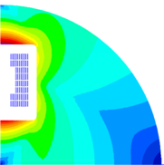
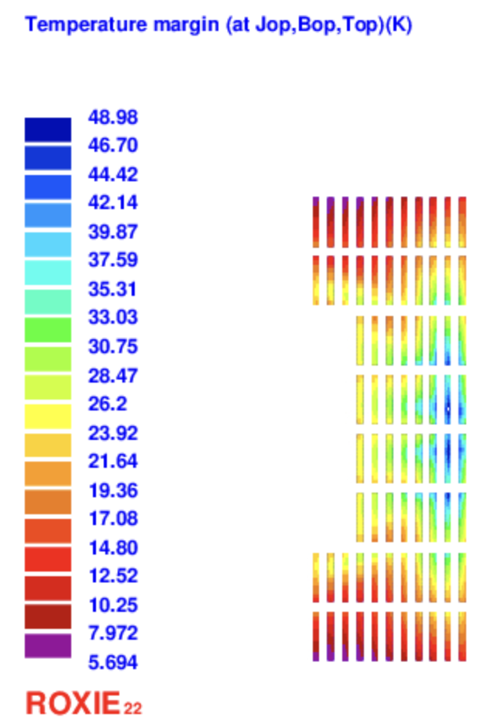
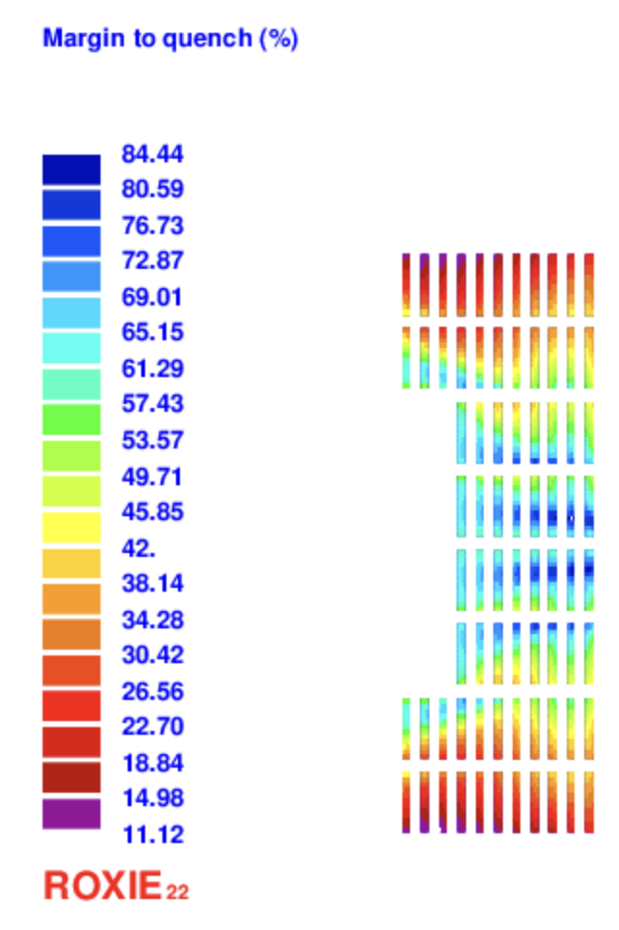
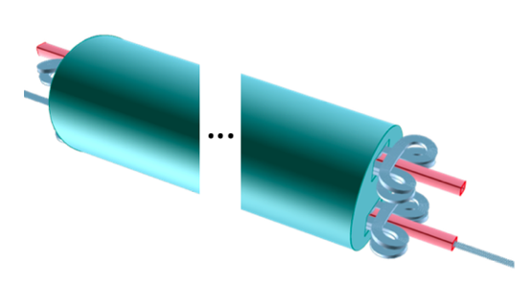
The 14 T Block Coil Design
Cable:
Non-graded design. 15x 12 mm tapes per cable. Tape-stack surrounded by 1 mm copper. 0.15 mm insulation thickness.
Coil geometry:
Vertical arrangement of apertures for independent clover-leaf ends. Yoke diameter 700 mm.
There is space for an internal structure around the apertures and for a 4.5 K screen for condensation of residual gas.
No amount of work has done on the mechanical structure

Slide 4
5-stack and 14 T block-coil benchmarks
On the 5-stack benchmark we can evaluate modeling depth and convergence with different numerical approaches – even if a detailed model is too heavy for use in magnet design.
With the 14 T block-coil benchmark we can compare our implementations before we embark on a design study, and we may implement very detailed models once to evaluate the relevance of simplifications.

Slide 5
FINE

