Slide 1

Simulation of the 14 T block-coil benchmark by LBE
HFM
High Field Magnets
Programme
HTS Modeling WG Mtg
B. Auchmann
24 October 2024

Slide 2




Why LBE?
Numerically stable and efficient 3D simulation of screening currents.
  Able to simulate small coils as we will build them soon →
  path towards model validation.
    If a) our 2D models agree with LBE’s straight-section results, and b) LBE’s 3D models agree with our small coils measurements, then c) our 2D models have increased credibility for the study of designs for long magnets which will underpin our R&D roadmap.
Goal remains to perform independent simulations. Other work, e.g., on STEAM FiQuS, at TU Darmstadt, and with commercial tools by Quanscient and COMSOL shall provide options.

Slide 3
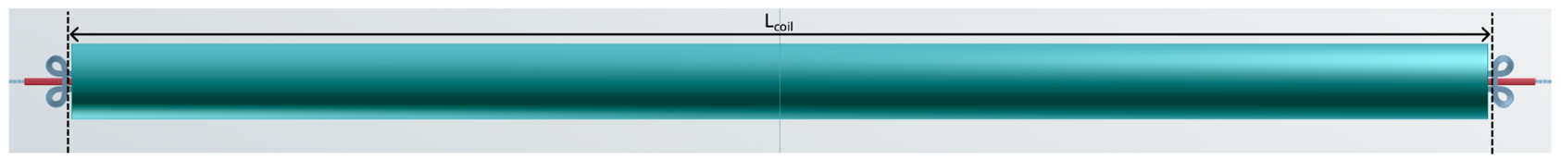
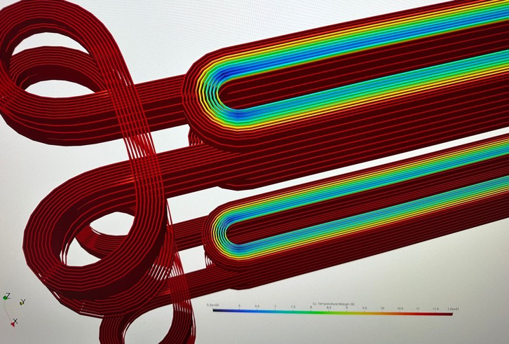
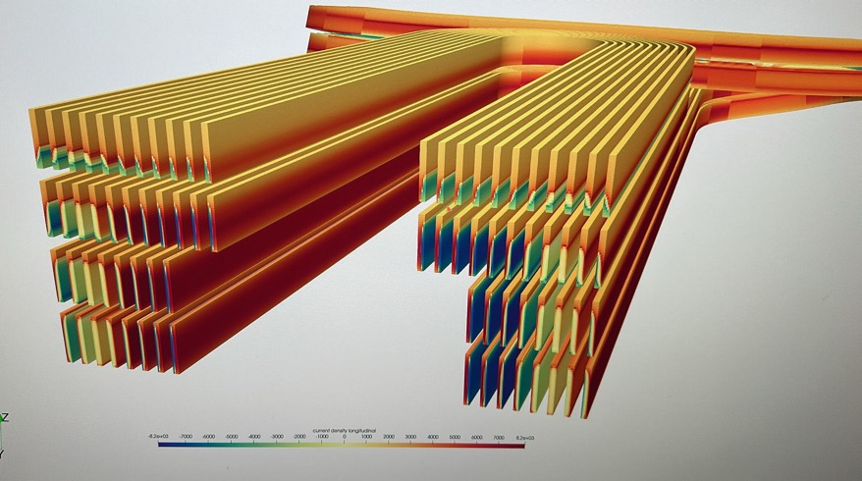
LBE Implementation: 15 m, cloverleaf outer pancake, racetrack inner pancake
5 K temperature margin confirmed also in 3D.

Slide 4
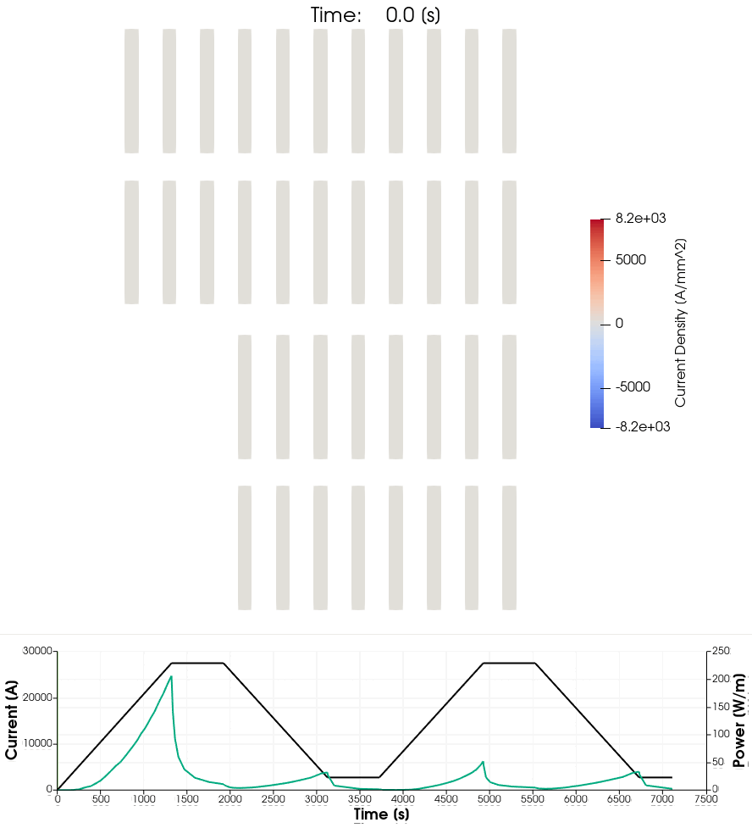
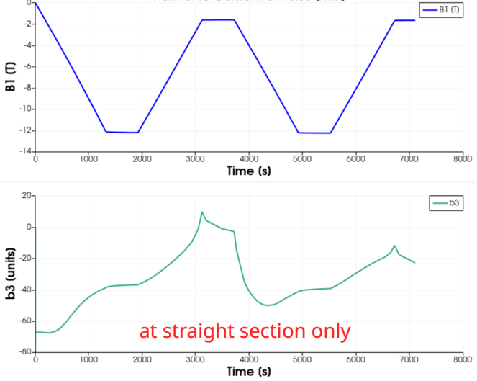
LBE Results
Straight section loss values reached already in 2-m-long magnet.
Convergence study completed.
Iron-yoke represented by a field offset.
2nd and 3rd cycle losses ~identical: 44 kJ/m
Field quality: b₃ variation on ramp by ~45 units.
Long field-quality decay on plateau → plateau length now 2 hrs.

Slide 5
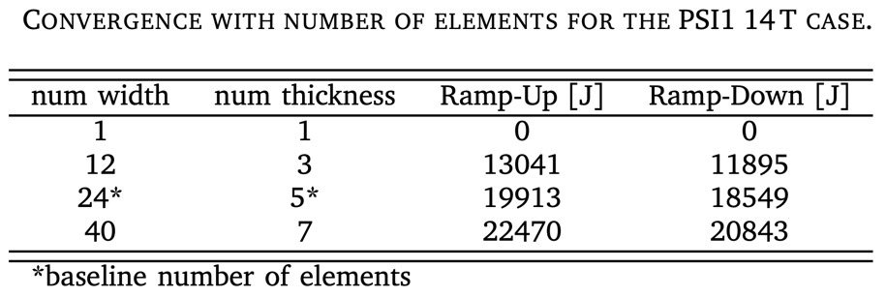

Slide 6
FINE

