Slide 1
Collider Experiments: the LHC & Beyond 1
N. Tuning

Slide 2
Who am I
1973: Born in the Netherlands
1996-2001: PhD on ZEUS, HERA, DESY: Proton Structure
2001-2004: Fellow on LHCb, CERN: Trigger + VELO
2004-2007: Postdoc on LHCb, Nikhef: Outer Tracker
2007-present: Senior at Nikhef
2007-2017: Outer Tracker, Analysis, Phenomenology
2017-2018: Run coordinator LHCb
2020-2022: Physics coordinator LHCb
2023: Run coordinator LHCb
2024-2025: Deputy group leader Nikhef + Scintillator Fiber
I like cats and skiing and Costa Rica

Slide 3
Credits
Werner Riegler (2024): https://indico.cern.ch/event/1347523/
Roger Forty (2023): https://indico.cern.ch/event/1210891/
Cecilia Gerber (2019): https://indico.cern.ch/event/763013/
Paras Sphicas (2017): https://indico.cern.ch/event/575526/
Peter Jenni (2015): https://indico.cern.ch/event/343570/
And many others!
I tried to give the source of the material as much as possible…

Slide 4
Outline
SM & LHC
LHC detectors
LHCb Physics Highlights
ATLAS, CMS, the HL-LHC and beyond
These lectures will contain a mix of
history, accelerators, experiments and particle detection.
But with a large dose of physics,
revealing my passion for particle physics!

Slide 5
Outline
SM & LHC
Physics motivation: The Standard Model
LHC: History, operations, performance & schedule
LHC detectors
ATLAS, CMS and LHCb
Particle Detection
LHCb
Physics Highlights: Indirect, CKM, Spectroscopy & Rare Decays
ATLAS/CMS and beyond
Physics Highlights: QCD; W/Z; top; Higgs; SUSY
HL-LHC
Future: HL-LHC, LHCb Upgrade II, Higgs self-coupling and beyond

Slide 6
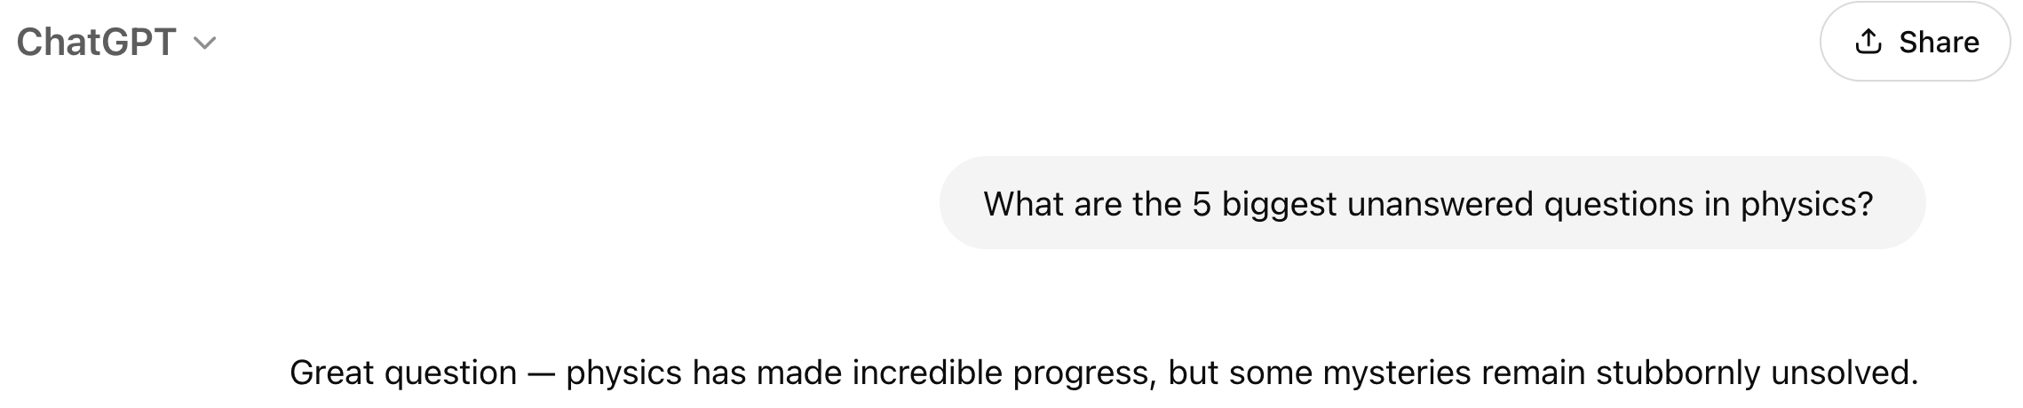
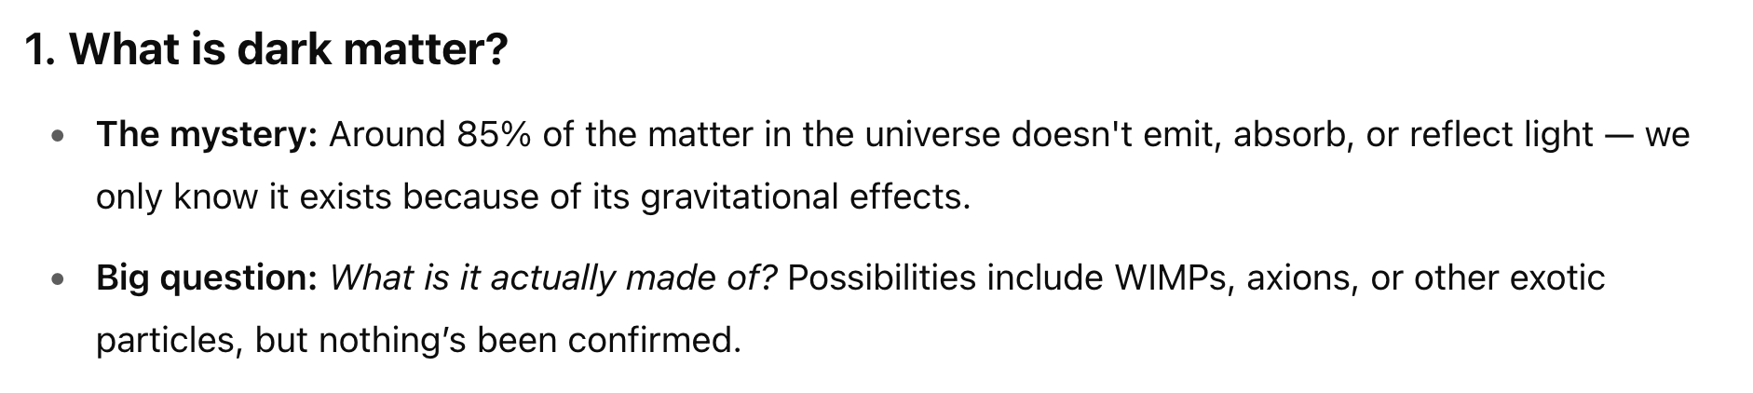
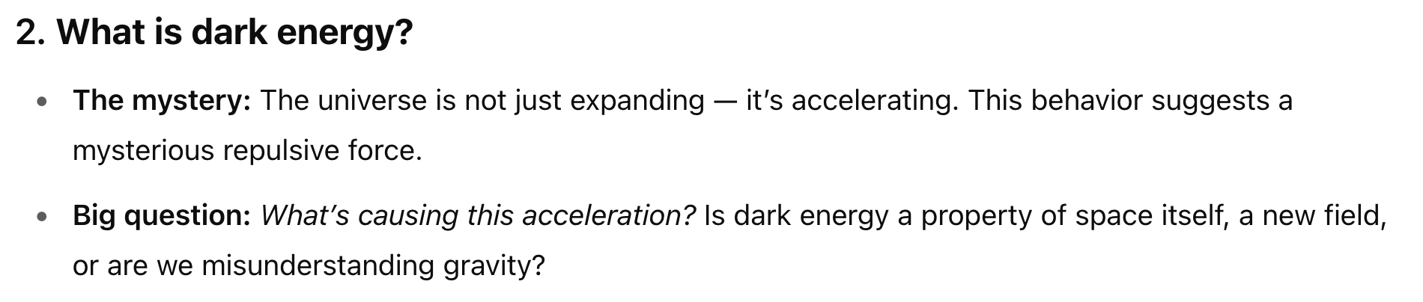
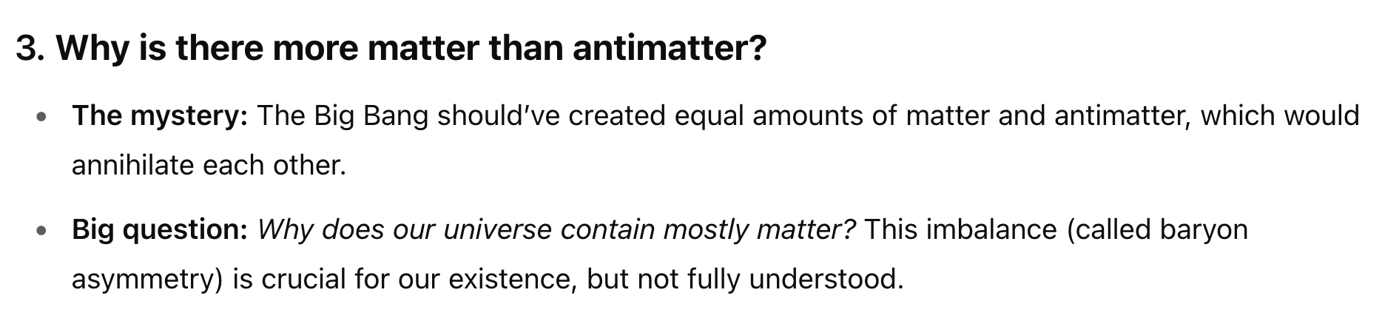
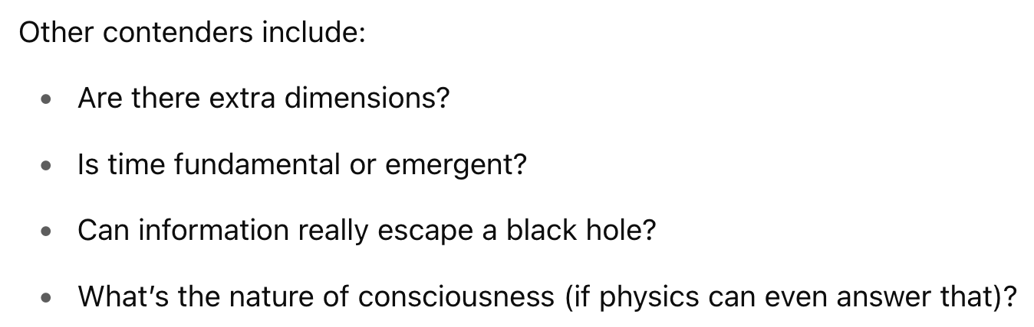
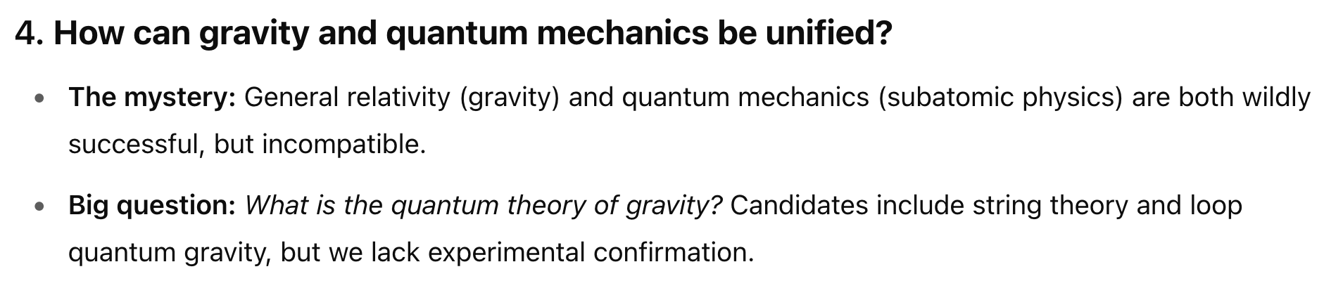
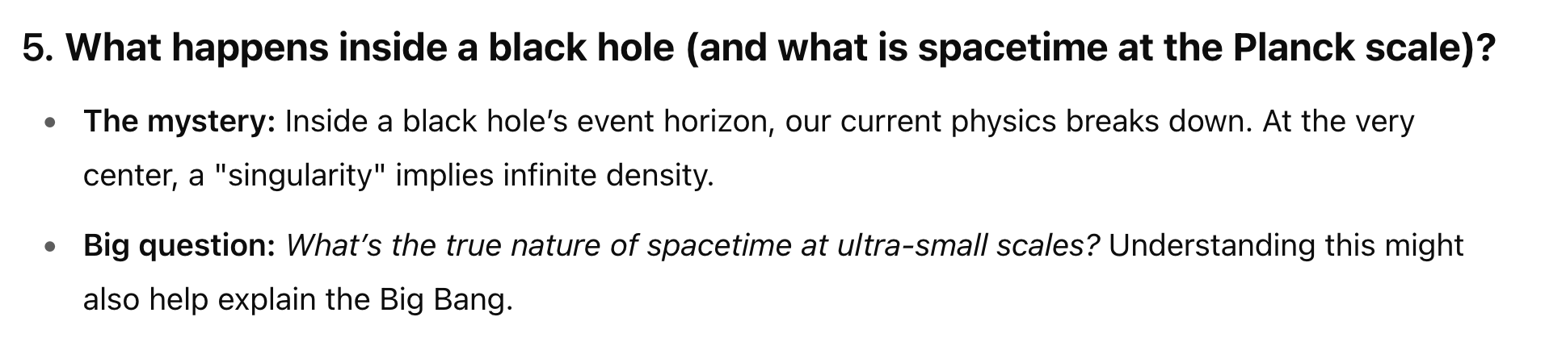
Physics Motivation

Slide 7
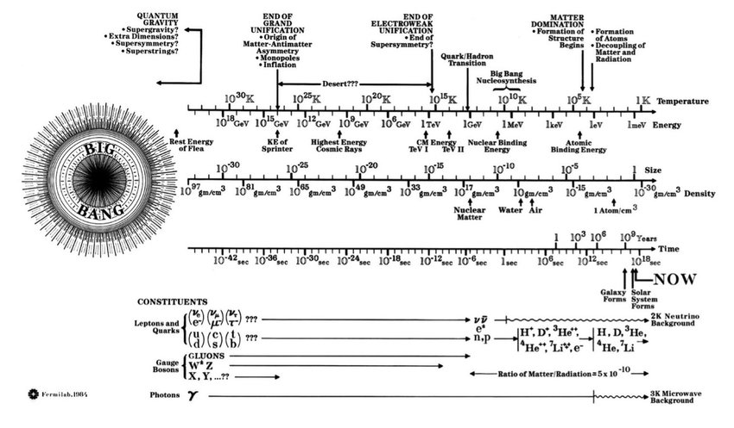
Complete History of the Universe
https://www.researchgate.net/publication/357823952/figure/fig1/AS:1111988524589069@1642130132503/Complete-history-of-the-Universe-a-collaboration-of-Angela-Gonzalez-of-Fermilab-and-the.jpg

Slide 8
Complete History of the Universe
You are here: 10⁻¹⁶ m, 10⁻¹⁴ s, 10¹⁶ K
https://www.researchgate.net/publication/357823952/figure/fig1/AS:1111988524589069@1642130132503/Complete-history-of-the-Universe-a-collaboration-of-Angela-Gonzalez-of-Fermilab-and-the.jpg

Slide 9
J.Kopp, https://indico.global/event/5574

Slide 10
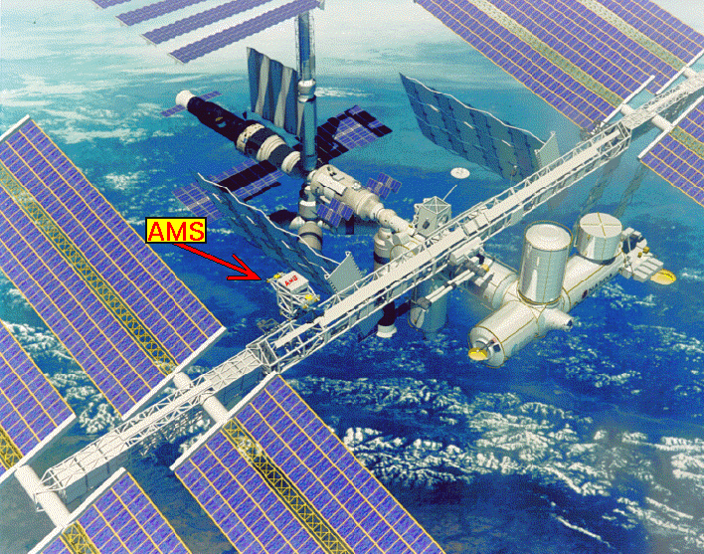
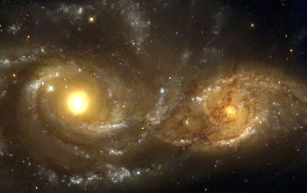
I. Big questions: “Antimatter”
Why is there something?
No antimatter with satellites
No antimatter galaxies

Slide 11
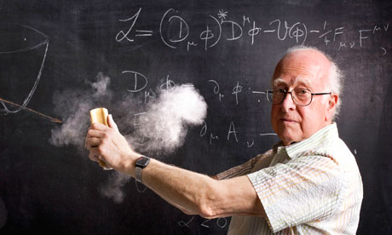
II. Big questions: “Higgs”
Particles’ mass
Partially answered 4 July 2012
Neutrino’s
Elektron
Muon
Tau
up,down, strange
charm
Higgs boson: theoretical framework to give mass to
W/Z bosons (and fermions!)
+ Hierarchy problem?
+ Fate of the vacuum of the Universe?
+ Portal?
Top quark
bottom

Slide 12
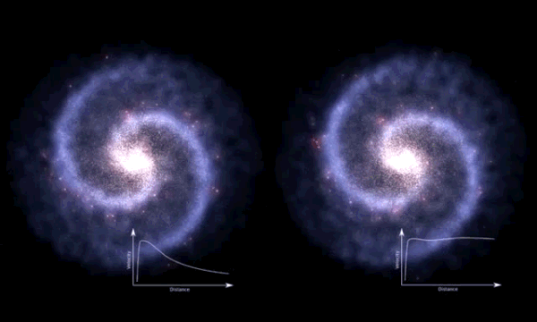
III. Big questions? “Dark matter”
https://en.wikipedia.org/wiki/File:Comparison_of_rotating_disc_galaxies_in_the_distant_Universe_and_the_present_day.webm

Slide 13
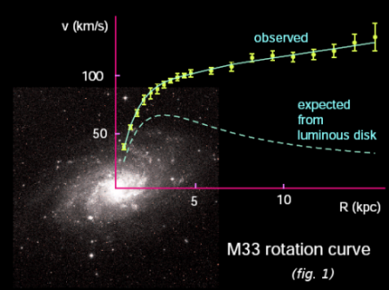
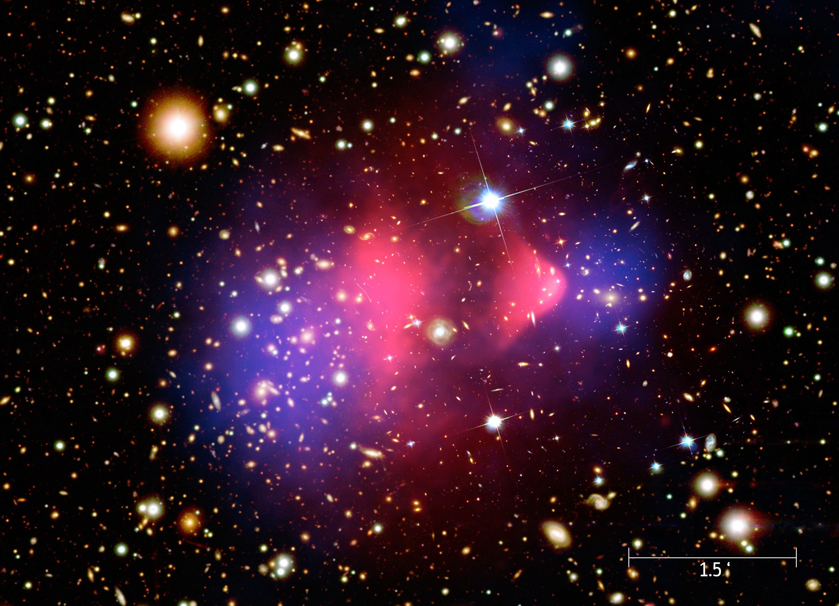
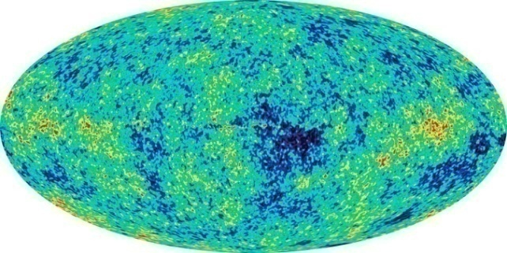
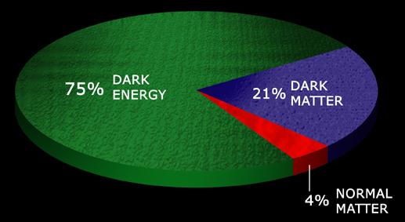
III. Big questions? “Dark matter”
Temperature fluctuations structure of universe
Rotation-curves
Gravitational lensing
What is dark matter ?

Slide 14
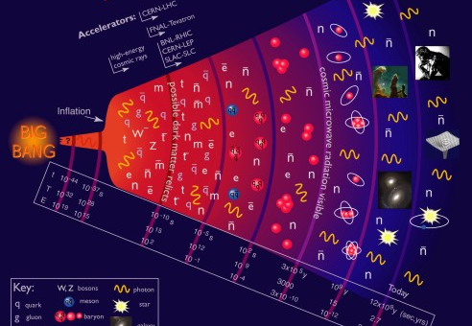
Big questions
10⁹ yr
10² s ~ 100 keV
10⁻¹⁰ s ~ 100 GeV
II. Higgs??
(EW-Sym.Break)
I. Anti-matter??
(recombination)
III. Dark matter??
(what clumps galaxies)

Slide 15
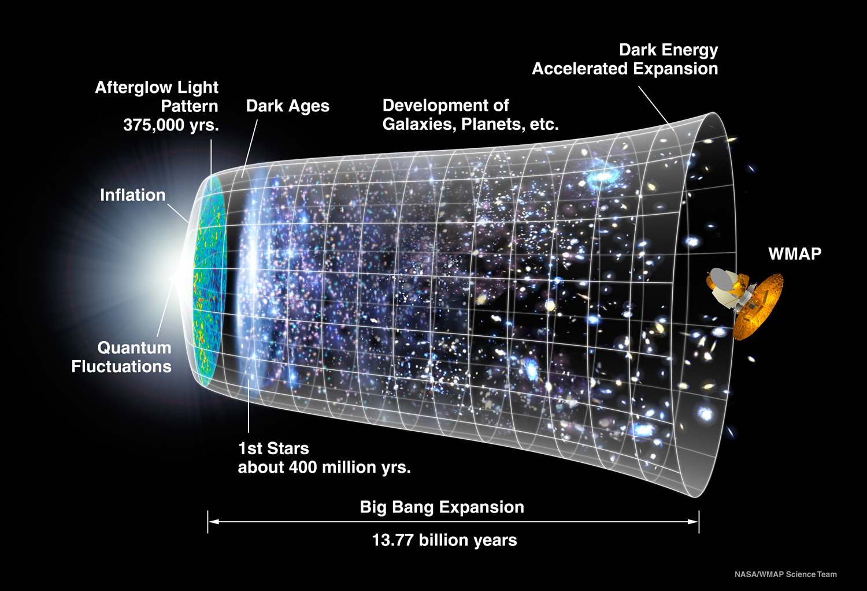
Een ander veld: de Big Bang

Slide 16
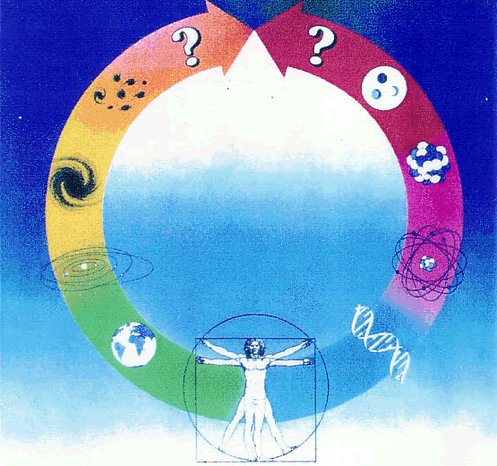
Astronomy
Particle
physics
Fundamental
(curiosity driven)
research
Waar is de Anti-materie heen?

Slide 17
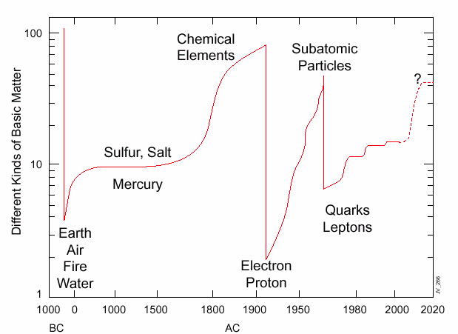

The number of ‘elementary’ particles
1932:
electron
proton
neutron
1936:
electron
proton
neutron
muon
1947:
electron
proton
neutron
muon
pion

Slide 18
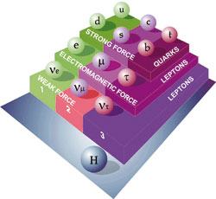
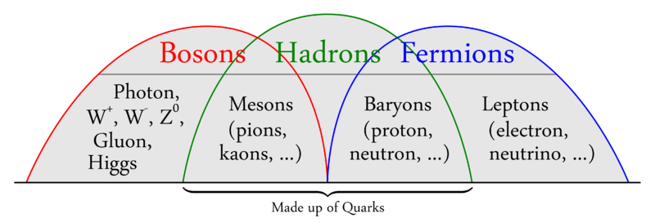
Particles
Quarks and leptons…:

Slide 19
Forces
M. Klute, https://indico.cern.ch/event/1347523/timetable/

Slide 20
Standard Model

Slide 21
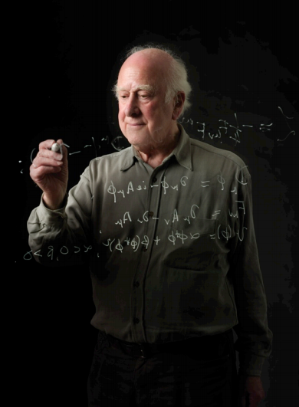
Prof. P. Higgs
What are the rules for subatomic particles?

Slide 22
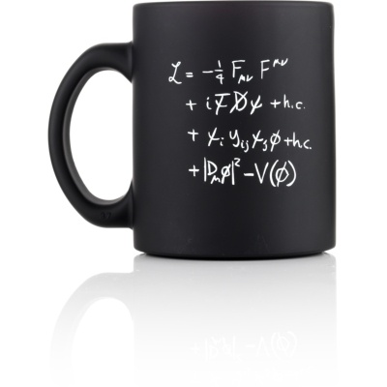
Describes the behaviour of particles

Slide 23
The Standard Model
All “matter” particles are described here as Ψ (fermions)

Slide 24
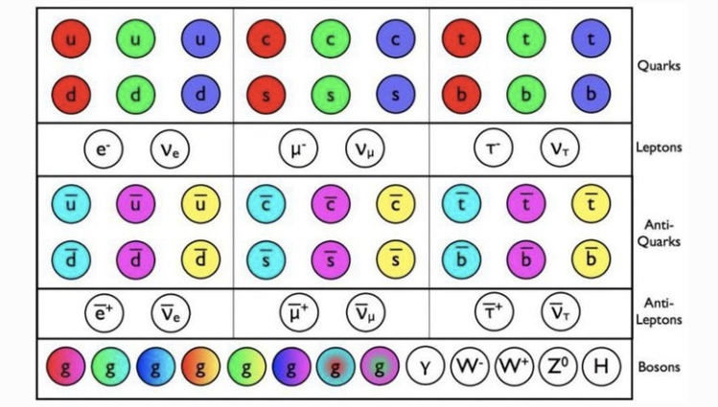
The Standard Model

Slide 25
Photons F_{μν}
(Maxwell equations!
E-field, B-field,
electro-magnetic waves, …)
Particles ψ
(“normal” matter, electrons, quarks, …)
Interactions D
(how the partiles “feel” eachother)
ψψφ Mass
(for “normal” particles)
φ Higgs

Slide 26
Half of the mug is about Higgs!

Slide 27


Lagrangian and Equation of motion: Example
1) Lagrangiaan
2) Euler-Lagrange vergelijking
Equation of motion
q: generalized coordinates
pendulum

Slide 28



Lagrangian in Field Theory
Replace Lagrangian by a Lagrangian density
in terms of field φ(x):
Least-action principle:
Euler-Lagrange equations:
(classic)

Slide 29





Lagrangian ➔ Equation of motion
spin-0 particles (Klein-Gordon)
spin-1/2 fermions (Dirac)
Photons
Klein-Gordon equation
Dirac equation
Maxwell equations

Slide 30
SM Lagrangian

Slide 31
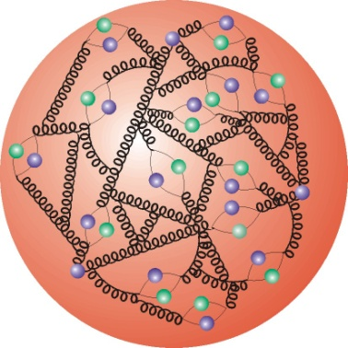
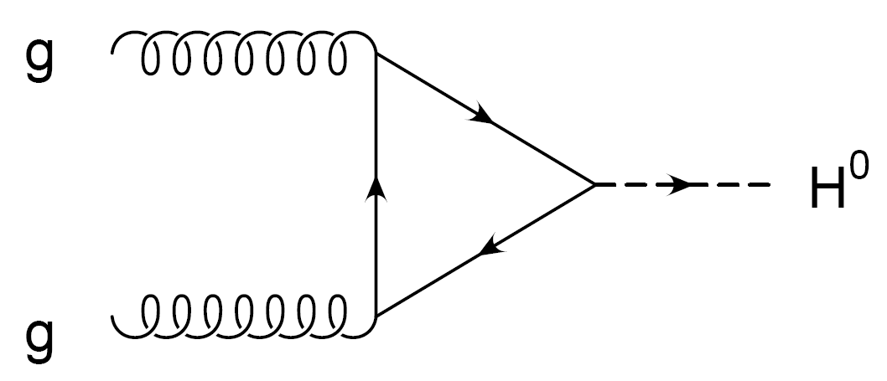
Higgs ←→ Yukawa ←→ CKM ?
proton
b
b
u
V_{ub}
proton
c
V_{cb}
Y_{ij} ➔ V_{cb}, V_{ub}
Difference between matter and anti-matter

Slide 32
The Flavour Puzzle
J.Kopp, https://indico.global/event/5574

Slide 33
The Standard Model Lagrangian
L_{Kinetic} : • Introduce the massless fermion fields
• Require local gauge invariance ➔ gives rise to existence of gauge bosons
L_{Higgs} : • Introduce Higgs potential with <φ> ≠ 0
• Spontaneous symmetry breaking
The W⁺, W⁻,Z⁰ bosons acquire a mass
L_{Yukawa} : • Ad hoc interactions between Higgs field & fermions
Niels Tuning (33)
Notes:
33

Slide 34
Fields: Notation
Y = Q - T₃
Fermions:
with ψ = Q_{L}, u_{R}, d_{R}, L_{L}, l_{R}, ν_{R}
Quarks:
Interaction rep.
Under SU2:
Left handed doublets
Right hander singlets
SU(3)_{C}
SU(2)_{L}
Hypercharge Y
(=avg el.charge in multiplet)
Left-
handed
generation
index
Leptons:
Scalar field:
Note:
Interaction representation: standard model interaction is independent of generation number
Niels Tuning (34)
Notes:
34

Slide 35
Fields: Notation
Q = T₃ + Y
Y = Q - T₃
Explicitly:
The left handed quark doublet :
Similarly for the quark singlets:
The left handed leptons:
And similarly the (charged) singlets:
Niels Tuning (35)
Notes:
35

Slide 36
:The Kinetic Part
: Fermions + gauge bosons + interactions
Procedure:
Introduce the Fermion fields and demand that the theory is local gauge invariant under SU(3)_{C}xSU(2)_{L}xU(1)_{Y} transformations.
Start with the Dirac Lagrangian:
Replace:
Fields:
G_{a}^{μ} : 8 gluons
W_{b}^{μ} : weak bosons: W₁, W₂, W₃
B^{μ} : hypercharge boson
Generators:
L_{a} : Gell-Mann matrices: ½ λ_{a} (3x3) SU(3)_{C}
T_{b} : Pauli Matrices: ½ τ_{b} (2x2) SU(2)_{L}
Y : Hypercharge: U(1)_{Y}
For the remainder we only consider Electroweak: SU(2)_{L} x U(1)_{Y}
Niels Tuning (36)
Notes:
36
Replace the derivative with the covariant derivative introducing the force carriers: gluons, weak vector bosons and photon.
The constants g_s, g and g’ are the corresponding coupling constants of the gauge particles.

Slide 37
: The Kinetic Part
For example, the term with Q_{Li}^{I} becomes:
Writing out only the weak part for the quarks:
u_{L}^{I}
W^{+μ}
L=J_{μ}W^{μ}
W⁺ = (1/√2) (W₁+ i W₂)
W⁻ = (1/√ 2) (W₁ – i W₂)
g
d_{L}^{I}
Niels Tuning (37)
Notes:
37
Writing out the weak part leads to terms that can be illustrated by Feynman diagrams. The interactions are usually written as a current J times a gauge field.
Exercise:
To show this use the defitions of the parity and charge operators. Start by setting q_l = ½ (1+g_5) q, etc. Use also (1-g_5)g_0 = g_0(1+g_5). Show for a few terms that Parity leads to q_l -> q_R. For C it goes similarly using transformation properties under C.
In fact, one can see immediately that, since the lagrangian contains vector terms and axial vector terms, which transform with opposite sign, that it cannot be Parity or charge conserving. Under CP, both the vector and axial currents are odd.

Slide 38
Recap
u^{I}
W
d^{I}
Diagonalize Yukawa matrix Y_{ij}
Mass terms
Quarks rotate
Off diagonal terms in charged current couplings
u
W
d,s,b
Niels Tuning (38)
Notes:
38

Slide 39
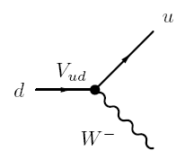


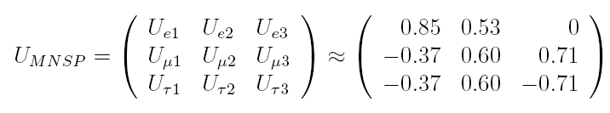
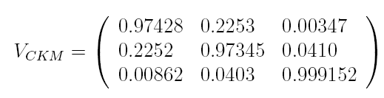
CKM magnitude mysterious
CKM matrix:
Coupling strength of charged current
Completely different hierarchy !
vs
flavour
mass
flavour
mass

Slide 40


CKM magnitude mysterious
CKM matrix:
Coupling strength of charged current
Completely different hierarchy !
vs
flavour
mass
flavour
mass
ν₁
ν₂
ν₃
d
s
b
ν_{e}
d'
PhD thesis R. de Adelhart Toorop

Slide 41
Proton collisions
proton
b
b
u
V_{ub}
proton
c
V_{cb}
Y_{ij} ➔ V_{cb}, V_{ub}
Difference between matter and anti-matter

Slide 42
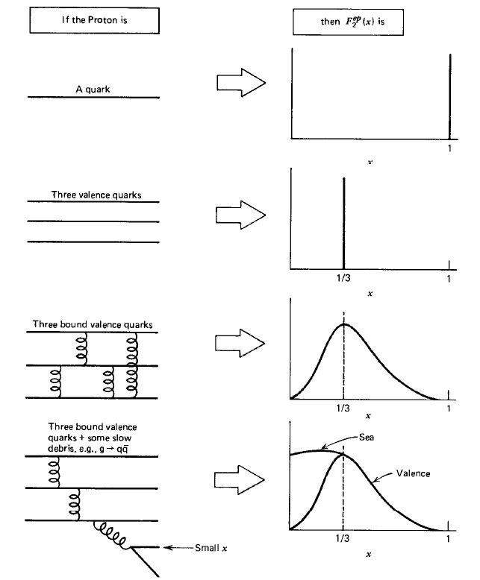
Proton: x
What is ‘momentum fraction’ distribution of quarks??
Quarks:
“Valence”
“Sea”
Dynamic, QCD !
(From: Halzen & Martin)

Slide 43
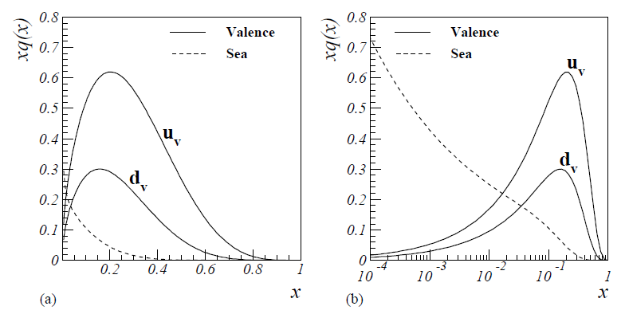
Proton: x
x=1/3
(From: PhD thesis N.Tuning)
What is ‘momentum fraction’ distribution of quarks??
Quarks:
“Valence”
“Sea”
Dynamic, QCD !
(From: Halzen & Martin)

Slide 44
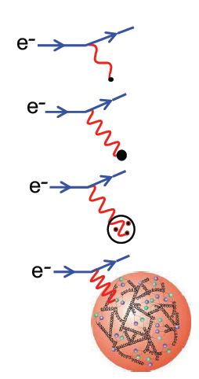
Proton: Q²
The “deeper” one looks into the proton, the more quarks and gluons

Slide 45
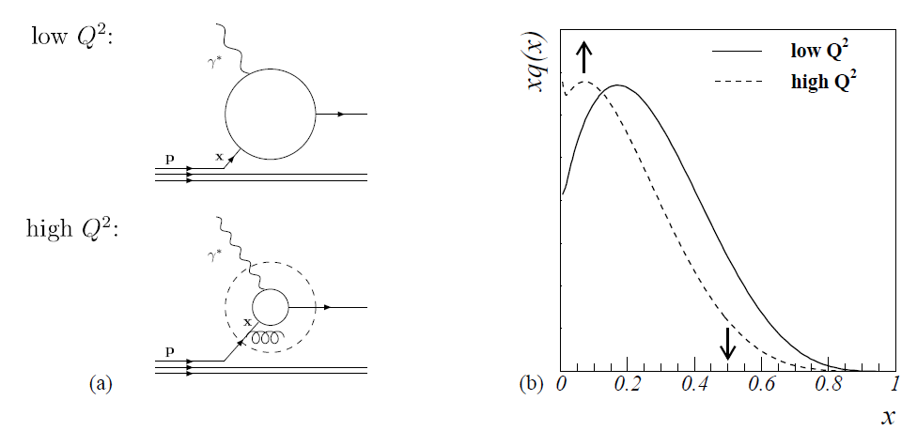
Proton: x, Q²
(From: PhD thesis N.Tuning)

Slide 46
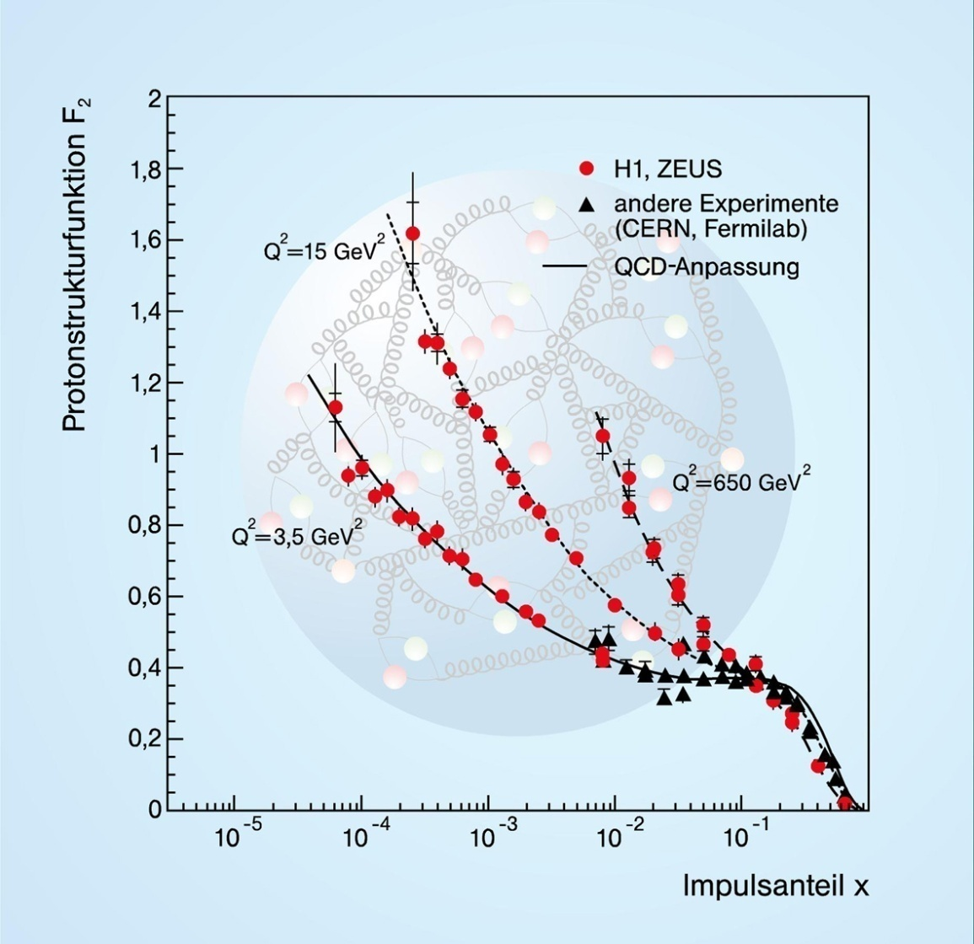
Proton Structure
The deeper you look, the more low-x quarks
45

Slide 47
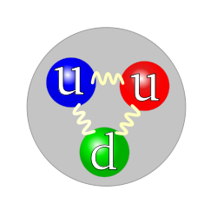
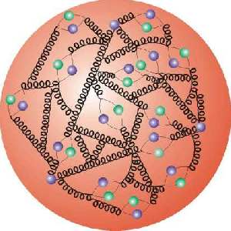
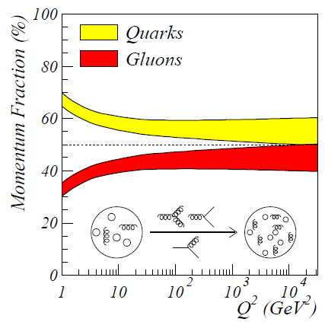
Proton Structure

Slide 48
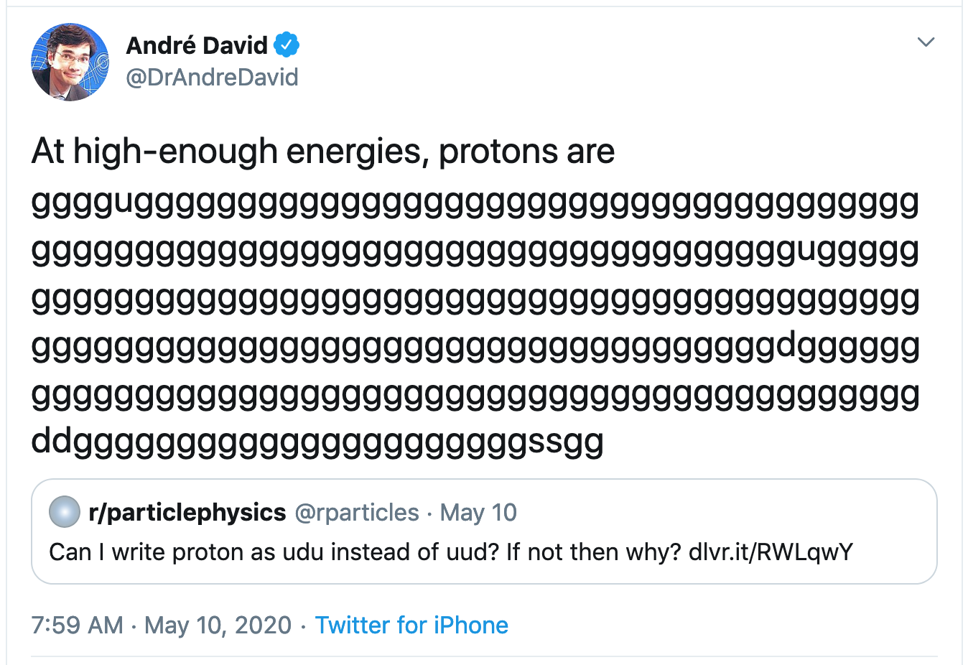

Slide 49
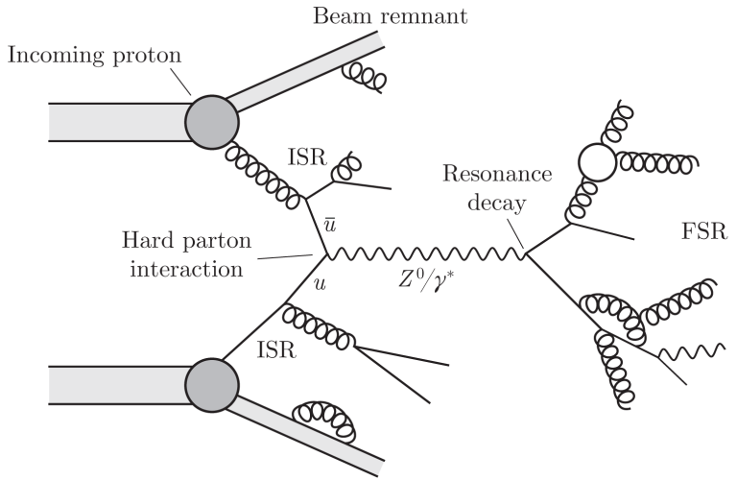
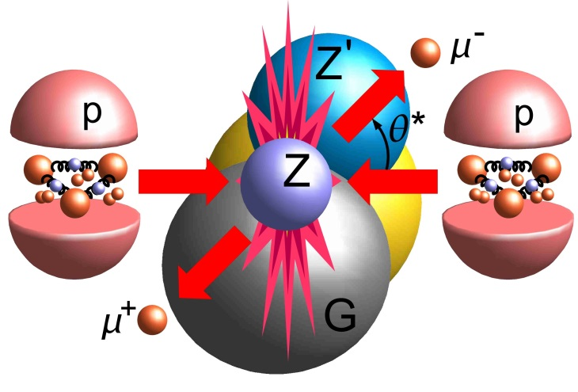
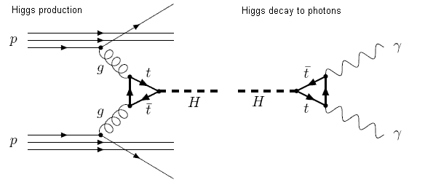
Proton Structure: knowledge needed for predictions
?

Slide 50
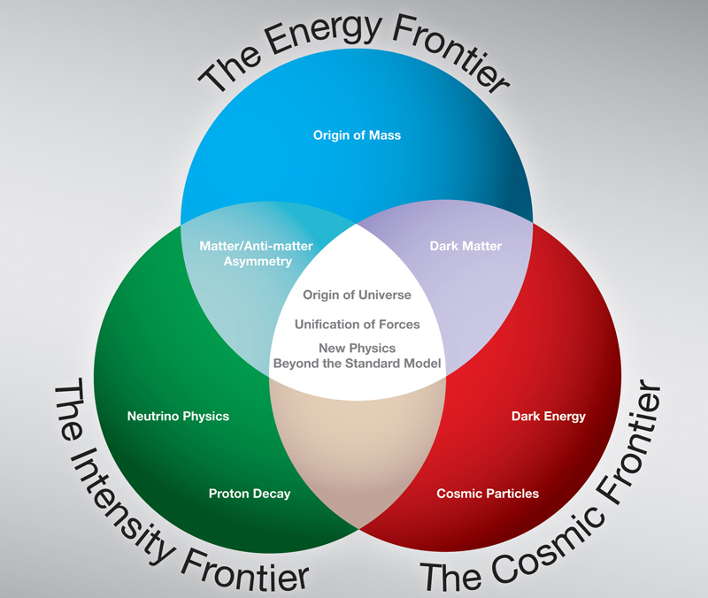
LHC
https://www.bnl.gov/newsroom/news.php?a=2800

Slide 51
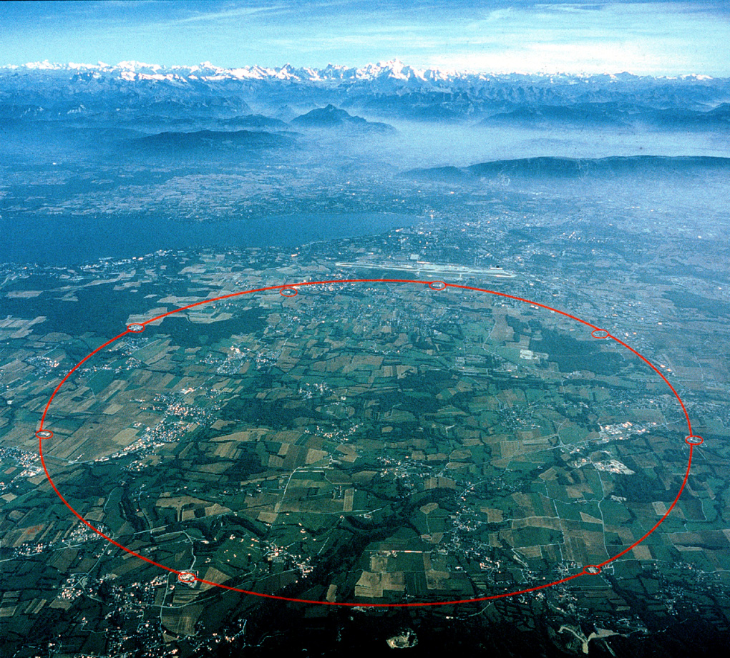
2) Indirect searches
1) Direct detection
LHCb
ATLAS
CMS
ALICE

Slide 52
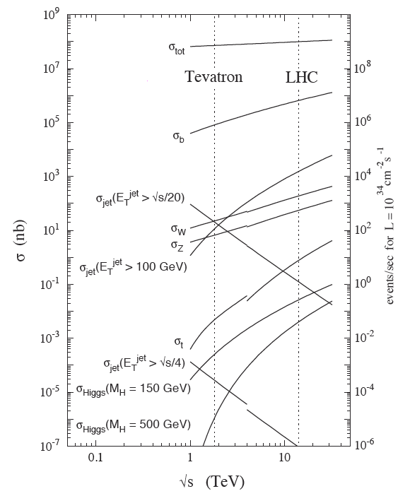
Physics production
1 Higgs per 100 sec
10⁶ B mesons per sec
500 μb →
1.000.000 events / sec
( L=2x10³³ )
Notes:
Difficult situation: new detector and new theory.
‘A pair of top quarks has it all’. Millions of pictures → learn about properties top quarks.
Transition: what do you need to take on such an approach.

Slide 53
LHC history

Slide 54
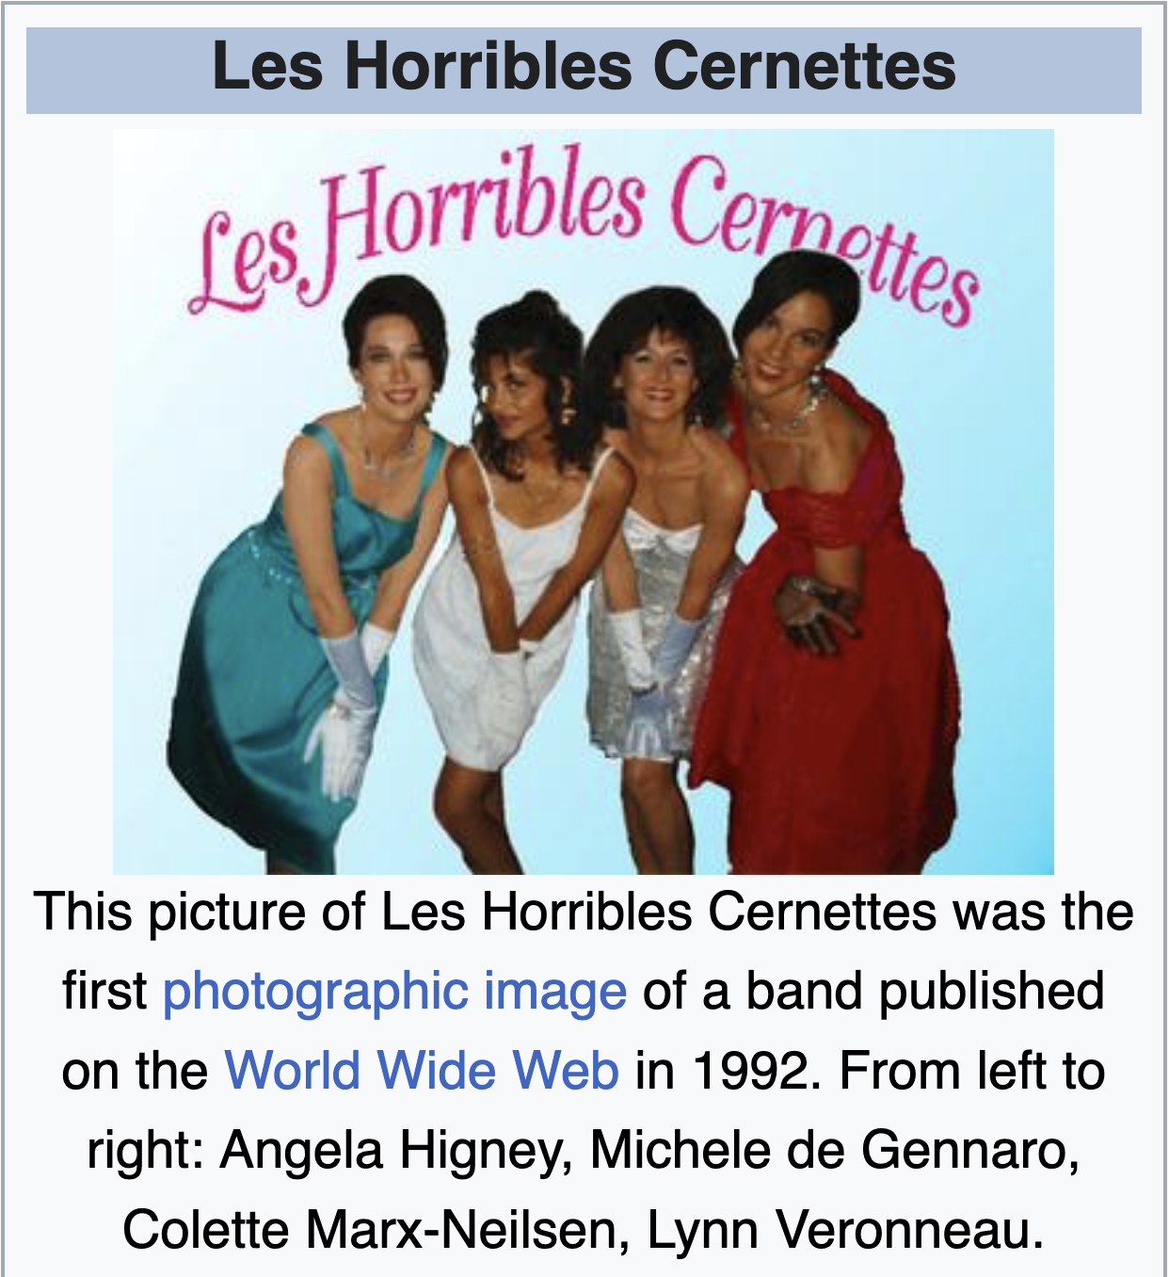
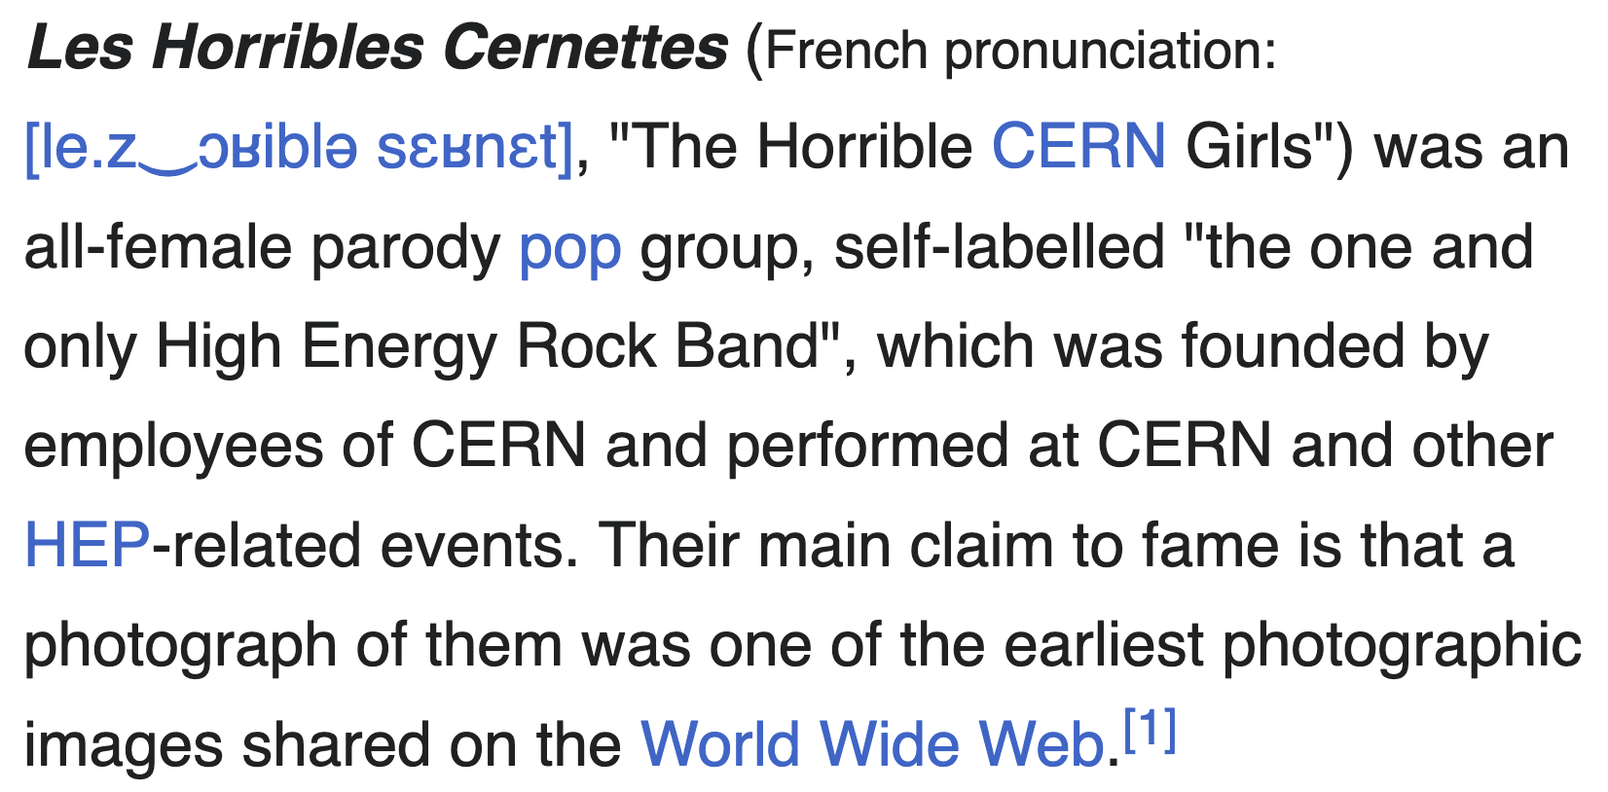
CERN history
First picture on the internet
https://en.wikipedia.org/wiki/Les_Horribles_Cernettes

Slide 55
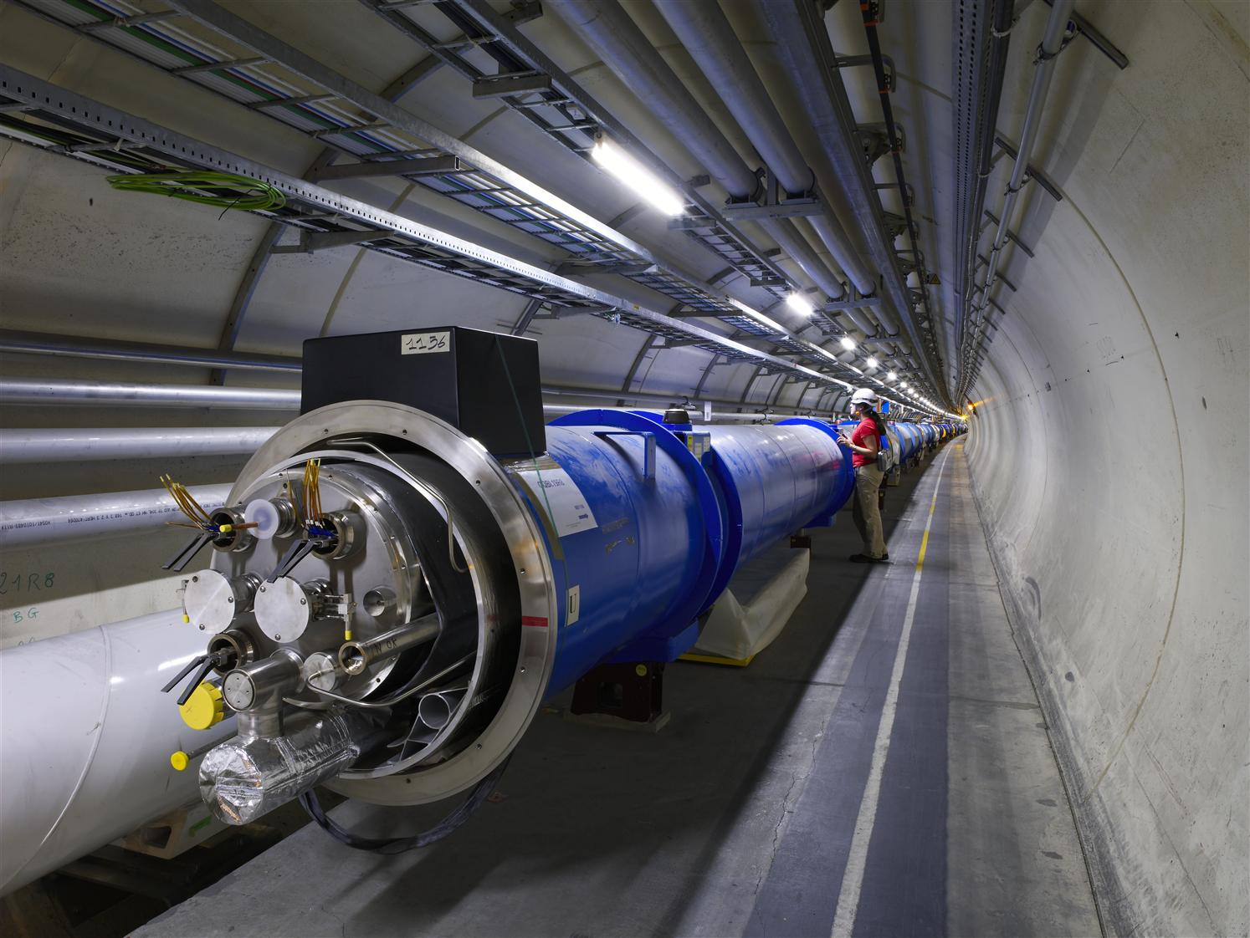

Slide 56

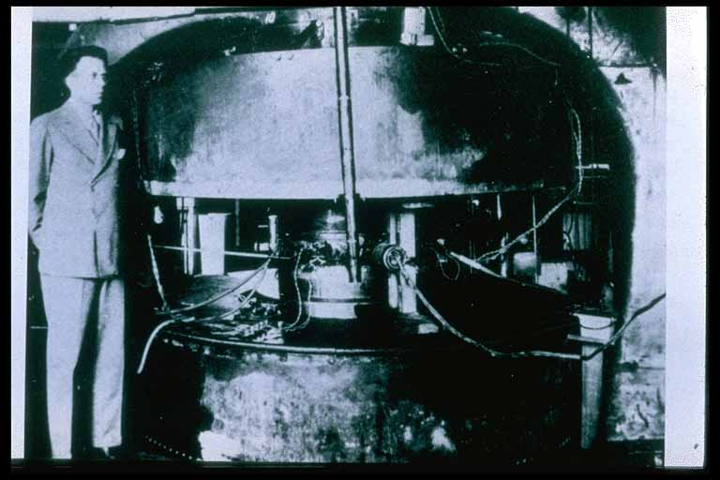
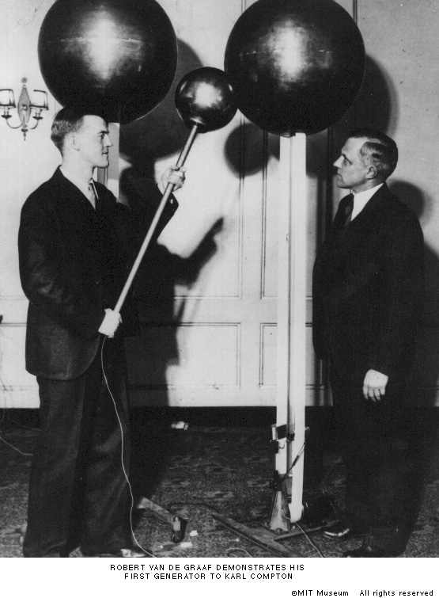

Accelerator history: 1930’s
Electrostatic Accelerator
Limited by arcs (corona)
Voltage multiplier
Voltages ~MV can be achieved for beams of ~100s of mA
Van der Graaff generator
LINAC
Voltage changes sign, the particles are accelerated every time they enter a gap
Cyclotron
Accelerated up to ~20 MeV
Synchrotron (50’s)
Magnetic field increases synchronously with beam energy, keeping radius fixed

Slide 57




From bubble chamber to LHC
Discoveries made with the help of Accelerators:
- 2012: Higgs discovered
The Nobel Prize
in Physics 2013

Slide 58


Cyclotron
Ernest “atom smasher” Lawrence
Nobelprize 1939
First cyclotron 1930

Slide 59


Cyclotrons in real life
First
Largest
TRIUMF
Dee
Dee
1931: r = 12 cm → 1 MeV protons
1974: B = 0.46 [T], r = 9 [m]
→ 520 MeV protons

Slide 60


Linac (principle)
Hollow tube (no field)
+
+
~
-
-
Equal frequency, larger velocity
→ (space between) tubes increasingly larger
Linac typically first step in acceleration chain
Typical: ~50m, ~100 MeV

Slide 61


Livingston
LHC
What would be E_{b} to reach √s=13.6 TeV with fixed-target?
$\sqrt{s}=\sqrt{2Em}$ $=13.6 TeV→E=99,000 TeV$
HERA
https://www.quantumdiaries.org/2011/11/05/the-ponderator-a-one-trick-pony/
https://www.slac.stanford.edu/cgi-wrap/getdoc/ce/slac-pub-9483.ps.gz

Slide 62
https://www.physik.uni-hamburg.de/iexp/gruppe-hillert/lehre/beschleunigerphysik-2/dokumente/vl-beschleunigerphysik-2/lumi-colliders-beschleunigerphysik-2.pdf

Slide 63
Luminosity
https://www.physik.uni-hamburg.de/iexp/gruppe-hillert/lehre/beschleunigerphysik-2/dokumente/vl-beschleunigerphysik-2/lumi-colliders-beschleunigerphysik-2.pdf

Slide 64




Building Blocks of a Synchrotron
Main components:
Dipole Magnets:
Bending
Quadrupole Magnets:
(De-)Focusing
Higher order magnets:
Corrections
RF cavities:
Acceleration

Slide 65
Birth of LHC
http://cdsweb.cern.ch/record/154938/files/CERN-84-10-V-1.pdf

Slide 66

The tunnel
“The excavation of the LEP tunnel was
Europe's largest civil-engineering project prior to the Channel Tunnel.
Three tunnel-boring machines started excavating the tunnel in Feb 1985 and
the ring was completed three years later.”
https://cds.cern.ch/record/779458
https://home.cern/science/accelerators/large-electron-positron-collider

Slide 67
Timeline towards LHC
1984 CERN - ECFA Workshop Lausanne
feasibility of a hadron collider in the future LEP tunnel
1987 La Thuile Workshop
Long Range Planning Committee
1989 ECFA Study Week Barcelona
LHC instrumentation
1990 Large Hadron Collider Workshop Aachen (CERN - ECFA)
1992 CERN – ECFA meeting Evian
“Towards the LHC Experimental Programme”
ATLAS and CMS were born with Letters of Intent (LoI), submitted on 1st October 1992
1991 December CERN Council
“LHC is the right machine for advance of the subject and the future of CERN”
1993 December proposal of LHC with commissioning in 2002
1994 (June) Council
Staged construction was approved, but some countries could not yet agree, so Council session vote was suspended until:
1994 (December) Council
(Two-stage) construction
1995 – 1997
A lot of negotiations took place; Japan, Russia, India, Canada and the USA were agreeing to contribute to the LHC
1996
December Council approved finally the single-stage 14 TeV LHC for completion in 2005

Slide 68

Injectors

Slide 69

Accelerator chain
CERN Proton chain
LINAC-4 (H⁻) 160 MeV
Proton Synchrotron Booster 2 GeV
Proton Synchtrotron 26 GeV
Super Proton Synchrotron 450 GeV
Large Hadron Collider 6.8 TeV
CERN Ion chain
LINAC-3
Low Energy Ion Ring
Proton Synchtrotron
Super Proton Synchrotron
Large Hadron Collider
https://inspirehep.net/literature/1820060

Slide 70
The components

Slide 71

The Interaction Regions (IR)
http://dx.doi.org/10.1016/j.nima.2016.02.050

Slide 72
The Collimators
S. Redaelli, https://arxiv.org/abs/1608.03159

Slide 73


Filling schemes, for example:
https://lpc.web.cern.ch/cgi-bin/filling_schemes.py

Slide 74

Energy Stored…
S. Redaelli, 2016. https://inspirehep.net/literature/1480416

Slide 75
Ions

Slide 76


Heavy Ion at LHCb: collider + gas target modes
Collider Mode
Fixed Target Mode
2024: x100 larger fixed target sample thanks to new gas target
76

Slide 77

“Page 1”

Slide 78
Where are we now?
https://op-webtools.web.cern.ch/vistar/

Slide 79
LHC performance - machine
Klute, https://indico.cern.ch/event/1347523/

Slide 80

Limitations?
Vacuum → “Electron Cloud” → Cooling power
Electrons inside vacuum chamber accelerated by field from passing bunch
Electrons hit inside of vacuum chamber, releasing more electrons, in turn accelerated → ever increasing cascade of electrons
Causes heating, potential beam instabilities, worse vacuum...
Big challenge for LHC, even more for FCC-hh
Mitigations:
Beam screen design, surface treatment, coatings
If nothing else helps: increase spacing between bunches

Slide 81


LHC performance - 2024
https://lpc.web.cern.ch/plots.html?year=2024

Slide 82

LHC performance - experiments
https://lpc.web.cern.ch/plots.html?year=2024

Slide 83
LHC performance - experiments

Slide 84


LHC performance - experiments

Slide 85
Hadron Collider Legacy (so far)
Klute, https://indico.cern.ch/event/1347523/

Slide 86
1998
P.Jenni 2015, https://indico.cern.ch/event/343570/

Slide 87

Schedule
You are here

Slide 88
Schedule
You are here
ATLAS + CMS Upgrade
HL-LHC
LHCb-UII + ALICE-3
HIC SVNT LEONES

Slide 89
Summary
Physics motivation
The Big picture
The Standard Model
The Lagrangian
The need for high-energy collisions
LHC
History
Operations
Performance
Schedule
Next: experiments

Slide 90
Outline
SM & LHC
Physics motivation: The Standard Model
LHC: History, operations, performance & schedule
LHC detectors
ATLAS, CMS and LHCb
Particle Detection
LHCb
Physics Highlights: Indirect, CKM, Spectroscopy & Rare Decays
ATLAS/CMS and beyond
Physics Highlights: QCD; W/Z; top; Higgs; SUSY
HL-LHC
Future: HL-LHC, LHCb Upgrade II, Higgs self-coupling and beyond

Slide 91
From Alex Lenz, LHCb Upgrade II workshop, Heidelberg, 26 March 2025

