Slide 1
Collider Experiments: the LHC & Beyond 3
N. Tuning

Slide 2
Outline
SM & LHC
LHC detectors
LHCb Physics Highlights
ATLAS, CMS, the HL-LHC and beyond
These lectures will contain a mix of
history, accelerators, experiments and particle detection.
But with a large dose of physics,
revealing my passion for particle physics!

Slide 3
Outline
SM & LHC
Physics motivation: The Standard Model
LHC: History, operations, performance & schedule
LHC detectors
ATLAS, CMS, ALICE and LHCb
Particle Detection
LHCb
Physics Highlights: Indirect, CKM, Spectroscopy & Rare Decays
ATLAS/CMS and beyond
Physics Highlights: QCD; W/Z; top; Higgs; SUSY
HL-LHC
Future: HL-LHC, LHCb Upgrade II, Higgs self-coupling and beyond

Slide 4
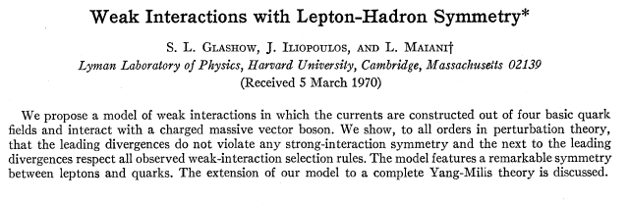
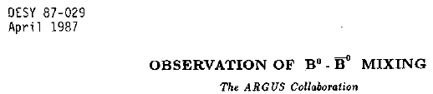


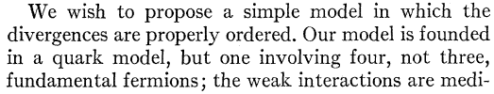
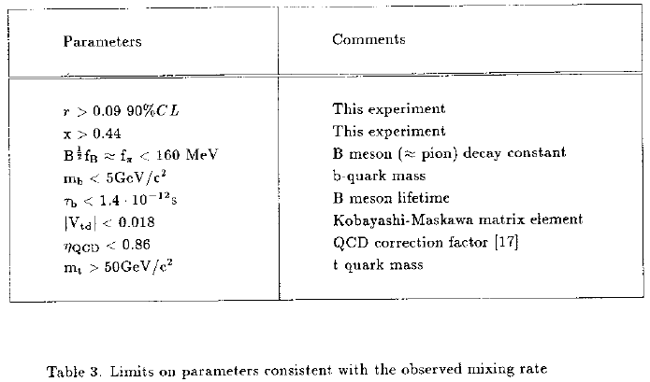
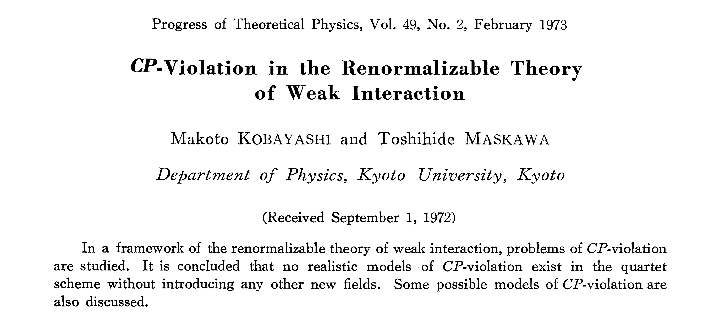
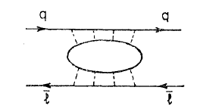
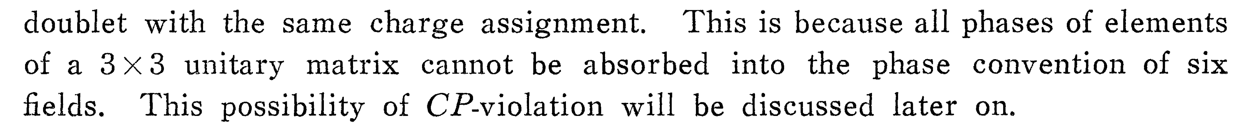
Historical record of indirect discoveries
GIM mechanism in K⁰→μμ
CP violation, K_{L}⁰→ππ
B⁰←→B⁰ mixing
Glashow, Iliopoulos, Maiani,
Phys.Rev. D2 (1970) 1285
Christenson, Cronin, Fitch, Turlay,
Phys.Rev.Lett. 13 (1964) 138
Kobayashi, Maskawa,
Prog.Theor. Phys. 49 (1973) 652
ARGUS Coll.
Phys.Lett.B192 (1987) 245
“Discovery” of charm
“Discovery” of beauty
“Discovery” of top
4

Slide 5
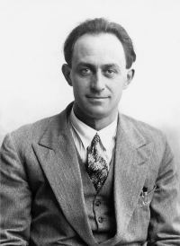
Historical perspective: W
Radioactive decay was “discovery” of weak interaction?
5

Slide 6
Historical perspective: W
Radioactive decay was “discovery” of weak interaction?
Direct
Indirect
E.Fermi, Z.Phys. 88 (1934) 161
UA1 Coll., Phys.Lett. B122 (1983) 103
6

Slide 7
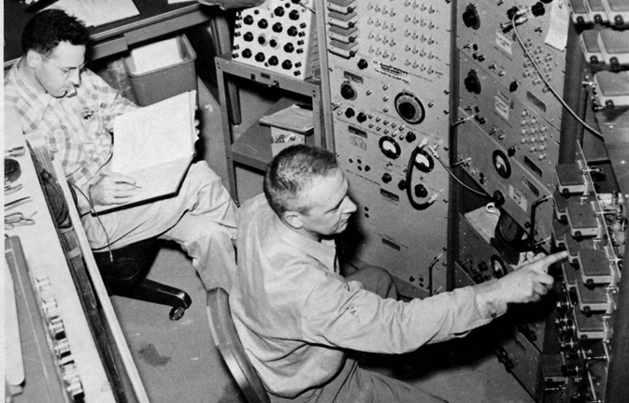
Historical perspective: ν
Radioactive decay was “discovery” of neutrino?
Direct
Indirect
E.Fermi, Z.Phys. 88 (1934) 161
Cowan, Reines, et al., Science 124 (1956) 103-104
7

Slide 8
Historical perspective: charm
Kaon decay was “discovery” of charm quark?
Direct
Indirect
GIM, Phys.Rev. D2 (1970) 1285
B.Richter et al, Phys.Rev.Lett. 33 (1974) 1406
8

Slide 9
Historical perspective: charm
d
s
cosθ_{c}
sinθ_{c}
u
W
W
ν_{𝜇}
𝜇⁺
𝜇⁻
9
There was however one major exception which Cabibbo could not describe: K⁰→ 𝜇⁺𝜇⁻
Observed rate much lower than expected from Cabibbos rate correlations (expected rate ~ g⁸sin²θ_{c}cos²θ_{c})
Notes:
9

Slide 10
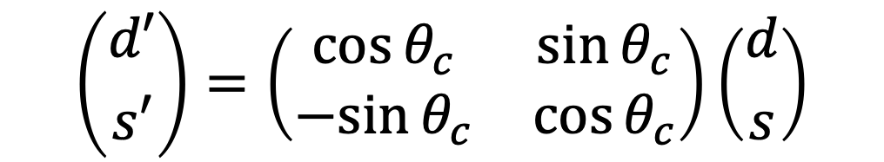
Historical perspective: charm: GIM-mechanism
Solution to K⁰ decay problem in 1970 by Glashow, Iliopoulos and Maiani → postulate existence of 4th quark
Two ‘up-type’ quarks decay into rotated ‘down-type’ states
Appealing symmetry between generations
u
c
W⁺
W⁺
d’=cos(θ_{c})d+sin(θ_{c})s
s’=-sin(θ_{c})d+cos(θ_{c})s
$$\left({d′ \atop s′}\right)=\left(\begin{matrix}\cos{θ_{c}} & \sin{θ_{c}} \\ −sin{θ_{c}} & \cos{θ_{c}}\end{matrix}\right)\left({d \atop s}\right)$$
10
Notes:
10

Slide 11
Historical perspective: charm: GIM-mechanism
Phys.Rev.D2,1285,1970
…
…
…
11

Slide 12
Historical perspective: charm: GIM-mechanism
d
s
d
s
cosθ_{c}
+sinθ_{c}
-sinθ_{c}
cosθ_{c}
u
c
ν_{𝜇}
ν_{𝜇}
𝜇⁺
𝜇⁻
𝜇⁺
𝜇⁻
12
How does it solve the K⁰→ 𝜇⁺𝜇⁻ problem?
Second decay amplitude added that is almost identical to original one, but has relative minus sign → Almost fully destructive interference
Cancellation not perfect because u, c mass different
Notes:
12

Slide 13
Historical perspective: bottom
CP violation was “discovery” of 3rd generation?
Direct
Indirect
Cronin and Fitch, Phys.Rev.Lett. 13 (1964) 138
L.Lederman et al., Phys.Rev.Lett. 39 (1977) 252
13

Slide 14
Historical perspective: top
Bottom mixing was “discovery” of top quark?
Direct
Indirect
ARGUS, Phys.Lett. B192 (1987) 245
CDF Coll., Phys.Rev.Lett. 74 (1995) 2626
14

Slide 15
Historical perspective: Z
Neutral current interaction was “discovery” of Z?
Direct
Indirect
Gargamelle Coll., Phys.Lett. B46 (1973) 138
UA1 Coll., Phys.Lett. B126 (1983) 398
15

Slide 16
Historical perspective: Higgs
Precision measurements at LEP were “discovery” of Higgs?
Direct
Indirect
LEP, Phys.Rept. 427 (2006) 257
ATLAS Coll., Phys.Lett. B716 (2012) 1
16

Slide 17
Historical perspective
Historical record of indirect discoveries:
Particle | Indirect |  |  | Direct
ν | β decay |  | 1932 | Reactor ν-CC | Cowan, Reines | 1956
W | β decay |  | 1932 | W→eν | UA1, UA2 | 1983
c | K⁰→μμ | GIM | 1970 | J/ψ | Richter, Ting | 1974
b | CPV K⁰→ππ | CKM, 3rd gen | 1964/72 | Υ | Ledermann | 1977
Z | ν-NC | Gargamelle | 1973 | Z→ e⁺e⁻ | UA1 | 1983
t | B mixing | ARGUS | 1987 | t→ Wb | D0, CDF | 1995
H | e⁺e⁻ | EW fit, LEP | 2000 | H→ 4μ/γγ | CMS, ATLAS | 2012
? | What’s next ? |  | ? |  |  | ?
17

Slide 18
Historical perspective
18

Slide 19
“Precision Physics” - Jargon
Flavour physics
EDM
quarks
quarks
CP
violation
Rare
decays
Precision physics
neutrinos
τ, μ
Leptons
g-2
19

Slide 20
Flavour Physics Landscape
20

Slide 21
Flavour Physics Landscape
21

Slide 22
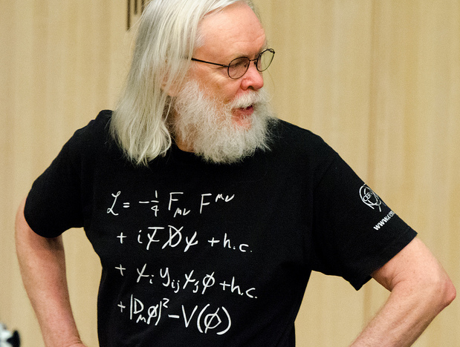
Prof.dr. J. Ellis
Origin of
CKM matrix

Slide 23






CKM: where does it come from?
Charged current:
flavour diagonal
Yukawa couplings:
mix between generations
23

Slide 24




CKM: where does it come from?
Charged current:
flavour diagonal
Yukawa couplings:
mix between generations
Diagonalize Yukawa matrix:
Off diagonal in CC Mass terms
24

Slide 25
CKM: where does it come from?
Flavour physics closely connected to Higgs??
25

Slide 26
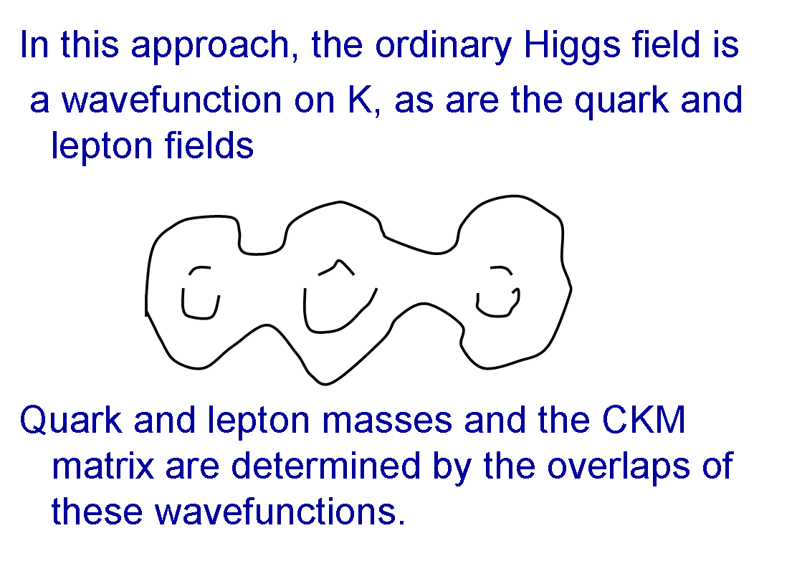
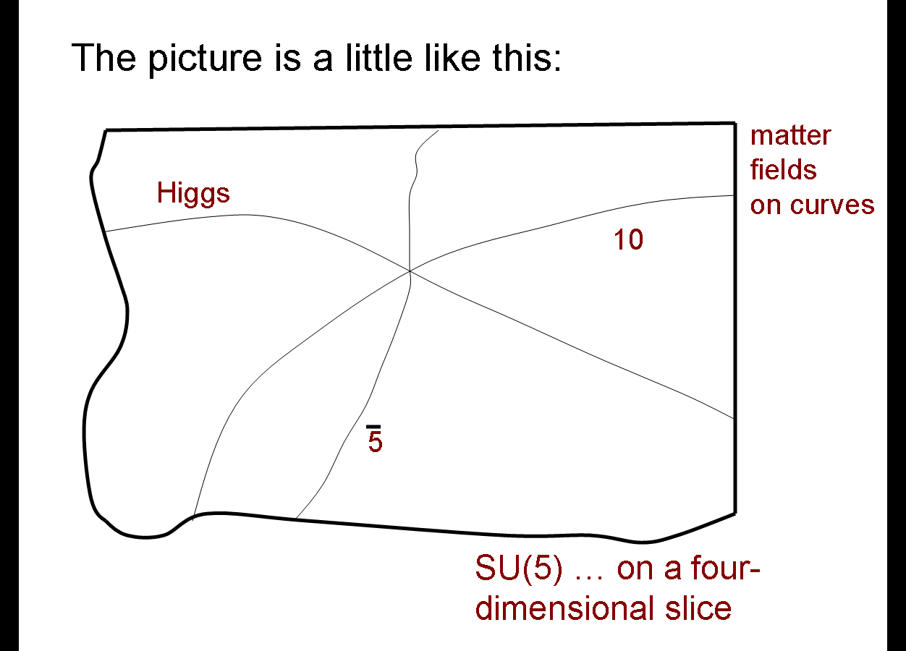
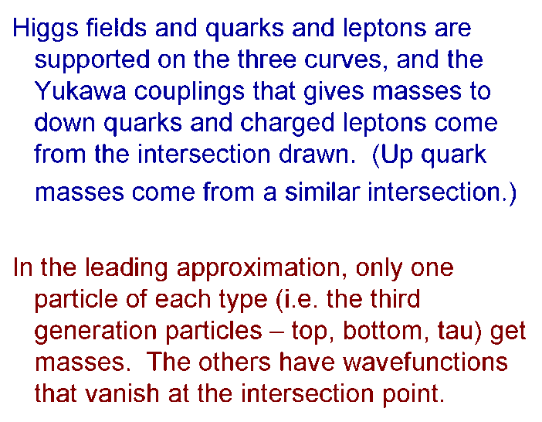
Intermezzo: “The picture is a little like this” 😳
In 2004, Time magazine stated that Witten was widely thought to be the world's greatest living theoretical physicist.
E. Witten, The problem of flavor, 17 Feb 2009, https://indico.cern.ch/event/51958/
Vafa&Heckman, “From F-Theory GUT’s to the LHC” arXiv:0809.3452
26

Slide 27

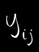
CKM: in a nutshell
1) Matrix to transform weak- and mass-eigenstates:
u^{I}
u
W
W
1
V_{uq}
d^{I}
d,s,b
Weak eigenstates
Mass eigenstates
i.e. diagonalize:
27

Slide 28
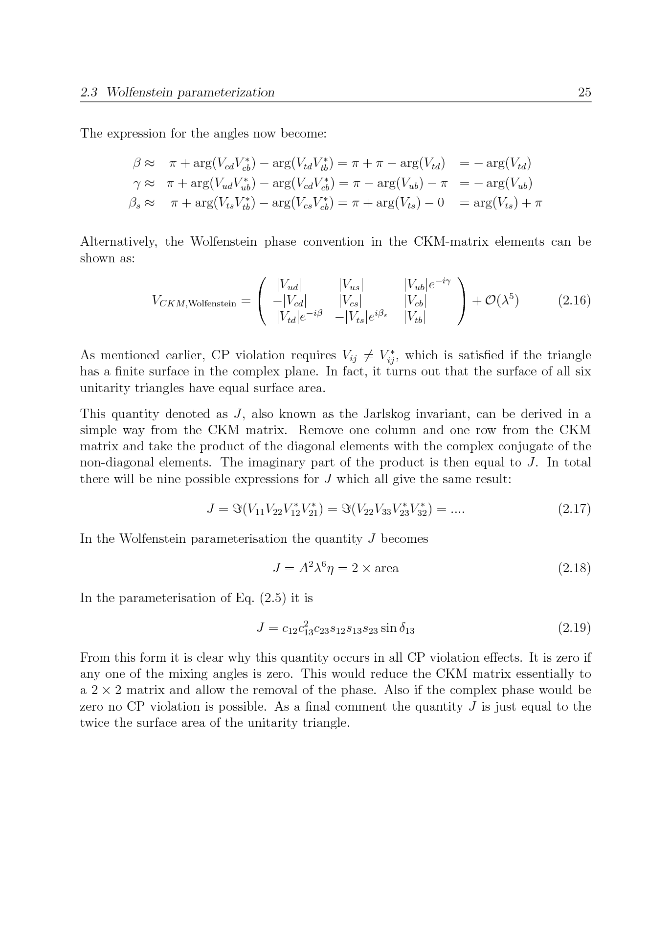
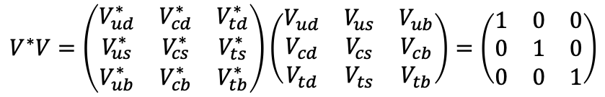
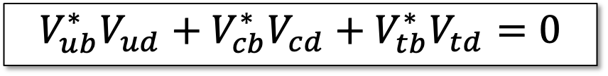
CKM: in a nutshell
1) Matrix to transform weak- and mass-eigenstates:
u^{I}
u
W
W
1
V_{uq}
d^{I}
d,s,b
Weak eigenstates
Mass eigenstates
2) Matrix has complex phases:
3) Matrix is unitary:
$$V^{∗}V=\left(\begin{matrix}V_{ud}^{∗} & V_{cd}^{∗} & V_{td}^{∗} \\ V_{us}^{∗} & V_{cs}^{∗} & V_{ts}^{∗} \\ V_{ub}^{∗} & V_{cb}^{∗} & V_{tb}^{∗}\end{matrix}\right)\left(\begin{matrix}V_{ud} & V_{us} & V_{ub} \\ V_{cd} & V_{cs} & V_{cb} \\ V_{td} & V_{ts} & V_{tb}\end{matrix}\right)=\left(\begin{matrix}1 & 0 & 0 \\ 0 & 1 & 0 \\ 0 & 0 & 1\end{matrix}\right)$$
γ
β
(0,0)
(1,0)
$$V_{ub}^{∗}V_{ud}+V_{cb}^{∗}V_{cd}+V_{tb}^{∗}V_{td}=0$$
28

Slide 29
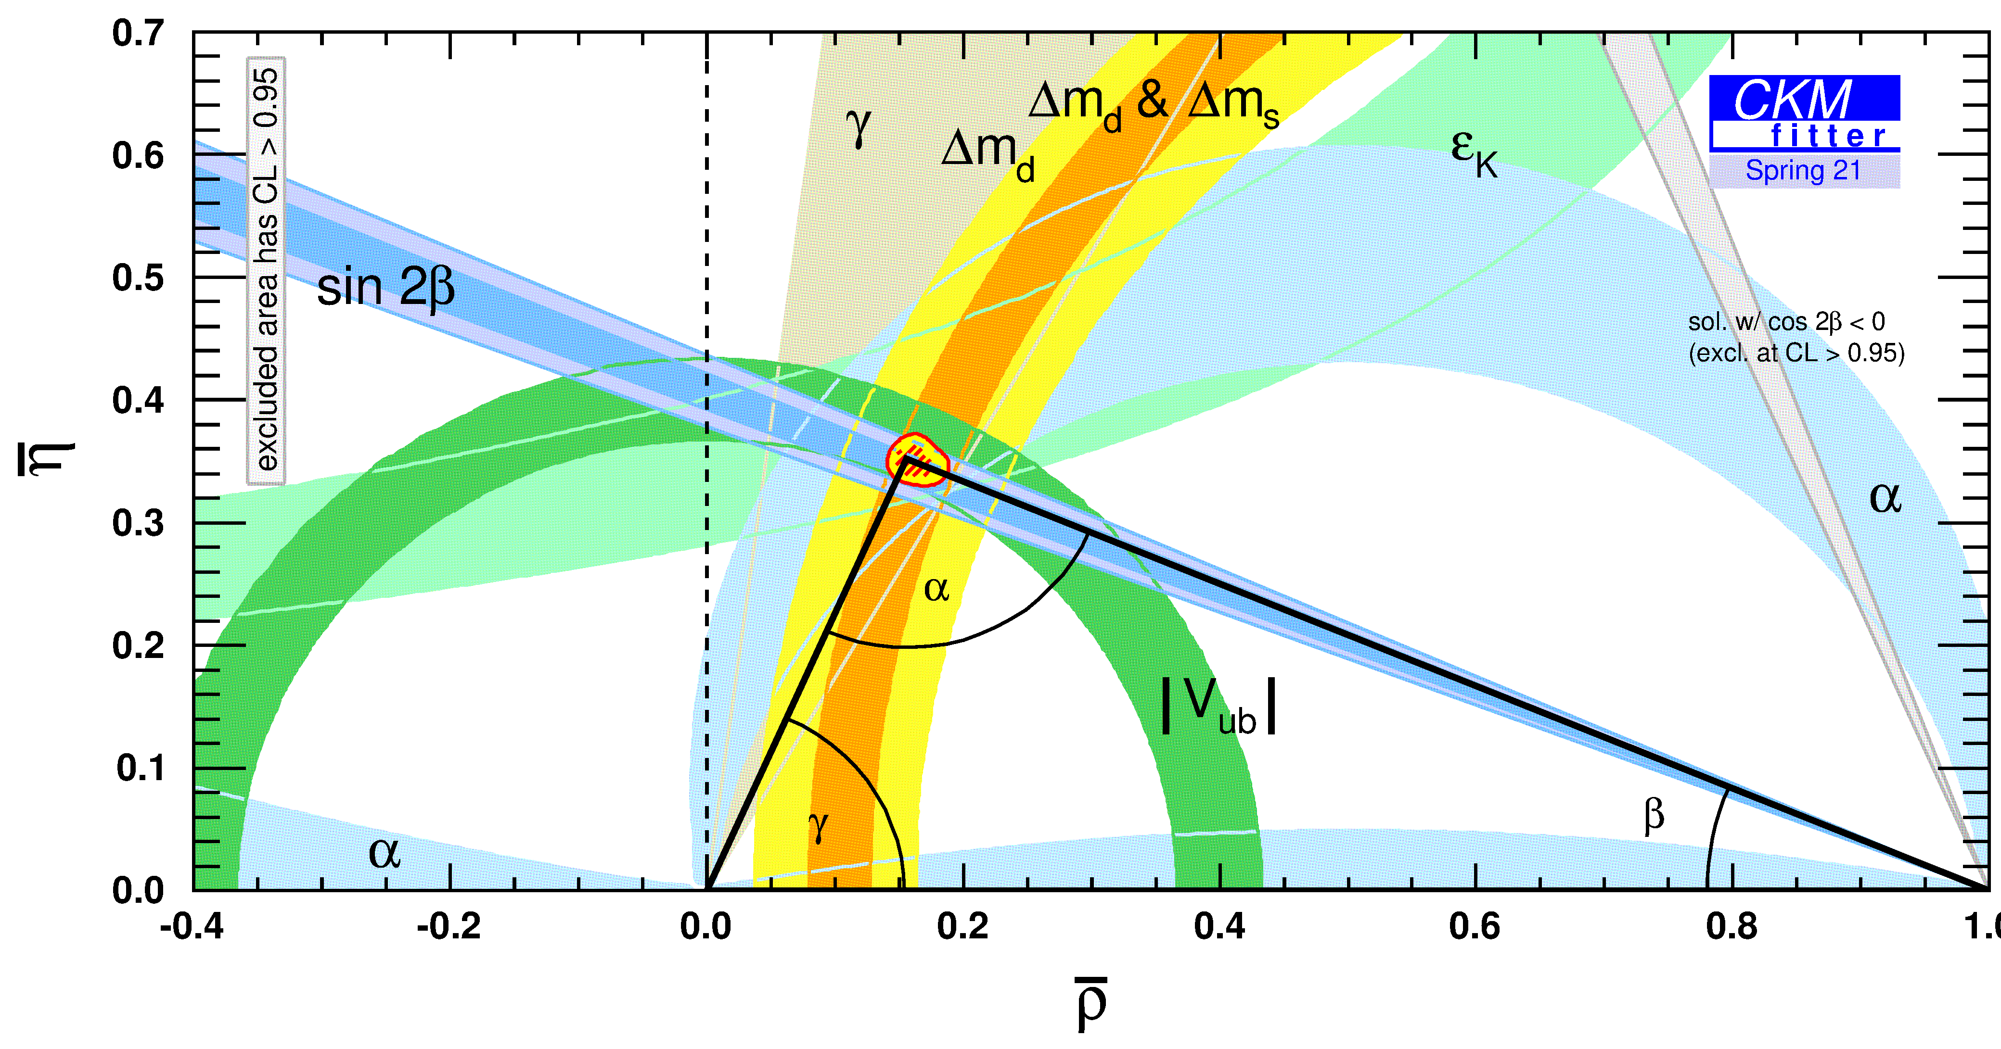
CKM: recent results
Δm_{s}
~V_{td}
~V_{ub}
|V_{ub}|
γ
sin2β
Global fits:
CKMfitter: http://ckmfitter.in2p3.fr/
UTFit: http://www.utfit.org/Utfit/
29

Slide 30
CP violation
Compare decay rates between conjugate final states
Example: B_{s}⁰➝ K⁻𝜋⁺
30

Slide 31
CP violation
Compare decay rates between conjugate final states
Example: B_{s}⁰➝ K⁻𝜋⁺
31

Slide 32
CP violation
Compare decay rates between conjugate final states
32

Slide 33
CP violation
Compare decay rates between conjugate final states
33

Slide 34
CP violation – Take home message
Two interfering amplitudes
Relative CP violating phase
Relative CP conserving phase
34

Slide 35
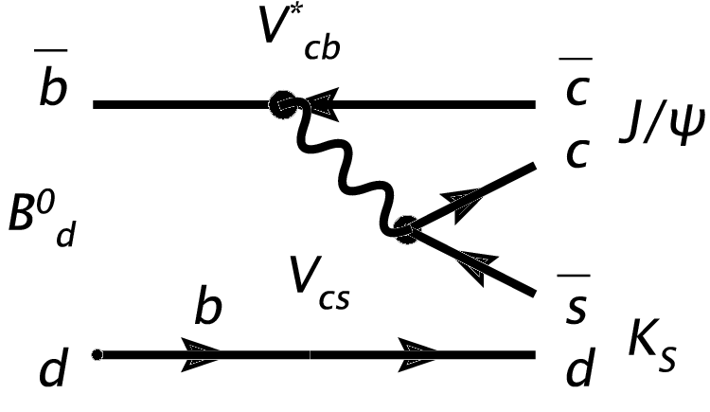
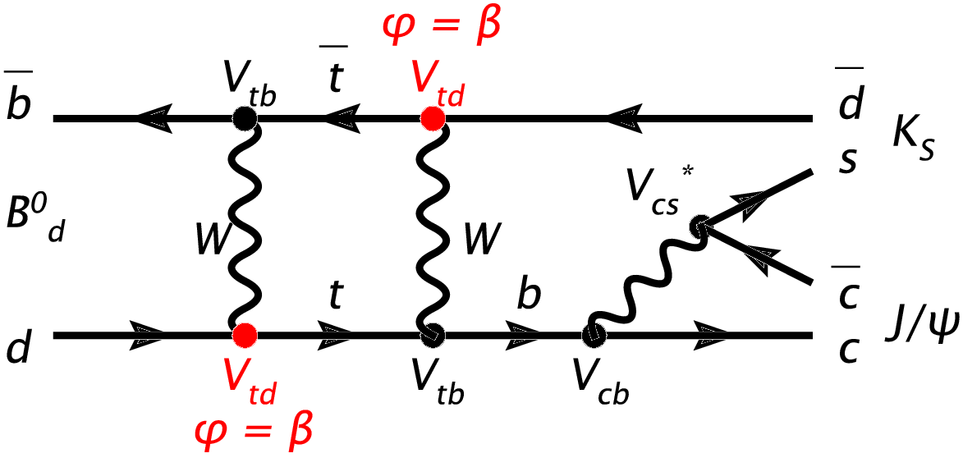
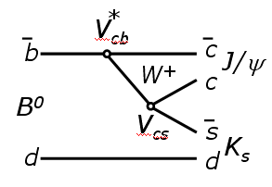

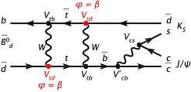
sin2β
CP violation:
Two interfering amplitudes
Two relative phases
Different amplitude under CP conjugation
B⁰→J/ψK⁰_{S} : The golden mode!
Relative phase: arg(V_{td}²)=2β (and π/2)
+
=
2
Γ(B⁰→J/ψK⁰_{S} )=
π/2+2β
CP
+
2
=
Γ(B⁰→J/ψK⁰_{S} )=
π/2-2β
35

Slide 36
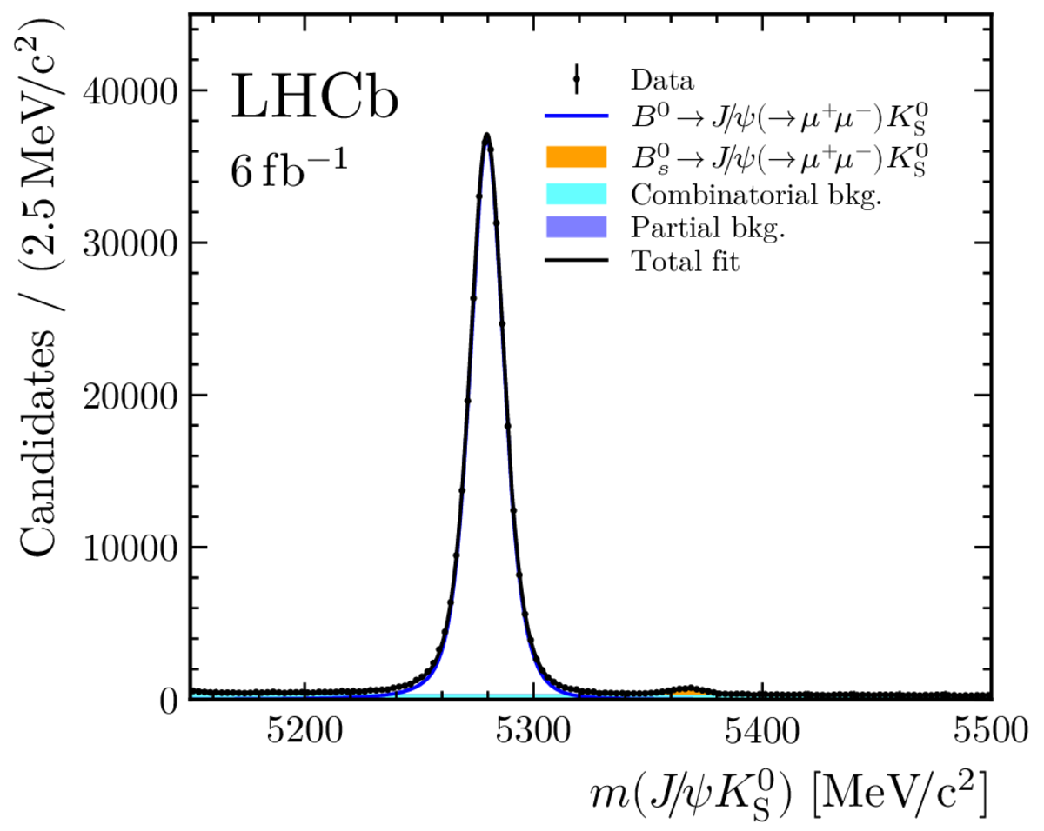
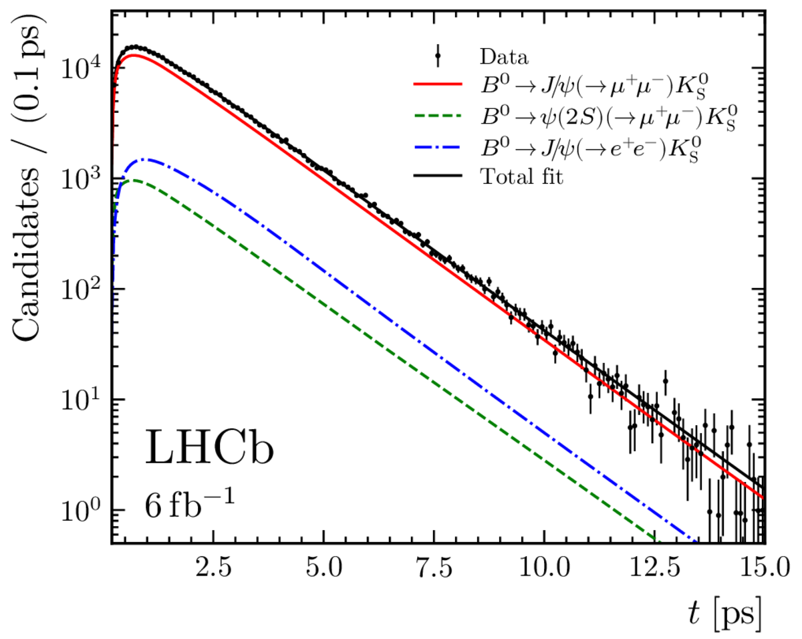
sin2β
“Flavour tagging” essential
Which B⁰ was a B⁰ ?
LHCb arXiv:2309.09728
Phys. Rev. Lett. 132 (2024) 021801
36

Slide 37
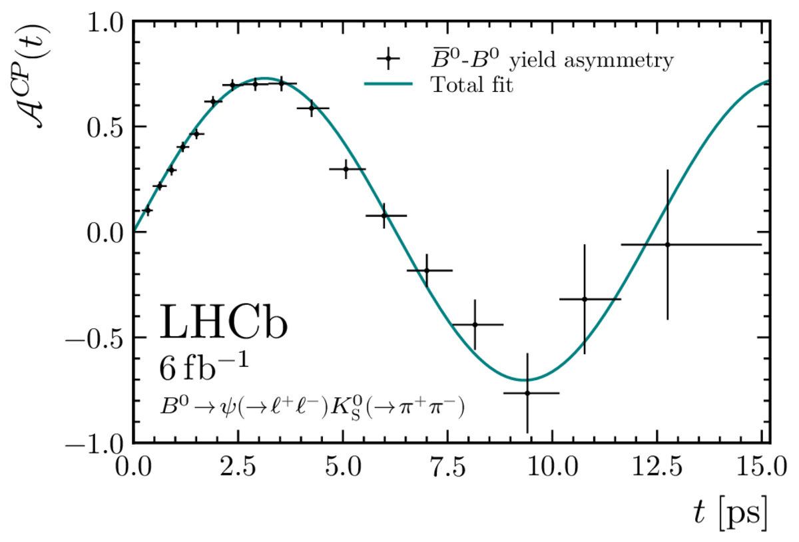
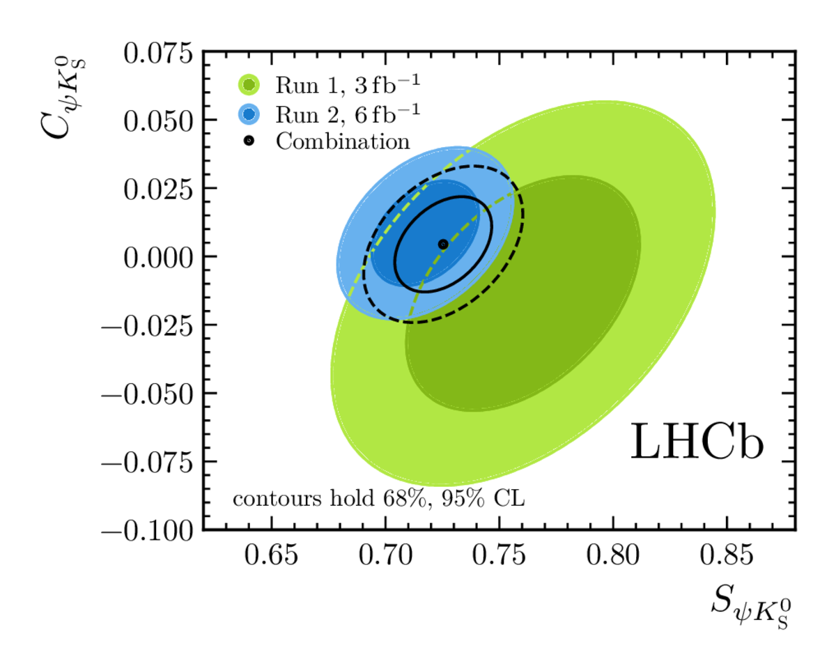
sin2β
“Flavour tagging” essential
Wrong tag fraction w~39%
D=(1-2w)~0.22
~sin2β
LHCb arXiv:2309.09728
Phys. Rev. Lett. 132 (2024) 021801
→ B decay time [ps]
sin2β =
37

Slide 38
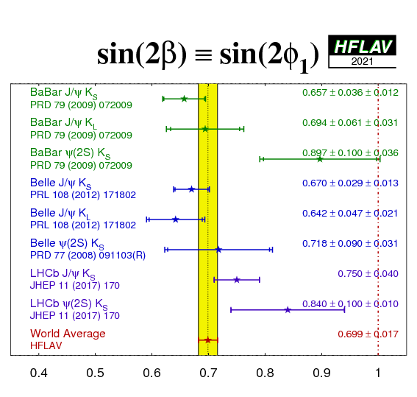
sin2β
(Run 2)
LHCb arXiv:2309.09728 PRL132 (2024) 021801
OLD:
(Run 1)
Large B production competes
with good tagging:
38

Slide 39
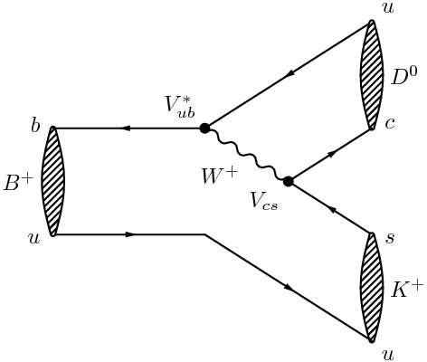
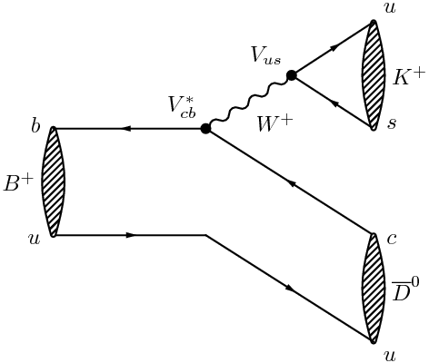
Constraints on angle γ
Different yields for B⁺ and B⁻ decays
two amplitudes contribute with different relative phase: V_{ub} = |V_{ub}|e^{-iγ}
Amplitude 1
Amplitude 2
V_{ub}*
V_{cb}*
+
39

Slide 40
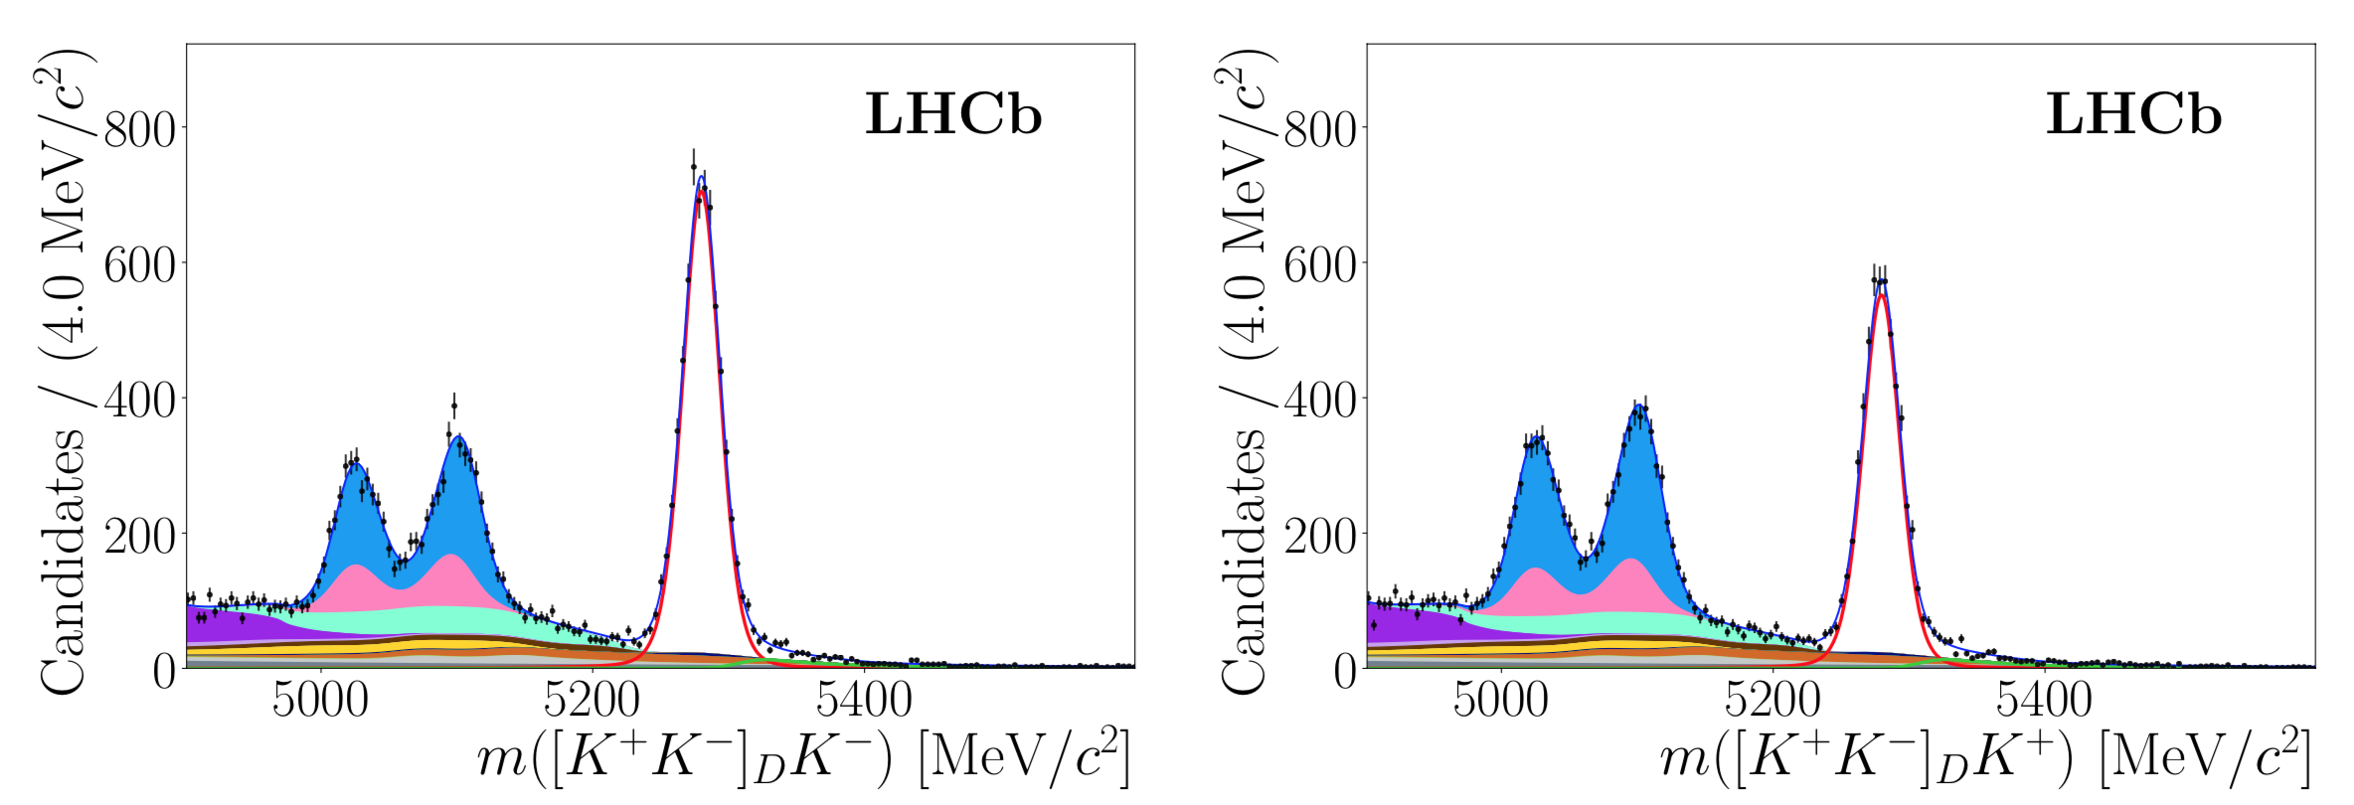
Constraints on angle γ - with B±→D^{(∗)}K± and D⁰→h±h±
B⁻→D^{(*)}K⁻
B⁺→D^{(*)}K⁺
V_{ub}
V_{cb}
LHCb, arXiv:2012.09903, JHEP 04(2021) 081
40

Slide 41
Constraints on angle γ - with B±→D^{(∗)}K± and D⁰→h±h±
B⁻→D^{(*)}K⁻
B⁺→D^{(*)}K⁺
V_{ub}
V_{cb}
B⁺→D^{0*}K⁻
B⁺→D⁰K⁺
LHCb, arXiv:2012.09903, JHEP 04(2021) 081
Many final states for D*⁰ or D⁰ !
B±→D⁰K±, B±→D⁰π±, B±→D^{0*}K±, B±→D^{0*}π±
D⁰→K⁺K⁻, D⁰→K⁺π⁻, D⁰→π⁺π⁻, D⁰→K_{S}⁰K⁻K⁺, D⁰→K_{S}⁰π⁻π⁺,
Very precise input for gamma
41

Slide 42
CKM angle γ: Combination
Different yields for B and anti-B decays
two amplitudes contribute with different relative phase: V_{ub} = |V_{ub}|e^{-iγ}
many D^{(*)}_{(s)} final states:
LHCb-CONF-2022-002, Oct 2022
42

Slide 43
CKM angle γ
Different yields for B and anti-B decays
two amplitudes contribute with different relative phase: V_{ub} = |V_{ub}|e^{-iγ}
many D^{(*)}_{(s)} final states:
 | γ (º)
LHCb | 64.4 ± 2.8°
CKMfitter | 65.6^{+1.1}_{-2.7}°
UTFit | 65.8^{+2.2}_{-2.2}°
43

Slide 44
Precision Δm_{s} with B⁰_{s}→ D_{s}⁺π⁻
Frequency ~ transition rate!
“Flavour specific” : final state reveals flavour of the decaying B
44

Slide 45
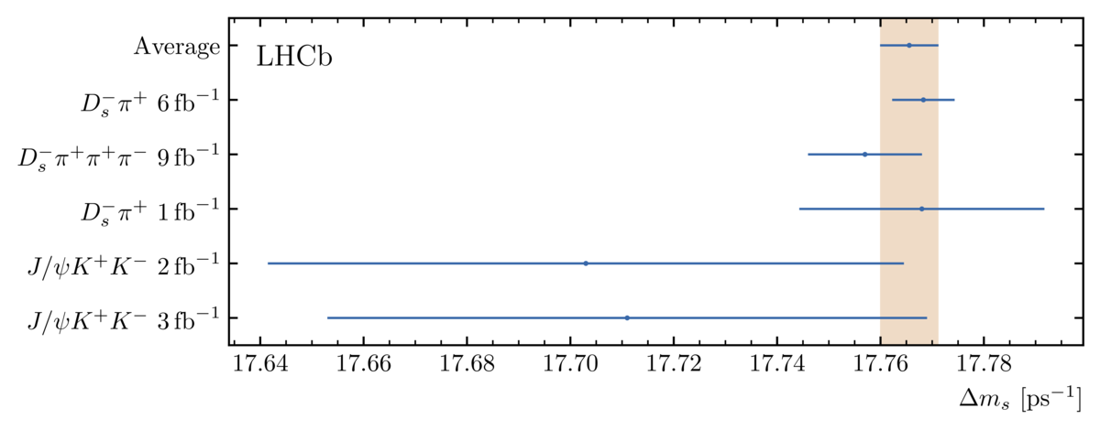
Precision Δm_{s} with B⁰_{s}→ D_{s}⁺π⁻
Legacy “textbook” measurement
“Flavour specific” : final state reveals flavour of the decaying B
3 trillion oscillations per second, with 3 x 10⁻⁴ precision
Combination :
B⁰_{s}→D_{s}⁺π⁻ :
B⁰_{s}→D_{s}⁺π⁻π⁺π⁻ :
 | Δm_{s} (ps⁻¹) | Stat | Sys | Ref.
B⁰_{s}→D_{s}⁺π⁻ | 17.7683 | 0.0051 | 0.0032 | arXiv:2104.04421 acc. Nat.Phys
B⁰_{s}→D_{s}⁺π⁻π⁻π⁻ | 17.757 | 0.007 | 0.008 | arXiv:2011.12041 JHEP 03(2021)137
Combination | 17.7656 | 0.0057 |  | arXiv:2104.04421 acc. Nat.Phys
LHCb, arXiv:2104.04421
Nature Physics 18, (2022) 1-5
45

Slide 46
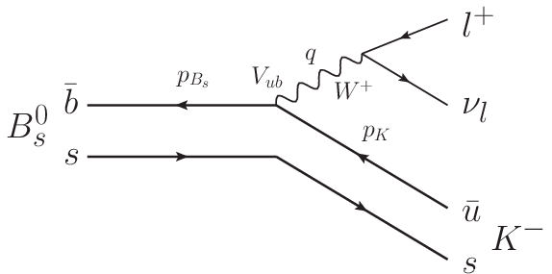
Measurement ∣V_{ub}∣/∣V_{cb}∣ from B(B_{s}⁰→K⁻μ⁺ν)
V_{ub}*
Interesting input to |V_{ub}| ! (and form factor calculations)
46

Slide 47
Measurement ∣V_{ub}∣/∣V_{cb}∣ from B(B_{s}⁰→K⁻μ⁺ν)
q² < 7 GeV²
q² > 7 GeV²
LHCb, arXiv:2012.05143 PRL126(2021)8, 081804
LCSR:
Lattice:
First observation of B_{s}⁰→K⁻μ⁺ν
47

Slide 48
CKM: recent results
Δm_{s}
sin2β
~V_{td}
~V_{ub}
γ
|V_{ub}|
48

Slide 49
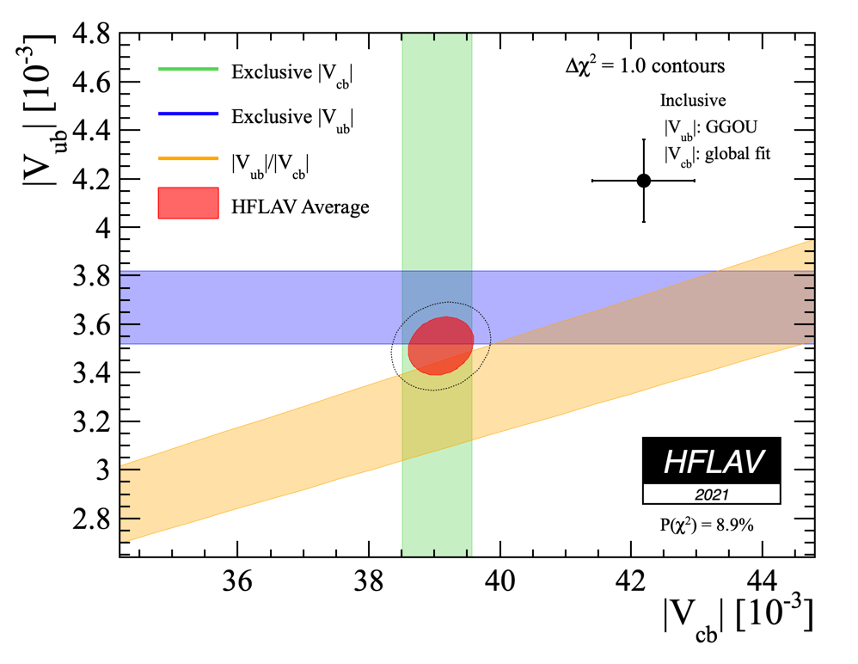
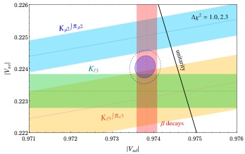
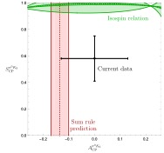
CKM: recent results
HFLAV, 2021
Δm_{s}
sin2β
Crivellin et al, arXiv:2212.06862
~V_{td}
~V_{ub}
γ
|V_{ub}|
Fleischer, Jaarsma, Malami, Vos, arXiv:1806.08783
So far so good, but stay vigilant…
V_{ub} and V_{cb} : incl. and excl. measurements differ…
V_{us}: too small for unitarity (Cabibbo angle anomaly)
Kπ puzzle: CP asymmetries should be related through isospin symmetry…
BR(B → Dh): Factorisation?
…
Skidmore, 2 Jun 2022, Siegen Workshop
49

Slide 50
CP violation in mixing?
50

Slide 51
Consistency
Courtesy: O.Deschamps, CKM fitter group
51

Slide 52
Spectroscopy: many new states discovered at LHC
Courtesy P.Koppenburg, https://www.nikhef.nl/~pkoppenb/particles.html
52

Slide 53
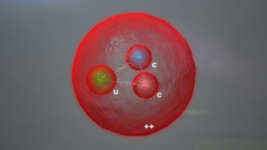
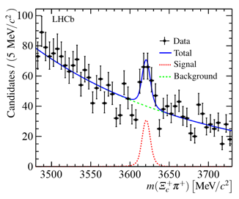
Many observations of ‘classical’ states
(ccu): Ξ_{cc}⁺⁺ (buu): Σ_{b}(6097)⁺ (bdd): Σ_{b}(6097)⁻
c
u
d
u
c
b
u
b
d
++
+
-
arXiv:1707.01621 Phys. Rev. Lett. 119 (2017) 112001
arXiv:1809.07752 Phys. Rev. Lett. 122(2019) 012001
53

Slide 54
Spectroscopy: many are exotic!
PDG naming scheme (2023): https://pdg.lbl.gov/2023/reviews/rpp2023-rev-naming-scheme-hadrons.pdf
54

Slide 55
Exotic spectroscopy

Slide 56
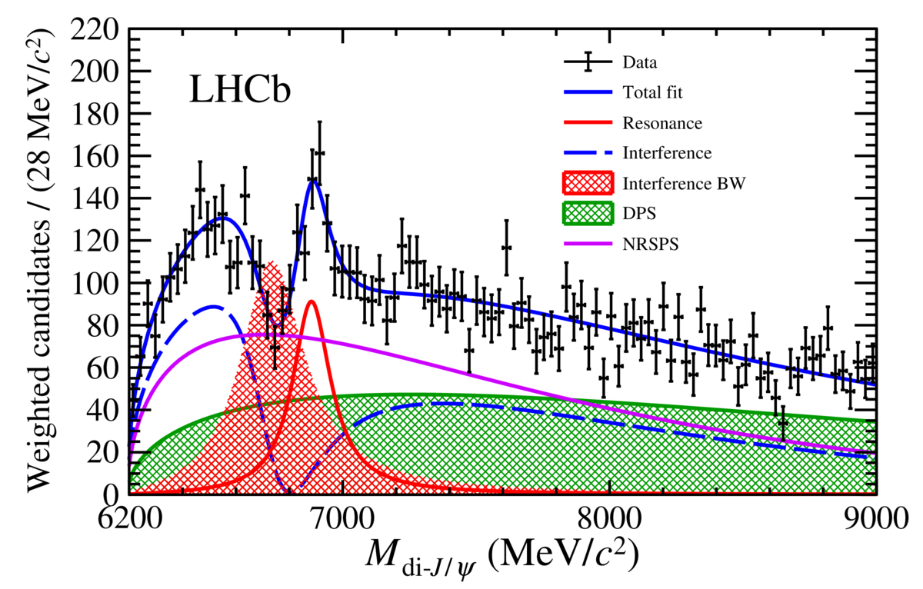
Exotic spectroscopy
arXiv:2009.06619
PRL. 126 (2021) 092001
X(3872) [ccuu]
”Classic” tetraquark discovered by Belle
Production different from ψ(2S)
P_{c}(4312)⁺, P_{c}(4440)⁺, P_{c}(4457)⁺ [ccuud]
Strikingly close Σ_{c}⁺D⁽*⁾⁰ thresholds
T_{cc}⁺(3875) [ccud]
Doubly charmed!
Consistent with isosinglet
Below D⁰D*⁰ threshold, but strong decay
T_{bc} or T_{bb} only weak decay?
T_{cs0}(2900), T_{cs1}(2900) [csdu]
With strangeness! Spin-0 and spin-1
D⁻K⁺ final states
Tª_{cs0}(2900)⁰, Tª_{cs0}(2900)⁺⁺ [csdu]
Isospin triplet
Close to DK* threshold
D_{s}⁺π⁻ and D_{s}⁺π⁺ final states
X(6900) [cccc]
Excited states
arXiv:1904.03947
PRL122 (2019) 222001
arXiv:2109.01038 Nat Phys 18(2022)751
arXiv:2009.00025
PRL125 (2020) 242001
arXiv:2009.00025 PRL125(2020)242001
arXiv:2006.16957
Science Bulletin 65 (2020) 1983
56

Slide 57
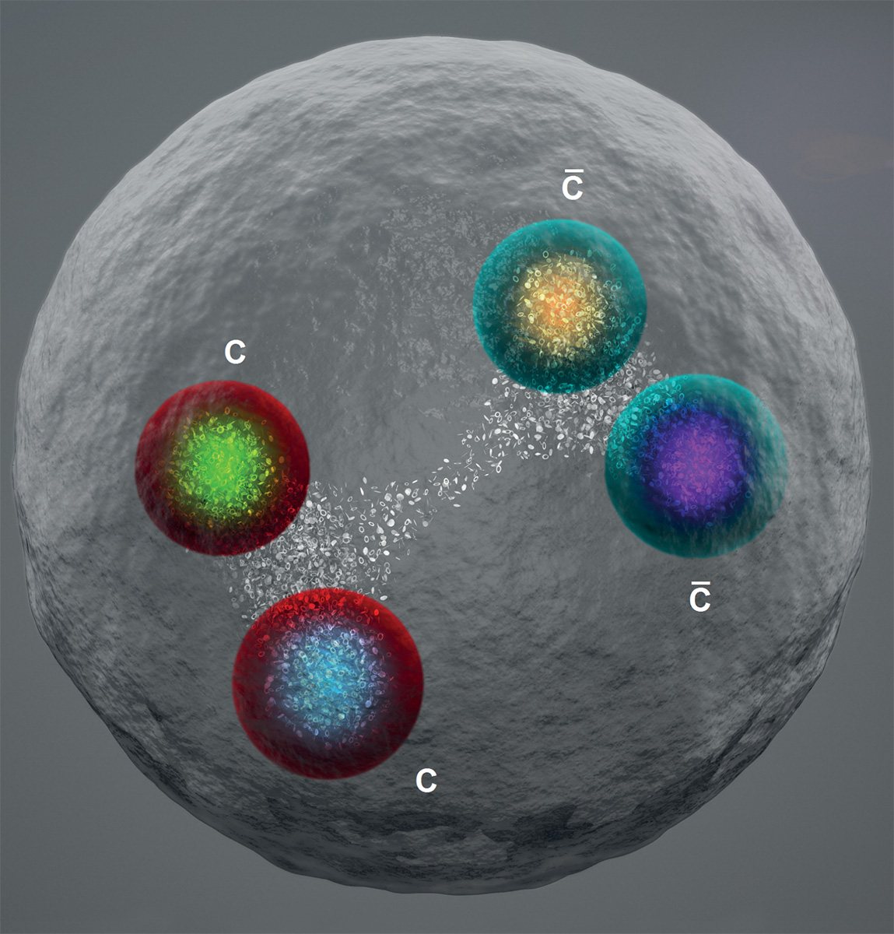
Exotic spectroscopy - tetraquarks
57

Slide 58
Exotic spectroscopy - pentaquarks
58

Slide 59
CC and FCNC
Semileptonic
CC
b → cl⁻ν
“Semileptonic”
FCNC EWP Penguin
b → sl⁺l⁻
59

Slide 60
R(D*) vs R(D)
Signal: distinguish “μ” from ”μ-from-τ” …
B⁰→D*⁺l⁻ν → (D*⁺µ) sample
B⁺→D⁰l⁻ν → (D⁰µ) sample
Main backgrounds:
B → DDX
B → D**µ⁻ν
= muon energy
Courtesy:
P.Hamilton, Impl.Workshop, 19 Oct 2022
60

Slide 61
R(D*) vs R(D)
LHCb, arXiv:2302.02886 Phys. Rev. Lett. 131 (2023) 111802
Simultaneous 3D-fit to 8 samples (and in 4 q² bins…)
Signal
(D**µ) enriched
Comb+Fake
DDX enriched
61
Courtesy: P.Hamilton, Impl.Workshop, 19 Oct 2022

Slide 62
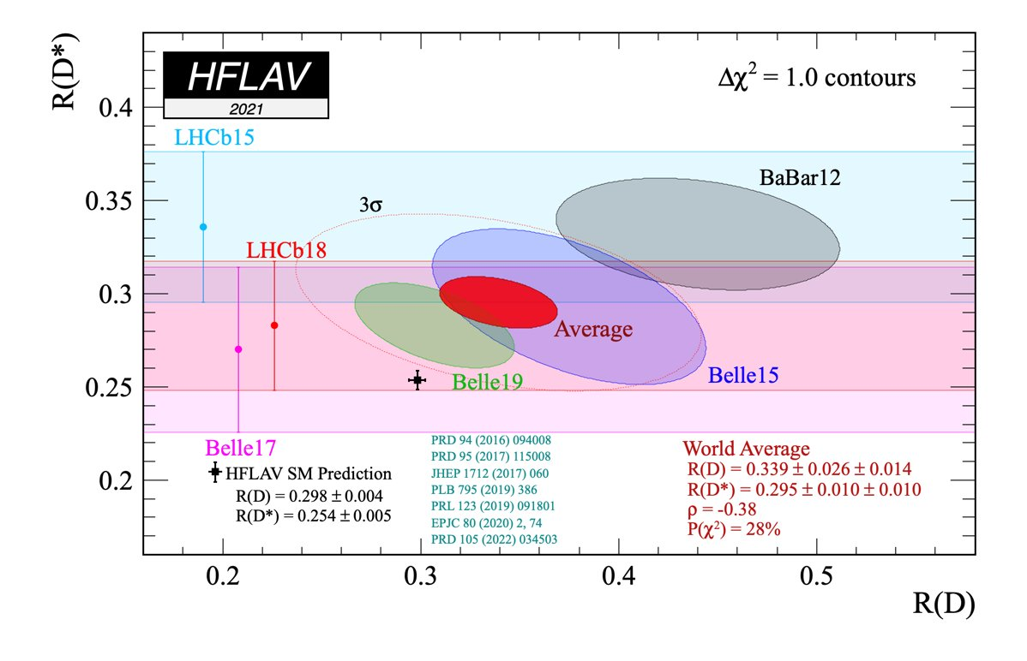
R(D*) vs R(D)
World average 3.3σ to 3.2σ
NB: contours contain less than 68% CL…
62

Slide 63
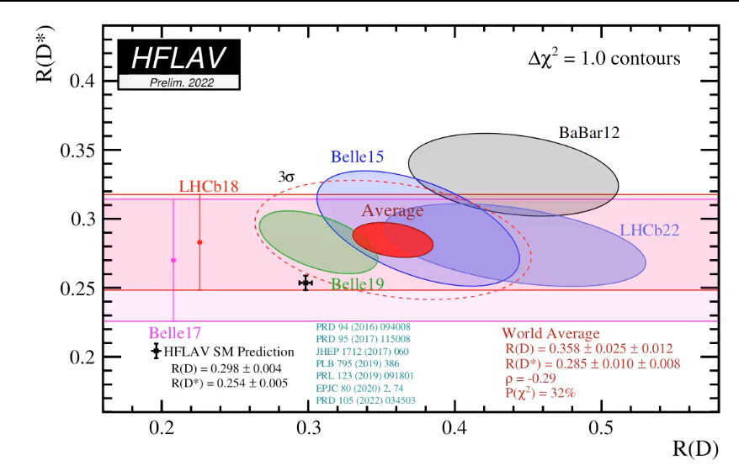
R(D*) vs R(D)
World average 3.3σ to 3.2σ
https://hflav-eos.web.cern.ch/hflav-eos/semi/fall22/html/RDsDsstar/RDRDs.html
63

Slide 64

Recent measurement of R(D*) (hadronic tau decay)
World average 3.3σ to 3.2σ to 3.34σ
LHCb, arXiv:2305.01463 Phys. Rev. D108 (2023) 012018
https://hflav-eos.web.cern.ch/hflav-eos/semi/fall22/html/RDsDsstar/RDRDs.html
64

Slide 65
CC and FCNC
Semileptonic
CC
b → cl⁻ν
“Semileptonic”
FCNC EWP Penguin
b → sl⁺l⁻
65

Slide 66
Decay rates
Study same process with different hadrons:
66

Slide 67
b→sl⁺l⁻
T.Blake et al. arXiv:1606.00916
Rich laboratory:
Purely leptonic
Decay rates
Angular asymmetries
Ratio of decay rates
67

Slide 68
Decay rates: consistently low
68

Slide 69
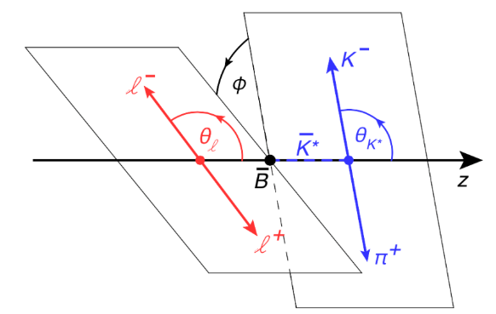
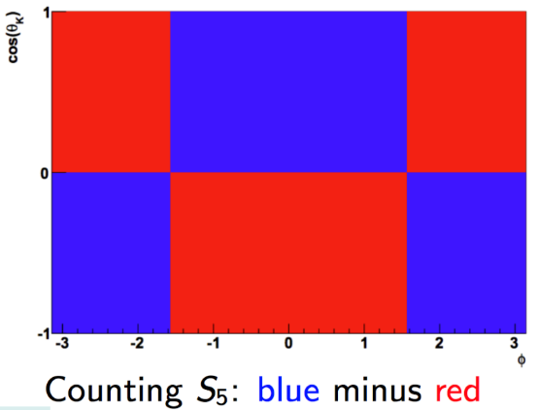
Angular asymmetries
P₅’:
Forward & upward K⁻
Backward &
downward K⁻
Backward &
downward K⁻
69

Slide 70
Angular asymmetries: eg. P₅’
Compilation:
(~2.7σ from SM)
LHCb, arXiv:2003.04831 Phys. Rev. Lett. 125 (2020) 011802
Plot from:
Albrecht, van Dyk, Langenbruch, PIPNP120 (2021) 103885, arXiv:2107.04822
70

Slide 71
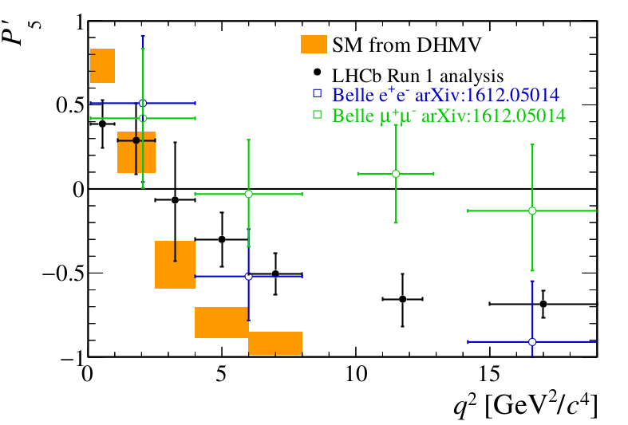
Angular asymmetries
Interesting to compare angular asymmetries for μ and e
LHCb, arXiv:1512.04442
71

Slide 72
B⁰→K⁰*μ⁺μ⁻ : more than just P₅’
LHCb Coll, arXiv:2003.04831
72

Slide 73
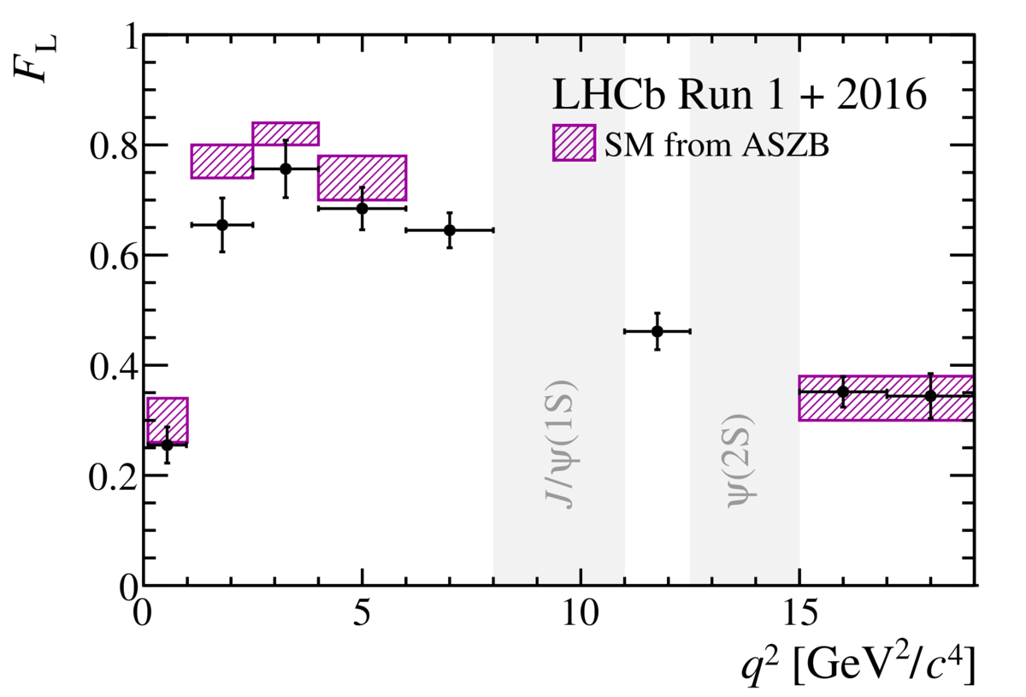
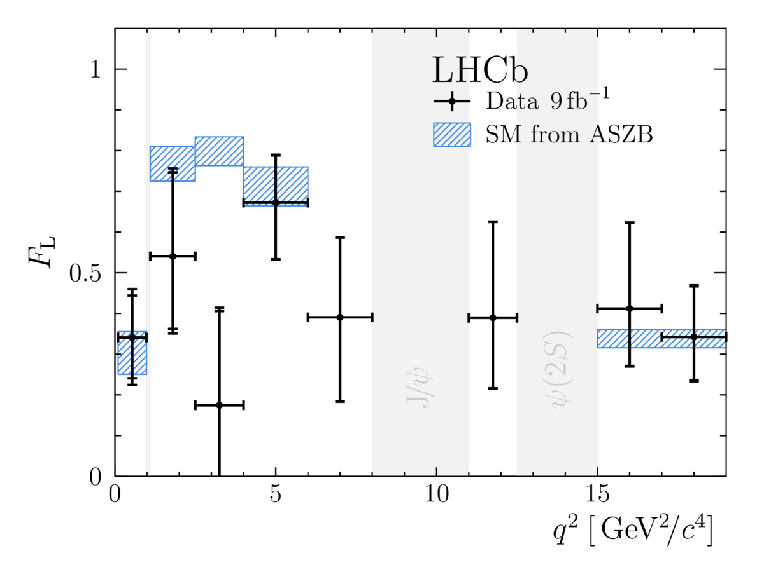
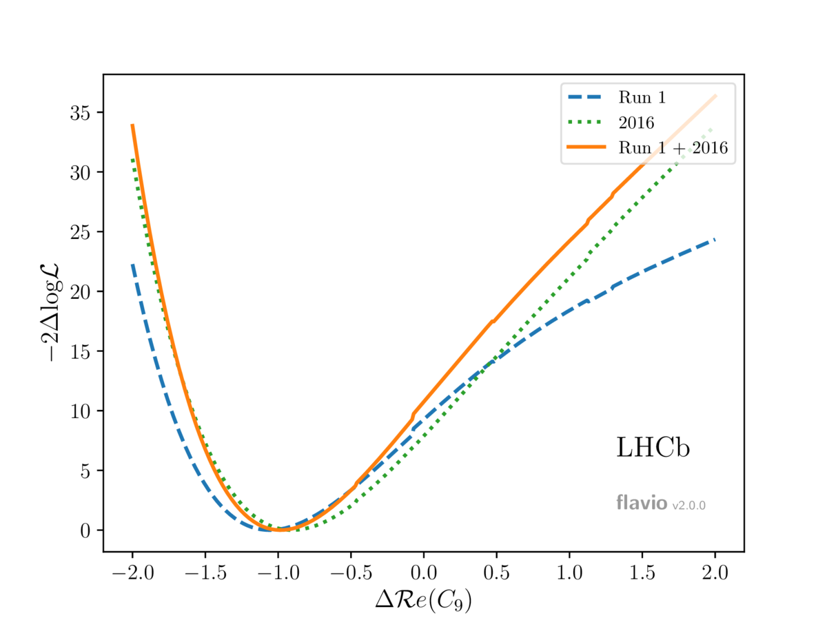
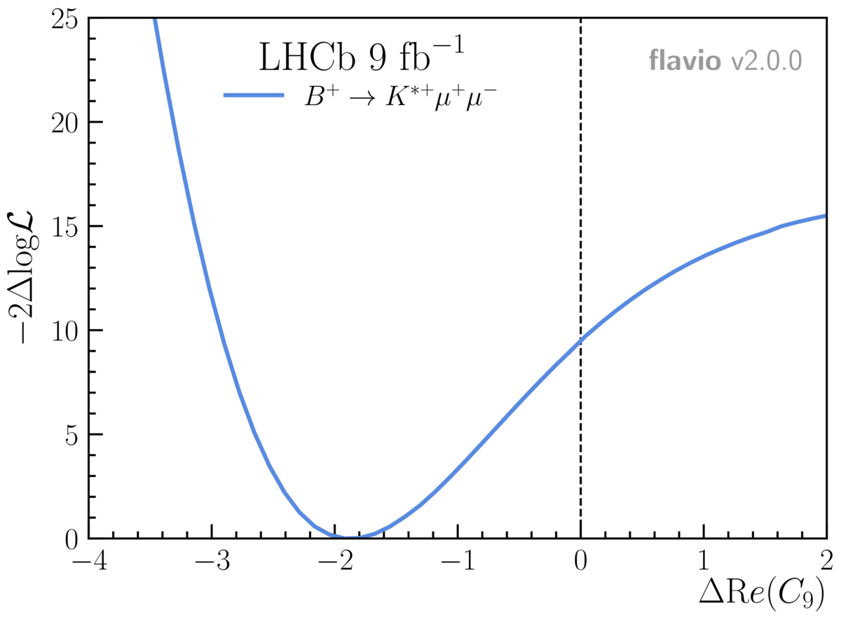
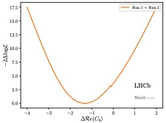
Coherent pattern
arXiv:2003.04831: B⁰→ K*⁰μ⁺μ⁻
arXiv:2012.13241: B⁺→ K*⁺μ⁺μ⁻
arXiv:2107.13428: B⁰_{s}→ φμ⁺μ⁻
SM
SM
SM
→ New vector coupling?
From: Martino Borsato, Flavour Anomaly Workshop,
20 Oct 2021, https://indico.cern.ch/event/1055780/
73

Slide 74
B_{s}⁰→μ⁺μ⁻
Purely leptonic b→sl⁺l⁻
+ B_{s}⁰→e⁺e⁻ (LHCb, arXiv:2003.03999 )
+ B_{s}⁰→τ⁺τ⁻ (LHCb, arXiv:1703.02508)
74

Slide 75
B_{s}⁰→μ⁺μ⁻
75

Slide 76
B_{s}⁰→μ⁺μ⁻ (LHCb)
LHCb Coll. arXiv:2108.09284
<
Beneke, Bobeth, Szafron, arXiv:1908.07011
76

Slide 77
B_{(s)}⁰→μ⁺μ⁻ (2020)
Including B⁰:
ATLAS, CMS, LHCb Coll, Aug. 2020 https://inspirehep.net/literature/1810424
77

Slide 78
B_{(s)}⁰→μ⁺μ⁻
Summer 2021
Including B⁰:
NB: new result
from CMS at ICHEP
not included here
Relative production of B_{s}⁰ wrt B⁰ mesons, f_{s}/f_{d} :
LHCb Coll. arXiv:2108.09284
(Integrated, p_{T} [0.5,40] GeV/c, η [2.6,4] )
LHCb Coll, arXiv:2103.06810
78

Slide 79
B_{s}⁰→μ⁺μ⁻
Summer 2022
Courtesy: D.Kovalskyi (CMS), ICHEP, 9 July 2022, [CMS-PAS-BPH-21-006]
79

Slide 80
Intermezzo: Effective couplings
Historical example
Both are correct, depending on the energy scale you consider
80

Slide 81
Intermezzo: Effective couplings
Historical example
Analog: Flavour-changing neutral current
Liverpool – 7 Nov 2022
81

Slide 82

Intermezzo: Effective couplings
Effective coupling can be of various “kinds”
Vector coupling: C₉
Axial coupling: C₁₀
Left-handed coupling (V-A): C₉-C₁₀
Right-handed (to quarks): C₉’, C₁₀’, …
…
See e.g. Buras & Fleischer, hep-ph/9704376
Analog: Flavour-changing neutral current
Liverpool – 7 Nov 2022
82

Slide 83


Intermezzo: Effective couplings
C₇ (photon), C₉ (vector) and C₁₀ (axial) couplings hide everywhere:
83

Slide 84

Coherent pattern
Model independent fits:
C₉^{NP} deviates from 0 by >4σ
Independent fits by many groups favour:
C₉^{NP}=-1 or
C₉^{NP}=-C₁₀^{NP}
All measurements (175) agree with a single (simple?) shift…
C₁₀^{NP}
NP=(V-A)
Altmannshofer & Stangle, arXiv:2103.13370
0
NP=V
SM
0
C₉^{NP}
84

Slide 85
Coherent pattern
Charm loop effects could also cause a shift in C₉
From: Martino Borsato, Flavour Anomaly Workshop,
20 Oct 2021, https://indico.cern.ch/event/1055780/
From: Martino Borsato, Flavour Anomaly Workshop,
20 Oct 2021, https://indico.cern.ch/event/1055780/
85

Slide 86

B⁰→K⁰*μ⁺μ⁻ : unbinned analysis
New analysis without q² binning
Run-1 + 2016
Use all the information
Control long-distance (non-factorisable) QCD effects (B⁰→K⁰*J/ψ)
Reduced discrepancy: consistent with SM at 1.8σ (1.4σ global signficance)
LHCb-PAPER-2023-032/033, arXiv:2312.09102, arXiv:2312.09115
86

Slide 87
Ratio of decay rates
Pre 2022
Theoretically “clean”
Experimentally
Signal yields
Backgrounds
Electron reconstruction
Efficiencies cancel in ratio
Belle II: good electron reconstruction
LHCb: large B sample
LHCb, arXiv:2103.11769
Nature Physics 18, (2022) 277-282
87

Slide 88
Ratio of decay rates
December 2022
Theoretically “clean”
Experimentally
Signal yields
Backgrounds
Electron reconstruction
Efficiencies cancel in ratio
Belle II: good electron reconstruction
LHCb: large B sample
LHCb, arXiv:2212.09152
Phys. Rev. Lett. 131 (2023) 051803
88

Slide 89


Ratio of decay rates
December 2022
Theoretically “clean”
Experimentally
Signal yields
Backgrounds
Electron reconstruction
Efficiencies cancel in ratio
Belle II: good electron reconstruction
LHCb: large B sample
LHCb, arXiv:2212.09152
Phys. Rev. Lett. 131 (2023) 051803
Pre 2022: 3.1σ
December 2022
Tightening electron PID
Led to uncovering previously underestimated peaking backgrounds
Estimated from data by inverting mis-id cuts and forming control regions
89

Slide 90
Flavour Physics Landscape
90

Slide 91
Comparing Sensitivities
91

Slide 92
Comparing Sensitivities
https://arxiv.org/abs/2503.24346
92

Slide 93
Comparing Sensitivities
https://arxiv.org/abs/2503.24346
93

Slide 94
Summary
LHCb physics
The power of Indirect measurements
CKM triangle
Rare Decays
Spectroscopy
Next: ATLAS, CMS & beyond
94

Slide 95
Outline
SM & LHC
Physics motivation: The Standard Model
LHC: History, operations, performance & schedule
LHC detectors
ATLAS, CMS, ALICE and LHCb
Particle Detection
LHCb
Physics Highlights: Indirect, CKM, Spectroscopy & Rare Decays
ATLAS/CMS and beyond
Physics Highlights: QCD; W/Z; top; Higgs; SUSY
HL-LHC
Future: HL-LHC, LHCb Upgrade II, Higgs self-coupling and beyond

