Slide 1

Cesar Lattes’ Centennial 2024
Remembering his life and legacy
Carola Dobrigkeit Chinellato
Instituto de Física Gleb Wataghin / UNICAMP / BRAZIL
CLASHEP 2025

Slide 2
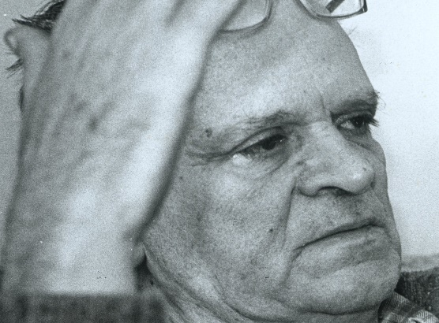
César Lattes
1924-2005

Slide 3
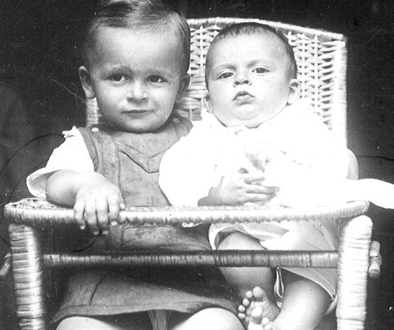
Lattes with his older brother David

Slide 4
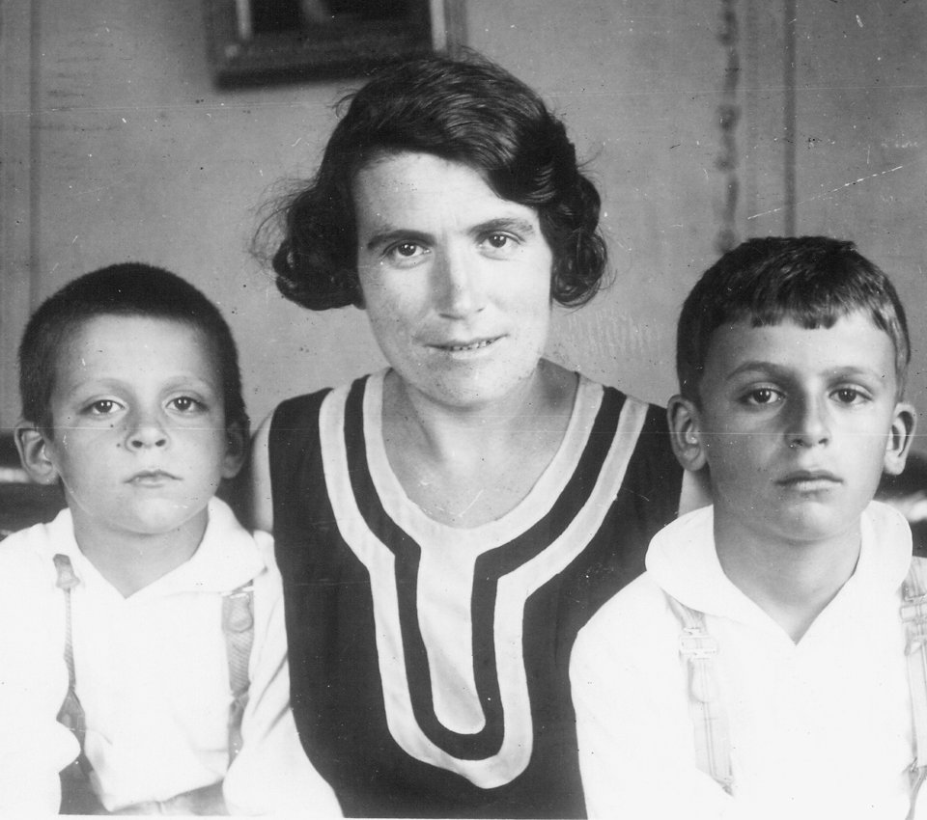
Lattes with his mother Carolina and David

Slide 5
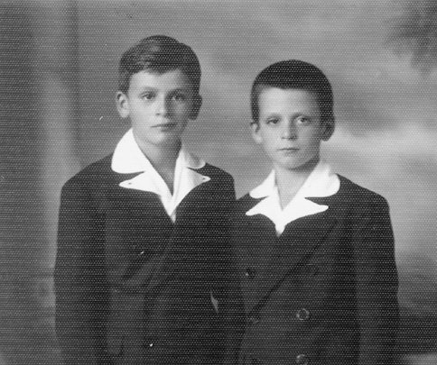
David and Cesar Lattes

Slide 6
His early years
Cesare Mansueto Giulio Lattes, known in short as César Lattes, was born to a family of Italian immigrants in Curitiba (State of Paraná, in the south of Brazil) on 11 July 1924.
His high school years were spent at the traditional institution Colégio Dante Alighieri in São Paulo from 1934 to 1938.
Already then, he demonstrated his ability and ease in learning Physics and Mathematics.
He used to say: “I didn’t even have to study! Only paying attention to what the teacher was saying was enough to do very well in the exams”.

Slide 7
São Paulo at the beginning of the 1930’s
Existing higher education institutions: Faculty of Law (founded 1827), Polytechnic School (1893) and Faculty of Medicine (1912).
There was still no University in São Paulo to serve other interests (such as Philosophy, Literature, Biology, Physics, Chemistry, Mathematics).
There was already a movement among intellectuals from São Paulo demanding the creation of a university.

Slide 8
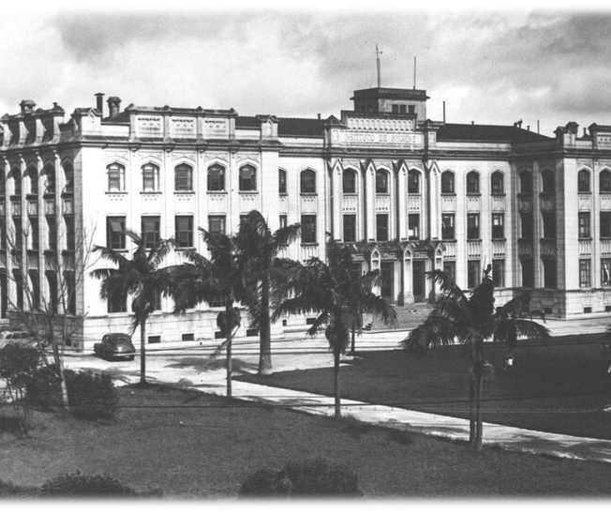
Creation of USP and Gleb Wataghin to São Paulo
In 1934, the then-governor of the State of São Paulo, Armando de Salles Oliveira, sent some local intellectuals on a mission to invite eminent professors in Europe to come to São Paulo and participate in the implementation of the Faculty of Philosophy, Sciences and Letters, designed to be a hub for the creation of the University of São Paulo (USP).
Biologists, botanists, and zoologists came from Germany. Humanists came from France. Mathematicians and physicists came from Italy.
The envoy, Theodoro Ramos, contacted Enrico Fermi, who suggested inviting Gleb Wataghin, then a young professor at the University of Turin.

Slide 9
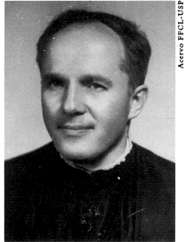
One of the few photos of
Gleb Wataghin when he arrived in Brazil

Slide 10
Wataghin at the University of São Paulo
Wataghin began teaching physics to engineers and physicists at Polytech, introducing them to the recent developments in Modern Physics and Quantum Mechanics. Several engineering students switched to Physics!
In 1937, Wataghin invited the Italian physicist Giuseppe Occhialini to come to USP. He brought with him the experience acquired working previously with Bruno Rossi and Patrick Blackett on experiments involving cosmic rays and cloud chambers.
Although Wataghin was himself a theoretical physicist (he later published a theoretical paper on multiple meson production in 1948), Wataghin recognized the importance of experiments and organized a group of experimental physicists counting on the help of his young students to study interactions induced by cosmic particles.
The electronic instrumentation developed by his group was competitive worldwide (improved temporal resolution by a factor of 10).
Notes:
On the Multiple Production of Mesons, G. Wataghin, PDFShare , Phys. Rev. 74, 975 – Published 15 October, 1948, DOI: https://doi.org/10.1103/PhysRev.74.975

Slide 11
Wataghin’s first laboratory (8×8 m²)
At the beginning, still in the attic of the Escola Politécnica..

Slide 12
Wataghin at the USP Physics Laboratory, in the 1930s, next to the Geiger counter used in experiments with cosmic rays.

Slide 13
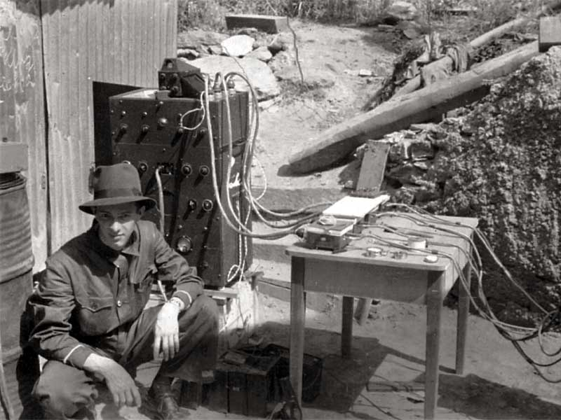
The young assistant Marcello Damy, in 1939, during the experiment at the Morro Velho gold mine
“Cosmic-Ray Showers at Great Depth”, G. Wataghin e M. Damy de Souza Santos, Annaes da Academia Brasileira de Sciencias (1939)
“Simultaneous Penetrating Particles in the Cosmic Radiation”, G. Wataghin, M. Damy de Souza Santos, P. A. Pompeia, The Physical Review, 57 (1940) 61

Slide 14
Wataghin carried out experiments at altitude with planes provided by the Brazilian Air Force (1940s).
Notes:
Andrea Wataghin, Gleb Wataghin (3º da esquerda para a direita) e Yolande Monteux (5ª da esquerda à direita)

Slide 15
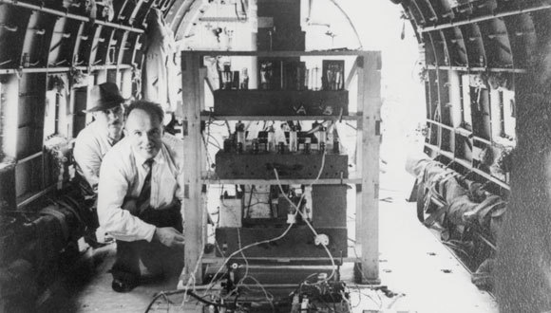
Wataghin conducted cosmic ray experiments during airplane flights
Gleb Wataghin and his technician in 1940, in a plane of the Brazilian Air Force to measure cosmic rays at high altitudes.

Slide 16
Lattes’ academic background
Lattes’ destiny became intertwined with that of Gleb Wataghin through his father, Giuseppe Lattes, who managed Wataghin's bank account in São Paulo.
Knowing that Giuseppe's son was gifted with extraordinary ability in Physics and Mathematics, Wataghin paved the way for Lattes to enroll in the Physics course.
Lattes studied Physics at USP from 1939 to 1943, graduating with honors at only 19.
Lattes is the fruit of a generation of brilliant physicists trained by Wataghin while working over a decade at USP.

Slide 17
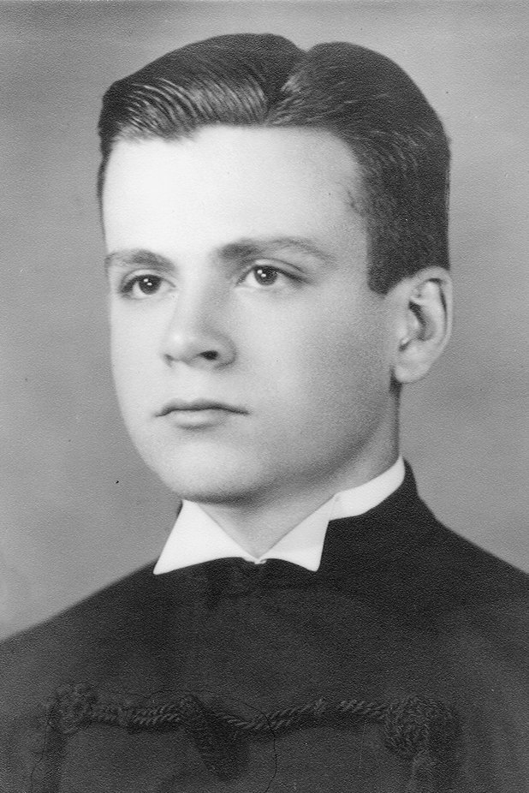
Lattes em 1943, at his graduation in Physics at USP.

Slide 18
Opening a parenthesis to travel back to the 1930s
The decades of the 1920s and 1930s saw many discoveries and experimental breakthroughs.
I will mention a few of them that are related to the main purpose of this talk.
18

Slide 19
Discoveries and Developments in the 1930s: Theory
The energy of a charged particle can be deduced by measuring the distance it travels before stopping in a medium.
Charged particles heavier than electrons lose energy through the ionization of atoms. The range of a particle of a given energy in a medium depends on the mass density of the material and the density of electrons.
Electrons also lose energy by interacting with electrons of the medium and by emitting radiation (Bremsstrahlung).
The mean energy loss per distance travelled by highly energetic charged particles (protons, alpha particles, ions) propagating through a medium was described theoretically by Bethe and Heitler.

Slide 20
Ionization energy loss
At fixed momentum, the energy loss of charged particles depends primarily upon their masses and can be used to identify particles.
The curves show the values recently measured for the energy loss dE/dx in e⁺e⁻ collisions. The data were obtained with the Time Projection Chamber developed at the Lawrence Berkeley Laboratory by D. Nygren, and the measurements were taken at the Stanford Linear Accelerator Center.*
Energy deposit per unit length dE/dx (keV/cm)
e
MIP
Momentum (GeV/c)
* TPC/Two-Gamma Collaboration, Phys. Rev. Lett. 61 (1988) 1263
Notes:
Bethe-Bloch equation

Slide 21
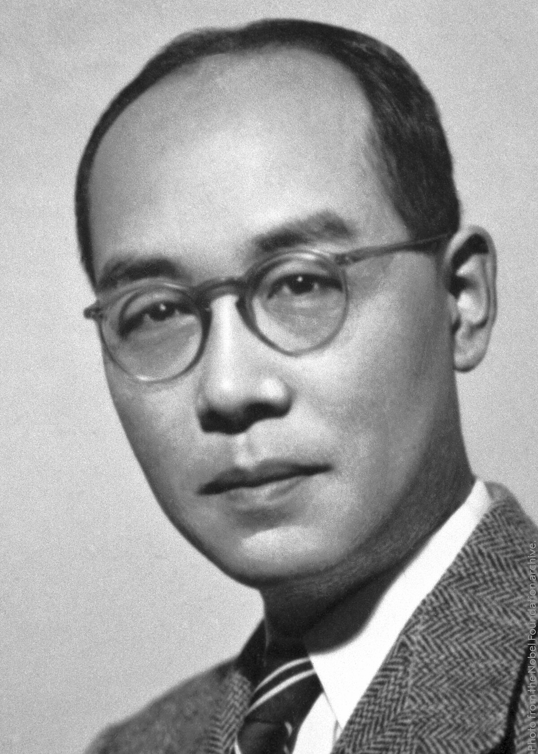
Discoveries and Developments in the 1930’s: Theory
In 1935, Hideki Yukawa predicted the existence of a particle mass intermediate of those of the electron and the proton.
This particle was supposed to be the carrier of the nuclear force, in close analogy to the photon's role as the electromagnetic force's intermediator.
From the range of nuclear forces of ∼1 fm, Yukawa could estimate its mass to be about 200 MeV/c².

Slide 22
Discoveries and Developments in the 1930’s: Experiments
Cosmic rays were studied primarily with cloud chambers (used for tracking) and Geiger counters (used for trigger and veto).
Bothe and Kolhörster, Rossi, Blackett and Occhialini, among others, contributed with the development of the coincidence and anticoincidence techniques, leading to the observation of cosmic-ray showers and other discoveries.
In 1937, Anderson and Neddermeyer and, at nearly the same time, Street and Stevenson reported the observation of particles with an intermediary mass between those of the electron and the proton and highly “penetrating”. Their experiments used cloud chambers and cosmic-ray particles.
The crude estimates of the masses were 130m_{e}.
Could the observed particle be the meson predicted by Yukawa?
Notes:
They observed particles in the range 100 to 500 MeV/c, if they were electrons, they would be relativistic and would lose energy in proportion to their energy and also create an electromagnetic shower. What they observed was two types of particles: one following the predictions of Bethe and Heitler’s theory and the ones of the second type were “penetrating”, losing nearly no energy in the Pt plate.
In 1937, Anderson and Neddermeyer made energy loss measurements in a cloud chamber placing a 1-cm platinum plate in it. Measuring the curvature of the tracks on both sides of the plate, they were able to determine the loss in momentum. By studying the energy losses of the particles, they concluded that they were observing “penetrating” particles, losing nearly no energy in the Pt plate.
At nearly the same time, Street and Stevenson reported similar results. They determined the mass of the observed particle measuring both their momentum and ionization. The particle ionized too much to be an electron and traveled too far to be a proton: it could be the meson predicted by Yukawa.

Slide 23
Discoveries and Developments in the 1930’s: Experiments
In 1946, Conversi, Pancini and Piccioni investigated in depth the decays of the positive and negative particles that came to rest in various materials.
They selected either positive or negative penetrating particles from cosmic rays and studied whether they decay or not when stopped in the material.
They observed that the positive particles would decay (confirming earlier predictions of Tomonaga and Araki for these particles). Negative particles would decay in carbon but be absorbed in iron, contrary to what was expected by the Japanese.
These results put in doubt that the penetrating particles were the meson of Yukawa.

Slide 24
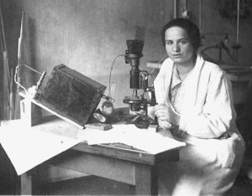
Nuclear Emulsions
Nuclear emulsions were explored mainly from 1930 onwards.
One of the pioneers in using photographic methods to image
high-energy nuclear particles and events was Marietta Blau in Austria.
In 1937, she and her former student Hertha Wambacher were the first to observe “disintegration stars” : tracks of massive nuclear disintegrations due to spallation in emulsions exposed to cosmic radiation at the height of 2,300 m on a mountain near Innsbruck. This discovery launched the use of emulsions in the field of particle physics.
Emulsions were perfected as charged particle detectors from 1946 onwards.
The Ilford company, which produced the emulsions for Powell’s group, achieved a crucial important improvement by increasing the concentration of silver bromide grains in the gelatin by eight times.
24
Notes:
In 1937, as austríacas Marietta Blau and her former student Hertha Wambacher discovered nuclear disintegration stars (Zertrümmerungsterne) due to spallation in nuclear emulsions that had been exposed to cosmic radiation at a height of 2300m on the Hafelekarspitze above Innsbruck.

Slide 25
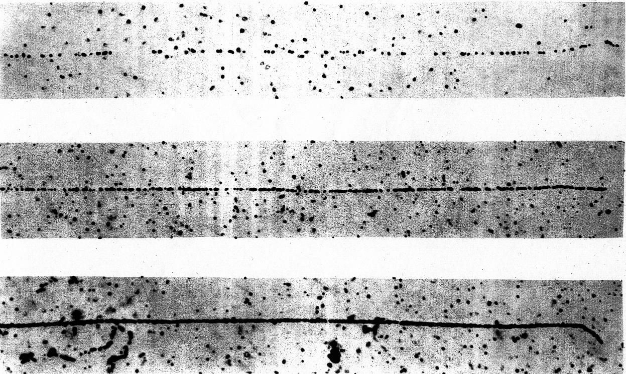
Nuclear Emulsions
Nuclear emulsions present the highest spatial resolution in measuring ionizing particle tracks (O ~ submicrometer).
A nuclear emulsion consists of a thin layer (50 to 100 µm) of a gelatin containing silver halides crystals (often AgBr) spread on a solid a base (at that time, glass) and forming the sensitive component.
The gelatin consists mainly of carbon, nitrogen and oxygen. While gelatine provides the support structure, its constituents function as targets for the occurring interactions.
After being exposed to cosmic rays or to a particle beam in an accelerator, the emulsion passes through a chemical process of developing. The redox reaction transforms the Ag⁺ ions in metallic Ag which would then form large Ag grains (∼0.3 μm) visible under a microscope.
The Ilford company, which made the emulsions for Powell’s group, achieved an important improvement in their sensitivity by increasing the concentration of silver bromide grains in the gelatin by eight times.
Tracks due to particles of charge |e| with increasing mass.
Notes:
In 1937, as austríacas Marietta Blau and her former student Hertha Wambacher discovered nuclear disintegration stars (Zertrümmerungsterne) due to spallation in nuclear emulsions that had been exposed to cosmic radiation at a height of 2300m on the Hafelekarspitze above Innsbruck.

Slide 26

Be alert!!
In the 1930s and1940s, all particles with mass between the mass of the electron and that of the proton were referred as mesons!
Today, we know, of course, that
π-mesons are truly mesons and are dubbed pions,
and μ-mesons are, in reality, leptons and are called muons.

Slide 27
Now, I will close the parenthesis, and we will return to Cesar Lattes.
27

Slide 28
Lattes em 1943, at his graduation in Physics at USP.

Slide 29
Once graduated,…
Lattes liked to tell us that Wataghin gave him a theoretical problem involving a 99-term Lagrangian. He developed the work with Mario Schönberg and Walter Schützer, which was published in the Annals of the Brazilian Academy of Sciences in 1947.
Lattes later laughed, saying that this immersion in theoretical work convinced him of his inability to deal with lengthy calculations and led him choose experimental physics!
29

Slide 30
Exchanging letters with Occhialini
In 1945, Lattes was working at USP with a non-operating cloud chamber left there by Occhialini, who had moved to Bristol to work with Cecil Powell's group.
Lattes recovered the cloud chamber and got it working again with the help of Ugo Camerini and Andrea Wataghin.
He exchanged letters with his now friend Occhialini, sending photos of particle tracks in the cloud chamber and receiving in return photos of particle tracks in nuclear emulsions.
Lattes was so excited by the photos of the tracks left by the particles in the emulsions that he asked to participate in the experiments in Bristol. Powell and Occhialini requested a grant, thus enabling Lattes to travel to Bristol in 1946.

Slide 31
Lattes' task:
Upon arriving in Bristol, Powell asked to determine the shrinkage factor of the new nuclear emulsions after development.
To this end, he should expose emulsions to a Cockroft-Walton accelerator that produced particles with energies of the order of 10 MeV to establish a relationship between the range of protons in the emulsion and their energies by studying the reactions
Notes:
Acelerador da Universidade de Cambridge

Slide 32
Lattes' request to Ilford:
Lattes intended to place these emulsions in the direction of the 13 MeV neutron beam emerging from the reaction
to make them induce the reaction
and then obtain a calibration curve for the neutron energy and momentum.
With this intention in mind, Lattes asked the manufacturer to add a boron salt to the gelatin of the most concentrated emulsions. This addition would have the surprising effect of reducing the fading of the emulsion ( i.e., the loss of the latent image).

Slide 33

The race begins
meson
“Nuclear disintegration by meson capture”, D. H. Perkins in Nature 159 (January 1947) 159 –
Ilford emulsions of lower concentration exposed to cosmic rays in aircraft for several hours at 9,000 m height.
The three protons produced have energies between 3 and 6 MeV.

Slide 34
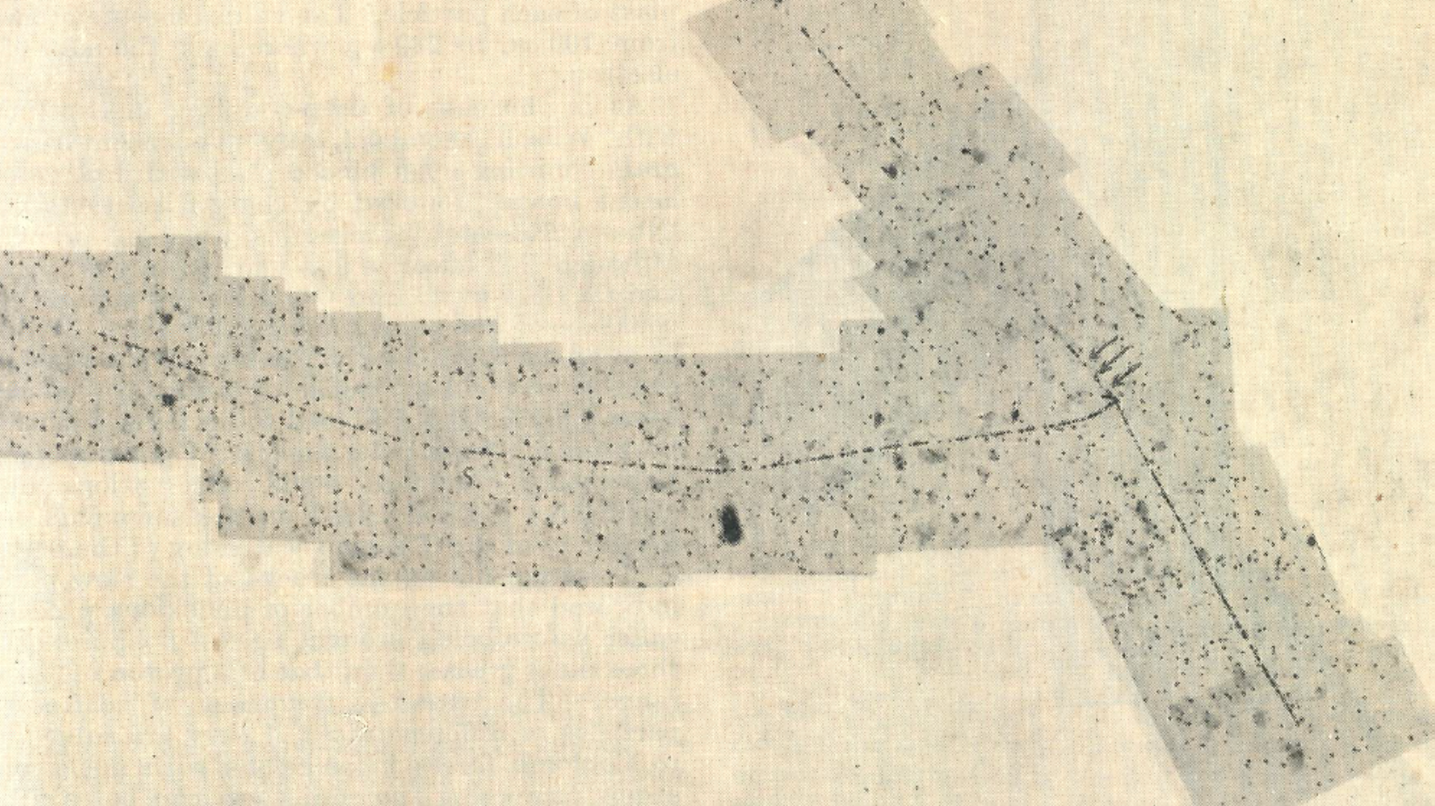
“Nuclear disintegrations produced by slow charged particles of small mass”, G.P.S.Occhialini and C.F. Powell in Nature 159 (February 1947) 186 –
First mention of Lattes in the acknowledgements.
m
The particle m suffers changes of direction more frequently, and the grain density increases faster than as the particle approaches the disintegrating nucleus expected for a proton, indicating its lower mass, also confirmed by grain counting. Mosaic of photomicrographs showing m entering the nucleus and producing two heavier particles and probably an electron of short range.
34
Notes:
Six similar tracks of lower mass particles out of 800 tracks. Estimates of the mass: between 100 me and 230 me from grain counting, and 350 me from coulomb scattering.
Confirming Rasetti’s results and the theoretical prediction of Araki and Tomonaga: negative mesons at the end of the range have a high probability of being captured by the nucleus. Positive mesons sugger decay near

Slide 35
“Nuclear disintegrations produced by slow charged particles of small mass”, G.P.S.Occhialini and C.F. Powell in Nature 159 (February 1947) 186 –
First mention of Lattes in the acknowledgements.
α
m
e
α
Two alpha particles of short range and possibly an electron ejected in the disintegration.
35

Slide 36
Exposing emulsions to cosmic rays at the Pic du Midi
When Occhialini went to spend some time at the Pyrenees at the Pic du Midi (2,800 m a.s.l.), Lattes asked him to take some of the concentrated emulsions loaded with and without boron for exposure to cosmic rays.
After exposing the emulsions for about one month and developing them, tracks of particles with masses smaller than the mass of the proton were found. The emulsions containing boron recorded many more tracks (showing less image loss over time, resulting in greater recording stability).
Only two cases allowed the identification of a particle that decayed into a secondary one. Unfortunately, in one of the events, the path of the secondary particle of the decay was not entirely contained in the emulsion. It turned out that they had only “1.5 observations”.

Slide 37
The two observations of mesons in emulsions exposed at the Pic du Midi
“Processes Involving Charged Mesons” - C.M.G. Lattes, H. Muirhead, G.P.S. Occhialini and C.F. Powell, in Nature 159 (May 24, 1947) 486.
m₁
m₂
Here m₁ represents the primary and m₂ the secondary meson. The arrows indicate points where changes in direction greater than 2° occur, as observed under the microscope.

Slide 38
The two observations of mesons in emulsions exposed at the Pic du Midi
“Processes Involving Charged Mesons” - C.M.G. Lattes, H. Muirhead, G.P.S. Occhialini and C.F. Powell, in Nature 159 (May 24, 1947) 486.
m₂ out
m₁
Here m₁ represents the primary and m₂ the secondary meson. The arrows indicate points where changes in direction greater than 2° occur, as observed under the microscope. The secondary meson leaves the emulsion.

Slide 39
a (s)
Emission of Mesons from Nuclei
“Processes Involving Charged Mesons” - C.M.G. Lattes, H. Muirhead, G.P.S. Occhialini and C.F. Powell, in Nature 159 (May 24, 1947) 486.
The letters at the edge of the mosaic indicate whether a particular track passes out of the surface of the emulsion (s), into de glass (g) or ends in the emulsion ( e).
b(g)
c( e)
f( e )
(375±70)m_{e}
d(s)
e ( s )
The track (b) dips steeply and its apparent grain density appears greater than the true value. Both (b) and (c ) were probably produced by α particles. The track f is probably due to a light particle since it suffers frequent changes of directions due to scattering and there is a rapid change in grain density along the trajectory. Grain counting gives an estimate for the mass of 375±70 m_{e}. The energy of the primary is estimated as at least 200 MeV.
39

Slide 40
α₁
α₂
α₃
Emission of Mesons from Nuclei
“Processes Involving Charged Mesons” - C.M.G. Lattes, H. Muirhead, G.P.S. Occhialini and C.F. Powell, in Nature 159 (May 24, 1947) 486.
Tracks α_{1,} α₂ and α₃ end in the emulsion; α₁ and α₂ were certainly produced by α particles, and grain counting shows that α₃ is due to a proton. Grain counting of the track d, which passes out of the emulsion, indicates that if a proton produced it, the initial energy of the particle was about 15 MeV.
The minimum mass m of the primary meson obtained from energy conservation and grain counting is 240m_{e} .
m
d
40

Slide 41
Possible existence of mesons of different mass
“Observations on the tracks of slow mesons in photographic emulsions” - Part 1: Existence of Mesons of Different Mass - C.M.G. Lattes, G.P.S. Occhialini and C.F. Powell, in Nature 160 (October 4, 1947) 486.

Slide 42
What can we learn from these conclusions?
The first observed production of slow π in nuclear disintegration in photographic emulsion (1947) gave support for the view that
  The particles interact strongly with nucleons,
  That they are directly produced in nuclear interactions of great energy,
  That, when moving in the atmosphere, they give rise to the weakly interacting muon by decaying “in-flight”.
The early examples of the creation of pions were all negative particles.
In escaping from a nucleus, the positive particles are commonly accelerated by the electrostatic repulsion. Therefore, they rarely appear with low kinetic energy and commonly escape from a thin emulsion before being brought to rest.
On the other hand, the negative particles must escape from the parent nucleus against the electrostatic attraction. They are therefore frequently emitted with low velocity and reach the end of their range in the emulsion.
42

Slide 43
The urgency
At this point, everybody in Powell's group realized the importance of the research they were developing and that obtaining more observations of this fundamental phenomenon was urgent. Other groups were also doing research on the same subject using cloud chambers and observing secondary particles produced by cosmic rays.
Lattes searched for a higher location to expose the emulsions to cosmic rays and found Mount Chacaltaya in Bolivia, at 5,500 m, which was reasonably easy to access.
Notes:
“Dinheiro de Sua Majestade”, recontava Lattes. Em sua ida a Londres, de onde embarcaria, Lattes escutou de um membro da embaixada brasileira o seguinte comentário: os aviões das companhias britânicas eram refugo, ou seja, bombardeiros da Segunda Guerra reformados; além disso, a comida servida a bordo era ruim, e as aeromoças pouco atrativas. Sugestão do interlocutor: vá pela brasileira Panair. Razões: aviões novinhos, comida boa e aeromoças bonitas.

Slide 44
Including the first results from emulsions exposed at Mt. Chacaltaya: π- and μ-mesons
“Observations on the tracks of slow mesons in photographic emulsions” - Part 1: Existence of Mesons of Different Mass - C.M.G. Lattes, G.P.S. Occhialini and C.F. Powell, in Nature 160 (October 4, 1947) 486.
a
π
μ
a
The track of the μ meson is given in two parts. The point of junction is indicated by a and an arrow.
44

Slide 45
π
“Observations on the tracks of slow mesons in photographic emulsions” - Part 1: Existence of Mesons of Different Mass - C.M.G. Lattes, G.P.S. Occhialini and C.F. Powell, in Nature 160 (October 4, 1947) 486.
a
μ
a
45

Slide 46
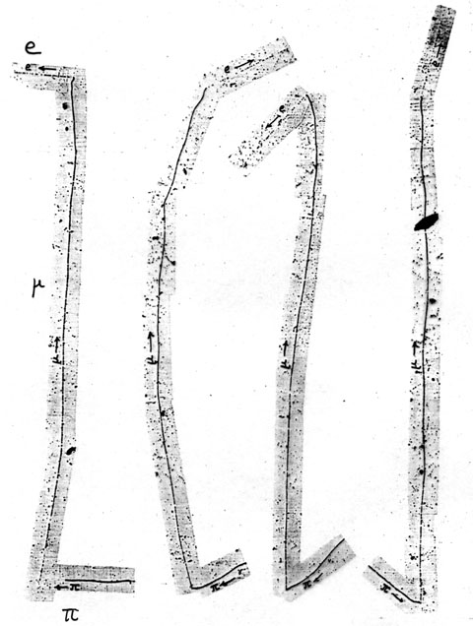
The discovery of the pi mesons in 1947 and what we know today:
Powell’s Nobel Lecture
Some early examples of pion decays were observed in a photographic emulsion in 1947. The charged particle tracks in the emulsions exposed at Mount Chacaltaya revealed successive decays interpreted as being due to pions → muons → electrons.
The positive pions come to rest before decaying by the reaction π⁺ → μ⁺ + ν_{μ}, to give monoenergetic muons. These travel about 600 μm in the emulsion before coming to rest and decay by the reaction to give a positron.

Slide 47
“Observations on the tracks of slow mesons in photographic emulsions” - Part 2: Origin of the slow mesons by C.M.G. Lattes, G.P.S. Occhialini and C.F. Powell, in Nature 160 (October 11, 1947) 486.
The observations proof that mesons can be produced in processes associated with explosive disintegration of nuclei by cosmic ray particles of great energy (P).
At the end of its range (S), the ejected meson can lead to a disintegration of a nucleus.
S
S
P
P
47

Slide 48
Conclusions of the two October papers:
Two types of mesons of different masses exist. The authors named them π- and μ-mesons.
In conjunction with D. Perkins’ observations, some slow mesons can enter nuclei to produce disintegrations. They regarded these negatively charged π-mesons (and named them provisory σ-mesons).
Possibly π-mesons can be produced in processes associated with explosive disintegrations of nuclei, as observed in emulsions exposed to cosmic rays.
Positive π-mesons and negative π-mesons (dubbed “σ-mesons”) are particles of the same type interacting strongly with nucleons. The positive mesons decay and the negative ones are captured by both light and heavy nuclei to produce disintegrations with the emission of heavy particles.
The heavier π-mesons suffer spontaneous decay in μ-mesons, and in the decay process, the momentum of the μ-meson is balanced by that of a neutral particle of approximately the same mass.

Slide 49
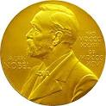
The Nobel Prize for Cecil Powell
The results of the measurements published in the two papers in the journal Nature in 1947 had great international repercussions.
Bohr invited Lattes to go to Copenhagen to give a seminar on the discovery.
The importance of the discovery of mesons for advancing knowledge about the structure of matter and its interactions can be noticed in the two Nobel Prizes awarded in consecutive years: to Hideki Yukawa in 1949 and in 1950 to Cecil Powell.

Slide 50
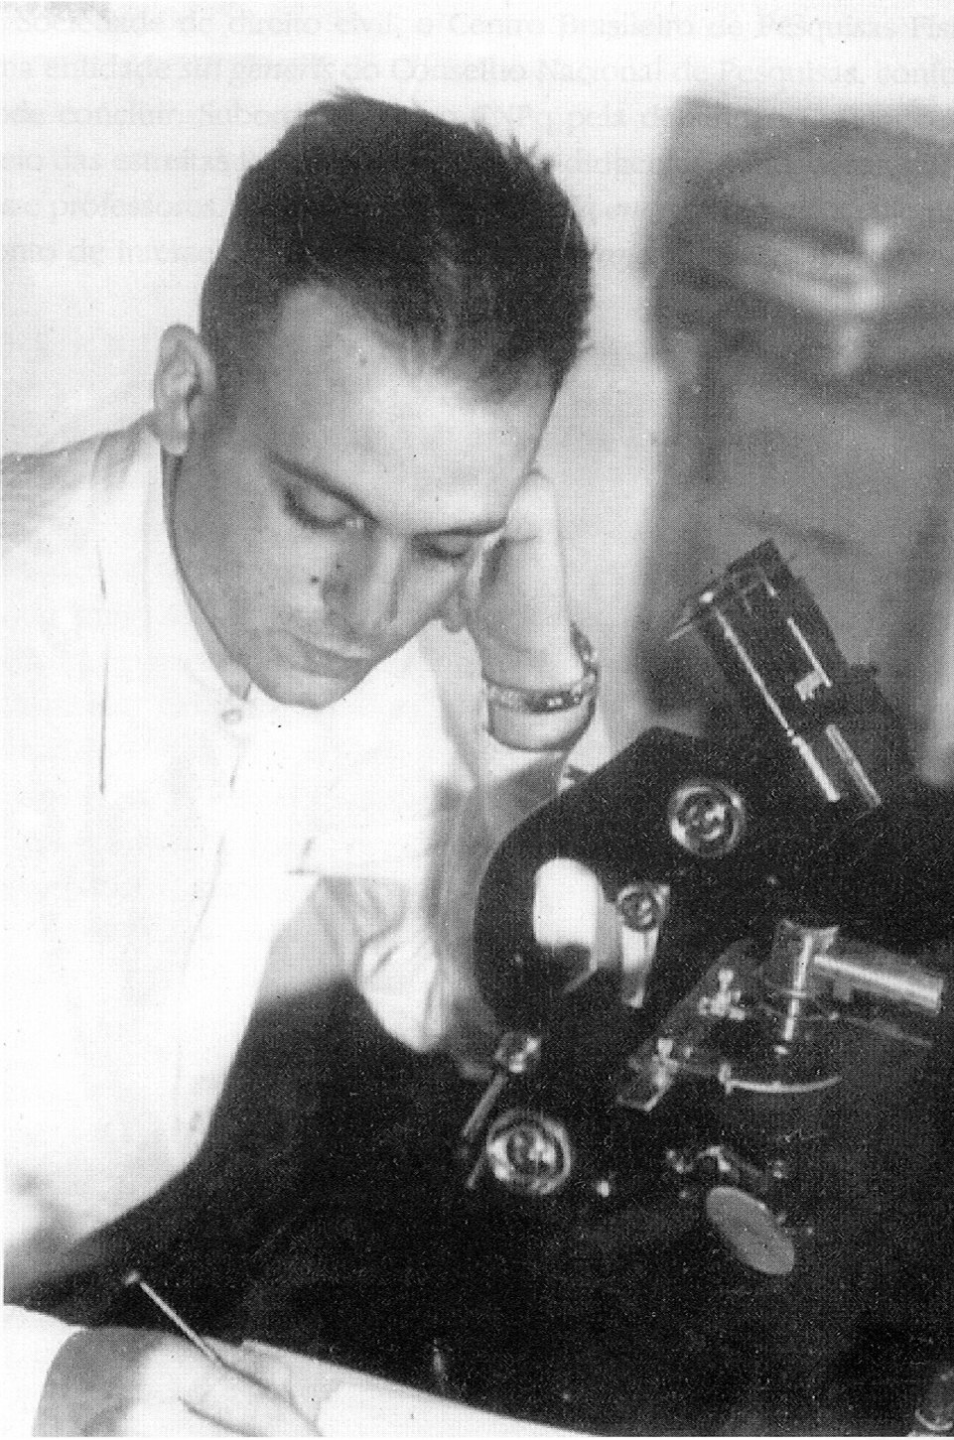
Cesar Lattes at the microscope counting grains!
A great deal of calm and patience is required to count the silver grains under a microscope and to establish the relationship between the particle’s range in the emulsion and its energy.

Slide 51
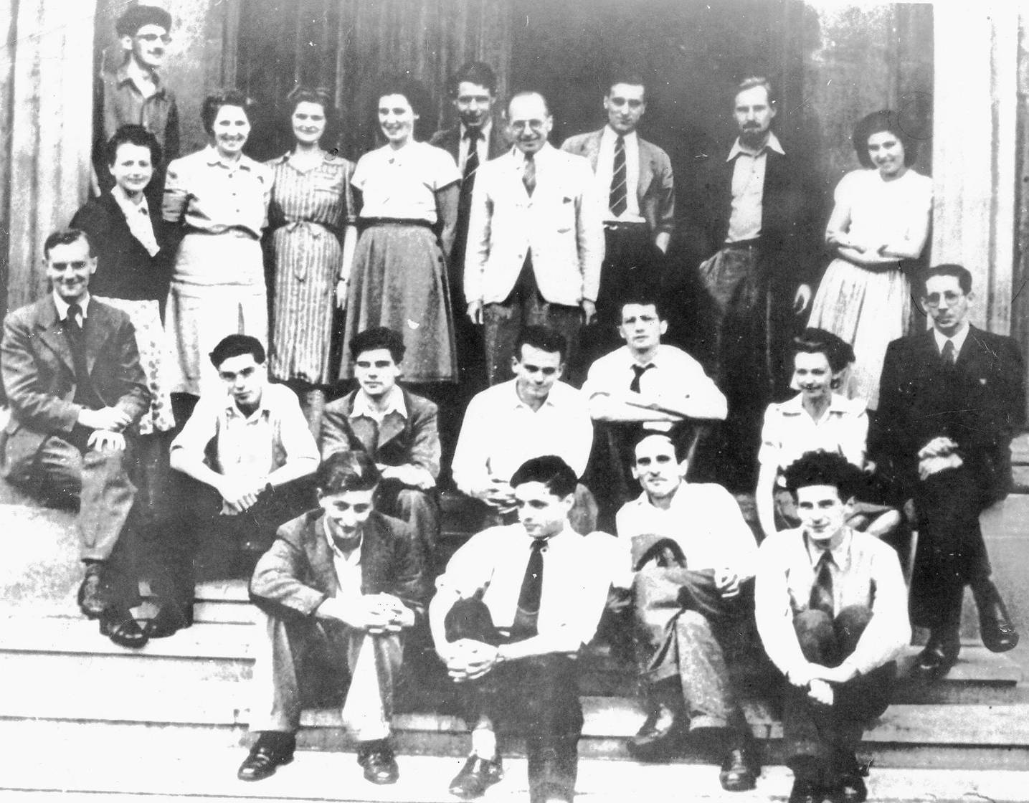
The group of Cecil Powell (at the left) with the microscopists,
with Lattes (at the center) and Giuseppe Occhialini (in front of Lattes, on the right in the photo).

Slide 52
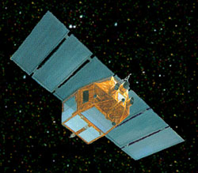
Giuseppe “Beppo” Occhialini & BeppoSAX
The satellite BeppoSAX was named in honour of Occhialini.
SAX stands for “Satellite per Astronomia a raggi X” or “Satellite for X-ray Astronomy”.
BeppoSAX was an Italian–Dutch satellite for X-ray astronomy which played a crucial role in the study of gamma-ray bursts. The mission run from 1996 to 2002.
Figure from NASA-http://heasarc.gsfc.nasa.gov/docs/sax/saxgof.html

Slide 53
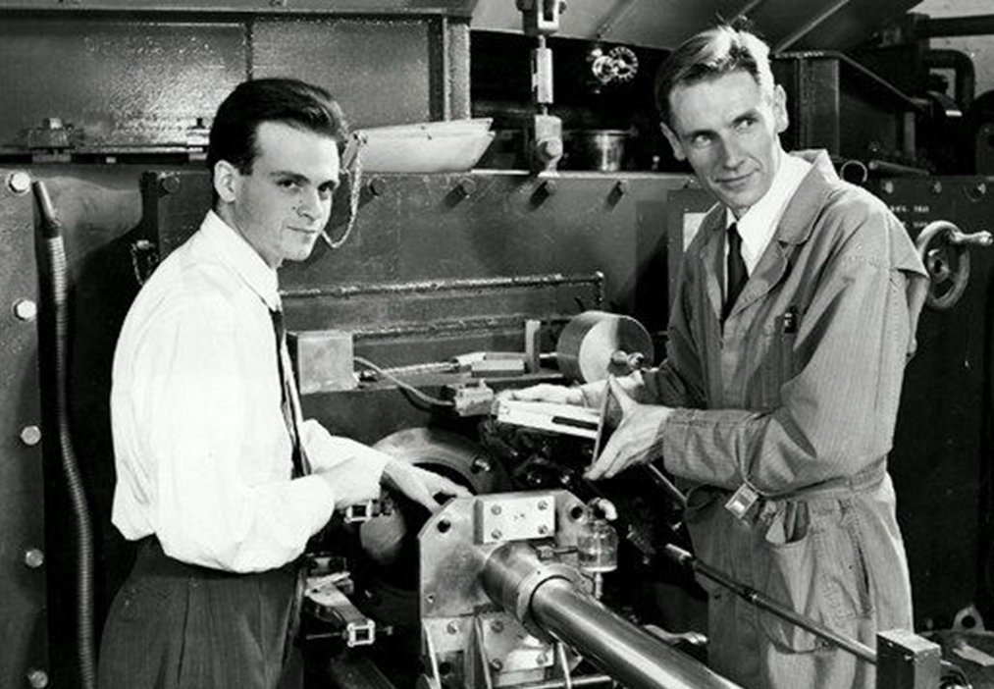
Lattes detecting pions produced in accelerators
In 1948, Lattes took some emulsions to the USA and exposed them to the 380 MeV cyclotron at Berkeley Laboratory (accelerating alpha particles incident on a carbon target).
In about ten days, Lattes and Eugene Gardner showed that pions were being produced artificially in the accelerator.
The research resulted in two published papers, the first reporting the observation of negative pions, and the second, of positive pions.
This discovery represents the beginning of the era of experiments with particle accelerators.
Notes:
Gardner, E., Lattes, C. M. G. (1948). «Production of mesons by the 184-inch Berkeley cyclotron». Science. 107 (2776): 270–271 DOI: 10.1126/science.107.2776.27
Positive Mesons Produced by the 184-Inch Berkeley Cyclotron, John Burfening*, Eugene Gardner, and C. M. G. Lattes†, PDFShare, Phys. Rev. 75, 382 – Published 1 February, 1949
DOI: https://doi.org/10.1103/PhysRev.75.382

Slide 54
General arrangement of the apparatus in the cyclotron
Production of mesons by the 184-inch Berkeley cyclotron
Gardner, E., Lattes, C. M. G. (1948). “Production of mesons by the 184-inch Berkeley cyclotron”. Science. 107 (2776): 270–271
Notes:
DOI: 10.1126/science.107.2776.27

Slide 55
First observations of negative pions
For a 10-minute exposure in the cyclotron, about 50 meson tracks are found along the 3-inch edge (7.62 cm) edge of a photographic plate. They used Ilford emulsion plates, 50 μm alpha current 0.1 μA).
The mass has been determined by measuring the bending in the magnetic field and the range in emulsion.
Two-thirds of the tracks produce observable stars at end of their range.
They found a mass of (313 ± 16)m_{e} .
Note the scattering along the track and the increase in grain density at the end of the track.

Slide 56
The second image provided in the paper
Edge of
photographic
plate

Slide 57
An interesting discussion in the paper
“The mass value found would indicate that at least 160 Mev should be available in the collision to produce these particles, and furthermore it seems likely that this energy should be concentrated in a single nucleon-nucleon collision. The means for this concentration is provided by the internal motions of the nucleons in the colliding nuclei,…”
“There are three velocities to consider: the relative velocity of the two nuclei (corresponding to an energy per nucleon of 95 MeV), the velocity of a nucleon inside the alpha particle (corresponding to a maximum energy of about the Fermi limit, 25 MeV), and a similar internal velocity in the carbon nucleus. In the most favorable collision, these can add together, giving an effective available energy of
in the c.m.s. of the two nucleons concerned. Thus, the observations are not inconsistent with a simple picture of meson formation by nucleon-nucleon collisions.”

Slide 58
Positive Mesons Produced by the 184-Inch Berkeley Cyclotron
Carbon target ~1,6 mm thick
Thicker emulsions (100 μm) favors detecting secondaries
In addition to the meson tracks found on the plates there is a background of tracks due to protons and alpha-particles.
Energy obtained measuring the bending in the magnetic field of the cyclotron and the range in the emulsion.
Preliminary measurements indicate that there are two groups of mesons having masses of about 300m_{e} and 200m_{e} respectively.
Neither the heavy nor the light positive mesons initiate stars.
Tracks of secondaries: 600 μm (energy 4 MeV).

Slide 59
Positive Mesons Produced by the 184-Inch Berkeley Cyclotron
Apparatus used for placing photographic plates below the circulating beam for exposure to positive mesons
Notes:
Positive Mesons Produced by the 184-Inch Berkeley Cyclotronm, John Burfening*, Eugene Gardner, and C. M. G. Lattes†, , ,PDFShare, , Phys. Rev. 75, 382 – Published 1 February, 1949
DOI: https://doi.org/10.1103/PhysRev.75.382

Slide 60
Positive Mesons Produced by the 184-Inch Berkeley Cyclotron
Apparatus used for placing photographic plates in a position to receive positive mesons which leave the target in a direction opposite to the beam direction. Plates exposed in this way have tracks of negative mesons along one edge, and tracks of positive mesons along the opposite edge.

Slide 61
Positive Mesons Produced by the 184-Inch Berkeley Cyclotron
Disintegration of a heavy positive meson to give a secondary.
In each case the heavy positive meson enters from the bottom left.

Slide 62
Positive Mesons Produced by the 184-Inch Berkeley Cyclotron
Disintegration of a heavy positive meson to give a secondary. The heavy tracks on the lefthand side are due to protons from the target.
Notes:
The heavy tracks on the lefthand side are due to protons from the target. They are often the most troublesome part of the background.

Slide 63
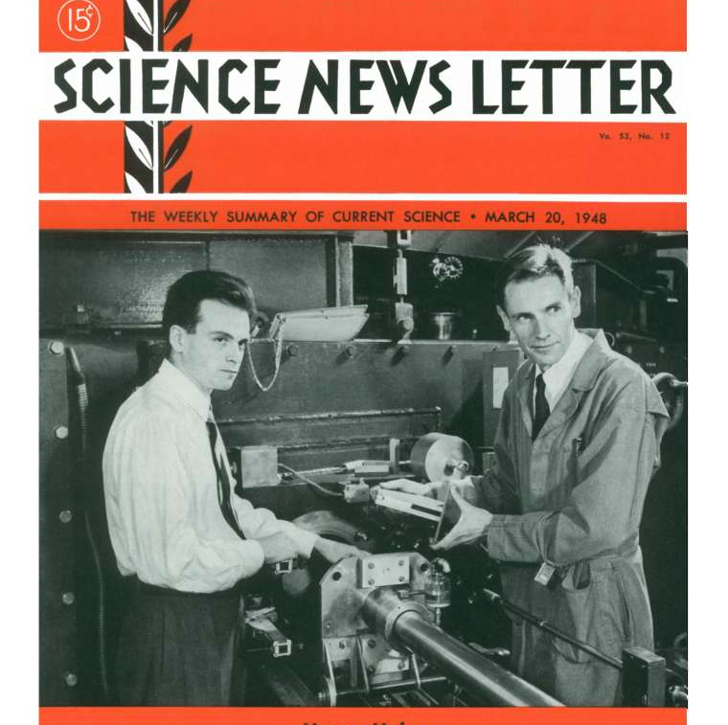
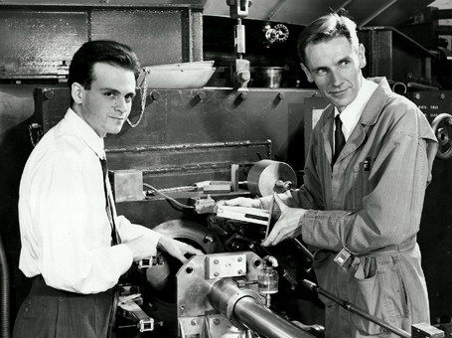
Cover of the magazine Science News Letter
March 1948

Slide 64
Still in 1949,...
Lattes also participated with Edwin McMillan in the first observation of pion photoproduction at the University of California synchrotron that accelerated electrons to 300 MeV.
Knowing what to look for, Lattes soon found dozens of traces of pions in the emulsions exposed to the gamma rays produced in the accelerator.
Unfortunately, this result was never published.

Slide 65
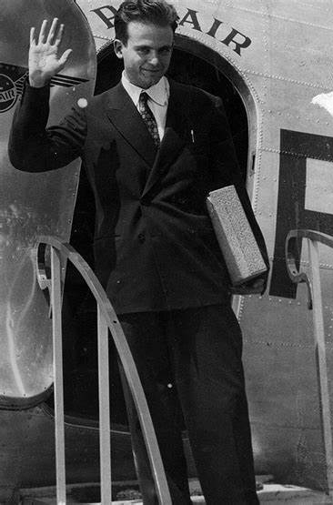
His return to Brazil
He became a celebrity!
He participated in the creation of the Brazilian Center for Physics Research (CBPF) in Rio de Janeiro in 1949 and was its first scientific director until 1955.
In the early 1950s, the CBPF had the necessary instrumentation for Lattes to create a research group dedicated to cosmic rays. When necessary, the instruments were taken to Mount Chacaltaya.
65

Slide 66
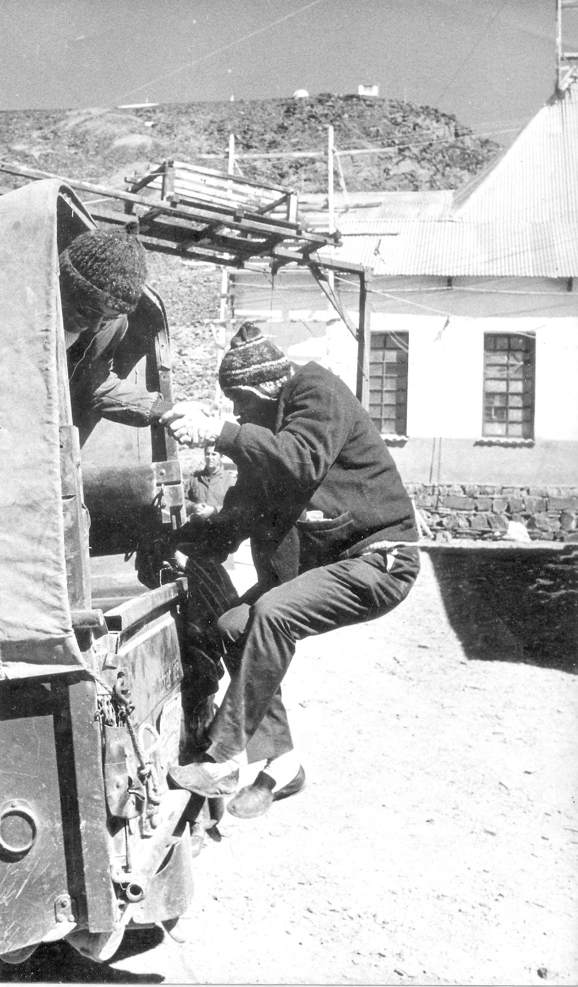
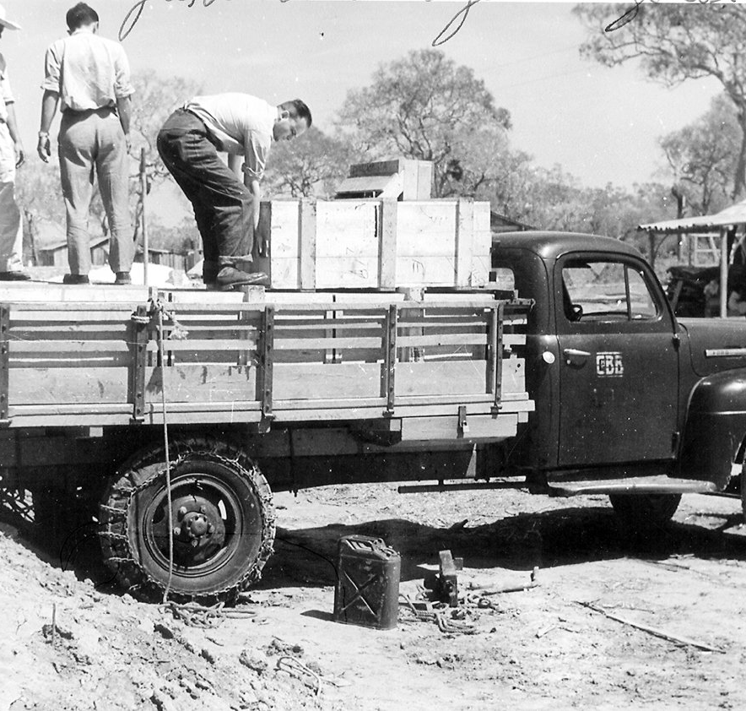

Lattes in Bolivia in the 1950s

Slide 67
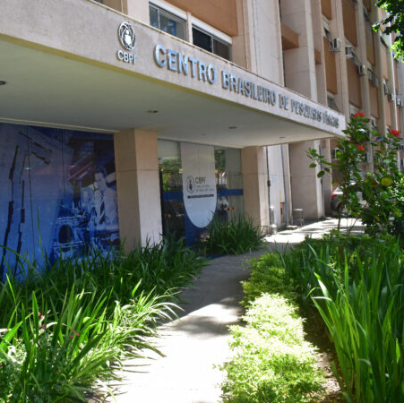
Creation of CBPF (1949)
Lattes participated in the creation
of the Centro Brasileiro de
Pesquisas Físicas (CBPF).
(This photo is from nowadays, sorry !)

Slide 68
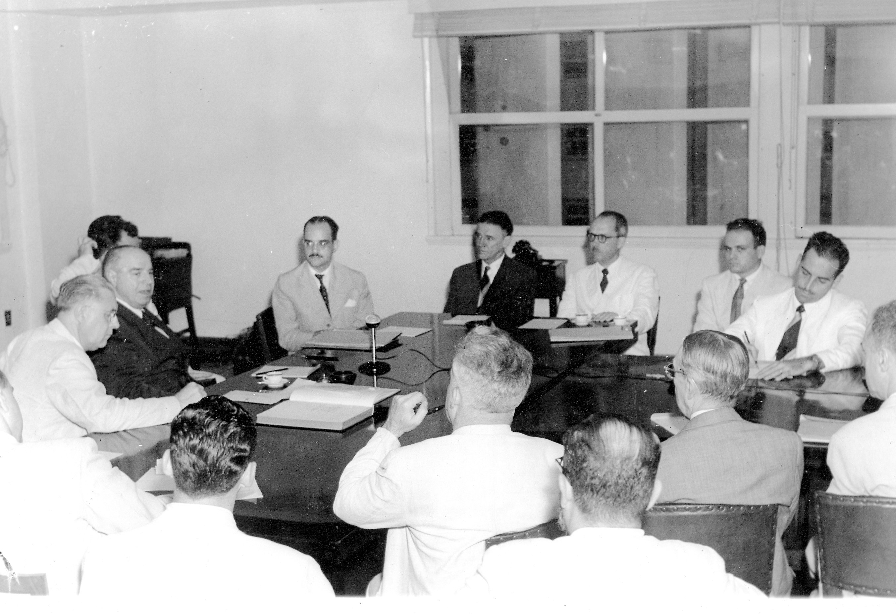
Creation of the National Research Council (CNPq) in 1951
Lattes also participated in the creation of the National Research Council (CNPq), today the National Council for Scientific and Technological Development.
68

Slide 69
Lattes in the 1950s
Between 1955 and 1956, Lattes spent a sabbatical year in the United States, initially as an associate researcher at the Enrico Fermi Institute for Nuclear Studies at the University of Chicago and later at the University of Minnesota. He participated in studies on the decay of pions produced by interactions with high-energy cosmic rays.
During this time, he participated in the International Cooperative Emulsion Flights (ICEF), a project coordinated by Marcel Schein of the University of Chicago, exposing stacks of emulsions to cosmic rays in balloon flights.
Nuclear emulsions were used as detectors and exposed in balloons at an altitude of 30 km for two days. After chemical processing, the emulsions were distributed among the various laboratories participating in the collaboration in fifteen countries, Lattes' group at USP being one of them.
Notes:
Late last January, an ambitious cosmic‐ray experiment conducted by scientists from fourteen nations and sponsored jointly by the National Science Foundation and the Office of Naval Research was set in motion from the flight deck of the “USS Valley Forge”, then cruising just east of the Leeward Islands and the Caribbean. The object was to send two Navy Skyhook balloons of unprecedented size to an altitude of 18–22 miles and to keep them aloft for two full days. Each balloon was to carry in its gondola an 800‐pound stack of photographic emulsion sheets for recording primary cosmic‐ray events involving energies as high as 1015 electron volts—energies thousands of times greater than are available in the world's largest high‐energy accelerators. The Caribbean area was chosen because of its proximity to the equator, where the earth's magnetic field serves as a barrier to cosmic rays of energies lower than about 10 BeV, effectively filtering them out.

Slide 70
Lattes at USP in the 1960s
In the early 1960s, Lattes temporarily assumed the chair of Higher Physics at USP at the invitation of Mario Schenberg, his former colleague and student of Wataghin in the 1930s.
He also took the first steps towards starting research by the Brazil-Japan Collaboration on interactions with very high-energy cosmic rays.

Slide 71
The first international cosmic-ray collaboration: the Brazil-Japan Collaboration
By the end of the 1950s, Hideki Yukawa and Cesar Lattes were the leading authorities on pions in Japan and Brazil.
On April 16, 1959, Yukawa wrote a letter to Lattes, reporting on the research activities of a group of young Japanese physicists on Mount Fuji related to cosmic rays and suggesting a collaboration with Brazilian physicists on Mount Chacaltaya.
The first emulsion chamber of the Brazil-Japan Collaboration was exposed on Mount Chacaltaya in 1962, followed by more than twenty others in the following decades.
Yoichi Fujimoto and Shun-ichi Hasegawa were the main forces behind the Japanese team.

Slide 72
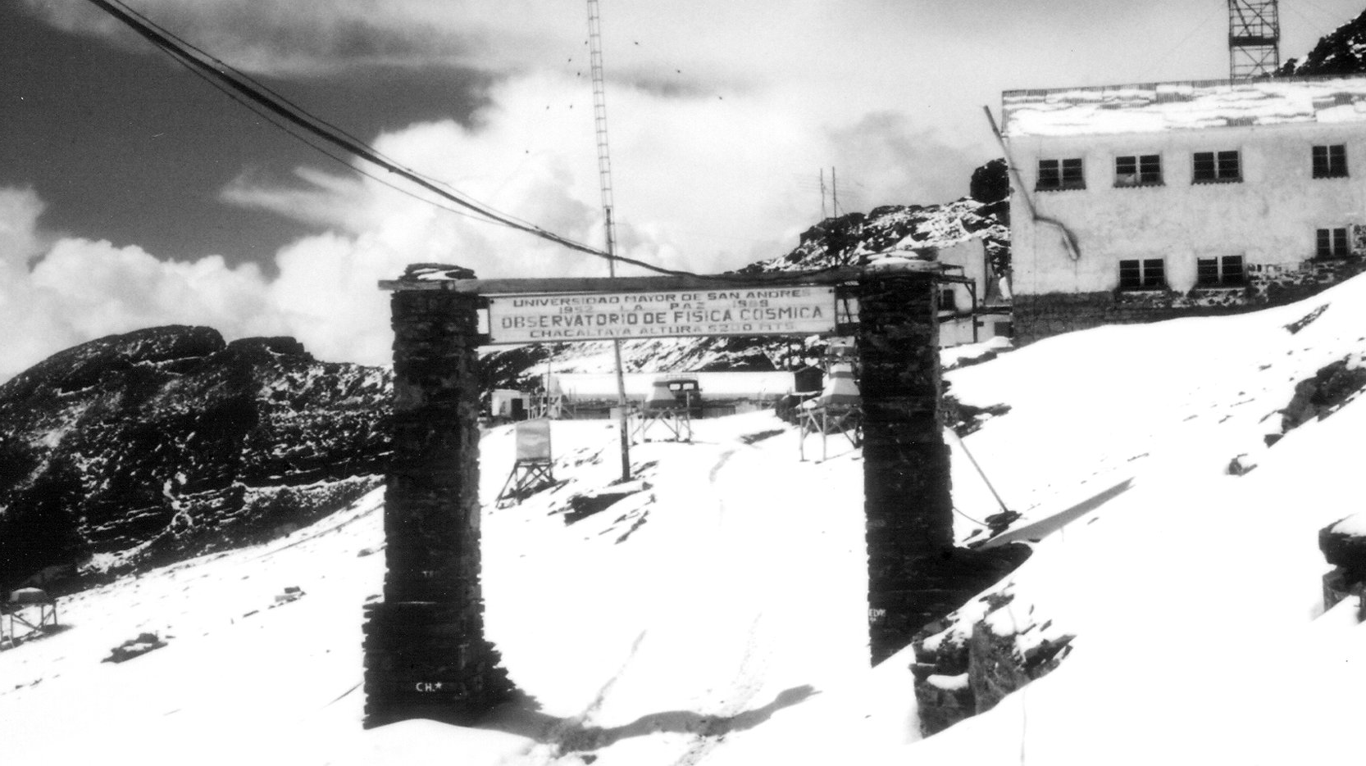

Slide 73
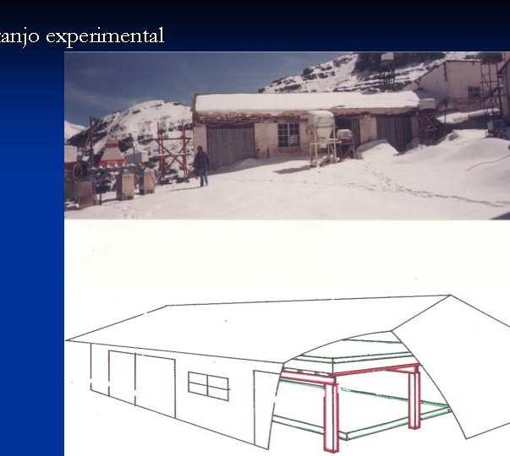
The Cosmic-Ray Laboratory at Mt.
Chacaltaya (Bolivia) at 5,220 m

Slide 74
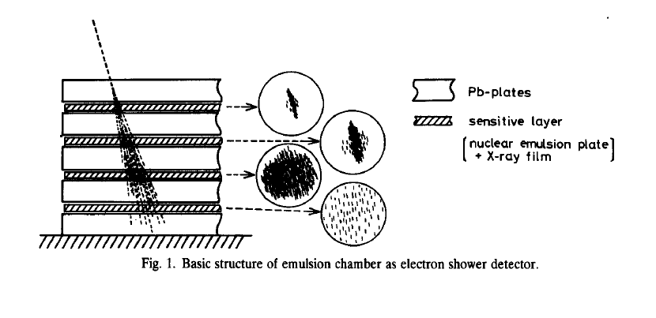
A chamber of nuclear emulsions, X-rays and lead
Pb plates
Sensitive layer with nuclear emulsion plate and X-ray film
Basic structure of the first emulsion chambers as an electromagnetic cascade detector

Slide 75
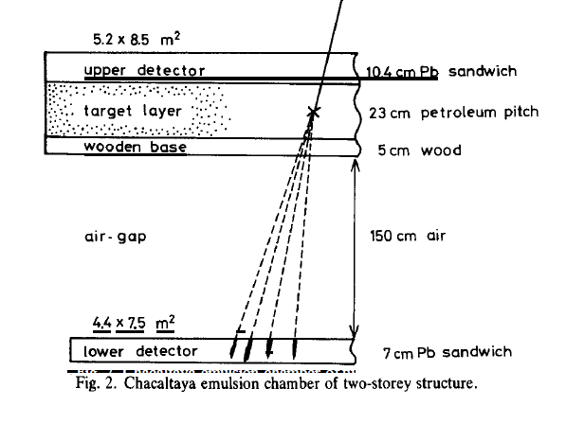
A two-story emulsion chamber
A two-story emulsion chamber like those on display at Mount Chacaltaya by CBJ.
75

Slide 76
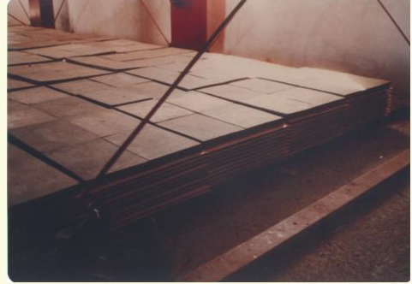
The lower part of an emulsion chamber
76

Slide 77
The highest-energy event Andromeda
“Hadronic Interactions of High Energy Cosmic-Rays Observed with Emulsion Chambers”
C.M.G.Lattes, Y. Fujimoto, S. Hasegawa,
Physics Reports 65 (1980) 151-229
5 cm
Estimated energy in hadrons of 20 PeV
(Photo of the X-ray film)

Slide 78
The 1960s – Lattes at UNICAMP
Lattes remained at USP until the middle of the decade, when he joined the project to create the University of Campinas, at the invitation of his old colleague and friend at USP, Marcello Damy.
Damy, also a student of Wataghin in the 1930s, became the first director of the Physics Institute at UNICAMP.

Slide 79
Lattes at UNICAMP (1966 − 1985)
Lattes moved to UNICAMP, transferring the scientific leadership of the Brazilian part of the Brazil-Japan Collaboration project to Campinas.
He brought with him members of the group of researchers who worked with him at USP.
Lattes and his group continued their research in collaboration with Japanese scientists, setting up emulsion and X-ray chambers in Bolivia.

Slide 80
Lattes at UNICAMP (1966 − 1985)
The group's experience contributed to the formation of the Department of Cosmic Rays and Chronology at the nascent Institute of Physics.
Lattes and his group continued their research in collaboration with Japanese scientists, setting up emulsion and X-ray chambers in Bolivia. The Brazil-Japan Collaboration lasted for many decades, studying the characteristics of hadronic interactions at energies between 10¹⁴ and 10¹⁷ eV that occur in the atmosphere or in lead or pitch in the chamber. Publications analyzing the results persisted into the 21st century.
In parallel, he started a group dedicated to mineral dating through fission tracks, pursuing evidence of the variation of the fundamental constants in Physics as predicted by Dirac.

Slide 81
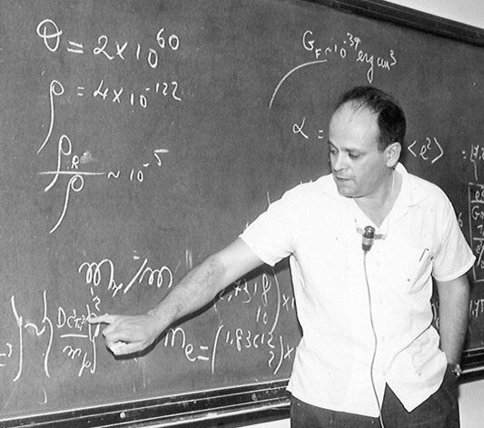
Lattes at UNICAMP
(1966 − 1985)

Slide 82
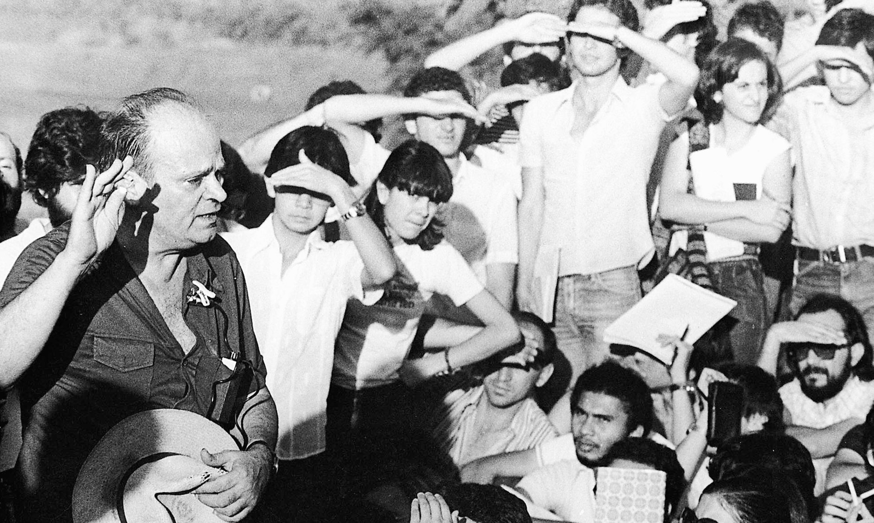
Lattes managed to gather students to listen to his lectures
(UNICAMP, 1980)

Slide 83
After retiring from UNICAMP,..
Lattes also began another venture at the Federal University of Mato Grosso, to create a research group in Chronology there, thus living up to his reputation as a huge initiative in creating groups and institutions.
Unfortunately, the mission did not succeed due to lack of continued support.

Slide 84
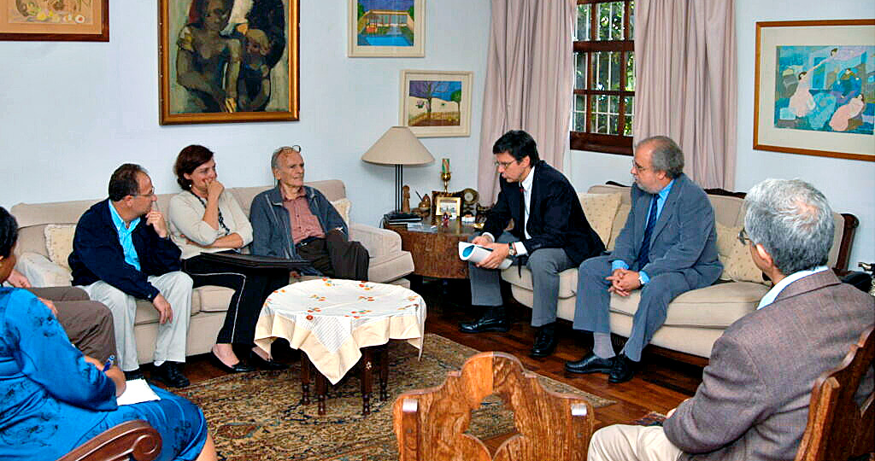
On October 15, 2004, Lattes received from the hands of Rector Prof. Brito Cruz the titles of Professor Emeritus and Doctor Honoris Causa that had been conferred on him by Unicamp in 1986.

Slide 85
A few words of Lattes
I would like to end with some words from Lattes himself, taken from an interview he gave to Ms. Micheline Nussenzveig and Dr. Cássio Leite Vieira in 1995:
Lattes said (and I quote):
  “I will give you some quotes from my everyday philosophy. The first is: History is the most important of the sciences. I know that without history there is no objective reality, paraphrasing Schrödinger.
  The second is from a very old guy, Thomas Aquinas, who says: “Science cannot predict what will happen, it can only predict the probability of something happening. This is what scientists only discovered in 1927, with the uncertainty principle and other things.
  The mission of science is to increase and coordinate our empirical knowledge. This quote is from Niels Bohr.
  I would add again the phrase from Leonardo da Vinci: Go learn your lessons from nature.”

Slide 86
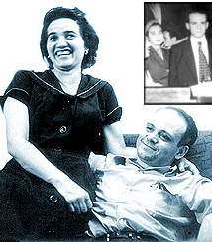
Finally, my humble homage to a special person: Dona Martha
More than his wife and companion, Dona Martha was Lattes’ “retaining wall”, his “muro de arrimo”, his “muro de contención” for 55 years.
Dona Martha took care of all the daily family affairs and raised their four daughters, Maria Carolina, Maria Cristina, Maria Lúcia and Maria Teresa.
She was a Math high-school teacher most feared among the students.
Above all, she welcomed everyone who visited the Lattes family with extreme warmth and a smile on her face.
She passed away three years before him, in 2002. I am sure that Lattes also died a little when losing his companion of so many years, his safe haven.
Dona Martha Lattes was the living proof of the idea that behind every great man stands a great woman!

Slide 87
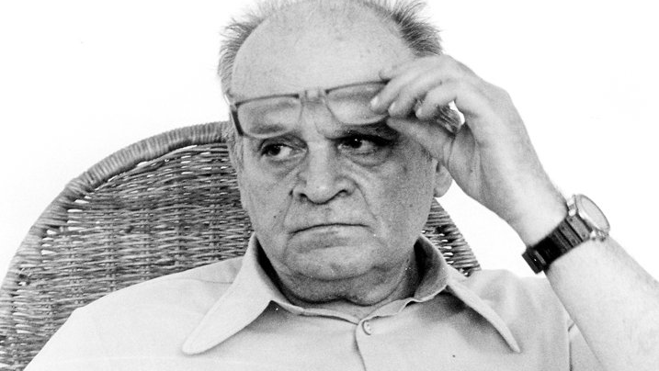
Thank you for the opportunity to talk about this great man!

