Slide 1



Jet-flavour tagging at
FCC-hh
FCC-hh Physics & Performance Meeting
Wei Sheng Lai, Nikita Pond, Tim Scanlon, Sebastien Rettie, Sam Van Stroud
17th October 2024

Slide 2

Overview
Flavour tagging
  Motivation
  Transformer based model (first attempt @ FCC-hh)
Validating workflow with FCC-ee
Data simulation
  Fast detector simulation (Delphes)
  Input variables
Performance
Summary

Slide 3
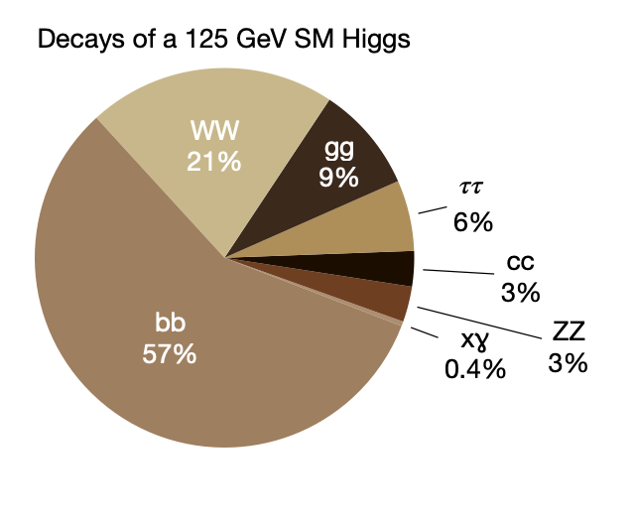
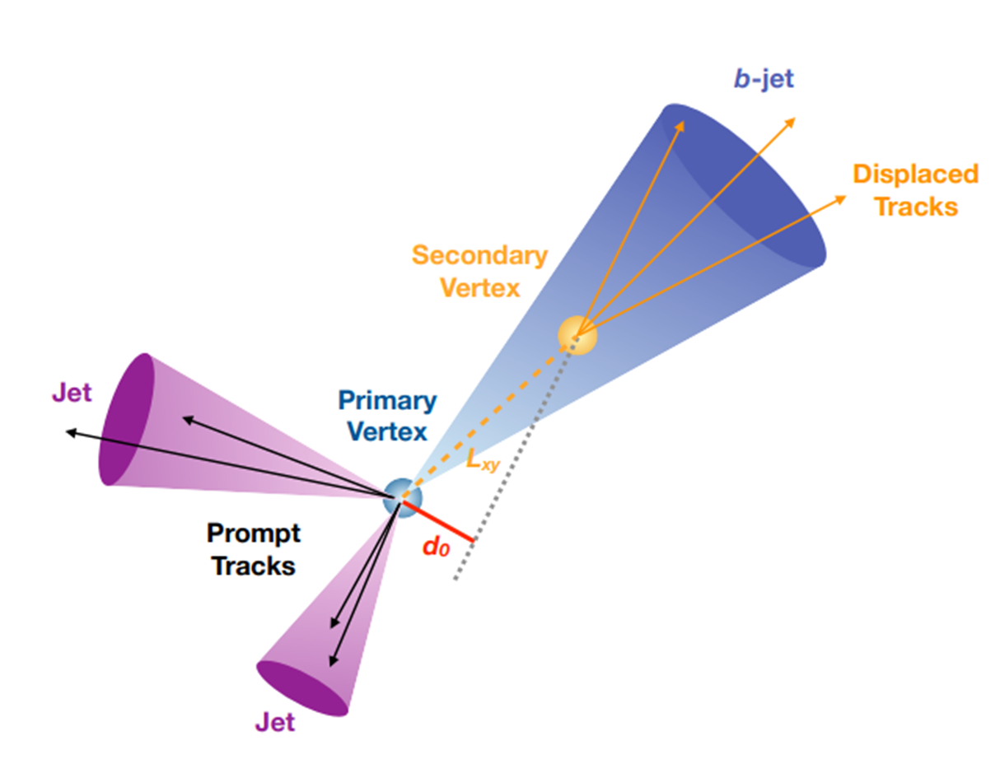
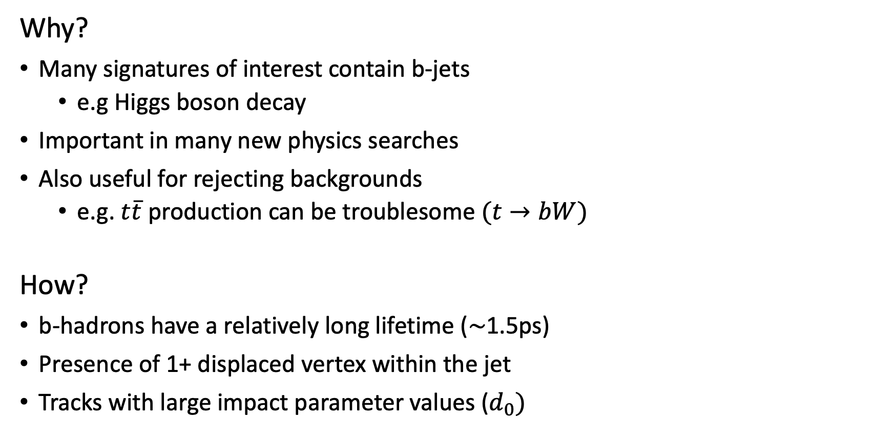
Flavour tagging (b-tagging)
Why?
Many signatures of interest contain b-jets
  e.g Higgs boson decay
Important in many new physics searches
Also useful for rejecting backgrounds
  e.g. $t\overline{t}$ production can be troublesome $(t→bW)$
How?
b-hadrons have a relatively long lifetime ($\sim$1.5ps)
Presence of 1+ displaced vertex within the jet
Tracks with large impact parameter values ($d_{0})$

Slide 4
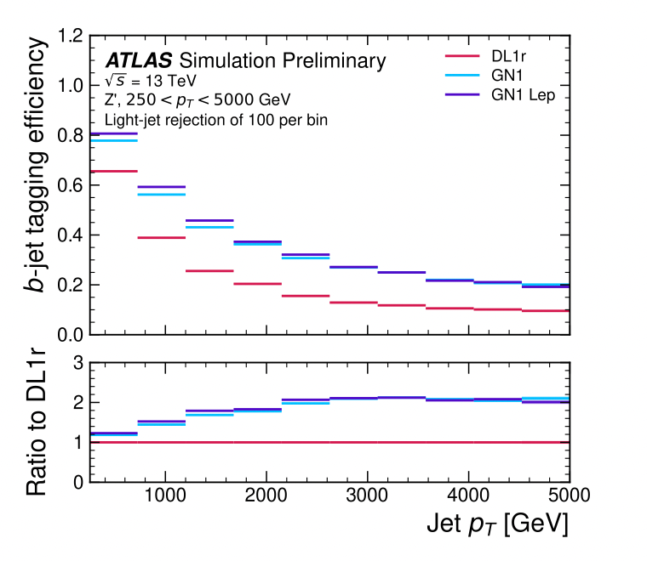
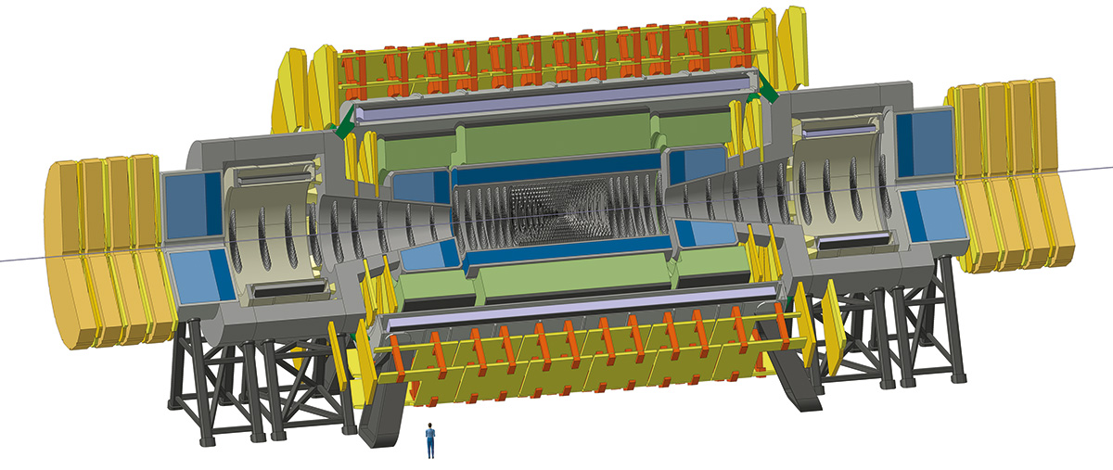

Flavour tagging at FCC-hh
Understand flavour-tagging performance at FCC-hh
  Impact of new detector designs and collider conditions
Study:
  Performance as a function of pT and $η$
  Impact on very large pile-up
Ref

Slide 5
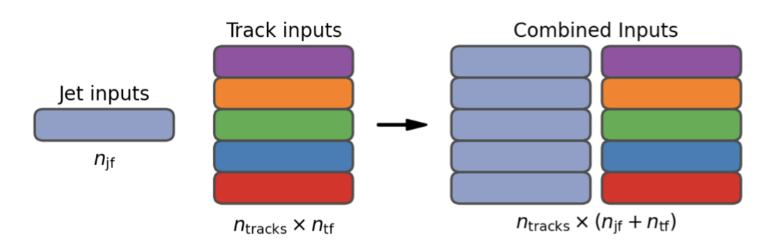
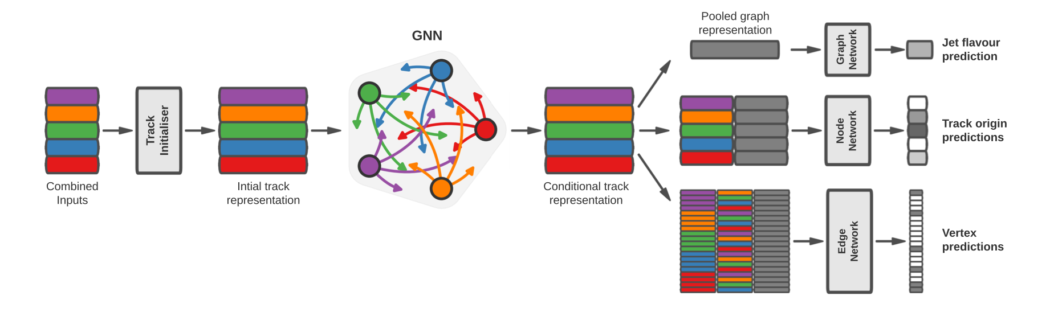
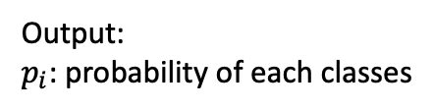
GN2
Transformer-based architecture (GN2) [ATL-PHYS-PUB-2022-027]
Jet kinematics are concatenated with jet constituents inputs
Predict: Jet flavour classification (primary task),
  track truth origin and vertexing (auxiliary task)
Output:
$p_{i}$: probability of each classes
Transformer

Slide 6
Workflow
Delphes + Pythia
Event generation
Salt [link]
Model training
DelphesFTAG
ROOT to h5 ntuples (preferred format for ML training)
Extracting auxiliary task information
Detector simulation

Slide 7
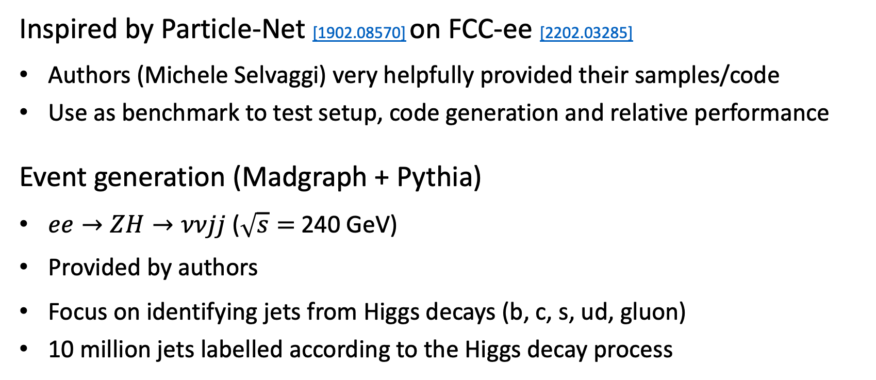
Validate setup with FCC-ee
Inspired by Particle-Net [1902.08570] on FCC-ee [2202.03285]
Authors (Michele Selvaggi) very helpfully provided their samples/code
Use as benchmark to test setup, code generation and relative performance
Event generation (Madgraph + Pythia)
$ee→ZH→ννjj$ ($\sqrt{s}=$240 GeV)
Provided by authors
Focus on identifying jets from Higgs decays (b, c, s, ud, gluon)
10 million jets labelled according to the Higgs decay process

Slide 8
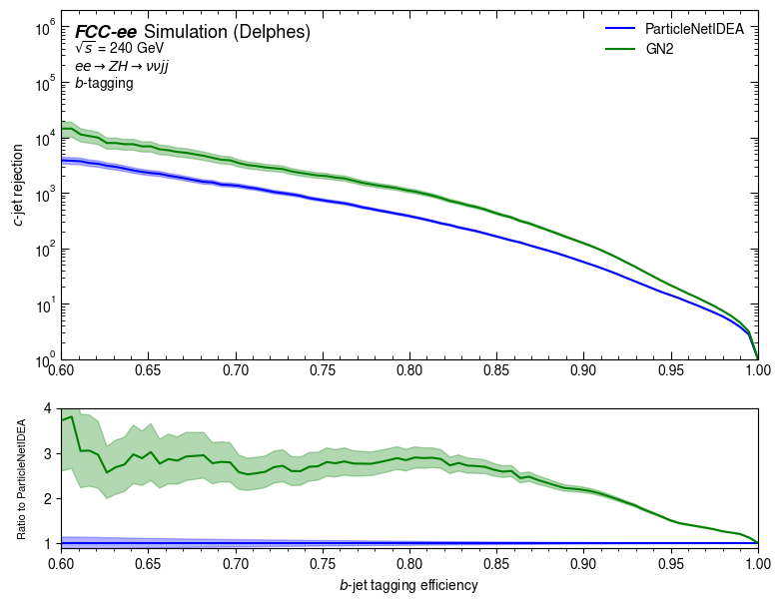
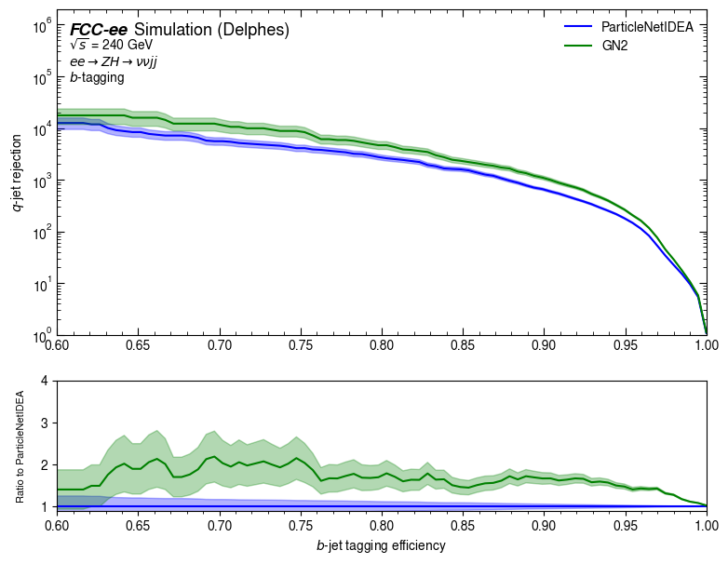
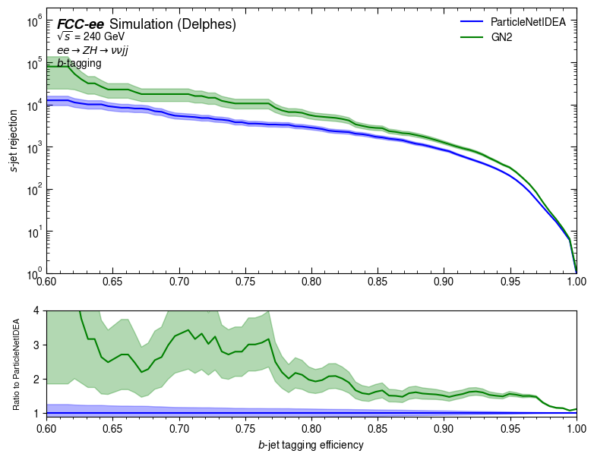
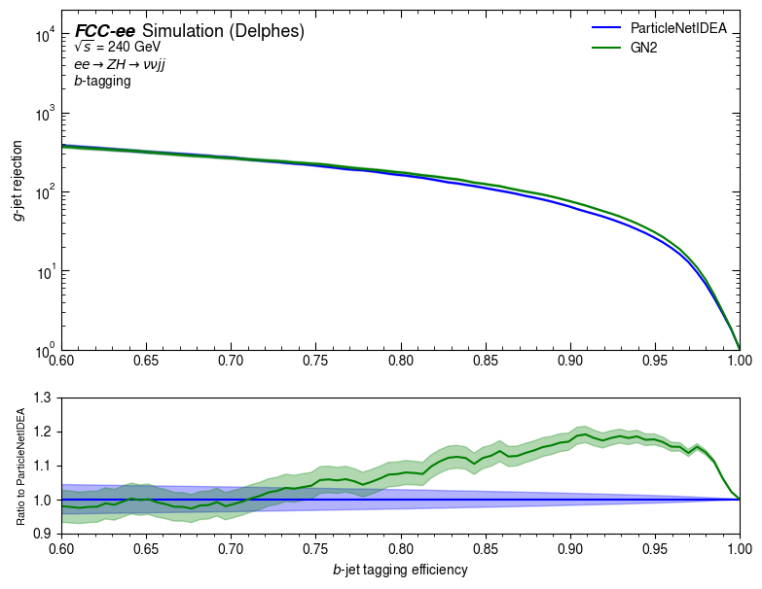
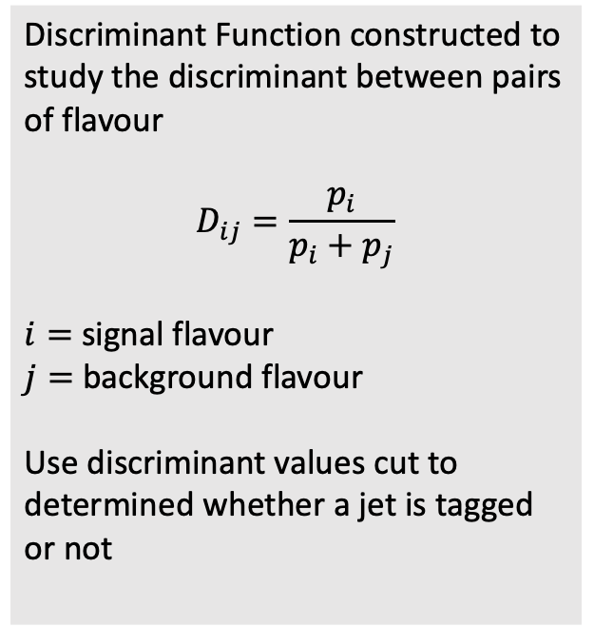
Performance
Discriminant Function constructed to study the discriminant between pairs of flavour
$$D_{ij}=\frac{p_{i}}{p_{i}+p_{j}}$$
$i=$ signal flavour
$j=$ background flavour
Use discriminant values cut to determined whether a jet is tagged or not
Results:
Reproduced ParticleNetIDEA results
Validated sample generation/evaluation
Similar performance achieved

Slide 9
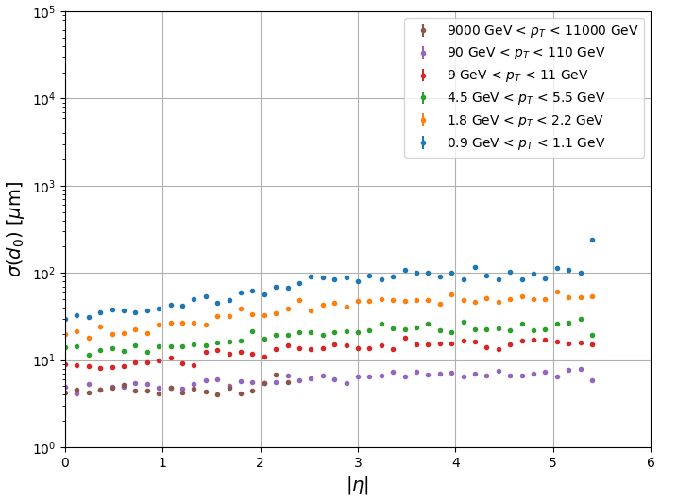
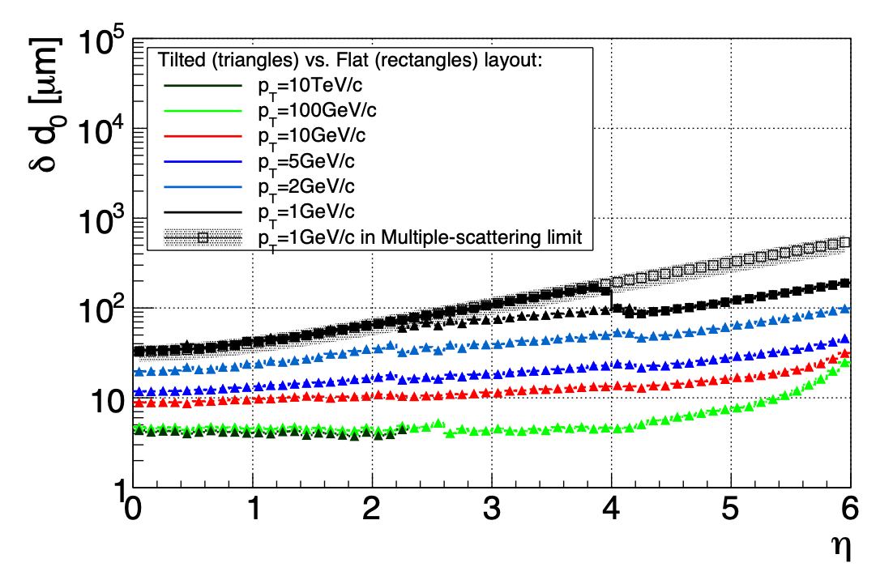
FCC-hh with Delphes
Modified baseline FCC-hh Delphes cards based on conceptual design report (CDR) [CERN-2022-002]
DenseTrackFilter module:
  Remove overlapping tracks in dense environment
TrackCovariance module:
  Similar to FCC-ee IDEA detector approach
  Implemented simple description of tracking detector layout (tklayout link)
  Simulate track parameters and covariance matrix
  Validated resolutions agree with predictions from CDR
Same approach to Scenario I detector card (Optimistic: higher tracking efficiency)
FCChhTrackCov_II
CDR

Slide 10
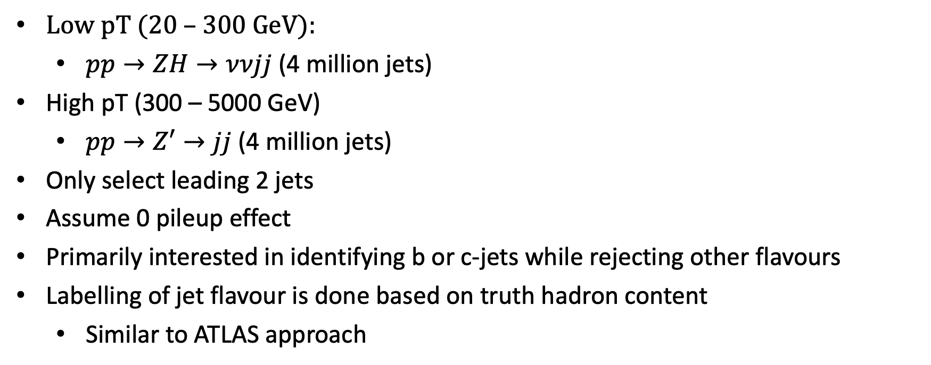
Simulating data (Pythia)
Low pT (20 – 300 GeV):
  $pp→ZH→ννjj$ (4 million jets)
High pT (300 – 5000 GeV)
  $pp→Z′→jj$ (4 million jets)
Only select leading 2 jets
Assume 0 pileup effect
Primarily interested in identifying b or c-jets while rejecting other flavours
Labelling of jet flavour is done based on truth hadron content
  Similar to ATLAS approach
Jet Flavour | Presence of b-Hadron | Presence of c-Hadron
b-jet | ✓ | -
c-jet | ✗ | ✓
light-jet | ✗ | ✗

Slide 11
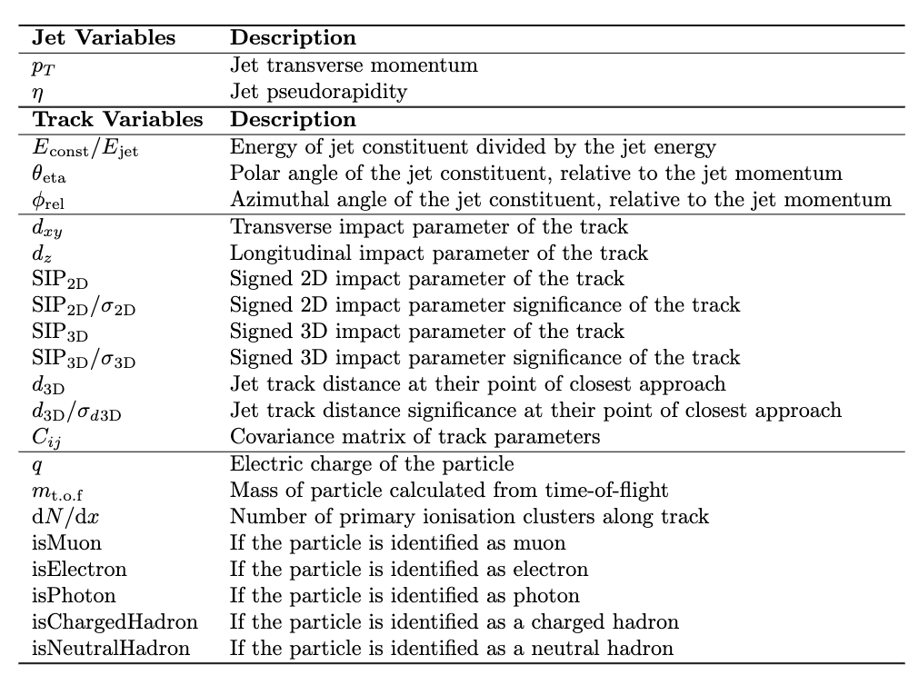

Input variables
Jet kinematics
Relative kinematics
Track parameters
Particle Identification

Slide 12
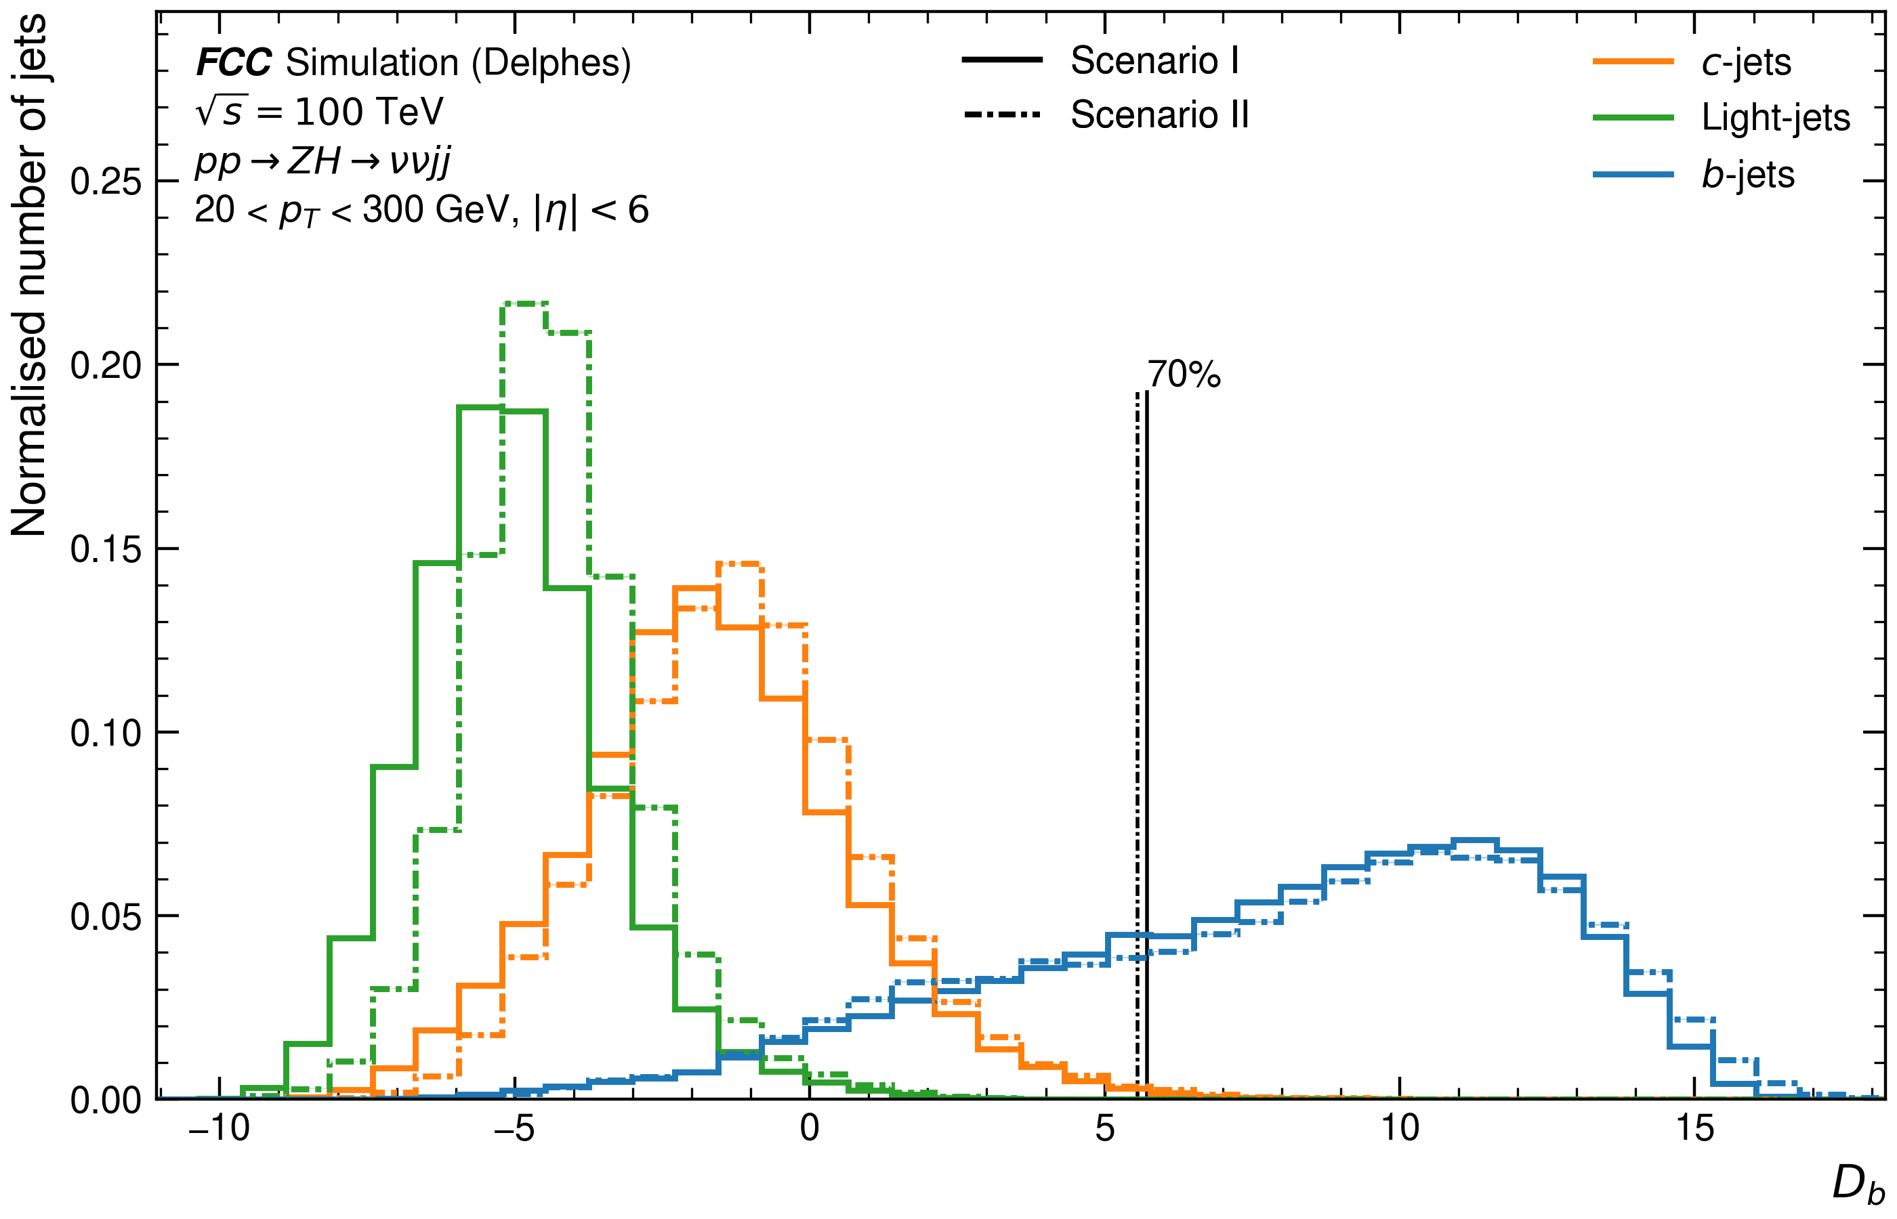
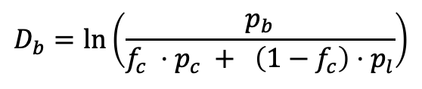
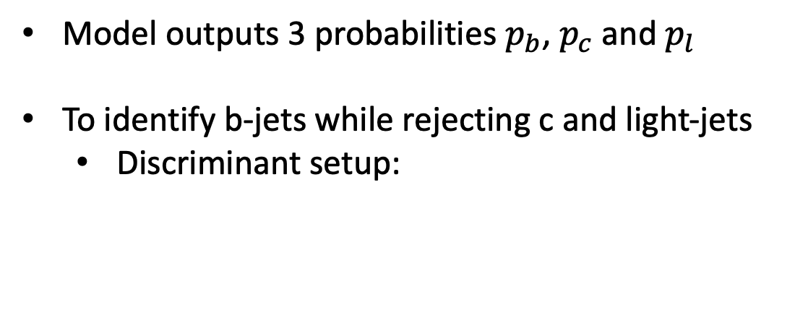
ATLAS-style discriminant
Model outputs 3 probabilities $p_{b}$, $p_{c}$ and $p_{l}$
To identify b-jets while rejecting c and light-jets
  Discriminant setup:
$$D_{b}=ln\left(\frac{p_{b}}{f_{c} ⋅p_{c} + \left(1−f_{c}\right)⋅p_{l}}\right)$$

Slide 13
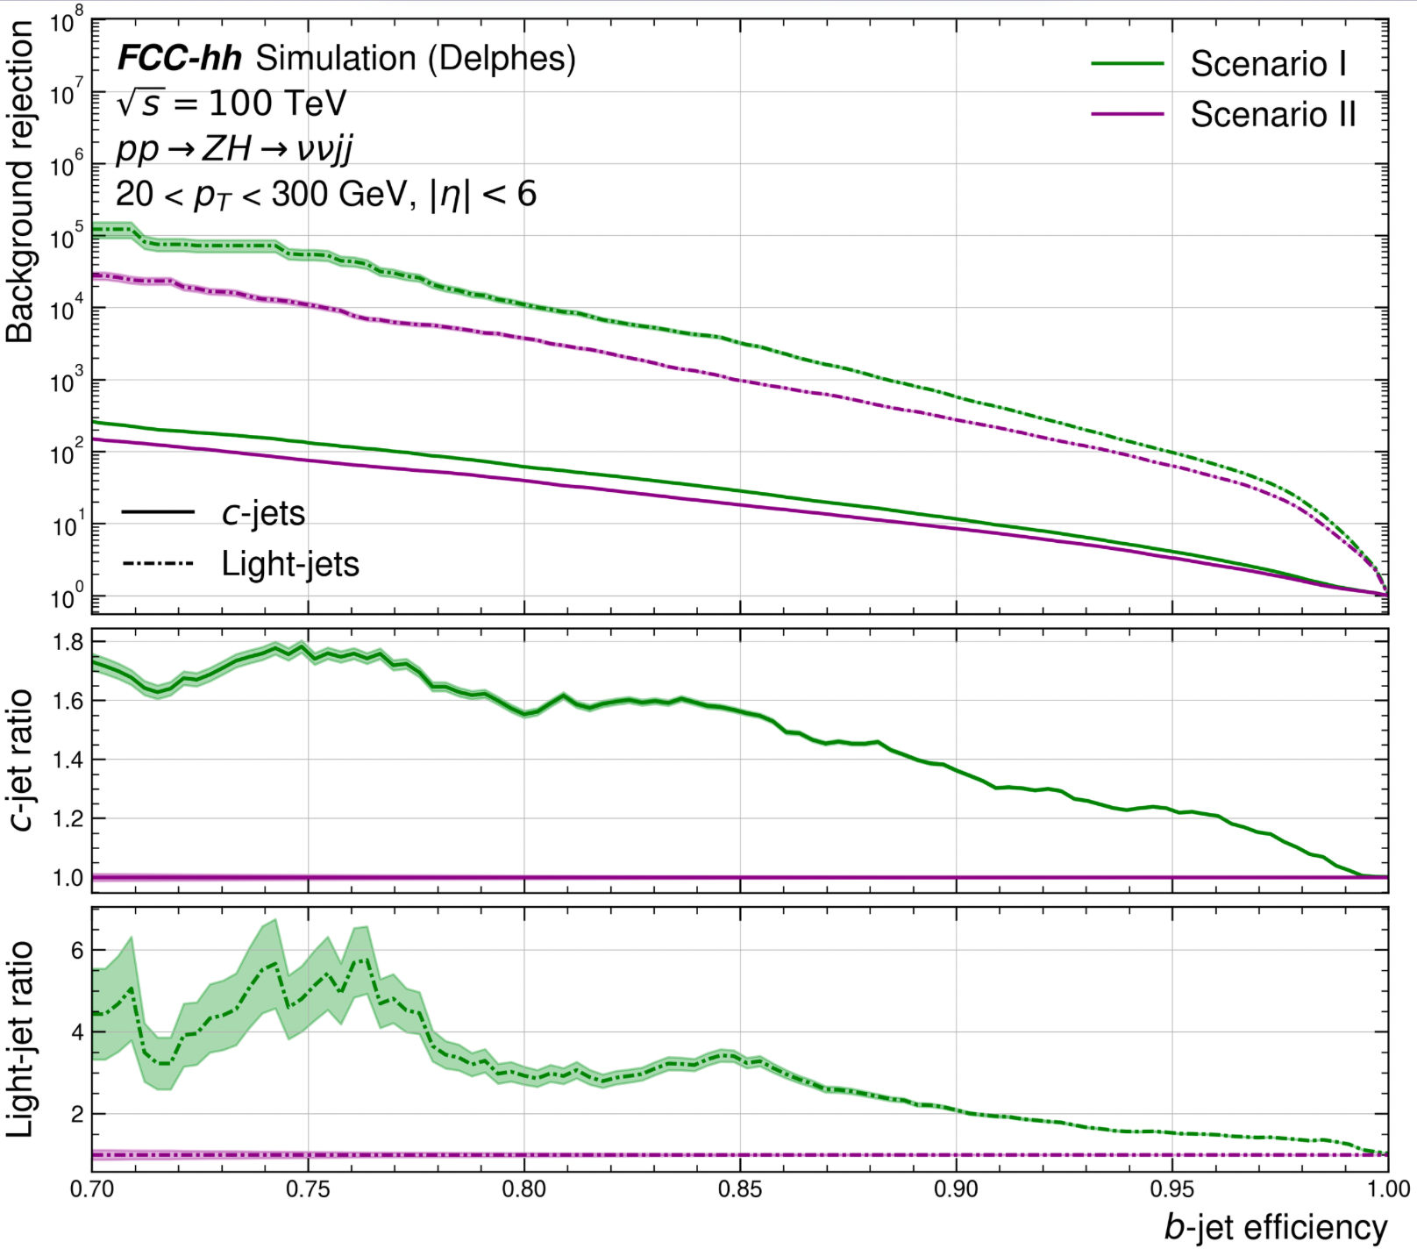
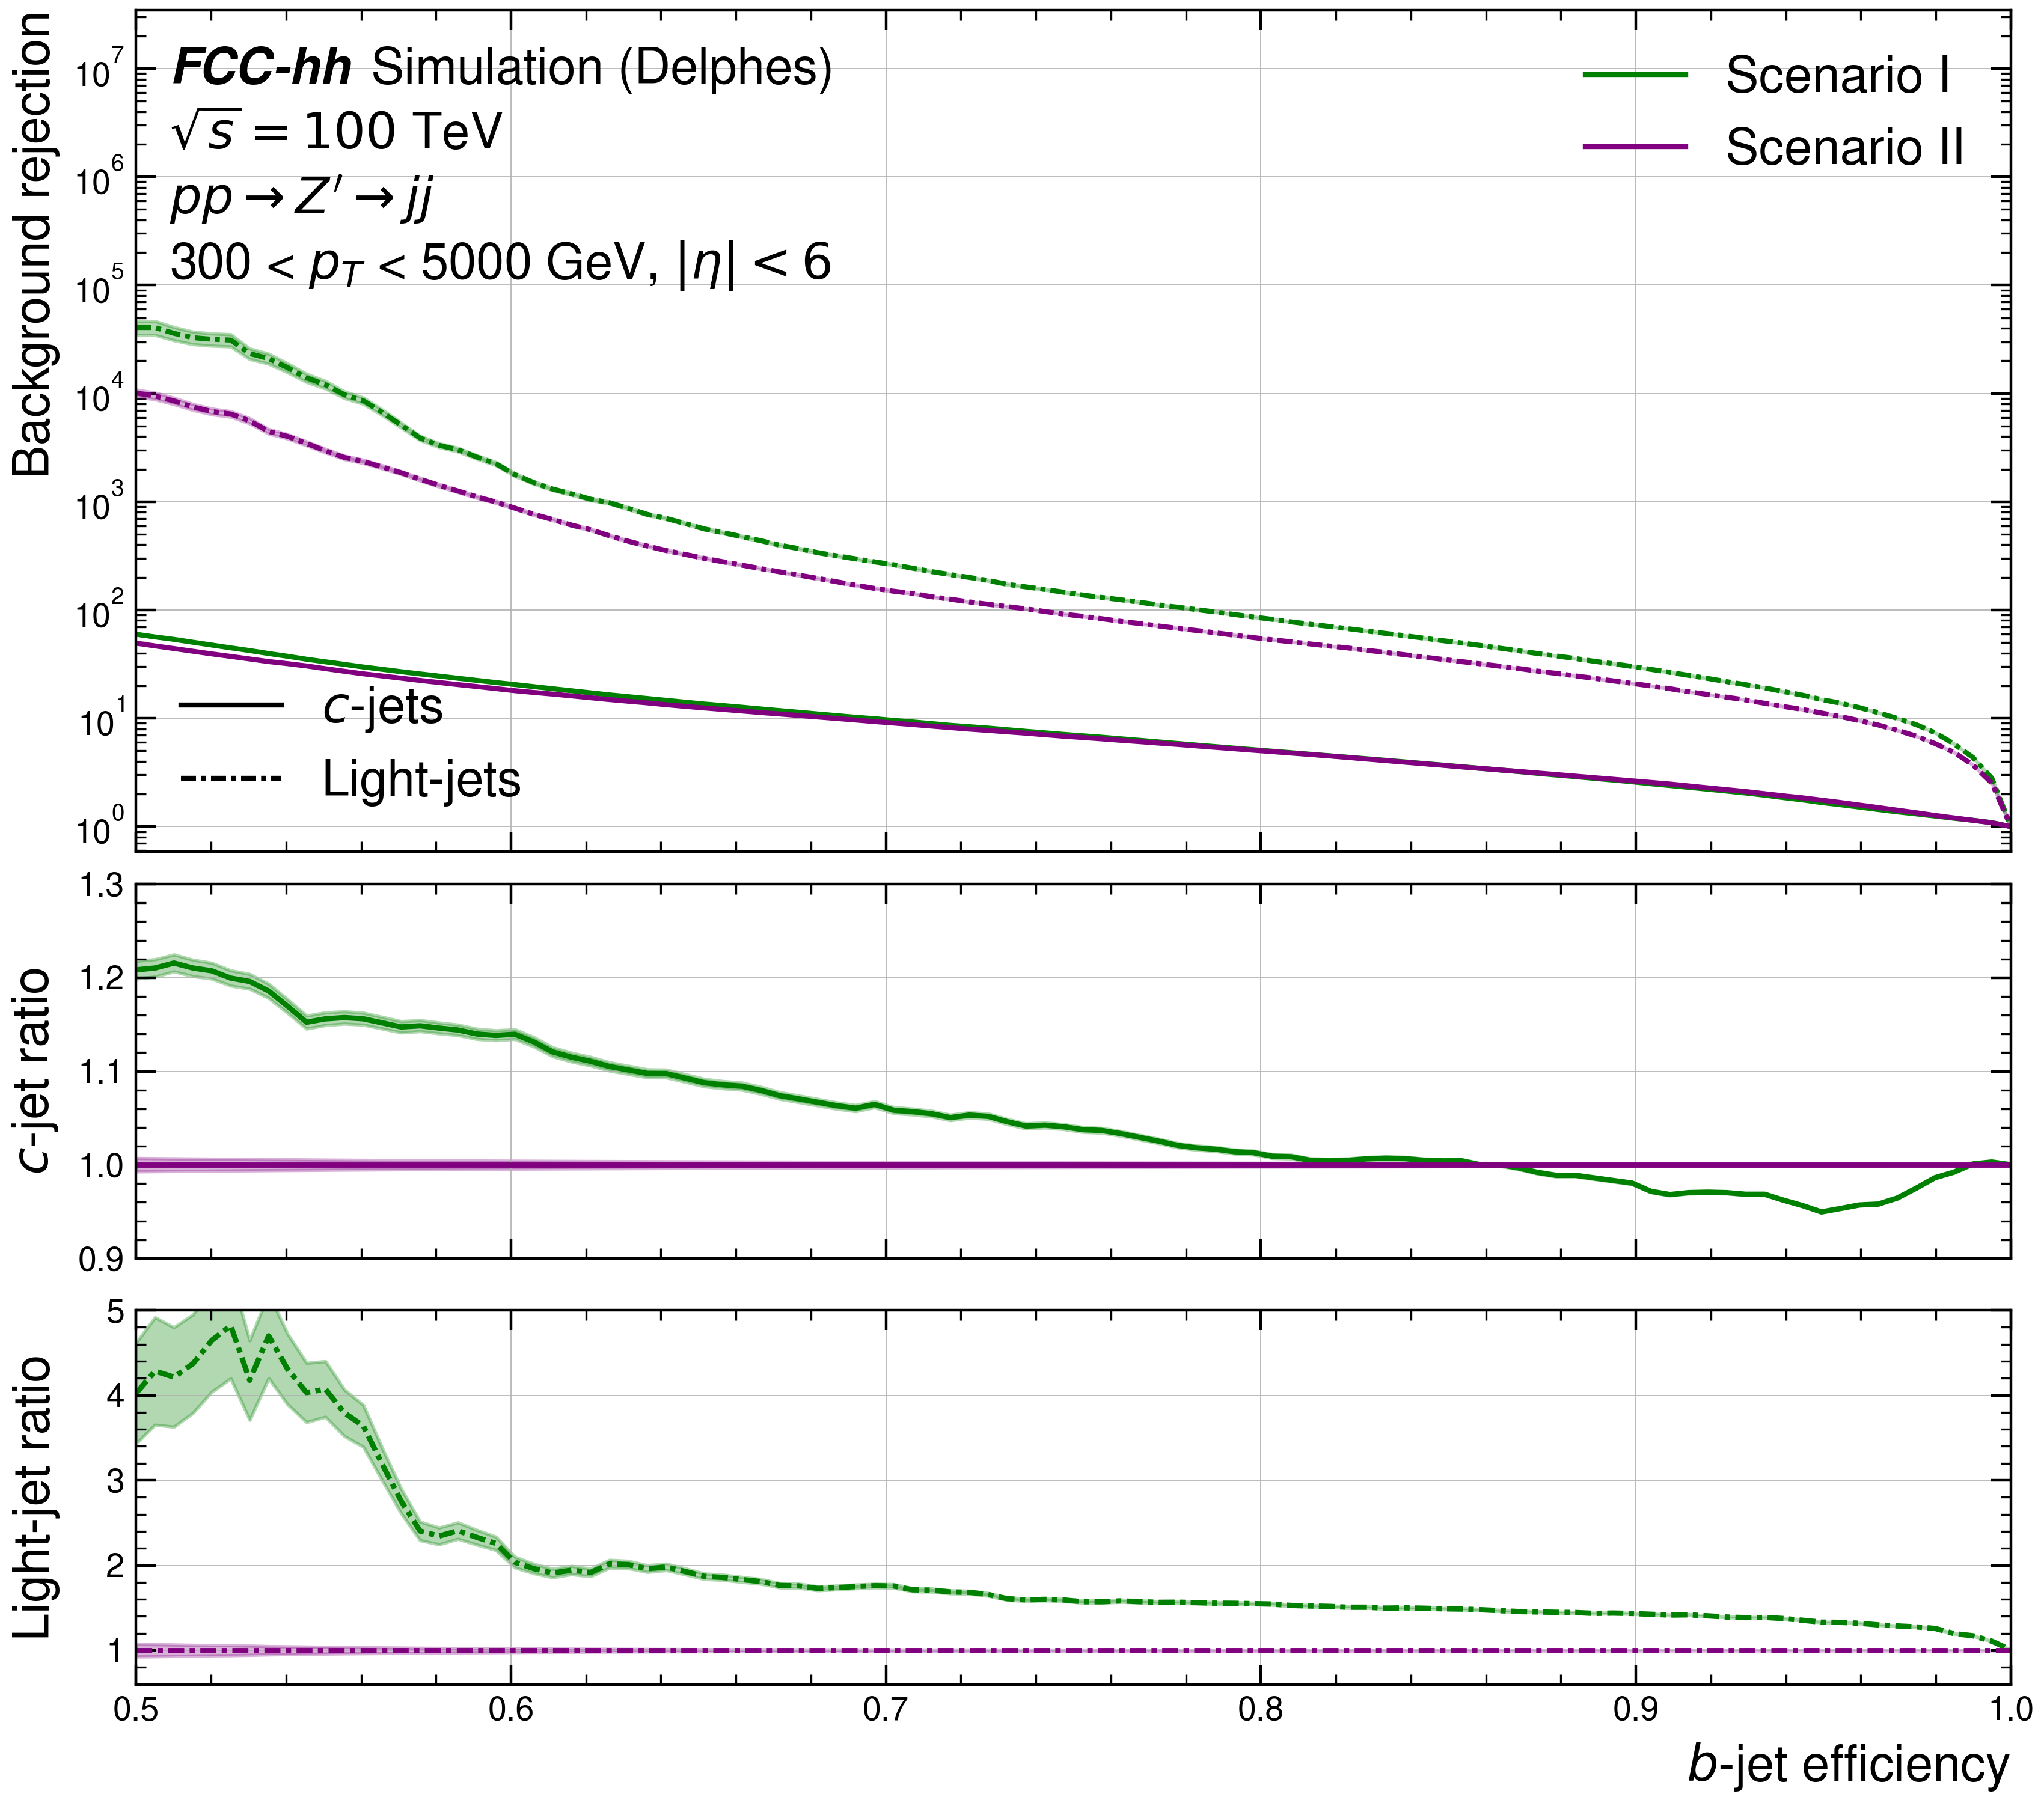
GN2 @ FCC-hh
Low pT (20 – 300 GeV)
High pT (300 – 5000 GeV)
Better!
Very strong b-tagging performance!
With scenario I better than II (as expected)

Slide 14
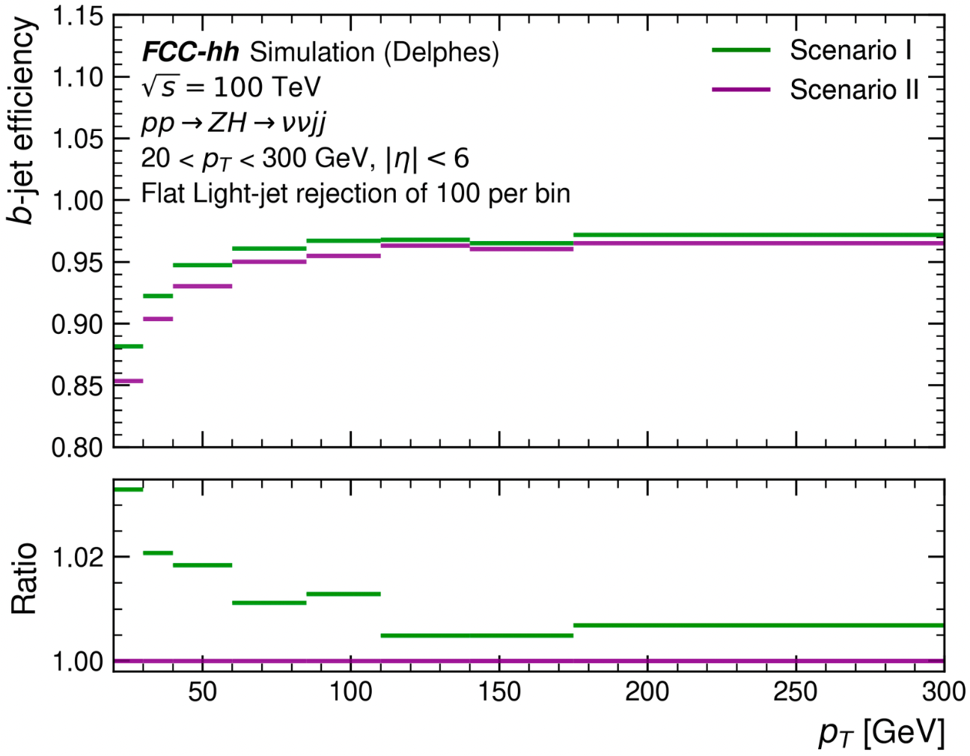
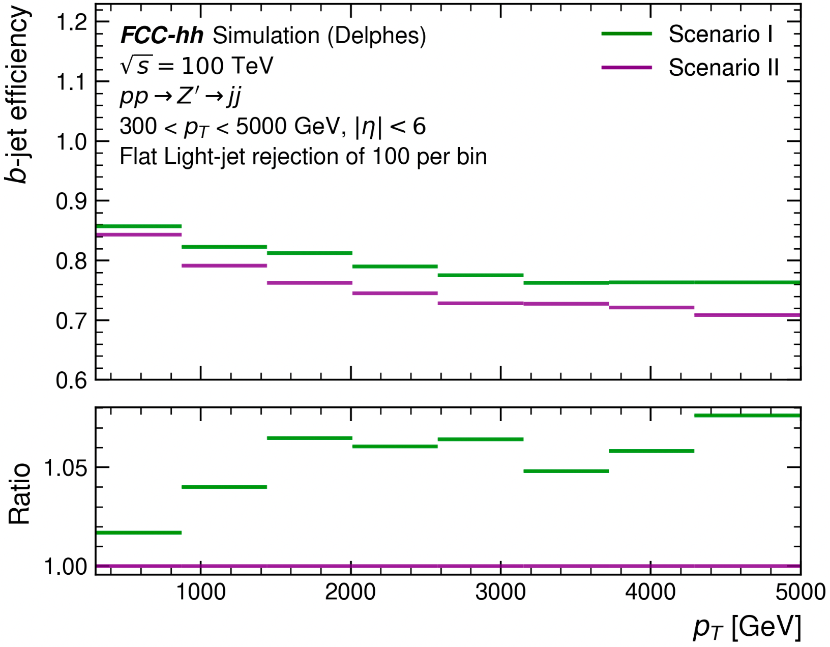
GN2 @ FCC-hh profiling performance
Low pT (20 – 300 GeV)
High pT (300 – 5000 GeV)
1% light jet mis-tagging rate
Reaches b-tagging efficiencies > 95% for moderate pT range
1% light jet mis-tagging rate
> 70% b-tagging efficiency for jets in TeV pT range

Slide 15
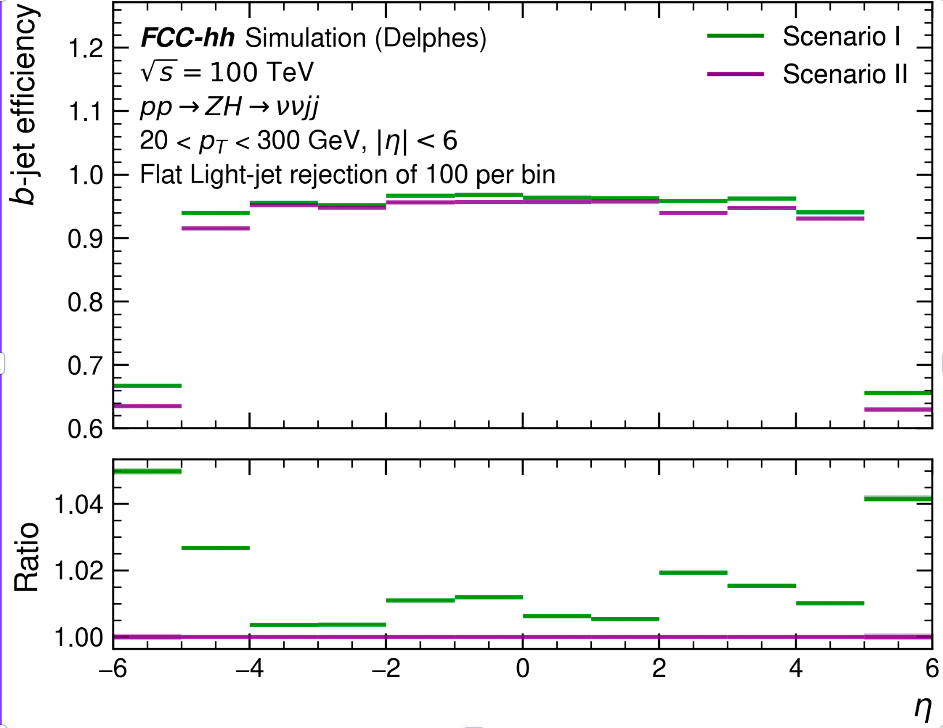
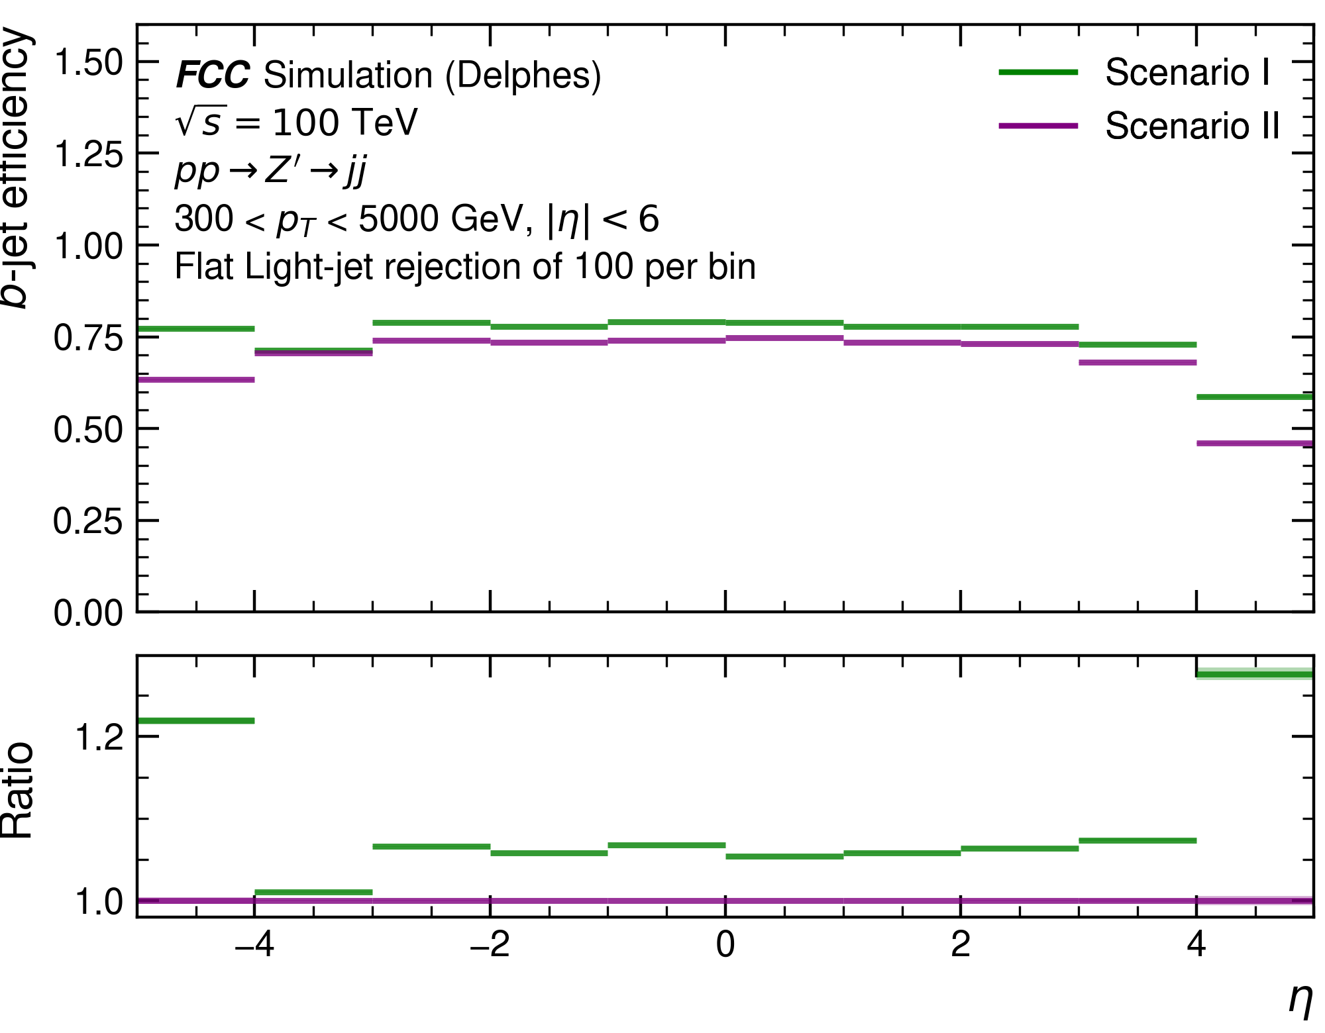
GN2 @ FCC-hh profiling performance
Low pT (20 – 300 GeV)
High pT (300 – 5000 GeV)
Flavour tagging performance maintained up to | $η$| < 5

Slide 16




Summary
Workflow established to study flavour-tagging performance at FCC-hh
Studied performance with different detector scenarios (I/II)
Provided parameterisations of b-tagging performance:
Interesting study: Adding pile-up
1% light jet mis-tagging rate
Obtain b-tagging efficiency > 95% for moderate pT jets
1% light jet mis-tagging rate
Maintain b-tagging efficiency > 70% for jets in TeV pT range
Maintain performance up to | $η$| < 5

Slide 17
Backup

Slide 18
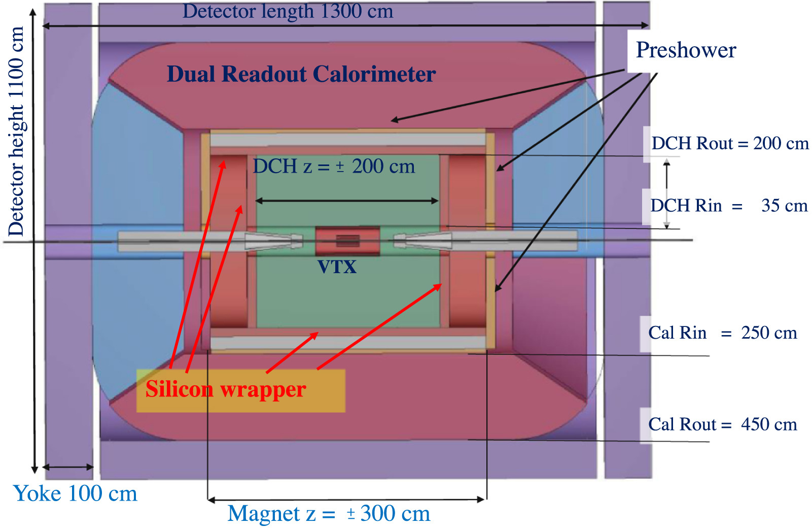
FCC-ee IDEA detector

Slide 19
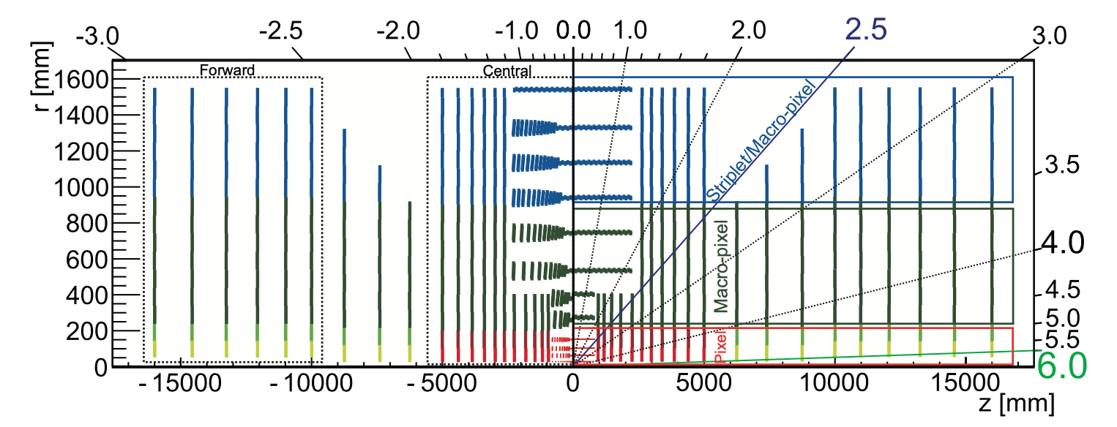
FCC-hh tracking detector

Slide 20
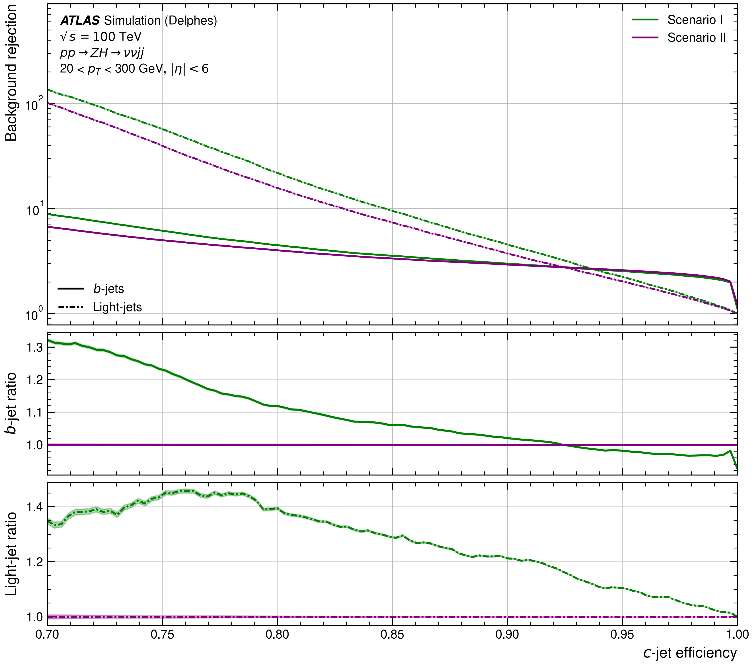
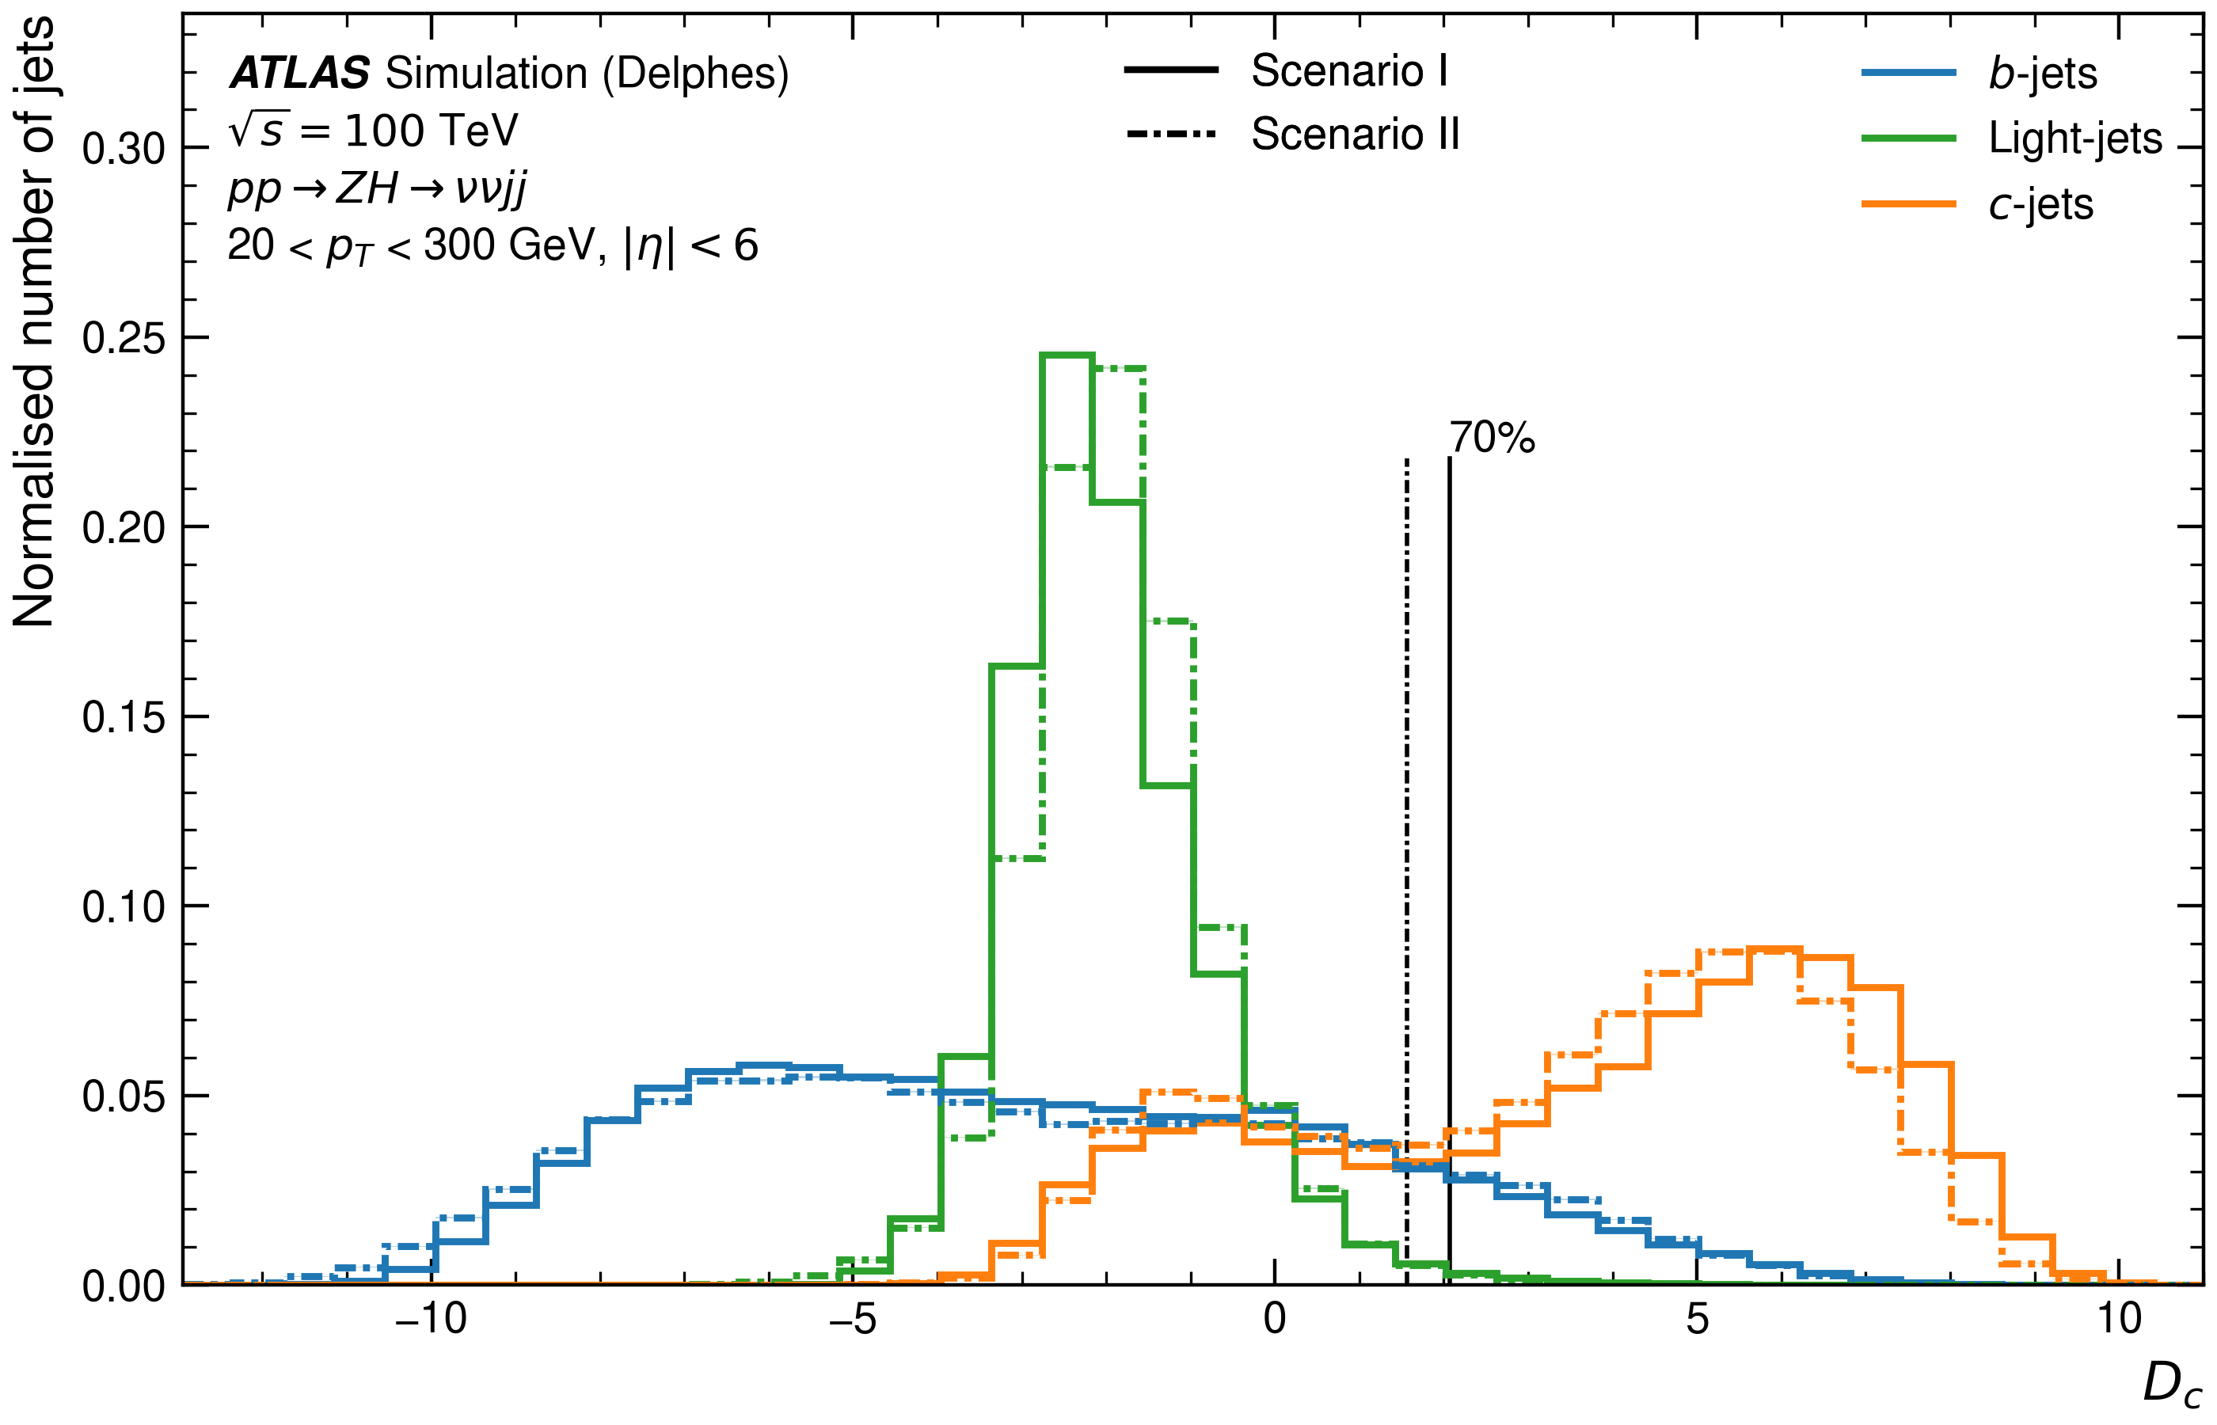
GN2 @ FCC-hh (c-tagging)

Slide 21
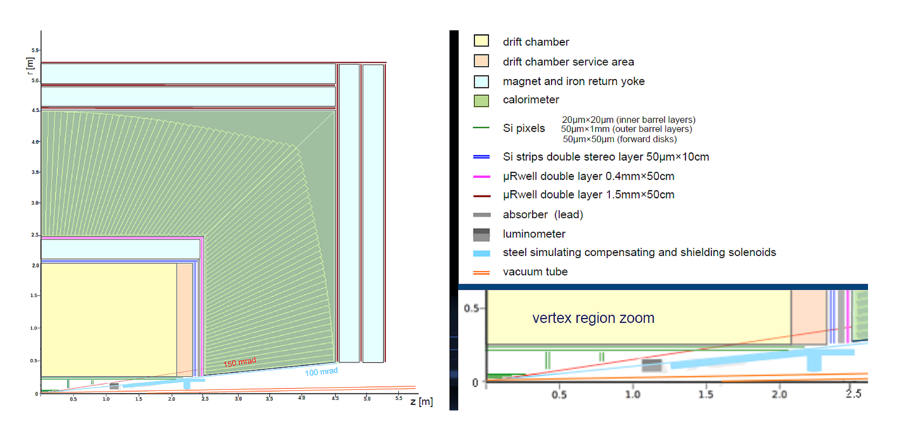
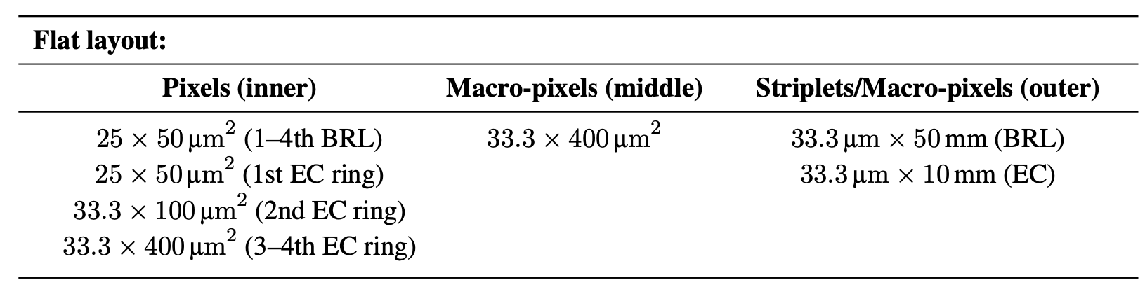
IDEA vs FCC-hh 1st layer
IDEA detector silicon pixel pitch size:
20um x 20um
Resolution of 3um x 3um
FCChh detector silicon pixel pitch size:
25um x 50um
Resolution of 7um x 14 um

Slide 22
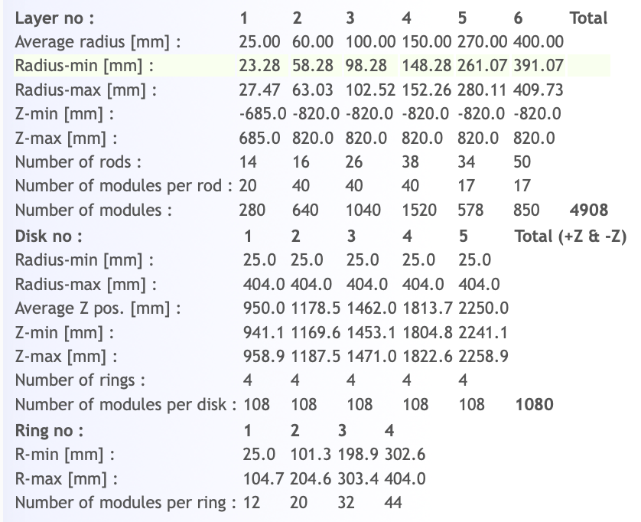
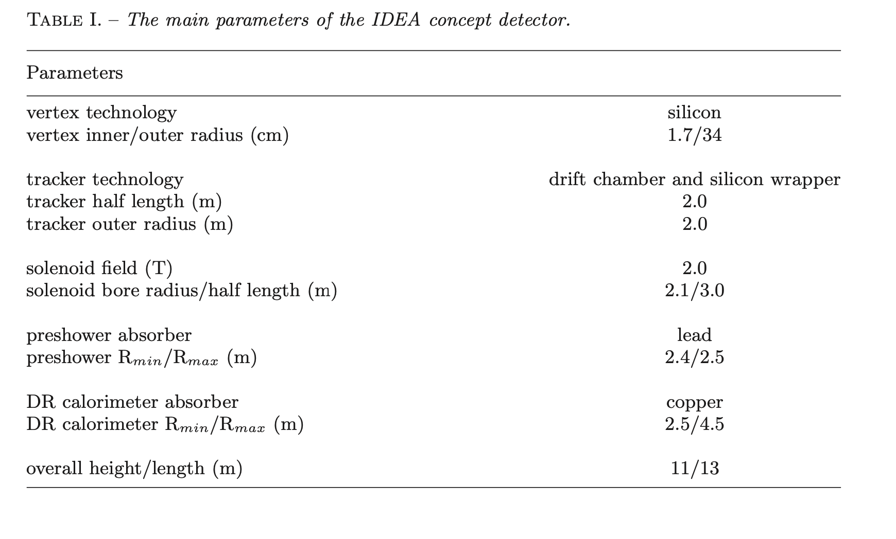
IDEA vs FCC-hh 1st layer
Inner layer of IDEA assumed to be closer to collision point
IDEA detector
FCC detector

Slide 23
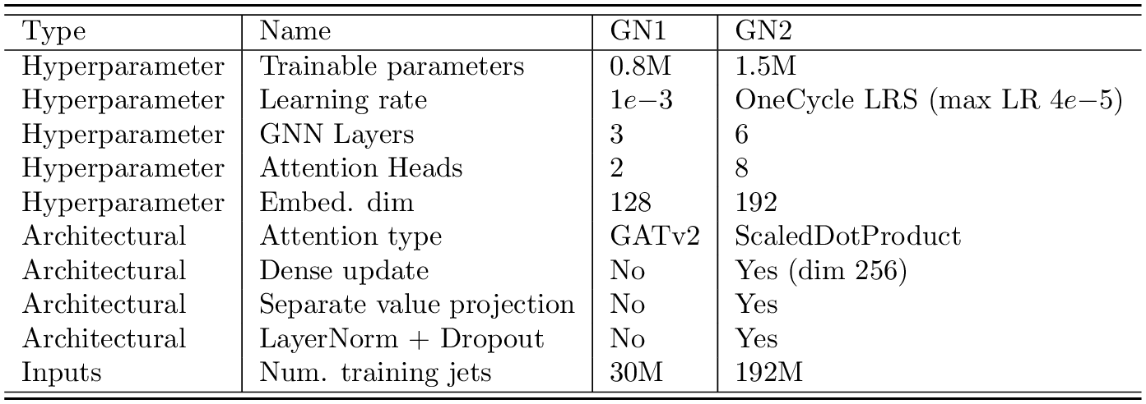
GN2 architecture
[FTAG-2023-01]

Slide 24
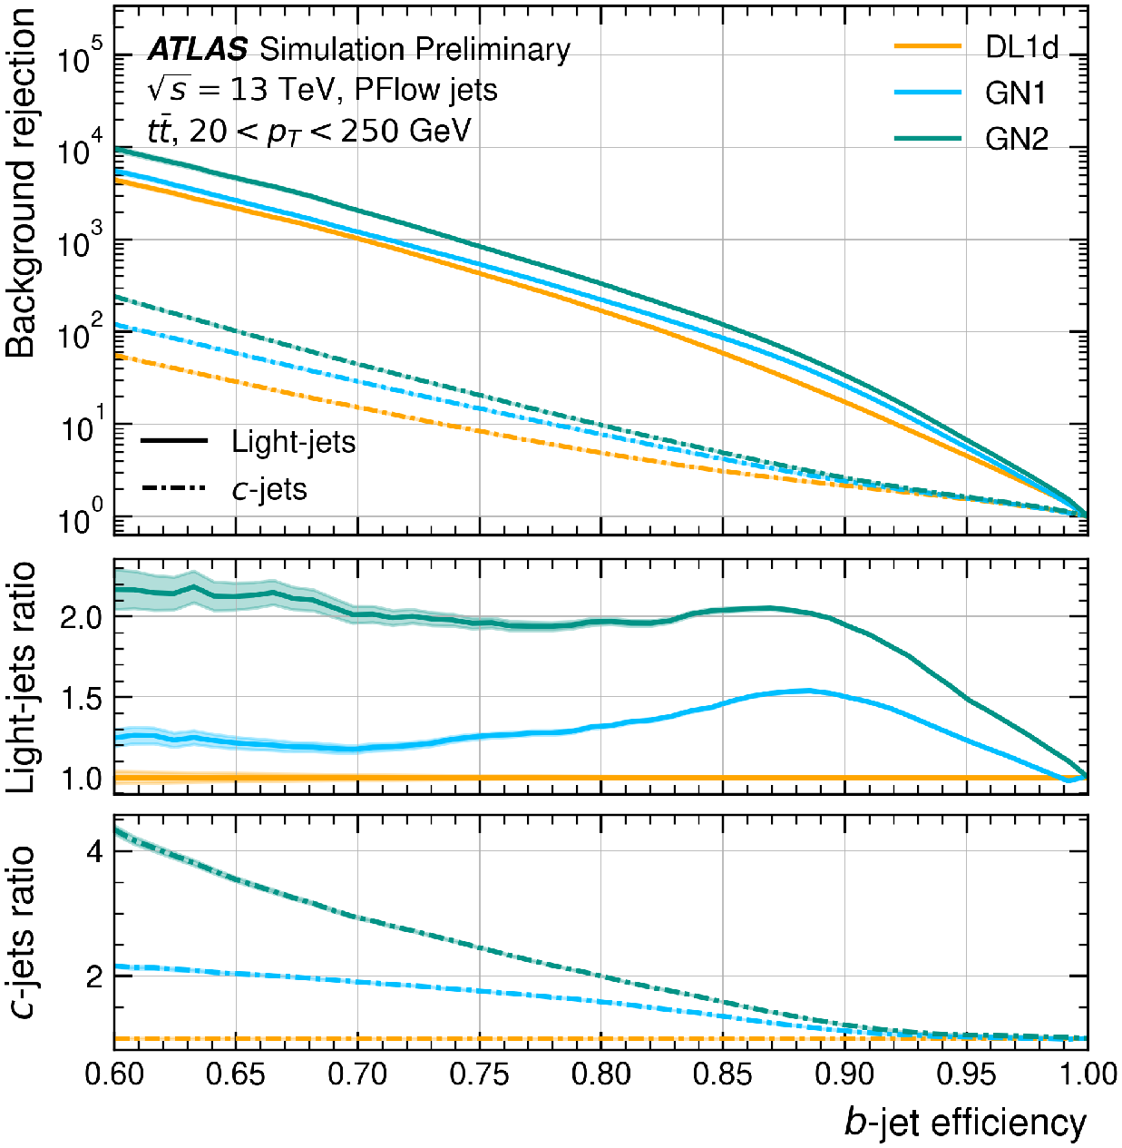
GN2 @ ATLAS vs FCC-hh

Slide 25
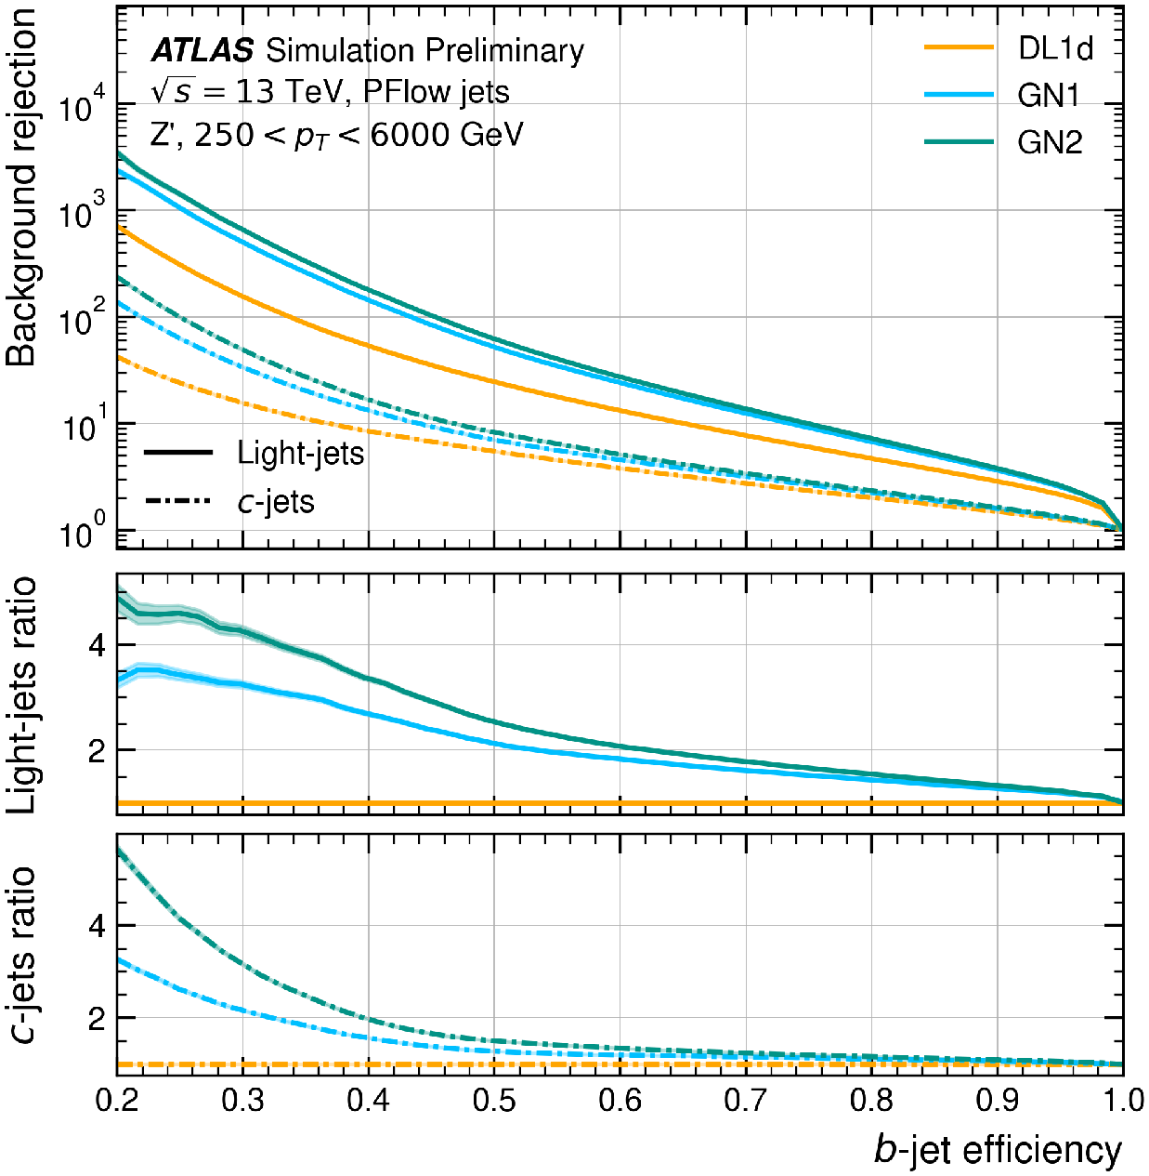
GN2 @ ATLAS vs FCC-hh

Slide 26
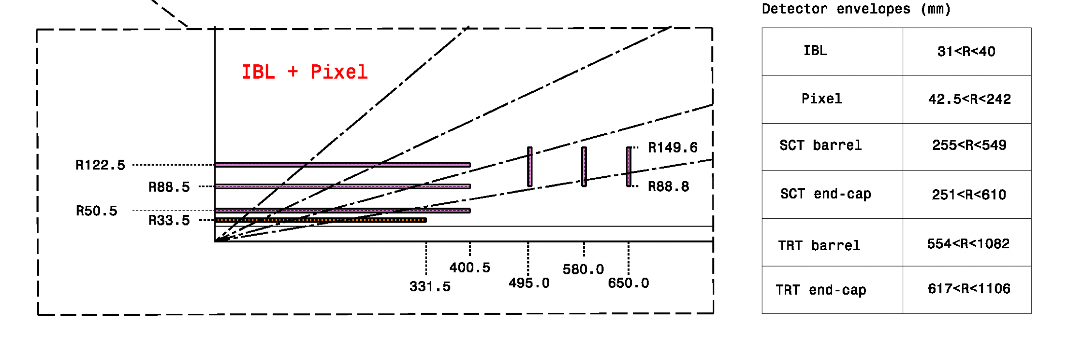
GN2 @ ATLAS vs FCC-hh
 | LHC (IBL) | FCC-hh
Resolution | 10μm x 66μm | 7μm x 14μm
IBL pitch size:
50um x 250um
Resolution of 10um x 66 um
FCChh detector silicon pixel pitch size:
25um x 50um
Resolution of 7um x 14 um

