Slide 1
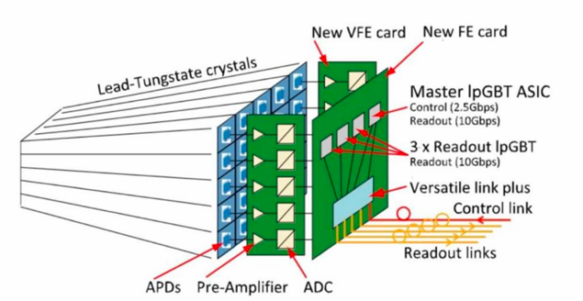
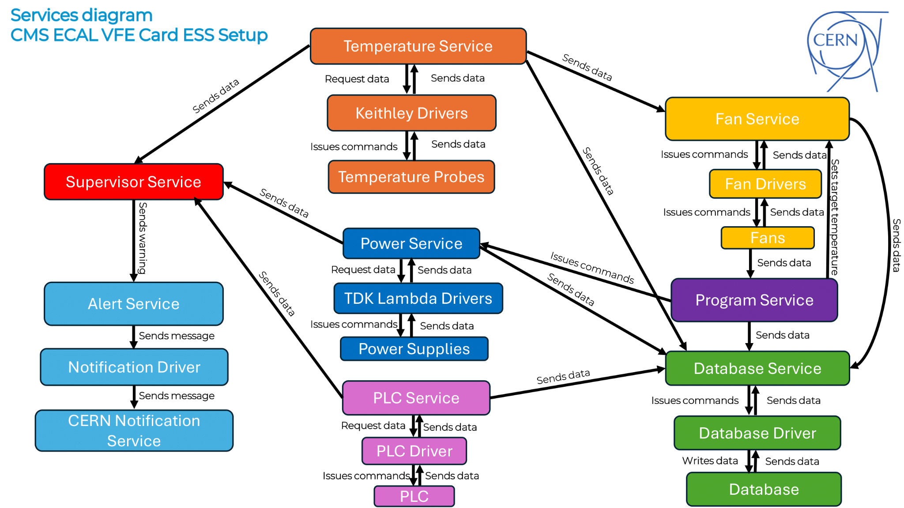
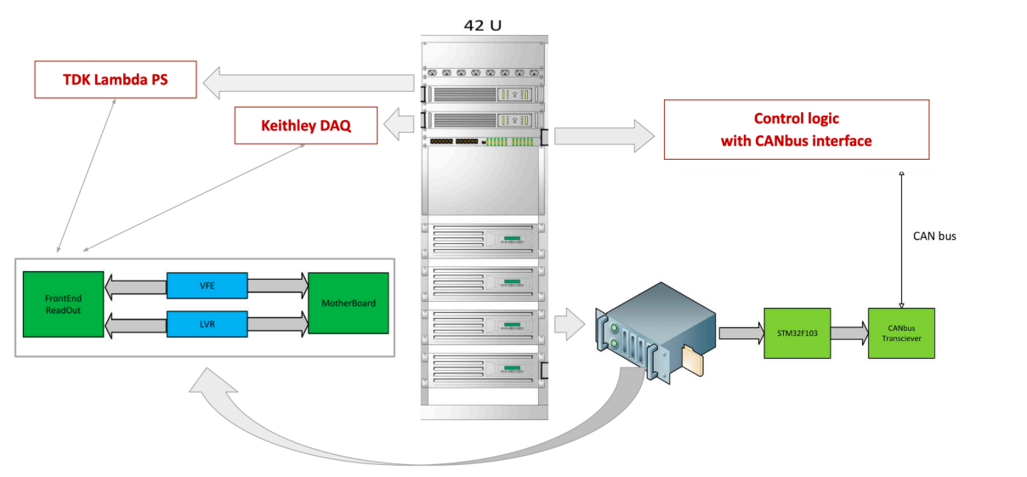
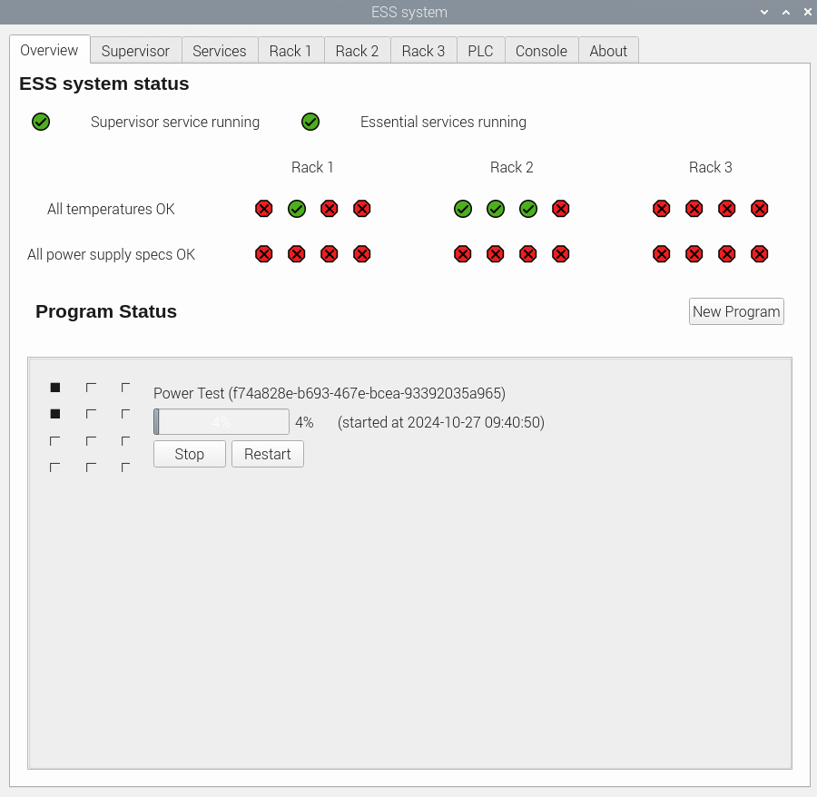
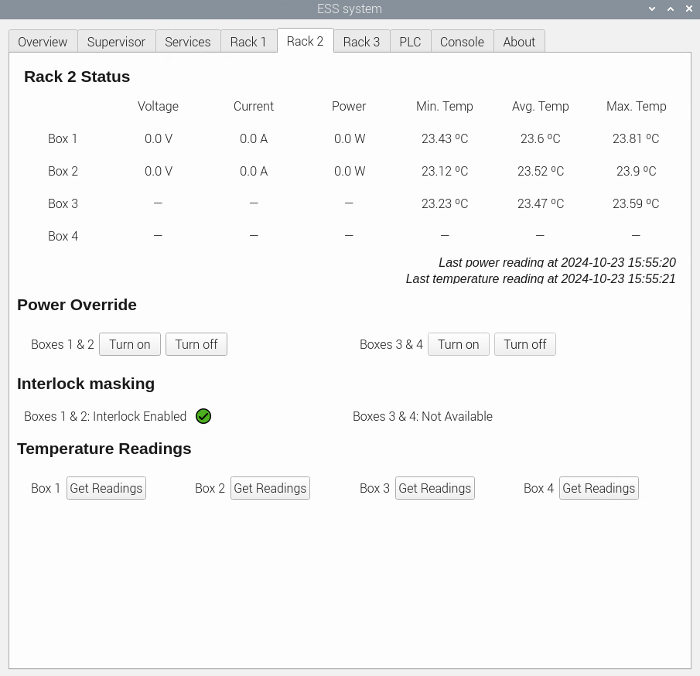
CMS ECAL Upgrade - systematic testing/screening of readout electronics
To accomodate/provide: the higher trigger rates (750 MHz), full detector readout at 40 MHz, and improve timing resolution ( 30 ps for E ≥ 50 GeV), the entire on-detector and off-detector CMS ECAL [1] electronics will be replaced! [3]
Extracting an EB [2] module for repair is not foreseen for the operation period of ~20 years, thus we aim at excellent quality and reliability targeting <0.5% of failing readout channels at end-of-life. This will be achieved by systematic testing/screening with dedicated systems for the Environmental Stress Screening (ESS).
ESS has been designed and built as a highly modular, configurable,
scalable and safe system by Faculty of Physics Belgrade
in cooperation with ETH Zurich.
ESS is capable of performing the testing/screening program of about
750 different ECAL readout electronics boards simultaneously,
within period of about 5 days.
Serbian participants in the project:
Nikola Rasevic, electronics engineer
Milorad Mijic, physicist
Darko Brunet, PhD student
Predrag Milenovic, physicist
Lazar Cokic, electronics engineer
Irena Veljajnovic, automation engineer
Dusan Belca, master student
Bogdan Popovic, master student
[1] CMS Collaboration, G.L. Baya an et al., “The Compact Muon Solenoid: Technical Proposal”, CERN LHCC-94-38, CERN-LHCC-P-1, Dec. 1994
[2] CMS Collaboration, G.L. Baya an et al., “The Electromagnetic Calorimeter: Technical Design Report”, CERN/LHCC 97–33, Dec. 1997
[3] CMS Collaboration, A.M. Sirunyan et al. “The Phase-2 Upgrade of the CMS Barrel Calorimeters: Technical Design Report”, CERN-LHCC-2017-011, CMS-TDR-015, Sep 2017

