Slide 1
Case Study 2
from
CryoSpain team
Rita Perez Martinez
Teresa Guillen Hernandez
Diego Garcia Robles

Slide 2
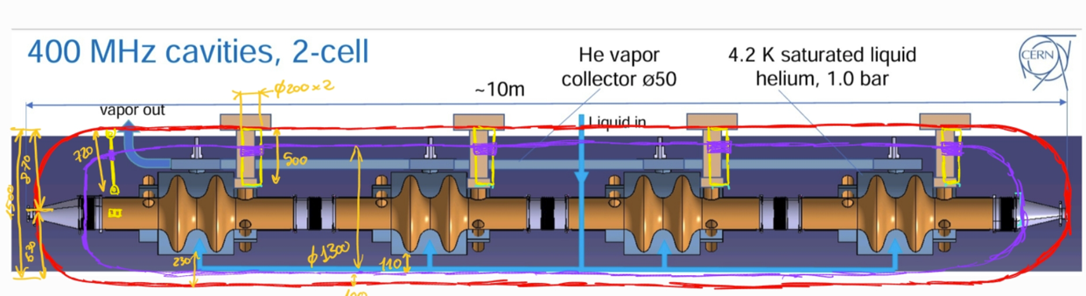
1. Schematic design

Slide 3
1.a,b He tank, vacuum vessel
Description | Material | Diameter | Thickness (mm) | Comments
He tank | SS304L | 800 | >1 (calculations) 15 (chosen) | 15mm because we dimension it as a vacuum vessel in case a leak detection test needs to be performed.
Vacuum vessel | SS304L | 1500mm (inner D) | 27 (conservative) <20 (chosen) | Thickness of 20 (or 15, more optimized study to be performed) and used of reinforcements around the RF couples

Slide 4
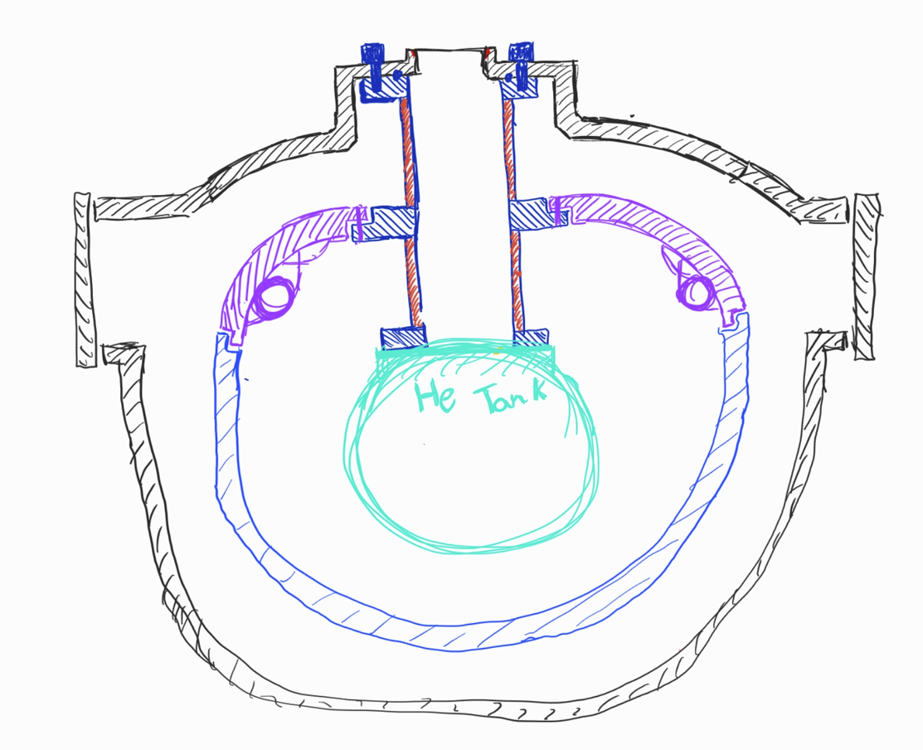
1. c thermal shield
Description | Material | Diameter | Thickness (mm) | Comments
Thermal shield | Al 6082 | 1300mm (outer D) | 5 mm | Thicker in attachment areas. Flexible alu connections to allow thermal contraction / expansion of the thermal shield.

Slide 5
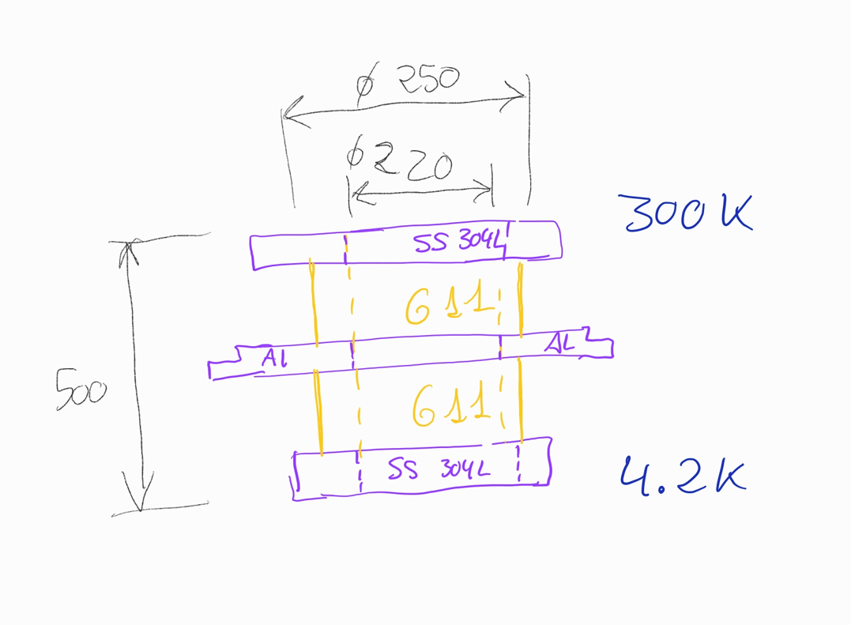
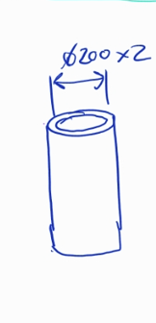
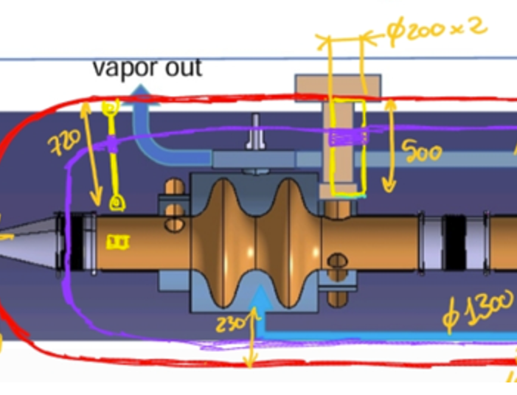
1. D. Supporting system
Supports around RF couplers. Inner diameter >200mm → 220mm as inner diameter
Total mass per cavity (including thermal shield ): 775 kg → minimum section calculated with axial and bending forces. Minimum thickness of 7mm, with SF 2
Thickness increased to 15mm for safety in the predimensioning
Tie rods M10 (vertical and lateral).

Slide 6
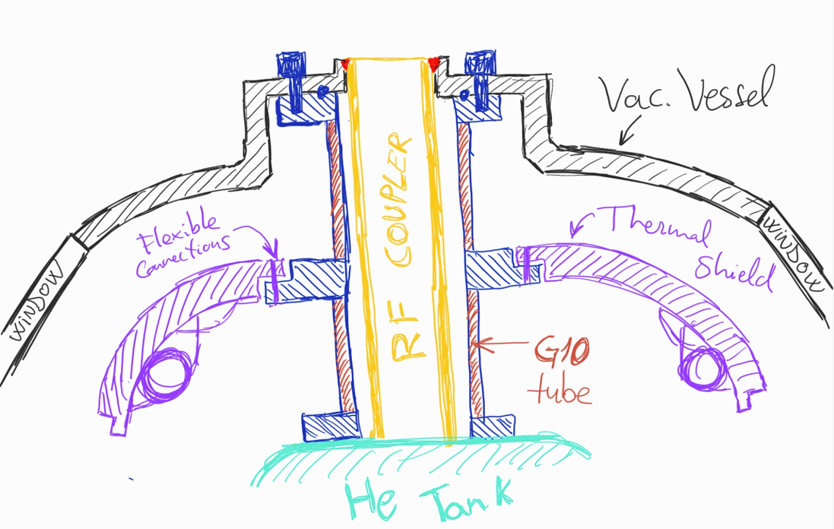
1. D. Supporting system

Slide 7
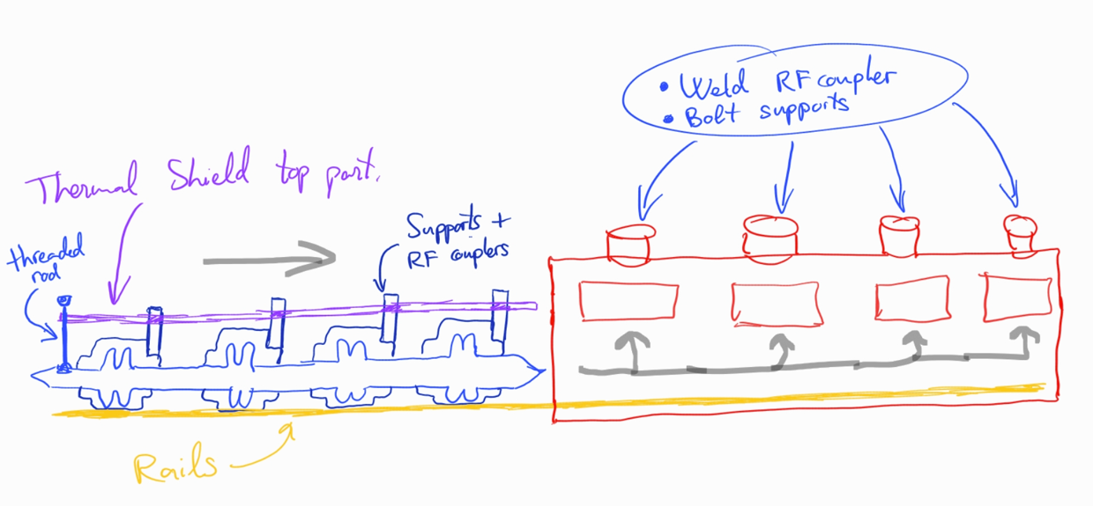
1. E Assembly method
Installation of cavities assembly
Installation of remaining thermal shielding

Slide 8
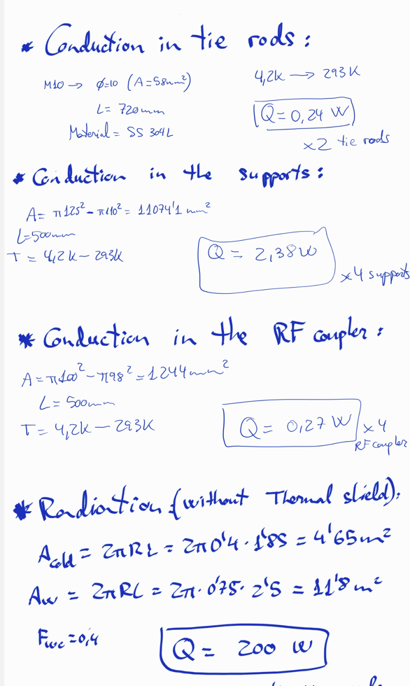
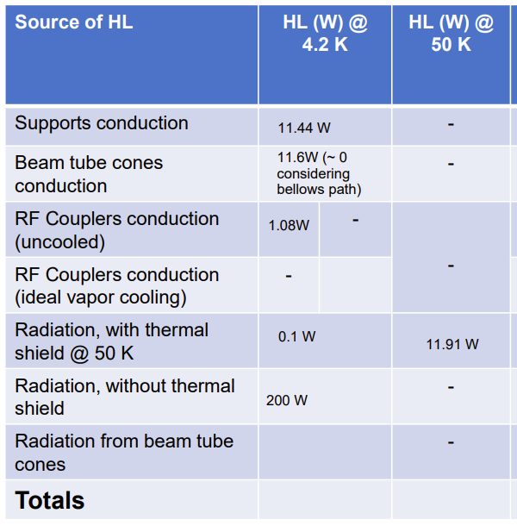
2. Thermal calculations

