Slide 1
Helium Cryostats for Superconducting Devices
Vittorio Parma
CERN – SY/RF Group
Technical Training: Cryostat Engineering for helium superconducting devices
CERN, 13-15 November 2024

Slide 2
Cryostats by their application
Cryostats
Liquid storage/transport
SC devices for accelerators
Test cryostats
Accelerator devices
SC devices for medical applications
Commercial vertical test cryostat
SC magnet cryostats
SRF cavities cryomodules
Specific test cryostats
Transfer Lines
Valve Boxes

Slide 3
Cryostat Design for SC devices for accelerators:
A multidisciplinary activity
Heat Transfer
Applied
Superconductivity
Mechanics
Cryostat
Design
System
Integration
Cryogenics
Vacuum

Slide 4
Content
Helium cryostats for SC devices, functions and requirements
Examples of cryostats
Mechanical design and construction of cryostats:
  Materials for cryostats and their properties
  Pressure/vacuum vessels, codes, and norms
  Thermo-mechanical considerations
  Supporting systems
Heat transfer mechanisms at cryogenic temperatures:
  Thermal radiation and thermal design solutions (thermal shielding, MLI)
  Thermal conduction and thermal design solutions (feedthroughs, heat intercepts)
Notions of cryogenic safety
2 h
2 h

Slide 5
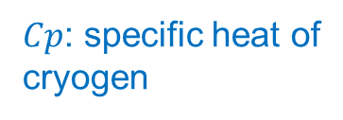
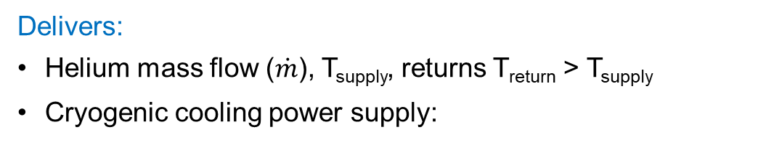






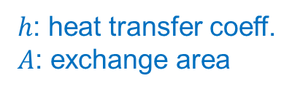
Cryostats/cryomodules and cryogenic operation
W_{el}
(plug power)
Cryoplant
SC device
cryostat/cryomodule
$$\text{T}\text{return}$$
$$\text{T}\text{op}$$
$\dot{Q}$(heat load)
T_{supply}
Cryogen transfer line
Delivers:
Helium mass flow ($\dot{m}$), T_{supply}, returns T_{return} > T_{supply}
Cryogenic cooling power supply:
Needs:
T_{op}, reached “conveniently” → transients
Cryogenic cooling power received:
$\dot{m} Cp (\text{T}\text{return}$- T_{supply}) ^{(*)}
$$≥$$
$\dot{m} h A (\text{T}\text{op}$– T_{supply})
$h$: heat transfer coeff.
𝐴: exchange area
$Cp$: specific heat of
cryogen
→ Cryostat designed to minimise Heat Loads from environment (T_{ambient})
→ Cryostat (and the SC device) designed to ensure cooling heat exchange
^{(*)} simplification assuming constant pressure and single phase btw supply and return

Slide 6
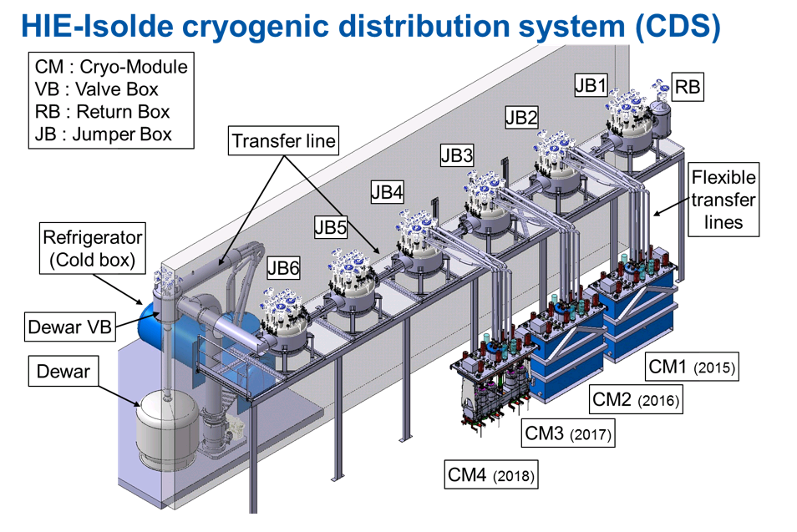
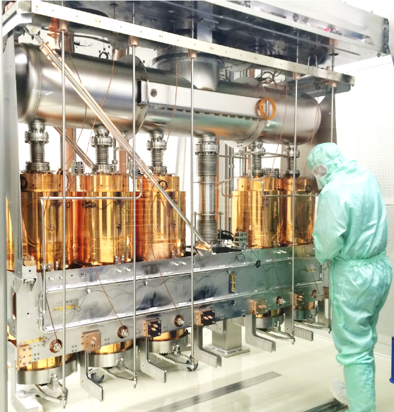
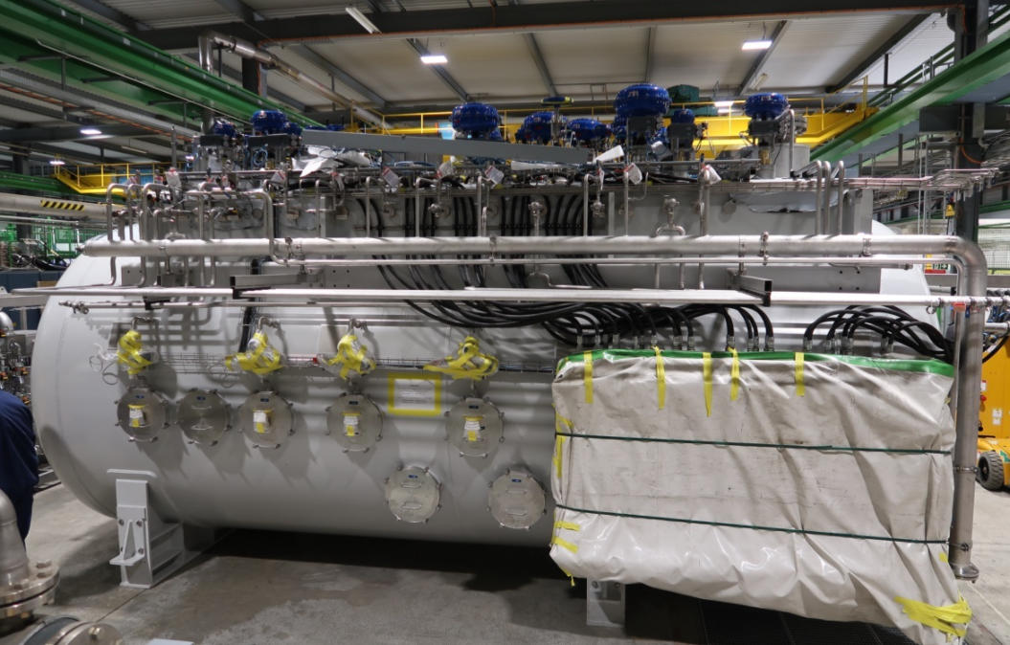
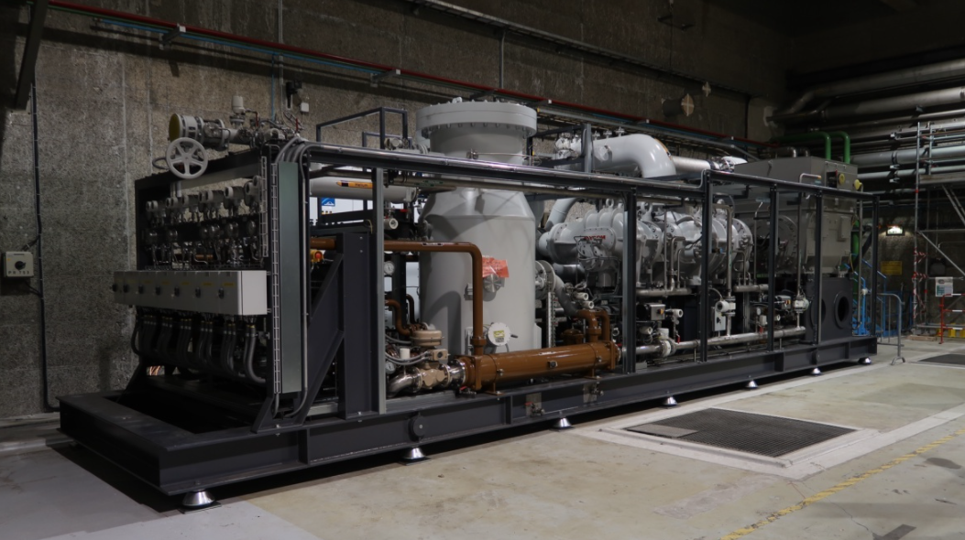
Cryostats for helium SC devices in accelerators
Cryoplant
SC device
Cryogen transfer line
Linde 35 g/s coldbox
Warm compressor station (Mayekawa)
Inside a HIE Isolde Cryomodule

Slide 7
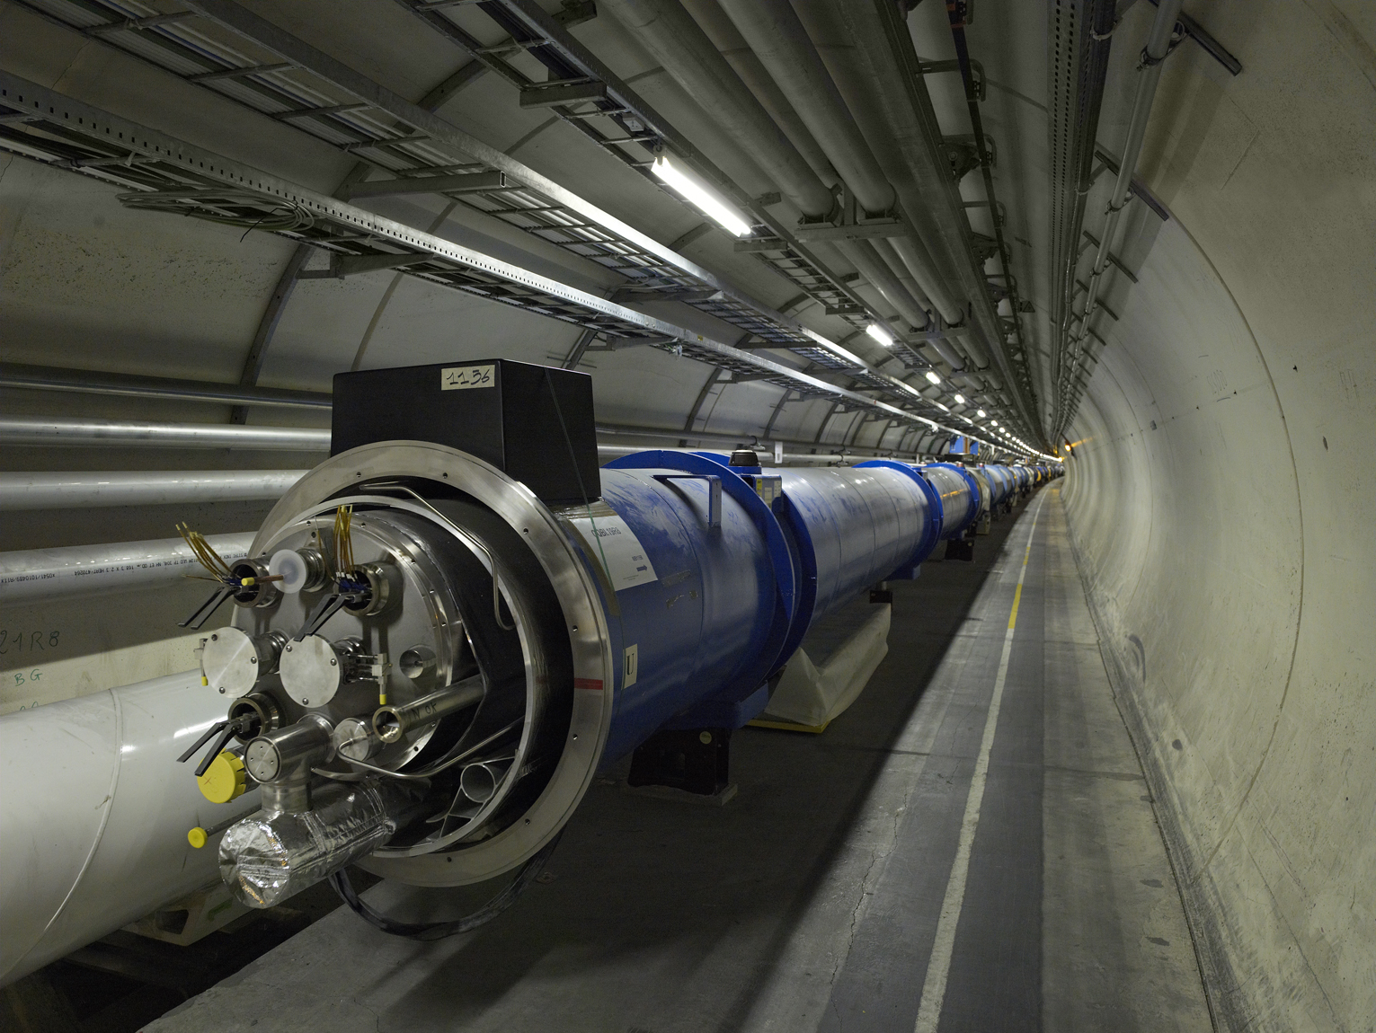
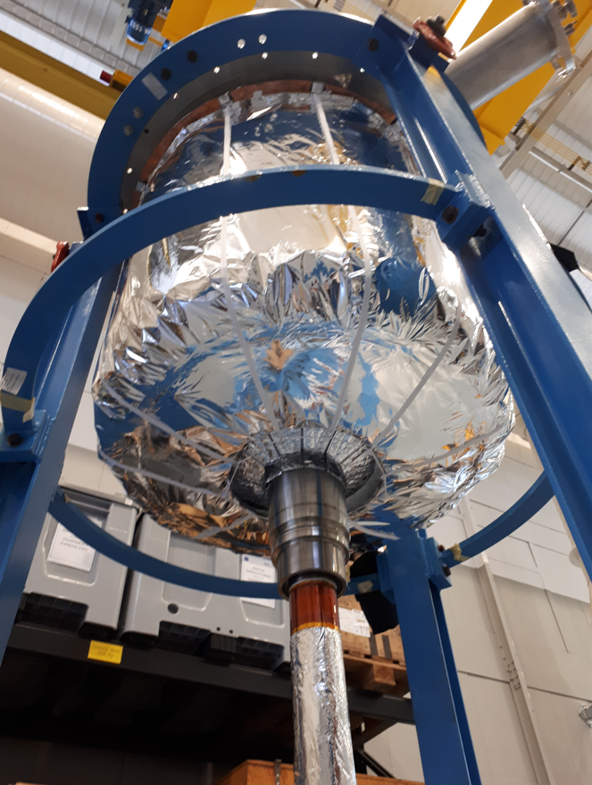
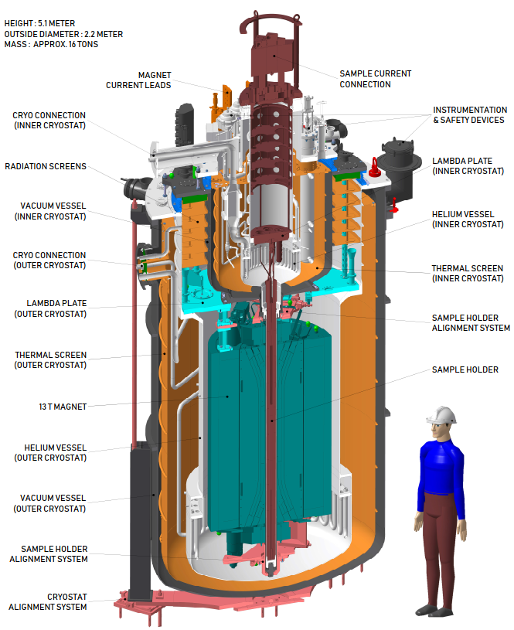
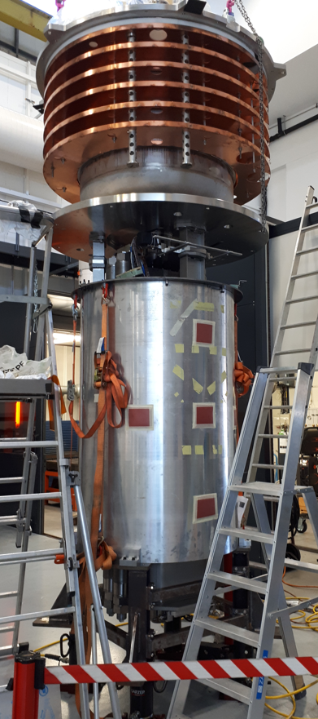
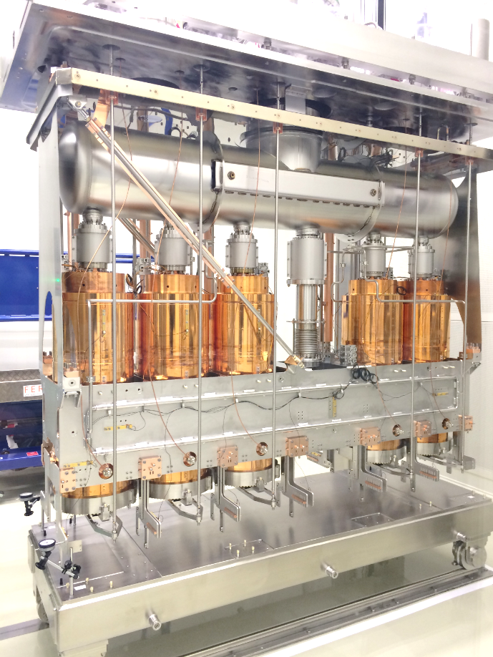
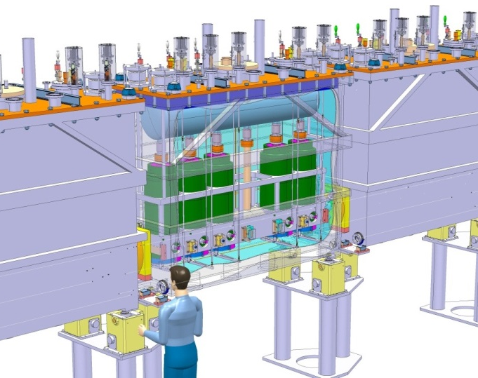
A few examples at CERN
Sample holder
The LHC cryostats
Fresca 2: test station for new SC cables
The HIE Isolde cryo-modules
HFM 13 T dipole

Slide 8
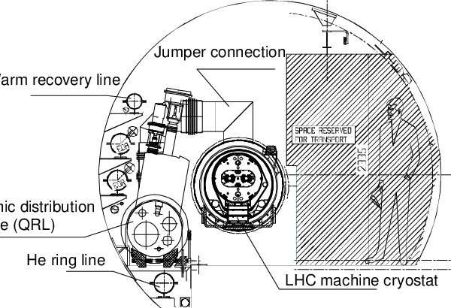
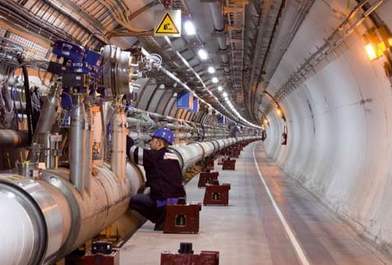
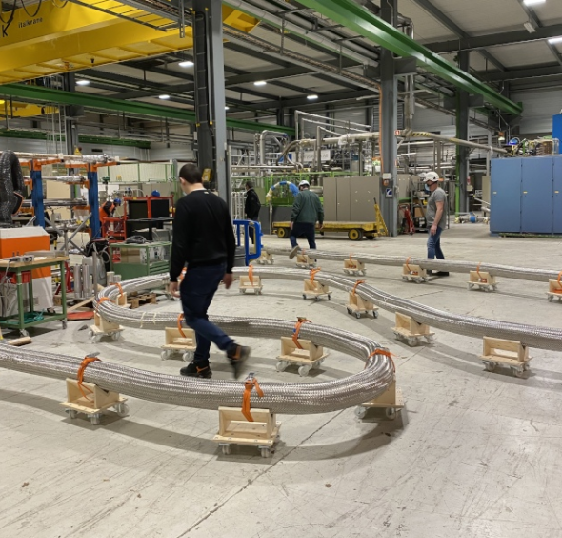
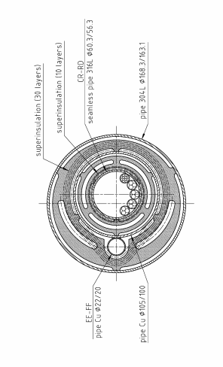
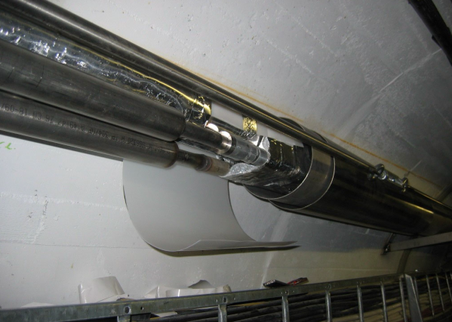
A few examples at CERN transfer lines, valve boxes
Rigid SC power line in LHC
Flexible SC power line for HL LHC

Slide 9
Functions of a SC device cryostat
Main function: house a SC device to enable it’s operation.
Two technical requirements:
1. Mechanical housing of the device:
  Supporting, accurate and reproducible positioning of SC devices in accelerators
2. Thermal performance:
  Enable operation at cryogenic T (CD/WU, steady state operation) → thermal heat exchange
  Low T preservation → thermal heat insulation
Often conflicting → calls for trade off design solutions
Many other complementary functions and requirements…:
  Cryogenics operation and control → specific equipment (piping, ph.separators, valves, instrumentation etc.)
  SC device powering: → magnet current leads, cavity RF power couplers/HOMs, etc.
  Integration of instrumentation (beam, vacuum, cryo, control/diagnostics, etc.) → feed-throughs
  magnetic shielding
  Maintainability (accessibility ports)
  Handling and transport features
  …

Slide 10
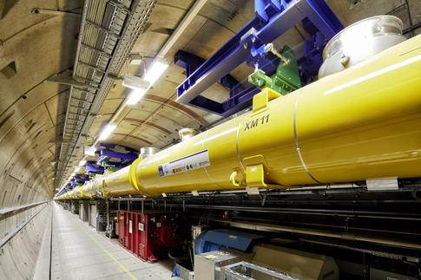
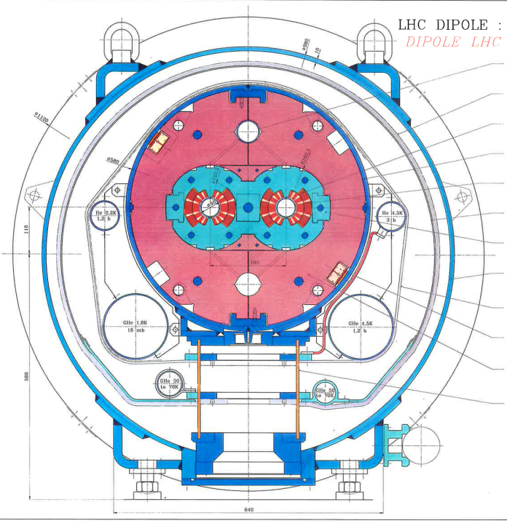
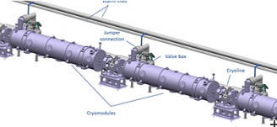
Accelerator architecture and cryostat layouts
Some key aspects:
Continuity of SC magnets electrical circuits
Thermal efficiency of continuous cryostats with integrated cryo-distribution
C/W transitions: costs and heat loads
RT equipment needs (e.g. beam instrumentation, beam sect. valves, non-SC magnets, etc.)
Segmentation for maintainability (e.g. SRF CM can be replaced)
LHC: 2.7 continuous cryostats with separate cryo-distribution line (QRL)
XFEL main linac: 96 CM, 1.7 km quasi-continuous cryostat
with integrated cryo-distribution line.
1st version with integrated lines
→ No general rule, but “long” machines opt for continuous cryostats to maximize magnetic length (LHC) or real estate gradient (XFEL, ILC)
ESS: ~300 m SRF linac, 49 standalone cryomodules with C/W transitions, separate cryo-distribution line

Slide 11
Positioning of SC devices

Slide 12
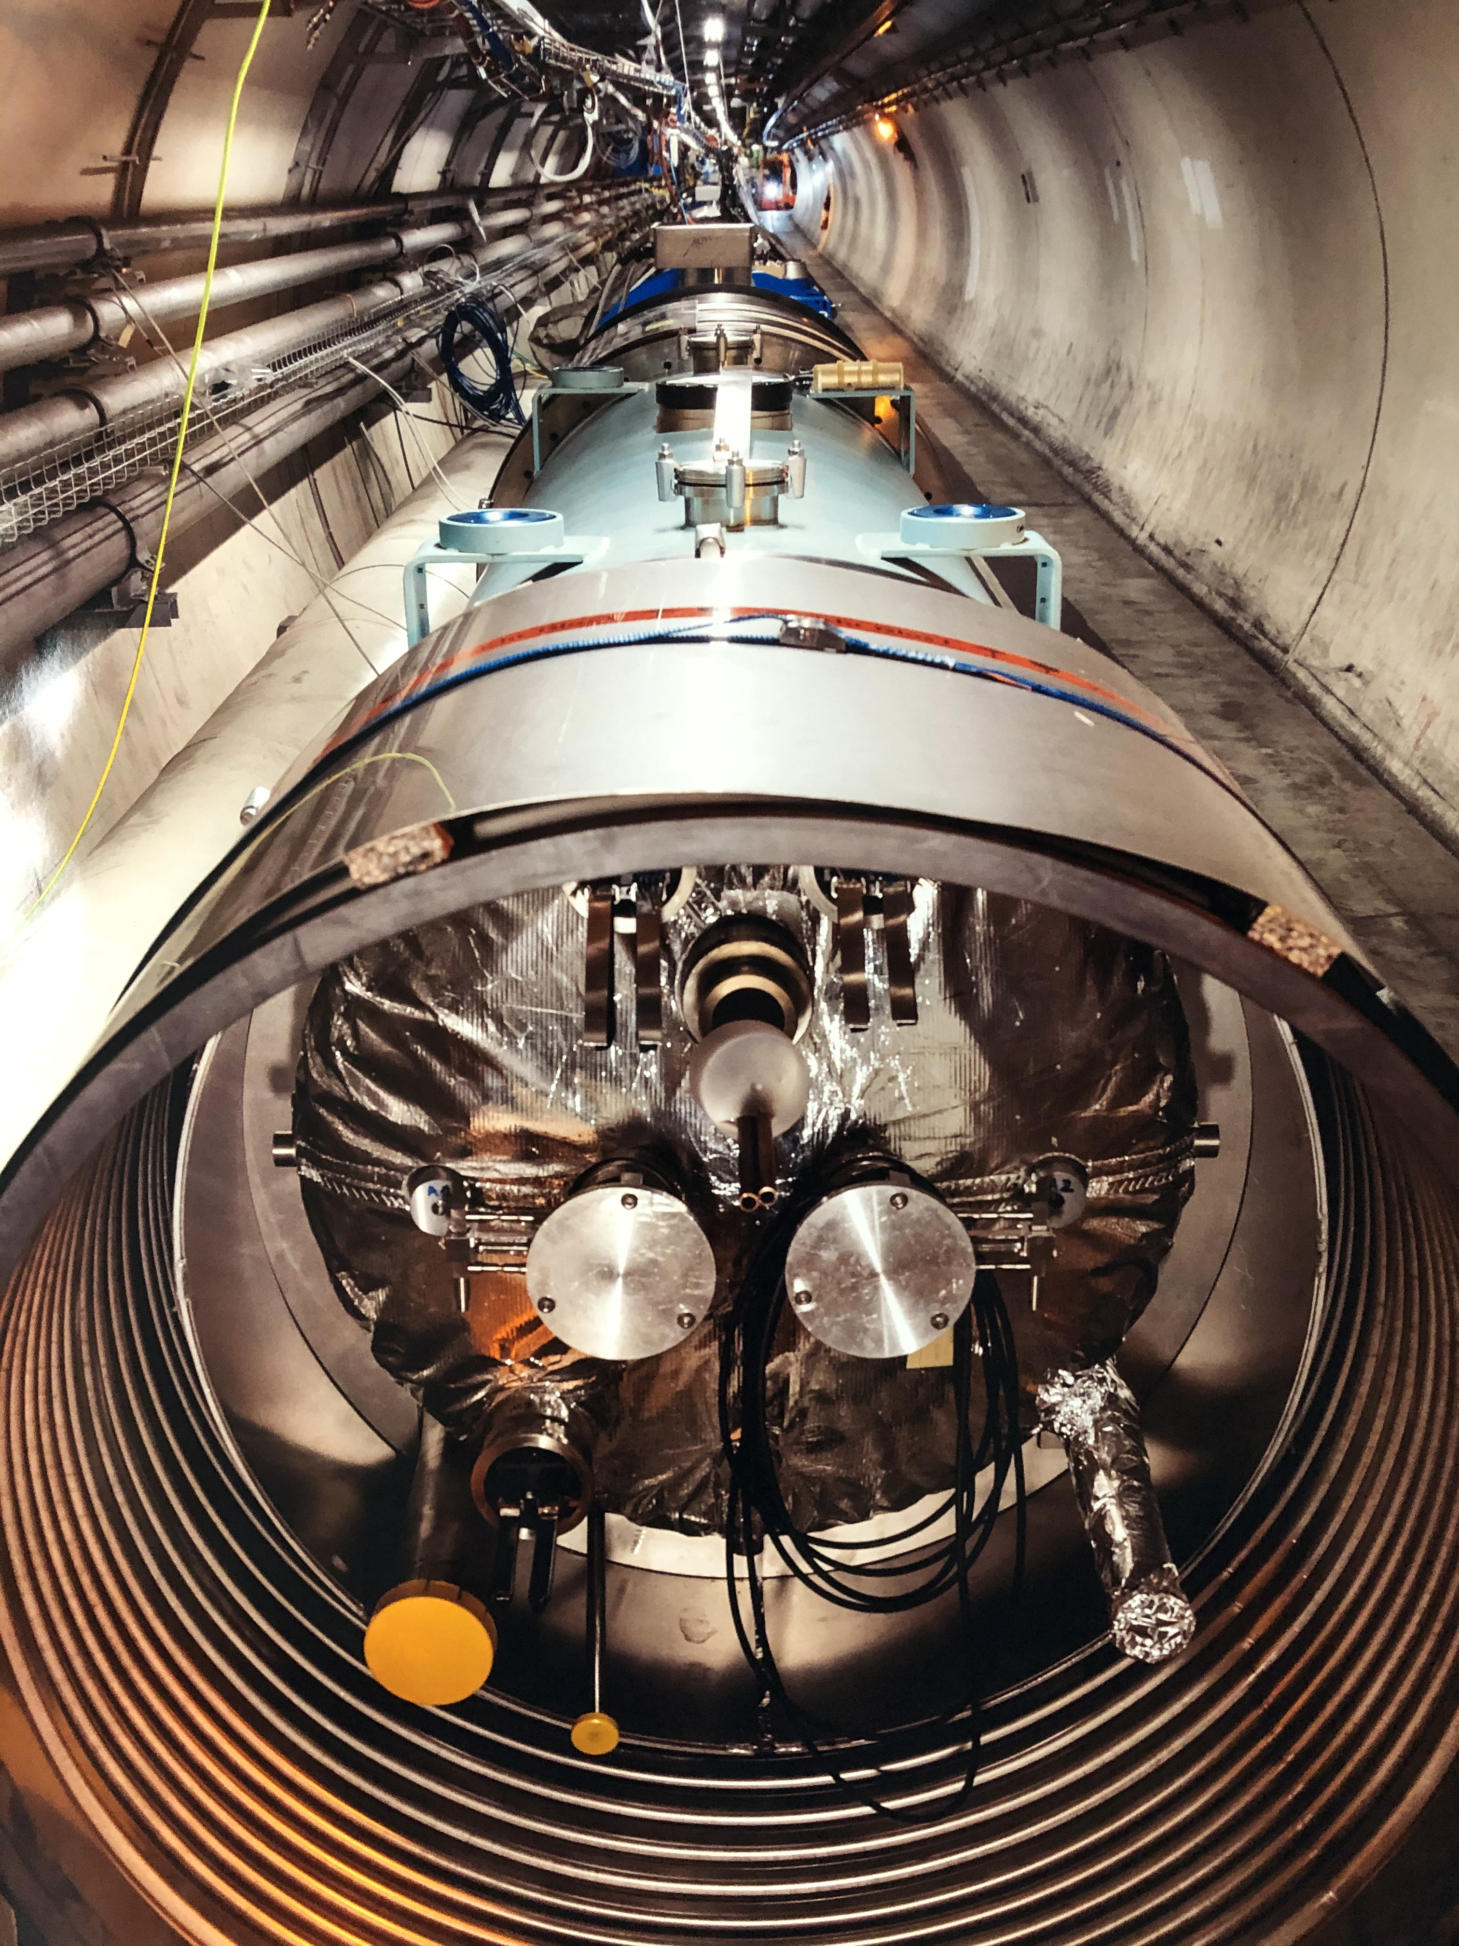
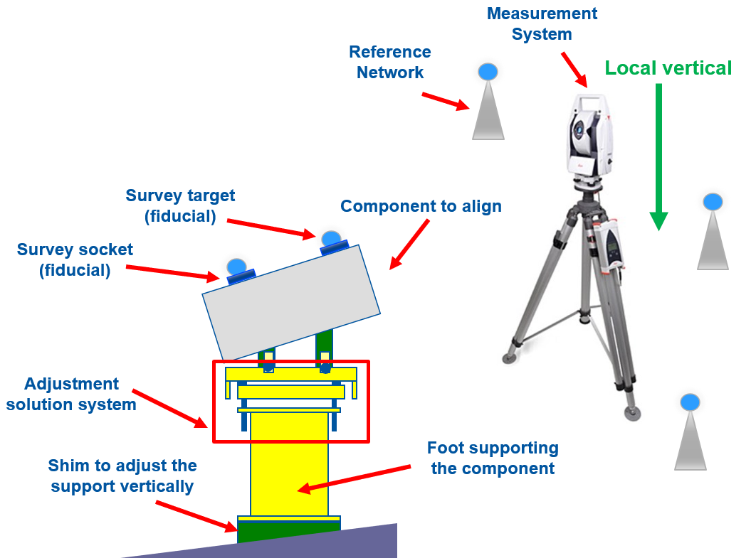
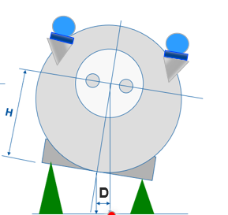
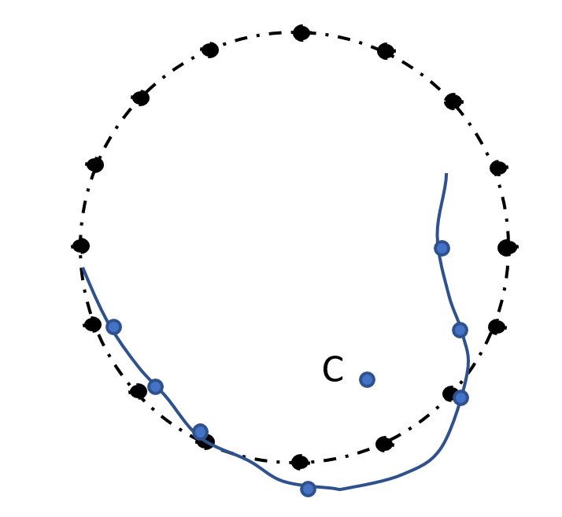
Positioning of a SC device in the accelerator
Accurate & reproducible alignment of the SC device w.r.t. a tunnel geodesic network
Survey team measures fiducials on the cryostat vessel (not directly the SC device inside the vessel!)
Typically, alignment within a few tenths of mm w.r.t. nominal positions
Laser-tracker
Alignment jacks
Aligning elements in a ring
Survey consider cryostat and SC device are rigid bodies !
Alignment is done by adjusting external jacks

Slide 13
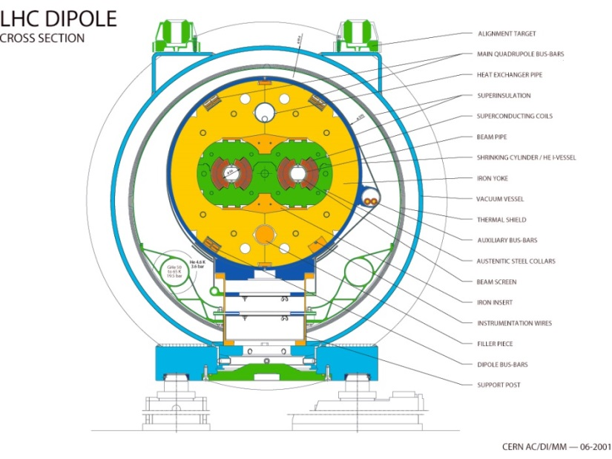
Reproducible positioning, a tough requirement !
Cryostats/SC device are not rigid bodies:
SC devices are “weakly” supported inside the cryostat (thermal efficiency!)
Cryostat vessels are (generally) “relatively” rigid, and not subject to “excessive” permanent deformation
SC device supporting system: designed to guarantee “accurate & reproducible positioning of the SC device w.r.t. to cryostat fiducials”
Main dipole
Note: internal monitoring excluded for cost reasons in large machines (LHC, XFEL, etc.)

Slide 14
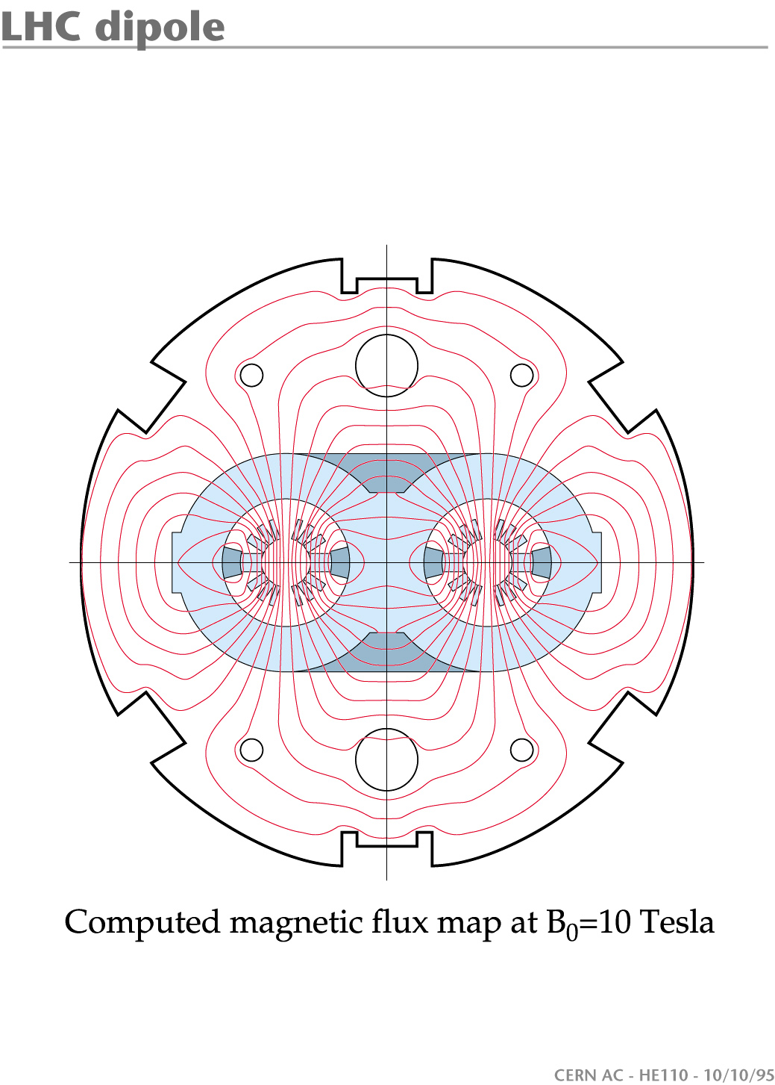
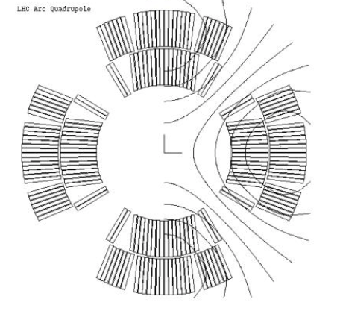
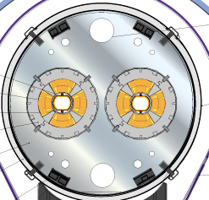
Positioning of magnets in cryostats: how accurate/reproducible ?
LHC dipole
Dipole magnet positioning:
  Transverse (x-z): tolerant (field has no horizontal axis). (LHC < 0.5 mm (rms))
  Roll (about y): sensitive (gives a kick out of orbit plane). (LHC < 0.5 mrad (rms))
Quadrupole magnet positioning:
  Transverse (x-z): sensitive (magnetic axis). (LHC < 0.25 mm (rms))
  Roll (about y): tolerant (LHC < 1 mrad (rms))
z
x
y
LHC quadrupole
z
x
y
Reminder: 1 mrad ~ 1mm/m (small angles)

Slide 15
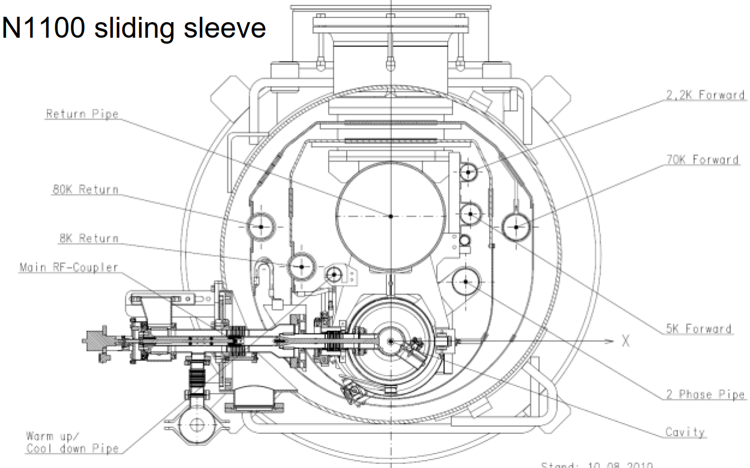
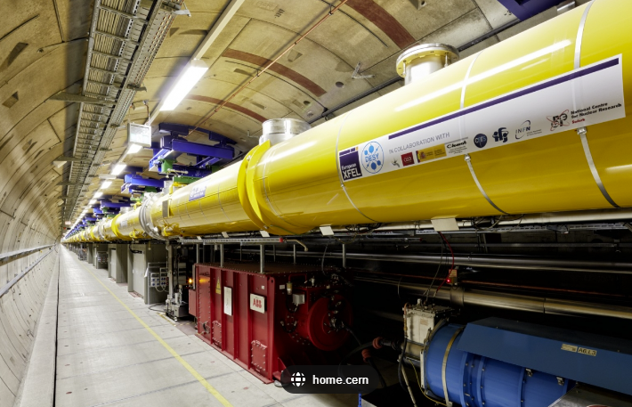
Positioning of cavities in cryomodules: how accurate/reproducible ?
In general, less stringent positioning tolerances. Also, cavities are smaller and lighter than magnets → less demanding support systems
Main effects of misalignment:
  increased beam losses
  beam emittance growth
Typical figures (r.m.s.):
  EXFEL: cavities transverse ~ 1 mm, roll insensitive
  HIE Isolde CM:
    Cavities: transverse < ±0.45 mm
    Solenoid: transverse < ±0.23 mm
EXFEL, Desy, Hamburg

Slide 16
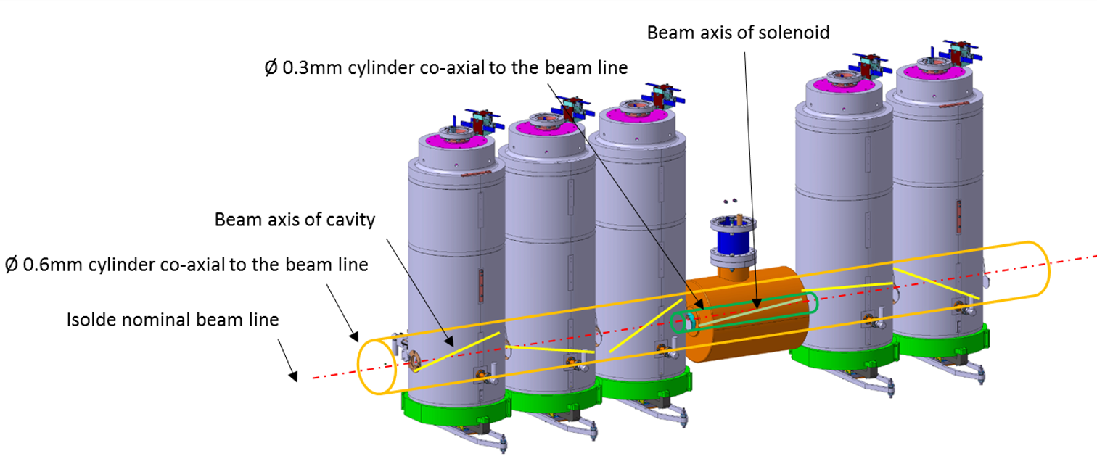
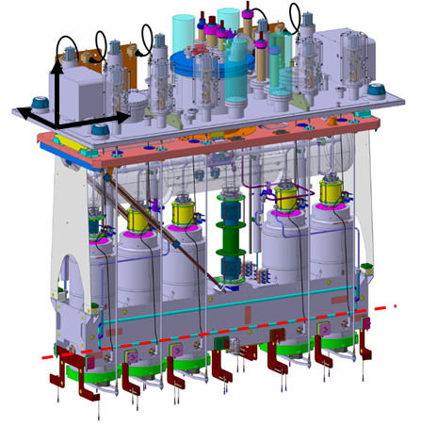
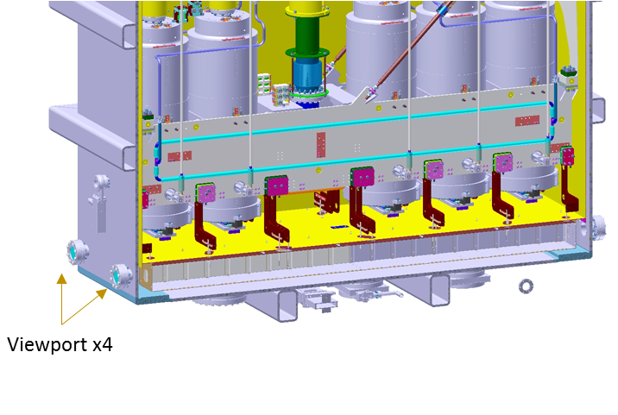
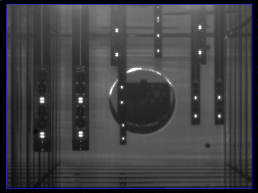
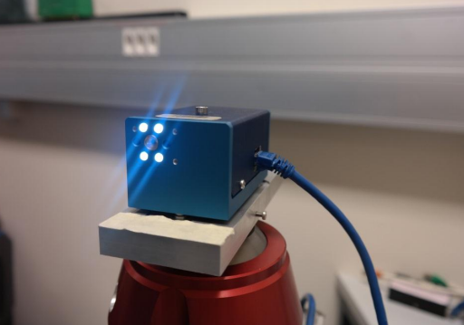
HIE Isolde CM
    Cavities: transverse < ±0.45 mm
    Solenoid: transverse < ±0.23 mm
Cavities/solenoid
adjustment step motors
Suspension
plate
Targets viewed from viewports
optical monitoring and adjustment of position
“milk bottle” type
Support frame
HBCM optical CCD cameras
Optical reflectors

Slide 17
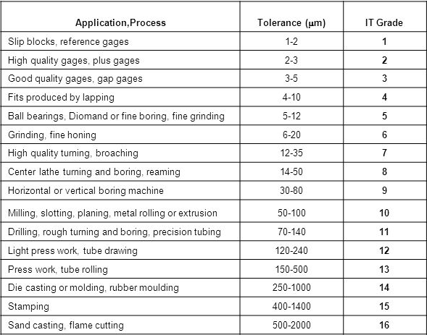
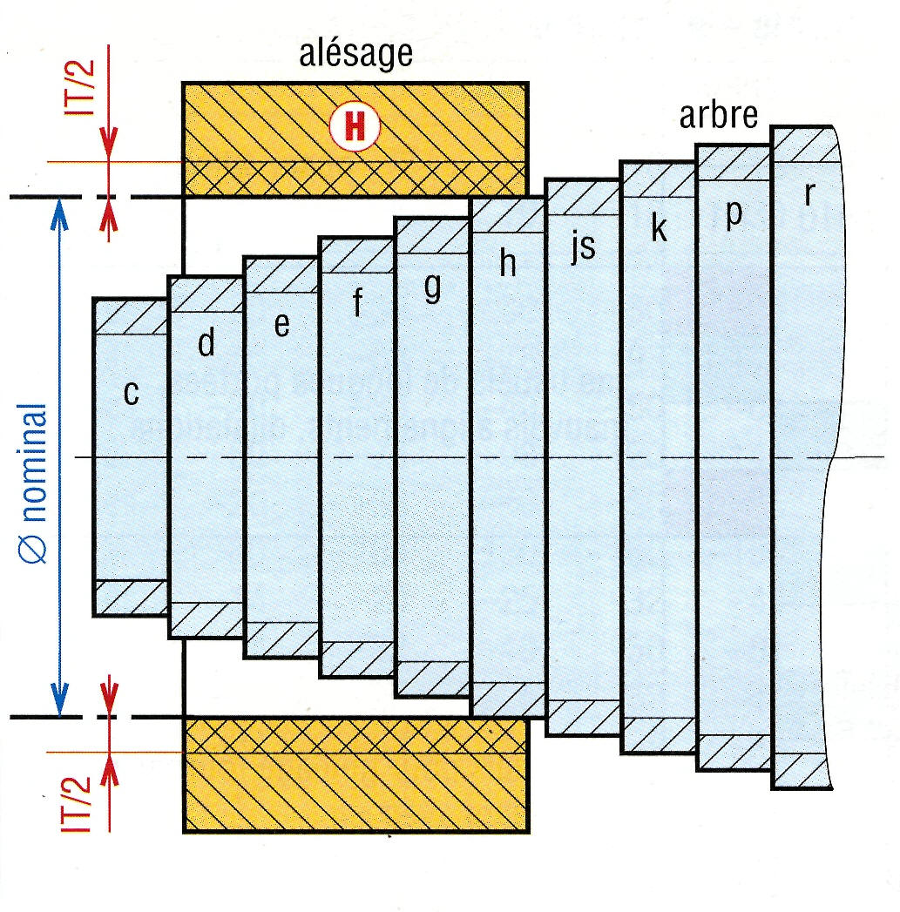
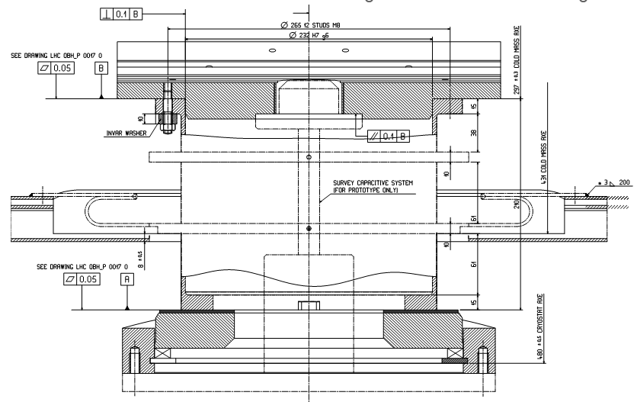
Mechanical accuracy in cryostats parts/assembly
Positioning accuracy is ensured by precision fitting at assembly
Machining IT Grade range: 8-10
Typical close fits: H7/g6
xc
(example of an LHC special SSS)
xc
Fixed post
Central support post interfaced to vessel/coldmass
(232 H7/g6 → play: 15-90 microns )
Sliding posts

Slide 18
Positioning reproducibility in cryostats assembly
Positioning reproducibility on:
1. Every cryo-assembly throughout lifetime (transport, thermal-cycles, etc.) → design concepts
2. Across total population of cryo-assemblies → quality & cost
Design concepts:
Cryostat components in elastic domain (limited local plasticity)
Stress relieving for dimensional stability (vacuum vessels after welding)
Reproducibility to thermal cycles (limited plays & stick-slips, no micro-cracking etc.)
No creep
…
→ Prototyping and testing are mandatory !

Slide 19
Thermal performance

Slide 20
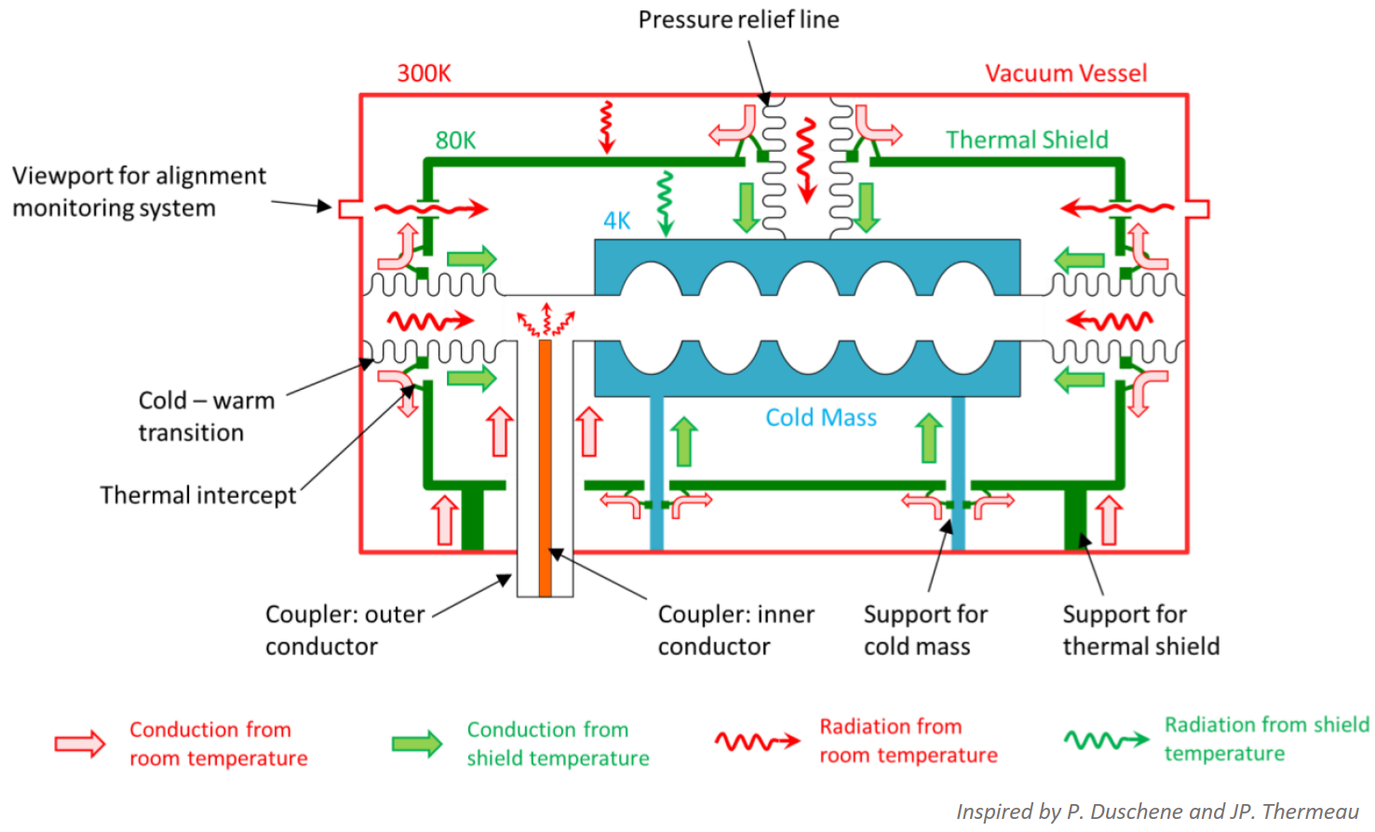
Heat Loads
Static:
    Very much cryostat related (supports, shielding, feedthroughs, etc.)
    always present when machine is cold
Dynamic:
    SC device operation (e.g. RF surface resistive heating)
    Beam interaction (e.g. synchrotron radiation, HOM)
    Can be dominant, but only present during machine operation (duty cycles)
3 heat transfer mechanisms:
    Convection → vessel under vacuum (~10⁻⁶ mbar) → negligeable
    Radiation → sizeable !
    Solid conduction → sizeable !
RF surface resistive heating

Slide 21
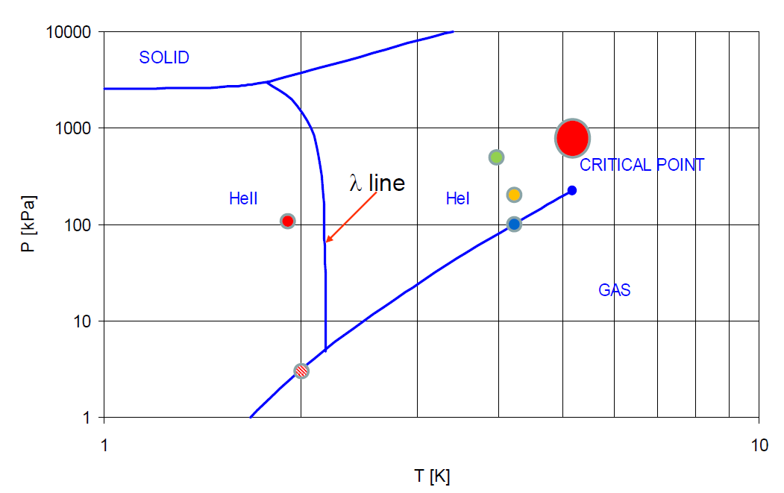
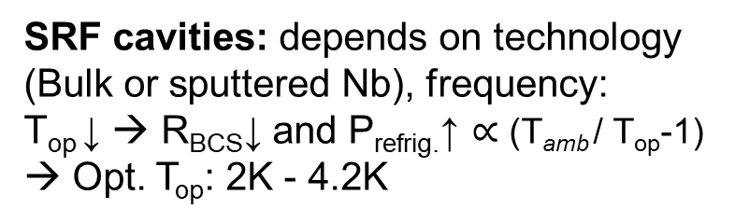
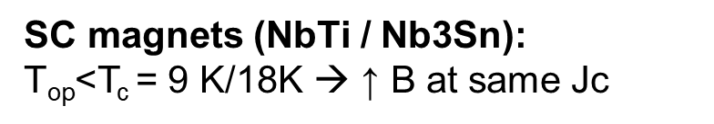
What temperature $\text{T}\text{op}$ (and pressure) ?
SC magnets (NbTi / Nb3Sn):
$\text{T}\text{op}$<T_{c} = 9 K/18K → ↑ B at same Jc
Phase diagram of helium-4 (⁴He)
1.9 K He II, Magnets (LHC/HL LHC, Tore Supra)
4.2 He I, Magnets (HERA, Tevatron)
P: > 1 bar (1.3-5 bar) for higher voltage breakdown (Paschen curve in He)
SRF cavities: depends on technology (Bulk or sputtered Nb), frequency:
$\text{T}\text{op}$↓ → R_{BCS}↓ and P_{refrig.}↑ ∝ ($\text{T}\text{amb}$/ $\text{T}\text{op}$-1) → Opt. T_{op}: 2K - 4.2K
(5.2 K, 2.27 bar)
(1.9 K, 1.3 bar)
Saturated He II (2K), CEBAF, SNS, EXFEL, ESS, PIP-II, ILC
Pool boiling, He I (4.2K), HERA, LEP, LHC, KEKB
(2.17 K, 49.7 mbar)
P: 31mbar / 1 bar (saturation line)
Thermal shields (∼50 K, ~6-20 bar), heat intercepts (5-50 K):
Non-isothermal cooling (ΔT ~ 5-20 K)
→ supercritical helium
(1.8 K, 16 mbar)
(2 K, 31 mbar)
4.2 k

Slide 22
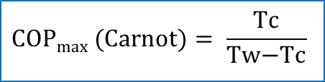

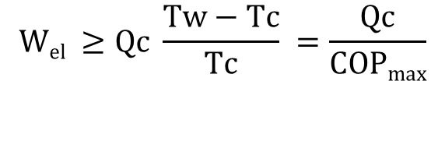

What is the power need for refrigeration ?
Heat extracted at Tc < Tw and rejected at Tw (normally Tw = 293 K)
Minimum mechanical work depends solely on Tw and Tc (Carnot cycle, ideal machine) → Maximum Coeff. of Performance (COP_{max})
All real machines have a lower efficiency (non-reversible transformations), expressed in fraction of COP_{max}
Tw
Qw
$$Qc+Wel=Qw$$
1st and 2nd laws of thermodynamics
Work (W_{el})
$$\frac{Qw}{Tw} ≥\frac{Qc}{Tc}$$
Qc
Carnot cycle
Tc
T
reversible isothermal
Tw
$$Wel ≥Qc \frac{Tw−Tc}{Tc} =\frac{Qc}{\text{COP}\text{max}}$$
$$\text{COP}\text{max} \text{(}\text{Carnot}\text{)}= \frac{\text{Tc}}{\text{Tw}\text{−}\text{Tc}}$$
W
Tc
reversible adiabatic (isoentropic)
Fluid (at 1 bar) | T [K] | Carnot factor (1/COPmax or W_{el}/Qc) [W_{el}/W_{th}] (considering Tw=293K)
LN2 | 77 | 2.8
LH2 | 20.4 | 13.4
LHe | 4.2 | 68.4
LHe | 1.8 | 161.8
Efficiency of a real machine is expressed in fraction (or %) of Carnot:
S
$Wel= \frac{1}{\text{COP}} Qc$ = $\frac{1}{\text{x}\text{\% }\text{COP}\text{max}} Qc$

Slide 23
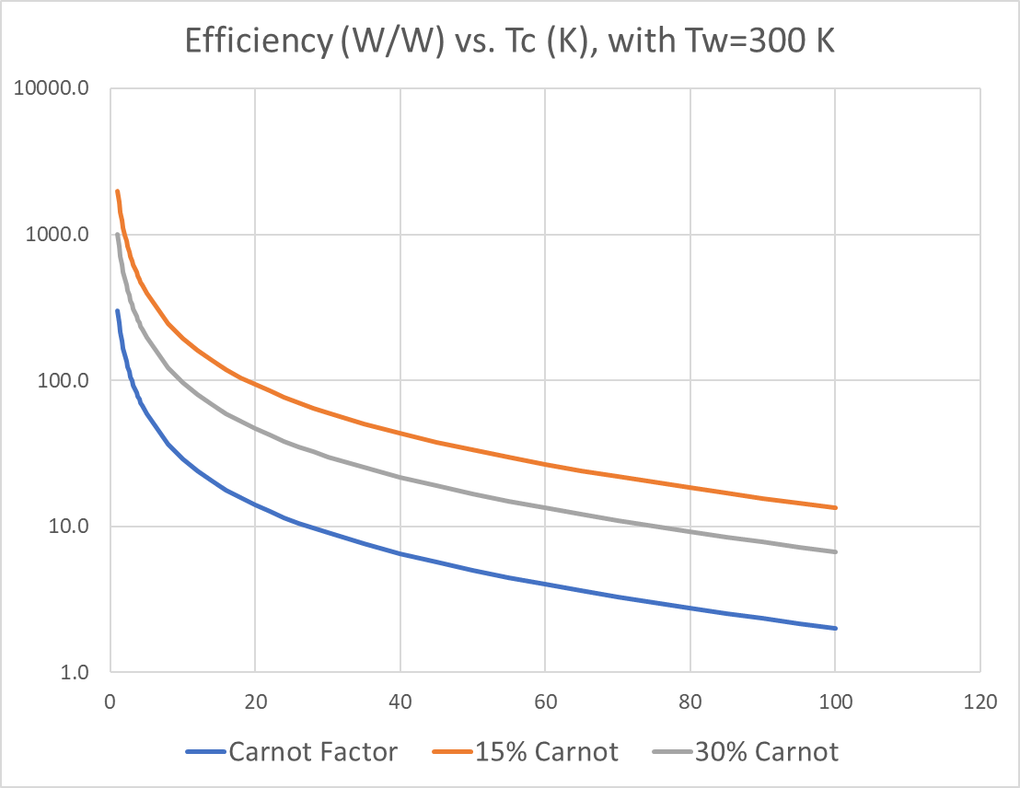
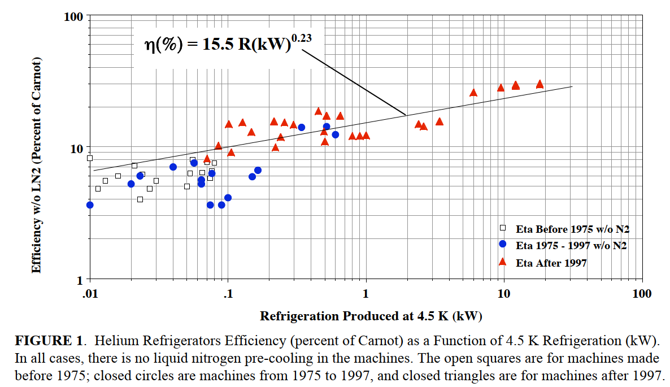
Efficiency for large cryoplants
State-of-the-art figures for large cryo-plants (LHC-like, ~18 kW @ 4.5K):
COP @ 2 K → ~ 15% of Carnot (990 W_{el}/W_{th})
COP @ 4.5 K → ~ 30% of Carnot (210 W_{el}/W_{th})
COP @ 50 K → ~ 30% of Carnot (16 W_{el}/W_{th})
Efficiency (W_{el}/W_{th}) vs. T_{c} (K), with T_{w}=300K
990
210
16
4.5
50
2
→ To minimize cryostat refrigeration costs: heat extraction at higher T levels:
  Heat intercepts on feedthrough (at least one)
  Actively cooled thermal shield
(Green, “The Cost of Helium Refrigerators and Coolers for Superconducting Devices as a Function of Cooling at 4 K”, AIP Conference Proceedings 985, 872 (2008))

Slide 24
LHC Cryostats

Slide 25

Heat Loads (per m length)
LHC magnet Cryostats
Static Heat Loads:
  0.25 W/m at 1.9 K
  5 W/m at 50-65 K
Heat exchange: 0.45 W/m at 1.9 K
Dynamic Heat Loads (resistive heating + beam induced effects):
  ~ 0.2 W/m at 1.9 K (magnet)
  ~ 0.15 W/m at 4.6-20 K (beam-screen)
Thermal radiation from vacuum vessel at room temperature (293 K) to thermal shield (50 K)
Thermal radiation from thermal shield (50 K) to magnet (1.9 K)
Heat extraction: 5 W/m at 50 K
Refrigeration power (for 1 m cryostat)
0.05 W per support
Heat extraction: 0.15 W/m at 10 K
0.5 W per support
7 W per support

Slide 26
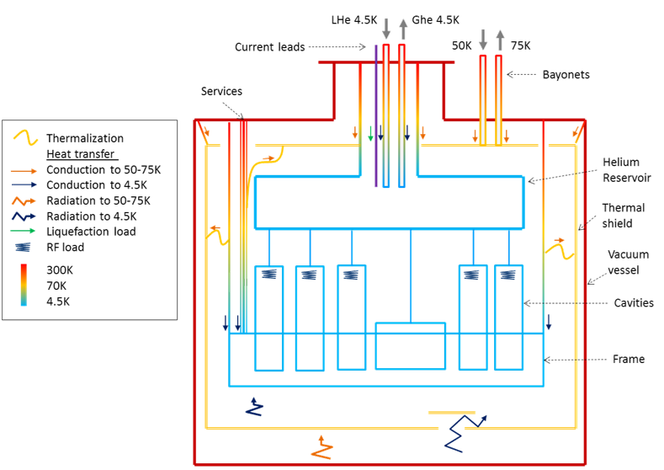
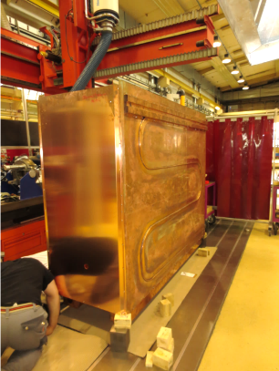
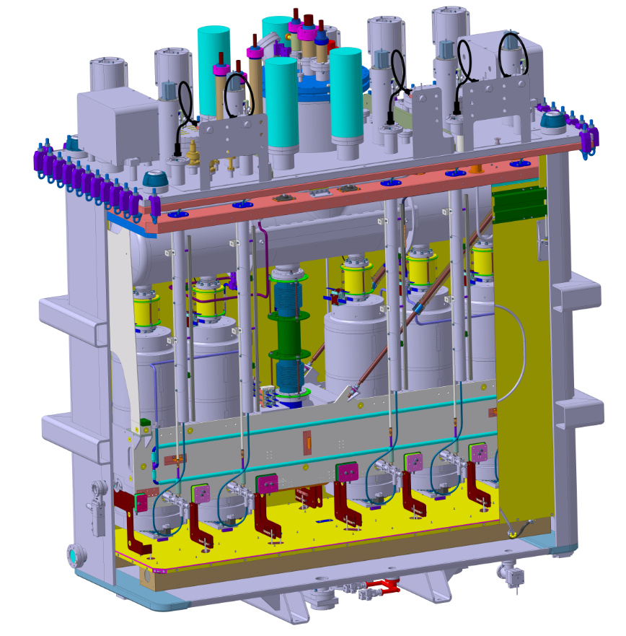



HIE Isolde Cryomodule: No MLI
low-ɛ Ni plated (MLI-free)
Cu thermal shield
Static and dynamic heat load to the GHe circuit.
Static and dynamic heat load to the LHe circuit.

Slide 27
A few more examples from other accelerators

Slide 28


Hera Dipole
4.7 T, 75mm aperture
9m long
(4.5 K)
HERA dipole. 1 Helium vessel containing cold mass, 2 Suspension, 3 Radiation shield, 4 Vacuum vessel, 5 Helium pipes.

Slide 29


Tevatron Dipole
4.5 T, 76 mm aperture
6m long
(4.6 K), warm yoke

Slide 30


Hi Lumi LHC new focusing quadrupole triplets
132 T/m, 150 mm aperture
8 m long (1.9 K)
Reflecting targets for
optical position survey
NbTi SC magnets operated at 1.9 K (superfluid)
Larger cold mass to be fitted within LHC dipole outer vacuum vessel diameter (tunnel limitations)
Conical support posts for better mechanical stability
Optical position survey and motorized external jacks (alignment in highly irradiated environment)

Slide 31
Mechanical design and construction of cryostats

Slide 32
Typical breakdown of a SC device cryostat/cryomodule
Helium tank (for SC device, ph.separator, etc.):
  austenitic st.steels (Fe-Cr-Ni): 304L(1.4307), 316L(1.4404), 316LN
  titanium alloys (Grade-5 (Ti-6Al-4V)) in SRF
Internal (cold) supporting system
  Composites (e.g. GFRE, CFRP, ULTEM)
  St.steel, titanium alloys (tie rods)
Thermal shielding/MLI:
  aluminum alloys (series 5xxx, 6xxx, 7xxx)
  Copper (Cu OF, Cu OFE)
Vacuum vessel:
  Low carbon steels (e.g. DIN GS-21 Mn5)
  st.steels (304L)
Cryogenic piping and expansion joints (bellows):
  st.steel (304L)
  Cu (HX tubes)
Current leads (for SC magnets)
  Cu, HTS, st.steel, elect. insulating (Kapton), thermal insulating (G10),etc.
RF Couplers/HOM (for SRF):
  St.steel Cu plated, Nb, ceramics, etc.
Magnetic shielding (for SRF, as needed)
  μ-metal, Cryoperm®, etc.
Main dipole
basic components

Slide 33
Relevant mechanical failure mechanisms in cryostats
Helium tanks:
  Rupture (rare!) or permanent deformation due to excessive mechanical stress (pressure loads)
  Helium leaks in welds or material micro-crack
Cryogenic lines/expansion joints:
  Buckling of expansions joints with or without rupture/leaks
  Helium leaks in welds or material micro-crack
Vacuum vessels:
  Buckling under external pressure
  Permanent deformations due to excessive stress concentrations
Internal supporting systems:
  Failure due to excessive mechanical stress
  Failure due to thermo-mechanical stress
  Buckling under compressive load
Thermal shields:
  Permanent deformation due to thermo-mechanical stress (CD/WU transients)
Alignment jacks:
  Break of floor/fixations due to excessive load

Slide 34
Useful material standards for cryostats
Plates and sheets | • EN 10028-1:2007+A1:2009 Flat products made of steels for pressure purposes - Part 1: General requirements • EN 10028-3:2009 Flat products made of steels for pressure purposes - Part 3: Weldable fine grain steels, normalized • EN 10028-7:2007 Flat products made of steels for pressure purposes - Part 7: Stainless steels
Tubes | • EN 10216-5:2004 Seamless steel tubes for pressure purposes - Technical delivery conditions - Part 5: Stainless steel tubes • EN 10217-7:2005 Welded steel tubes for pressure purposes - Technical delivery conditions - Part 7: Stainless steel tubes
Forged blanks | • EN 10222-1:1998 Steel forgings for pressure purposes - Part 1: General requirements for open die forgings • EN 10222-5:1999 Steel forgings for pressure purposes - Part 5: Martensitic, austenitic and austenitic-ferritic stainless steels
Castings | • EN 10213:2007 Steel castings for pressure purposes
Pipe fittings | • EN 10253-4:2008 Butt-welding pipe fittings - Part 4: Wrought austenitic and austenitic-ferritic (duplex) stainless steels with specific inspection requirement
Bars | • EN 10272:2007 Stainless steel bars for pressure purposes
Aluminium | • EN 12392:2000 Aluminium and aluminium alloys – Wrought products – Special requirements for products intended for the production of pressure equipment (choose materials included in the list given in EN 13445-8 section 5.6)

Slide 35

Tensile test material properties
F/2
Stress
σ=F/s₀ (N/m²≡Pa)
cross section s₀
ΔL
Ultimate tensile strength
UTS
Fracture
F/2
Yield tensile strength
YS
σ_{0.2}
0.2% offset line
→ stiffness k=EA/L
Slope: Young modulus E
Plastic deformation
Necking
$$σ=E ∙ ε$$
Strain
Elastic deformation
ε = ΔL/L (%)

Slide 36
Ductile vs. brittle
  Brittle behaviour
  (think about glass)
Ductile behaviour
  (think about lead, gold...)
Stress
Stress
Strain
Strain

Slide 37
Low temperature effect of tensile properties
T₁
>
T₂
>
T₃
Fragile fracture
F/S₀
F/S₀
F/S₀
F/S₀
UTS
YS
A%
A%
A%
T
T₃
T₂
T₁
Ductile materials tend to become brittle (fragile) at cryogenic temperatures
Increase of the yield and ultimate strength
Young modulus also (marginally) increases.

Slide 38



Mechanical Properties at cryogenic temperatures
Yield, ultimate strength
  Yield and ultimate strengths increase at low temperature
From: Ekin, J.W. Experimental Techniques for Low Temperature Measurements

Slide 39



Mechanical Properties at cryogenic temperatures (cont.d)
Young modulus
Impact resistance
Fracture toughness
Young Modulus
1 : 2024 T4 aluminium
2 : copper-beryllium
3 : K monel
4 : Titanium
5 : SS 304
6 : Carbon Steal C 1020
7 : Steel 9% Ni
From: Ekin, J. Experimental Techniques for Low Temperature Measurements
From: Technique de l’Ingénieur

Slide 40



Thin shells under external pressure
Buckling:
Non-linear phenomenon. Actual critical pressure depends on initial imperfections: Safety factor needed!
Buckling critical pressure for a thin tube of infinite length
A conservative rule of thumb for steel tubes under vacuum:
With a safety factor of > 3 :
t $≥ 3.6\% r$
Alternatively, we need to add reinforcements
Example:
r = 500 mm
t > 18.5 mm
Reference formulas for various geometries in “Roark’s Formulas for Stress and Strain”, Warren C. Young, Richard G. Budynas, Seventh Edition
In practice, use standards:EN 13458-2 (Cryogenic Vessels – Static vacuum insulated vessels)

Slide 41

Thin shells under internal pressure
For preliminary calculation:
Example: cyl.helium tank
r = 400 mm
p = 4 barg (0.4 MPa)
σ_{a}= 160 MPa (304L, Rp_{0.2}= 240 MPa, SF=1.5)
t ≥ 1 mm
(Note: under vacuum (previous calculation) → t ≥ 15 mm !)
For detailed calculation: use standards, EN 13458-2 Cryogenic vessels – static vacuum insulated vessels

Slide 42


Real case (CERN, May 2013): collapse of a modified vertical test cryostat
Modified helium tank (inner vessel) to be used dry (cavity helium filled)
Helium tank vacuum pumped before insulation vacuum space
Δp=1 bar external pressure → buckling collapse
New parts

Slide 43

Pressure vessel codes regulations
Pressure European Directive 2014/68/EC (PED) is a legal obligation in the EU since 2002
  Applies to internal pressure ≥ 0.5 bar gauge
  Vessels must be designed, fabricated and tested according to the requirements defined
  Establishes the conformity assessment procedure depending on the vessel category, which depends on the stored energy, expressed as Pressure x Volume in bar.l
Category | Conf. assessment module | Comment
SEP | None | The equipment must be designed and manufactured in accordance with sound engineering practice. No CE marking and no involvement of notified body.
I | A | CE marking with no notified body involvement, self-certifying.
II | A1 | The notified body will perform unexpected visits and monitor final assessment.
III | B1+F | The notified body is required to approve the design, examine and test the vessel.
IV | G | Even further involvement of the notified body.
Pressure vessels
Article 4, paragraph 3
Vacuum vessels
For vessels with non-dangerous gases (cryogenic liquids are treated as gas)

Slide 44

Harmonised codes and standards
Harmonised standards give presumption of conformity with the PED, within their scope. Useful codes for cryostat design and fabrication, including safety devices:
Very useful
guidelines and design rules

Slide 45





LHC dipole Vacuum Vessels
Main features:
Pipeline standard size: 36-inch OD (1013 mm), 12-mm thick, low carbon steel (DIN GS-21 Mn5) tubes
St. steel extremity flanges
Material resilience: > 28 J/cm2 at -70ºC
Forged cradles, welded rings reinforcements
Dimensional stability:
  Stress relieving
  Final machining to achieve tolerances at interface
Production:
1250 units
2 firms
4 yrs of production
Forged cradle
Final lathe machining
Out-doors storage at CERN
Stress relieving

Slide 46


LHC thermal shields
Aluminium alloy 6063 extrusions and 1100 top sheets
LHC Main Cryostat
(Cross-Section)
Al 1100 sheets
He cooling (50-65K)
Al 6063 extrusions

Slide 47
Thermo-mechanical considerations

Slide 48


Thermal expansion of some materials

Slide 49





Thermal stress in composite material assemblies: 3 cases
ΔT
A) Restrained component
$$ε=α⋅ΔT$$
$σ=$ $α⋅ΔT⋅E$
B) Assembly of different materials
ΔT
Material 1: α1, E1, A1
restrained
Material 2: α2, E2, A2
$$σ1=\frac{E1 E2 A2}{E1 A1+E2 A2}\left(α2−α1\right)⋅ΔT$$
$$σ2=\frac{E1 E2 A1}{E1 A1+E2 A2}\left(α2−α1\right)⋅ΔT$$
C) Different cooling ΔT₁(t) ≠ ΔT₂(t) (different material diffusivity or different cooling)
ΔT₁(t)
Material 1: α1, E1, A1
restrained
ΔT₂(t)
Material 2: α2, E2, A2
$$σ1=\frac{E1 E2 A2}{E1 A1+E2 A2}\left(α2 ΔT2−α1 ΔT1\right)$$
$$σ2=\frac{E1 E2 A1}{E1 A1+E2 A2}\left(α2 ΔT2−α1 ΔT1\right)$$

Slide 50
Example of LHC cryostats: longitudinal thermal contractions
Cold mass, thermal shield, support posts and vacuum vessel must be free with each other to cope with longitudinal thermal contractions
One fixed point per each component
Leave plays to cope with all extreme T cases (ex. Cold mass cold, thermal shield warm)
Guided sliding of cold mass onto vacuum vessel → slot/key
Flexible thermalisation anchors
(example of an LHC special quadupole)
Fixed post
Sliding posts
Δl _{cold mass}= 30 mm (10m x 3mm/m)
Δl _{thermal shield}= 40 mm (10m x 4 mm/m)

Slide 51
Content
Helium cryostats for SC devices, functions and requirements
Examples of cryostats
Mechanical design and construction of cryostats:
  Materials for cryostats and their properties
  Pressure/vacuum vessels, codes, and norms
  Thermo-mechanical considerations
  Supporting systems
Heat transfer mechanisms at cryogenic temperatures:
  Thermal radiation and thermal design solutions (thermal shielding, MLI)
  Thermal conduction and thermal design solutions (feedthroughs, heat intercepts)
Notions of cryogenic safety
2 h
2 h

Slide 52
Supporting systems

Slide 53

LHC Cryomodule
400 MHz cavities (Nb on Cu) at 4.5 K

Slide 54



LHC Cryomodule Supporting System
For each cavity assembly (about 500 kg):
7 adjustable st.steel tie rods:
4 vertical
2 horizontal
1 longitudinal

Slide 55

LHC magnet Cryostats
Main dipole
Cold mass interface flange: 2 K
5-10 K heat intercept
50-65 K heat intercept
GFRE composite
column
Vac.vessel
Interface: 293 K
4-mm thickness, glass-fiber epoxy
Manufactured by Resin Transfer Moulding (RTM):
  Suited to a large-scale industrial production (4’700 units)
  High reproducibility in thermo-mechanical properties

Slide 56
LHC Supporting system
The design is a trade-off between 2 conflicting requirements:
High flexural stiffness (for mechanical stability) → thick and bulky structure
Low heat in-leaks → thin and slender structure and low conductivity material
→ Flexural stiffness/conductivity as figure of merit in the choice of the material
(F is mainly the result of
interconnect forces
and gravity component)
F = 5 kN
x = 0.1 mm
ᶿ = 1 mrad
F
θ
(The acceptable x and θ
are alignment requirements)
x
Q
(Q is to be within budget)

Slide 57





Lay-up, calculated safety factors, material properties
Compression load: 175kN (175% gravity load, transport limit)
Tsai-Wu ply failure: Safety Factor = 6
E modulus: 24 GPa
Triaxial braid and % fiber volumes
layup
Bending cantilever 40 kN. (vacuum barrier load)
Tsai-Wu ply failure: Safety Factor = 2.7

Slide 58





Resin Transfer Moulding
Cutting the fabrics to length
Lay-up stacking
Sealed closing of mould
RTM processing
(complete manufacture cycle: 4 hrs)
Columns as de-moulded

Slide 59



SC magnet supporting systems from other machines
Tevatron
Hera dipole
SCC
RHIC dipole

Slide 60



Supporting system of Tesla/TTF/ILC Cryomodule
2 K
RF coupler (with bellows)
Fixed support
Invar longitudinal positioner
Sliding support
DN 300 as back-bone
External supports (jacks)

Slide 61



Supporting system of SNS and ESS high β Cryomodules
SNS
“Space-frame” and tie rods
ESS

Slide 62

Supporting system of PIP II Cryomodule
“strongback”:
rigid supporting plate in vacuum at RT
strongback

Slide 63




SPL cryomodule: RF Coupler as support
Vacuum vessel
Vertical loading of cavities string

Slide 64
Heat transfer mechanisms and thermal design

Slide 65
Heat transfer mechanisms
Thermal radiation
Thermal conduction
Heat intercepts

Slide 66
Thermal Radiation

Slide 67










Thermal Radiation
Stefan-Boltzmann’s law
$$σ=5.67 {10}^{−8} W m^{−2}{ K}^{−4}$$
Q $=σ {A T}^{4}$
$$black body$$
Stefan-Boltzmann’s constant
Q $=ε σ {A T}^{4}$
$$gray body, ε<1$$
A, T $area and temperature$
$of the body$, 𝜀 emissivity
$$exchange between black bodies$$
F, geometrical view factors${ F}_{1−2}$(<1) between $A_{1}$and $A_{2} (or F_{2−1}$ between $A_{2}$ and $A_{1}$), with $A_{1}E_{12}$= $A_{2}E_{21}$.
E, effective emissivity, a function of view factors and emissivity $ε1$and $ε2$of the bodies
$$Q_{1−2}=F12A1 σ \left({T_{1}}^{4}−{T_{2}}^{4}\right)=F21A2 σ \left({T_{1}}^{4}−{T_{2}}^{4}\right)$$
$$exchange between gray bodies$$
$$Q_{1−2}=E12 σ A1\left({T_{1}}^{4}−{T_{2}}^{4}\right)=E21 σ A2\left({T_{1}}^{4}−{T_{2}}^{4}\right)$$
Figures source: “Heat Transfer”, A.Bejan, John Wilney & Sons, Inc.

Slide 68






Black and diffuse-gray model
Black model
$$α → absorptivity \\ ρ→ reflectivity \\ τ→ transmissivity$$
Practical application in cryostats: every gap in shields is a black surface
(1 cm² gap exposed to 293 K, ɛ = 0.2 → ~10 mW)
Black surface: α = 1
Diffuse-gray model
Diffuse-gray model (good approximation for real surfaces in engineering):
Gray: $ε_{λ}$(λ,T) ≈ $ε$(T)
Diffuse emitter/absorber (not directional)
Opaque ($\text{τ}$ = 0)
$α$(T) = $ε$(T)
Figures source: “Heat Transfer”, A.Bejan, John Wilney & Sons, Inc.

Slide 69



Emissivity
𝜀 depends on wave-length and direction (neglected in gray-diffuse model). In metals emissivity rises sharply and up to more than 40% above 50 deg. incidence from the surface normal
Clean, well-polished metallic surfaces have smaller 𝜀, non-metallic materials have higher 𝜀
Metals: 𝜀 decreases with decreasing temperature, almost linearly at cryo temperatures
Non-metals: 𝜀 may decrease or increase with decreasing temperature (increases for organic materials)
Engineering approach. Due to uncertainties on real 𝜀 values, take conservatively high values for preliminary design. Measurement validation may be necessary
normal
Φ_{Ω}
Directional distribution
Ref. https://neutrium.net/heat-transfer/emissivity/
Ref. R.B.Scott, Cryogenic Engineering, (Van Nostrand, New York, 1959; Y.S.Touloukian, Thermophysical Properties of Matter, (Plenum Press, New York, 1995))
Ref. Cryogenie, ses applications en supraconductivite.Techniques de l’ingenieur, Ed.1995

Slide 70


Radiation between 2 diffuse-gray enclosures
Radiation balance between A1 and A2 surfaces:
For 2 enclosed cylinders or spheres (not necessarily concentric!), F₁₂=1 :
$$q_{1−2}=\frac{σA1(T1^{4}−T2^{4})}{\frac{1}{ε1}+\frac{A1}{A2}\left(\frac{1}{ε2}−1\right)}$$
A1
A2
  For cryostats, to reduce heat load to inner cold surface:
  Limit size of A₁ (SC device vessel)
  Reduce A2 (vac.vessel as small as possible)
  Small emissivities: ε1 reduced by low T; ε2 at RT & moderated by A1/A2
Figures source: “Heat Transfer”, A.Bejan, John Wilney & Sons, Inc.

Slide 71
Radiation between 2 diffuse-gray flat plates
Radiation balance between A1 and A2 (A1=A2=A), F₁₂=1 :
T1
T2

Slide 72






Radiation with an intermediate floating shield
Radiation balance between A1 and A2:
Ts
A1 to S gap
S to A2 gap
For flat surfaces approximation, and same ɛ :
T1
T2
$q_{1−s}=\frac{σ A (T1^{4}−Ts^{4})}{(\frac{2}{ε}−1)}$ = $\frac{σ A (Ts^{4}−T2^{4})}{(\frac{2}{ε}−1)}=q_{s−2}$
${\text{T}\text{s}}^{4 }$= $\frac{{T_{1}}^{4}+{T_{2}}^{4}}{2}$
…
$$q_{1−2}=\frac{σ A (T1^{4}−T2^{4})}{2(\frac{2}{ε}−1)}$$
1
…N
→ with 1 shield ½ of the rate without shield
→ Can be generalized to N shields
$$q_{1−2}=\frac{σ A (T1^{4}−T2^{4})}{(N+1)(\frac{2}{ε}−1)}$$
→ with N shield 1/(N+1) of the rate without shield

Slide 73

N shields → Multi Layer Insulation (MLI)
T
Tw
T_{ext layer}
Working principles:
Multi-layer to enhance radiation protection:
  N+1 radiation shielding
Low emissivity of aluminium layer
Minimal thermal conduction between reflective layers → interposing of isolating layers (e.g polyester net):
Enhanced performance at low T → use actively cooled shield:
  Lower emissivity of reflective material layers at low T
  Reduce radiation from inner-most layers, cooled at T of shield
  Extract heat at higher thermal shield T → thermodynamic efficiency
Tc
x
Tw
Tc < Tw
Interleaved reflectors and spacers
Warm wall
Colder wall (actively cooled
thermal shield)
Q_{c}
Q_{r}
Reflective film
Insulating spacer
Actively cooled (50-80 K range) thermal shield with MLI is a must in all cryostats

Slide 74





MLI material
LHC MLI:
Reflecting film: 6 µm thick polyethylene teraphthalate (PET) film coated with 400 Å minimum aluminium on each side (Physical Vapor Deposition process)
Spacer: polyester net of very low weight (< 5 g/m2)
10 or 15 layer pre-assembled blankets (outermost layer reinforced with a polyester net)
Blanket overall thickness: > 2 (3) mm for 10 (15) layers
Perforated layers for outgassing: 0.05-0.15 % surface
MLI in Space applications
Decoration Al films
Interleaved reflectors and spacers
Velcro™ fasteners
Blanket manufacturing
MLI in residential construction

Slide 75


MLI performance
Typical values (for a thermally well optimized large-scale application like LHC) :
  293 K to 50 K thermal shield with 30 MLI layers: → ~1 W/m²
  50 K to 2 K magnet with 10 MLI layers: → ~ 50 mW/m²
LHC MLI Features:
1 blanket (10 reflective layers) on cold masses (1.9 K)
2 blankets (15 reflective layers each) on Thermal Shields (50-65 K)
Reflecting film: 6 µm thick polyethylene teraphthalate (PET) film coated with 400 Å minimum aluminium on each side
Spacer: polyester net of very low weight (< 5 g/m2)
Stitched Velcro™ fasteners for rapid mounting and quality closing
1 blanket on CM, 2 on thermal shield
MLI on Cold-to-Warm
transitions

Slide 76

MLI: How many reflective layers (N)?
No straightforward answer ! Not just a matter of N !
Complex system to model, with parameters needing experimental qualification
Radiation vs. conduction
  Radiation reduces as 1/N
  Conduction proportional to packing density (N/mm)
Residual helium gas conduction
  Negligeable at res. pressure p < 10⁻⁴ Pa (10⁻⁶ mbar)
  Sizeable contribution at res. pressure 10⁻⁴ Pa < p < 10⁻³ Pa (10⁻⁵ mbar)
  Dominates at res. pressure p > 10⁻² Pa (10⁻⁴ mbar)
Packing density should be limited → typically 20-25 N/cm
  Avoid “compressed” blankets (do not put as much MLI as you can fit!)
  Reserve space allocation for MLI blankets
  Consider differential thermal contractions wrt support (Al shields, cold mass…): blankets must remain quite loose at cold
Overall performance depends very much on:
  Application design solutions
  Craftsmanship quality
Arbitrary units
Total heat flow
Radiation
Conduction
No. layers/cm

Slide 77









MLI application: important tips
Thermal path warm to cold layers
Handle MLI with gloves
(fingerprints are a black body!)
loose at RT
(MLI contracts more than metal support)
T_{hot}
Velcro TM
Reflective layer
T_{cold}
T_{hot}
T_{cold}
Some tapes are
resin coated = black body !
Check conductivity
Not tool much MLI
(risk of thermal shorts)
(images: courtesy of Meyer Tool & MFG.)

Slide 78
Performance measurements on MLI samples
300 K - 77 K, abundant literature (see a few ref. [1], [2])
77 K - 4 K, fewer results. CERN experimental work (see a few ref.[3],[4],[5] )
Some values, in good vacuum (<10⁻⁴ Pa) [3]:
T_{w} = 300 K
N | T_{c} = 5 K-80 K
10 | ~ 1.0 W/m²
20 | ~ 0.5 W/m²
30 | ~ 0.4 W/m²
Virtually no Tc dependency, T_{w} radiation dominates
(compare with 1 W/m² calculated in exercise)
T_{w} = 80 K
N | T_{c} = 4.2 K
1 or more | ~ 30-60 mW/m²
Virtually no N dependency
(compare with 110-140 mW/m² calculated in exercise)
[1] T.Nast, Multilayer Insulation Systems, in Handbook of Cryogenic Engineering, ed. J.G.Weisend II, Taylor & Francis, Philadelphia (1998),
[2] M. G. Kaganer, Thermal Insulation in Cryogenic Engineering, Jerusalem, Israel Program for Scientific Translation, (1969),
[3] L.Mazzone et al., Measurements of Multi-Layer Insulation at high boundary temperature, using a simple non-Calorimetric method. Proceedings ICEC 19, 2002, Grenoble, France.
[4] Ph.Lebrun et al., Investigation and qualification of thermal insulation systems between 80 K and 4.2 K, Proceedings ICEC/ICMC, 1992, Kiev, Ukraine
[5] V.Venturi, Thermodynamic and technological optimization of complex insulation systems. PhD thesis, 2019, WUST University, Poland.

Slide 79
Practical MLI performance values
MLI samples measured performance is considerably degraded in applications due to the engineered solutions and installation procedures:
  pre-assembled blankets vs. rolled MLI
  complex (non developable) geometries
  junctions, stitches, VelcroTM fasteners, etc.
  higher than ideal packing density (e.g. self-weight compaction)
  thermal shorts between cold and warm layers (e.g. overlapped blanket closure)
  quality of assembly (lab vs. industrial scale)
Engineering values: what values should one use for HL first estimates?
  Take generous margins. Rule of thumb → x 2 sample measurements
LHC cryostat (+) (a thermally well optimized large-scale application), average measure on 2.7 km length sector :
  293 K to 50 K thermal shield with 30 MLI layers: → ~1 W/m²
  50 K to 2 K magnet with 10 MLI layers: → ~ 54 mW/m²
(+) C. Maglioni, V. Parma: “Assessment of static heat loads in the LHC arc, from the commissioning of sector 7-8”, LHC Project Note 409, 2008.

Slide 80
Thermal Conduction

Slide 81

Thermal Conduction
Tc
Tw
When a T gradient exists in a body, there is a heat transfer from the high T region to the low T region (Fourier Law):
For one-dimensional problems (ex. a bar or tube):
k is the thermal conductivity (W m⁻¹ K⁻¹), normally a function of P,T, material structure, non-homogeneity, anisotropy (ex. Composite materials).
k is strongly T-dependent and non-linear at low T
“good conductors” vs. “poor conductors” → k range ~ 5-6 orders of magnitude
6 decades

Slide 82

Thermal conductivity of various materials
Metals: mainly free electron contribution
Resistivity from electron scatter with phonons (lattice vibrations) α T² and with impurities α 1/T
Increasing effect of impurities in less pure metals and dominates in alloys
Maximum of conductivity reduces and shifts towards higher T with increasing impurities
Al and st.steel alloys: conductivity α T
Non cristalline materials and insulators dominated by phonon contribution

Slide 83



Thermal conductivity in epoxy-based composite materials
Low conduction (little electron conduction), essentially phonon driven
Anisotropic structure, (fibers/matrix) with constituents-specific thermal conductivity properties
Conductivity highly depends on:
  Material (fiber) orientation
  Ratio between fibre and matrix (Vf)
Glass-fiber is the “conductive” fraction and also the “structural” constituent
Epoxy is the “isolating” fraction material and is the “less structural” constituent
Vf typically around 40-70%
Cryogenic grade G10-CR and G11 are widely used standard laminates in various forms (plates, tubes, rods). Properties data can be found in: https://trc.nist.gov/cryogenics/index.html
(Data from Schwartzberg F.H., Cryogenic Material Data Handbook,
Martin Marietta Corrp, Denvers, Co, 1970)
Longitudinal and transversal conductivity laminate studies for LHC supports, (based on data from Schwartzberg F.H.), collaboration CERN-ESIGEC (Univ.Savoie), 1997
Glass-fiber dry fabric
Standard G10-CR plate and rods

Slide 84

LHC supports
Two intercepts, 5K & 75K
One intercept, 75K
No intercepts

Slide 85

The conduction equation (unidirectional case)
(Fourier law of heat conduction)
(change of internal energy)
Longitudinal
conduction
Internal
heat
generation
Thermal
inertia

Slide 86

No heat deposition and steady-state
with boundary conditions:
x=0, T=T₀
X=L, T=T_{L}
If k constant with T:
If k = k(T):
T₀
$$\dot{q}$$
T_{L}
L
(Linear solution)
Thermal conductivity
Integral (conductance)
T
For metal alloys (ex.steels) at low T:
T₀
T_{L}
(quadratic solution)
L
x

Slide 87
Thermal conductivity integrals (conductance) for some materials [W/m]
4.2K
Tw
Qc
Highest T (Lowest T =4.2 K) | 20 K | 80 K | 290 K
OFHC Copper | 11000 | 60600 | 152000
DHP Copper | 395 | 5890 | 46100
Aluminium 1100 | 2740 | 23300 | 72100
Aluminium 2024 | 160 | 2420 | 22900
Stainless steel AISI 304 | 16,3 | 349 | 3060
Typical Glass-fiber/Epoxy Composite G-10 | 2 | 18 | 153

Slide 88

…more conductivity integrals

Slide 89
Electrical network analogy
The inverse of the thermal conductance → thermal resistance:
For variable k, define an average value k_{AV}:
Analogy with the electrical resistance (replace q with I, T with V):
We can therefore model a complex thermal conductivity problem by elementary thermal resistances Ri, and solve the network by using Kirckhoff’s laws.

Slide 90

Thermal conduction with uniform heat deposition
t
To
x
Beam of length L, thickness t, width w (= 1m);
beam thermalized on one side at To
uniform heat deposition from one side, q (W/m²)
considering k constant with T
Boundary conditions: a) for x= 0 T=To (heat sink); b) q=0 for x=L (isolated tip)
Integrating and imposing the 2 boundary conditions:
T
T_{L}
T₀
L
practical interest:
calculate minimum thickness to limit ΔT_{max}
$$t=\frac{q⋅{L^{2}}^{}}{2⋅k⋅ΔTmax }$$
x

Slide 91










Thermal diffusivity
$$\frac{∂}{∂x}\left(k\frac{∂T}{∂x}\right)= ρ c \frac{∂T}{∂t}$$
Conduction equation (no heat generation)
For small variations of k with x:
Solid bar cooled at one tip
T perturbation $δ$ travels towards warm end:
t_{c}, critical time for T perturb. to reach warm tip:
$$\frac{∂^{2}T}{{∂x}^{2}}= \frac{1}{α} \frac{∂T}{∂t}$$
$$with α= \frac{k}{ρ c}$$
$$δ(t)≈ \sqrt{α t}$$
Thermal diffusivity [m²/s]
$$tc≈ \frac{L^{2}}{α}$$
T
T_{i}
$$tc$$
t _{increase}
T₀=T∞
$$t → ∞$$
$$\dot{q}$$
T∞
$$δ(t)$$
$$δ\left(tc\right)=$$
L
x

Slide 92



Heat capacity
Specific heats:
For incompressible substances:
Change of internal energy U (or enthalpy):
  $ΔU=Q=m \int_{T1}^{T2}{c(T) dT}$
Cooling (or heating) power:
  $P(T)=m c(T)\frac{dT}{dt}$
Specific heats/unit vol.
sometimes preferred
Below 10 K enthalpy of
helium overtakes all solids
(from J. Ekin, Experimental Techniques for Low-Temperature Measurements)

Slide 93
Measuring Thermal Performance of Cryostats

Slide 94






Measure of Heat Loads to liquid helium tanks
Isothermal cooling (2-phase helium tanks)
He boil-off along saturation line
  Latent Heat (L_{v}) of vaporisation
  Isothermal cooling (T constant if P constant)
  Measure p, and
  Liquid/gas volumetric corrective factor
SC level gauge
vapor
liquid volume replaced by fraction of boil-off vapor (no filling)
$$\overset{•}{m}$$
$$\overset{•}{q}=\overset{•}{m}⋅Lv⋅(\frac{vg}{vg−vl})$$
Latent heat of vaporization
Example:
  Mass flow measurement: 7 g/s
  P measured: 1.78 bar
  (T on saturation line (phase diagram): 4.8 K)
  L_{v} = 14’116 (J/kg) (tables, or state equations)
  𝑣_{𝑔} = 3.0 10-2 (m3/kg); 𝑣_{l} = 9.3 10-3 (m3/kg); (phase diagrams)
  → $\overset{•}{q}=7.0 10−3⋅14116⋅(\frac{3.0 10−2}{3.0 10−2 − 9.3 10−3})$ = 143 W
measure
from diagrams
He boil-off liquid level measurement:
  Measure level l with SC level gauge
  Boil-off mass flow measure through reservoir geometrical correlation between level and volume: f(l), and knowledge of density ρ and L_{v}
1.45 !
Density of saturated liquid helium
$\overset{•}{q}= f(Δl)$ $⋅ρ⋅Lv$

Slide 95

Measure of Heat Loads to liquid helium tanks (cont.d)
Non-isothermal cooling
Calorimetry in superfluid helium (LHeII):
  LHe II very high thermal conductivity → isothermal bath
  Measure internal energy change (closed system) in time Δt
  Needs precise measure of helium content
  and sub-mK resolution measurement of T at T< 2.17 K
$$\overset{•}{q}=\frac{ΔU(t)}{Δt}=\frac{m⋅Δu(t)}{Δt}$$

Slide 96


Measure of Heat Loads to Thermal Shields
Non-isothermal cooling
Forced internal (conduit) convection of single-phase fluid:
  Non-isothermal cooling: enthalpy change of fluid (here c_{p} assumed constant)
  Needs the measure of mass flow, and T at entry and exit of conduit
T_{in}
T_{out}
$$\overset{•}{m}$$
$\overset{•}{q}=ΔH=\overset{•}{m}⋅cp$ $⋅$ (T_{out} – T_{in})

Slide 97




Forced Convection heat transfer in conduits
D
U
L
Forced flow of coolant fluid in round tube cooling lines
Considering hydro-dynamically and thermally fully developed flow
Uniform wall heat flux (linear T profiles)
Convection heat transfer from wall to fluid:
Enthalpy balance along the line L:
Reynolds No.:
ReD>2000 → turbulent flow,
ReD<2000 → laminar flow
Nusselt No.:
$$k=therm. conductivity$$
For laminar flow: constant
$$NuD=\frac{h⋅D}{k}=4.364$$
For turbulent flow, NuD=f(ReD, Pr):
(Dittus and Boelter formula)
$$NuD=0.023⋅{\operatorname{Re}{D}}^{4/5}{Pr}^{2/5}{}$$

Slide 98

Frictional pressure drop in a tube
Pressure drop along tube
Experimental plots or semi-empirical formulations (ex. Colebrook formulation)
Ref. “Heat Transfer”, A.Bejan, John Wilney & Sons, Inc.

Slide 99
Feedthroughs and heat intercepts

Slide 100



Feedthroughs in cryostats
Solid conduction paths:
Supporting systems
Current leads
RF main coupler
Instrumentation feed-throughs
Beam tubes Cold-to-Warm (CWT) transitions
Necks (vertical cryostats)
LHC Main dipole
Magnet Support Posts (GFRE)
Current leads
LHC instrumentation capillary at assembly
CWT SPL cryomodule
Neck

Slide 101
Heat intercepts (heat sinking) at intermediate temperatures
Tw=293K
simple solid conduction
A
L
Tc=2K
1 heat intercept at optimal distance
L₁
A
Q @ 80K
L
→ L₁
2 heat intercepts at optimal distance
L₁
A
Q @ 80K
L₂
L
Q @ 8K
→ L₁, L₂

Slide 102

LHC supports
Cold mass interface flange: 2 K
5-10 K heat intercept
Two intercepts, 5K & 75K
Minimizing using efficiency factors:
C₁ = 16 w/w @ 75 K
C₂ = 210 w/w @ 5 K
C₃ = 990 w/w @ 1.9 K
One intercept, 75K
50-65 K heat intercept
No intercepts
GFRE composite
column
Vacuum vessel
Interface flange: 293 K
4-mm thickness, glass-fiber epoxy
Manufactured by Resin Transfer Moulding (RTM):
  Suited to a large-scale industrial production (4’700 units)
  High reproducibility in thermo-mechanical properties

Slide 103





Vapour cooling in solid conduction
Vapor cooled wall
Assuming perfect exchange (T_{vapor} = T_{wall})
Tw
$$k(T)⋅A⋅\frac{dT}{dx}=\overset{•}{Q}bath+\overset{•}{m}⋅Cp⋅\left(T−Tl\right)$$
A
With $\overset{•}{Q}$the residual heat to the bath
If $\overset{•}{Qbath}$ is equivalent to the evaporation mass flow → self-sustained mode:
L
x, T(x)
$$\overset{•}{→Qbath=}\overset{•}{m}⋅Lv Lv, \text{latent} \text{heat} \text{of} \text{evap}\text{.}$$
$$\overset{•}{Q}bath=\frac{A}{L}⋅\int_{Tl}^{\text{Tw}}{\frac{k(T)}{1+\frac{\left(T−Tl\right)⋅Cp}{Lv}}}⋅d\text{T}$$
$$\overset{•}{Q}bath$$
@ T_{l}
Large enthalpy in He vapours (1550 kJ/kg from 4.2K to 300K) → usable cooling capacity
attenuation factor (w.r.t. solid conduction)
thermal conductivity integral (4K - 300 K) | Conduction [W.cm⁻¹] | Self-sustained vapour-cooling [W.cm⁻¹] | % Ratio
ETP copper | 1620 | 128 | 8%
OFHC copper | 1520 | 110 | 7%
Aluminium 1100 | 728 | 39.9 | 5%
Nickel 99% pure | 213 | 8.65 | 4%
Constantan | 51.6 | 1.94 | 4%
AISI 300 st. steel | 30.6 | 0.92 | 3%

Slide 104



A few applications
Vapour cooled current leads
RF couplers external conductors
Neck cooling in vertical test cryostats
Cu radiation baffles
SPL RF Coupler
Effectiveness:
Reduced static heat conduction
Partial intercepting of RF resistance heating
Regulation flexibility (stand by, RF power on)
Effectiveness:
Reduced heat conduction (x30 for st.steel)
Baffles cooling → emissivity/radiation reduction
Effectiveness:
Reduced static heat conduction
Partial intercepting of ohmic resistance heating on resistive part

Slide 105
Notions of Cryogenic Safety

Slide 106








Cryostats and safety
Cryostats include inventory of cryogenic fluids, potentially unstable stored energy, and sometimes large electro-magnetic stored energy in superconducting devices
Managing safety in cryostat covers multiple aspects: safety of personnel and equipment
  Risk assessment: cryostat as part of a cryogenic system in an environment
  Safety hazard from relief of cryogens to the environment: ODH, burns, escape paths, safety training, use of personnel protection equipment, risk to adjacent equipment, etc.
  → Understanding pressure hazards and making the correct choice of the pressure relief devices to protect from overpressure of the cryostat envelopes

Slide 107

Example. 2005: LN2 dewar (70 l) overpressure blast at Ganil (France)
(courtesy N.Bazin, CEA-Saclay)

Slide 108





Example at CERN. LHC 19th sept. 2008
vacuum relief device clogged with MLI
…5 MW arc in an interconnect
~2 t of helium in first 2 minutes, estimated He peak mass flow of 20 kg/s
Report of the Task Force on the incident of 19 September 2008
at the LHC, CERN EDMS 992622
…~50 t of longitudinal;pressure force, ~50 magnets displaced …
…uprooting of jacks

Slide 109
Liquid helium (and nitrogen) stored energies
Property | Unit | ⁴He | N₂
T_{boil.}(at 1’013 mbar) | [K] | 4.2 | 77.3
Liquid density (at T_{boil.}) | [kg/m³] | 125 | 804
Density ratio ρ_{liquid}/ρ_{gas} (gas at boiling temperature and 1’013 mbar) | - | 7.4 | 175
Gas/liquid volume ratio (gas at 273 K, 1’013 mbar) | - | 702 | 652
Latent heat of evaporation (at T_{boil.,} and 1’013 mbar) | [kJ/kg] | 21 | 199
Latent heat of evaporation per unit vol. (at T_{boil.,} 1’013 mbar) | [kJ/l] | 2.6 | 160
Enthalpy change from T_{boil.} to 300 K per unit vol. (at 1’013 mbar) | [kJ/l] | 194 | 189
Total liquefaction energy in 1 liter of liquid | [kJ/l] | 196.6 | 349
Expansion work (isobar at 1’013 mbar, reversible) for 1 liter of liquid | [kJ/l] | 71 | 66
One LHC dipole:
Magnetic stored energy: ~7 MJ
Helium content: 375 liters
Total stored energy (in liquid): 74 MJ (x10 times stored magnetic energy!)
Total magnet cold surface in insulation vacuum: ~4 m²
Latent heat per unit volume: He x60 lower than N₂ → (roughly) venting a cryostat with ~6 liter air (~N₂) boils off He in 1 dipole
Air condensation power on cold surface with MLI: 6 kW/m² (40 kW/m² on bare surface !)
Vacuum insulation breach: peak power deposition: 24 kW → ~40 s to boil-off liquid.
Cryogenics fluid
Vacuum
Air
→ Large volumetric inventories and energies released in reduced time ! → pressure relief devices !

Slide 110
Pressure hazards in cryostats
Potential pressure hazards:
  Compressors connected to cryo lines
  Heating of “trapped” volumes (typically in a circuit between valves) during warm-ups
  Helium leak to insulation vacuum, with consequent increased conduction/convection heat loads to cryogenic liquid vessels
  Cryo-condensed air leaks on cold surfaces and consequent pressure increase and increased conduct/convection heat loads during warm-ups
  …
  A) Heating/vaporization of cryogens from sudden release of stored energy in SC device (e.g. quench or arcing in a SC magnet circuit)
  B) Accidental release of cryogenic fluid to higher T surfaces (thermal shield and vacuum vessel), and consequent pressure increase and increased of conduction/convection heat loads to cold surfaces
  C) Accidental air venting of insulation vacuum with sudden condensation on cold surfaces, helium boil-off and pressure build-up
Usually the most critical
Cryogenics fluid
Cryogenics fluid
Cryogenics fluid
Vacuum
Air
Vacuum
Air
Vacuum
Air
A) Quench (or el.arc)
B) Rupture of helium tank
C) Air venting
(Snowball effect A) + B) + C) → LHC event of Sept.2008)

Slide 111

General approach for sizing of safety devices
Risk analysis & mitigation:
Make a thorough risk analysis and evaluate risk hazards
Identify mitigation measures (e.g. protections of exposed bellows and flanged connections)
Identify severity of consequences and appreciate probability of the event
Define the maximum credible incident(s) (MCIs) and design the safety relief system accordingly
The safety relief system must be designed to keep pressure rise within the limits of the Maximum Allowable Working Pressure (MAWP)
Design steps for the MCI:
Estimate the heat flux to helium and its conversion to mass flow rates to be discharged
Choose the type of safety device (burst disks, valves, plates) and size the safety device (orifice area and set pressure). Make use of standards and safety device manufacturers datasheet
Check the sizing of piping (generally designed for normal operation) to the relief device and increase if necessary (pressure drop limited to a few % of total discharge Δp)
$\dot{Q}$ → $\dot{M}$
Heat flux (W) → Relieving mass flow rate (kg/s)
→ Methodology explained in a new standard EN 17527 (2022) devoted to Helium cryostats - Protection against excessive pressure (now implemented in HSE’s S/W package Kryolize. → contact Andre.Henriques@cern.ch)

Slide 112

EN 17527 Helium cryostats - Protection against excessive pressure
Scope includes:
SC magnet cryostats
SRF cavity cryomodules
Ultra-low T refrigerator systems
Coldboxes of helium refrigerators and liquefiers
Helium distribution systems including valve boxes
Overall concept:
Standardization of the approach
Specification of procedures and minimum requirements
Risk assessment, definition of scenarios
Protection concepts (single-stage, multi-stage)
Dimensioning rules of pressure relief devices (HEM Model)

Slide 113



Safety devices
Safety valves
Burst discs
Pressure relief plate
2.
3.
1.
  A few suppliers
  Herose, Rembe, Ramseyer, Leser…

Slide 114
EN Standards for Safety Relief Devices
EN 764-7:2002 Pressure equipment. Part 7: Safety systems for unfired pressure equipment
EN ISO 4126-1:2013 / Safety devices for protection against excessive pressure - Part 1: Safety valves (ISO 4126-1:2013) 12/08/2016
EN ISO 4126-2:2013 / Safety devices for protection against excessive pressure - Part 2: Bursting disc safety devices
EN ISO 4126-3:2006 / Safety devices for protection against excessive pressure - Part 3: Safety valves and bursting disc safety devices in combination (ISO 4126-3:2006) 12/08/2016
EN ISO 4126-4:2013 / Safety devices for protection against excessive pressure - Part 4: Pilot-operated safety valves (ISO 4126-4:2013) 12/08/2016
EN ISO 4126-5:2013 / Safety devices for protection against excessive pressure - Part 5: Controlled safety pressure relief systems (CSPRS) (ISO 4126-5:2013) 12/08/2016
EN ISO 4126-7:2013 / Safety devices for protection against excessive pressure - Part 7: Common data (ISO 4126-7:2013) 12/08/2016
EN 13648-1:2008 / Cryogenic vessels - Safety devices for protection against excessive pressure - Part 1: Safety valves for cryogenic service 12/08/2016
EN 13648-2:2002 / Cryogenic vessels - Safety devices for protection against excessive pressure - Part 2: Bursting disc safety devices for cryogenic service 12/08/2016
ISO 21013-3:2016 Cryogenic vessels -- Pressure-relief accessories for cryogenic service -- Part 3: Sizing and capacity determination
EN ISO 4126-6:2013 / Safety devices for protection against excessive pressure - Part 6: Application, selection and installation of bursting disc safety devices
EN ISO 4126-10:2013 / Safety devices for protection against excessive pressure - Part 10: Sizing of safety valves for gas/liquid two-phase flow
EN 13648-3:2002 Cryogenic vessels. Safety devices for protection against excessive pressure. Determination of required discharge. Capacity and sizing
ISO 21013-1:2008 Cryogenic vessels -- Pressure-relief accessories for cryogenic service -- Part 1: Reclosable pressure-relief valves
(ISO/AWI 21013-1 Cryogenic vessels -- Pressure-relief accessories for cryogenic service -- Part 1: Reclosable pressure-relief valves [Under development])
ISO 21013-2:2007 Cryogenic vessels -- Pressure-relief accessories for cryogenic service -- Part 2: Non-reclosable pressure-relief devices + ISO 21013-2:2007/Amd 1:2018
ISO 21013-4:2012 Cryogenic vessels -- Pilot operated pressure relief devices -- Part 4: Pressure-relief accessories for cryogenic service + ISO 21013-4:2012/Amd 1:2019
EN 17527 Helium cryostats - Protection against excessive pressure NEW (May 2022)

Slide 115











Thank you for your attention

Slide 116
References and selected bibliography
A.Bejan, Heat Transfer, J.Wiley & Sons, Inc
CRYOGENIE, SES APPLICATIONS EN SUPRACONDUCTIVITE, IIF/IIR 1995, Techniques de l’ingenieur.
Superconducting Magnets, M.Wilson, Oxford Science Publications
R.R.Conte, Éléments de Cryogénie, Masson & Cie, Éditeurs.
Steven W.Van Sciver, Helium Cryogenics (Second Edition), The International Cryogenics Monograph Series, Springer.
K. Mendelssohn, The quest for absolute zero, McGraw Hill (1966)
R.B. Scott, Cryogenic engineering, Van Nostrand, Princeton (1959)
G.G. Haselden, Cryogenic fundamentals, Academic Press, London (1971)
R.A. Barron, Cryogenic systems, Oxford University Press, New York (1985)
B.A. Hands, Cryogenic engineering, Academic Press, London (1986)
S.W. van Sciver, Helium cryogenics, Plenum Press, New York (1986)
K.D. Timmerhaus & T.M. Flynn, Cryogenic process engineering, Plenum Press, New York (1989)
Proceedings of CAS School on Superconductivity and Cryogenics for Particle Accelerators and Detectors, Erice (2002)
  G. Vandoni, Heat transfer
Proceedings of CAS School on Superconductivity, Erice (2013)
  B. Boudoy, Heat transfer and cooling techniques at low temperature
J.Ekin, Experimental Techniques for Low-Temperature Measurements: Cryostat Design, Material Properties and Superconductor Critical-Current Testing
CRYOCOMP® is a database code of the state and thermal properties for technical materials.
NIST Cryogenic Materials database: http://www.cryogenics.nist.gov/MPropsMAY/material%20properties.htm

Slide 117
Acknowledgments
The content of the training includes contributions from many colleagues from CERN and from external institutes. I wish to thanks them for their precious contributions.

Slide 118
Spare slides

Slide 119
Material mechanical properties at cryogenic temperatures
Source: Techniques de l’ingenieur

Slide 120

Material mechanical properties at cryogenic temperatures
Source: Techniques de l’ingenieur

Slide 121
Thermal conductivity in solids (& metals)
e-
The conductivity is attributed to the movement of conduction electrons (“electron gas”), ke, and the effects of phonon lattice vibrations, kl :
N+
In metals, the electron contribution dominates :
The movement of conduction electrons is impeded by scatter: interactions with phonons, and interactions with impurities/imperfections. We can introduce thermal resistivities:
Therefore for metals, the resistivity can be expressed as:
And has a maximum, which shifts at higher T with increasing impurity (see coppers ) and vanishes for highly impure alloys (see steels), as impurity scatter dominates, and for which at T < RT:
For metals, analogy between electron thermal and electrical diffusion → Wiedemann-Franz law :
  Good agreement at T<< RT >> T
  Better agreement from T<< to T>> with increasing impurities
Lorentz constant

Slide 122
Vacuum in cryostats
Good insulation vacuum
2-4.5 K surfaces have high pumping speed & capacity.
Gas species have very low vapour pressure except helium.
Without helium leaks, equilibrium pressures ≤ 10⁻⁶ mbar are obtained

Slide 123







He gas conduction
λ_{molecule} = mean free path
$$λ_{\text{molecule}} = \frac{η}{p}\sqrt{\frac{π R T}{2 M}}$$
$$η= gas viscosity in [Pa.s] \\ p = pressure in, [Pa] \\ T = temperature, K$$
R = gas constant [J.K⁻¹.mol⁻¹]
$M = molar mass$ [kg/mol]
T₁
A₁
T2 (>T1)
A₂
Viscous regime (λ_{molecule} << d):
  At “high” gas pressure: classical conduction (Fourier law-like)
  independent of pressure
  (natural convection should be added !)
Molecular regime (λ_{molecule} >> d):
  At “low” gas pressure
  Kennard’s law
  Conduction is proportional to p
  A1 is the surface receiving the flow
  α(T) → accommodation coefficient depending on gas species, T1, T2 and surface geometry (applicable for flat parallel surfaces, coaxial cylinders and spheres)
$$Qc=A1⋅k⋅\frac{(T2−T1)}{d}$$
d
with $k =\frac{1}{3}ρ\sqrt{\frac{8RT}{π M} }$λ C_{v}
ρ $= gas density in [kg/m3]$
$$R =ideal gas constant \\ \text{λ}=mean free path [m]$$
$\text{C}\text{v}$ $=$ specific heat at constant pressure $[\text{J}\text{.}\text{kg}\text{−1}\text{K}\text{−1}\text{.}]$
$$Qres=A1⋅α⋅\left(\frac{γ+1}{γ−1}\right)⋅{\left(\frac{R}{8 π}\right)}^{1/2}⋅\frac{p}{\sqrt{M T}}⋅(T2−T1)$$
$with γ\text{ = }\text{C}\text{p}$/$\text{C}\text{v}$
Accommodation coefficient α_{i}
Temp. [K] | Helium
300 | 0.3
80 | 0.4
20 | 0.6
4 | 1

Slide 124
Thermal conductivity in solids (& metals)
e-
The conductivity is attributed to the movement of conduction electrons (“electron gas”), ke, and the effects of phonon lattice vibrations, kl :
N+
In metals, the electron contribution dominates :
The movement of conduction electrons is impeded by scatter: interactions with phonons, and interactions with impurities/imperfections. We can introduce thermal resistivities:
Therefore for metals, the resistivity can be expressed as:
And has a maximum, which shifts at higher T with increasing impurity (see coppers ) and vanishes for highly impure alloys (see steels), as impurity scatter dominates, and for which at T < RT:
For metals, analogy between electron thermal and electrical diffusion → Wiedemann-Franz law :
  Good agreement at T<< RT >> T
  Better agreement from T<< to T>> with increasing impurities
Lorentz constant

Slide 125

2 main mechanisms of interest for cryostats
Vaporisation in pool boiling (2-phase)
  Latent Heat (Lv) of vaporisation
  Isothermal cooling (T constant if P constant)
Vaporisation under 1 W heat load
Cryogen | Latent Heat (at 1tm) [kJ/kg] | [mg/s] | [l/h] (liquid) | [l/min] (gas NTP)
Helium | 21 | 48 | 1.38 | 16.4
Nitrogen | 199 | 5 | 0.02 | 0.24
Vapor
$$\overset{•}{q}=\overset{•}{m}⋅Lv$$
Forced internal (tube) convection of single-phase fluid:
  Non-isothermal cooling: enthalpy change of fluid (c_{p} assumed constant)
  Depends on thermo-hydraulics of the flow (see next slide)
  Used in cooling of thermal shields (supercritical He)
T_{in}
T_{out}
U
For more cooling mechanisms see dedicated lectures

Slide 126

Helium as a coolant for SC devices
Property | Units | ⁴He | N₂
Boiling T (at 1 atm) | K | 4.2 | 77.3
Critical temperature | K | 5.2 | 126.1
Critical pressure | 10⁵ Pa | 2.23 | 33.1
Latent Heat of evaporation (at 1 atm) | kJ/kg | 21 | 199
Enthalpy between T boiling and 300K | kJ/kg | 1550 | 233
Liquid density (boiling at 1 atm) | kg/m3 | 125 | 810
Saturated vapor density (at 1 atm) | kg/m3 | 17 | 4.5
Gas density (at 1 atm 273.15K) | kg/m3 | 0.18 | 1.25
Liquid viscosity (at boiling T) | μPa.s | 20 | 17
(5.2 K, 2.27 bar)
(2.17 K, 49.7 mbar)
(1.8 K, 16 mbar)
(2 K, 30 mbar)
4.2 k
Specific heat of saturated liquid
Pressurized He II, Magnets: LHC, Tore Supra
Pressurized He I, Magnets, HERA, Tevatron
Saturated He II, SRF: CEBAF, TTF, SNS, EXFEL, ESS, ILC
Pool boiling He I, SRF: HERA, LEP, KEKB
Supercritical helium: cooling of thermal shielding
Latent heat of vaporization
Density of saturated liquid helium
(ref. S. Van Sciver, Helium Cryogenics)

Slide 127

Heat capacity
Specific heats:
For (incompressible) substances:
Change of internal energy U (or enthalpy):
  $ΔU=Q=m \int_{T1}^{T2}{c(T) dT}$
Cooling (or heating) power:
  $P(T)=m c(T)\frac{dT}{dt}$
Specific heats/unit vol.
sometimes preferred
Below 10 K enthalpy of
helium overtakes all solids
(from J. Ekin, Experimental Techniques for Low-Temperature Measurements)

Slide 128


Design stresses for some materials
Design stresses for plates less than 12 mm thick applicable to membrane stress (safety factor 1.5 included) according to EN 13445-3
For stainless steels:
Material | R_{p1.0} (MPa) | f (MPa) | f_{test} (MPa)
1.4306 (304L) | 240 | 160 | 228
1.4435/1.4404 (316L) | 260 | 173 | 247
1.4406/1.4429 (316LN) | 320 | 213 | 304
AW 5083-O/H111 |  | 83
For aluminium-magnesium alloys:
Material | R_{p1.0} /R_{m} (MPa) | f (MPa) | f_{test} (MPa)
AW 5083-O/H111 | 125/270 | 83 | 119

Slide 129
Best practices
Using a coherent set of standards throughout the lifecycle of the cryostat is the simplest and safest approach. As an example when using only EN harmonised standards:
  Error margins of pressure relief devices are taken into account in the design rules
  The design rules are only applicable if the material has enough ductility
  Materials certified for pressure vessels have measured minimum fracture toughness
  Safety factors included in buckling formulae take into account shape imperfections up to the allowable tolerances layed out in the manufacturing section of the standards
  The extent of welding inspection must be compatible with the joint coefficient used in thickness calculations
  Coherence of test pressure and testing procedure with the design rules

Slide 130


Liquid helium pumping
Pressure reduction by pumping above helium liquid at 4.2 K, with latent heat L(T) and specific heat c(T):
$$L\left(T\right) dm=m c\left(T\right) dT$$
Neglecting external heat loads and vessel heat capacity
Integrating over T and m, with m₀ initial helium mass:
$\frac{dm}{m}=\frac{c\left(T\right)}{L\left(T\right)} dT$ → $log\frac{m}{m0}=\int_{4.2 K}^{T}{ \frac{c(T)}{L(T)}}dT$
$$\frac{m}{m0} {= e}^{\int_{4.2 K}^{T}{ \frac{c(T)}{L(T)}}dT}$$
100%, 4.2 K
70%, 2 K
50%, 1 K
(ref. R.R.Conte, Elements de Crogenie)

Slide 131


LHC dipole cryostat assembly
Assembly bench
Towing through, sliding on vacuum vessel

Slide 132


Expansion joints (bellows) for cryogenic lines
Compensation of longitudinal thermal contractions
Compensation of transversal and angular offsets (not twist!)
→Extensive use in cryo-magnet interconnections
Beware of bellows stability issues in pressurised lines:
  Stiff guiding
  Limit transversal and angular off-sets
RHIC, BNL
LHC String 1, CERN

