Slide 1

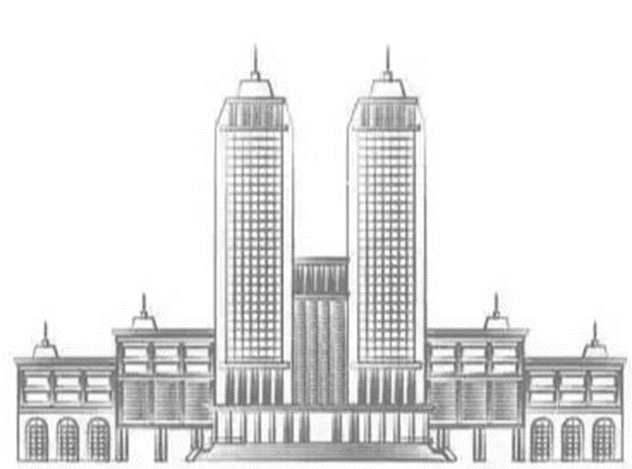
Quantum simulation of 2-color QCD on a (2+1) dimensional small lattice
Speaker：Zhen-Xuan Yang
Collaborator: Hidefumi Matsuda, Xu-Guang Huang and Kouji Kashiwa
Based on arXiv:2503.20828

Slide 2


Outline
Introduction
Hamiltonian formulation
Quantum simulation
Summary and outlook

Slide 3



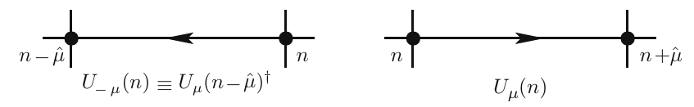


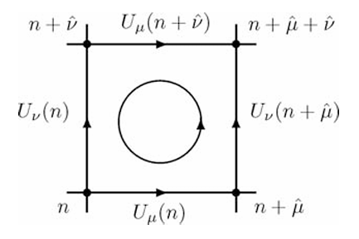
Introduction
QCD in the continuum:
fermion action
gluon action
lattice QCD:

Slide 4
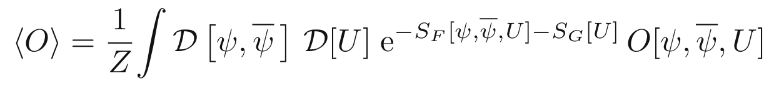
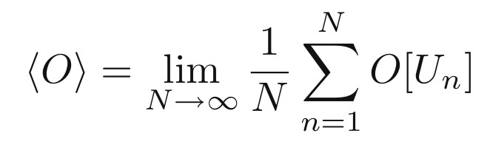

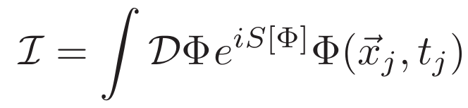
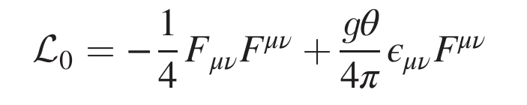
Introduction
Path integral on the lattice:
Markov-Chain Monte Carlo(MCMC) method
Sign problem occurs when :
chemical potential
real-time
topological term

Slide 5
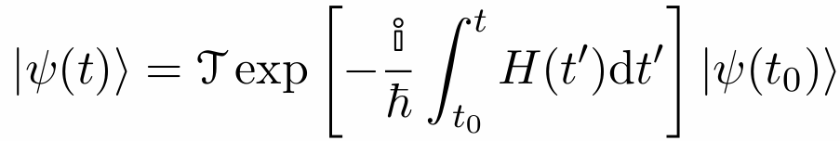
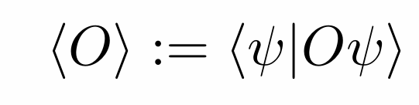
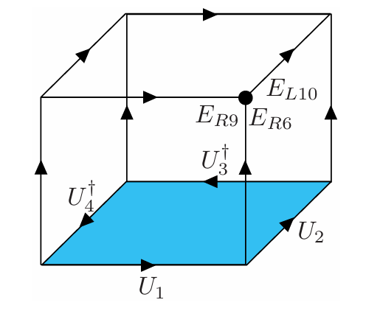
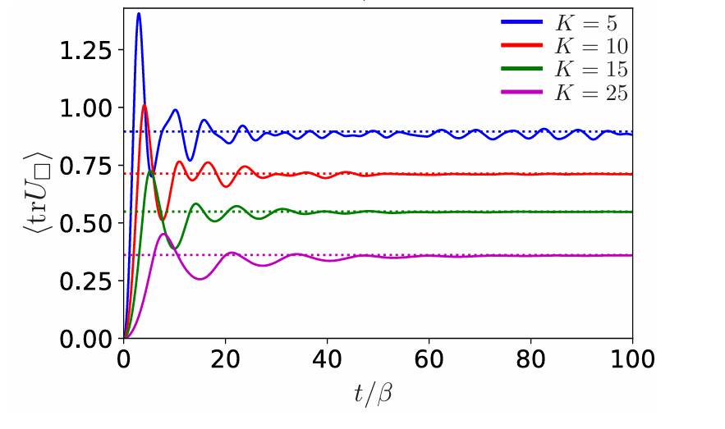
Introduction
Hamiltonian formulism:
time evolution
observable
From Phys. Rev. D 103, 094502 (2021), arXiv:2011.09814

Slide 6
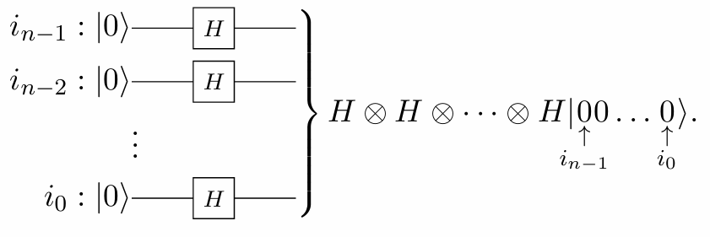
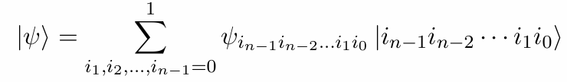

Introduction
Quantum circuit model
Memory of quantum circuit can be $2^{n}$ where n is the number of qubits

Slide 7
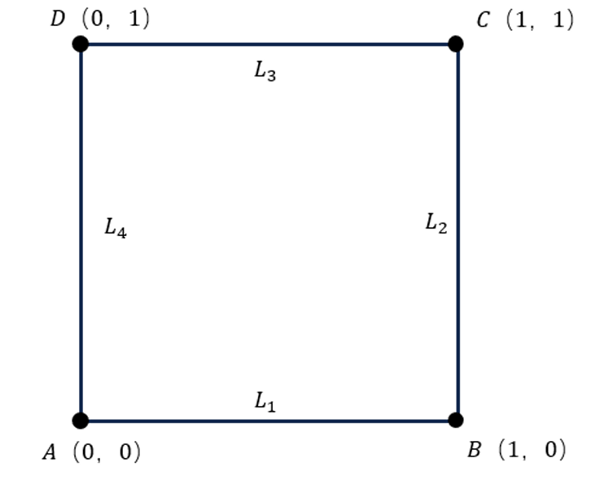
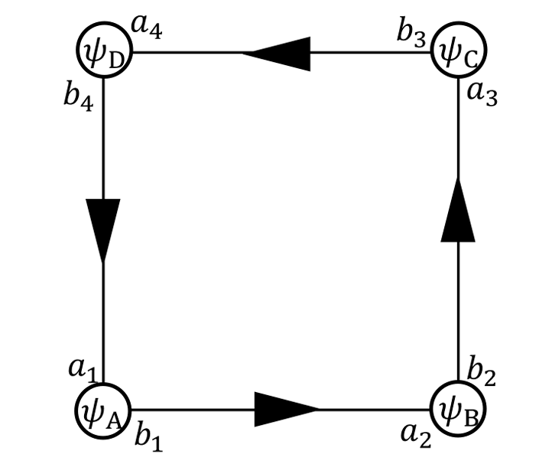
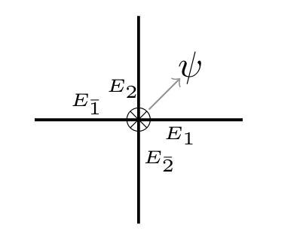
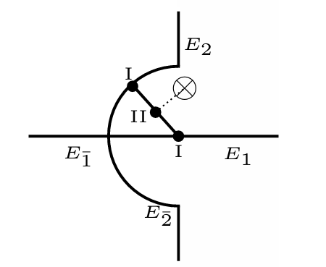
Introduction
(2+1）dimensional small lattice model
lattice label variables label
Point-splitting:
From Indian J. Phys. 95, 1651 (2021), arXiv:1906.03893

Slide 8

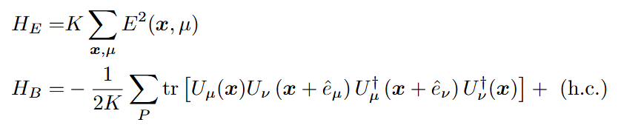
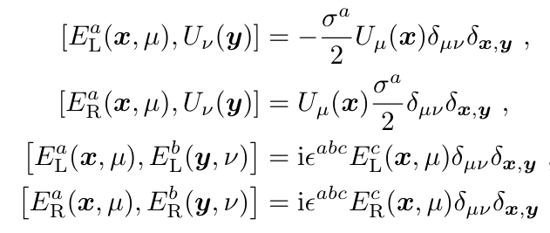

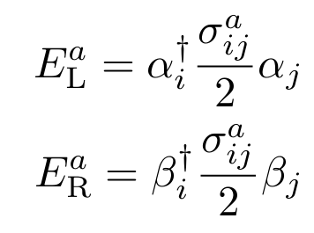
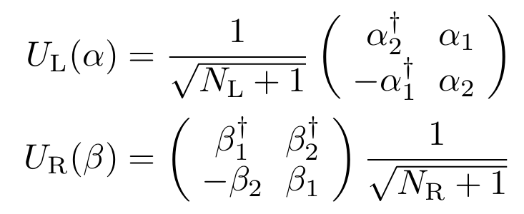
Hamiltonian formulation
The Kogut-Susskind Hamiltonian with staggered fermion
The commutate relation Schwinger boson

Slide 9
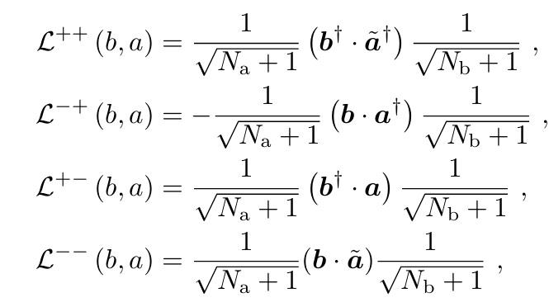


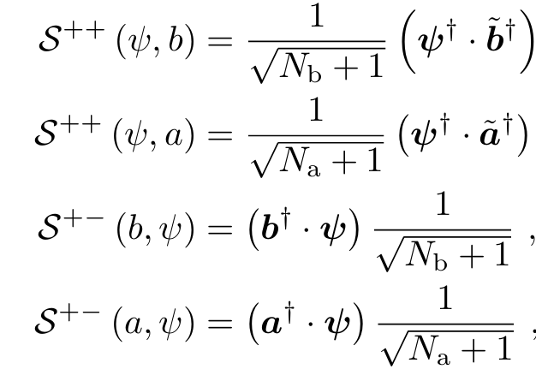
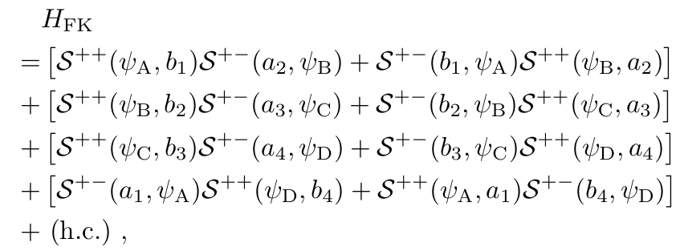
Hamiltonian formulation
02
The Hamiltonian of the small lattice Gauge invariant operator

Slide 10
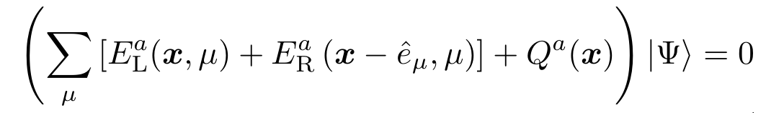



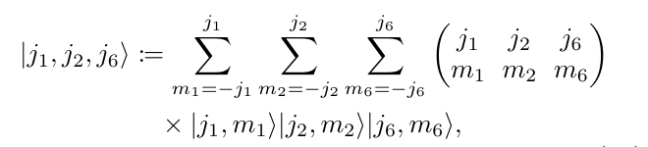
Hamiltonian formulation
02
Construction of Gauge invariant state
The Gauss law condition Charge operator
Gauge invariant state using Loop-String-Hadron (LSH) formulation
Angular momentum singlet state

Slide 11




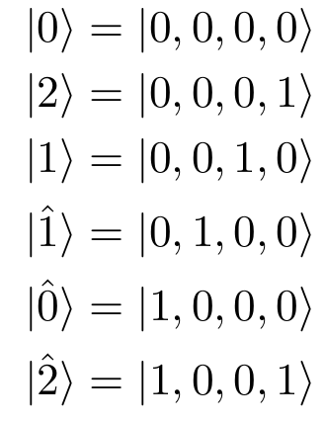
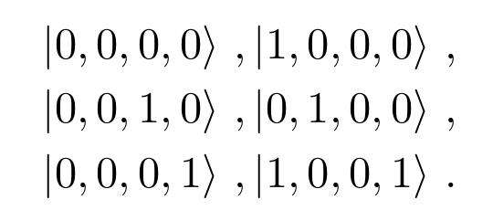
Hamiltonian formulation
Single point states:
the Loop-String-Hadron basis
angular momentum basis
relation between these two representation
do the truncation at
single point states can be for convenience

Slide 12
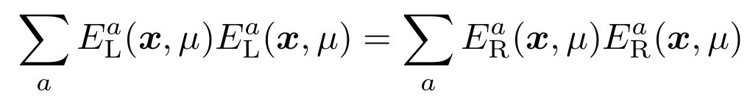

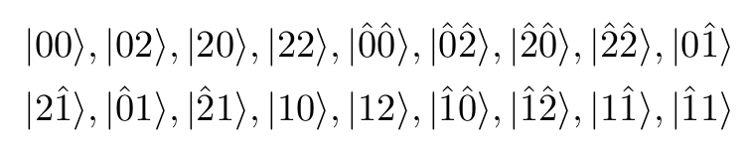

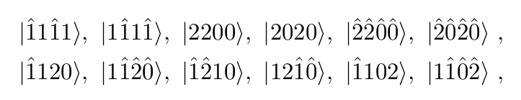
Hamiltonian formulation
Global states：
U(1) constraint
indicate
all possible neighbor states
global states with total fermion number
Number of these states is 38, which needs at least 6 qubits to simulate

Slide 13


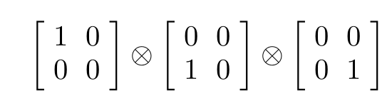

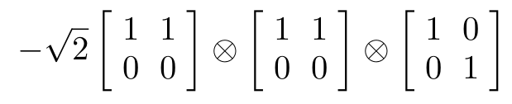

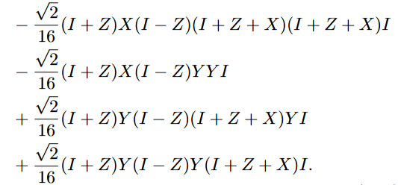
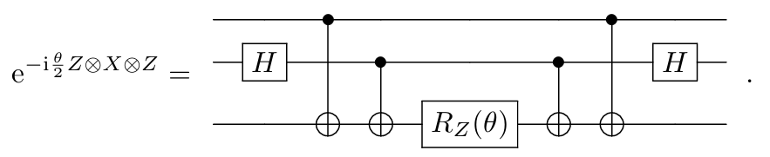
02
Quantum simulation
Map the model into a spin system
Figure out the Hamiltonian matrix using Pauli matrix :
for the first three qubits Suzuki-Trotter decomposition
for the last three qubits time evolution
transform to Pauli matrix quantum circuit for Pauli type matrix

Slide 14

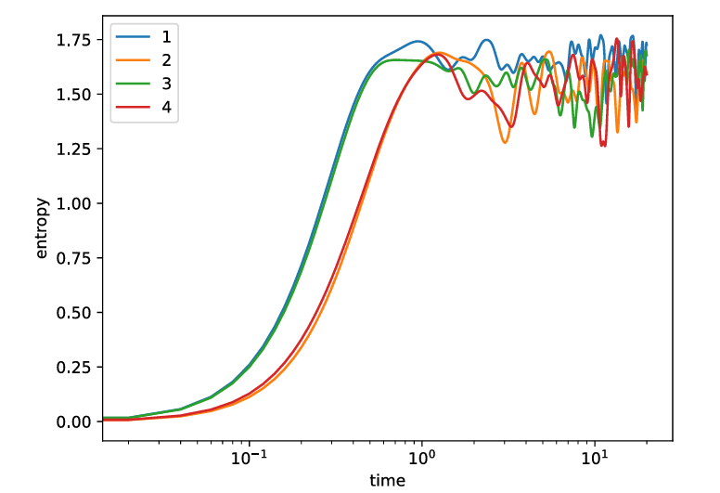
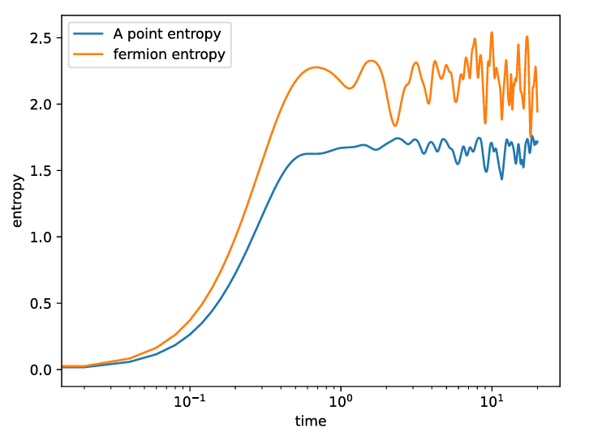



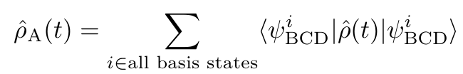



Quantum simulation
02
Real-time evolution: density matrix
Single point entropy fermion entropy

Slide 15
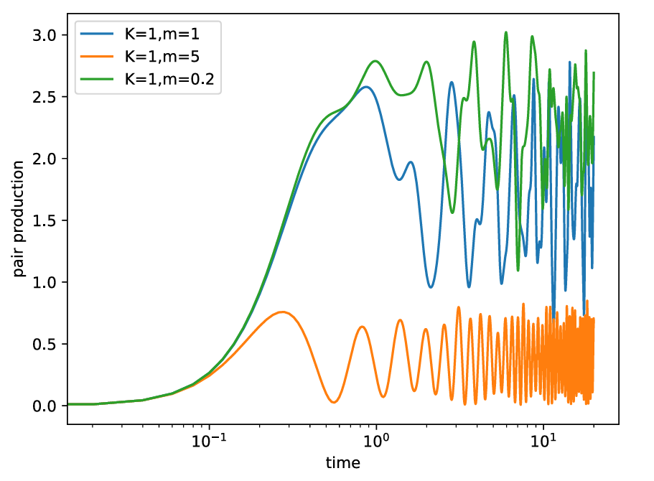
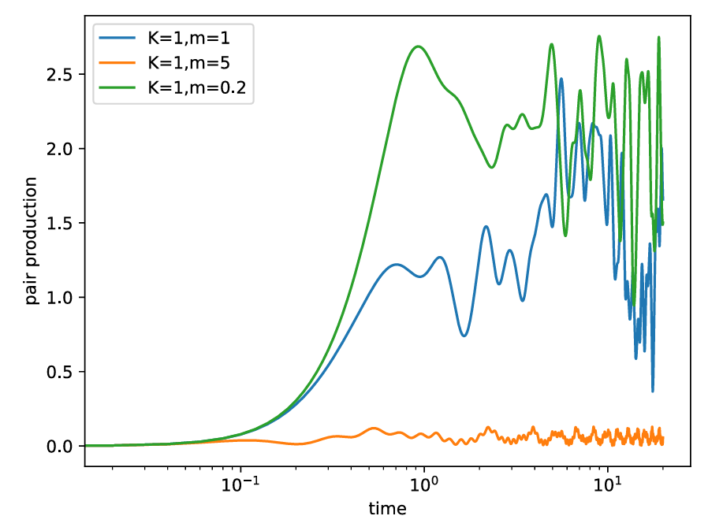


Quantum simulation
02
Time evolution of pair production:
pair production

Slide 16
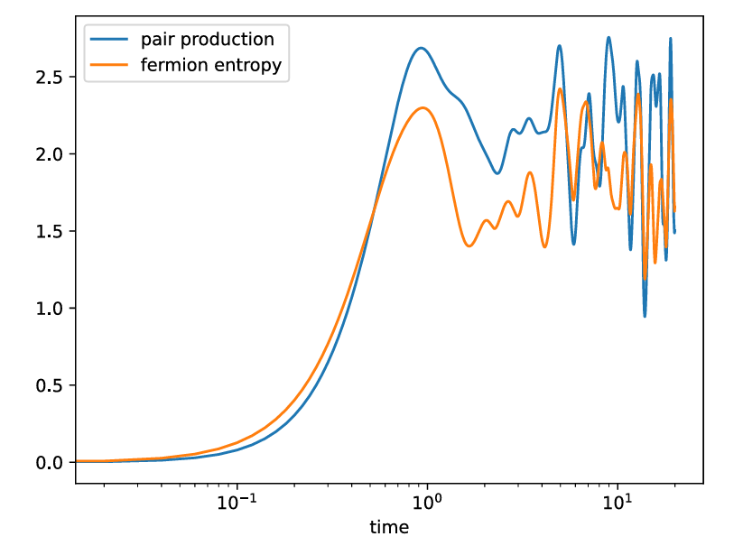
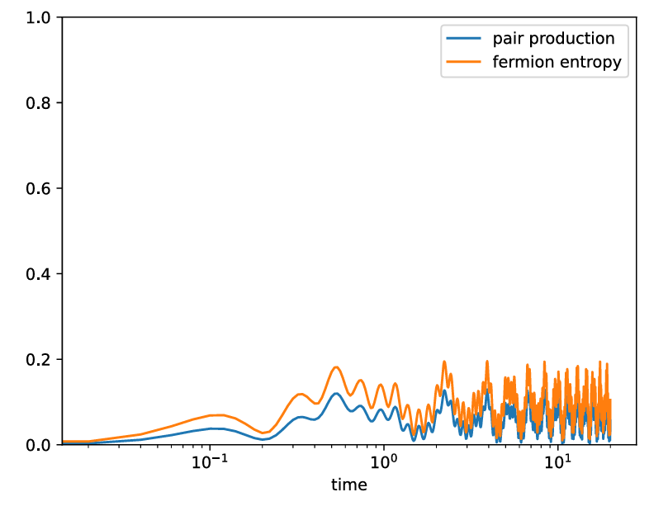



Quantum simulation
02
Comparison between pair production and fermion entropy:

Slide 17
02
Summary and Outlook
Summary:
We have simulated the real-time evolution of SU(2) gauge theory with fermions on a small two-dimensional lattice using the loop-string-hadron (LSH) formulation. We have mapped the formulated model to a spin system, laying the groundwork for future quantum simulations on actual quantum computers. We have tracked the real-time quantum evolution of the system starting from nonequilibrium states and have studied the entanglement entropy and fermion production.
Outlook:
In the future, to achieve our objective of simulating real QCD, we need to improve our model step by step. In particular, to investigate more aspects of SU(2) Yang-Mills theory, we need to increase the lattice size and consider higher-energy states, which may provide a testing ground for thermalization. Furthermore, we would like to consider a more realistic scenario, namely, SU(3) Yang-Mills theory with fermions. Once we achieve this objective, we hope to gain deeper insights into the physics of QCD.

Slide 18
Thanks！

