Slide 1



Azimuthal modulation in light-by-light scattering from ultraperipheral collisions at LHC
Shuo Lin
Department of Modern Physics,
University of Science and Technology of China
Notes:
Good morning, everyone. It is my great honor to have this opportunity to introduce our work. My topic is Azimuthal Modulation in Light-by-Light Scattering from Ultraperipheral Collisions at the LHC.

Slide 2
Outline
Introduction & Motivation
Photon-photon interactions and photon nucleus interaction in heavy ion collisions
Azimuthal modulation in light-by-light scattering from ultraperipheral collisions at LHC
Summary
Notes:
I will introduce it from the following four aspects: The first part is an introduction to ultraperipheral heavy ion collisions. In the second part, I’ll talk about Photon-photon interactions and photon nucleus interaction in heavy ion collisions. In the third part, I will focus on a process—Light-by-Light scattering. In this section, we will discuss its azimuthal asymmetry, and the final part is my summary.

Slide 3
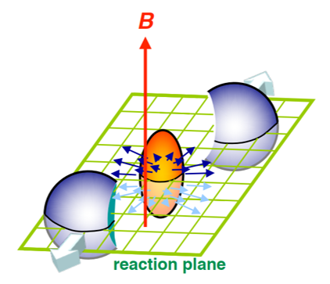
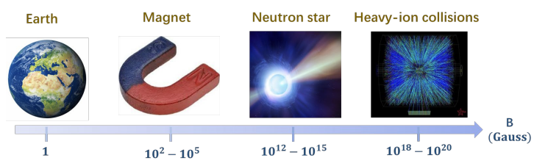
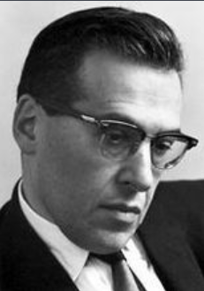
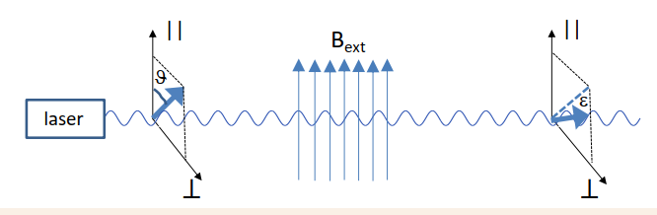

Strong EB fields in HIC
$eB\sim γZαv/b_{T}^{2}\sim {10}^{18}Gauss$
$\sqrt{s_{NN}}=200GeV$ Au+Au
Such strong electromagnetic field provides a platform for studying QED phenomena under extreme conditions
Schwinger Effect
Vacuum birefringence
Notes:
In relativistic heavy ion collisions, due to the large charge number of the nucleus, extremely strong electromagnetic fields can be generated. For example, in a 200 GeV gold-gold collision, the electromagnetic field can reach up to 10 to the power of 18 Gauss

Slide 4
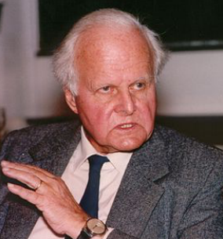
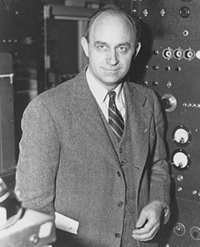
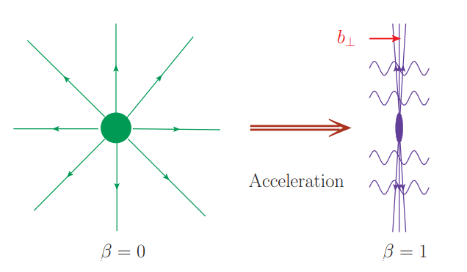
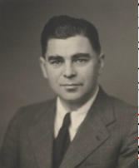
Equivalent Photon Approximation
Ultra-relativistic charged particle produce highly Lorentz contracted electromagnetic field
Equivalent Photon Approximation
Classical EM ⇔ Quasi-real photons
Notes:
Fermi,Weizsäcker and Williams discovered that charged particles moving at high speeds can produce a highly Lorentz-contracted electromagnetic field, and scuh transverse classical field can be viewed as a quasi-real photon beam. We call this method the equivalent photon approximation.

Slide 5
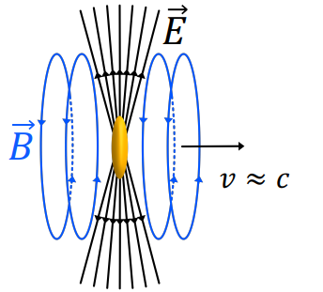
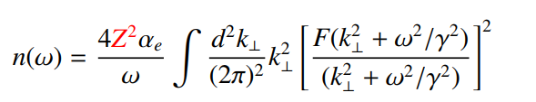
Equivalent Photon Approximation
Due to the large flux of quasi-real photon,the cross-section can be enhanced by the Ze
Notes:
On the other hand, Due to the large flux of quasi-real photon , the cross-section can be enhanced by the charge number.

Slide 6
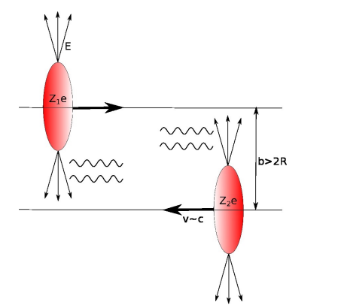
Ultraperipheral Collisions(UPC)
UPC: the impact parameter is larger than 2 times the radius of a nucleus
Clean background
Notes:
In relativistic heavy ion collisions, there is a very special case called ultraperipheral collisions. The UPC means that the impact parameter is larger than 2 times the radius of a nucleus. In this case ,the environment is very clean.

Slide 7
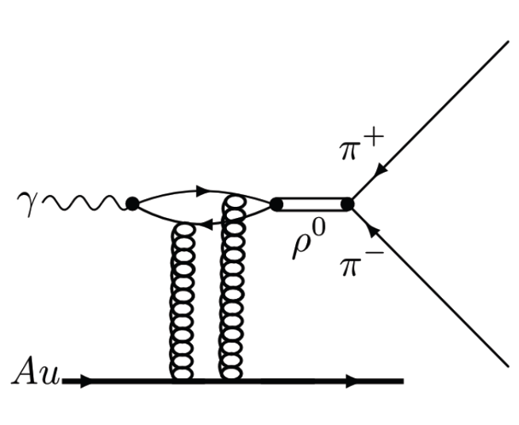
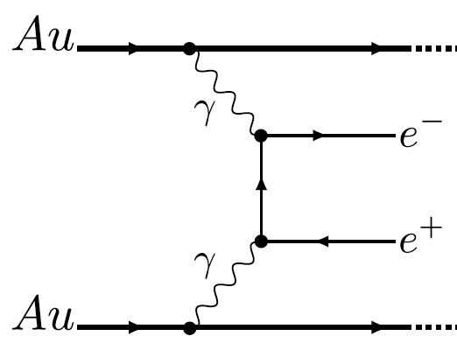


Photoproduction in HIC
$$γγ→l^{+}l^{−}$$
$$γℙ→ρ$$
Notes:
A quasi-real photon emitted by one nucleus can interact with photons from the other, exchange a pomeron to produce vector mesons. These two types of processes have recently become hot topics in experimental and theoretical studies.

Slide 8
Photon-photon interactions

Slide 9
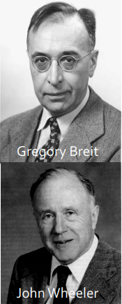
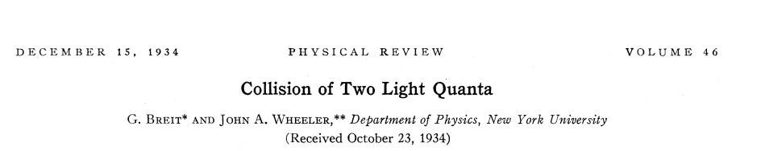
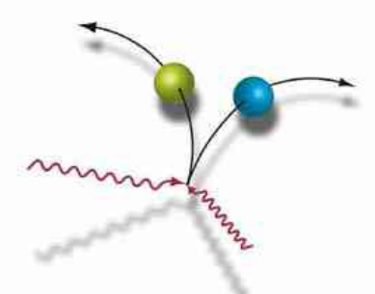
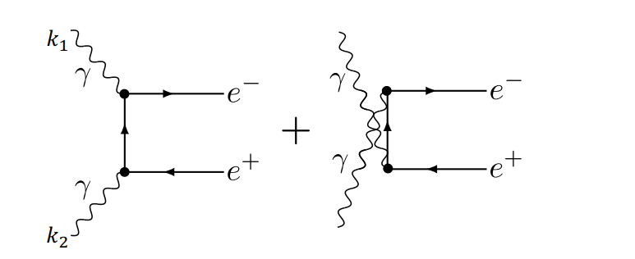
Breit-Wheeler Process
In 1934 Breit and Wheeler
Notes:
As early as 1934, Breit and Wheeler propose that the production of lepton pairs by two real photon collisions. Howerver it requires very high energy photons to achieve this process, so how can such photons be produced experimentally?

Slide 10
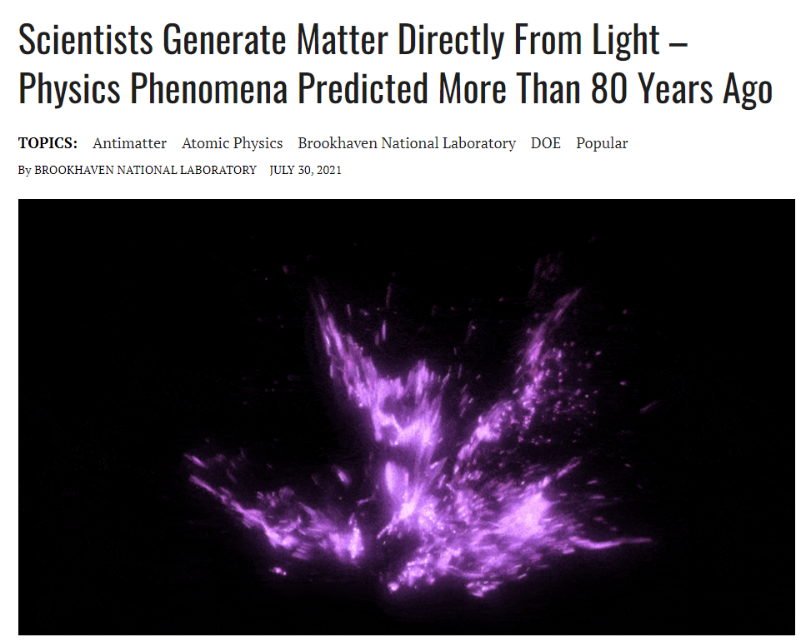
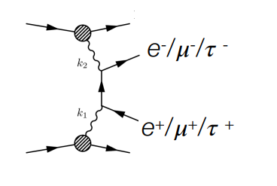

Breit-Wheeler Process
$γγ→l^{+}l^{−}$ processes have been measured in UPC
STAR, J. Adam et al., Phys. Rev. Lett. 127, 052302 (2021), 1910.12400.
ATLAS, G. Aad et al., Phys. Rev. C 104, 024906 (2021), 2011.12211.
CMS, A. M. Sirunyan et al., Phys. Rev. Lett. 127, 122001 (2021), 2011.05239.
ALICE, Abbas, E et al., Eur.Phys.J.C 73 (2013)11, 2617, 1305.1467.
Notes:
The experimentalists achieved this process by Ultraperipheral Collisions in relativistic heavy ions. Several collaborations performed measurements. the subjects of study included not only electrons but also muons and tauns

Slide 11
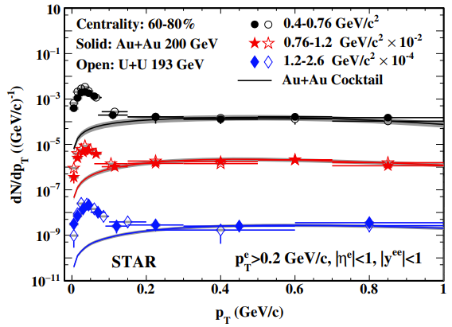
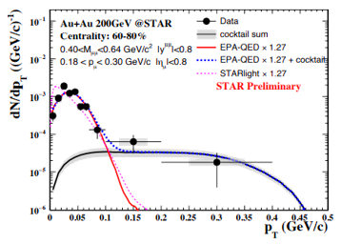

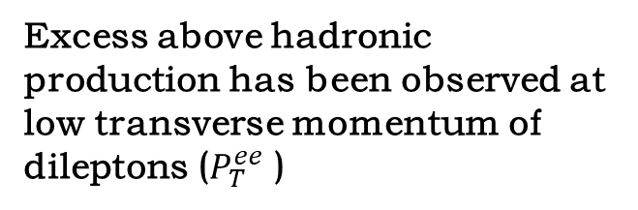
Breit-Wheeler Process
$γγ→l^{+}l^{−}$ processes have also been measured in peripheral collisions ($b<2R_{A}$ PC)
STAR, J. Adam et al., Phys. Rev. Lett. 121, 132301 (2018), 1806.02295.
ATLAS, M. Aaboud et al., Phys. Rev. Lett. 121, 212301 (2018), 1806.08708.
ALICE, Sebastian Lehner et al., PoS LHCP2019 (2019) 164, 1909.02508.
Excess above hadronic production has been observed at low transverse momentum of dileptons ($P_{T}^{ee}$ )
Notes:
This process has also been measured in peripheral collisions 。These two figures show the star measurements. The data come from experiment and these line comes from hadronic production. Excesses above hadronic production has been observed at low transverse momenta of dileptons. This contribution can be explained by Photoproduction.

Slide 12

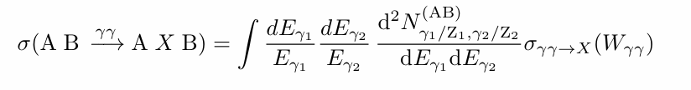
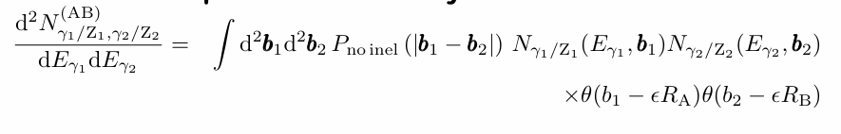
Theoretical framework
Traditional Equivalent Photon Approximation (EPA)
• C.A. Bertulani, S.R. Klein, J Nystrand, Ann.Rev.Nucl.Part.Sci. 55 (2005) 271-310
• A. J. Baltz, Y. Gorbunov, S. R. Klein and J. Nystrand, PRC 80, 044902 (2009)
• W. Zha, L. Ruan, Z. Tang, Z. Xu and S. Yang, PLB 781, 182 (2018)
Effective two-photon luminosity:
Notes:
At first, people used Traditional Equivalent Photon Approximation for such calculations, as shown in the following formula. But this method does not include some information of the photon , so they can,t describe the experimental results well.

Slide 13
Theoretical framework
kt＆bt dependent
• C. Li, J. Zhou and Y. J. Zhou, PLB 795, 576(2019) ;PRD 101 (2020) 3, 034015
• Klein, Muller, Xiao, Yuan, PRL 122 (2019) 13, 132301; PRD 102 (2020) 9,094013
• W. Zha, J. D. Brandenburg, Z. Tang and Z. Xu, PLB 800 (2020) 13508
• R.J. Wang, S.Pu, Q. Wang, PRD 104 (2021) 5, 056011
Review
• Coherent photons induced high energy reactions in ultraperipheral heavy ion collisions， S.Pu,B. Xiao,F. Yuan,J. Zhou ,Acta Phys.Sin. 72 (2023) 7, 072503
Notes:
Later, it was realized that we need to take into account both the transverse momentum and the impact parameter in the theoretical framework

Slide 14
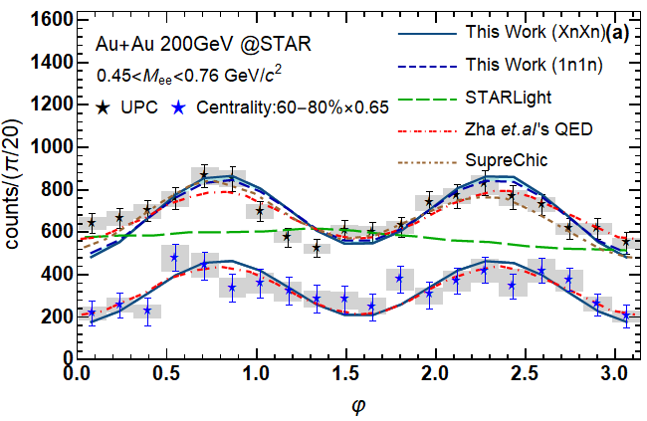
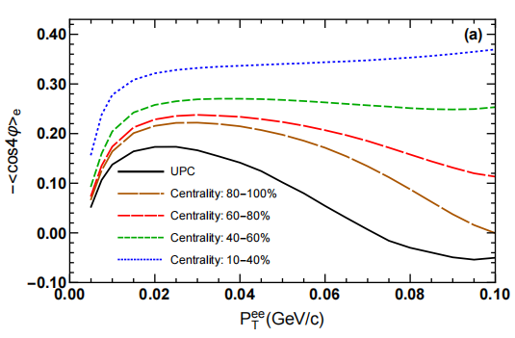
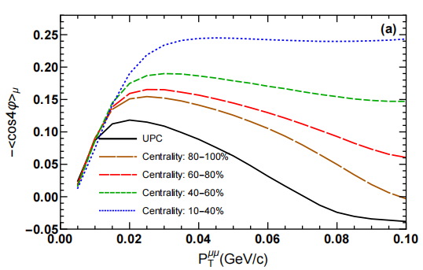
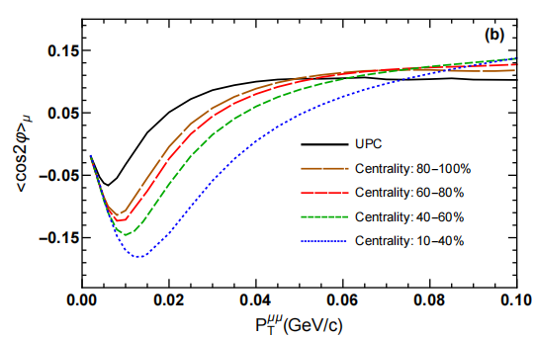

Azimuthal Modulations
R.J. Wang, S. Lin, S.Pu,Y.F. Zhang, Q. Wang，Phys.Rev.D 106 (2022) 3, 034025
The linear polarization
information of photons
is important for
understanding the
azimuthal asymmetry of
the lepton pair.
The $cos2φ$ modulations of $μ^{+}μ^{−}$ are higher than $e^{+}e^{−}$ case.
C. Li, J. Zhou, and Y.-J. Zhou, 1903.10084, 1911.00237.
Notes:
The green line is based on the traditianal EPA approximation, doesn't include the effect of photon polarization, therefore fails to describe the experimental results well.

Slide 15
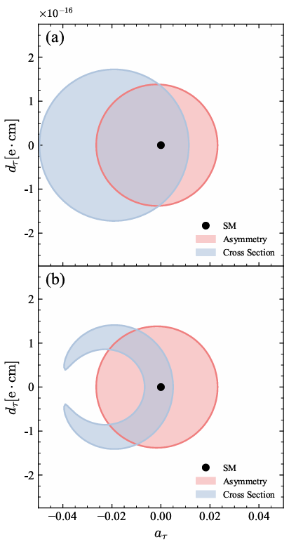
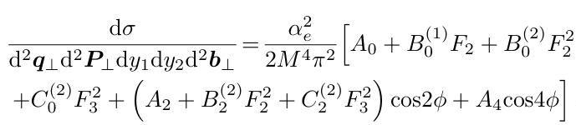
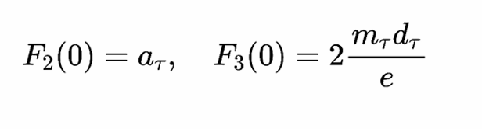
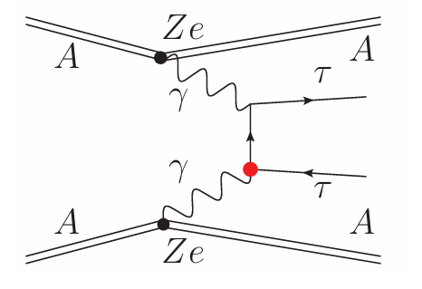
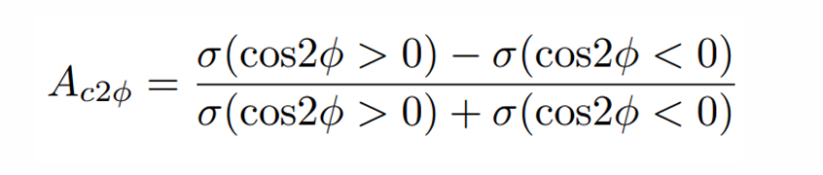
Azimuthal Modulations
Dingyu Shao, Bin Yan, Shu-Ruan Yuan, Cheng Zhang, Sci. China Phys. Mech. Astron. 67 (2024) 281062
Anomalous magnetic
Electric dipole moments
Notes:
In this paper ,they proposed using azimuthal asymmetry to constrain anomalous magnetic moments and electric dipole moments.

Slide 16
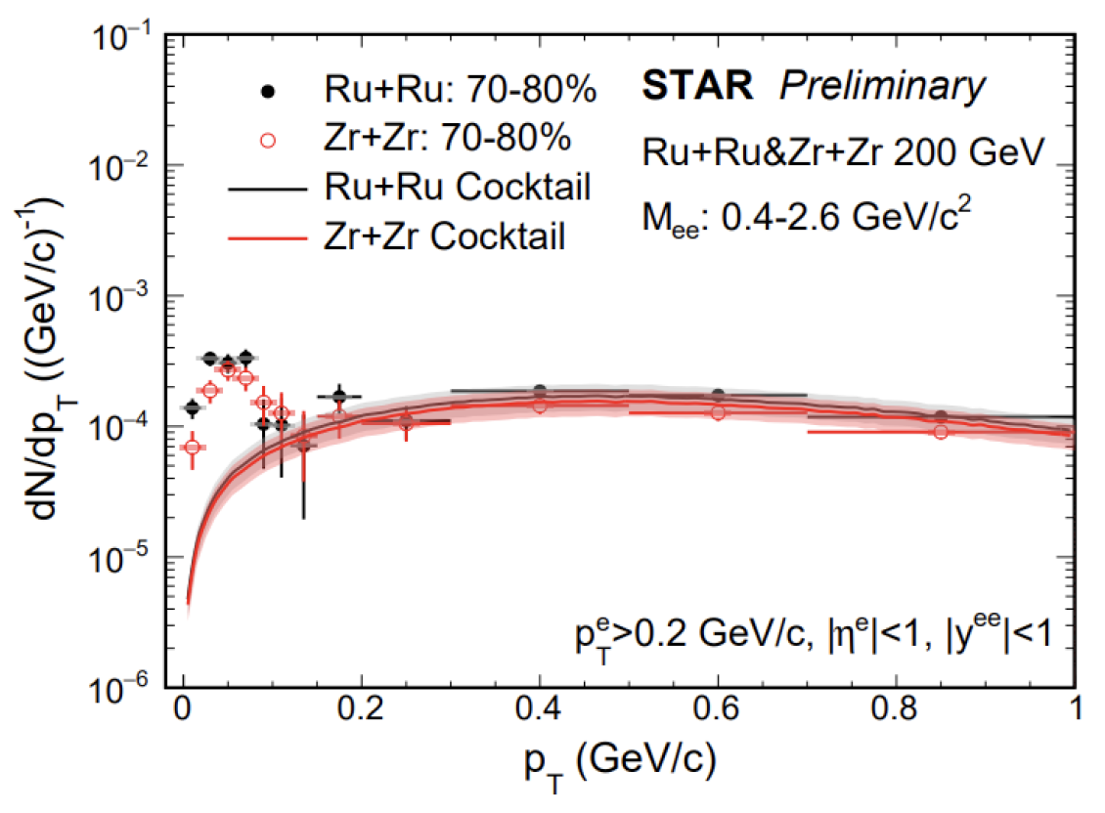
Isobar collisions
Notes:
Breit wheeler process has also been measured in the isobar peripheral collision. I will briefly introduce our related research. First, let me briefly introduce the isobar collision.

Slide 17
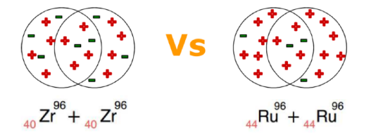
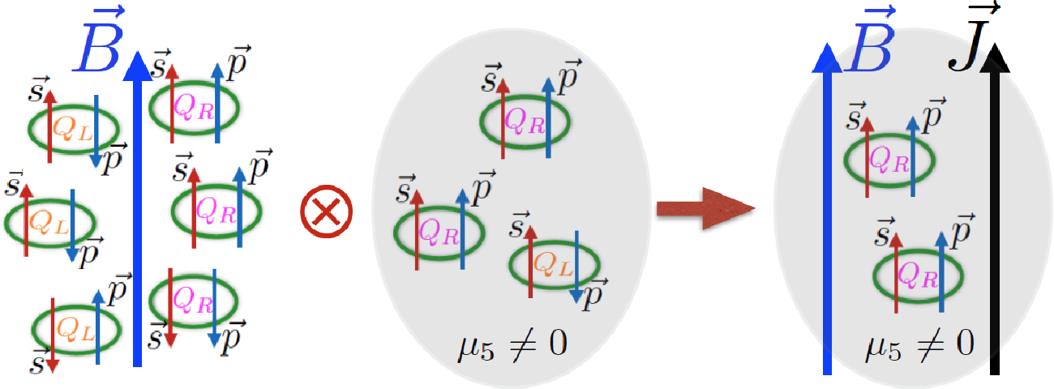

Isobar collisions
The isobar collision was proposed to measure the chiral magnetic effect.
• Same background
• Different magnetic field => different CME signal
$$j_{CME}=\frac{e^{2}}{2π^{2}}μ_{5}B$$
D. Kharzeev, L. McLerran, and H. Warringa, Nucl.Phys. A 803, 227 (2008)
......
Notes:
Isobar means Same nucleon number , different charge number. The isobar collisions was proposed to measure the chiral magnetic effect. People at first thought Same number of nucleons can lead to Same background and Different magnetic field can lead to different size of CME signal.

Slide 18
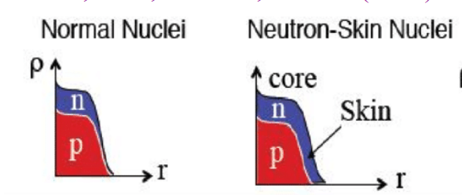
Isobar collisions
Precision isobar data can be used to probe neutron skin thickness ,nuclear symmetry energy and nuclear deformation
H.J. Xu, et.al., PRL121, 022301 (2018)
H. Li, H.J. Xu et.al., PRC98, 054907(2018)
C. Zhang, J. Jia, PRL128, 022301(2022)
S. Zhao, H.J. Xu, et.al, PLB839, 137838 (2023)
……
Backgrounds are not identical!
Notes:
However, with the deepening of the study, it was found that the background was not exactly the same due to some factors such as nuclear structure. At the same time, people have also realized that Precision isobar data can be used to probe neutron skin thickness ,nuclear symmetry energy and nuclear deformation

Slide 19
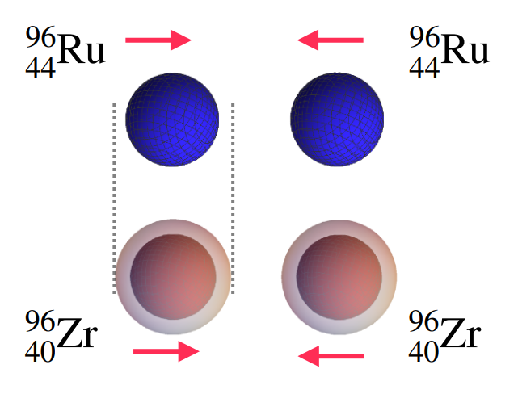
Isobar collisions
Can nuclear structure information be reflected in the photoproduction in isobar collision ?
Notes:
A natural question is Can nuclear structure information be reflected in the photoproduction of lepton pairs ?

Slide 20
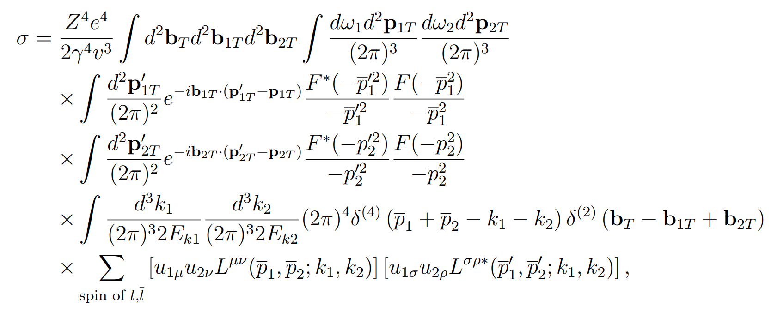
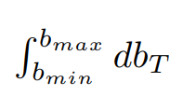

Peripheral isobar collisions
Charge density distribution
$$F$$
Mass density distribution
The lepton pair photoproduction is calculated with the charge density distribution, while the centrality is defined from the Glauber model with the nuclear mass density.
Notes:
Let us review the theoretical framework.

Slide 21
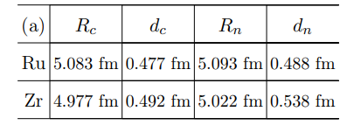

Nuclear structure calculation by DFT
Nuclear charge density ≠ Nuclear mass density
c: nuclear charge density n:nuclear mass density
S. Lin,R.J. Wang, J.F. Wang, H.J. Xu, S. Pu and Q. Wang, Phys.Rev.D 107 (2023), 054004.

Slide 22
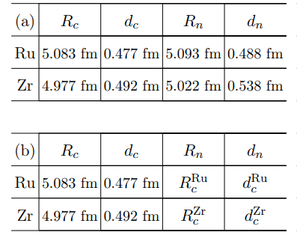
Parameter setting
For comparison, we also use the charge density distribution as the mass density distribution to define the centrality
S. Lin,R.J. Wang, J.F. Wang, H.J. Xu, S. Pu and Q. Wang, Phys.Rev.D 107 (2023), 054004.
Notes:
For comparison, we also use the charge density distribution as the mass density distribution to define the centrality

Slide 23
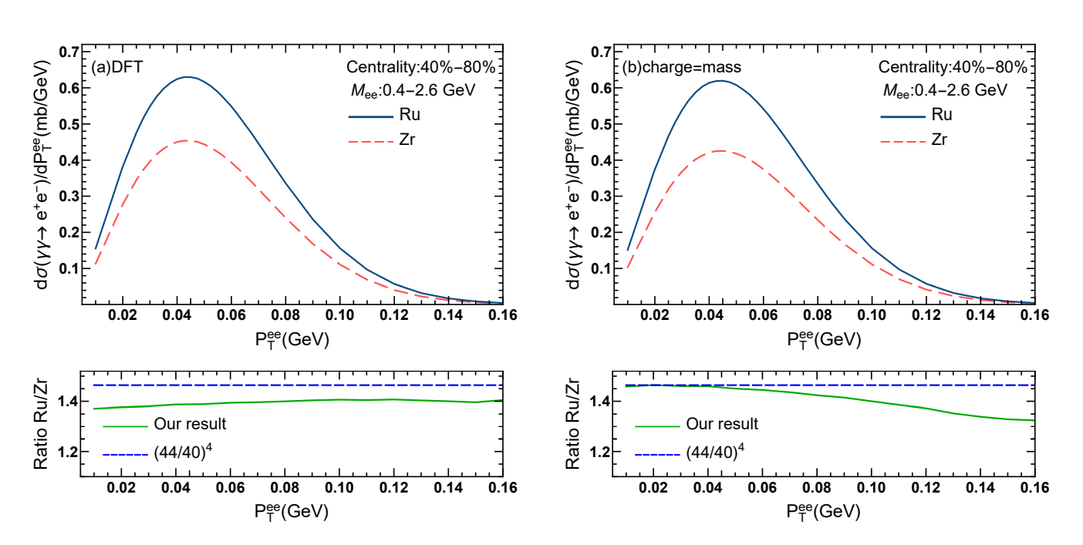

Numerical results
$P_{T}^{ee}$ distribution
S. Lin, R.J. Wang, J.F. Wang, H.J. Xu, S. Pu and Q. Wang, Phys.Rev.D 107 (2023), 054004.
Notes:
We see that the charge and mass distributions can lead to a difference between (a) and (b) .the ratio is always smaller than (44/40)4 , while for case (b) in which the nuclear mass density distribution is set to be equal to the charge density distribution, it is very close to (44/40)4 at P ee T ≤40 MeV

Slide 24
Photoproduction of vector meson in
ultraperipheral collisions
Notes:
Next, I'll introduce

Slide 25
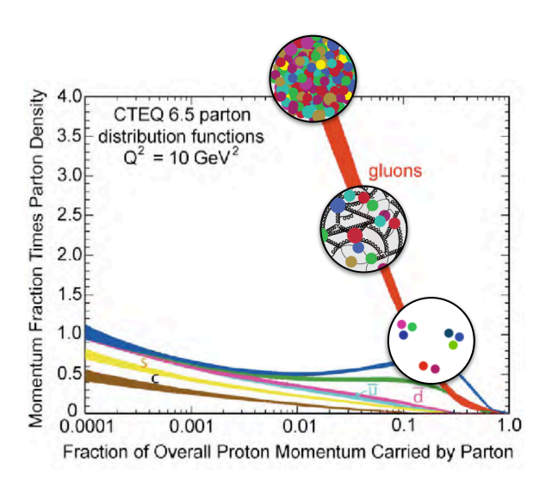

Photoproduction of vector meson
γ+p/A→V+p/A
parton structure
Gluon saturation and small x physics
Phys. Rev. Lett. 131, 262301
Notes:
This process has links to many interesting topics such as parton structure One can also use this process to study small x physics, limiting the behavior of gluons

Slide 26

UPC in isobar collisions
Notes:
The isobar experiment also measured the production of rho mesons in ultra-peripheral collisions.
We can observe positive slope

Slide 27





Photoproduction of vector meson
Total cross section through the EPA method
Dipole model
Dipole nucleus scattering amplitude parameterization
thickness function
S. Lin, J.Y Hu, H.J. Xu, S. Pu and Q. Wang,Phys.Rev.D 111 (2025) 7, 074020
.
Notes:
Let me briefly introduce the theoretical framework, we use CGC to describe the process, the amplitude can be written as follows
The photon splits into the qqbar,
This part describes the scattering of quark-antiquark pairs with nuclei.
the positive and negative quarks combine into the hadron wave function
For the N part, we use a phenomenological model, which is directly related to the thickness function

Slide 28




Nuclear deformation
Ru deformed as an ellipsoid Zr deformed as a pear
The Woods-Saxon distribution
$β_{2}$:quadrupole deformation $β_{3}$:octupole deformation
Notes:
Studies of nuclear structure tell us that

Slide 29


Compared to the experiment
We calculate the ratio of transverse momentum spectra of $ρ^{0}$in isobar UPCs.(tip-tip collision, body-body collisions , deformation average, no deformation, respectively)
Deformation
S. Lin, J.Y Hu, H.J. Xu, S. Pu and Q. Wang,Phys.Rev.D 111 (2025) 7, 074020
.
No deformation
The slope of the transverse momentum spectrum ratio is sensitive to nuclear deformation
Notes:
This line corresponds to the result with deformation taken into account, while this one shows the result without deformation

Slide 30
light-by-light scattering
Based on: 2410.13781
In collaboration with: Yu Jia, Jian Zhou, Ya-jin Zhou
Notes:
Now, let us focus on light-by-light scattering. This work is based on this paper, in collaboration with Professor Yu Jia, Jian Zhou, and Ya-jin Zhou.

Slide 31


light-by-light scattering
The study has a long history
Initially predicted based on Dirac's theory. Halpern 1933
Low frequency limit Euler-Heisenberg Lagrangian
Heisenberg, Euler and Kockel 1935-36
High frequency limit Akhieser, Landau and Pomeranchuk 1936
The first complete LO calculation in QED Karplus & Neuman 1951
Notes:
The study of this process has a long history.It was initially predicted based on Dirac's theory in 1933. In 1935-36, Heisenberg, Euler, and Kockel systematically studied LbL scattering in the low-frequency limit.In 1936 Akhieser, Landau, and Pomeranchuk also studied this process in the high-frequency limit. In 1951, Karplus and Neuman presented complete LO calculation of helicity amplitude in QED. Their result is valid for arbitrary photon frequencies.

Slide 32

light-by-light scattering
It is closely related to many fascinating topics.
One of the most fascinating processes in Standard Model
Notes:
Light-by-light scattering is closely related to several interesting physical topics. It is a quantum-mechanical process that is forbidden in the classical theory of electrodynamics. It proceeds at one-loop level via virtual box diagrams involving charged fermions or W bosons in SM. So it is one of the most fascinating processes in Standard Model.

Slide 33

light-by-light scattering
It is closely related to many fascinating topics.
One of the most fascinating processes in Standard Model
Strong field related phenomena
Delbrück scattering
photon splitting
Notes:
It related to strong-field phenomena such as Delbrück scattering, photon splitting. Each cross denotes external field legs.Delbrück scattering refers to photon scattering in the Coulomb field of a nucleus.Photon splitting refers to the process in which a photon splits into two photons via interaction with external fields.

Slide 34

light-by-light scattering
It is closely related to many fascinating topics.
One of the most fascinating processes in Standard Model
Strong field related phenomena
The anomalous magnetic moments
.
Notes:
It also related to anomalous magnetic moments . Light-by-light scattering must be taken into account in precision calculations of the anomalous magnetic moment.

Slide 35

light-by-light scattering
It is closely related to many fascinating topics.
One of the most fascinating processes in Standard Model
Strong field related phenomena
The anomalous magnetic moments
A playground to search for new physics.
Notes:
Besides, it provides us a playground to search for new physics such as axion.

Slide 36

Experimental measurement
M. Aaboud et al. (ATLAS), Nature Phys. 13, 852 (2017), 1702.01625.
A. M. Sirunyan et al. (CMS), Phys. Lett. B 797, 134826 (2019), 1810.04602.
G. Aad et al. (ATLAS), Phys. Rev. Lett. 123, 052001 (2019), 1904.03536.
G. Aad et al. (ATLAS), JHEP 03, 243 (2021), [Erratum: JHEP 11, 050 (2021)], 2008.05355.
Notes:
Since the production rate is suppressed by the fourth power of alpha., it is quite challenging to directly observe. Fortunately, due to the high photon flux provided by heavy ions, Experimentalists have realized this process using UPC. These are papers related to ATLAS and CMS.

Slide 37


light-by-light scattering
kt＆bt dependence
Y.Jia, S. Lin, J.Zhou, Y.J. Zhou, arxiv:2410.13781
Notes:
We investigate the LbL scattering at UPCs by employing a joint impact parameter and transverse momentum de pendent formalism. Here, b is impact parameter.

Slide 38




light-by-light scattering
Notes:
We calculated the spectra of transverse momentum, invariant mass and rapidity.

Slide 39

Azimuthal modulation
The linear polarization of initial photons
→azimuthal asymmetry of final photon pairs
Y.Jia, S. Lin, J.Zhou, Y.J. Zhou, arxiv:2410.13781
Azimuthal modulation could be a valuable new observable for distinguishing between different BSM model.
Notes:
The linear polarization of the initial state photons can lead to non-trivial azimuthal distribution of the final state photons.. We can observe a very clear azimuthal asymmetry of cos(2φ). As we mentioned earlier, Prof. Yanbin and collaborators aim to constrain new physics parameters through the azimuthal asymmetry of dileptons. So we think Azimuthal modulation of photon can also be a valuable new observable for new physics

Slide 40


light-by-light scattering
Prediction for the Pb+Pb
Y.Jia, S. Lin, J.Zhou, Y.J. Zhou, arxiv:2410.13781
Notes:
These two figures shows the azimuthal asymmetries of LbL scattering with respect to the invariant mass Q and the transverse momentum of the diphoton. The red line show cos(2φ) asymmetry, and the blue line show cos(4φ) asymmetry.Here we see that the 2 times ⟨cos⁡(2ϕ)⟩ asymmetry is about 17% .In contrast, 2⟨cos⁡(4ϕ)⟩ is smaller, peaking around 5%

Slide 41


Electron–Ion Colliders
Electron-Ion colliders with high collision energy and high luminosity
Notes:
In the future, Electron-Ion Collider will be built, and we can use this type of collider to study light-by-light scattering.

Slide 42



The photon PDF of the electron

Slide 43

light-by-light scattering
Prediction for the EIC
Y.Jia, S. Lin, J.Zhou, Y.J. Zhou, arxiv:2410.13781
Notes:
This is our prediction.We can observe an azimuthal asymmetry of cos(2φ) and a smaller azimuthal asymmetry of cos(4φ).

Slide 44


light-by-light scattering
Prediction for the EIC
Y.Jia, S. Lin, J.Zhou, Y.J. Zhou, arxiv:2410.13781
Notes:
These two figures shows the azimuthal asymmetries of LbL scattering with respect to the invariant mass Q and the transverse momentum of the diphoton.Here we see that the 2 times ⟨cos⁡(2ϕ)⟩ asymmetry is about 10% .In contrast, 2⟨cos⁡(4ϕ)⟩ is smaller. The azimuthal asymmetry of cos(4φ) is approximately a few percent.

Slide 45
Summary
The photoproduction in heavy ion collisions are closely connected to a wide range of physical topics.
light-by-light scattering is a fundamental process for many interesting questions.
We show that the linear polarization of incident photons generates a sizable cos2ϕ-type azimuthal modulation, which awaits the test in future LHC and EIC/EicC experiments.

Slide 46
Thanks for your attention!

