Slide 1








A-B Plots Update
Workshop at LASA
D. Novelli^{1,2}, L. Alfonso², A. Bersani², L. Bottura⁵, B. Caiffi²,
S. Farinon², F. Mariani¹, S. Mariotto³ , A. Pampaloni², T. Salmi⁴
¹Sapienza University of Rome
²INFN – Genoa
³INFN and University of Milan
⁴Tampere University
⁵CERN
Funded by the European Union (EU). Views and opinions expressed are however those of the author only and do not necessarily reflect those of the EU or European Research Executive Agency (REA). Neither the EU nor the REA can be held responsible for them.
November 2024

Slide 2
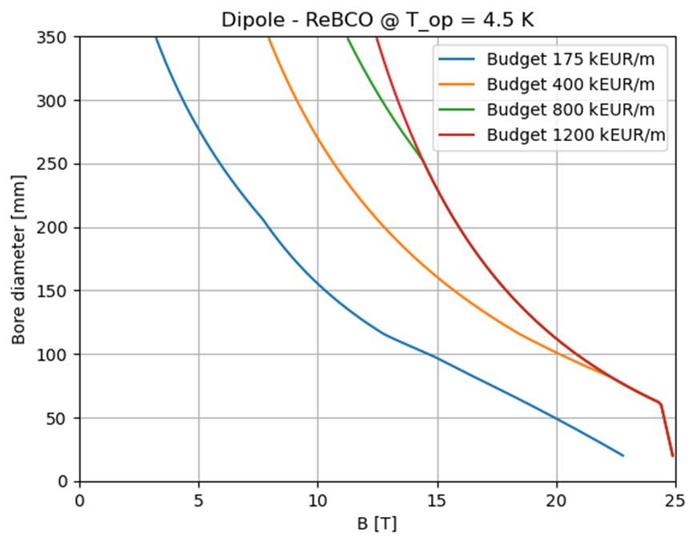
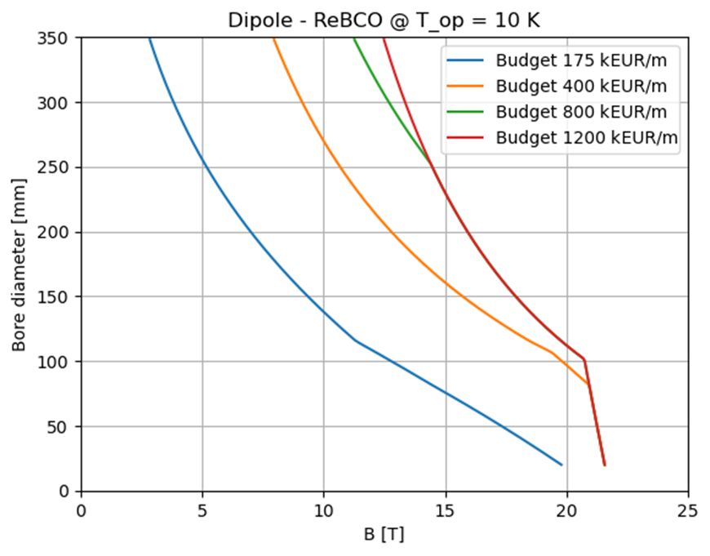
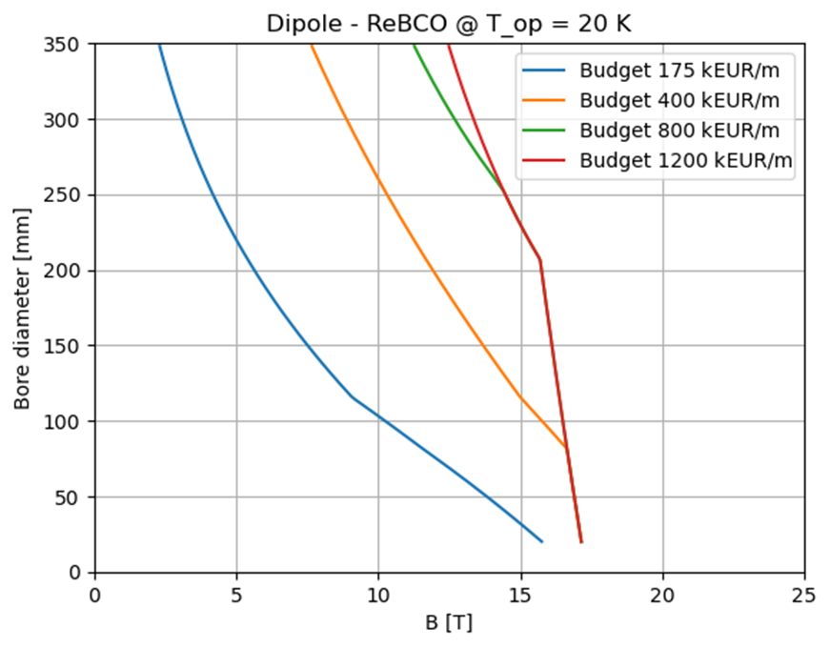
Recap: A-B Plots for HTS dipoles
Summary of cost assumptions:
We use the ReBCO’s aspirational cost 2500 EUR/kg
  Today’s price is around 8000 EUR/kg
The starting budget of 175 kEUR/m for each magnet is taken from the FCC cost model
  We can assume a higher budget than FCC because we have a smaller circumference and less magnets.
Cryogenic, protection and shielding costs are not taken into account.
Summary of assumptions:
Single sector coil dipole
Maximum stress: 400 MPa
Fujikura Tape for the J_{c} fit
Roebel cable
Non-insulated or Metal-insulated cable
Maximum coil width: 80 mm
Final Focusing: (v 0.8)
  8.1 T, 320 mm
  9.7 T, 320 mm
Arc: (v 0.7)
  16 T, 160 mm
  (140mm @ 20K)

Slide 3
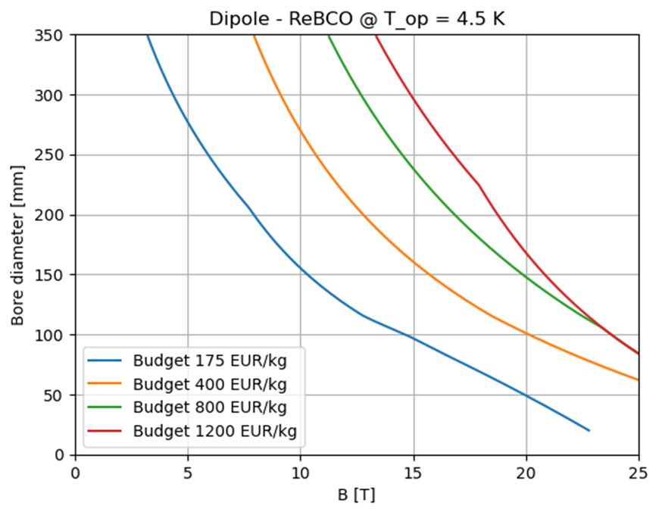
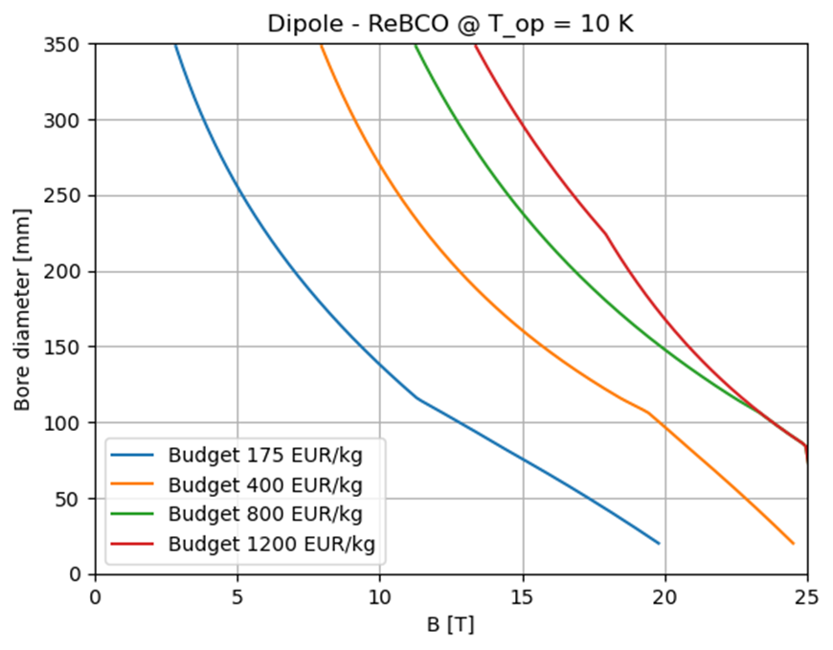
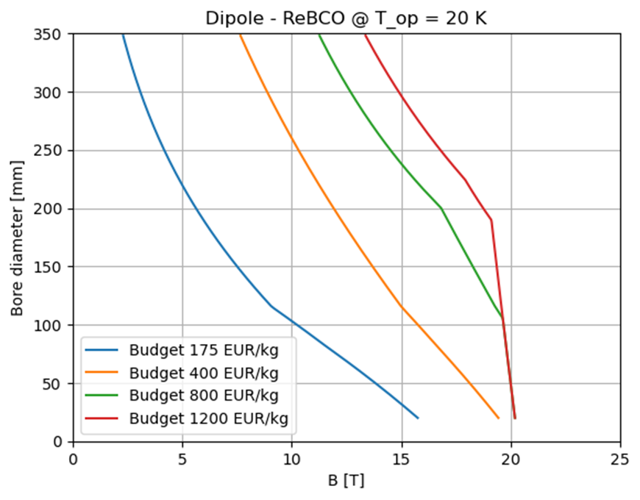

Dependence on max. coil width
Summary of cost assumptions:
We use the ReBCO’s aspirational cost 2500 EUR/kg
  Today’s price is around 8000 EUR/kg
The starting budget of 175 kEUR/m for each magnet is taken from the FCC cost model
  We can assume a higher budget than FCC because we have a smaller circumference and less magnets.
Cryogenic, protection and shielding costs are not taken into account.
Summary of assumptions:
Single sector coil dipole
Maximum stress: 400 MPa
Fujikura Tape for the J_{c} fit
Roebel cable
Non-insulated or Metal-insulated cable
Maximum coil width: 120 mm
Final Focusing: (v 0.8)
  8.1 T, 320 mm
  9.7 T, 320 mm
Arc: (v 0.7)
  16 T, 160 mm
  (140mm @ 20K)

Slide 4
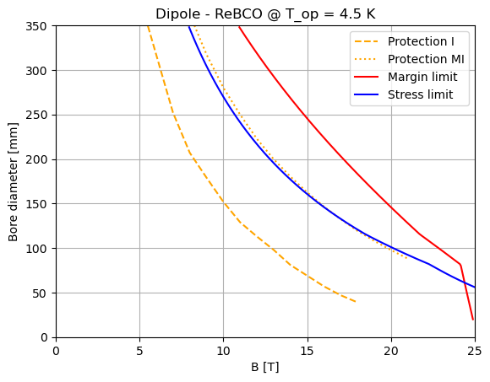
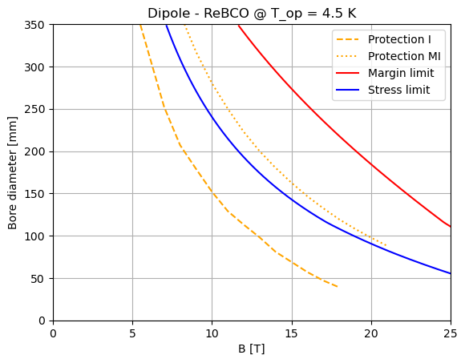
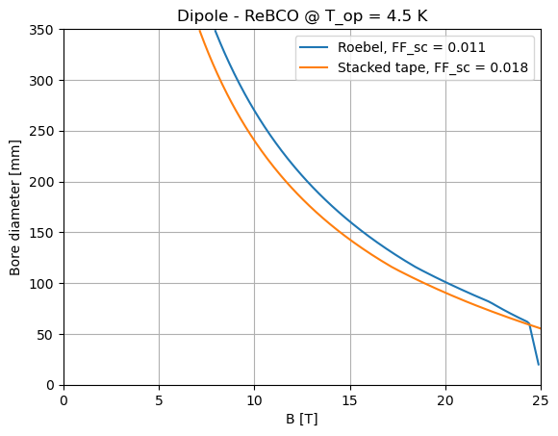
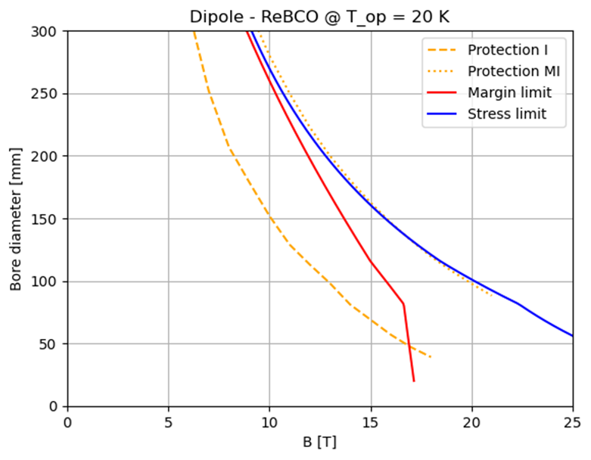
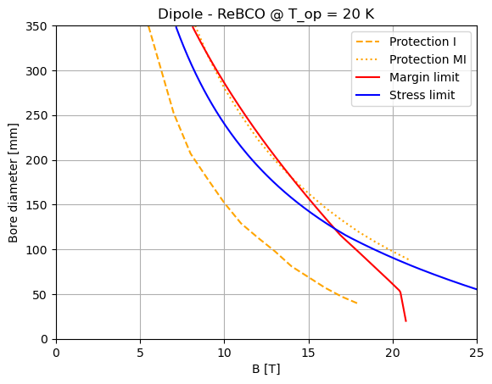
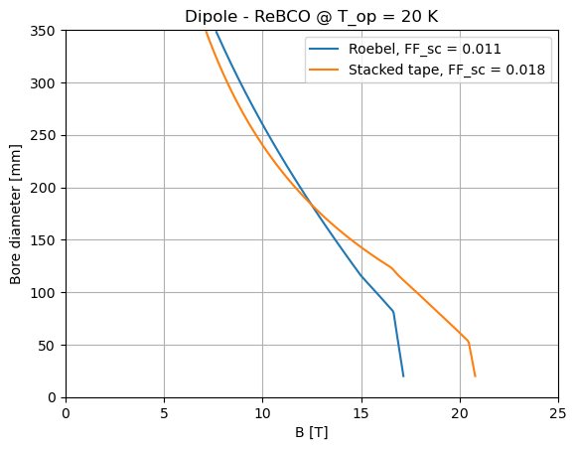
Dependence on cable type
Summary of assumptions:
Single sector coil dipole
Maximum stress:
400 MPa
Fujikura Tape
for the J_{c} fit
Stacked tape cable
Non-insulated or
Metal-insulated cable
Maximum coil width:
80 mm
Roebel
FF = 0.011
Stacked cable
FF = 0.018
Comparison
Roebel
FF = 0.011
Stacked cable
FF = 0.018
Comparison

Slide 5
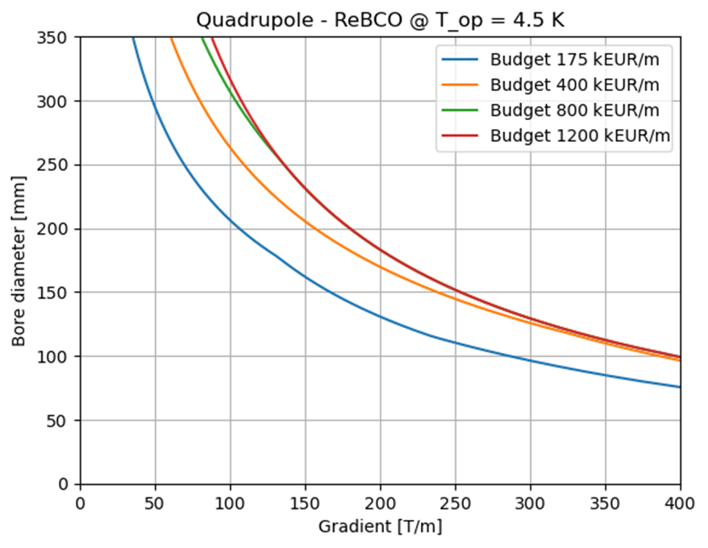
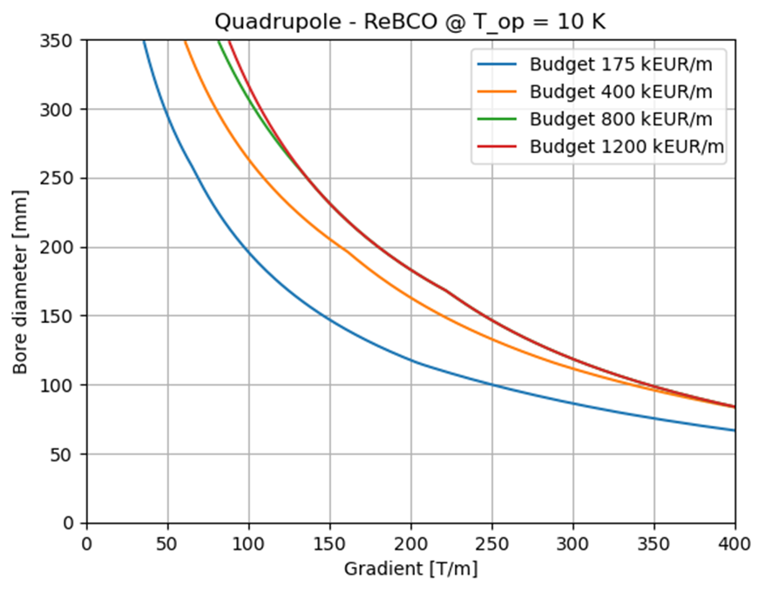
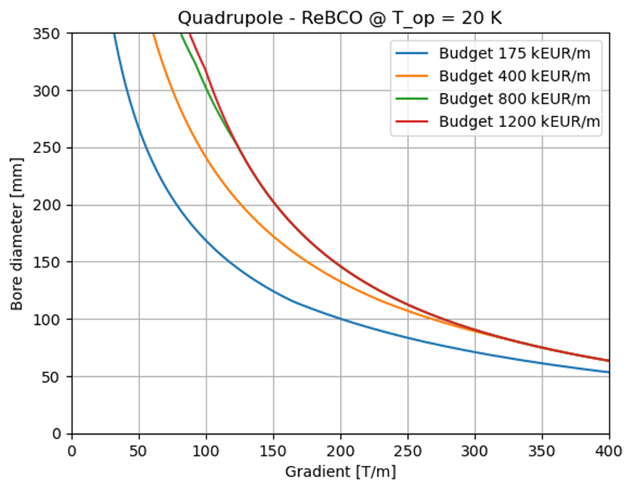
Recap: A-B Plots for HTS quad.
Summary of cost assumptions:
We use the ReBCO’s aspirational cost 2500 EUR/kg
  Today’s price is around 8000 EUR/kg
The starting budget of 175 kEUR/m for each magnet is taken from the FCC cost model
  We can assume a higher budget than FCC because we have a smaller circumference and less magnets.
Cryogenic, protection and shielding costs are not taken into account.
Summary of assumptions:
Single sector coil quadrupole
Maximum stress: 400 MPa
Fujikura Tape for the J_{c} fit
Roebel cable
Non-insulated or Metal-insulated cable
Maximum coil width: 80 mm
Final Focusing: (v 0.8)
  85 T/m, 280 mm
  85 T/m, 266 mm
  115 T/m, 290 mm
  205 T/m, 204 mm
  242 T/m, 172 mm
  300 T/m, 140 mm

Slide 6
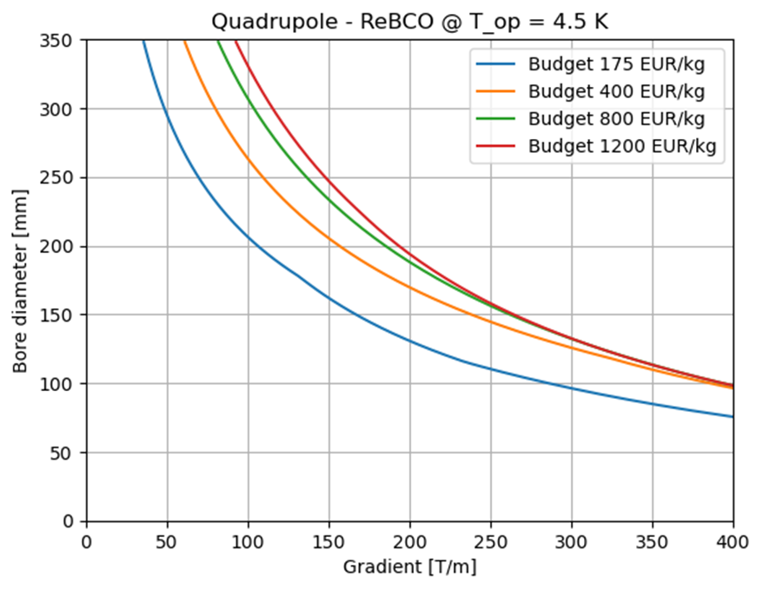
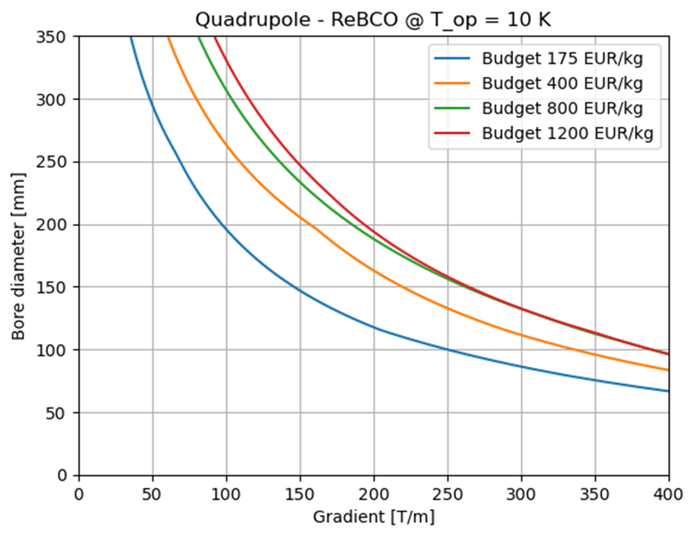
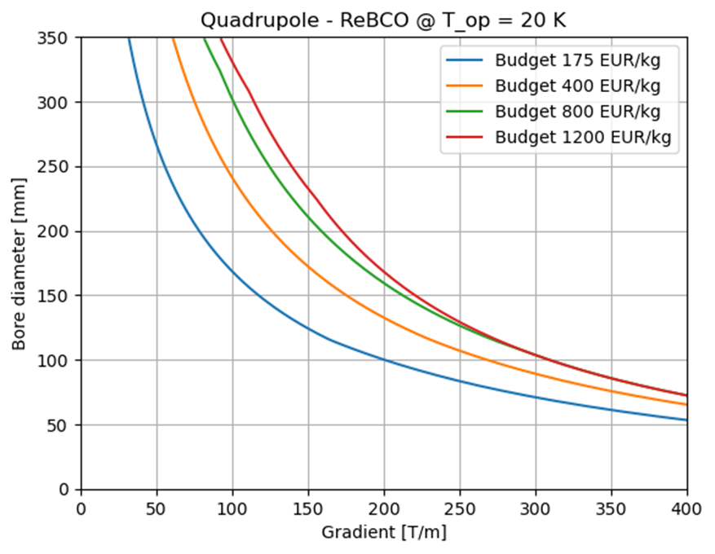
Dependence on max. coil width
Summary of cost assumptions:
We use the ReBCO’s aspirational cost 2500 EUR/kg
  Today’s price is around 8000 EUR/kg
The starting budget of 175 kEUR/m for each magnet is taken from the FCC cost model
  We can assume a higher budget than FCC because we have a smaller circumference and less magnets.
Cryogenic, protection and shielding costs are not taken into account.
Summary of assumptions:
Single sector coil quadrupole
Maximum stress: 400 MPa
Fujikura Tape for the J_{c} fit
Roebel cable
Non-insulated or Metal-insulated cable
Maximum coil width: 120 mm
Final Focusing: (v 0.8)
  85 T/m, 280 mm
  85 T/m, 266 mm
  115 T/m, 290 mm
  205 T/m, 204 mm
  242 T/m, 172 mm
  300 T/m, 140 mm

Slide 7
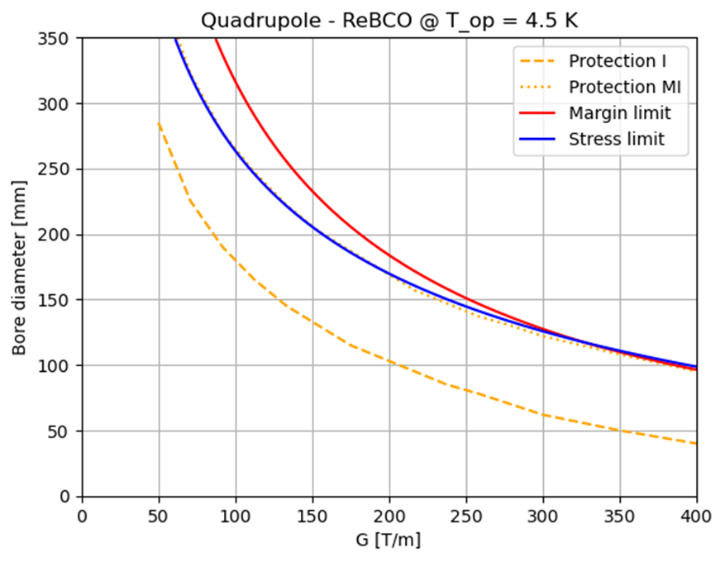
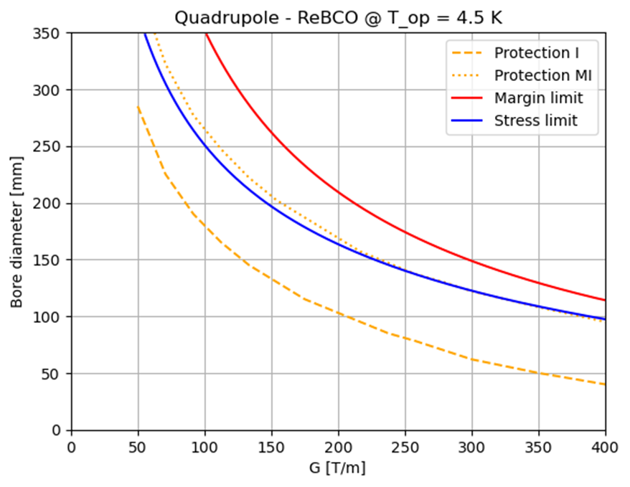
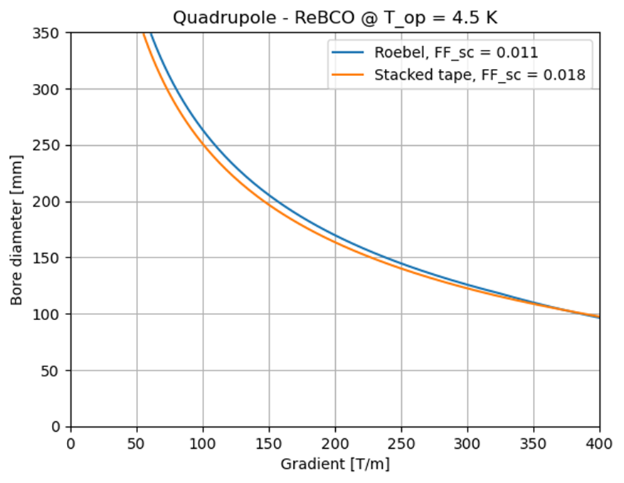
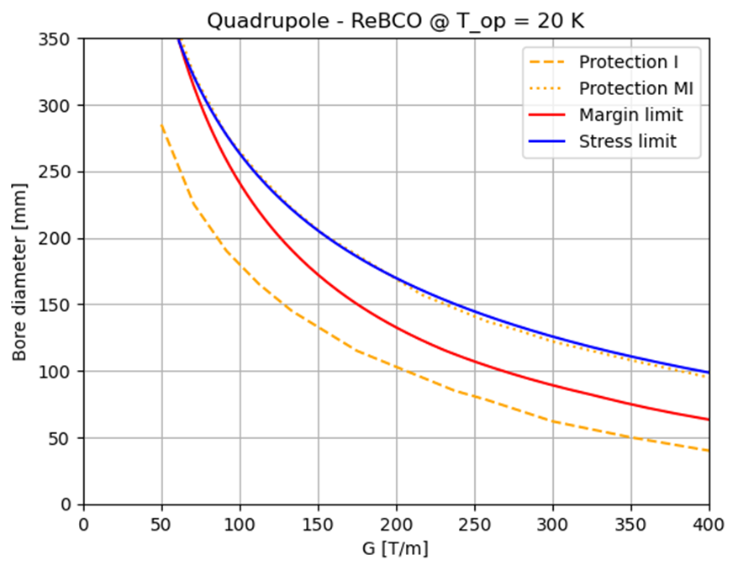
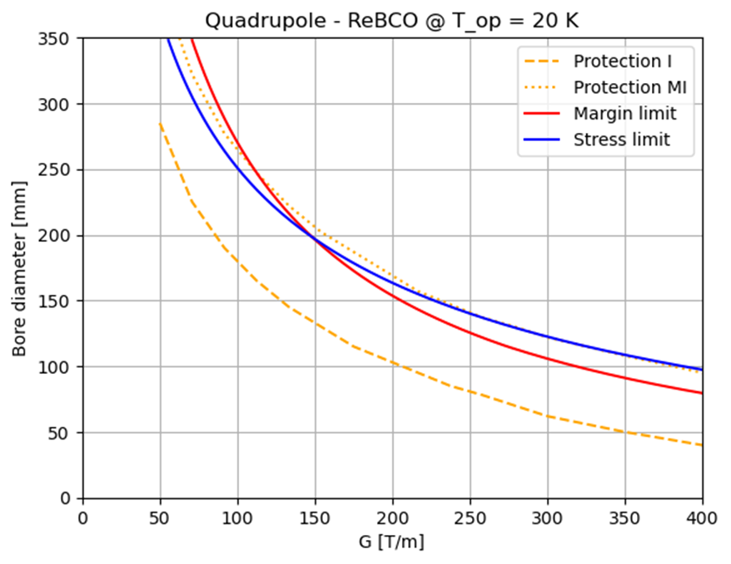
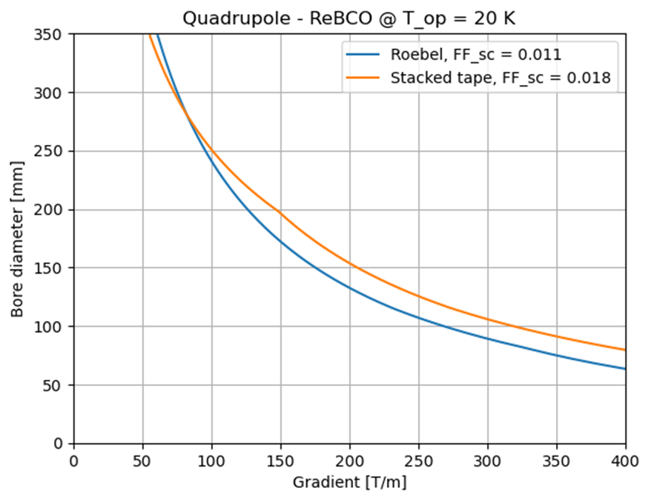
Dependence on cable type
Summary of assumptions:
Single sector coil dipole
Maximum stress:
400 MPa
Fujikura Tape
for the J_{c} fit
Stacked tape cable
Non-insulated or
Metal-insulated cable
Maximum coil width:
80 mm
Roebel
FF = 0.011
Stacked cable
FF = 0.018
Comparison
Roebel
FF = 0.011
Stacked cable
FF = 0.018
Comparison

Slide 8
Conclusions
Does it make sense to proceed with an evaluation on the block coil?
How could we possibly add uncertainty bands on the plots?
Protection curves depend only on a1, w and material properties (ff), right?
(If not, we need the metal/not-insulated curves for the different cases.)
We are assuming non-insulated magnets as the baseline.
Do we continue along this line, or do we bring back insulated LTS and HTS?
For the A-B plot I’m still using roebel cable.
Do we align with the assumptions of Luca and Francesco?
(If yes, I need new protection curves).

Slide 9
Thank you
for your attention
Workshop at LASA
D. Novelli^{1,2}, L. Alfonso², A. Bersani², L. Bottura⁵, B. Caiffi²,
S. Farinon², F. Mariani¹, S. Mariotto³ , A. Pampaloni², T. Salmi⁴
¹Sapienza University of Rome
²INFN – Genoa
³INFN and University of Milan
⁴Tampere University
⁵CERN
November 2024

