Slide 1








Combined Function Magnets
Workshop at LASA
D. Novelli^{1,2}, L. Alfonso², A. Bersani², L. Bottura⁵, B. Caiffi²,
S. Farinon², F. Mariani¹, S. Mariotto³ , A. Pampaloni², T. Salmi⁴
¹Sapienza University of Rome
²INFN – Genoa
³INFN and University of Milan
⁴Tampere University
⁵CERN
Funded by the European Union (EU). Views and opinions expressed are however those of the author only and do not necessarily reflect those of the EU or European Research Executive Agency (REA). Neither the EU nor the REA can be held responsible for them.
November 2024

Slide 2
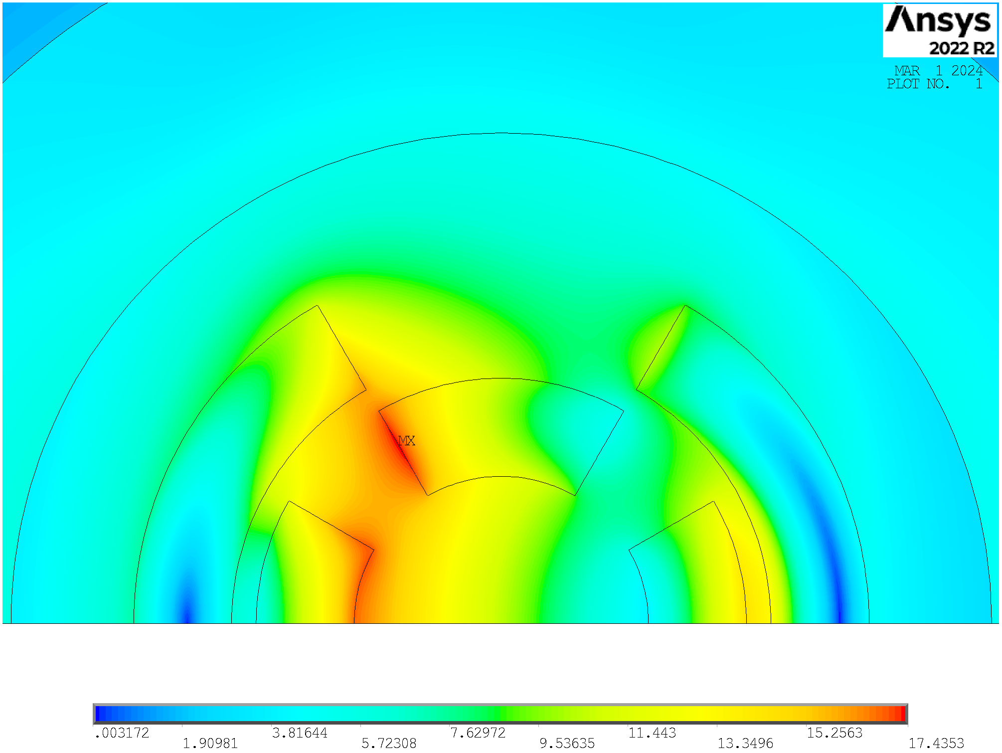
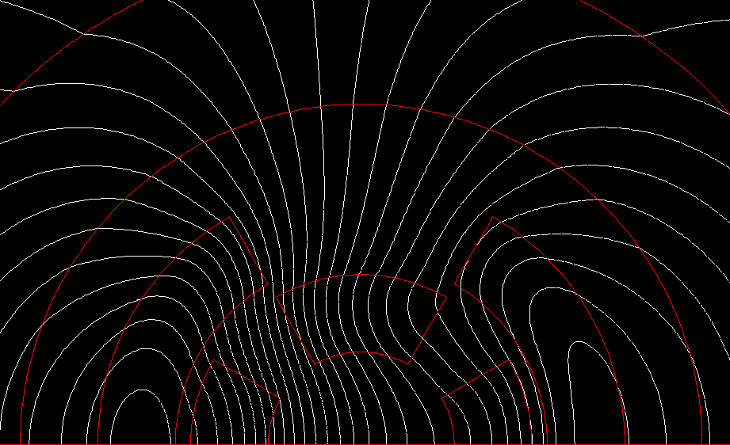
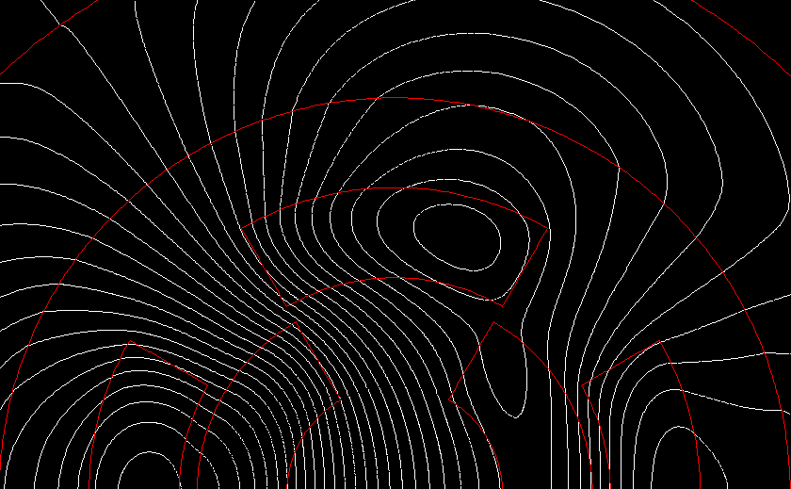
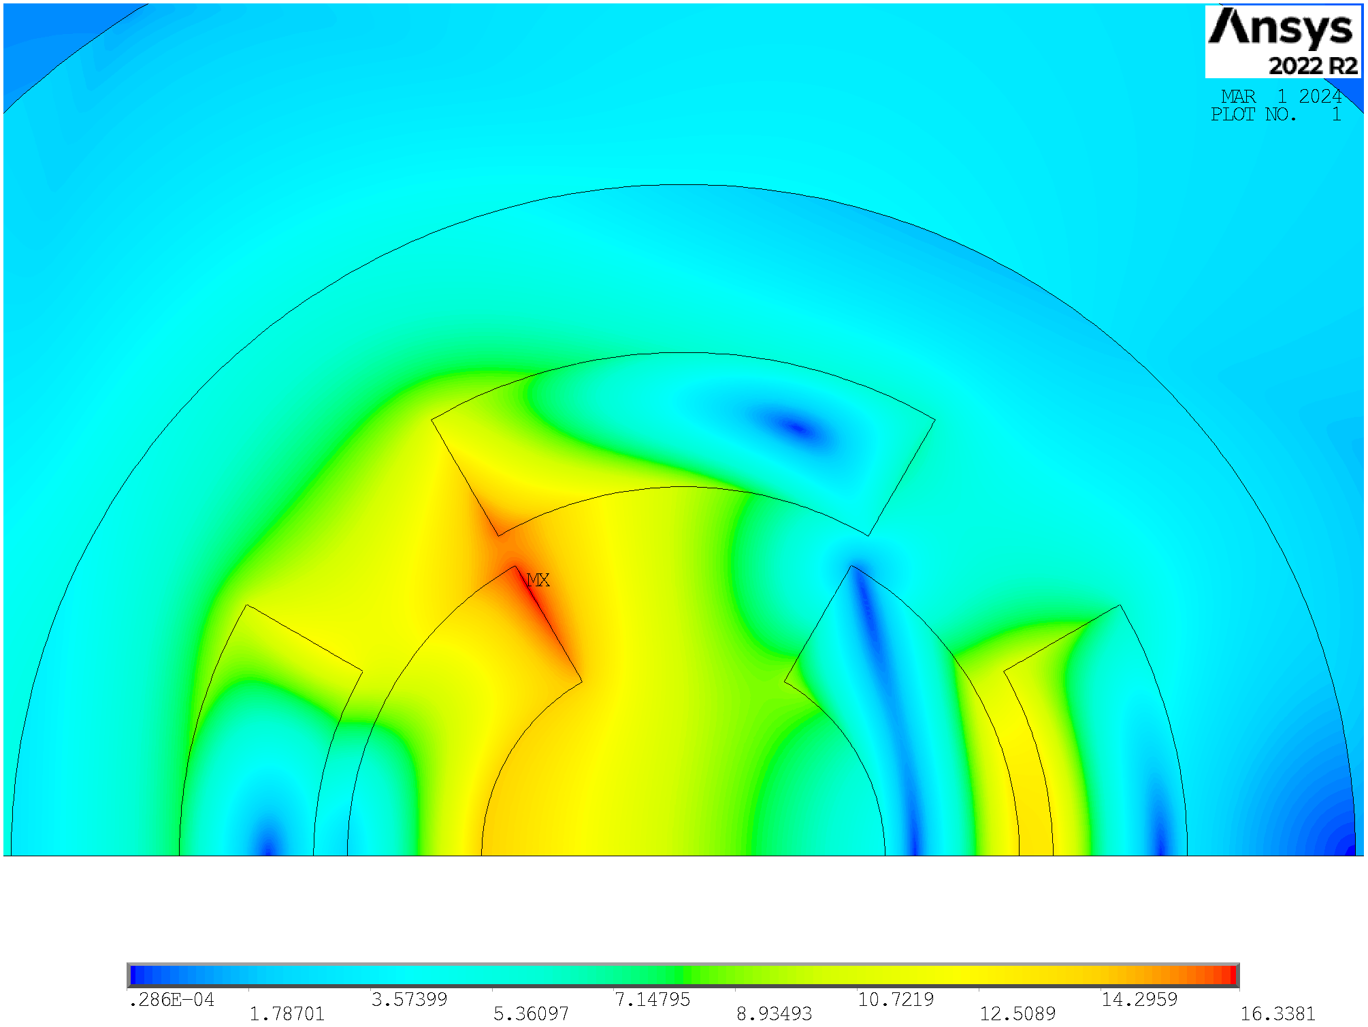
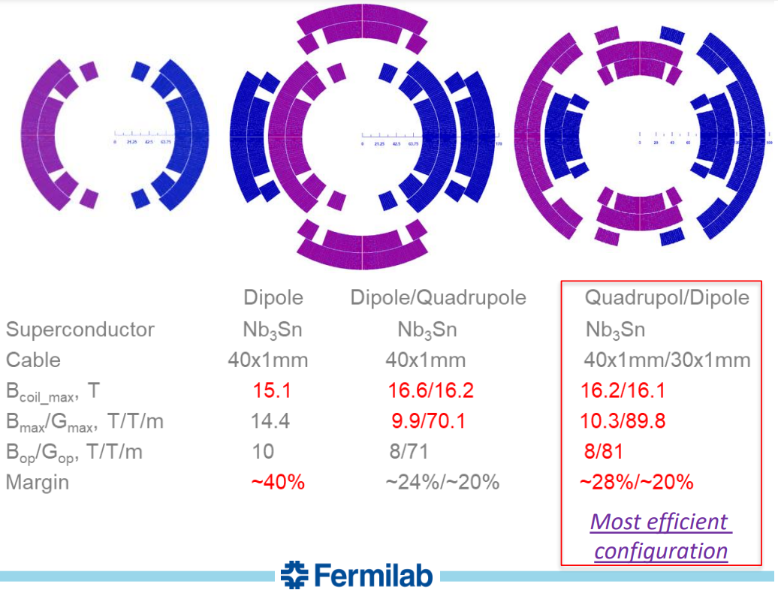
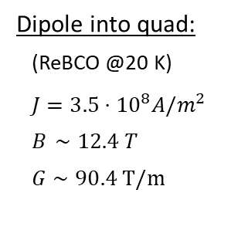
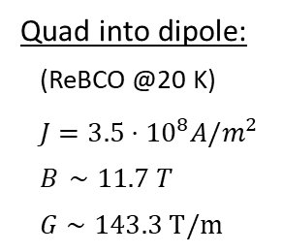
Nested Configurations
Quad into dipole:
(ReBCO @20 K)
$J=3.5⋅{10}^{8}A/m^{2}$
$B_{ }∼11.7 T$
$G∼143.3 T/m$
Dipole into quad:
(ReBCO @20 K)
$J=3.5⋅{10}^{8}A/m^{2}$
$B_{ }∼12.4 T$
$G∼90.4 T/m$
Arc:
Combined function magnets: B1, B1+B2 and B1+B3
B ≈ 8…16 T; G ≈ 320 T/m; G’ ≈ 7100 T/m²
Aperture ≈ 160 mm
Final focus:
Combined function magnets: B1, B2, B1+B2 , B1+B3
B ≈ 4…16 T; G ≈ 100…300 T/m; G’ ≈ 12000 T/m²
Aperture ≈ 120…300 mm
The quadrupole into dipole configuration is the most efficient one, in accordance with US-MAP. Additionally, for combined function magnets in the muon collider, quadrupoles are generally required to be stronger than dipoles.

Slide 3
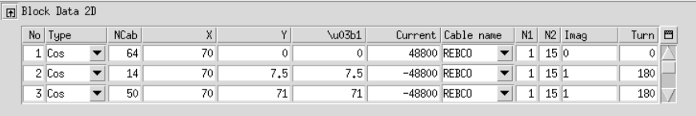
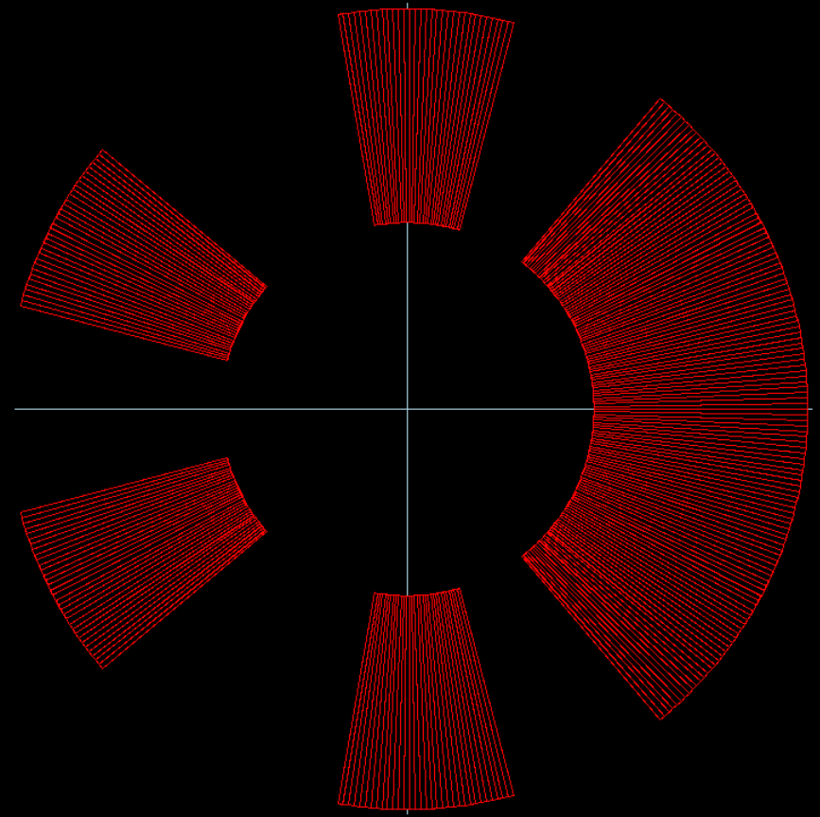
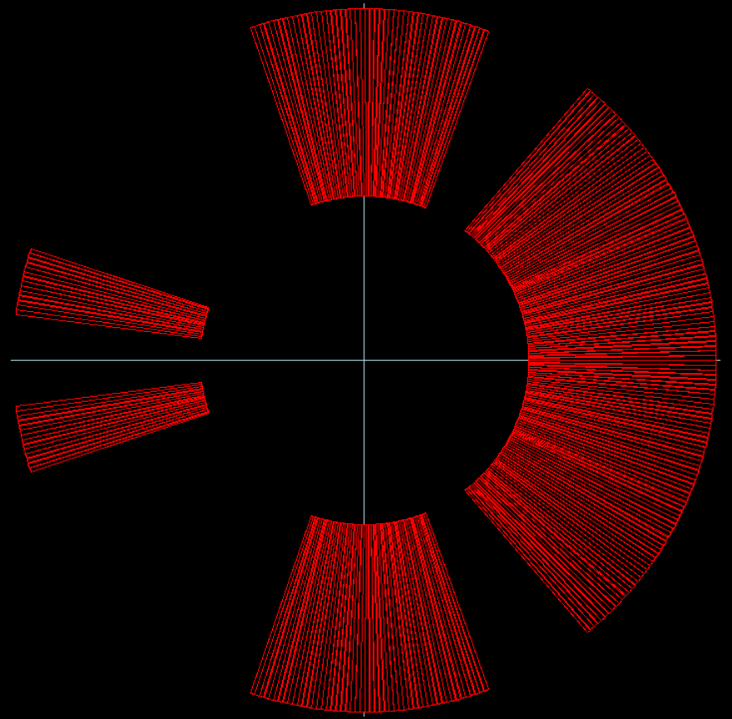

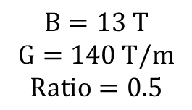


Asymmetric Dipole
As first approx. I used the same cable assumption of L. Alfonso.
Optimization of $α_{1},α_{2},N_{1} and N_{2}$ with ROXIE by
maximizing$B_{2}(@ R_{ref}=50 mm)$with a weight of 1 and $B_{1}$ with a weight of 0.5
N₂
$$B=13 T$$
$$G=140 T/m$$
$$Ratio=0.5$$
N₁
$α_{2}$
ROXIE
optimization
$α_{1}$
$$Ratio=\frac{B_{2}@R_{ref}}{B1}$$
Starting from the experience of T.Ogitsu:
https://indico.cern.ch/event/1043242/contributions/4448798/attachments/2279860/3873498/MCM20210712SCFM.pdf

Slide 4
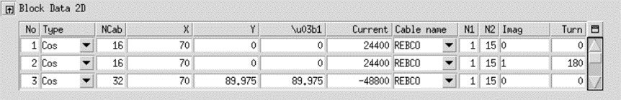
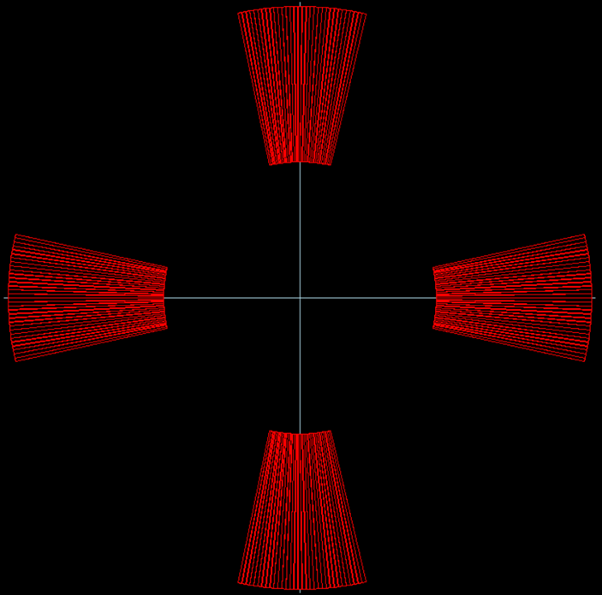
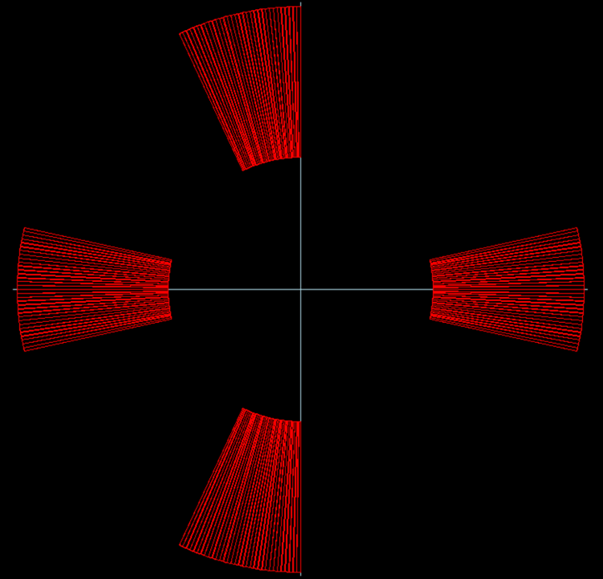


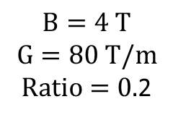
Asymmetric Quadrupole
As first approx. I used the same cable assumption of L. Alfonso.
Optimization of $α_{1}$ with ROXIE by
maximizing$B_{2}(@ R_{ref}=50 mm)$with a weight of 0.5 and $B_{1}$ with a weight of 1
$$B=4 T$$
$$G=80 T/m$$
$Ratio=0.$2
$α_{1}$
ROXIE
optimization
$$Ratio=\frac{B1}{B_{2}@R_{ref}}$$
By also allowing the number of conductors to vary, it becomes again an asymmetric dipole.

Slide 5
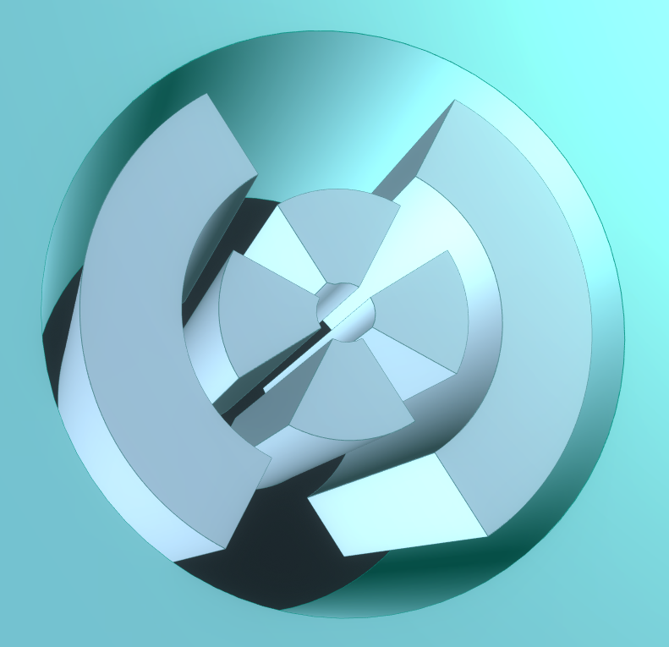
Python-Ansys Interface
Initialization
a1_quad = 25 mm
a1_quad loop
Increment of 25mm
(from 25 to 100)
30 mm
w_quad = 10 mm
w_quad loop
Increment of 10mm
(from 10 to 80)
a1_quad
w_quad
w_dip
w_dip = 10 mm
When w_quad = 80 mm
30 mm
w_dip
loop
Increment of 10mm
(from 10 to 80)
When w_dip = 80 mm
Current density
optimization
Save the output
If:
a1_quad = 100mm
w_quad = 80mm
w_dip = 80mm
256 Ansys simulations
for each temperature
End

Slide 6
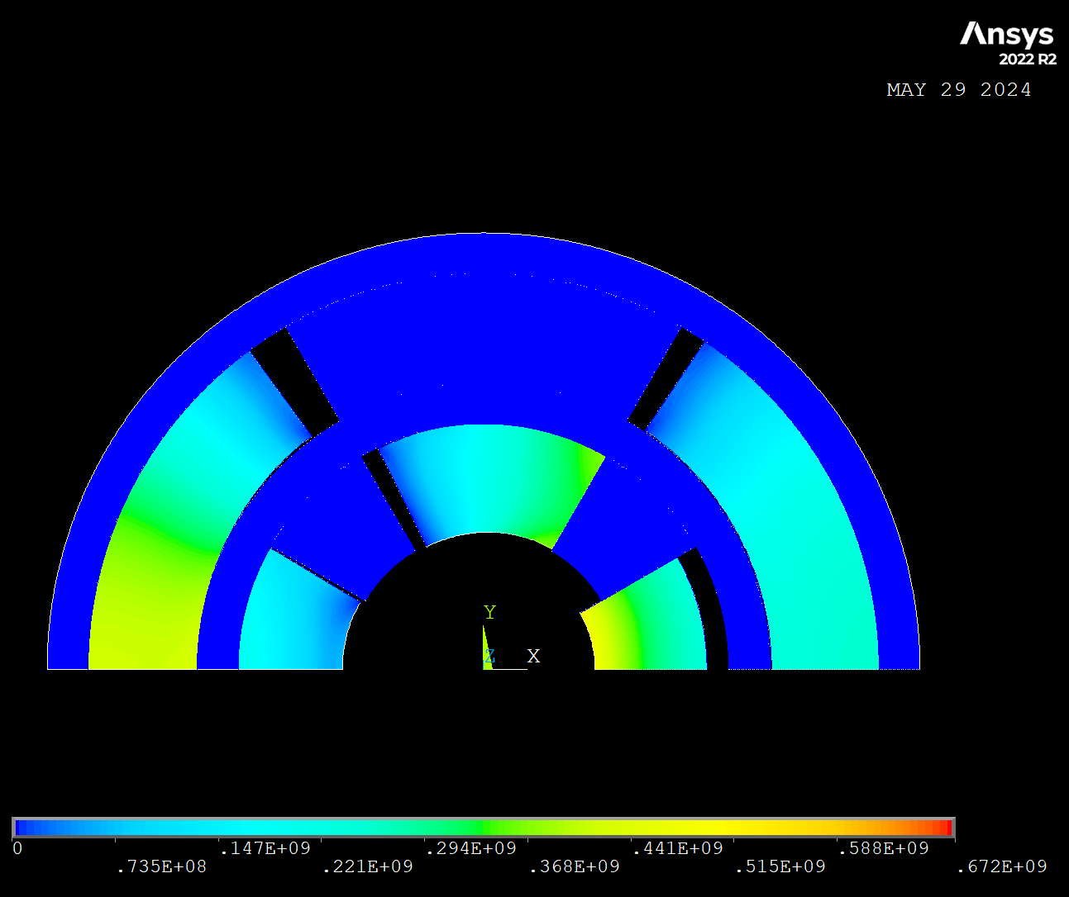
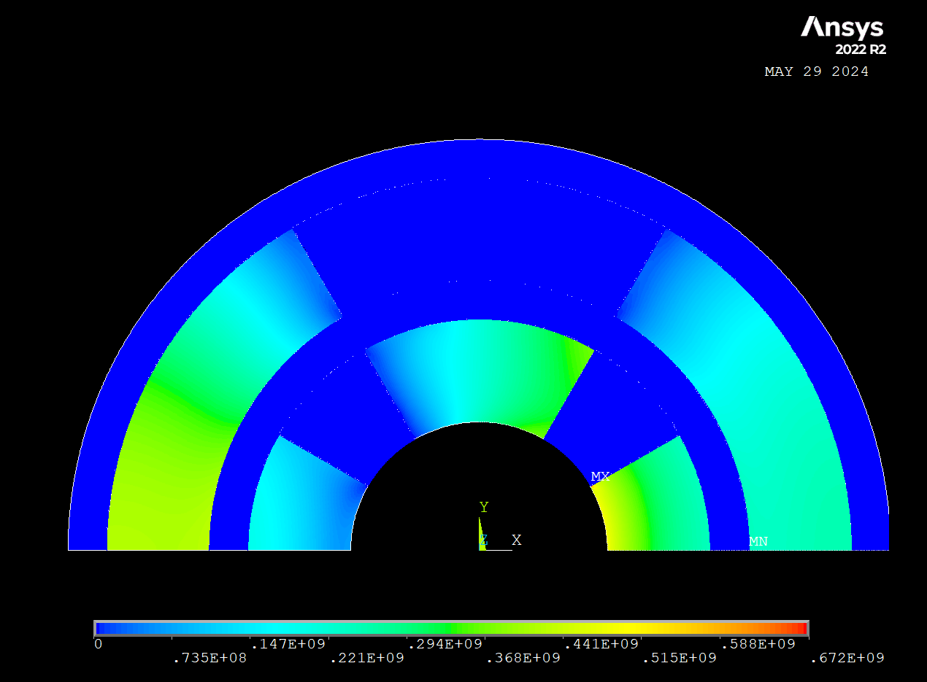
Stress Issue
Zoom-in on the displacements shows that this sector of the quadrupole moves inward
The Von Mises peak stress is on the inner part of the coil

Slide 7
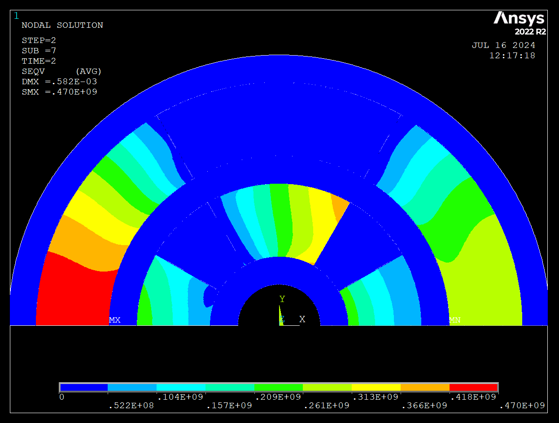
Stress Issue
To address the issue, we insert an infinitely rigid internal structure to enable the study of stress behavior in the coils.
Now the peak stress, in the same configuration discussed so far, is on the dipole in compression on the midplane (by changing the parameters, the maximum could be shifted).
Now that we have a stress distribution in the coils, we can run the code and add a column with the peak stress to the data.
With all information we will try to create B-G plots for the combined.
$$a_{1}=75mm, w_{quad}=80mm,w_{dip}=80mm, T_{op}=20K$$

Slide 8
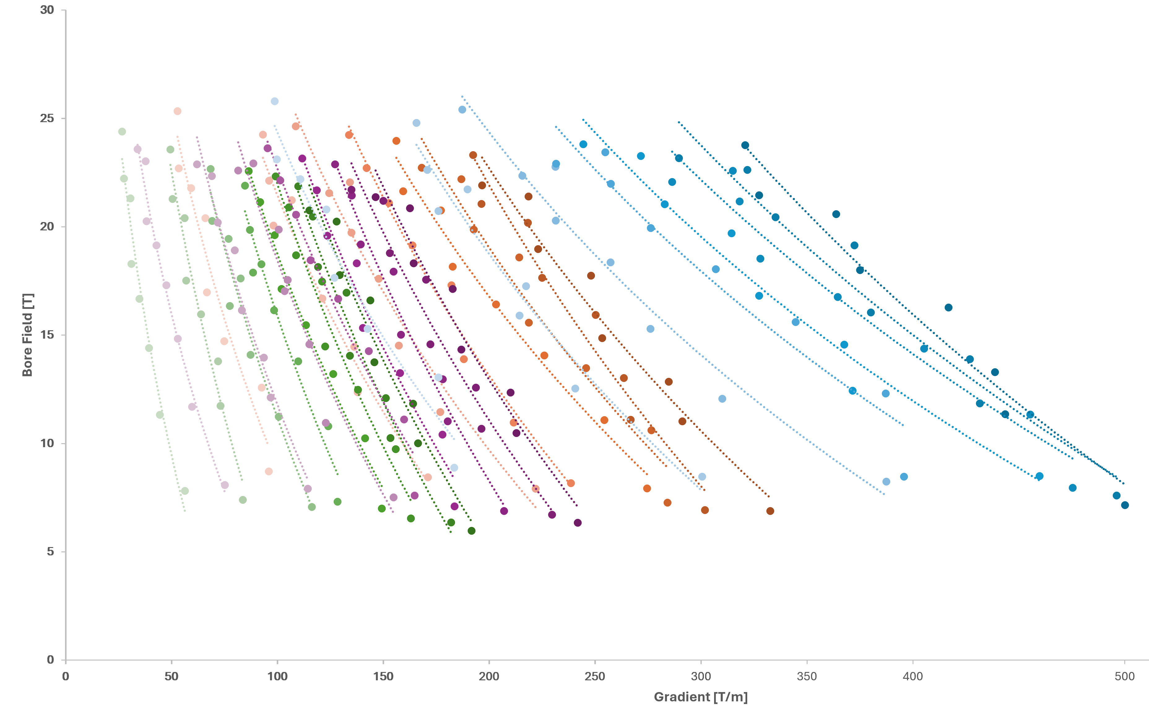
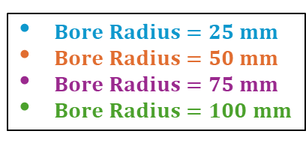
B-G plot at 4.5K
Only EM optimization
$Bore Radius=25 mm$
$Bore Radius=50 mm$
$Bore Radius=75 mm$
$Bore Radius=100 mm$
Current density
optimization (10%)
Optimize J_quad​ and J_dip​ to be close to the critical current density:
….
while not ( 0.9 < f < 1.1 ):
…..
→ ANSYS input (a1, w_quad, J_quad, w_dip, J_dip)
Run ANSYS
ANSYS output →
f = J_c (B_peak) / J
if f > 1: J=J*1.1
else: J = J*0.9
…..
…..
the optimization acts on J_quad and J_dip
with corrections of 10%,
and the cycle closes when either
J_quad or J_dip is within 10% of J_c
w_dip
w_quad
What if we performed a
1% optimization ?

Slide 9
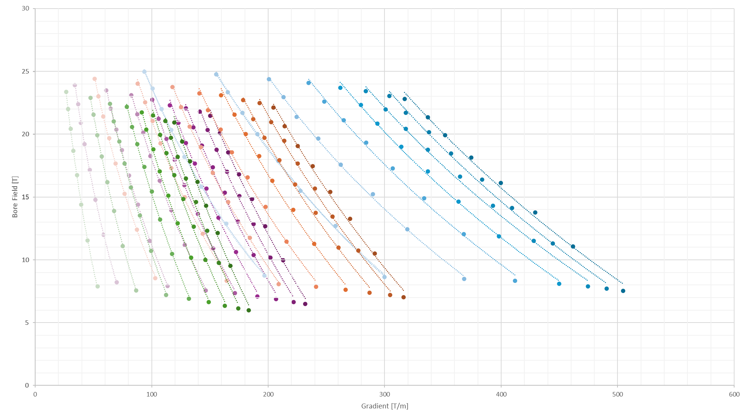
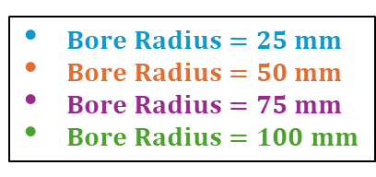
B-G plot at 4.5K
Only EM optimization
$Bore Radius=25 mm$
$Bore Radius=50 mm$
$Bore Radius=75 mm$
$Bore Radius=100 mm$
Current density
Optimization (1%)
Optimize J_quad​ and J_dip​ to be close to the critical current density:
….
while not ( 0.99 < f < 1.01 ):
…..
→ ANSYS input (a1, w_quad, J_quad, w_dip, J_dip)
Run ANSYS
ANSYS output →
f = J_c (B_peak) / J
if f > 1: J=J*1.01
else: J = J*0.99
…..
…..
the optimization acts on J_quad and J_dip
with corrections of 1%,
and the cycle closes when either
J_quad or J_dip is within 1% of J_c
w_dip
w_quad
This optimization requires more computational effort, but the result is more understandable graphs.

Slide 10
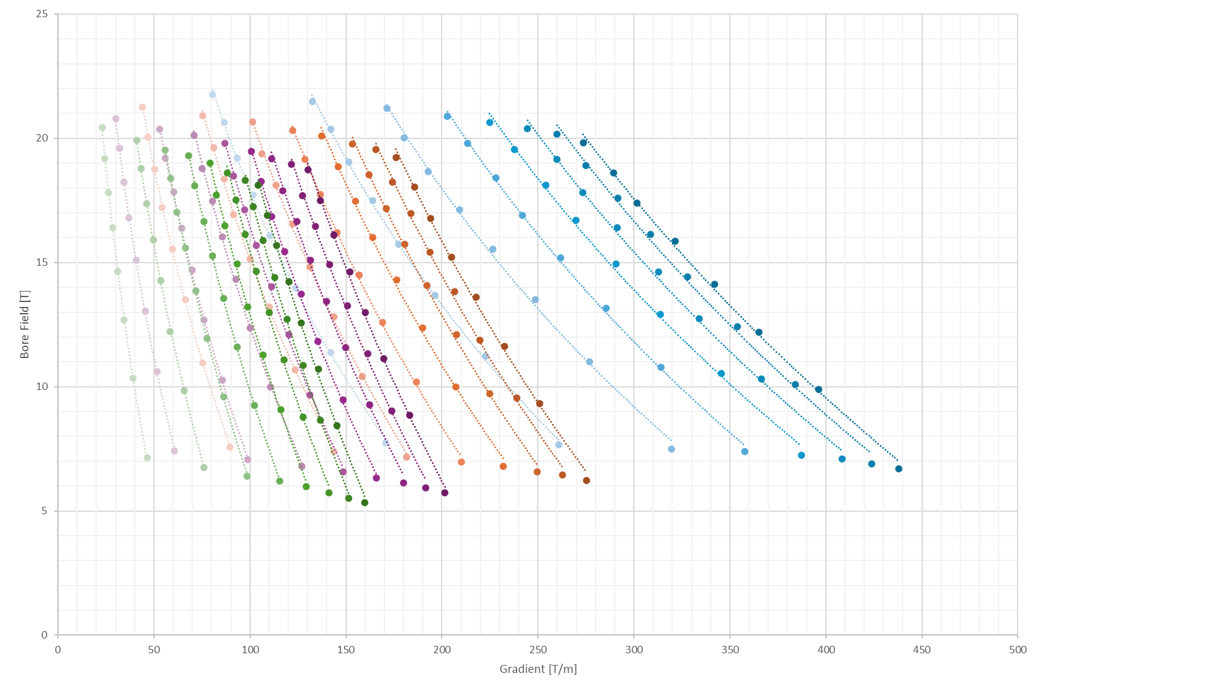
B-G plot at 10K
Only EM optimization
$Bore Radius=25 mm$
$Bore Radius=50 mm$
$Bore Radius=75 mm$
$Bore Radius=100 mm$
Current density
Optimization (1%)
Optimize J_quad​ and J_dip​ to be close to the critical current density:
….
while not ( 0.99 < f < 1.01 ):
…..
→ ANSYS input (a1, w_quad, J_quad, w_dip, J_dip)
Run ANSYS
ANSYS output →
f = J_c (B_peak) / J
if f > 1: J=J*1.01
else: J = J*0.99
…..
…..
the optimization acts on J_quad and J_dip
with corrections of 1%,
and the cycle closes when either
J_quad or J_dip is within 1% of J_c
w_dip
w_quad
This optimization requires more computational effort, but the result is more understandable graphs.

Slide 11
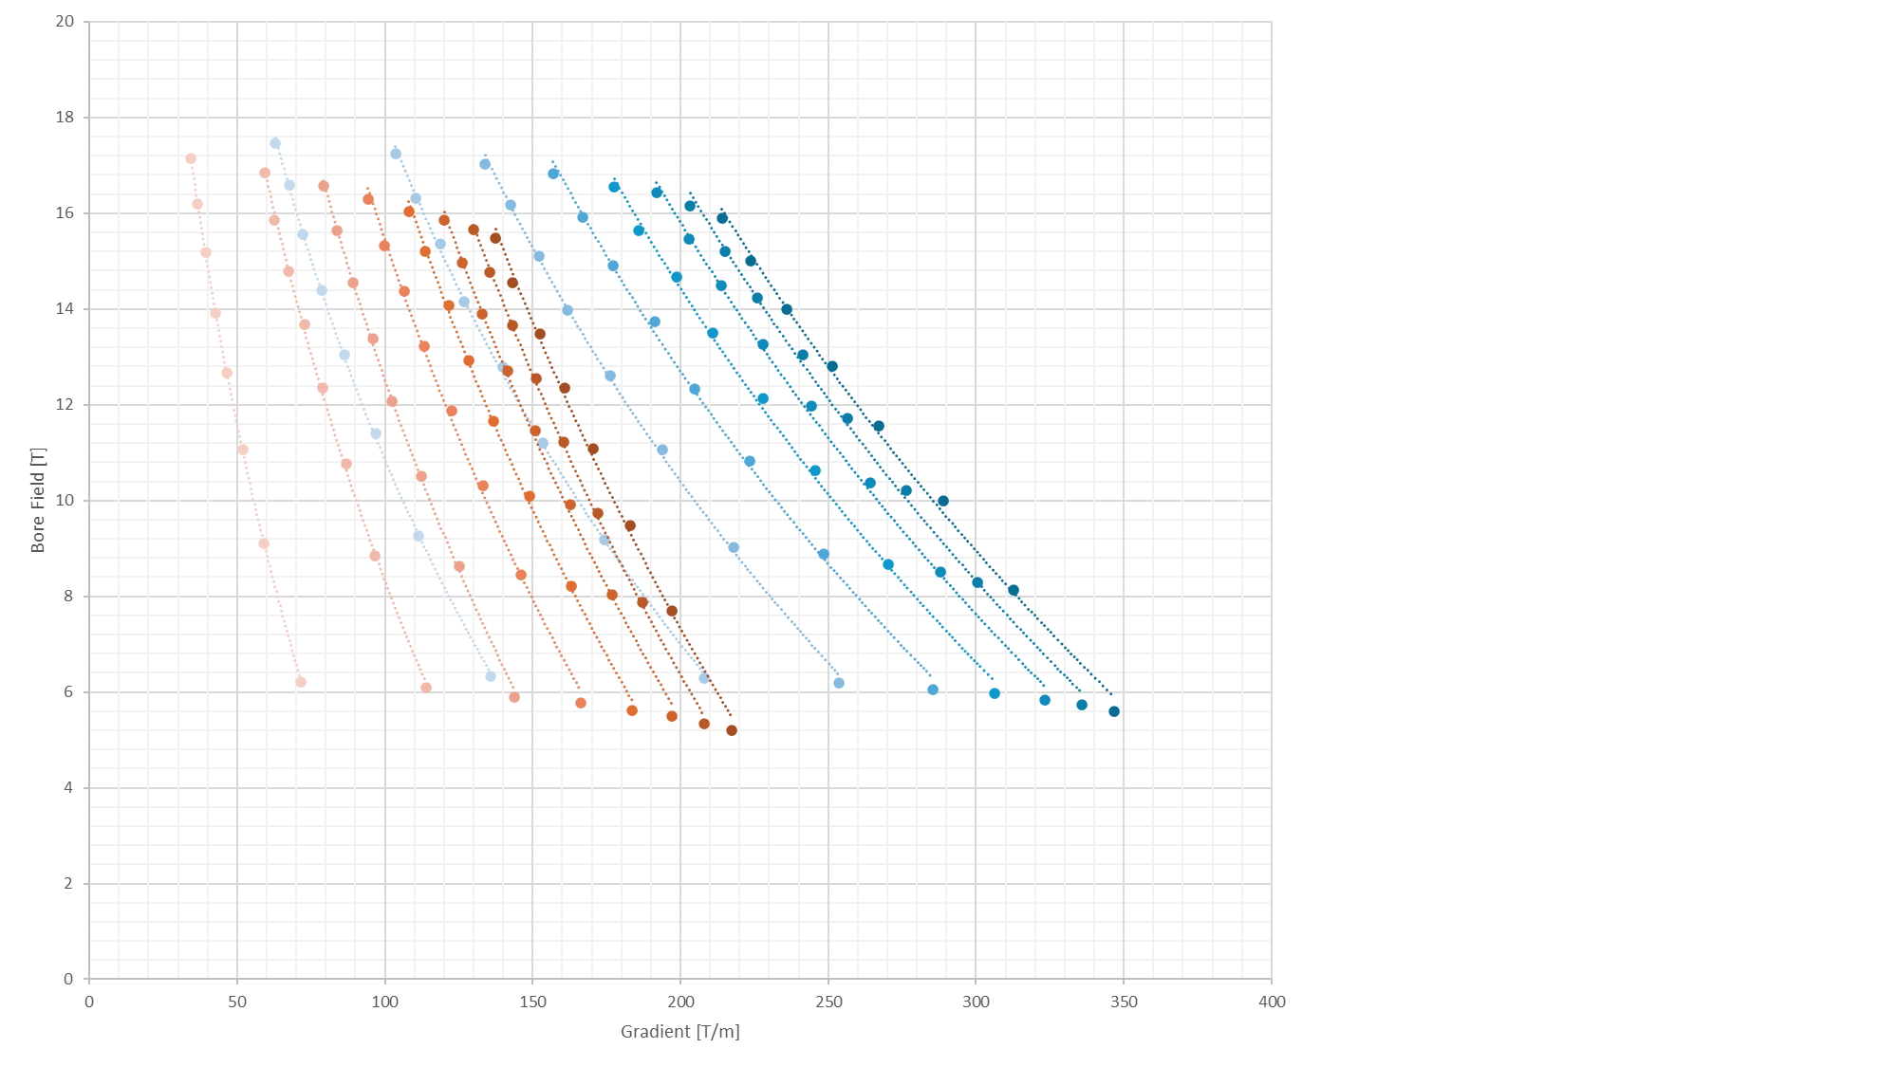
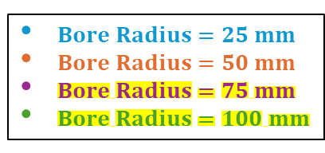
B-G plot at 20K
Only EM optimization
$Bore Radius=25 mm$
$Bore Radius=50 mm$
$Bore Radius=75 mm$
$Bore Radius=100 mm$
Current density
Optimization (1%)
The simulations with bore radius
75 mm and 100 mm are still running
Optimize J_quad​ and J_dip​ to be close to the critical current density:
….
while not ( 0.99 < f < 1.01 ):
…..
→ ANSYS input (a1, w_quad, J_quad, w_dip, J_dip)
Run ANSYS
ANSYS output →
f = J_c (B_peak) / J
if f > 1: J=J*1.01
else: J = J*0.99
…..
…..
the optimization acts on J_quad and J_dip
with corrections of 1%,
and the cycle closes when either
J_quad or J_dip is within 1% of J_c
w_dip
w_quad
This optimization requires more computational effort, but the result is more understandable graphs.

Slide 12
Stress and Cost considerations
Manually excluding the points that exceed the cost (400 kEUR/m) and the stress (400 MPa) limits
We should optimize the stress instead of excluding the points manually

Slide 13
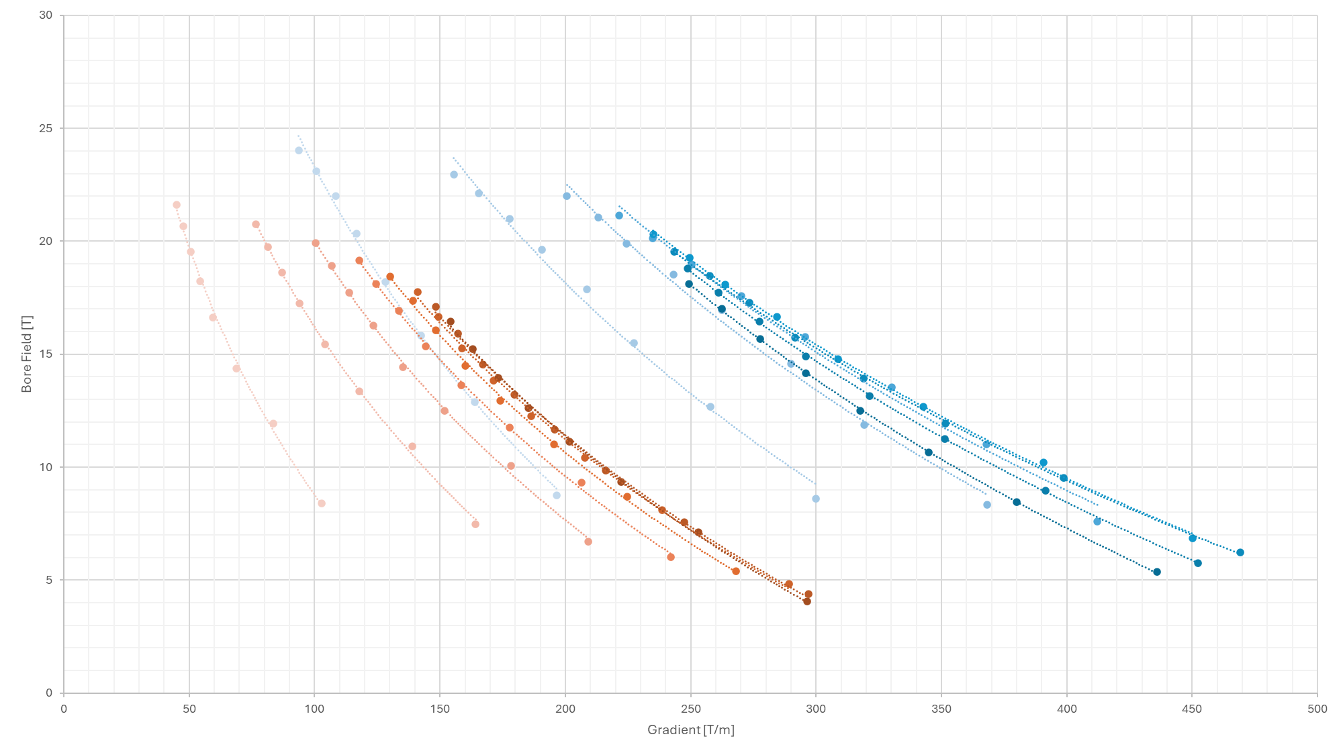

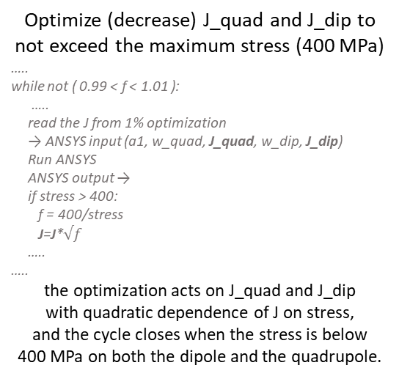
B-G plot at 4.5K
EM and Stress optimization
$Bore Radius=25 mm$
$Bore Radius=50 mm$
$Bore Radius=75 mm$
$Bore Radius=100 mm$
Midplane pressure
optimization
The simulations with bore radius
75 mm and 100 mm are still running
Optimize (decrease) J_quad​ and J_dip​ to not exceed the maximum stress (400 MPa)
…..
while not ( 0.99 < f < 1.01 ):
…..
read the J from 1% optimization
→ ANSYS input (a1, w_quad, J_quad, w_dip, J_dip)
Run ANSYS
ANSYS output →
if stress > 400:
f = 400/stress
J=J*$√f$
…..
…..
the optimization acts on J_quad and J_dip
with quadratic dependence of J on stress,
and the cycle closes when the stress is below
400 MPa on both the dipole and the quadrupole.
w_dip
w_quad
Limitations on cost are still missing

Slide 14
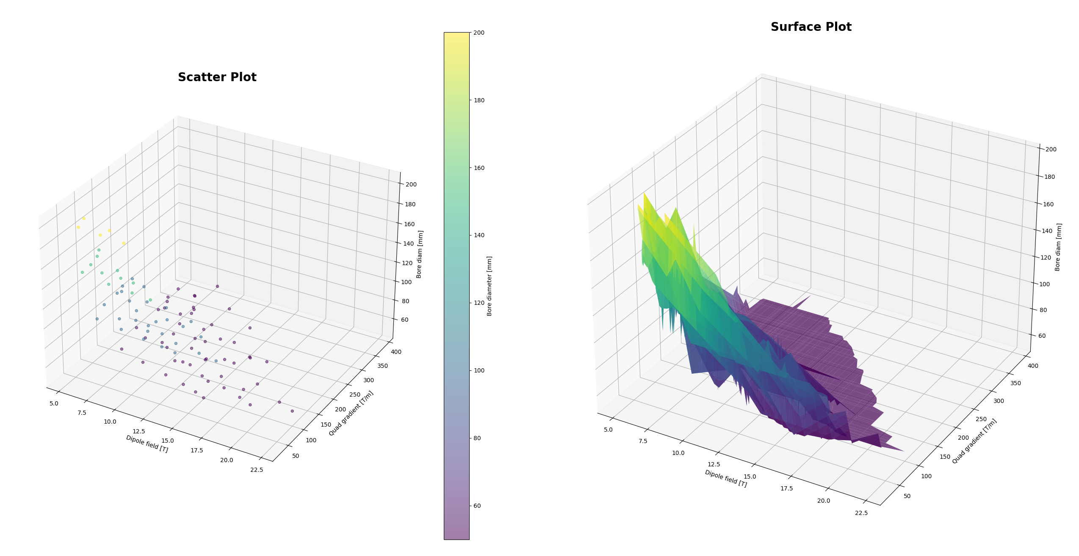
3D plot
Is it useful to have a 3D representation of the 3 planes of interest?

Slide 15
Conclusions
Do we exclude the asymmetric configuration a priori? We have seen the cos-theta, but what about the CCT? The nested configuration may be best for the B-G plot, allowing B2 values greater than B1, but to study specific configurations the asymmetric might be better.
We inserted an internal support to solve the problem of the coil wanting to enter the aperture. I assumed an internal support with infinitely rigid structure, so the thickness does not matter for the code, but it is relevant to the results. How thick do we consider the inner support?
The code throws simulations with w from 10 to 80 mm (step 10mm), bore diameter from 50 to 200 (step 50mm). How can we make the graphs more accessible? Could it be useful to add points with w from 1 to 10 mm in 1mm steps? Add aperture points?
Now I’m considering roebel cable, 150 MPa as Young module of the ReBCO tape, etc. Should I align with the dipole design considerations? What about the protection of these kind of magnets?
Is it possible to interface the new plots with the old A-B plots? It might be useful to have a relationship between the new work with the old work. Is there a way to analytically assess if we are on the right path with the combined?
Should we start focusing on a specific configuration? If so, nested or asymmetric?

Slide 16
Thank you
for your attention
Workshop at LASA
D. Novelli^{1,2}, L. Alfonso², A. Bersani², L. Bottura⁵, B. Caiffi²,
S. Farinon², F. Mariani¹, S. Mariotto³ , A. Pampaloni², T. Salmi⁴
¹Sapienza University of Rome
²INFN – Genoa
³INFN and University of Milan
⁴Tampere University
⁵CERN
November 2024

Slide 17
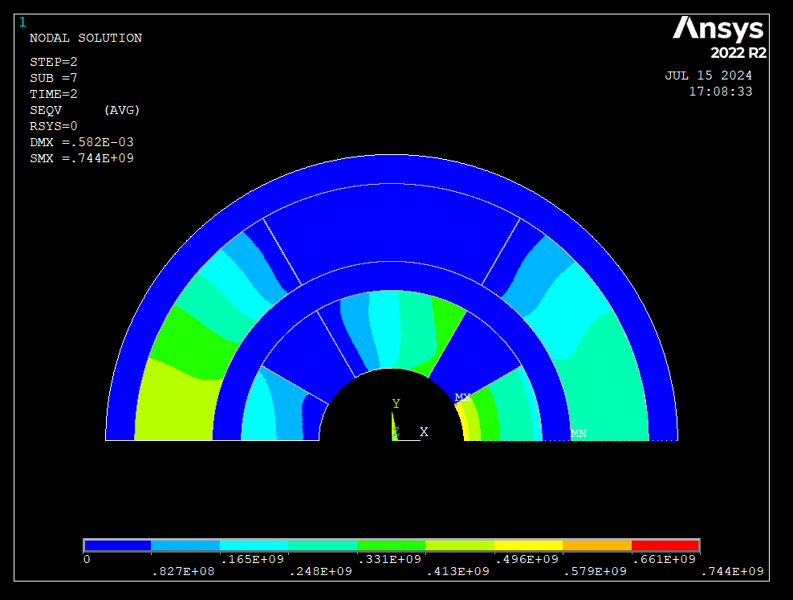
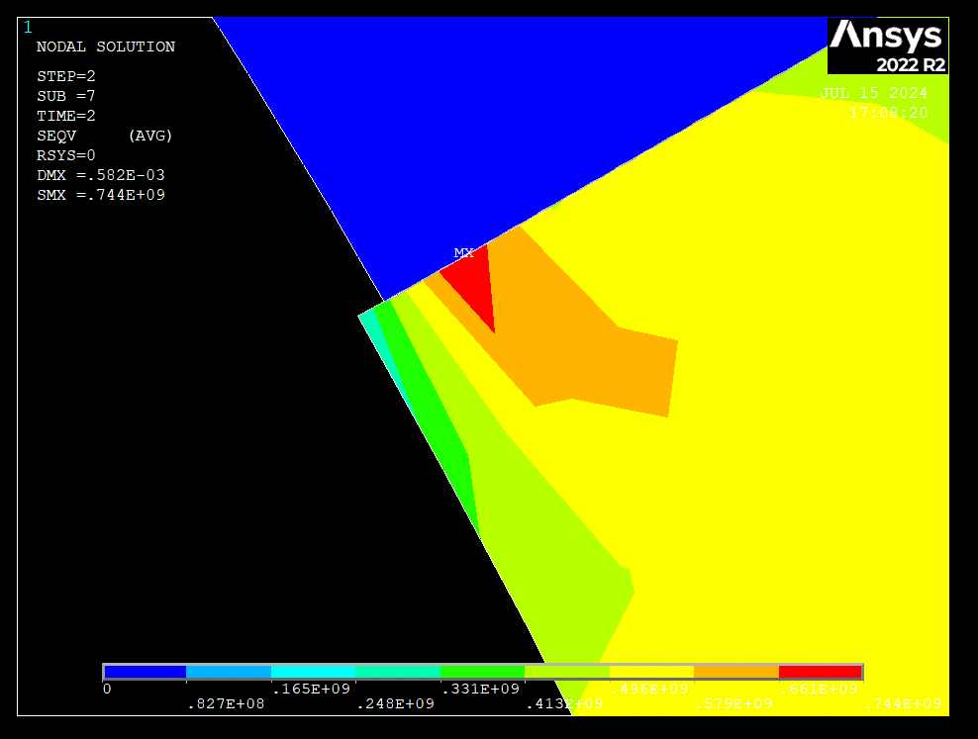
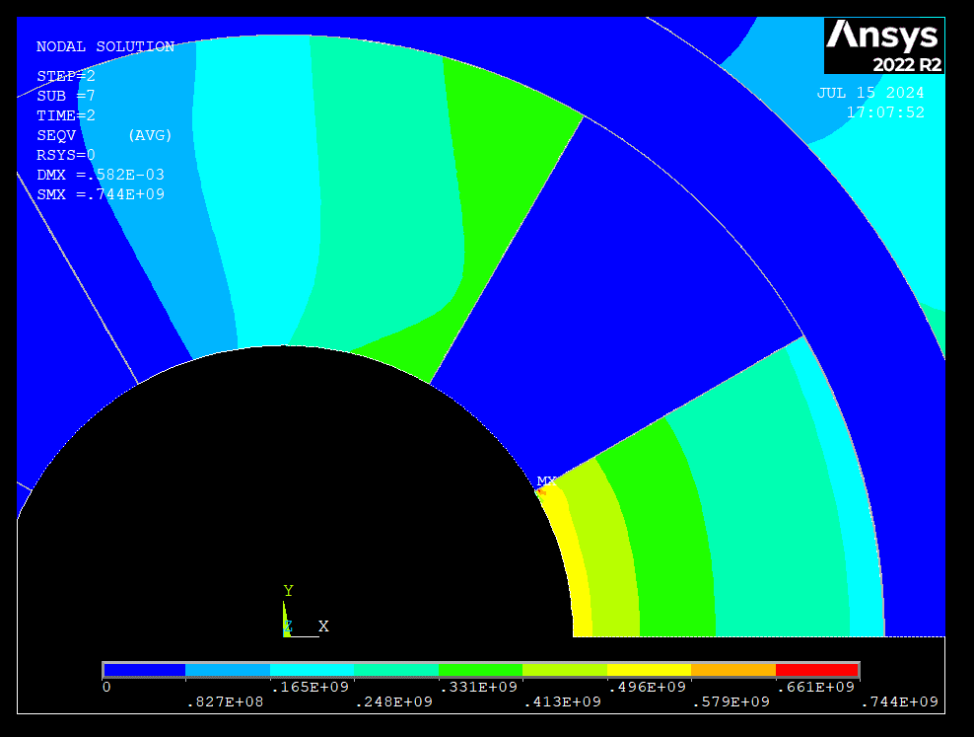
Stress Issue
A “tooth” is formed that undergoes a peak of stress.

Slide 18
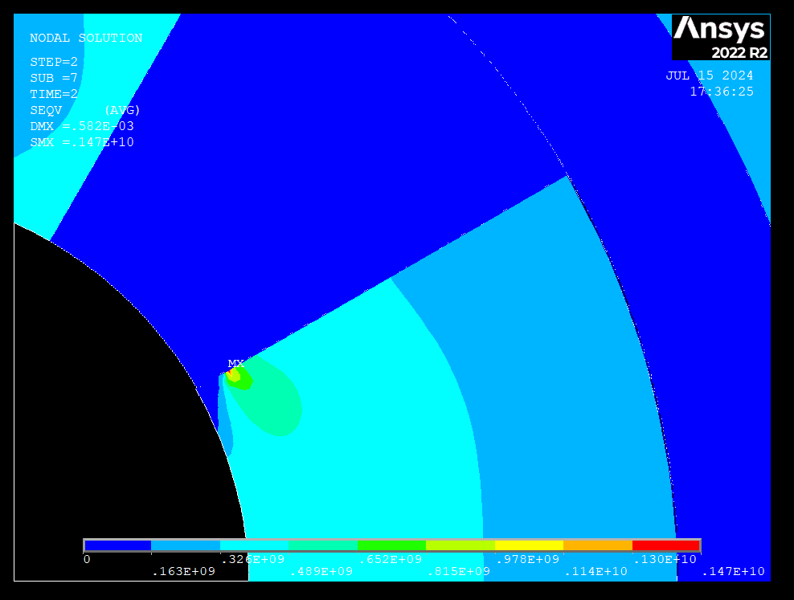
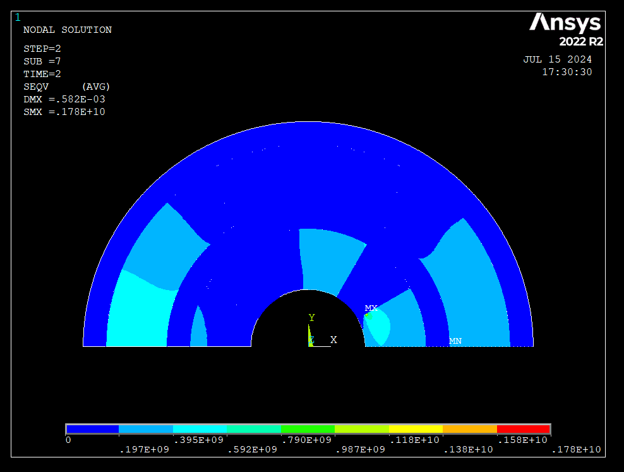
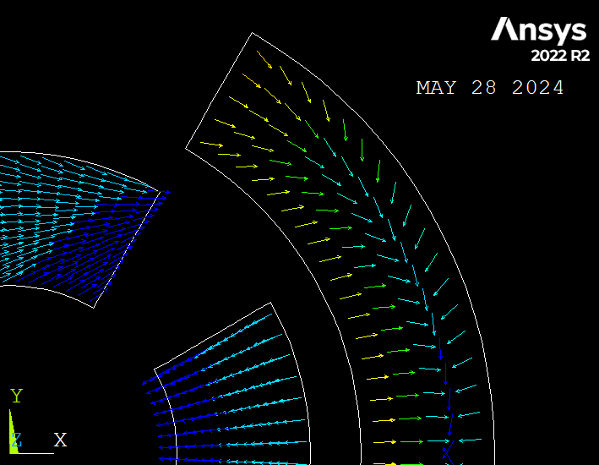
Stress Issue
If we manually remove the “tooth,” it moves to the first zone not excluded.
This is due to the fact that wedges are infinitely rigid, and the coil wants to move inside.

Slide 19
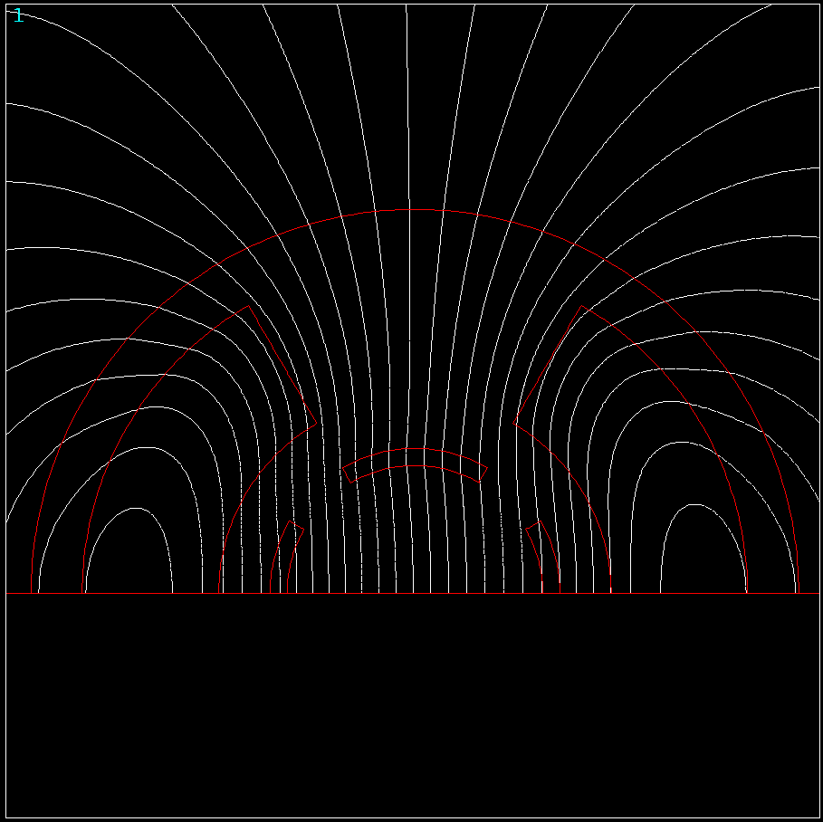
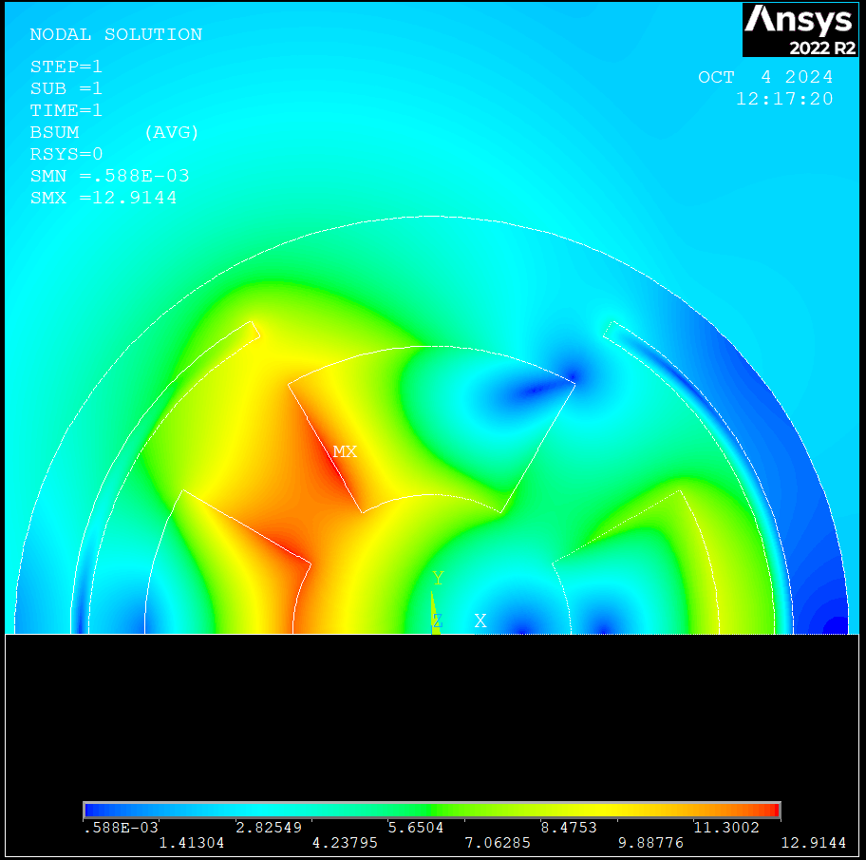
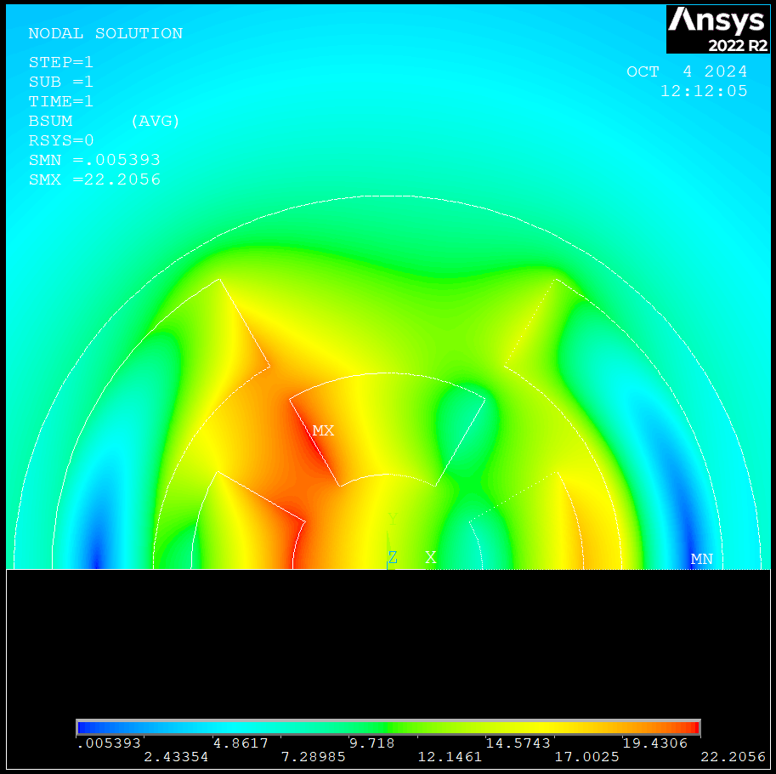
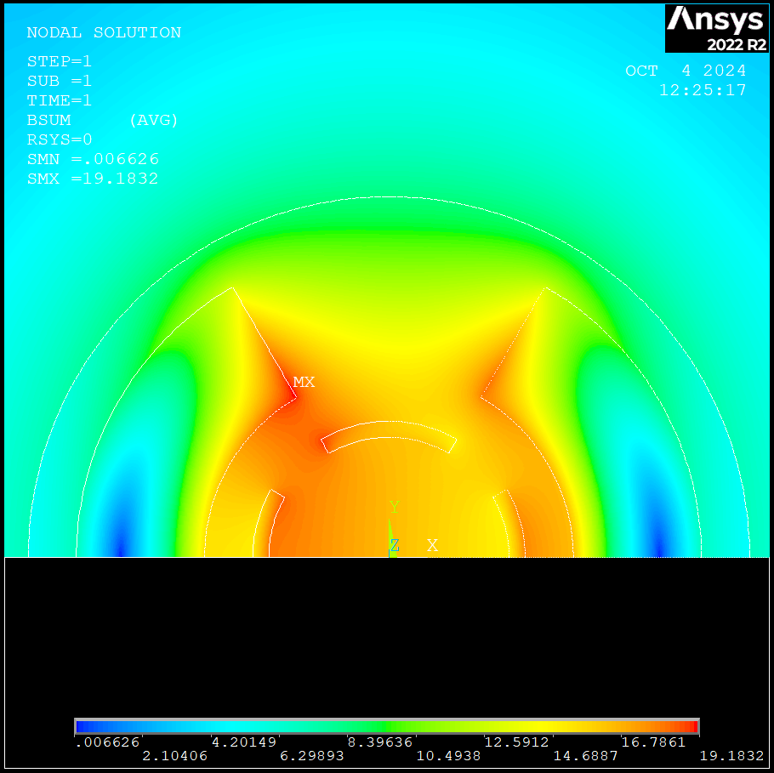
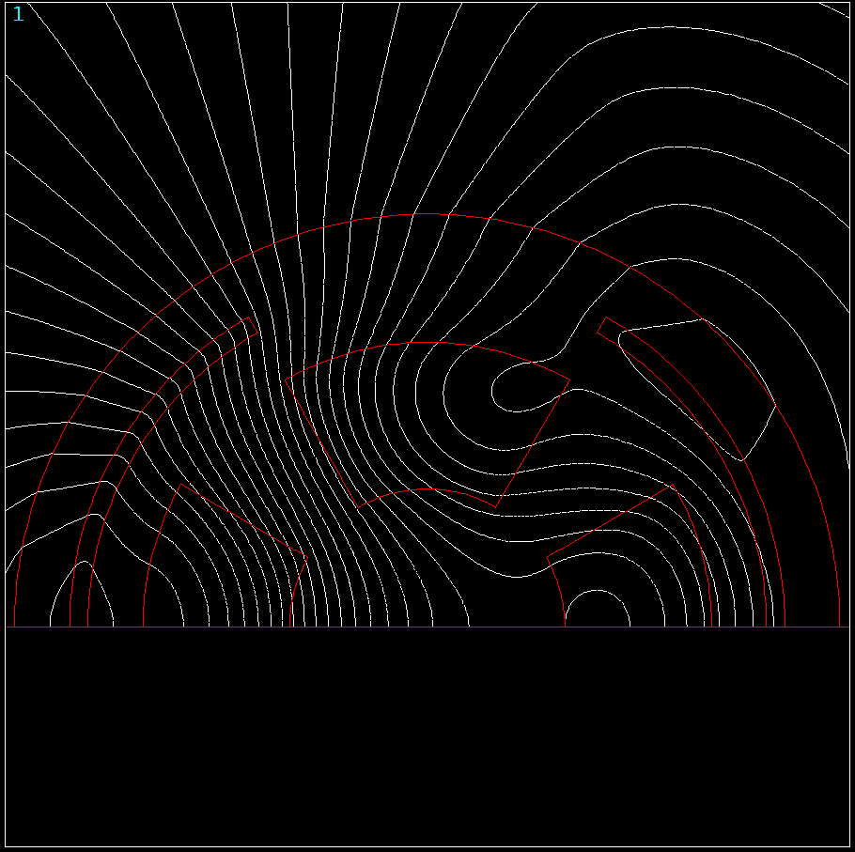
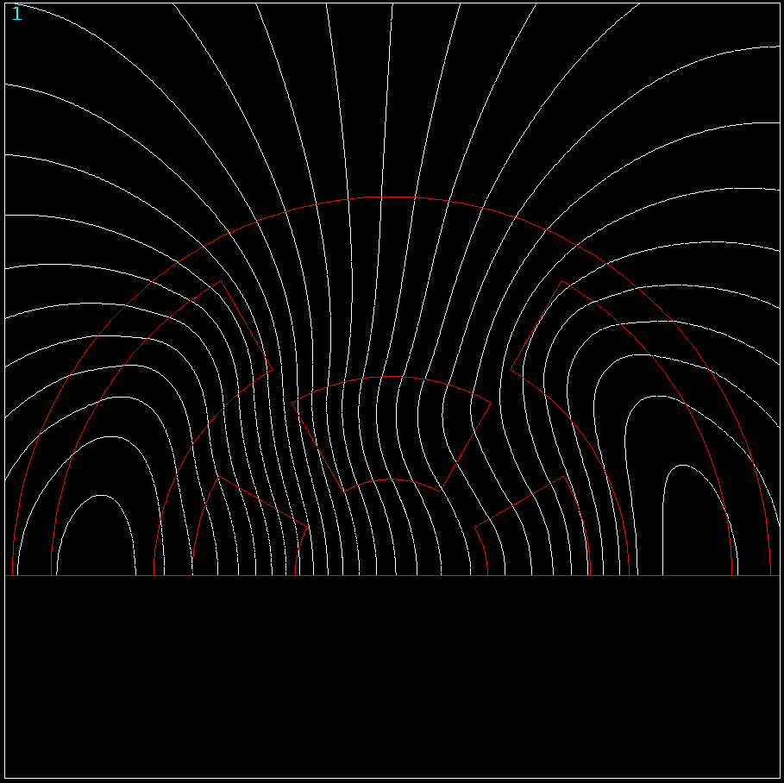
Bsum + plf2d
$$a_{1}=75mm, w_{quad}=80mm,w_{dip}=10mm, T_{op}=20K$$
$$a_{1}=75mm, w_{quad}=80mm,w_{dip}=80mm, T_{op}=20K$$
$$a_{1}=75mm, w_{quad}=10mm,w_{dip}=80mm, T_{op}=20K$$

