Slide 2
Outline
1. Requirements
2. Brandt model (cos-theta)
3. Bean model (block coil)
4. Open points

Slide 3
Requirements
Estimation of the hysteretic losses
Block coil
Cos-theta coil
Requirements
Brandt model
Bean model
Open points
Bean model
Brandt model

Slide 4







Implementation of Brandt Model in MATLAB for REBCO magnetization effect

Slide 5
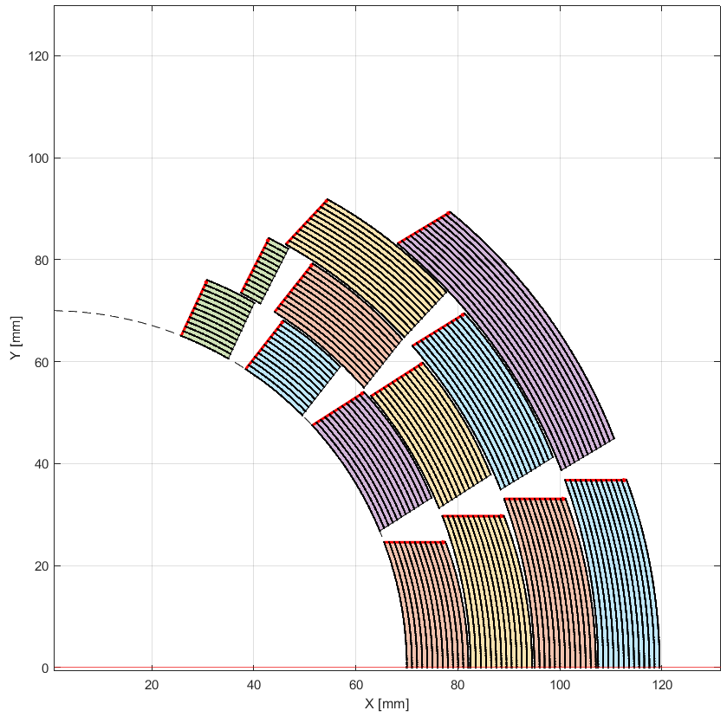
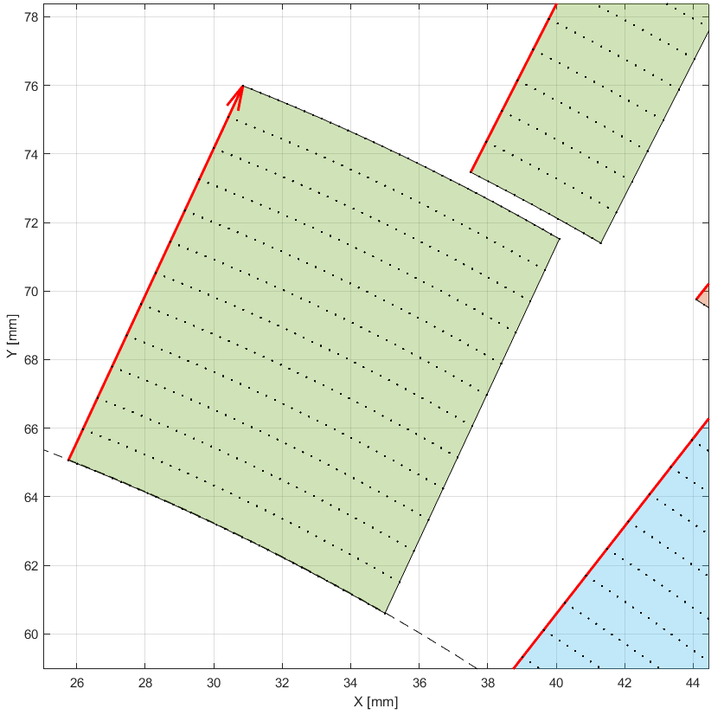

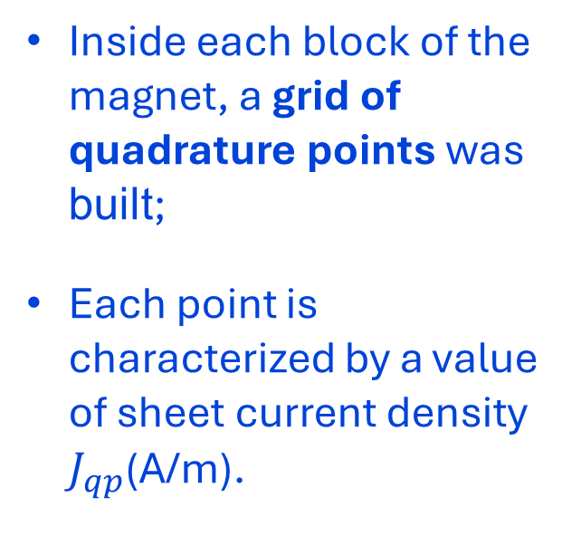
Quadrature points “qp” in Matlab
Inside each block of the magnet, a grid of quadrature points was built;
Each point is characterized by a value of sheet current density $J_{qp}$(A/m).
Requirements
Brandt model
Bean model
Open points

Slide 6
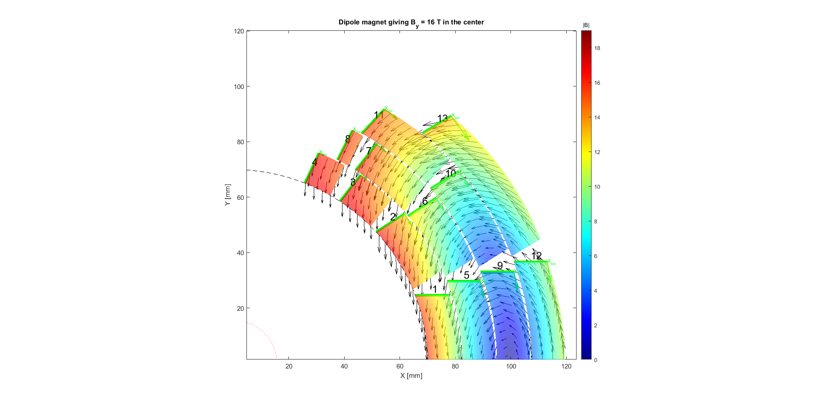
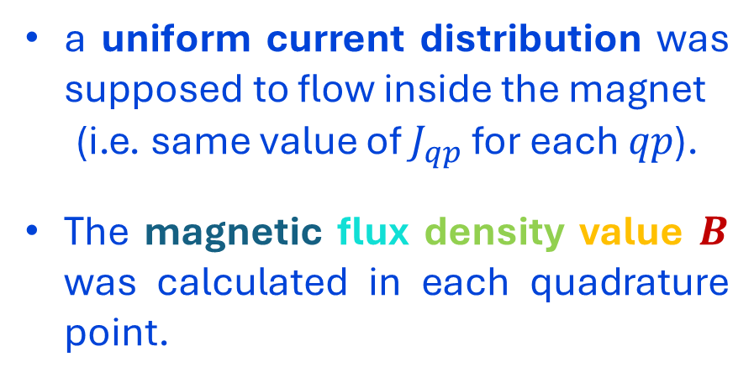
Inizialization
a uniform current distribution was supposed to flow inside the magnet
(i.e. same value of $J_{qp}$ for each $qp$).
The magnetic flux density value $B$ was calculated in each quadrature point.
Requirements
Brandt model
Bean model
Open points

Slide 7
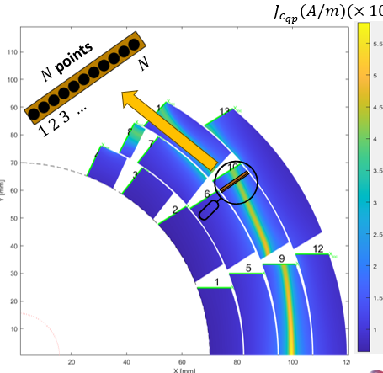
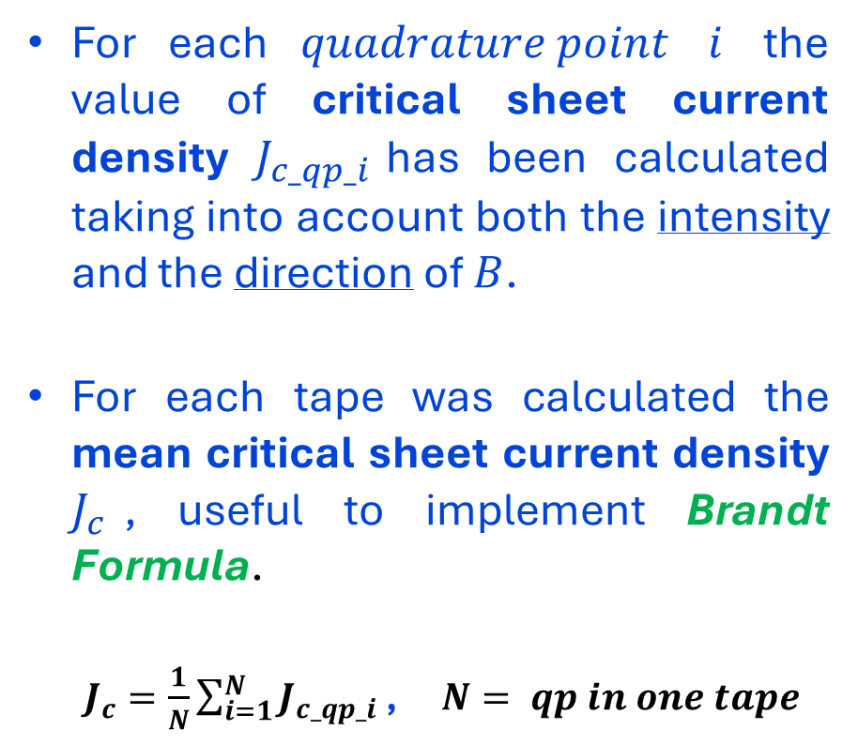

Critical sheet current $J_{c_qp}$
$$J_{c_{qp}}(A/m)(×{10}^{5})$$
For each $quadrature point$ $i$ the value of critical sheet current density $J_{c_qp_i}$has been calculated taking into account both the intensity and the direction of $B$.
For each tape was calculated the mean critical sheet current density $J_{c}$, useful to implement Brandt Formula.
$J_{c}=\frac{1}{N}\sum_{i=1}^{N}{J_{c_qp_i}}$ ,$N= qp in one tape$
Requirements
Brandt model
Bean model
Open points

Slide 8
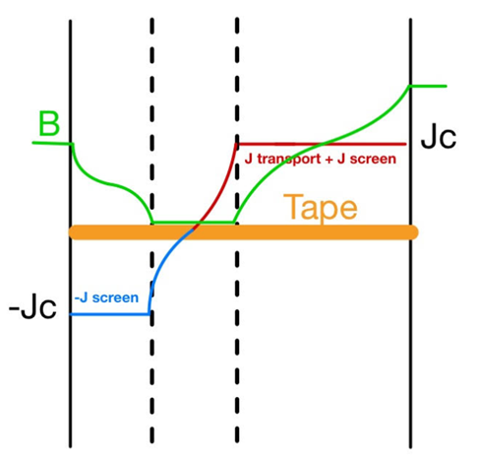
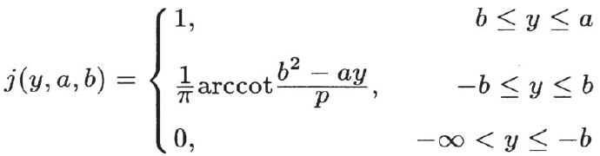





Brandt Formula
To calculate the new sheet current density $J_{qp}$for each $qp$ by the following formula
$J_{qp}\left(y\right)=J_{c}[ j\left(y+w, a+w, b\right)+tj\left(−y−w,a−w,b\right)]$
where
the values of $b,w$ for each tape must be obtained
($2a=tape width$and ).
qp 2
qp 3
qp n
qp 1
qp 4
qp 5
…
Requirements
Brandt model
Bean model
$$x$$
$$y$$
N.B. the parameter $t=+1$ if $r^{∗}=\frac{I}{2πaH_{a}}>1$, while$t=−1$ if $r=\frac{I}{2πaH_{a}}<1$
*$r≔$ self-field versus field contribute

Slide 9

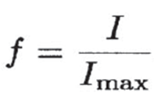



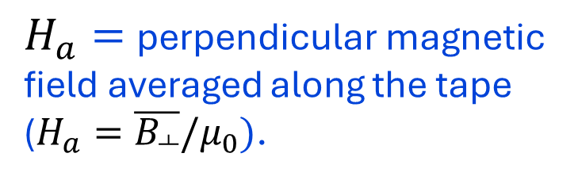



b, w values
$$a$$
$$w=afc$$
Requirements
Brandt model
Bean model
Open points
$H_{a}=$perpendicular magnetic field averaged along the tape ($H_{a}=\overline{B_{┴}}/μ_{0})$.

Slide 10
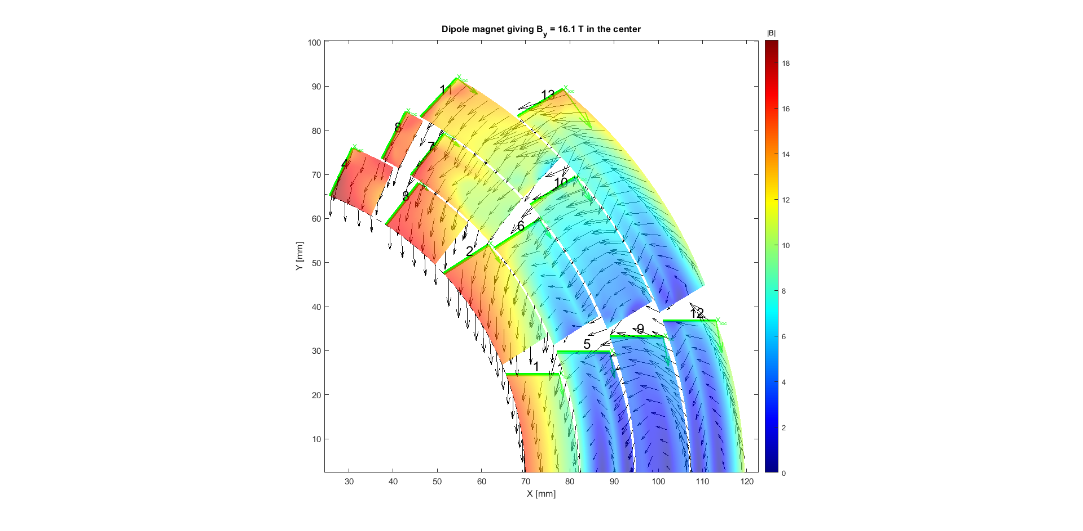
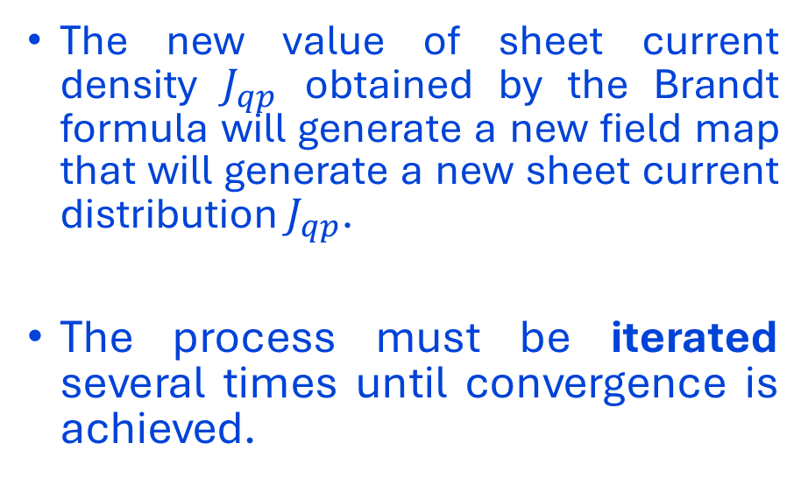

Iteration process
The new value of sheet current density $J_{qp}$ obtained by the Brandt formula will generate a new field map that will generate a new sheet current distribution $J_{qp}$.
The process must be iterated several times until convergence is achieved.
Requirements
Brandt model
Bean model
Open points
$$B_{bore}$$
1
Iteration n
100

Slide 11
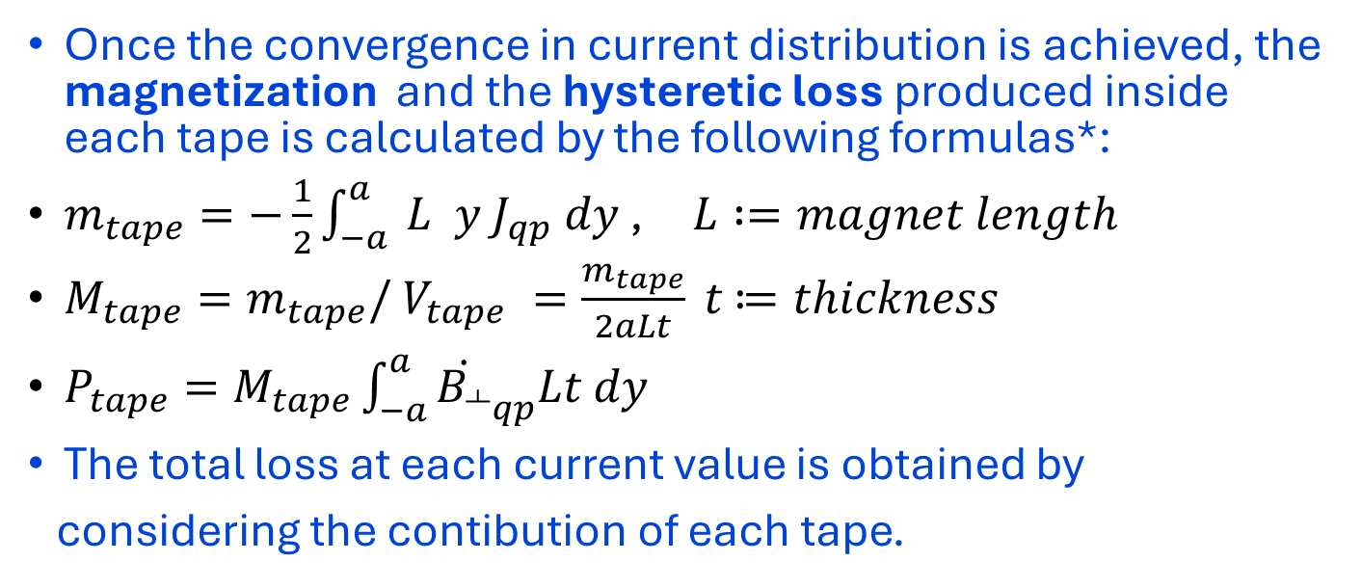
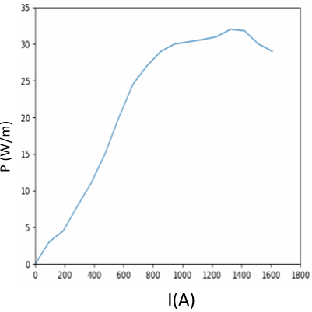
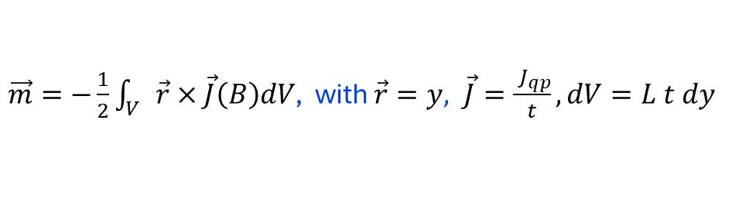

Slide 12
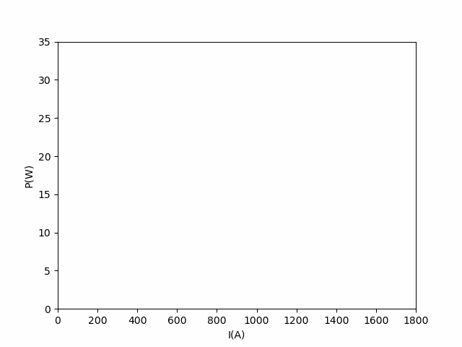
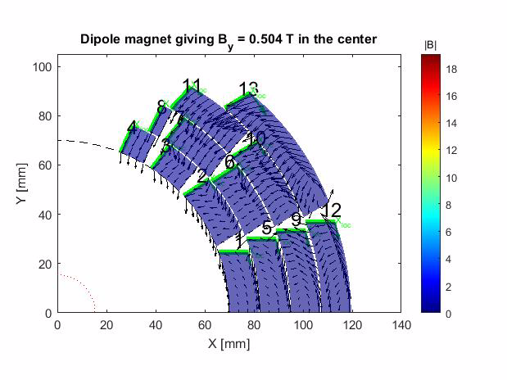
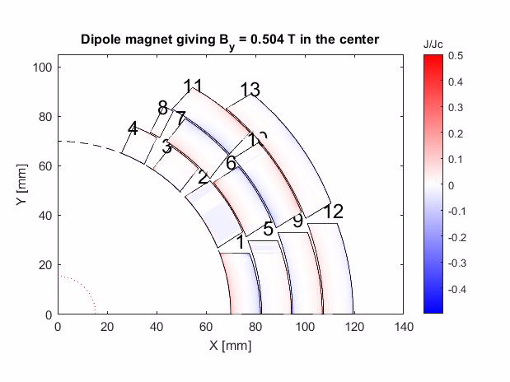
Field, Current, Losses
MAGNETIC FIELD (B)
CURRENT DISTRIBUTION (J/Jc)
HYSTERETIC LOSSES (P)
Requirements
Brandt model
Bean model
Open points
P(W/m)

Slide 13
References
https://en.wikipedia.org/wiki/Biot-Savart_law
E. H. Brandt and M. Indenbom, “Type-ii-superconductor strip with current in a perpendicular magnetic field” ,
Physical review B, vol. 48, no. 17, p. 12893, 1993.
https://en.wikipedia.org/wiki/Magnetic_moment
Requirements
Brandt model
Bean model
Open points

Slide 14
Estimation of the hysteretic losses in SC layer via Brandt Model

Slide 15
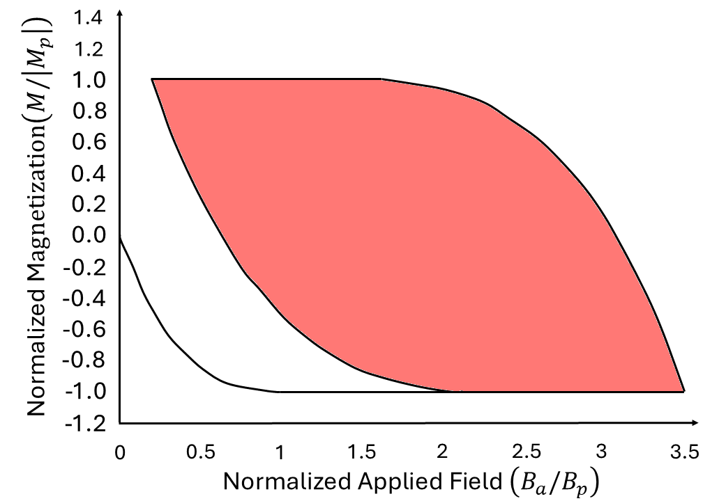
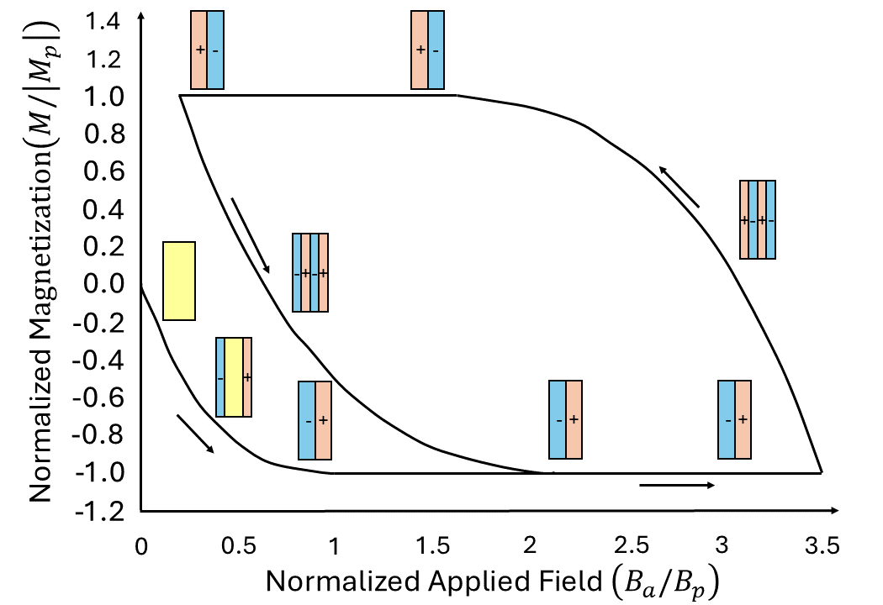
Goals
Although the loss mechanism is of a resistive nature, the resistance is highly nonlinear, with the results that the loss per cycle is independent of the cycle time.
Hysteretic losses = red area between the two curves.
Problem: we do not know the trend of the curves.
We can estimate hysteretic losses by circumscribing the hysteresis losses with a rectangle.
We are only interested in the ramping phase of the magnet → we can only consider half rectangle.
Requirements
Brandt model
Bean model
Open points

Slide 16
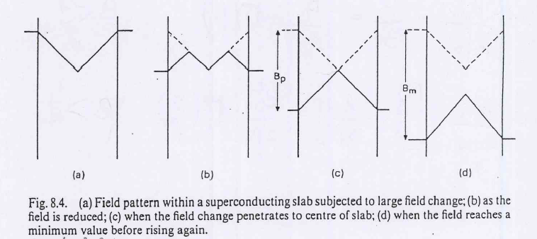
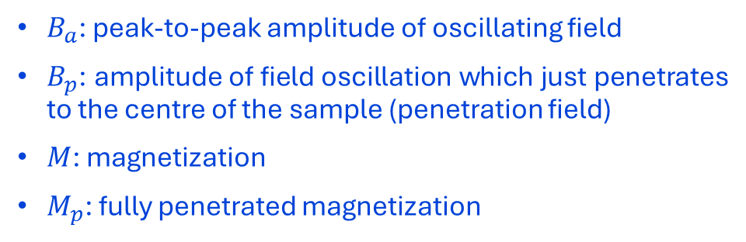
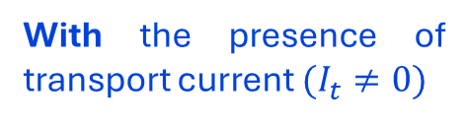
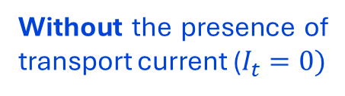
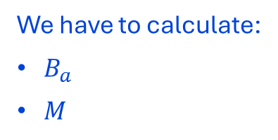
Goals
$B_{a}$: peak-to-peak amplitude of oscillating field
$B_{p}$: amplitude of field oscillation which just penetrates to the centre of the sample (penetration field)
$M$: magnetization
$M_{p}$: fully penetrated magnetization
Requirements
Brandt model
Bean model
Open points
We have to calculate:
$B_{a}$
$M$
Without the presence of transport current ($I_{t}=0)$
With the presence of transport current $(I_{t}≠0)$

Slide 17
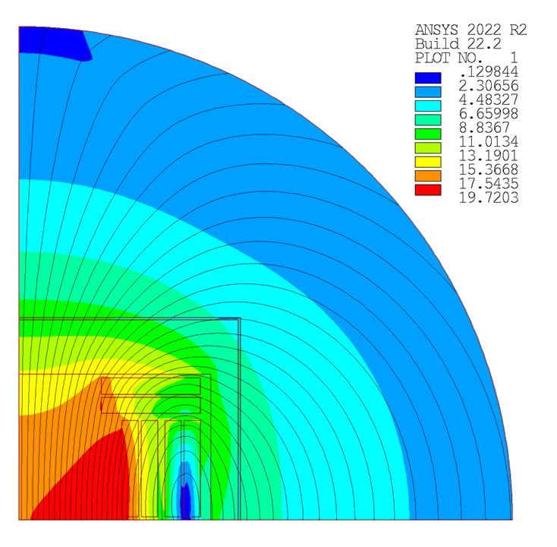

Studied configuration
$$B_{sum} (T)$$
N° double pancakes | N° tapes (m/m)
1 | 1048 (524+524)
2 | 1048 (524+524)
3 | 1080 (540+540)
Tot | 3176
Requirements
Brandt model
Bean model
Open points
3
x
1
2

Slide 18

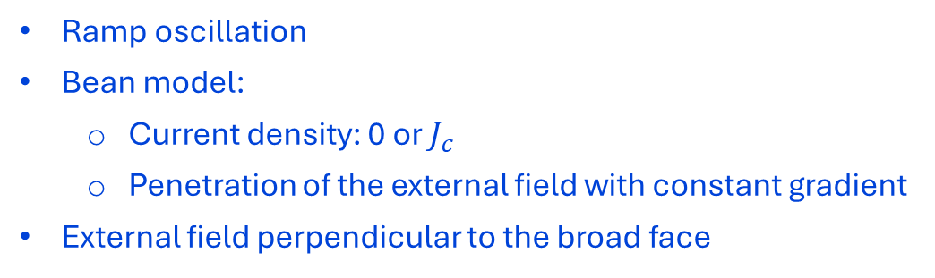







Assumptions with $I_{t}=0$
Ramp oscillation
Bean model:
  Current density: 0 or $J_{c}$
  Penetration of the external field with constant gradient
External field perpendicular to the broad face
Requirements
Brandt model
Bean model
Open points
$$y$$
$$z$$
$$B_{ext}$$
$$2b$$
$$+J_{c}$$
$$−J_{c}$$
$$x$$
$$2a$$

Slide 19
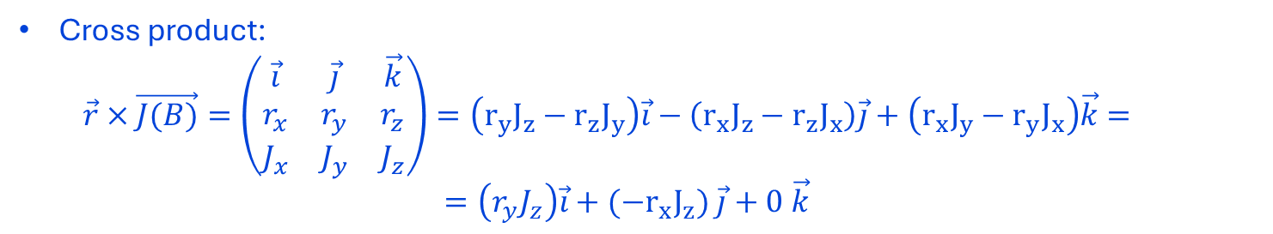
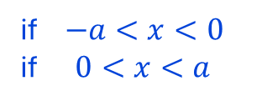
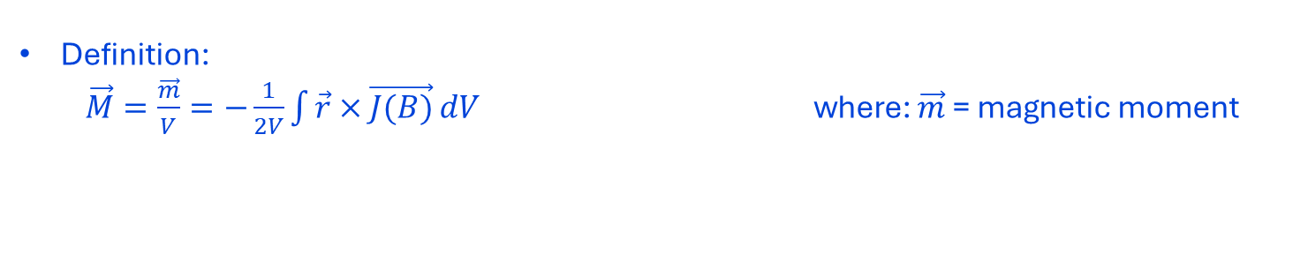

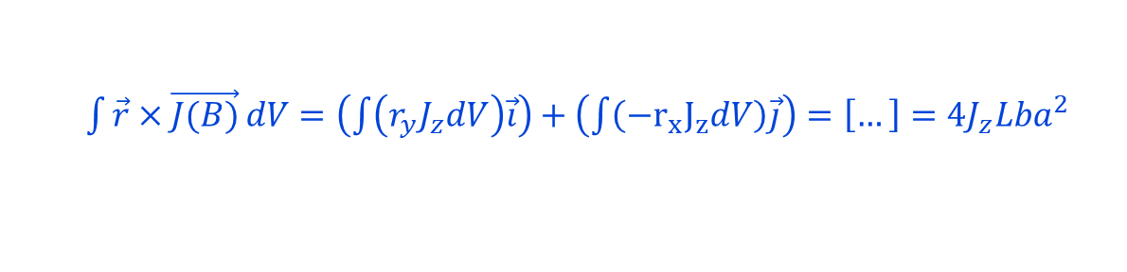
Magnetization
Definition:
  $\vec{M}=\frac{\vec{m}}{V}=−\frac{1}{2V}\int{\vec{r}×\vec{J(B)}}dV$ where: $\vec{m}$= magnetic moment
Cross product:
  $$\vec{r}×\vec{J(B)}=\left(\begin{matrix}\vec{i} & \vec{j} & \vec{k} \\ r_{x} & r_{y} & r_{z} \\ J_{x} & J_{y} & J_{z}\end{matrix}\right)=\left(r_{y}J_{z}−r_{z}J_{y}\right)\vec{i}−\left(r_{x}J_{z}−r_{z}J_{x}\right)\vec{j}+\left(r_{x}J_{y}−r_{y}J_{x}\right)\vec{k}=$$
  $=\left(r_{y}J_{z}\right)\vec{i}+(−r_{x}J_{z})$ $\vec{j}+0 \vec{k}$
Requirements
Brandt model
Bean model
Open points
  $\int{\vec{r}×\vec{J(B)}}dV=\left(\int{\left(r_{y}J_{z}dV\right)\vec{i}}\right)+\left(\int{\left(−r_{x}J_{z}dV\right)\vec{j}}\right)=\left[…\right]=4J_{z}Lba^{2}$
$$\left\{\begin{aligned}+J_{C} \\ −J_{c}\end{aligned}\right.$$
if $−a<x<0$
if $0<x<a$
Magnetization (with $J_{z}=J_{c}$ for Bean model):
  $\vec{M}=−\frac{1}{2V}4J_{c}Lba^{2}=\frac{1}{4}J_{c}a$

Slide 20
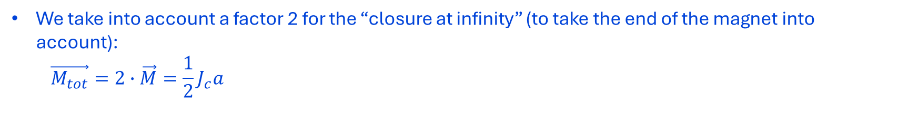
Magnetization (M)
We take into account a factor 2 for the “closure at infinity” (to take the end of the magnet into account):
  $$\vec{M_{tot}}=2∙\vec{M}=\frac{1}{2}J_{c}a$$
Requirements
Brandt model
Bean model
Open points

Slide 21
Peak-to-peak amplitude
We assume that the value of the peak-to-peak amplitude of oscillating field is equal to the average field inside the SClayer (slab)
  $$B_{a}=B_{avg}$$
Requirements
Brandt model
Bean model
Open points

Slide 22
Hysteretic losses $\left(J/m^{3}\right)$
Hysteretic losses per unit volume $(J/m^{3})$ = red area:
  $$\frac{q}{V}=B_{a}∙M=B_{avg}∙\frac{1}{2}J_{c}a \left(\frac{J}{m^{3}}\right)$$
Requirements
Brandt model
Bean model
Open points

Slide 23







Hysteretic losses $\left(J/m\right)$
Hysteretic losses per unit length $(J/m)$:
  $\frac{q}{L}=\frac{q}{V}∙A_{sec}=\frac{1}{2}J_{c}B_{avg}a∙2b2a=2$ $J_{c}B_{avg}a^{2}b \left(\frac{J}{m}\right)$
Requirements
Brandt model
Bean model
Open points
$$2b$$
$$y$$
$$z$$
$$+J_{c}$$
$$−J_{c}$$
$$x$$
$$2a$$

Slide 24










Assumptions with $I_{t}≠0$
Ramp oscillation
Bean model:
  Current density: 0 or $J_{c}$
  Penetration of the external field with constant gradient
External field perpendicular to the broad face
Requirements
Brandt model
Bean model
Open points
$$y$$
$$z$$
$$B_{ext}$$
$$2b$$
$$+J_{c}$$
$$−J_{c}$$
$$x$$
$$δ$$
$$2a−δ$$
$$2a$$

Slide 25
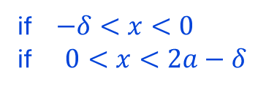

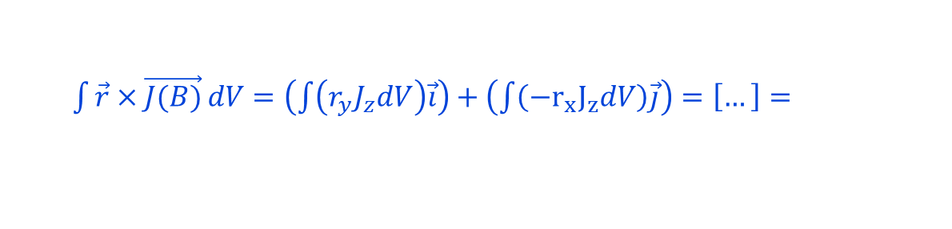
Magnetization
Definition:
  $\vec{M}=\frac{\vec{m}}{V}=−\frac{1}{2V}\int{\vec{r}×\vec{J(B)}}dV$ where: $\vec{m}$= magnetic moment
Cross product:
  $$\vec{r}×\vec{J(B)}=\left(\begin{matrix}\vec{i} & \vec{j} & \vec{k} \\ r_{x} & r_{y} & r_{z} \\ J_{x} & J_{y} & J_{z}\end{matrix}\right)=\left(r_{y}J_{z}−r_{z}J_{y}\right)\vec{i}−\left(r_{x}J_{z}−r_{z}J_{x}\right)\vec{j}+\left(r_{x}J_{y}−r_{y}J_{x}\right)\vec{k}=$$
  $=\left(r_{y}J_{z}\right)\vec{i}+(−r_{x}J_{z})$ $\vec{j}+0 \vec{k}$
Requirements
Brandt model
Bean model
Open points
  $\int{\vec{r}×\vec{J(B)}}dV=\left(\int{\left(r_{y}J_{z}dV\right)\vec{i}}\right)+\left(\int{\left(−r_{x}J_{z}dV\right)\vec{j}}\right)=\left[…\right]=$
$$\left\{\begin{aligned}+J_{C} \\ −J_{c}\end{aligned}\right.$$
if $−δ<x<0$
if $0<x<2a−δ$
  $=2J_{z}Lb(4a^{2}−4aδ+2δ^{2})$
Magnetization (with $J_{z}=J_{c}$ for Bean model):
  $\vec{M}=−\frac{1}{2V}2J_{c}Lb\left(4a^{2}−4aδ+2δ^{2}\right)=\frac{1}{8a}J_{c}(4a^{2}−4aδ+2δ^{2})$

Slide 26
Magnetization (M)
We take into account a factor 2 for the “closure at infinity” (to take the end of the magnet into account):
  $\vec{M_{tot}}=2∙\vec{M}=\frac{1}{4a}J_{c}(4a^{2}−4aδ+2δ^{2})$
Requirements
Brandt model
Bean model

Slide 27









Magnetization (M)
We determine the $δ$ value as a function of transport current $I_{t}$ → we balance the currents:
  $J_{t}∙2a2b={+J}_{c}∙δ2b−J_{c}∙\left(2a−δ\right)2b → \left[…\right] →$
  $δ=a\left(\frac{J_{t}}{J_{c}}+1\right)$
Requirements
Brandt model
Bean model
Open points
$$y$$
$$z$$
$$2b$$
$$+J_{c}$$
$$−J_{c}$$
$$x$$
$$δ$$
$$2a−δ$$
$$2a$$

Slide 28

Magnetization (M)
We substitute the value of $δ$ in the total magnetization expression:
  $\vec{M_{tot}}=\frac{1}{4a}J_{c}\left(4a^{2}−4aδ+2δ^{2}\right)=\left[…\right]=\frac{1}{2}aJ_{c}\left(\frac{J_{t}^{2}}{J_{c}^{2}}+1\right)$
Same expression as in the case with $I_{t}=0$
Requirements
Brandt model
Bean model
Open points

Slide 29
Peak-to-peak amplitude
We assume that the value of the peak-to-peak amplitude of oscillating field is equal to the average field inside the Sc layer (slab)
  $$B_{a}=B_{avg}$$
Requirements
Brandt model
Bean model
Open points

Slide 30

Hysteretic losses $\left(J/m^{3}\right)$
Hysteretic losses per unit volume $(J/m^{3})$ = red area:
  $$\frac{q}{V}=B_{a}∙M=B_{avg}∙\frac{1}{2}aJ_{c}\left(\frac{J_{t}^{2}}{J_{c}^{2}}+1\right) \left(\frac{J}{m^{3}}\right)$$
Same expression as in the case with $I_{t}=0$
Requirements
Brandt model
Bean model
Open points

Slide 31







Hysteretic losses $\left(J/m\right)$
Hysteretic losses per unit length $(J/m)$:
  $\frac{q}{L}=\frac{q}{V}∙A_{sec}=B_{avg}∙\frac{1}{2}aJ_{c}\left(\frac{J_{t}^{2}}{J_{c}^{2}}+1\right)∙2b2a=2J_{c}B_{avg}a^{2}b\left(\frac{J_{t}^{2}}{J_{c}^{2}}+1\right) \left(\frac{J}{m}\right)$
Same expression as in the case with $I_{t}=0$
Requirements
Brandt model
Bean model
Open points
$$y$$
$$z$$
$$2b$$
$$+J_{c}$$
$$−J_{c}$$
$$x$$
$$δ$$
$$2a−δ$$
$$2a$$

Slide 32
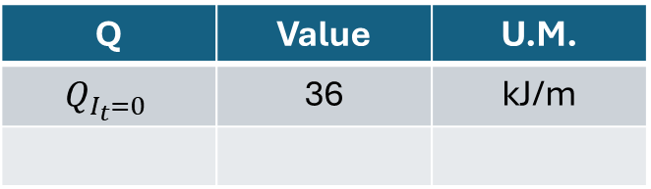
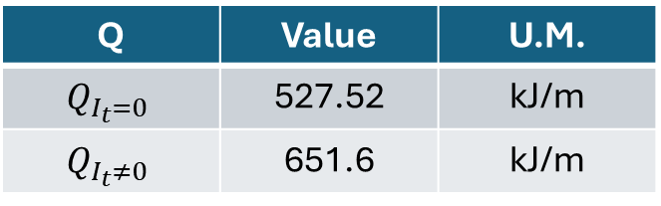
Results
Block coil with Bean model
Cos-theta with Brandt model
Q | Value | U.M.
$$Q_{I_{t}=0}$$ | 527.52 | kJ/m
$$Q_{I_{t}≠0}$$ | 651.6 | kJ/m
Q | Value | U.M.
$$Q_{I_{t}=0}$$ | 36 | kJ/m
Requirements
Brandt model
Bean model
Open points
Results referred to the entire cross section (not a quarter!)
Results referred to the entire cross section (not a quarter!)

Slide 33
Open points
Is there a maximum time limit for the ramp phase of the magnet ?
Do these values constitute a problem from a cryogenic point of view ?
Considering the workforce and time schedule, does it make sense to further investigate the hysteretic losses ?
Requirements
Brandt model
Bean model
Open points
Goal: draw conclusions

Slide 34
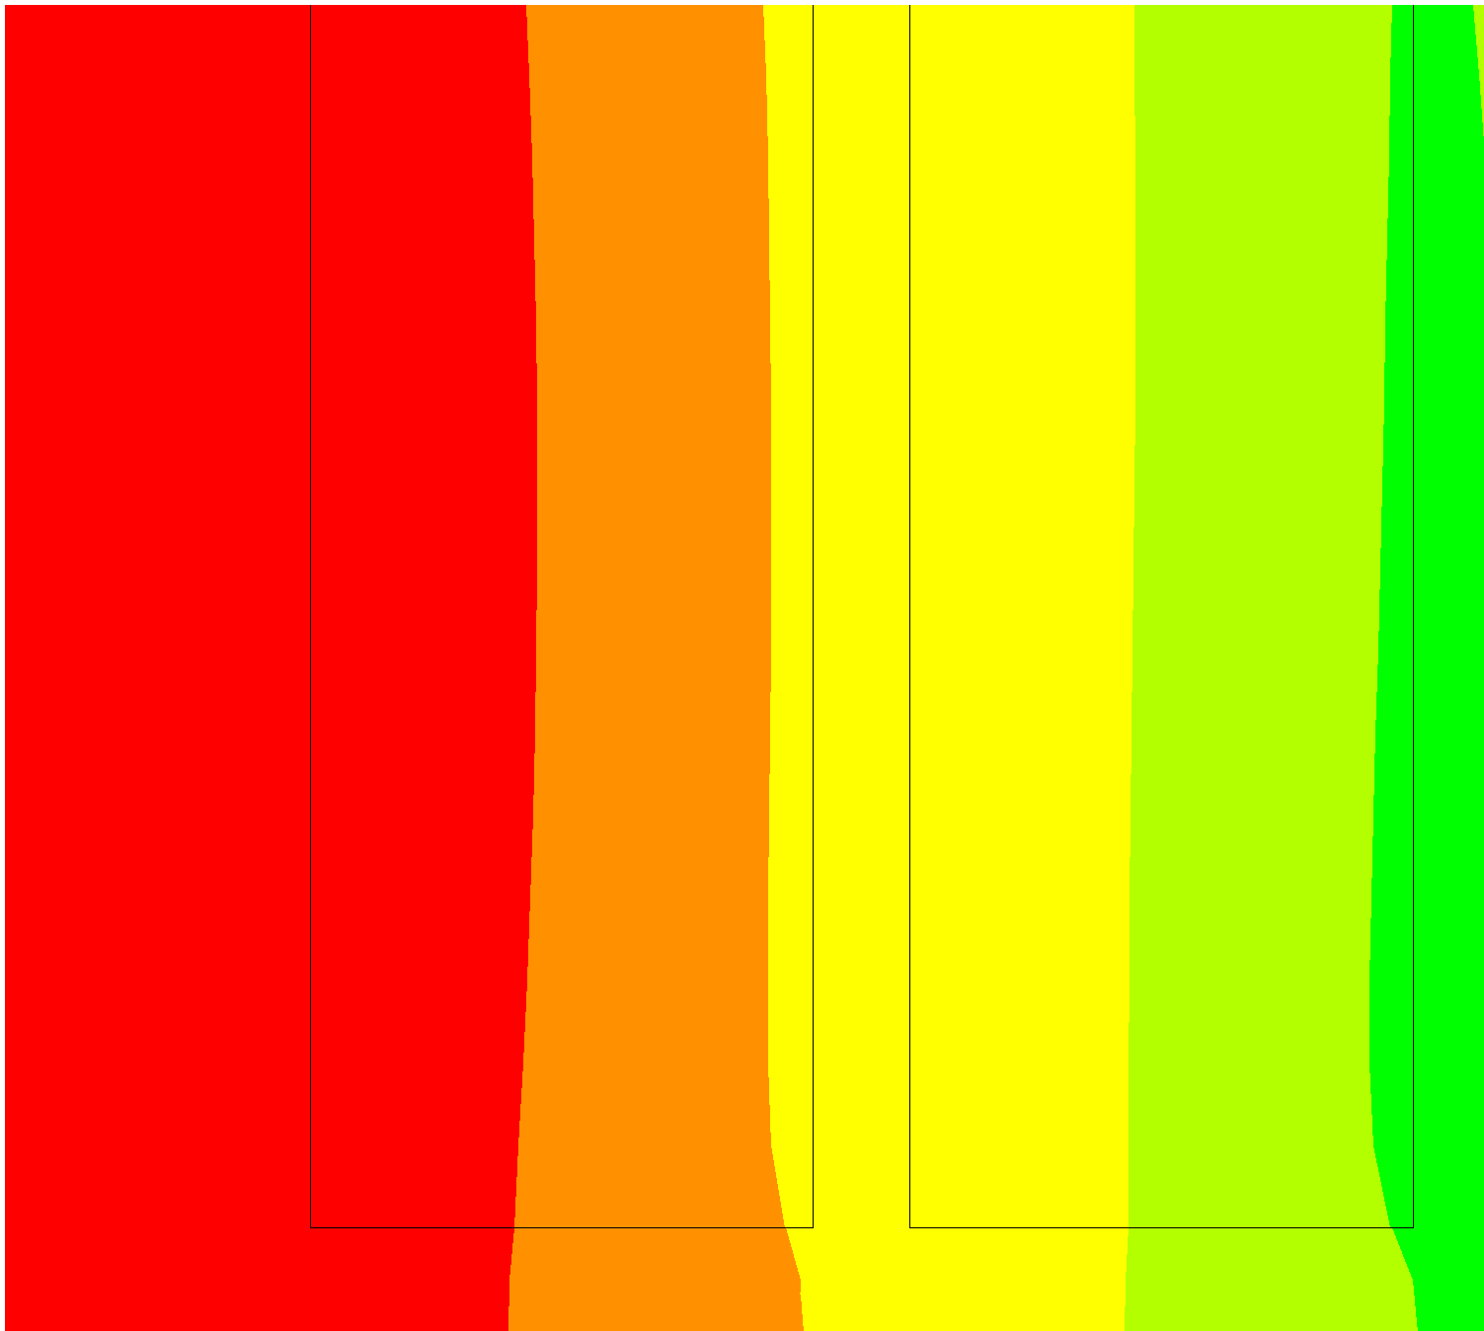

How we implemented the method in Ansys
We must calculate each parameter of the following formula:
$$B_{sum} (T)$$
  $\frac{q}{L}=\frac{q}{V}∙A_{sec}=2J_{c}B_{avg}a^{2}b\left(\frac{J_{t}^{2}}{J_{c}^{2}}+1\right) \left(\frac{J}{m}\right)$
Calculation of $B_{avg}$
We apply a uniform engineering current density to each pancake in ANSYS.
We extrapolate the field map.
We create a path of 100 points corresponding to each SC layers (for simplicity of calculation, we divide the thickness of each pancake by the number of SC layers).
We know the field distribution → we can calculate the average field inside each SC layer
3
x
1
2

Slide 35
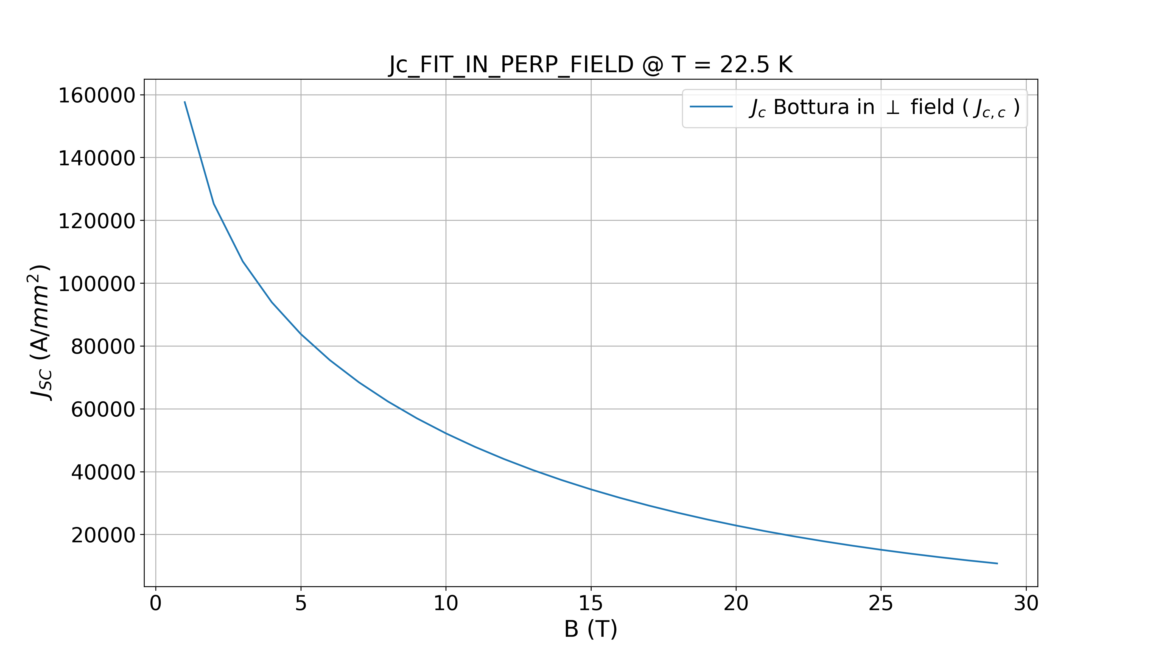


How we implemented the method in Ansys
We must calculate each parameter of the following formula:
  $\frac{q}{L}=\frac{q}{V}∙A_{sec}=2J_{c}B_{avg}a^{2}b\left(\frac{J_{t}^{2}}{J_{c}^{2}}+1\right) \left(\frac{J}{m}\right)$
Calculation of $Jc$
We can use the critical current density fit
  We calculate the critical current density for each SC layer with the previously calculated average field values.
Requirements
Brandt model
Bean model
Open points
$$B_{avg}$$

Slide 36

How we implemented the method in Ansys
We must calculate each parameter of the following formula:
  $\frac{q}{L}=\frac{q}{V}∙A_{sec}=2J_{c}B_{avg}a^{2}b\left(\frac{J_{t}^{2}}{J_{c}^{2}}+1\right) \left(\frac{J}{m}\right)$
Calculation of $a,b$
We know the cross section of the SC layer.
Requirements
Brandt model
Bean model
Open points
$$y$$
$$z$$
$$2b$$
$$+J_{c}$$
$$−J_{c}$$
$$x$$
$$δ$$
$$2a−δ$$
$$2a$$

Slide 37
How we implemented the method in Ansys
We must calculate each parameter of the following formula:
  $\frac{q}{L}=\frac{q}{V}∙A_{sec}=2J_{c}B_{avg}a^{2}b\left(\frac{J_{t}^{2}}{J_{c}^{2}}+1\right) \left(\frac{J}{m}\right)$
Calculation of $Jc$
We can use the critical current density fit
  We calculate the critical current density for each SC layer with the previously calculated average field values.
Requirements
Brandt model
Bean model
Open points
$$B_{avg}$$

Slide 38

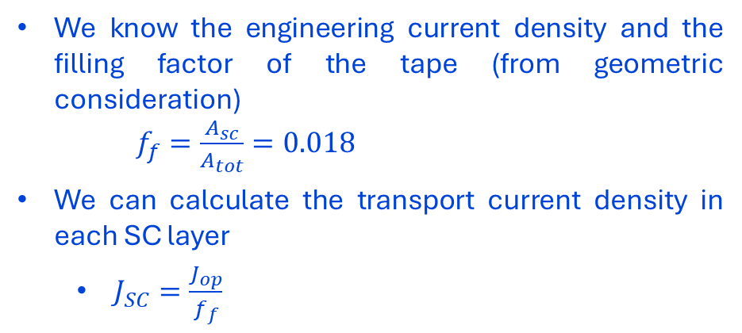
How we implemented the method in Ansys
We must calculate each parameter of the following formula:
  $\frac{q}{L}=\frac{q}{V}∙A_{sec}=2J_{c}B_{avg}a^{2}b\left(\frac{J_{t}^{2}}{J_{c}^{2}}+1\right) \left(\frac{J}{m}\right)$
Calculation of $Jt$
We know the engineering current density and the filling factor of the tape (from geometric consideration)
$f_{f}=\frac{A_{sc}}{A_{tot}}=0.018$
We can calculate the transport current density in each SC layer
  $J_{SC}=\frac{J_{op}}{f_{f}}$
Requirements
Brandt model
Bean model
Open points

