Slide 1

Magnetic design of the large aperture HTS superconducting dipoles for the accelerator ring of the Muon Collider
T. Maiello^{1,4,5}, L. Alfonso¹, L. Balconi^{2,6}, A. Bersani¹, L. Bottura⁴, B. Caiffi¹, S. Fabbri⁴, S. Farinon¹, A. Gagno^{1,5}, F. Levi¹, F. Mariani^{2,6}, S. Mariotto^{2,3}, D. Novelli^{1,6}, A. Pampaloni¹, D. Rinaldoni ⁴, C. Santini², S. Sorti^{2,3}, M. Statera² , G. Vernassa²
¹ INFN – Genova, ² INFN LASA – Milano, ³ University of Milan, ⁴ CERN, ⁵ Università degli Studi di Genova, ⁶ Sapienza Università di Roma

Slide 2

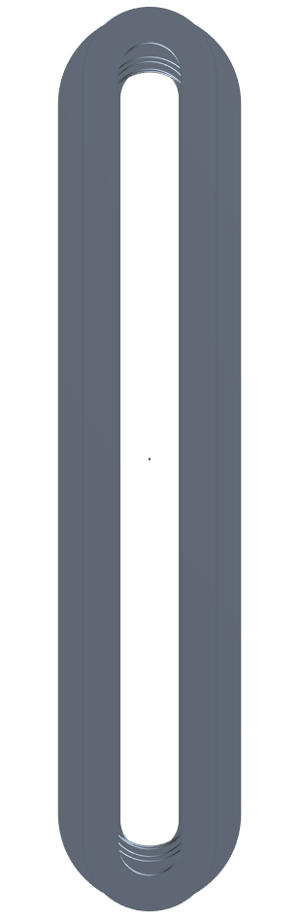
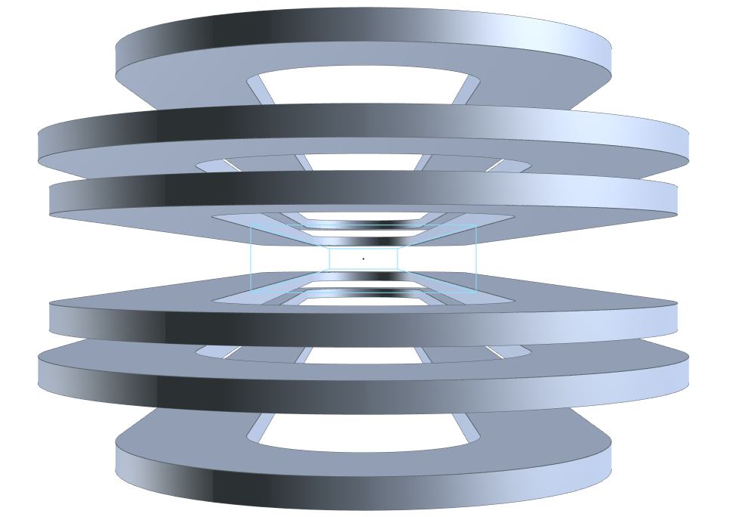
Requirements for the SC dipoles
Main characteristics:
Open midplane dipole to avoid deposition of the radiation from muon decay
10 T of central field
Rectangular aperture of 100 mm x 30 mm
Proposed solution:
Magnet design based on metal insulated HTS racetracks
Aperture
30 mm
100 mm

Slide 3
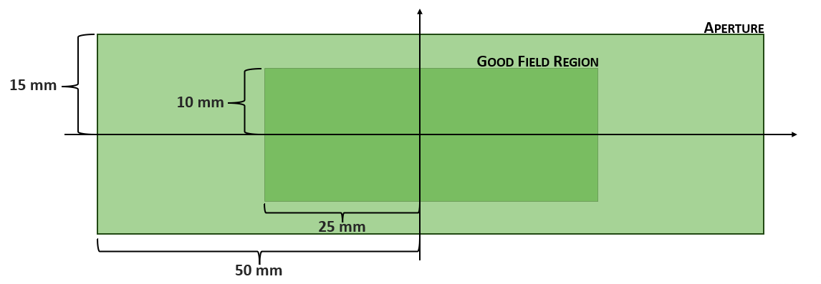

Requirements for the SC dipoles
Field quality requirements:
Rectangular aperture of 100 mm x 30 mm
Rectangular good field region of 50 mm x 20 mm
Field quality: $b_{n}<10$ units in beam radius of 10 mm
First question: are these numbers confirmed, or can they be reduced?
Harmonic coils
0 mm
5 mm
15 mm
25 mm

Slide 4

Requirements for the SC dipoles
Field quality requirements:
Rectangular aperture of 100 mm x 30 mm
Rectangular good field region of 50 mm x 20 mm
Field homogeneity $≤$ 1% in the good field region
First question: are these numbers confirmed, or can they be reduced?
10 mm
6.6 mm
3.3 mm
Field Paths
0 mm

Slide 5
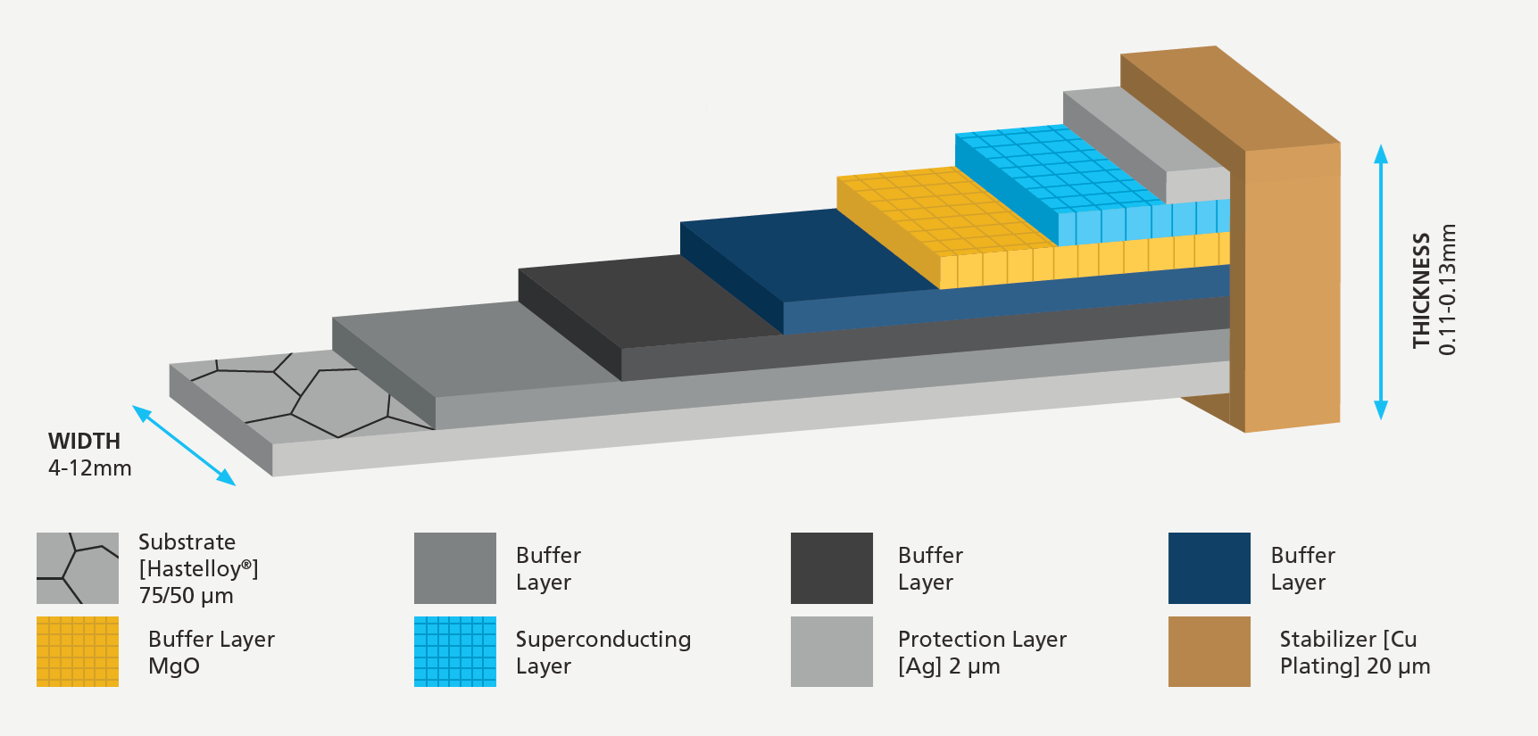
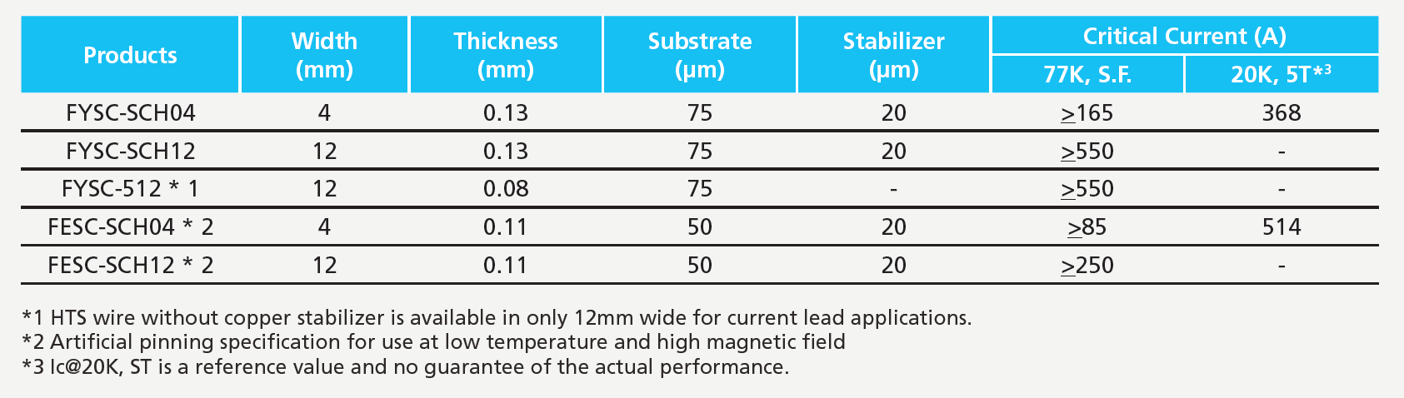






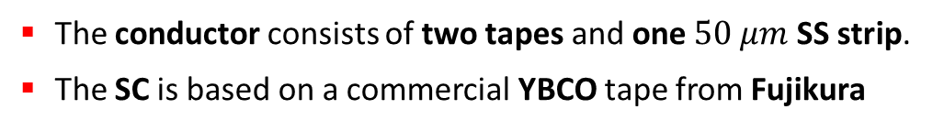


HTS Cable Assumptions
The conductor consists of two tapes and one $50 μm$ SS strip.
The SC is based on a commercial YBCO tape from Fujikura
Same assumption as for the collider studies
SC
Cu
$$2.5 μm$$
Substrates
$$20 μm$$
$$110 μm$$
$$50 μm$$
$$12 mm$$
$$A_{tot}=3.24 mm^{2}$$
$$A_{SC}=0.0598 mm^{2}$$
$$A_{Cu}=0.9656 mm^{2}$$

Slide 6
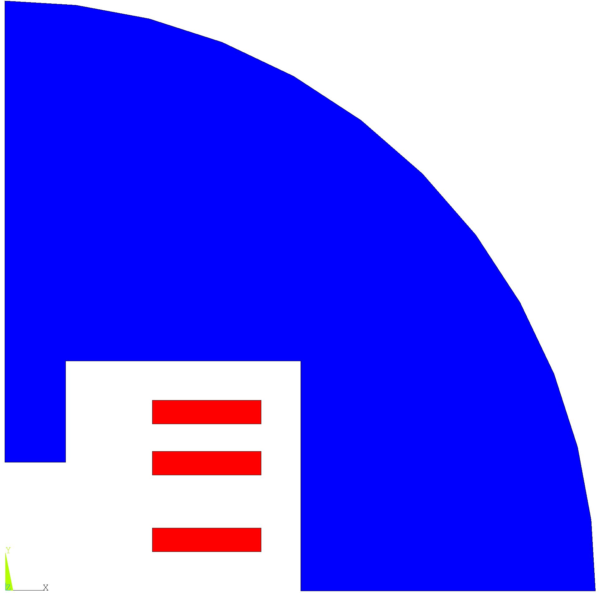
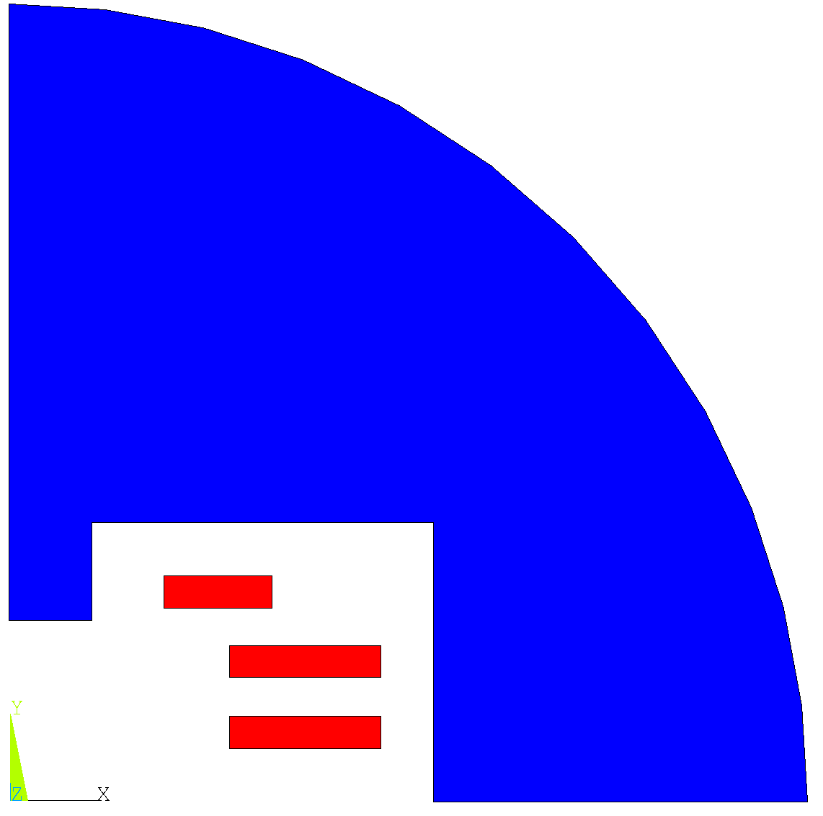
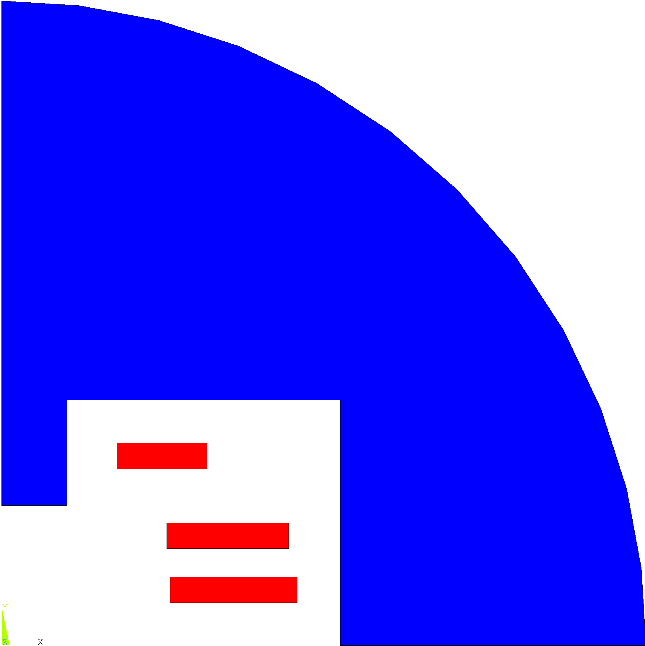
Configurations
Several configurations were found to meet various magnetic requirements. Since 3 racetracks are required, the possibilities are:
3 aligned
2 aligned
no aligned

Slide 7
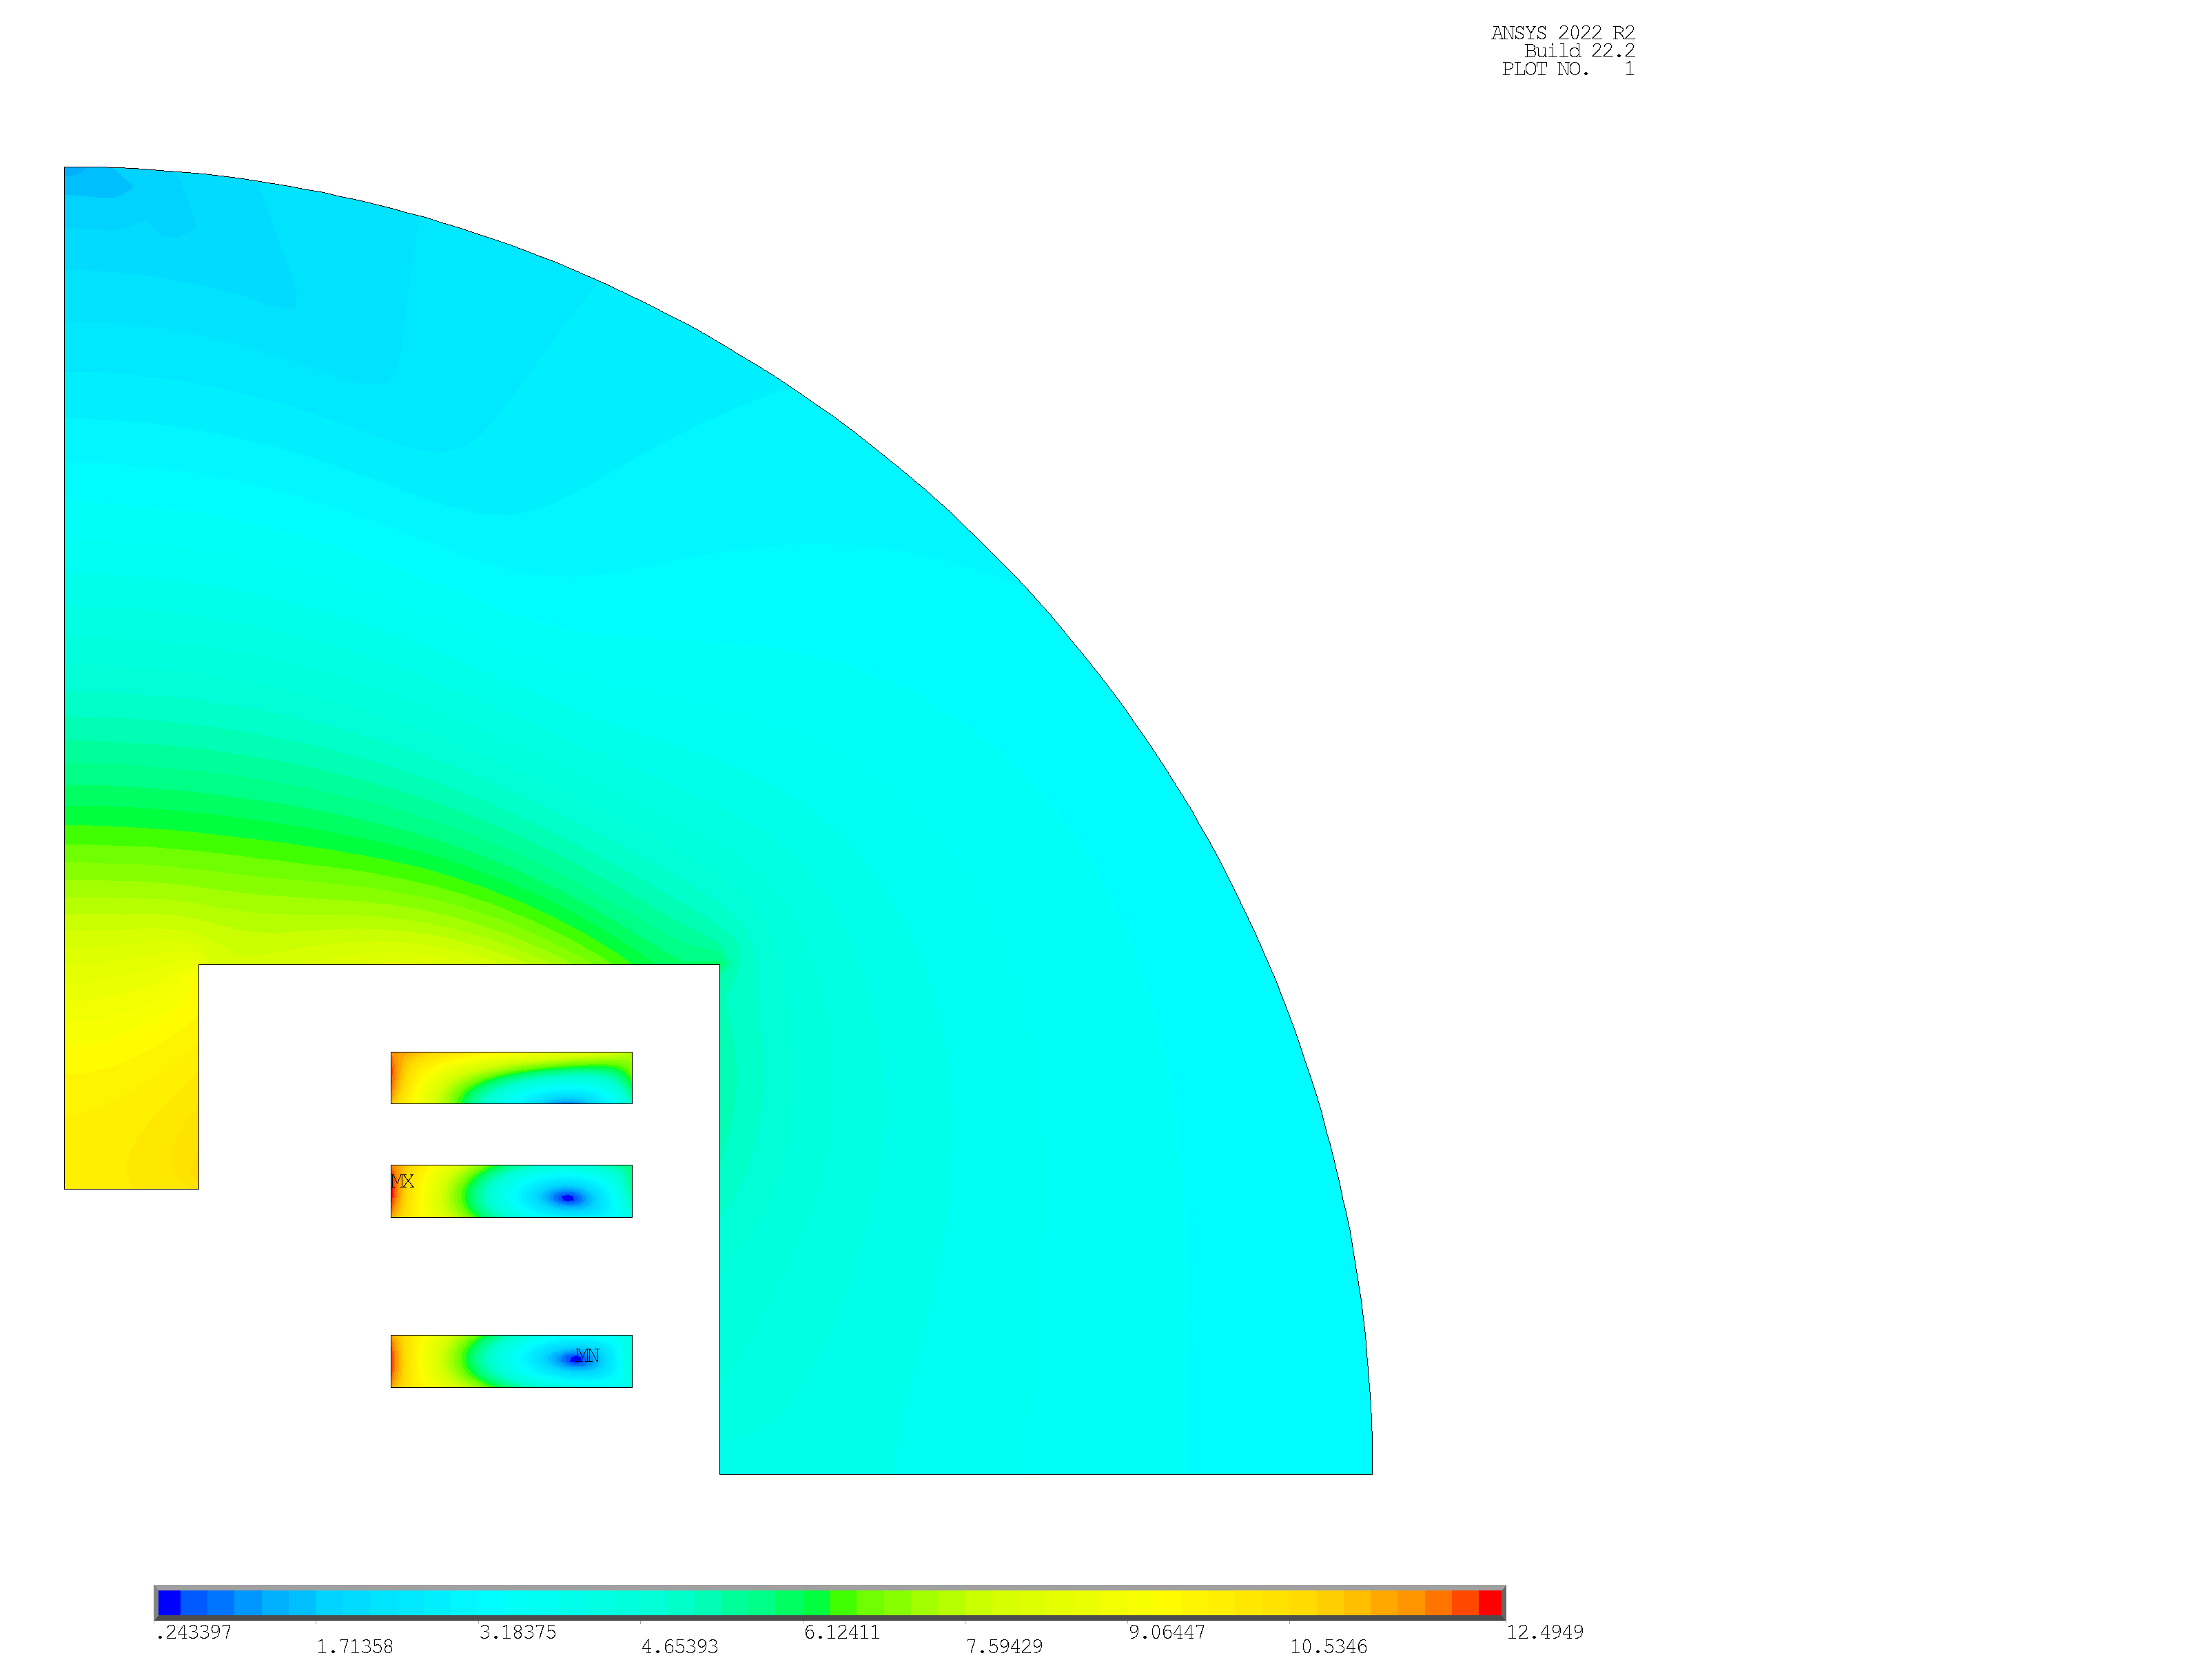
3 Aligned Magnetic Design
I [A] | J_{eng} [A/mm²] | B₀ [T] | B_{p} [T] | B_{p}/B₀
2336.12 | 721.02 | 10.00 | 12.49 | 1.25
T_{op} [K] | T margin [K] | Mag Length [m] | Mec Length [m] | Yoke radius [m] | Coord. Point A [mm]
20 | >2.5 | ~1.3 | ~1.6 | 0.3 | (150.22;116.98)
.
Racetrack 1 | N conductors | N tapes
 | 205 | 410
Racetrack 2 | N conductors | N tapes
 | 205 | 410
A
3
2
Racetrack 3 | N conductors | N tapes
 | 205 | 410
1
B [T]

Slide 8
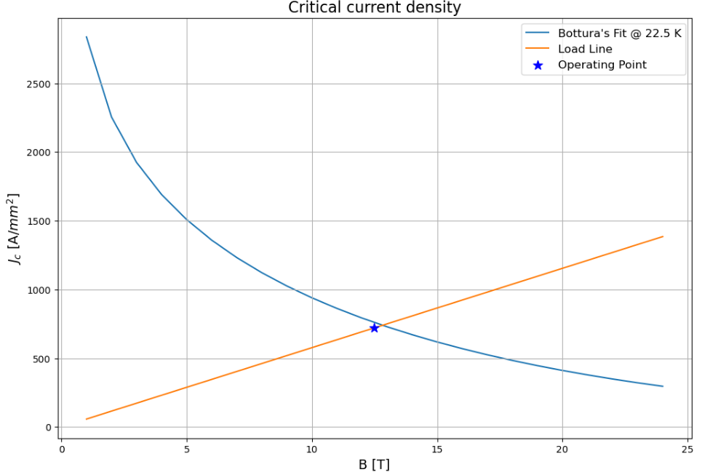
3 Aligned Magnetic Design
Margin in temperature

Slide 9
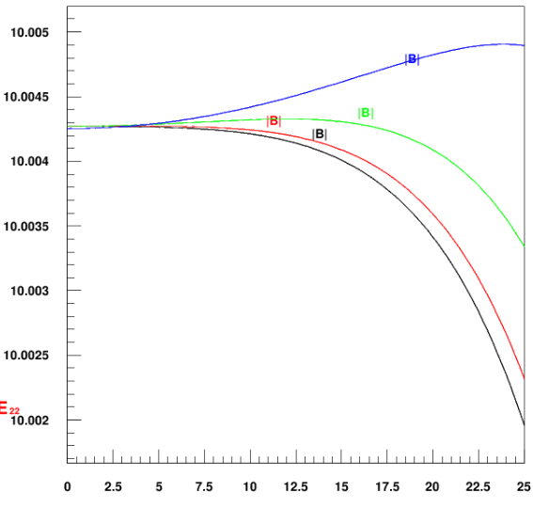
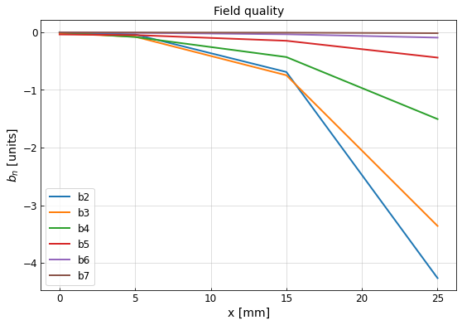
3 Aligned Magnetic Design
Results:
All harmonics greatly less then 10 units
The harmonics higher than the 7th order are negligible (less than 0.003 units)
The field homogeneity evaluated at x = 25 mm is about 0.029%
Field along paths
B [T]
higher path
lower path
x [mm]

Slide 10
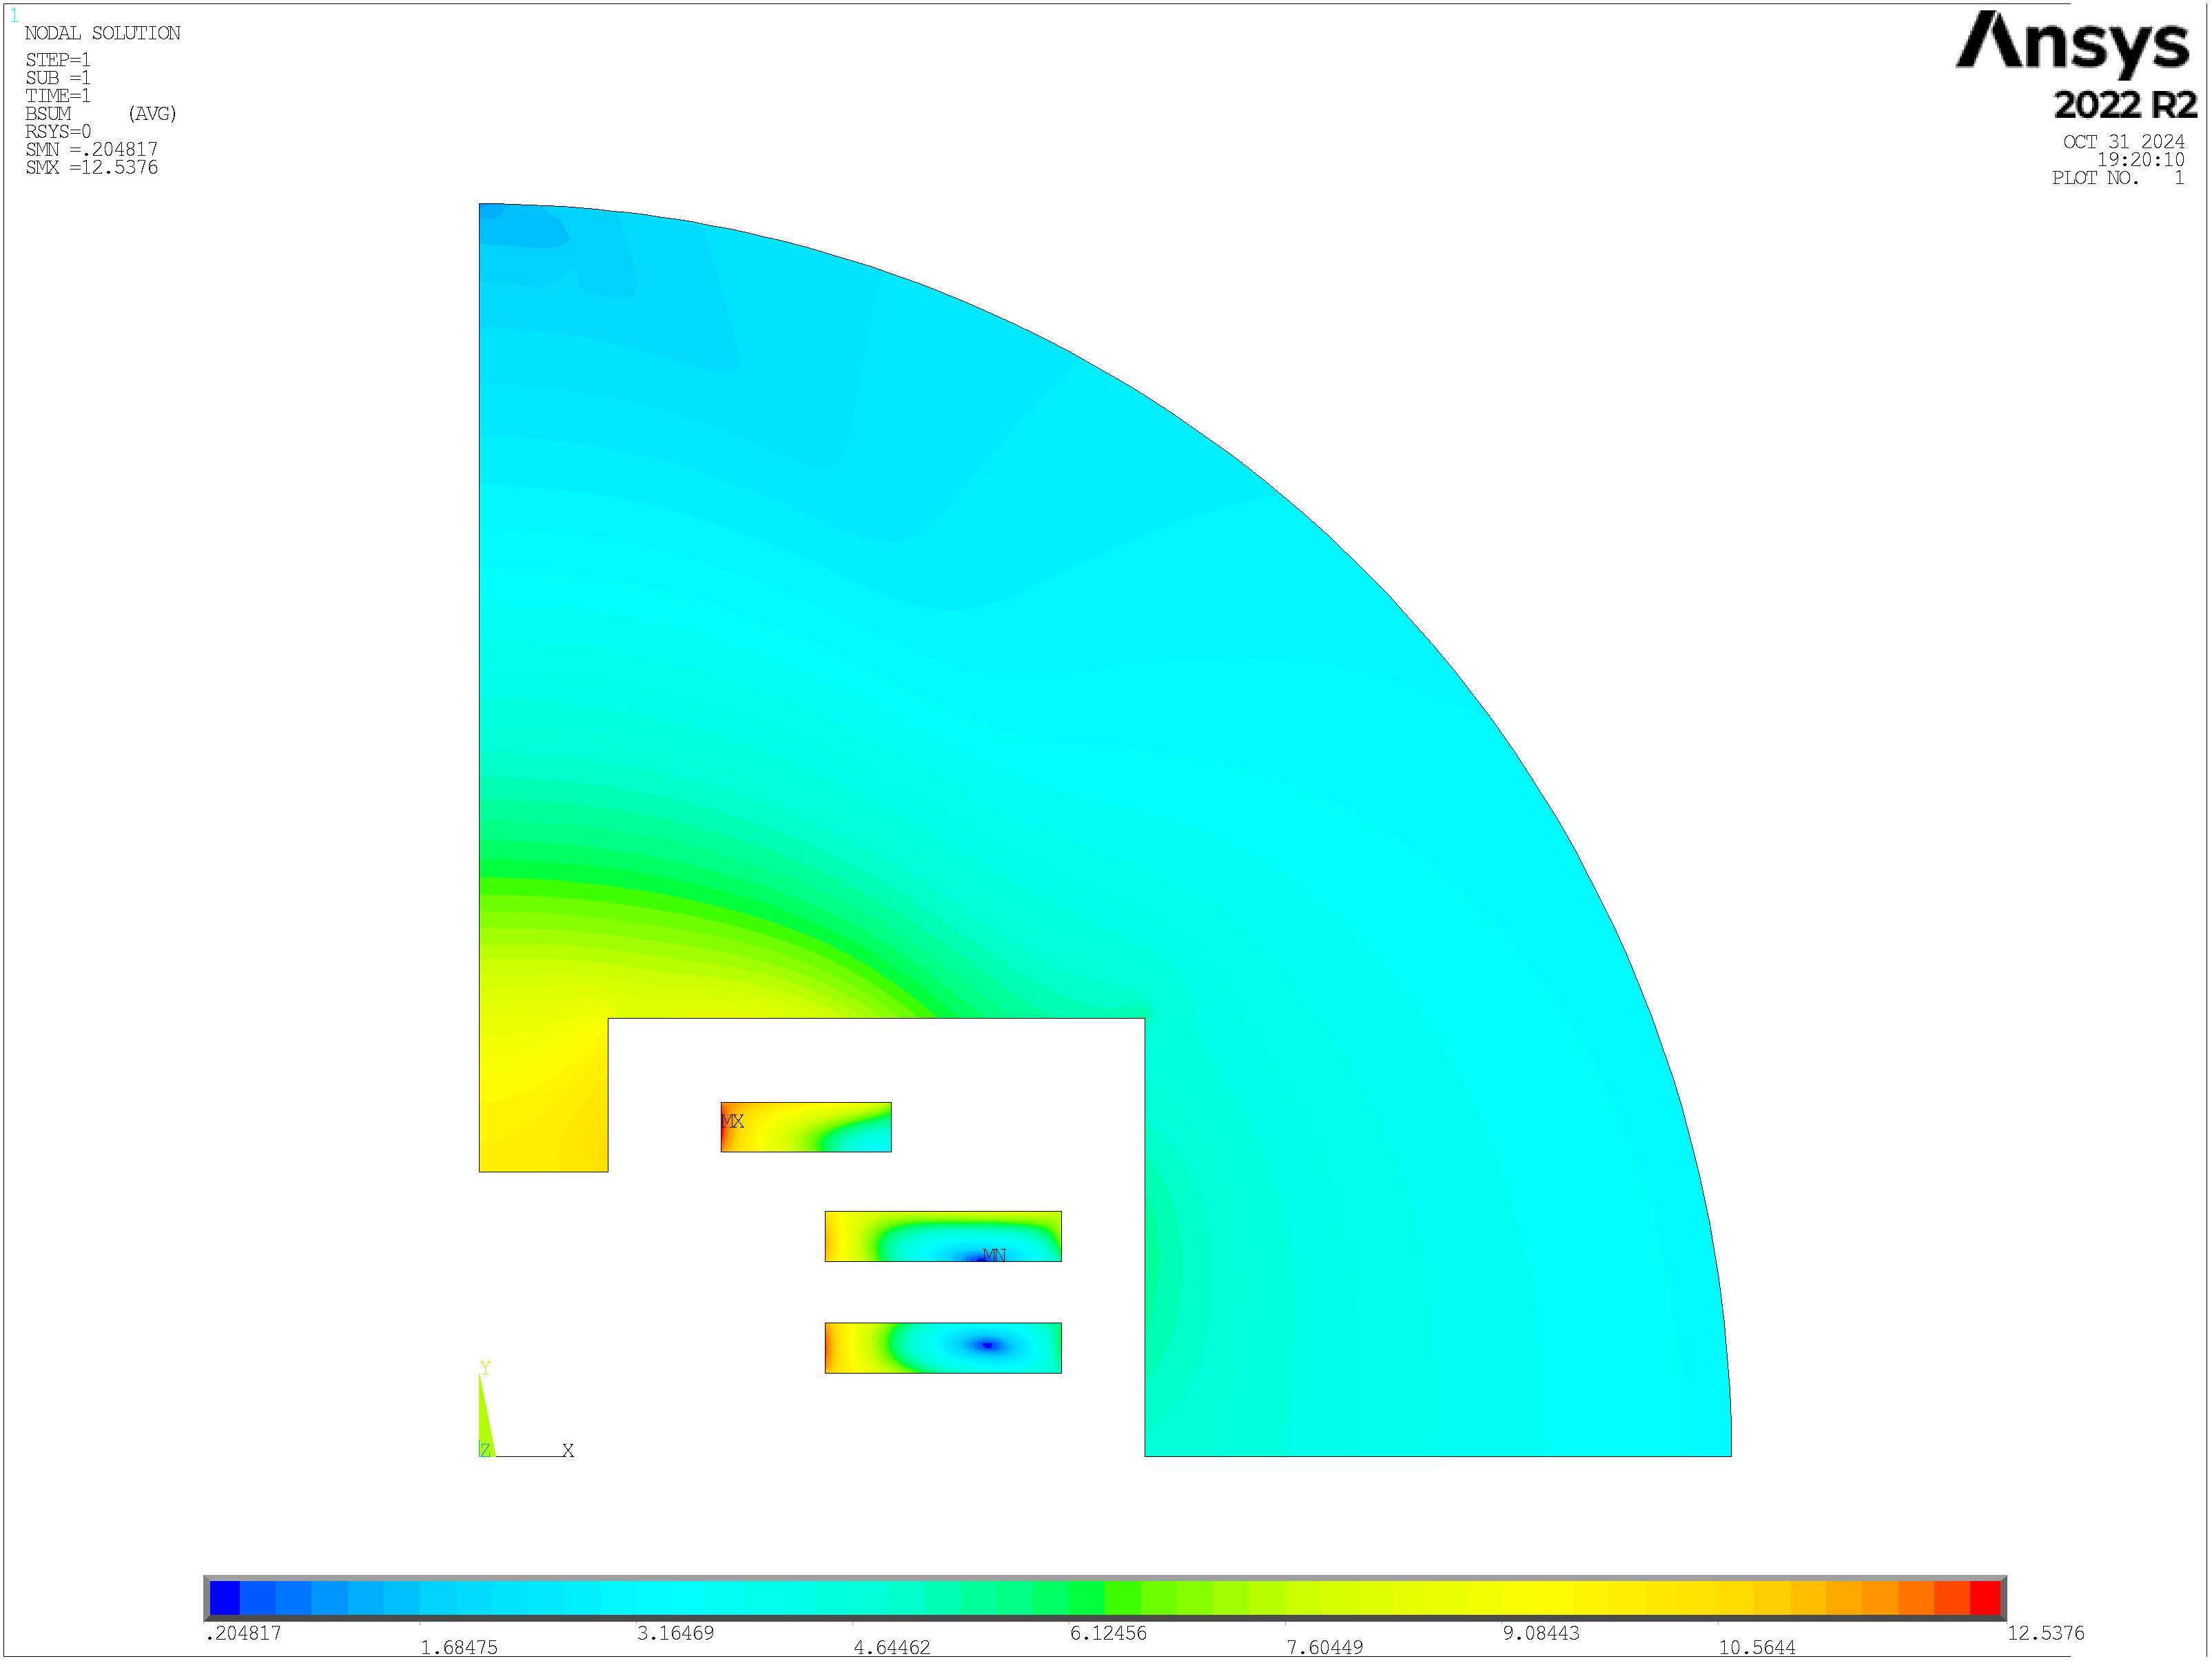
2 Aligned Magnetic Design
I [A] | J_{eng} [A/mm²] | B₀ [T] | B_{p} [T] | B_{p}/B₀
2392.00 | 738.27 | 10 | 12.54 | 1.25
T_{op} [K] | T margin [K] | Mag Length [m] | Mec Length [m] | Yoke radius [m] | Coord. Point A [mm]
20 | >2.5 | ~1.3 | ~1.6 | 0.3 | (159.53;105.00)
.
Racetrack 1 | N conductors | N tapes
 | 210 | 420
Racetrack 2 | N conductors | N tapes
 | 210 | 420
A
3
2
Racetrack 3 | N conductors | N tapes
 | 151 | 302
1
B [T]

Slide 11
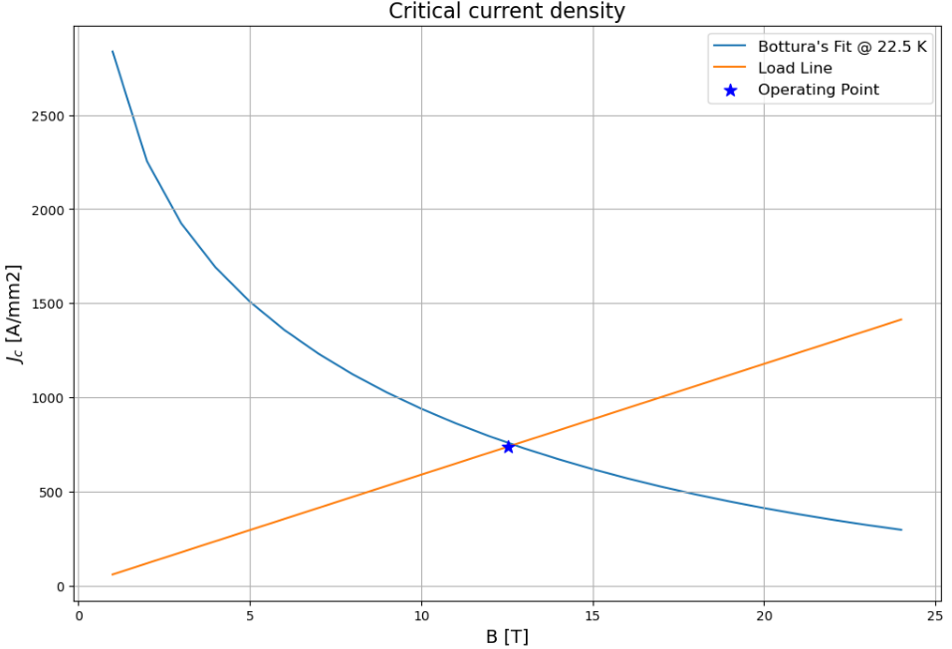
2 Aligned Magnetic Design
Margin in temperature

Slide 12
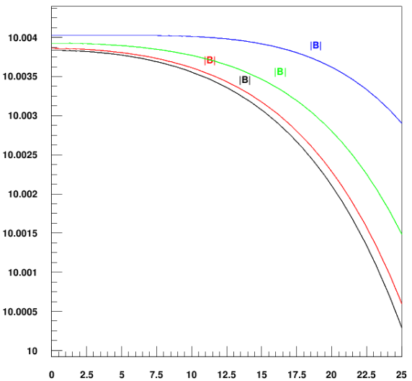
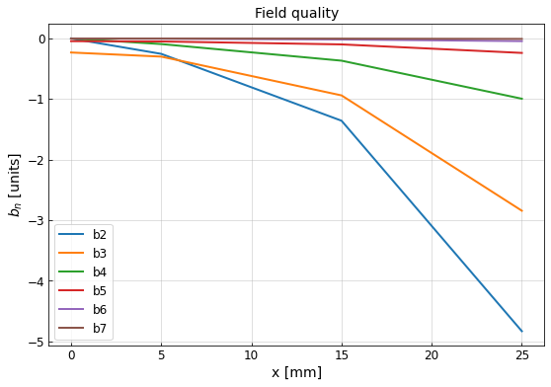
2 Aligned Magnetic Design
Results:
All harmonics greatly less then 10 units
The harmonics higher than the 7th order are negligible (less than 0.003 units)
The field homogeneity evaluated at x = 25 mm is about 0.033%
Field along paths
B [T]
higher path
lower path
x [mm]

Slide 13
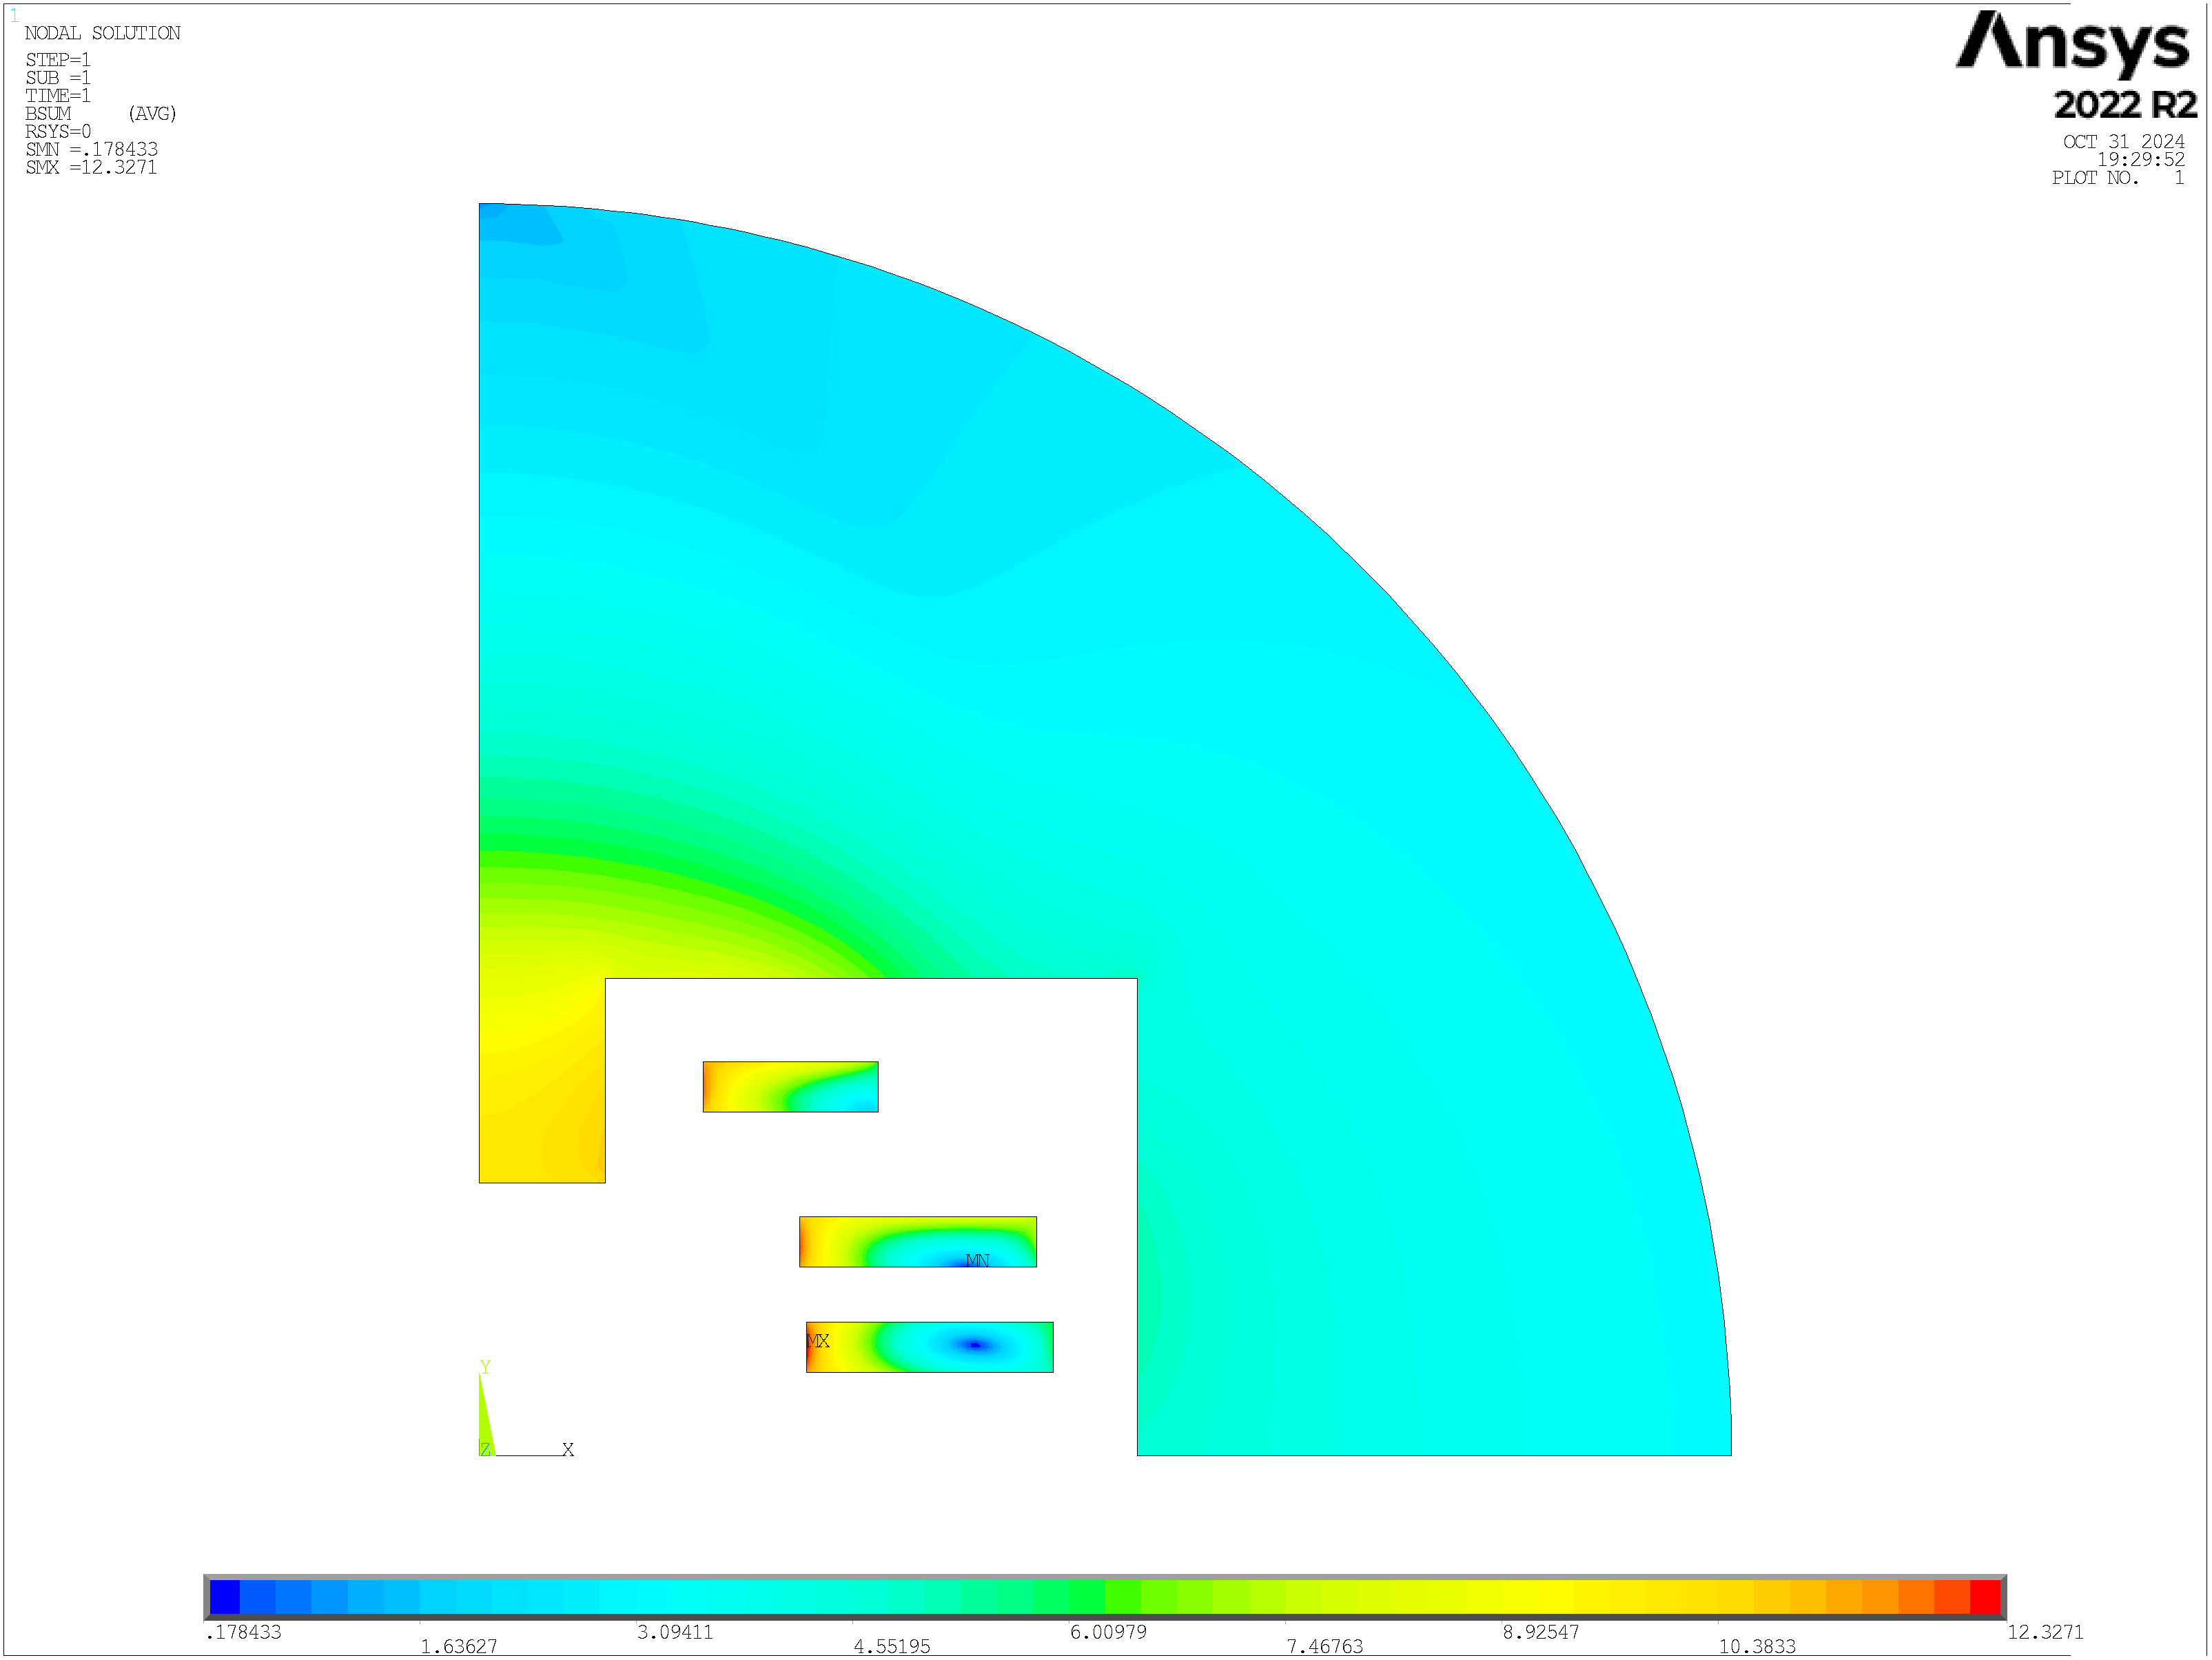
0 Aligned Magnetic Design
I [A] | J_{eng} [A/mm²] | B₀ [T] | B_{p} [T] | B_{p}/B₀
2347.61 | 724.47 | 10 | 12.33 | 1.23
T_{op} [K] | T margin [K] | Mag Length [m] | Mec Length [m] | Yoke radius [m] | Coord. Point A [mm]
20 | >2.5 | ~1.3 | ~1.6 | 0.3 | (157.70;114.30)
.
Racetrack 1 | N conductors | N tapes
 | 219 | 438
Racetrack 2 | N conductors | N tapes
 | 210 | 420
A
3
2
Racetrack 3 | N conductors | N tapes
 | 155 | 310
1
B [T]

Slide 14
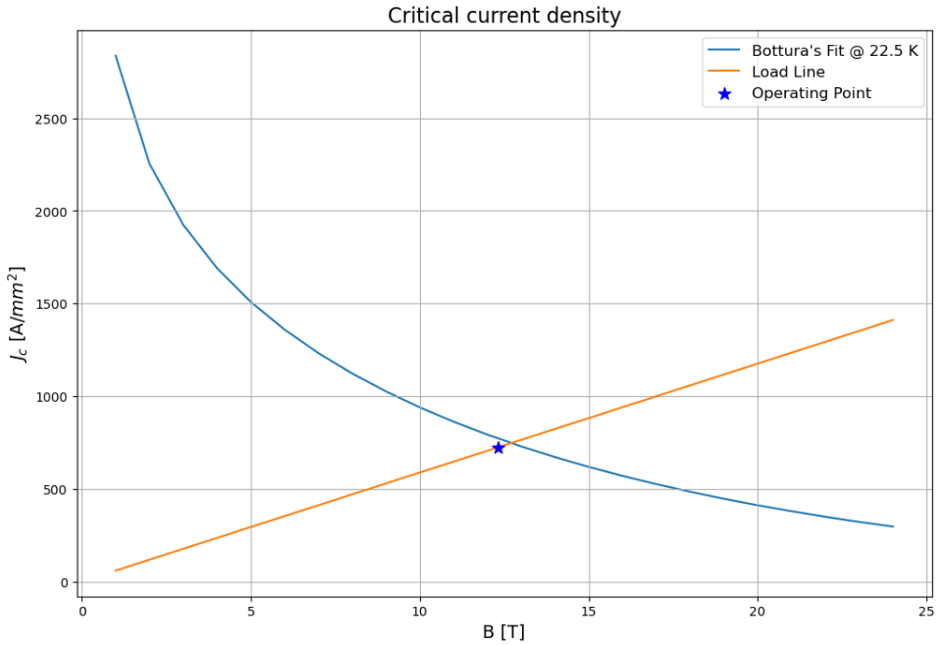
0 Aligned Magnetic Design
Margin in temperature

Slide 15
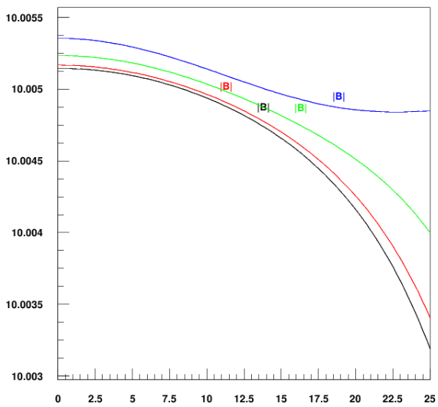
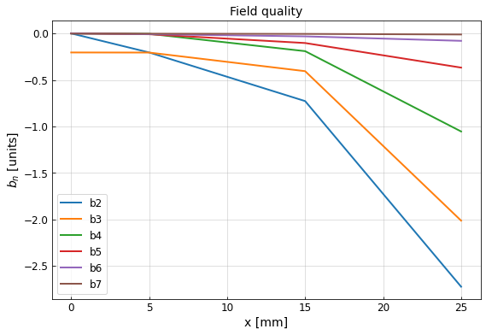

0 Aligned Magnetic Design
Results:
All harmonics greatly less then 10 units
The harmonics higher than the 7th order are negligible (less than 0.003 units)
The field homogeneity evaluated at x = 25 mm is about 0.016%
Field along paths
B [T]
higher path
lower path
x [mm]

Slide 16
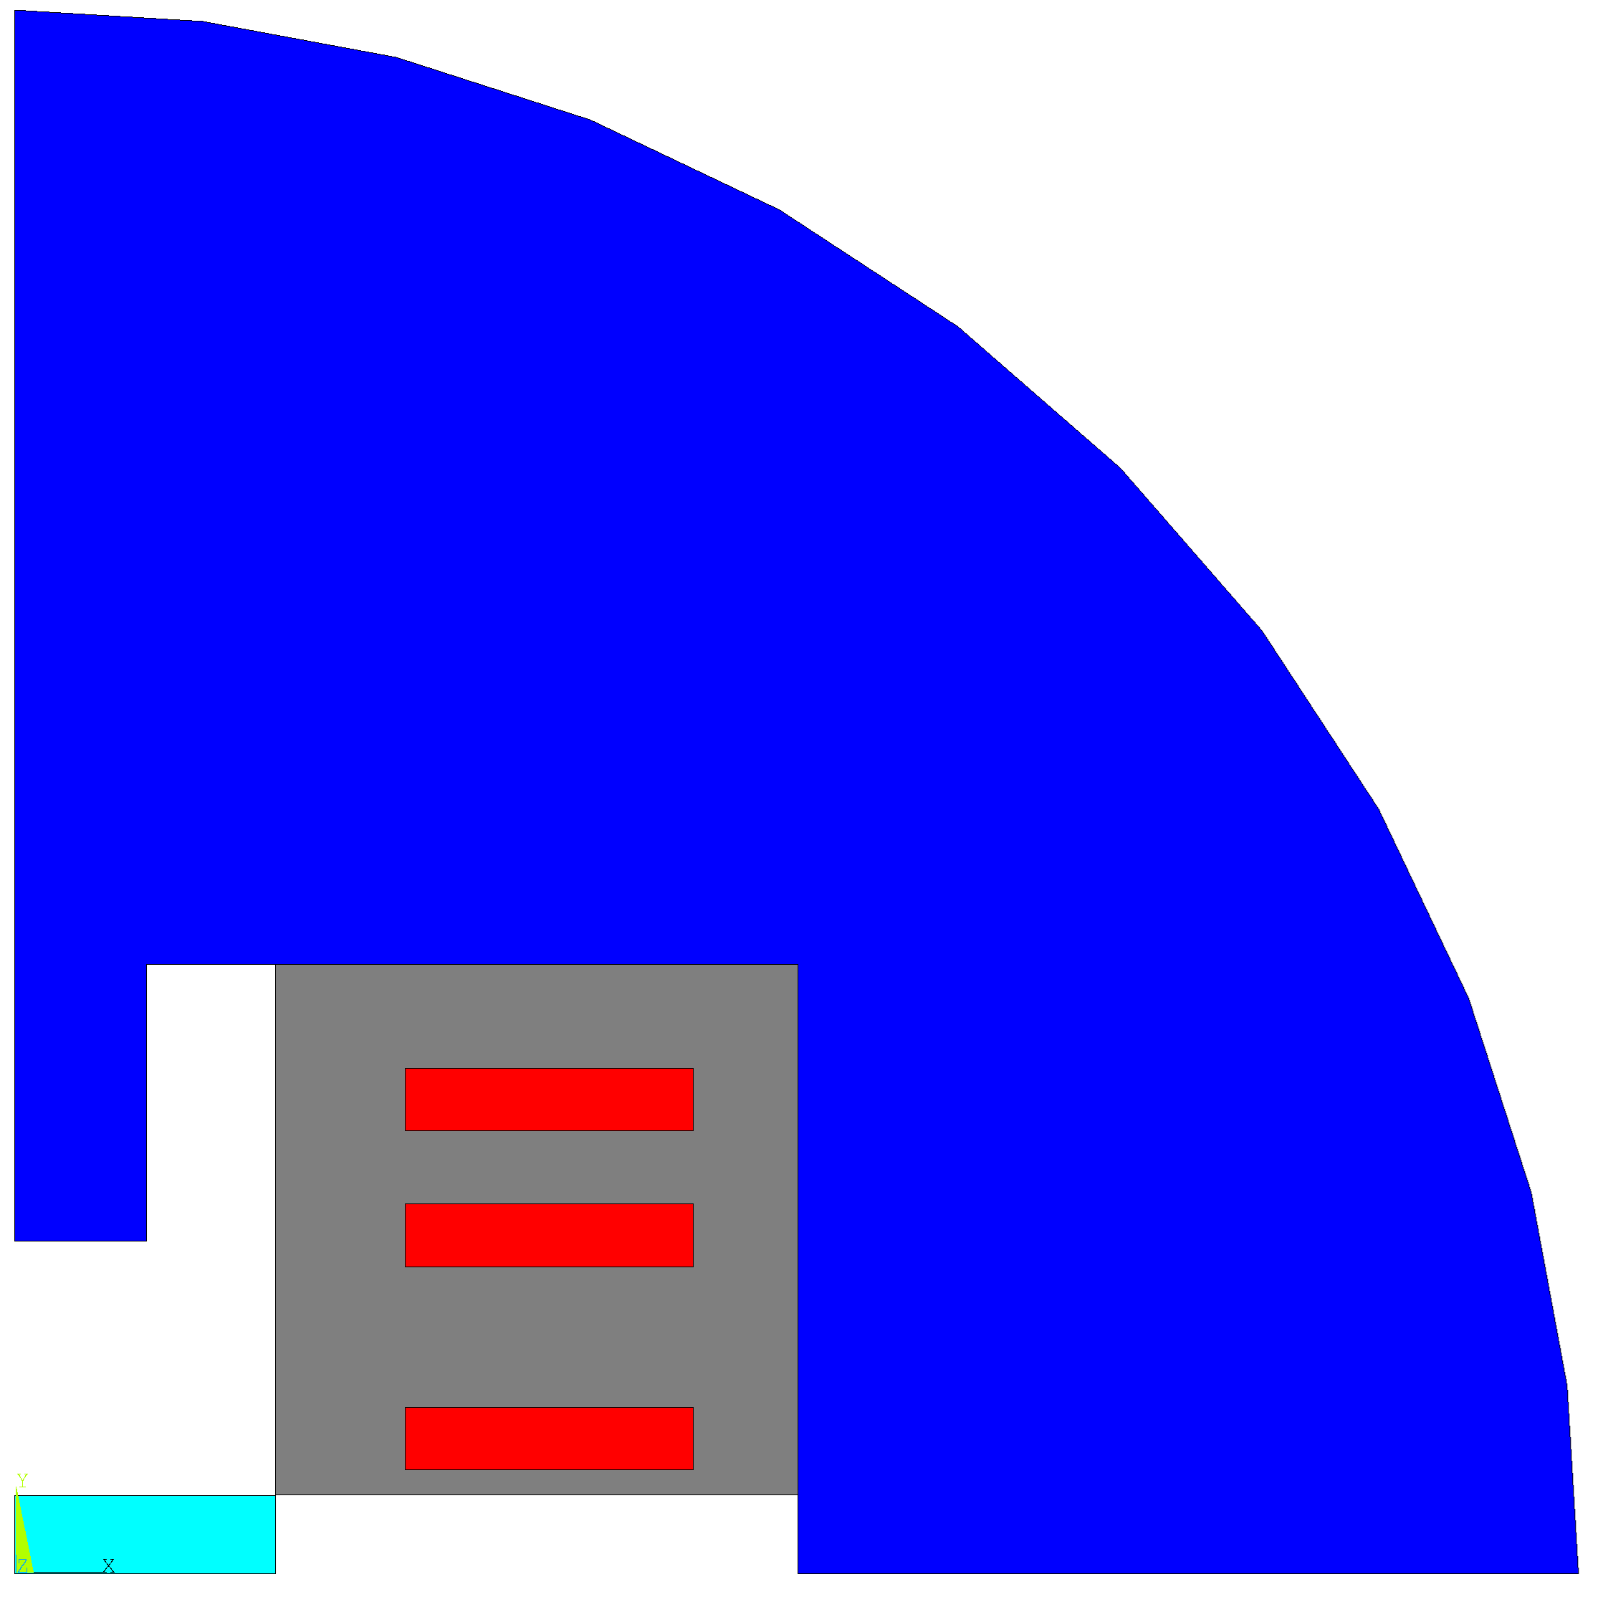
Preliminary Cost Model
Costs hypothesis:
2500 €/kg of YBCO superconductor.
8 €/kg of iron.
10 €/kg of SS for mechanical structure and conservative configuration (total space filling)
Conductor | 160 k€/m
Iron yoke | 14 k€/m
Mechanical structure | 3 k€/m
Assembly | 20 k€/m
Total cost | 197 k€/m
Aperture

Slide 17
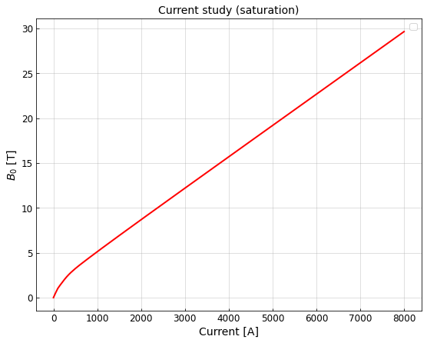
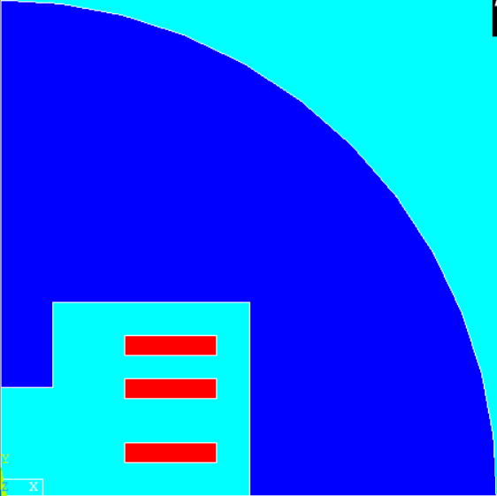

Future Studies
Since the iron pole is practically saturated, a future magnetic analysis involves studying various configurations by removing the pole and inserting holes inside the yoke to manage its saturation.
?
B [T]
Nominal current: 2336.12 A
$$\sim 9.3 \left[T\right]$$

Slide 18
Thanks for your attention
T. Maiello^{1,4,5}, L. Alfonso¹, L. Balconi^{2,6}, A. Bersani¹, L. Bottura⁴, B. Caiffi¹, S. Fabbri⁴, S. Farinon¹, A. Gagno^{1,5}, F. Levi¹, F. Mariani^{2,6}, S. Mariotto^{2,3}, D. Novelli^{1,6}, A. Pampaloni¹, D. Rinaldoni ⁴, C. Santini², S. Sorti^{2,3}, M. Statera² , G. Vernassa²
¹ INFN – Genova, ² INFN LASA – Milano, ³ University of Milan, ⁴ CERN, ⁵ Università degli Studi di Genova, ⁶ Sapienza Università di Roma

