Slide 1
Muon Collider Magnet Design Second Workshop
Charging, losses and quench in (NI) HTS magnets
S. Sorti on behalf of LASA HTS team
05/11/2024

Slide 2
Motivation, objectives, and summary
To contribute to the discussion about assumptions, parameters, models and strategies for the design of MuCol dipole and c.f. magnets
Mainly sharing LASA experience, plus what we have learnt from many experts → not a seminar, a lot of topics are better covered by others (like INS coils)
The presentation will cover:
  Charging and losses for Non-insulated coils
    Lumped formula for preliminary design
    More advanced models
  How Non-insulated coils quench
    Phenomenology of NI quench (ESMA example)
  Grounds for future activities

Slide 3
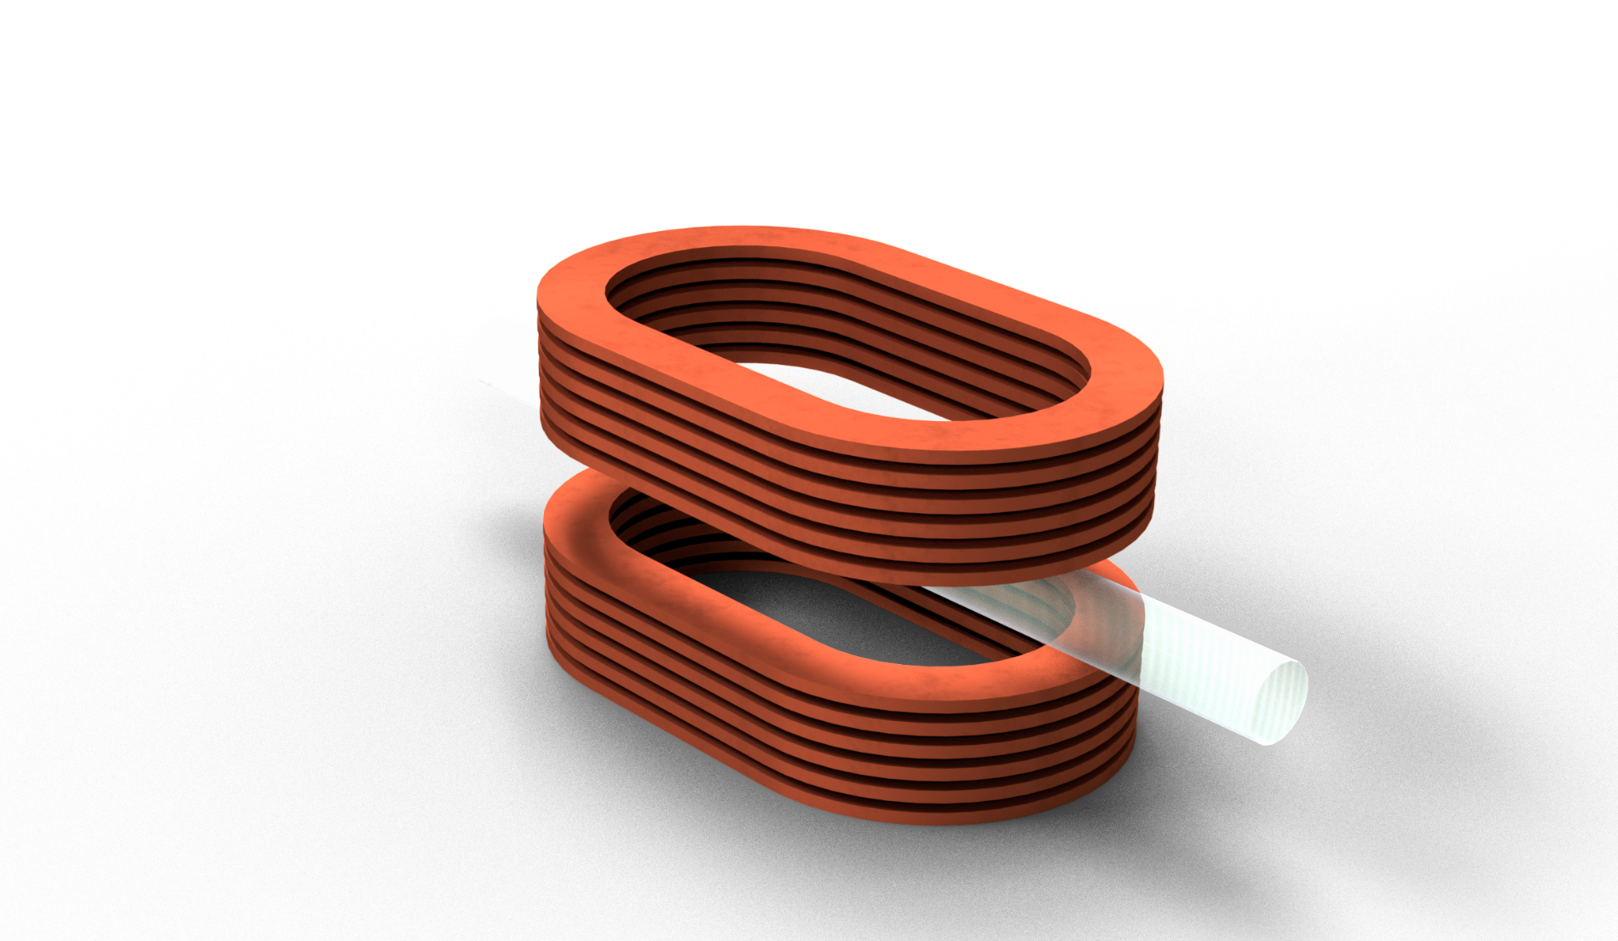
LASA research on HTS Framework
PNRR
IRIS
Purchasing machines
Quench simulations
HFM & MuCol
Magnet design and forecasted prototypes
Small Coils
Conductor properties
Metal
Cu stabil.
Tape
YBCO
Substrate

Slide 4
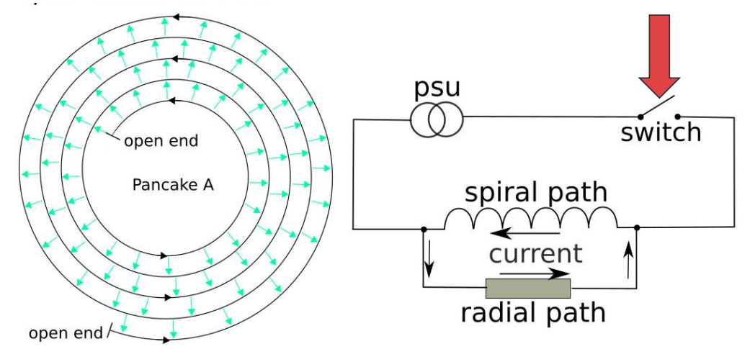
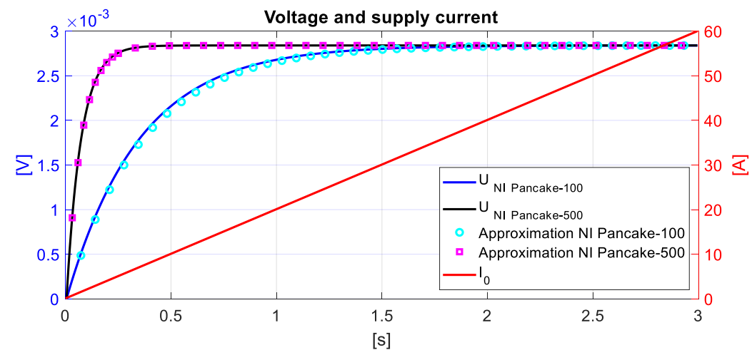
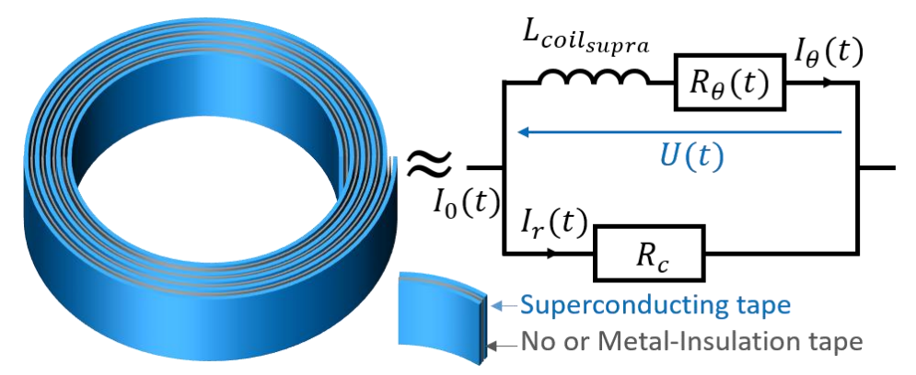
Charging of NI coils
The main phenomena is straightforward: current flows radially during transients (including open circuits).
Far from superconductor saturation,
lumped models are pretty good, also quantitively
Courtesy of Jeroen van Nugteren
Reprinted from C. Genot, Numerical and experimental studies for the optimization and protection of NI-MI HTS coils

Slide 5
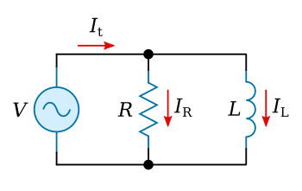
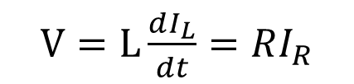
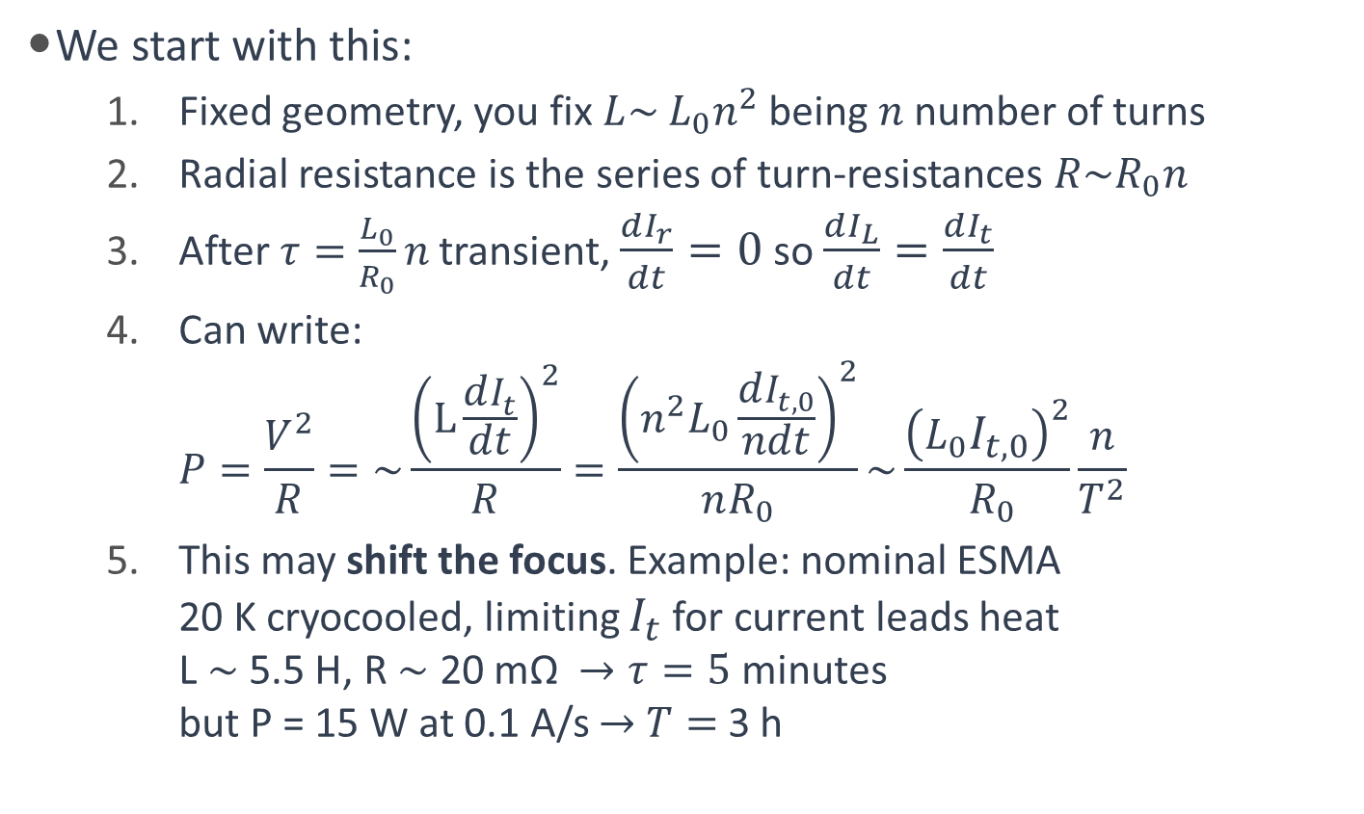
Charging of NI coils: lumped formula
We start with this:
  Fixed geometry, you fix $L\sim$ $L_{0}n^{2}$ being $n$number of turns
  Radial resistance is the series of turn-resistances $R\sim R_{0}n$
  After $τ=\frac{L_{0}}{R_{0}}n$ transient, $\frac{dI_{r}}{dt}=0$ so $\frac{dI_{L}}{dt}=\frac{dI_{t}}{dt}$
  Can write:
  $P=\frac{V^{2}}{R}=\sim \frac{{\left(L\frac{dI_{t}}{dt}\right)}^{2}}{R}=\frac{{\left(n^{2}L_{0}\frac{dI_{t,0}}{ndt}\right)}^{2}}{nR_{0}}\sim \frac{{\left(L_{0}I_{t,0}\right)}^{2}}{{ R}_{0}}\frac{n}{T^{2}}$
  This may shift the focus. Example: nominal ESMA
  20 K cryocooled, limiting $I_{t}$ for current leads heat
  L $\sim$ 5.5 H, R $\sim$ 20 mΩ $→τ=5$ minutes
  but P = 15 W at 0.1 A/s $→$ $T=$3 h
Quantities 0 are the ones for a single-turn magnet
$V=L\frac{dI_{L}}{dt}=RI_{R}$
Bottleneck never been charging tau but heat!

Slide 6
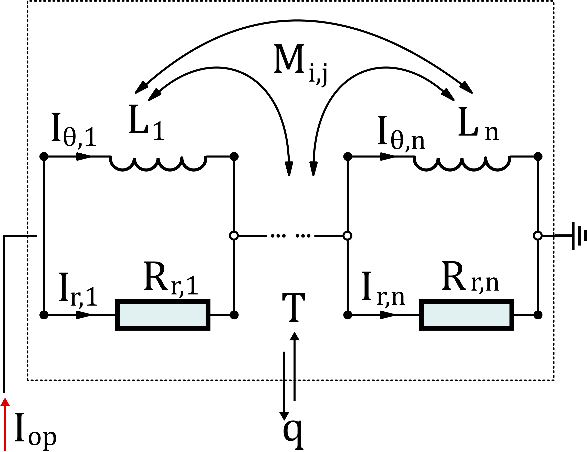
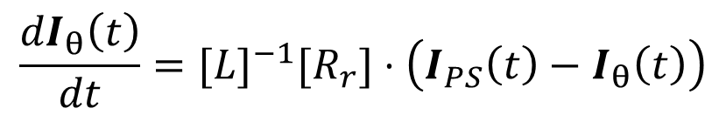
Charging of NI coils: lumped formula
L. Balconi work
For more complex geometries, one element
per coil can be introduced
  In addition, 0D model for cooling if needed
  Successfully employed, for instance, in
  Magnus Dam et al 2023 Supercond. Sci. Technol. 36 014007
  (experimental validation on a NI coil)
  We used it for a specific application (see later)
Indeed, radial-current losses are only half of the story, as we have also magnetization M losses, still, from our (very limited experience, see later)
  Magnetization is comparable to r.c. losses in the first ramp
  Magnetization is just a fraction of r.c. losses in following cycles
  Still, it really depends on the scenario, cannot take it for any case
$$\frac{{dI}_{θ}\left(t\right)}{dt}={[L]}^{−1}[R_{r}]⋅\left(I_{PS}\left(t\right)−I_{θ}\left(t\right)\right)$$

Slide 7
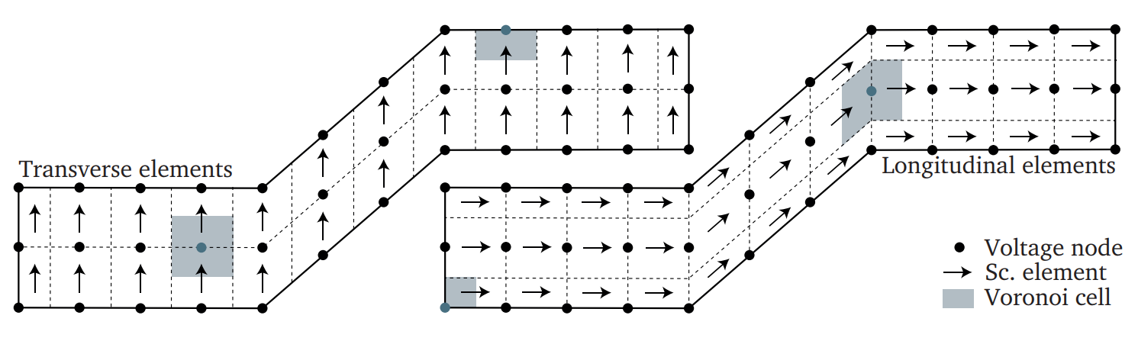
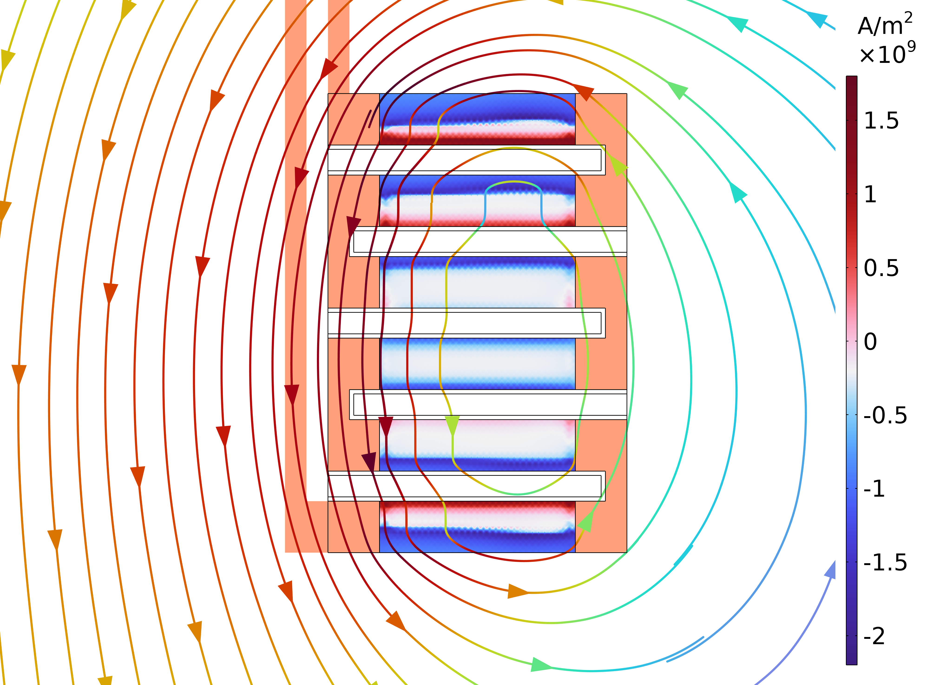
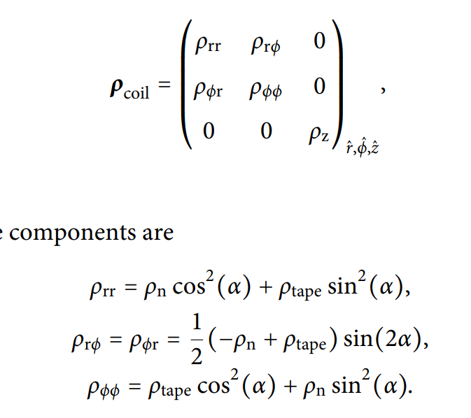
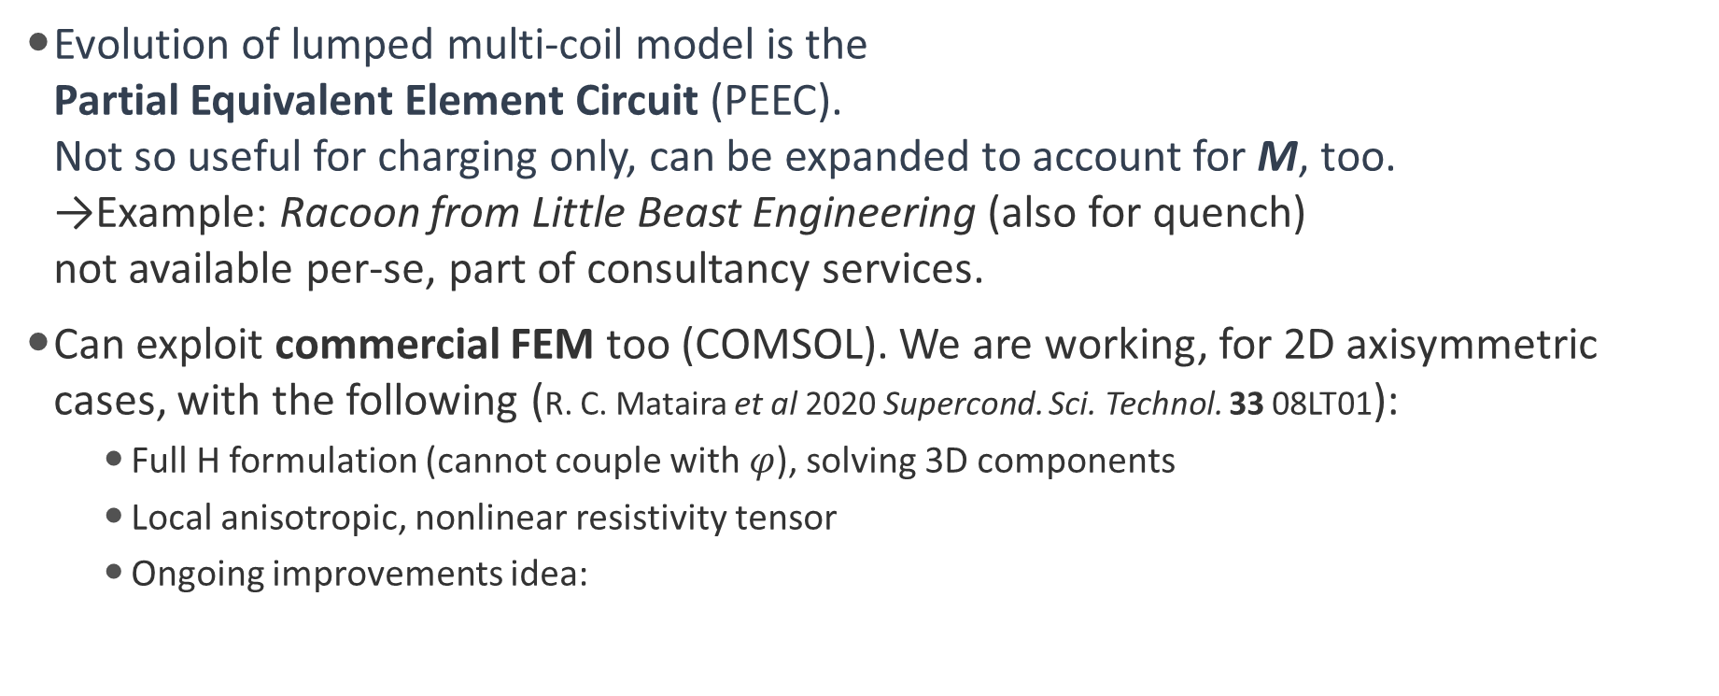
Charging of NI coils: numerical models
Evolution of lumped multi-coil model is the
Partial Equivalent Element Circuit (PEEC).
Not so useful for charging only, can be expanded to account for M, too.
→Example: Racoon from Little Beast Engineering (also for quench)
not available per-se, part of consultancy services.
Can exploit commercial FEM too (COMSOL). We are working, for 2D axisymmetric cases, with the following (R. C. Mataira et al 2020 Supercond. Sci. Technol. 33 08LT01):
  Full H formulation (cannot couple with $φ$), solving 3D components
  Local anisotropic, nonlinear resistivity tensor
  Ongoing improvements idea:
Mesh homogeneization | Verified
Quench model | Possible
2D linear model | To be investigated
G. Scarantino work

Slide 8
From charging to quench of NI coils
Pretty simple tools exist, and we are using them at LASA, for the charging of NI (or related technologies) coils. Analytical are fine for general overviews (magnet maps/graphs to span design space), then can refine estimations with PEEC/FEM.
Things get complicated with quench. To our knowledge, no simple tools exist for this scope. The reason is the complex mechanism of NI coil quench.
Main point about NI-like quench: transfer[ing] of the overheating (quench) issue of insulated coils to a mechanical issue due to new unbalanced and torque forces
(Thibault Lécrevisse et al 2022 Supercond. Sci. Technol. 35 074004)

Slide 9
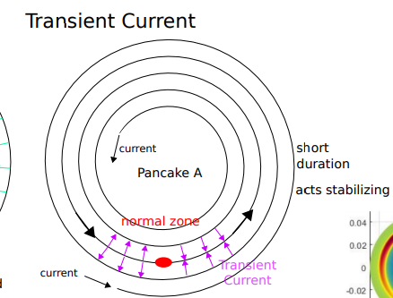
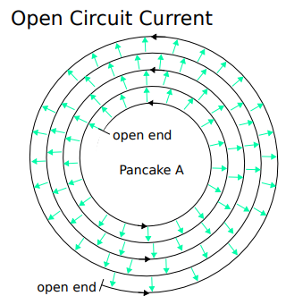
Generalities about quench of NI coils
Adapted from private communication with Jeroen van Nugteren
When the radial resistance is low (soldered NI), quench propagation would be by normal zone heating, but current easily bypass it with low losses.
Small coils are self-protected, i.e. NZ never propagates as all current goes radial without heating enough.
When radial resistance is high (MI high-res), the resistance of the normal zone not enough to push enough transport current into the radial path.
Must act, like opening the circuit breaker to force it, leading to a somehow self-quench-heater at the cost of large voltages over the coil.
When radial resistance is in between, superimposition. Both propagation (NZ and radial) can even take spiral paths. Hybrid protection, should open the circuit but with a “relaxed” quench detection (heat is spreading)
And this is only for electrical resistivity. Then we have the combination with thermal resistivity and the mechanical effects!

Slide 10

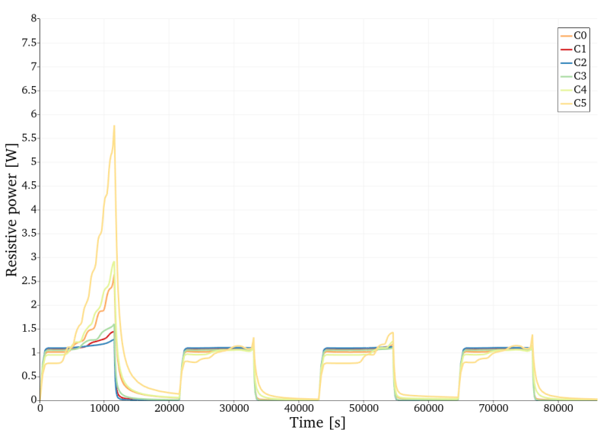
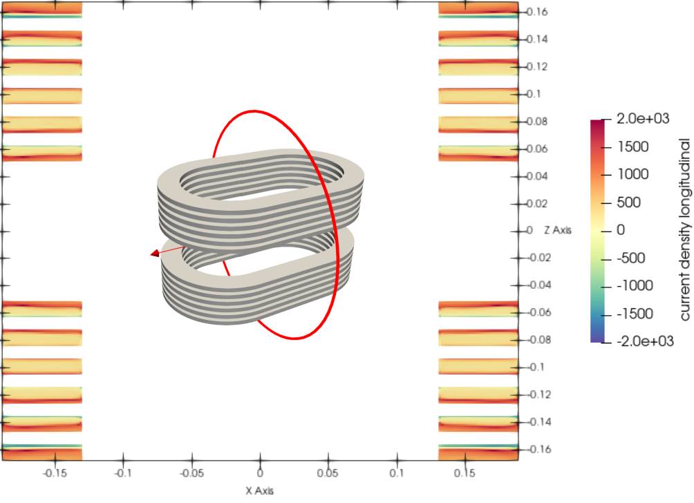
ESMA example, AC losses
Parameter | Unit | Value
Central field | tesla | 10
Current for 10 T | A | 1150
Free bore dimensions | mm | ⌀70
Coil Mechanical length | mm | 600
Good field region uniformity | N/A | 1.5%
Good field region extension | mm | H50xV30xL400
Operating temperature | K | 20
C₅
Good validation of model,
12 W for T = 3.2 h
Confirmation of reduced contribution from magnetization (power called “resistive” but takes it all). Tape is not saturating, thus lower overall loop.
C₀

Slide 11
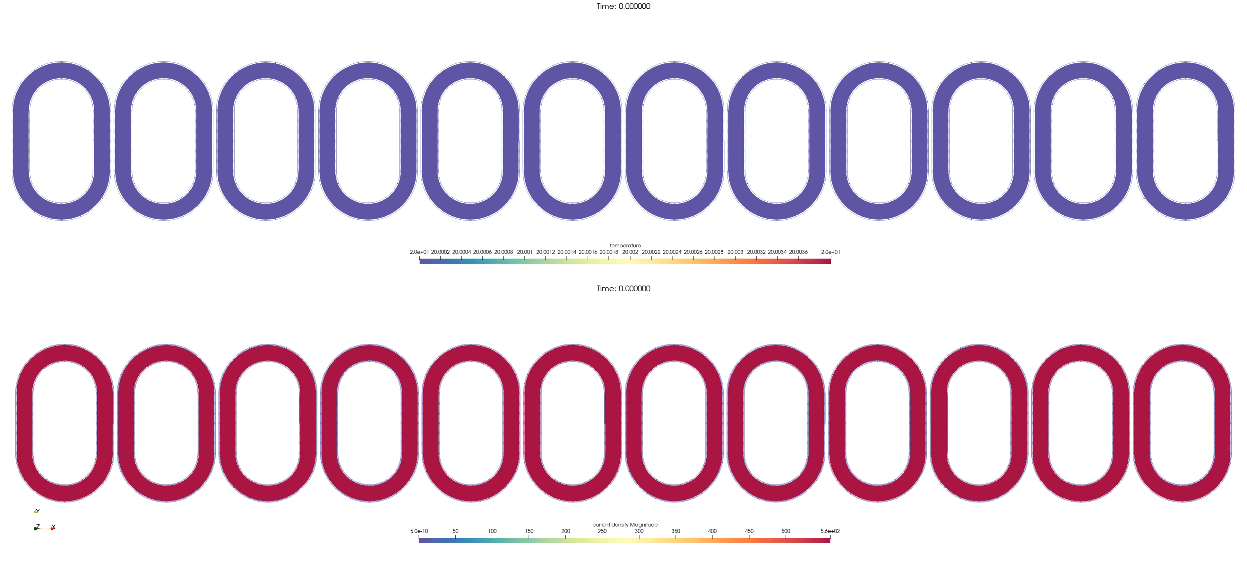
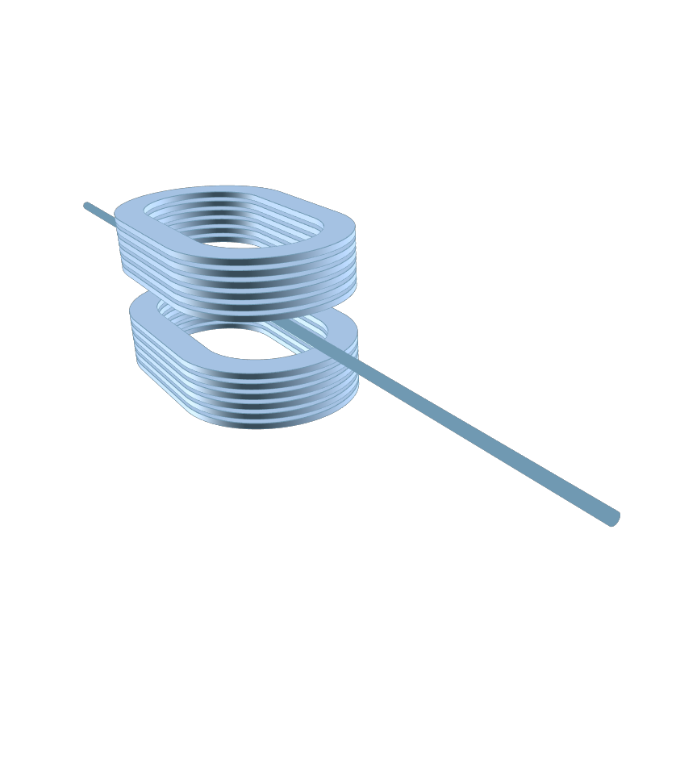

ESMA example
Contact resistivity of the order of 1 mΩcm² with artificial heater
40 W X 0.1 s
T above 400 K
(but very simple thermal model)
J up to 2$×$J_{op}

Slide 12
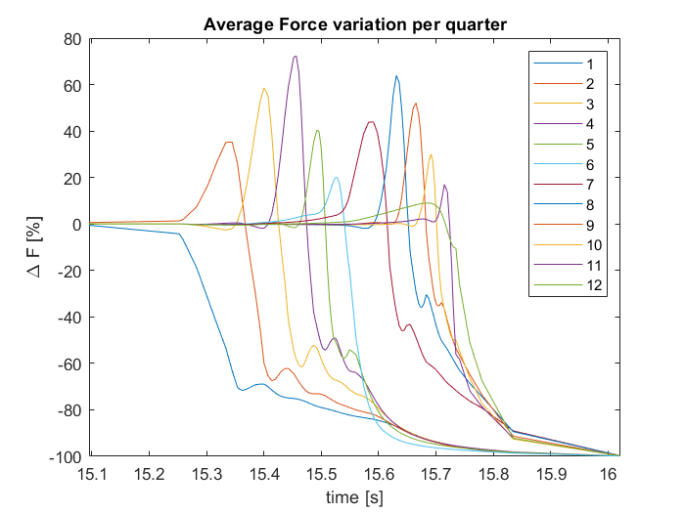
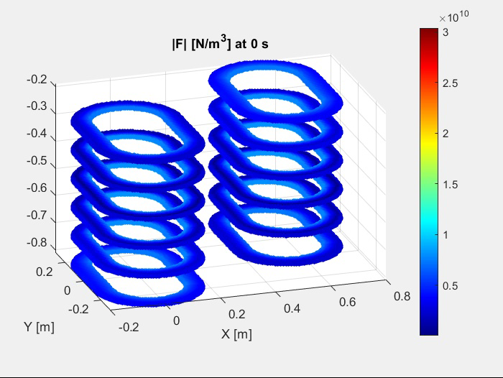
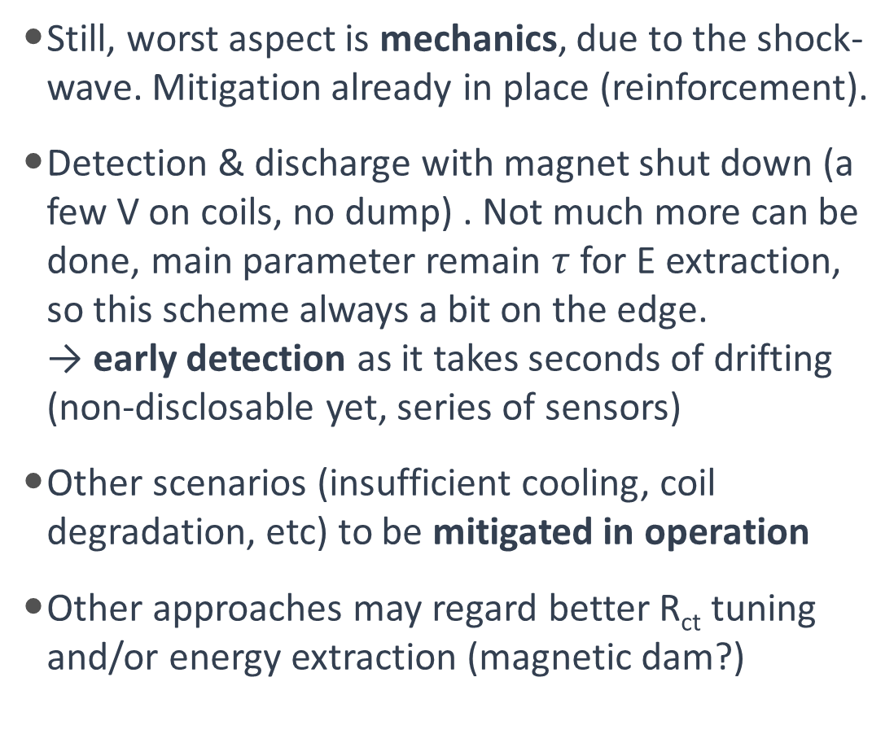
ESMA example
Still, worst aspect is mechanics, due to the shock-wave. Mitigation already in place (reinforcement).
Detection & discharge with magnet shut down (a few V on coils, no dump) . Not much more can be done, main parameter remain $τ$ for E extraction, so this scheme always a bit on the edge.
→ early detection as it takes seconds of drifting
(non-disclosable yet, series of sensors)
Other scenarios (insufficient cooling, coil degradation, etc) to be mitigated in operation
Other approaches may regard better R_{ct} tuning and/or energy extraction (magnetic dam?)

Slide 13
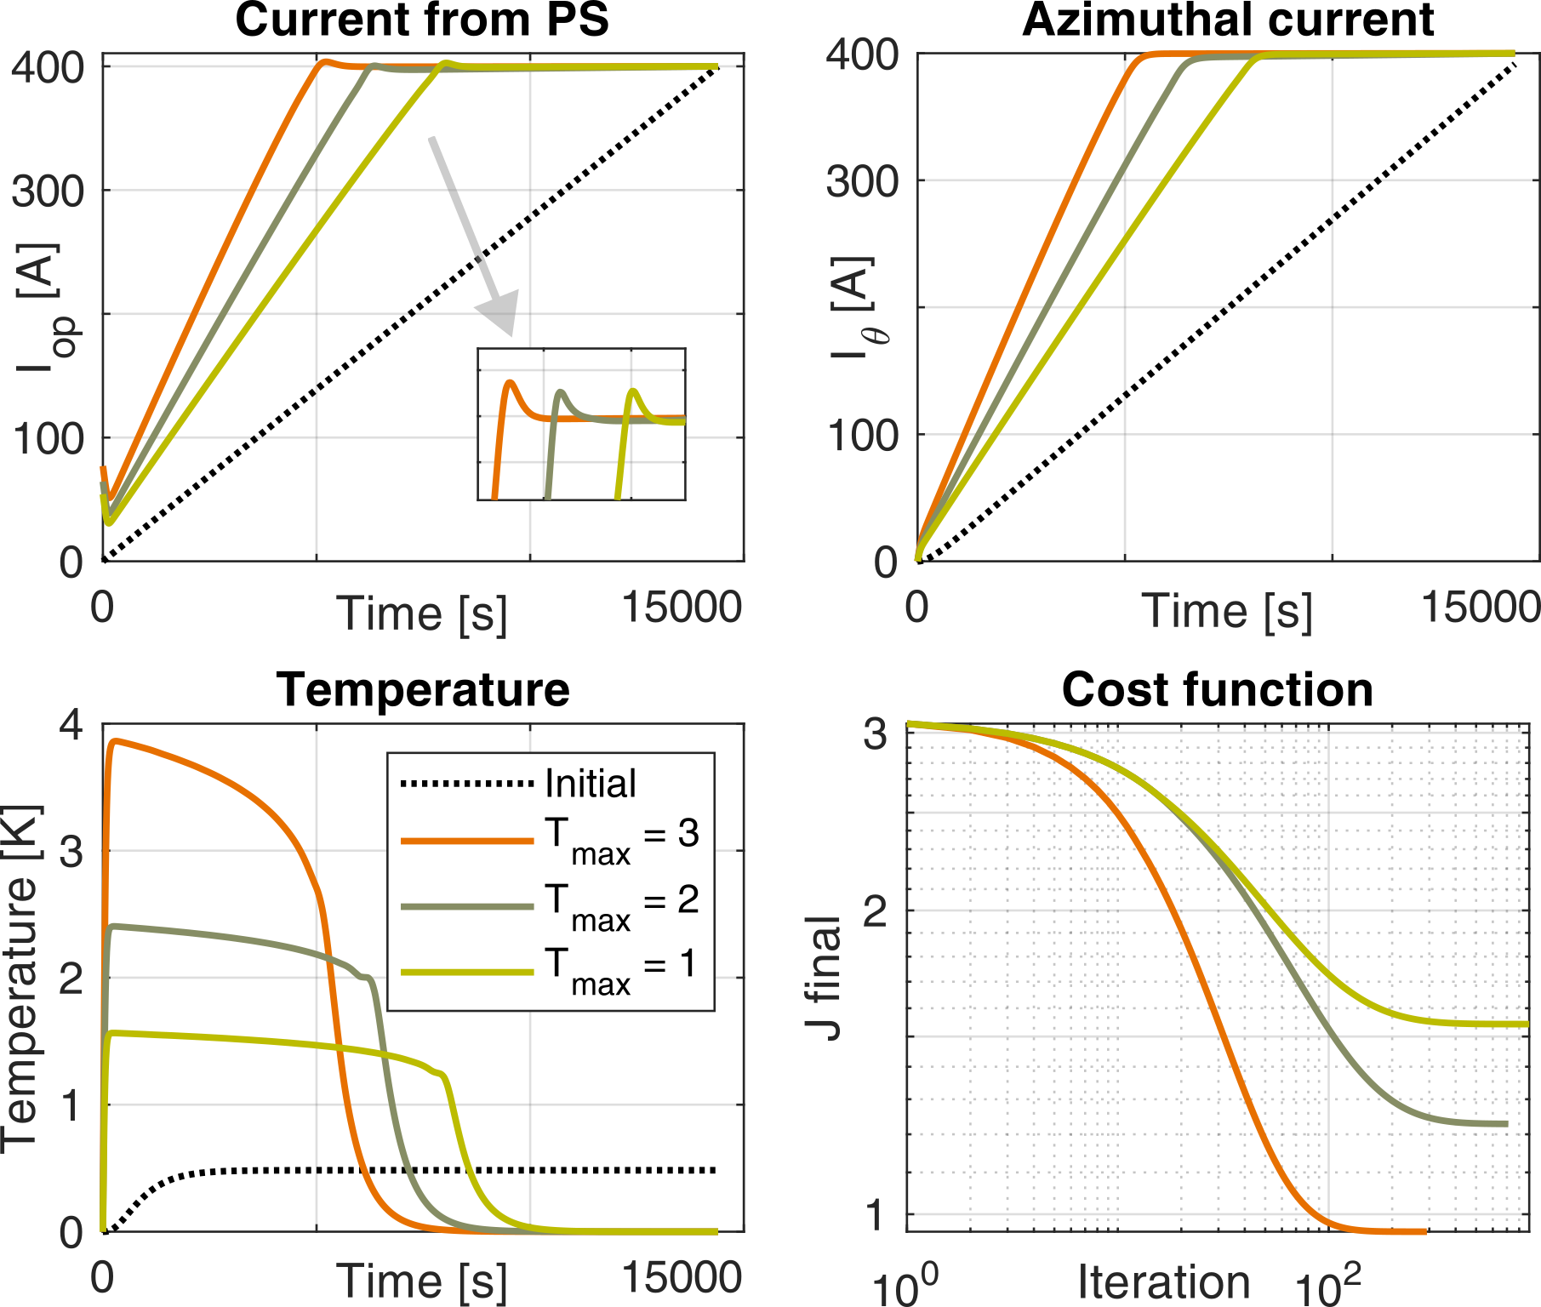
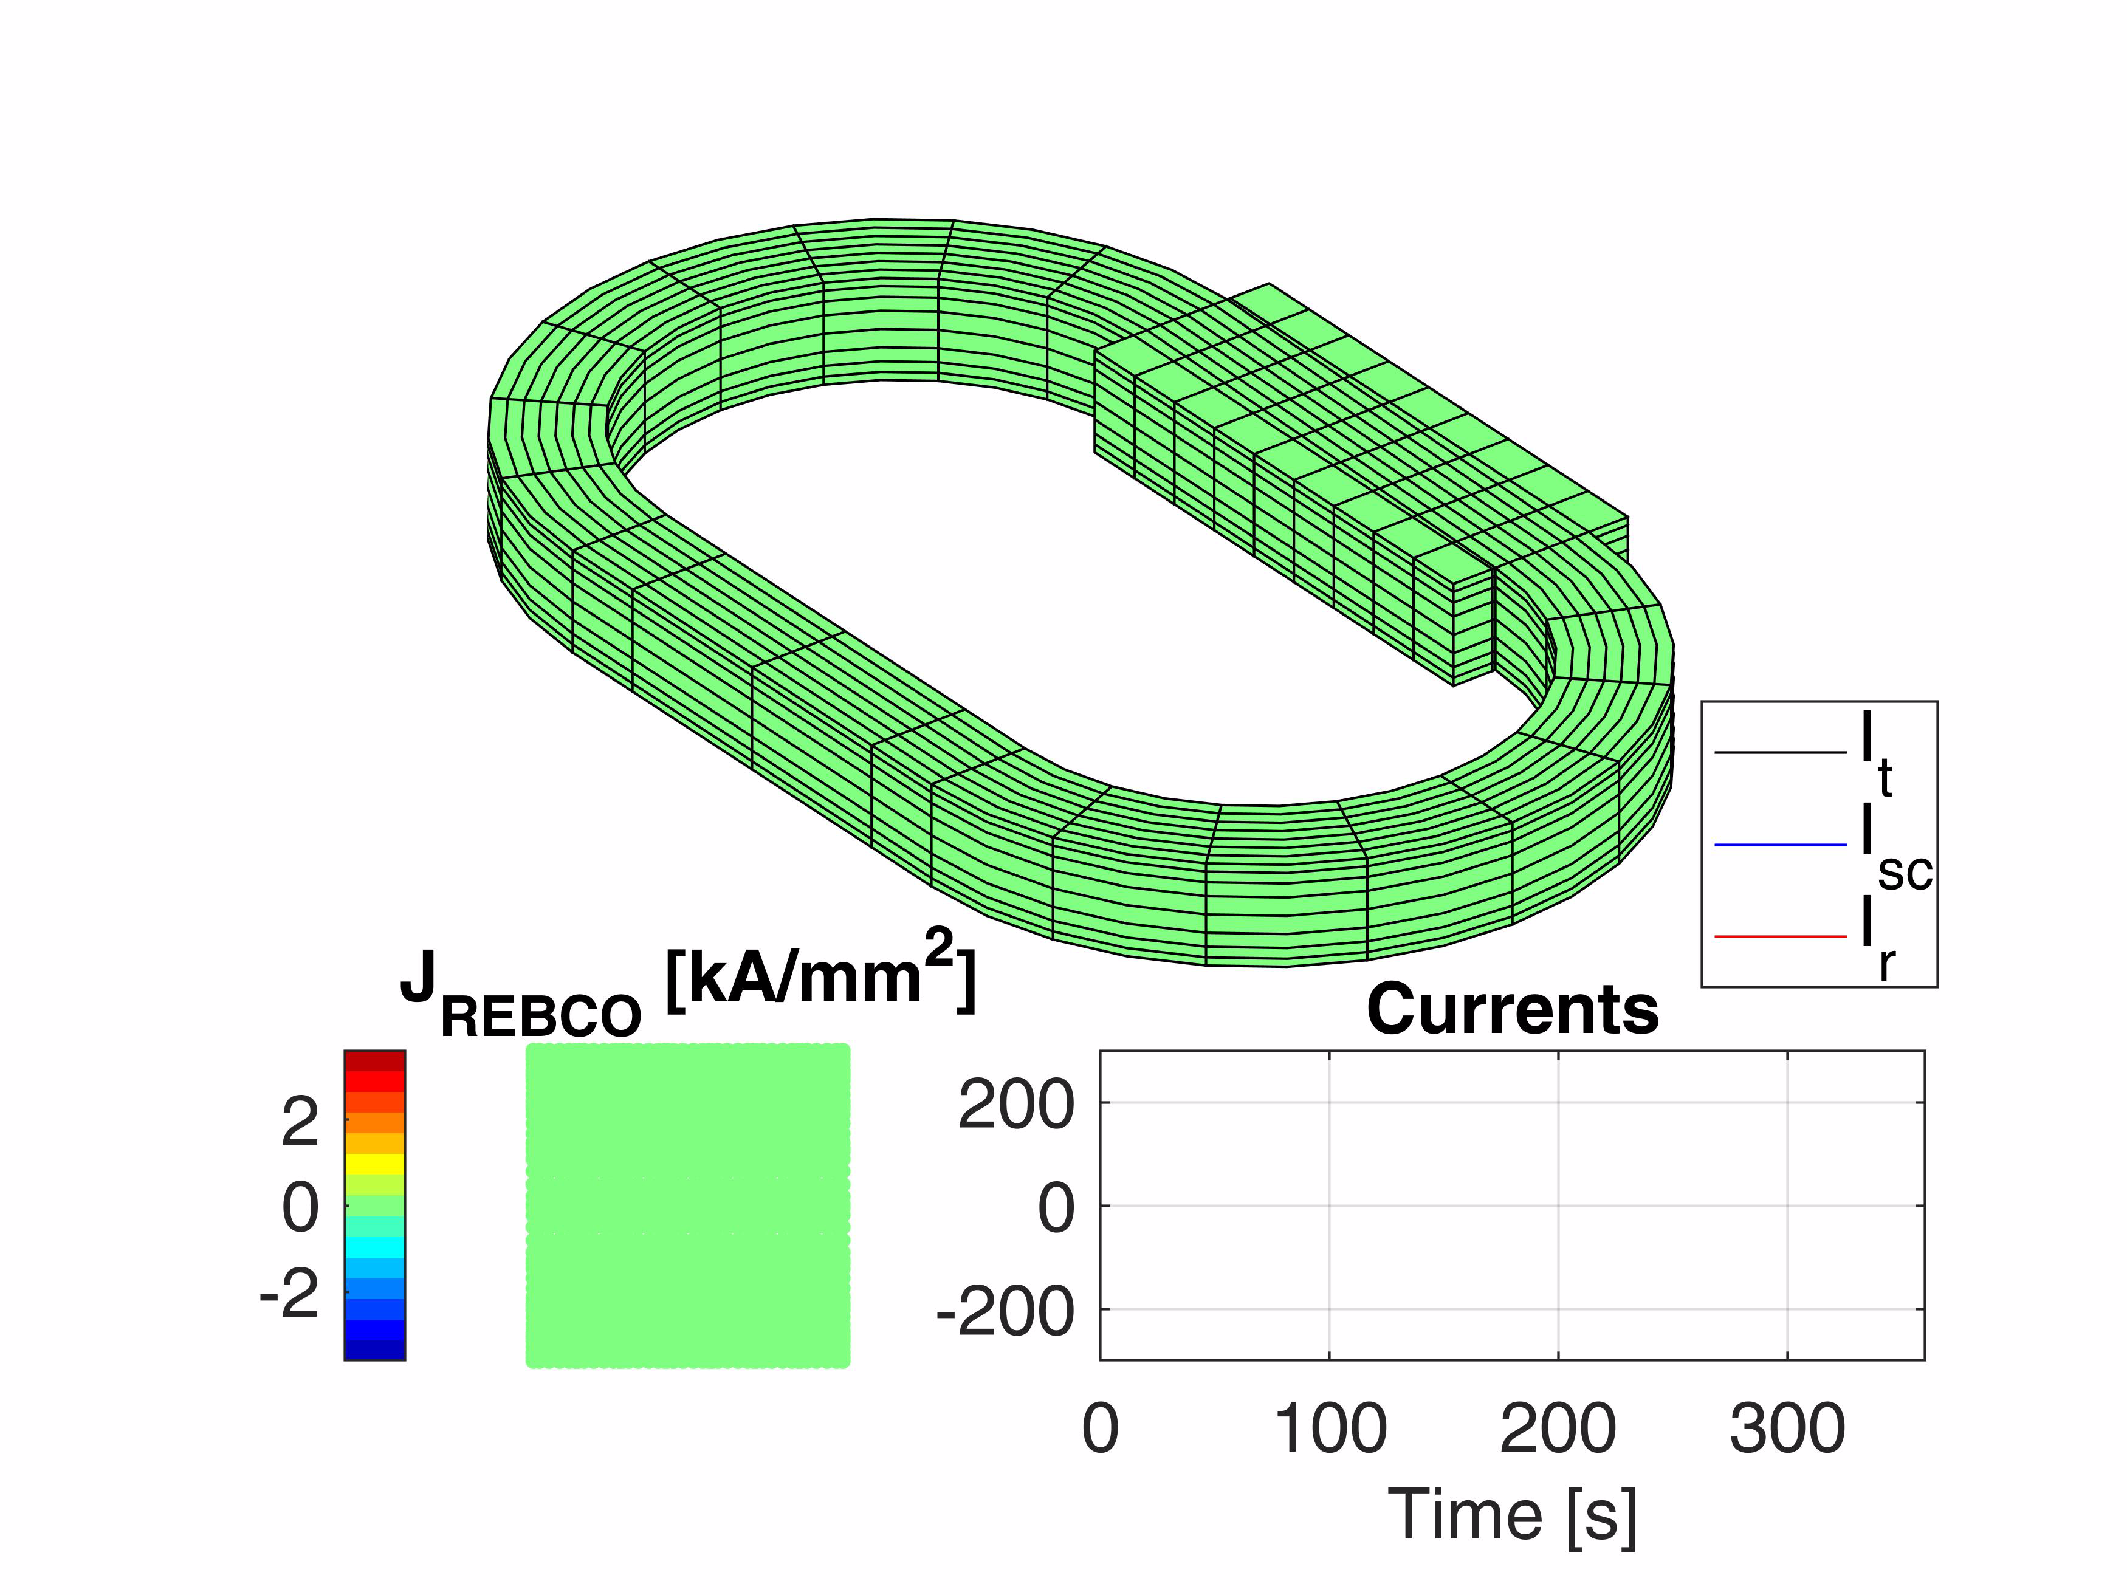
Ongoing activities
Modelling in COMSOL for NI charging (future 2D linear, quench,…), for RFMFTF in IMCC, by G. Scarantino
Modelling analytic + COMSOL
for insulated HTS (see F. Mariani talk)
Automation studies for NI and INS coils (in-house codes)
Ideas about REBCO-oriented magnet design optimization

Slide 14
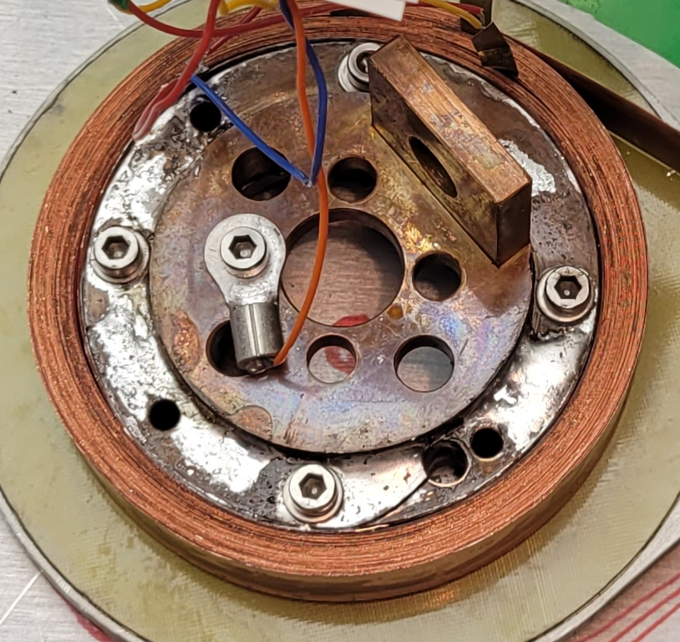
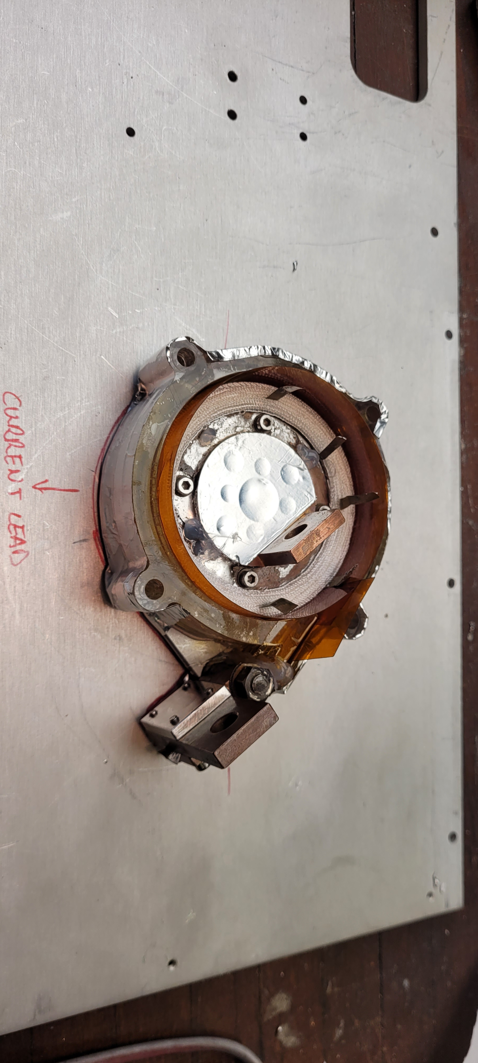
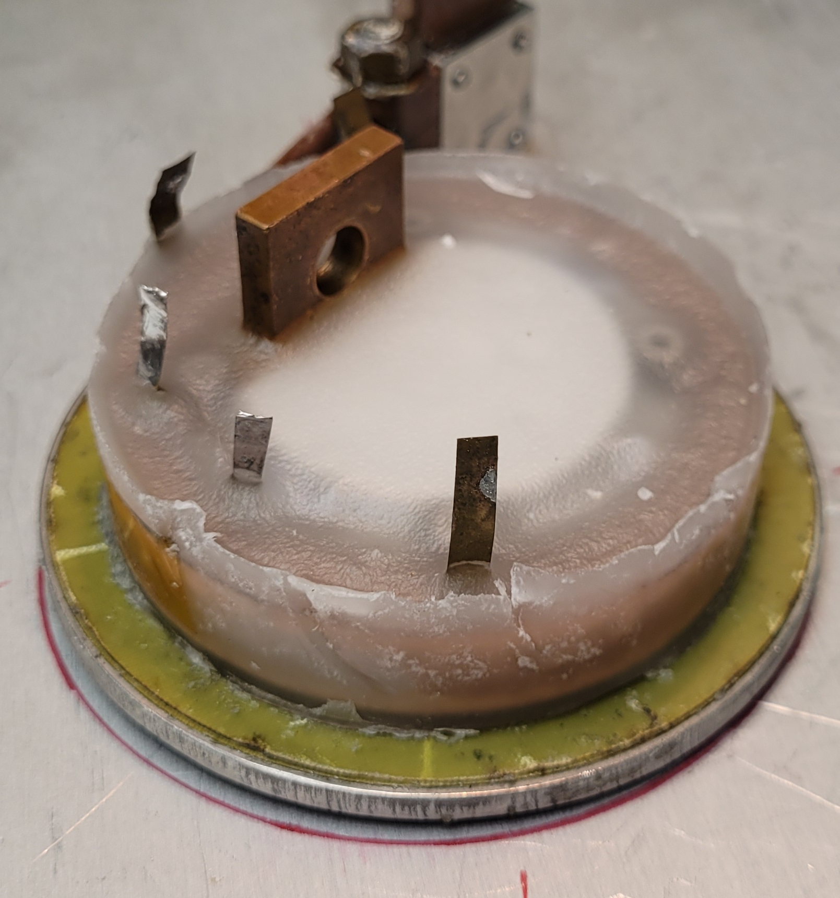
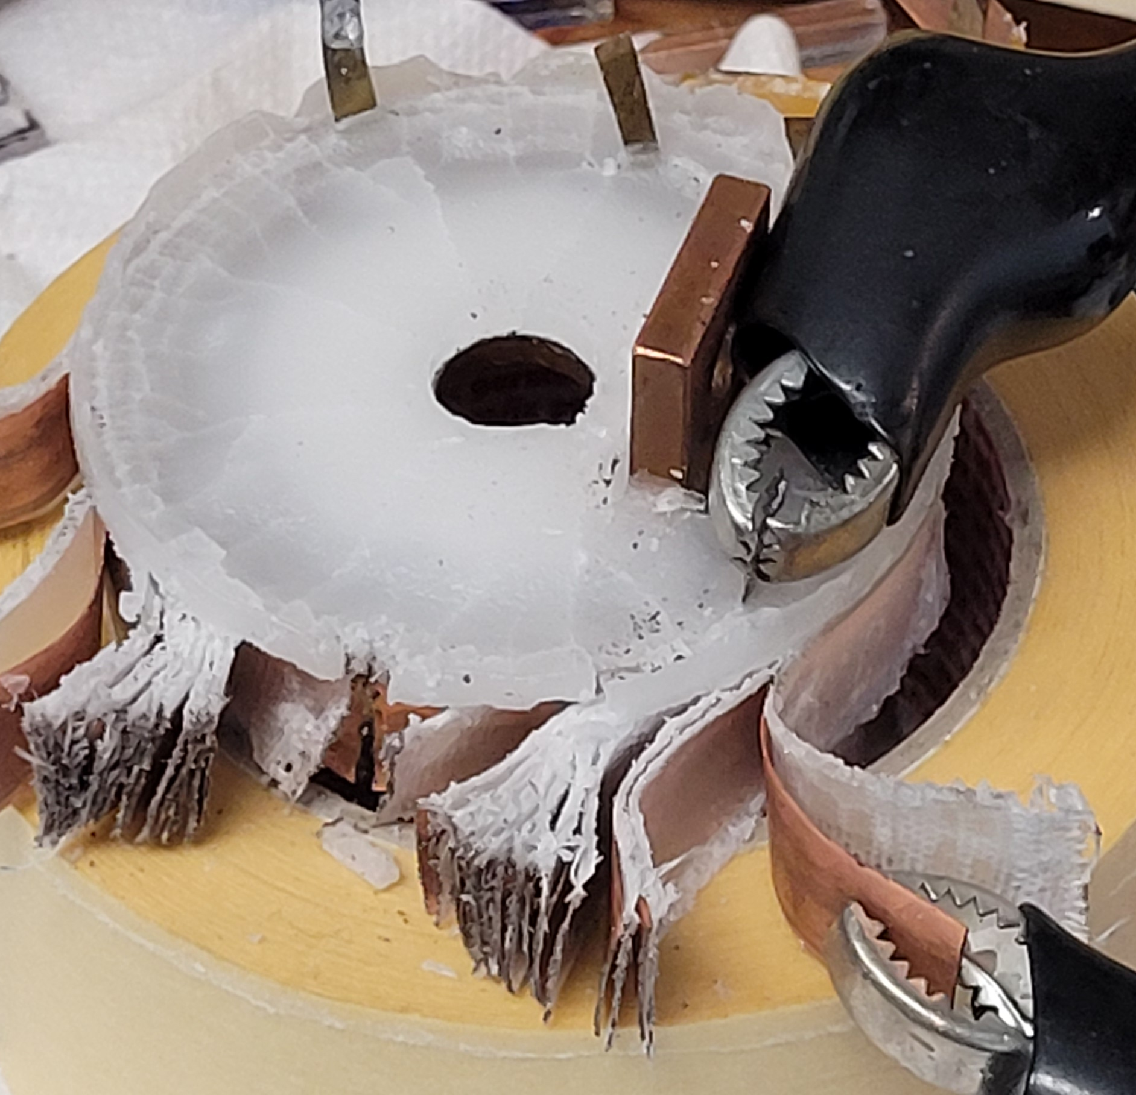


Ongoing activities: 2023/2024 campaign closed, now new one
I_{p}
I_{θ}
I_{p}
I_{R}
$$V(t)=V_{0}e^{−\frac{t}{τ}}$$
L_{HTS}
R_{c}
I_{θ}
$$τ=\frac{L_{HTS}}{R_{c}}$$
I_{R}
> 150 GΩ
@ 2.5 kV

Slide 15
Opportunities for IMCC
Charging can easily become part of early evaluations if needed.
ESMA-like magnets may hope to get limited M losses
For protection, fast-running models are missing for quench propagation. Maybe some estimations can be drawn (about costs for pre-quench detection systems?)
We could select some models to be further developed, aiming at mid-speed models (like Comsol 2D).
In parallel to that, experimental validation.

