Slide 1

Preliminary mechanical design of the large aperture HTS superconducting dipoles for the accelerator ring of the Muon Collider
T. Maiello^{1,4,5}, L. Alfonso¹, L. Balconi^{2,6}, A. Bersani¹, L. Bottura⁴, B. Caiffi¹, S. Fabbri⁴, S. Farinon¹, A. Gagno^{1,5}, F. Levi¹, F. Mariani^{2,6}, S. Mariotto^{2,3}, D. Novelli^{1,6}, A. Pampaloni¹, D. Rinaldoni ⁴, C. Santini², S. Sorti^{2,3}, M. Statera² , G. Vernassa²
¹ INFN – Genova, ² INFN LASA – Milano, ³ University of Milan, ⁴ CERN, ⁵ Università degli Studi di Genova, ⁶ Sapienza Università di Roma

Slide 2

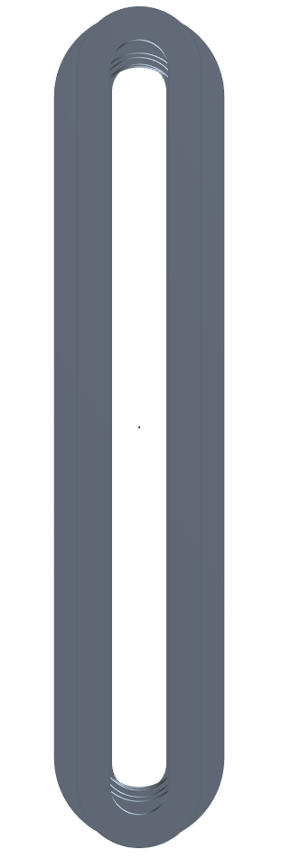
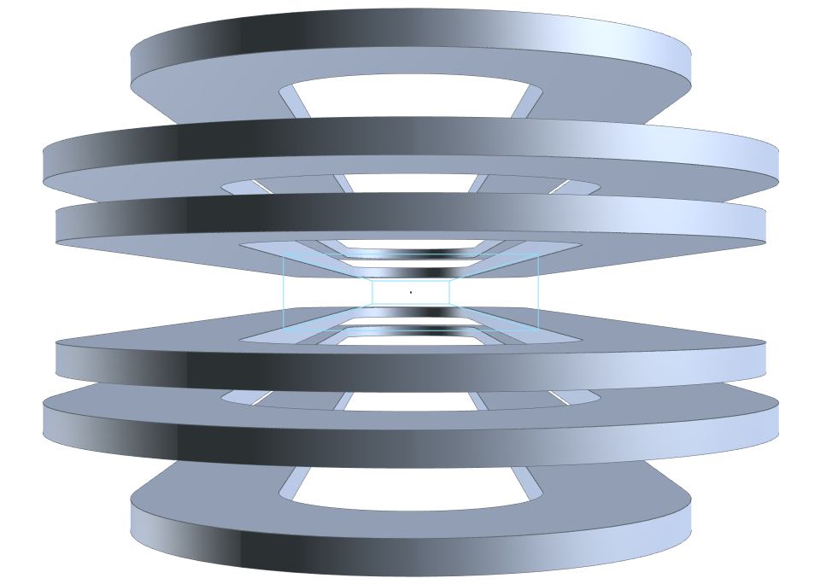
Requirements for the SC dipoles
Main characteristics:
Open midplane dipole to avoid deposition of the radiation from muon decay
10 T of central field
Rectangular aperture of 100 mm x 30 mm
Proposed solution:
Magnet design based on metal insulated HTS racetracks
Aperture
30 mm
100 mm

Slide 3
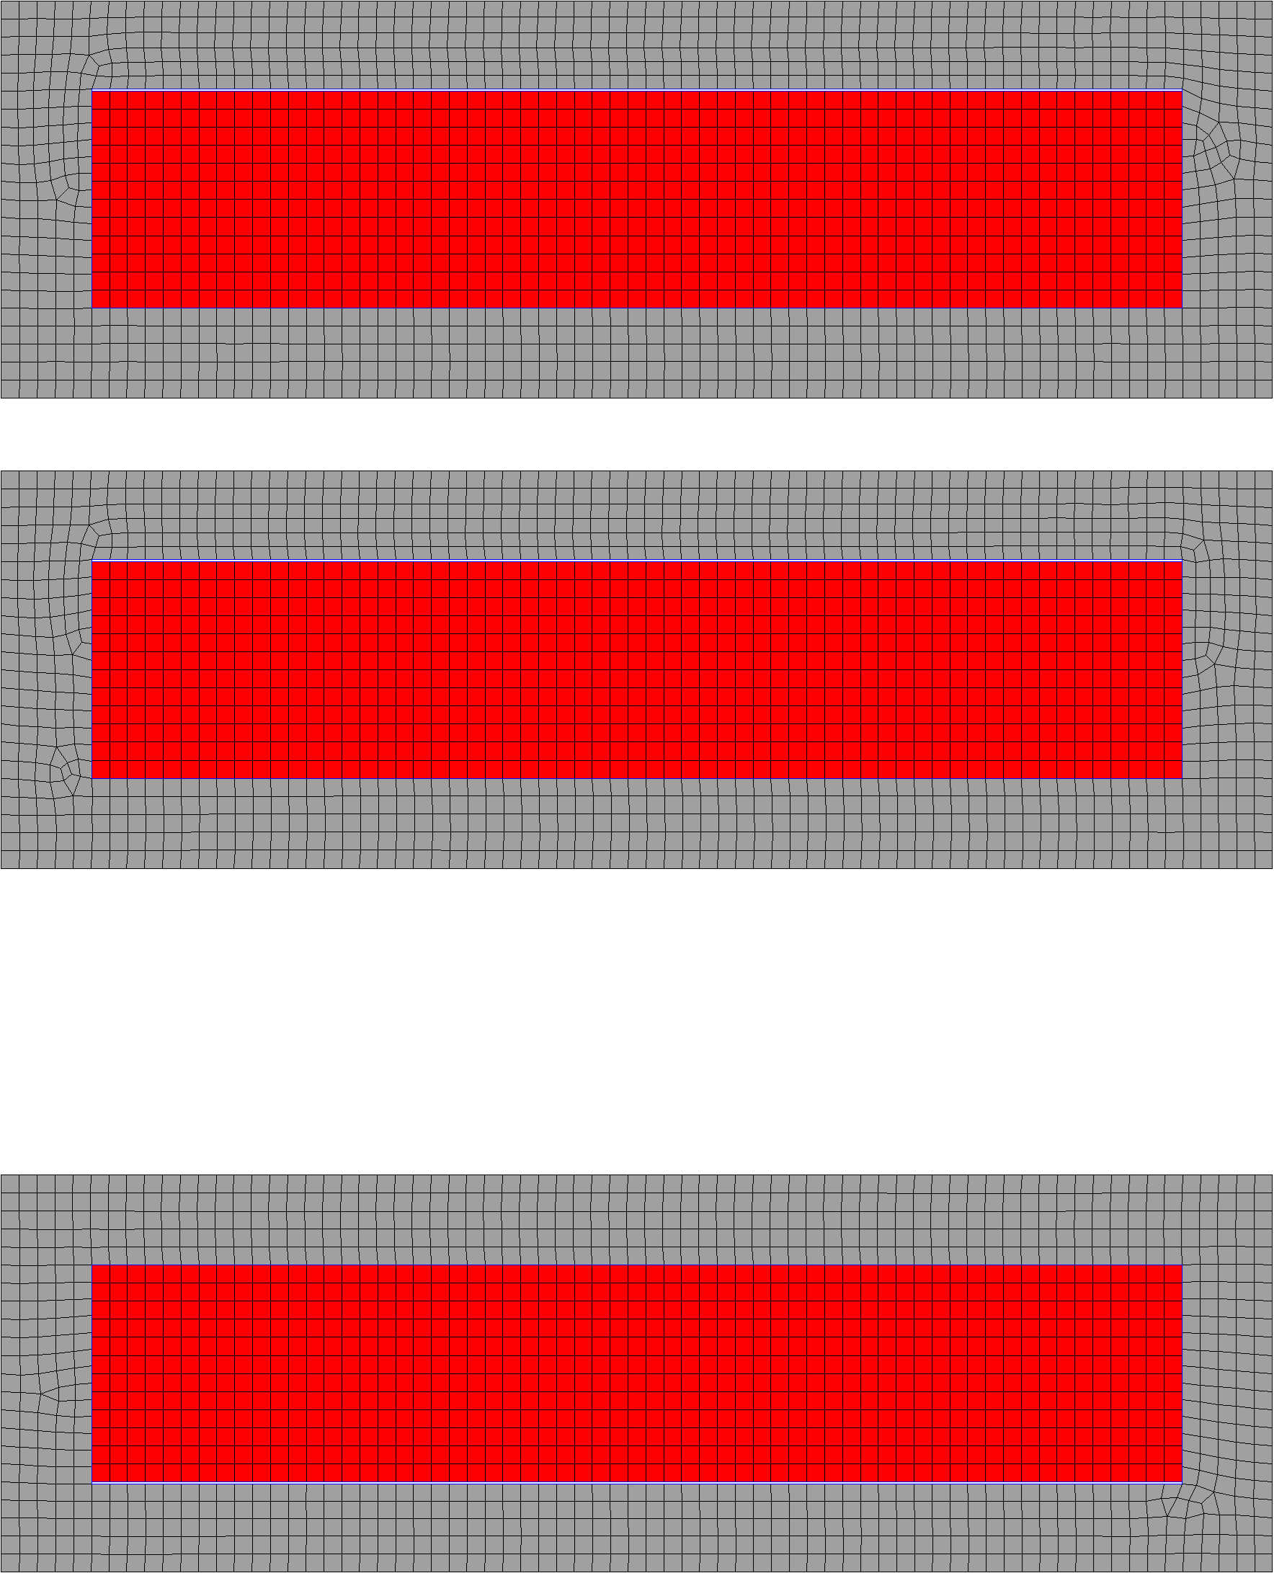
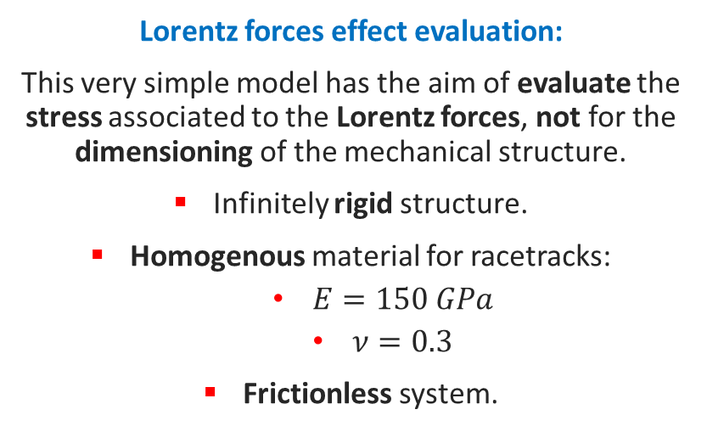
Mechanical Performance
Lorentz forces effect evaluation:
This very simple model has the aim of evaluate the stress associated to the Lorentz forces, not for the dimensioning of the mechanical structure.
Infinitely rigid structure.
Homogenous material for racetracks:
  $E=150 GPa$
  $ν=0.3$
Frictionless system.
5 mm
¹
¹ Value taken from “Electro-mechanical properties of REBCO coated conductors from various industrial manufacturers at 77 K, self-field and 4.2 K, 19 T”
https://iopscience.iop.org/article/10.1088/0953-2048/28/4/045011

Slide 4
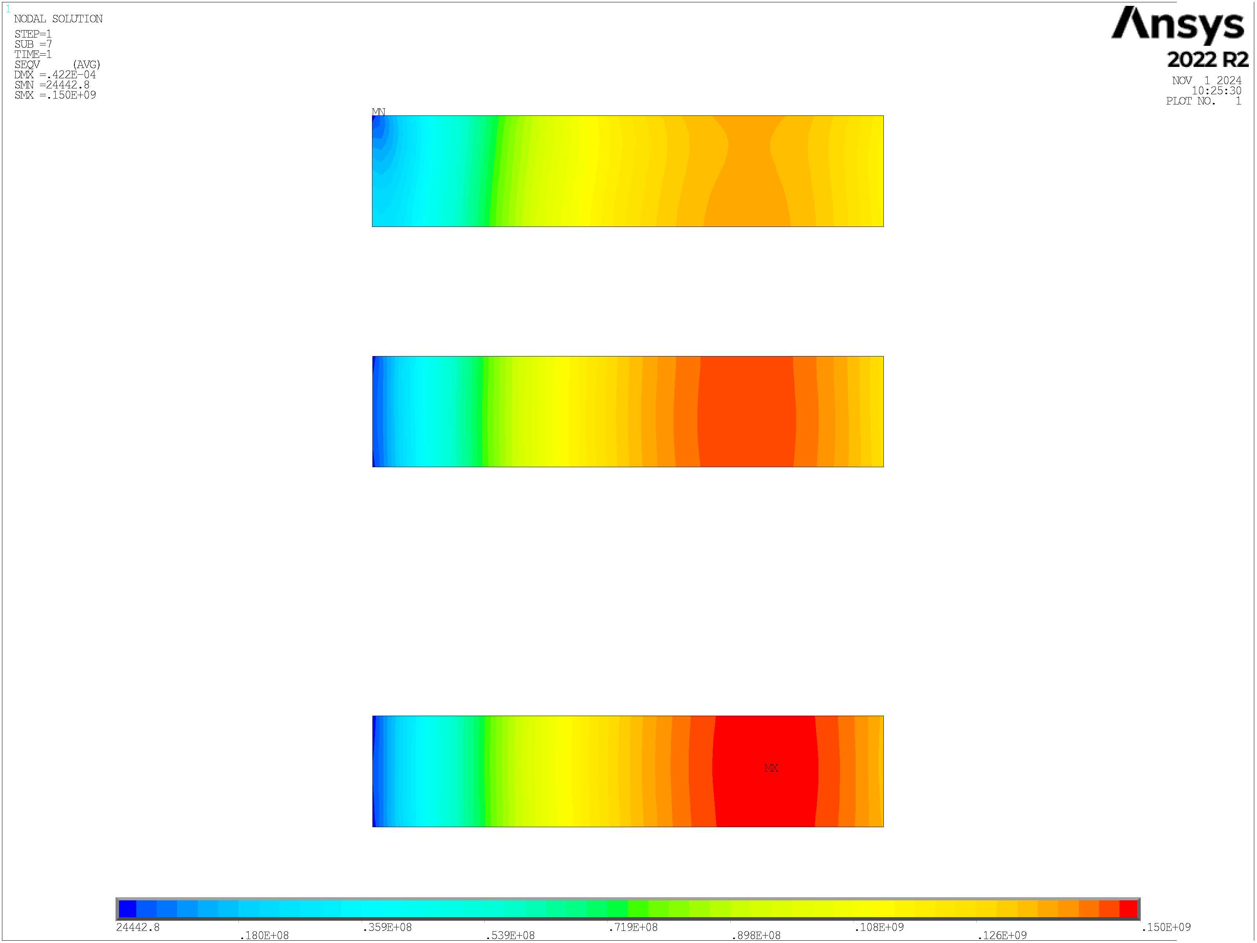
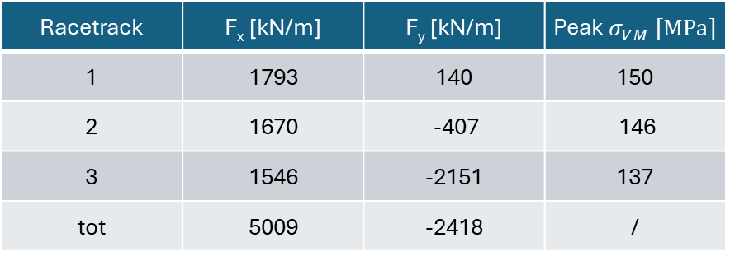

Mechanical Performance
3
Lorentz forces effect evaluation:
This very simple model has the aim of evaluate the stress associated to the Lorentz forces, not for the dimensioning of the mechanical structure.
Infinitely rigid structure.
Homogenous material for racetracks:
  $E=150 GPa$
  $ν=0.3$
Frictionless system.
2
¹
Racetrack | F_{x} [kN/m] | F_{y} [kN/m] | Peak $σ_{VM} [MPa]$
1 | 1793 | 140 | 150
2 | 1670 | -407 | 146
3 | 1546 | -2151 | 137
tot | 5009 | -2418 | /
1
24442.8
.180E+08
.359E+08
.539E+08
.719E+08
.898E+08
.108E+09
.126E+09
.150E+09
$$σ_{VM} [MPa]$$
¹ Value taken from “Electro-mechanical properties of REBCO coated conductors from various industrial manufacturers at 77 K, self-field and 4.2 K, 19 T”
https://iopscience.iop.org/article/10.1088/0953-2048/28/4/045011

Slide 5
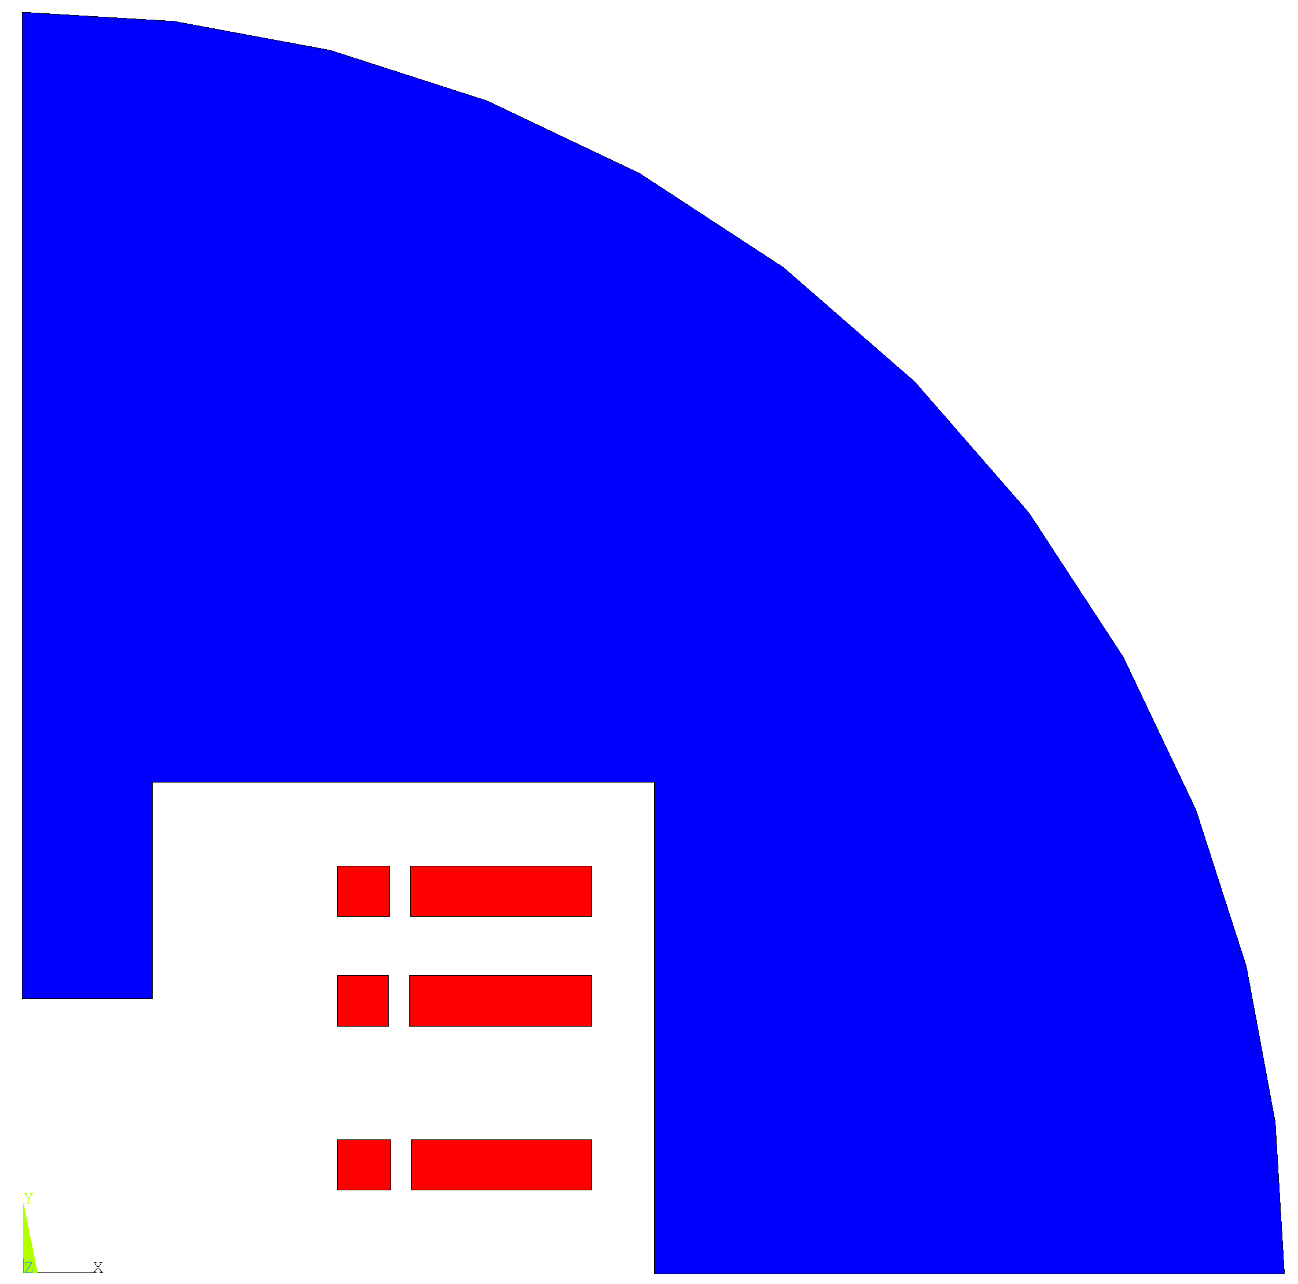
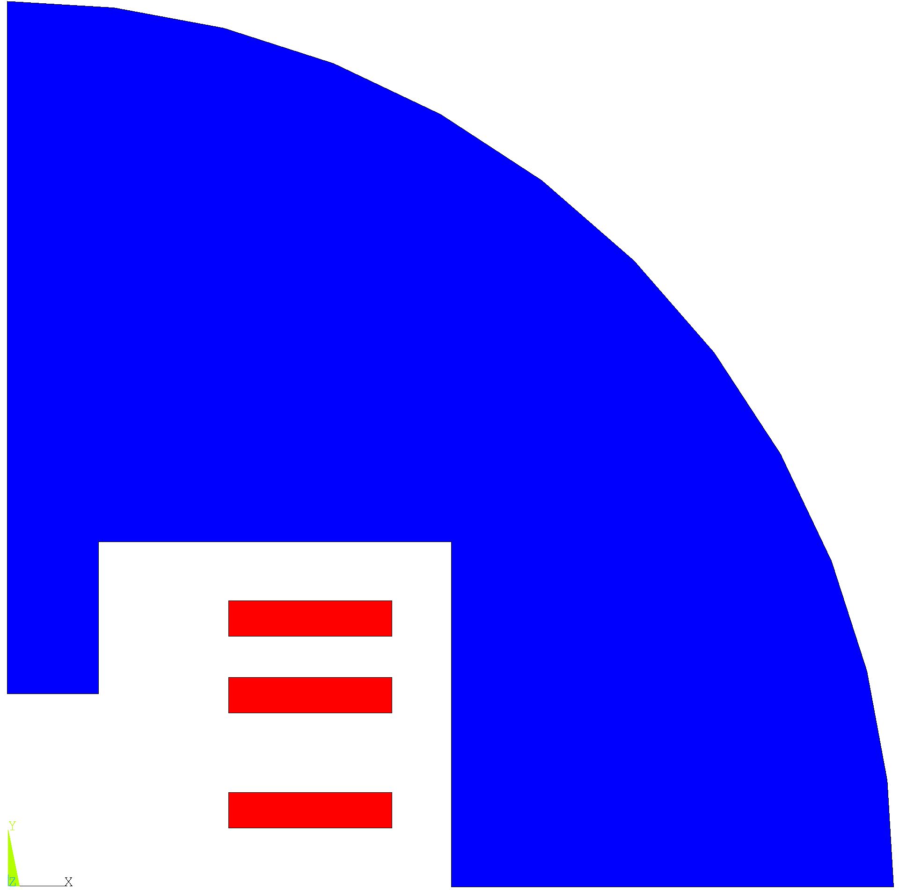
Stress management Strategy
A 5 mm vertical sector splitting the racetracks into two was inserted to reduce the stress. The position of each sector is the result of an optimization study.

Slide 6
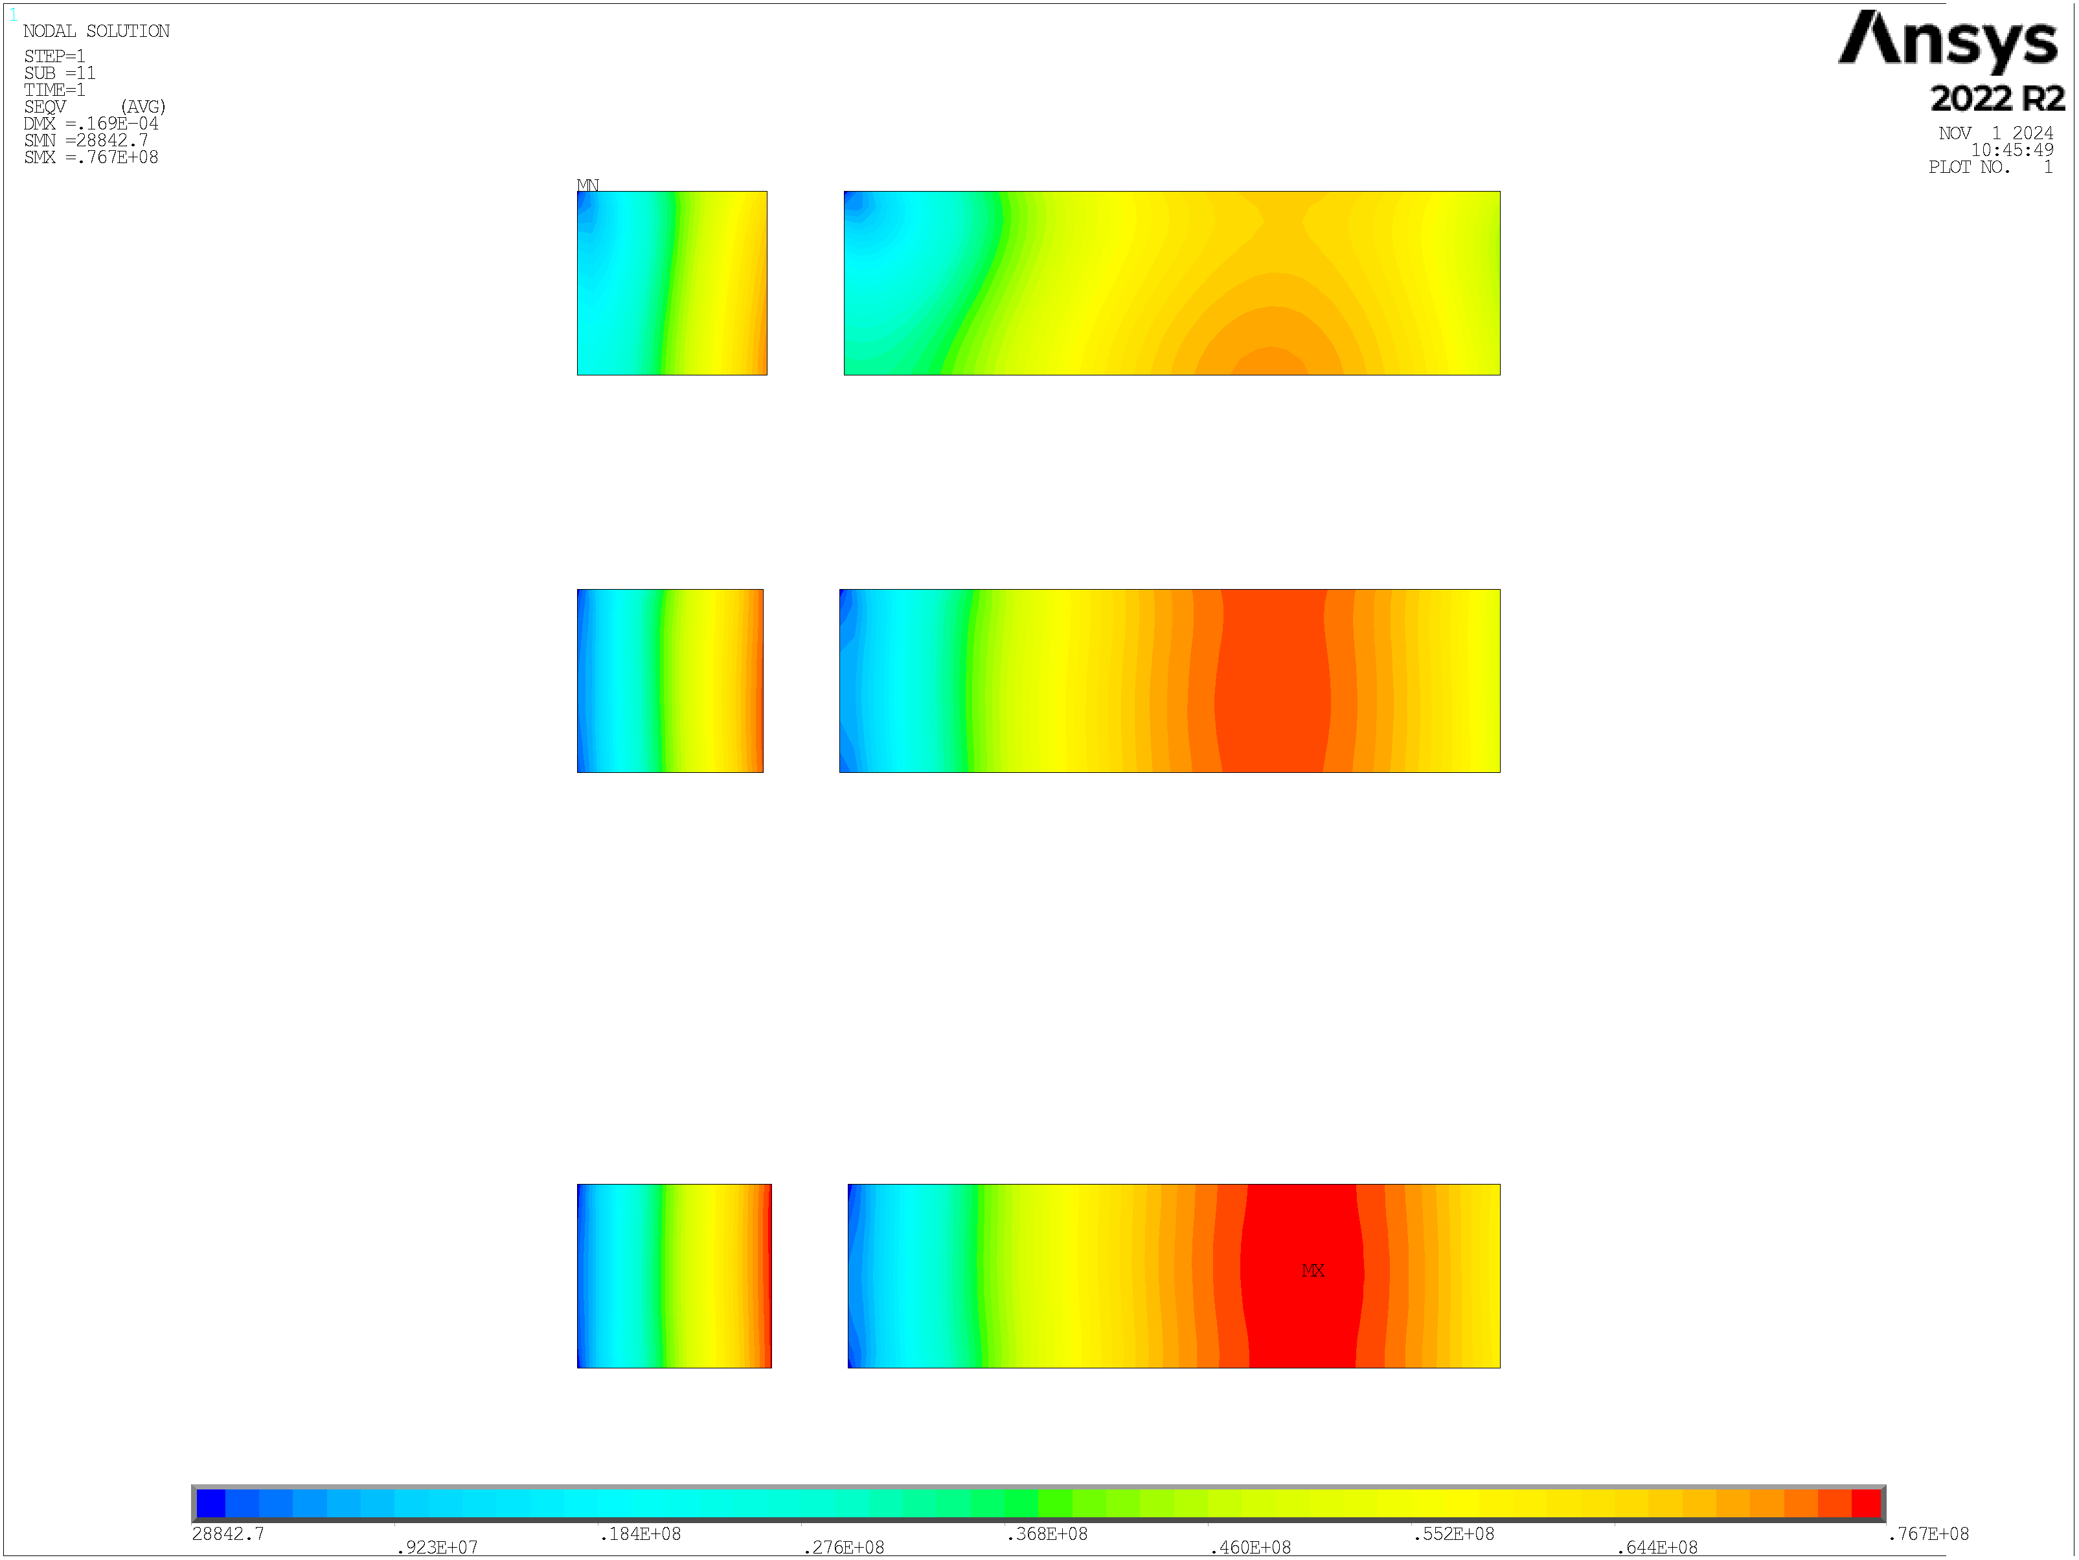

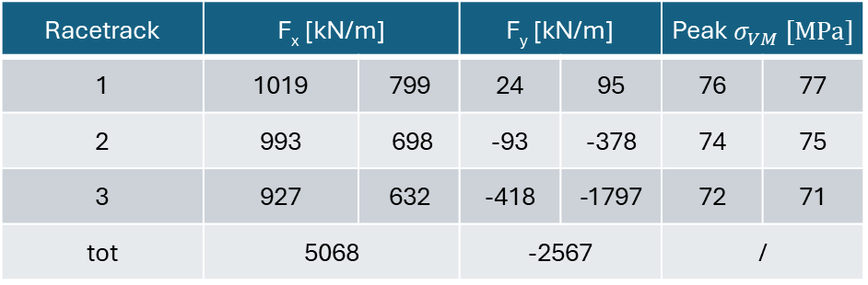
3 Aligned
Lorentz forces effect evaluation:
This very simple model has the aim of evaluate the stress associated to the Lorentz forces, not for the dimensioning of the mechanical structure.
Infinitely rigid structure.
Homogenous material for racetracks:
  $E=150 GPa$
  $ν=0.3$
Frictionless system.
N cond
N rt
N cond
46
3
159
¹
45
2
160
Racetrack | F_{x} [kN/m] |  | F_{y} [kN/m] |  | Peak $σ_{VM} [MPa]$
1 | 1019 | 799 | 24 | 95 | 76 | 77
2 | 993 | 698 | -93 | -378 | 74 | 75
3 | 927 | 632 | -418 | -1797 | 72 | 71
tot | 5068 |  | -2567 |  | /
47
1
158
28842.7
.923E+07
.184E+08
.276E+08
.368E+08
.460E+08
.552E+08
.644E+08
.767E+08
$$σ_{VM} [MPa]$$
¹ Value taken from “Electro-mechanical properties of REBCO coated conductors from various industrial manufacturers at 77 K, self-field and 4.2 K, 19 T”
https://iopscience.iop.org/article/10.1088/0953-2048/28/4/045011

Slide 7
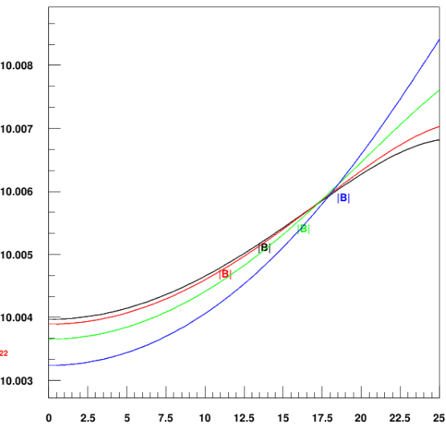
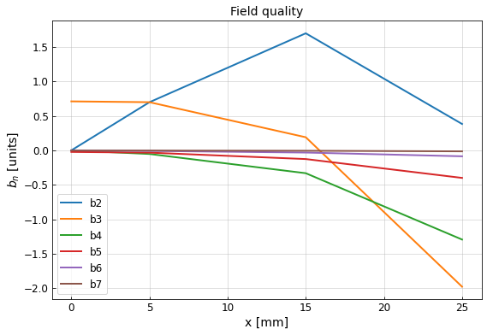
3 Aligned
B [T]
The new field homogeneity at x = 25 mm is about 0.058%.
I [A] | J_{eng} [A/mm²] | B₀ [T] | B_{p} [T] | B_{p}/B₀
2380.91 | 734.85 | 10.00 | 12.32 | 1.23
+2.0% | +2.0% | / | -1.4% | -1.4%
higher path
lower path
x [mm]

Slide 8
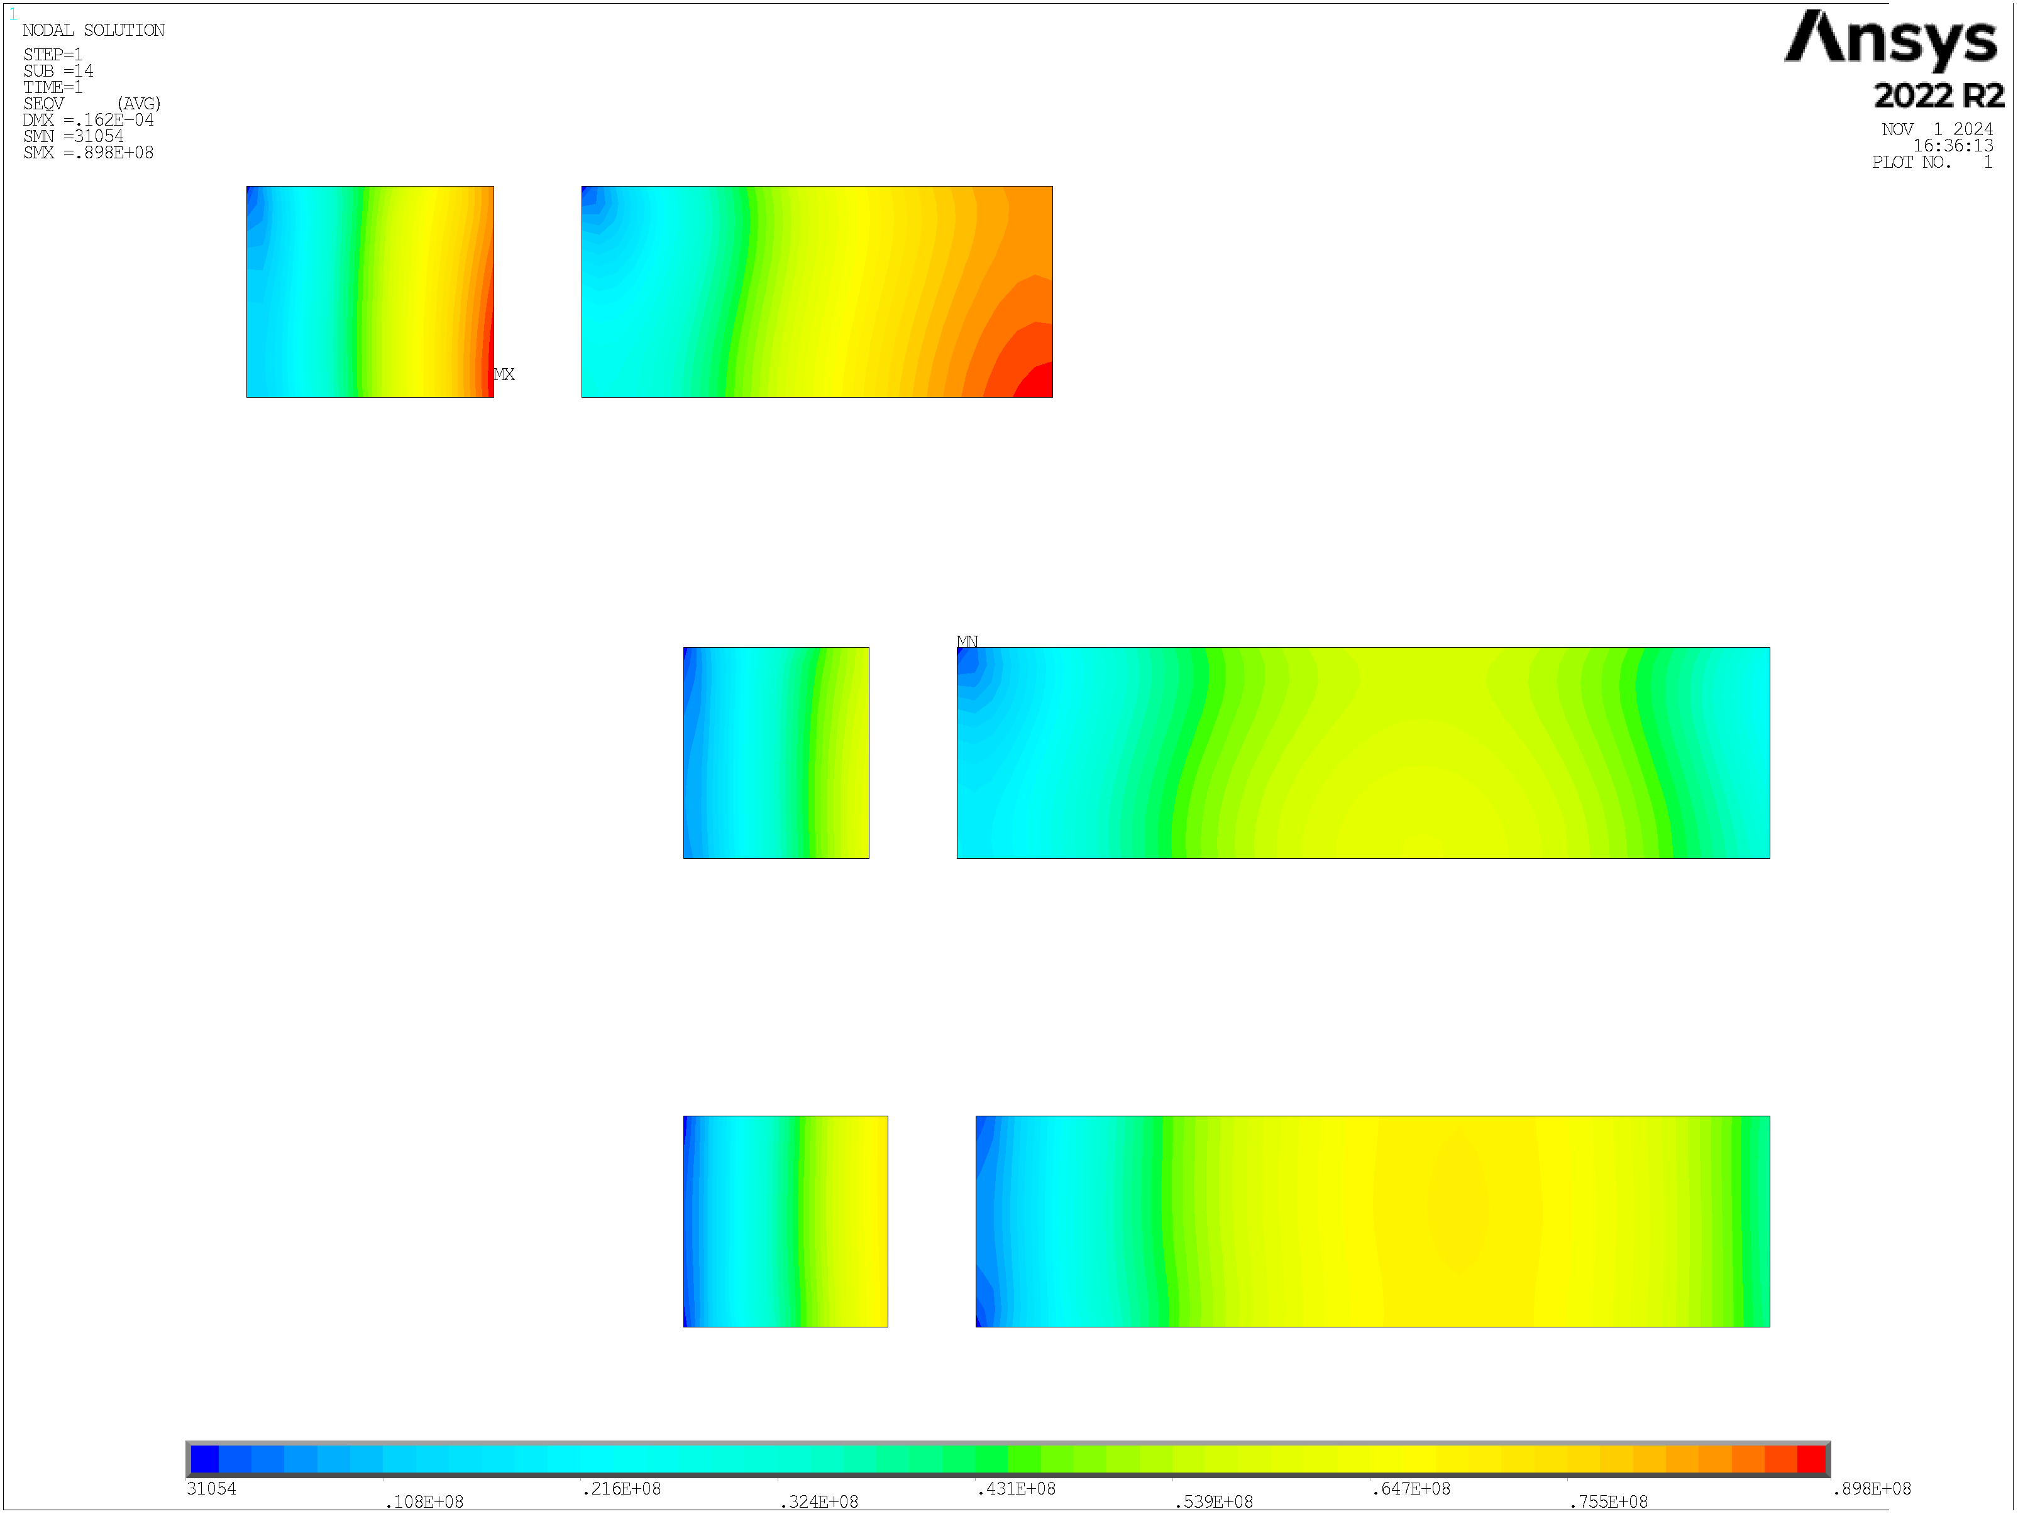
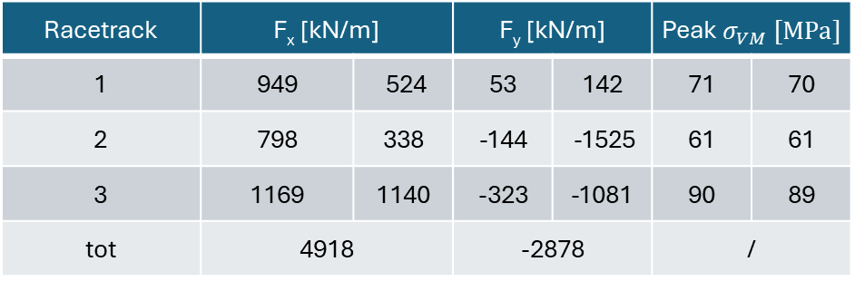
2 Aligned
Lorentz forces effect evaluation:
This very simple model has the aim of evaluate the stress associated to the Lorentz forces, not for the dimensioning of the mechanical structure.
Infinitely rigid structure.
Homogenous material for racetracks:
  $E=150 GPa$
  $ν=0.3$
Frictionless system.
N cond
N rt
N cond
52
3
99
¹
39
2
171
Racetrack | F_{x} [kN/m] |  | F_{y} [kN/m] |  | Peak $σ_{VM} [MPa]$
1 | 949 | 524 | 53 | 142 | 71 | 70
2 | 798 | 338 | -144 | -1525 | 61 | 61
3 | 1169 | 1140 | -323 | -1081 | 90 | 89
tot | 4918 |  | -2878 |  | /
43
1
167
31054
.108E+08
.216E+08
.324E+08
.431E+08
.539E+08
.647E+08
.755E+08
.898E+08
$$σ_{VM} [MPa]$$
¹ Value taken from “Electro-mechanical properties of REBCO coated conductors from various industrial manufacturers at 77 K, self-field and 4.2 K, 19 T”
https://iopscience.iop.org/article/10.1088/0953-2048/28/4/045011

Slide 9
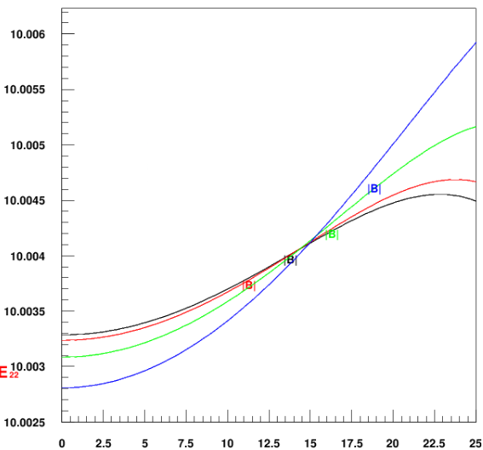
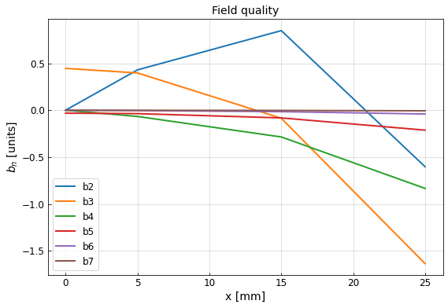
2 Aligned
B [T]
The new field homogeneity at x = 25 mm is about 0.036%.
higher path
I [A] | J_{eng} [A/mm²] | B₀ [T] | B_{p} [T] | B_{p}/B₀
2441.72 | 753.62 | 10.00 | 12.36 | 1.23
+2.1% | +2.1% | / | -1.4% | -1.4%
lower path
x [mm]

Slide 10
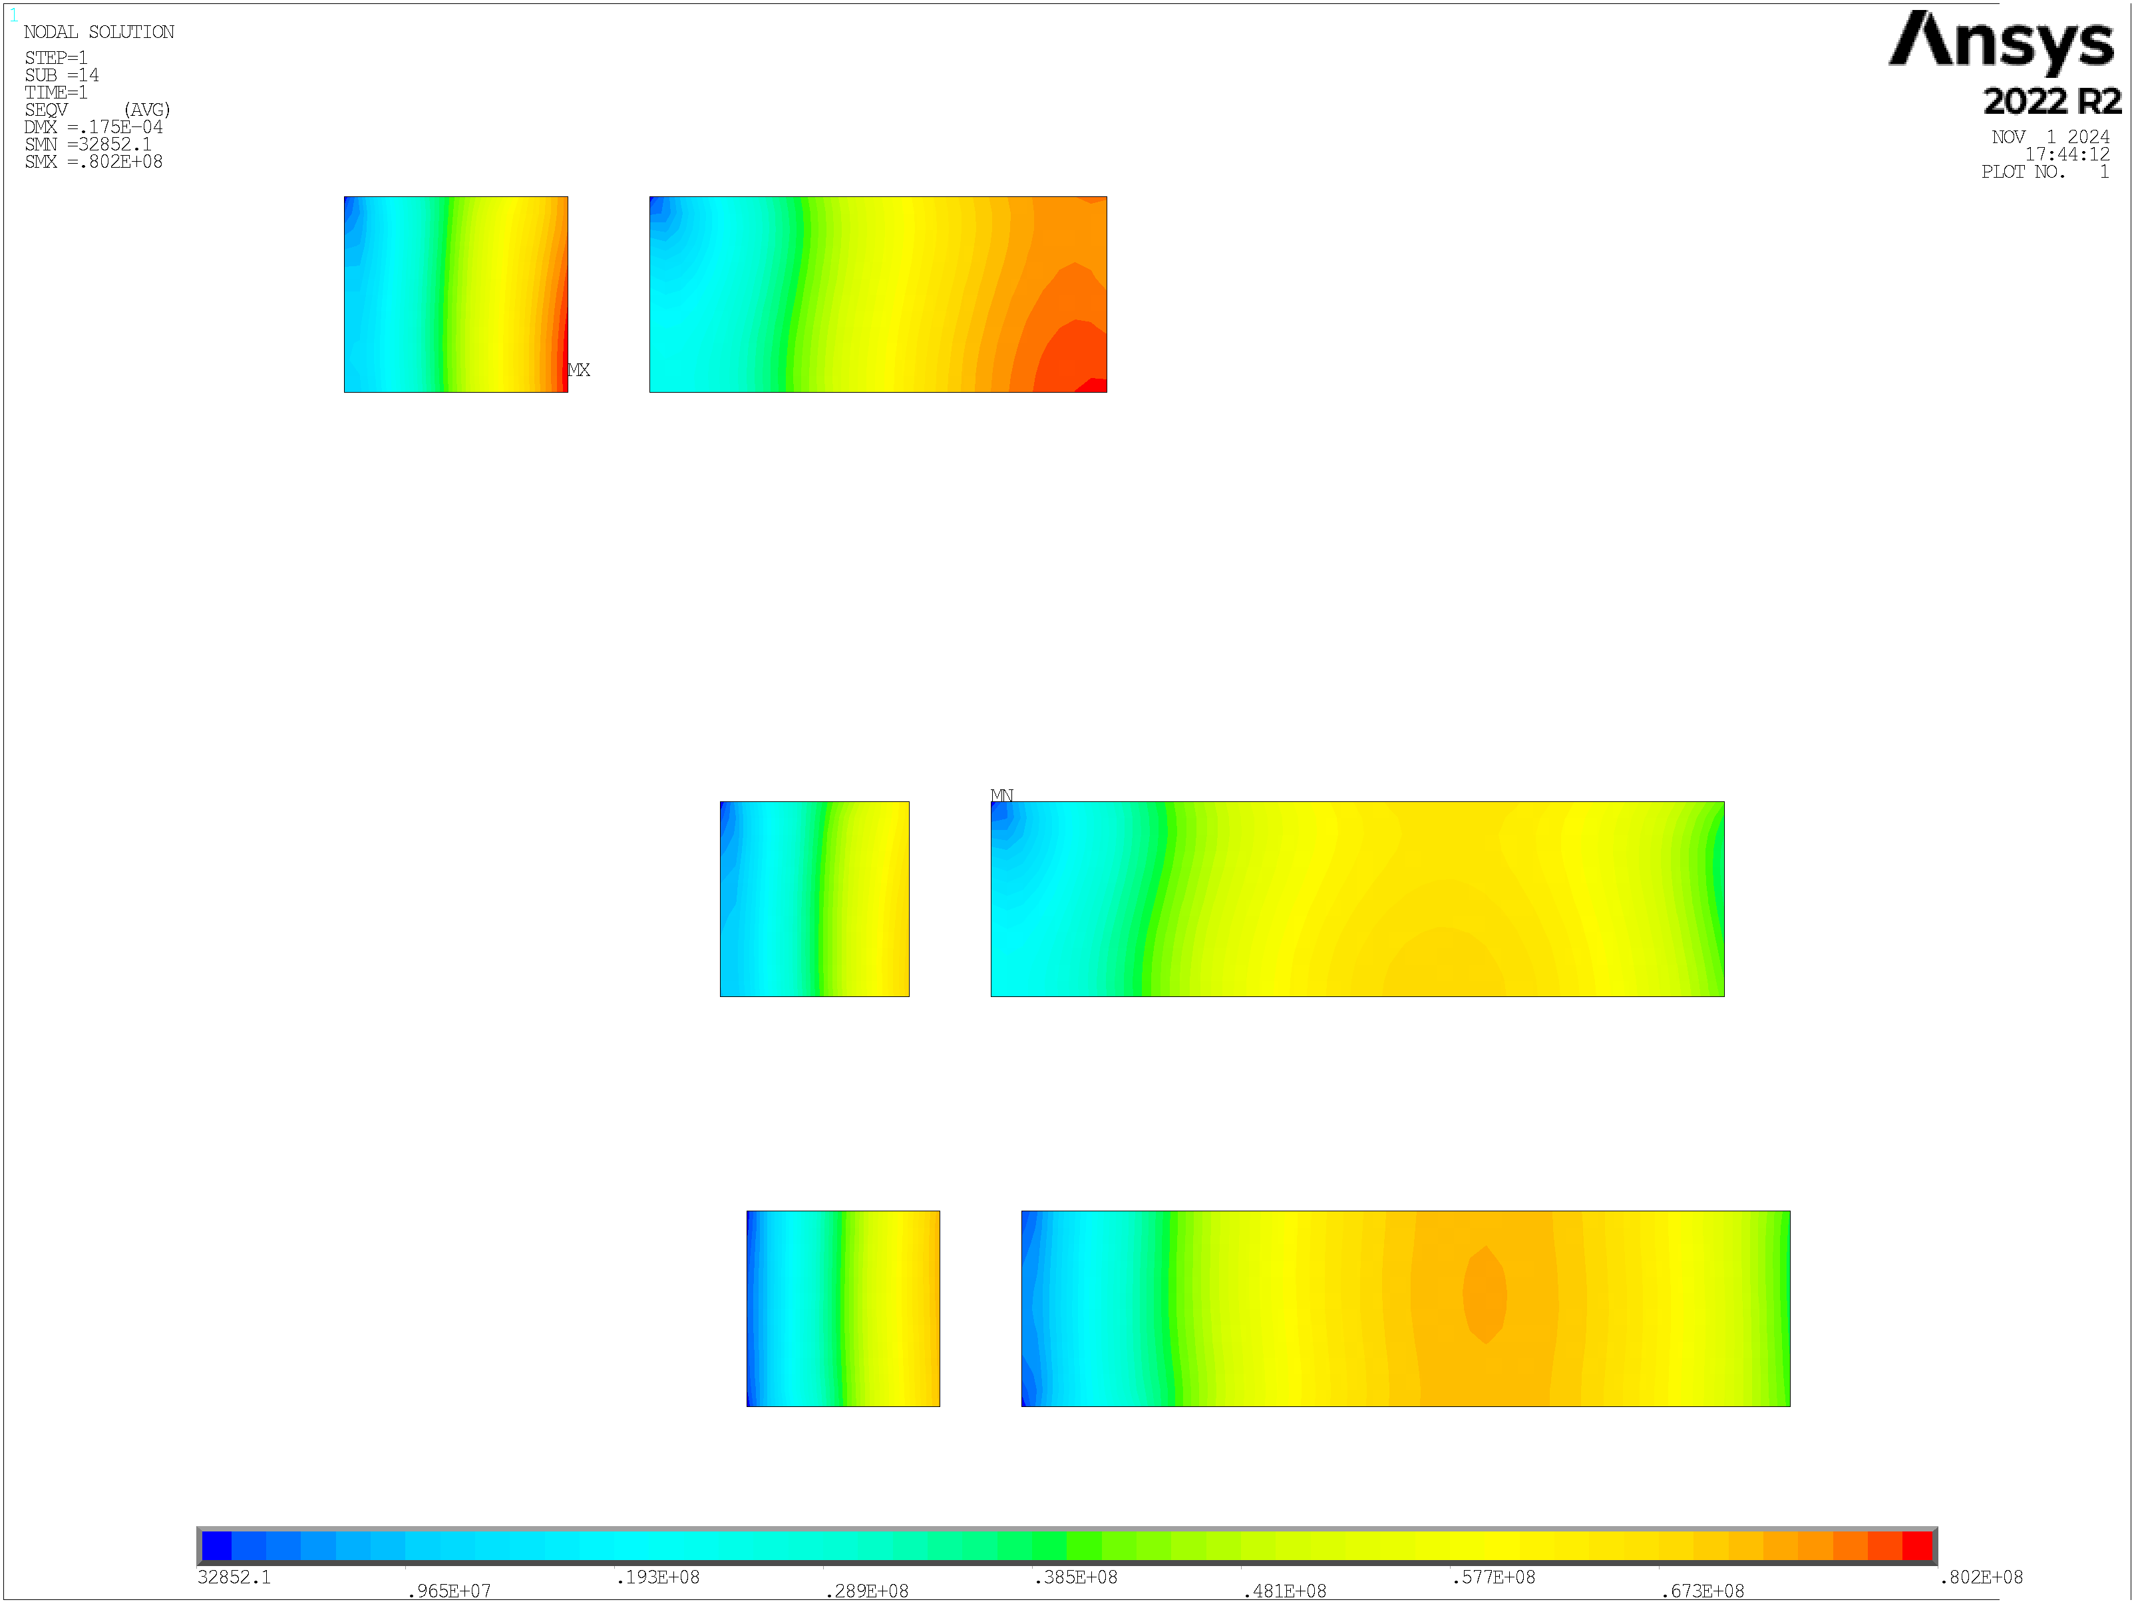

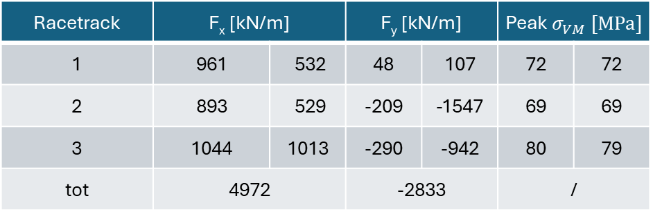
0 Aligned
Lorentz forces effect evaluation:
This very simple model has the aim of evaluate the stress associated to the Lorentz forces, not for the dimensioning of the mechanical structure.
Infinitely rigid structure.
Homogenous material for racetracks:
  $E=150 GPa$
  $ν=0.3$
Frictionless system.
N cond
N rt
N cond
51
3
155
¹
43
2
167
Racetrack | F_{x} [kN/m] |  | F_{y} [kN/m] |  | Peak $σ_{VM} [MPa]$
1 | 961 | 532 | 48 | 107 | 72 | 72
2 | 893 | 529 | -209 | -1547 | 69 | 69
3 | 1044 | 1013 | -290 | -942 | 80 | 79
tot | 4972 |  | -2833 |  | /
44
1
219
32852.1
.965E+07
.193E+08
.289E+08
.385E+08
.481E+08
.577E+08
.673E+08
.802E+08
$$σ_{VM} [MPa]$$
¹ Value taken from “Electro-mechanical properties of REBCO coated conductors from various industrial manufacturers at 77 K, self-field and 4.2 K, 19 T”
https://iopscience.iop.org/article/10.1088/0953-2048/28/4/045011

Slide 11
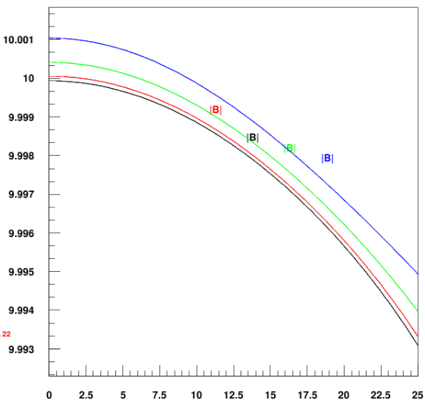
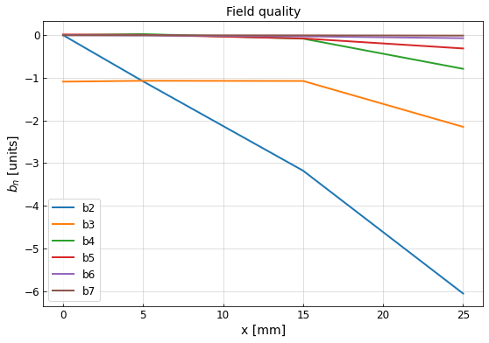
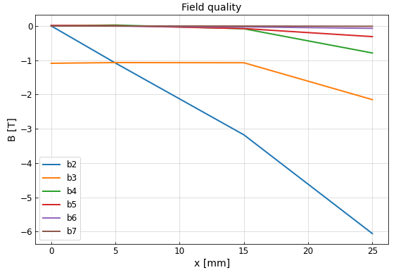
0 Aligned
B [T]
The new field homogeneity at x = 25 mm is about 0.030%.
I [A] | J_{eng} [A/mm²] | B₀ [T] | B_{p} [T] | B_{p}/B₀
2395.09 | 739.22 | 10.00 | 12.20 | 1.22
+2.0% | +2.0% | / | -1.0% | -1.0%
higher path
lower path
x [mm]

Slide 12
Thanks for your attention
T. Maiello^{1,4,5}, L. Alfonso¹, L. Balconi^{2,6}, A. Bersani¹, L. Bottura⁴, B. Caiffi¹, S. Fabbri⁴, S. Farinon¹, A. Gagno^{1,5}, F. Levi¹, F. Mariani^{2,6}, S. Mariotto^{2,3}, D. Novelli^{1,6}, A. Pampaloni¹, D. Rinaldoni ⁴, C. Santini², S. Sorti^{2,3}, M. Statera² , G. Vernassa²
¹ INFN – Genova, ² INFN LASA – Milano, ³ University of Milan, ⁴ CERN, ⁵ Università degli Studi di Genova, ⁶ Sapienza Università di Roma

Slide 13

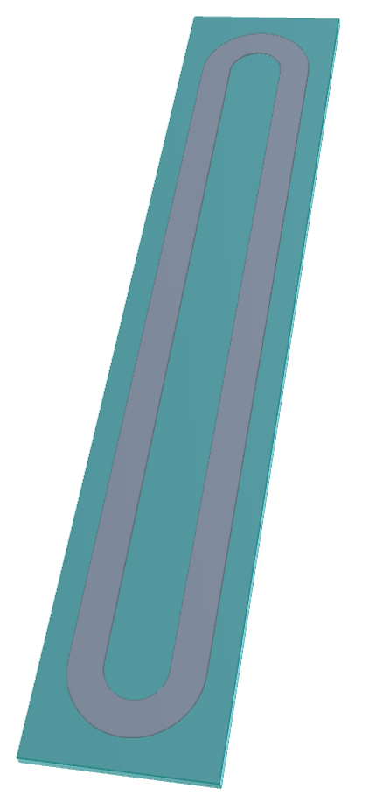
case
Very preliminary mechanical concept:
SS both inside and outside of the racetrack.
Threads to convey the preload from outside.

Slide 14

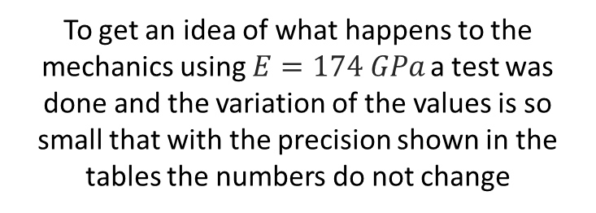
3 Aligned
N cond
N rt
N cond
To get an idea of what happens to the mechanics using $E=174 GPa$ a test was done and the variation of the values is so small that with the precision shown in the tables the numbers do not change
46
3
159
45
2
160
Racetrack | F_{x} [kN/m] |  | F_{y} [kN/m] |  | Peak $σ_{VM} [MPa]$
1 | 1019 | 799 | 24 | 95 | 76 | 77
2 | 993 | 698 | -93 | -378 | 74 | 75
3 | 927 | 632 | -418 | -1797 | 72 | 71
tot | 5068 |  | -2567 |  | /
47
1
158
28844.4
.923E+07
.184E+08
.276E+08
.368E+08
.460E+08
.552E+08
.644E+08
.767E+08
$$σ_{VM} [MPa]$$
¹ Value taken from “Electro-mechanical properties of REBCO coated conductors from various industrial manufacturers at 77 K, self-field and 4.2 K, 19 T”
https://iopscience.iop.org/article/10.1088/0953-2048/28/4/045011

