Slide 1
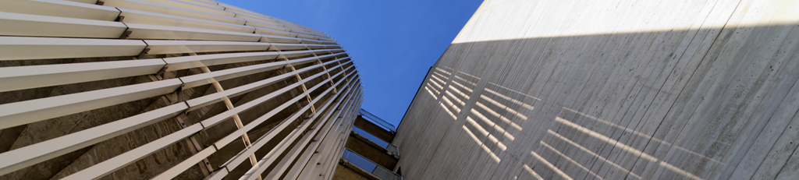






Workshop on Muon Collider Superconducting Magnet Design
Muon Collider Workshop @ LASA
6th-7th November 2024 | Milan, Italy
S. Mariotto, B. Caiffi, A. Pampaloni

Slide 2
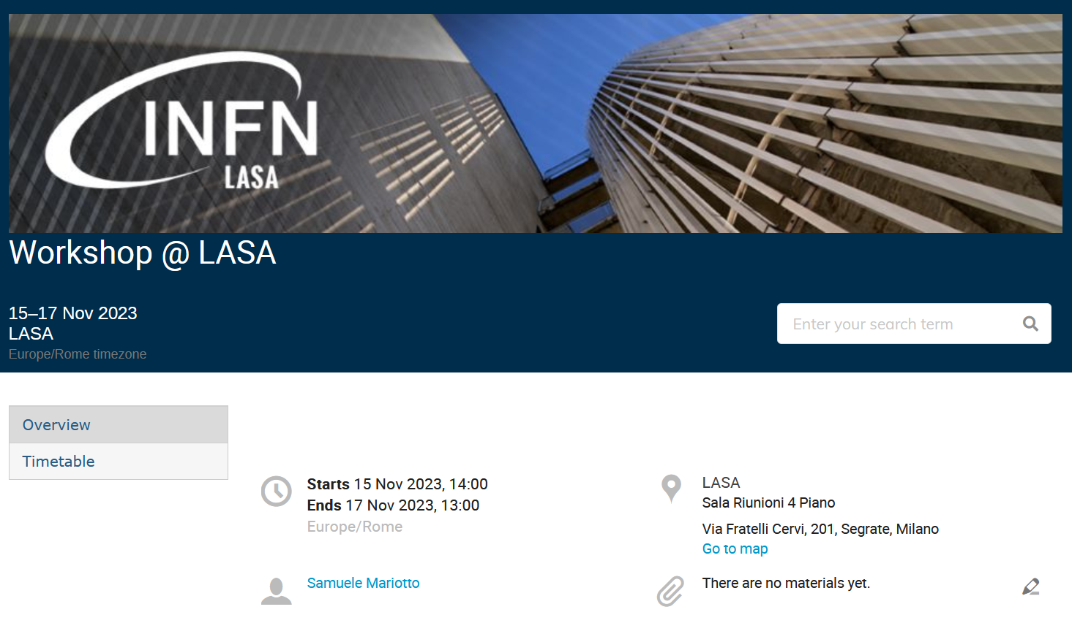
Workshop Introduction
First Workshop on 15th -17th Novembre 2023 dedicated to superconducting magnet organized at LASA to discuss detailed topics on magnet design and scaling law for the Muon Collider conceptual design study
Outcome of the discussion useful for magnet detailed design work in 2023-2024 and interaction with other WP
IMCC MDI Workshop (1 presentation)
IMCC Annual Meeting (1 presentation)
ASC 2024
  2 presentations
  3 posters

Slide 3
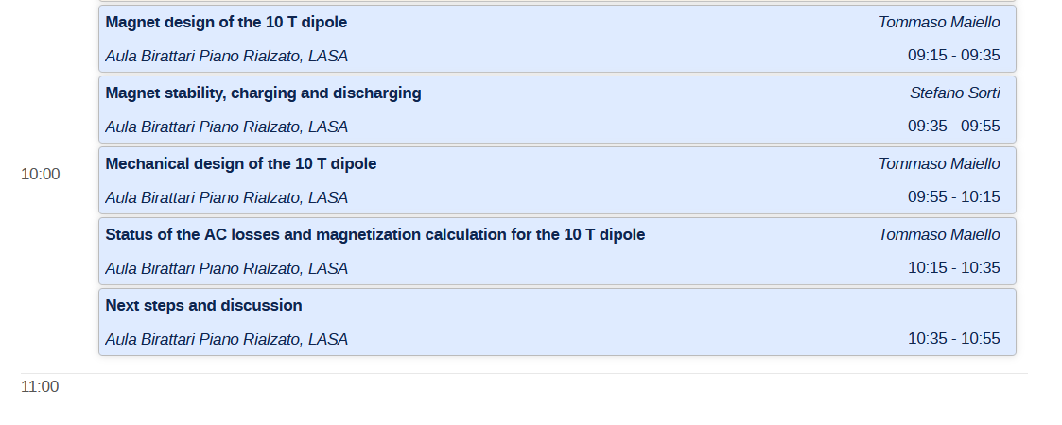
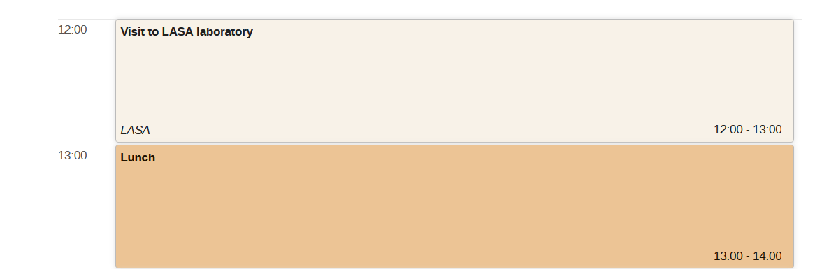
Timetable: 6th November
Morning
Accelerator Superconducting Dipole
Guided tour of LASA

Slide 4
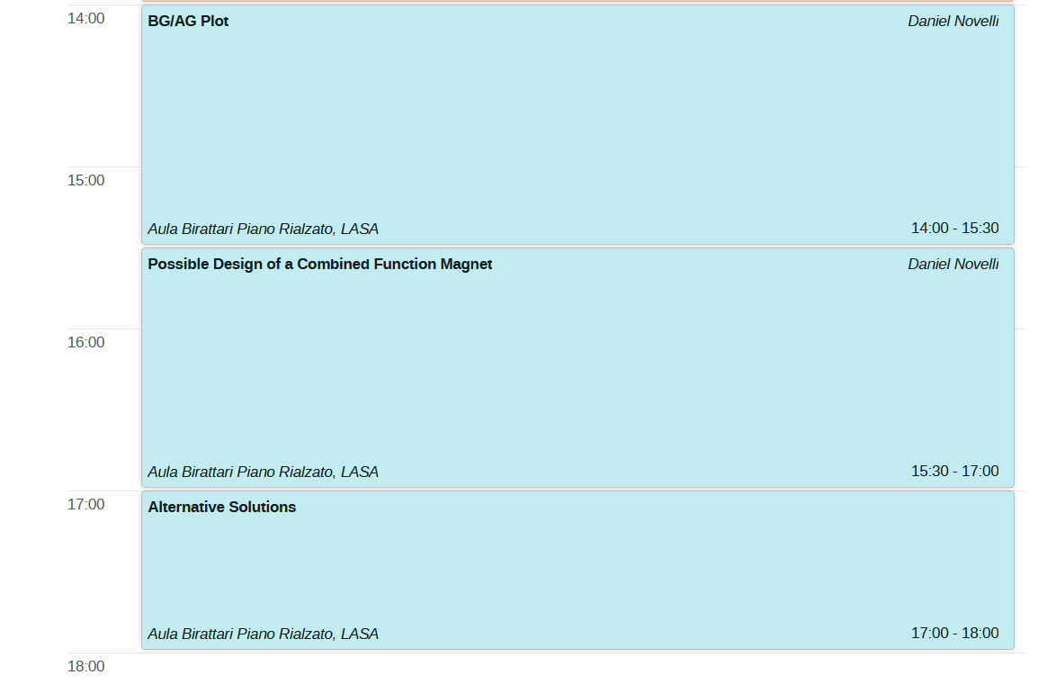
Timetable: 6th November
Afternoon
Combined Function
Magnet Discussion

Slide 5
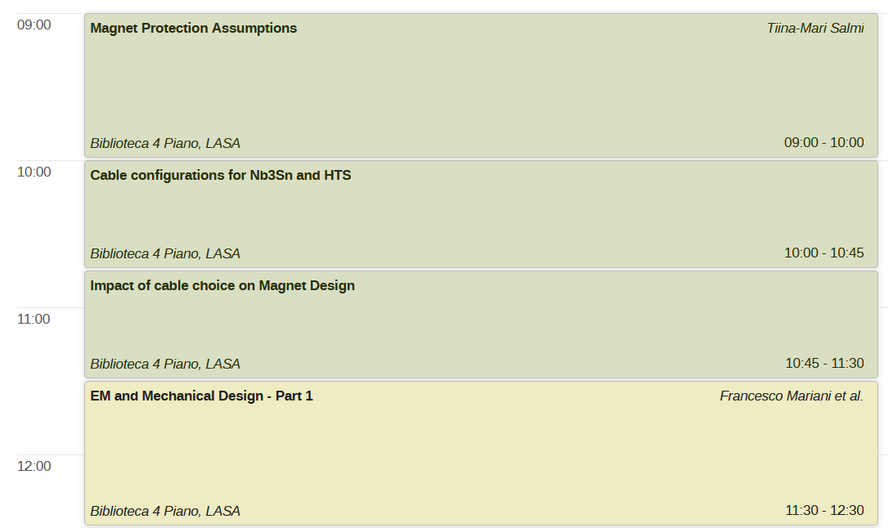
Timetable: 7th November
Morning
Magnet Protection and Cable Assumptions
Dipole Magnet Design

Slide 6
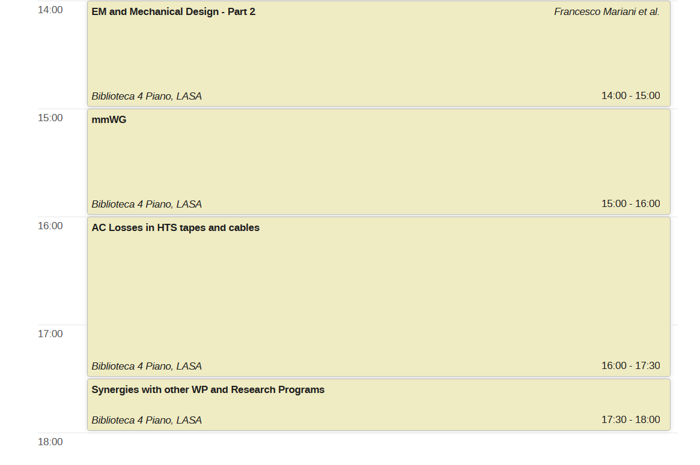
Timetable: 7th November
Afternoon
Dipole Magnet Design
Models for Magnetization

Slide 7
Outcome of the Workshop
Definition of the assumptions for magnet design
  Cable: tapes arrangement, geometric parameters, J_{c}
  Protection: metal insulation, not insulated and insulated to be studied in parallel?
    Need of refined protection scheme according to the work on magnet cross-section
Description of all analyzed magnet performances
  Define final version of AB plots and BG/A plot
  How to present results of analysis at other WP
    MORE IMPORTANT: how to present them outside IMCC collaboration?
      Comparison of the difference in assumptions and results with other programs
      HFM
      USMDP

Slide 8
Outcome of the Workshop
Design:
16 T – 140 mm
T > 10 K
EM and Mechanical Design
  Define the material properties to be used in the simulations
  Which FQ target do we use for the design optimization?
    What about the «variable» constraints? (Budget, Temperature)
  Omogenized properties for HTS: are they appropriate for the mechanical behaviour?
    Which level of detail do we want to achieve in the analysis? (Principal Stresses)
  Steps of mechanical simulations: assembly, cool down, energization???
    Which constraints do we use?
AC Losses
  Magnetization Modeling: Which model do we use?
  Thermal Design and charging/discharging for the NI coils

Slide 9


Enjoy the Workshop!!!
Funded by the European Union (EU). Views and opinions expressed are however those of the author(s) only and do not necessarily reflect those of the EU or European Research Executive Agency (REA). Neither the EU nor the REA can be held responsible for them.

