Slide 1




Collider Magnet Systems Cost Estimate
B. Caiffi², A. Bersani², S. Farinon², S. Mariotto³ ,
D. Novelli^{1,2} , A. Pampaloni ², T. Salmi⁴ , L. Bottura⁵, ...
¹Sapienza University of Rome , ²INFN – Genoa , ³INFN – Milan , ⁴Tampere University , ⁵CERN

Slide 2
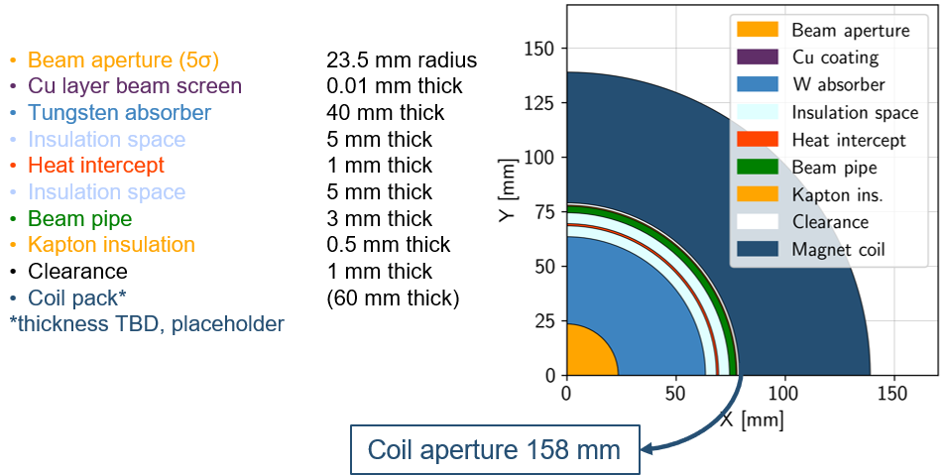
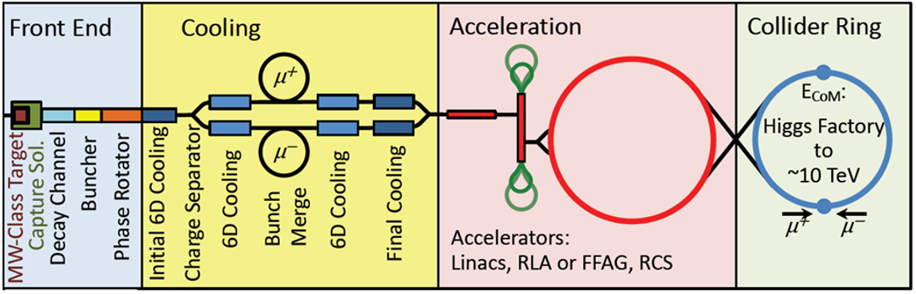
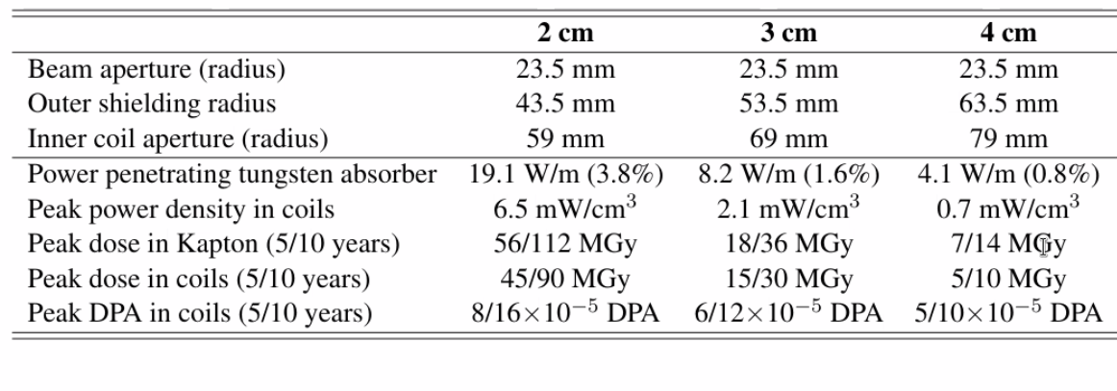
Magnet requirements
10 TeV collider
10 km ring
Radial Build
Task 7.4 Collider Ring Magnets (INFN)
138 mm
Courtesy of Patricia Borges de Sousa
https://indico.cern.ch/event/1250075/contributions/5357594/
4 cm W_{abs} @ T<10K (LTS) (P<5 W/m)
→ 158 mm magnet aperture
3 cm W_{abs} @ T=20K (HTS) (P<10 W/m)
→ 138 mm magnet aperture
Courtesy of Anton Lechner

Slide 3
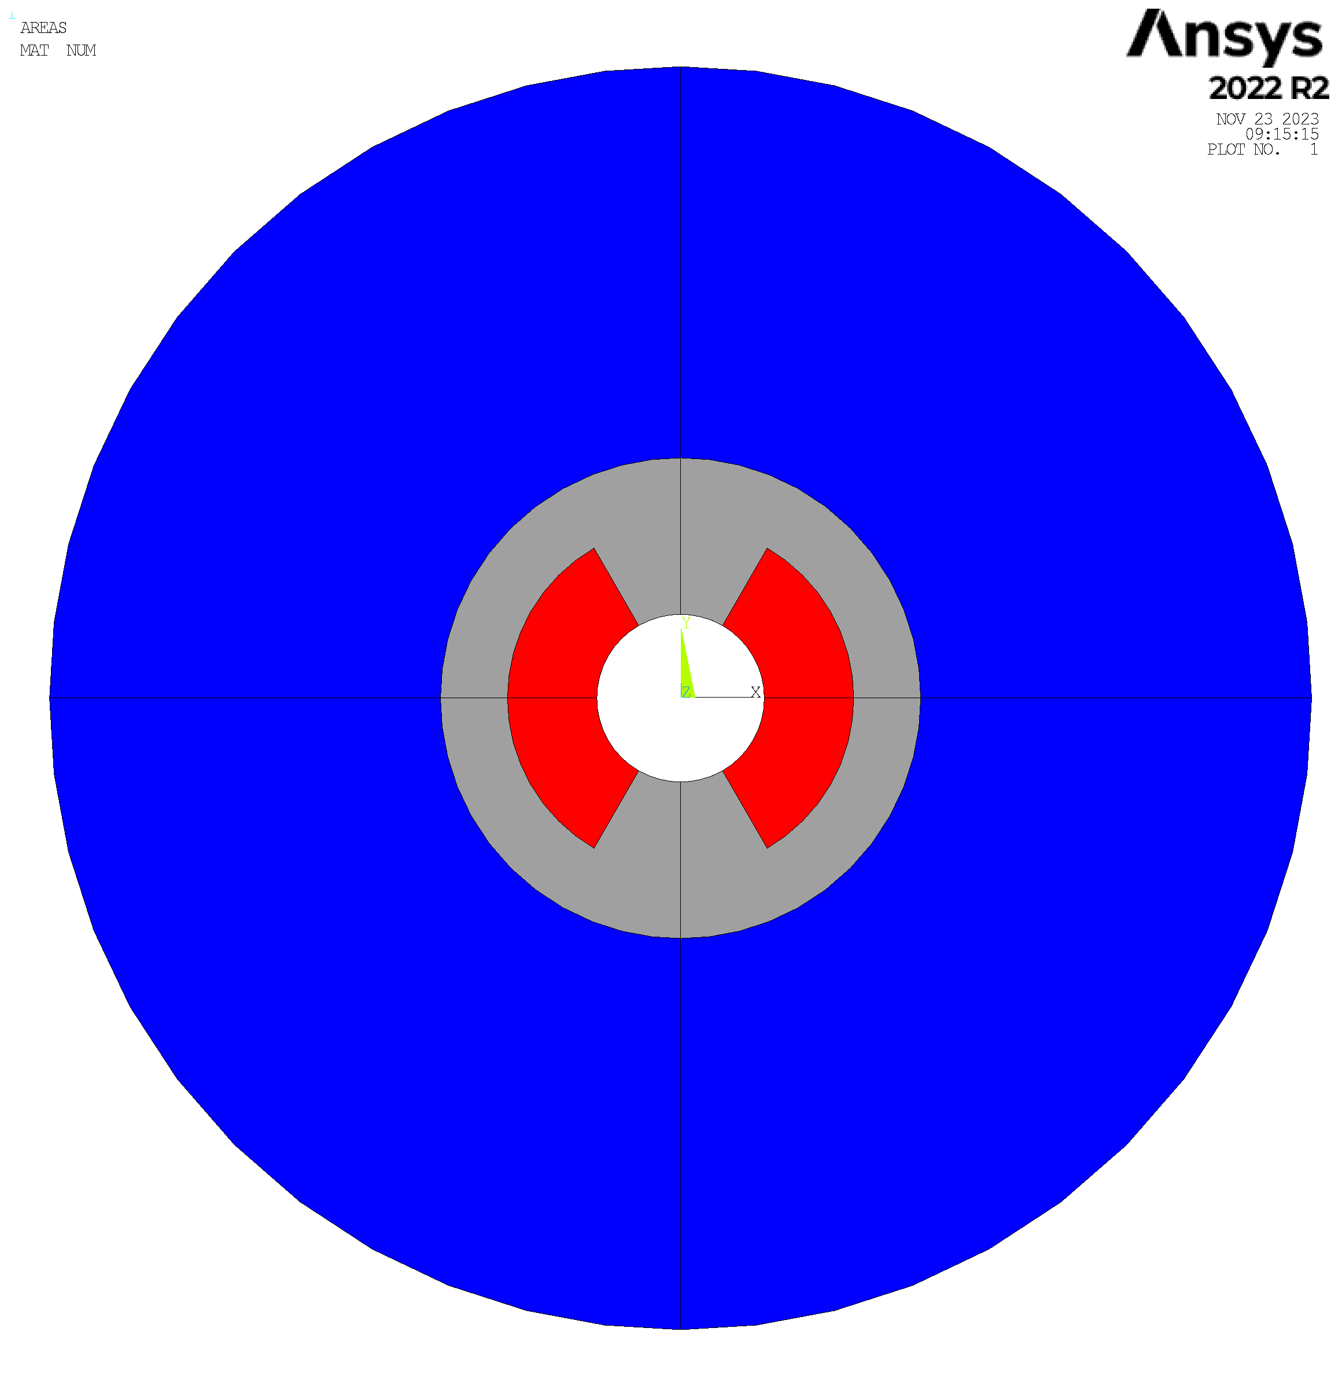

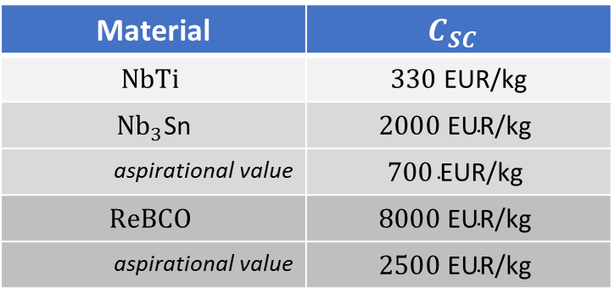
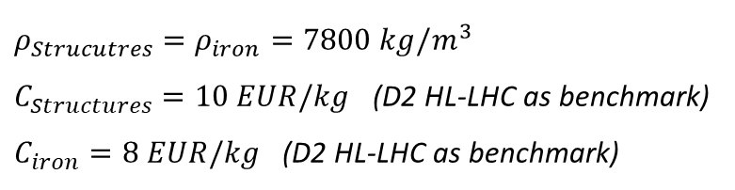
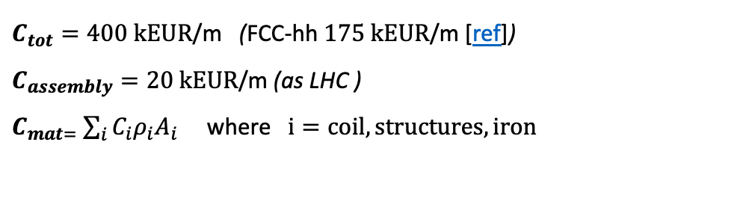
Cost Model
Optimization of the cross section still ongoing.
Cost estimate performed on a simplified geometry with a sector coil dipole, iron and steel structure modelled as circular crowns.
R _{bore}, w_{coil}, w_{iron} and w_{struct} optimized to fulfill beam optics requirements, margin on the load line, acceptable stress on the conductor and effectiveness of the quench protection [ref])
$C_{tot}=400 \text{k}\text{EUR}\text{/}\text{m}$ (FCC-hh $175 \text{k}\text{EUR}\text{/}\text{m}$ [ref])
$C_{assembly}=20 \text{k}\text{EUR}\text{/}\text{m}$ (as LHC )
$C_{mat=}$ $\sum_{i}{C_{i}ρ_{i}A_{i}}$ where $i=coil, structures, iron$
$$ρ_{Strucutres}=ρ_{iron}=7800 kg/m^{3}$$
$C_{Structures}=10 EUR/kg$ (D2 HL-LHC as benchmark)
$C_{iron}=8 EUR/kg$ (D2 HL-LHC as benchmark)
Bore
Coil
Structures
Iron
$$ρ_{coil}=8000 kg/m^{3}$$
Material | $$C_{SC}$$
$$NbTi$$ | $330 \text{EUR}\text{/}\text{kg}$
${Nb}_{3}$Sn | $$2000 \text{EUR}\text{/}\text{kg}$$
aspirational value | $$700 \text{EUR}\text{/}\text{kg}$$
$$ReBCO$$ | $$8000 \text{EUR}\text{/}\text{kg}$$
aspirational value | $$2500 \text{EUR}\text{/}\text{kg}$$
Escalated price in 2016
The right value in 2016
Corresponds to the ITER target
The value of today (2023)
A realistic projection for the next years

Slide 4

Cost Estimate 10 TeV
Dipoles of the arc for the series production
(quadrupoles and IR not included)
  14T /140 mm (REBCO)
€/kg iron | €/kg struct | €/kg conductor *
8 | 10 | 2500
  *50 €/kAm: 1/3 of today prize (150€/kAm)
  Also based on projection of ref
  A. Molodyk and C. Larbalestier, Science, 2023
Iron [Kg/m] | Structure [kg/m] | Coil [kg/m]
4560 | 213 | 130
Iron cost [k€/m] | Structure cost [ k€/m] | Coil cost [k€/m]
36 | 2.1 | 322
Tot. Material = (C_{iron}+ C_{struct})*f_{struct}
f_{struct} = 1.5
Tot. Material k€/m | 56 | 14%
Tot. Assembly k€/m | 20 | 5%
Tot. Conductor k€/m | 322 | 81%
Tot. Cost k€/m | 400
Template geometrical parameter taken for cost estimate
100 k€/magnet ( $\sim$2FTE)
R_{bore}= 70 mm
w_{coil}= 60 mm
w_{struct}= 30 mm
w_{iron}= 300 mm
N units=1200, Length= 5m
Coordination, design and follow-up: 4 FTE x 4 years= 16 FTE-years (1.6 MEur)
TOTAL COST: 2.4 GEur (19.0% overall magnets budget)
Disclaimer: cryostat, specific tooling, W absorber not taken into account
Notes:
J=3.5 10^8 A/m2

Slide 5
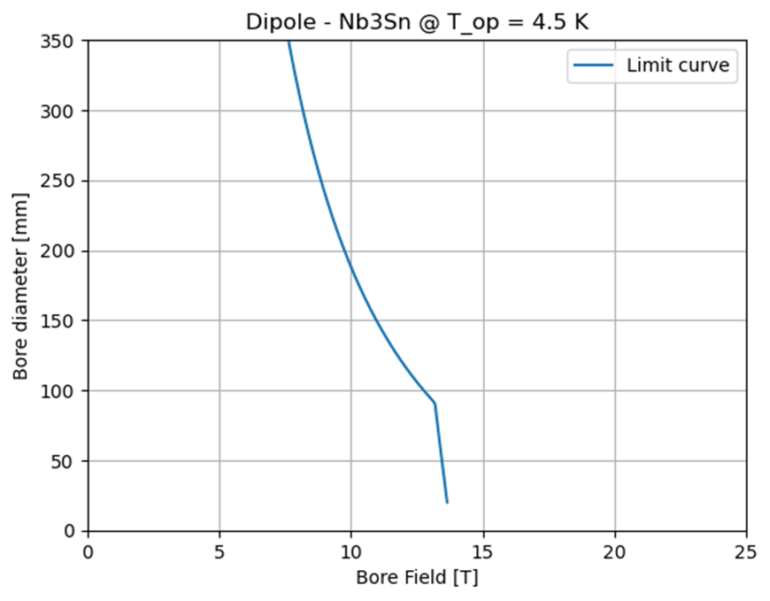
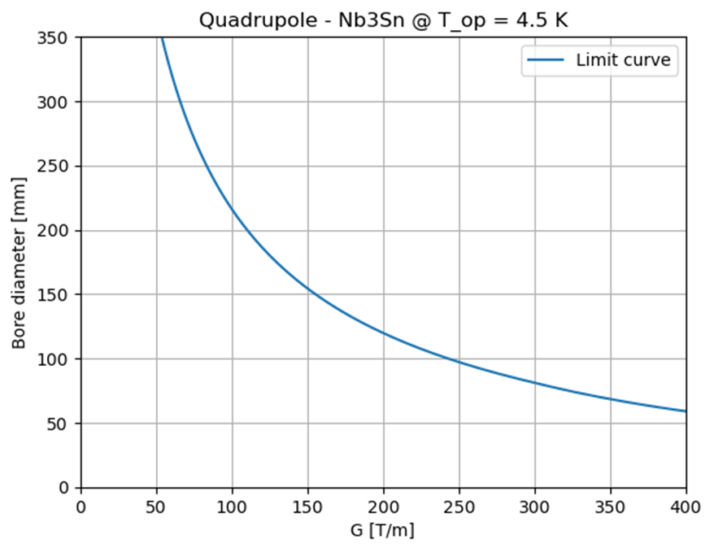
A-B plots for Nb₃Sn
DIPOLES
QUADRUPOLES
Final Focusing: (v 0.8)
  8.1 T, 320 mm
  9.7 T, 320 mm
Arc: (v 0.7)
  16 T, 160 mm
  (140mm @ 20K)
Final Focusing: (v 0.8)
  85 T/m, 280 mm
  85 T/m, 266 mm
  115 T/m, 290 mm
  205 T/m, 204 mm
  242 T/m, 172 mm
  300 T/m, 140 mm
Summary of magnet assumptions:
Single sector coil quadrupole
Maximum stress: 150 MPa
FCC design target cable for the J_{c} fit
Filling factor SC of 0.3
Protection with quench heater
Maximum coil width: 80 mm
The white area is the allowed design space where all constraints of the magnet are satisfied.
The limit curve is an ensemble of the many technological limitations taken into consideration to make the magnet design realistic [ref].
For the 10 TeV and 10 km collider, Nb₃Sn falls short of required performance.
Summary of cost assumptions:
We use the Nb3Sn aspirational cost 700 EUR/kg (from FCC)
  Today’s price is around 2500 EUR/kg
The starting budget of 400 kEUR/m is roughly double the estimate given by the FCC cost model for each magnet.
  In principle, we can assume a higher budget for each magnet than FCC because we have a smaller circumference and less magnets.
Cryogenic, protection and shielding costs are not taken into account.
Nb3Sn not suitable technology for the 10 TeV collider
Notes:
J=3.5 10^8 A/m2

Slide 6
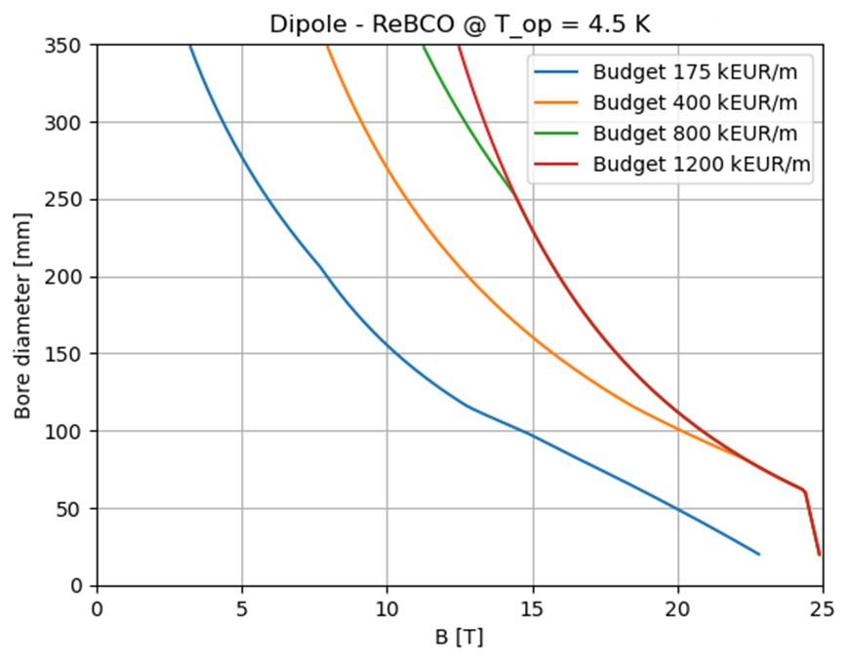
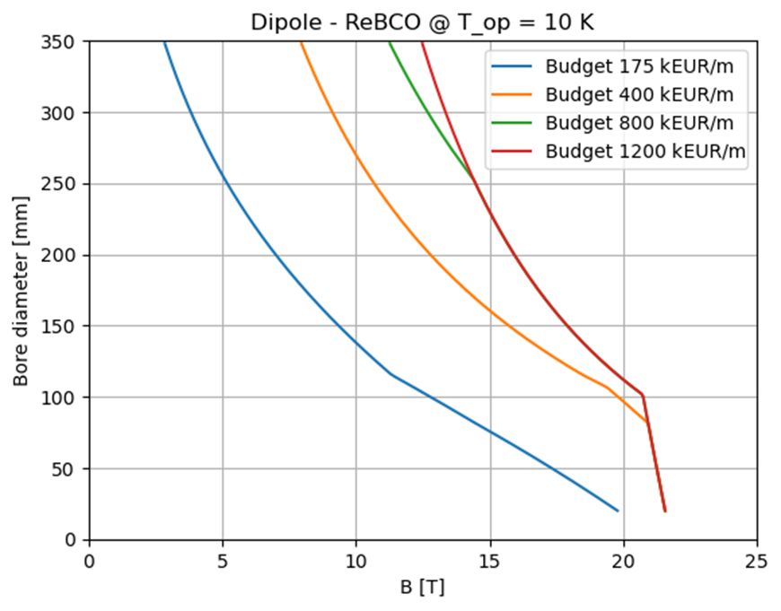
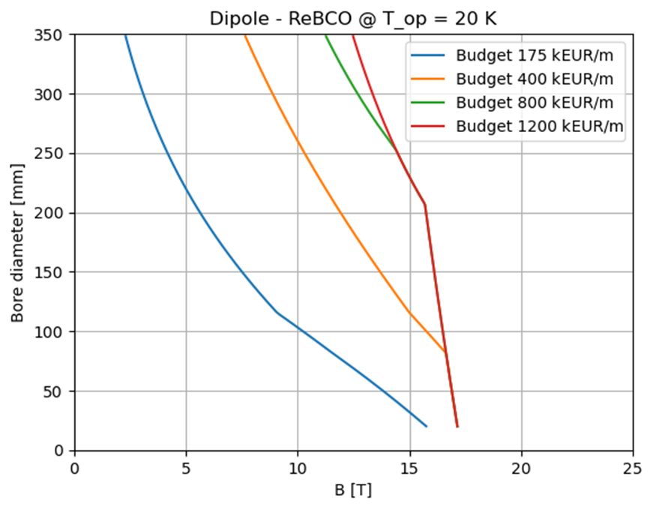
A-B plots for HTS dipole
Summary of cost assumptions:
We use the ReBCO’s aspirational cost 2500 EUR/kg
  Today’s price is around 8000 EUR/kg
The starting budget of 175 kEUR/m for each magnet is taken from the FCC cost model
  We can assume a higher budget than FCC because we have a smaller circumference and less magnets.
Cryogenic, protection and shielding costs are not taken into account.
Summary of assumptions:
Single sector coil dipole
Maximum stress: 400 MPa
Fujikura Tape for the J_{c} fit
Filling factor SC of 0.011
Non-insulated or Metal-insulated cable
Maximum coil width: 80 mm
Final Focusing: (v 0.8)
  8.1 T, 320 mm
  9.7 T, 320 mm
Arc: (v 0.7)
  16 T, 160 mm
  (140mm @ 20K)
Notes:
J=3.5 10^8 A/m2

Slide 7
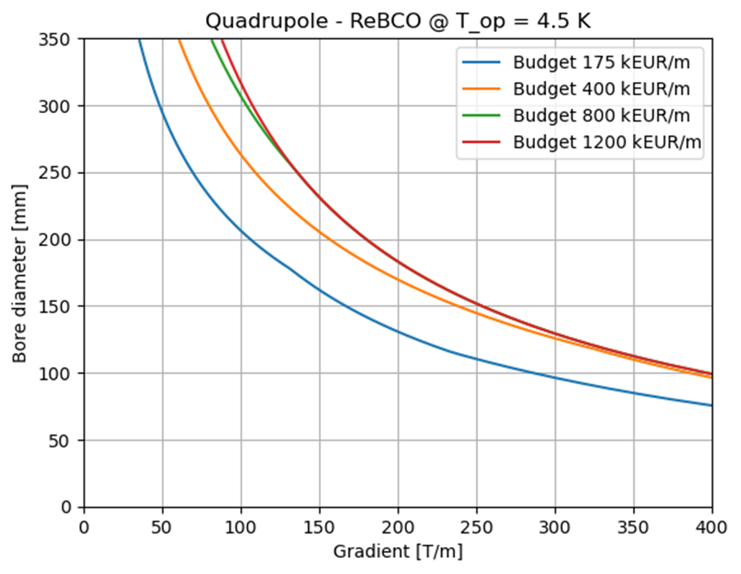
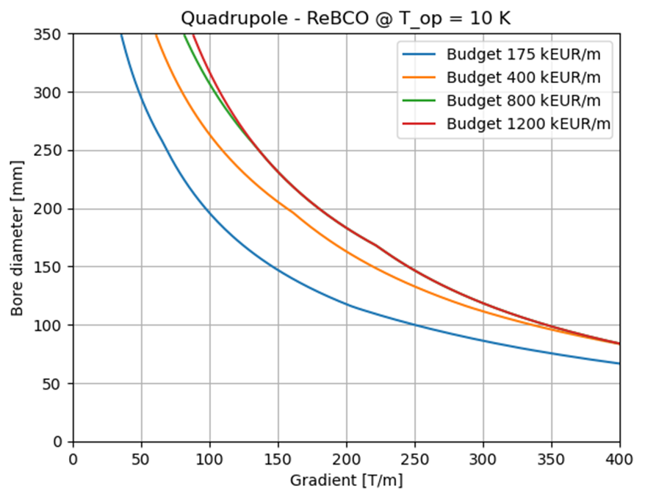
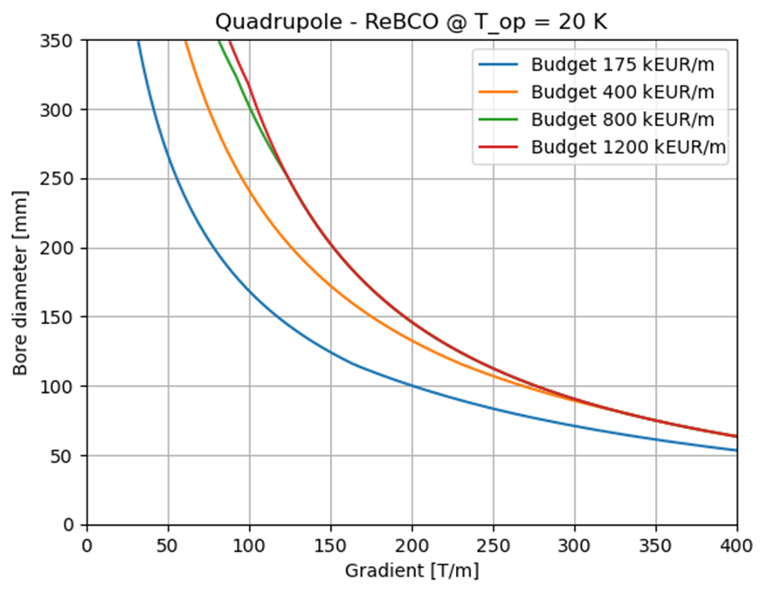
A-B plots for HTS quadrupole
Summary of cost assumptions:
We use the ReBCO’s aspirational cost 2500 EUR/kg
  Today’s price is around 8000 EUR/kg
The starting budget of 175 kEUR/m for each magnet is taken from the FCC cost model
  We can assume a higher budget than FCC because we have a smaller circumference and less magnets.
Cryogenic, protection and shielding costs are not taken into account.
Summary of assumptions:
Single sector coil quadrupole
Maximum stress: 400 MPa
Fujikura Tape for the J_{c} fit
Filling factor SC of 0.011
Non-insulated or Metal-insulated cable
Maximum coil width: 80 mm
Final Focusing: (v 0.8)
  85 T/m, 280 mm
  85 T/m, 266 mm
  115 T/m, 290 mm
  205 T/m, 204 mm
  242 T/m, 172 mm
  300 T/m, 140 mm
Notes:
J=3.5 10^8 A/m2

Slide 8
Final Consideration
With a proper revision of the optics , 400 kEur/m can be considered a credible maximum budget for the ARC dipoles and quadrupoles ( assuming as baseline HTS @ 20 K).
For the IR magnets, a budget of 800 kEur/m must be taken into account, together with a lower working temperature (T<10 K), which can be estimated more accurately only when the revised optics will be available.
Notes:
J=3.5 10^8 A/m2

Slide 9
Thank you for your attention

Slide 11

Cost Estimate (3TeV)
Dipoles of the arc for the series production
(quadrupoles and IR not included)
  11T /158 mm (Nb₃Sn)
€/kg iron | €/kg struct | €/kg conductor *
8 | 10 | 700
* 7€/kAm, FCC target 5€/kAm
Iron [Kg/m] | Structure [kg/m] | Coil [kg/m]
6587 | 450 | 223
Iron cost [k€/m] | Structure cost [ k€/m] | Coil cost [k€/m]
53 | 4.5 | 156
Tot. Material = (C_{iron}+ C_{struct})*f_{struct}
f_{struct} = 1.5
Tot. Material k€/m | 84 | 30%
Tot. Assembly k€/m | 40 | 14%
Tot. Conductor k€/m | 156 | 56%
Tot. Cost k€/m | 280
R_{bore}= 79 mm
w_{coil}= 80 mm
w_{struct}= 50 mm
w_{iron}=350 mm
200 k€/magnet ( $\sim$2FTE)
Coordination, design and follow-up: 4 FTE x 4 years= 16 FTE-years (1.6 MEur)
TOTAL COST: 6.7% O.M.B. (overall magnets budget)
Disclaimer: cryostat, specific tooling (e.g. oven for thermal treatment of Nb3Sn) W absorber not taken into account
Notes:
J= 3 e8

Slide 12
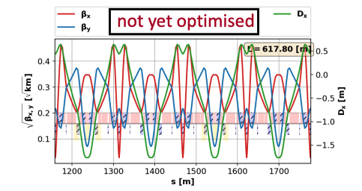
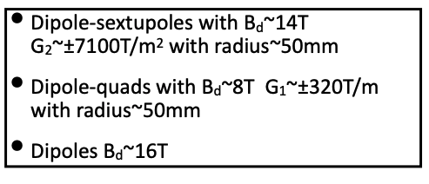
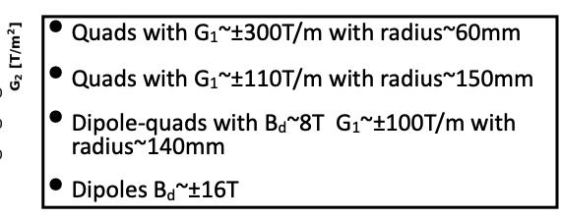
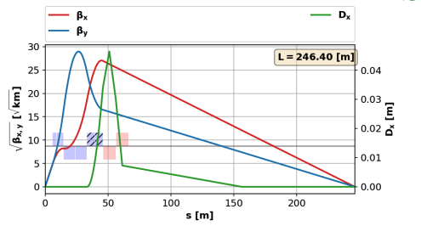
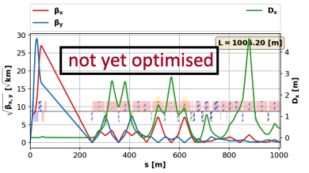
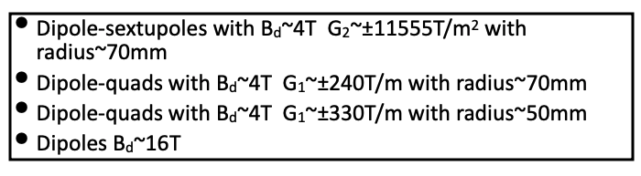
Magnet requirements for Lattice
10TeV collider[ref] - preliminary
ARC
Final Focusing
Chromatic correction
Courtesy of Kyriakos Skoufaris
Several magnet typology needed (dip, quad, combined, etc) , but optimization & definition of requirements still on going

Slide 13
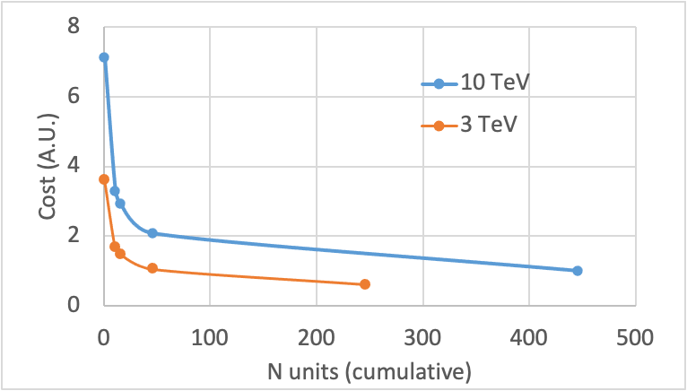

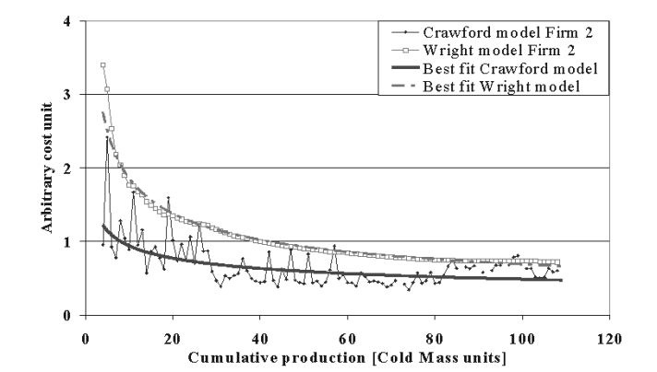
Cost reduction learning curve
How to rescale for the other steps (pre-series, prototypes, short models, demonstrators)?
Learning curve
Wright's law
b: learning percentage
Applied to LHC magnets works perfectly! [ref]
 | 3 TeV |  | 10 TeV
 | N units (cumulative) | cost (A.U.*) | N units (cumulative) | cost (A.U.*)
demostrator | 1 | 3.36 | 1 | 7.13
short model | 11 | 1.55 | 11 | 3.29
proto | 16 | 1.38 | 16 | 2.92
pre series | 46 | 0.98 | 46 | 2.08
series | 246 | 0.57 | 446 | 1.00
b=0.8
*w.r.t. cost of 10 TeV series magnet

Slide 14
Cost Estimate (3TeV)
Pre-series
Prototypes
Iron cost [k€/m] | Structure cost [ k€/m] | Coil cost [k€/m]
91 | 8 | 269
Iron cost [k€/m] | Structure cost [ k€/m] | Coil cost [k€/m]
127 | 11 | 377
Tot. Material k€/m | 144 | 30%
Tot. Assembly k€/m | 69 | 14%
Tot. Conductor k€/m | 269 | 56%
Tot. Cost k€/m | 481
Tot. Material k€/m | 201 | 30%
Tot. Assembly k€/m | 96 | 14%
Tot. Conductor k€/m | 377 | 56%
Tot. Cost k€/m | 674
N units | length [m] | N years | cost FTE-y [k€] | Total cost [o.m.b*]
90 | 5 | 4 | 1600 | 1.70%
N units | length [m] | N years | cost FTE-y [k€] | Total cost [o.m.b*]
5 | 5 | 5 | 2000 | 0.15%
Short Models
Demonstrators
Iron cost [k€/m] | Structure cost [ k€/m] | Coil cost [k€/m]
143 | 12 | 425
Iron cost [k€/m] | Structure cost [ k€/m] | Coil cost [k€/m]
310 | 27 | 919
Tot. Material k€/m | 227 | 30%
Tot. Assembly k€/m | 109 | 14%
Tot. Conductor k€/m | 425 | 56%
Tot. Cost k€/m | 761
Tot. Material k€/m | 491 | 30%
Tot. Assembly k€/m | 235 | 14%
Tot. Conductor k€/m | 919 | 56%
Tot. Cost k€/m | 1645
N units | length [m] | N years | cost FTE-y [k€] | Total cost [o.m.b*]
10 | 1.5 | 6 | 3000 | 0.11%
N units | length [m] | N years | cost FTE-y [k€] | Total cost [o.m.b*]
1 | 1.5 | 4 | 12000 | 0.03%
*overall magnets bugdet

Slide 15
Cost Estimate (10TeV)
Pre-series
Prototypes
Iron cost [k€/m] | Structure cost [ k€/m] | Coil cost [k€/m]
75 | 4.3 | 633
Iron cost [k€/m] | Structure cost [ k€/m] | Coil cost [k€/m]
105 | 6.1 | 888
Tot. Material k€/m | 116 | 15%
Tot. Assembly k€/m | 42 | 5%
Tot. Conductor k€/m | 632 | 80%
Tot. Cost k€/m | 790
Tot. Material k€/m | 163 | 15%
Tot. Assembly k€/m | 58 | 5%
Tot. Conductor k€/m | 888 | 80%
Tot. Cost k€/m | 1109
N units | length [m] | N years | cost FTE-y [k€] | Total cost [o.m.b*]
90 | 5 | 4 | 1600 | 2.80%
N units | length [m] | N years | cost FTE-y [k€] | Total cost [o.m.b*]
5 | 5 | 5 | 2000 | 0.24%
Short Models
Demonstrators
Iron cost [k€/m] | Structure cost [ k€/m] | Coil cost [k€/m]
119 | 7 | 1000
Tot. Structure k€/m | 185 | 15%
Iron cost [k€/m] | Structure cost [ k€/m] | Coil cost [k€/m]
257 | 15 | 2168
Tot. Material k€/m | 183 | 15%
Tot. Assembly k€/m | 66 | 5%
Tot. Conductor k€/m | 1000 | 80%
Tot. Cost k€/m | 1250
Tot. Material k€/m | 397 | 15%
Tot. Assembly k€/m | 143 | 5%
Tot. Conductor k€/m | 2168 | 80%
Tot. Cost k€/m | 2708
N units | length [m] | N years | cost FTE-y [k€] | Total cost [o.m.b*]
10 | 1.5 | 8 | 4000 | 0.18%
N units | length [m] | N years | cost FTE-y [k€] | Total cost [o.m.b*]
1 | 1.5 | 6 | 24000 | 0.05%
*overall magnets bugdet

Slide 16
Tentative Schedule (3 TeV collider)
  ARC DIPOLES 11T/158mm
  (quadrupoles and IR still not included)
  Initial proposal
R&D and
demonstrators
3 years
demonstrator
Models
Prototypes
Pre-series
Series
 | 2025 | 2026 | 2027 | 2028 | 2029 | 2030 | 2031 | 2032 | 2033 | 2034 | 2035 | 2036 | 2037
5 years
models
Aggressive time schedule, 13 years from R&D to end of construction
4 years
full length prototypes
3 years
3x90 dipole magnets
4 years
3x200 dipole magnets
  Revised proposal
+ 4 years
R&D and
demonstrators
4 years (+1)
Models
Prototypes
Pre-series
Series
 | 2025 | 2026 | 2027 | 2028 | 2029 | 2030 | 2031 | 2032 | 2033 | 2034 | 2035 | 2036 | 2037 | 2038 | 2039 | 2040 | 2041
demonstrator (1)
6 years (+ 1)
models (10)
17 years from R&D to end of construction
5 years (+ 1)
full length prototypes (5)
4 years (+ 1)
3x30 dipole magnets
4 years
3x200 dipole
magnets
Nb3Sn demonstrator program $\sim$ 6 years
LHC: 13 short models in 11 years, 6 prototypes in 4 years, pre-series 4 years, series 4 years

Slide 17
Tentative Schedule (10 TeV collider)
  ARC DIPOLES 15T/138 mm
  (quadrupoles and IR still not included)
  Initial proposal
Specifications and concept development
23 years from R&D to end of construction
3 years
Models
Prototypes
Pre-series
Series
 | 2025 | 2026 | 2027 | 2028 | 2029 | 2030 | 2031 | 2032 | 2033 | 2034 | 2035 | 2036 | 2037 | 2038 | 2039 | 2040 | 2041 | 2042 | 2043 | 2044 | 2045 | 2046 | 2047
R&D and demonstrators
5 years
demonstrator
7 years
models
6 years
full length prototypes
3 years
3x30 dipole magnets
5 years
3x400 dipole magnets
+3 years
  Revised proposal
Specifications and concept development
4 years (+1)
R&D and demonstrators
Models
Prototypes
Pre-series
Series
 | 2025 | 2026 | 2027 | 2028 | 2029 | 2030 | 2031 | 2032 | 2033 | 2034 | 2035 | 2036 | 2037 | 2038 | 2039 | 2040 | 2041 | 2042 | 2043 | 2044 | 2045 | 2046 | 2047 | 2048 | 2049 | 2050
6 years (+1)
26 years from R&D to end of construction
demonstrator model ( 1 per concept)
8 years (+1)
models (10)
5 years (-1)
full length prototypes (5)
4 years (+1)
3x30 dipole magnets
4 years (-1)
3x400 dipole magnets
More emphasis on demonstrator and short model phase (REBCO or hybrid solutions still to be studied)

Slide 18
Tentative Schedule (3 TeV collider)
  ARC DIPOLES 11T/150mm
  (quadrupoles and IR still not included)
4 years
R&D and
demonstrators
Models
Prototypes
Pre-series
Series
 | 2025 | 2026 | 2027 | 2028 | 2029 | 2030 | 2031 | 2032 | 2033 | 2034 | 2035 | 2036 | 2037 | 2038 | 2039 | 2040 | 2041
4 FTE/y, 0.08 ‰ o.m.b.*
6 years
5 FTE/y, 0.19‰ o.m.b.*
5 years
4 FTE/y, 0.30‰o.m.b.*
4 years
4 FTE/y, 4.31 ‰ o.m.b.*
4 years
4 FTE/y,16.6 ‰ o.m.b.*
TOTAL: 8.67% o.m.b.*
*overall magnets bugdet

Slide 19
Tentative Schedule (10 TeV collider)
  ARC DIPOLES 15T/150 mm
  (quadrupoles and IR still not included)
4 years
Specifications and concept development
2 FTE/y, 0.016‰ o.m.b.*
R&D and demonstrators
Models
Prototypes
Pre-series
Series
 | 2025 | 2026 | 2027 | 2028 | 2029 | 2030 | 2031 | 2032 | 2033 | 2034 | 2035 | 2036 | 2037 | 2038 | 2039 | 2040 | 2041 | 2042 | 2043 | 2044 | 2045 | 2046 | 2047 | 2048 | 2049 | 2050
6 years
4 FTE/y, 0.09‰ o.m.b.*
8 years
5 FTE/y, 0.22‰ o.m.b.*
5 years
4 FTE/y, 0.47‰ o.m.b.*
4 years
4 FTE/y, 7.06‰ o.m.b.*
4 years
4 FTE/y, 47.5‰ o.m.b.*
TOTAL: 22.3% o.m.b.*
*overall magnets bugdet

Slide 20
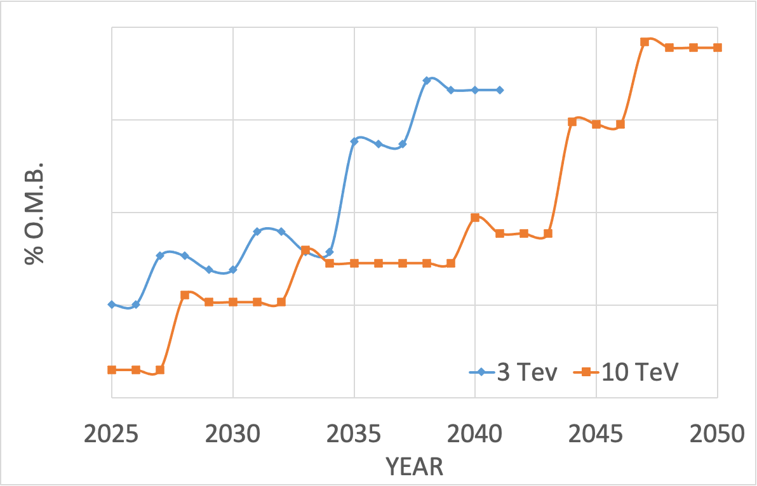
Cost Profile
8
0.8
0.08
0.008
*overall magnets bugdet

