Slide 1





Working with limited resources
Take-aways for CBI A³
Thinking exponentially, design for thinking
Better understand complexity in systems thinking
Some knowledge relating to water systems
What if
Net impact
Notes:
Abstraction of water solutions from context. FLIP, generating from scratch last week – intervening this week.

Slide 2

Using 2 x systems thinking frameworks
Opportunity Cards
Delving deeper into earth problem spaces

Slide 3
Expand system understanding of parts and their relationships
Purpose:
Create a foundation for new ideas that intervene and improve water systems from your opportunity cards
Take an “existing solution” you have identified.
Consider scale, hierarchy and consequence

Slide 4
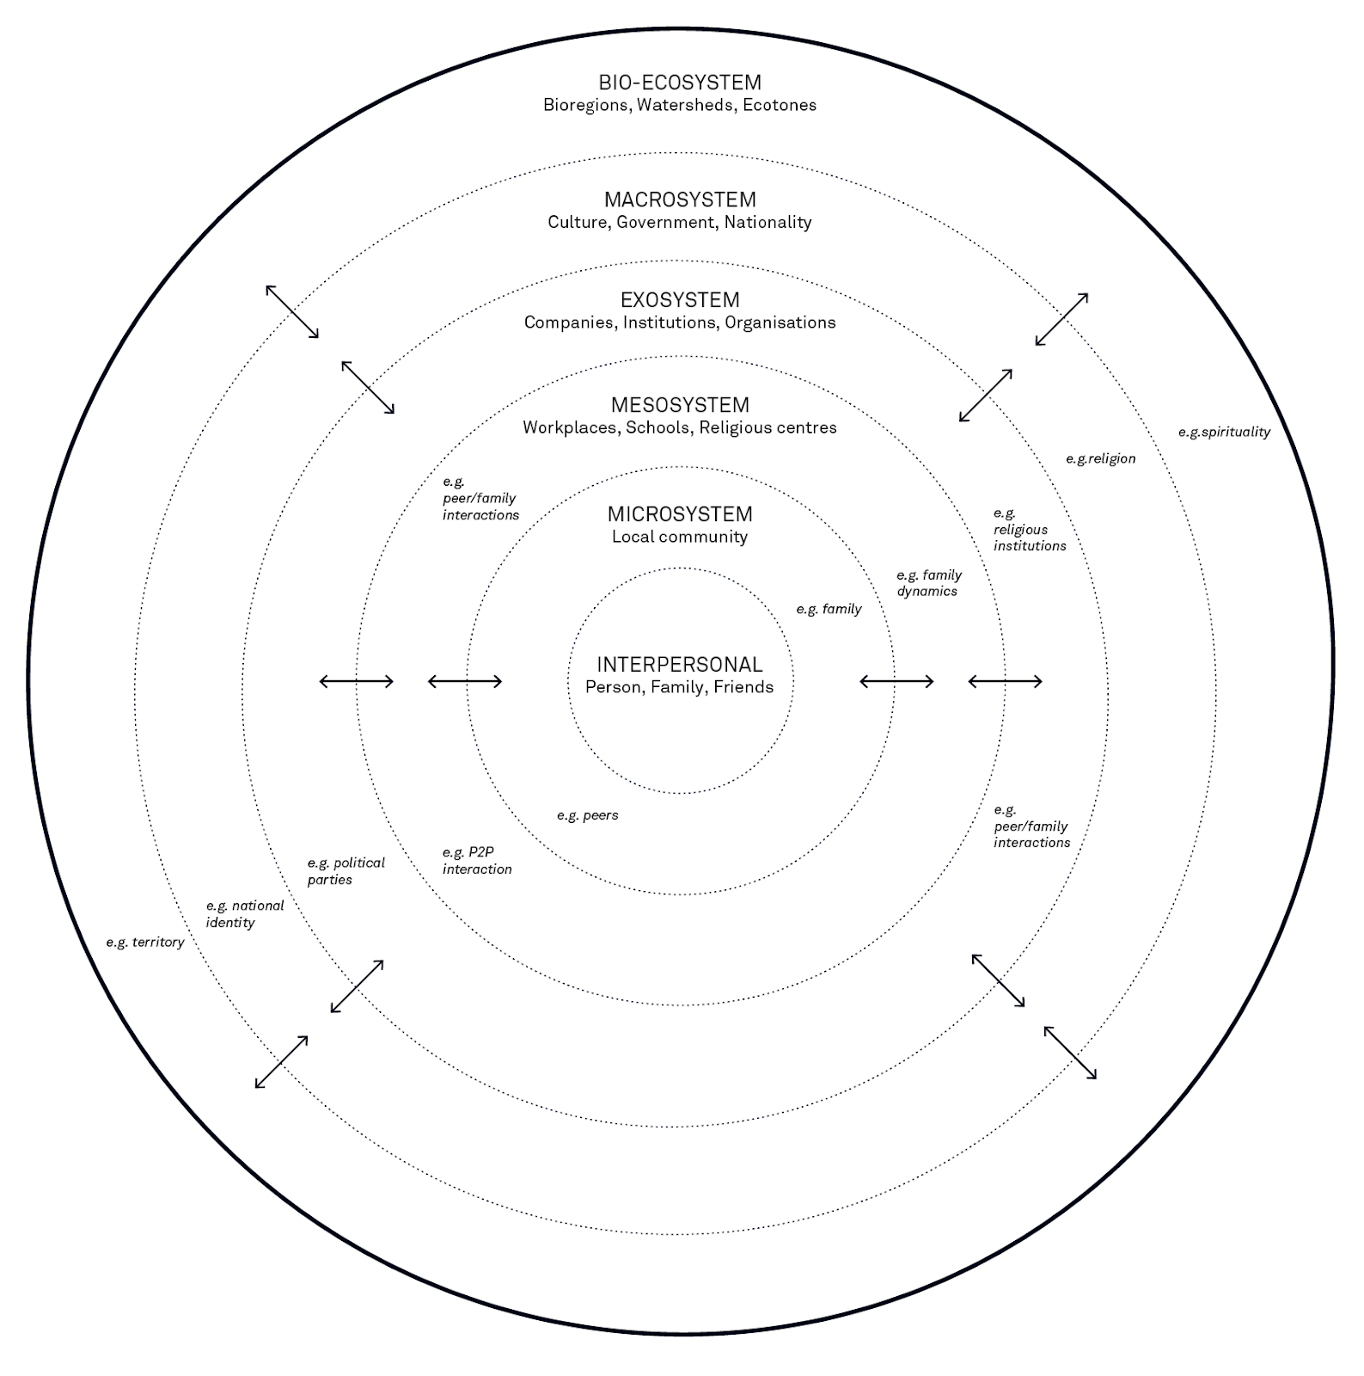
1. Social
Ecosystem
Map
Peter Jones & Kristel Van Ael
(2022)

Slide 5
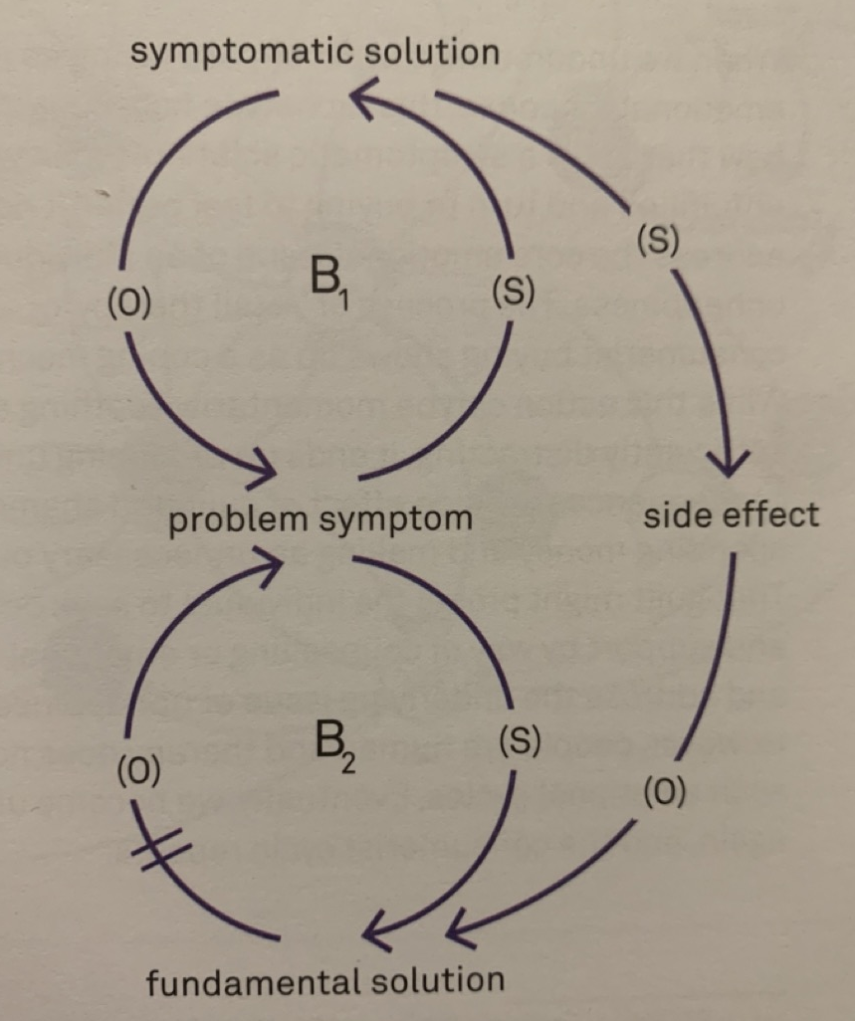
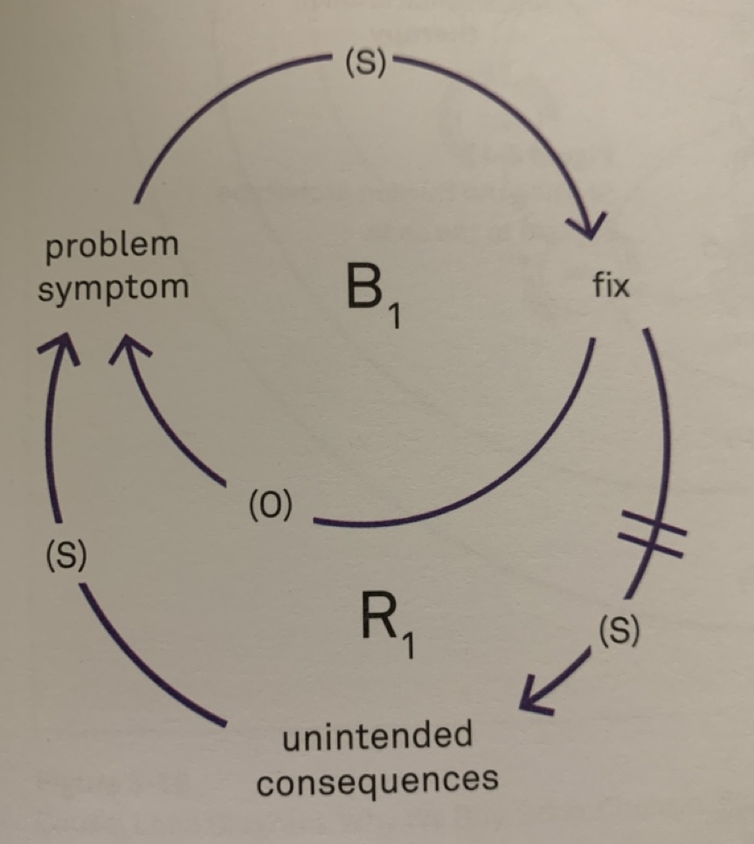
2. Causal
Loops
Peter Jones & Kristel Van Ael (2022)
Notes:
https://thesystemsthinker.com/causal-loop-construction-the-basics/

Slide 6
Add as many system parts as you can think of
Social Ecosystem mapping:
Choose 1 x card per person
Use the given template (individual exercise)
Use directional arrows to depict relationships across levels
Some levels may be more/less populated (ok, shows gaps!)

Slide 7
Interpersonal: Individual actors;
Microsystem: everyday social context in the geography and society - e.g. workplaces, neighborhoods;
Mesosystem: structured community and organizational settings - e.g. company structure, schools, the local community in a city;
Exosystem: companies, industry, healthcare institutions, municipal or regional government;
Macrosystem: national culture, political context, economy, factors influencing quality of life - e.g. information and media sources, population demographics;
Bio-ecosystem: natural environment - e.g. watersheds, health of flora and fauna, biodiversity, pollution effects;
‘force lines’ indicate relational dynamics within and across levels
Peter Jones & Kristel Van Ael (2022)

Slide 8

User journey and ethics (pick one key user from your card)
Inspire identifying more parts by considering:
the ecosystem map levels
the 5 x i2planet (rough) themes
Wellbeing & Health
Power (energy) needs
Water quality &/or hygiene
Construction & infrastructure
Image generated by ChaptGPT

Slide 9
2. Causal
Loops
Peter Jones & Kristel Van Ael (2022)
Notes:
https://thesystemsthinker.com/causal-loop-construction-the-basics/

Slide 10
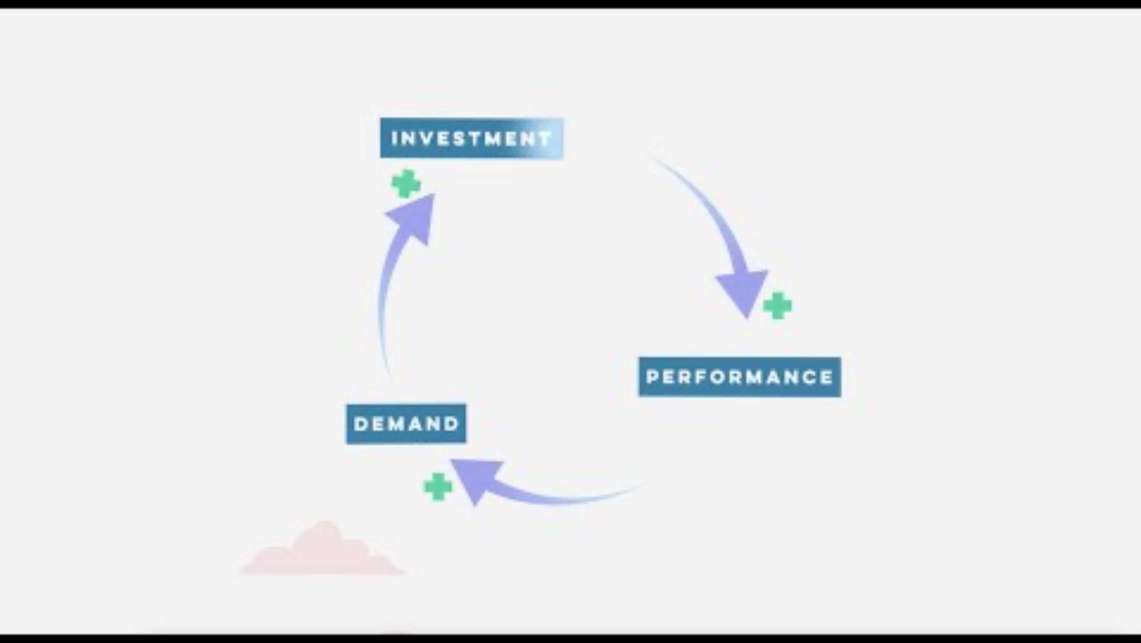
Notes:
Discuss examples. Unintended consequences or side effects. Limitations? Time, can get super, super complex and mis-reasoning or understanding of why. Doesn’t quantify in full.

Slide 11
Causal loop mapping:
Continue on the same 1 x card per person
Take an “existing solution” you have identified.
to better understand…
What levels & parts of the system does the solution intervene with?
Are there any side effects or unintended consequences?

Slide 12
Identify variables (descriptor that can increase or decrease)
Causal loop mapping:
Follow these steps:
What direction are the interconnecting relationships
+ or – flows.
Balanced or reinforcing?

