Slide 1
Introduction to prototyping
CBI A3
Dina Zimmermann
06.11.2024

Slide 2

What is a prototype?
“An approximation of the product along one or more dimensions of interest” (Ulrich & Eppinger, 2016)
“Any representation of a design idea, regardless of the medium” (Houde and Hill, 1997)
“A physical representation of your idea or project” (Dina, 2024)

Slide 3

Why do we prototype?
Exploration through action
Experimenting and learning by doing
Challenging assumptions
Investigate assumptions through building and testing, instead of theoretically thinking
Internal communication
Can make internal communication more focused
External communication
Tool to communicate, test and validate with externals
Creating serendipity
Create unplanned discoveries

Slide 4
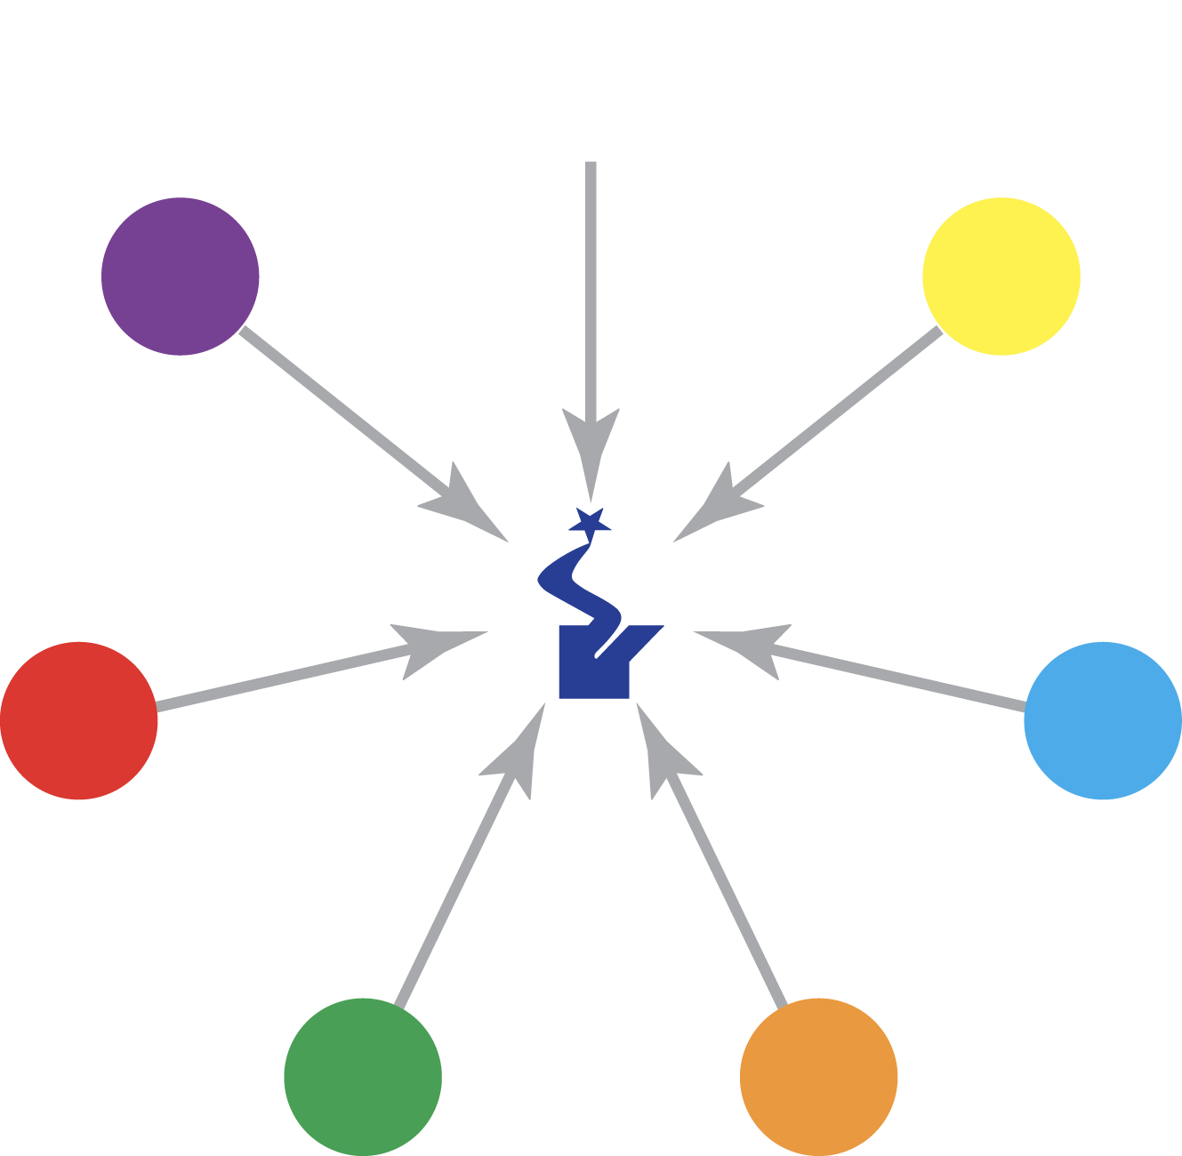
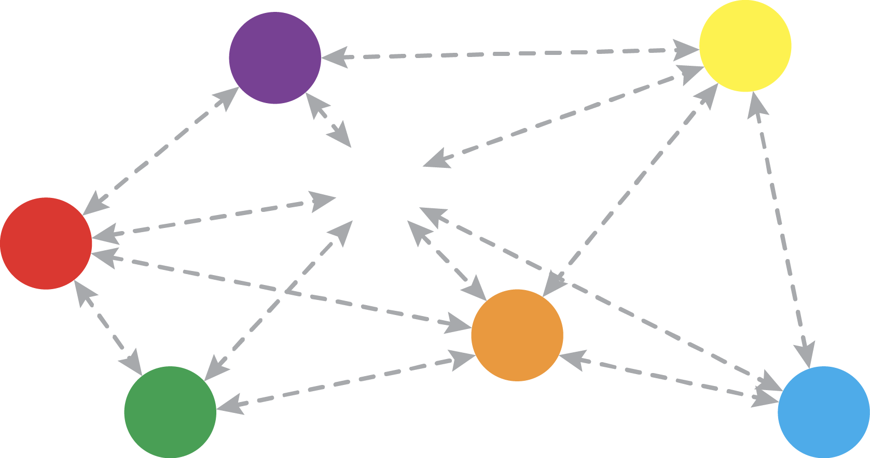
Internal communication
Notes:
Internal communication. Suddenly the team can discuss something physical in front of them and it forces the team to get on the same page.
Some of you might say ask – but why do we have to build a prototype? Why can’t we just make a drawing? It will have the same effect.
Well, then your teammate draws something like this and everyone is confused.

Slide 5
Why do we prototype?
Exploration through action
Experimenting and learning by doing
Challenging assumptions
Investigate assumptions through building and testing, instead of theoretically thinking
Internal communication
Can make internal communication more focused
External communication
Tool to communicate, test and validate with externals
Creating serendipity
Create unplanned discoveries

Slide 6
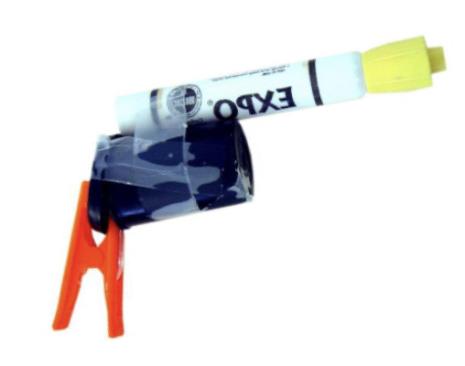
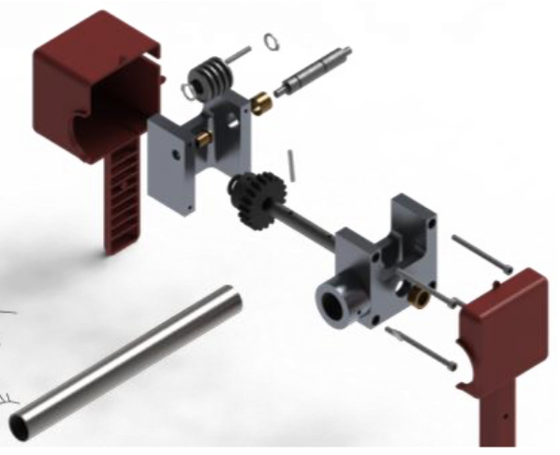
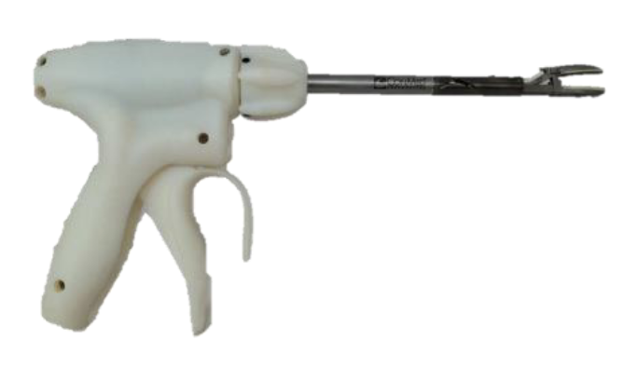
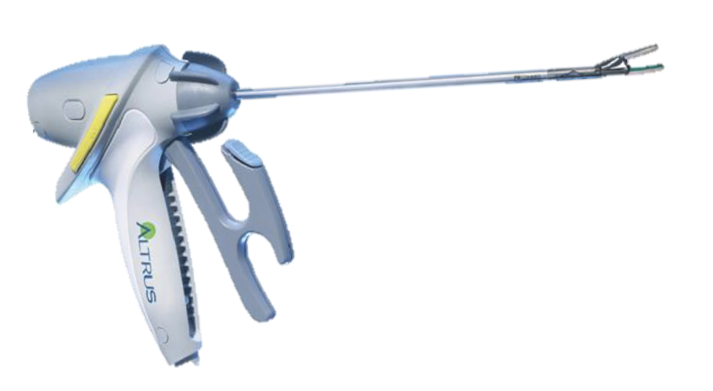
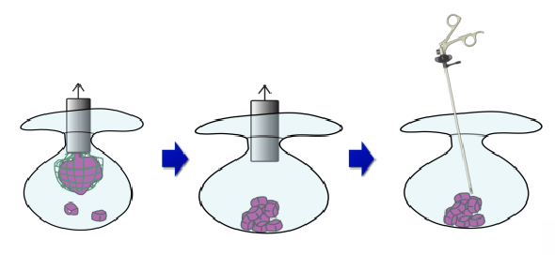
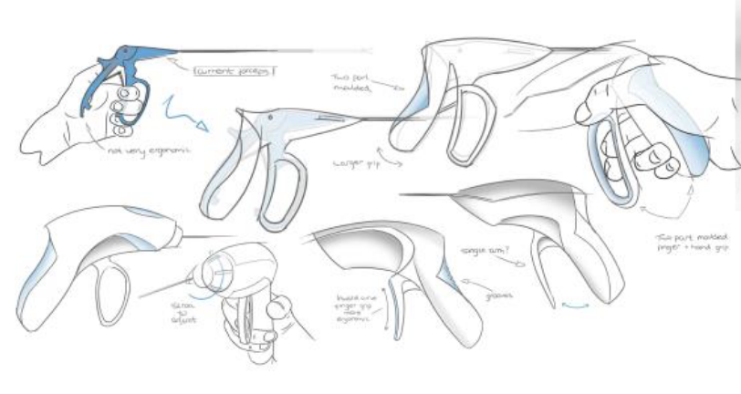
The fidelity of the prototype
Fidelity refers to how close a prototype is to the final product
Low fidelity
High fidelity
Concept
visualization
Sketching
Quick & dirty
mockup
3D model
Functional
Prototype
Pre-production
prototype
© Carlye Lauff, University of Colorado Boulder
Notes:
HOW to Prototype?
Fidelity refers to how close a prototype is to the final product
High-fidelity
Closer to the final product in terms of look, feel, and means of interaction
More expensive
Time consuming to build
Low-fidelity
• Simple design
• What ever materials are available • Can be tested immediately
• Cheap & Fast

Slide 7
Iteration
Build
Test
Repeat
Beginning of the week
End of the week

Slide 8



How to prototype
Anything that is interactive, collaborative and helps in communicating, testing and validation of ideas and sorting out potential problems
Prototypes can take many forms, and just about the only thing in common the various forms have is that they are all tangible forms of your idea
There are as many ways to prototype as you can imagine

Slide 9
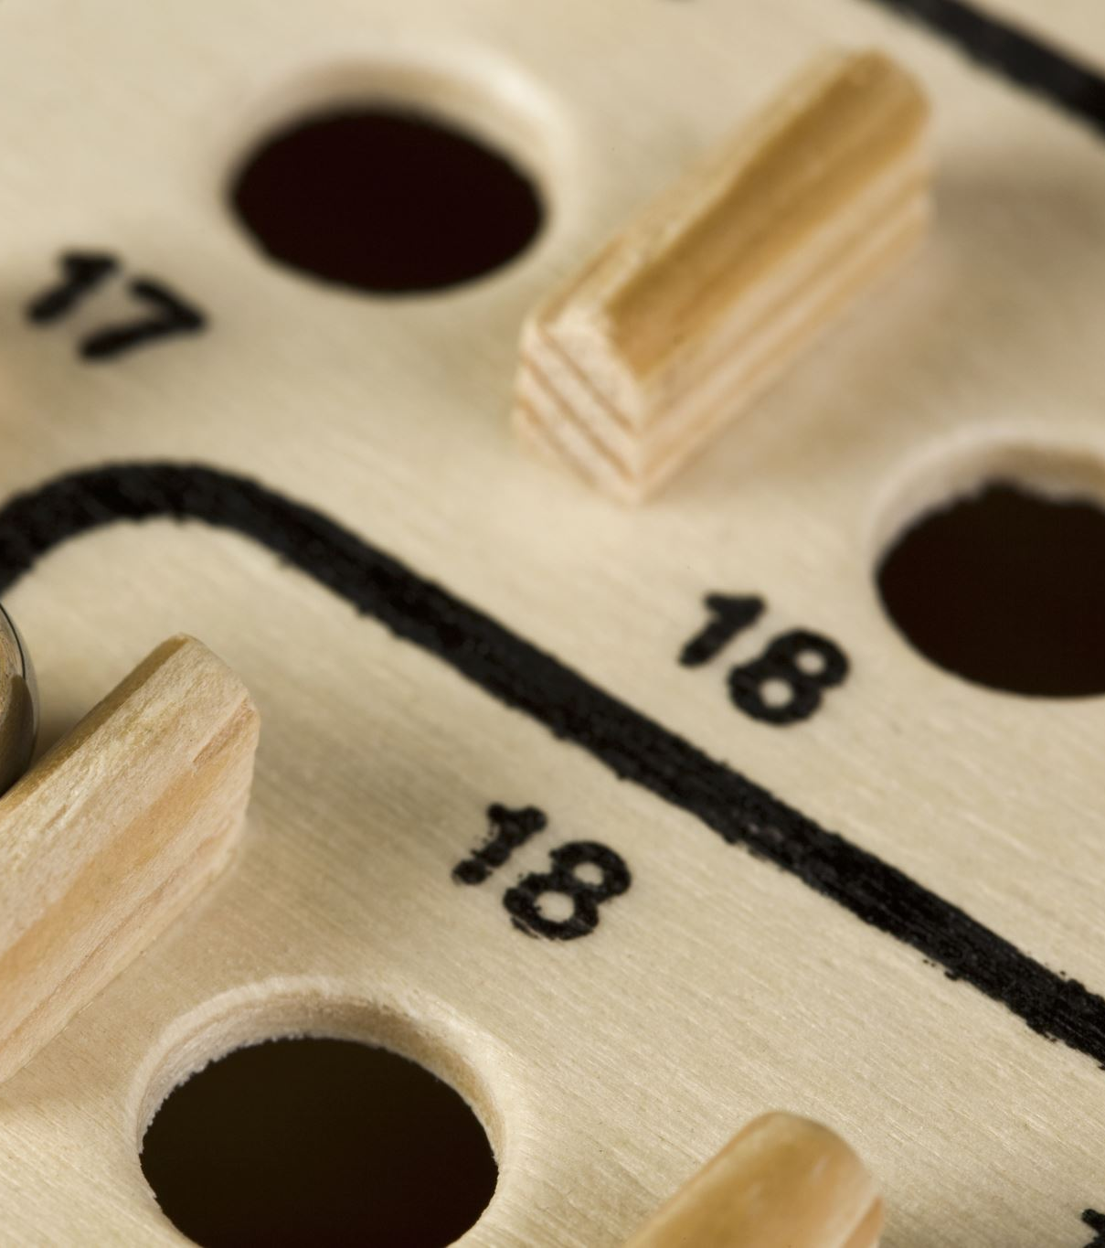
Types of prototypes
Dark Horse Prototype
Functional Prototype
Critical Prototype
Digital Prototype
Mechanical Prototype
Proof of Concept
Minimum Viable Product
Pre-Production Prototype
Role-Playing Prototype
Storyboard
Lego Prototype
Paper prototype
User-Driven Prototype
Wizard of Oz
Tabletop Prototyping
Part-X Is Finished Prototype

Slide 10
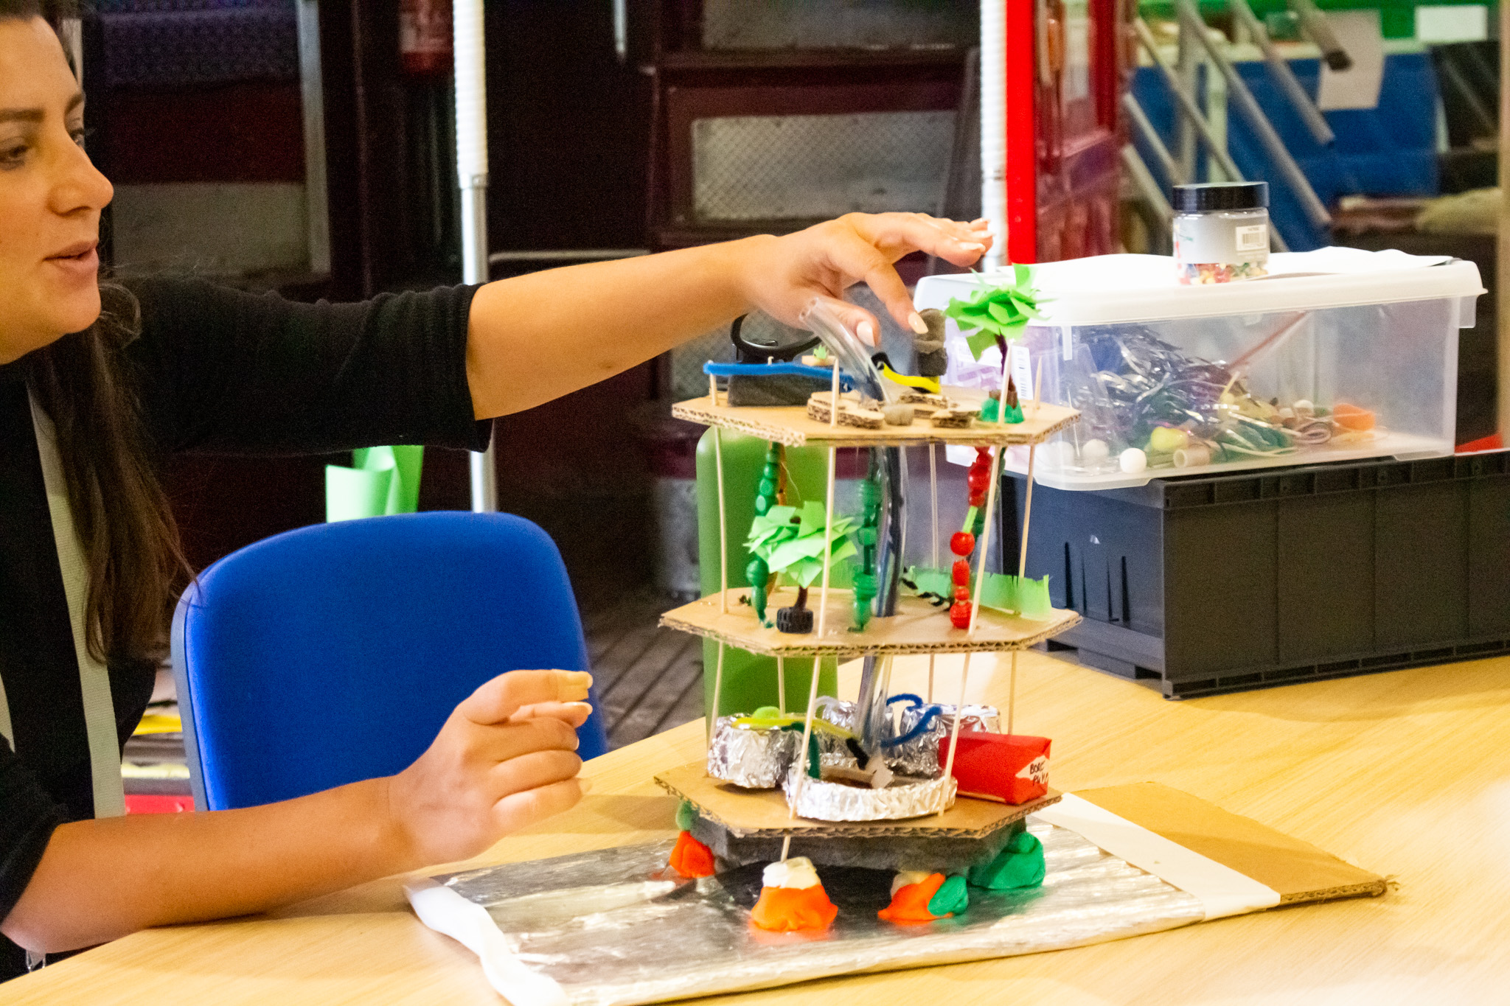
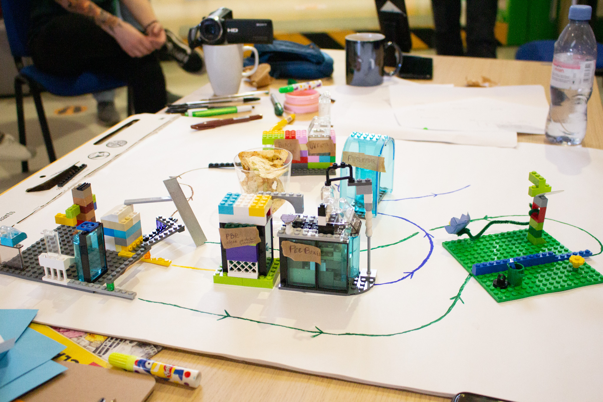

Systems

Slide 11
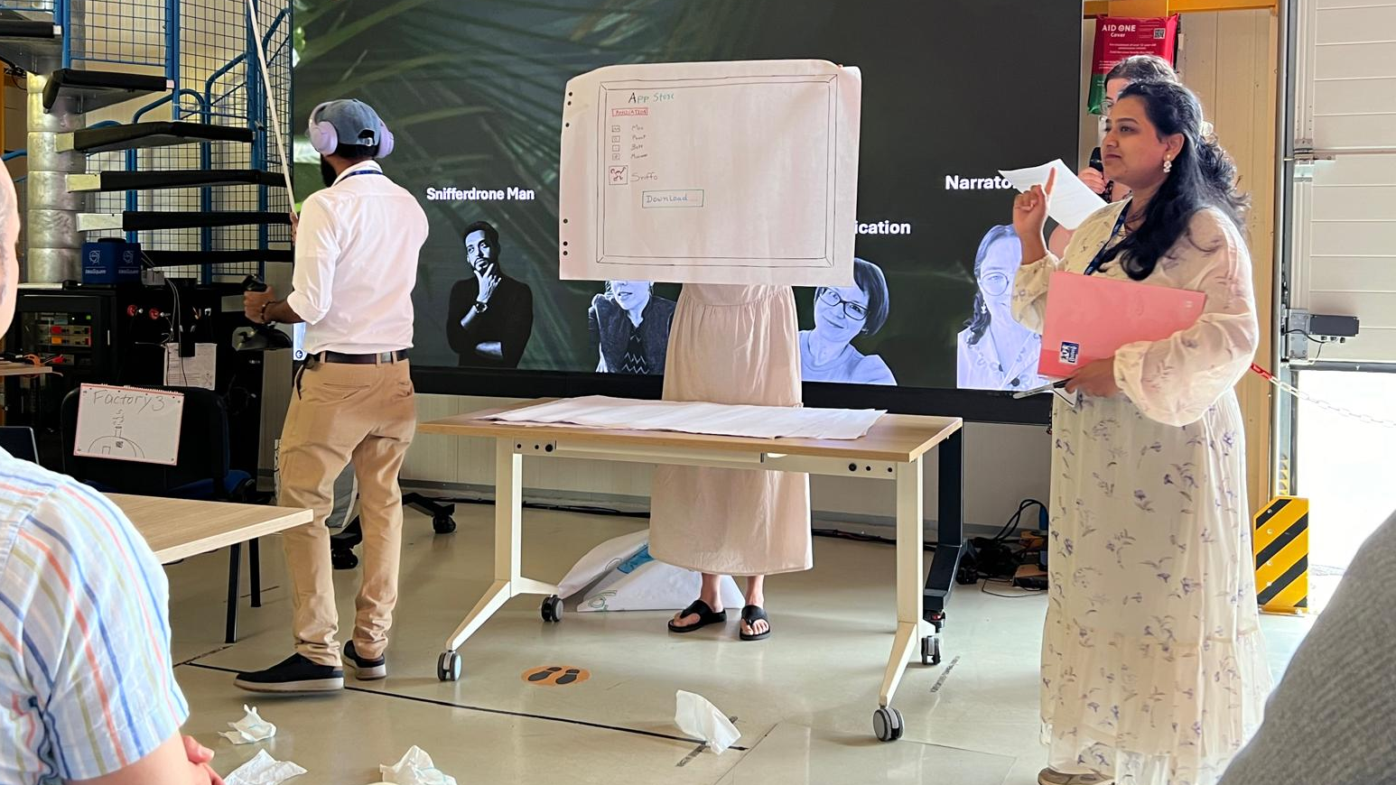
roleplay

Slide 12
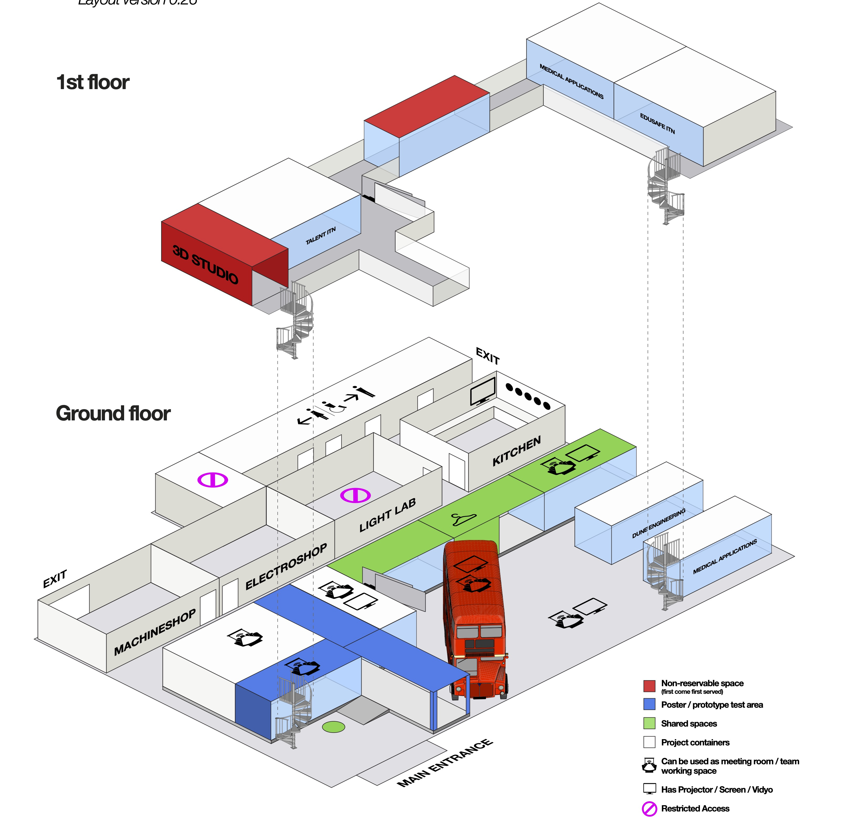

Slide 13
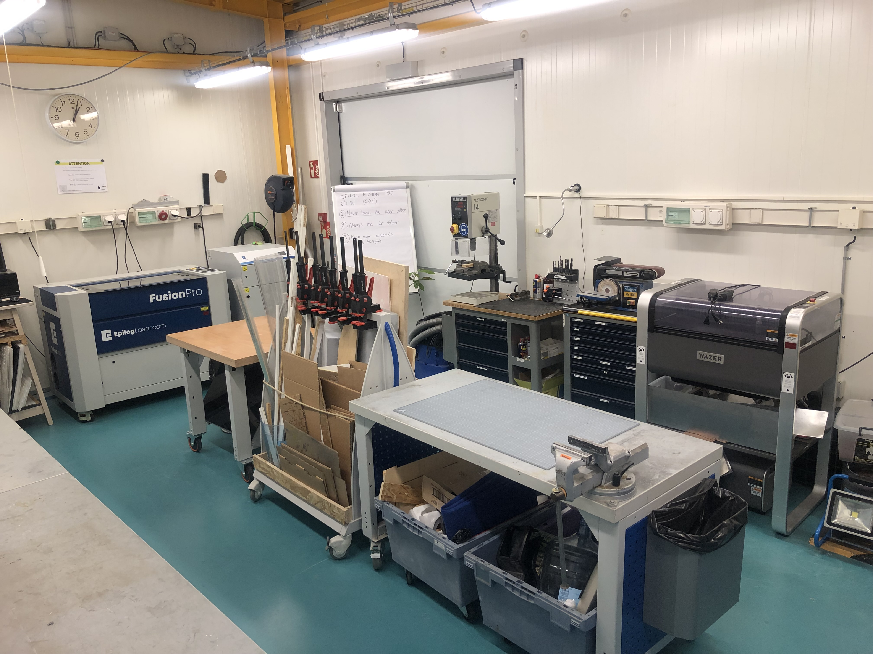
The Machine Shop

Slide 14
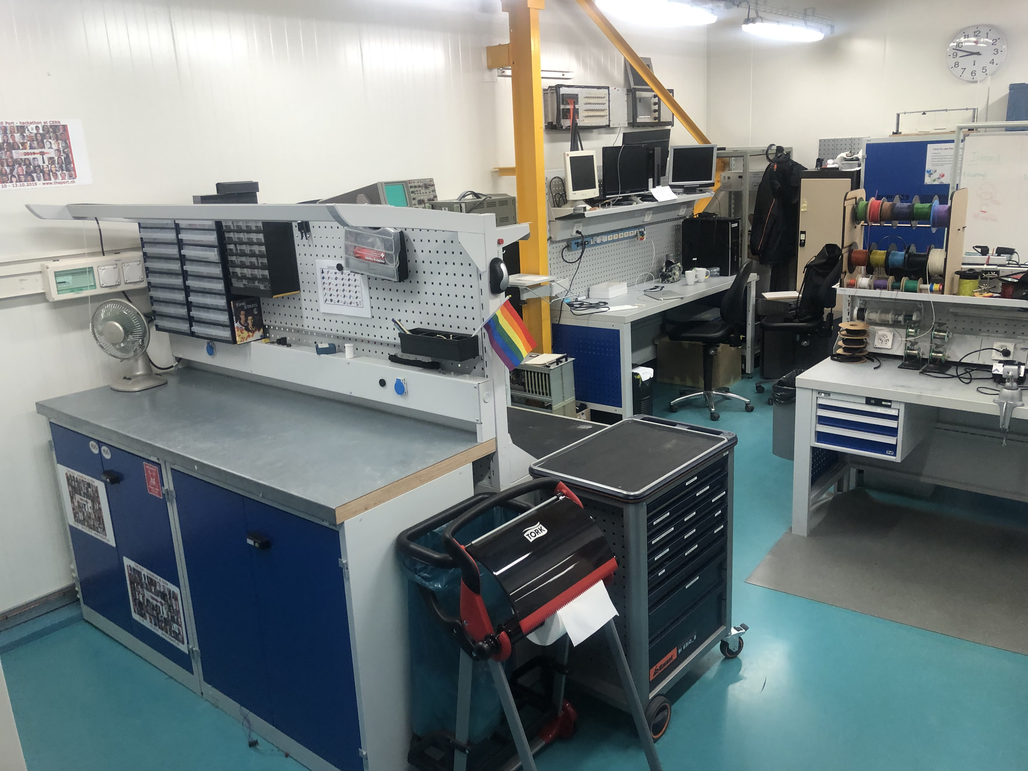
The Electro Shop

Slide 15
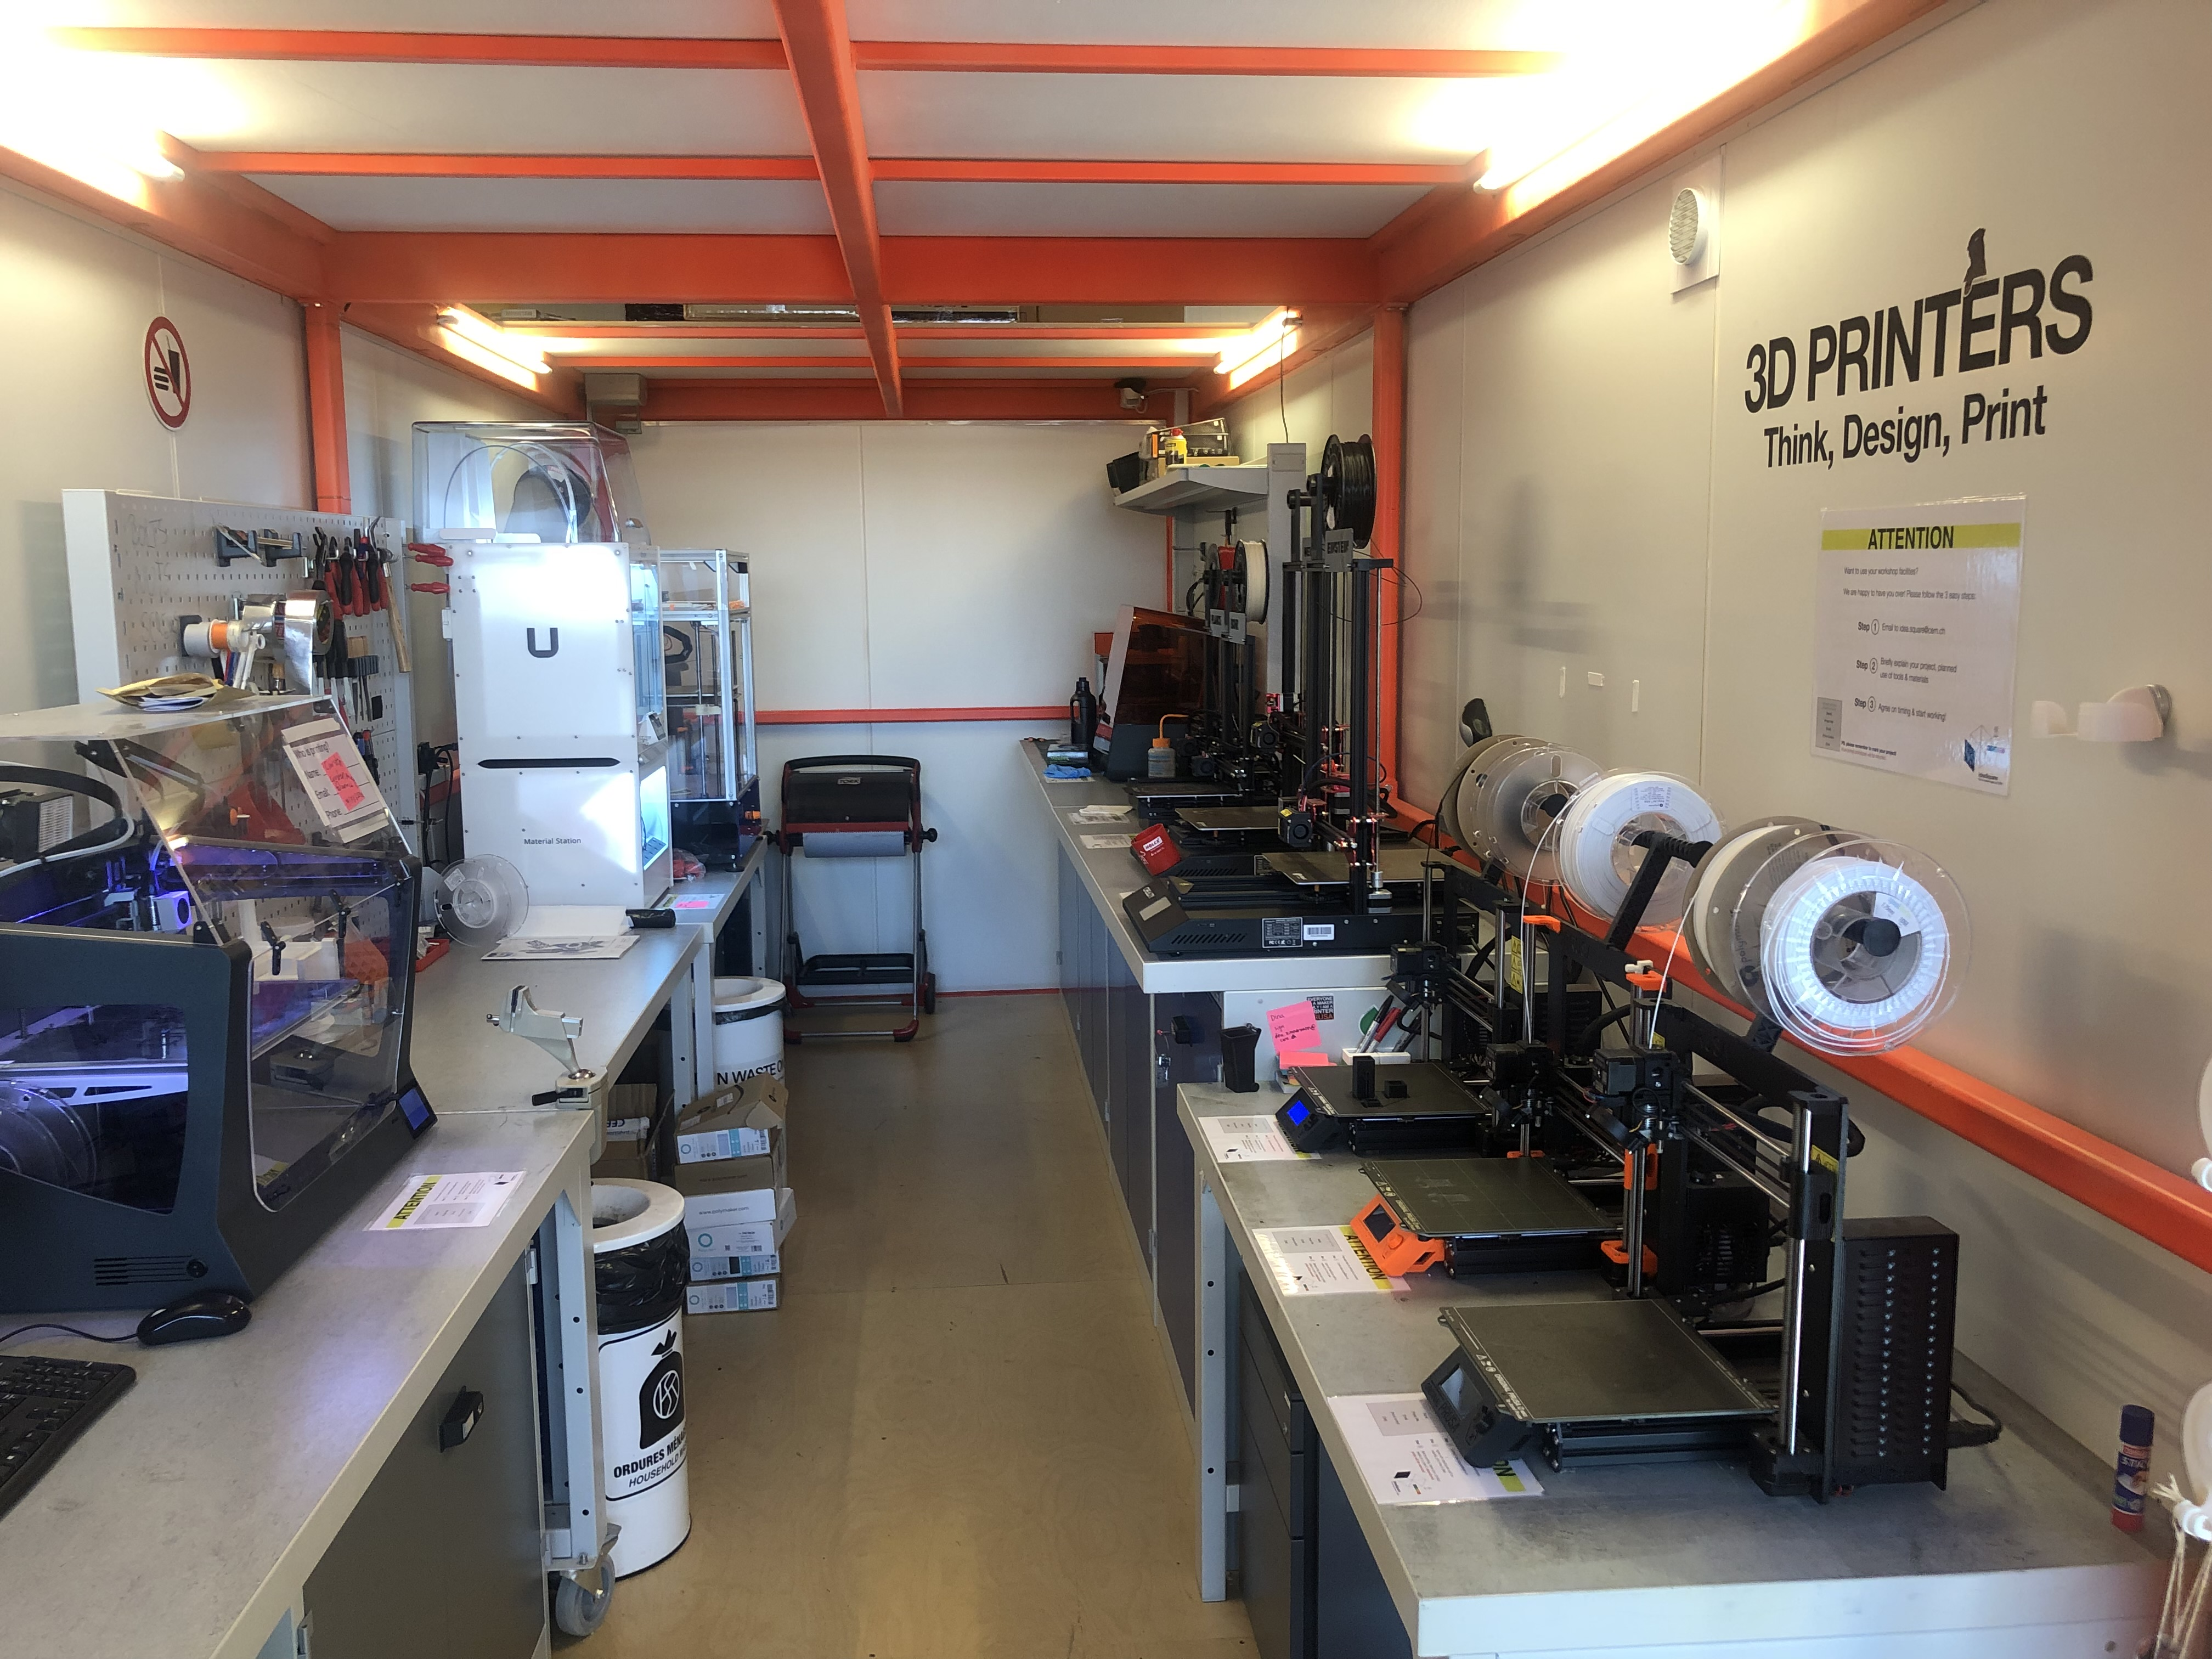
The 3D Studio

Slide 16
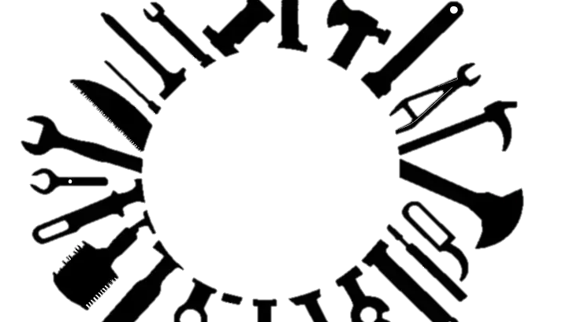

Prototyping charades

Slide 17





Mock-up
explain
Miming
Sketch

