Slide 1




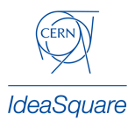
Drawing Inspiration from Futures
Notes:
We will cover some content around Futures – which is a key component of CBI A3. Stretch your thinking, make you

Slide 2
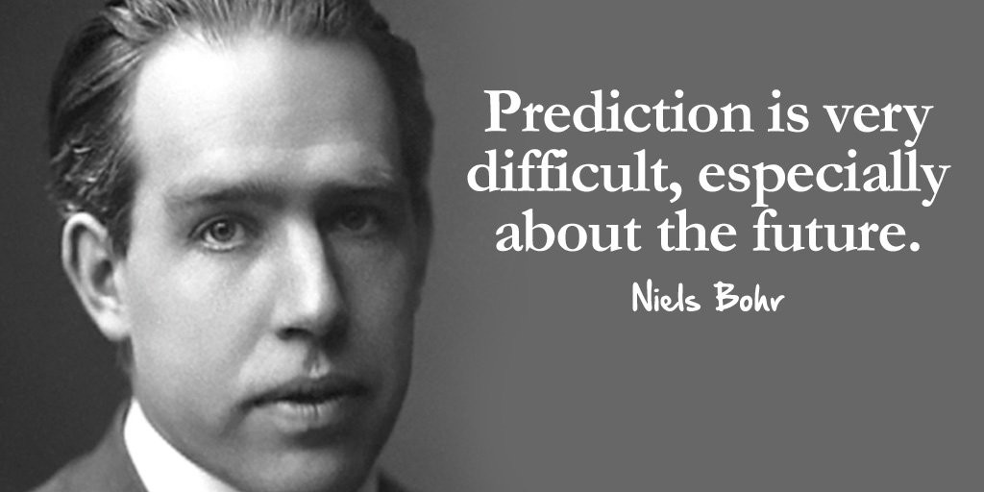

Slide 3
~30 years from now
What will you be doing?
Slides courtesy of Bridgette Engeler, Swinburne University
Notes:
Thought experiment. What will you be doing 30 years from now.

Slide 4
What were you doing in 1988?
Slides courtesy of Bridgette Engeler, Swinburne University

Slide 5
What were you doing in ~1988?
George HW Bush beat Michael Dukakis to be POTUSA.
Floppy disks were a thing (a few years on from Windows 1.0).
The Netherlands became the second country connected to the internet. (Australia still had a year to go.)
Table tennis became an Olympic sport.
Stephen Hawking released A Brief History of Time.
Photoshop shipped (and I mean shipped) its first software.
First World AIDS Day was held.
NASA climate scientist James Hansen used the term 'global warming' in testimony to the United States Congress.
The Morris worm was released, affecting about 10% of computers. It was the first worm to spread over the internet, and its author was the first convicted malware writer in history.
World Expo 88 in Brisbane.
In the US, CDs outsold vinyl records for the first time.
World Population was ~ 5,070,000,000 (~9 billion in 2048).
Slides courtesy of Bridgette Engeler, Swinburne University

Slide 6
And in 2058?
Poverty and hunger
Global crises
Technology
Health and disease
Planet, climate and environment
Research and exploration
Entertainment
Geopolitics
Human security
Slides courtesy of Bridgette Engeler, Swinburne University

Slide 7
And in 2058?
How old will you be?
Where will you live?
Who is your family? Your community?
Will you be working? What is work 30 years from now?
What does life look like?
What will you need?
What do you use as transport? What do you eat? Wear? Use?
How do you communicate?
Do we travel? Where?
How do we power our worlds?
Slides courtesy of Bridgette Engeler, Swinburne University

Slide 8
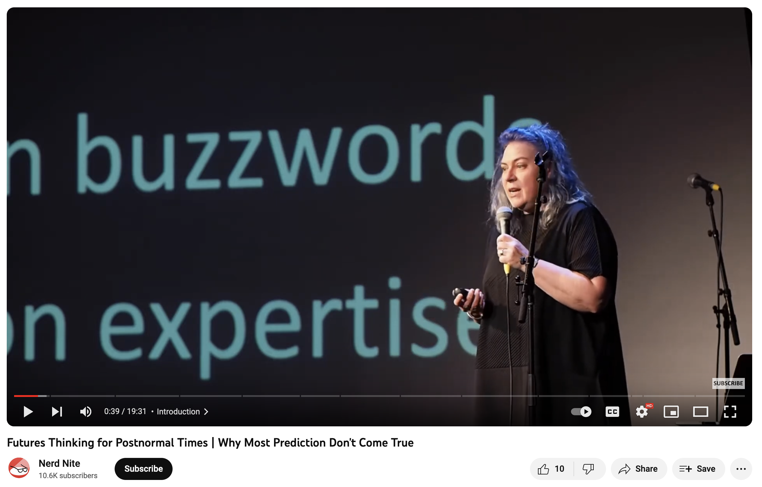
Opportunities vary by scenario – images of different futures
Depiction not prediction
There is no ‘one’ defined future.
The craziest ideas of the future are often the most useful.
Use different – longer – time horizons
https://www.youtube.com/watch?v=31fEmEEQmn8
Slides courtesy of Bridgette Engeler, Swinburne University

Slide 9

Notes:
Prediction is very difficult – expecialliy about the future.
Through foresight, instead of doing the impossible and predicting a single plausible future, we imagine different alternative scenarios of a sustainable EU in 2050. Imagining alternative paths towards 2050 helps us to draw up strategic areas of interventions to reach our goals in 2050.

Slide 10
X

Slide 11
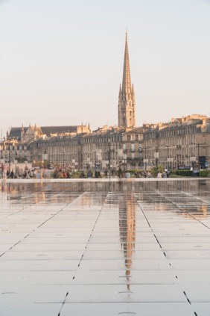
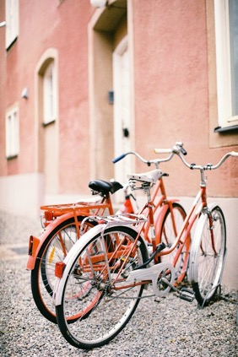
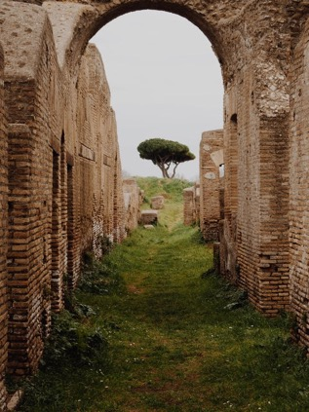
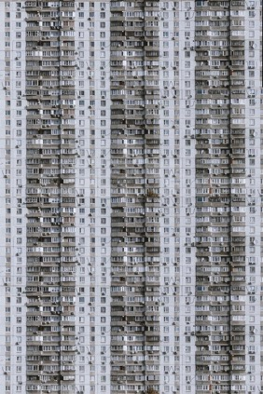
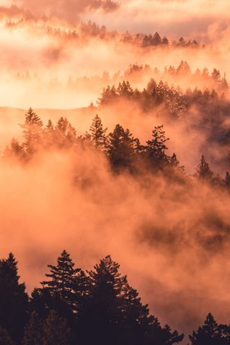
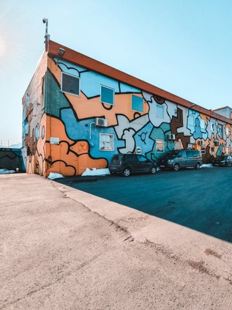
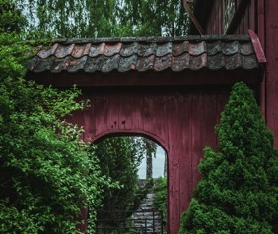
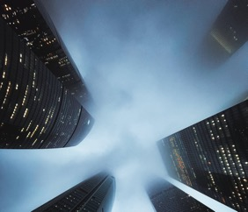
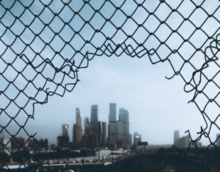
X
Notes:
Instead – there are multiple different poissiblities. Multiple depictions.

Slide 12
Scan for trends + signals
Now
Past
Social
Technological
Economic
Environmental
Political
Legal
Ethical
Notes:
Process of strategic foresight and futuring.

Slide 13
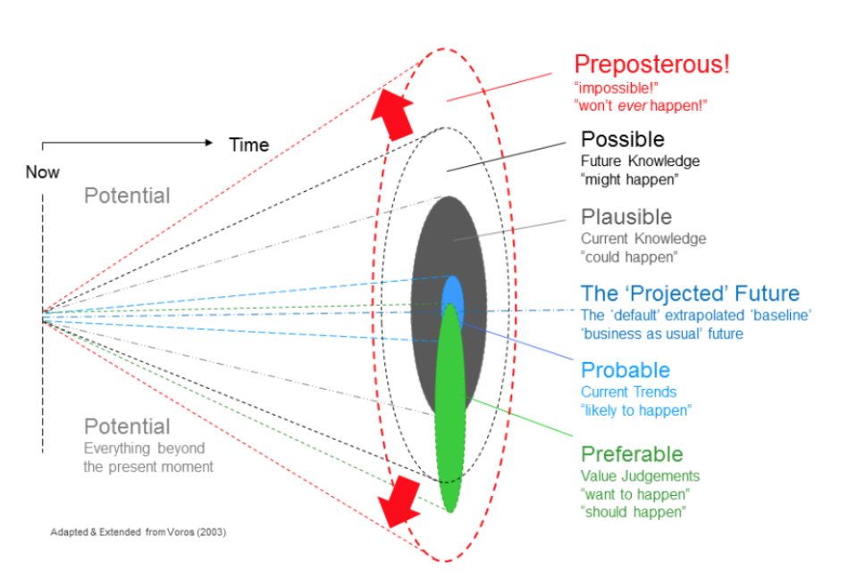
Multiple potential future scenarios
Scan for trends + signals
Past
Social
Technological
Economic
Environmental
Political
Legal
Ethical

Slide 14
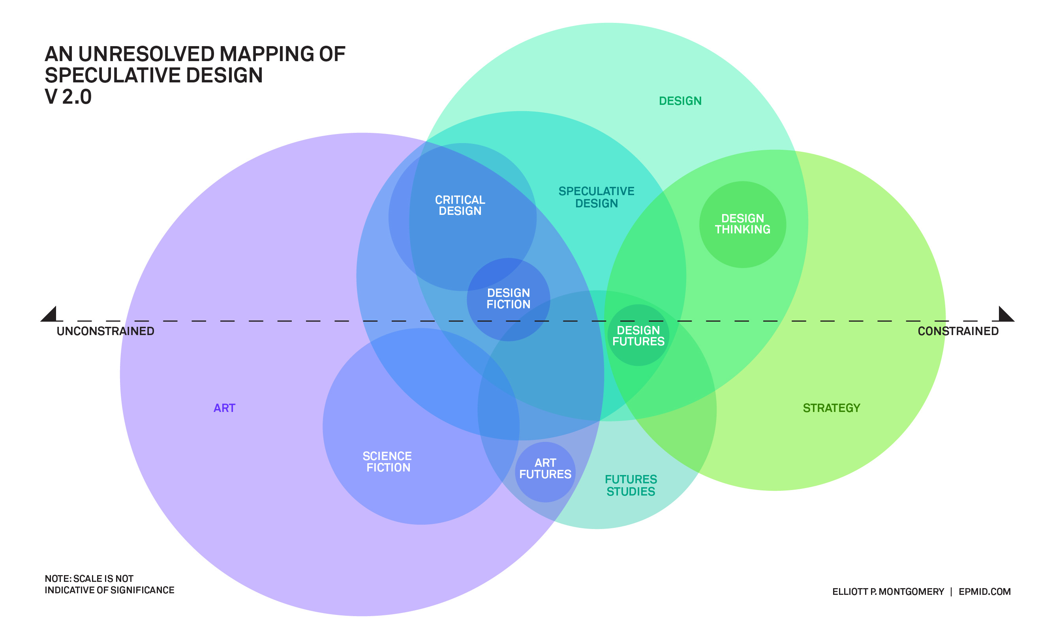
Notes:
This is a discipline in its self. Speculative Design is this category of interconnected ways of thinking and approaching things. Blend of science fiction, design fiction, art and strategy as. Speculative design often concerns itself with using design as a way to make the future tangible.

Slide 15
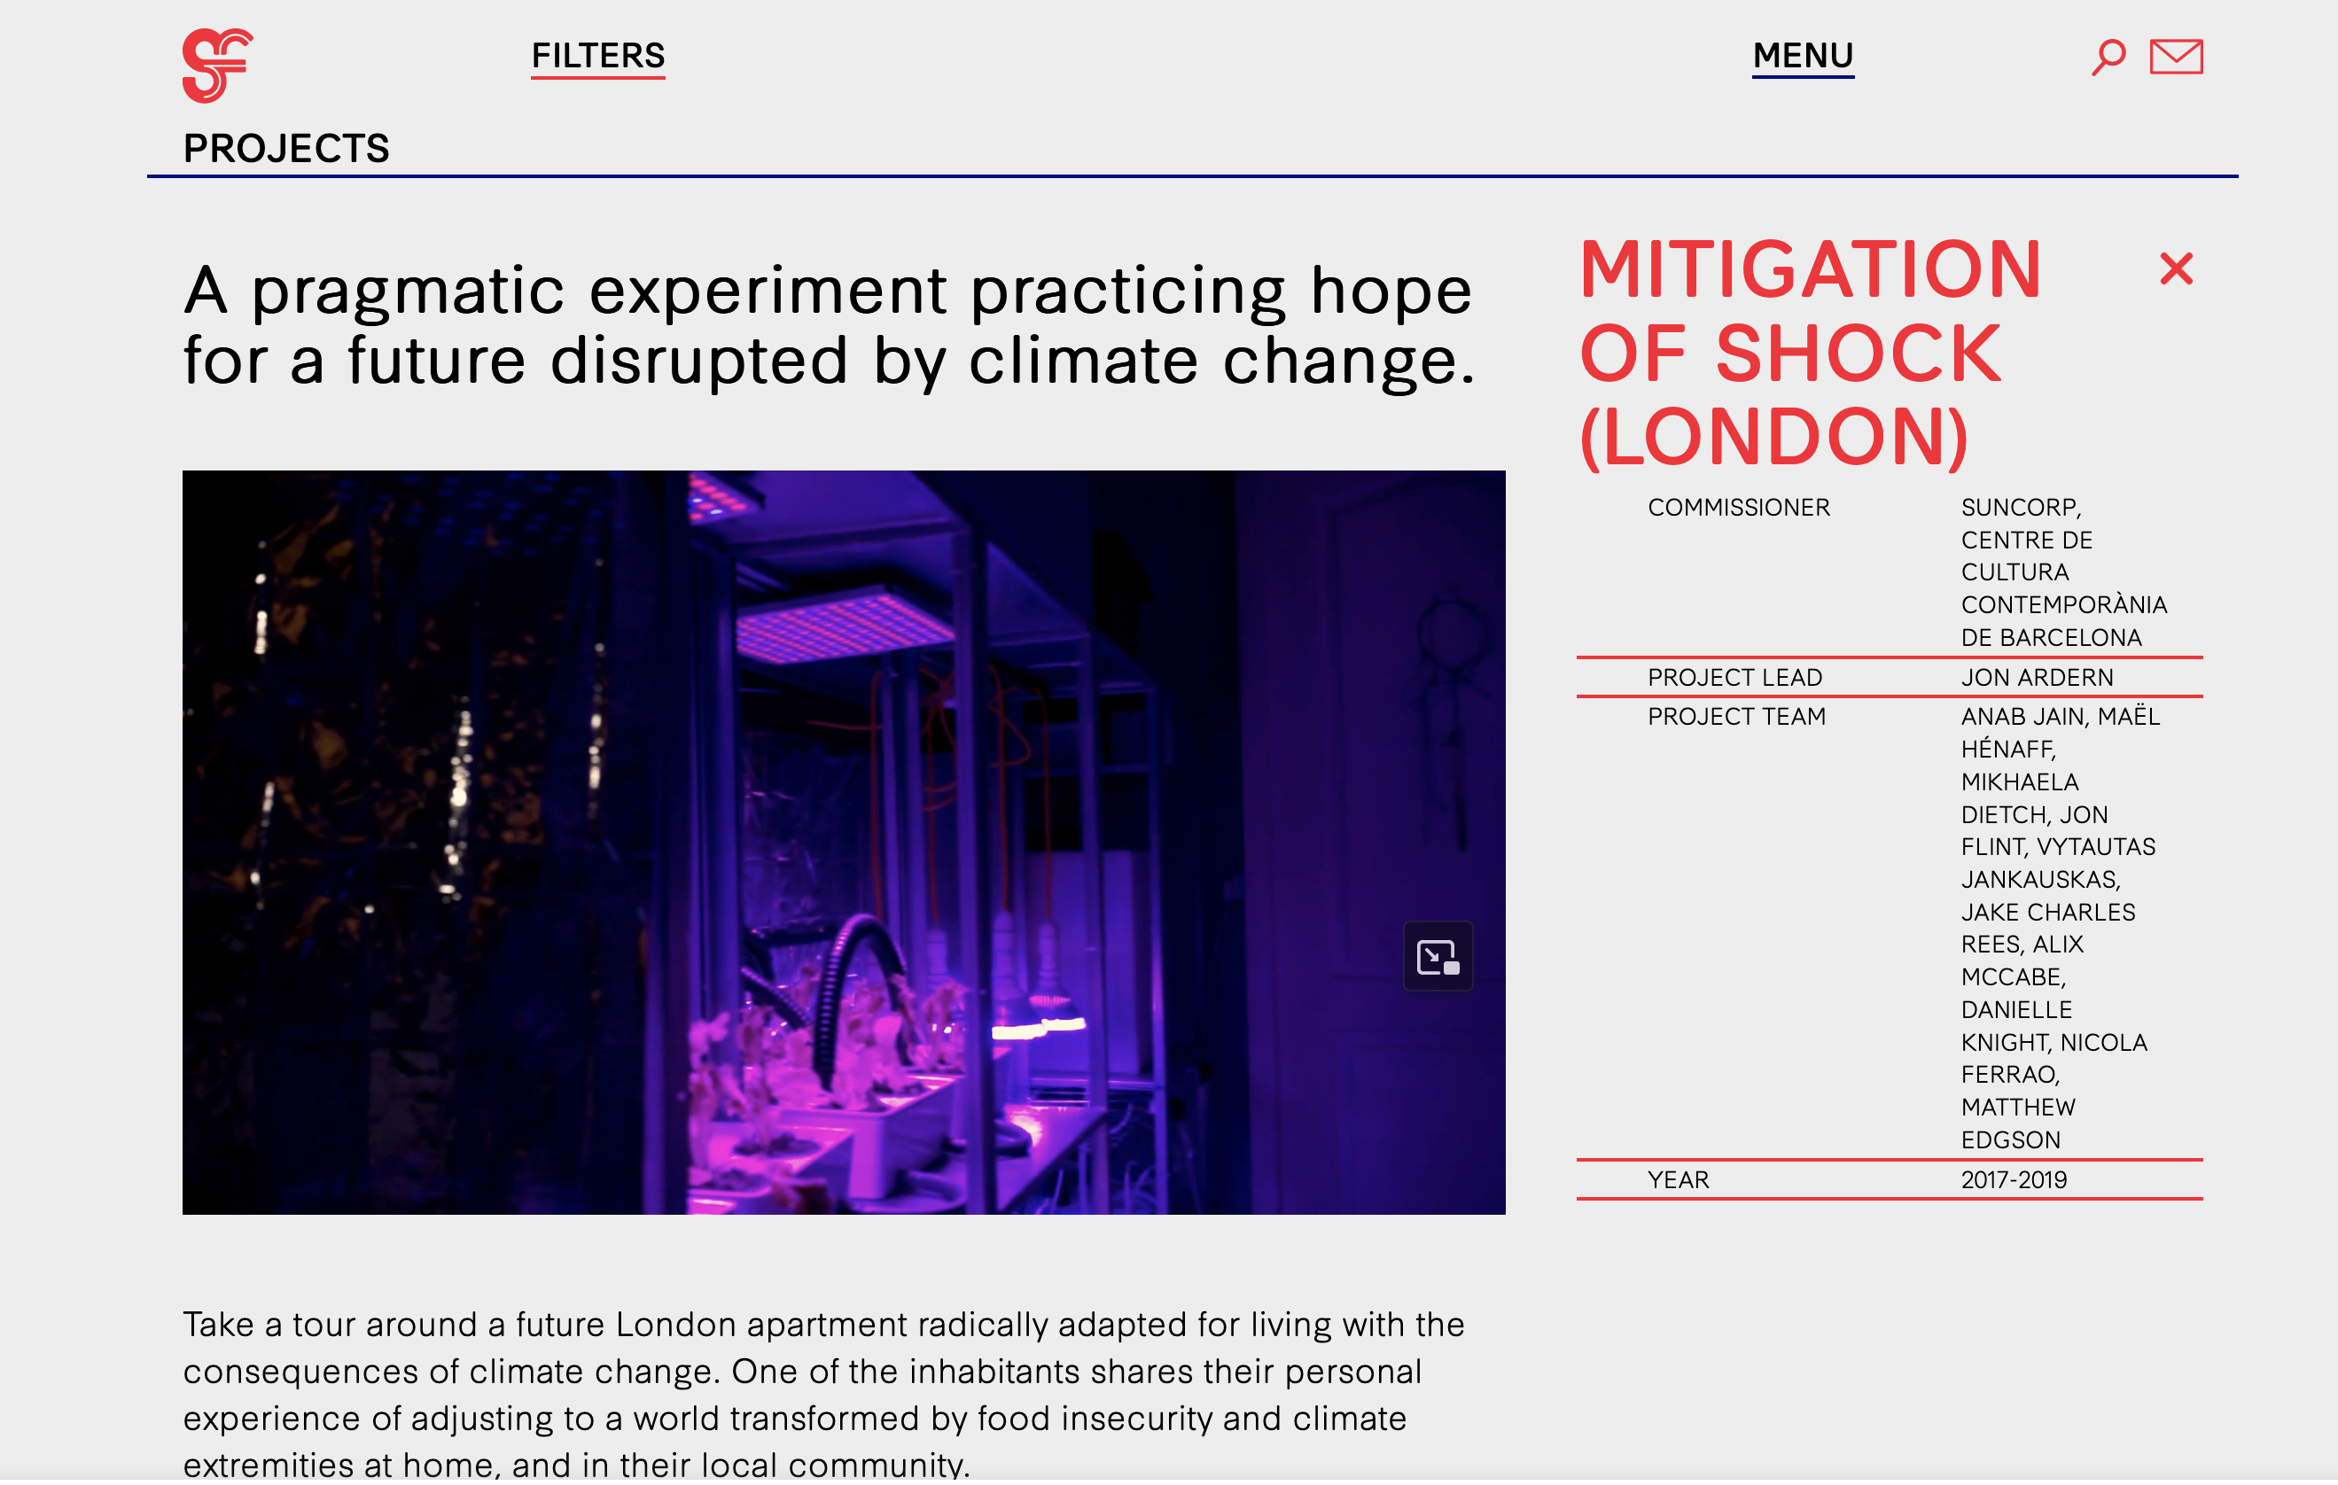
https://superflux.in/index.php/work/mitigation-of-shock/#
Superflux - speculative design
Notes:
Example – if you are interested in a design consultancy that do great speculative design. They create instatlions and provications for the future.

Slide 16
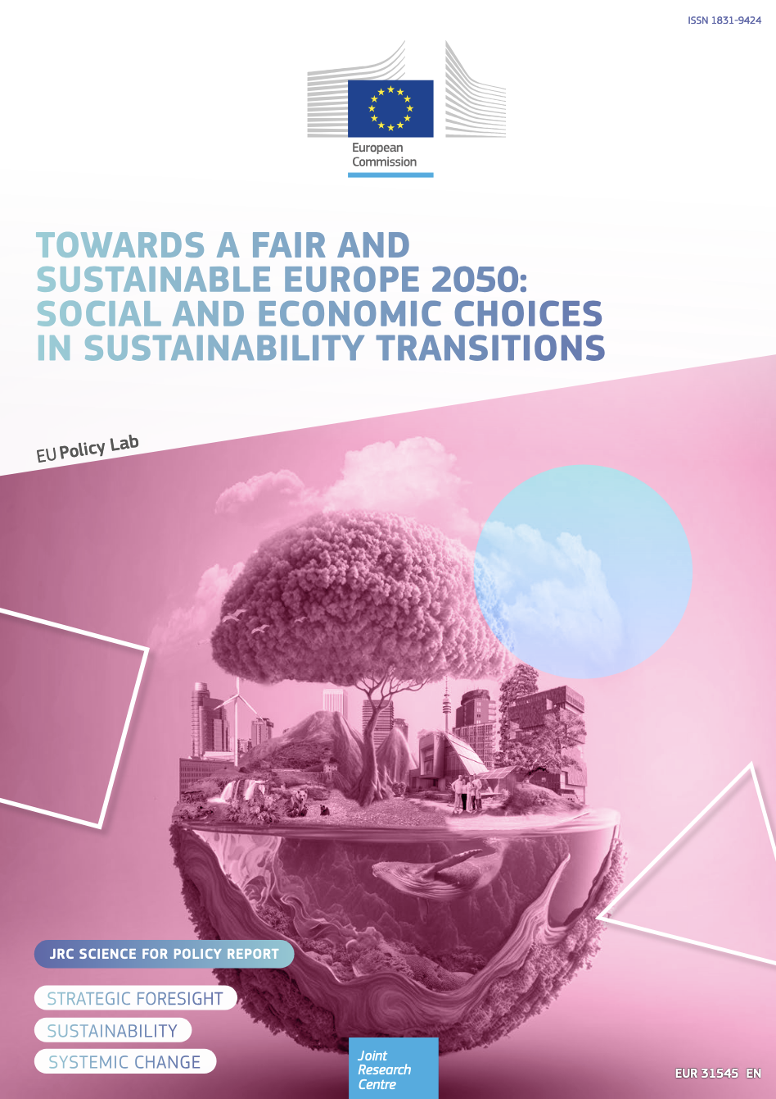
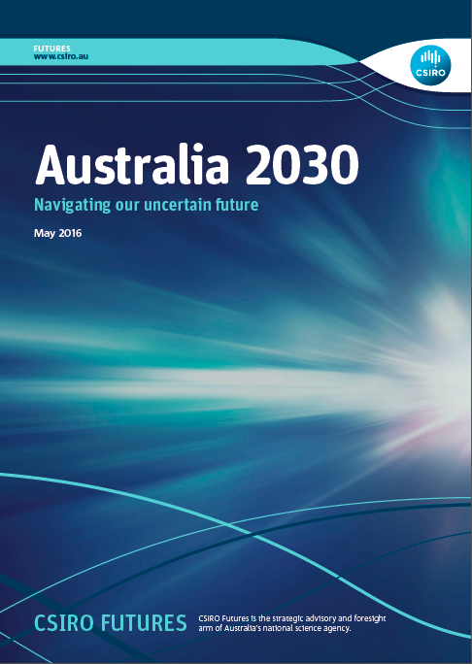
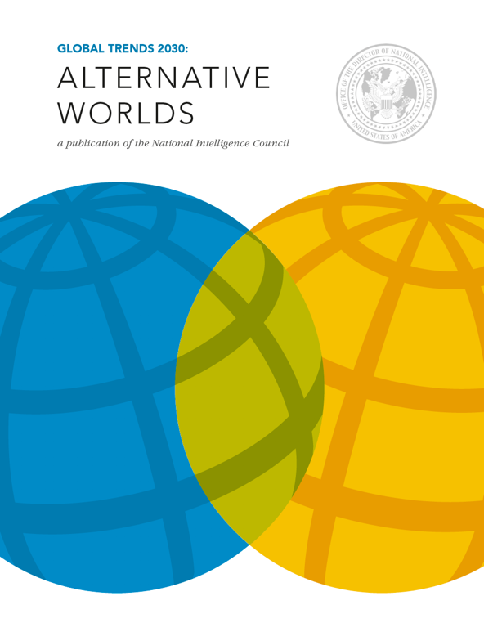
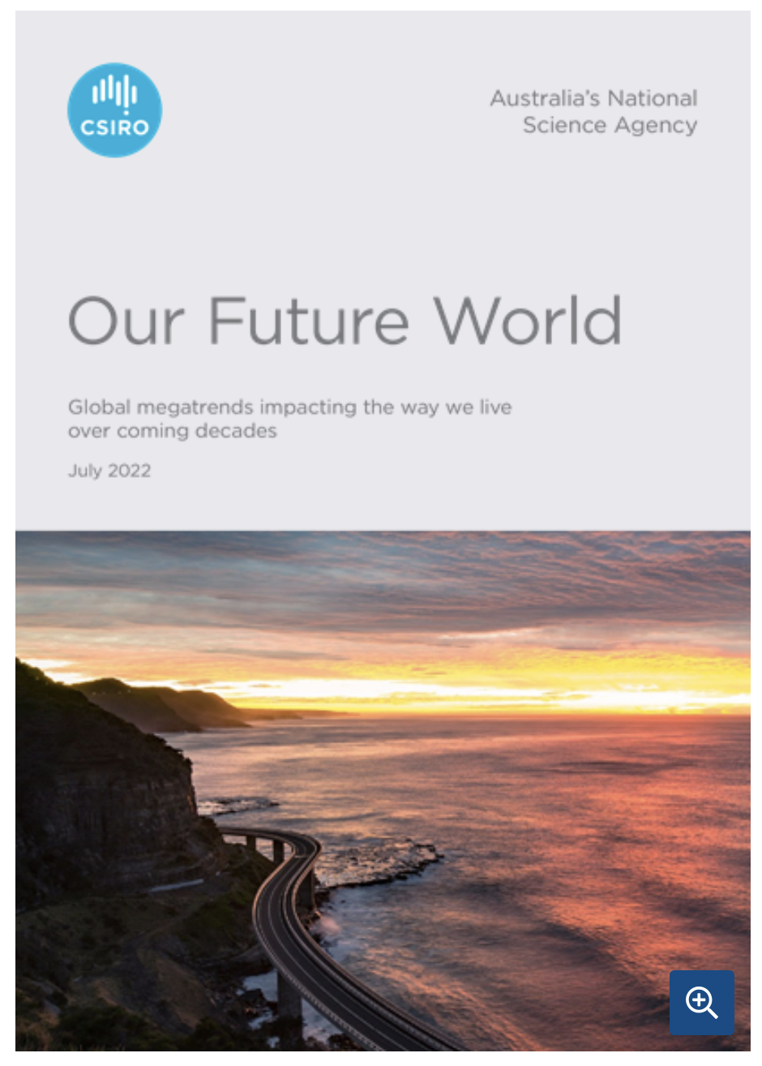
Future Scenarios & Trends
Notes:
But we can also leverage the insights and learnings from others who have done this work. Range of forecasting reports, trends and scenarios. There will be some element of speculation/assumptions in there prooblems.

Slide 17
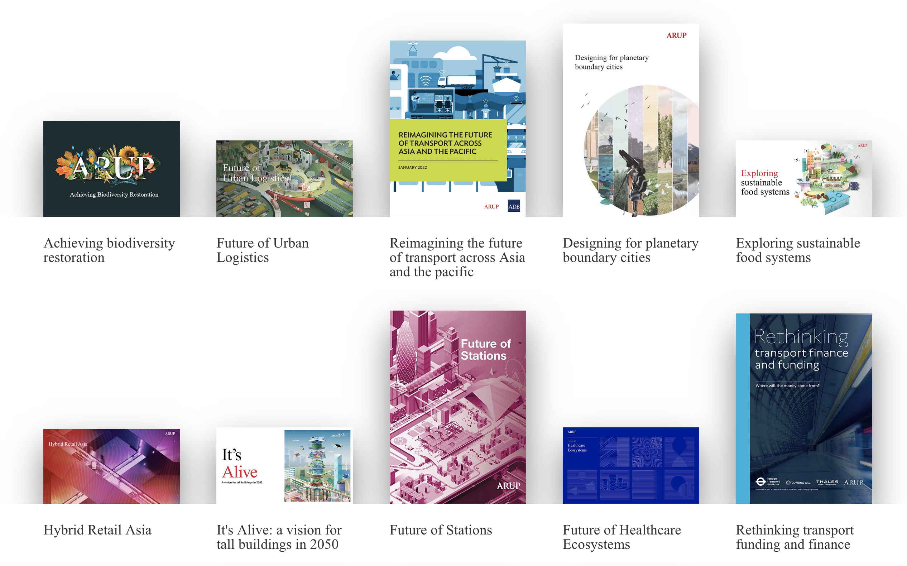
ARUP – International Architecture + Urban Design
https://www.arup.com/perspectives/publications/all/foresight
Notes:
Global
Megatrends,
revised 2015

Slide 18
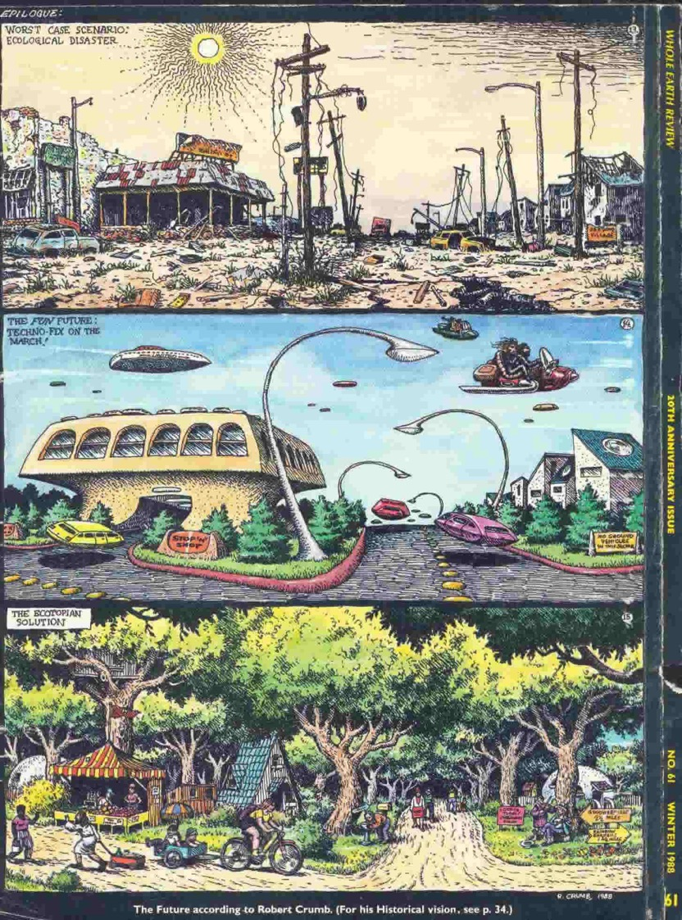
Let’s explore Futures and how this impacts our systems…
Notes:
First acknowledge traditional owners of the land.

Slide 19
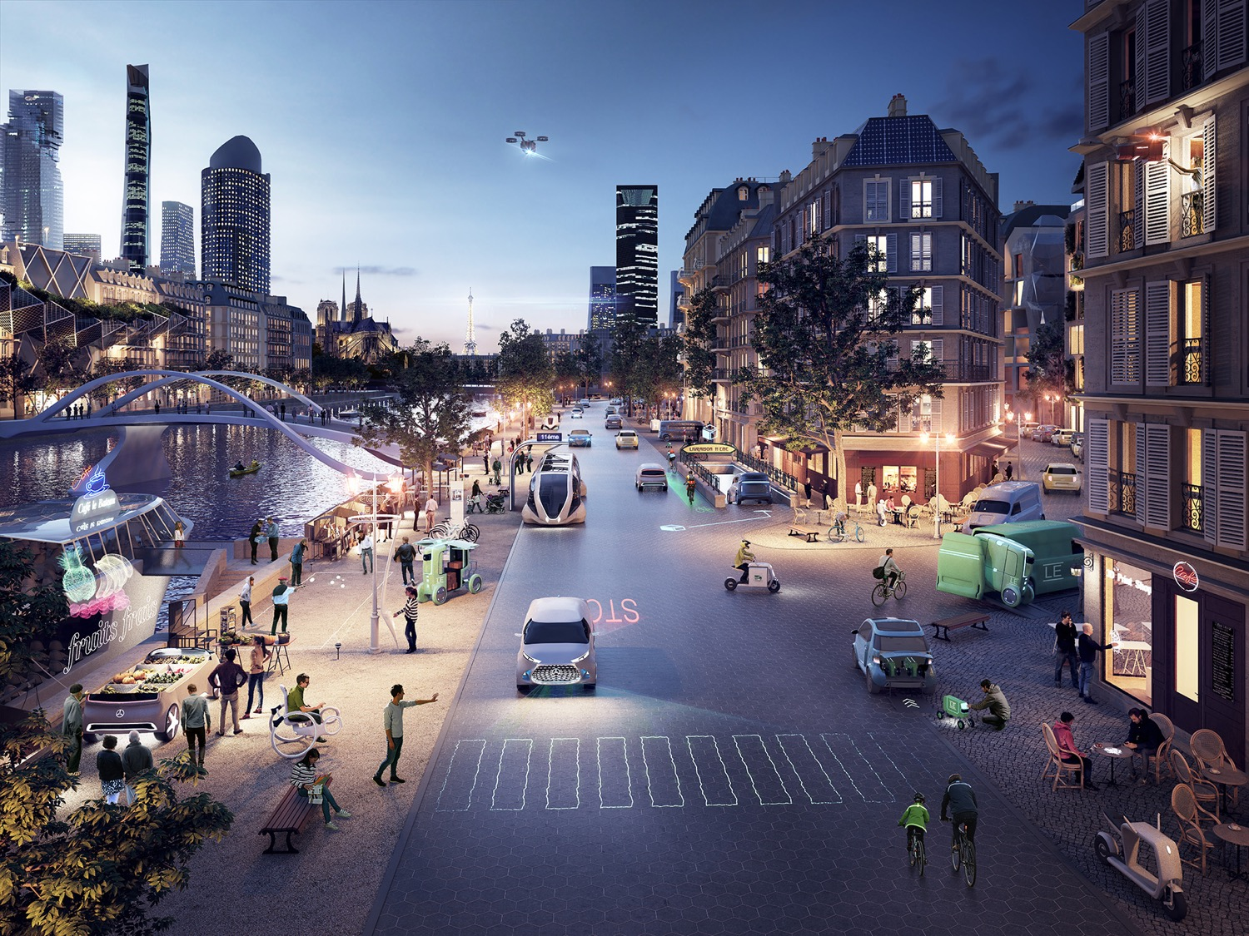
Overview
We will use 2050 future scenarios to inspire us to think about our systems and how they might change in the future…
We will take one opportunity space – and look at it through two lenses - two different future scenarios – two rounds
Share back outcomes of this exploration and possible pockets of change

Slide 20
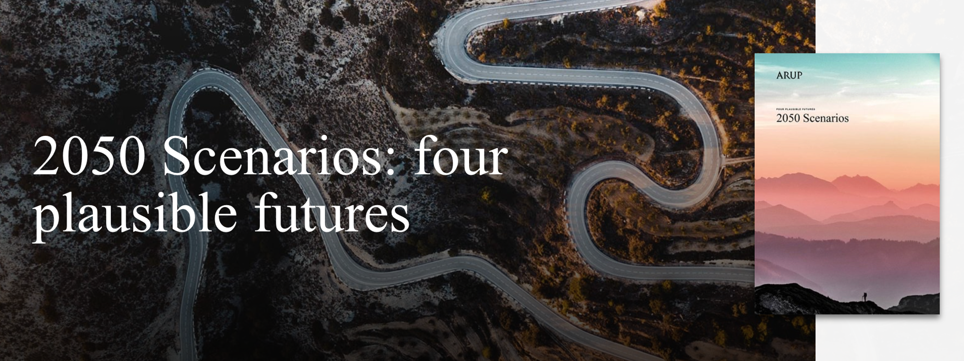
ARUP – International Architecture + Urban Design
https://www.arup.com/perspectives/publications/research/section/2050-scenarios-four-plausible-futures
Notes:
Global
Megatrends,
revised 2015

Slide 21
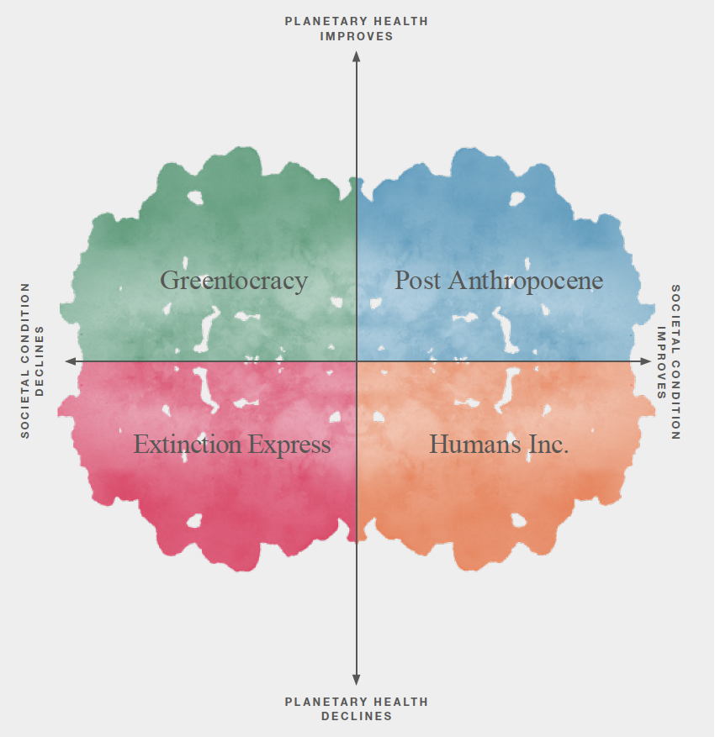
https://www.arup.com/perspectives/publications/research/section/2050-scenarios-four-plausible-futures
Notes:
Global
Megatrends,
revised 2015

Slide 22
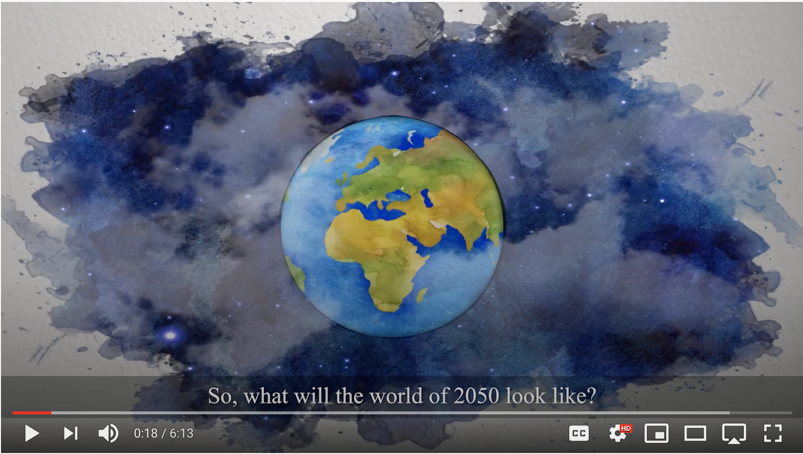
Drivers + Trends
https://www.youtube.com/watch?v=waeysF6h6po
Notes:
Global
Megatrends,
revised 2015

Slide 23
For each scenario – we would like you to think and discuss the following
How does your system look in 2050 in ARUPs specific scenario?
How has your system changed over time? What elements of your problem space are still present? How have things shifted within your system or problem? Is there still a problem in this future?
Are there new opportunities in your 2050 system for intervention? Can you highlight any pockets of change to improve things?
Do you have any possible ideas to tackle these?
Notes:
Be inspired by the scenario and consider how you systems has changed – for better, could be for the worst.
WHAT IF things change.

Slide 24
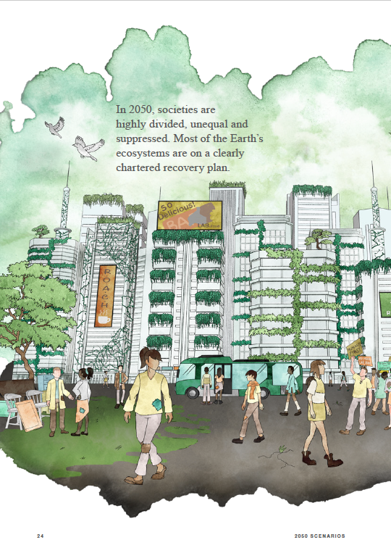
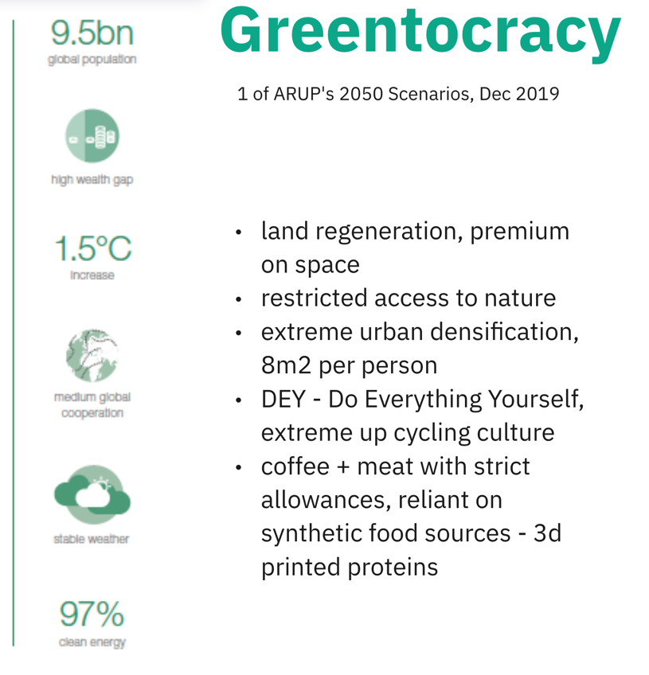
^{First Scenario to consider…}

Slide 25
For this scenario – we would like you to think and discuss the following
How does your system look in 2050 in ARUPs Greentocracy scenario?
How has your system changed over time? What elements of your problem space are still present? How have things shifted within your system or problem? Is there still a problem in this future?
Are there new opportunities in your 2050 system for intervention? Can you highlight any pockets of change to improve things?
Do you have any possible ideas to tackle these?
Notes:
Be inspired by the scenario and consider how you systems has changed – for better, could be for the worst.
WHAT IF things change.

Slide 26
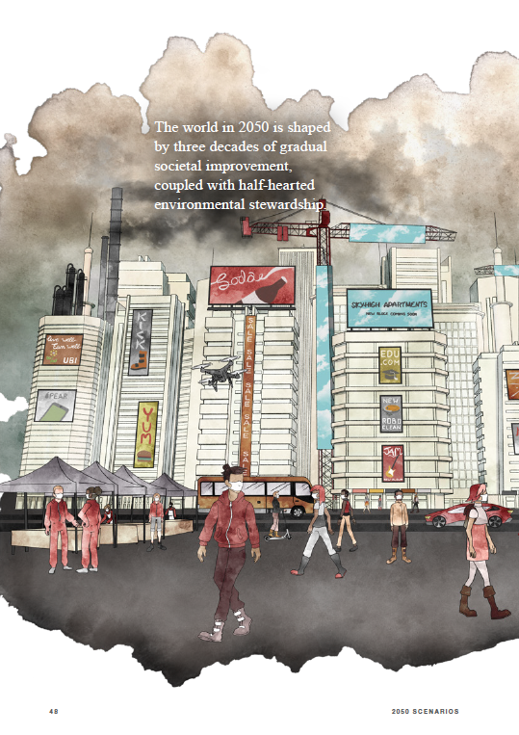
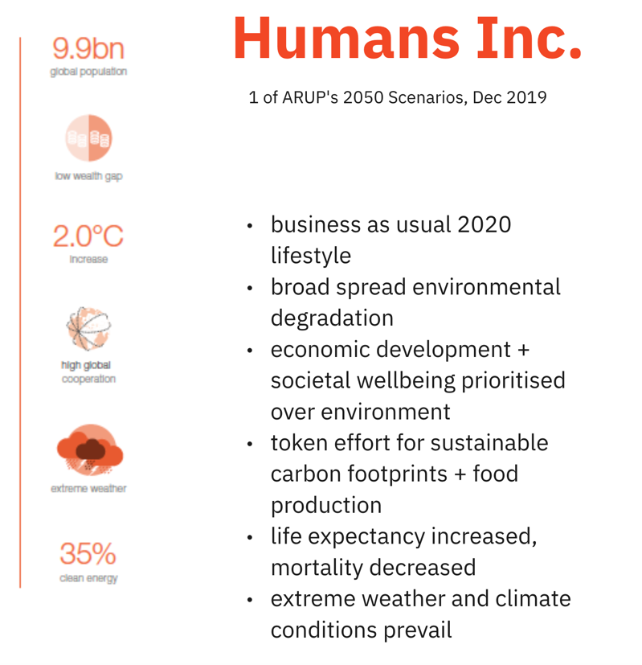
^{Second Scenario to consider…}

Slide 27
For this scenario – we would like you to think and discuss the following
How does your system look in 2050 in ARUPs Human’s Inc scenario?
How has your system changed over time? What elements of your problem space are still present? How have things shifted within your system or problem? Is there still a problem in this future?
Are there new opportunities in your 2050 system for intervention? Can you highlight any pockets of change to improve things?
Do you have any possible ideas to tackle these?
Notes:
Be inspired by the scenario and consider how you systems has changed – for better, could be for the worst.
WHAT IF things change.

Slide 28
What did you come up with?
What did you discover?
Notes:
Quick share back.

