Slide 1





Recalling Pablo’s
What If…
Notes:
We are recalling Pablo’s What if… - we want them to consider this as another way of ideating and searching for these leverage points that we keep mentioning - so how can we use the assumption reversal as a way ideating and finding opportunities to intervene in the current system?

Slide 2
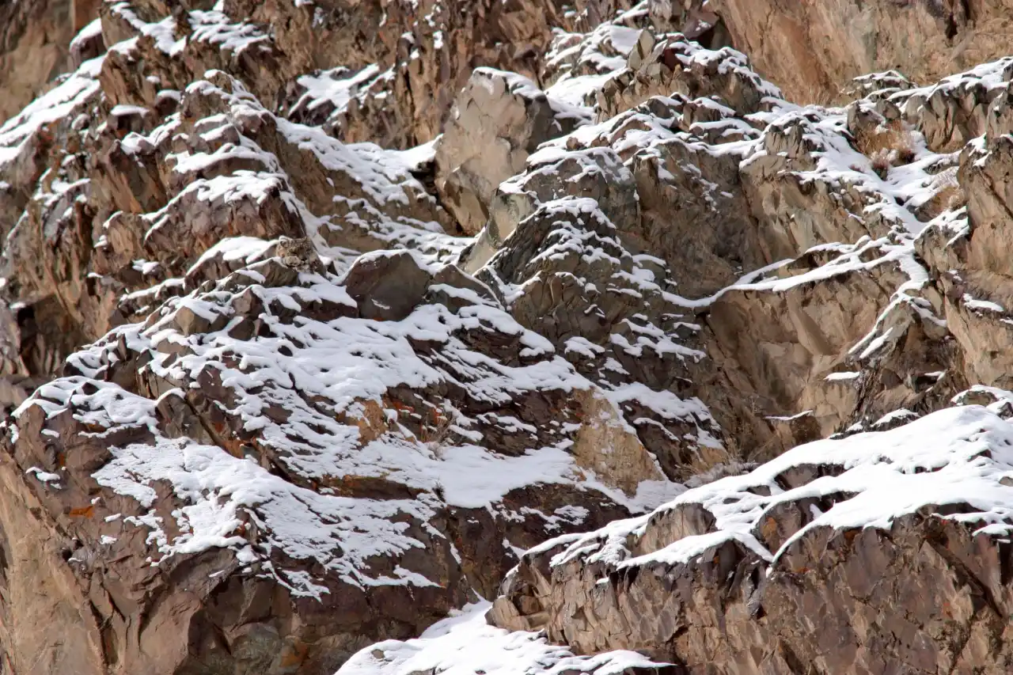
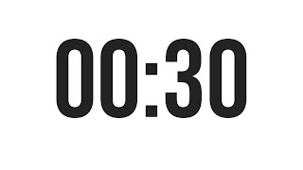
Notes:
5 mins recap

Slide 3
Notes:
5 mins recap

Slide 4
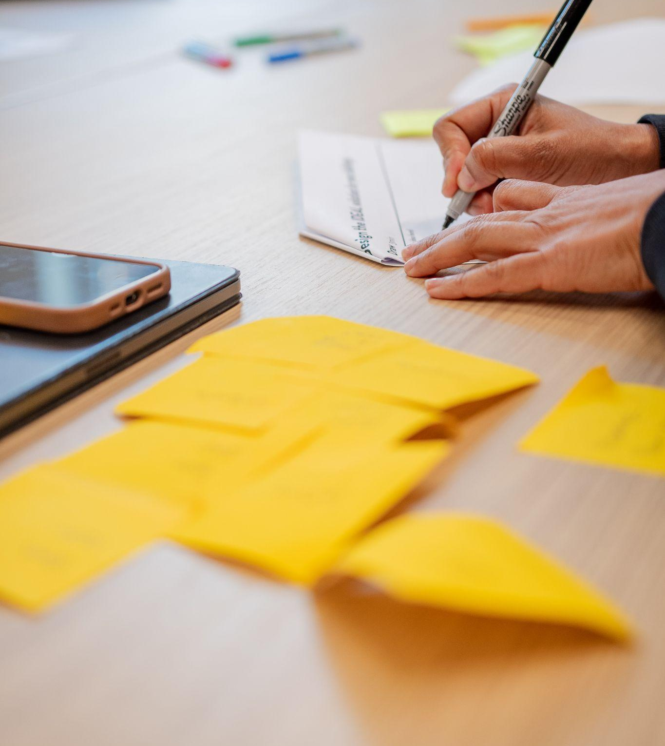



Exercising the What If…
As a team, choose a new opportunity card
Generate 3 assumptions
at three different levels of the social ecosystem maps
2. Reverse them
3. Ideate
Notes:
15 mins
NO PRESENT BACK present back - each team 1 assumption 1 reversal 1 ideation - 5 mins
we want you yo look at your opportunities, choose one you haven’t spent time with yet.
consider the different levels of each the system - generate your assumptions at different levels of the system
ideating a new thing that sits in the system - considering the reversal
Ex: healthcare unit
A patient’s condition determines their need for care - all patients receive the same amount of care -
Healthcare is accessible to all (in america?) - healthcare is hard to obtain and is not offered equally -
The physical environment, like patient rooms or building layout, impact delivery of care - patient environment have no impact on care
5 buffer

Slide 5
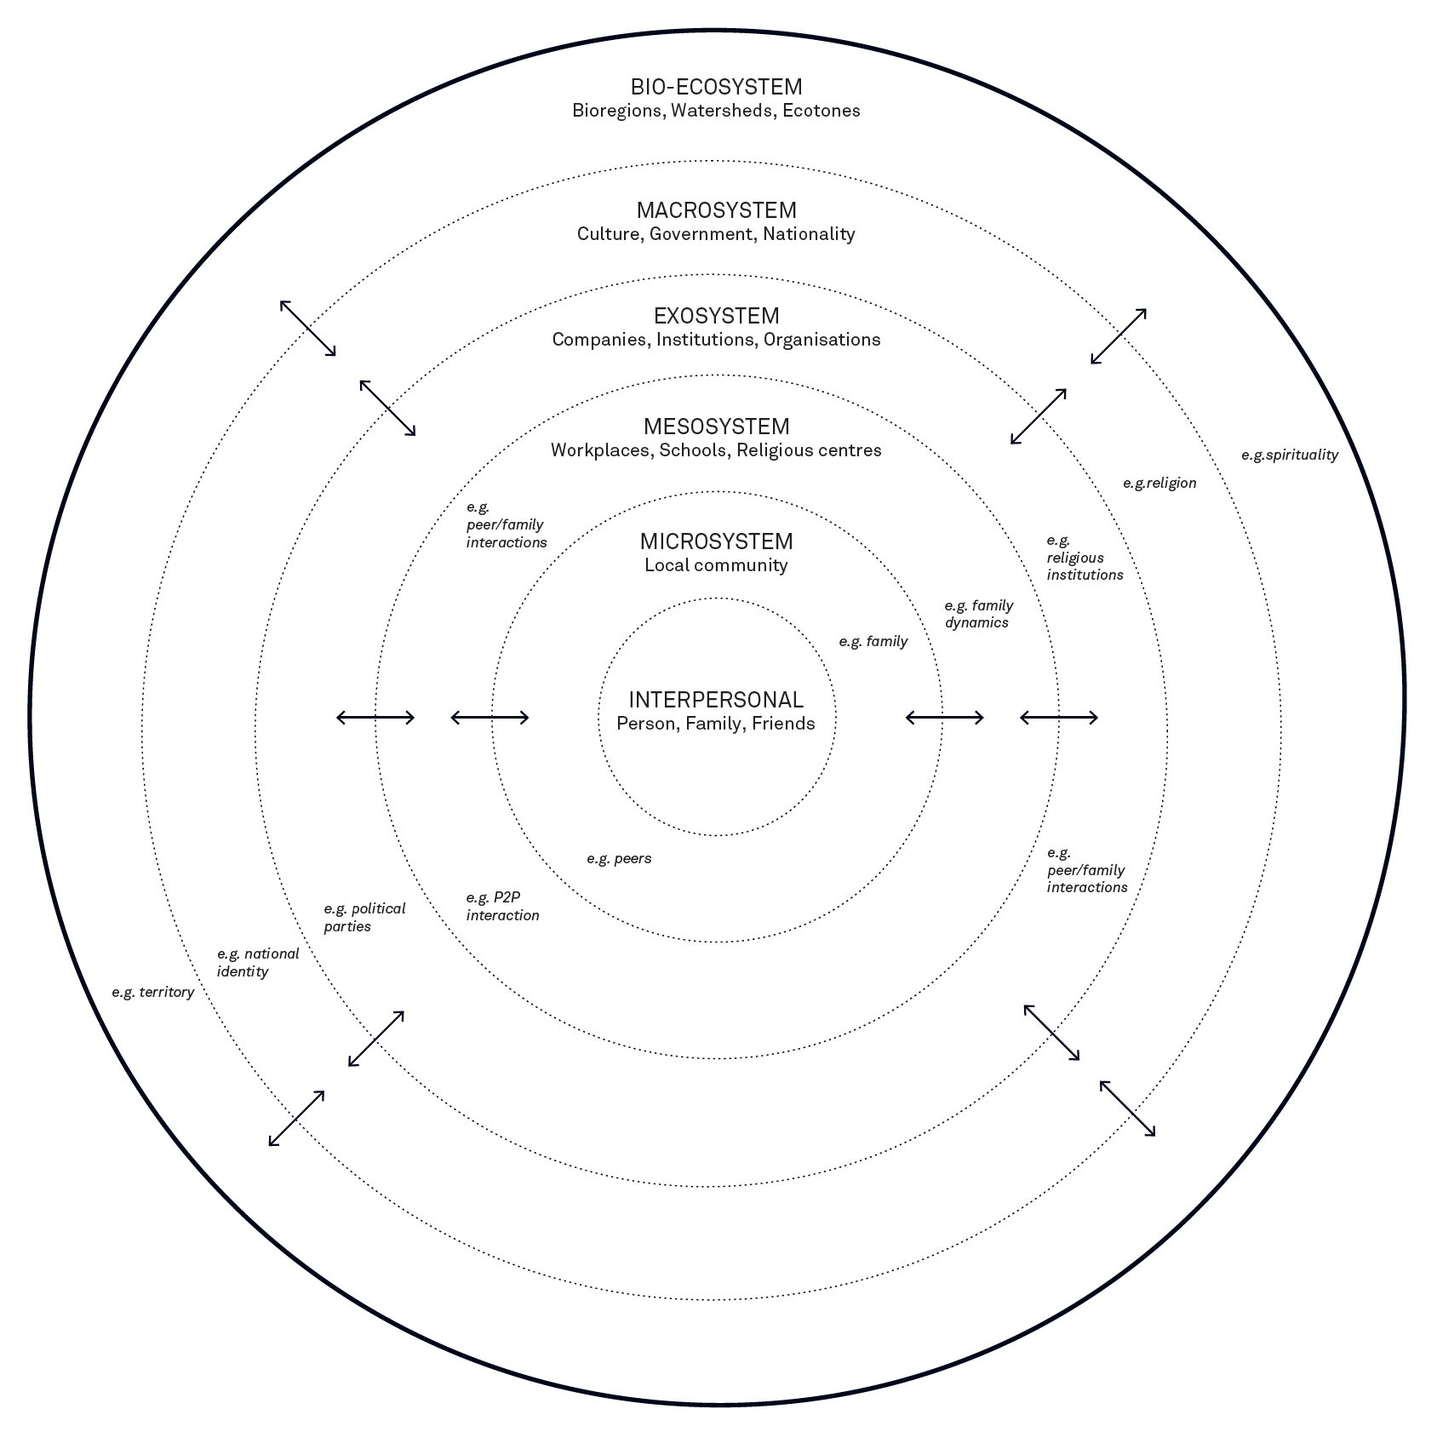
Exercising the What If…
As a team, choose a new opportunity card
Generate 3 assumptions
at three different levels of the social ecosystem maps
2. Reverse them
3. Ideate
Peter Jones & Kristel Van Ael (2022)
Notes:
15 mins
NO PRESENT BACK present back - each team 1 assumption 1 reversal 1 ideation - 5 mins
we want you yo look at your opportunities, choose one you haven’t spent time with yet.
consider the different levels of each the system - generate your assumptions at different levels of the system
ideating a new thing that sits in the system - considering the reversal
Ex: healthcare unit
A patient’s condition determines their need for care - all patients receive the same amount of care -
Healthcare is accessible to all (in america?) - healthcare is hard to obtain and is not offered equally -
The physical environment, like patient rooms or building layout, impact delivery of care - patient environment have no impact on care
5 buffer

Slide 6
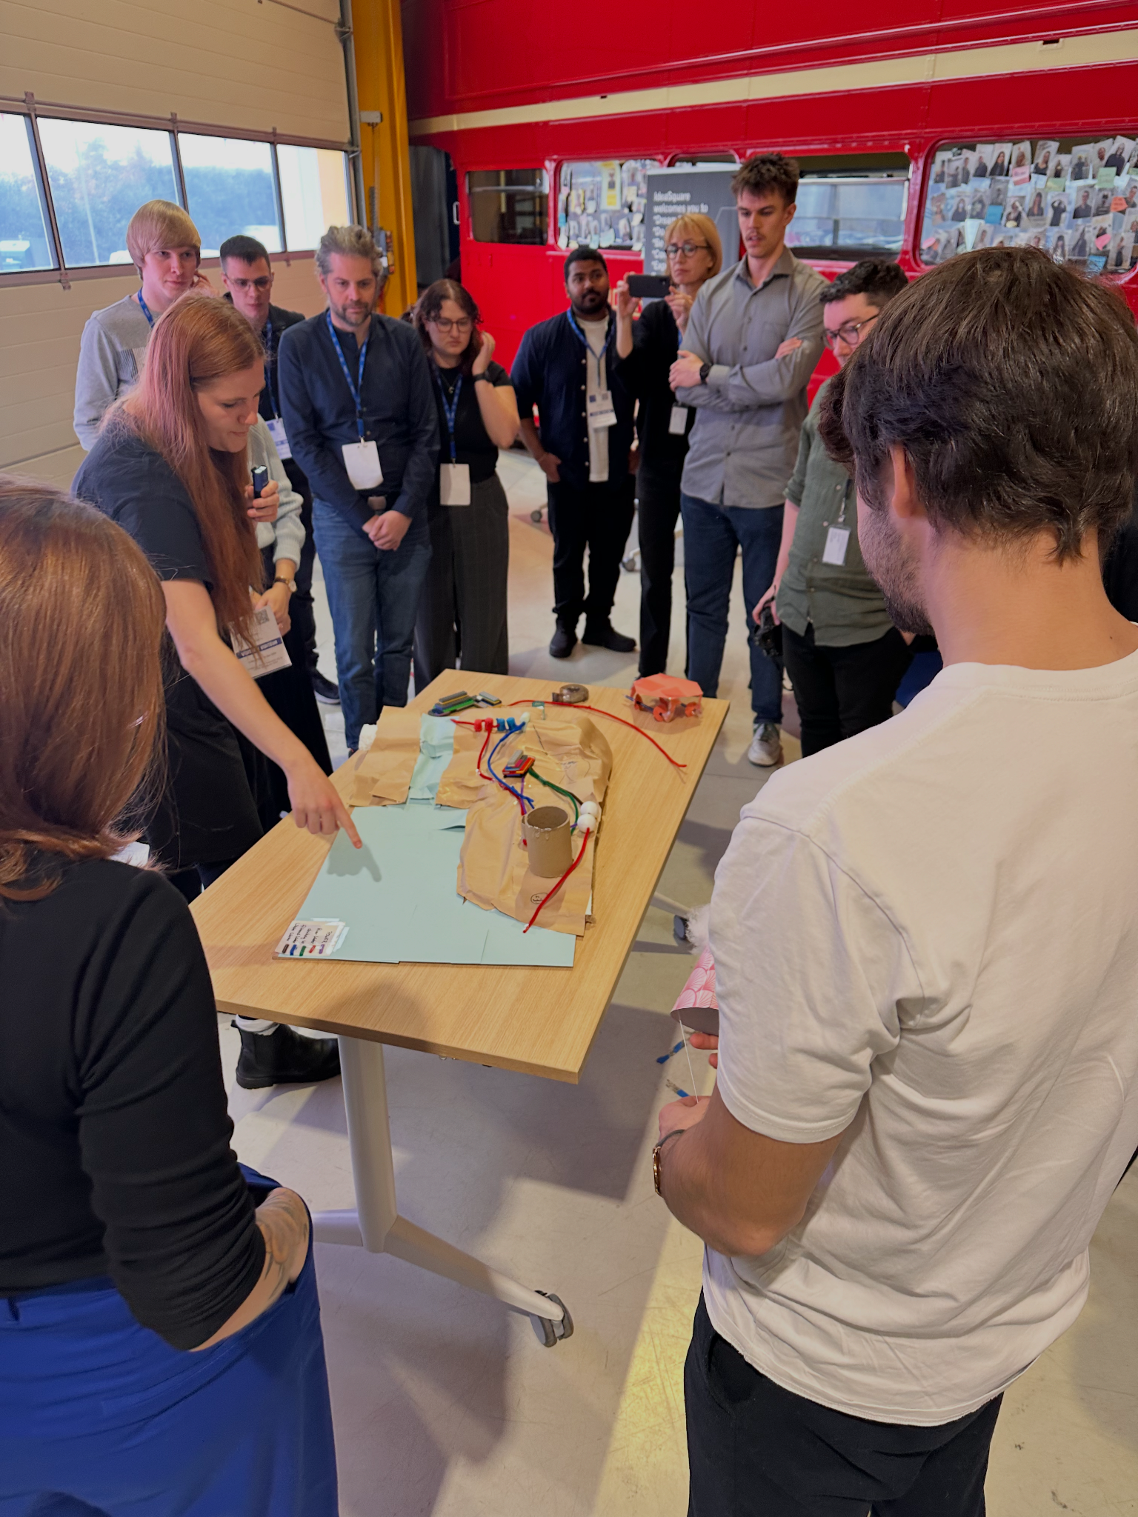
Rapid Prototyping & Feedback
Choose 1 x What if… idea
Prototype! (15 mins)
2. Share & feedback.
i like, i wish, i wonder (10 mins)
Notes:
15 mins
NO PRESENT BACK present back - each team 1 assumption 1 reversal 1 ideation - 5 mins
we want you yo look at your opportunities, choose one you haven’t spent time with yet.
consider the different levels of each the system - generate your assumptions at different levels of the system
ideating a new thing that sits in the system - considering the reversal
Ex: healthcare unit
A patient’s condition determines their need for care - all patients receive the same amount of care -
Healthcare is accessible to all (in america?) - healthcare is hard to obtain and is not offered equally -
The physical environment, like patient rooms or building layout, impact delivery of care - patient environment have no impact on care
5 buffer

Slide 7
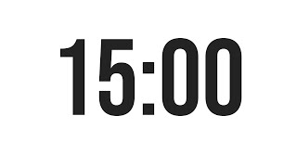
Peter Jones & Kristel Van Ael (2022)
Notes:
15 mins
present back - each team 1 assumption 1 reversal 1 ideation - 5 mins
we want you yo look at your opportunities, choose one you haven’t spent time with yet.
consider the different levels of each the system - generate your assumptions at different levels of the system
ideating a new thing that sits in the system - considering the reversal
Ex: healthcare unit
A patient’s condition determines their need for care - all patients receive the same amount of care -
Healthcare is accessible to all (in america?) - healthcare is hard to obtain and is not offered equally -
The physical environment, like patient rooms or building layout, impact delivery of care - patient environment have no impact on care
5 buffer

Slide 8

Daily warm-ups (energisers)…
Tues 5th Nov Teaching Team!
Wed 6th Nov Mark, Niklas, Nicholas
Thurs 7th Nov Claudia, Fabian, Eugenia
Fri 8th Nov Nico, Janki, Anoop
Mon 11th Nov Fatma, Carson, Ralf
Tues 12th Nov Rosa, Valerio, Ann-Kathrin
Wed 13th Nov Shannon, Surbhi
Thurs 14th Nov Shreeyya, Cori
Fri 15th Nov Teaching Team!

Slide 9
Prototype a floorplan of the settlement…
15 min
Choose your method: Sketch or Build
Team A
Anoop
Cori
Nick
Surbhi
Nico
Shannon
Team B
Rosa
Ralf
Ann-Kathrin
Carson
Claudia
Shreeyya
Fabian
Team C
Janki
Niklas
Eugenia
Fatma
Valerio
Mark

