Slide 1
CERN in Sweden 2024

Slide 2
Student engagement

Slide 3






Elias Walter Waagaard
PhD-student accelerator physics
#CERN70 - Tour de Suède

Slide 4
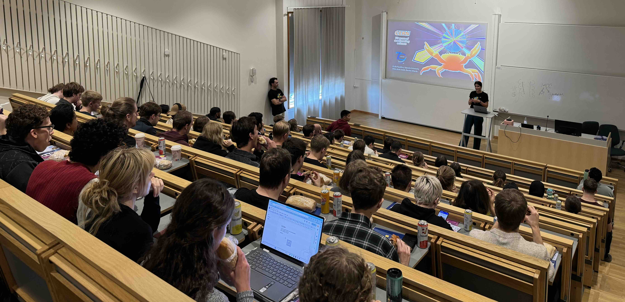
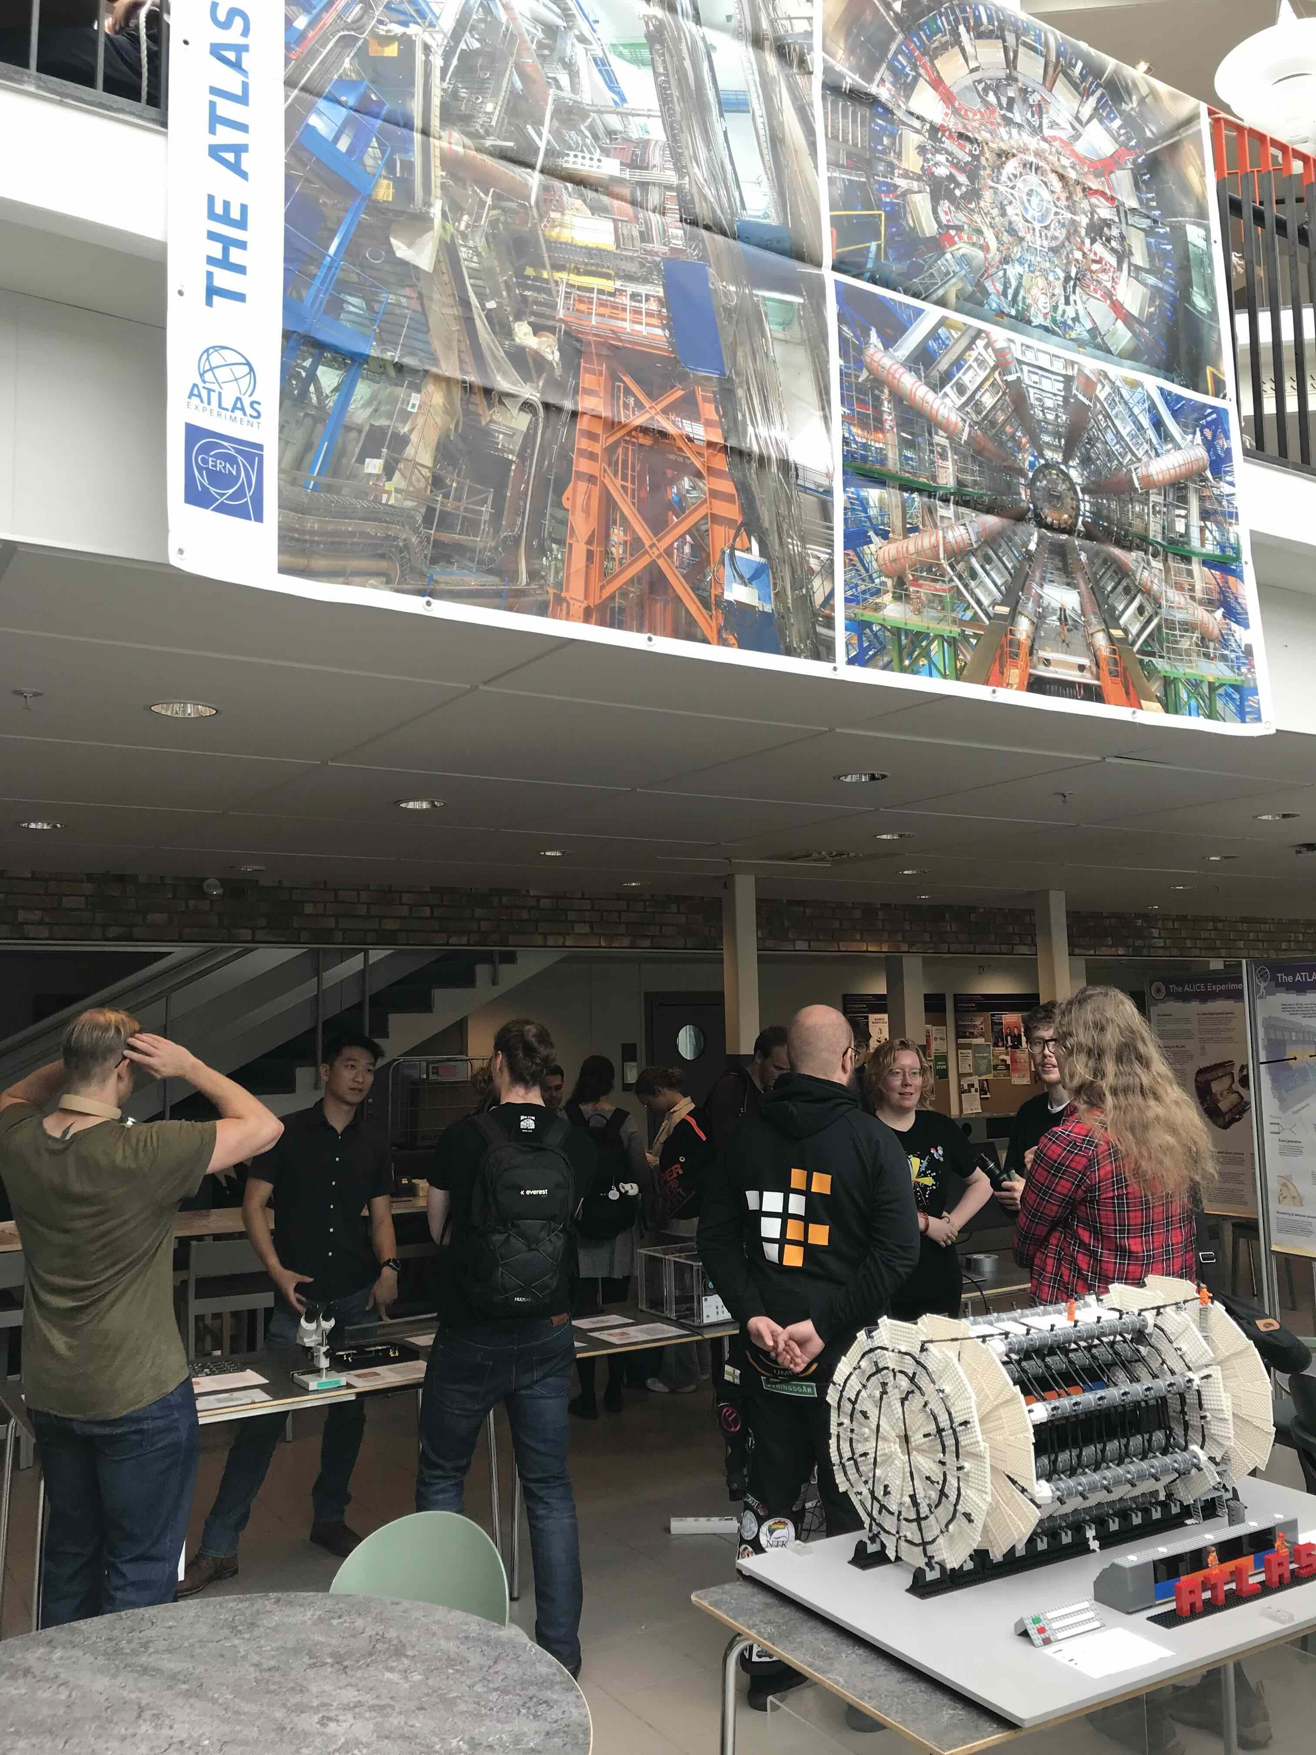
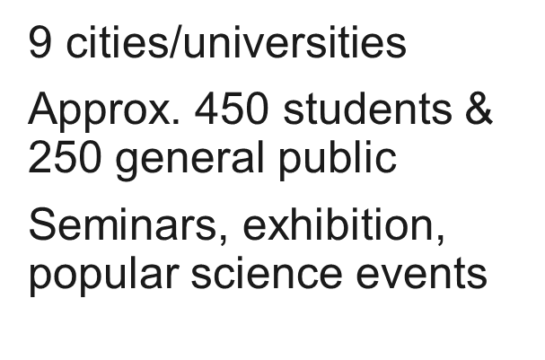

Slide 5
Industry engagement

Slide 6
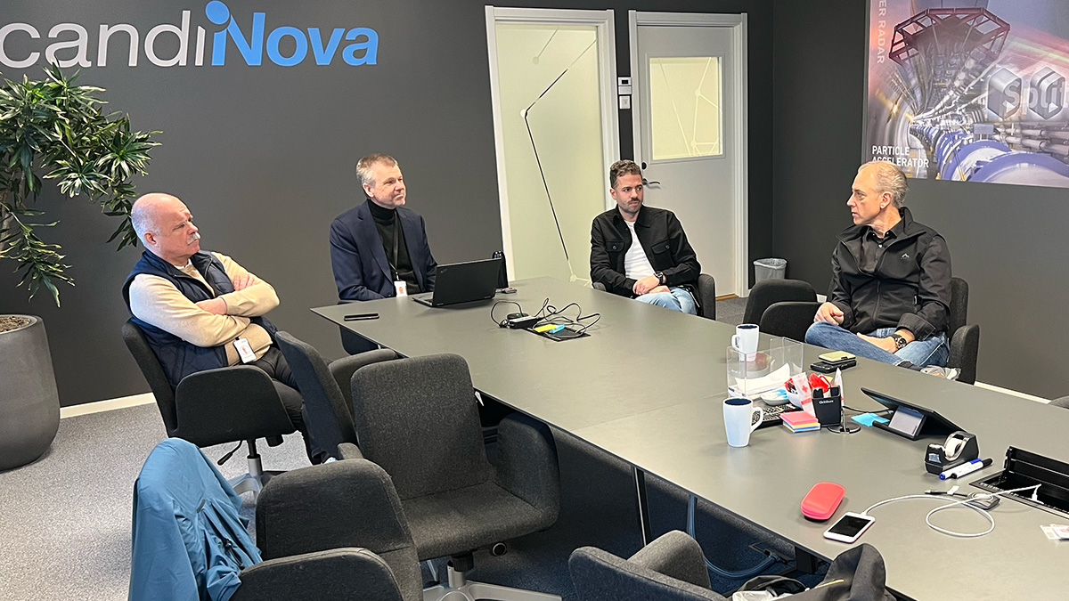
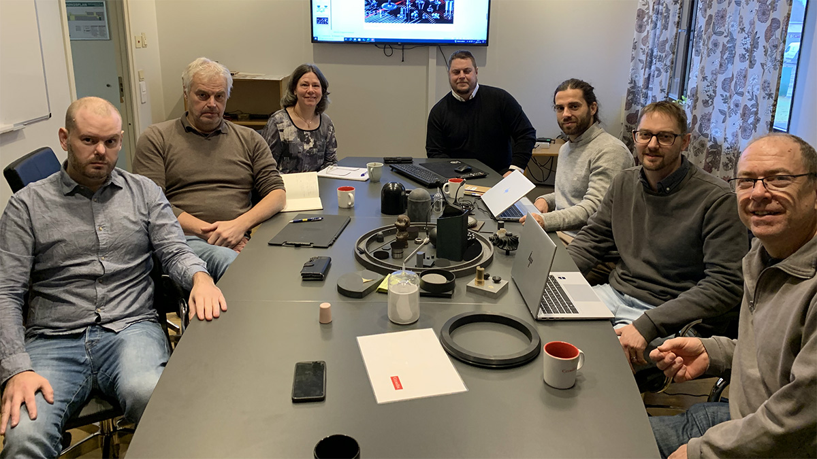

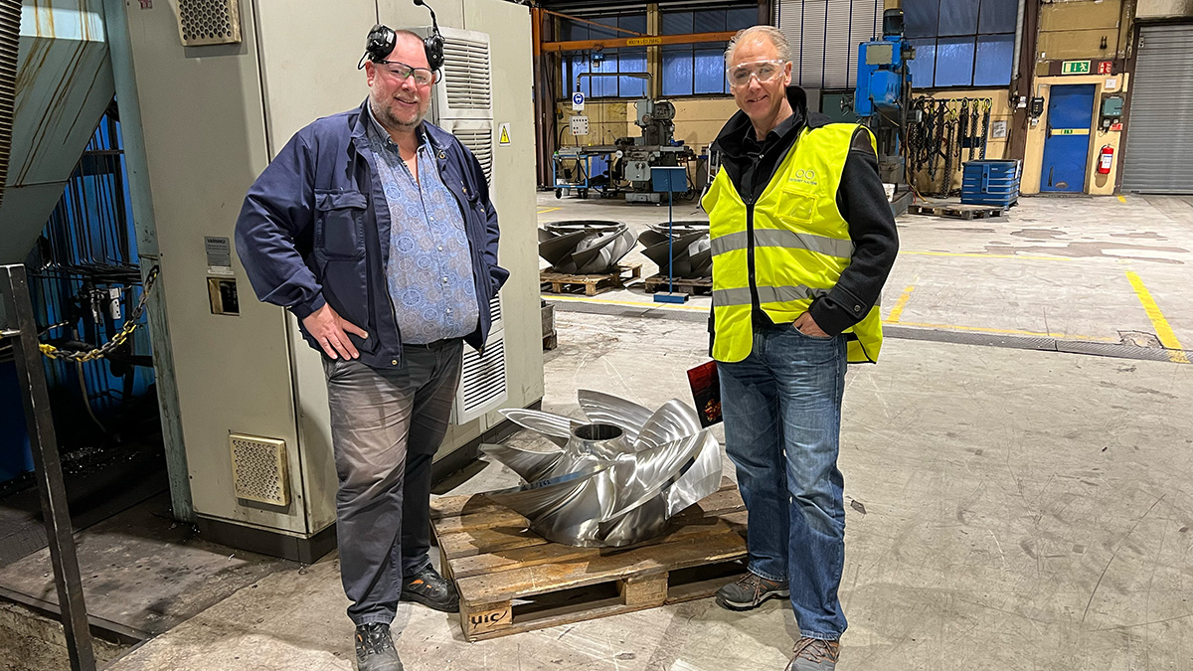
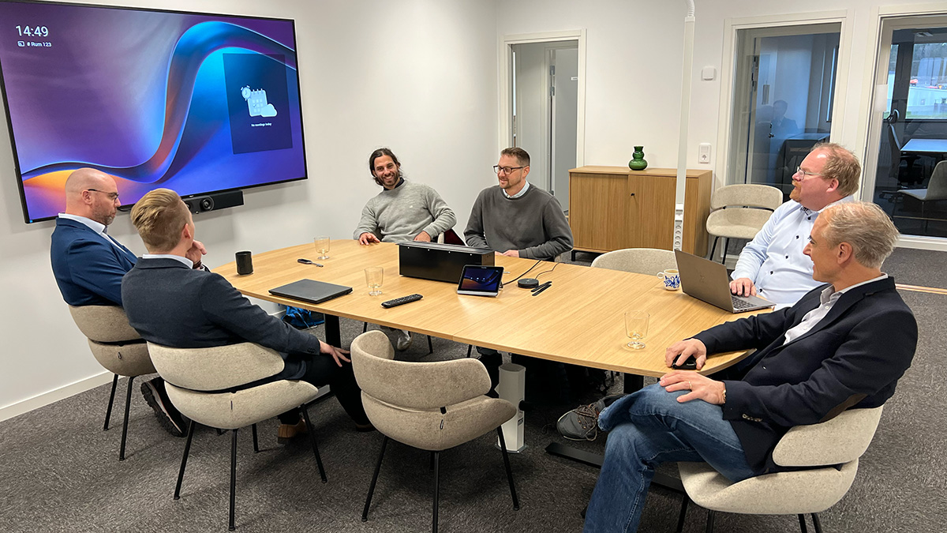
Activity
Richard Jacobsson, Swedish Senior Physicist at CERN, is project leader for the international ground-breaking experiment SHiP.
The SHiP project is the largest project approved at CERN since the LHC (Large Hadron Collider), and is currently a collaboration between CERN and 33 research institutes and 5 associated institutes from a total of 15 countries. The aim is to begin construction of the facility in 2027.
Seminar in Uppsala with Richard Jacobsson: Presentation about the research in the SHiP project, and business opportunities for academia and industry.
Company visits at: ScandiNova, CoorsTek, MTC Powder Solutions, Österby Gjuteri.

Slide 7

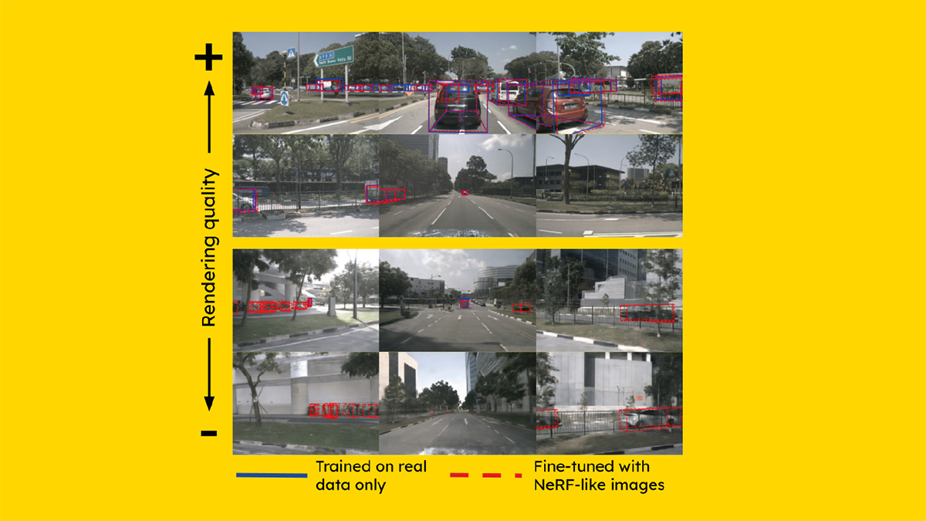
Knowledge Transfer
ABB and CERN – Innovation partnership for reducing energy consumption
ABB, a technology leader in electrification and automation, and CERN have developed a roadmap for reducing energy consumption in the cooling and ventilation systems used in CERN's accelerator complex, experimental areas, and data centres.
Zenseact and CERN – Knowledge transfer project contributes to research on autonomous driving
CERN and the Swedish AI company Zenseact, which develops car safety software, both need advanced technology to enable rapid analysis of large quantities of data.

Slide 8
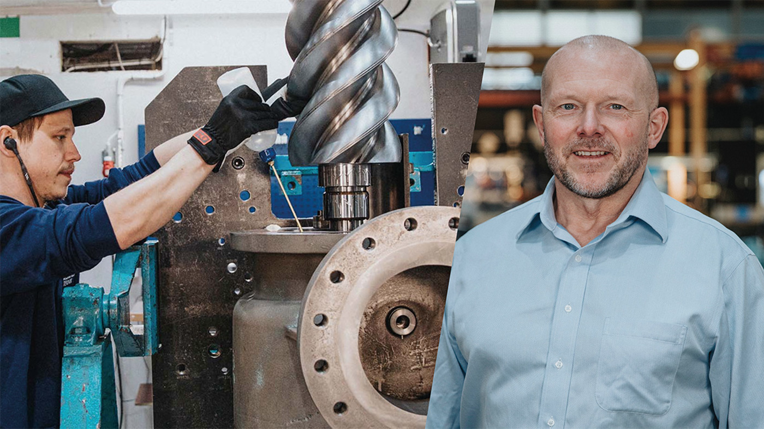
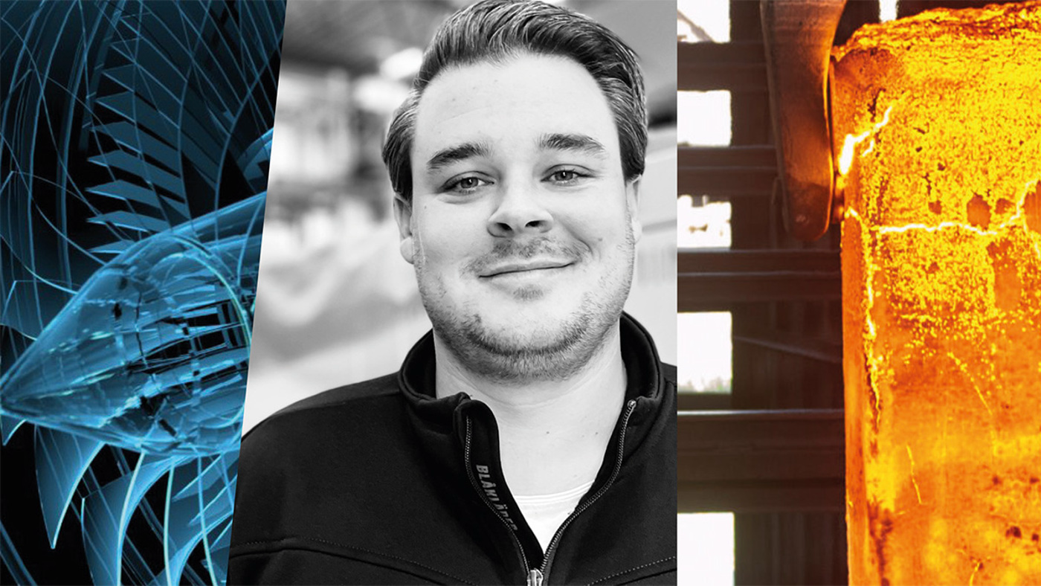
Business
Kompressorteknik wins new order from CERN
Another sizeable order extends the collaboration by a further four years. The new order involves CO2 accumulators for the ATLAS and CMS Phase II upgrades.
Big Science a new market for ElectroHeat
By winning its first Big Science contract — an order from CERN — ElectroHeat is entering a new market.
ElectroHeat Sweden AB, with its head office in Göteborg, makes industrial ovens and heat treatment equipment for industrial companies all over the world.

Slide 9
Funder engagement

Slide 10
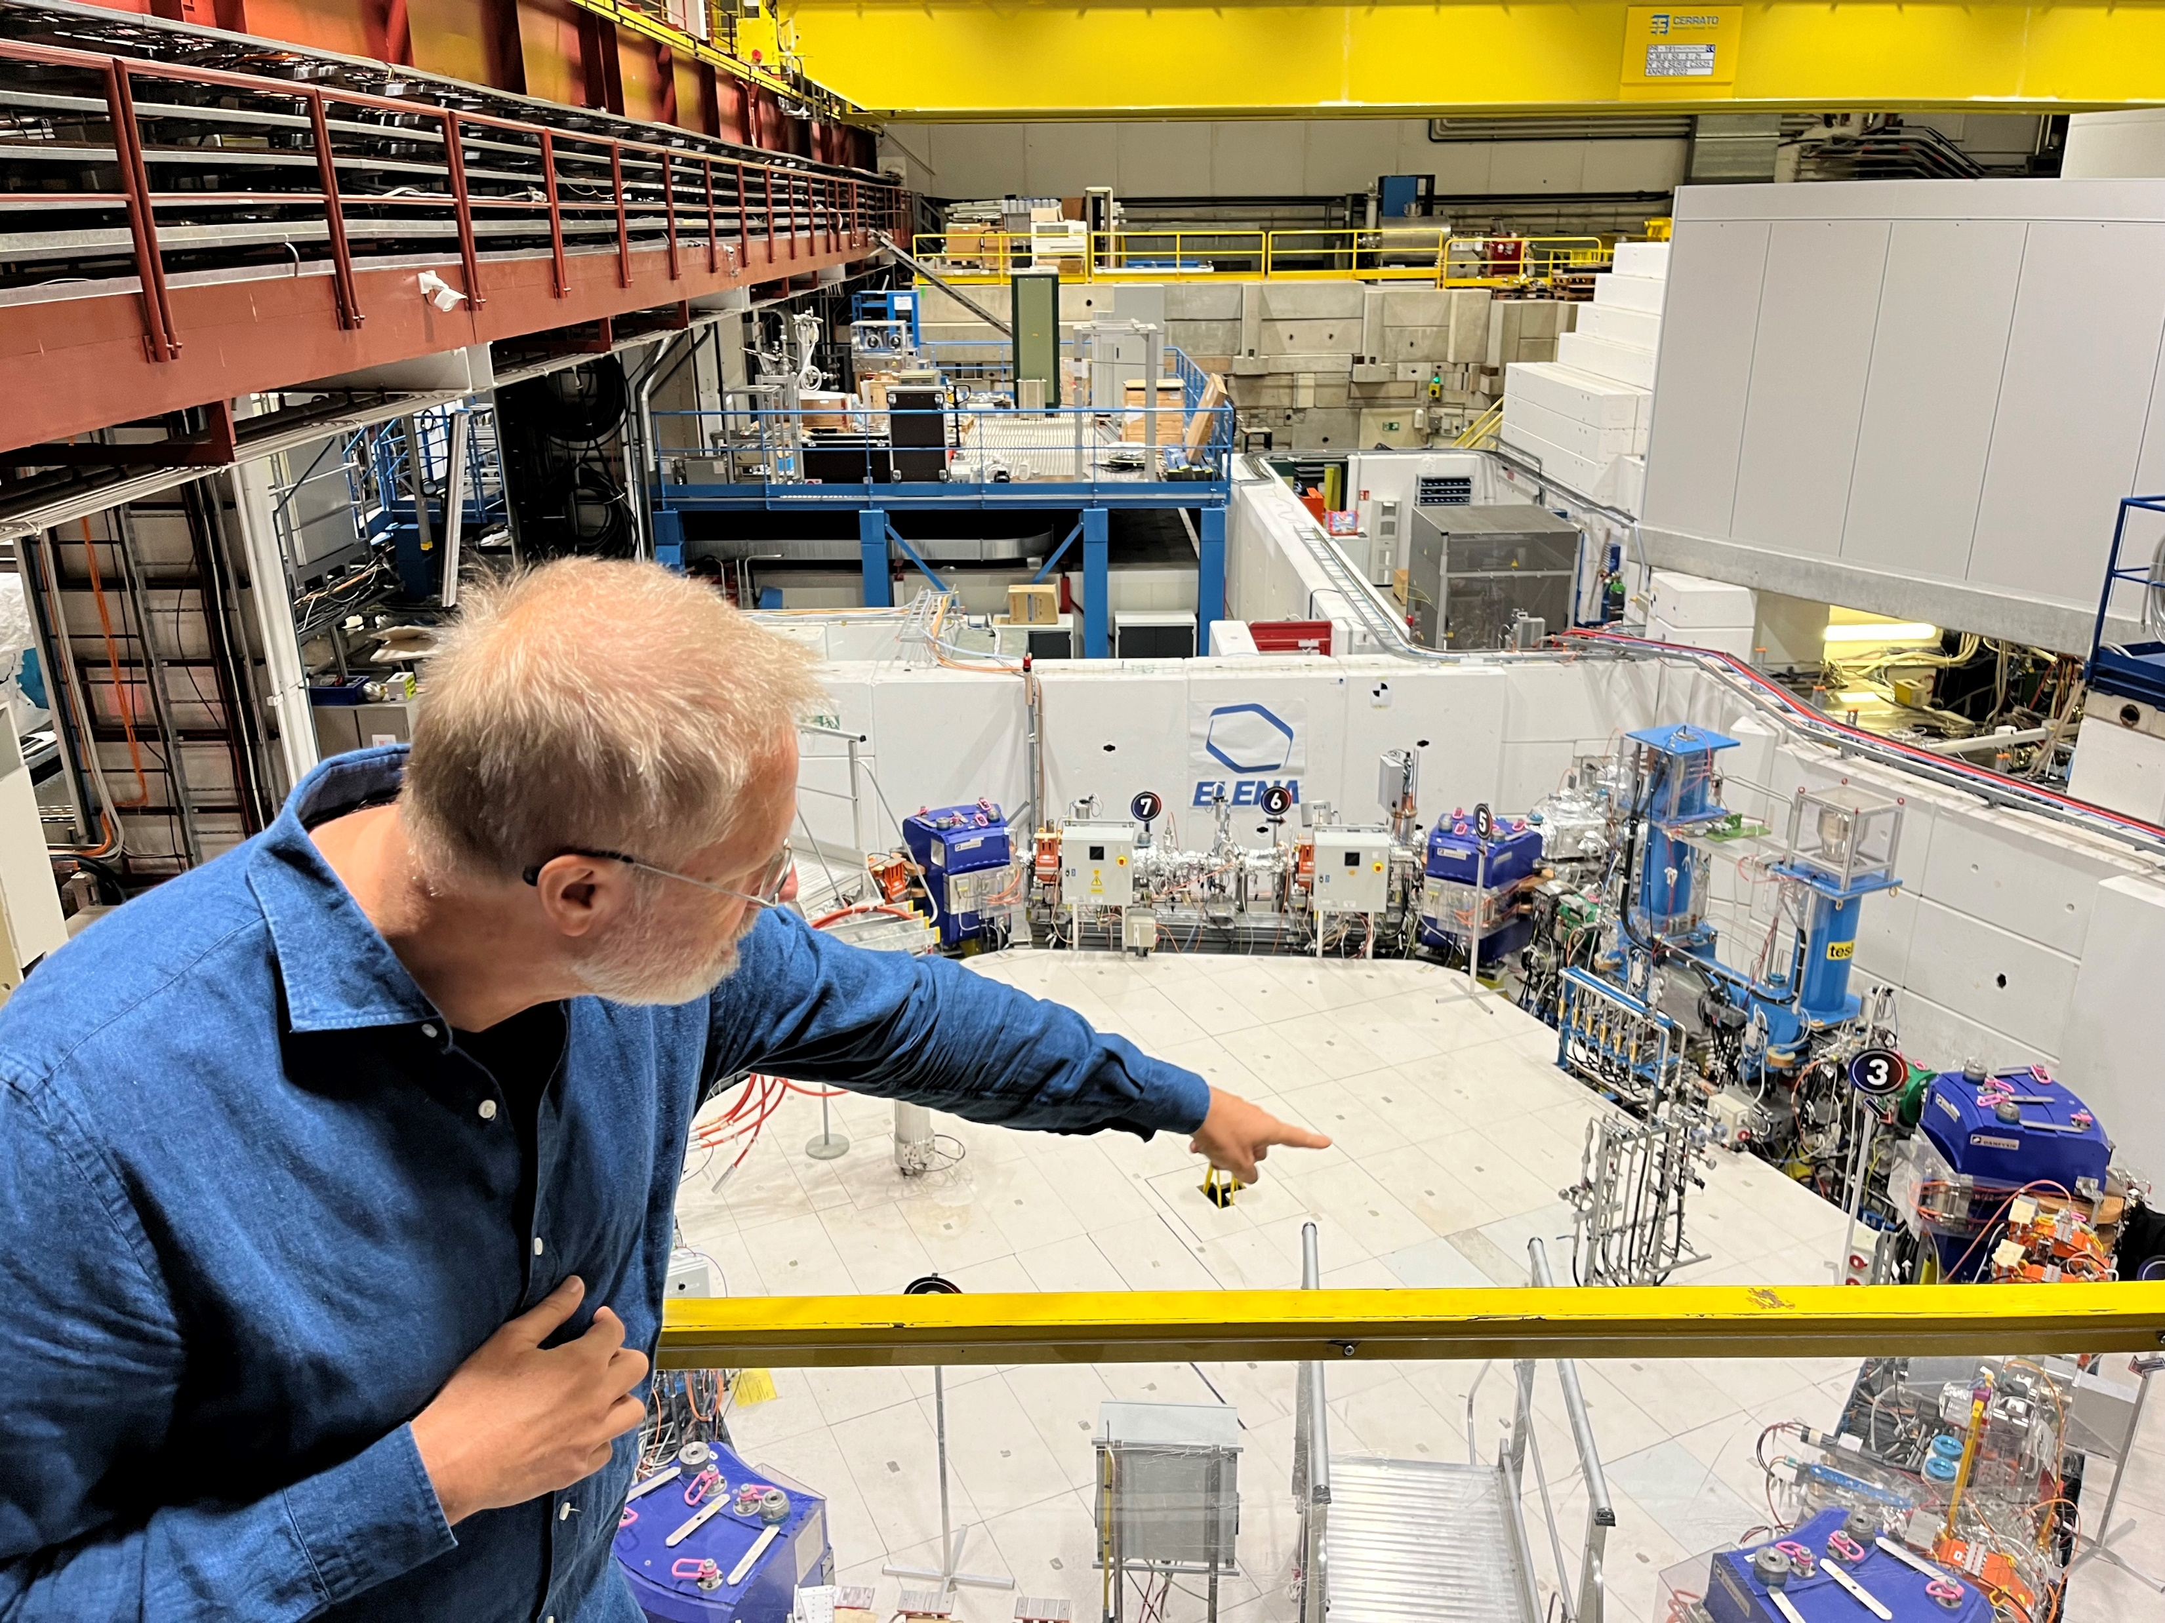
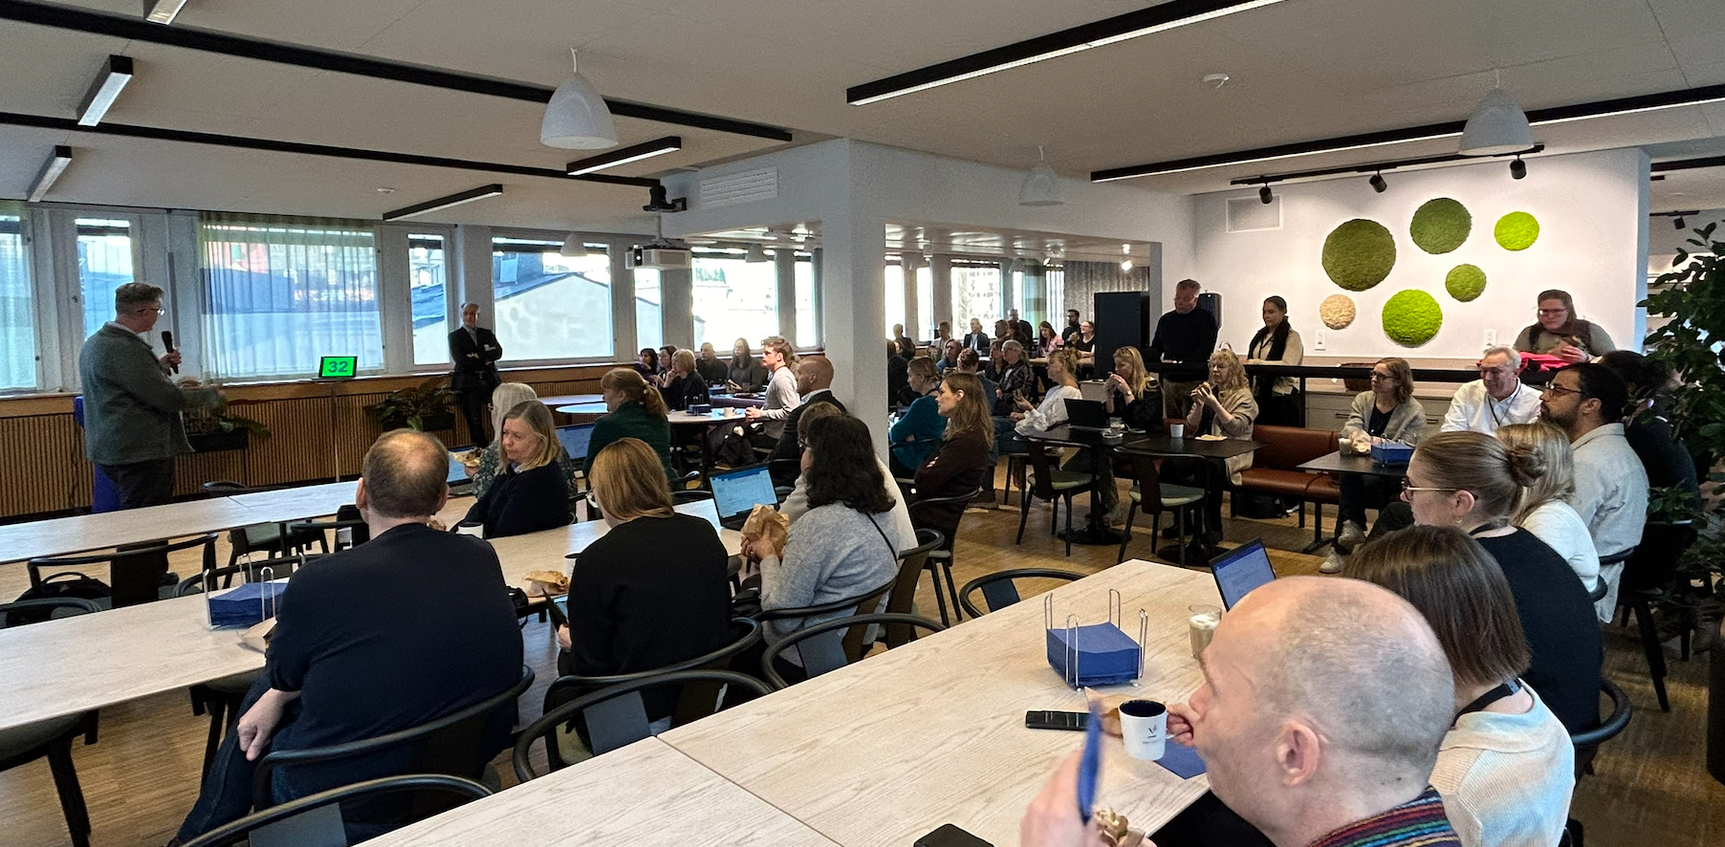
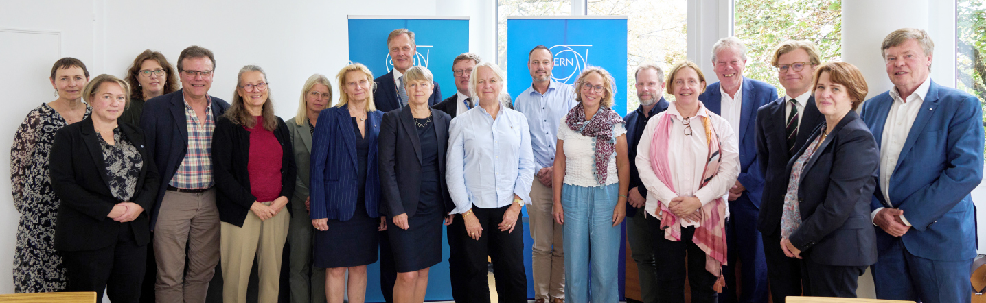
Notes:
Board of Swedish Research Council visiting CERN 25-26 September
70-ish staff at the Swedish Research Council listening to Richard Jacobsson explaining SHIP, 13 November

