Slide 1
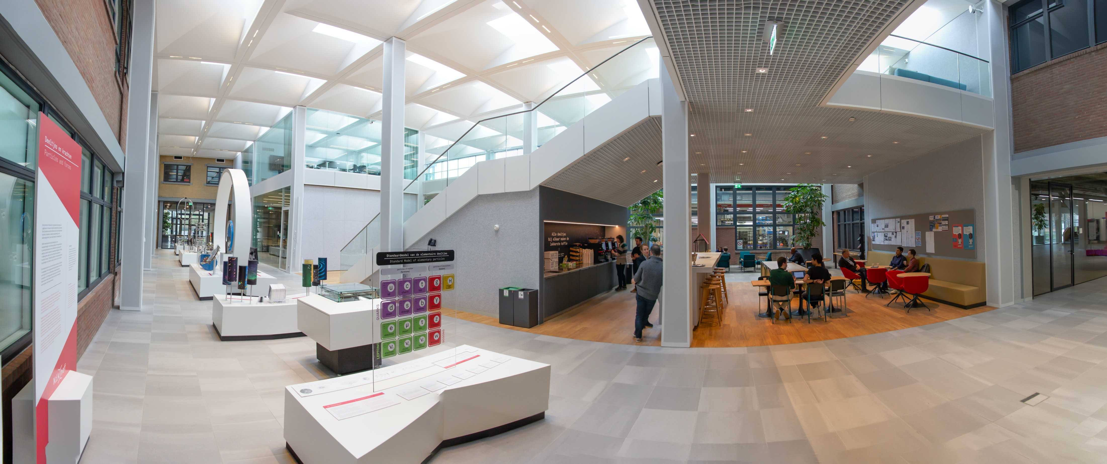
NL Highlight 2024
NEW EXPOSTRIP

Slide 2
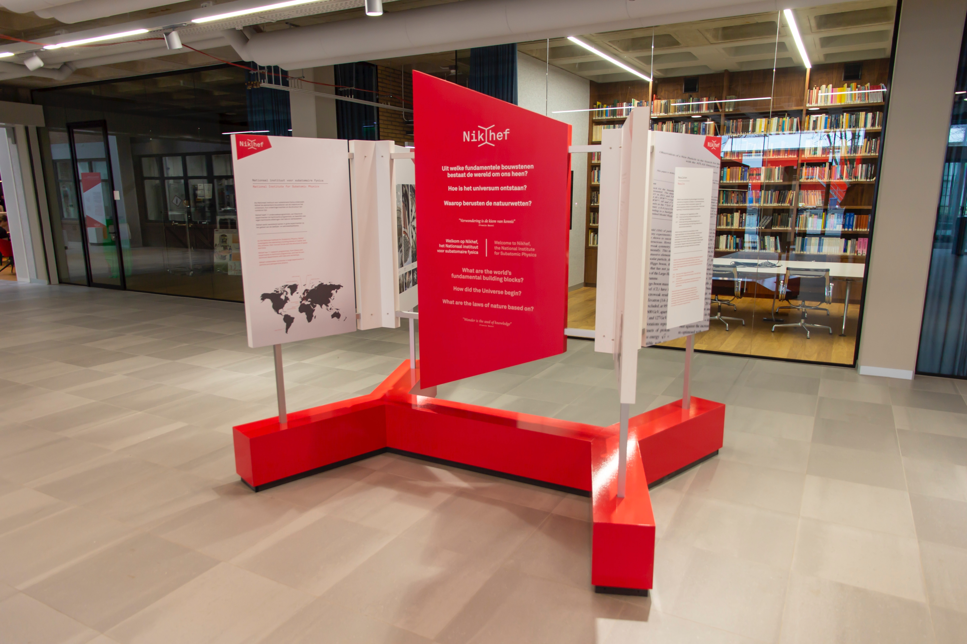
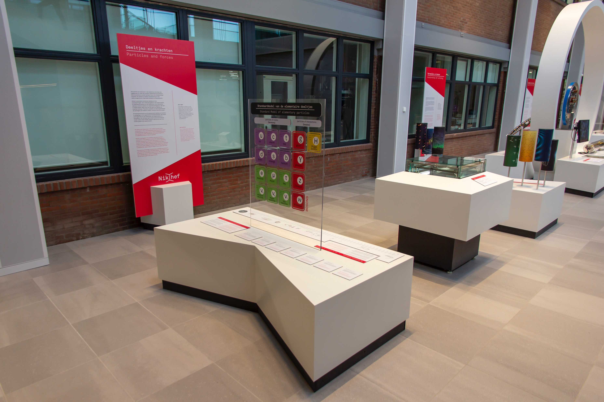
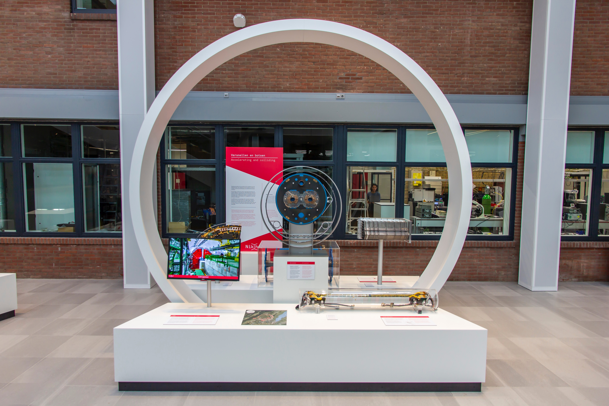
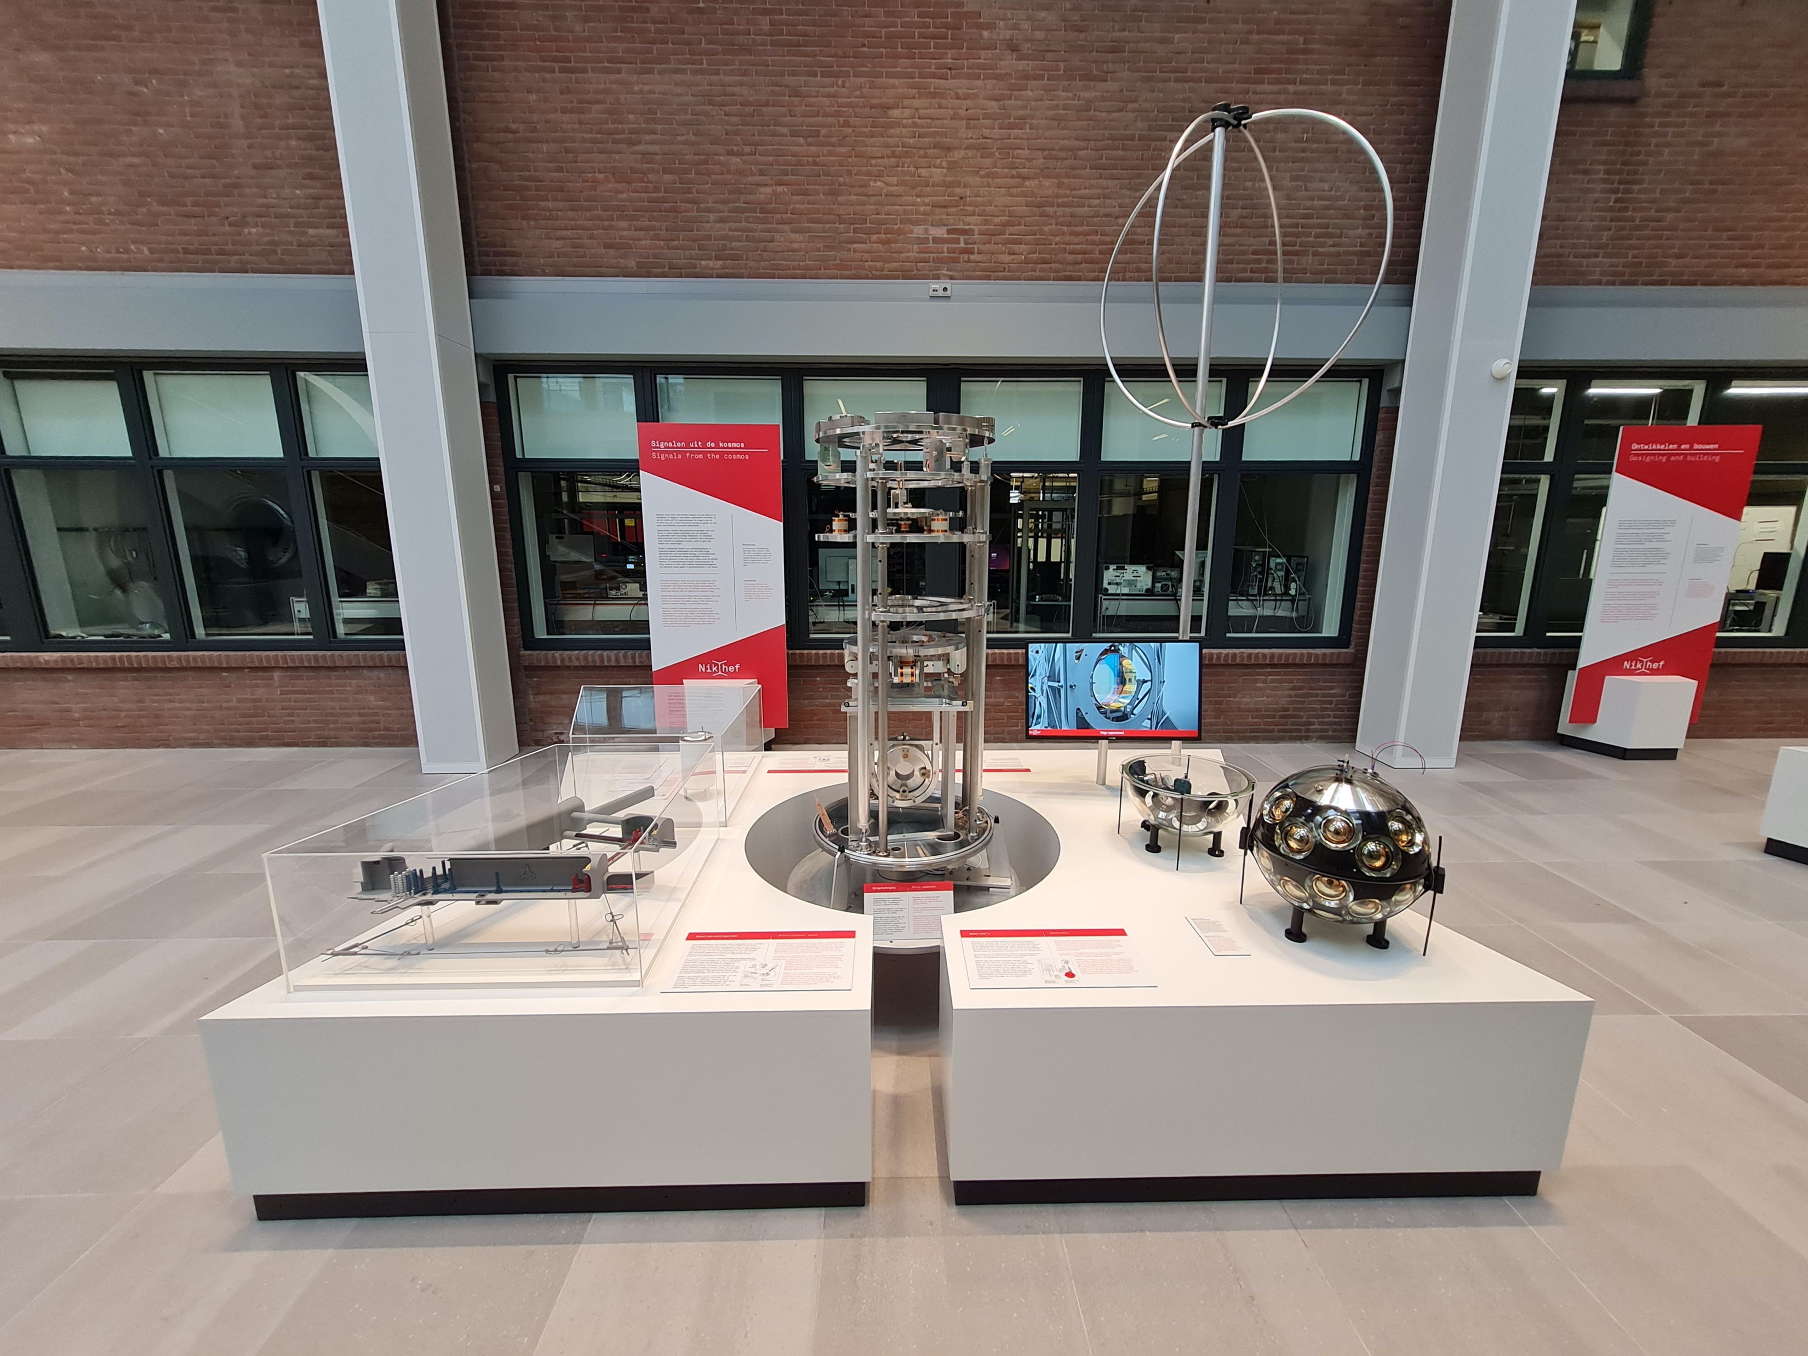
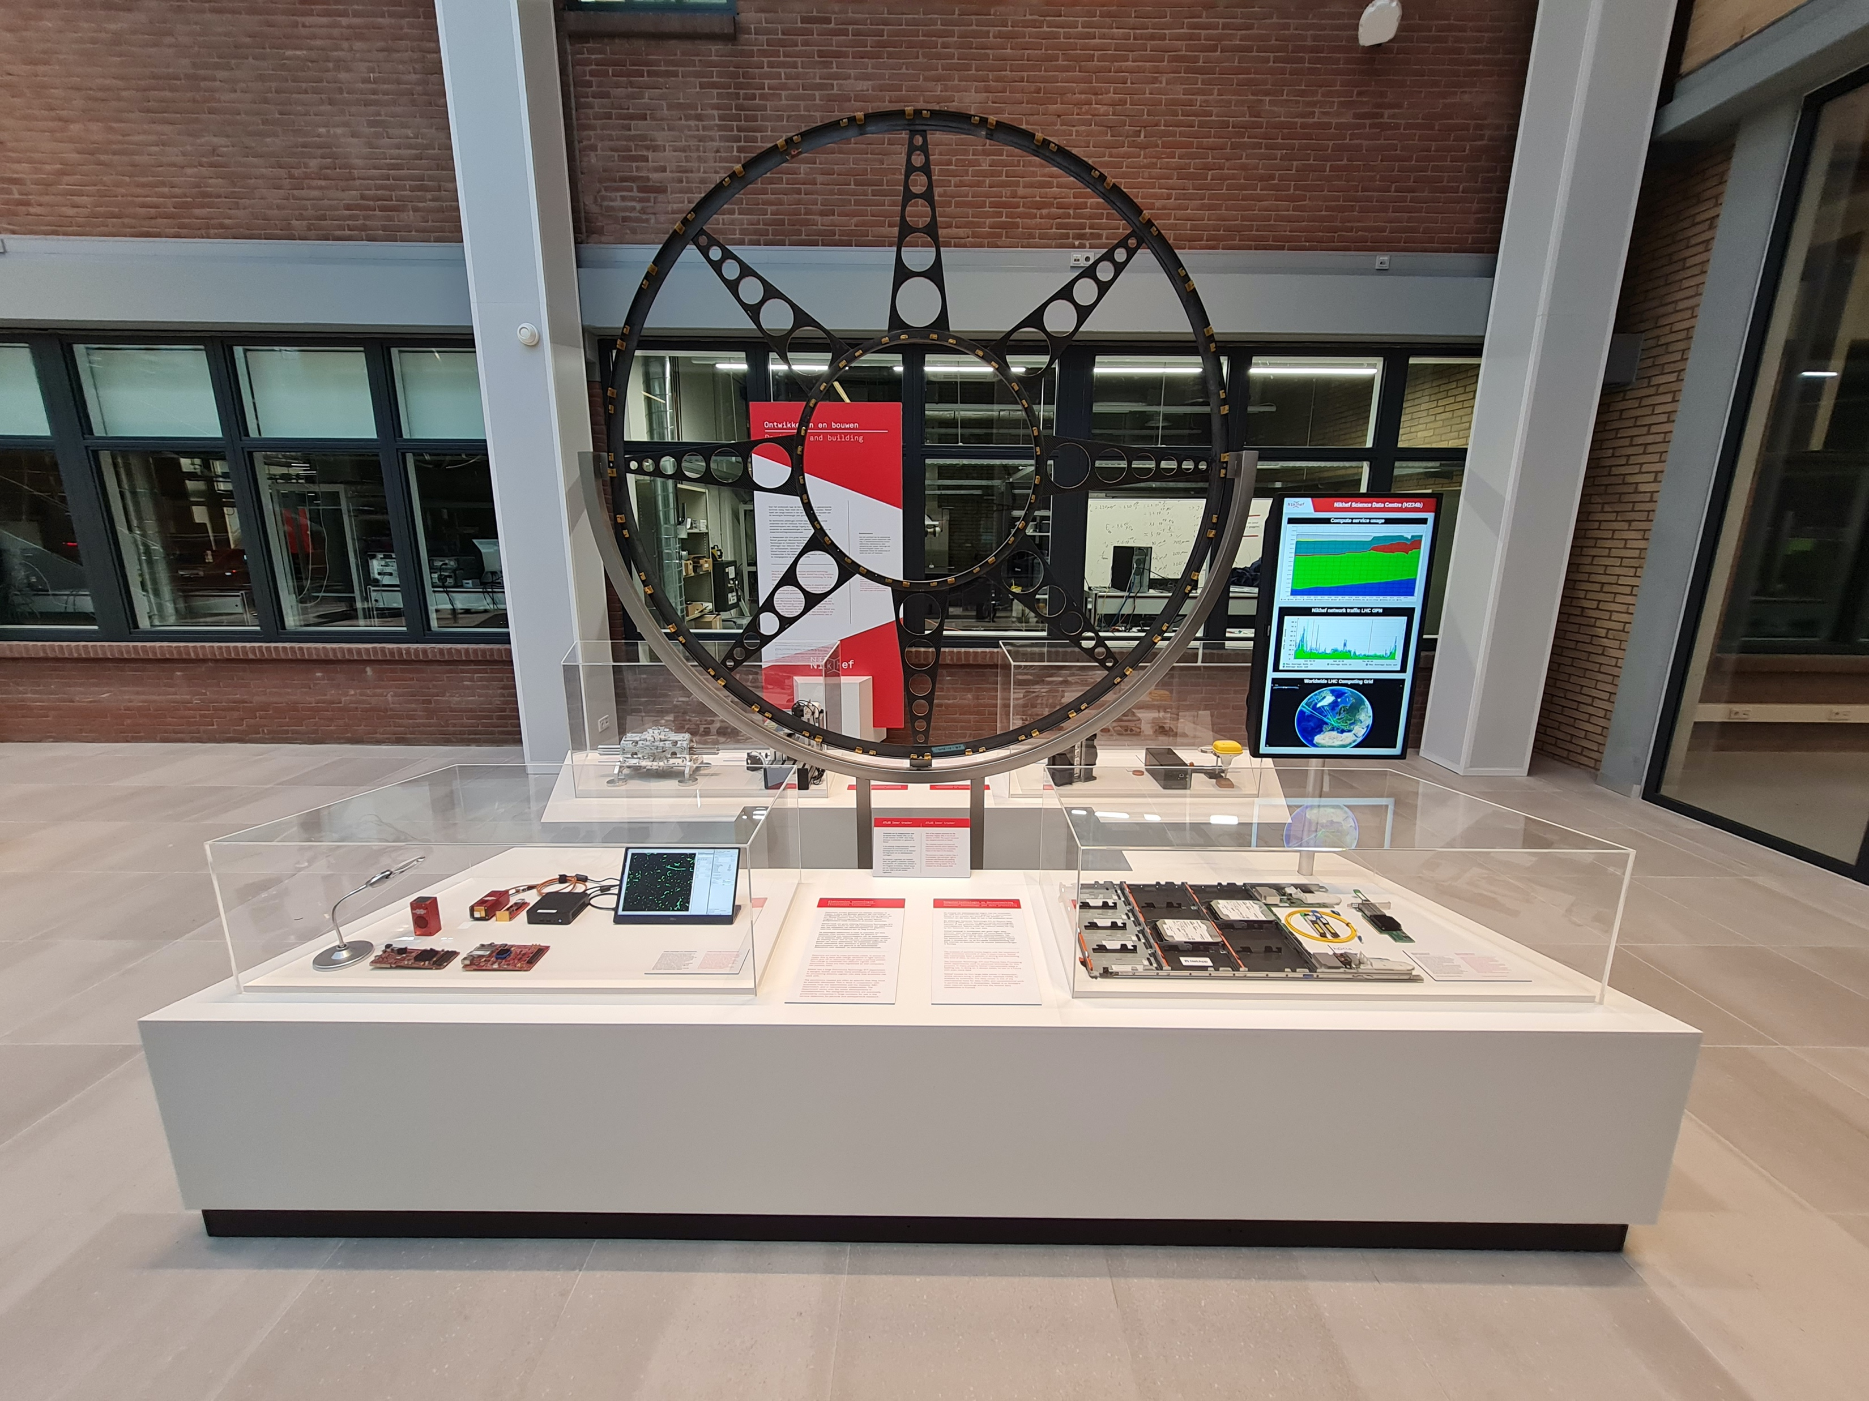
EXPOSTRIP
Five themes:
Nikhef,
Particles and Forces,
Accelerating and Colliding,
Signals from the cosmos,
Designing and building

