Slide 1
CERN communication in Serbia
2023/2024
Slobodan Bubnjević
Institute of Physics Belgrade
EPPCN member Serbia

Slide 2
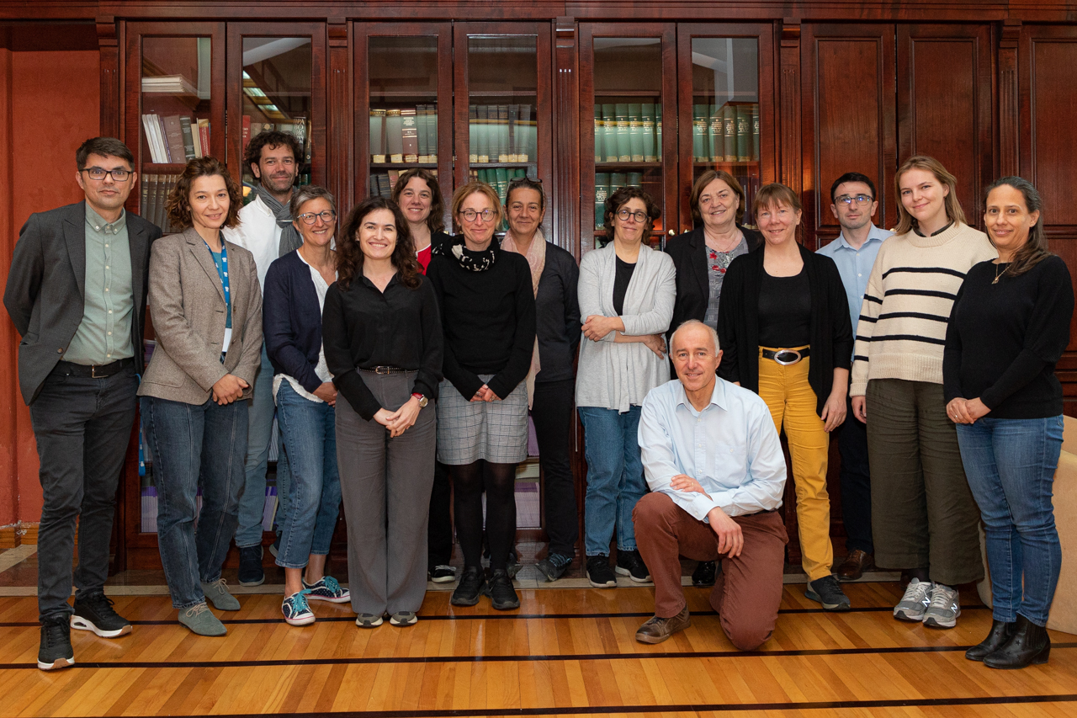
Remember when…
EPPCN meeting in Belgrade,
May 2023

Slide 3
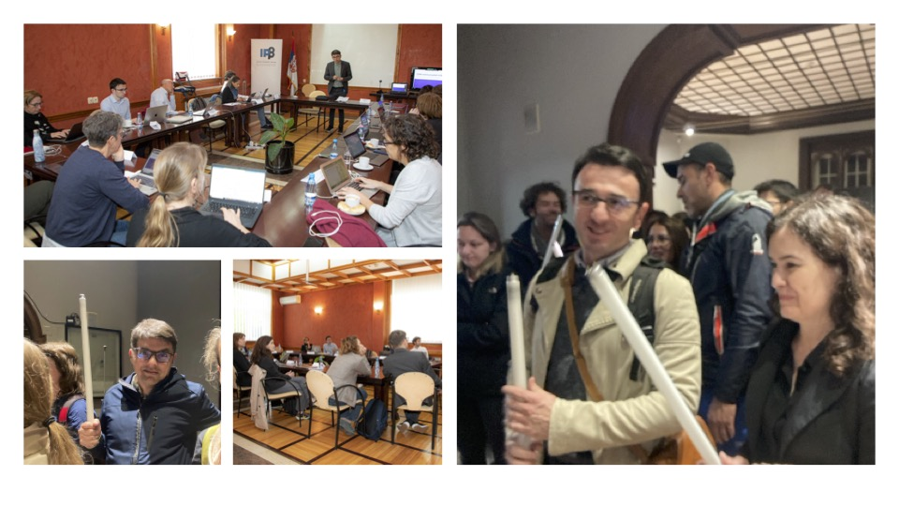

Slide 4
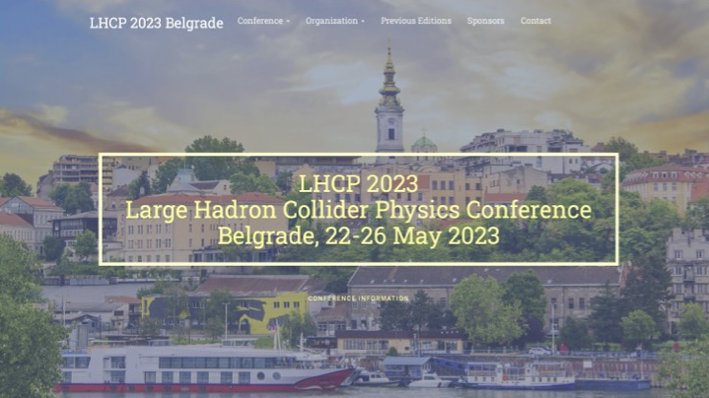
LHCP 2023 in Belgrade
More than 400 physicists from around the world

Slide 5
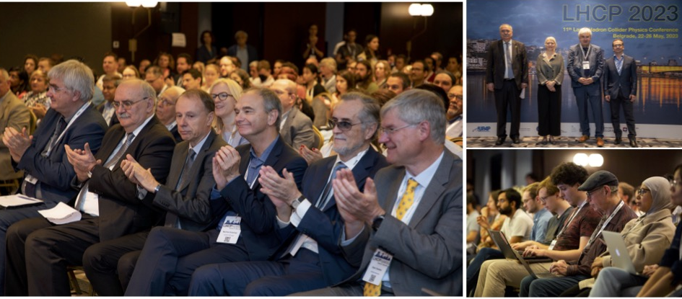

Slide 6
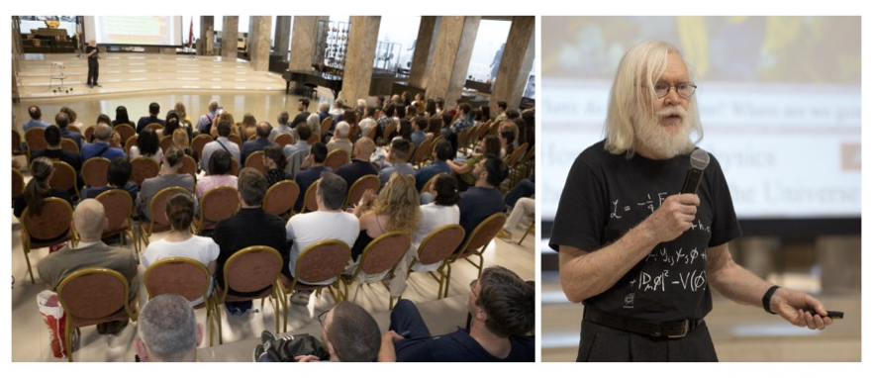
John Ellis
Lecture in the National Museum of Serbia

Slide 7

2024 – CERN 70
Series of lectures in April and May 2024, to mark the 70th anniversary of CERN (Institute of Physics Belgrade and Belgrade University)
First lecture held our CERN Council member, professor Petar Adžić.

Slide 8






CERN 70
Lectures

Slide 9
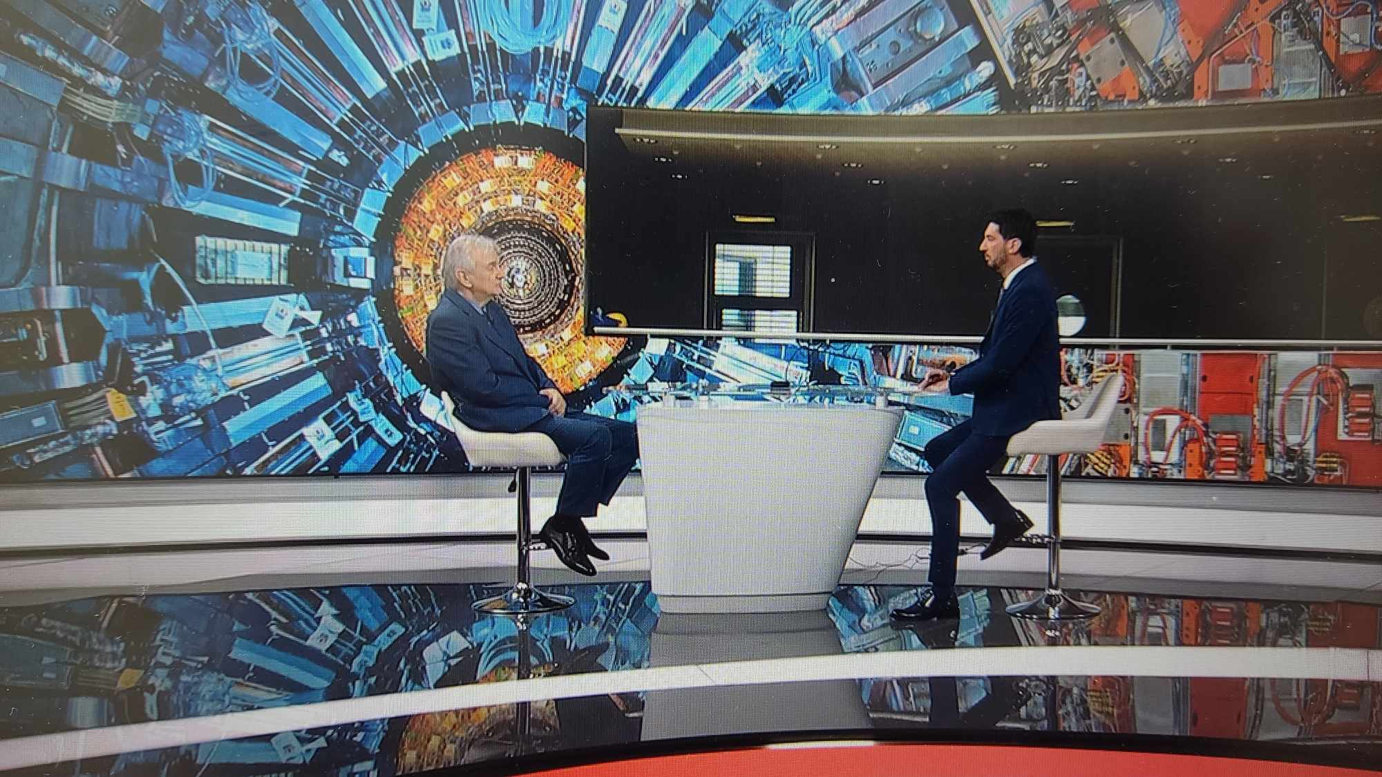
CERN 70 MEDIA ACTIVITIES

Slide 10
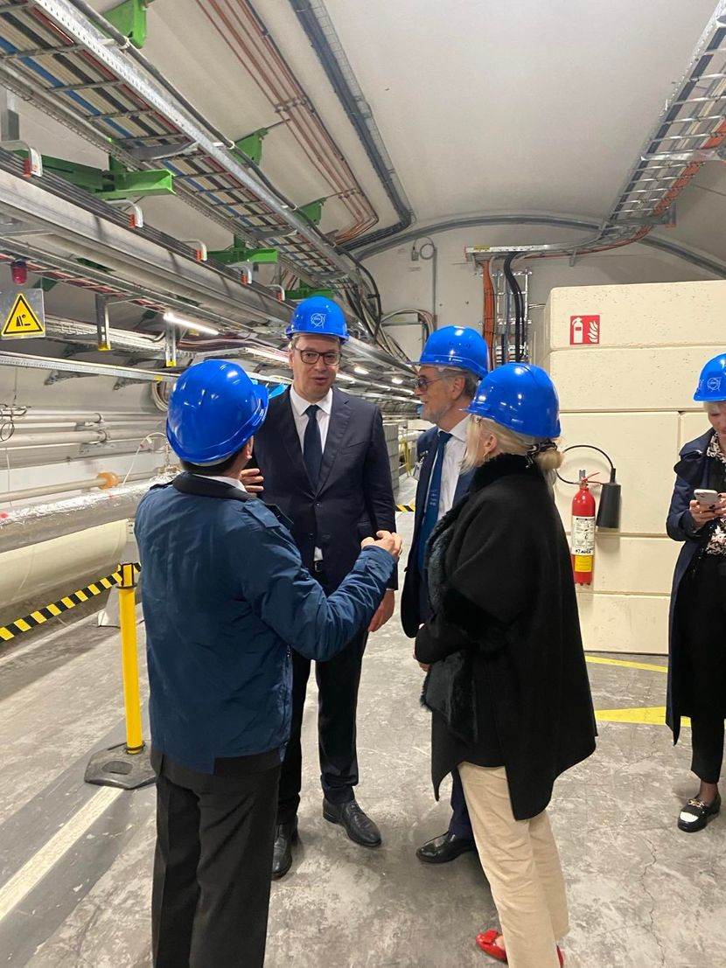
CERN 70 VISIT
The President of Serbia, Aleksandar Vučić, strongly supported cooperation with CERN, emphasized the importance of research, and announced an increase in Serbia's investment in this cooperation. He also called on other countries to increase their contributions to CERN.

Slide 11

Next:
RECFA VISIT TO SERBIA
November 29th
CERN IN SERBIA
Exhibition, November 29th

