Slide 1
HL-LHC optics MD results
Yannis Angelis
LNO Meeting, 01-11-24

Slide 2
Contents
Arc45,81 corrections for Beam1
Arc45 correction for Beam2
Investigation of possible source of phase error
Focus only at a single β*, to compare before and after the applied corrections

Slide 3
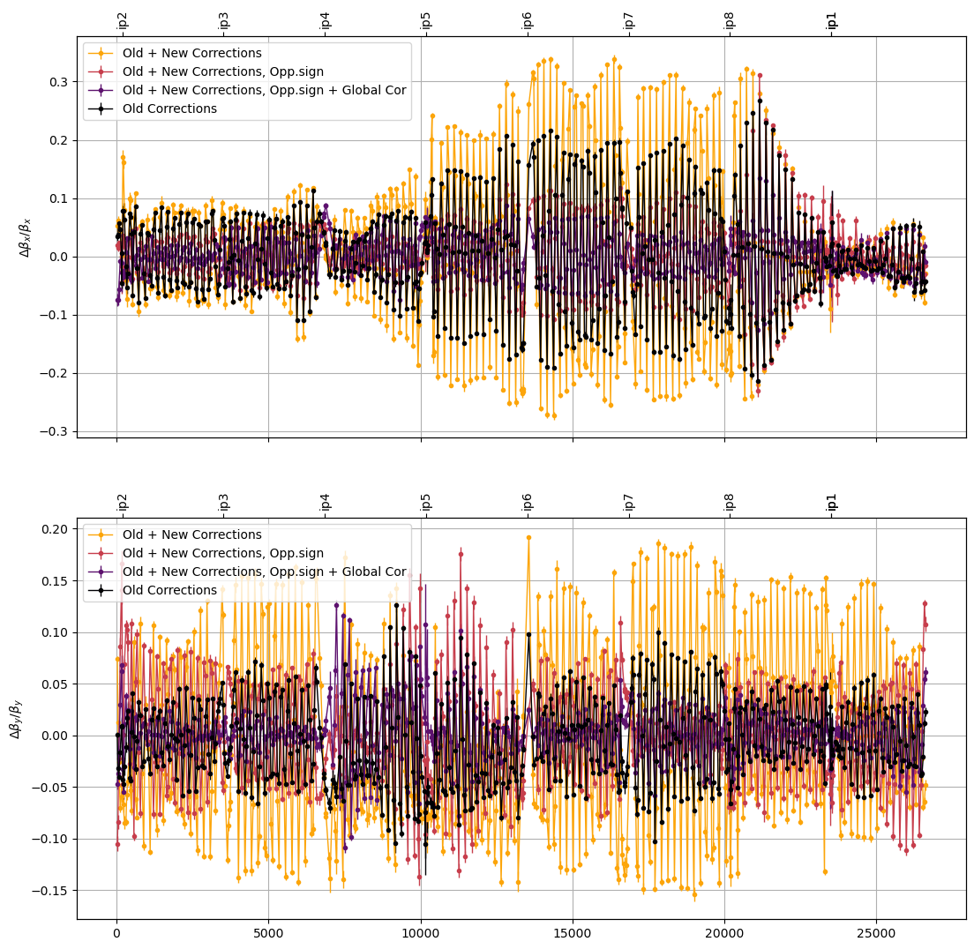
Arc corrections for Beam1
Analysis for the step: 165/84cm
Old corrections: Sextupole Bumps + Q10 + MQT, at Arc45, Arc81
New Corrections: Sextupole Bumps +MQT at Arc45, Arc81
Goal: Reduce β-beating by reducing the phase errors in the arcs

Slide 4
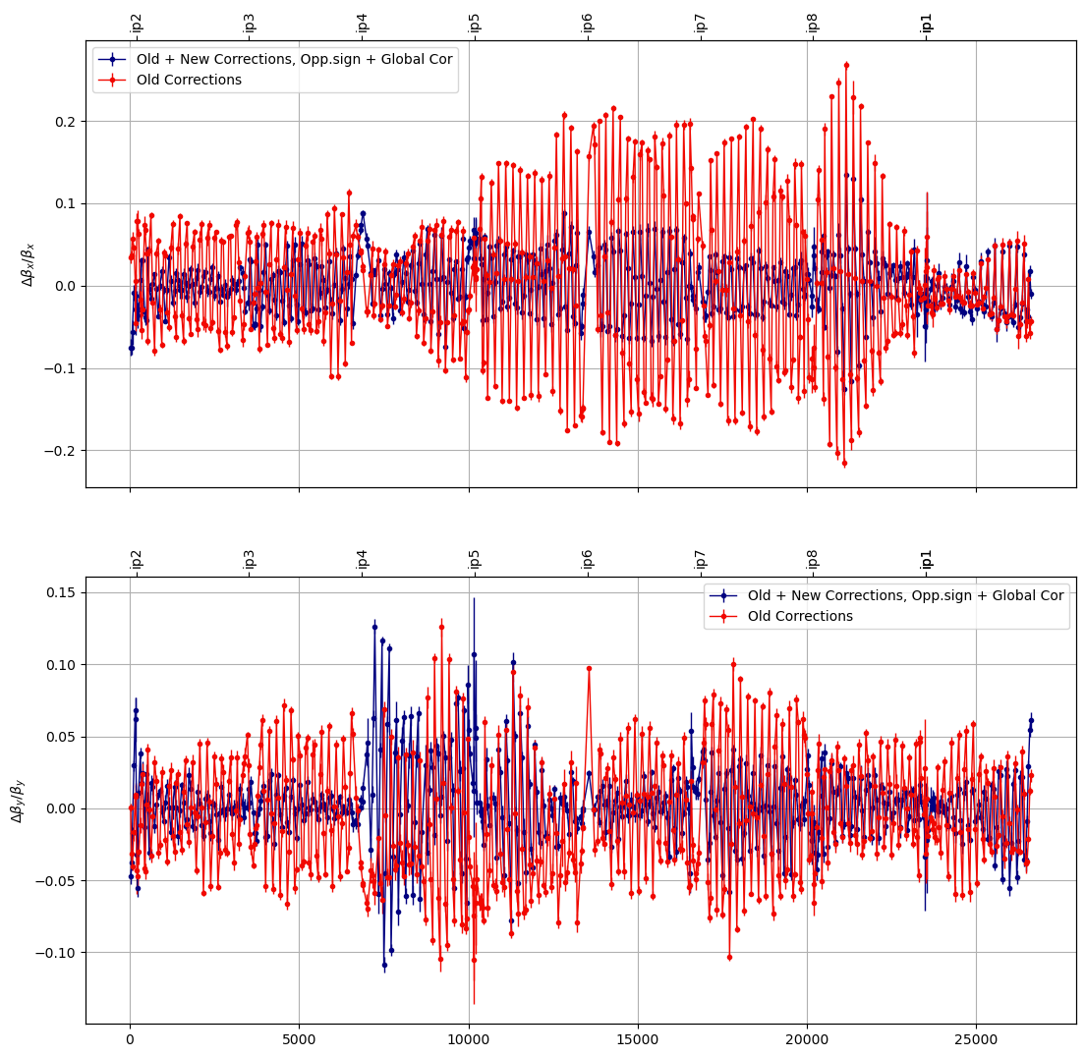
Arc corrections for Beam1
Analysis at the step: 165/84cm
Old corrections: Sextupole Bumps + Q10 + MQT
New Corrections: Sextupole Bumps +MQT
‘Similarly’ for both arcs
Goal: Reduce β-beating by reducing the phase errors in the arcs

Slide 5
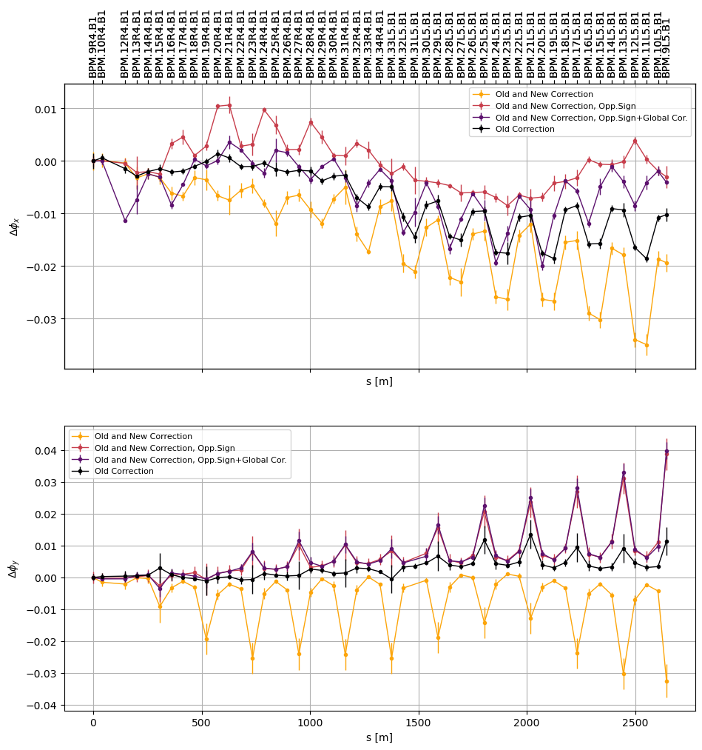
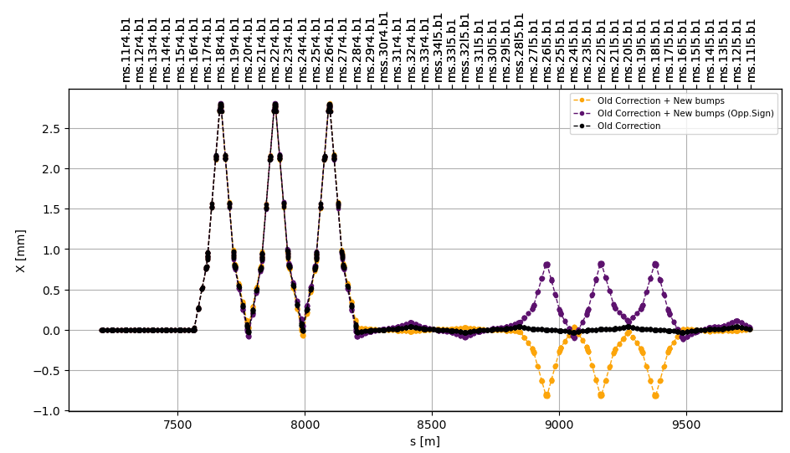
Arc45 corrections for Beam1
Old corrections: Left side of the arc
New Corrections: Right side of the arc

Slide 6
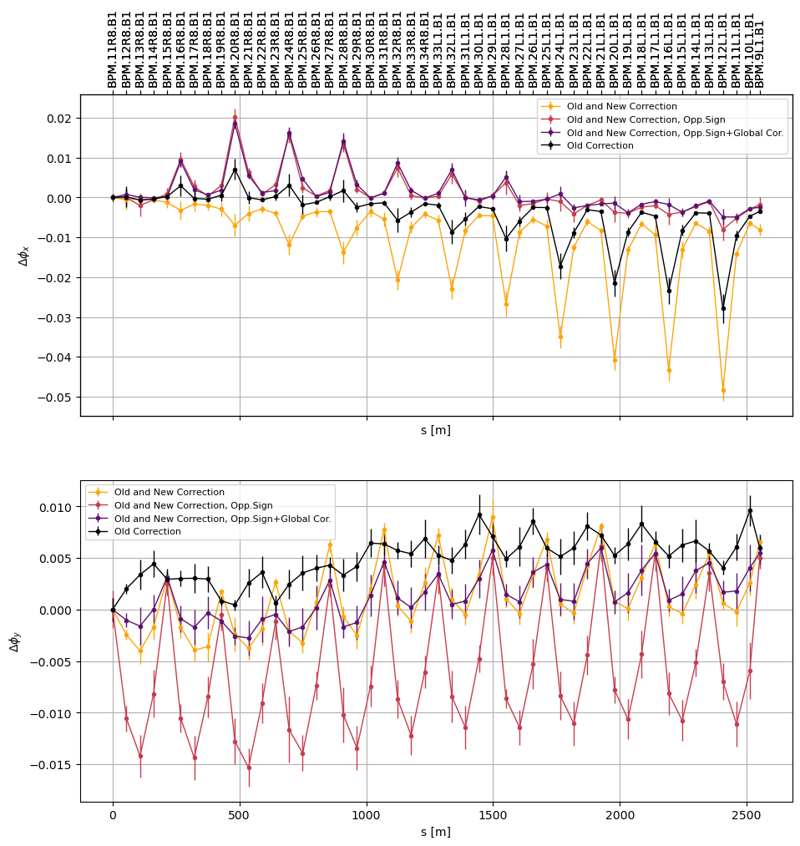
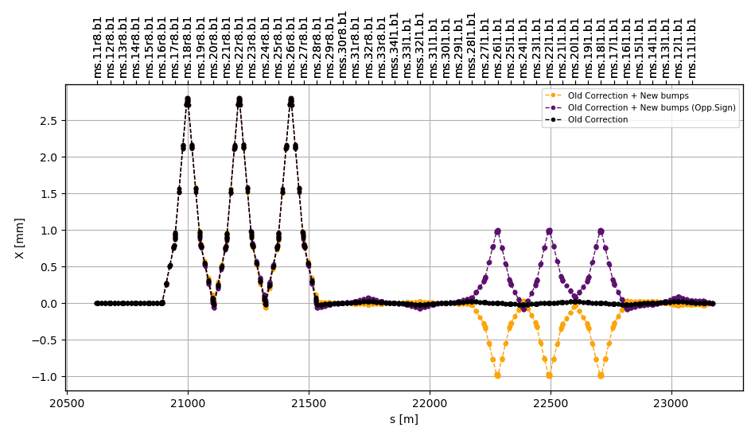
Arc81 corrections for Beam1
Old corrections: Left side of the arc
New Corrections: Right side of the arc

Slide 7
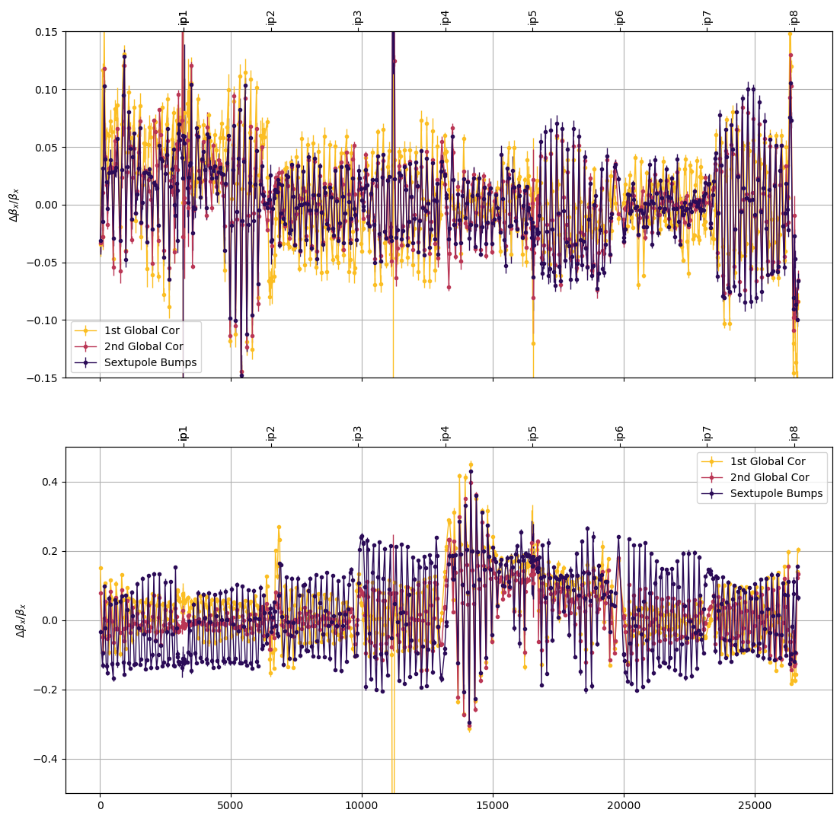
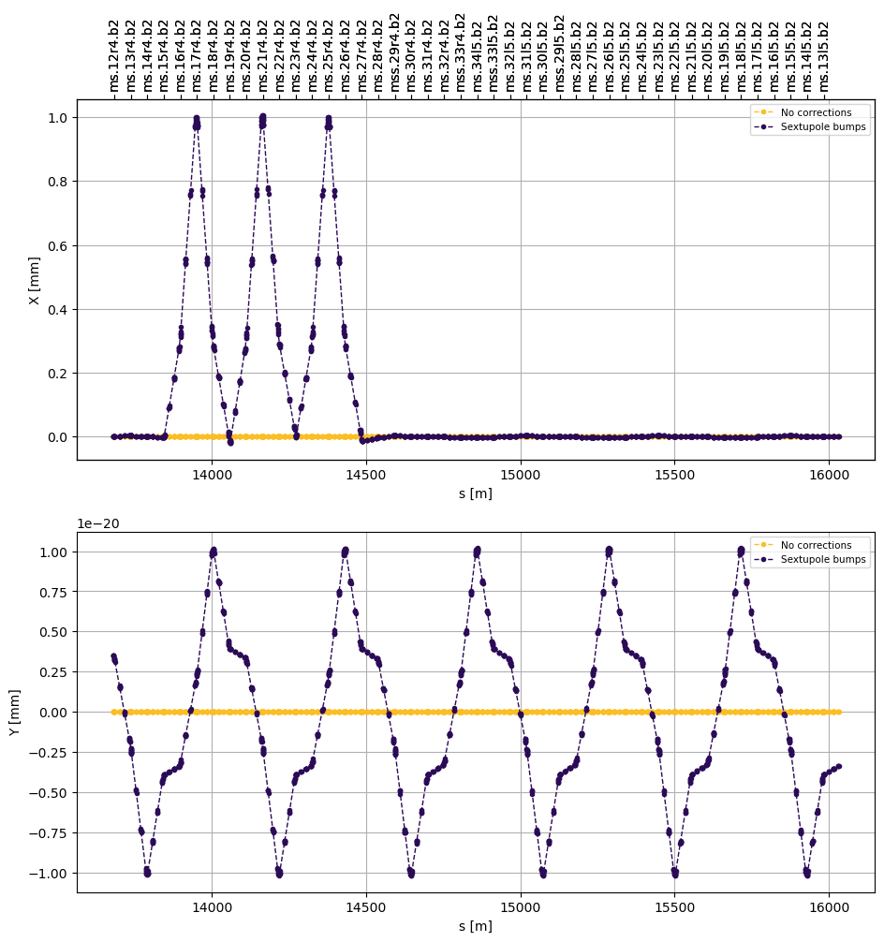
Arc45 corrections for Beam2
110/43cm
Sextupole bumps: Applied with the 1st iteration of Global corrections
2nd iteration did not improve arc45 beating
Correction: Sextupole bumps on the left side of the arc + KQTD.A45B2

Slide 8
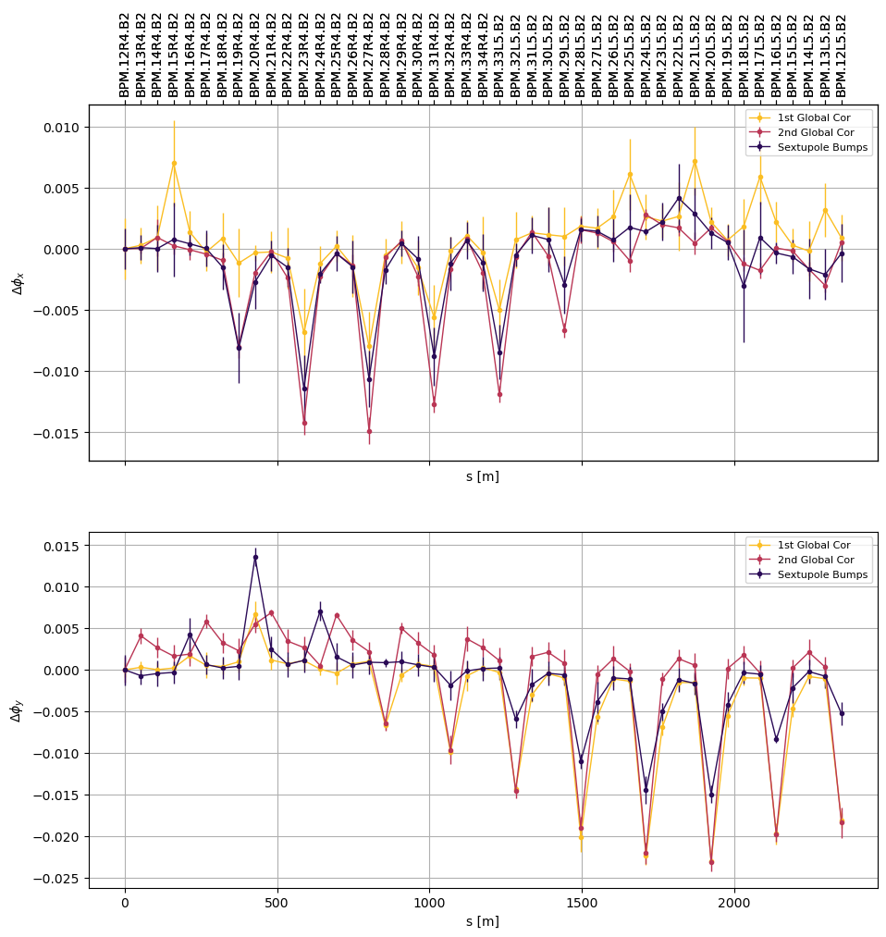
Arc45 corrections for Beam2
Correction: Sextupole bumps on the left side of the arc + KQTD.A45B2

Slide 9
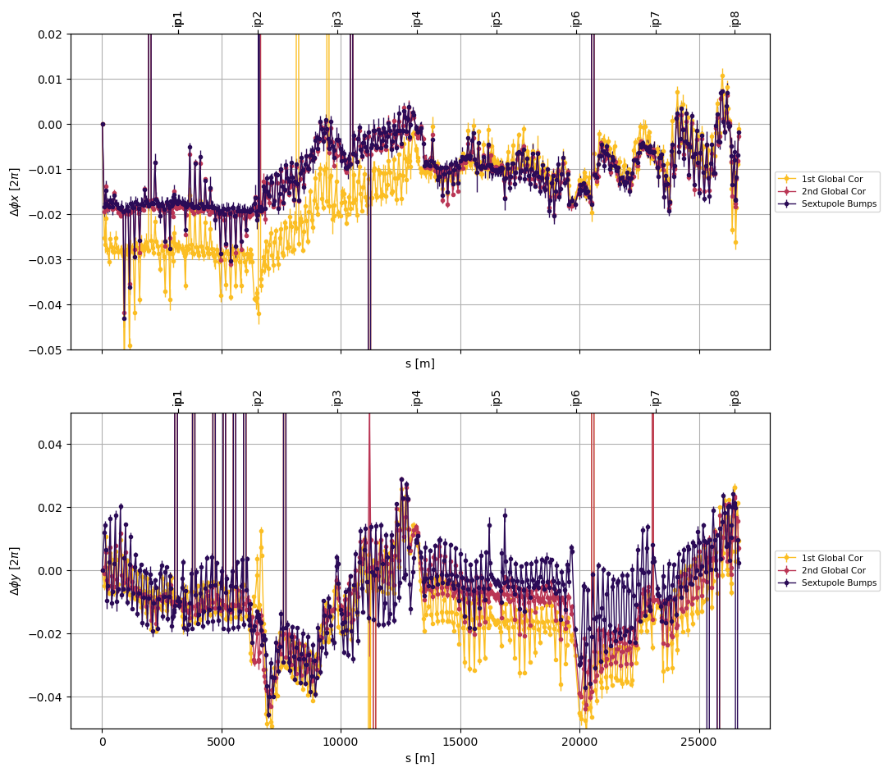
Arc45 Beam2
Investigating the source of the phase error: Focusing around IP4
Phase error ‘drift’ in Arc45
Correction did not improve globally the vertical plane

Slide 10
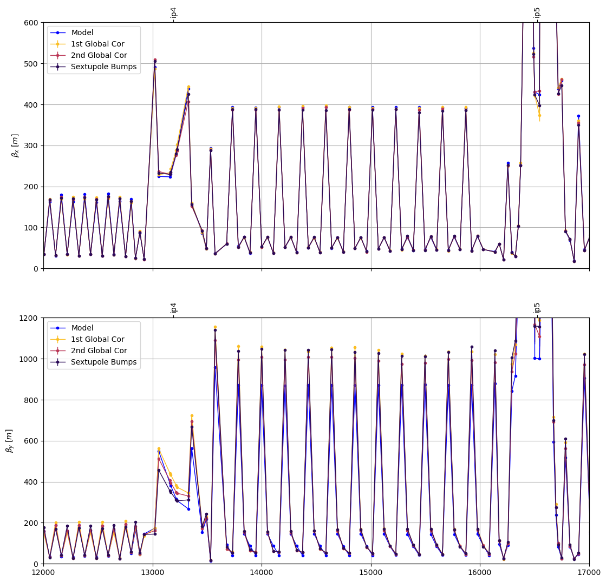
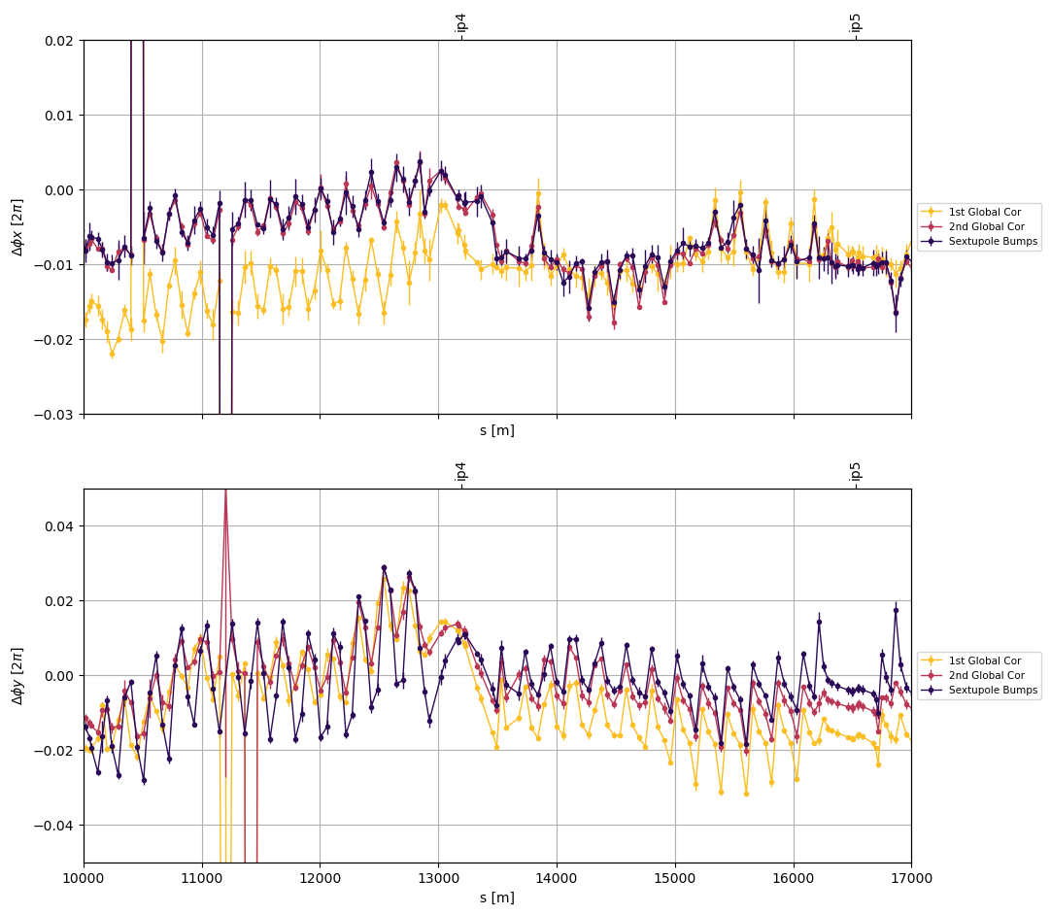
Arc45 Beam2
Investigating the source of the phase error: Focusing around IP4
Visible difference in β

Slide 11
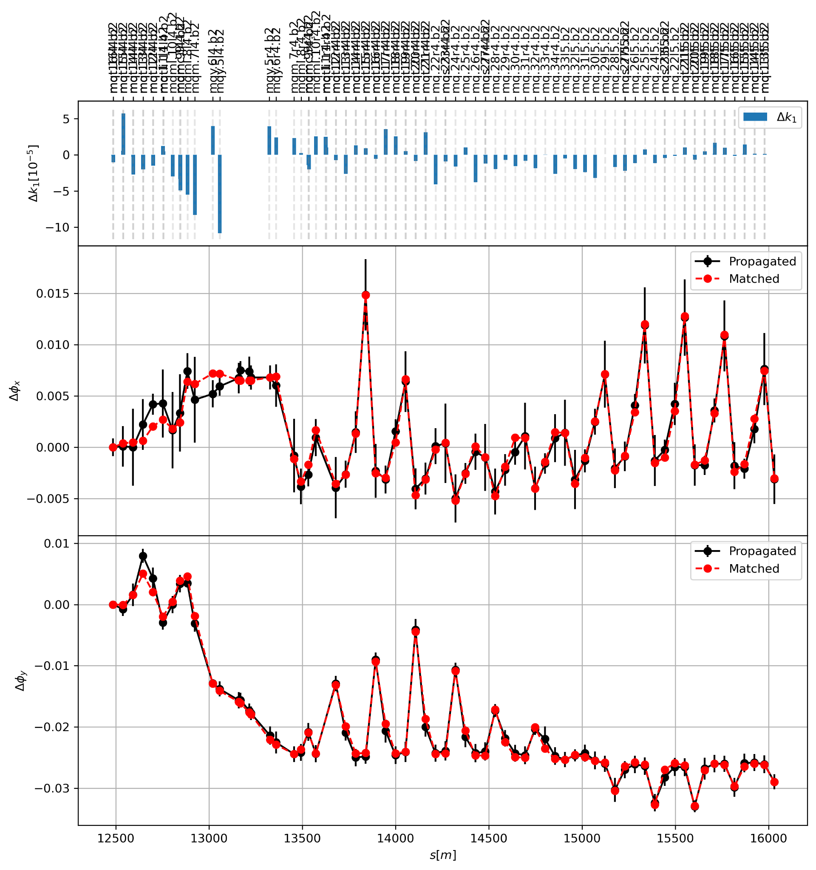
Arc45 Beam2
Investigating the source of the phase error
Selection of quadrupoles in the segment
Response matrix for the phase error
Preliminary analysis

Slide 12
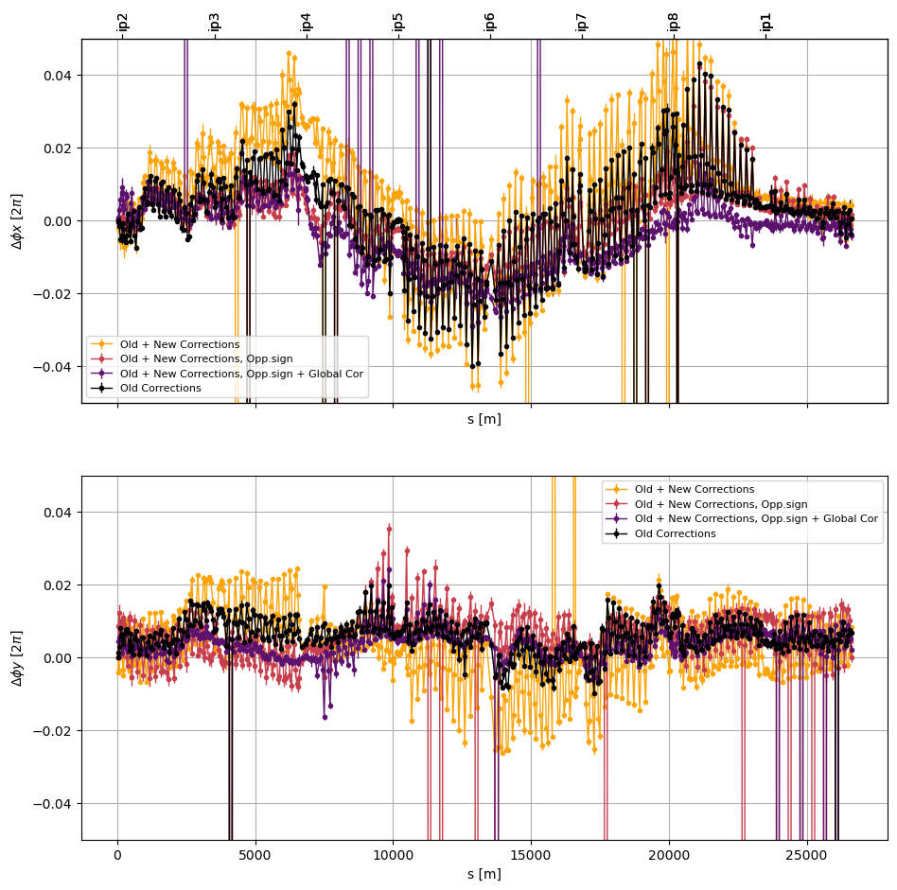
Arc45 Beam1

Slide 13
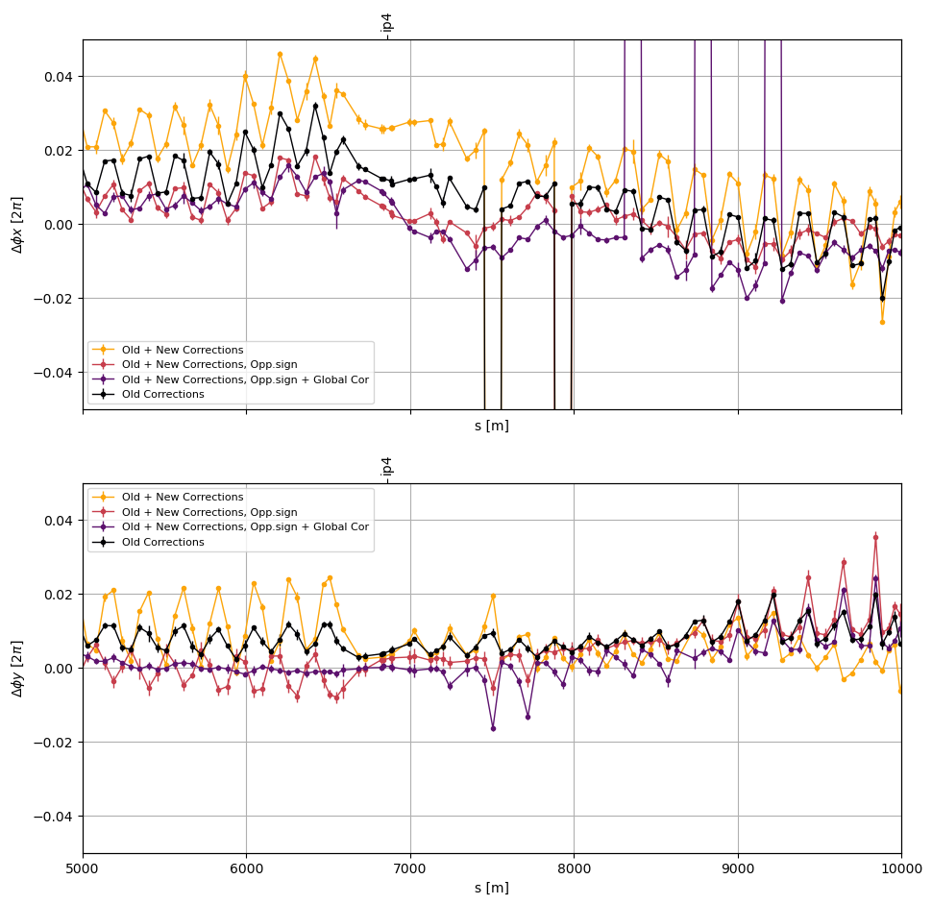
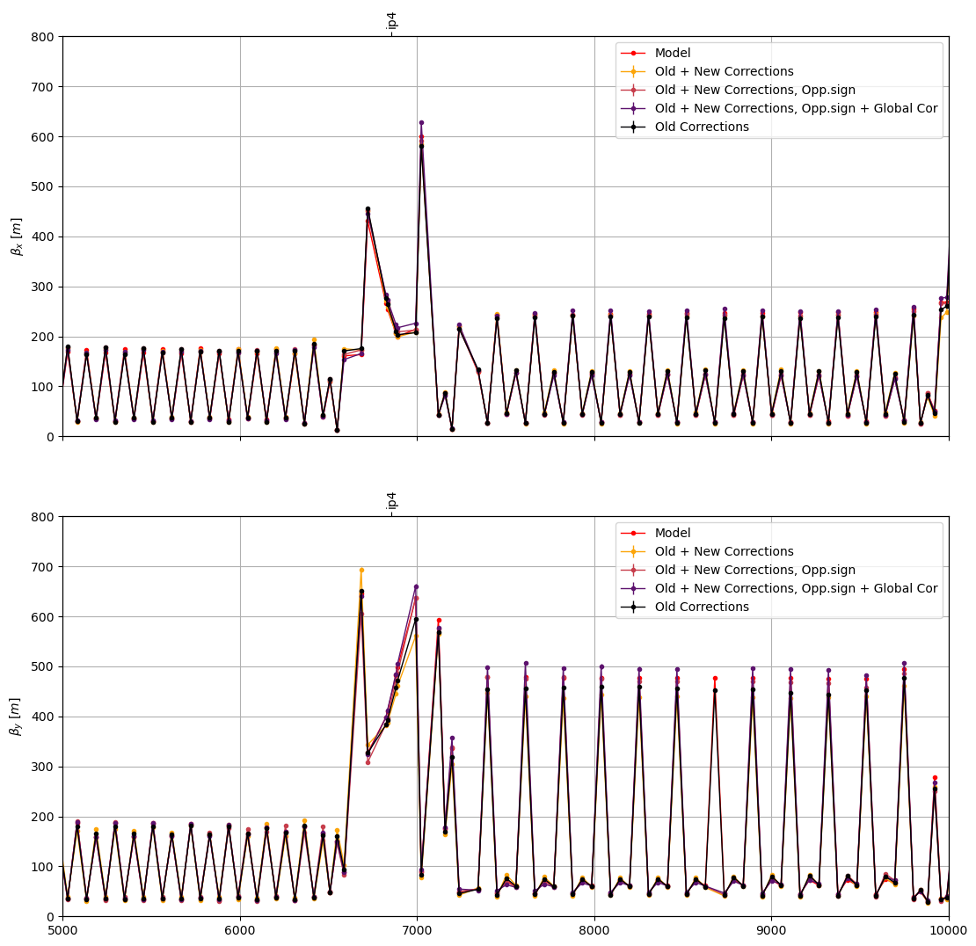
Arc45 Beam1

Slide 14
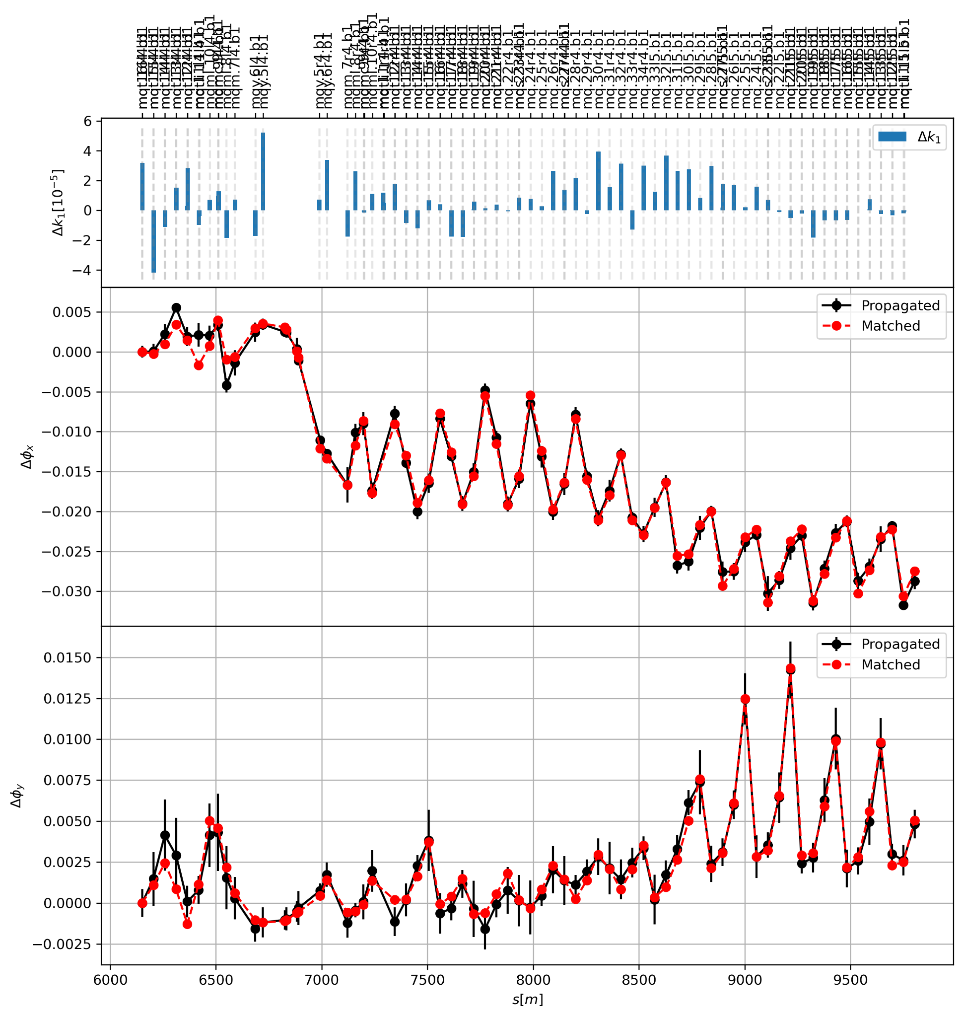
Arc45 Beam1
Investigating the source of the phase error
Selection of quadrupoles in the segment
Response matrix for the phase error
Preliminary analysis

Slide 15
Conclusions
Local arc corrections in the arc improve optics control Beam1
Beam2 arc correction not enough
Plan to either modify the Beam2 correction or apply extra global corrections (postponed since MD5 part was cancelled)
Possible source of Q5.L4

