Slide 1
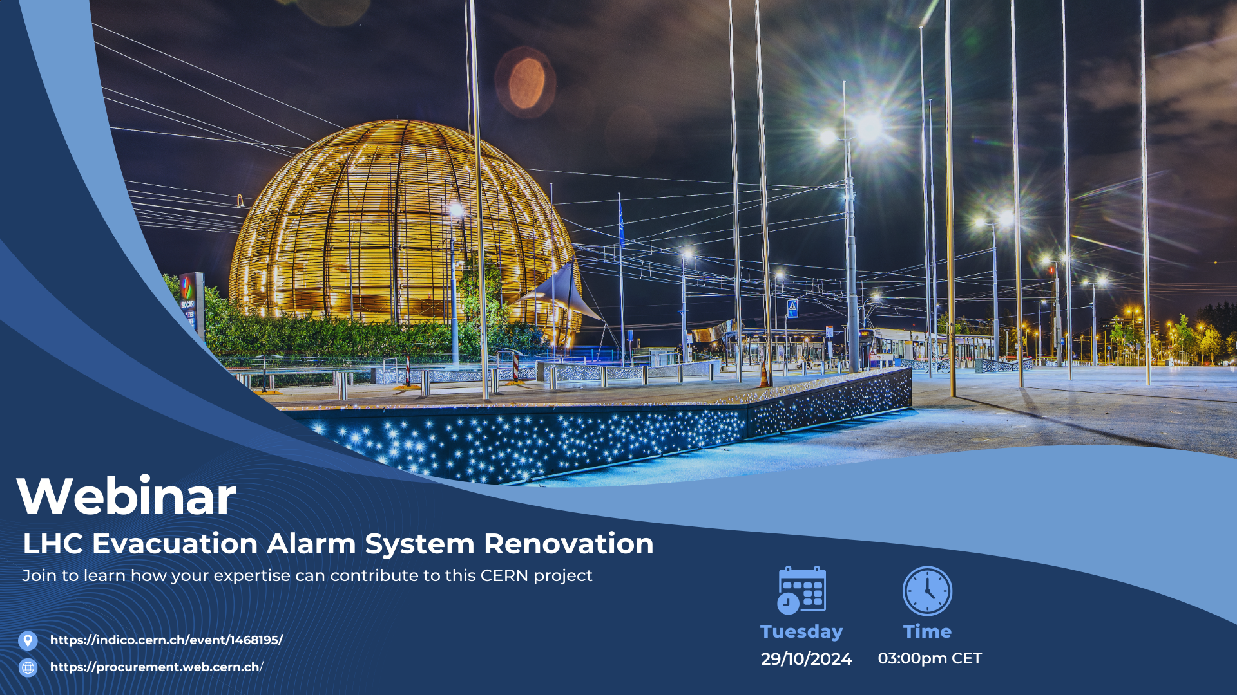
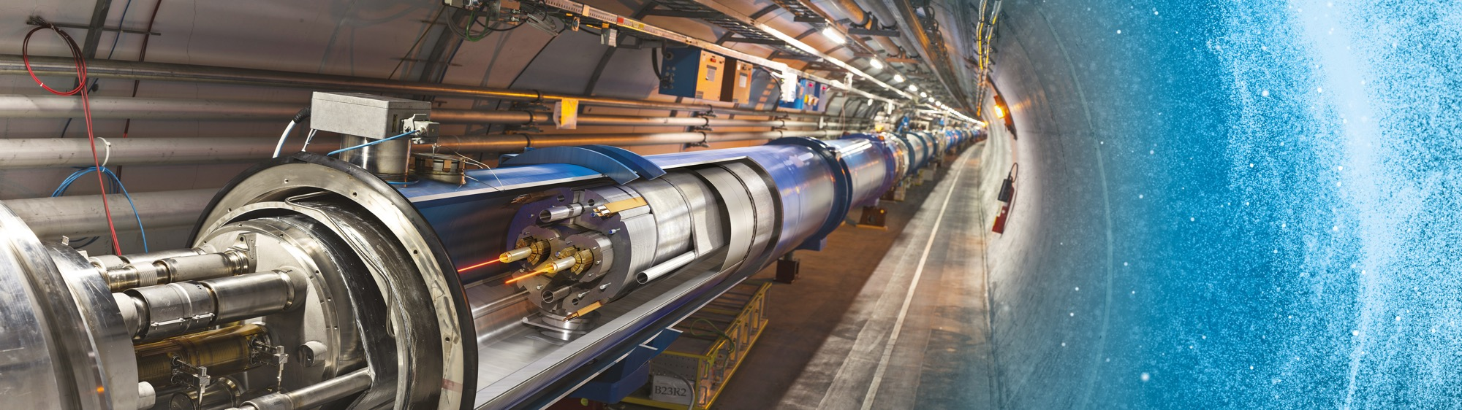
INVITATION TO TENDER
IT-4890/EN – Bidders’ conference 24 November 2023

Slide 2
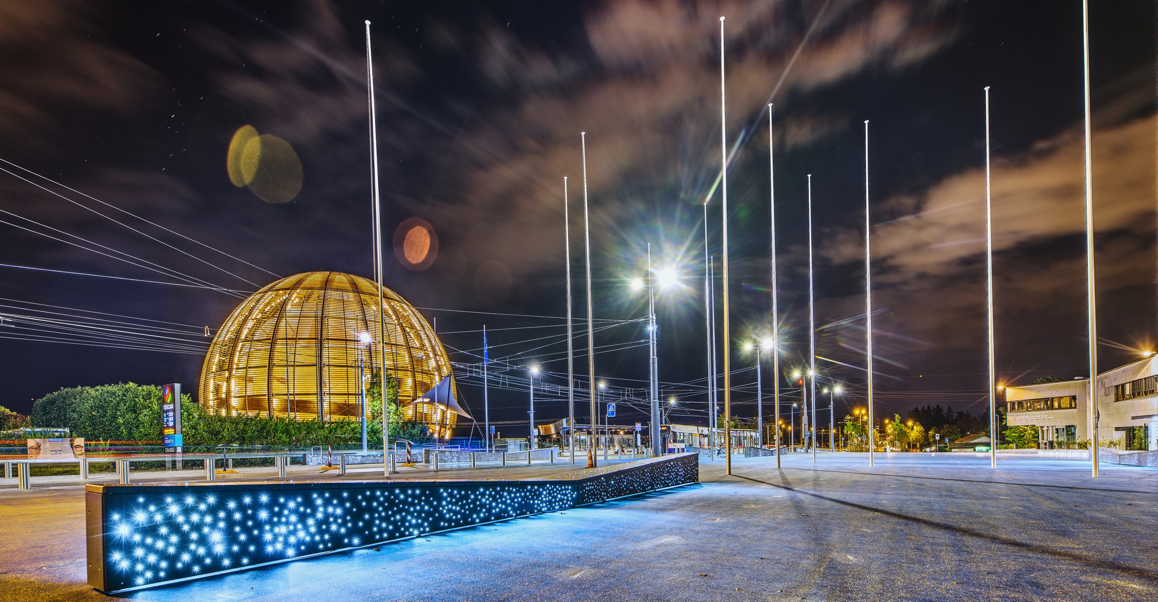
AGENDA
14:00-14:15
Introduction to CERN (video)
14:15– 14:30
Tendering Process & Procurement Rules (J.Metcalfe)
14:30 – 14:45
MS-4983 Voice Alarm and Evacuation – Technical overview (E. Sanchez-Corral Mena)
14:45-15:00
Questions – Answers (E. Sanchez-Corral Mena; J. Metcalfe)

Slide 3
SOME HOUSEKEEPING
The event will be recorded and made available to participants
All slides will be available to you on the event page
Webinar mode – Questions can be submitted via the Q&A button

Slide 4

Introduction to CERN

Slide 5
The Procurement Service
Mission
The Procurement Service (PS) procures all supplies and services for CERN
Meeting the specified and financial, technical, environmental and delivery requirements
Keep overall costs for CERN as low as possible and to ensure the most advantageous use of CERN’s resources
While achieving balanced industrial return for CERN Member States
Respecting CERN
Procurement Rules
29/1
MS-4983 | LHC Evacuation - Webinar
5

Slide 6
Principles of the Procurement Rules (1/4)
1
Transparency and Impartiality
2
Tenders open to Member States only
3
Objectivity and equal treatment: tendering packages are objective and impartial

Slide 7
Principles of the Procurement Rules (2/4)
Selective tendering procedures: CERN’s tendering procedures are not open to any interested firms
Confidentiality: Opening and evaluation of bids as well as negotiations are not public

Slide 8
Principles of the Procurement Rules (3/4)
Award for on Lowest compliant bid basis
Most commonly for Supply contracts
Technical
Financial
2
Delivery

Slide 9
Principles of the Procurement Rules (4/4)
Award on Best Value For Money basis
Most commonly used for industrial service contracts
2
No alignment rule

Slide 10

Tendering at CERN – A Quick Recap
“Price enquiry” (Demande d’Offre - DO)
A single-step tendering process for requirements up to 400k CHF
“Market Survey” (MS) >400k CHF
CERN’s prequalification phase to qualify and select suitable companies for tendering requirements above 400k CHF
“Invitation to Tender” (IT)
Bidding phase for requirements above 400k CHF issued to firms

Slide 11
Country of origin
SUPPLIES
“Country(ies) where the supplies (including their components and sub-assemblies) are manufactured or undergo the last major transformation by the contractor or its sub-contractor”
If at least 60% of the total amount of the bid comes from a poorly balanced MS, then the whole bid will be treated as that from a bidder in a poorly balanced MS.
SERVICES
“Country(ies) in which the bidder is established.”
If at least 40% of the total amount of the bid comes from a poorly balanced MS, then the whole bid will be treated as that from a bidder in a poorly balanced MS.

Slide 12
Alignment rule
Applicable for:
1
Contracts awarded on the lowest
compliant basis (mainly supply contracts)
2
With a total amount exceeding
100’000 CHF.
Under certain conditions as defined in CERN Procurement Rules, a bidder offering goods originating* in poorly balanced Member States is allowed to align his price to that of the
lowest bidder and thereby be awarded the contract.
RULE
* At least 60% for supply contracts or; at least 40% for service contracts awarded on the lowest compliant basis.

Slide 13
Tender Detailed Schedule – MS-4983: Design, Supply, Installation, Commissioning and Maintenance of LHC Voice Alarm System
Tender Process Milestones | Provisional Schedule
MS-4983 documents dispatched to firms | 13 Sept 2024
MS Industry Webinar | 29th October 24
MS answers submission | 2nd December 24
MS answers evaluation by CERN ( including visits to firms and references if required) -> Qualification of firms (prior to IT dispatch) | Dec 24’ – January 25
Dispatch of IT documents to firms | W10 – March 25
Bidder’s conference (+2-3w after dispatch) | W12 - 3rd week of March 25
Submission deadline for bidders (+6w after dispatch) | W16 : End April 25
Bid evaluation by CERN and clarifications with selected bidder (s) (lowest complaint). VACIE compatibility tests (simulation by CERN) | May - mid-June 25
Contact negotiations | June-mid July
Preparation of contract startup by the firm (resources, organisation) | September
Finance Committee and contract award | 3rd week September
Contract start-up | October 2025

Slide 14
MS-4983 Qualification process
Two key documents:
Technical Description
Outlines the key technical requirements, standards, and delivery schedule
Qualification Questionnaire (financial and technical)
Only firms fulfilling the qualification criteria and having been selected by CERN on the basis of the Market Survey will be invited to participate in the forthcoming Invitation to Tender.
We also consider CERN’s previous experience with the firm as well as the total number of firms selected from each Member State

Slide 15
So what do we want to know?
Commercial and contractual criteria
Technical criteria and capabilities

Slide 16
MS-4983 – Key Qualification requirements
Distribution of the contract performance
  One of the firms must be a manufacturer of EN-54 compliant voice alarm systems
Country of Origin
  Must be originating from CERN Member States (see here for more information)
Minimal annual turnover of 5m CHF per annum and appropriate levels of staff resources
Proven competence and experience in designing, manufacturing, installation and commissioning, maintenance (option) of EN-54 compliance voice alarm systems.
  Ideally with prior experience in underground environments or radioactive/nuclear facilities.
  Large- scale, volume, different sites, complexity (external interfaces)
  Provide relevant references that are similar in size and scope complexity.

Slide 17
Distribution of Contract Performance
Technical deliverables and activities | Shall be performed by the Firm or the Lead Firm only | May be performed by any member of the Group of Firms (2nd Firm) | May be subcontracted
Contract management |  | x
Availability during VACIE compatibility tests by CERN (§ 3.3 Technical Description) | x
Design of the voice alarm systems, including the test platform, manufacture, and supply of the VACIEs | x
VACIEs assembly |  | x
Supply of equipment other than VACIEs |  | x | x
Test Platform assembly |  | x | x
Test Platform factory acceptance tests | x
VACIEs factory acceptance tests |  | x
On-site installation (including electrical tests and equipment unit tests) |  | x | x
Dismantling of current systems |  | x | x
Systems commissioning and site acceptance tests | x
Training of CERN maintenance personnel, supply of spare parts and consumables, after sales technical support | x
Maintenance |  | x | x

Slide 18
Conclusion
You can bid as a single firm or group of firms
To be invited to the Invitation to Tender, you must have been qualified through the Market Survey
Gain a full understanding of CERN’s requirements and ask questions if needed
Submit bid documentation in full and on time
Be mindful of adjudication method lowest compliant bid and country or origin requirements
Readiness to adapt production techniques and meet demanding tolerances

Slide 19
MS-4983 LHC Evacuation with Voice Alarm
Introduction to Access and Alarms Group of CERN Engineering Department: mandate, goal, objectives and constraints
Contract Overview
The Large Hadron Collider
LHC Underground Areas
System Architecture
Key Requirements
Timeline and Delivery Schedule
What we are looking for

Slide 20
Access and Alarms Group of CERN Engineering Department
The AA group is in charge of the specification, engineering, installation, monitoring and maintenance of the systems that ensure the safety of the CERN personnel, users and visitors, on all CERN accelerators, experiments sites and facilities
It concerns any system whose failure could threaten human life, the environment or the image and existence of the organization, as well as beam time
The accelerator and experiments Safety Systems are sensitive and integrate multiple technologies
The Safety Systems concerned are:
  Fire, gas and ODH detection, emergency phones, evacuation, alarm transmission and monitoring,
  Interlocks to protect people against radioactivity, X rays, lasers, electricity and cryogenics hazards,
  Access control to all CERN conventional or nuclear facilities and sites,
  Video: surveillance, protection and intrusion detection,
  Access data management applications.

Slide 21

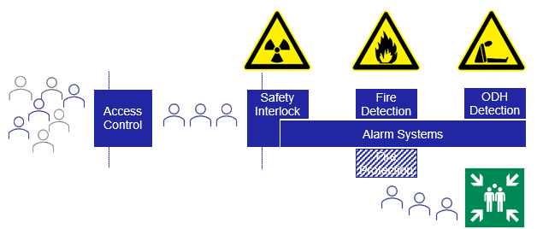
Goal
Provide prevention and mitigation barriers to protect personnel, users, equipment and surroundings against the risks raised by the operation of the CERN Accelerators and Experiments:
  Radiation
  Fire
  Gas
  ODH
  Electrical hazards
  Lasers hazards
Ensure that systems provided cope with the field specific regulatory requirements of the hosts states

Slide 22
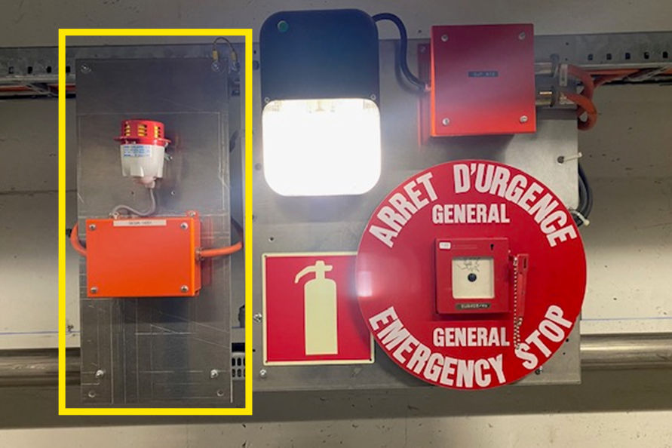
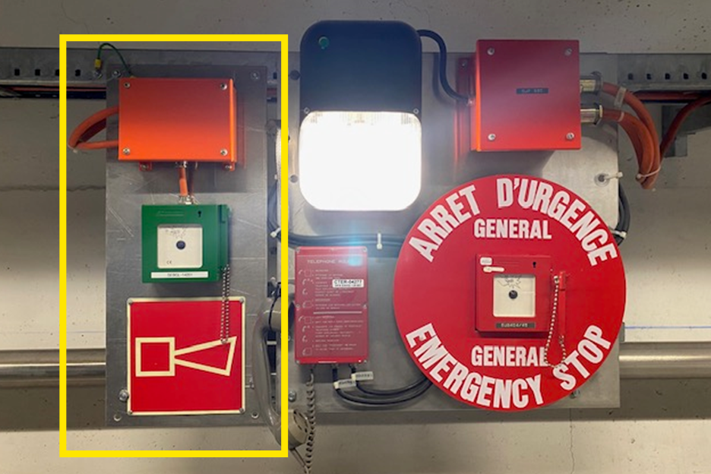

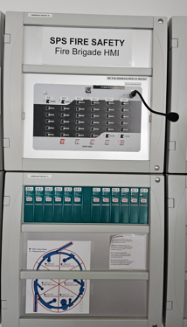
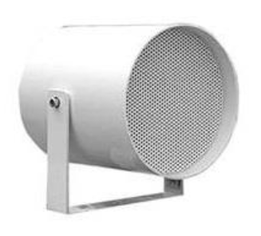
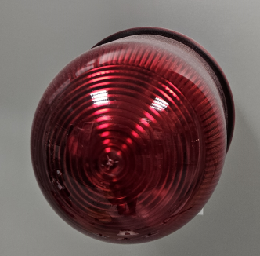
LHC Evacuation Voice Alarm System Contract Overview
Contract Type: Supply blanket contract
Tendering: Tender estimated to be published during Q2-2025
Contract duration: 5 + 2 x 1 Years
  LHC VAS Project plus smaller voice alarm projects across the CERN site
  Maintenance (optional)
Motivation and purpose: Current siren evacuation system has been running for over 20 years, reaching its end of life. The objective is to replace the current system with a new EN 54 compliant Evacuation Voice Alarm System
Scope: System design*, manufacture and supply, installation and commissioning, maintenance, and the dismantling of the sirens and manual points of the current system
  15 VACIE in 10 sites (FR, CH) in a FO network acting as a unique EN 54 Voice Alarm system implementing big complex evacuation matrix
  ~2000 loudspeakers, ~125 lines of different lengths up to 2.5 kms + flashing lights.
  HMIs for remote operation by Fire Brigade and messages broadcasting by LHC operation teams, and system supervision
  *Currently: Functional design (evac-matrixes) and Acoustic Studies ongoing. This will pre-define loudspeaker lines and locations.
Technical competencies, experience and constraints:
  EN 54 compliant voice alarms systems commercial products
  VACIE in the surface non-radioactive areas, equipment in underground radioactive areas must be radiation hard
Execution: The renovation is due to be implemented during the LHC’s next Long Shutdown (LS3), between end-2026 and mid-2029

Slide 23
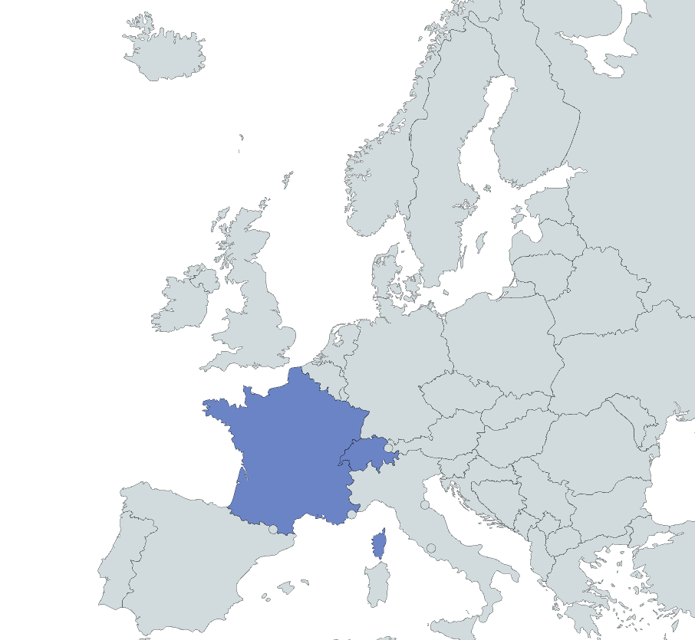
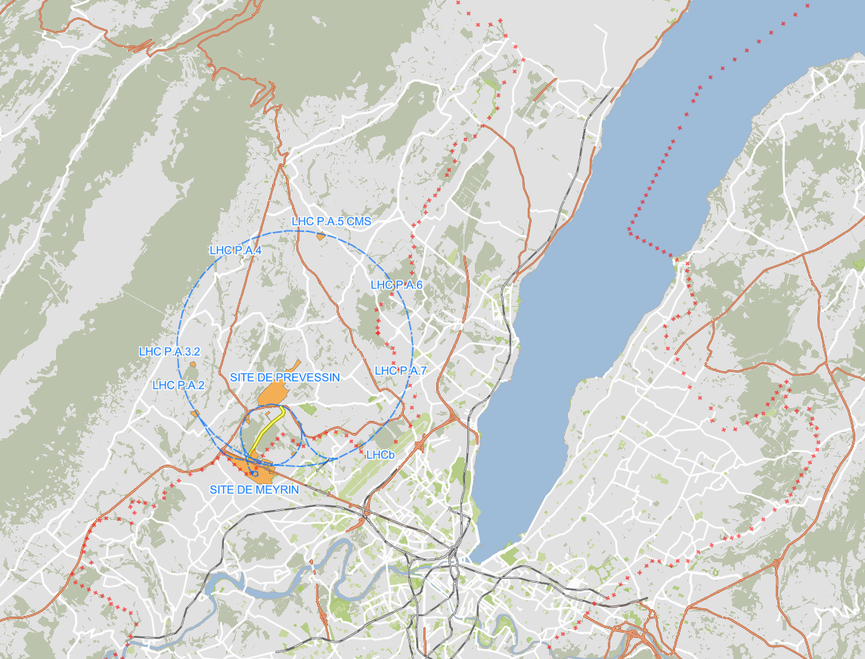
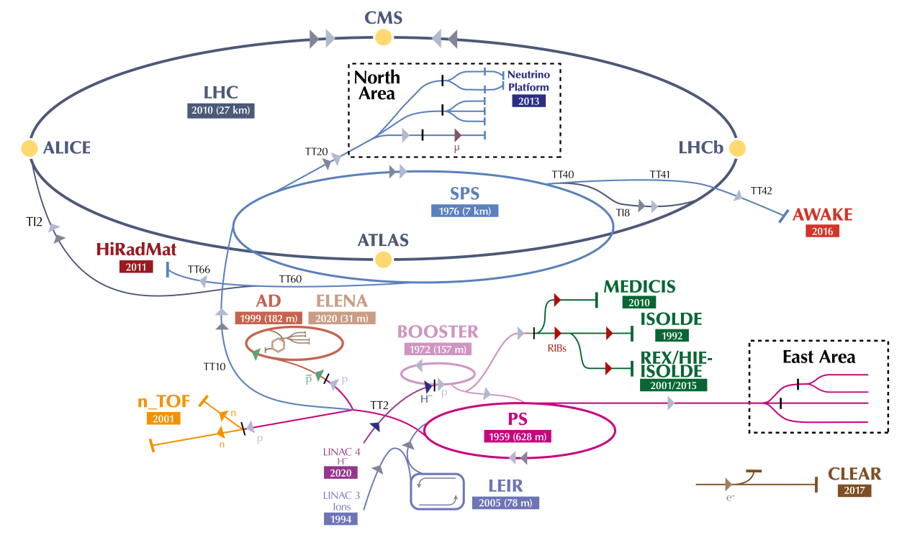
The Large Hadron Collider – LHC
Located in the border between France and Switzerland, near Geneva, CERN’s Large Hadron Collider (LHC) is the world’s largest and most powerful particle accelerator. It first started up on 10 September 2008 and remains the latest addition to CERN’s accelerator complex. The LHC sits about 100 meters below ground and consists of a 27-kilometre ring of superconducting magnets with several accelerating structures to boost the energy of the particles along the way.
Inside the accelerator, two high-energy particle beams travel at close to the speed of light before they are made to collide at four locations around the accelerator ring, corresponding to the positions of four particle detectors – ATLAS, CMS, ALICE and LHCb.
The beams travel in opposite directions in separate ultrahigh vacuum pipes. They are guided around the accelerator ring by a strong magnetic field maintained by over 1500 superconducting electromagnets to accelerate, bend and focus the particle beams. To reach the electromagnets superconducting state, these are cooled down to ‑271.3°C – a temperature colder than outer space – via a distributing system of liquid helium.

Slide 24
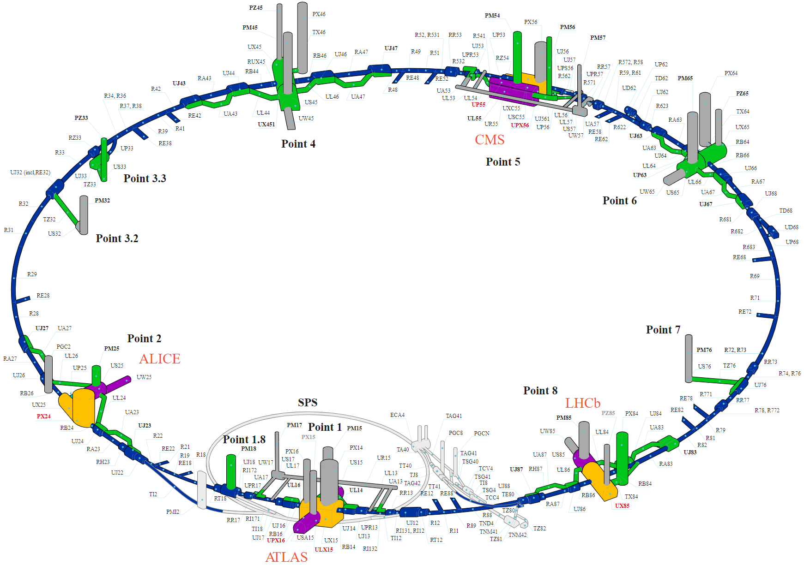
Scope – LHC Underground (Radiation) Areas
LHC Machine Tunnel
LHC Service Areas
Experimental Caverns
Experimental Service Areas
LHC Machine Tunnel
  Long distances – up to 2,5 km loudspeaker lines
  Relatively similar all the way long
LHC Service Areas
  High noise levels
  Cooling equipment, switchboards, control racks, piping, cable trays, etc.
Experimental Caverns
  High noise levels
  Big volumes
  Heavily industrial areas, platforms, walkways, stairs.
  Cooling equipment, switchboards, control racks, piping, cable trays, etc.
Experimental Service Areas
  Like LHC Service Areas
23 Evacuation Zones based on CERN’s existing evacuation matrixes
Evacuation triggered by safety detection systems
Fire detection
Oxygen Deficiency Hazard
Gas detection
Beam Imminent Warning (BIW)
Other safety systems

Slide 25
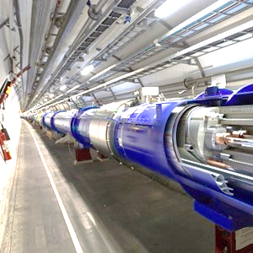
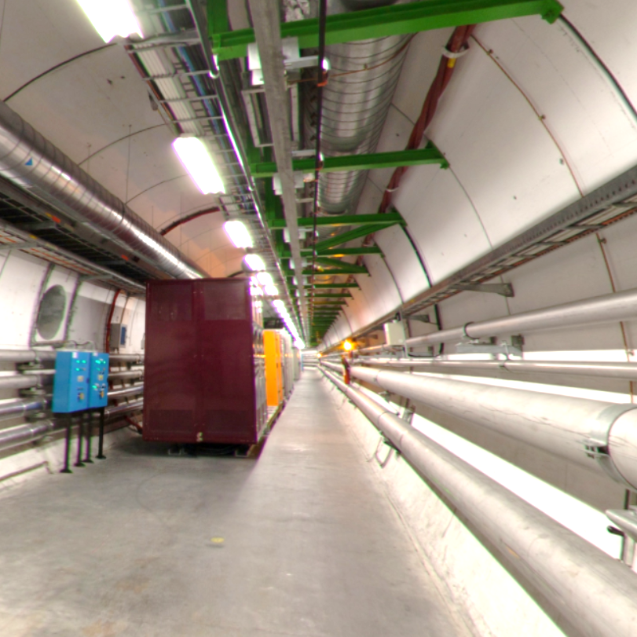
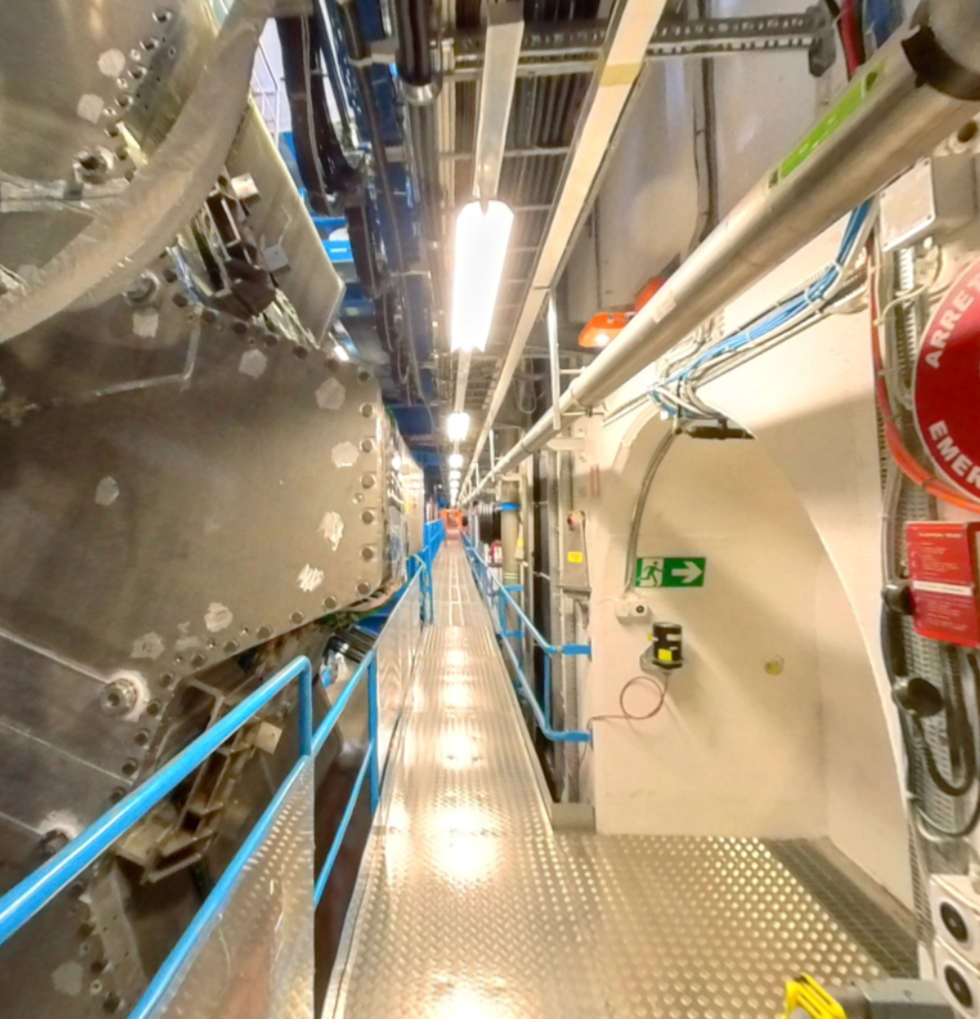
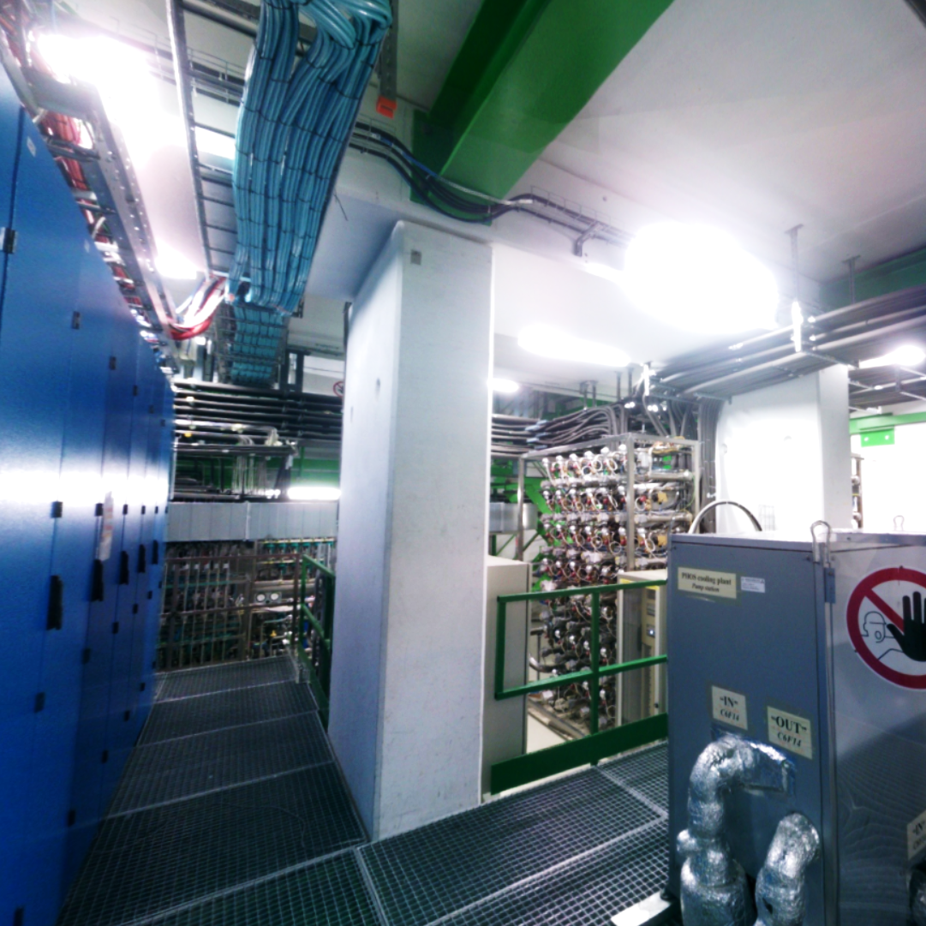
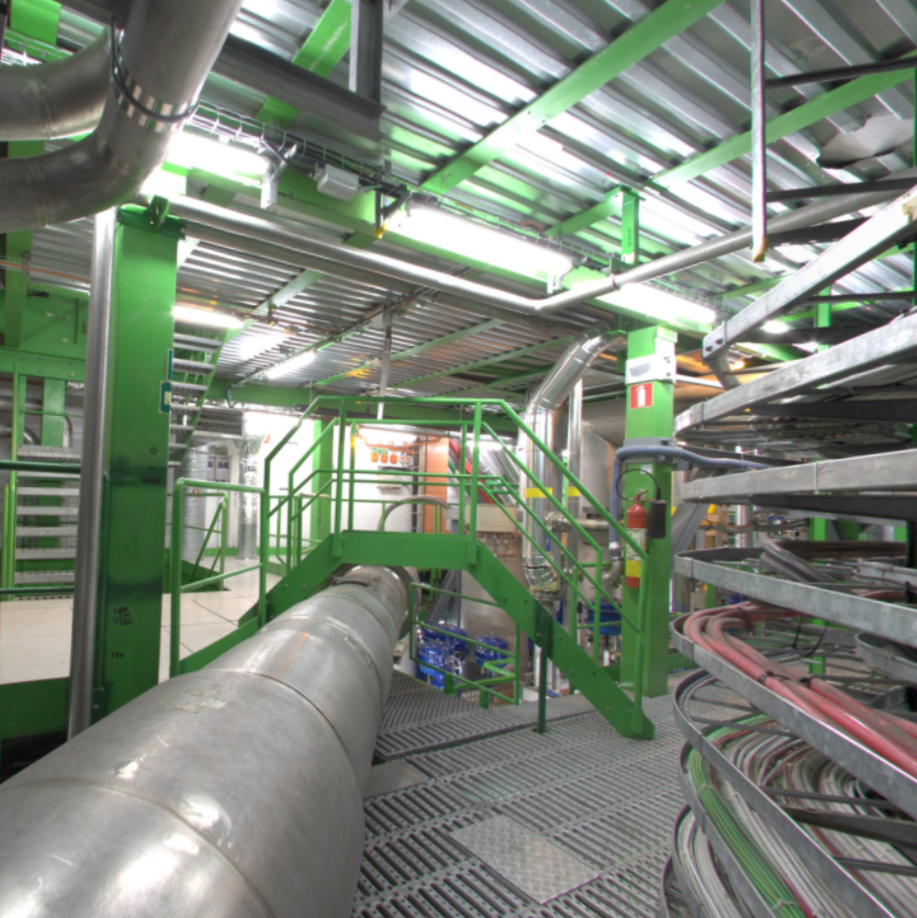
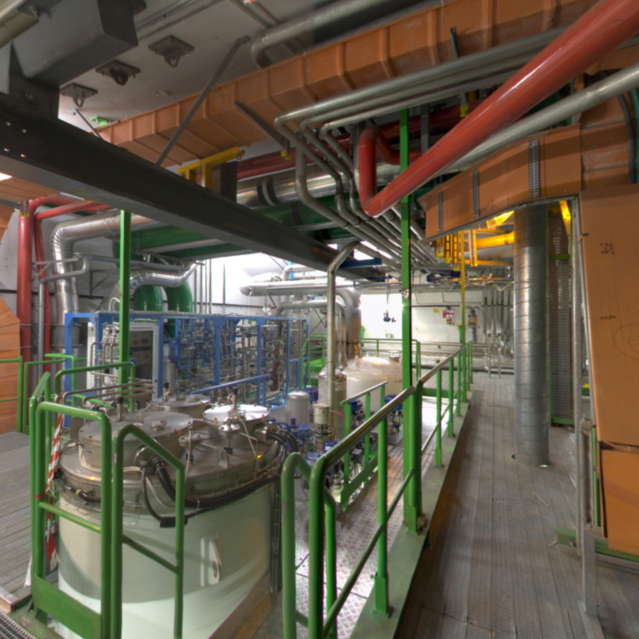
Scope – LHC Underground Areas
LHC Machine Tunnel
LHC Service Areas
Experimental Caverns
Experimental Service Areas
LHC Machine Tunnel
LHC Service Areas
Experimental Caverns
Service Caverns

Slide 26
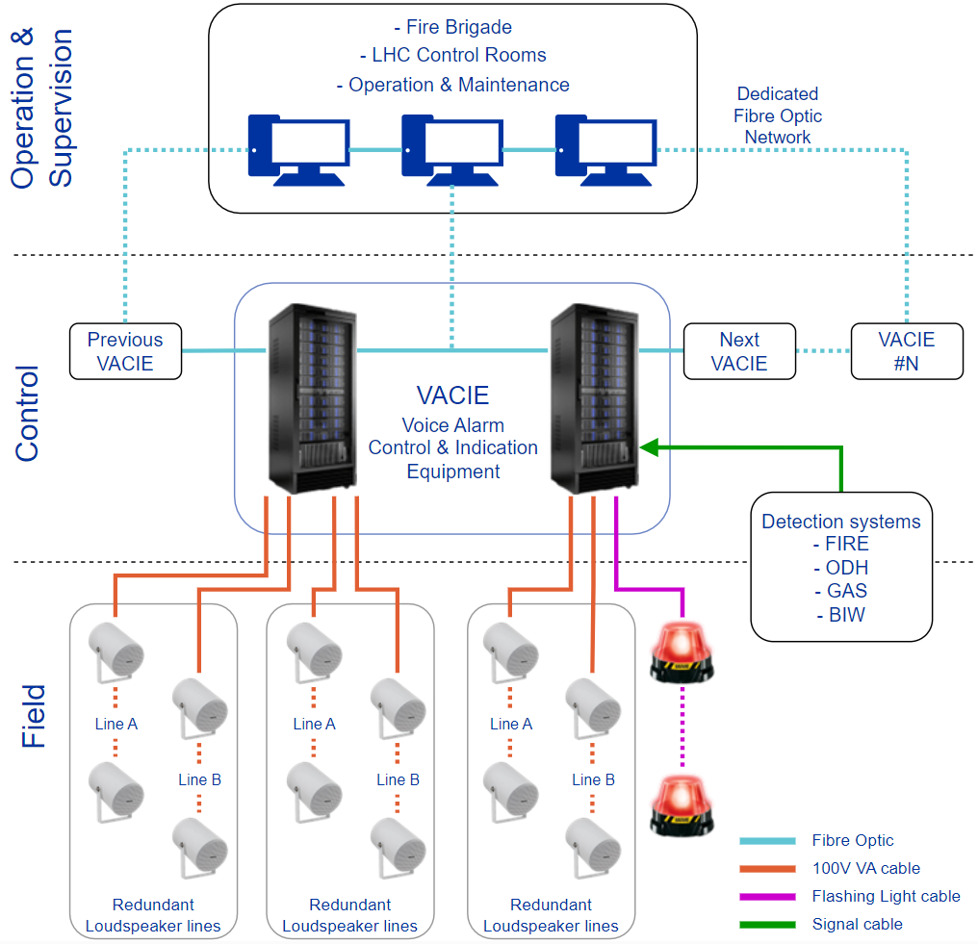
VAS System Architecture
23 Evacuation Zones (ZAV) defined by CERN’s evacuation group
2 HMIs for remote evacuation operation and supervision by Fire Brigade
~ 6 HMIs for messages broadcasting and supervision by LHC machine & experiments operation teams
15 VACIEs in 10 sites at surface level
VACIEs in FO network working as one unique EN54 compliant Voice Alarm System
~2000 Loudspeakers distributed in ~125 lines installed in underground radiation monitored areas, and flashing lights in complement for noisy areas → Positions pre-defined by acoustic studies
Dry contact input signals from different detection systems triggering evacuation procedures
Long-distance cabling and optical fibres (>10m) and secured electrical power supplies installed by CERN

Slide 27
Key Requirements
Technical:
  Large scale system, long distance lines up to 2.5 km. → Optimise configuration and design of VACIEs
  Radiation-hard equipment in underground areas (loudspeakers, flashing lights)
  Complex matrixes (large, interfaces), critical system → Simple and reliable solutions
  Reliability (fail-safe), availability and maintainability
  Synchronisation of message broadcasted by different VACIEs in adjacent areas
  HMIs: simple and clear instructions for users (fire brigade, LHC operation team)
  Interface OPC UA with CERN SCADAs (safety alarm and technical faults monitoring)
  Diagnostics tools for support to maintenance teams, reduce breakdown time and cost
Organisational
  Current evacuation system in operation during LS3 while new voice alarm system being deployed
  System on-site installation and commissioning per site during LS3, ~2 years, followed by one week of Global Tests
    Challenging preparation and execution of the Global Tests in a short period mitigating effects on personnel safety
  Commissioning of new system after Global Tests and acceptance by CERN Safety Unit (HSE)
  Decommissioning of current evacuation sirens system by CERN
  Dismantling of underground equipment (not the CIEs) by future contractor by end LS3 or next technical stops

Slide 28
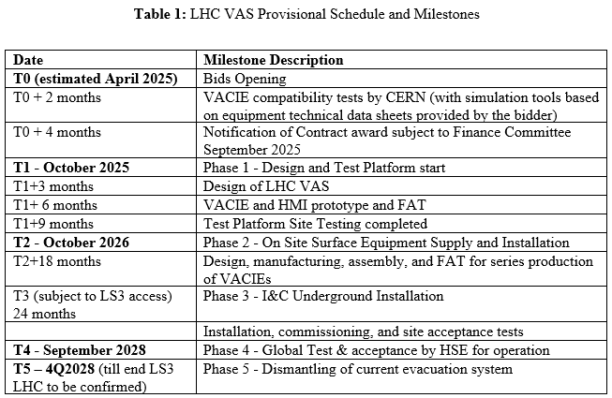
LHC Voice Alarm System – Delivery Schedule
MS Technical Description – Provisional Schedule updated:
Contract award: Finance Committee September 2025
Integrate the 6 months of the CERN Accelerators LS3 Shutdown
Phases and milestones:
VACIE compatibility tests will not be done by the pre-selected bidder connecting the proposed VACIE to a CERN pilot installation loudspeakers line but by CERN with simulation tools based on equipment technical data sheets provided in IT bid -> Bidder available for questions/provide additional details
Installation of all the cabling (copper, FO, power supply) by CERN EN-EL group prior to installation
Dismantling: only underground equipment (sirens, manual points)
  Not in the scope: de cabling, CIEs decommissioning of current evacuation system

Slide 29
What we are looking for
Contractors having strong technical competencies and proven experience in:
  EN 54 compliant Evacuation with Voice Alarm systems
Contractor to take responsibility for:
  Designing, supplying, installing and commissioning the voice alarm system in the specified areas
  Ensuring the supplied voice alarm system(s) keep their performance overtime by the adequate corrective, preventive maintenance and taking care of system evolutions
System lifetime 20 - 25 years, maintenance and upgrades planned within the CERN’s accelerator schedule
Long term collaboration with industrial partners, contract duration is 5 years
  Tendering: ~1 years
  System Design & Validation in Test Platform: 1 year
  Installation, commissioning, and dismantling: 2-3 years -> Project duration : ~ 3 – 4 years
  Possibility of maintenance contract following project completion
We need competent, experienced, motivated and competitive industrial partners engaged in long term collaboration projects and services, and constrained to CERN’s accelerators schedule

Slide 30
Thank you

