Slide 1
Outcome of BGI Review
James Storey (SY-BI-XEI)
BI-TB on 27th November 2024

Slide 2
Outline
Recap of BGI Instrument & Readout System
Background to the Review - HW/SW Issues
Review Actions

Slide 3
BGI Profile Monitors
Refs. IBIC 2017, IBIC 2019, IBIC 2021
Measure beam profile by counting # ionisation electrons detected in each column.
Beam Gas Ionisation (BGI) beam profile monitors are designed to provide non-destructive continuous bunch-by-bunch measurements of the transverse beam profile in both the horizontal & vertical planes.

Slide 4
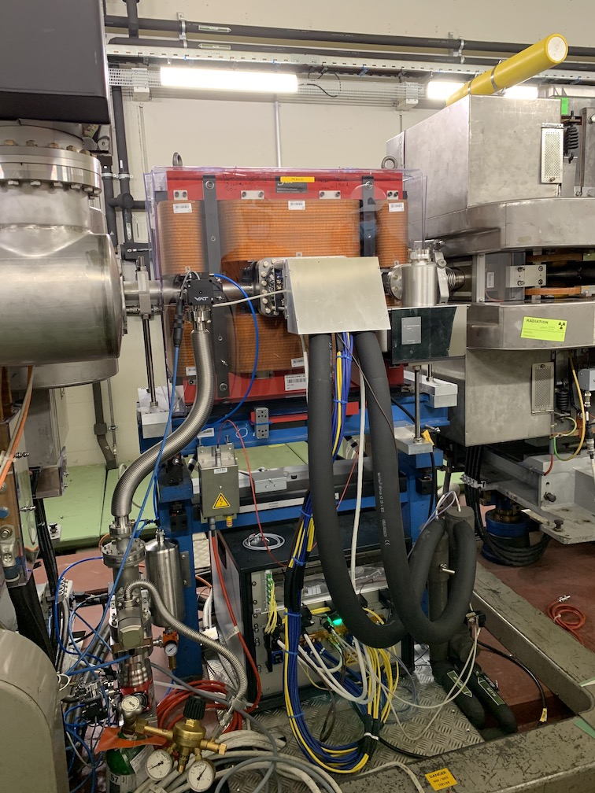
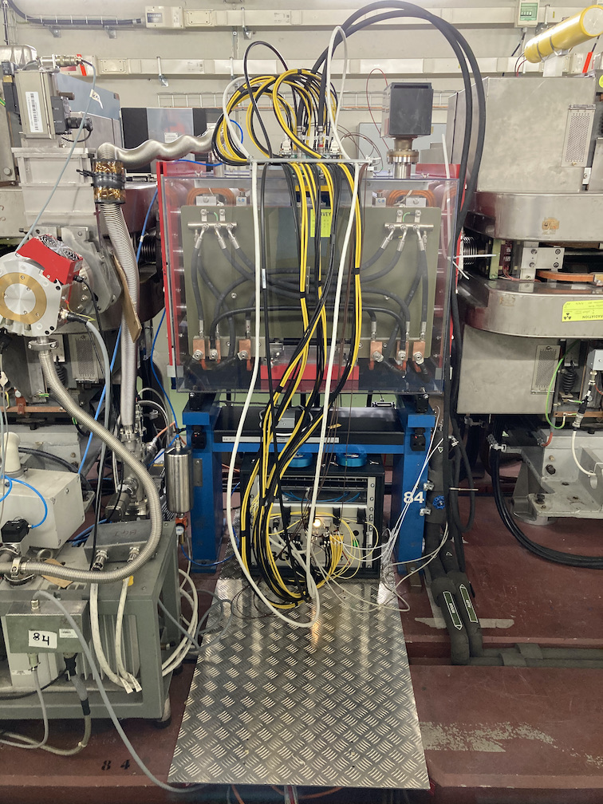
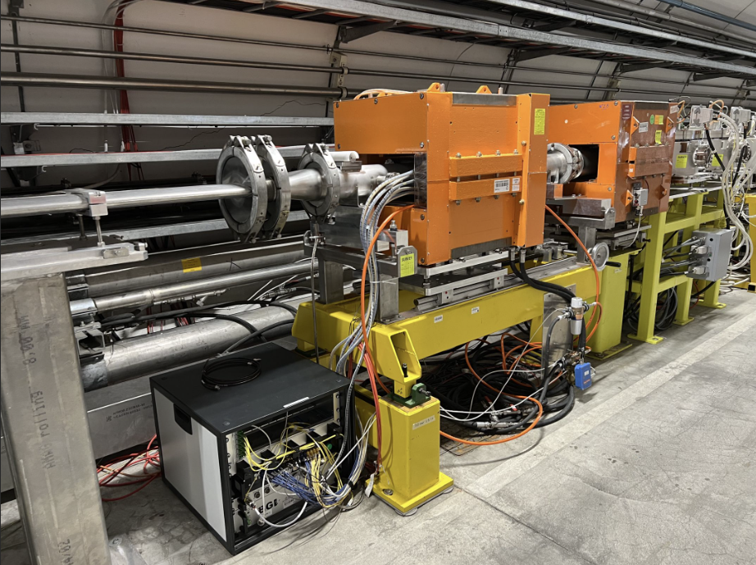
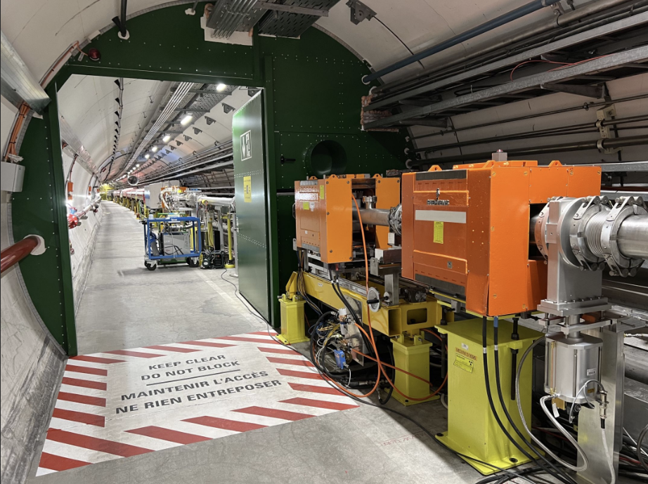
Installations & Timeline
PS BGI’s
Funded by LHC Injector Upgrade (LIU) project;
Prototype installed in YETS 2016/17;
BGI-Horizontal (PS BGIH) installed during LS2;
BGI-Vertical (PS BGIV) installed during LS2.
SPS
Funded by CONS;
BGI-Horizontal (SPS BGIH) installed during YETS 23/24, second version installed during Technical Stop #1 (TS1) 2024;
BGI-Vertical (SPS BGIV) installed during TS#1, but failed leak test after installation and was removed.
PS BGIH at SS #82
PS BGIV at SS #84
SPS BGIH at 51634
SPS BGIV at 51634

Slide 5
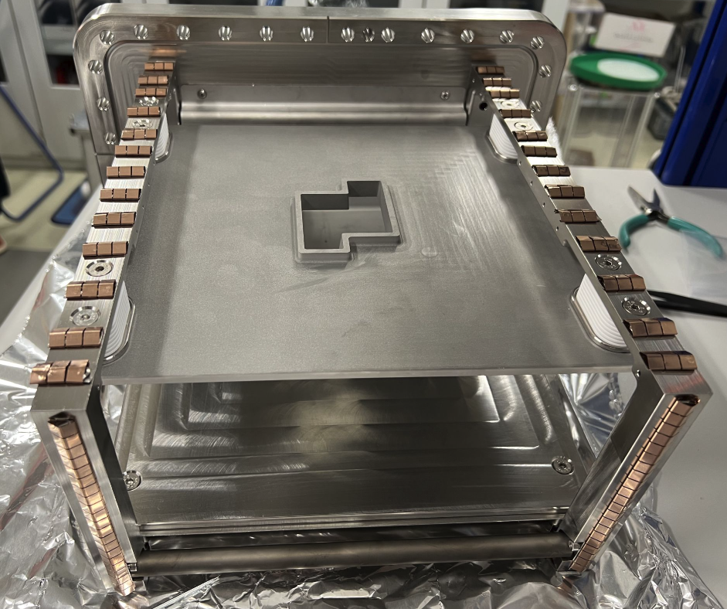
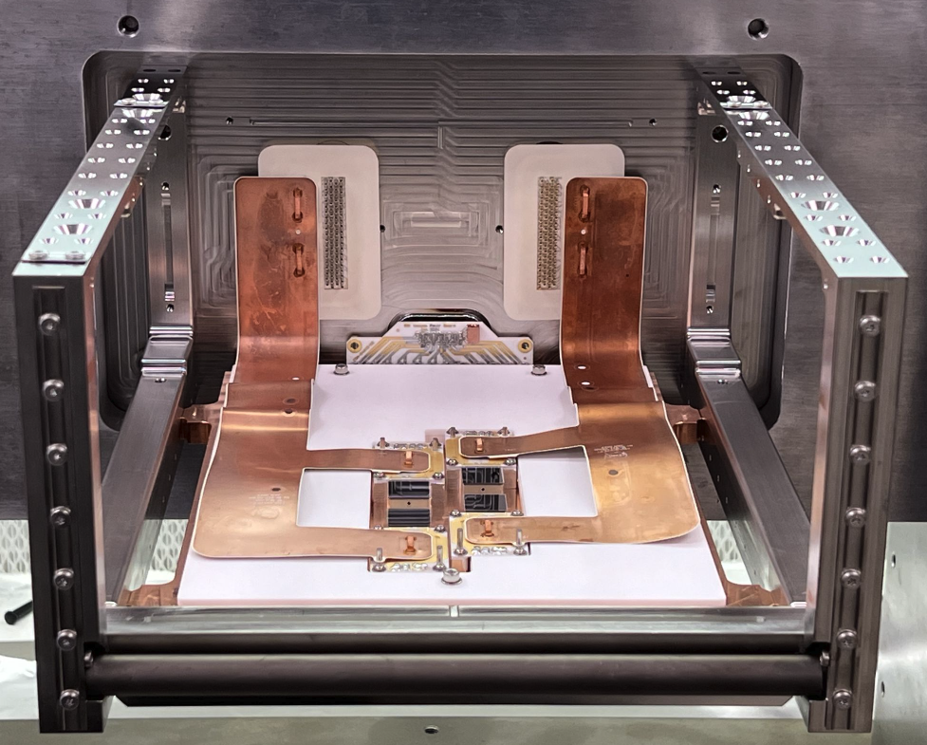
Instrument Overview
SPS BGI instrument
Timepix3 electronics

Slide 6
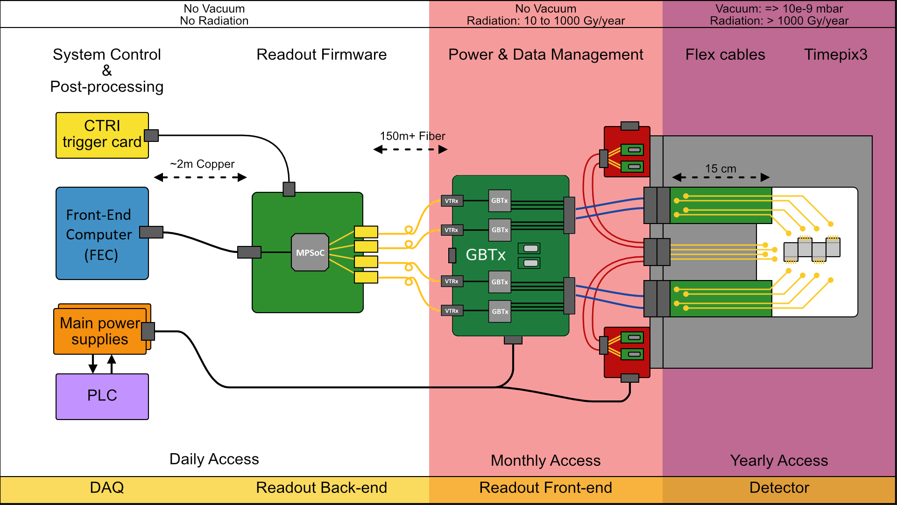
Overview of Current System
Ref. CERN-THESIS-2020-236

Slide 7
Timepix3 Data Rates & Signal Rates
Timepix3 Maximum Data Rates
Each Timepix3 event is composed of 60 bits (pixel address, Time-of-Arrival (ToA), Time-over-Threshold (ToT)).
Data is readout from a Timepix3 through eight serial links at 320 Mbit/s, giving a total maximum total data rate of 2.56 Gbit/s per Timepix3 → 2.56 Gbit/s / 60 bits = 43 MEvents/s/Timepix3.
Both PS and SPS BGI instruments are each consist of 4 x Timepix3’s, giving a total of 10.24 Gbit/s per BGI instrument.
Signal Rates
Ionisation electron yield = 73 electrons / turn ( 26x10¹⁰ p/b, 72 b, H₂ 5e-10 mbar )
→ 32 MEvents/s = 1.90 Gb/s ( 1 electron ~= 1 Timepix3 event )
Proportionally higher rates with gas injection ( e.g. Ar 1e-8 mbar )

Slide 8
Timepix3 Data Rates & Signal Rates
OP Requirements
Asked to provide 1000 beam profiles / s ( beam or bunch-by-bunch );
Measure on consecutive cycles;
Latency between acquisition & published profiles = (O)seconds.
Need 1000 electrons for a reasonable beam size measurement (error on sigma = 2%), corresponding to a data rate of 1000 profiles / s * 1000 electrons / profile → 1 MEvents/s = 60 Mb/s.
(i.e. OP ask for 1 kHz, however, residual gas ionisation signal is available to support 20 kHz.)
Background Estimate
43,000 events per ms → 2.6 Mb/ms
Typically (O)10ms of beam loss per cycle

Slide 9
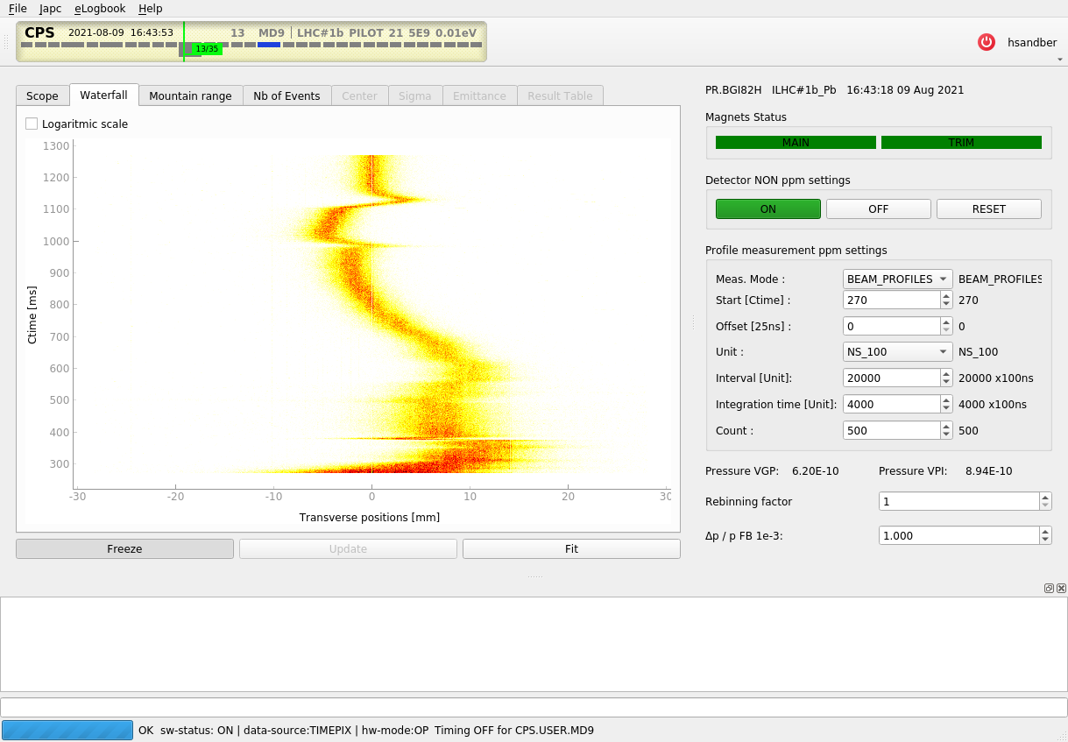
Background to the Review: PS BGI
Measurement start time
Time between consecutive measurements
Integration time per measurement
Number of measurements per cycle
Pb ion beam measured with PS BGI-Horizontal (M.Coly BE-OP-PS)

Slide 10
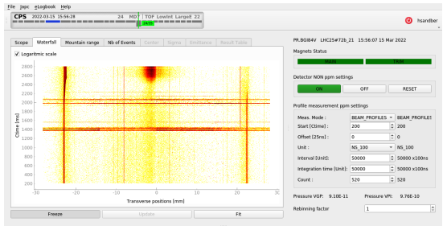
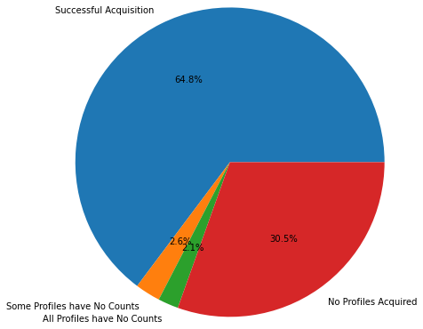
Background to the Review: PS BGI
Operational Issues
Beam loss
Can be removed in post-processing;
But causes saturation problems in the Timepix3 and readout.
Ionisation electron signal at flat-top
Low gain of BGI-Vertical at injection
Readout issues
Noisy pixel

Slide 11
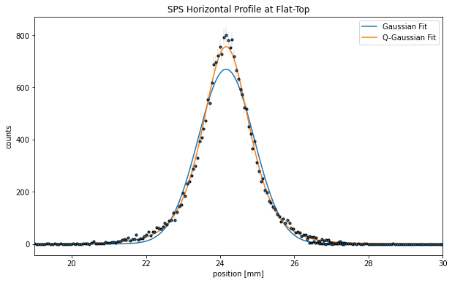
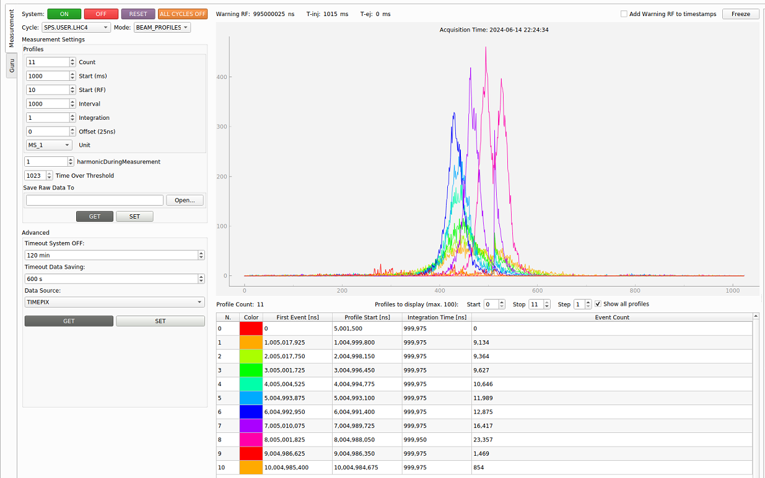
Background to the Review: SPS BGI
Measurement of single LHC bunch (LHC4)
Single beam profile at flat-top
Multiple beam profiles measurements in a cycle
EMC Issue
During LHC25 & AWAKE (after bunch rotation) cycles communication lost with Timepix3;
Communication recovered after Timepix3 reconfiguration.

Slide 12
Background to the Review: Summary of Issues
Hardware issues
EMC issue of SPS BGI instruments;
Low gain of PS BGI-Vertical at injection energy;
Saturation of Timepix3 due to beam loss & noisy pixels.
Software issues
Stability & complexity of current FEC + SoC readout system;
Limited analysis of Timepix3 data on SoC processor;

Slide 13
Review Objectives & Mandate
Ref. David Nisbet, “Outcome of BGI Review”, CTTB 20th Sept. 2024
Review has the following objectives:
Examine the software and hardware engineering of the present concept and solution;
Expose the reasons for the design choices taken and share any lessons learned;
Check for possible synergies going forward with the SoC project (SW modules, testing, architecture, etc.);
Review and update the functional specification with OP, in view of possible optimisations;
Critically examine the timeline, priorities and milestones (including SPS and LHC versions) for getting the PS BGI ‘operational.’
Panel Mandate
The review panel is asked to consider the implementation of the Beam Gas Ionization (BGI) Profile Monitors for use in the PS and SPS before LS3, with a particular emphasis on the controls. The panel is asked to review the controls architecture and implementation, together with the functional specifications, and highlight the main risks for a successful deployment before LS3. The panel is further requested to propose any mitigating factors that will improve the chances of success, such as design, specification, schedule or milestone changes.

Slide 14
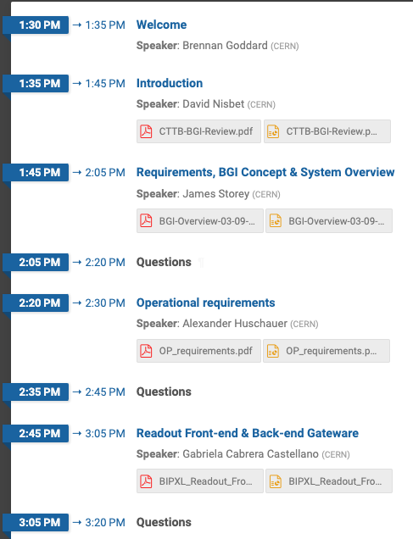
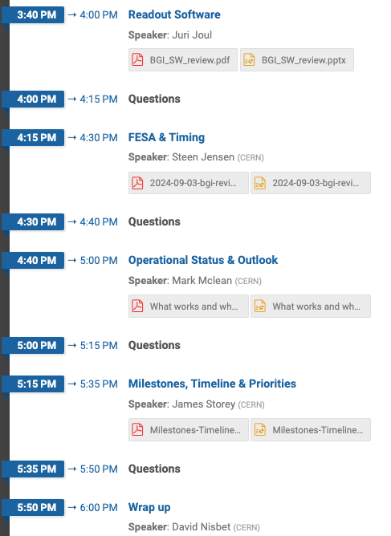
Review Panel, Agenda
Panel
Agenda
Jan Buytaert (EP-ESE)
Greg Daniluk (BE-CEM)
Irene Degl'Innocenti (SY-BI)
Alex Huschauer (BE-OP)
Greg Kruk (BE-CSS)
Xavi Llopart Cudi (EP-ESE)
David Nisbet (CTTB, Chair)
Scientific Secretary: Justus Braach (SY-BI)

Slide 15
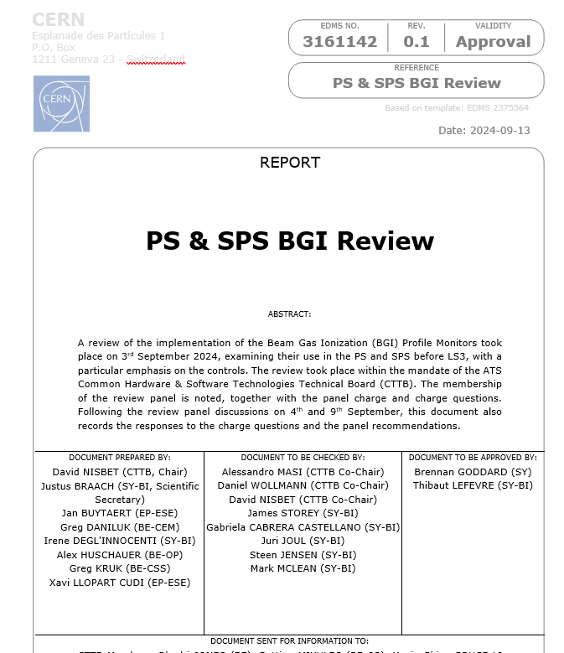
Review Findings
Synthesis of the Review Panel discussions and recommendations https://edms.cern.ch/document/3161142

Slide 16
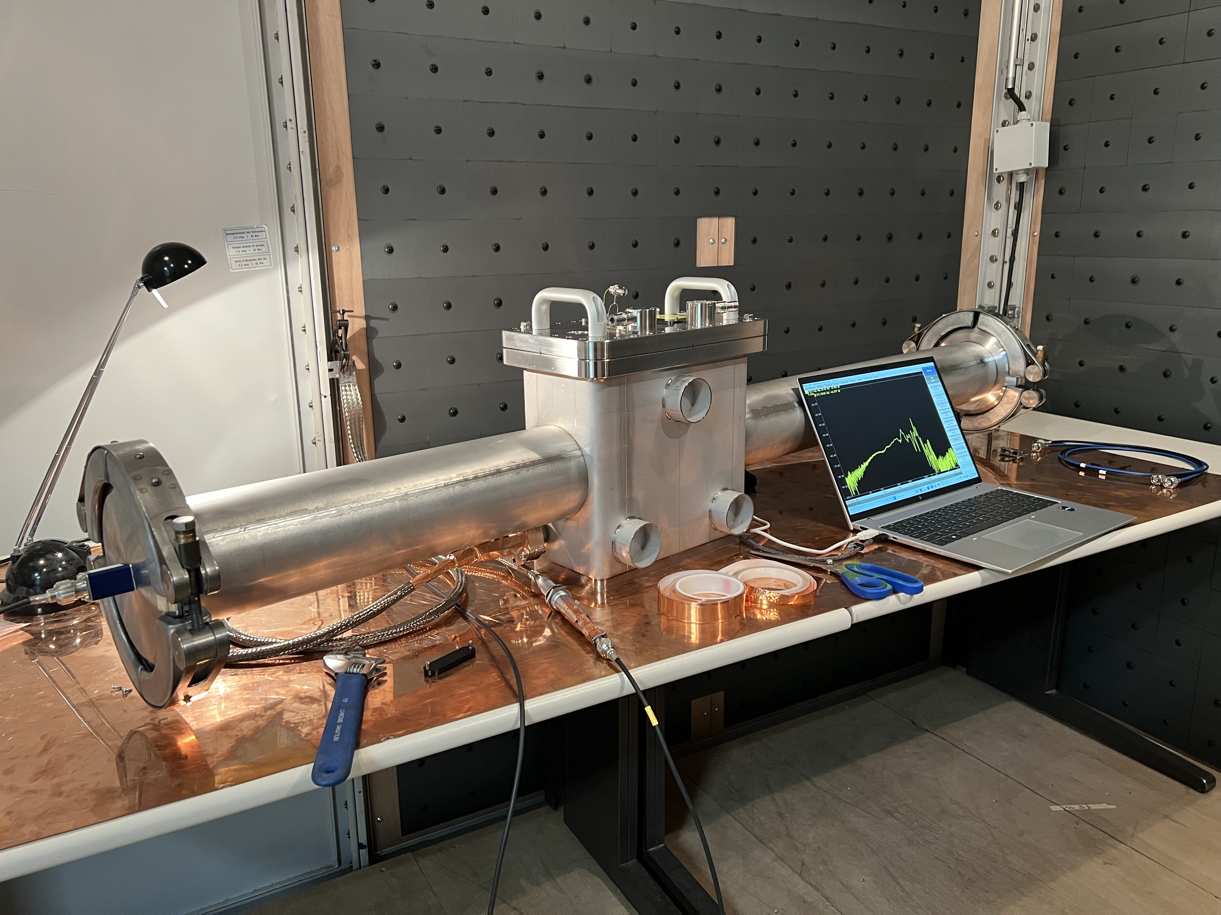
Action 1) SPS BGI EMC Issues
Action(s):
Study the current design & possible solutions with help of ATS EMC Lab (Daniel Valuch SY-RF);
Install SPS BGI instrument with EMC mitigations.
Ref. talk later by Mark on “EMC Results & Plans.”
EMI measurements of SPS BGI in ATS EMI Lab

Slide 17
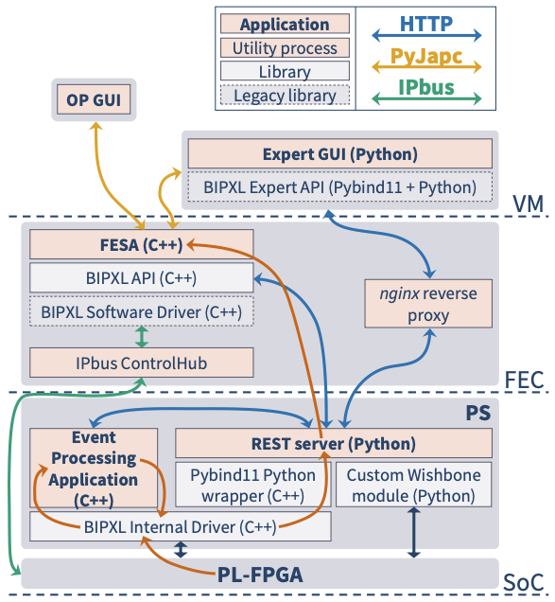
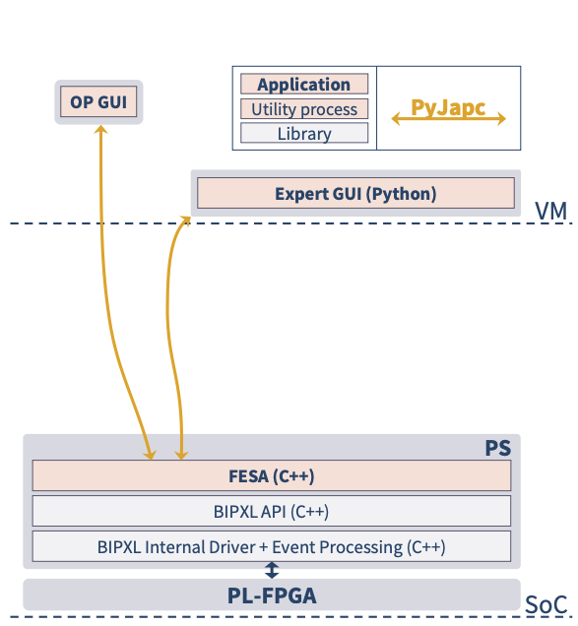
Action 2) SoC Platform
Ref. Juri Joul, “Readout Software”, BGI Review 3rd Sept. 2024
Action:
Move to ATS (FESA-on-)SoC platform.
Timeline:
Transition to ATS (FESA-on-)SoC platform Q2/3 2025;
First operational tests of new architecture Q4 2025.
Current “FESA-on-FEC” + SoC architecture
Future “FESA-on-SoC” architecture

Slide 18
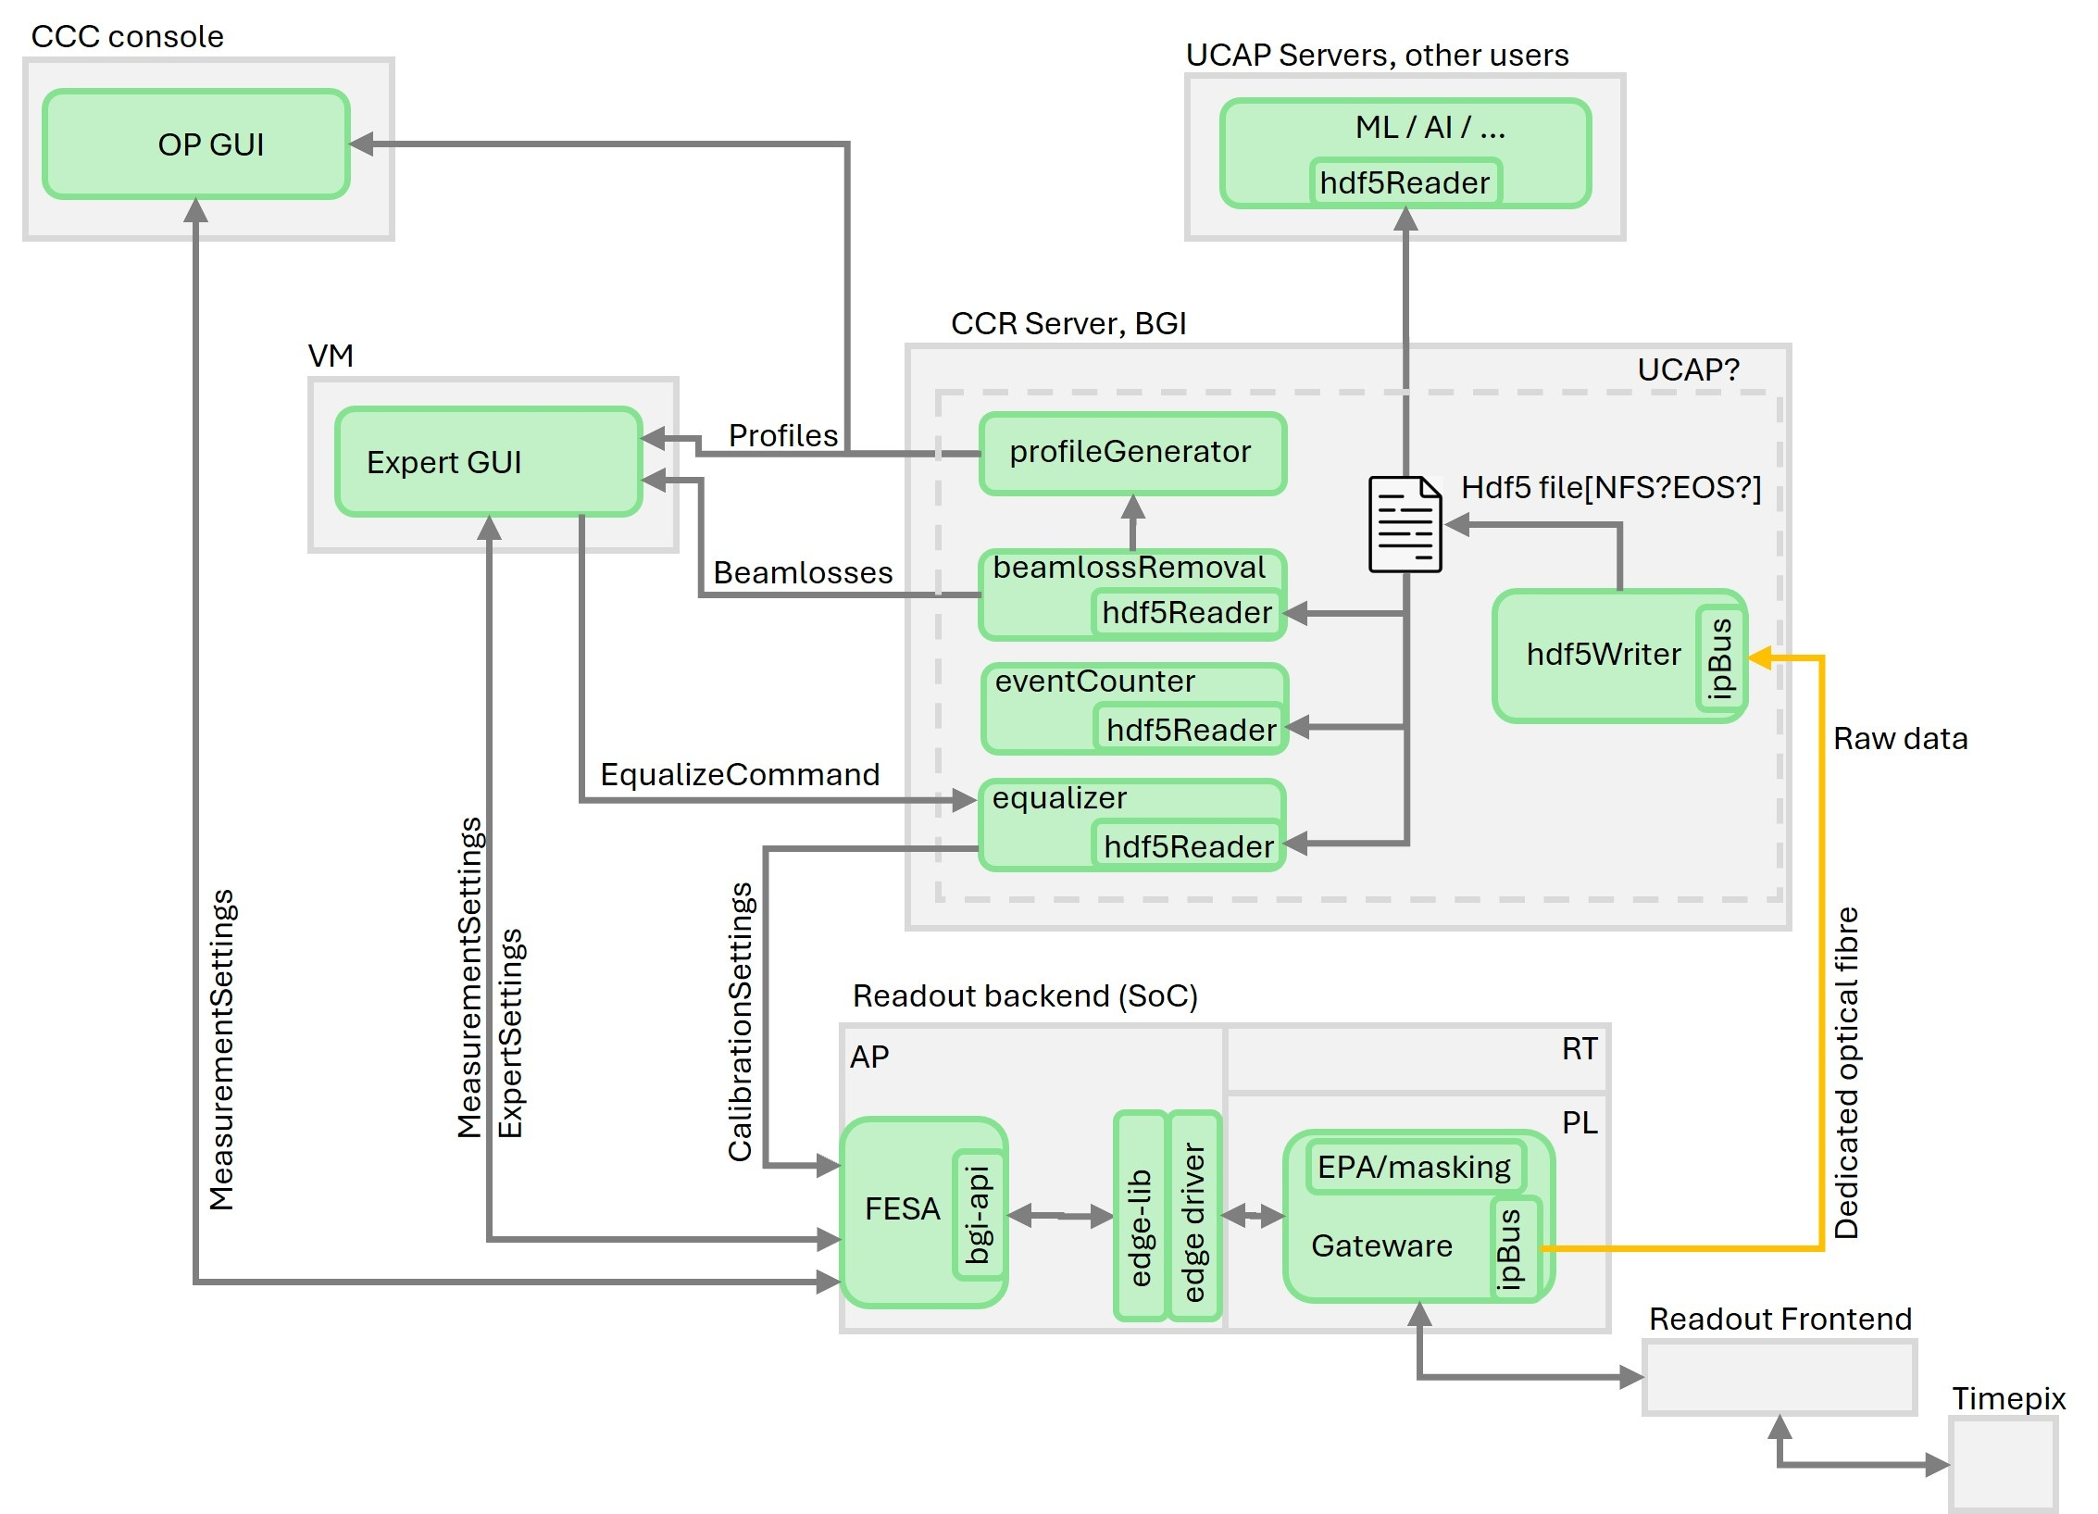
Action 3) Data Processing
Action:
Re-engineer readout architecture to facilitate storage and processing (e.g. beam loss removal) of raw Timepix3 data.
Timeline:
Review at BI Technical Board on 28th Nov. 2024;
Engineering spec. by end of 2024;
Re-engineer architecture Q1/2 2025.
Ref. talk later by Juri on “BIPXL Architecture: Current & Future Options”
A possible data processing architecture based on FESA-on-SoC + Data Processing on CCR Server

Slide 19
Action 4) Functional Specifications
Action:
OP to take the lead to prepare functional specification for PS, SPS & LHC BGI instruments.
Timeline:
Q4 2024 ( required for readout architecture decision. )

Slide 20
Timeline
Q4 24
Q1 25
Q2 25
Q3 25
Q4 25
EMI measurements
Installation of SPS BGI-V during EYETS 24/25
(If required) further iteration to fix EMC issue during ITS1
Review of new readout & data processing architecture
Implementation of new BIPXL readout & data processing architecture
ATS SoC Platform available for testing
Engineering spec. for new readout architecture
Transition to FESA-on-SoC platform
Operational tests of BGI instruments with new architecture (FESA-on-SoC + Server processing.)
Functional spec. for PS, SPS & LHC
Installation of additional SPS BGI corrector magnets during EYETS 24/25
Key:
Action 1) SPS EMI Issue
Action 2)+3) New readout & data processing architecture
Other actions

Slide 21
Spare Slides

Slide 22
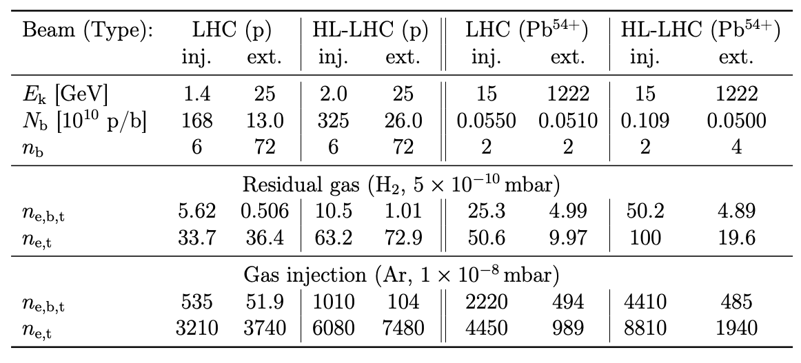
Ionisation Electron Yields
Ref. CERN-THESIS-2020-236

Slide 23
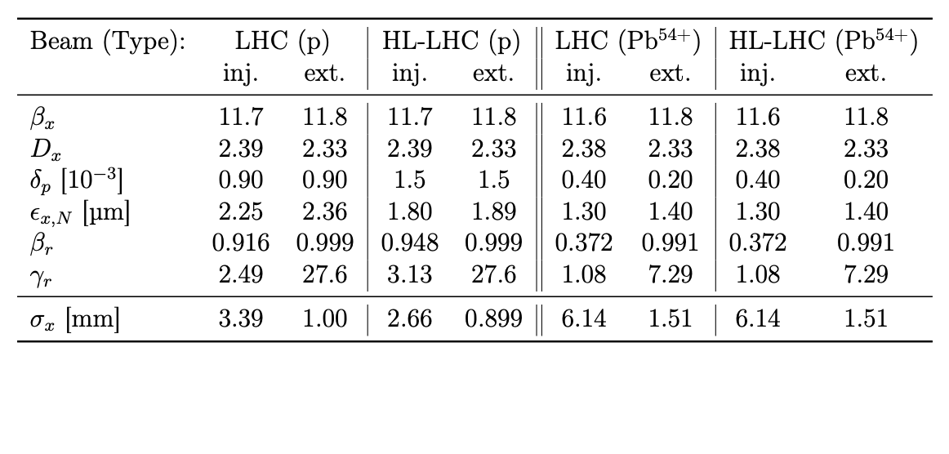
PS Beam Parameters
Ref. CERN-THESIS-2020-236

Slide 24
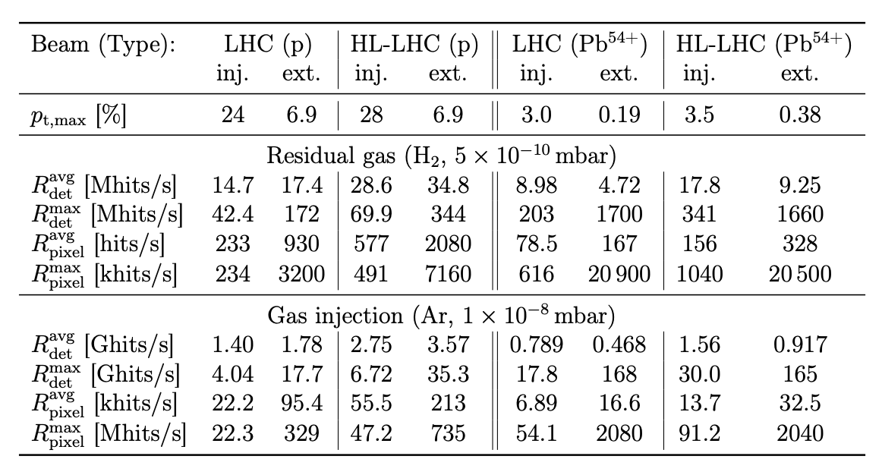
Expected Detector Hit Rates
Ref. CERN-THESIS-2020-236
Maximum pixel processing rate = 1 Mhits/s (Each pixel has dead time of 475ns + ToT (e.g.20) = 1us).

Slide 25
Charge Questions & Responses
Ref. David Nisbet, “Outcome of BGI Review”, CTTB 20th Sept. 2024
Is the proposed controls architecture for the BGI platform appropriate for the PS and SPS applications?
Not clear. The review panel concurs with the project team that the future implementation will use more processing at a higher “server” level. As such the emphasis will be on the fast gateware control of the Timepix device. It is likely that the currently in-place SoC baseline technology can be used in a simplified mode, exploiting principally the FPGA and gateware aspects with potential primitive monitoring of the recorded data stream and feedback to the detector control.
Is the strategy to solve the actual technical issues experienced by the BGI project well defined and appropriate?
NO. The panel agrees with the BGI project main direction and priorities to solve the technical issues, particularly the EMI problems and general trend to adjust the control architecture. We however recommend progressing more rapidly to the definitive technical implementation based on a fast network link to a server. We also recommend to delay the delivery of the operational system, which will free up resources in the short term and reduce re-validation work made by both OP and BI teams.
Does the BGI project have a suitable set of milestones that fulfil the requested priorities and schedule?
NO. The technical milestones until Feb 2025 are found to be appropriate. The panel estimates that there is a high risk of missing the presented milestones beyond this date. We recommend the negotiation of new delivery dates with OP for an operational platform once the definitive hardware and software architecture has been determined. This will release resources on both the OP and BI side to invest in the definitive platform. The delivery of a stable and reliable instrument in late 2025 or early 2026 is a possible outcome.

Slide 26
Charge Questions & Responses
Ref. David Nisbet, “Outcome of BGI Review”, CTTB 20th Sept. 2024
Does the BGI project have the correct resources to fulfil those milestones?
NO. Given the technical challenges on several instruments, and the resources to both debug the existing controls and reengineer a longer-term solution, the project will require additional resources. A staff expertise of the gateware and software is needed to maintain such a project. A suitable manpower plan should be put in place, that considers a long-term maintenance strategy drawing on expertise within the team, within the group and from the ATS.
Are there synergies between the BGI project and the SoC project that could be beneficial?
YES. If the SoC is maintained then gateware, firmware and software developments should align as much as possible with the SoC framework that currently is under development. The BGI project is encouraged to participate to the framework development if resources allow.
Are there any changes to be considered to the functional specifications that would increase the chance of success before LS3?
YES. A functional specification should be prepared by OP that is matched by a BI engineering specification. Both documents align the requested functionality with the achievable functionality based on applied technologies, clarify ambiguous points and ranks priorities. Agreements should be found for criteria such as the acceptable time delay between acquisition and analysis being available, desired number of acquisitions per cycle, acceptable rate of rejected measurements, etc should be agreed.

Slide 27
Review Panel Recommendations
Ref. David Nisbet, “Outcome of BGI Review”, CTTB 20th Sept. 2024
We observe that the BGI project strives for a simplified controls implementation. We fully support the proposal to move processing from the SoC towards a powerful server computer. We believe this opens the possibility of a controls architecture that more closely resembles that implemented by other Timepix users and would allow easier adoption of frameworks and code already in use by the community.
We recommend that the OP group takes the lead in preparing a functional specification, in close collaboration with the BI group (BGI team). In addition to the fundamental technical requirements (resolution, stability, etc), operability criteria such as the acceptable time delay between acquisition and analysis being available, desired number of acquisitions per super cycle, acceptable rate of rejected measurements, etc should be included.
The EMI issues are a significant problem, and we note that the project is taking this seriously and requesting outside expertise from the EMC forum. The related efforts should continue with a high priority.
The milestone plan presented during the review implies a lot of effort to achieve a partial solution to the instrument's challenges with tight deadlines. We perceive the plan to have a high risk of further delays.

Slide 28
Review Panel Recommendations
Ref. David Nisbet, “Outcome of BGI Review”, CTTB 20th Sept. 2024
We recommend a strong focus on data processing solution independent of the backend of the instrument, which is also the likely roadmap to a suitable LHC implementation and has use for other BI devices (eg. telescope). Where possible, this architecture should adopt an existing supported hardware solution.
Projects which may serve as a reference for a future architecture are the Frequency Scanning Interferometry (based on DIOT supported by BE/CEM), or LHC RF ObsBox (using fast commercial servers, developed by SY/RF). We note that a support model exists for the DIOT based platform.
The existing hardware is relying on a commercial development kit, which will present maintenance challenges in the future. In the context of moving to a server-based solution, the front-end hardware should also evolve to a more standard part. Suitable hardware may be the DIOT platform, or the ATS SoM (if its availability is compatible with the updated milestone plan).
Due to the likely changes in the data processing architecture, we recommend reducing the deliverables to the machine in the short term. Testing can continue in an expert mode if needed, and delivery of a truly operational instrument should be foreseen when a definitive implementation is more mature.
Explore the possible adaptation of existing frameworks and drivers from the Timepix and experiment community.

Slide 29
SPS BGI’s: Situation Today & After YETS 24/25
Situation Today
After YETS 24/25
BGI Horizontal
Instrument installed with “Diamond” RF shield
Magnets in doublet configuration
BGI Vertical
Prototype instrument installed
Magnets in doublet configuration
BGI Horizontal
Same instrument with “Diamond” RF shield
External HV countermeasures
Magnets in triplet configuration (*)
BGI Vertical
New instrument with “Denser” RF shield
External HV countermeasures
Magnets in triplet configuration (*)
(*) ECR 3168184 "Modification of magnetic bump for operation of the BGI profile monitors in SPS LSS5.

Slide 30
Telescope Data Taking
Beam Characteristics:
Typical 5E6 particles per spill
Headroom up to 1E7 particles per spill
Up to 2E6 particles per second
Telescope Setup:
Target cluster size MPV of 3
Tracks traverse up to 6 Tpx detector planes
flexible classes for individual single hybrid detector assemblies wrapped in a telescope class
TOTAL: 2E6 • 3 • 6 = 36E6 pixel hits per second • 48 bit per pixel hit ~ 1.8 Gb per second
Data Handling:
Measurement “runs” extend over multiple spills
Run data is saved to disk per run as set of individual files, one file per detector
5 second per spill, 2-3 spills per super cycle
performant spatial measurement precision

Slide 31

Telescope Run Control
Run Management
Schedule consecutive measurements in run list → Prerequisite for automated data taking
Run list parameter can modify detector configuration → Enables scans of bias voltage, threshold, …
Logging
Centralized for INFO, ERROR and USER messages
USER data: detector configuration, periphery parameters, user comments
Monitoring, Reconstruction and Analysis in Corryvreckan:
Versatile, highly configurable test beam data reconstruction framework with modular structure (C++)
Benchmark:
… load
Timestamps: 0.130 ms/evt
Pixel events: 2.000 ms/evt
Clustering 4D: 0.010 ms/evt
Correlations: 0.015 ms/evt
Tracking 4D: 0.140 ms/evt
Increase hardware to match beam
CPU: i5-6500 @ 3.20GHz
RAM: 8GiB SODIMM DDR4
SSD: 2700/1050 MBps r/w
5 min runtime
→ 27k tracks
… reconstruct
2020 JINST 16 P03008
2021 JPS Conf. Proc. 34, 010024

Slide 32
BIPXL Readout & Control Architecture

Slide 33
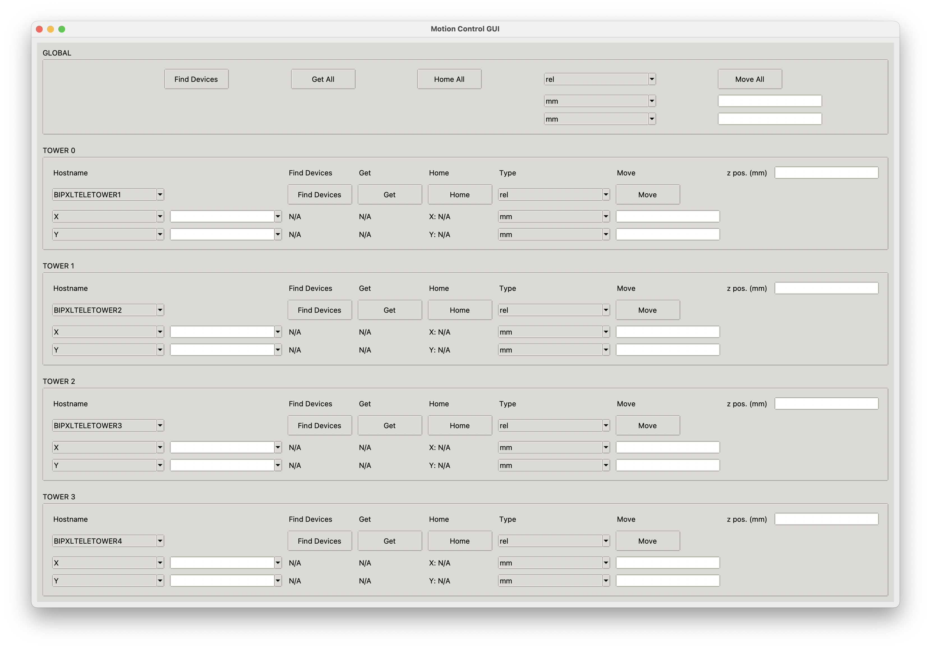
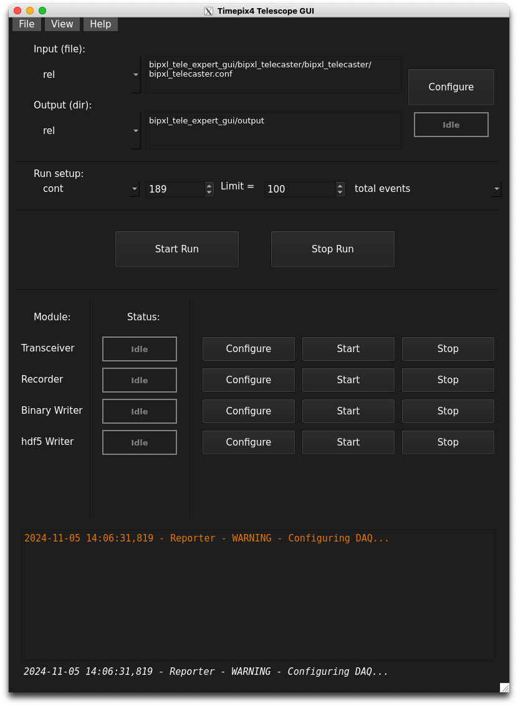
BIPXL Readout & Control GUIs

