Slide 1
POTENTIAL
PTP support in IT switches for us-level synchronisation
Electronics forum discussion #14: Synchronisation at ms and us level
31 October 2024
Maciej Lipinski, BE-CEM-EDL
Pau Jordan Oliveras Cejas, TE-MPE-EP
Maciej-Orson Suminiski, BE-CEM-IN
With support from Carles Kishimoto, IT-CS-NE

Slide 2
3 use cases for connectivity using IT switch
(current and future)
IT core infrastructure (racks)
TN
Router
Switch
Switch
User’s
racks
Private network
Switch
Switch
End-stations:
FEC, SoC, PC
Proxy
Use case 1
Use case 2
Use case 3
Connected to IT/TN switch in IT rack
Pay by socket
Full IT support, SLA
  Working hours: 1h15min
  Non-working hours: 3h
Connected to IT/TN switch (e-switch)
in user’s rack
Pay by switch
IT provides:
  Help with configuration
  Redirect of monitoring to user
  Spares for replacement by user
  Possible assisted replacement during working hours
Connected to isolated IT switch
in user’s rack
Pay by switch
IT provides
  Help with configuration
  Redirect of monitoring to user
  Spare for replacement by user

Slide 3

Potential future solution for
PTP us-level synchronisation to end-stations
UTC
IT core infrastructure (racks)
TN
WR Network
Router
PTP
Switch
WR Switch
Switch
User’s
racks
Private network
Switch
Switch
End-stations:
FEC, SoC, PC
PTP
PTP
PTP
Proxy
Use case 1
Use case 2
Use case 3
The basic concept: when an end-station (FEC, SoC, PC) needs PTP synchronisation and it connects to an IT Switch, assuming this IT switch supports PTP, connect this IT switch to a WR Switch in the WR Network
WR Switch is configured to provide PTP on the port connected to the IT switch
IT switch must support PTP and is configured as a PTP Boundary Clock
The link interconnecting the IT Switch and WR switch is blocked for other data than PTP

Slide 4
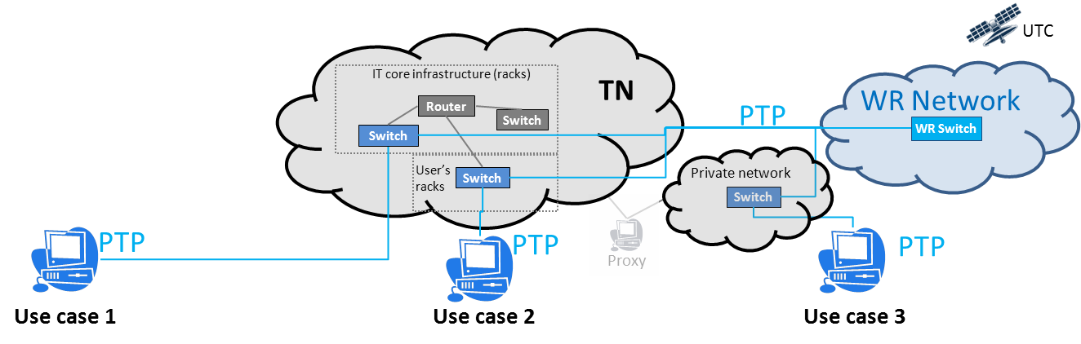
Feasibility study
Answer questions:
Does IT offer currently switches with PTP support? Which use cases can be covered?
Can IT switch(es) with PTP support interoperate with WR Switches?
  WR Switch support Default PTP Profile
  WR Switch has been proven to work with devices implementing Default PTP Profile
Could this solution be used in the future?

Slide 5
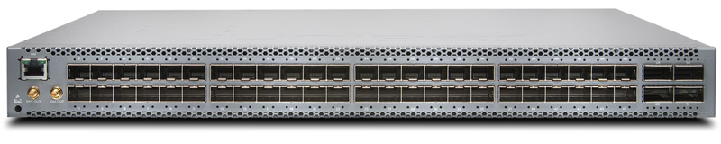
Does IT offer currently switches with PTP support?
IT switches currently installed in TN do not support PTP
From Data Center contract with Juniper, one model with PTP support is available from IT on request
  Model QFX5110-48S with 48 ports
  Can potentially cover use-cases 2 & 3
  Use-case 1 not is supported (Juniper switches are not deployed in the core TN infrastructure)

Slide 6
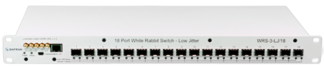
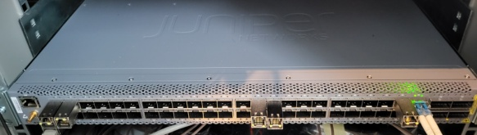
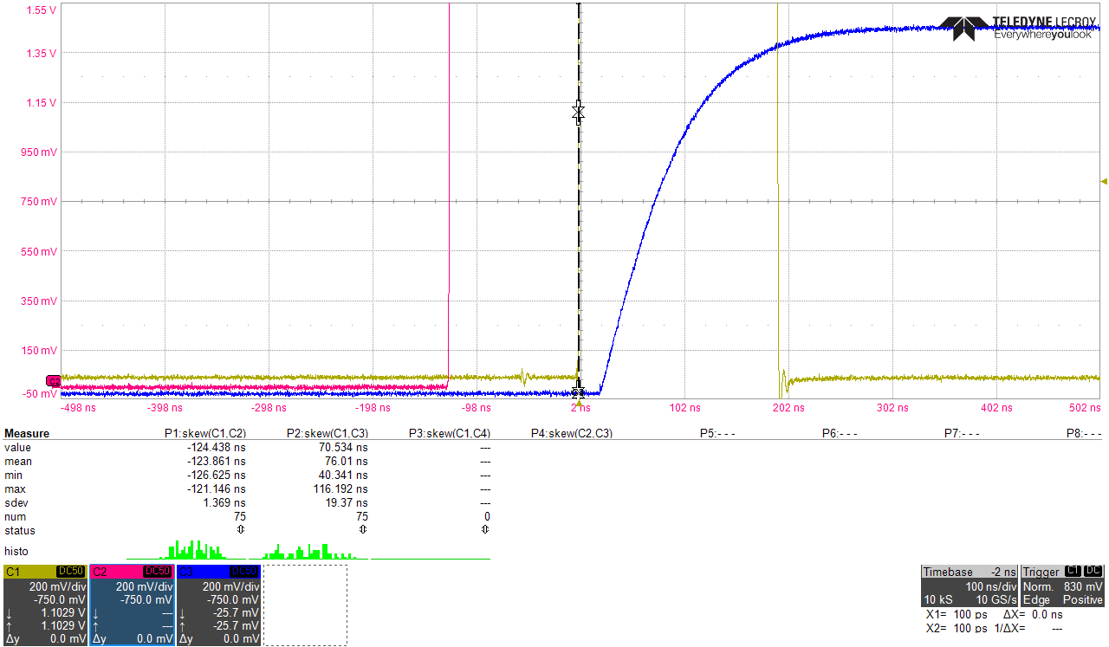
Can Juniper QFX5110-48S synchronise over PTP with WR Switches?
UTC
WR Backbone
Network
Juniper QFX5110 does not support Default PTP Profile
WR Switch does not support profiles implemented on Juniper
Interoperable configuration found:
  WR Switch: PTP Default Profile, IPv4, multicast, Sync rate 32 packet/s, PTP v2.0
  Juniper : AES67 Media PTP Profile, IPv4, multicast
Caveats
  WRS Switch: IPv4 currently requires manual configuration
  Juniper: multicast configuration available only in debug mode
Result
  Offset between WR switch and end station: << 1us
  Measured offset was < 100ns
To make it operational
  Centralized IPv4 configuration support to be added on WR Switch and in CCDE
  Multicast configuration to be added on Juniper
  (request on-hold, estimated delivery: 1 year)
\

Slide 7
Could this solution be used in the future (1)?
Current DC contract with Juniper expires 2026/2027
(only support beyond, unless awarded next DC tender)
Replacement of TN switches scheduled for LS3, ongoing tender for new TN switches
  PTP support not a requirement in the tender, yet included in the survey to be aware of available support
  We will know around May 2025 whether PTP support could be available in new TN, or switch family with PTP support available in the contract
  To make it compatible with WR, new TN switch must support
    Default PTP Profile or similar
    1 Gbps

Slide 8
Could this solution be used in the future (2)?
Two scenarios
  Optimistic: New TN contract DOES include as baseline switches with PTP support and 1Gbps ports
    Quite straightforward path for PTP support
    All 3 use cases could be potentially covered
  Less optimistic: New contract DOES NOT include as baseline switches with PTP support and 1Gbps ports
    Two sub-cases:
      New TN or DC contract DOES allows to buy switch with PTP support and 1Gbps
      Otherwise:
      Mitigation: in mid-2025 purchase from IT the number of Juniper switches required for Run4 (inc. spares),
      quantity limited by remaining money available within the current contract (TBC)
      Request Juniper to add multicast support (request on-hold, estimated delivery: 1 year)
    Only use case 2 & 3 covered
In both scenarios:
  Official request to IT for PTP support is needed (note: IT is overwhelmed with requests)
  Important to provide estimate of number of possible switches to be deployed
  Important to offer help and expertise in PTP (short/mid/long-term)
  IT provides for Run4: configuration/monitoring and hardware support, not debugging
  Procedures and monitoring tools to handle PTP issues needs to be developed (integration with WR monitoring?)

Slide 9
Conclusions
Most reasonable solution for us-level synchronisation using PTP:
  Use IT-supported switch with PTP support (whether connected to TN or not)
  Connect IT-supported switch to WRT Network for PTP synchronisation
  Prepare with IT comprehensive monitoring of PTP operation/issues
  Establish responsibilities/procedures in case of PTP-related issues
Discussion needed in this Forum:
  Whether the above solution should be endorsed by the Forum
  Available/possible alternative (plan B) options ? (if no IT support for PTP switches)
  If the above solution is endorsed by the Forum:
    Number of use-cases and switches needs to be estimate
    The subject needs to be presented to CTTB, to be followed up later with IT

Slide 10
Thank you

