Slide 1
Timing on SoC/SoM, without CTR
G. Kruk on behalf of the White Rabbit Timing team
31.10.2024

Slide 2

Timing on SoC, without a CTR/WREN
FESA subscribes to a Central Timing event
Subscribe to EventDistributor
Notify about the event in advance*
Wait until the event due time
Trigger the event
*) Not possible for all events, see next slide
SoC/SoM
(or FEC w/o CTR, WREN)
FESA/FGCD
(1)
(5)
Timing API
EventDistributor
(FESA class)
(1)
(5)
(2)
SOFT
WREN
CTR
(3)
(4)

Slide 3
Timing on SoC: Asynchronous Events
Scheduled events can be sent in advance
  LIC (LEI, PSB, CPS, SPS) cycles are scheduled 2-3 sec in advance
    All regular events can be sent out ~1 sec in advance
  LHC uses event tables, mostly started by Java applications (typically sequencer)
    Can send the events immediately but with postponed due time (to be seen if by 1 sec or less)
Asynchronous events can’t be sent in advance
  Triggered by TTL pulses:
    SPS: SX.AWK-10HZ-CT, SX.AWK-1HZ-CT, AWAKE Ej (SEX.F-W180-CT, …), SX.BIS-OPEN-CT
    LHC: HX.DUMPED1-CT, HX.DUMPED2-CT, HX.PM1-CT, HX.BINST1-CT, HX.BINST2-CT
  Safe Machine Parameter (SMP) messages, distributed at 10Hz
    Beam energy, intensity, safe machine flags, beta*, …
Asynchronous events would still work but with the interrupt some milliseconds after event due time
  With a noticeable jitter (publication by FESA, CMW transmission over TN, reception)

Slide 4
Timing on SoC: LTIM?
LTIM == Local Timing
  Local triggers (pulses, interrupts) generated on the FEC by the timing receiver module
  Typically, Central Timing event (CTIM) + delay [clock ticks]
    But supports more advanced scenarios e.g. started or stopped by external signals (TTL)
  Clock: 1KHz, 1MHz, 10MHz, 40MHz, 1GHz, LTIM, ext. TTL pulses (e.g. RF bunch or revolution)
  Single triggers, trigger trains
Without the receiver module, a VERY simplified version (subset of functionality)
  Clock: 1KHz, 1MHz
  Single interrupts, interrupt trains (N interrupts equally spaced in time)
  CTIM + delay [ms/us]

Slide 5
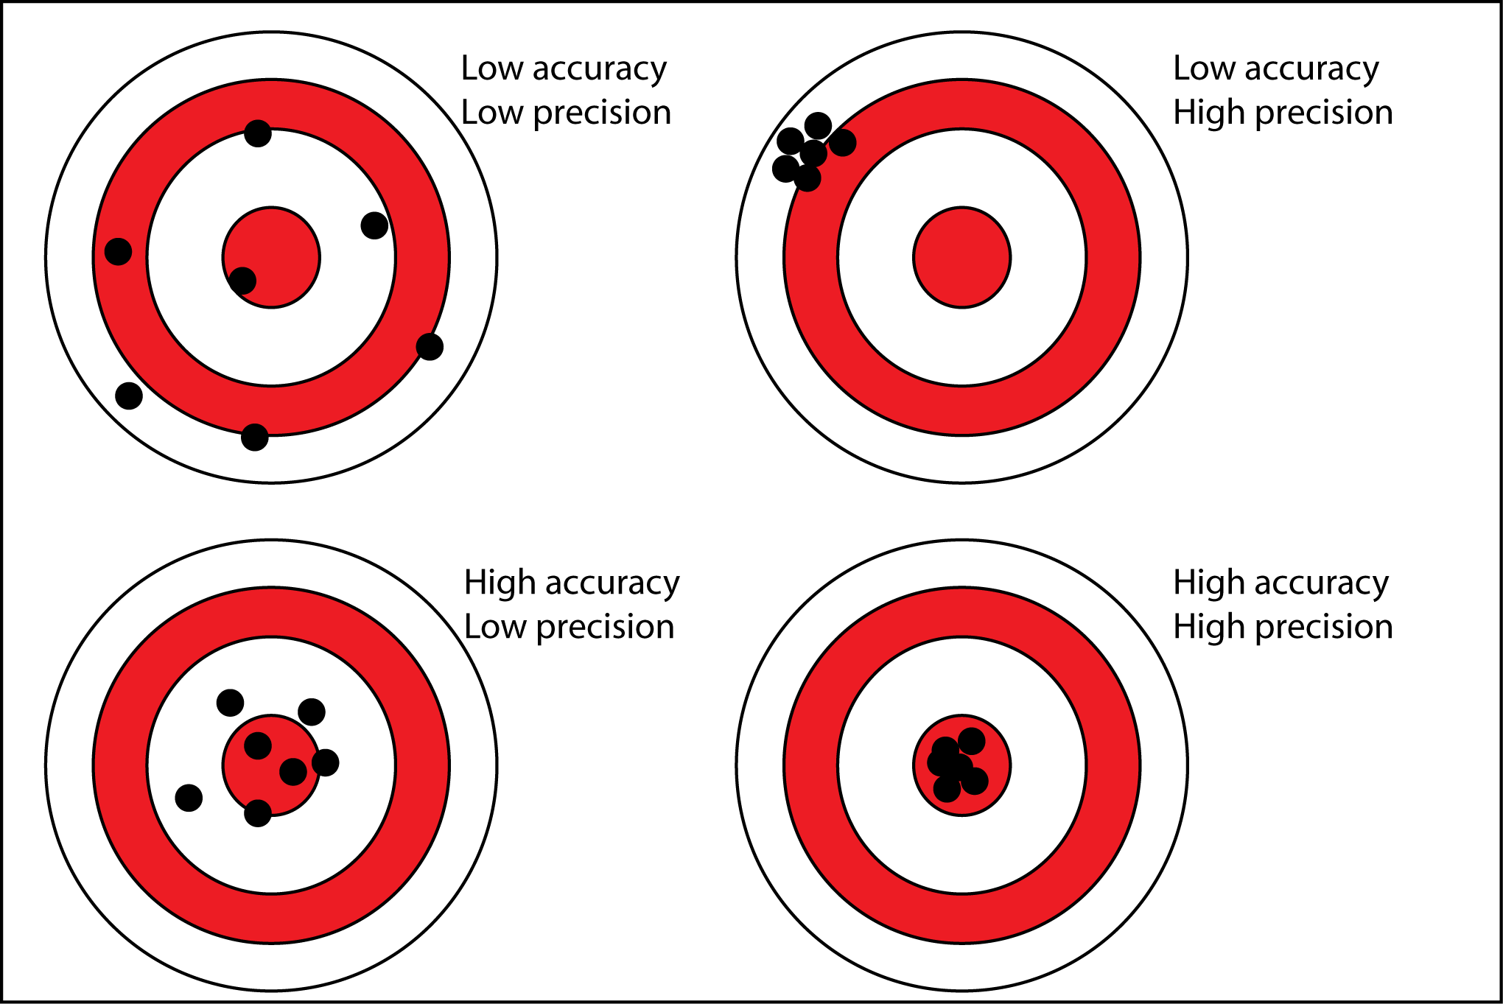
Timing on SoC: Accuracy and Precision
Accuracy (as good as on the OS):
  NTP: sub-millisecond
  PTP: sub-microsecond
  To be measured
Precision:
  Plan A: system call (clock_nanosleep)
    Expecting between tens and hundreds of microseconds
  Plan B (if need be): dedicated kernel module
  To be measured

