Slide 1

WLCG Service Report
5 weeks, April 15 – May 20
WLCG Management Board, May 20
Panos Paparrigopoulos, Maarten Litmaath
v1.0

Slide 2
Operations Coordination meetings
These meetings normally are held once per month
  Usually on the first Thursday
Each meeting has a standard agenda plus usually at least one dedicated topic, announced in advance
Experiments and sites are kindly asked to have the relevant experts attend, depending on the topic(s)
Next meeting on June 5
  Topic: Varnish

Slide 3
Operations Coordination highlights (1)
No Ops Coordination meeting since last MB, but…
A very successful WLCG/HSF workshop @ Orsay had
quite a few Ops-related topics discussed:
  Operations session
    Accounting
    GGUS
    Job allocation and handling
    Security training opportunities
  Tokens
  DOMA
With summaries on the last day
  Facilities
  Security
  Sustainability
  AI in operations
  Heterogeneous resources
  Analysis facilities

Slide 4
Selected items from Operations (1)
A widespread power outage in Portugal and Spain on Apr 28 affected many sites and services in both countries
  Several sites needed multiple days to recover
All FNAL experiments are now using CTA, which means that Enstore is no longer handling any tapes in FNAL, after 25 years!

Slide 5
Service Incident Reports
No service incident reports this month.

Slide 6
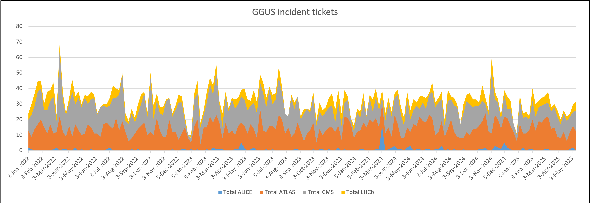
GGUS summary (5 weeks, Apr 14 – May 18)
VO | Incidents | Alarms | Total
ALICE | 3 | 0 | 3
ATLAS | 55 | 0 | 55
CMS | 58 | 0 | 58
LHCb | 18 | 0 | 18
Totals | 134 | 0 | 134
Delete this text box and put the Excel graph here instead.
Please follow the procedure described here:
https://twiki.cern.ch/twiki/bin/view/LCG/GgusOperations#Before_the_WLCG_MB_on_Monday

