Slide 1
Status and plans for a new initiative after I.FAST
M. Vretenar
TIARA Collaboration Meeting, 29.10.2025

Slide 2
HORIZON-INFRA-2025-01-TECH-02
Implementing research infrastructure technology roadmaps
Expected EU contribution: 10 – 15 MEUR
Total budget for the call: 45 MEUR (between 3 and 4 projects can be supported).
Deadline for submission: 18 September 2025
Infrastructure and technology communities mentioned in the call, with already developed research infrastructure technology roadmaps: accelerators, light sources, astronomy
Requirements: Projects should implement significant parts of, or entire research infrastructure technology roadmaps through co-creation with industrial partners from the earliest possible stage. The technology roadmaps should be the result of a community or cross-community effort already undertaken. The technological solutions developed should respond to the needs of several research infrastructures, and in some cases the needs of different types of research infrastructures.

Slide 3
Goals
enhanced scientific and technological competitiveness of European research infrastructures;
enhanced research infrastructure capacities to address research challenges and EU policy priorities;
increased technological level of European industries through the co-development of advanced technologies for research infrastructures and creation of potential new markets;
increased availability of research infrastructure component manufacturing capabilities currently not available in Europe;
long-term integration of research infrastructures into local, regional and global research and innovation ecosystems;
strengthened foundations for the development of innovative companies in Europe.

Slide 4
Conditions
include at least two research infrastructures (ESFRI infrastructure, or ERIC infrastructure, or International European research organisation).
Cascade funding (Innovation Fund) admitted, support to third parties in the form of grants (justification needed to exceed 60 kEUR).
Different ways of involving industry: consortium members, commitment via engagement letters, identified at a later stage, Pre-Commercia Procurement subcontracting, …
Should build on results from previous INFRAINNOV projects (I.FAST) or INFRA-TECH projects, but avoid overlap with them (i.e. no ERL, no muon colliders, no Eupraxia, no ESSnu-SB, no FCC).

Slide 5
Further conditions
involve research infrastructures and industrial partners, including SMEs, through co-creation of required technological solutions,
when appropriate, make use of large-scale platforms combining R&D, integration and validation for technological developments (technology infrastructure).
development of fundamental technologies underpinning efficient and joint use of the research infrastructures, taking into account resource efficiency (e.g. raw material and energy consumption) and environmental (including climate-related) impacts.
address prototyping of high-performance systems needed to upgrade the involved research infrastructures, construct their next generation, or develop new advanced applications.

Slide 6
My main comments
Opportunities:
This call retains most of the suggestions that we made during our interactions with the RI Unit of DG/RTD.
Is the appropriate call to make additional progress in the line of I.FAST: co-creation with industry from low TRL, some cascade funding, needs of several research infrastructures of different types, advanced prototyping complying with sustainability requirements.
Challenges:
Competition: if all go to 15 M€, space for only 3 projects with minimum 4 proposals (accelerators, detectors, light sources, astronomy), probably 6 or 7 (50%-75% success rate).
Requires a consolidated accelerator R&D roadmap that needs to be carefully defined – in a difficult moment of transition between two ESPP updates.
Limited space for applications (only some prototyping allowed “to develop new advanced applications”.

Slide 7
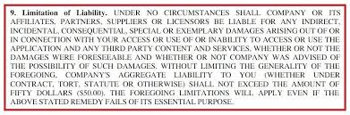
My proposal: guidelines for the new project
Based on the experience with I.FAST, to be discussed and possibly endorsed by TIARA.
(with the standard disclaimers…)

Slide 8
1. General guidelines
Need more top-down and less bottom-up activities than in I.FAST: we are at a critical moment for accelerator R&D and we need to push in some clear directions, shared by all communities. But we should not lose the creativity and innovation dimension…
Key activities should be funded at an appropriate level (higher than the 300-500kEUR of I.FAST).
There should be less partners than in I.FAST (now 48 + associates). We should avoid beneficiaries with less that 100k or 50k EC funding (I.FAST: 27 with <100k, 11 with ≤50k). There is now less pressure to integrate small partners, ideal team is one or 2 academic, one industry.
The rate of matching funds, so far 50% for academia and 30% for industry, is too challenging in these difficult and uncertain times, in particular for industry. New proposed rates: 30-35% for academia, 20-25% for industry (to be discussed).
Less space for Networks, possibly only in the frame of defining Technology Roadmaps.

Slide 9
2. Procedure
TIARA has to coordinate the preparation of the proposal.
Need to set-up a shared Roadmap for accelerator R&D with the following communities:
  ESPP (accelerator roadmap)
  LEAPS (accelerator roadmap)
  nuclear physics
  neutron and energy,
  Accelerator industry (via the AIPF).
Options to reach a consensus:
  Organise a mini-workshop with the 5 communities (e.g. 2 people/community, officially nominated).
  Continue with bilateral discussions with the communities and draw the conclusions in TIARA.
  Set-up a TIARA sub-committee with members endorsed by the communities (LEAPS, ESS, CERN, GSI,…)
  Go backwards: prepare a list of topics and submit it to official representatives of the communities.
  Invite to TIARA some representatives of the communities and devote a special meeting to a roadmap.
Prepare a written document, agreed by representatives of the communities above, defining a list of strategic R&D activities, to be used for project preparation.
Select priority topics (for top-down part) and requirements for proposals (for bottom-up part).
Nominate a Coordinator for the proposal (CERN ready to take the coordination responsibility, but selection after a job opening will be long and complex and might lead to surprises).
My favourite path:
A combination of 2-3-4-5 resulting in a special TIARA meeting on January 25

Slide 10

3. Possible structure
Based on the experience of I.FAST and on our discussions with the EC
Project based on 4 pillars (groups of Work Packages):
 | Pillar | Content | EC contribution per activity | Total EC contribution
1 | Instruments | General WP’s covering all activities |  | 3 M€ ?
2 | Enabling technologies | About 5 key technologies, selected top-down, higher TRL | 1 M€ | 6 M€ ?
3 | Emerging technologies | Selected technologies after bottom-up call, lower TRL | 200-500 k€ | 4 M€ ?
4 | Innovation Fund | Internal call after project start | 100-200 k€ | 2 M€ ?
 |  |  |  | 15 M€

Slide 11
4. Instruments pillar
General Work Packages, supporting all other activities:
Work Package | Title | Some proposed content
1 | Management, coordination
2 | Dissemination and outreach | CBI, Acc. News, Social media
3 | Training
4 | Industry | Support to AIPF
5 | Technology transfer | Scheme to support start-ups
6 | Sustainability | Methodologies, e.g. for LCA
7 | Societal applications | Medical and industrial roadmap
8 | Roadmap follow-up | Contact with other communities.
Recommendation: hire a full-time (or 50%) communication person

Slide 12
5. Enabling technologies pillar
Conditions: evolution from previous accelerator projects (I.FAST), possibly multi-platform (serving different communities), profit from engagement of industry, not covered by other EU projects. Funding at the level of 1 M€ / activity.
My personal ideas: (to be confirmed/modified by TIARA with other communities)
Thin Superconducting films (including a prototype cavity in collaboration with industry) – continuation from I.FAST, interest for HEP, nuclear, LEAPS, applications.
Additive manufacturing (including prototype linear copper accelerator) – continuation from I.FAST, interest for all accelerators.
High Temperature Superconducting magnets (including demonstrator) – continuation from ARIES, interest for colliders and applications.
Dielectric Laser Accelerators (including prototype), interest for colliders and applications.
A topic for synchrotron light sources (permanent magnets? HTS undulators – but this should be in the LEAPS proposal?)

Slide 13
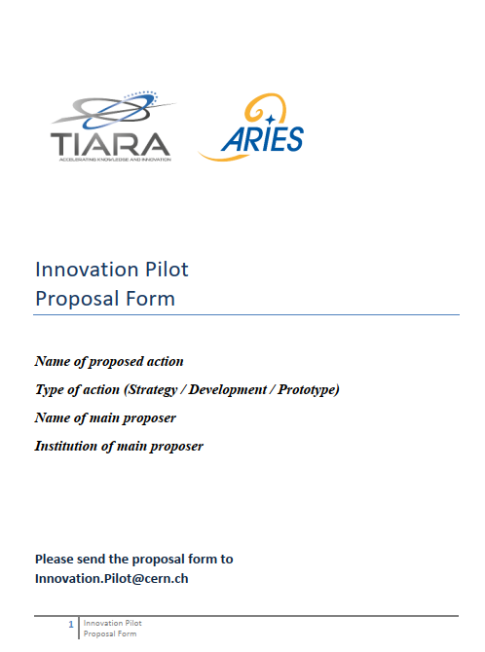
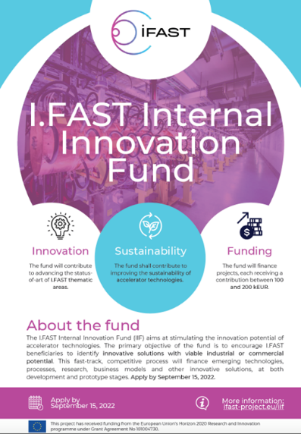
5. Emerging technologies and Innovation Fund pillars
Same procedure as for the setting-up of I.FAST and the I.FAST Innovation Fund.
Submission form structured as follows:
Title and summary (0.5 p.)
Participants (0.5 p.)
Description (excellence) (1 p.)
Impact (0.5 p.)
Methodology and Organisation (0.5 p.)
Budget and indicative budget share with co-funding (0.5 p.)
Schedule, Deliverables and Milestones (0.5 p.)
Potential risks and mitigations (0.5 p.)
Proposed length about 5 pages
I.FAST Task 4.2, Management of the Innovation Fund.
1 M€ funding to an internal competitive call for innovative projects, starting early 2023, for a duration of 2 years (to match termination of I.FAST in April 2025)
Funding between 100 and 200 k€ per project
Consortium: at least one I.FAST beneficiary and one industry;
Initial TRL 3 or higher (from proof-of-concept to laboratory/environment validation);
Project contributes to improving sustainability of particle accelerator technologies;
Project must have potential for industrialisation or commercialisation
Project must have potential to attract more resources than what deployed by IFAST alone.

Slide 14
6. Proposed Timeline
Tentative Timeline: Enabling technologies
January 2025: define common roadmap with other accelerator communities, with priority topics and guidelines for internal call.
February nominate WP Coordinators for enabling technologies and invite to set up collaboration.
31 March deadline for presenting WP’s.
30 April content and budget approved by TIARA.
May start editing.
Tentative Timeline: Emerging technologies call.
February 2025 send letter and submission form to all institutes having participated in previous programmes
31 March submission deadline, nominate selection committee.
30 April pre-analysis and classification of submissions completed.
31 May selection of projects completed, start editing.
Please note that in summer I will be busy in closing I.FAST – if it is not extended
June, July, August: the new Coordinator writes the proposal with the help of his/her team.

Slide 15
Questions and comments?

Slide 16
Thank you for your attention!

