Slide 1

Design criteria and present design status of the BGC v4.2 for the LHC
G. Schneider, C. Pasquino, R. Veness and BGC design team
11th BGC Collaboration Meeting 02.12.2024 Liverpool University

Slide 2
Content
Review of the fundamental design parameters for v4.2
Present Design Status of the BGC
Next Steps
Sum or Deliveries
Summary

Slide 3
Fundamental Design Parameters for v4.2 (1/2)
No design for the Hollow Electron Lens, but optimised for cost, construction time and function as beam instrumentation e.g. profile measurement device and halo monitoring for protons and ions.
Location: Beam 2 LHC Point 4, symmetric around IP4 with some margin to adopt for best position due to the cryogenic distribution line.
Gas curtain angle 90° to beam (maybe?)

Slide 4
Design Parameters for v4.2 (2/2)
Same curtain gasses as present, Neon and/or Nitrogen
Camera ideally away from beam axis to reduce noise
Mirror for light extraction accepted
All gas injection infrastructure to be copied for right side

Slide 5
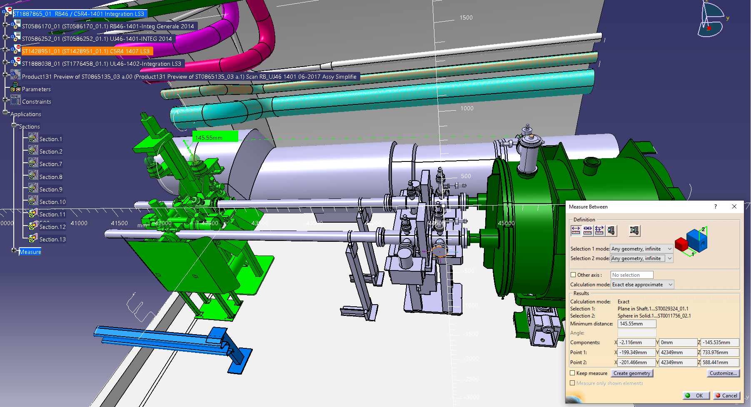
Design- BGC v3 moved to right side
Unfortunately copy/paste does not work, Beam 1 is in the way
“Krystians’ design” for space optimised BGC seen next slide far off from being engineered to its end

Slide 6
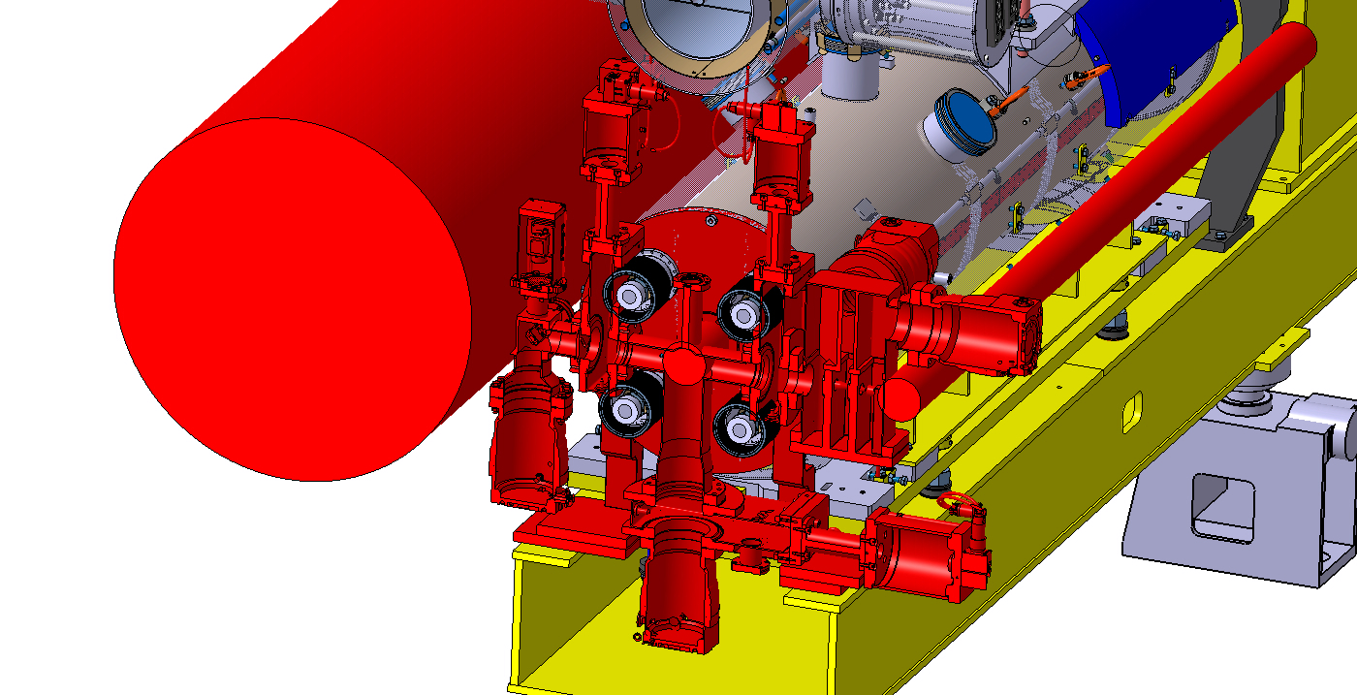
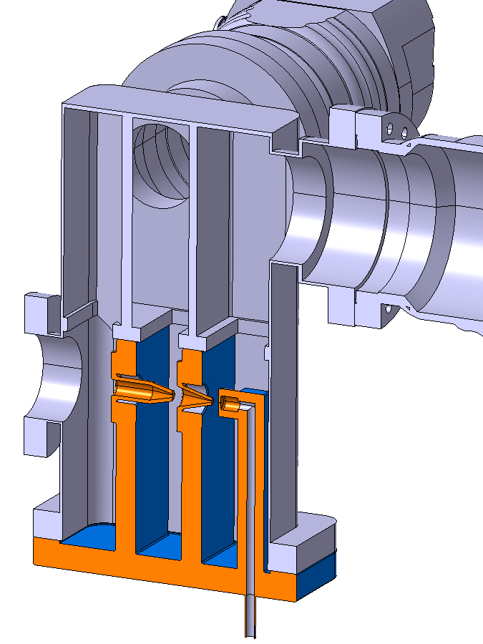
Krystians’ Design for HEL as a reminder
Install the Gas Injection System from the bottom

Slide 7
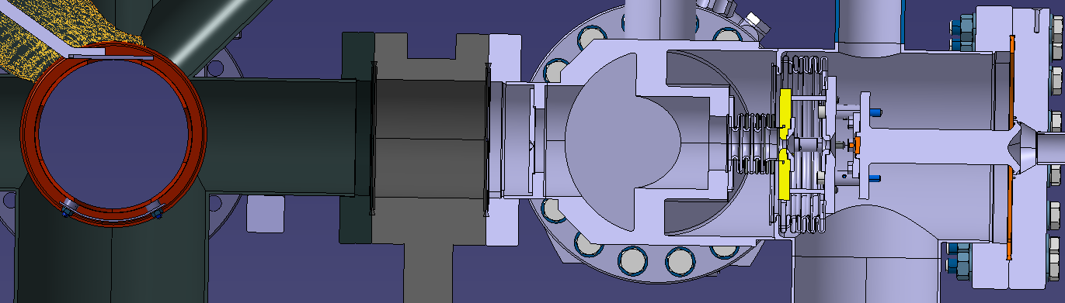
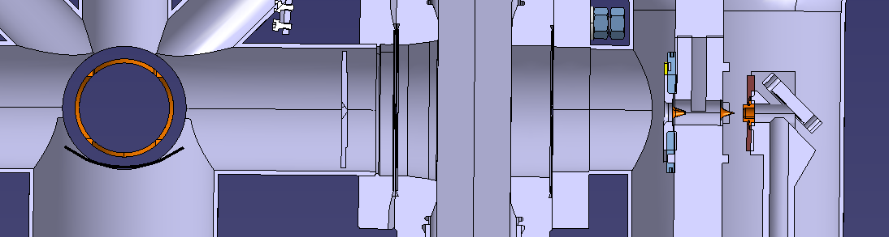
To make the “bottom installation” V4 design work would need major vacuum and mechanical engineering resources, which we do not have
Nozzle to IP: 378mm
3rd skimmer
2nd skimmer
1st skimmer
IP
Version 3
nozzle
222mm
135mm
17
4mm
3rd skimmer
2nd skimmer
1st skimmer
nozzle
3rd skimmer location range
Version 4
Bottom load
Concept
→ Not followed
IP
Nozzle to IP: 280mm
104mm
155mm
17
4mm

Slide 8
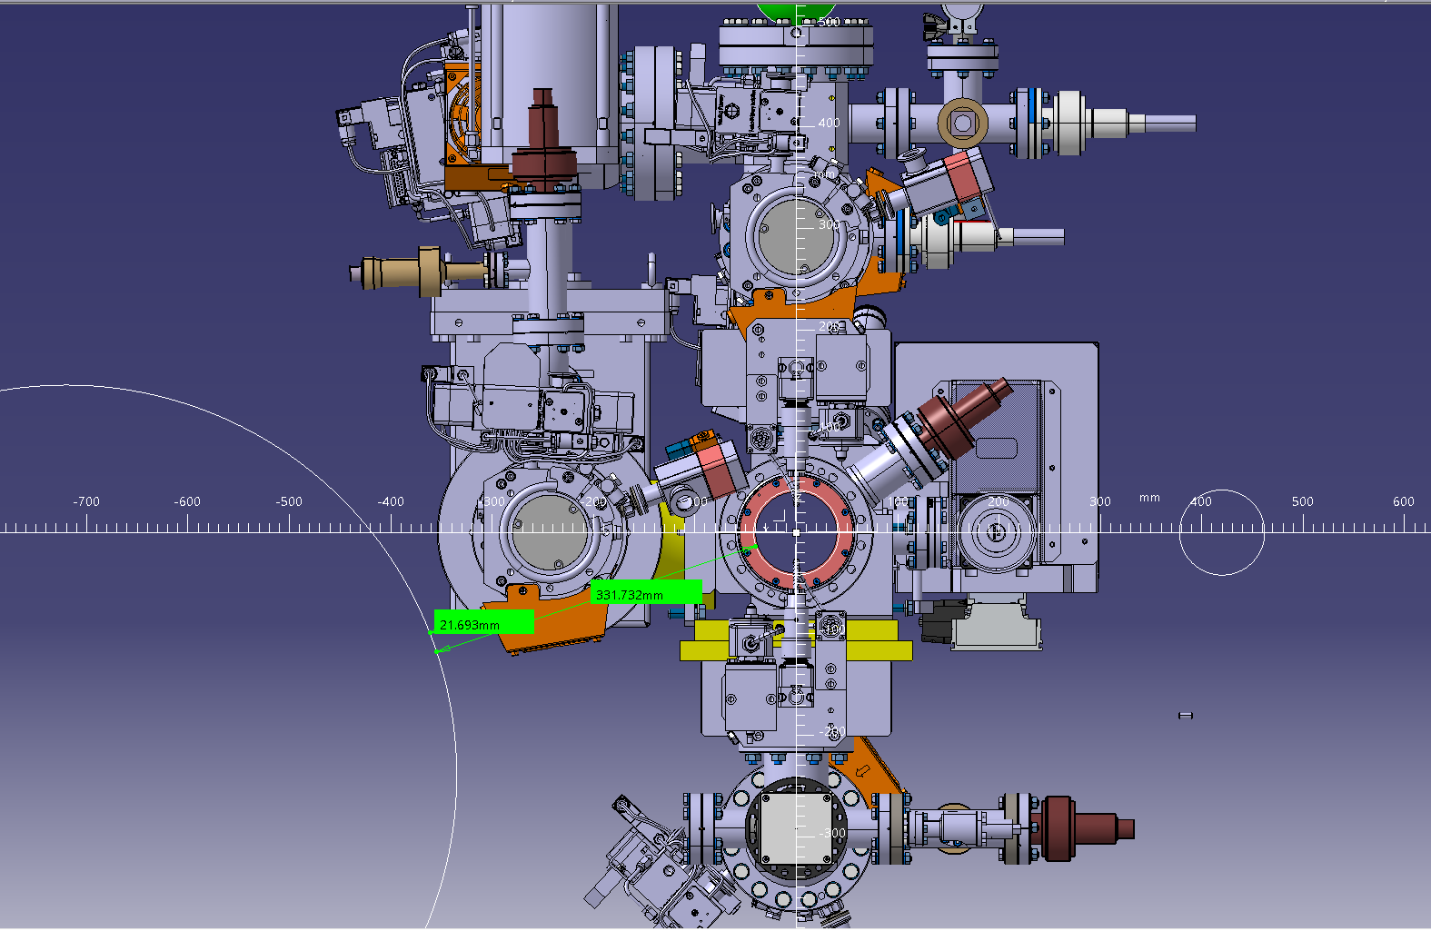
BGC v4.2 draft design
Base Parameter:
Turn V3 90° to have the
Gas Injection Top-Down
V4
V3

Slide 9
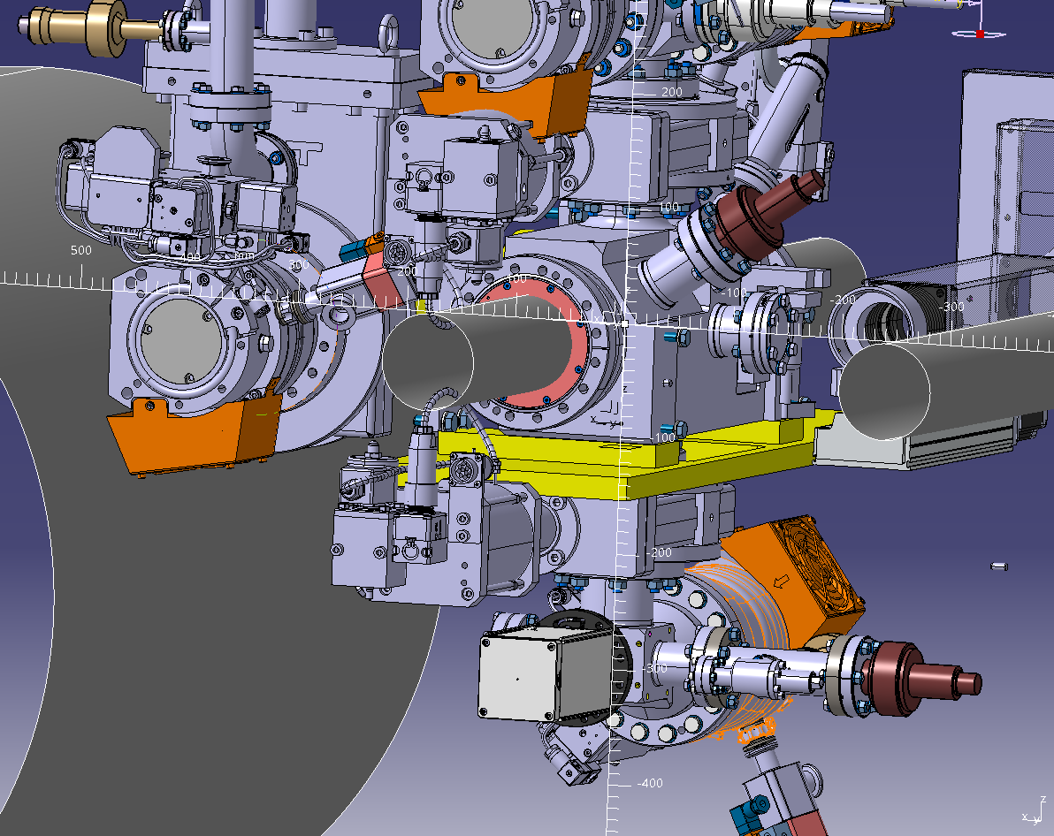
BGC v4.2 draft design – Next steps
Remove Interaction Chamber TPM
Add Ion Pumps on beam axis left and right of BGC 400 l/s or 1000 l/s, ideally re-cycled
Find not-in-axis camera location
Add BGC support
Define exact location and in-axis length of BGC
Some additional design support soon

Slide 10
Summary
BGC v4.2 preparation ongoing to become a HL-LHC baseline beam instrument for profile and/or halo measurements.
Design of v4.2 is based on v3 with top-down gas injection.
No HEL design, but cost and time optimised.
Design needs in 2025 a real push in order to start manufacture in 2026.
Paper work as Engineering Change Request, space reservation required in order to prepare for the adjacent beam pipes.
Phased approach as for the v3.

Slide 11
Sum of Deliveries
Central Beam pipe including liner, plate and calibration including cleaning and leak checks
Support and installation
Vacuum gauges, racks, cables controlers, gas injection valves tunnel side
Vacuum pumps turbo and primary
Vacuum gate valves
Vacuum Sectorisation
Tunnel cables
Injection chamber including bellows and nozzels
Dump chamber including skimmer, mirror and camera
Gas Rack, valves and line
Camera system
Ion pumps including supports, warm modules, controller and cabling
Testing, various, tools

Slide 12
Questions?

Slide 13
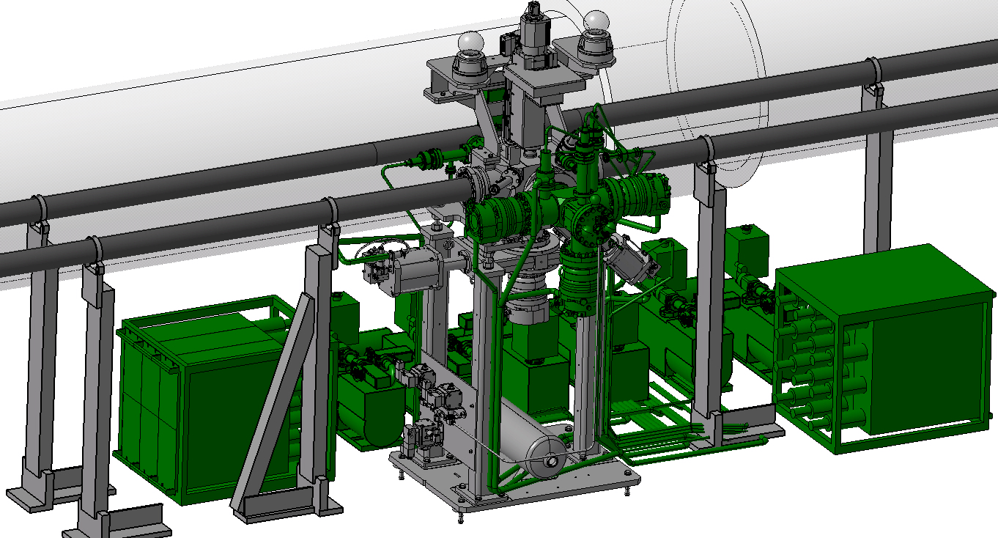
BGC V3 in the HEL
Notes:
QRL – cryogenic Ring line. Cryogenic supply line to supply helium to the magnets in the tunnel.
For Colling system
What is inside? Cold Helium

Slide 14
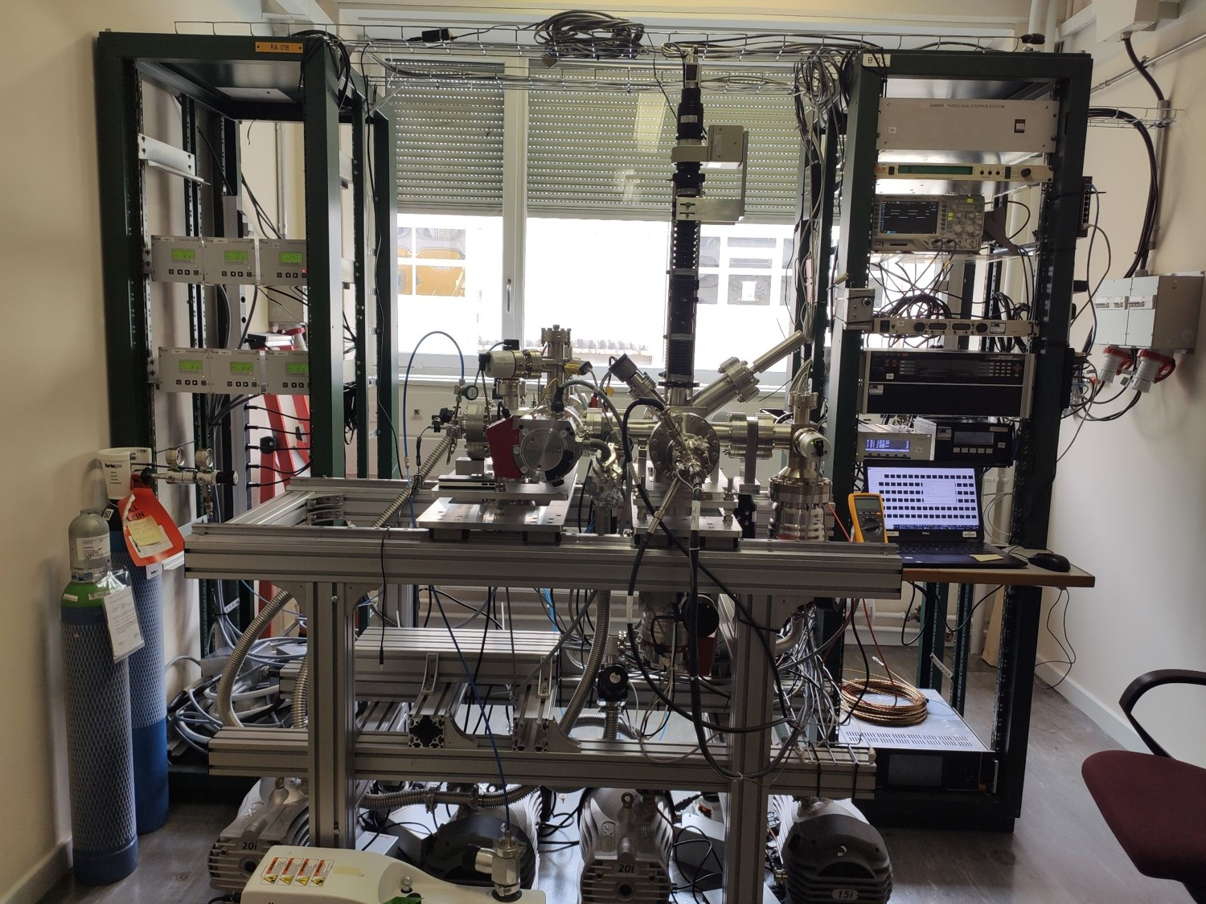
BGC V3 in the lab
Notes:
QRL – cryogenic Ring line. Cryogenic supply line to supply helium to the magnets in the tunnel.
For Colling system
What is inside? Cold Helium

Slide 15
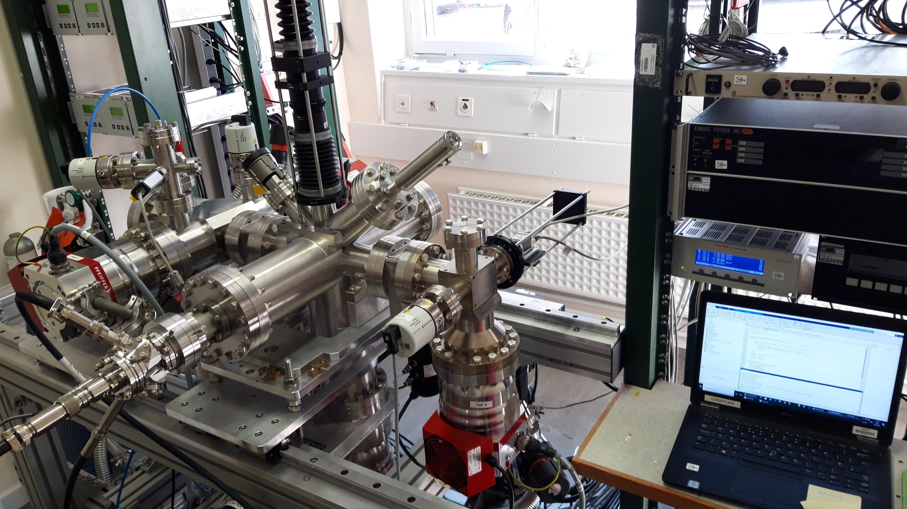
BGC V3 in the lab
Notes:
QRL – cryogenic Ring line. Cryogenic supply line to supply helium to the magnets in the tunnel.
For Colling system
What is inside? Cold Helium

Slide 16
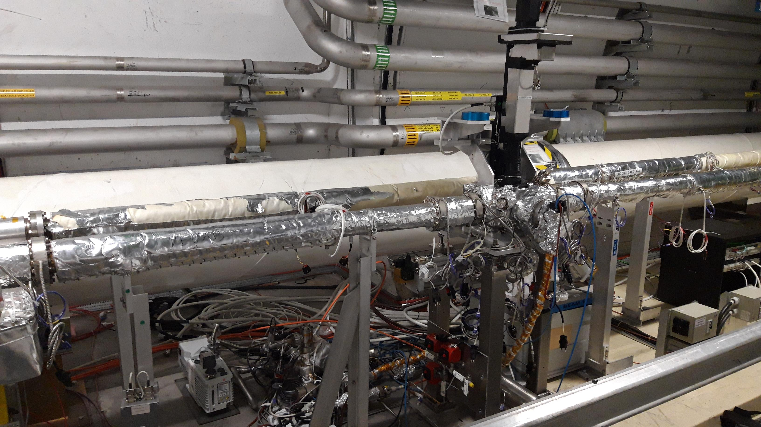
BGC in LHC tunnel 2022
Distributed neon Gas operation
Optical system
BGC vacuum chamber
Vacuum system
Gas injection line

Slide 17
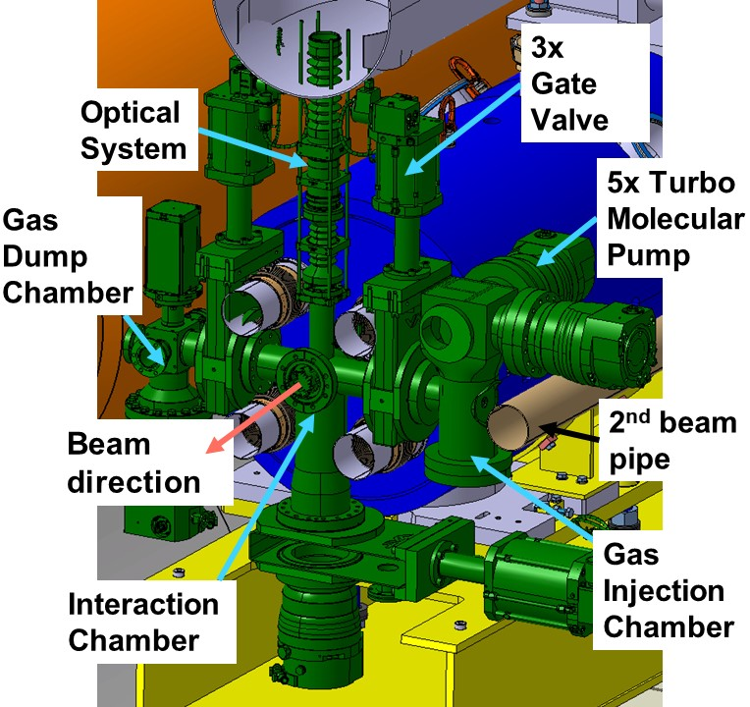
BGC V4
Notes:
QRL – cryogenic Ring line. Cryogenic supply line to supply helium to the magnets in the tunnel.
For Colling system
What is inside? Cold Helium

Slide 18
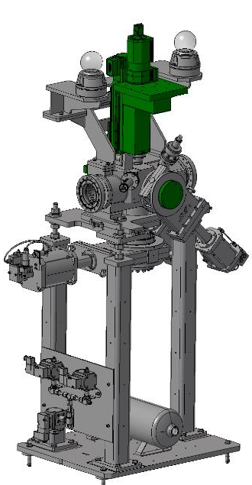
BGC Phase 1 2021 in YETS

Slide 19
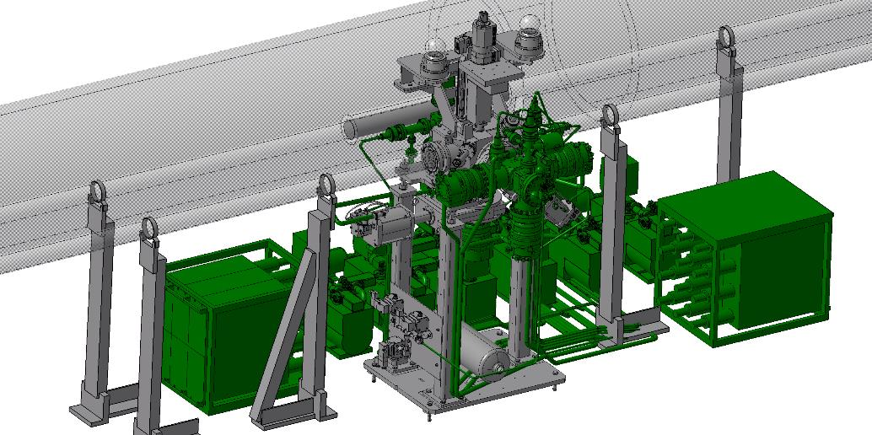
Phase 2 to be installed

Slide 20
Final BGC version (V4) in HEL, here 4R

Slide 21
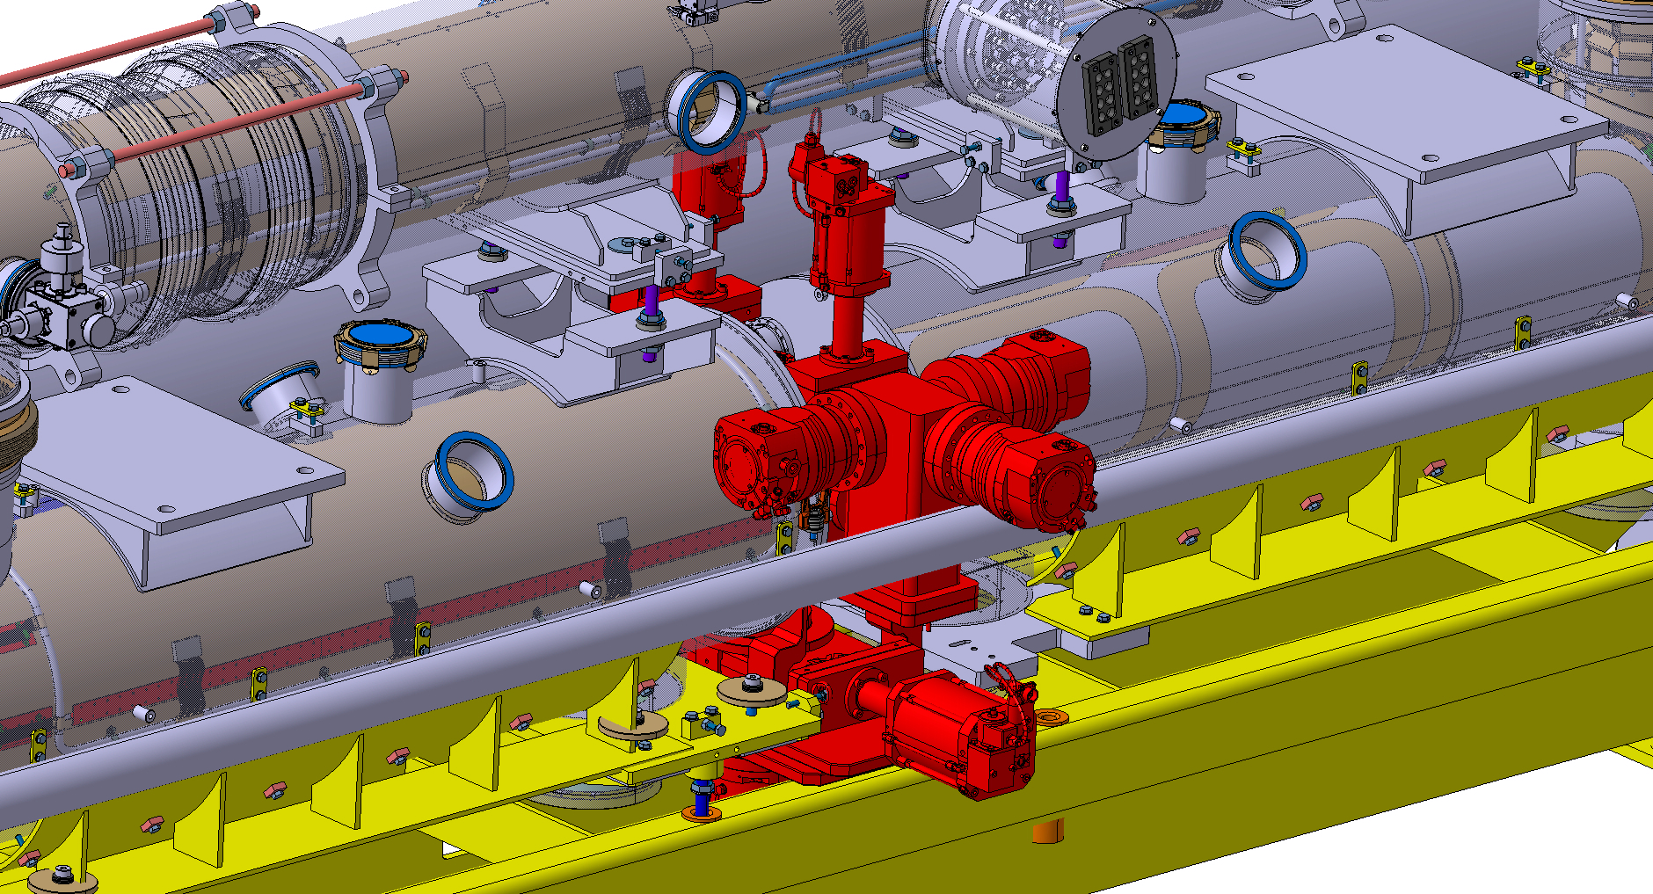
Design of final instrument (V4) for HEL well in Progress
Challenge: Space

