Slide 1




Summary of 2024 experimental results at LHC
11th BGC collaboration meeting
Liverpool
2nd December 2024
D. Butti on behalf of the BGC collaboration

Slide 2

Overview of 2024 run
YETS / machine commissioning
resolution and focusing studies
development of data processing tools
Proton run
re-commissioning with beam, addressing open points from 2023
systematic measurements
Oliver’s visit
Ion run
re-commissioning with ions
systematic measurements with real time emittance monitoring
Shakti’s visit

Slide 3
System re-commissioning

Slide 4
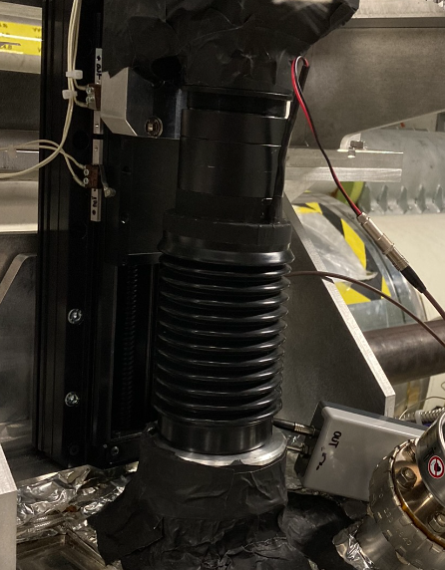
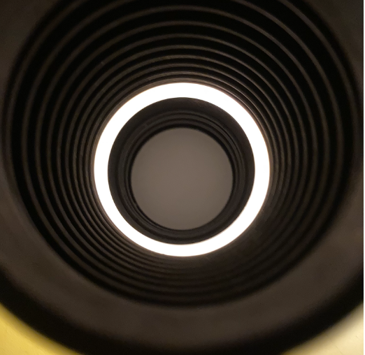
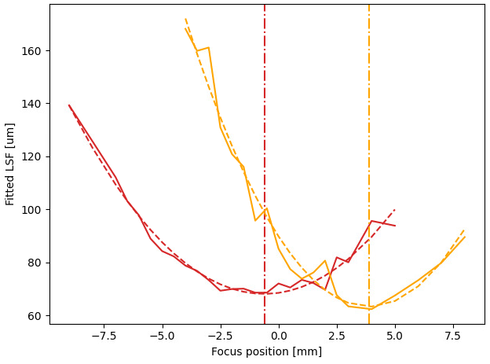
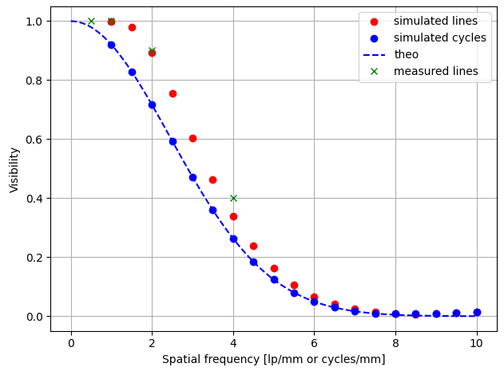
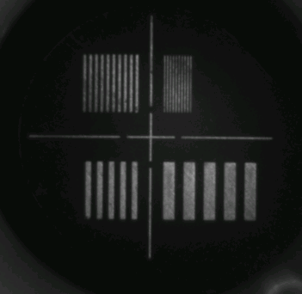




Focusing and resolution assessment
YETS 24
detector
Magnification and resolution of the optics needed to get beam size from the image size
$$σ_{image}=M\sqrt{σ_{source}^{2}+σ_{res}^{2}}$$
optics
Several tests during YETS
independent techniques yield consistently $\sim 65 um$ resolution
LED ring
585 nm
$$σ_{LSF}=65 um$$
warm white
$$σ_{LSF}=65 um$$
calibration target

Slide 5
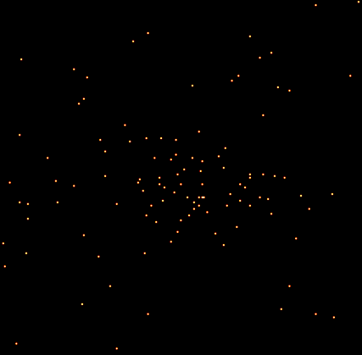
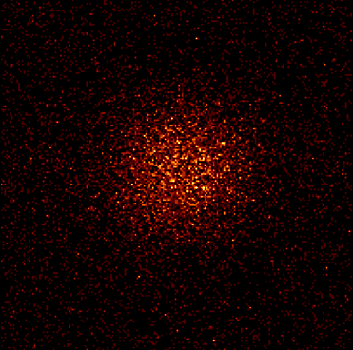
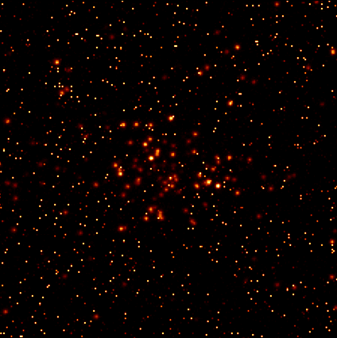
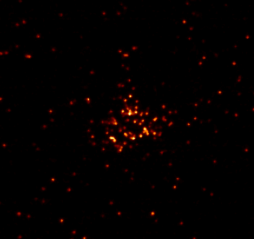
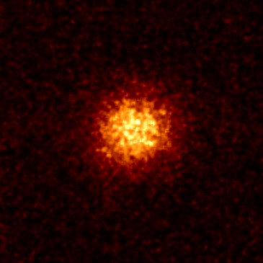

Data processing
YETS 24
EXPERT GUI
Photon detection
Stacking
Final image
Photon counting
Display
Analysis
Logging
Single frame acquisition
Pre-processing
Intensity stacking
Stacking
Final image
FESA
NXCALS

Slide 6
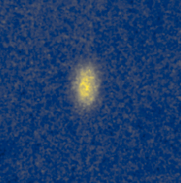
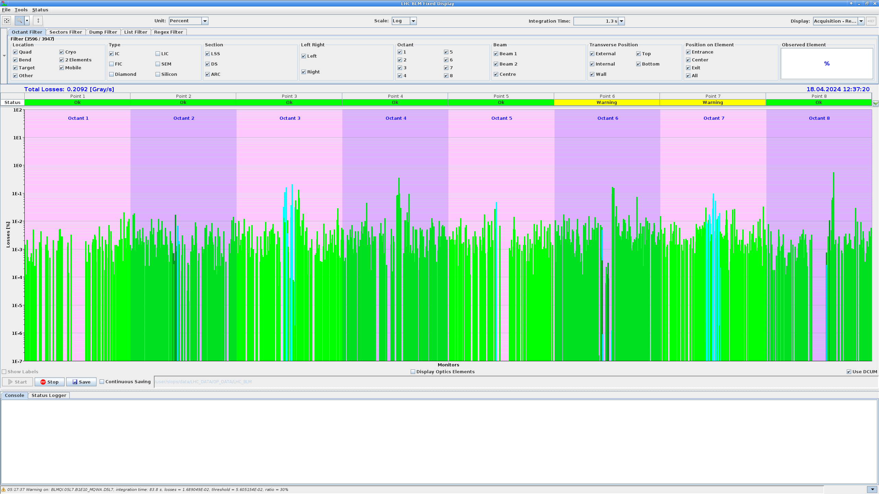
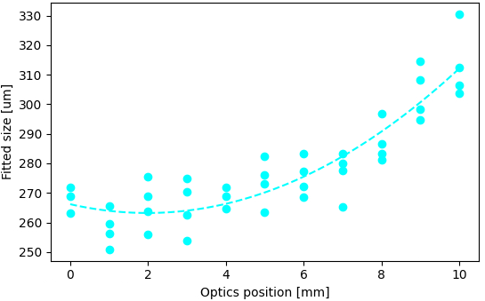
System re-commissioning
Intensity ramp-up
first 2024 BGC acquisition
BGC re-commissioned during LHC intensity ramp-up
optics centered and focused
recommissioning of gas injection system in steps
beam losses confirmed well within BLM limits
optics focusing with beam
Beam losses display
BGC <1% dump threshold

Slide 7
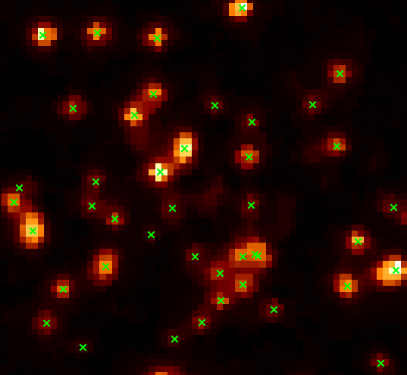
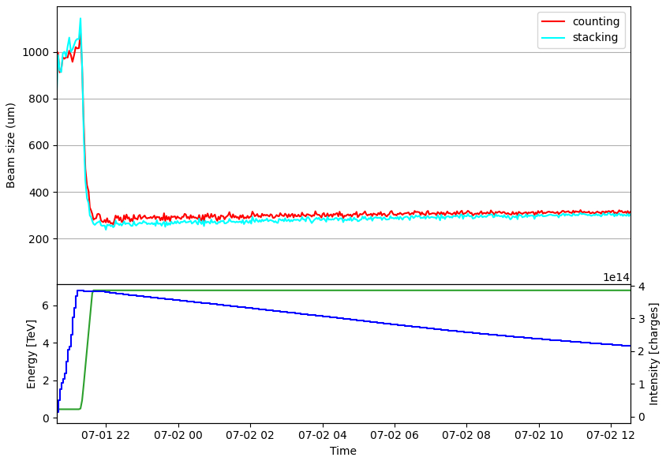
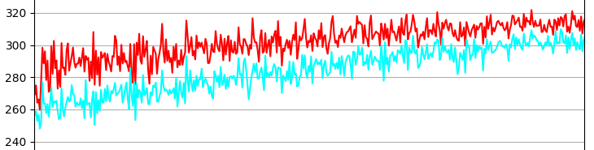


Photon counting vs frame stacking
Intensity ramp-up
0 → time in SB → ~10h
Photon counting and intensity stacking approaches compared
generally consistent, except for counting failure due to clustering
no evidence of major advantage with photon counting.
Stacking used in regular operation (simpler and faster)
Example of photon detection in a single frame of 50ms exposure
For large beams, counting and stacking coincide
(e.g. injection energy)
$$Δ\sim 10\%$$
$$Δ\sim 3\%$$
For small beams, counting is systematically larger, due to failure of photon counting at high photon density.
Exposure < 25 ms required in single photon studies.
Data recorded for offline analyses.

Slide 8
Highlights from proton run

Slide 9
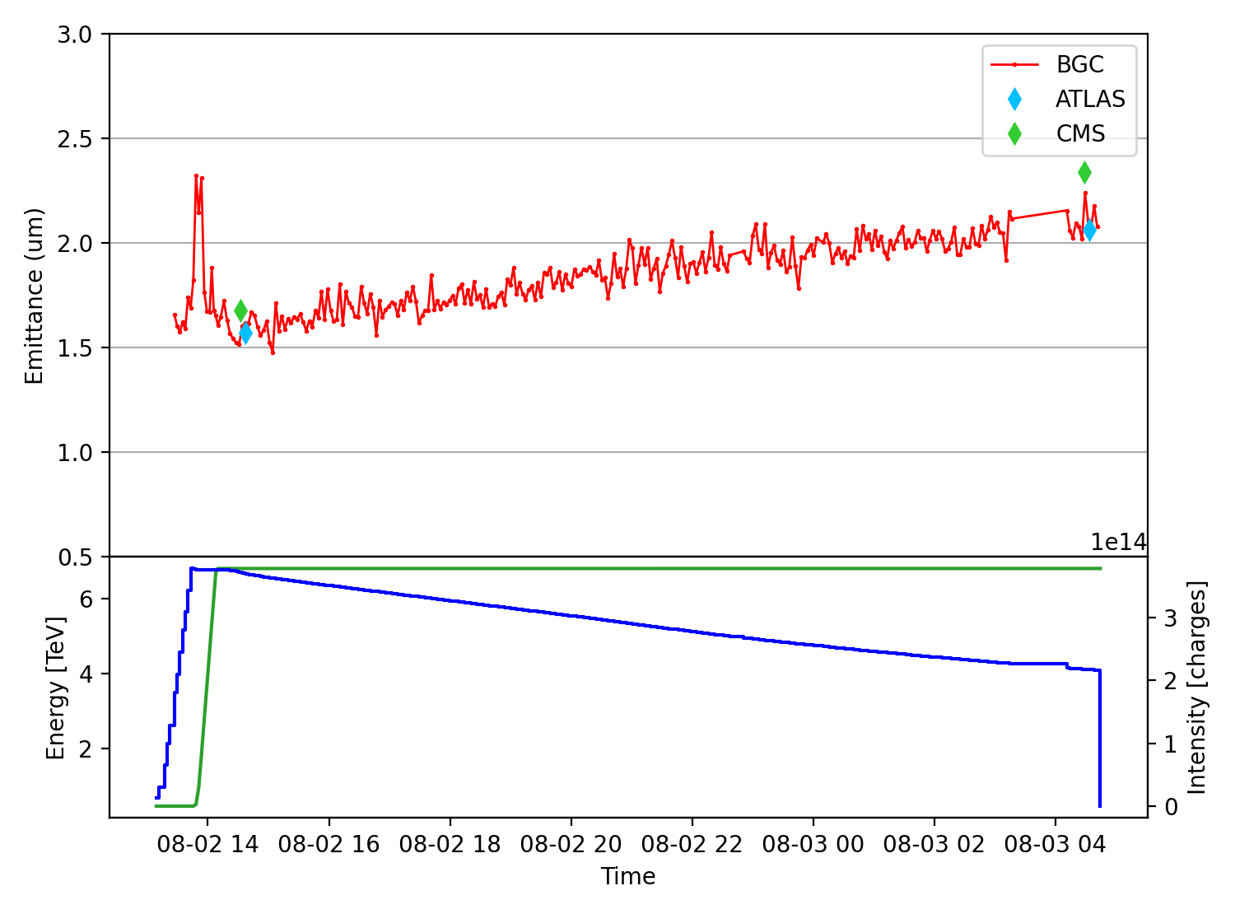
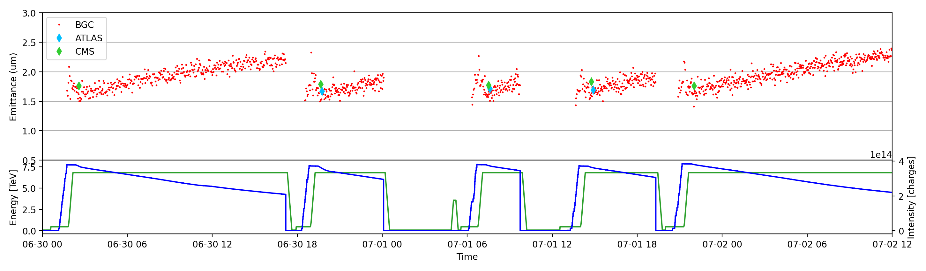
Accuracy validation
Proton physics
#9969
Assessing accuracy and reproducibility of absolute measurements
observing visible neon transition (no space charge)
considering horizontal direction (no jet thickness effect)
consistent with both emittance scans
Noisy measurements (±10% peak-to-peak) but values consistent with emittance scans and reproducible over several fills
120 s integration per point
#9842
#9843
#9846
#9848
#9849

Slide 10
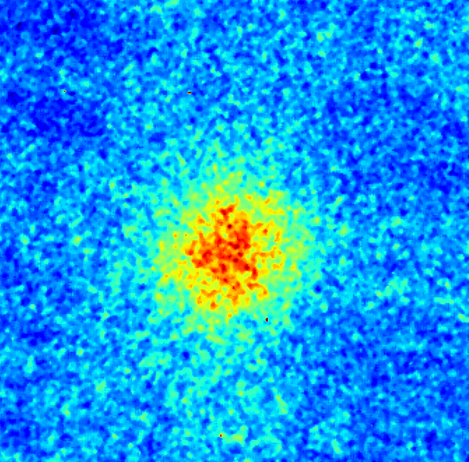
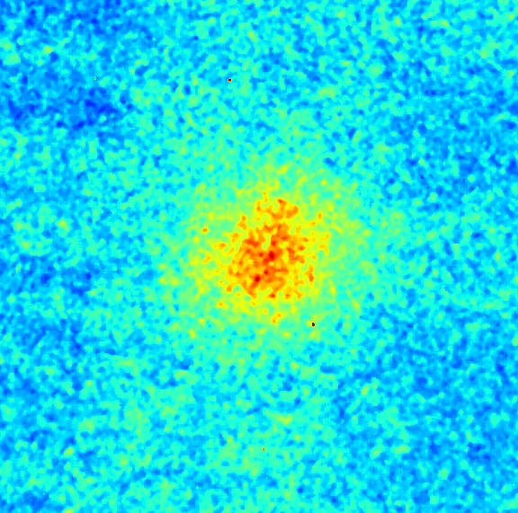
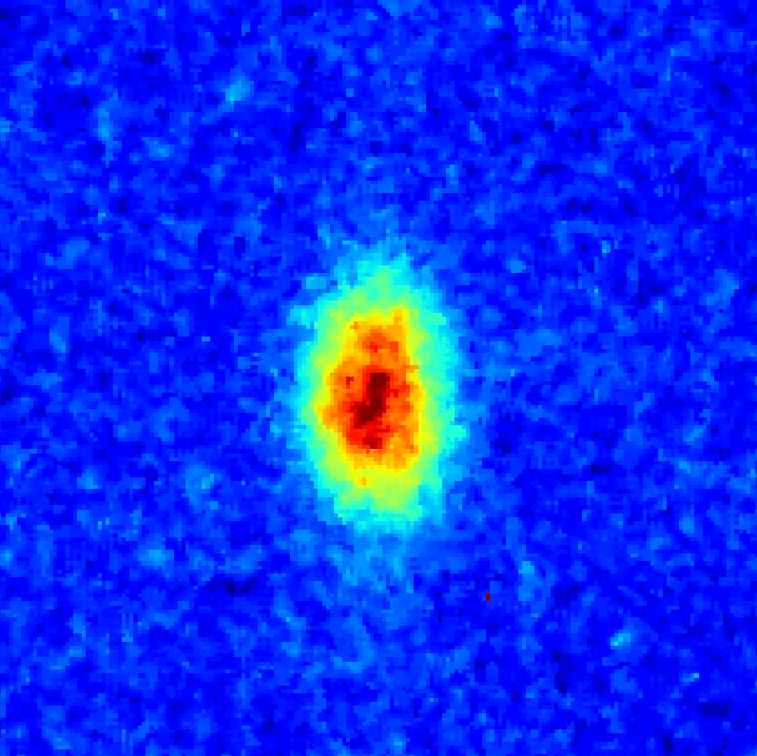
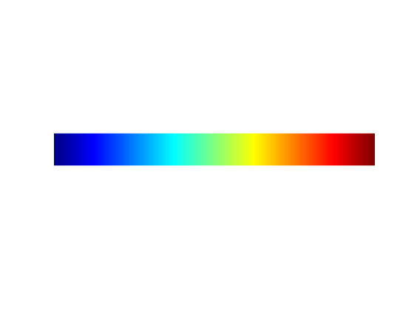
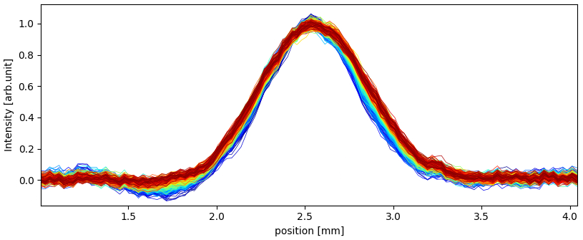
Limitations with visible fluorescence
Proton physics
Working with the neutral line has drawbacks
poor signal → noisy measurements
long exposures → limited use for transients
low profile quality → impossible to deconvolve
Injection
Start of ramp
Stable beams
0 → time in stable beams → 10h
Horizontal profiles in stable beams
Using visible line with existing configuration,
BGC is effective mostly for accurate assessment of horizontal emittance in stable beams
size evolution

Slide 11
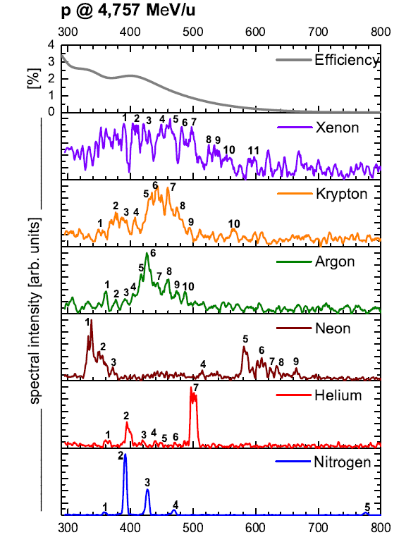
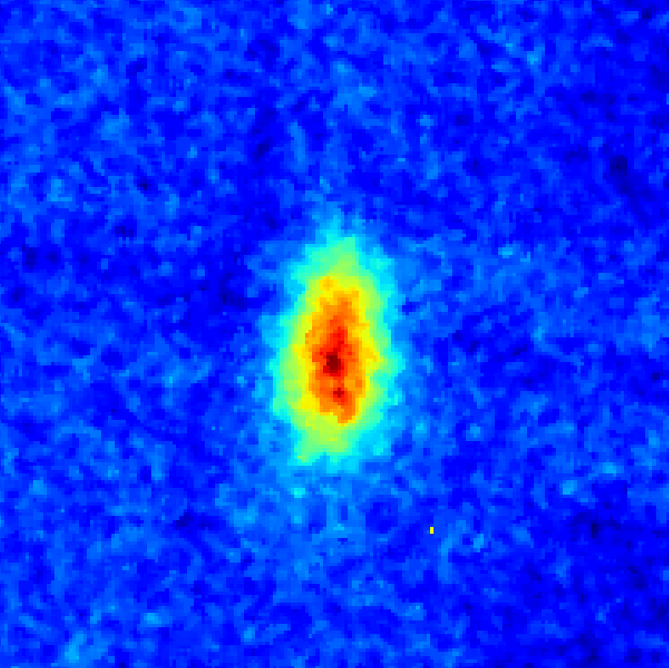
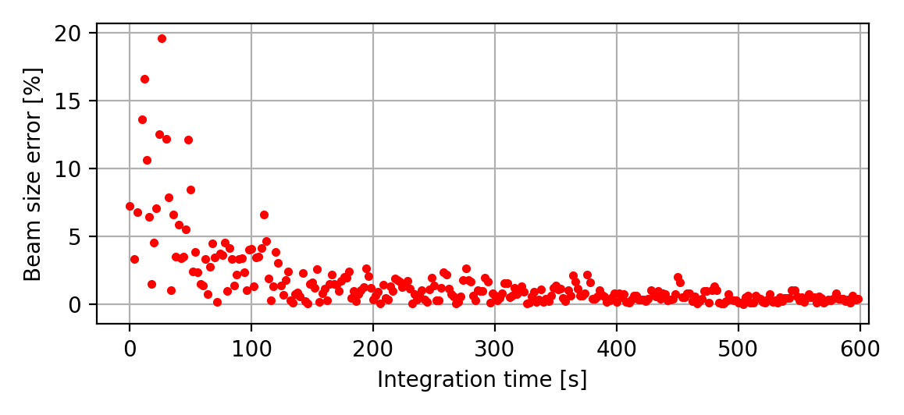
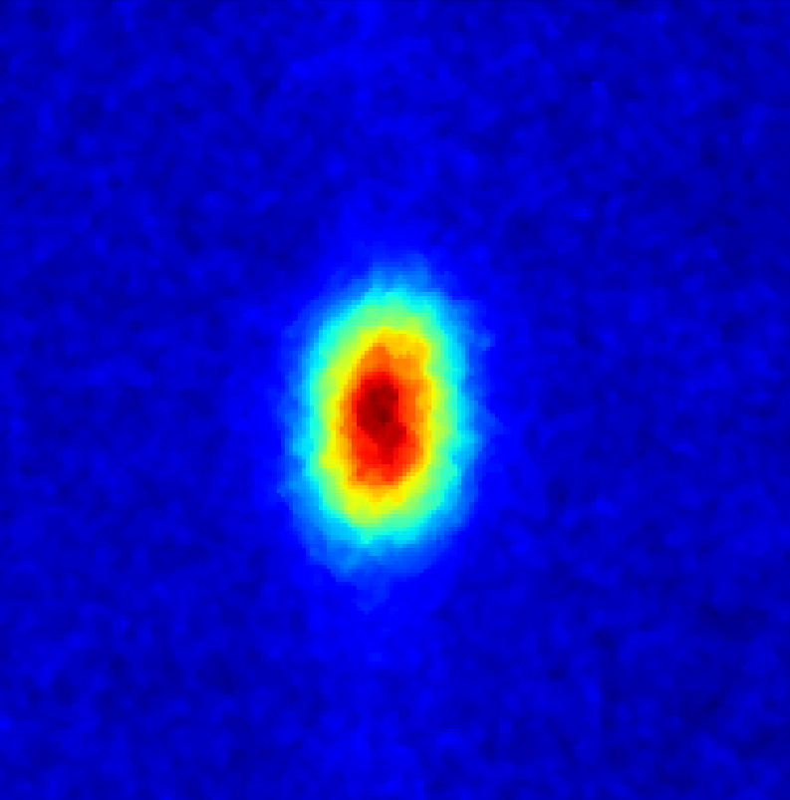
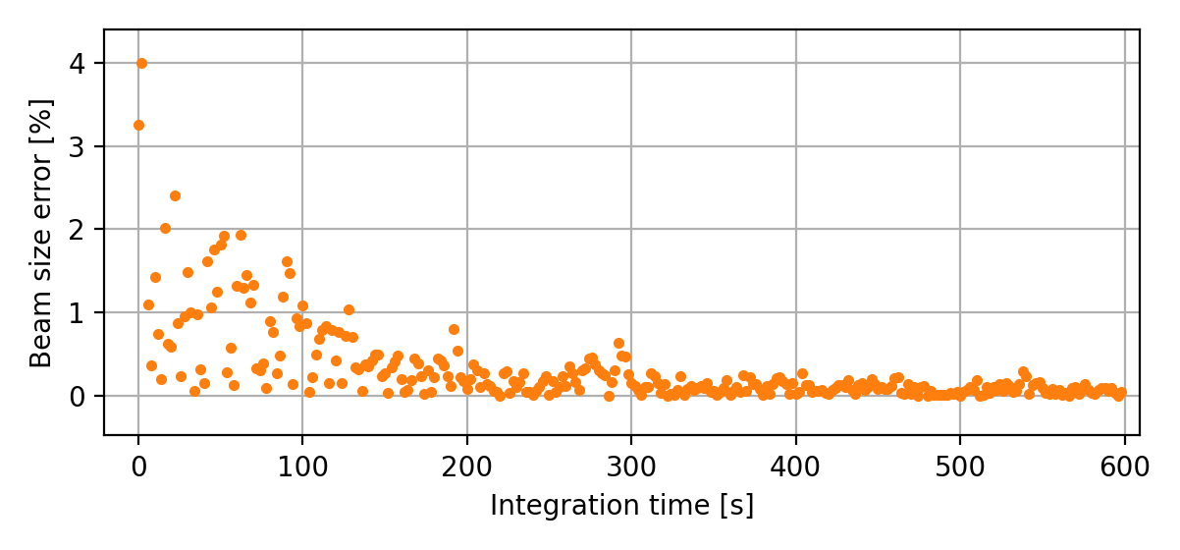
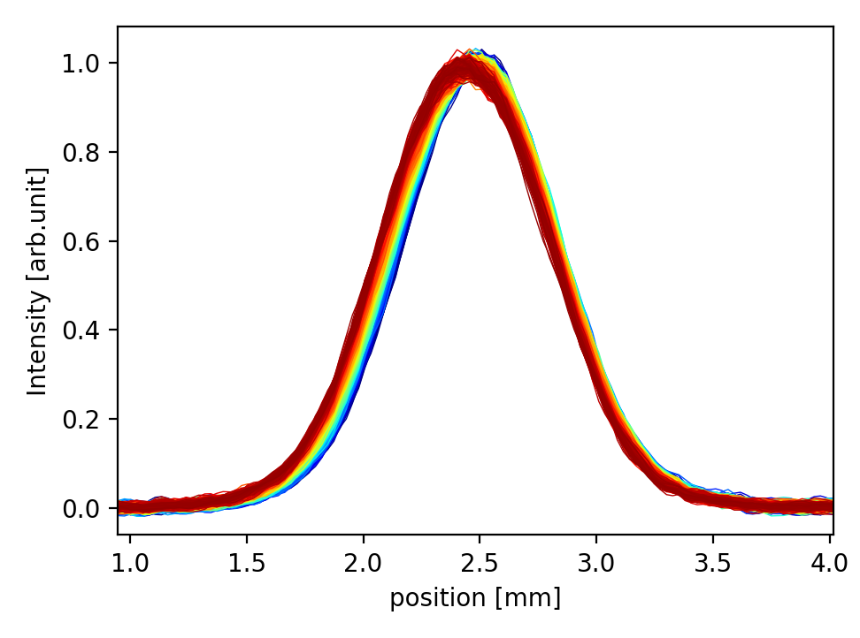
Combining visible and UV fluorescence
Proton physics
wavelength [nm]
BGC optics allows observing the more intense UV lines of neon
Non-destructive profile measurement of intensive heavy ion beams,
F. Becker 2010
VIS 120 s
±5% ~ 120s
Apparent gain in signal quality
exposure time < 1 min
lower statistical fluctuation of fitted size
better profiles
beam
UV 40 s
±2.5% ~ 40s
beam

Slide 12
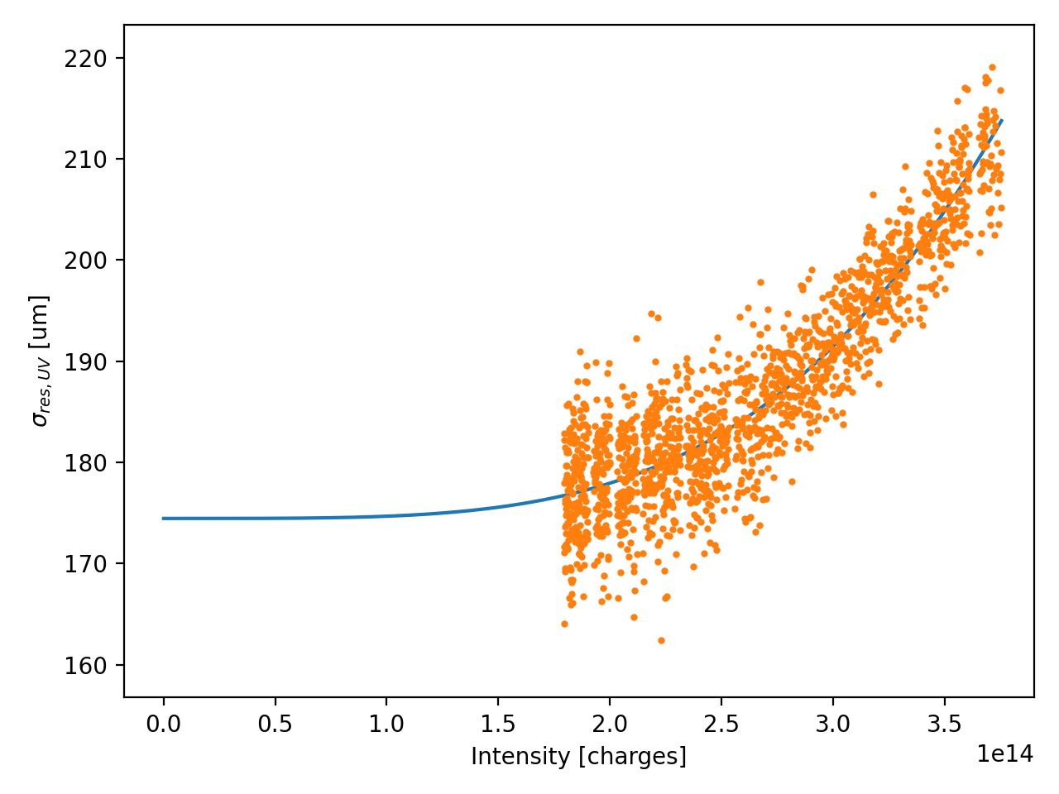
Combining visible and UV fluorescence
Proton physics
Better signal quality comes at the cost of poorer resolution due to space charge effects
Problem of UV resolution handled in semi-empirical way
assume visible measurement provides “true” beam size
derive UV resolution as a correction parameter, polynomial function of the beam current
Obtained resolutions in the order of 200 µm, vs 65 µm measured with visible light.
This is not ideal for flat-top beam size but good for injection and ramp, where the higher signal is actually demanded

Slide 13
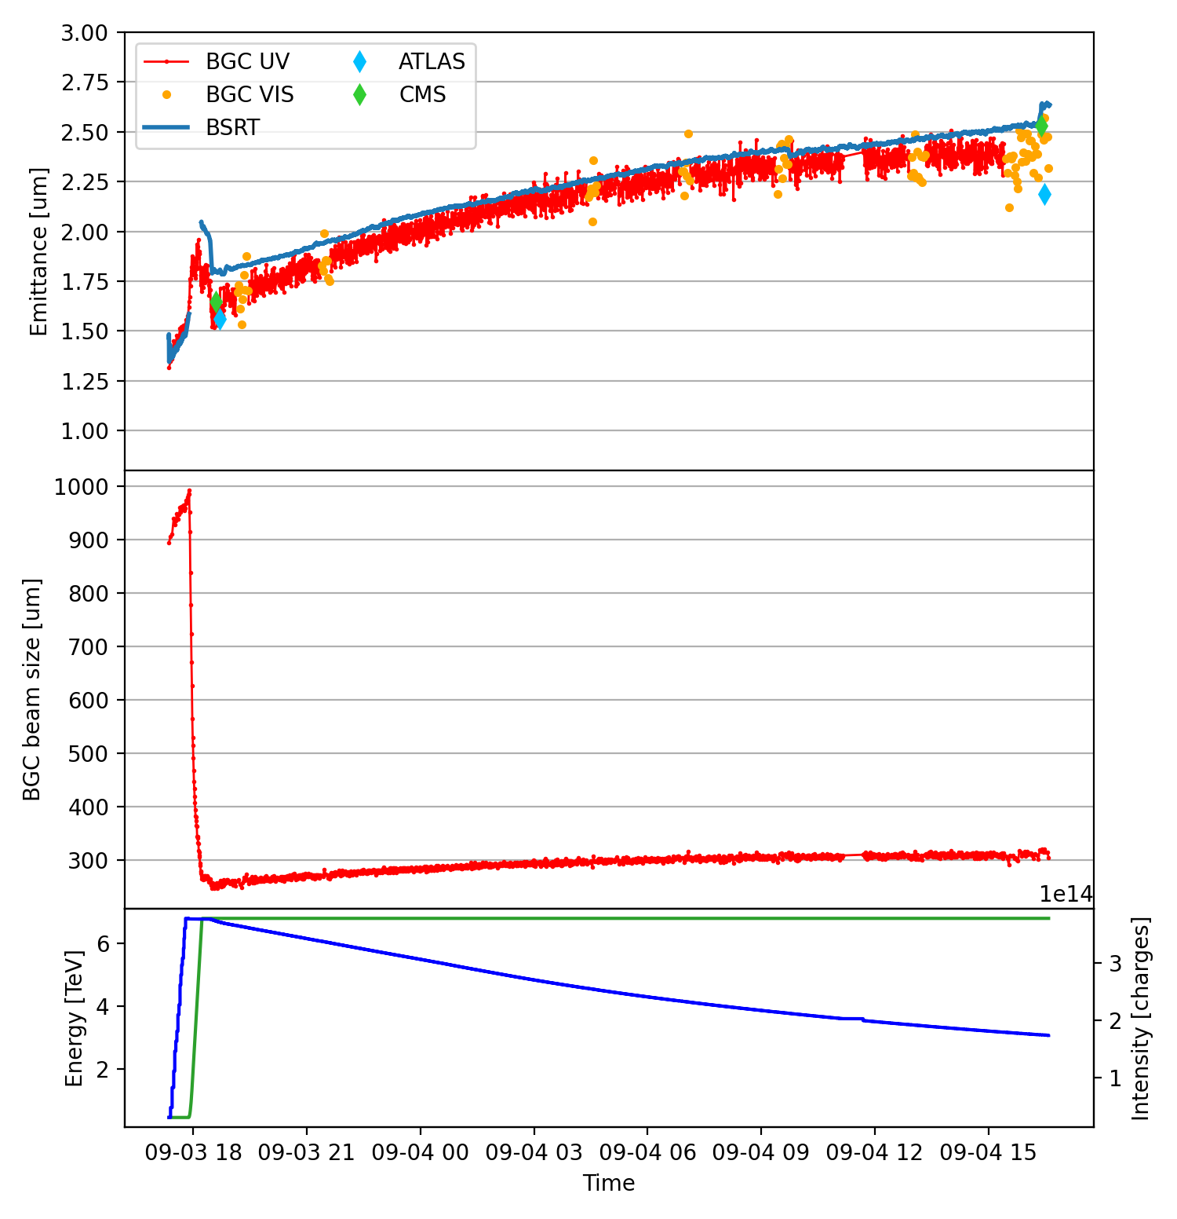
Combined results for horizontal plane
Proton physics
Combined UV and visible measurements allows accurate measurements every 40s
#10084
* BSRT calibration starts suffering…
Fluctuations within ±5% in emittance, compliant with specifications from operation
Absolute values still compatible with emittance scans at start and end of fill
This configuration was setup towards end of proton run, long term reproducibility to be assessed
>22h SB due to injectors unavailability

Slide 14
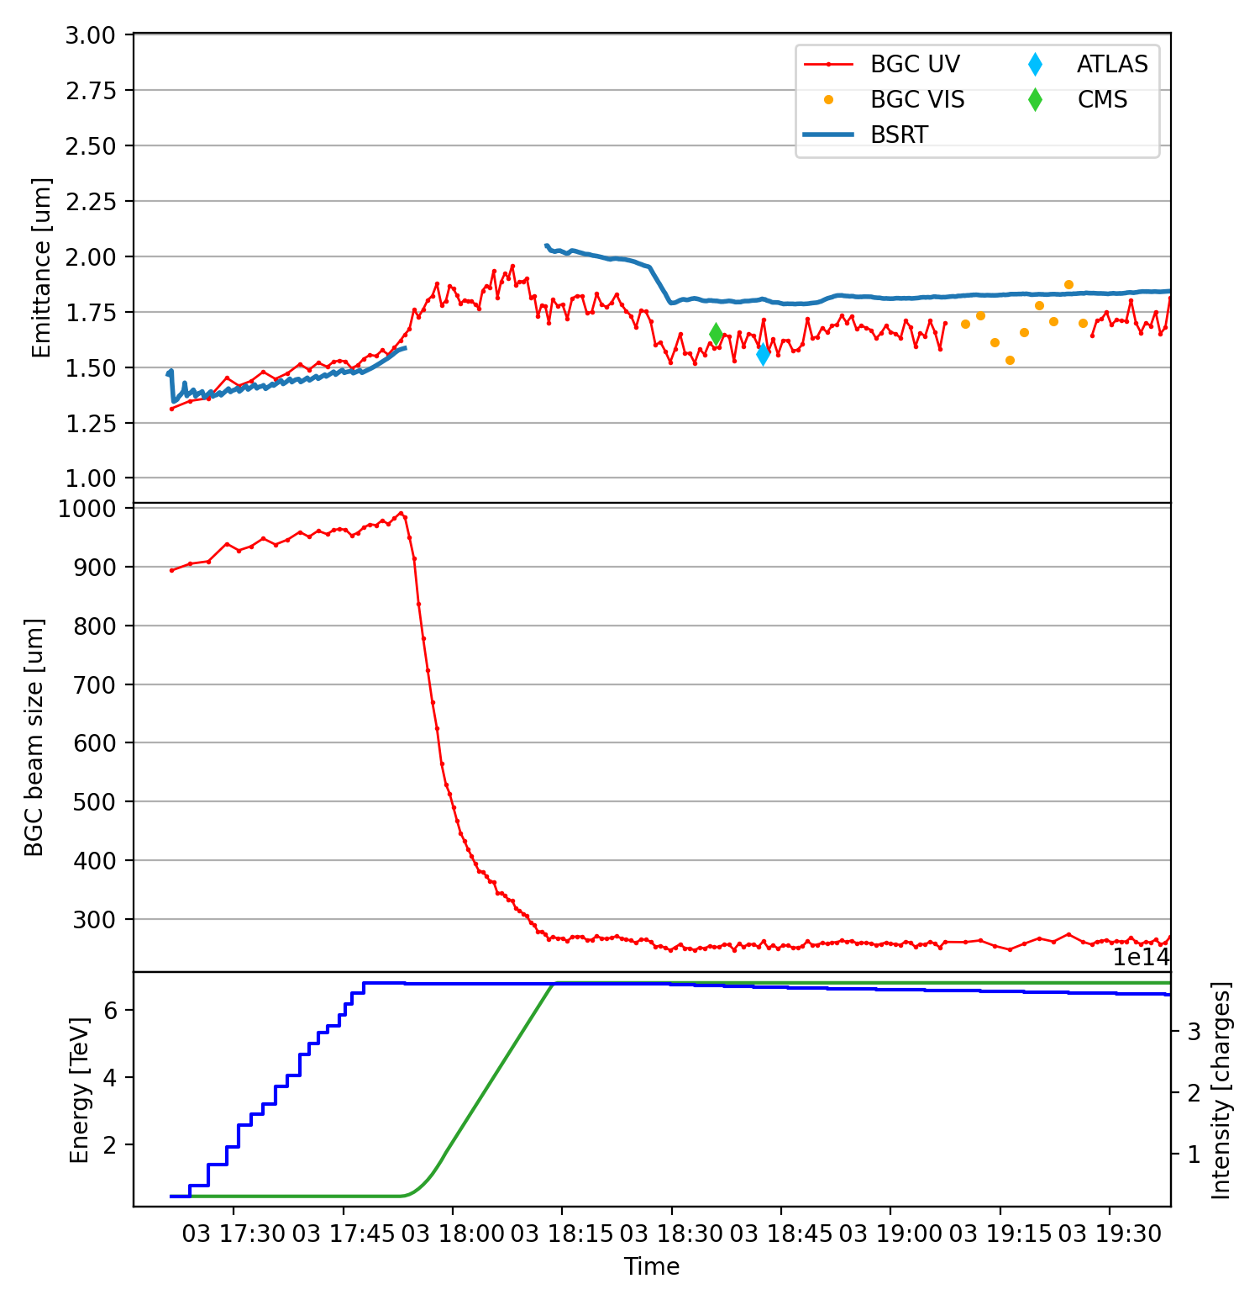
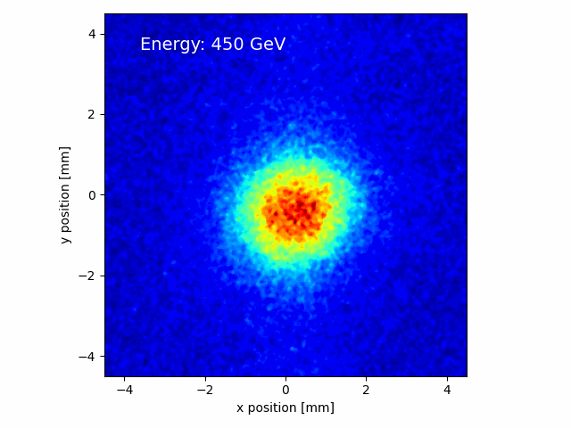
Combined results for horizontal plane
Proton physics
Overall positive results
quantitative agreement with BSRT at injection
“smooth” behavior in ramp
qualitative agreement with BSRT at FT
(e.g. dynamic beta effect on collision)
quantitative agreement with emittance scan
collision
~30 points in ramp
BGC UV acquisition
during energy ramp
(ROI follows beam size)

Slide 15
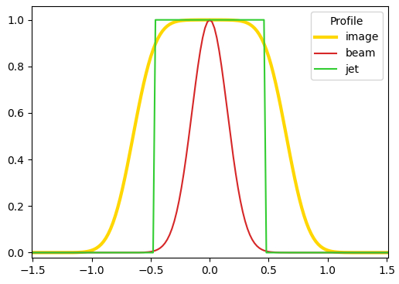
Vertical direction (perpendicular to jet)
Proton physics
Ideally, the vertical profile of the image has
intensity plateau from uniform jet distribution
Gaussian edges from beam distribution
beam size information only encoded in the edges, retrievable from deconvolution
If jet thin enough, deconvolution can be replaced by simple Gaussian fit and correction in quadrature
V profile
In reality,
deconvolution works with low-noise profiles → only BGC UV usable
real jet profile not perfectly rectangular → jet edges further correction to beam size
... these issues are mitigated if beam size is larger (low energy)

Slide 16
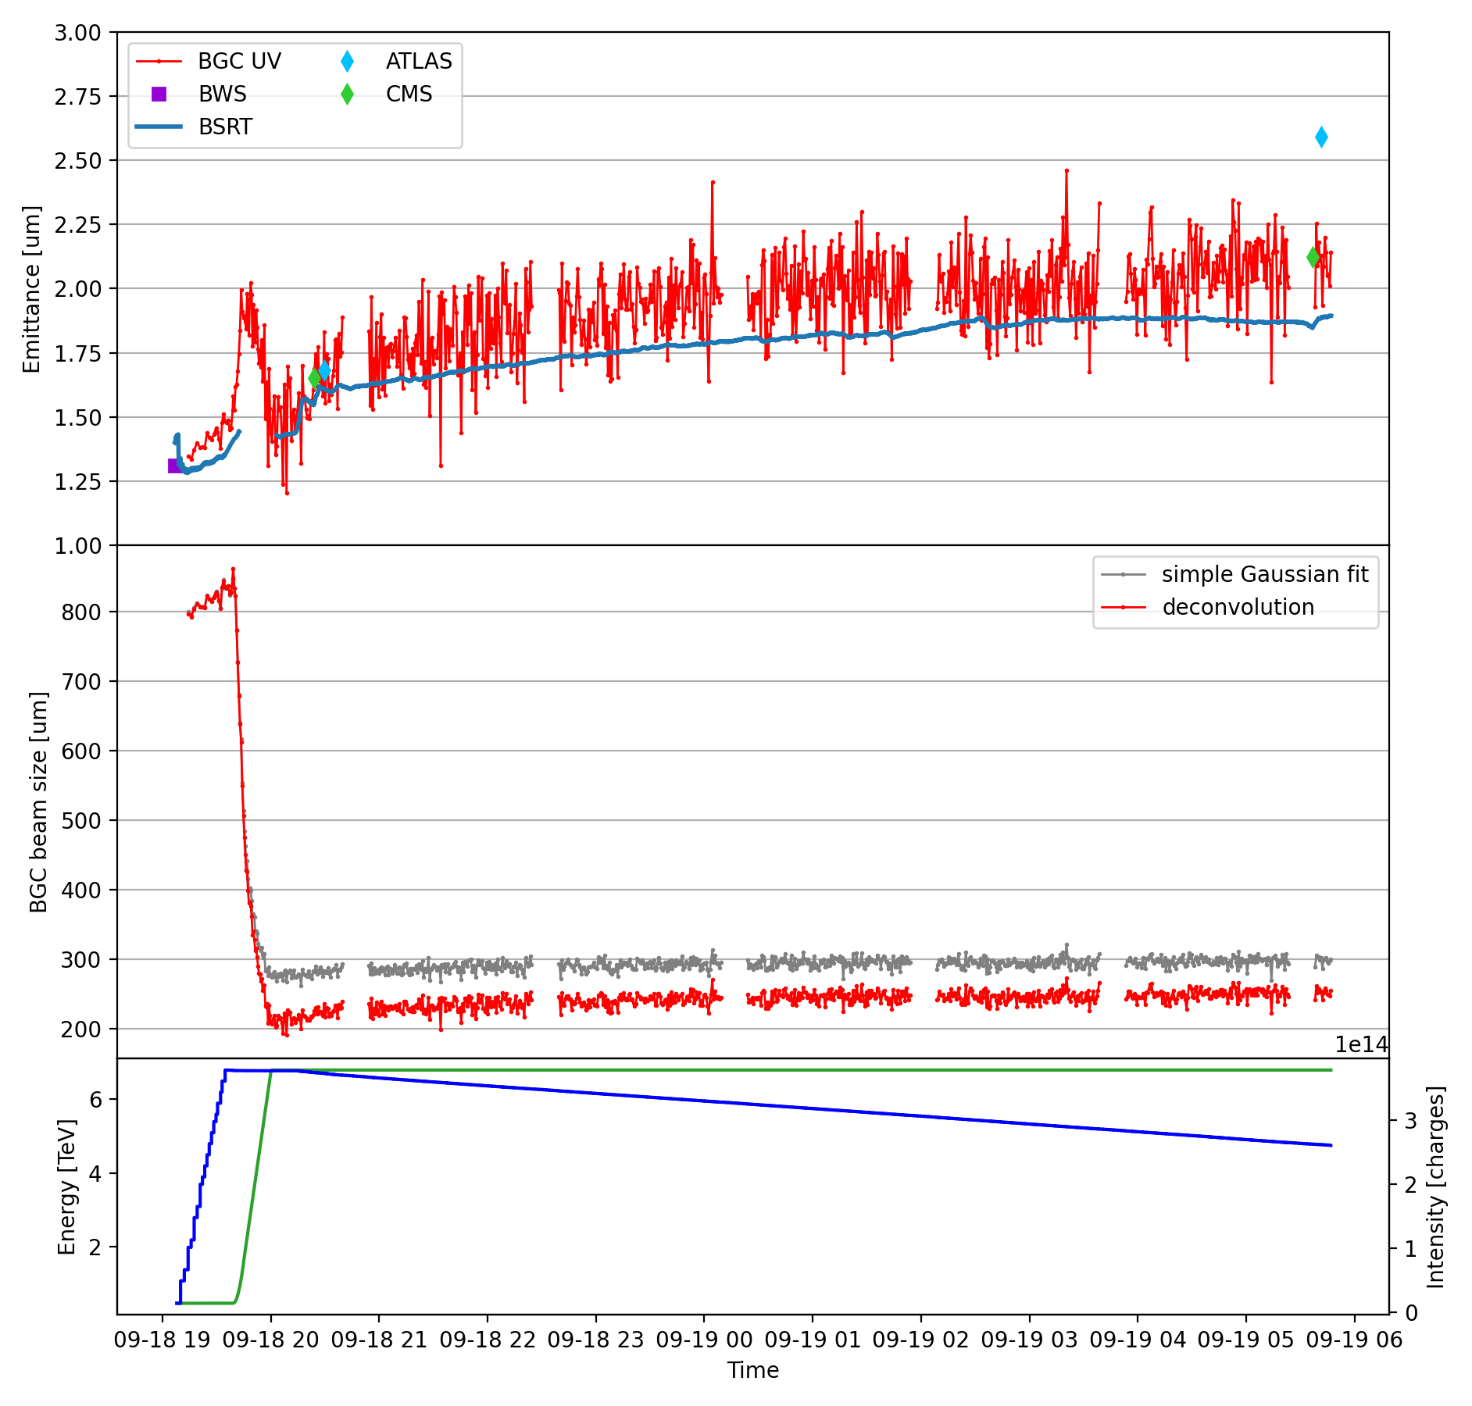
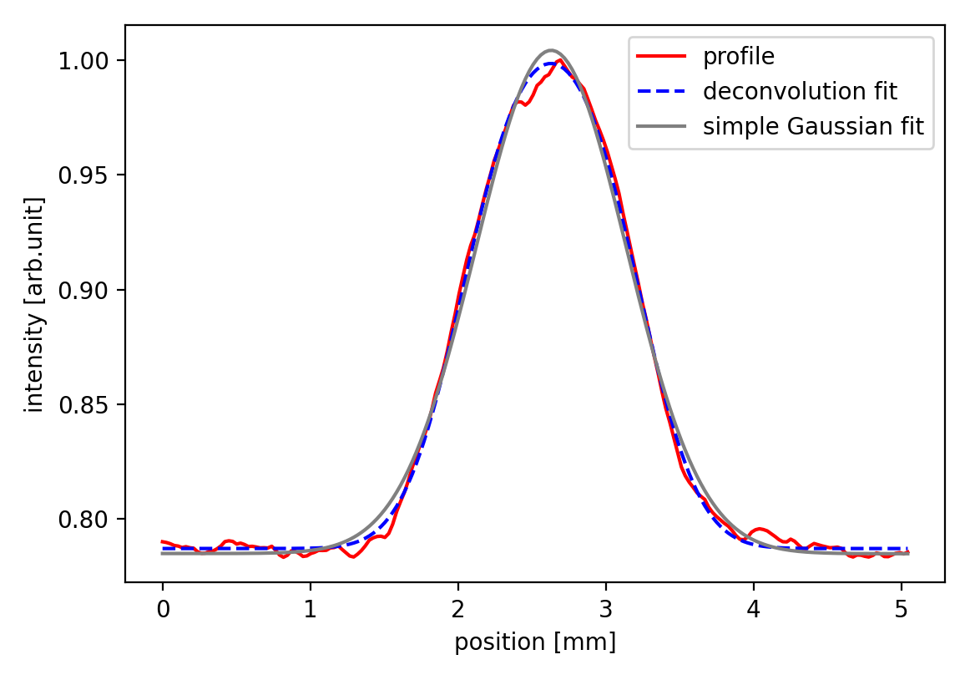
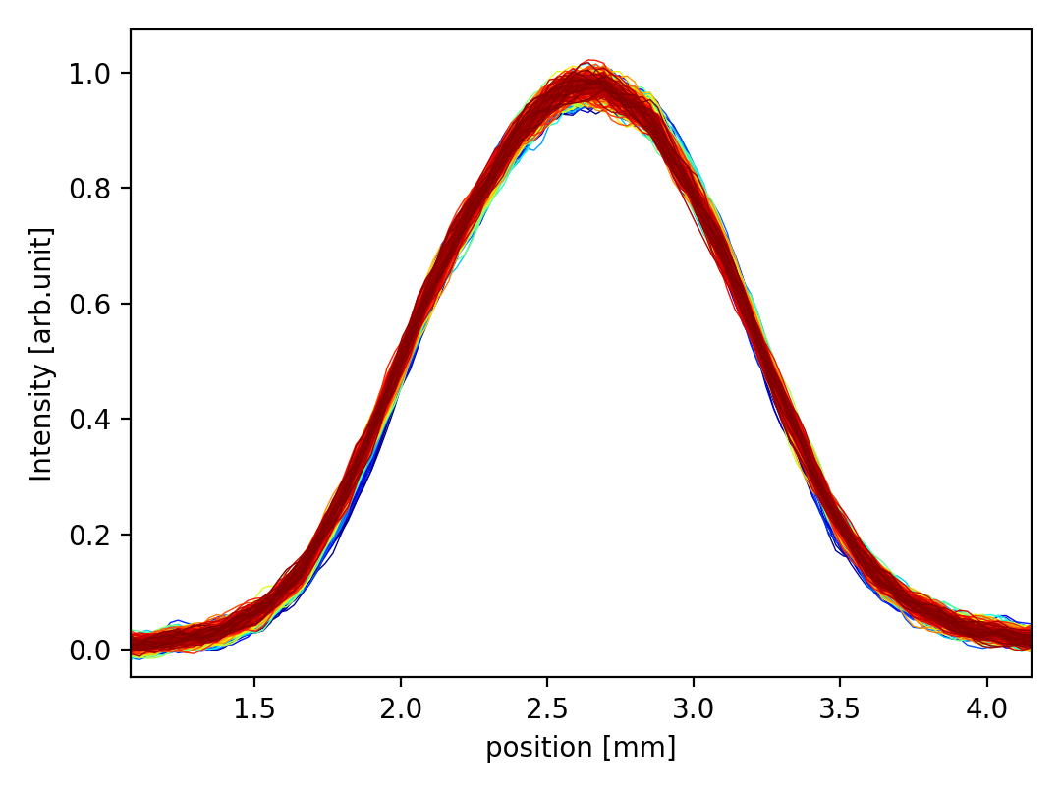
Vertical direction
Proton physics
Deconvolve BGC UV profiles to assess beam size
Larger fluctuations at flat-top than horizontal, ±15% emittance, due to extra correction for jet thickness
collision
#10127
No accurate reference from BGC VIS.
Deconvolution seems to match emittance scans but reproducibility to be assessed…
profile example in SB
profile evolution
→ time in SB →

Slide 17
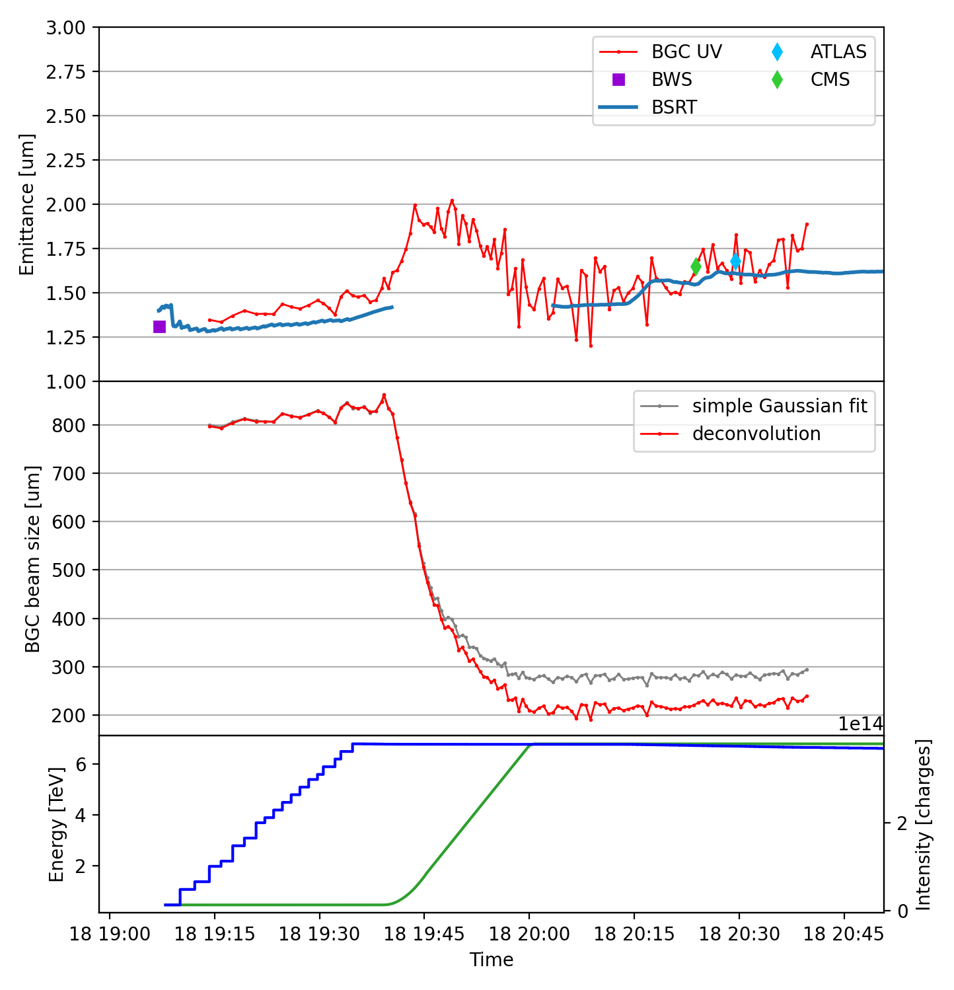
Vertical direction during ramp
Proton physics
#10127
Still some positive results:
BGC, BSRT and BWS are compatible within 10% at injection
“smooth” behavior in ramp, not so different from horizontal case
within larger BGC fluctuations, good agreement with BSRT and emittance scan at FT
collision
deconvolution becomes necessary
As size decreases, jet thickness effects appear
simple Gaussian fit deviates from deconvolution
measurements become noisier

Slide 18
Highlights from ion run

Slide 19
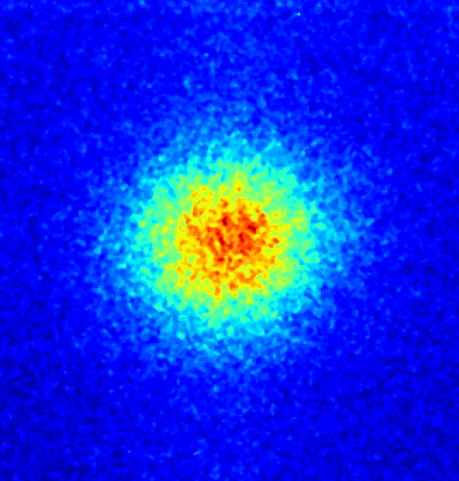
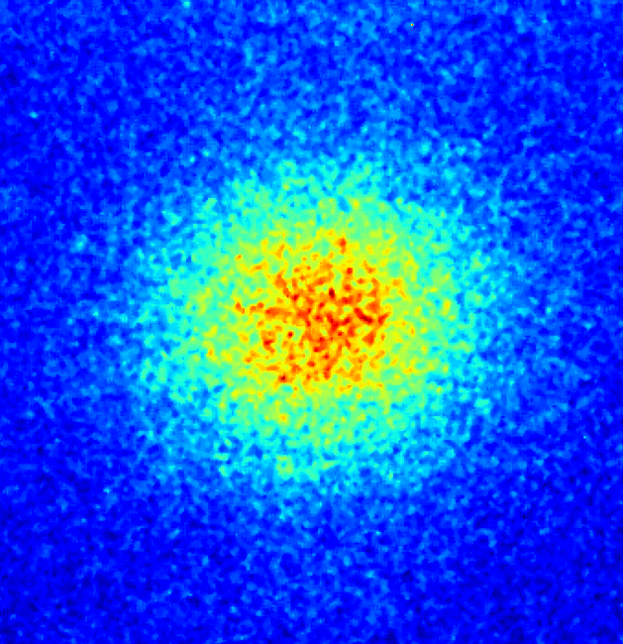
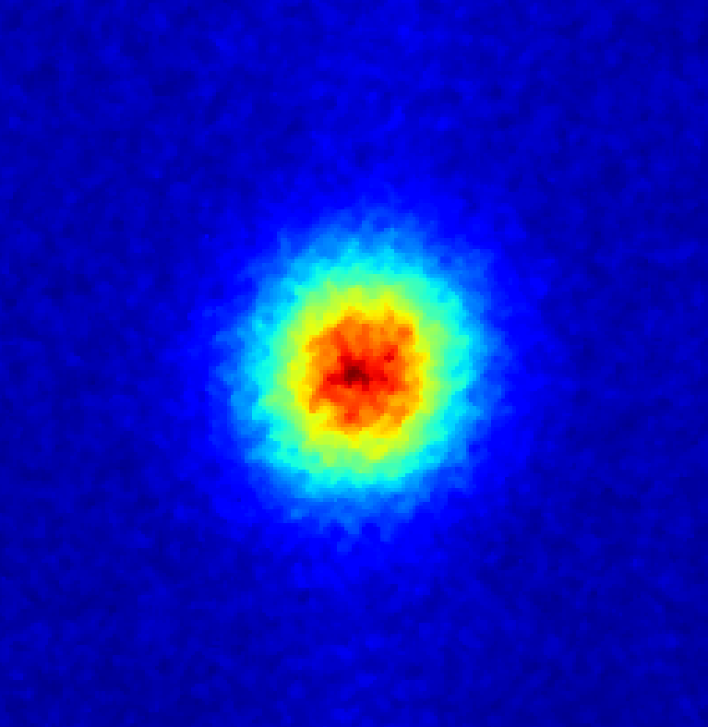
Performance with ion beams
Ion physics
More favorable conditions with ion beams
stronger fluorescence signal
larger beam sizes
sufficient signal with visible configuration, no need to combine UV signal
Protons VIS
Limited availability of BSRT with ions:
no light at injection
rarely calibrated at flat-top
there is already the case for extra diagnostics
Lead ions VIS
Injection
Start of ramp
Stable beams

Slide 20
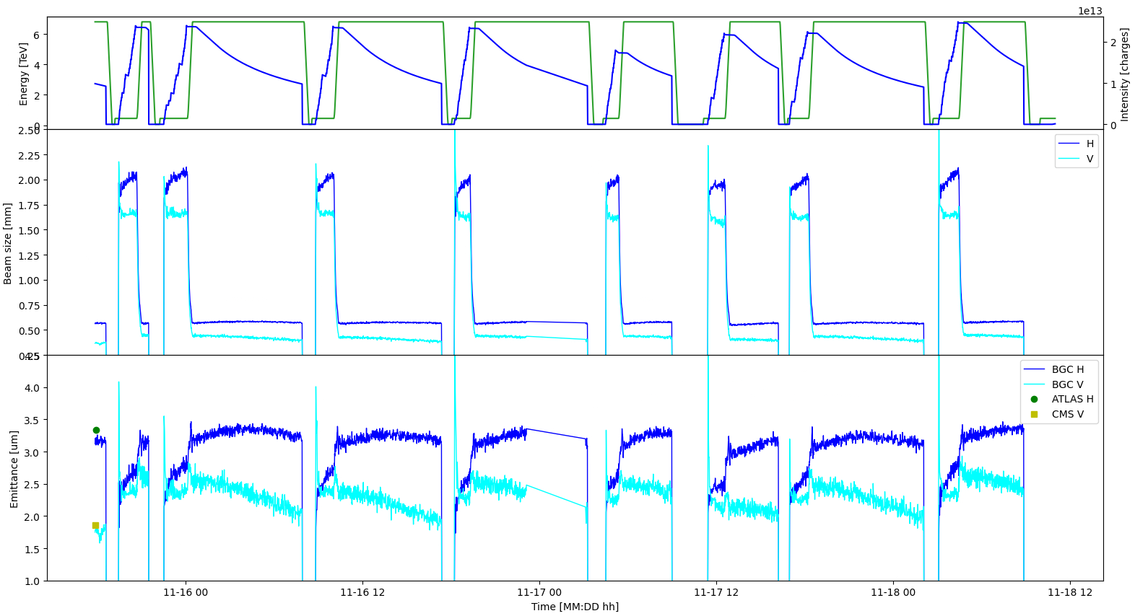
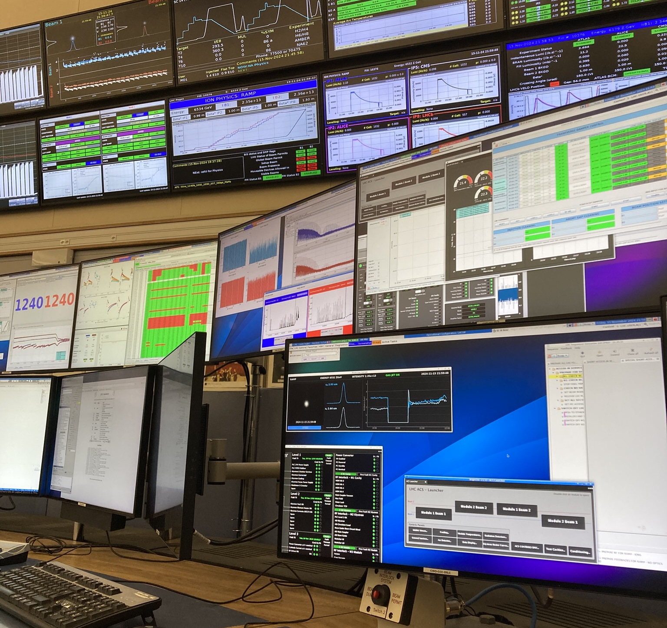
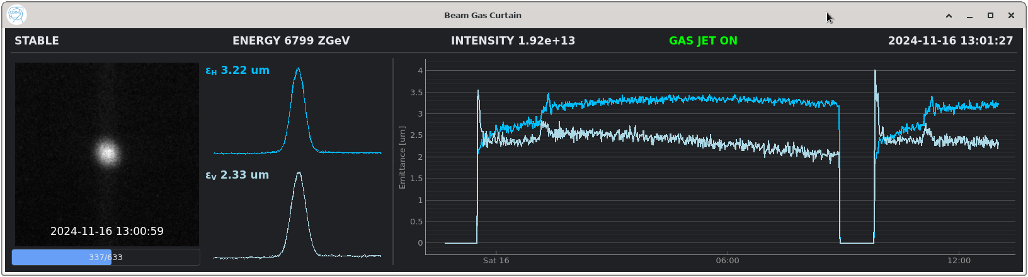
Highlights from 2024 ion run
Ion physics
BGC continuously running throughout 2024 ion run, close to an operational way
Average emittance measurements available online

Slide 21
Conclusion
BGC performance as emittance monitor thoroughly assessed in 2024
Achievements with proton beams
  accurate and reproducible measurements for horizontal direction in stable beams
  combined UV-visible operation best option for injection and ramp
  reducing jet thickness beneficial for vertical direction in stable beams
Achievements with ion beams
  stronger fluorescence and larger sizes simplifies BGC operation
  effective online emittance monitoring during ion physics production

Slide 22

Towards 2025…
2025 run will be shorter due to the extended YETS 24-25
Yet, dense program for BGC
assessment of long term stability
operational implementation of combined UV-visible operation
improve vertical measurements with thinner jet (hopefully)
extra O-O ion run planned
studies to upgrade to loss-based diagnostics
(but this is another story…)
…stay tuned!

Slide 23
Thank you for your attention!

