Slide 1
BGC Collaboration Meeting
Wrap-up
Ray VENESS
Liverpool 2-3 December 2024

Slide 2
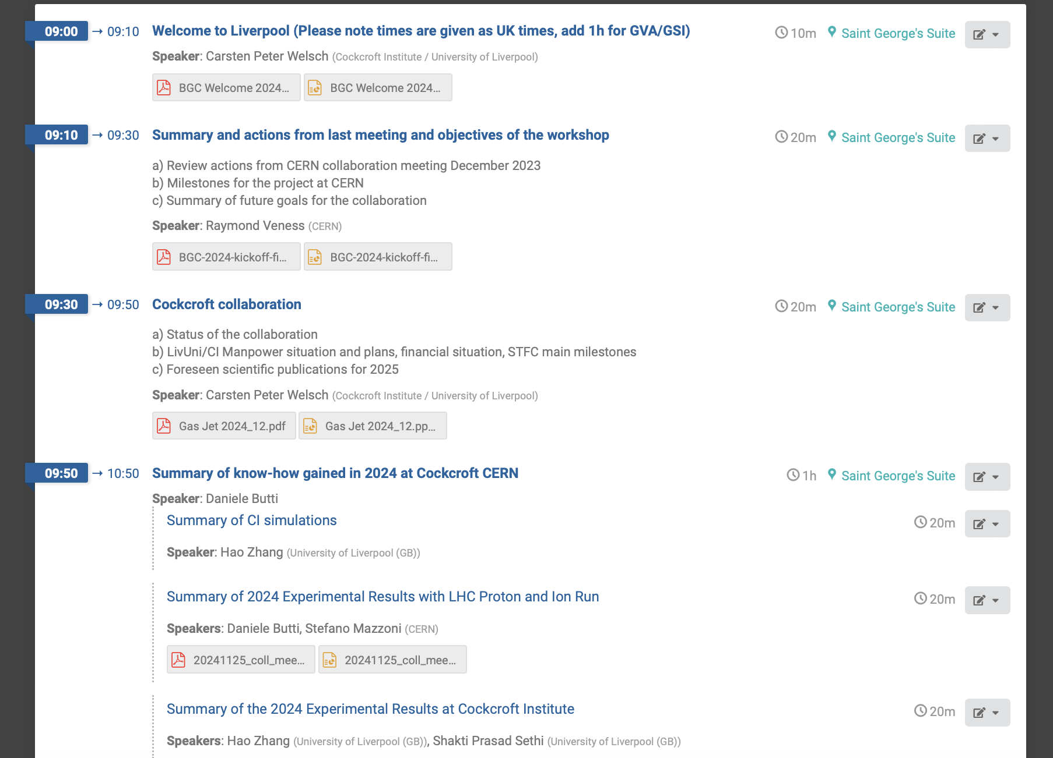

Slide 3
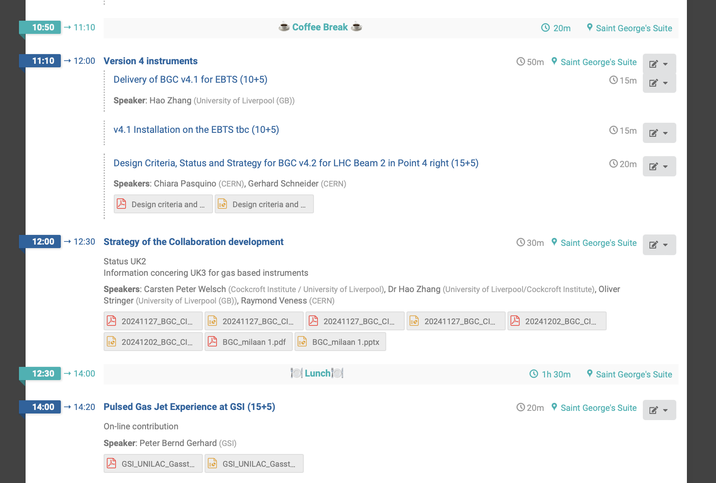

Slide 5
Scientific specification:
  What instrument do we want for the LHC? Precision instrument, on-line monitor, halo monitor or ‘all’?
    ‘Accurate’ profile instrument for absolute measurements
    ‘Complete’ beam size instrument for ions – with on-line capability
    Halo capability needs some resources and time to demonstrate feasibility with outcome unclear for now. Can we do any more preliminary estimates before the halo review on 18/12. However, will need physics runs in 2025 and perhaps 2026.
    Engineering for halo is principally resources and time
    Profile (protons and ions) are mutually compatible. Halo is (probably) a different set-up, but TBC depending on skimmer gas density measurements
  What is the best gas? N₂ or Ne? Does this depend on the above question?
    There is a scientific interest in using N2, for comparison with the SPS tests, but this justification should be written down

Slide 6
Technical specification
What are we able to build for the LHC with the space, time and resources available?
  Time and resources still need to be confirmed, but going in right direction with strong support within CERN and STFC
  I think we can assume that this will happen.
  We need to keep pushing, both for the physics case in the LHC as well as for funding. This is a task for all of us!
Do we need to compromise on the scientific spec (e.g., 45°, location…)
  Seems that there are 2 possible options with 90° or 45° rotation (with a second optical line) and either is achievable with some work
  Reconsider 4L or 4R location for services
  This is looking much more feasible than previously thought

Slide 7
Funding
We need to identify all the cost components (not necessarily the actual number) needed to have our preferred v4 designs on both LHC beamlines
  Gerhard listed hardware costs. We did not discuss in detail –we need to make sure this list is complete
  Need to add manpower: design, R&D (instrument design, simulation)
We need to assign these to our different possible resource sources
  HL-UK(2-3), BI LS3 budgets, HL-WP13 envelope for profile and halo measurements
  Add additional costs for LS3 delay to this list

Slide 8
Other actions from the meeting
Make a list of prospective papers along with content (Hao)
  Chase up the part-completed papers, also in the Friday meeting (Hao)
Prepare a list of content for HL-UK3 (Ray, Carsten)
Agree strategy for funding of HL-UK3 (Ray, Carsten)
Extend the duration of the CERN collaboration with CI (Ray)
Check the lifetime of the all-metal gas valves (Gerhard)
Use the EBTS instrument to test gas density with the new, alternative skimmers on-order (Hao)
Agree specification then propose technical solutions for a moveable gas jet for halo (Stefano, Gerhard)
Consider design of a custom lens system and see potential improvements (Serban)
What are the next ‘targets’ for improving the performance of the instrument? Halo in a higher intensity region? Integration time (why? For Ions?), other? (CERN)

Slide 9
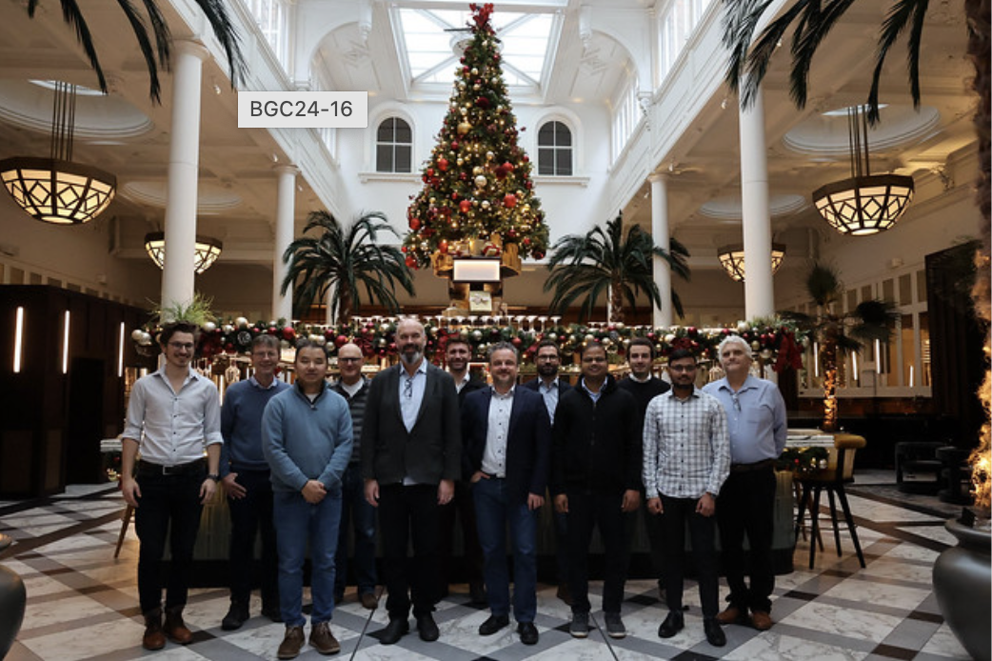
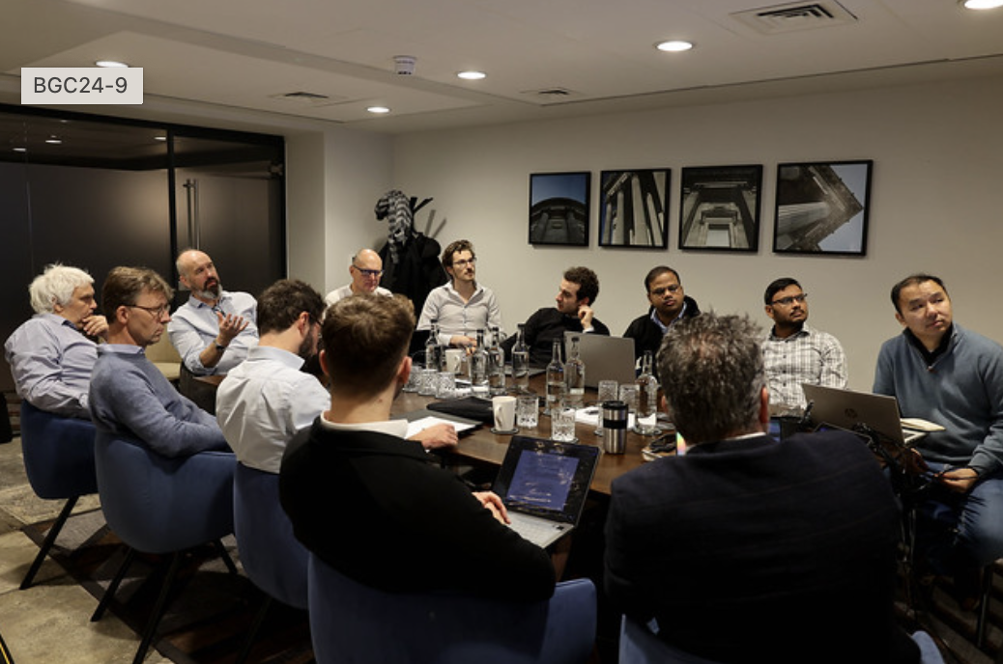
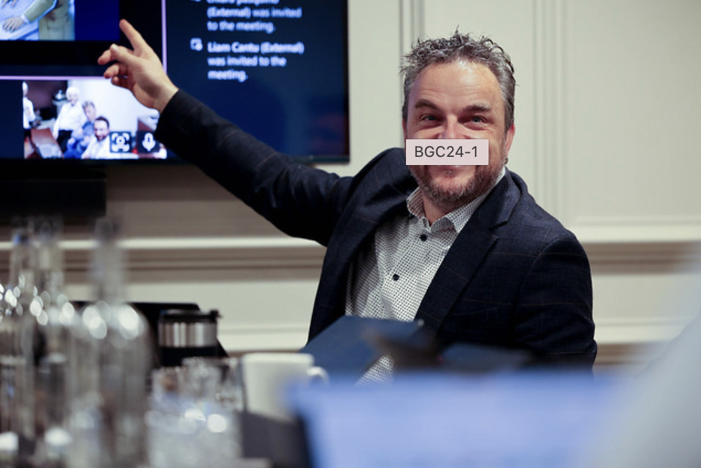
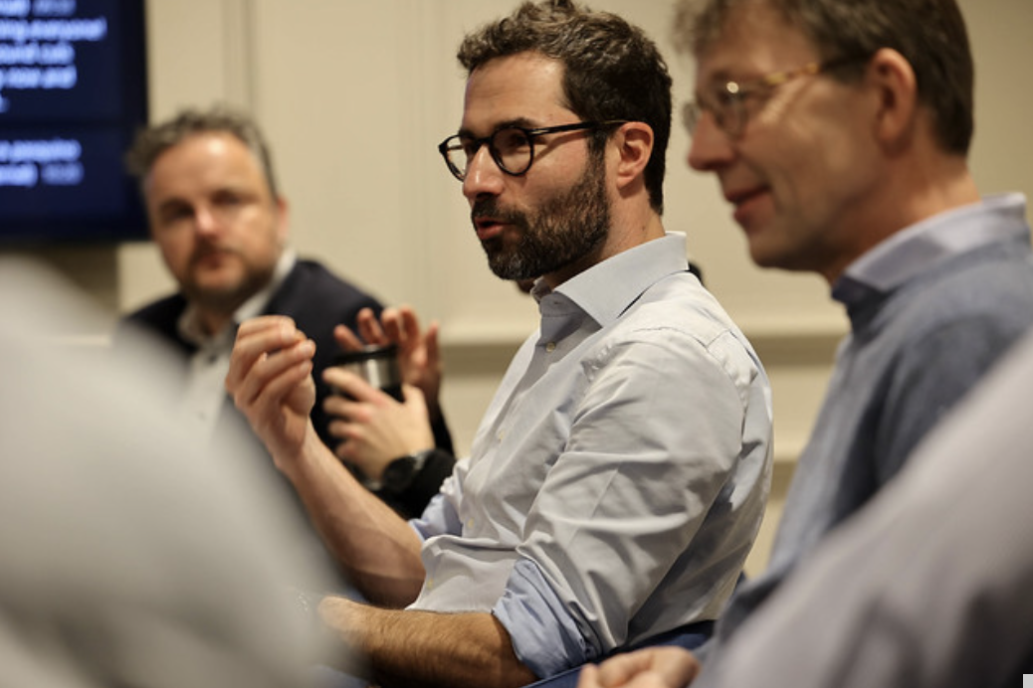

Slide 10



Slide 11
Thank you all for your participation, excellent presentations and discussions
Wishing you a safe trip home and a healthy and happy end of the year

