Slide 1
Delivery of BGC v4.1 for EBTS
CI team & EBTS team

Slide 2
Content
Demonstration of ~60 mm curtain.
V4 final design.
Simulated geometry => Manufactured geometry.
Procurement status.
Plan.

Slide 3
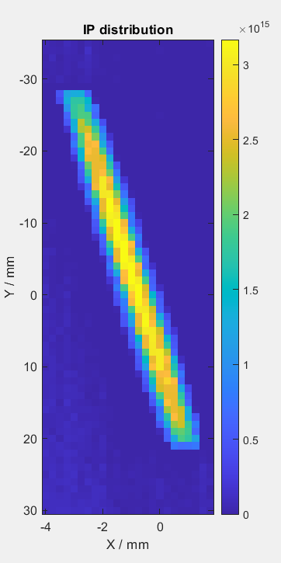
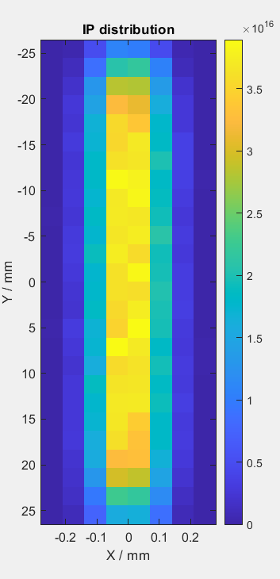
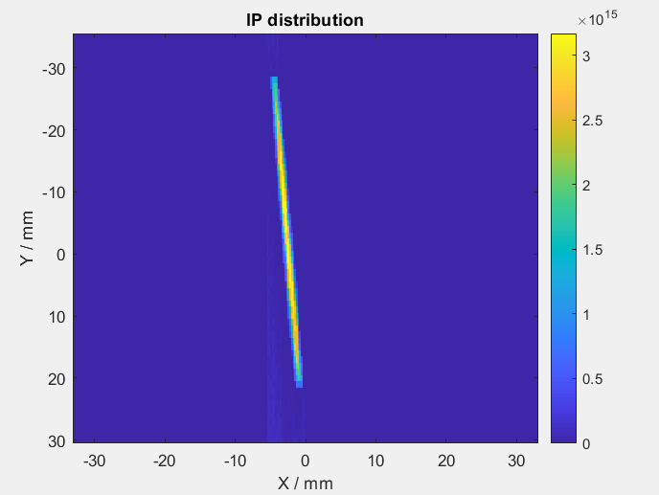
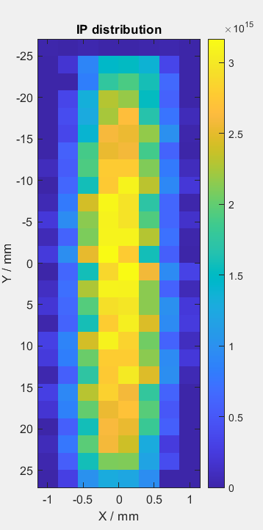
V4.1: Simulation and test on Jeremy setup
Measured ROI
Measured (1:1 axis)
Measured, Rotated
TPMC Simulation
Conclusion: The criteria of the BGC@EBTS can be met.

Slide 4
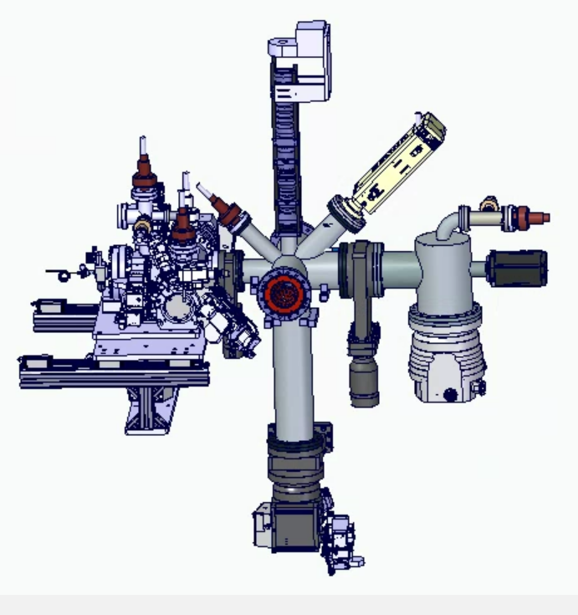
V4.1 design
Gas curtain formation
  Using the design of v3 injection with new skimmer sizes for 60 mm curtain.
  Could be used as spares for the LHC.
Interaction chamber
  Redesigned to host BTV and target for direct comparison.
  Optics will stay the same for now.
  4th skimmer will be installed in this chamber
Dump chamber
  Simplified to reduce cost. Most likely to be one time usage.
Details at https://indico.cern.ch/event/1394592/

Slide 5
v4.1 design: nozzle skimmer assembly
0.00
4.50mm
33.09mm
168.5mm
393.7 mm
543.7mm
Nozzle
1st Skimmer
2nd Skimmer
3rd Skimmer
IP
4th Skimmer
d
d
b
b
Optimised value suggested by simulation
a
a
d: 700 µm
d: 5.10 mm
a: 0.10 mm b: 25.9 mm
a: 1.1 mm b: 95.2mm
Installed in the EBTS interaction chamber
mechanical tolerances
d: 600 µm
d: 700 µm
d: 800 µm
d: 5.1 mm
d: 5.3 mm
d: 5.5 mm
a: 0.10 mm b: 26.0 mm
a: 0.20 mm b: 26.0 mm
Experiment planed value
a: 3 mm b: 100mm

Slide 6
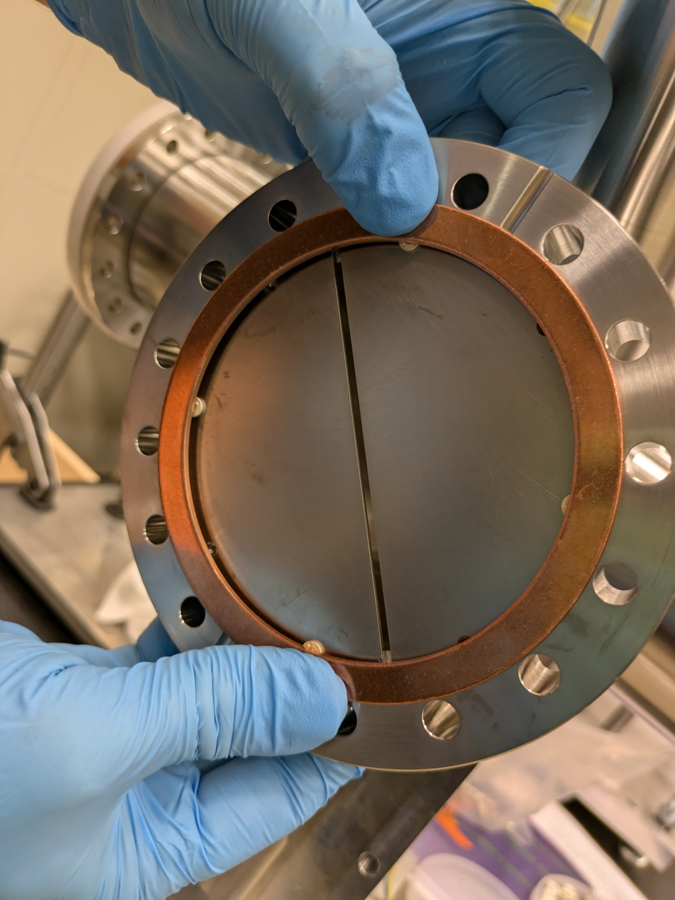
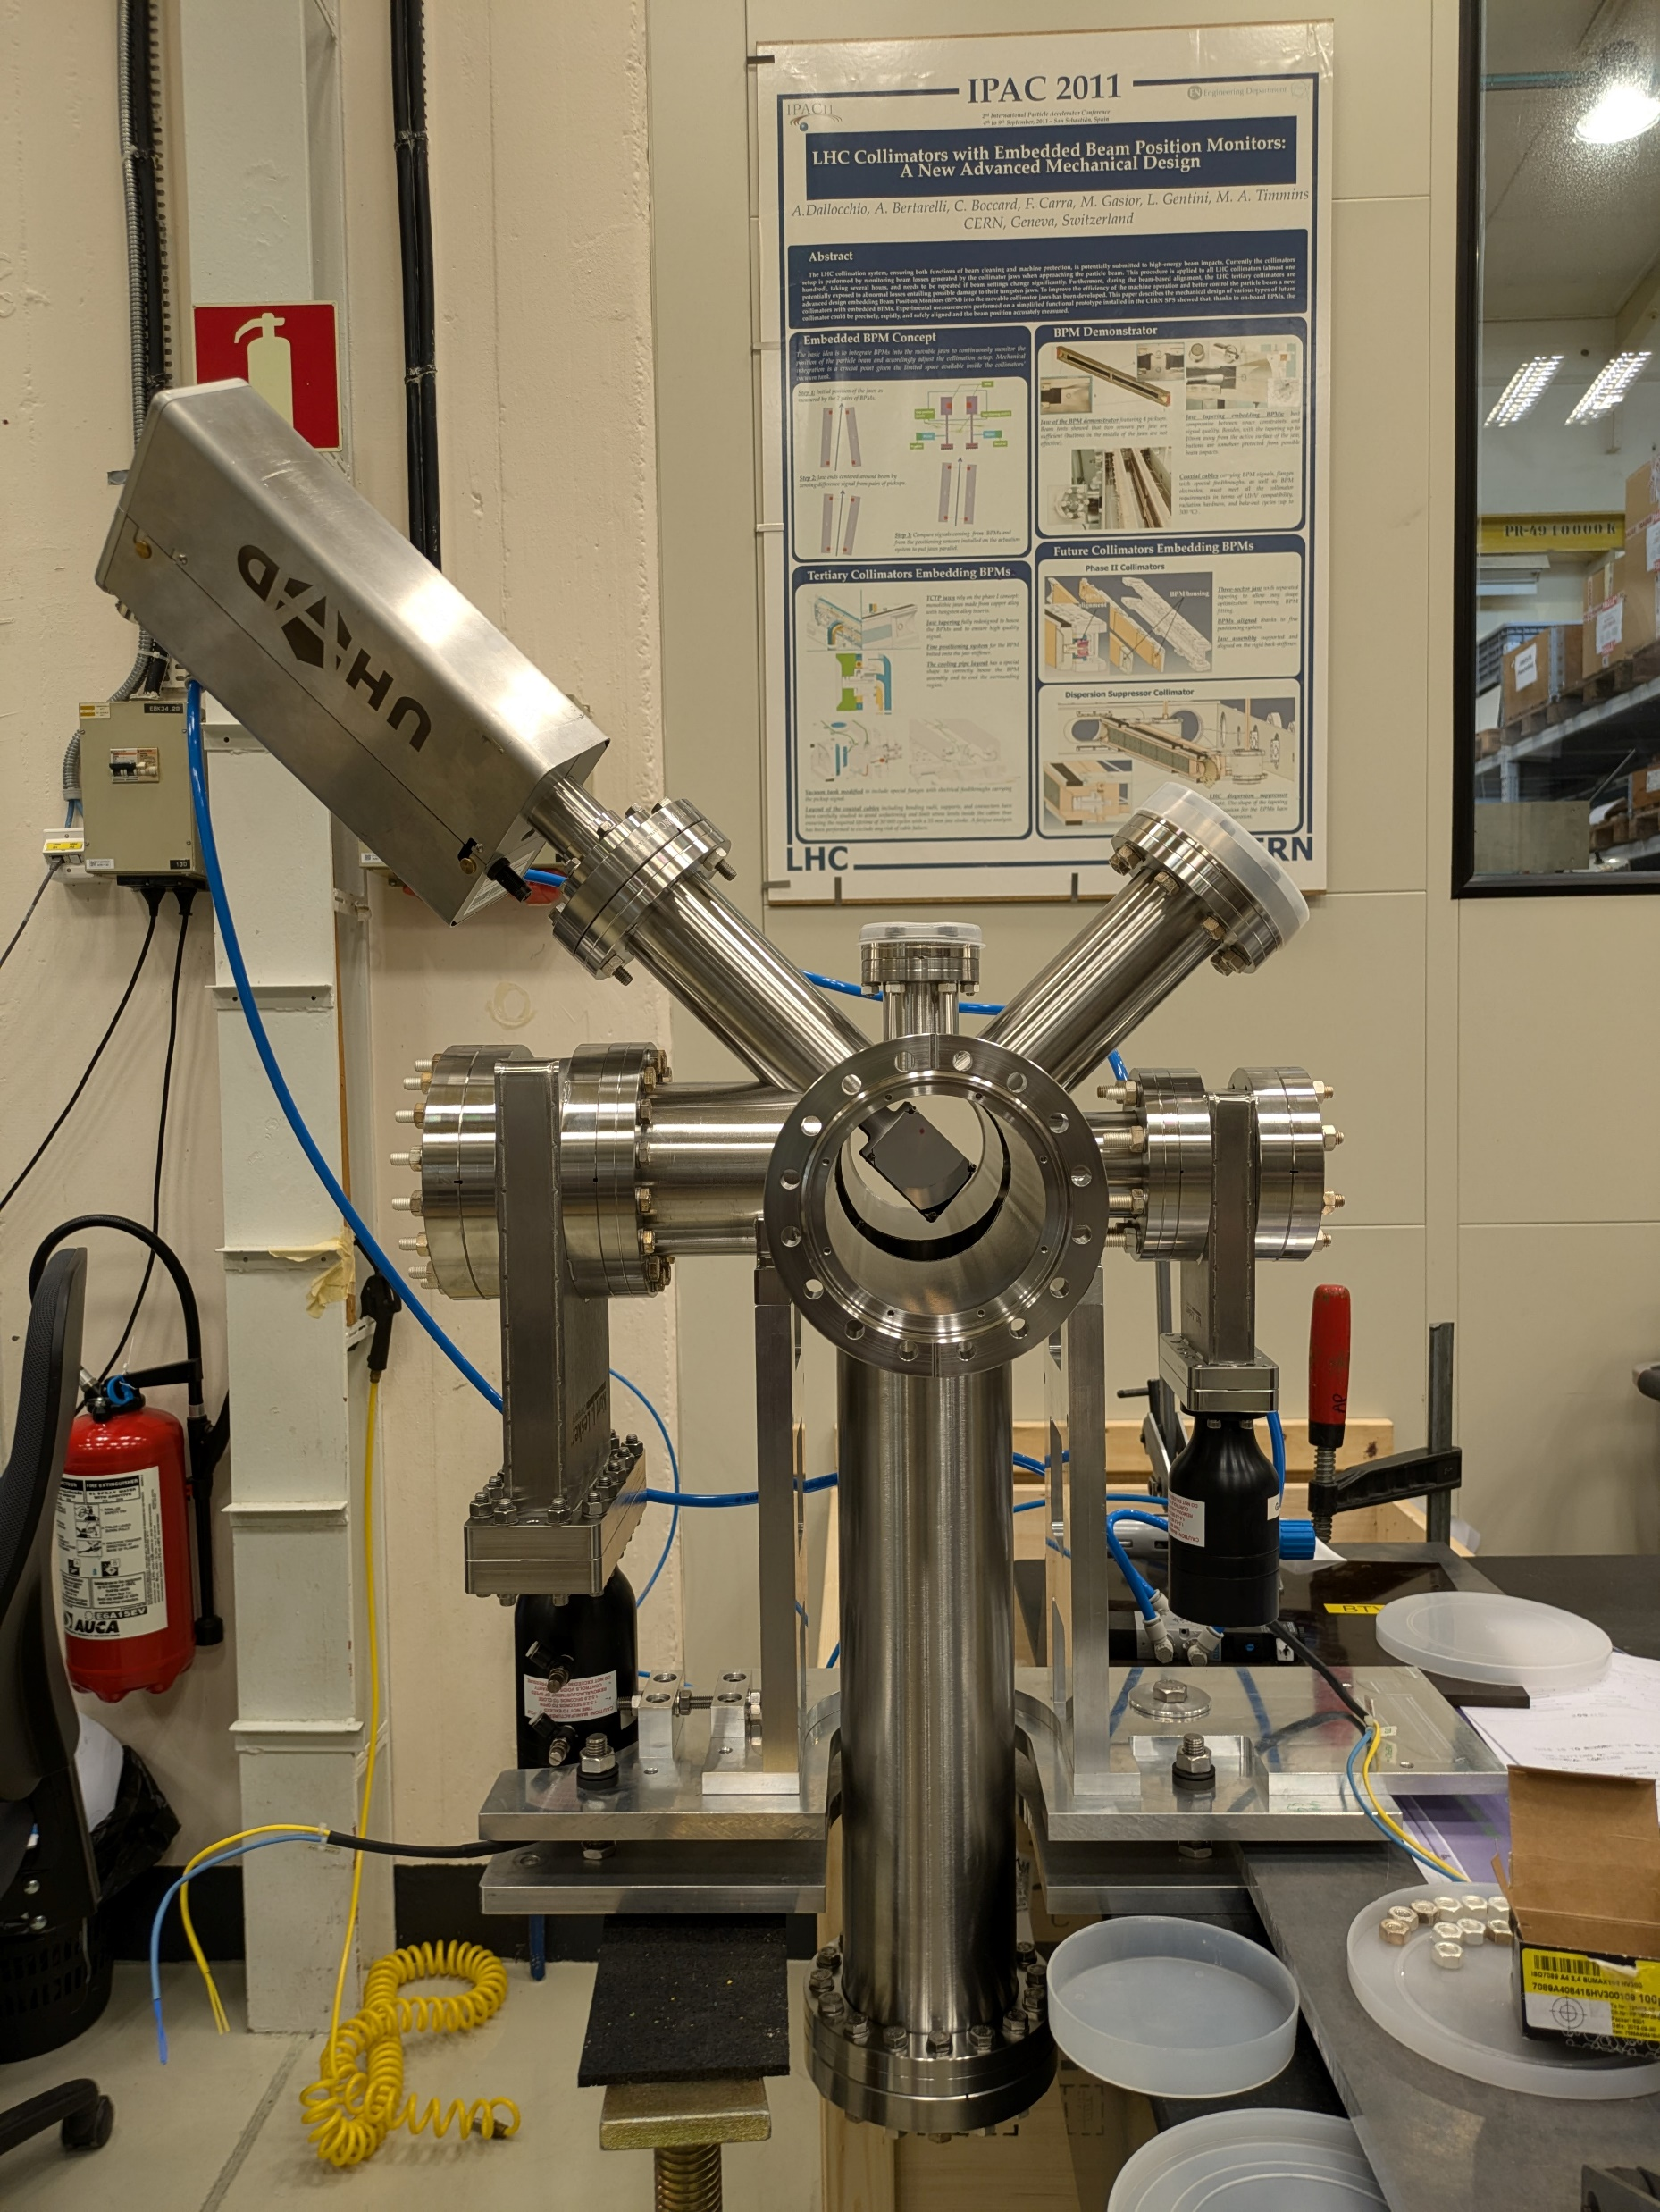
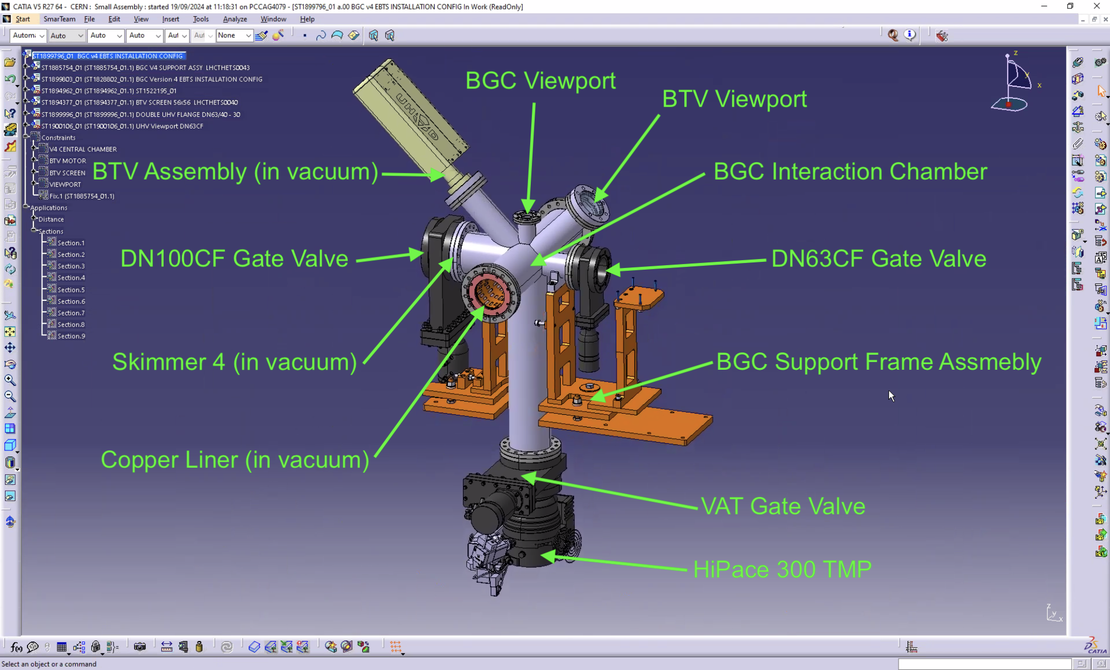
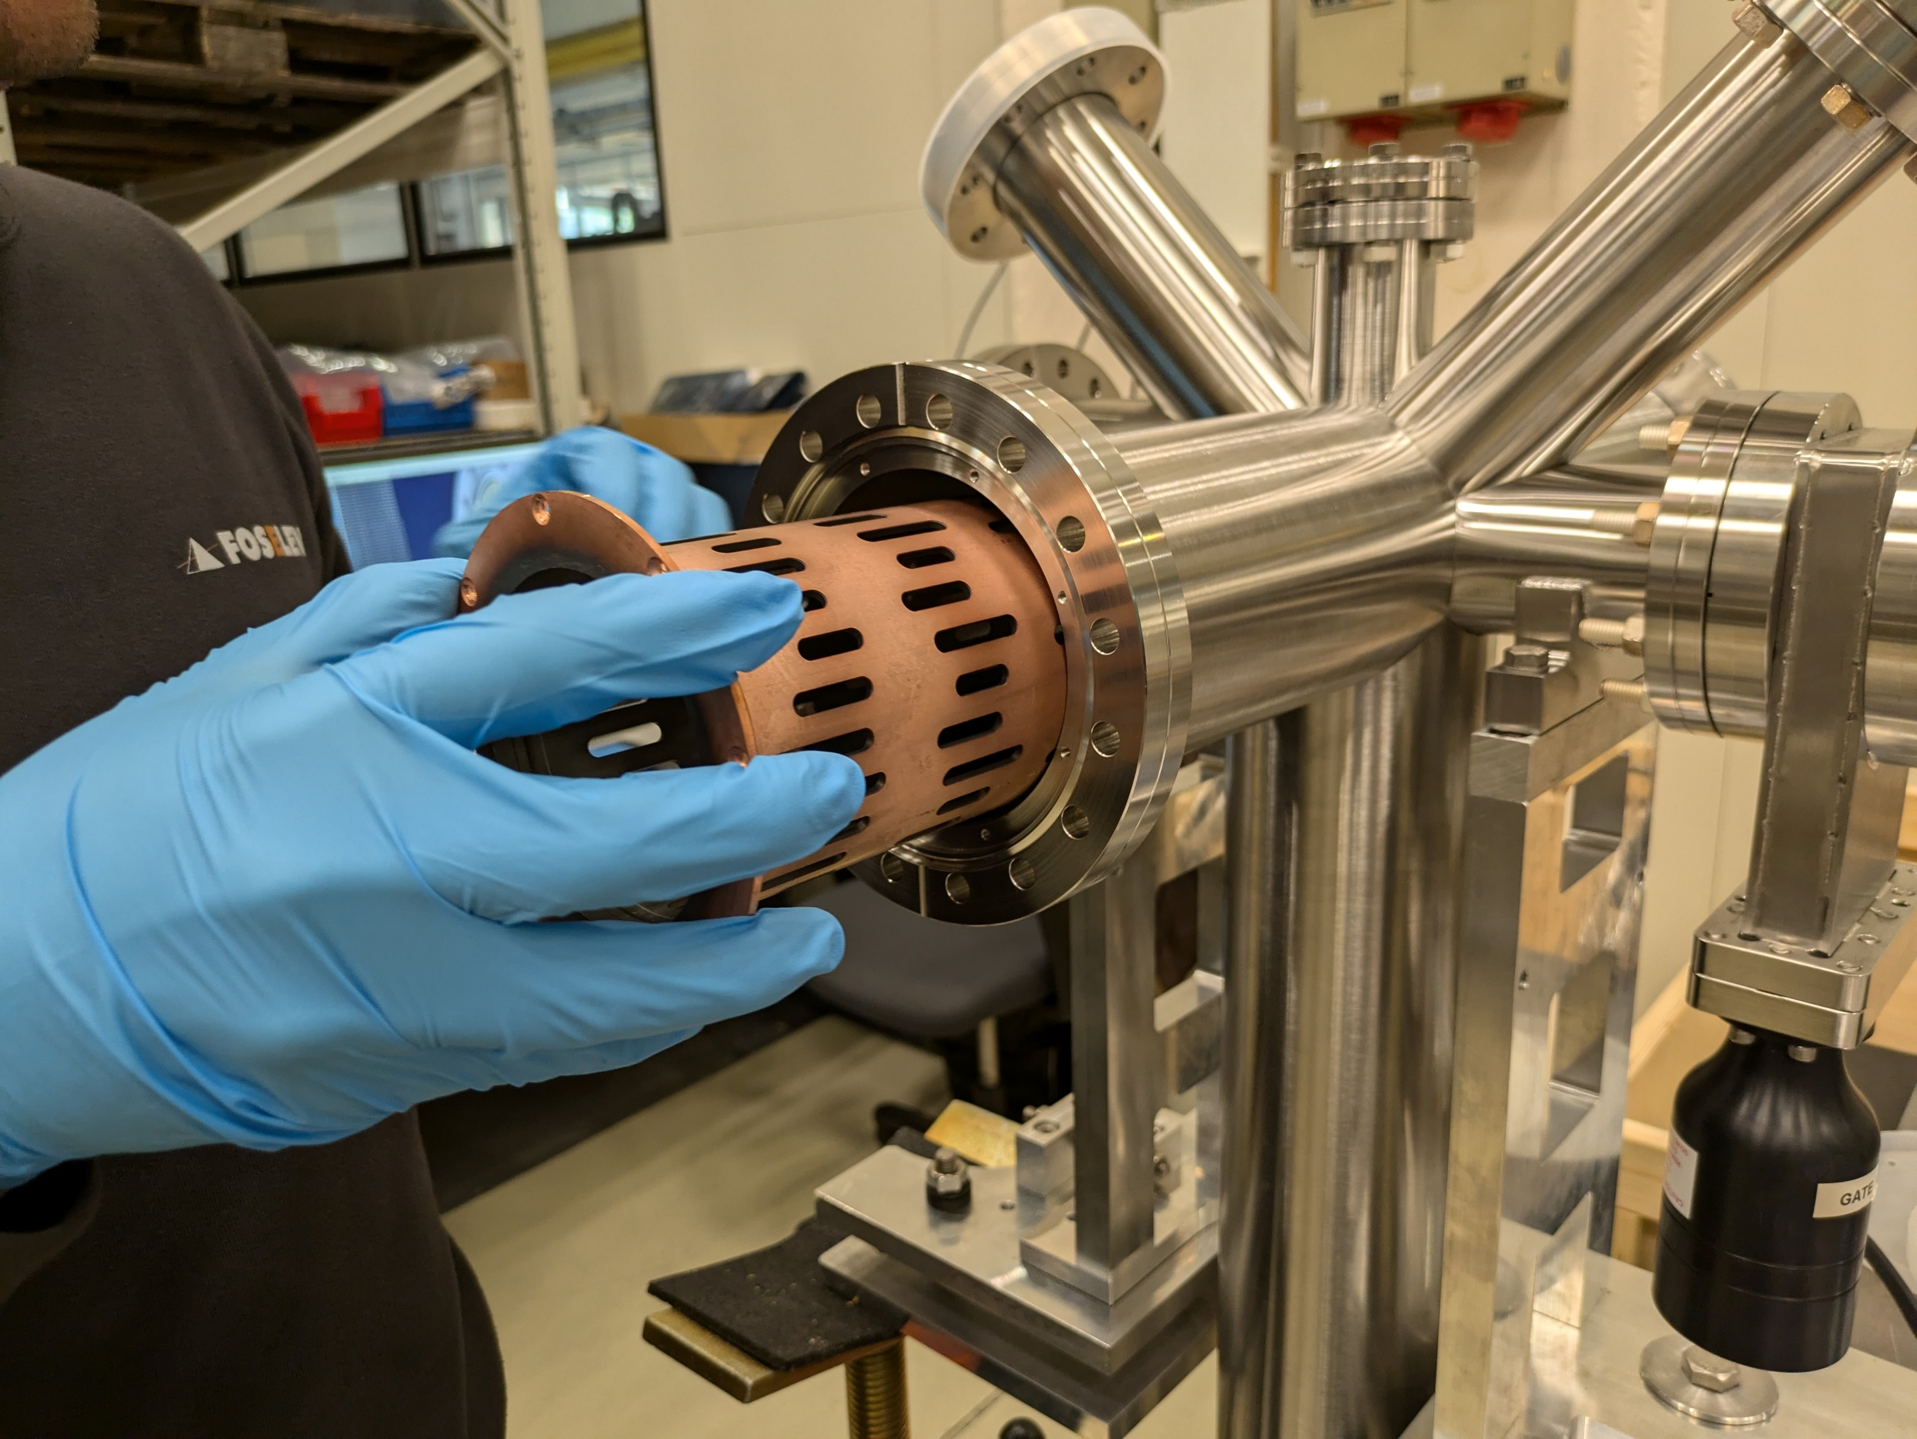
Procurement status
The interaction chamber built by CERN (Adriana) is ready together with 4th skimmers: 100mm x3mm. (done)
The 3 gate valves + 1 turbopump for the interaction chamber have been recovered at CERN as: 2 from the previous BGC @ test stand, 1 (100mm diam) from the current EBTS collector+pump. (Done)
The inner liner (at CERN) has been cut to accommodate the larger curtain.
Machining of the copper liner
4th skimmer 100 mm*3mm
New interaction chamber

Slide 7
Procurement status
Chiara has already ordered the pumps to go with the BGC, and they will be delivered at CERN in 8 weeks, expected in December.
The injection chamber and dump will be ordered and delivered at CI (December).
Gerhard shipped the bellows in December.
2nd and 3rd skimmers and alignment system in quotation.

Slide 8
Plan ahead
Gas injection test (December-January).
  Alignment of nozzle skimmers with the new geometry tested in the JEREMY setup.
  Pumping down time. Vacuum pressure of each chamber with jet on and off.
  Measurement of a 60 mm curtain with both Neon and Nitrogen gas.
  Measurement with CI e-beam (If time allowed).
Ship to CERN by February 2025
CI people will travel to CERN for the installation with the local help in February-March 2025.

