Slide 1
Summary of CI simulations
CI team

Slide 2
Contents
Recap the simulation methods
Simulated options for v3 modification.
Optimisation of BGC v4.1 @EBTS
Optimised options of BGC v4.2 @LHC

Slide 3
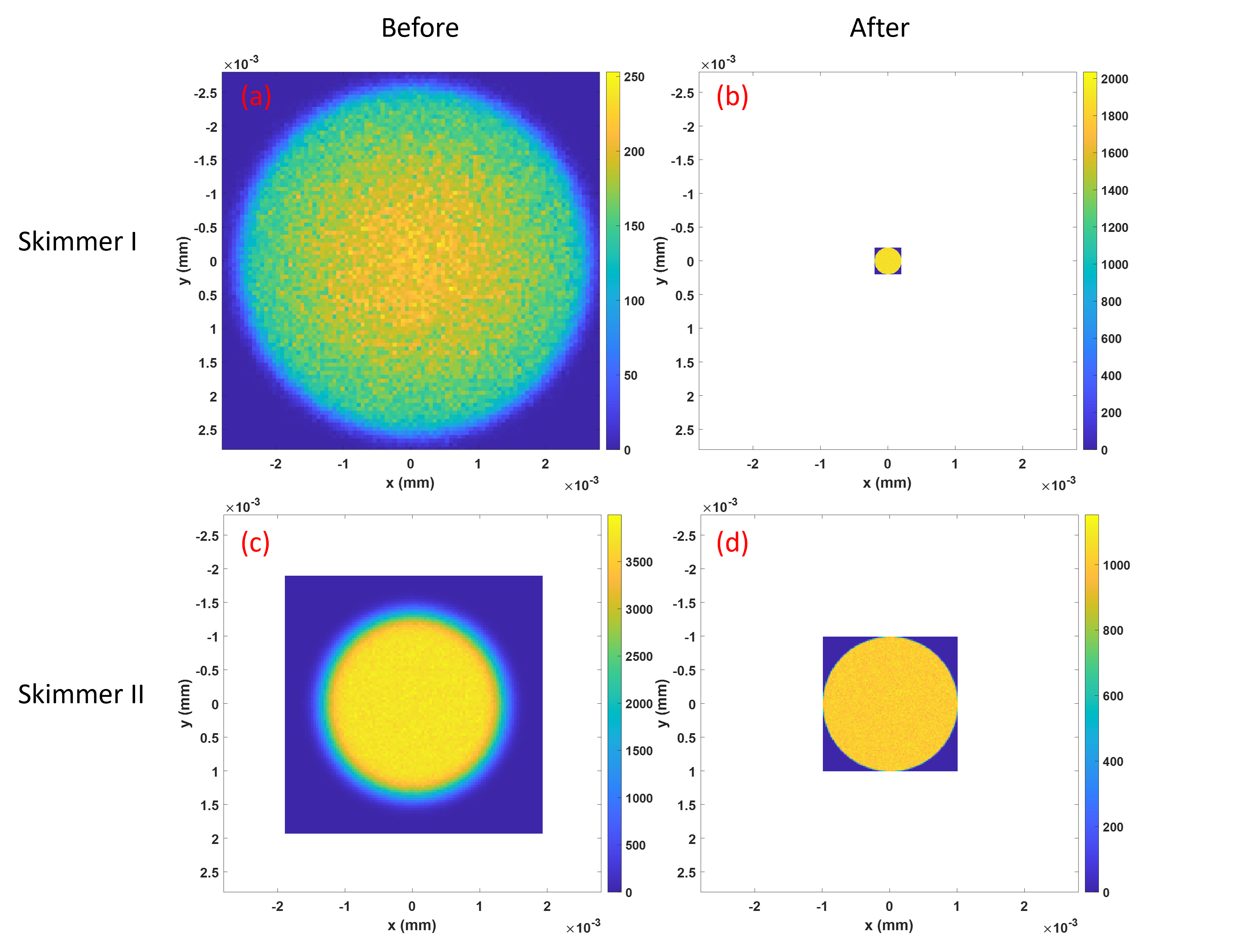
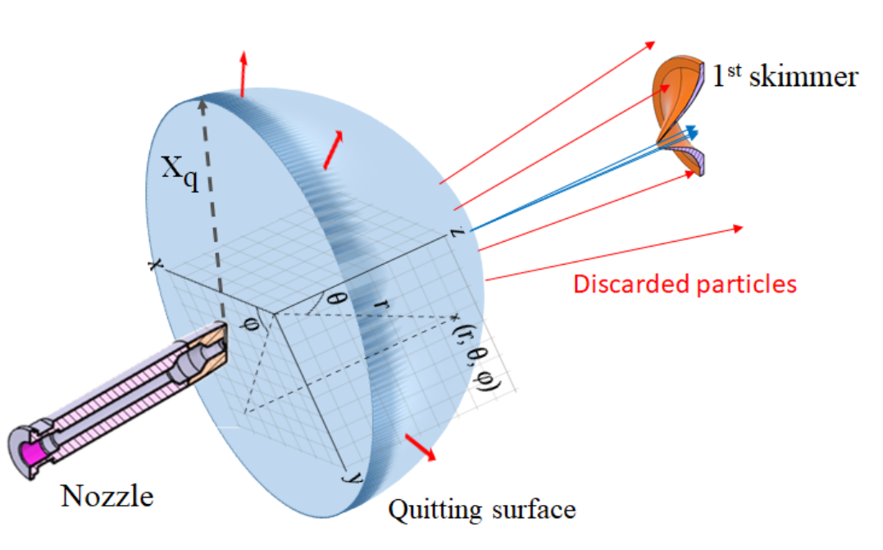
Simulation method (TPMC + MOGA)
TPMC: Test particle Monte Carlo simulation
Continuum flow + Ray tracing for Molecular flow
MOGA: Multi-object genetic algorithm for geometry optimisation

Slide 4
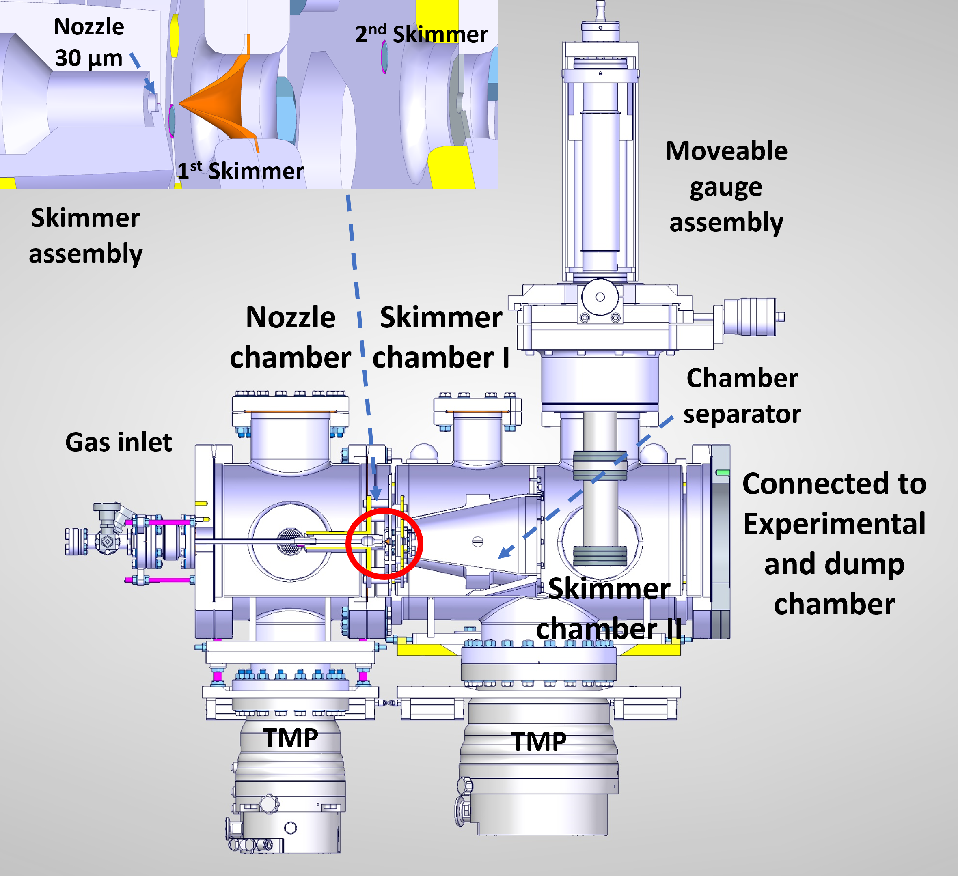
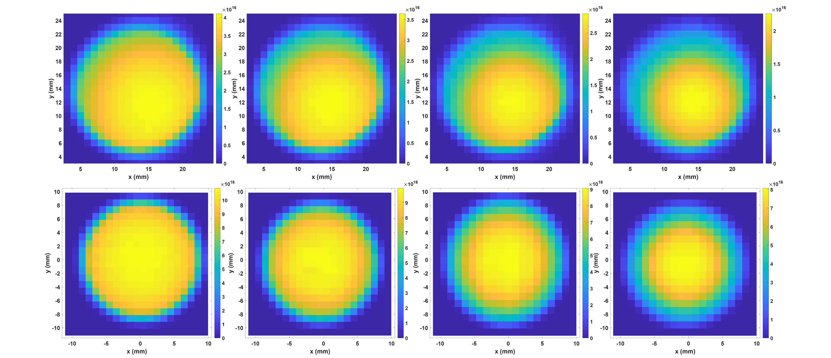
Good agreements between simulation and experiments
Experiments: N₂ gas, 5bar inlet pressure
Simulation
Test on V2 setup

Slide 5
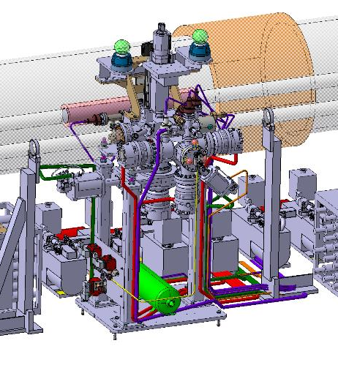
Simulation of V3 modification for YETS
0.00
4.50 mm
33.1 mm
168.5 mm
393.7 mm
595.1 mm
Nozzle
1st Skimmer
2nd Skimmer
3rd Skimmer
IP
4th Skimmer
d
d
b
b
a
a
d: 400 µm
d: 2.00 mm
a: 0.3 mm b: 9.0 mm
a: 7.0 mm b: 31.0 mm
Modify 3rd and 4th skimmer in YETS

Slide 6
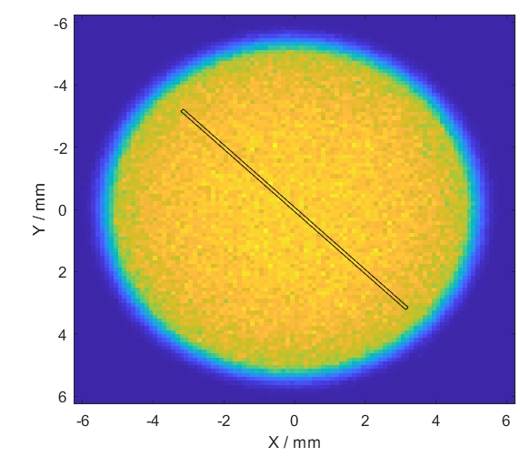
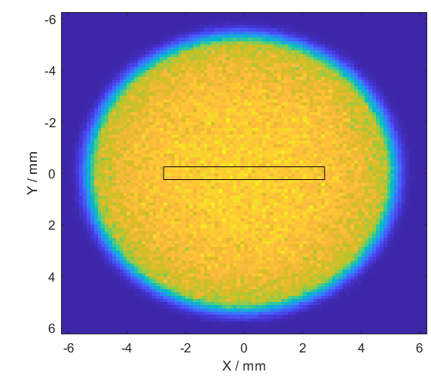

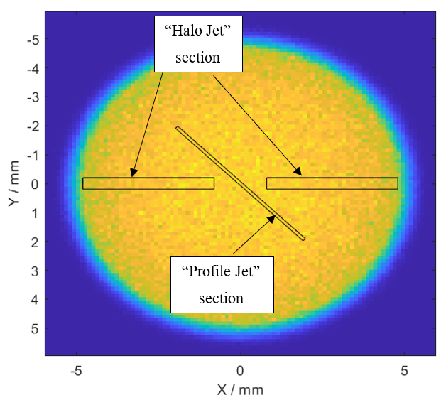
Simulation of V3 modification options for YETS
1.1 – Thin Curtain
Reduce thickness smearing for 2D profile
1.2 – Halo Single
Maximise losses for halo detection
1.3 – Halo Multi
Same as 1.2, but reduced chance of misalignment
1.4 – Profile & Halo
Combination of 1.1 and 1.2 (shared positives and negatives)
See technical notes: https://indico.cern.ch/event/1461184/

Slide 7
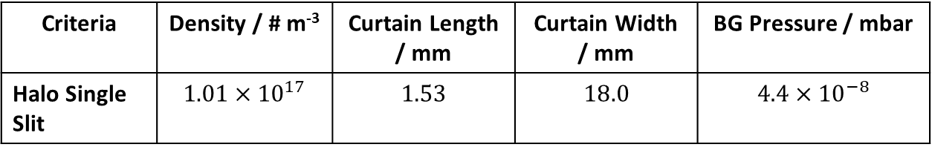
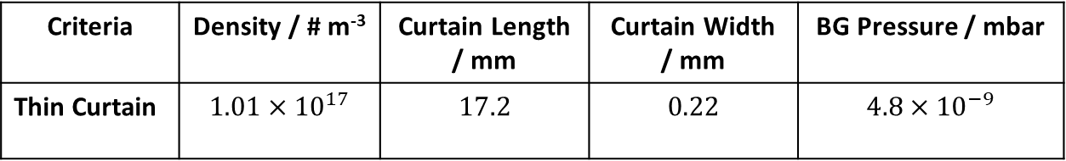
Optimised results for each option
3rd Skimmer
4th Skimmer
IP
Criteria | Density / # m⁻³ | Curtain Length / mm | Curtain Width / mm | BG Pressure / mbar
Thin Curtain | $$1.01×{10}^{17}$$ | $$17.2$$ | $$0.22$$ | $$4.8×{10}^{−9}$$
b
b
a
a
a: 0.1 mm
b: 7.5 mm
a: 0.8 mm
b: 26.4 mm
Criteria | Density / # m⁻³ | Curtain Length / mm | Curtain Width / mm | BG Pressure / mbar
Halo Single Slit | $$1.01×{10}^{17}$$ | $$1.53$$ | $$18.0$$ | $$4.4×{10}^{−8}$$
b
b
a
a
a: 7.8 mm
b: 0.7 mm
a: 27.0 mm
b: 3.2 mm

Slide 8
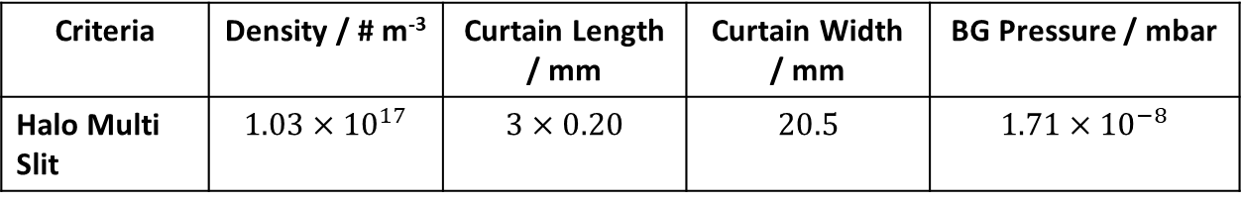
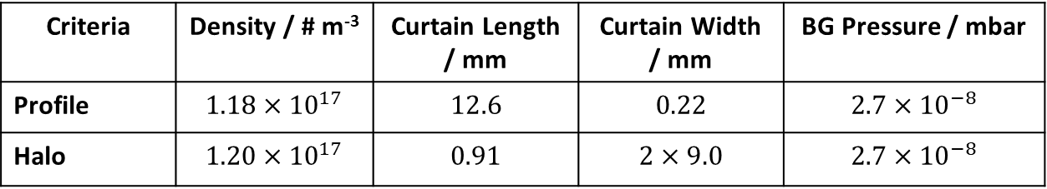
Results for each option
3rd Skimmer
4th Skimmer
IP
c
c
Criteria | Density / # m⁻³ | Curtain Length / mm | Curtain Width / mm | BG Pressure / mbar
Halo Multi Slit | $$1.03×{10}^{17}$$ | $$3×0.20$$ | $$20.5$$ | $$1.71×{10}^{−8}$$
b
b
c
c
a
a
a: 8.9 mm
b: 0.08 mm
c: 1.0 mm
a: 31.7 mm
b: 1.0 mm
c: 3.6 mm
Criteria | Density / # m⁻³ | Curtain Length / mm | Curtain Width / mm | BG Pressure / mbar
Profile | $$1.18×{10}^{17}$$ | $$12.6$$ | $$0.22$$ | $$2.7×{10}^{−8}$$
Halo | $$1.20×{10}^{17}$$ | $$0.91$$ | $$2×9.0$$ | $$2.7×{10}^{−8}$$
d
b
d
b
a
a
c
c
a: 4.0 mm b: 0.4 mm
c: 0.1 mm d: 5.5 mm
e: 2.8 mm
a: 14.4 mm b: 1.7 mm
c: 0.7 mm d: 20.0 mm
e: 10.0 mm

Slide 9
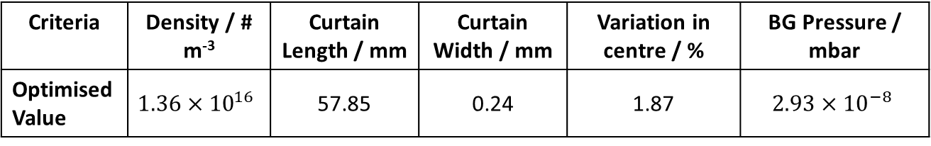
v4.1 design: nozzle skimmer assembly in simulation
0.00
4.50mm
33.09mm
168.5mm
393.7 mm
543.7 mm
Nozzle
1st Skimmer
2nd Skimmer
3rd Skimmer
IP
4th Skimmer
d
d
b
b
a
a
d: 700 µm
d: 5.10 mm
a: 0.10 mm b: 25.9 mm
a: 1.1mm b: 95.2 mm
Criteria | Density / # m⁻³ | Curtain Length / mm | Curtain Width / mm | Variation in centre / % | BG Pressure / mbar
Optimised Value | $$1.36×{10}^{16}$$ | 57.85 | 0.24 | 1.87 | $$2.93×{10}^{−8}$$
Now these are defined as a FWHM value.

Slide 10
v4.1 design: nozzle skimmer assembly
Table 1. On axis distances from nozzle of skimmers and IP
 | 1st Skim | 2nd Skim | 3rd Skim | IP
‘V4 – EBTS’ | 4.5 mm | 33.09 mm | 168.5 mm | 393.7 mm
JEREMY | 4.5 mm | 31.7 mm | 183.27 mm | 329.85 mm
Movable gauge also reduces this by 20mm (new = 309.85 mm)
Table 2. Nozzle and skimmer sizes
 | Nozzle | 1st Skim | 2nd Skim | 3rd Skim
‘V4 – EBTS’ | 30 µm | 700 µm | 5.1 mm | 0.1x25.9 mm
JEREMY | 30 µm | 700 µm | 5.3 mm | 0.1x30 mm

Slide 11
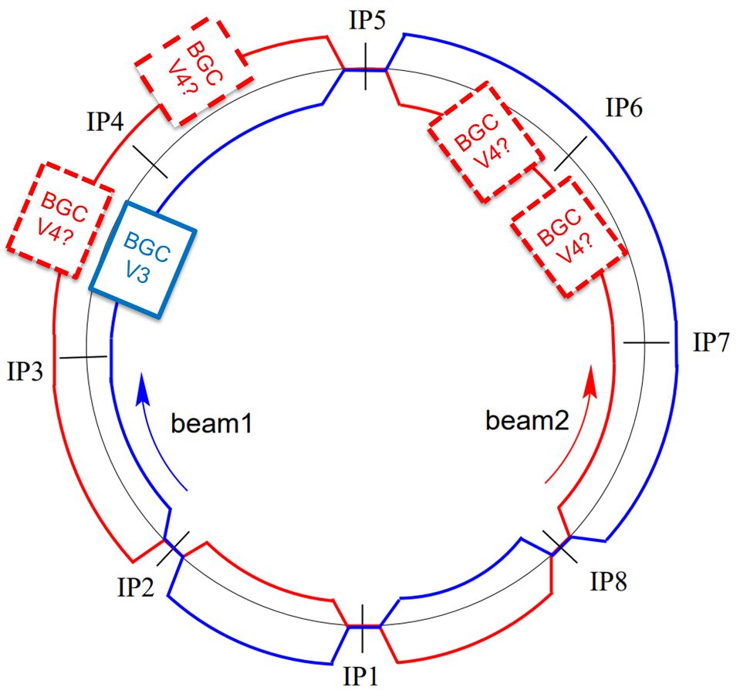
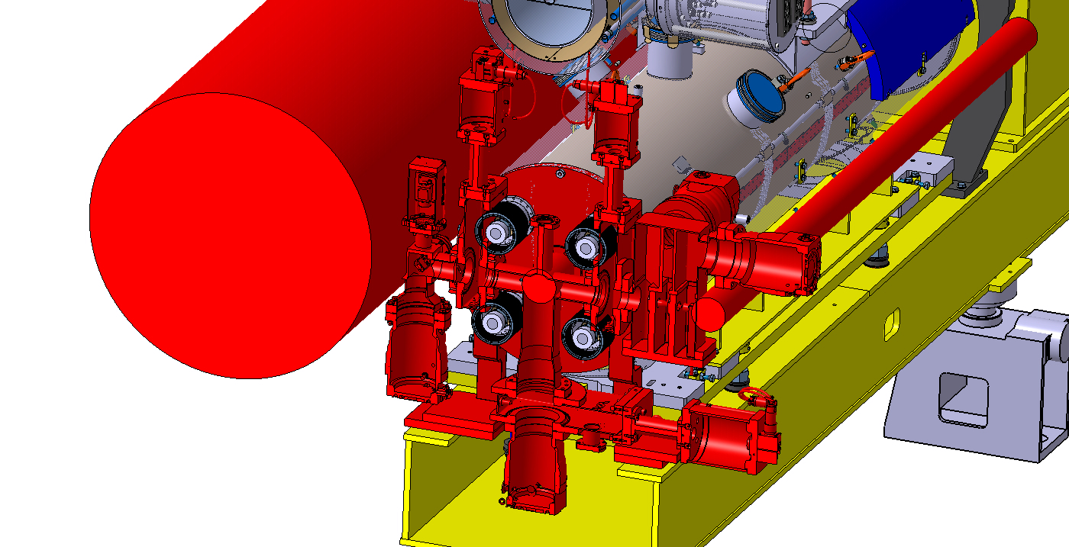
V4.2 design consideration
Point 4:
  Distance Beam1 – Beam2 axes limit the space of the injection.
  Space for injection will be reduced with v3 design
Point 6:
  Distance Beam1 – Beam2 axes is only 194mm
    Currently design need to squeeze the dump side from 420 to 194mm.

Slide 12
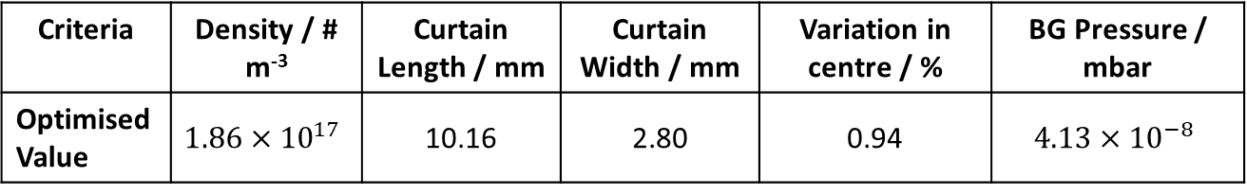
Simulation of v4.2 for point 4 beam 2
Optimised for 10 mm curtain Length.
Maximised the curtain width to increase the signal.
0.00
4.50 mm
27.7mm
185.1mm
294.94 mm
364.7mm
Nozzle
1st Skimmer
2nd Skimmer
3rd Skimmer
IP
4th Skimmer
d
d
b
b
a
a
d: 200 µm
d: 1.0 mm
a: 1.8 mm b: 6.7 mm
a: 4.4 mm b: 16.7 mm
Criteria | Density / # m⁻³ | Curtain Length / mm | Curtain Width / mm | Variation in centre / % | BG Pressure / mbar
Optimised Value | $$1.86×{10}^{17}$$ | 10.16 | 2.80 | 0.94 | $$4.13×{10}^{−8}$$
Notes:
Check the point 4 geometry. Pictures of point4 and point6

Slide 13
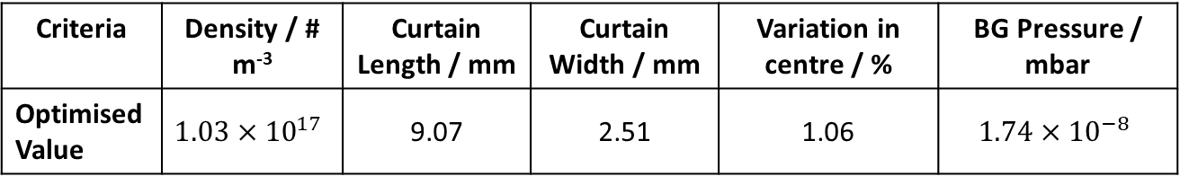
Simulation of v4.2 for point 6 beam 2
Optimised for 10mm curtain Length.
Maximised the curtain width to increase the signal.
0.00
4.50 mm
33.09 mm
168.5mm
393.7 mm
543.7 mm
Nozzle
1st Skimmer
2nd Skimmer
3rd Skimmer
IP
4th Skimmer
d
d
b
b
a
a
d: 200 µm
d: 800 µm
a: 1.1 mm b: 4.5 mm
a: 4.8 mm b: 16.6 mm
Criteria | Density / # m⁻³ | Curtain Length / mm | Curtain Width / mm | Variation in centre / % | BG Pressure / mbar
Optimised Value | $$1.03×{10}^{17}$$ | 9.07 | 2.51 | 1.06 | $$1.74×{10}^{−8}$$

Slide 14
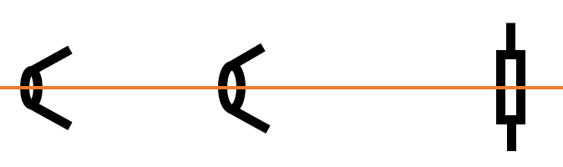
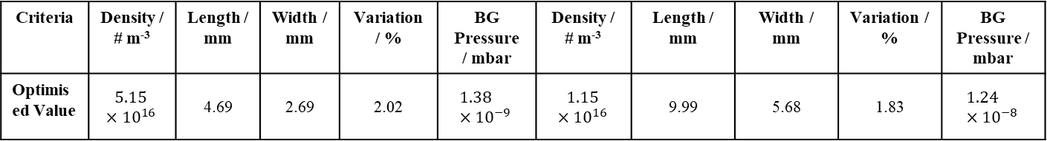
Simulation of v4.2 for point 4 both beam
Nozzle
1st Skimmer
2nd Skimmer
3rd Skimmer
Beam 1
4th Skimmer
Beam 2
5th Skimmer
0.00
4.50
33.09
168.5
393.7
613.7
833.7
1,053.7
(mm)
d
d
b
b
b
a
a
a
d: 400 µm
d: 530 µm
a: 1.2 mm
b: 2.0 mm
a: 5.0 mm
b: 8.9 mm
a: 8.0 mm
b: 13.8 mm
Criteria | Density / # m⁻³ | Length / mm | Width / mm | Variation / % | BG Pressure / mbar | Density / # m⁻³ | Length / mm | Width / mm | Variation / % | BG Pressure / mbar
Optimised Value | $$5.15×{10}^{16}$$ | 4.69 | 2.69 | 2.02 | $$1.38×{10}^{−9}$$ | $$1.15×{10}^{16}$$ | 9.99 | 5.68 | 1.83 | $$1.24×{10}^{−8}$$
Beam 1 conditions
Beam 2 conditions

Slide 15
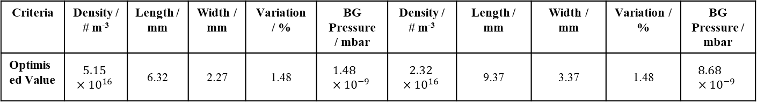
Simulation of v4.2 for point 6 both beam
Nozzle
1st Skimmer
2nd Skimmer
3rd Skimmer
Beam 1
4th Skimmer
Beam 2
5th Skimmer
0.00
4.50
33.09
168.5
393.7
489.7
585.7
681.7
(mm)
d
d
b
b
b
a
a
a
d: 300 µm
d: 560 µm
a: 1.0 mm
b: 2.8 mm
a: 4.4 mm
b: 8.8 mm
a: 5.2 mm
b: 12.8 mm
Criteria | Density / # m⁻³ | Length / mm | Width / mm | Variation / % | BG Pressure / mbar | Density / # m⁻³ | Length / mm | Width / mm | Variation / % | BG Pressure / mbar
Optimised Value | $$5.15×{10}^{16}$$ | 6.32 | 2.27 | 1.48 | $$1.48×{10}^{−9}$$ | $$2.32×{10}^{16}$$ | 9.37 | 3.37 | 1.48 | $$8.68×{10}^{−9}$$
Beam 1 conditions
Beam 2 conditions

Slide 16
Conclusion
Simulation serves the design work very well.
Lead to creative curtain design.
Planned publication on the simulation work.

