Slide 1






11th BGC Collaboration Meeting
Summary of the 2024 Experimental Results at
Cockcroft Institute
Presented by
Hao Zhang
Shakti Prasad Sethi
Department of Physics, QUASAR Group, University of Liverpool

Slide 2

Contents
JEREMY modification test stand
  JEREMY modification with bellows, 4th skimmer and dump chamber
  Background pressure for nozzle distance at different bellow positions
HaloJet
Density scan with rectangular 2nd skimmer in comparison with circular 2nd skimmer
Summaries
11th BGC Collaboration Meeting

Slide 3
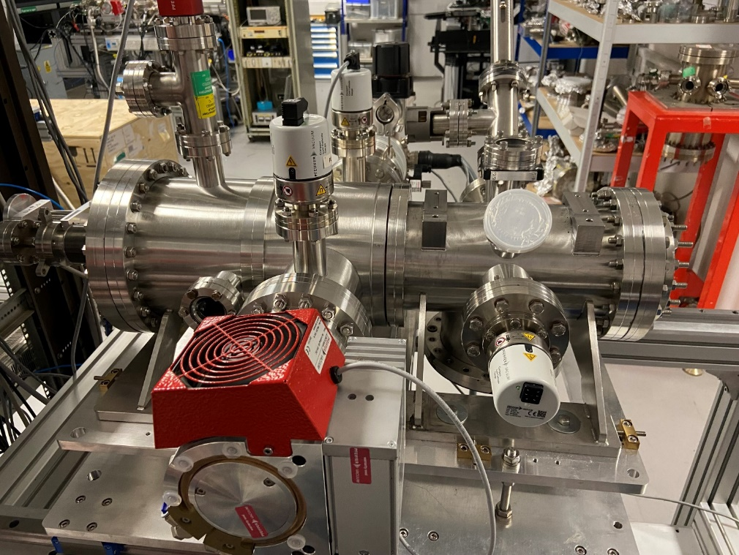
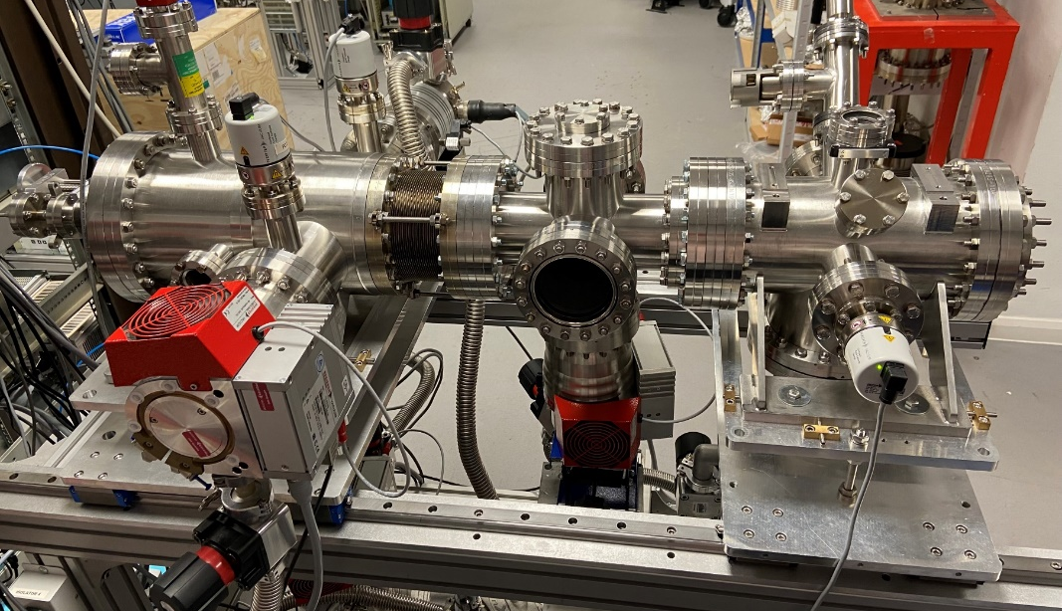
JEREMY modification setup
1st Skimmer
1st Skimmer
Bellow
IP
Dump chamber
2nd Skimmer
2nd Skimmer
3rd Skimmer
IP
3rd Skimmer
4th Skimmer
JEREMY Test stand
Modified JEREMY Test stand with Bellow,
4th Skimmer and Dump chamber
11th BGC Collaboration Meeting

Slide 4
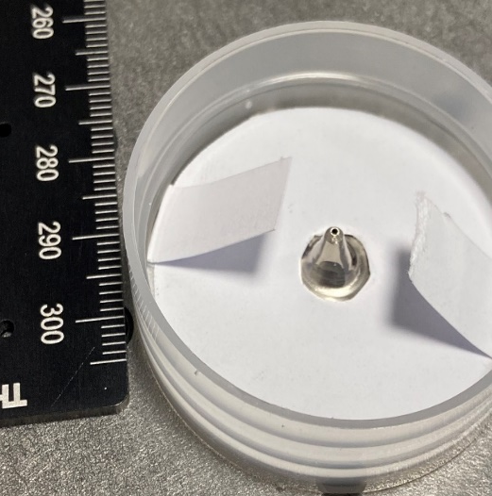
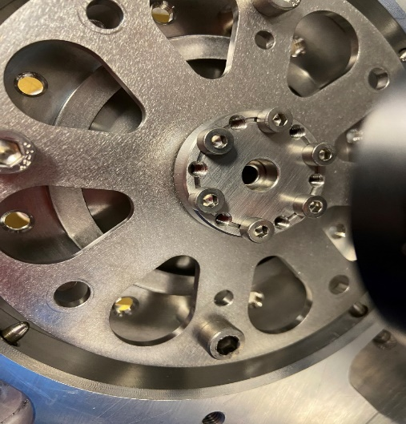
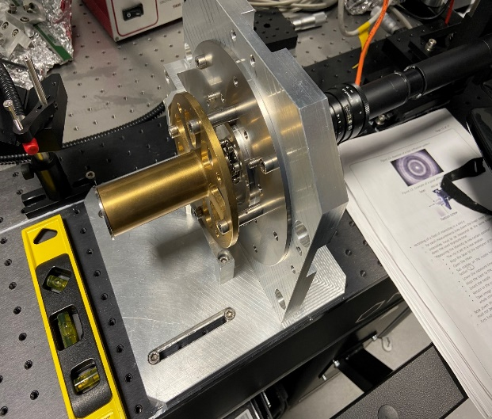
JEREMY setup tested with new 1st skimmers planned
700um 1st skimmer
Skimmer mount
Alignment
 | Nozzle | 1st Skim | 2nd Skim | 3rd Skim
Size | 30um | 700um | 5.3mm | 0.1x30mm
Distance | --- | 4.5mm | 31.7mm | 183.3 mm
New large 1st skimmers (400um, 600um, 700um, 800um)
30um Flat nozzle used
11th BGC Collaboration Meeting

Slide 5
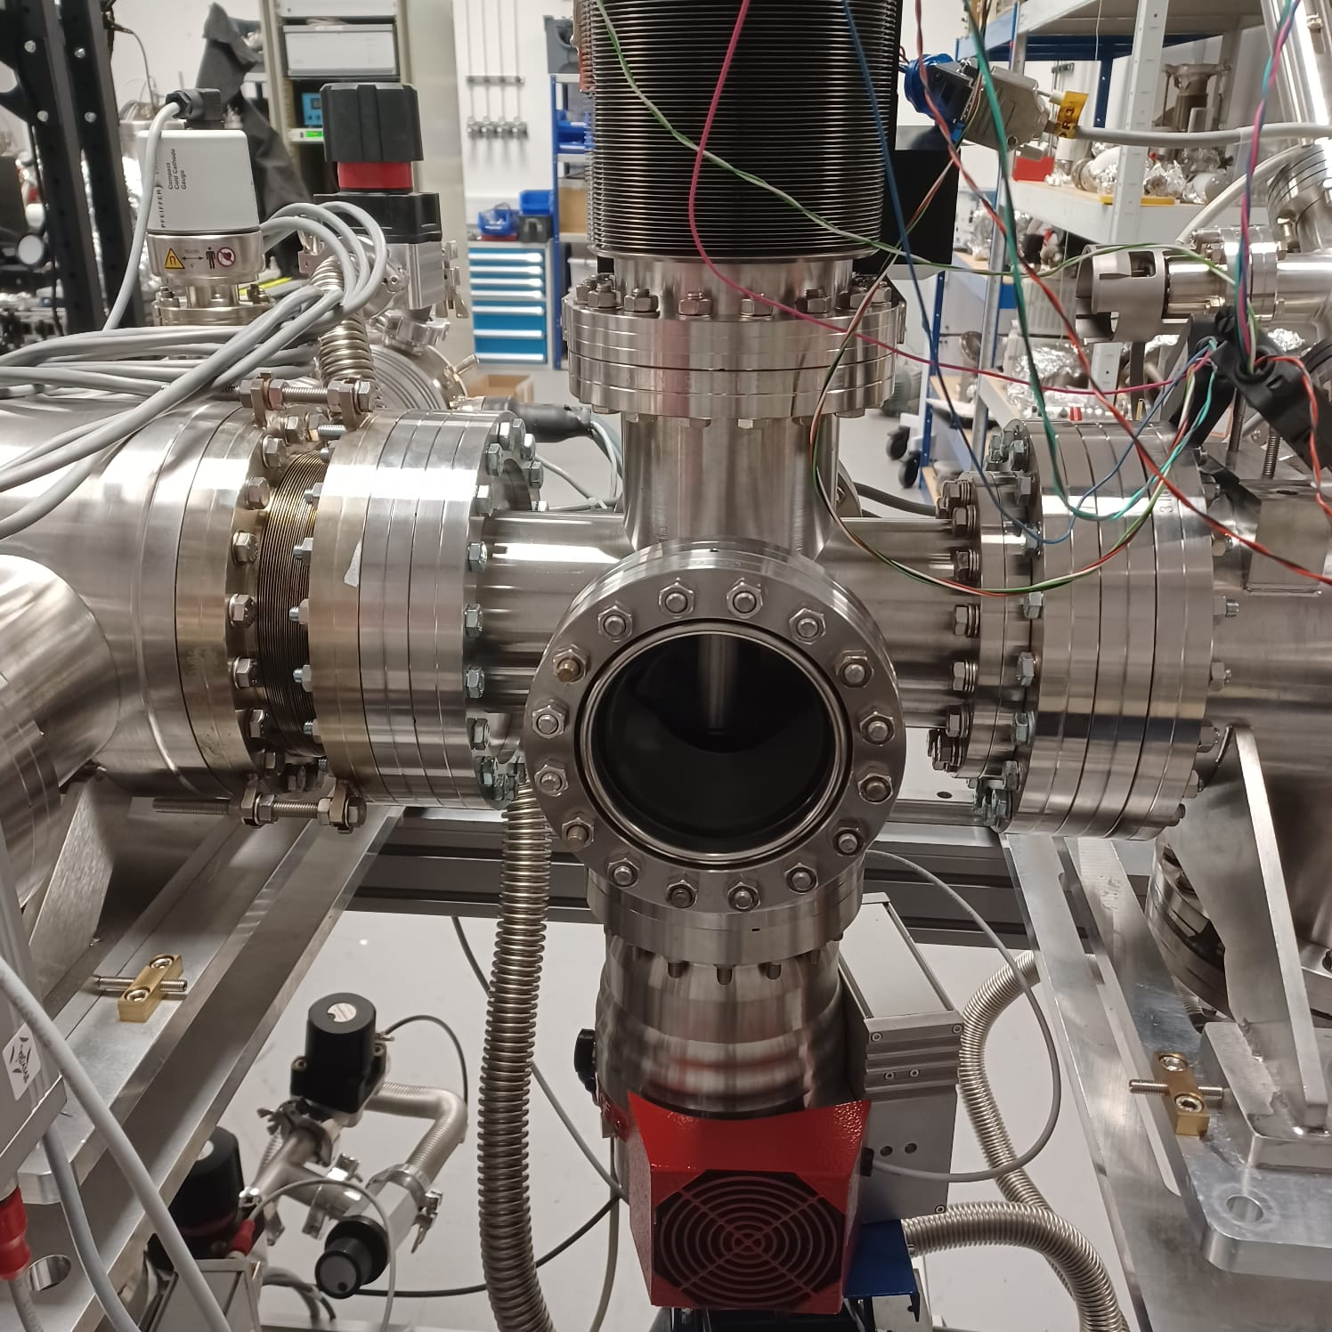
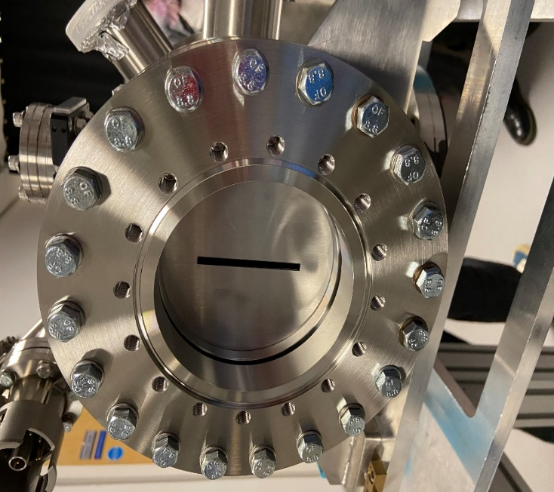
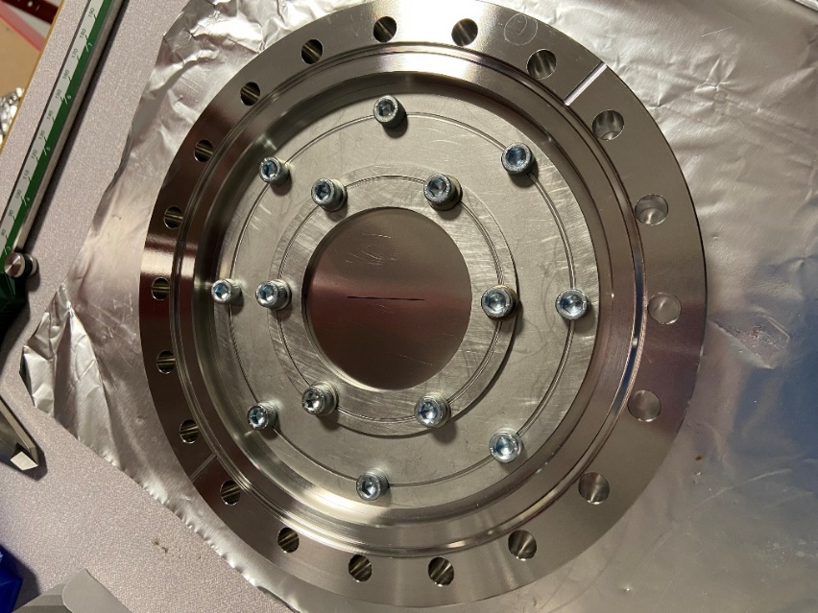
JEREMY modification with
Bellows, 4th Skimmer and Dump Chamber
Bellow
4th skimmer
Dump chamber
 | 1st Skim | 2nd Skim | 3rd Skim | IP | 4th Skim | Bellow variation
Size | 700um | 5.3mm | 0.4x30mm | --- | 4x60mm
Distance | 4.5mm | 31.7mm | 302.03mm | 452.21mm | 624.89mm | 80x120mm
11th BGC Collaboration Meeting

Slide 6
JEREMY modification New layout options
Nozzle
1st Skimmer
2nd Skimmer
3rd Skimmer
IP
4th Skimmer
Bellows + Spacers
Spacers
Bellows + Mount plate
Bellows + Mount plate
Bellows + Mount plate
Varying bellows is easy, but only one set of bellows between 3rd, IP and 4th so flange changes needed.
Take a range of BG pressures at different chamber sizes to validate MOGA predictions
11th BGC Collaboration Meeting

Slide 7
  Background pressure study with
  bellow positions at different nozzle skimmer distances
Nozzle – 1st skimmer distance variation (2-10mm)
JEREMY setup
Nozzle=0.03mm, 1st skimmer=0.6mm, 2nd skimmer=2mm, 3rd skimmer a=0.4,b=30
Modified JEREMY setup with Bellow distances 80mm, 100mm, 120mm between 2nd – 3rd skimmer Nozzle=0.03mm, 1st skimmer=0.6mm, 2nd skimmer=2mm, 3rd skimmer a=0.4,b=30,4th skimmer a=4,b=60
*Compare expected BG pressure per chamber, simulation vs measured
Distances in mm
Nozzle-1st | 1st-2nd | 2nd-3rd | 3rd-IP
2-10 | 24.75 | 250.33-290.33 | 150.18
Distances in mm
Nozzle-1st | 1st-2nd | 2nd-3rd | 3rd-IP | IP-4th
2-10 | 24.75 | 250.33-290.33 | 150.18 | 172.68
11th BGC Collaboration Meeting

Slide 8
  Background pressure study with/without
  bellow positions at different nozzle distance
JEREMY setup
Nozzle=0.03mm, 1st skimmer=0.6mm, 2nd skimmer=2mm, 3rd skimmer a=0.4,b=30
Distances in mm
Nozzle-1st | 1st-2nd | 2nd-3rd | 3rd-IP
2-10 | 24.75 | 250.33-290.33 | 150.18
Nozzle-skimmer distances | 1st skimmer | 2nd skimmer | 3rd skimmer | IP
2 (No gas) | 1.50E-08 | 7.30E-09 | 3.80E-09 | 4.29E-09
2 | 3.43E-03 | 1.10E-04 | 1.53E-05 | 1.92E-07
3 | 3.53E-03 | 1.00E-04 | 1.47E-05 | 1.91E-07
4 | 3.53E-03 | 9.87E-05 | 1.40E-05 | 1.85E-07
5 | 3.53E-03 | 9.77E-05 | 1.33E-05 | 1.79E-07
6 | 3.53E-03 | 9.63E-05 | 1.30E-05 | 1.72E-07
7 | 3.53E-03 | 9.60E-05 | 1.30E-05 | 1.66E-07
8 | 3.53E-03 | 9.57E-05 | 1.27E-05 | 1.61E-07
9 | 3.53E-03 | 9.57E-05 | 1.23E-05 | 1.57E-07
10 | 3.53E-03 | 9.50E-05 | 1.20E-05 | 1.52E-07
11th BGC Collaboration Meeting

Slide 9
Nozzle-skimmer (mm) | Bellow distances (mm) | 1st | 2nd | 3rd | IP | Dump
2 | 80 | 3.30E-03 | 1.10E-04 | 1.40E-05 | 1.59E-07 | 1.20E-07
3 | 80 | 3.63E-03 | 1.10E-04 | 1.40E-05 | 1.67E-07 | 1.20E-07
4 | 80 | 3.63E-03 | 1.07E-04 | 1.33E-05 | 1.62E-07 | 1.20E-07
5 | 80 | 3.60E-03 | 1.00E-04 | 1.30E-05 | 1.57E-07 | 1.20E-07
6 | 80 | 3.63E-03 | 1.00E-04 | 1.30E-05 | 1.53E-07 | 1.17E-07
7 | 80 | 3.63E-03 | 1.00E-04 | 1.20E-05 | 1.48E-07 | 1.10E-07
8 | 80 | 3.57E-03 | 9.93E-05 | 1.20E-05 | 1.45E-07 | 1.10E-07
9 | 80 | 3.60E-03 | 9.93E-05 | 1.20E-05 | 1.41E-07 | 1.10E-07
10 | 80 | 3.57E-03 | 9.90E-05 | 1.20E-05 | 1.38E-07 | 1.10E-07
2 | 100 | 3.13E-03 | 1.03E-04 | 1.40E-05 | 1.52E-07 | 1.40E-07
3 | 100 | 3.47E-03 | 1.10E-04 | 1.40E-05 | 1.58E-07 | 1.50E-07
4 | 100 | 3.47E-03 | 9.87E-05 | 1.30E-05 | 1.50E-07 | 1.50E-07
5 | 100 | 3.47E-03 | 9.67E-05 | 1.27E-05 | 1.46E-07 | 1.50E-07
6 | 100 | 3.47E-03 | 9.47E-05 | 1.20E-05 | 1.41E-07 | 1.40E-07
7 | 100 | 3.47E-03 | 9.37E-05 | 1.20E-05 | 1.36E-07 | 1.40E-07
8 | 100 | 3.43E-03 | 9.30E-05 | 1.20E-05 | 1.33E-07 | 1.30E-07
9 | 100 | 3.43E-03 | 9.30E-05 | 1.13E-05 | 1.30E-07 | 1.20E-07
10 | 100 | 3.43E-03 | 9.23E-05 | 1.07E-05 | 1.27E-07 | 1.20E-07
2 | 120 | 3.03E-03 | 1.00E-04 | 1.37E-05 | 1.47E-07 | 1.30E-07
3 | 120 | 3.33E-03 | 1.03E-04 | 1.40E-05 | 1.50E-07 | 1.40E-07
4 | 120 | 3.33E-03 | 1.01E-04 | 1.30E-05 | 1.43E-07 | 1.40E-07
5 | 120 | 3.33E-03 | 9.47E-05 | 1.23E-05 | 1.38E-07 | 1.37E-07
6 | 120 | 3.33E-03 | 9.27E-05 | 1.20E-05 | 1.33E-07 | 1.30E-07
7 | 120 | 3.33E-03 | 9.17E-05 | 1.17E-05 | 1.28E-07 | 1.27E-07
8 | 120 | 3.33E-03 | 9.13E-05 | 1.13E-05 | 1.25E-07 | 1.20E-07
9 | 120 | 3.33E-03 | 9.07E-05 | 1.10E-05 | 1.23E-07 | 1.10E-07
10 | 120 | 3.33E-03 | 9.07E-05 | 1.10E-05 | 1.21E-07 | 1.10E-07
Modified JEREMY setup with Bellow distances 80mm, 100mm, 120mm between 2nd – 3rd skimmer
Nozzle=0.03mm
1st skimmer=0.6mm
2nd skimmer=2mm
3rd skimmer a=0.4,b=30
4th skimmer a=4,b=60
Nozzle skimmer distance 10mm
Nozzle-1st | 2nd | 3rd | IP
3.53E-03 | 9.50E-05 | 1.20E-05 | 1.52E-07
11th BGC Collaboration Meeting

Slide 10
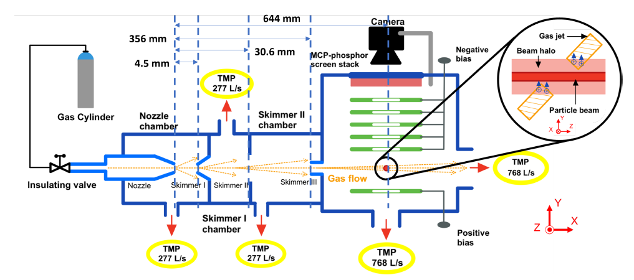
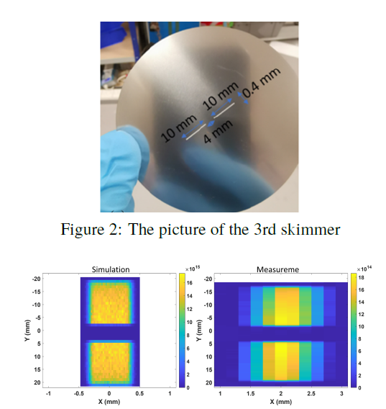
HaloJet
Fig. slotted 3rd skimmer
Fig. Principle of a gas-jet based beam profile monitoring
(a)
(b)
Fig. Number density distribution of the gas curtain,
(a) simulation and (b) experiment
11th BGC Collaboration Meeting

Slide 11
Density scan with Rectangular 2nd skimmer compared with Circular 2nd skimmer
Nozzle-1st skimmer distance | 1.5mm (initial distance)
Nozzle | 0.03
1st skimmer | 0.4
2nd skimmer | a=0.5, b=1.8
3rd Skim | a=0.4, b=30
bellows 2-3 | 80mm
Nozzle-1st skimmer distance | 1.5mm (initial distance)
Nozzle | 0.03
1st skimmer | 0.4
2nd skimmer | 2
3rd Skim | a=0.4, b=30
bellows 2-3 | 80mm
Fig. Density scan of circular and rectangular skimmer
2D profile of circular 2nd skimmer
2D profile of rectangular 2nd skimmer
11th BGC Collaboration Meeting

Slide 12
Chamber pressure at nozzle skimmer distances
  Fig. (a)
  Fig. (b)
  Fig. (c)
  a=2
  a=0.5, b=1.8
  Fig. (a)-(e), represents the chambers pressure of circular and rectangular 2nd skimmers of the JEREMY setup
  Fig. (e)
  Fig. (d)
11th BGC Collaboration Meeting

Slide 13
Summaries
Gas jet calibrated with circular and rectangular 2nd skimmer.
Background pressure measured at different bellows distance for 0.4mm and 0.7mm 1st skimmer.
HaloJet experiment performed using slotted 3rd skimmer in the Version 2 setup, and the work also presented at IBIC 2024.
Pulse jet (Gated injection) experiment for density measurement is planned.
11th BGC Collaboration Meeting

Slide 14
THANK YOU
Gas Jet group
Carsten Welsch
Hao Zhang
Oliver Stringer
Shakti Prasad Sethi
11th BGC Collaboration Meeting

Slide 15
Photon rate
11th BGC Collaboration Meeting

