Slide 1
Data Processing with FPGAs:
Parallel Computing on Compact Configurable Logic
iCSC 2025
Peter Hinderberger Technical University of Munich (TUM)
March 27, 2025

Slide 2
Key Contents
1 Field-Programmable Gate Array
  Principles and Structure
  Building Blocks
3 Parallel Processing
  Paradigms of Parallelism
  Neural Networks on FPGAs
2 Design Principles
  Design Flow
  VHDL „Hello World“
  High Level Synthesis
4 Summary

Slide 3
Introduction
What to expect, and what not to expect
Understand the principles of Field-Programmable Gate Arrays, their advantages and challenges
Know the differences between hardware and software programming and the basic principles of Hardware Description Language
Know what parallel processing means in the context of configurable logic
About me
PhD Student: FPGA-based onboard data processing for a small satellite-based
tracking calorimeter
MSc. Applied and Engineering Physics
Born 1992 in Schwäbisch Gmünd, Germany
Hobbies: Hunting, Fishing, Sports, Sailing, Movies, Gaming…

Slide 4
Field-Programmable Gate Arrays
Introduction and Overview

Slide 5



Field-Programmable Gate Arrays
Principles
FPGA: Field-Programmable Gate Array
?
From: stock.adobe.com

Slide 6
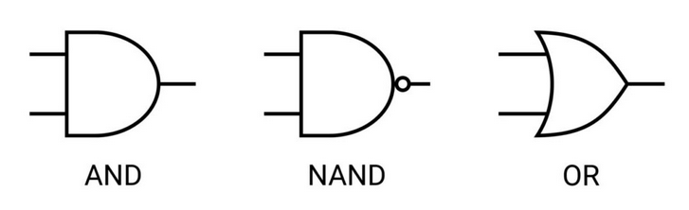
Field-Programmable Gate Arrays
Principles
FPGA: Field-Programmable Gate Array
?
From: stock.adobe.com

Slide 7
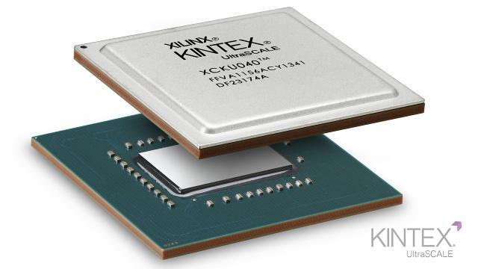
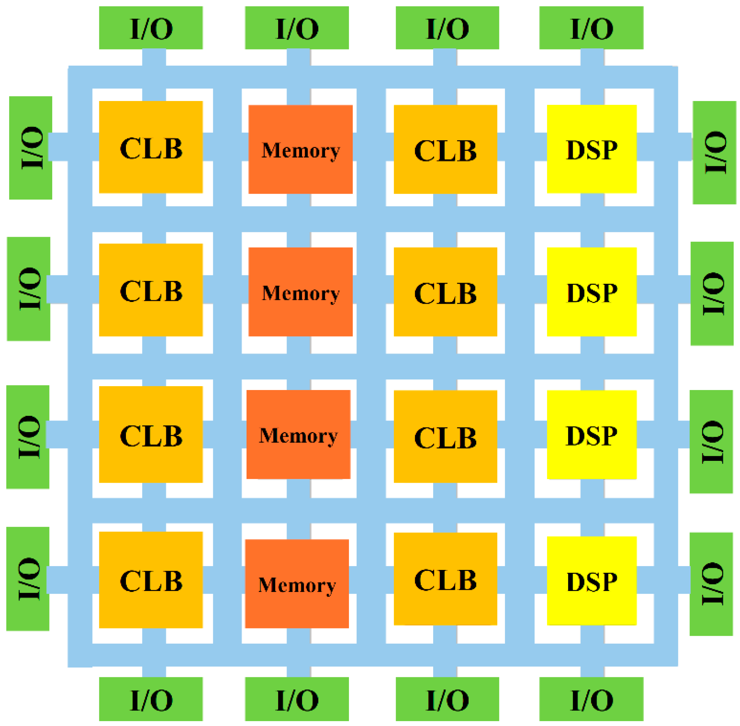
Field-Programmable Gate Arrays
Principles
FPGA: Field-Programmable Gate Array
“Gate Array” = Array of basic logical components
“Field-Programmable” = (Re-)Programmable wiring
Main components:
Flip Flops = Registers
Look-Up Tables (LUT)
Block RAM (BRAM)
Digital Signal Processors (DSP)
Clocking Structure
Input/Output Ports
From: www.xilinx.com
From: Khan et.al., 2024

Slide 8
Field-Programmable Gate Arrays
Principles
FPGA: Field-Programmable Gate Array
“Gate Array” = Array of basic logical components
“Field-Programmable” = (Re-)Programmable wiring
Main components:
Flip Flops = Registers
Look-Up Tables (LUT)
Block RAM (BRAM)
Digital Signal Processors (DSP)
Clocking Structure
Input/Output Ports
From: www.xilinx.com
D
FF
CE
Q
CLK
RST
From: Khan et.al., 2024

Slide 9
Field-Programmable Gate Arrays
Principles
FPGA: Field-Programmable Gate Array
“Gate Array” = Array of basic logical components
“Field-Programmable” = (Re-)Programmable wiring
Main components:
Flip Flops = Registers
Look-Up Tables (LUT)
Block RAM (BRAM)
Digital Signal Processors (DSP)
Clocking Structure
Input/Output Ports
From: www.xilinx.com
A0
LUT
A1
A2
Q
A3
A4
A5
From: Khan et.al., 2024

Slide 10
Field-Programmable Gate Arrays
Principles
FPGA: Field-Programmable Gate Array
“Gate Array” = Array of basic logical components
“Field-Programmable” = (Re-)Programmable wiring
Main components:
Flip Flops = Registers
Look-Up Tables (LUT)
Block RAM (BRAM)
Digital Signal Processors (DSP)
Clocking Structure
Input/Output Ports
From: www.xilinx.com
36kb per Block,
O(Mb) per Device
From: Khan et.al., 2024

Slide 11
Field-Programmable Gate Arrays
Principles
FPGA: Field-Programmable Gate Array
“Gate Array” = Array of basic logical components
“Field-Programmable” = (Re-)Programmable wiring
Main components:
Flip Flops = Registers
Look-Up Tables (LUT)
Block RAM (BRAM)
Digital Signal Processors (DSP)
Clocking Structure
Input/Output Ports
From: www.xilinx.com
From: Khan et.al., 2024

Slide 12
Field-Programmable Gate Arrays
Principles
FPGA: Field-Programmable Gate Array
Advantages:
Large data bandwidth, high number of GPIO ports
Low power consumption
Reconfigurability
Adaptability
Arbitrary granularities of optimization and control
Latency!
From: www.xilinx.com
From: Khan et.al., 2024

Slide 13
Field-Programmable Gate Arrays
Principles
FPGA: Field-Programmable Gate Array
Challenges:
Complex system: High number of
specialized components
FPGAs are configurable Hardware: VHDL/Verilog
Lower clock speeds: O(100 MHz)
On-chip memory
From: www.xilinx.com
From: Khan et.al., 2024

Slide 14
Recent Examples from Particle Physics
Examples @Cern
LHCb: Real-Time Cluster Finding at the Silicon Pixel Detector
Bassi et. al., 2023, IEEE Transactions on Nuclear Science 70, 1189–1201
ALICE: Hardware cluster finding algorithm in the HLT
Engel et. al., 2017, J. Phys.: Conf. Ser. 898 032018
CMS L1 Trigger: Tracklet Algorithm
Bartz et. al., 2017, EPJ Web of Conferences 150, 00016
ATLAS L0 Muon Trigger
Y. Mitsumori and on behalf of the ATLAS collaboration, 2023, JINST 18 C02019
Ospanov et. al., 2021, EPJ Web of Conferences 251, 04031
NA62 RICH detector L0 Trigger and DAQ @SPS
Barbanera et. al., 2017, Journal of Instrumentation, 12, C01023-C01023
Belle-2, AMBER, PANDA…
+ Growing use for space applications

Slide 15
Design Principles
Or: How to approach an FPGA

Slide 16
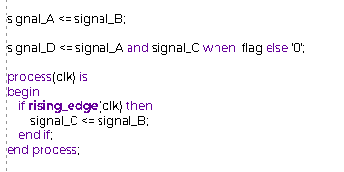
Design Principles
Hardware Description Languages (HDL)
Difference to Programming:
Concurrent statements!
Combinational Logic ⬄ Sequential Logic
Concurrent
Combinational
Combinational
Sequential
Code ➔ Circuit!

Slide 17
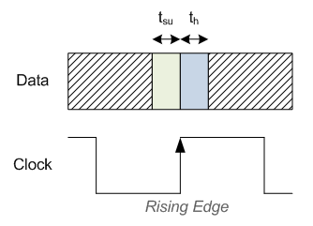
Design Principles
Things to think about
Difference to Programming:
Concurrent statements!
Combinational Logic ⬄ Sequential Logic
Concurrent
Combinational
Combinational
Sequential
+ Timing!
From: nandland.com
Setup and Hold Times

Slide 18

Design Principles
Things to think about
Difference to Programming:
Concurrent statements!
Combinational Logic ⬄ Sequential Logic
Concurrent
Combinational
Combinational
Sequential
Some Logic
+ Timing!
Reg
Reg
Setup and Hold Times
Clock

Slide 19
Design Principles
Things to think about
Difference to Programming:
Concurrent statements!
Combinational Logic ⬄ Sequential Logic
Concurrent
Combinational
Combinational
Sequential
Some Logic
Some Logic
+ Timing!
Reg
Reg
Reg
Setup and Hold Times
Clock

Slide 20
Design Principles
Things to think about
Difference to Programming:
Concurrent statements!
Combinational Logic ⬄ Sequential Logic
Concurrent
Combinational
Combinational
Sequential
+ Timing Constraints
+ Component Parameters
+ Number of Components
…

Slide 21
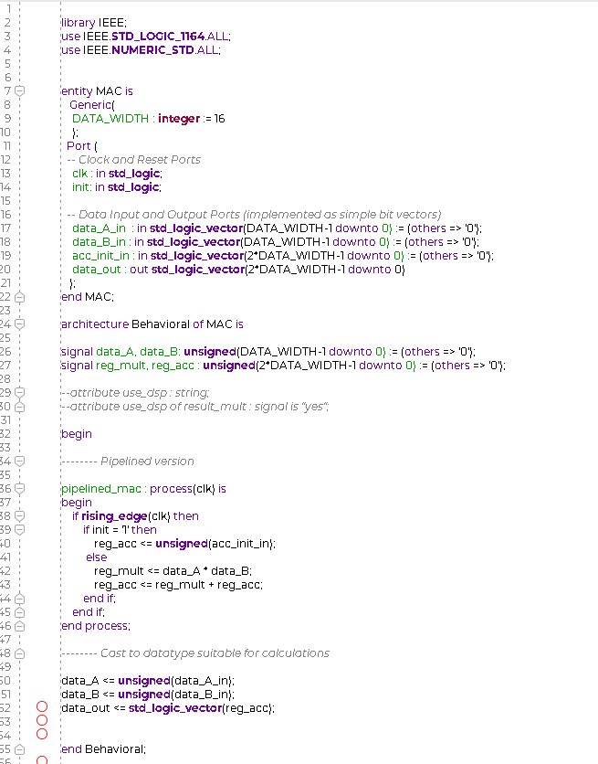
Design Principles
FPGA Design Flow
HDL
Code
HDL Testbench

Slide 22
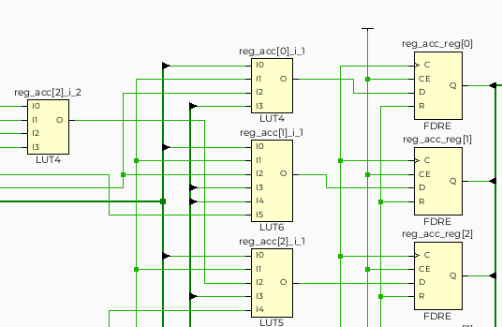
Design Principles
FPGA Design Flow
HDL
Code
Synthesis
Derive Circuit
HDL Testbench
Simulate

Slide 23
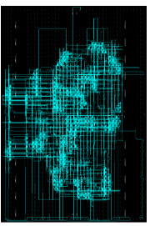
Design Principles
FPGA Design Flow
HDL
Code
Synthesis
Derive Circuit
Implementation
Place and Route
HDL Testbench
Simulate

Slide 24
Design Principles
FPGA Design Flow
HDL
Code
Synthesis
Derive Circuit
Implementation
Place and Route
Timing Successful?
HDL Testbench
Simulate

Slide 25
Design Principles
FPGA Design Flow
100110110101100001000111101100010101010000111101010011000000000111101111011
Adapted from: Stilkerich et. al., 2014
HDL
Code
Synthesis
Derive Circuit
Implementation
Place and Route
Bitstream
HDL Testbench
Simulate

Slide 26
Design Principles
FPGA Design Flow
100110110101100001000111101100010101010000111101010011000000000111101111011
Adapted from: Stilkerich et. al., 2014
HDL
Code
Synthesis
Derive Circuit
Implementation
Place and Route
Bitstream
HDL Testbench
Simulate
Simulate
Simulate
Verify

Slide 27
Hardware Description Language
How to Code
General Layout of a VHDL Module

Slide 28
Hardware Description Language
How to Code
General Layout of a VHDL Module
Choose packages to use (including own)

Slide 29
Hardware Description Language
How to Code
General Layout of a VHDL Module
Entity Declaration

Slide 30
Hardware Description Language
How to Code
General Layout of a VHDL Module
Architecture Head
Definition of
Types, Constants, Signals, and Wires
Functions and Procedures
Attributes
Components

Slide 31
Hardware Description Language
How to Code
General Layout of a VHDL Module
Architecture Body

Slide 32

Let’s code a MAC
type t_word is array (0 to 10) of std_logic_vector(7 downto 0);
signal message : t_word := std_logic_vector(“HelloWorld”);

Slide 33
Let’s code a MAC
type t_word is array (0 to 10) of std_logic_vector(7 downto 0);
signal message : t_word := std_logic_vector(“HelloWorld”);

Slide 34
Let’s code a MAC
Multiply-Accumulate
A
B
Acc
Out
type t_word is array (0 to 10) of std_logic_vector(7 downto 0);
signal message : t_word := std_logic_vector(“HelloWorld”);

Slide 35
Let’s code a MAC
Multiply-Accumulate
Python:
accumulator = 0
while clock:
accumulator += A * B
A
B
Acc
Out
type t_word is array (0 to 10) of std_logic_vector(7 downto 0);
signal message : t_word := std_logic_vector(“HelloWorld”);

Slide 36
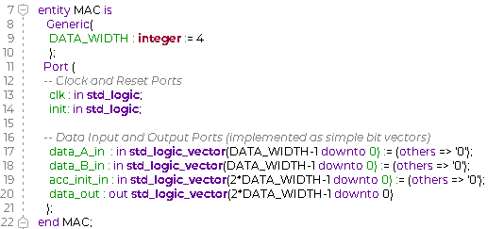
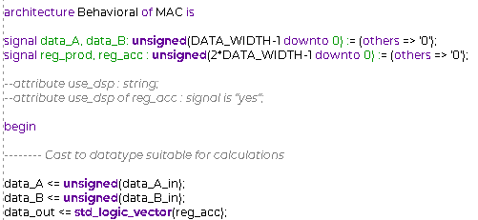
Entity Declaration Architecture Head and First Assignments

Slide 37
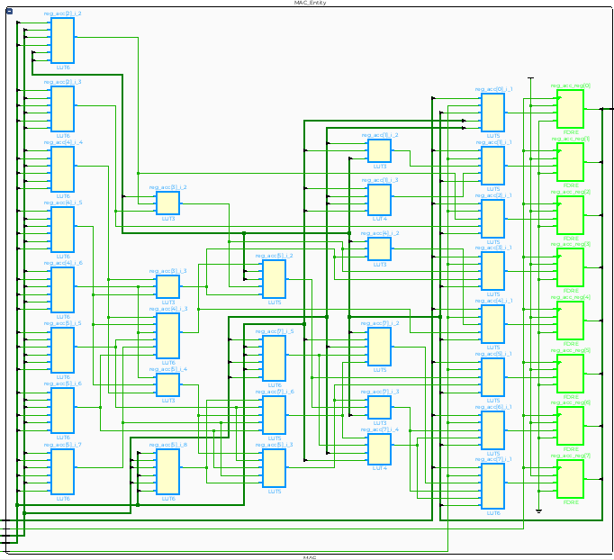
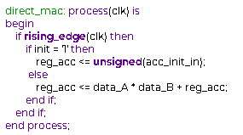
Architecture Body Resulting Circuit
D
FF
CE
Q
CLK
R
A0
LUT
A1
A2
Q
A3
Some Logic
A4
A5
Reg
Reg
Clock

Slide 38
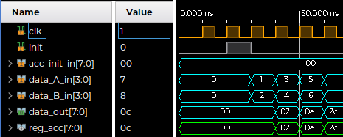
Architecture Body Simulation Result
Some Logic
Reg
Reg
Clock

Slide 39
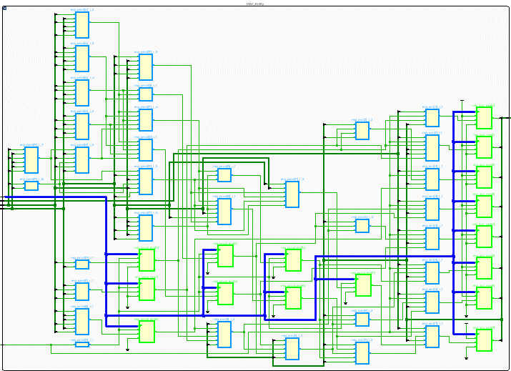
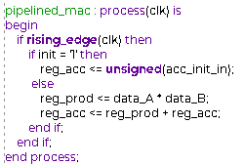
Architecture Body – With Pipeline Register Resulting Circuit
Some Logic
Some Logic
Reg
Reg
Reg
Clock

Slide 40
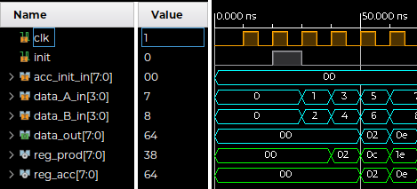
Architecture Body – With Pipeline Register Simulation Result
Some Logic
Some Logic
Reg
Reg
Reg
Clock

Slide 41
High-Level Synthesis
A software engineer’s perspective
Describe on a higher abstraction level using C/C++
Control
Resource consumption
Understanding of synthesized hardware
Design speed
Simplicity
C/C++
HDL
Synthesis
Implementation
Bitstream
FPGA
C/C++ Simulation
C/RTL Co-Simulation

Slide 42
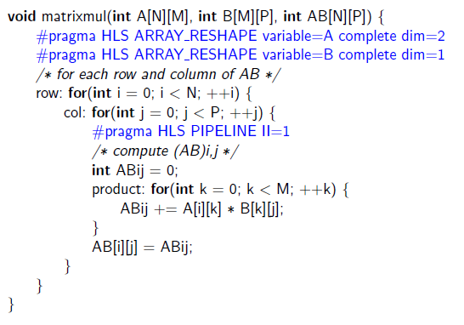
High-Level Synthesis
A software engineer’s perspective
Describe on a higher abstraction level using C/C++
Control
Resource consumption
Understanding of synthesized hardware
Design speed
Simplicity
C/C++
HDL
Synthesis
Implementation
Bitstream
FPGA
C/C++ Simulation
C/RTL Co-Simulation

Slide 43

High-Level Synthesis
HLS4ML: Neural Networks for FPGAs
Support: Keras, limited: PyTorch, ONNX
Growing range of features, currently:
  MLP
  CNN
  RNN
  GNN
Backends: Intel, Vitis, Catapult, oneAPI
fastmachinelearning.org
Python
C/C++
HDL
Synthesis
Implementation
Bitstream
FPGA
Alternative: MATLAB/SIMULINK
C/C++ Simulation
C/RTL Co-Simulation

Slide 44
Parallel Processing
What does “parallel” actually mean?

Slide 45
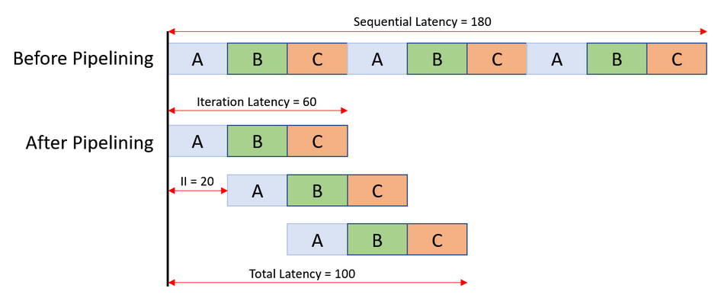
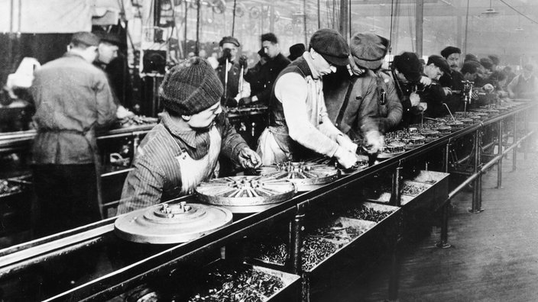
Paradigms of Parallelism
General
Data-Parallel
“Single Instruction, Multiple Data (SIMD)”
Vectorization
Easily implemented
Pipeline-Parallel
Different tasks…
…at the same time
…on different parts of the data
Inherent to FPGAs
Subtype of task-level
parallelism
Serial
A1
A2
A3
B1
B2
B3
C1
C2
C3
A1
B1
C1
…
From: Xilinx, UG1399
Data-
Parallel
A2
B2
C2
A3
B3
C3
Source: https://www.planet-wissen.de/gesellschaft/wirtschaft/
industrialisierung_in_deutschland/pwiedasfliessbandeineerfolgsgeschichte100.html

Slide 46
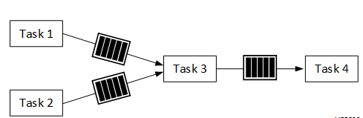
Paradigms of Parallelism
FPGA-specific
Stream-based data transfer
Task-level parallelism
Pipelining on all levels of granularity
Buffering: FIFOs (First In First Out)
Possible Bottlenecks:
Data transport, Interfaces
On-chip memory
Image adapted from: Xilinx, UG1399

Slide 47
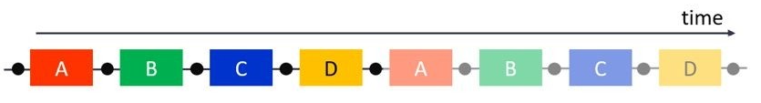
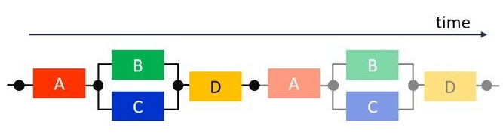
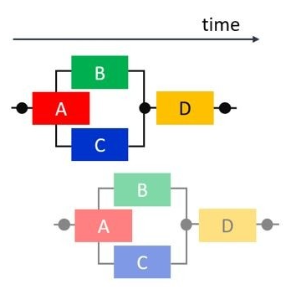
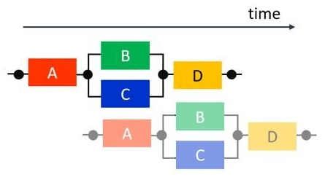
Combination of Paradigms
An Example
Serial Execution:
+ Task-Level Parallelism,
exploiting independence of B and C:
+ Pipeline-Level Parallelism
(Macroscopic):
+ Pipeline-Level Parallelism
(Microscopic):
Images From: Xilinx, UG1399

Slide 48
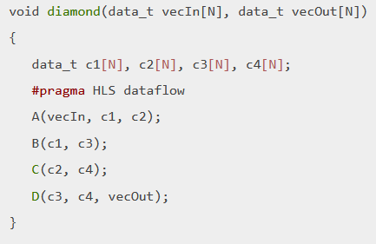
Combination of Paradigms
An Example
Serial Execution:
+ Task-Level Parallelism,
exploiting independence of B and C:
+ Pipeline-Level Parallelism
(Macroscopic):
+ Pipeline-Level Parallelism
(Microscopic):
Images From: Xilinx, UG1399

Slide 49
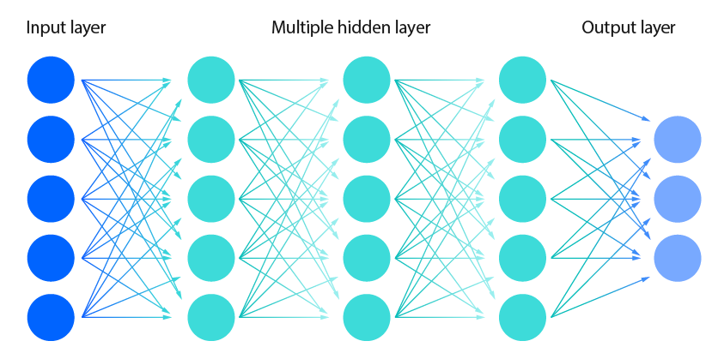
Neural Networks on FPGAs
Some Remarks
Matrix multiplications ➔ Highly parallel
Quantization: Fixed-point favorable
Floating-point possible
Performance often comparable to GPUs

Slide 50
Neural Networks on FPGAs
Some Remarks
Limitations: On-chip weight memory
MAC units (DSP or LUT)
Model compression and optimization for FPGAs:
Pruning
Knowledge distillation
Choice of Quantization
Choice of Activation Function

Slide 51
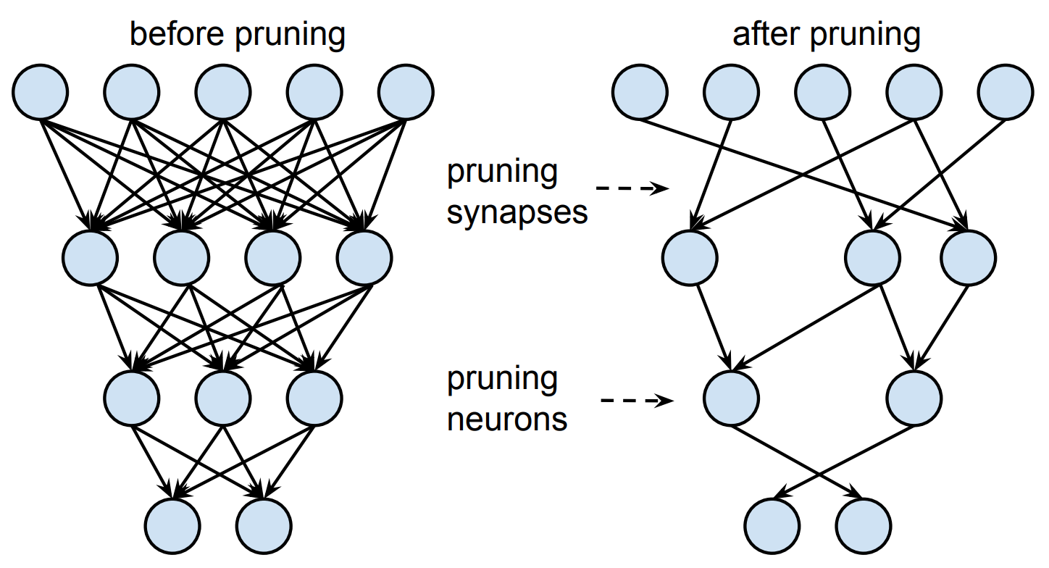
Neural Networks on FPGAs
Some Remarks
Limitations: On-chip weight memory
MAC units (DSP or LUT)
Model compression and optimization for FPGAs:
Pruning
Knowledge distillation
Choice of Quantization
Choice of Activation Function
arXiv:1506.02626

Slide 52
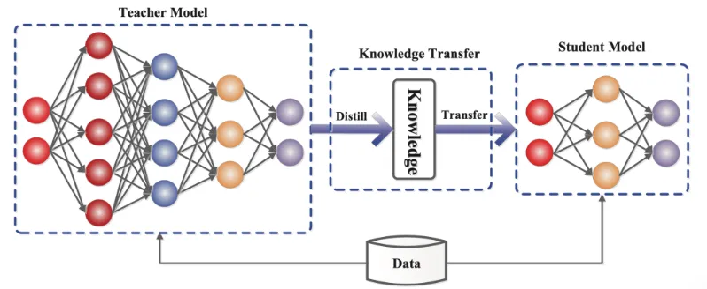
Neural Networks on FPGAs
Some Remarks
Limitations: On-chip weight memory
MAC units (DSP or LUT)
Model compression and optimization for FPGAs:
Pruning
Knowledge distillation
Choice of Quantization
Choice of Activation Function
https://medium.com/vafion/knowledge-distillation-9a0bf514fbeb

Slide 53
Neural Networks on FPGAs
Some Remarks
Limitations: On-chip weight memory
MAC units (DSP or LUT)
Model compression and optimization for FPGAs:
Pruning
Knowledge distillation
Choice of Quantization
Choice of Activation Function
Idea: Use LUTs as ultrafast “multipliers”
in binary neural networks (BNN)

Slide 54
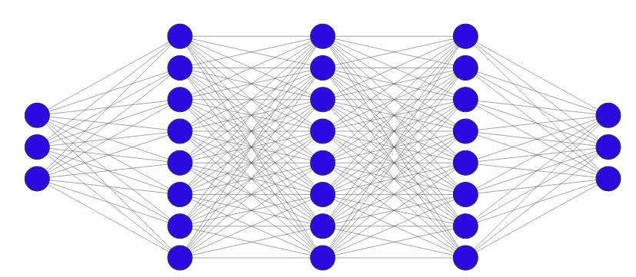
Recent Examples from Particle Physics
FPGA-based Data Processing @CERN
Giasemis et.al. 2025: Comparative Analysis of FPGA and GPU Performance
for Machine Learning-Based Track Reconstruction at LHCb
FPGA vs. GPU for a Multilayer Perceptron
HLS4ML
Xilinx Alveo U50 and U250 (Kintex UltraScale+)
Feed Forward Network:
Max. number of parallel instances of a simple network
8 bit quantization
RelU Activation
Notes:
Used in GNN-based track reconstruction for the LHCb Vertex Locator (VELO)

Slide 55
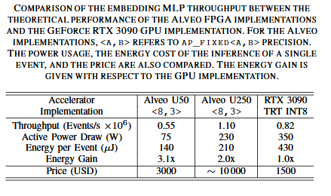
Recent Examples from Particle Physics
FPGA-based Data Processing @CERN
Giasemis et.al. 2025: Comparative Analysis of FPGA and GPU Performance
for Machine Learning-Based Track Reconstruction at LHCb
FPGA vs. GPU for a Multilayer Perceptron
HLS4ML
Xilinx Alveo U50 and U250 (Kintex UltraScale+)
Feed Forward Network:
Max. number of parallel instances of a simple network
8 bit quantization
RelU Activation
Better Performance
Lower Power Consumption
Notes:
Used in GNN-based track reconstruction for the LHCb Vertex Locator (VELO)

Slide 56
Recap

Slide 57
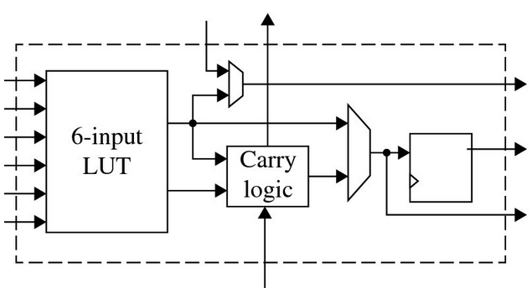
Summary
Field-Programmable Gate Arrays
= Configurable Hardware ≠ Software
➔ Matrix of basic, low-level digital components
+ Extreme flexibility and perfectly optimized, specialized computing
+ High degree of (inherent) parallelism on all levels of granularity
- Programming needs different way of thinking
- High verification and debugging effort
Parallelism:
Macro- and microscopic pipelining
Data and task-level parallelism
Streaming, buffering
FIFO = First In First Out

Slide 58
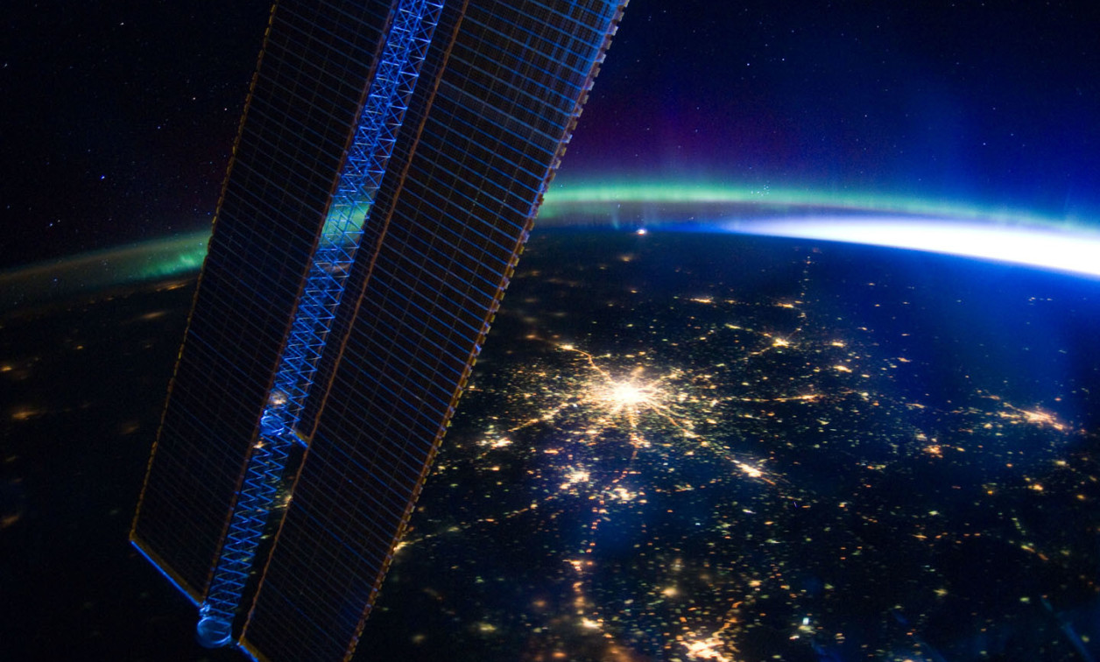
Thank You!
Contact: peter.hinderberger@tum.de
Contact: peter.hinderberger@tum.de
Notes:
Find better image

Slide 59
Resources
Kastner: Parallel Programming for FPGAs - The HLS Book
Gazi: A Tutorial Introduction to VHDL Programming
Gazi & Arli: State Machines using VHDL – FPGA Implementation of Serial Communication and Display Protocols
Snider: Advanced Digital System Design using SoC FPGAs
LaMeres: Quick Start Guide to VHDL
Bruno & Eschemann, 2024: The FPGA Programming Handbook
FPGA in Space Exploration: https://fpgainsights.com/blog/fpga-in-space-exploration-powering-satellites-and-spacecraft/
Woods: FPGA-based Implementation of Signal Processing Systems
Teubner: Data Processing on FPGAs
Vitis High-Level Synthesis User Guide (UG1399)
www.nandland.com

Slide 60
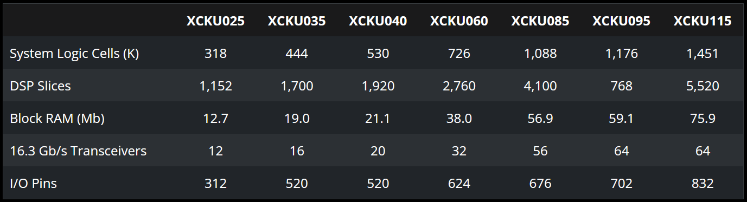
Field-Programmable Gate Arrays
Components of a Xilinx Kintex UltraScale FPGA
FF
Images from: Xilinx online component documentation

Slide 61
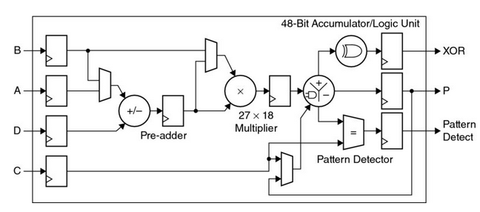
Field-Programmable Gate Arrays
Components of a Xilinx Kintex UltraScale FPGA
Configurable Logic Block (CLB) (x4):
Look-Up Table (LUT) + flip flop/register
Can be used as distributed memory
Block RAM (BRAM):
36 kB or 2 x 18 kB per block
Adjustable width x depth
Signal Processor (DSP):
27x18-bit multiplier, 48-bit accumulator
Several features and capabilities
FF
Images from: Xilinx online component documentation

Slide 62
Field-Programmable Gate Arrays
Some General Example
Concurrent and flexible
Use available area as you like
Use different clocking regions
Suitable as:
Highspeed interface and glue logic
Specialized accelerator
All-in-one solution
Limit: Clock speed, Area (= Resources)
Some Independent Logic
Online Test Functionality
Buffer
Control Logic
Status Registers
Processing
Stage 1
Processing
Stage 2
Processing
Stage 3
Softcore
Processor

Slide 63
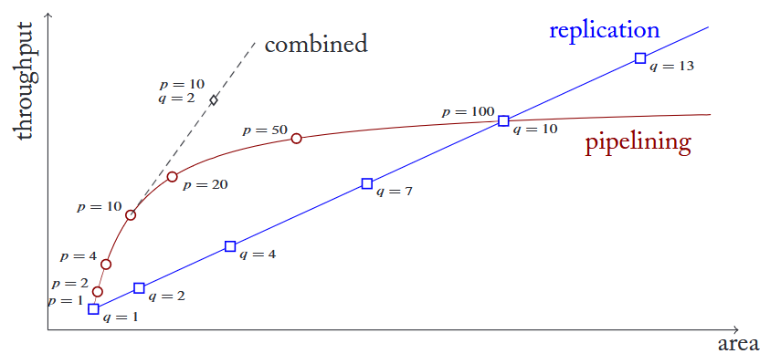

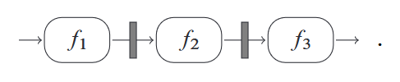
Types of Parallelism
Pipeline vs. Data:
Pipeline-parallelism should
always be employed
Throughput increase
>> Area consumption
More intermediate registers
➔ Higher possible clock frequency
Data-parallelism:
Use according to application and available area
Notes:
Image from: Teubner: Data Processing on FPGAs

Slide 64
Different Hardware Architectures in Comparison
Main Opponents
GPU:
Originally: Mainly for image and video processing
Simple programming (e.g. CUDA, OpenCL)
Massively parallel, high performance
Floating point
High power consumption
High volume
High on-chip memory
Others:
Application-Specific Integrated Circuits (ASICS)
Specialized Accelerators: Tensor Processing Unit (TPU), Vision Processing Unit (VPU), Analog Matrix Processor (AMP) etc.
FPGA:
Multi-purpose, extremely parallel, highly specialized
Complex+efficient, or simpler programming
Reprogrammable (compared with ASICs)
Lower clock frequencies (compared with CPUs)
Fixed-point
Low power consumption
Low volume
Lower on-chip memory
+ Cost, volume, design effort, available experience...
Choice is not always simple!

Slide 65
Field-Programmable Gate Arrays
History
1980s PROM (Programmable Read-Only Memory), PLD (Programmable Logic Device)
1983 Altera EP300: Erasable EPROM using UV light
1985 XC2064: First commercially available FPGA (Xilinx)
8x8 configurable logic blocks with one LUT and three inputs each
1992 Patent: Naval Surface Warfare Center, 600,000 reprogrammable gates
1990s Growth, main usage in networking and telecommunications, later also industrial and automotive use
In Physics: „Glue logic“, close to hardware
Now Vast range of applications, e.g. data centers or machine-learning
Kintex Ultrascale KU060: 663,360 CLBs, 1080x36Kb BRAM, 2760 DSP slices…

