Slide 1

Code You Won’t Regret (Too Much)
How to Write Maintainable Code
Niels Bugel
niels.alexander.bugel@cern.ch

Slide 2

Notes:
Mention story about working on my first project. why is it so difficult even though I followed all the rules?

Slide 3
Technical Debt
Intentional
Unintentional
“We’ll deal with it later”
“We should not have done this”
Notes:
Move from unintentional to intentional
And reduce intentional by making aware of the costs

Slide 4
Maintainable code is code that is easy to understand and easy to modify
Code is read much more often than it is written
Notes:
Provide a quick layout of the presentation here:
Or provide slide with disclaimer, can’t teach experience

Slide 5
Readability

Slide 6
Readability

Slide 7
Inconsistent formatting makes things difficult to read
BIG NO NO
void simulate(int endTime) {
while(currentTime<=endTime) {
if(events.find(currentTime)!=events.end())
{ for(auto &e: events[currentTime])
e(); }
currentTime++;
cout<<"Time: "<<currentTime<<" ticked"<<endl;
}
}
};
Notes:
Mention automization
They shouldn’t even think about it
Bad code make things horrible to read
Give some examples of commonly used formatters

Slide 8
Inconsistent formatting makes things difficult to read
Formalise the style and use a formatter!
C/C++: clang-format
Python: black, autopep8, yapf
Javascript: prettier, eslint
TypeScript: prettier, eslint
Java: checkstyle
Notes:
Mention automization
They shouldn’t even think about it
Bad code make things horrible to read
Give some examples of commonly used formatters

Slide 9
Naming is everything
void log(string msg, int l);
bool check(string f);
bool pay(double a, string c);
class Handler
class SessMgr
class Controller
class MiscUtils
class Item
BIG NO NO
temps/
pblc/
stuff/
Notes:
Larger font size
Better example
2 examples, where the 2nd example with good naming it is easy to spot what algorithm it is
Make a note on how type hints help

Slide 10
Names should be descriptive
No Single Letters
error_count
c
No abbrvtns
label_text
lbl_txt
Not too general
get_address()
fetch_data()
Notes:
Don’t abbreviate analysis
Maybe provide better examples here

Slide 11
Names should be concise
BIG NO NO
totalSumOfAllUserOrderAmountsDollars
4 - 5 words maximum

Slide 12
Names should be unambiguous
BIG NO NO
def process_file(file):
...
Notes:
file path?
file descriptor?
file contents?
process how?
Mention type hints

Slide 13

Names should be consistent
user_id
uid
userid
userId
UserID
user_key
id_user
BIG NO NO
Notes:
Mention abbreviation consistency here
Especially important for user facing items!

Slide 14
Consistency
Notes:
Consistency at different levels. We saw consistency on a syntax level but it should also be consistent on a functional/component level

Slide 15
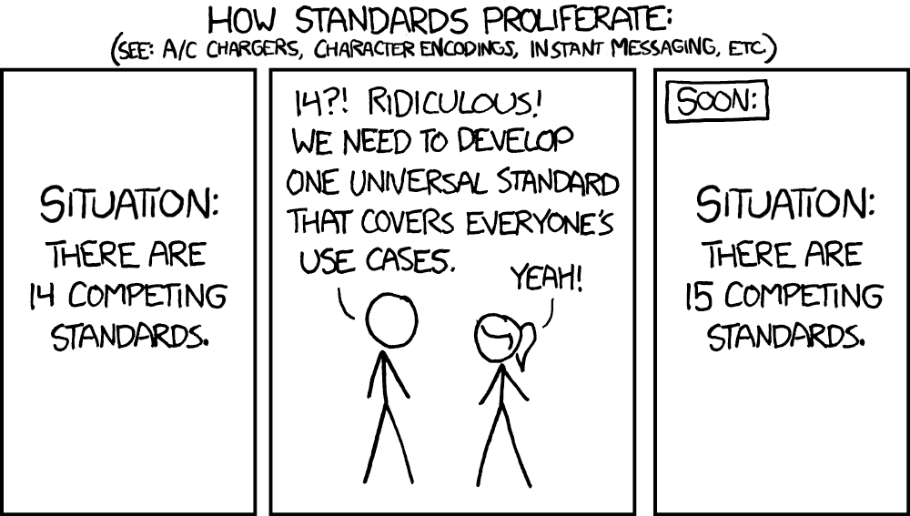

Slide 16
Inconsistency increases maintenance
Components
BIG NO NO
>:(
Notes:
(pro)active consistency?
Keep something similar to the diagram, but mention that adding a new thing you should refactor the old thing to use the new thing.
This costs time now (with no apparent benefit), but will safe time in the future
We talked about consistency on a syntactic level, but also at the functional and architectural levels
Talk about functional consistency (which can be something as simple as which order the parameters are provided in)

Slide 17
Inconsistency increases maintenance
Components
Notes:
(pro)active consistency?
Keep something similar to the diagram, but mention that adding a new thing you should refactor the old thing to use the new thing.
This costs time now (with no apparent benefit), but will safe time in the future
We talked about consistency on a syntactic level, but also at the functional and architectural levels
Talk about functional consistency (which can be something as simple as which order the parameters are provided in)
Tal about how much time it costs

Slide 18
Simplicity

Slide 19
“The definition of genius is taking the simple and making it complex.”
- Einbert Alstein

Slide 20
Stop flexing complexity
Start flexing simplicity
“The definition of genius is taking the complex and making it simple.”
- Albert Einstein
BIG NO NO
void swap(int& a, int& b) {
a = a + b
b = a - b
a = a - b
}
Notes:
Simple != easy
mention don’t be clever (giant one-liners)

Slide 21
Be careful with premature optimisation
void sort(std::vector<int>& numbers);
max size = 20
...
Notes:
Two cases of don’t be clever: don’t be clever with your syntax, don’t be clever with your algorithms/components
Sorting complexity example (i.e. fancy sorting algorithm for small array)
Both in cases of syntax and algorithm
premature optimisation
Not an argument to be lazy! Optimisations add maintenance while very often these parts are not critical for performance
So in a lot of cases, go with the simple solution first, measure & identify and then optimise what you need
Provided this is not baked into your architecture

Slide 22

State makes code difficult to reason about
Notes:
Do an experiment with the audience here?
Show a sequence of pictures and ask them to remember the third one or tell them numbers
Maybe have a pattern there so that you can give a stateless example

Slide 23
Reduce state as much as possible
def rotate_matrix(matrix):
n = len(matrix)
for i in range(n // 2):
for j in range(i, n - i - 1):
temp = matrix[i][j]
matrix[i][j] = matrix[n - j - 1][i]
matrix[n - j - 1][i] = matrix[n - i - 1][n - j - 1]
matrix[n - i - 1][n - j - 1] = matrix[j][n - i - 1]
matrix[j][n - i - 1] = temp
Notes:
Bad example, replace by matrix rotation
Mention const

Slide 24
Reduce state as much as possible
def rotate_matrix(matrix):
n = len(matrix)
return [[matrix[n-1-j][i] for j in range(n)] for i in range(n)]
Transpose & Reverse Rows
Notes:
Bad example, replace by matrix rotation
Mention const

Slide 25
public class FileOpener {
@Getter
private File file;
@Getter
private List<String> fileContents;
public void openFile(String filePath) {
this.file = new File(filePath);
}
public void getFileContents() throws IOException {
if (this.file == null || !this.file.exists()) {
throw new IOException("File not found or not opened.");
}
this.fileContents = Files.readAllLines(Paths.get(this.file.getPath()));
}
}
Notes:
Bad example, replace by matrix rotation
Mention const

Slide 26
public class FileOpener {
public File openFile(String filePath) {
return new File(filePath);
}
public List<String> getFileContents(File file) throws IOException {
if (file == null || !file.exists()) {
throw new IOException("File not found or not opened.");
}
return Files.readAllLines(Paths.get(file.getPath()));
}
}
Notes:
Bad example, replace by matrix rotation
Mention const
Anytime you write a void function, think extremely carefully

Slide 27
Single-Responsibility

Slide 28
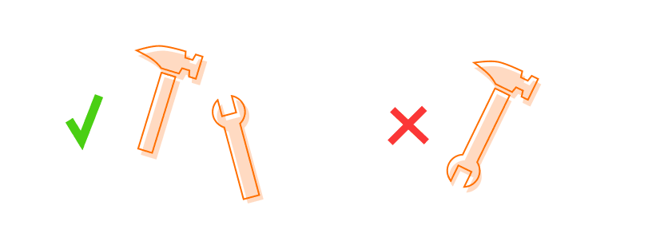
Single-Responsibility is not a single thing
Decomposition
Coupling
Cohesion
Notes:
Give some colors here

Slide 29

Decompose your problems
to make them manageable
Make Dinner
Make
Starter
Make
Meat Course
Make
Main Course
Make
Potatoes
Make
Vegetable Course
Make
Dessert
Make
Broccoli

Slide 30
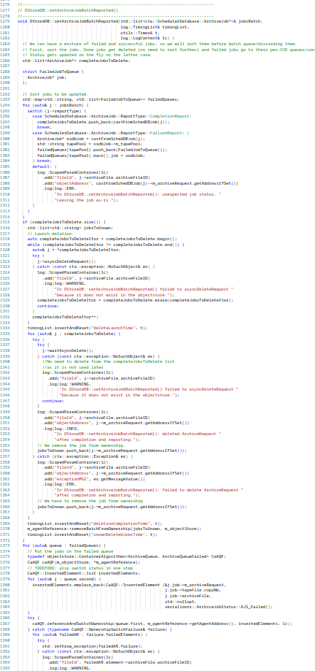
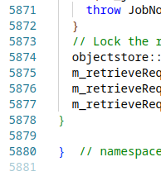
Decompose your problems
to make them manageable
BIG NO NO

Slide 31
Signs that you may not have decomposed enough
Be careful of:
Functions > ~20 lines
Classes > ~20 entry points

Slide 32
Reduce coupling to ensure you can
work on parts of the code independently
High Coupling
Low Coupling
Notes:
Maybe tie this into state?
Example directory tree?

Slide 33
public class FileOpener {
@Getter
private File file;
@Getter
private List<String> fileContents;
public void openFile(String filePath) {
this.file = new File(filePath);
}
public void getFileContents() throws IOException {
if (this.file == null || !this.file.exists()) {
throw new IOException("File not found or not opened.");
}
this.fileContents = Files.readAllLines(Paths.get(this.file.getPath()));
}
}
Notes:
With state, you inherently introduce coupling!

Slide 34
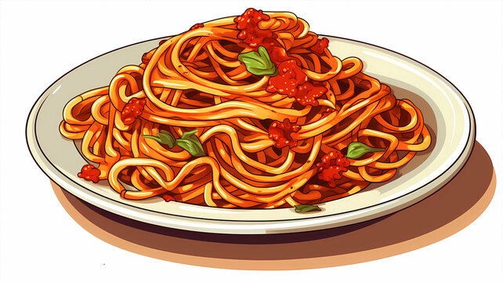
High Coupling = High Spaghetti

Slide 35

Increase cohesion
to know where to look
Notes:
Global state is not cohesive!

Slide 36
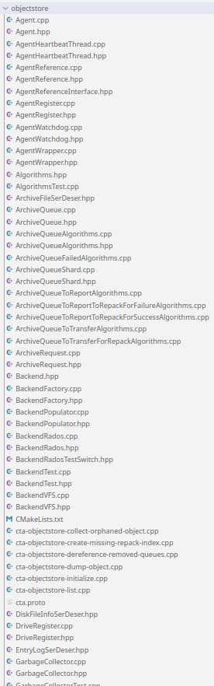
Increase cohesion
to know where to look
BIG NO NO
Notes:
At the simplest it means grouping in a directory, but depending on your language it can go to grouping in packages, modules, namespaces or even repositories

Slide 37
Abstractions

Slide 38
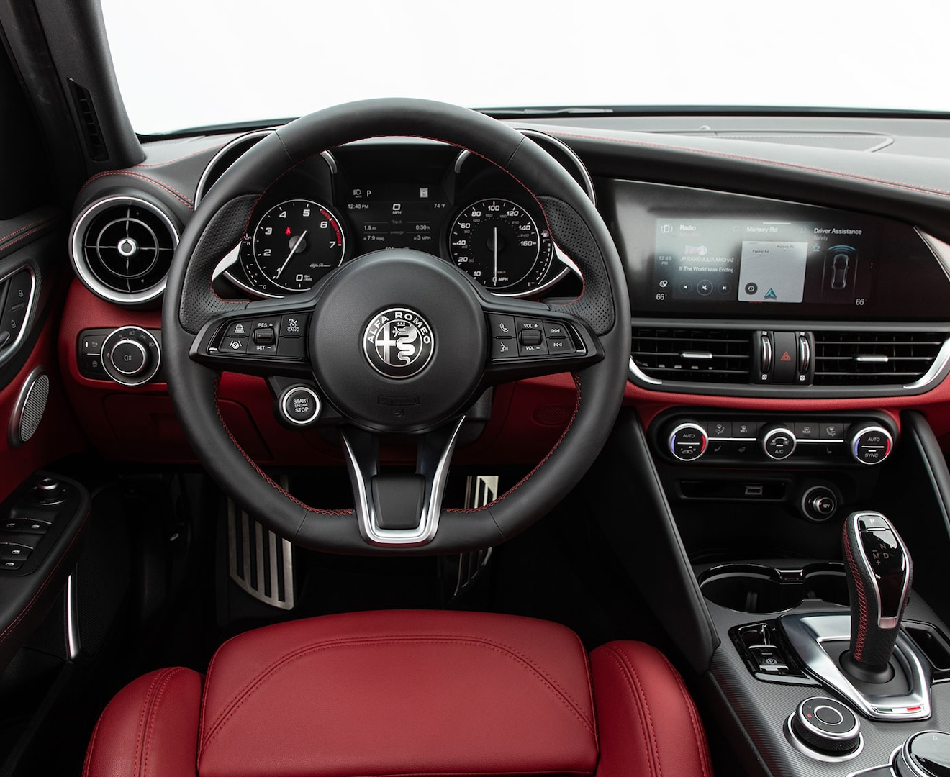
Abstractions hide complexity
turn()
brake()
accelerate()
Notes:
Mention engine replacement

Slide 39
Abstractions hide complexity
accelerate()
accelerate()
accelerate()

Slide 40
Abstractions allow for loose coupling
DataAnalyser
CSVLoader
VS
ROOTFileLoader
DataAnalyser
DataLoader
CSVLoader
HDF5Loader
Notes:
Mention engine replacement

Slide 41
Abstractions should tell you
WHAT not HOW
BIG NO NO
Logger
FileLogger
ConsoleLogger
Component
CloudLogger
DatabaseLogger
Abstraction
Implementation(s)
Notes:
Give database example

Slide 42
Dependency-Management

Slide 43
Don't repeat yourself
to reduce code duplication
Notes:
Tie this into cohesion. Things within the same component can do this
Mention accidental vs deliberate

Slide 44
Don't repeat yourself
to reduce code duplication
Notes:
Tie this into cohesion. Things within the same component can do this
Mention accidental vs deliberate

Slide 45



Repeat yourself
to avoid creating dependencies
BIG NO NO
Notes:
Just because they are similar now, doesn’t mean they will stay like that. They may evolve differently
Code duplication is not the rot of all evil

Slide 46
Repeat yourself
to avoid creating dependencies
Duplication is cheaper than the wrong abstraction
Notes:
tie this into coupling and cohesion
Mention components evolving in different directions
if you’re a stone, everything looks like 2 birds

Slide 47
Don't reinvent the wheel
to reduce the amount of code to maintain
Web Frameworks
Cryptography
Networking
Testing
Logging
Notes:
Logging example

Slide 48




Reinvent the wheel
to avoid creating dependencies
print(“Hello World”)
std::cout << “Hello World” << std::endl;
System.out.println(“Hello World”);
npm install hello-world

Slide 49
Documentation
// This part is about documentation

Slide 50
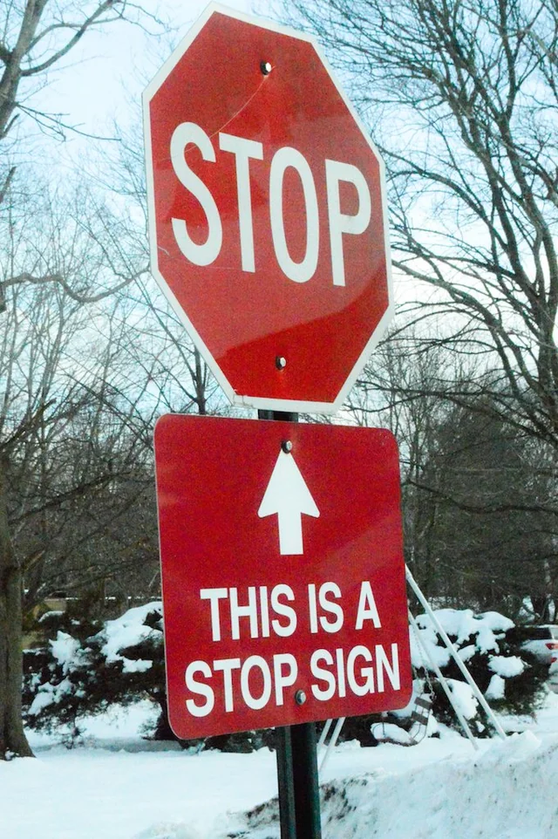
Don’t document the obvious
BIG NO NO
// Free the memory used by the array
free(array);
// I'm sorry for this
// This is a hack
Notes:
We are taught THAT we should comment, but not HOW we should comment.
I will teach you, but before I teach you what to comment, I will tell you what not to comment
Quote Martin Fowler: comments are like deoderant. Ideally you don’t need them, but when you do don’t overuse it

Slide 51
Document decisions so that others don’t have to figure it out again on their own
Document the why, not the what
Only document the what in case of complex code
// This loop starts at 1 because...
for(int i = 1; i < n; i++) { ... }
Notes:
IF focused on the developer (not all documentation is for the developer)
for-loop starting at 1 example

Slide 52
Use the documentation standards for the language you are working in
C/C++: Doxygen
Python: Docstrings
JavaScript: JSDoc
TypeScript: TSDoc
Java: Javadoc
/**
* Reverses the order of the elements
* in the specified list.
*
* This method runs in linear time.
*
* @param list the list whose elements
* are to be reversed.
* @throws UnsupportedOperationException if the
* specified list or list-iterator
* does not support the <tt>set</tt> operation.
*/
public static void reverse(List<?> list) {
Notes:
doxygen example
This is typically for user-focused development

Slide 53
Wrong documentation can be worse than no documentation
Inline Comments
Function Documentation
Class Documentation
Module Documentation
Project Documentation
Notes:
Mention where to look
(many uses, so difficult to update all places)

Slide 54
Wrap-up

Slide 55
Simple = Maintainable
Simple != Easy

Slide 56
Don’t just think about the benefits
Think about the (long-term) costs too!

