Slide 1
Reinforcement Learning in Particle Accelerators: an introduction to RL
Lecture 1/2
Inverted Cern School of Computing 2025
Acknowledgements:
M. Schenk, A. Lasheen
Presenter: Joel Wulff
Date of presentation: 25/03/2025

Slide 2



Who am I?
Experience @ CERN (and not)
Summer student →
Tech student → (Software Engineer @ Qualcomm) →
Quest Graduate (since July 2024) in the SY-RF group
  Beams and RF studies section
  Automation and anomaly detection in PS RF systems using Machine Learning (and RL!)
Joel Wulff
Studied M. Sc. in Engineering Physics + ML/AI in Lund
Love skiing!
From Malmö, Sweden

Slide 3

Who am I?
Experience @ CERN (and not)
Summer student →
Tech student → (Software Engineer @ Qualcomm) →
Quest Graduate (since July 2024) in the SY-RF group
  Beams and RF studies section
  Automation and anomaly detection in PS RF systems using Machine Learning (and RL!)
Joel Wulff
Studied M. Sc. in Engineering Physics + ML/AI in Lund
Love skiing!
From Malmö, Sweden

Slide 4
Lecture series: Overview
Two part lecture
Lecture 1: Fundamental concepts of Reinforcement Learning
  Focus on ideas, and introduce concepts behind deep RL techniques
  The foundation for following lecture 2
  Not rigorous definitions of RL formalism (for more see e.g. tCSC on ML, or sources at the end!)
Lecture 2: A practical example: RL for optimization of RF manipulations in the PS @ CERN
  A walkthrough from accelerator physics problem to solution
  Overcoming the inherent challenges of applying RL in practice

Slide 5
Lecture 1/2: Introduction to Reinforcement Learning
Overview
Introduction
Reinforcement Learning: Key concepts
  Agent-environment loop
  Value functions
Value Learning (Q-learning)
Policy Learning (policy gradients)
Reinforcement Learning in accelerators (setting up lecture 2)

Slide 6



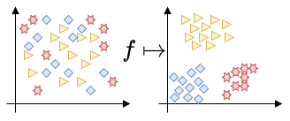
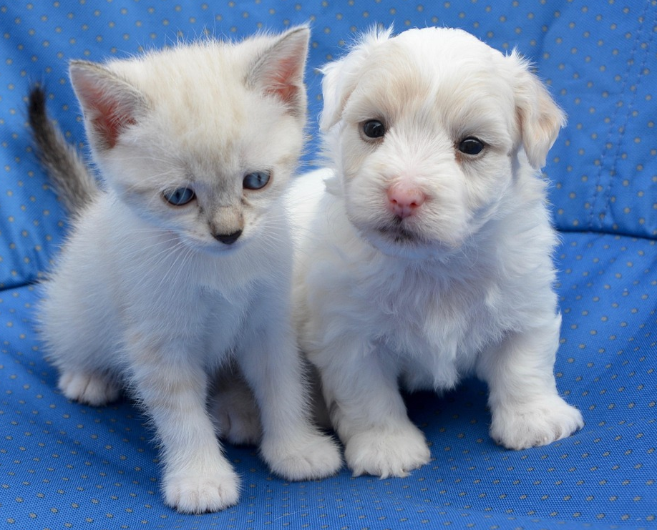
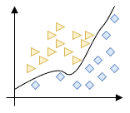
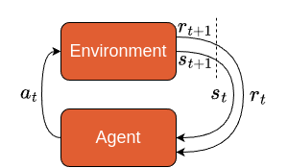
Introduction
RL: a special type of Machine Learning
Supervised Learning
Unsupervised Learning
MACHINE LEARNING
“Learning by example”
“Learning without examples”
Data: values and labels,
Goal: learn the mapping,
Data: values (no labels), X
Goal: learn underlying structure
Reinforcement Learning
CAT: 0.98
DOG: 0.88
“Learning through trial and error”
“Do something because it is rewarding”
Data: state, actions, rewards
Goal: Maximize future rewards (over many timesteps)

Slide 7

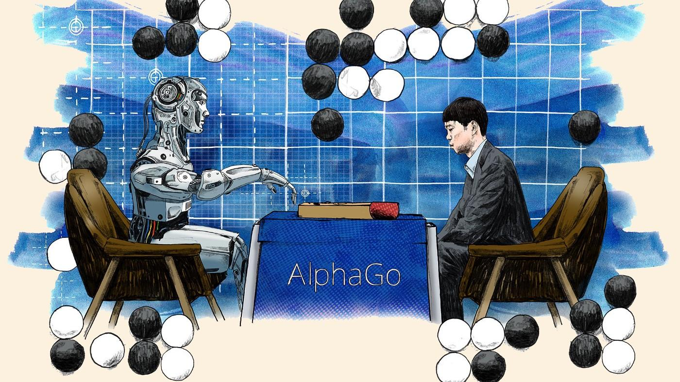

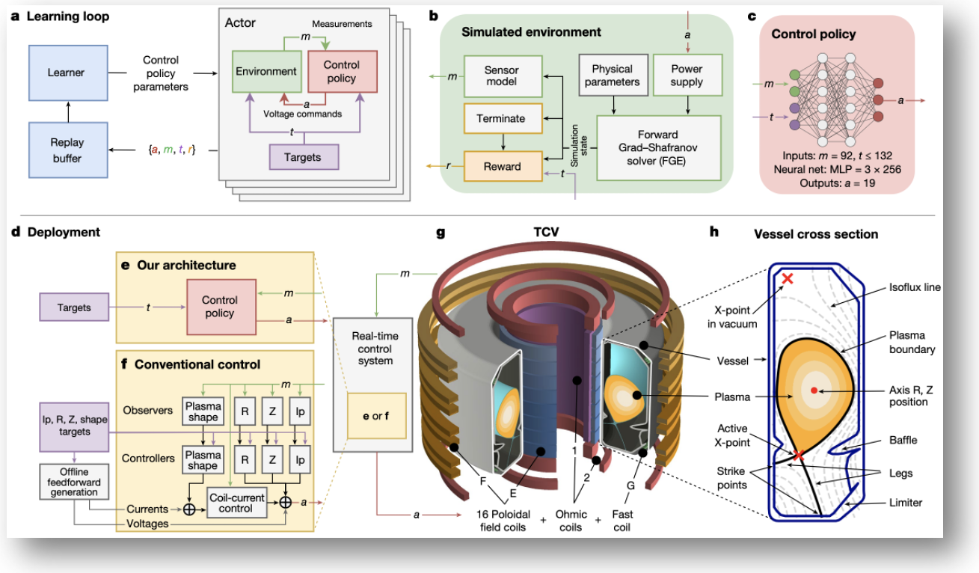

Introduction
Is RL useful…?
Align LLMs with human preference!
OpenAI, 2022: InstructGPT and ChatGPT
Achieved through Reinforcement Learning from Human Feedback (RLHF)
Play games!
DeepMind, 2016: AlphaGo
Beating top-ranked human players
Control fusion reactors!
DeepMind & SPC-EPFL, 2022: Tokamak control
Maintaining plasma within Tokamak
Really inspiring for accelerator controls!
DeepSeek, 2024: DeepSeek-R1
Incentivizing Reasoning Capability in LLMs via Reinforcement Learning
  Encourage reasoning and chain-of-thought feedback

Slide 8
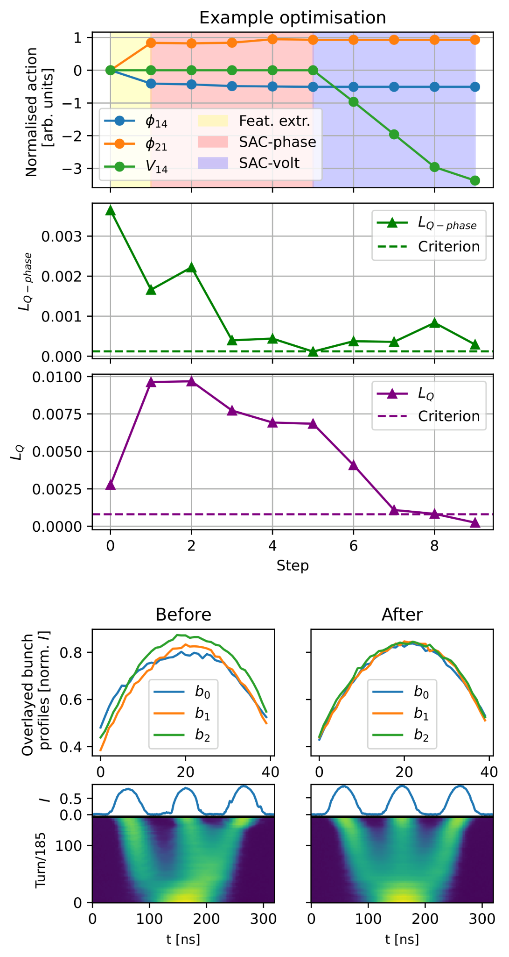
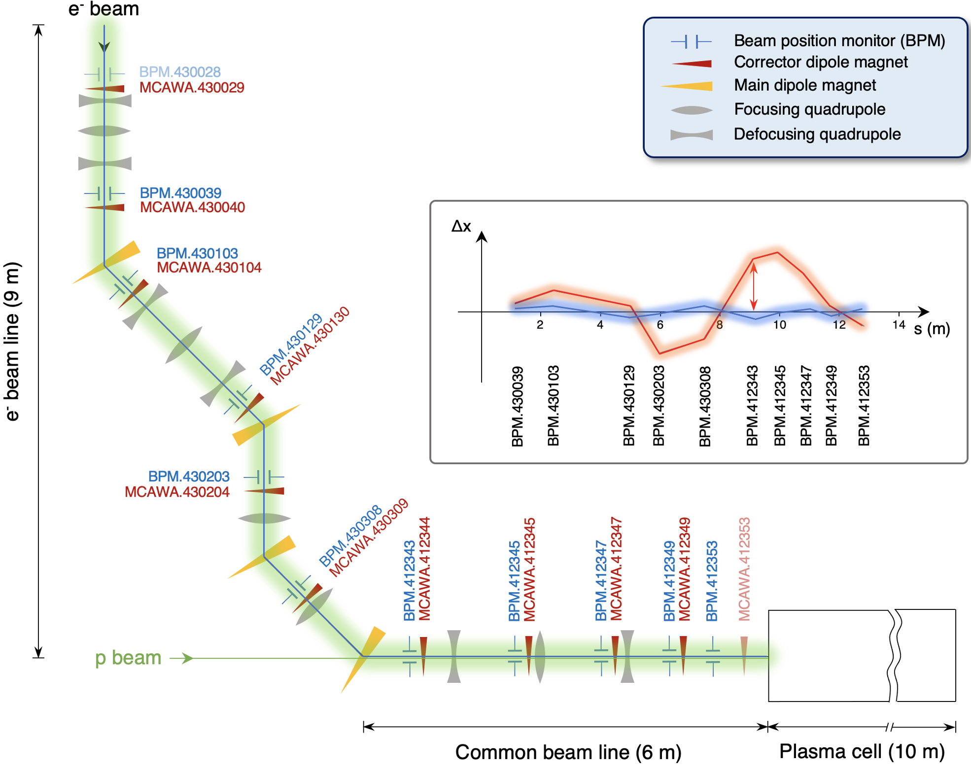
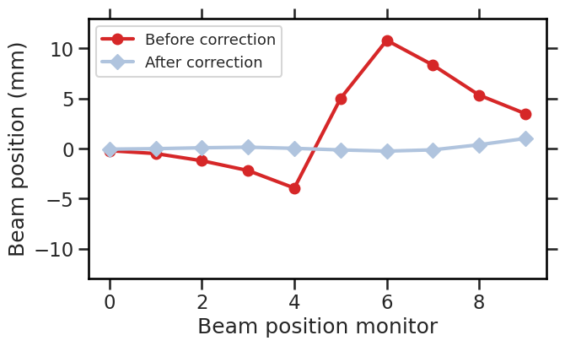
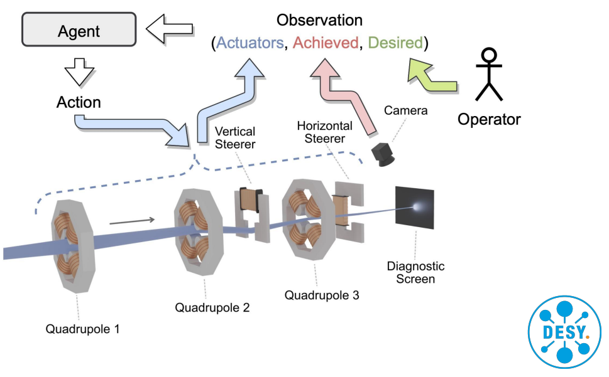
Introduction
Is RL useful… in accelerator physics?
Optimizing RF manipulations in the CERN Proton Synchrotron
More on this next lecture + exercise session :)
Trajectory steering at AWAKE, CERN
RL informed optimization of 10D-problem!
Focusing an electron beam on diagnostic screen, DESY
Allowing operators to set their desired end goal!
Trained in simulation, tested in operation.
Source: J. Kaiser, O. Stein, A. Eichler

Slide 9
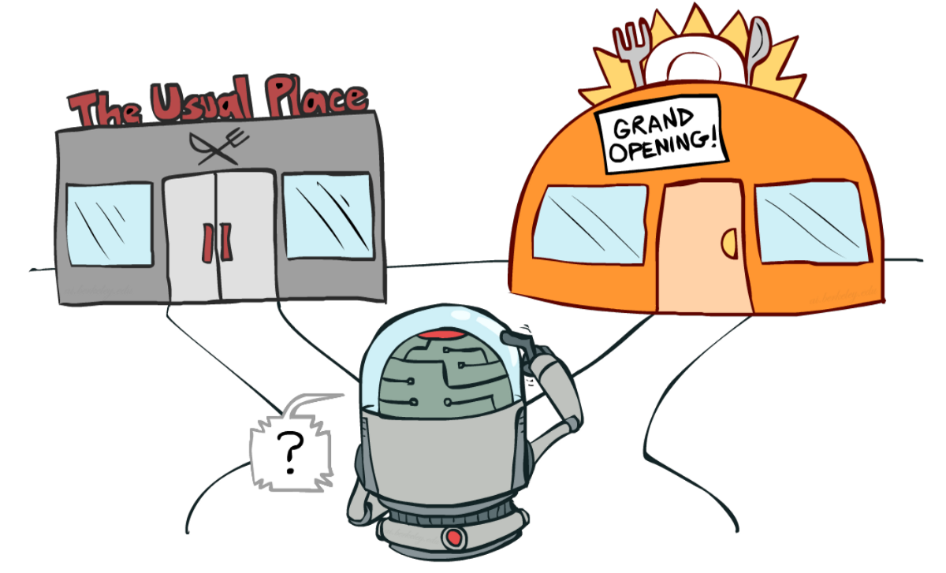
The RL problem
How do we learn new things?
Where to have dinner?
Maybe try the new place today…
EXPLORATION
Huh, the have ketchup on their steak? I’ll try it!
ACTION
image by Berkeley AI course
RESPONSE
I regret my decisions.
ADJUSTMENT
Reinforcement Learning is inspired by this!
I’m not going to try that again…
Mathematical theory and formalism builds on ideas from 1950s and Richard Bellman
Life has been using reinforcement learning to survive on earth for ~600M years

Slide 10
The RL problem
How do we learn?
Through iterative trial-and-error, we can learn to make good decisions,
Positive actions are rewarded (and reinforced)
Negative actions are punished (and discouraged)
→ Emergent, complex behaviours
Mathematical theory and formalism of Reinforcement Learning builds on ideas from 1950s and Richard Bellman
Life has been using reinforcement learning to survive on earth for ~600M years

Slide 11
Reinforcement Learning (RL): Key concepts

Slide 12
Reinforcement Learning (RL): Key concepts
AGENT
Agent: takes actions
E.g.: an accelerator operator,
a driver.
In RL: agent is often an algorithm

Slide 13

Reinforcement Learning (RL): Key concepts
AGENT
ENVIRONMENT
Environment: the world in which the agent lives and interacts

Slide 14

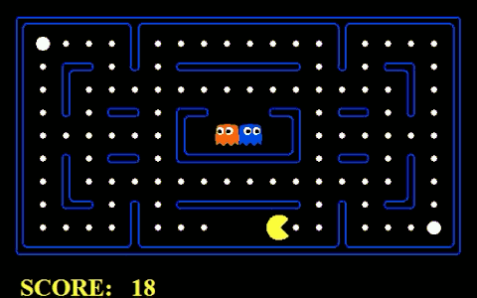

Reinforcement Learning (RL): Key concepts
The rule which describes the behaviours of the agent is usually called the policy,
🠔🠕🠖🠗
Action:
AGENT
ACTIONS
ENVIRONMENT
Action: a way in which the agent can move in the environment
Action space A: the set of all valid actions available to the agent
N.B: can be both discrete and continuous

Slide 15
Reinforcement Learning (RL): Key concepts
OBSERVATIONS
Action:
AGENT
ACTIONS
ENVIRONMENT
Observations: of the environment after taking an action.

Slide 16



Reinforcement Learning (RL): Key concepts
Agents observation of state may omit information
OBSERVATIONS
New state:
Action:
AGENT
ACTIONS
ENVIRONMENT
State: a complete description of the current world
Observation (more formally): a (possibly partial) view of the true state
Fully observable:
Partially observable:

Slide 17

Reinforcement Learning (RL): Key concepts
OBSERVATIONS
New state:
Reward:
Action:
AGENT
ACTIONS
ENVIRONMENT
Reward: a scalar feedback signal measuring how “good” the action was
N.B: Rewards can be immediate or delayed

Slide 18
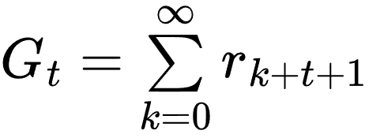
Reinforcement Learning (RL): Key concepts
OBSERVATIONS
New state:
Reward:
Action:
AGENT
ACTIONS
ENVIRONMENT
Total Reward
(Return)

Slide 19
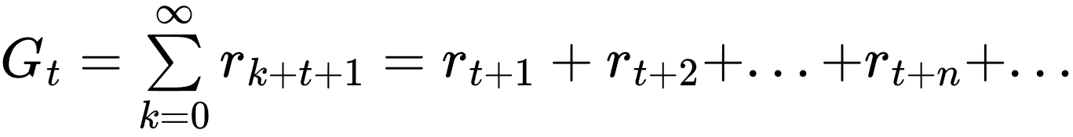
Reinforcement Learning (RL): Key concepts
OBSERVATIONS
New state:
Reward:
Action:
AGENT
ACTIONS
ENVIRONMENT
Total Reward
(Return)

Slide 20
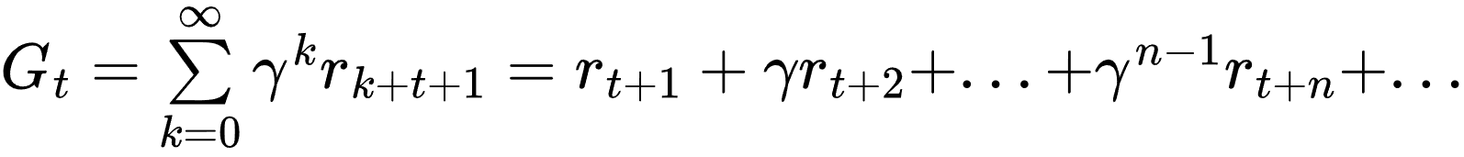

Reinforcement Learning (RL): Key concepts
RL objective: Find behaviour that maximises cumulative reward (=return)
OBSERVATIONS
New state:
Reward:
Action:
AGENT
ACTIONS
ENVIRONMENT
Discounted
Total Reward
(Return)
Infinite-horizon return
Discount factor:
Notes:
G_t = \sum\limits_{k=t}^\infty \gamma ^kr_k = \gamma^tr_t + \gamma^{t+1}r_{t+1} + ... + \gamma^{t+n}r_{t+n} + ...

Slide 21
Reinforcement Learning (RL): Quick recap
Agent: the thing taking actions (algorithm, driver, …)
Environment: the world in which the agent lives
State: a complete description of the world in a certain moment
Observation: a (possibly partial) view of the state
Return: the discounted future rewards (what we want to find a behaviour that maximises!)
formally described through…
Markov Decision Process (MDP)
States of an MDP fulfill the…
Important to consider when designing environments!
Markov Property
The future depends only on the current state (memorylessness)

Slide 22


Value functions
Total reward is given by the sum of discounted future rewards
It would be very useful to be able to estimate what our future rewards will be
→ VALUE FUNCTIONS
State-action value function
(a.k.a “Q-function”)
Optimal State-action value function
(a.k.a “optimal Q-function”)
“Expected return starting from state s, taking action a, and following policy ”
“Expected return starting from state s, taking action a, then following ”
What if the policy we were following was the optimal one?
Notes:
G_t = \sum\limits_{k=t}^\infty \gamma ^kr_k = \gamma^tr_t + \gamma^{t+1}r_{t+1} + ... + \gamma^{t+n}r_{t+n} + ...

Slide 23


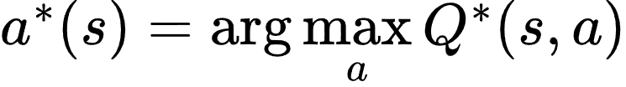
Given optimal Q-function
Optimal value functions
Optimal Q-function
Action selected by the optimal policy,
Connection!
=“Expected return starting from state s, taking (arbitrary) action a, then following ”
= “the action a that maximizes the expected return from state s”
Takeaway: If we know the optimal Q-function, finding the optimum action (and subsequently optimal policy) becomes trivial (similar formulations can be done with the optimal V-function)
Notes:
V_\pi (s)=\mathbb{E}_\pi[G_t|s_t=s]
Q_* (s,a)=\underset{\pi}{\max}~\mathbb{E}_\pi[G_t|s_t=s, A_t=a]

Slide 24



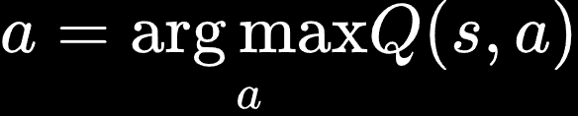
Reinforcement Learning Algorithms
Some examples we will go through…
Value Learning
Policy Learning
Combination methods
Find value functions
Find policy
Find both value functions and policy
E.g.:
Sample
Not going to be covered in detail…
We will go through some deep Reinforcement Learning examples for these types
Notes:
V_\pi (s)=\mathbb{E}_\pi[G_t|s_t=s]
Q_* (s,a)=\underset{\pi}{\max}~\mathbb{E}_\pi[G_t|s_t=s, A_t=a]

Slide 25
Reinforcement Learning Algorithms
Some examples we will go through…
Value Learning
Policy Learning
Combination methods
Find value functions
Find policy
Find both value functions and policy
E.g.:
Sample
Not going to be covered in detail…
Notes:
V_\pi (s)=\mathbb{E}_\pi[G_t|s_t=s]
Q_* (s,a)=\underset{\pi}{\max}~\mathbb{E}_\pi[G_t|s_t=s, A_t=a]

Slide 26
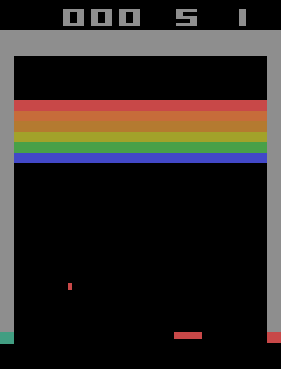
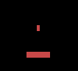
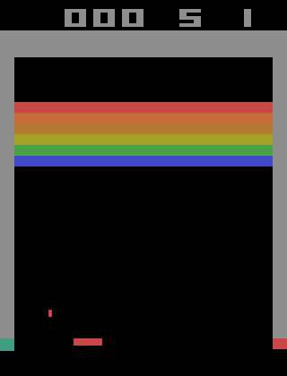
Focus on Q-learning…
Understanding the Q-function
Example: Atari breakout
Estimating Q-values can be unintuitive…
A
B
Question: Which (s, a) pair has a higher Q-value?
Notes:
V_\pi (s)=\mathbb{E}_\pi[G_t|s_t=s]
Q_* (s,a)=\underset{\pi}{\max}~\mathbb{E}_\pi[G_t|s_t=s, A_t=a]

Slide 27
Focus on Q-learning…
Understanding the Q-function
Example: Atari breakout - Middle (A)
Estimating Q-values can be unintuitive…
A is a safe strategy, but not optimal.
A
B
Question: Which (s, a) pair has a higher Q-value?
Notes:
V_\pi (s)=\mathbb{E}_\pi[G_t|s_t=s]
Q_* (s,a)=\underset{\pi}{\max}~\mathbb{E}_\pi[G_t|s_t=s, A_t=a]

Slide 28
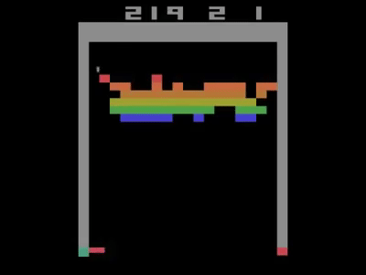
Focus on Q-learning…
Understanding the Q-function
Example: Atari breakout - Side (B)
Estimating Q-values can be unintuitive…
B is more likely to “breakout”
A
B
Question: Which (s, a) pair has a higher Q-value?
How do we learn ?
Notes:
V_\pi (s)=\mathbb{E}_\pi[G_t|s_t=s]
Q_* (s,a)=\underset{\pi}{\max}~\mathbb{E}_\pi[G_t|s_t=s, A_t=a]

Slide 29

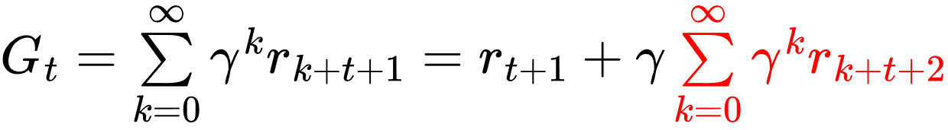
Toward the Bellman Optimality Equation
Bellman Equations: Set of self-consistency equations inherent to MDPs
Basic idea: exploit the recursive nature of the Return, to separate immediate reward from future rewards
The return
Notes:
V_\pi (s)=\mathbb{E}_\pi[G_t|s_t=s]
Q_* (s,a)=\underset{\pi}{\max}~\mathbb{E}_\pi[G_t|s_t=s, A_t=a]

Slide 30
Toward the Bellman Optimality Equation
Bellman Equations: Set of self-consistency equations inherent to MDPs
Basic idea: exploit the recursive nature of the Return, to separate immediate reward from future rewards
The return
Notes:
V_\pi (s)=\mathbb{E}_\pi[G_t|s_t=s]
Q_* (s,a)=\underset{\pi}{\max}~\mathbb{E}_\pi[G_t|s_t=s, A_t=a]

Slide 31


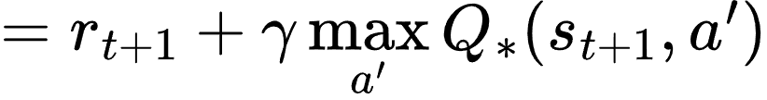

The Bellman Optimality Equation
The return
Bellman Optimality Equation
Math stuff
Can use to define an iterative way for estimating the optimal Q-function,
Notes:
Q_*(s,a) = \mathbb{E}_\pi^*[G_t]
Q_* (s,a)=\underset{\pi}{\max}~\mathbb{E}_\pi[G_t|s_t=s, A_t=a]

Slide 32

Q-learning update rule
Bellman optimality equation
At every time step, we take some action according to a policy
Estimator of optimal Q
Immediate reward is received (Ground Truth)
Future reward is estimated
Can we define a way of updating our estimation of Q, using the new information from the immediate reward?
Notes:
Q_*(s,a) = \mathbb{E}_\pi^*[G_t]
Q_* (s,a)=\underset{\pi}{\max}~\mathbb{E}_\pi[G_t|s_t=s, A_t=a]

Slide 33
Q-learning update rule
Bellman optimality equation
At every time step, we take some action according to a policy
Estimator of optimal Q
Immediate reward is received (Ground Truth)
Future reward is estimated
Q-learning update rule
learning rate
(size of update)
Old prediction
Updated target
Notes:
Q_*(s,a) = \mathbb{E}_\pi^*[G_t]
Q_* (s,a)=\underset{\pi}{\max}~\mathbb{E}_\pi[G_t|s_t=s, A_t=a]

Slide 34

Back to Atari
Q-learning update rule
Example: Atari breakout
Want to learn the Q-function, using our update rule
→ Need to decide how to represent our Q-estimator
Q-Table
Deep Q-Networks:
Approximation of real Q-function using NN
action
-1 | 2 | 0.41
-0.2 | …
…
Q-net
Feasible for small, discrete state-action spaces
state
-1
2
0.41
Notes:
V_\pi (s)=\mathbb{E}_\pi[G_t|s_t=s]
Q_* (s,a)=\underset{\pi}{\max}~\mathbb{E}_\pi[G_t|s_t=s, A_t=a]

Slide 35

Deep Q-Networks (DQN)
state, s
Q-value of action a
“move left”
action, a
Deep NN
Notes:
V_\pi (s)=\mathbb{E}_\pi[G_t|s_t=s]
Q_* (s,a)=\underset{\pi}{\max}~\mathbb{E}_\pi[G_t|s_t=s, A_t=a]

Slide 36

Deep Q-Networks (DQN)
state, s
Action + state → Expected return
Functionally fine, but inefficient
Deep NN
“move left”
Output
action, a
Agent
Input
Notes:
V_\pi (s)=\mathbb{E}_\pi[G_t|s_t=s]
Q_* (s,a)=\underset{\pi}{\max}~\mathbb{E}_\pi[G_t|s_t=s, A_t=a]

Slide 37



Deep Q-Networks (DQN)
State → Expected return for each action
More efficient: only one forward pass through neural net, to get Q-values for all available actions
state, s
Deep NN
Input
Agent
Output
Estimator of optimal Q
We can iteratively update our estimation of Q through the update rule
Notes:
V_\pi (s)=\mathbb{E}_\pi[G_t|s_t=s]
Q_* (s,a)=\underset{\pi}{\max}~\mathbb{E}_\pi[G_t|s_t=s, A_t=a]

Slide 38
Deep Q-Networks (DQN)
The Q-loss
Q-learning update rule
state, s
Deep NN
“Get labels to train our estimator, by visiting different state-action pairs”
Input
Agent
Output
Target
NN prediction
= Q-loss
Notes:
V_\pi (s)=\mathbb{E}_\pi[G_t|s_t=s]
Q_* (s,a)=\underset{\pi}{\max}~\mathbb{E}_\pi[G_t|s_t=s, A_t=a]

Slide 39
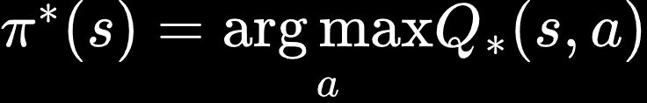

Deep Q-Networks (DQN)
Summary
Use NN as optimal Q-function estimator → infer optimal policy from optimal Q
state, s
Deep NN
Input
Agent
Output
Update weights of NN
Backpropagation
Notes:
\mathcal{L} = \mathbb{E}[||(r_{t+1} + \gamma \underset{a'}{\max}\hat Q_*(s',a')) - \hat Q_*(s,a)||^2]
Q_* (s,a)=\underset{\pi}{\max}~\mathbb{E}_\pi[G_t|s_t=s, A_t=a]

Slide 40
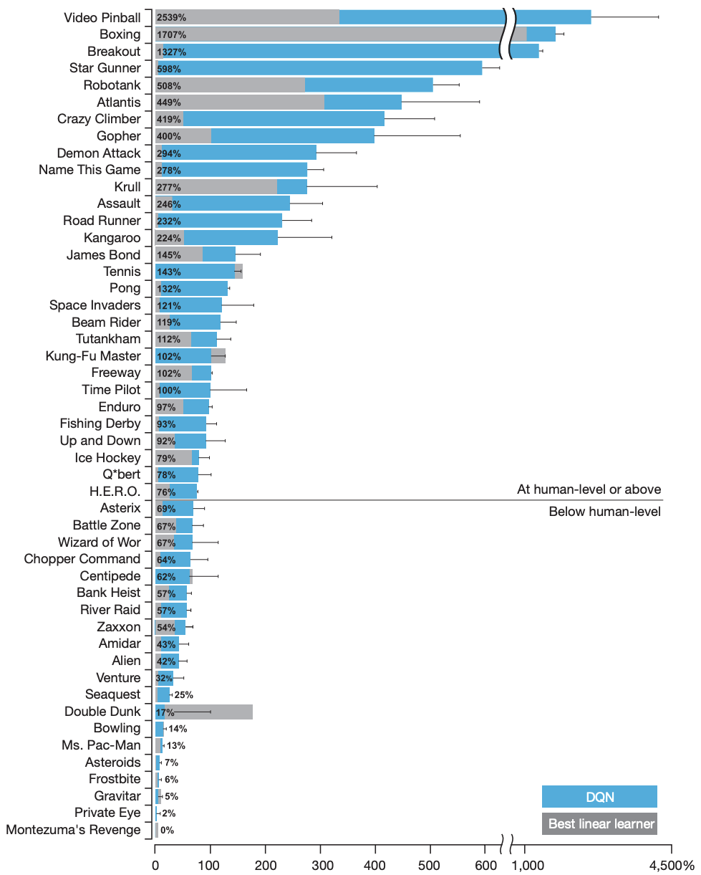
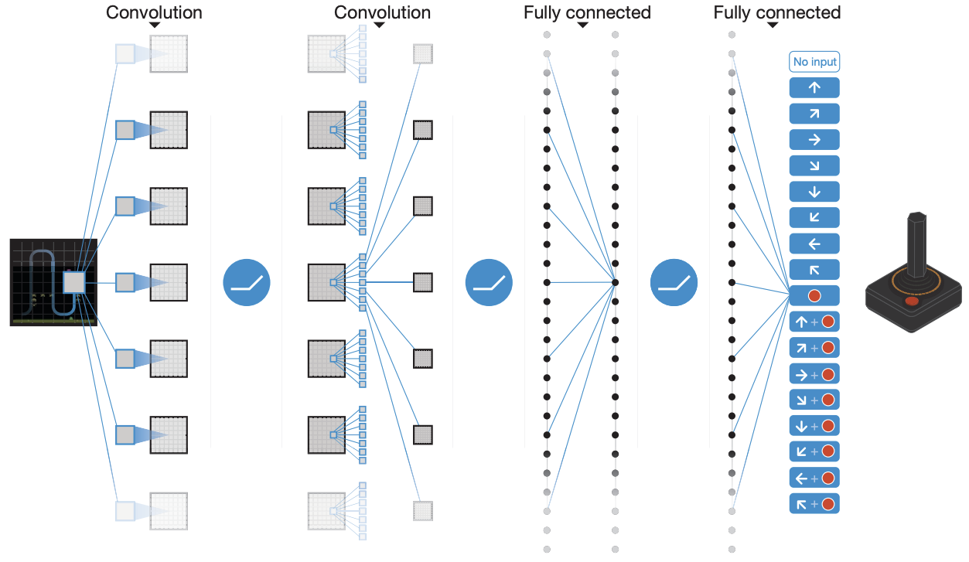
Example of DQN: DeepMind Atari
Results
Human level!
source
Notes:
V_\pi (s)=\mathbb{E}_\pi[G_t|s_t=s]
Q_* (s,a)=\underset{\pi}{\max}~\mathbb{E}_\pi[G_t|s_t=s, A_t=a]

Slide 41
Limitations of Q-learning
Limited to discrete action spaces A
Training can be unstable
  Temporal difference based learning: we update our guess with a newer (hopefully slightly better) guess
Can only learn deterministic policies
  We always pick the action from our Q-function that maximizes future reward
Many real-world problems require both continuous state and action spaces
→ Policy gradient methods (and later, Actor-Critic)
Notes:
\mathcal{L} = \mathbb{E}[||(r_{t+1} + \gamma \underset{a'}{\max}\hat Q_*(s',a')) - \hat Q_*(s,a)||^2]
Q_* (s,a)=\underset{\pi}{\max}~\mathbb{E}_\pi[G_t|s_t=s, A_t=a]

Slide 42
Reinforcement Learning Algorithms
Some examples we will go through…
Value Learning
Policy Learning
Combination methods
Find value functions
Find policy
Find both value functions and policy
E.g.:
Sample
Not going to be covered in detail…
Notes:
V_\pi (s)=\mathbb{E}_\pi[G_t|s_t=s]
Q_* (s,a)=\underset{\pi}{\max}~\mathbb{E}_\pi[G_t|s_t=s, A_t=a]

Slide 43
Reinforcement Learning Algorithms
Some examples we will go through…
Value Learning
Policy Learning
Combination methods
Find value functions
Find policy
Find both value functions and policy
E.g.:
Sample
Not going to be covered in detail…
Notes:
V_\pi (s)=\mathbb{E}_\pi[G_t|s_t=s]
Q_* (s,a)=\underset{\pi}{\max}~\mathbb{E}_\pi[G_t|s_t=s, A_t=a]

Slide 44


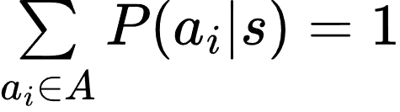




Policy gradient (PG) methods
Key idea
Instead of learning the policy indirectly through value (Q) functions, lets directly learn the policy
First step: represent the policy explicitly, as a parametrized function,
How do we adapt the output for continuous actions?
Parameters θ can be (and usually are) represented by the weights of a neural network
state, s
←
Deep NN
╳
→
Notes:
V_\pi (s)=\mathbb{E}_\pi[G_t|s_t=s]
Q_* (s,a)=\underset{\pi}{\max}~\mathbb{E}_\pi[G_t|s_t=s, A_t=a]

Slide 45
Policy gradient (PG) methods
Discrete action space:
Choose direction
← ╳ →
Continuous action space:
Choose direction and distance
“5.2mm left”
a
a
← →
← ╳ →
Move further left
Move further right
state, s
state, s
Discrete (categorical) P distribution
→ Learn action probabilities
Continuous P distribution
→ approximate with a Gaussian distribution
Notes:
V_\pi (s)=\mathbb{E}_\pi[G_t|s_t=s]
Q_* (s,a)=\underset{\pi}{\max}~\mathbb{E}_\pi[G_t|s_t=s, A_t=a]

Slide 46




Policy gradient (PG) methods
Enabling continuous actions: model policy as a gaussian distribution
state, s
Mean,
Deep NN
Variance,
Learn a probability distribution (gaussian for simplicity), giving probability for all possible actions
a
← →
Move further left
Move further right
Notes:
V_\pi (s)=\mathbb{E}_\pi[G_t|s_t=s]
Q_* (s,a)=\underset{\pi}{\max}~\mathbb{E}_\pi[G_t|s_t=s, A_t=a]

Slide 47



Policy gradient (PG) methods
Training a PG model
state, s
Deep NN
Simplified training algorithm
Initialize the agent (the NN)
Run the policy until termination
Record all states, actions and rewards.
Decrease probability of actions that resulted in low reward
Increase probability of actions that resulted in high reward
How do we actually do this?
Notes:
V_\pi (s)=\mathbb{E}_\pi[G_t|s_t=s]
Q_* (s,a)=\underset{\pi}{\max}~\mathbb{E}_\pi[G_t|s_t=s, A_t=a]

Slide 48

Policy gradient (PG) methods
Policy Gradient loss
Decrease probability of actions that resulted in low reward
Increase probability of actions that resulted in high reward
Our Neural Net output gives us a distribution over all possible actions
For visited state-actions, the network gives the likelihood of taking those actions (a.k.a., the policy)
likelihood of action a_{t}
Notes:
V_\pi (s)=\mathbb{E}_\pi[G_t|s_t=s]
Q_* (s,a)=\underset{\pi}{\max}~\mathbb{E}_\pi[G_t|s_t=s, A_t=a]

Slide 49
Policy gradient (PG) methods
Policy Gradient loss
Decrease probability of actions that resulted in low reward
Increase probability of actions that resulted in high reward
Our Neural Net output gives us a distribution over all possible actions
For visited state-actions, the network gives the likelihood of taking those actions (a.k.a., the policy)
likelihood of action a_{t}
Return
We want to maximize this!
Notes:
V_\pi (s)=\mathbb{E}_\pi[G_t|s_t=s]
Q_* (s,a)=\underset{\pi}{\max}~\mathbb{E}_\pi[G_t|s_t=s, A_t=a]

Slide 50
Policy gradient (PG) methods
Policy Gradient loss
Decrease probability of actions that resulted in low reward
Increase probability of actions that resulted in high reward
Our Neural Net output gives us a distribution over all possible actions
For visited state-actions, the network gives the likelihood of taking those actions (a.k.a., the policy)
log-likelihood of action
Return
Using Gradient Ascent:
The policy gradient
Notes:
V_\pi (s)=\mathbb{E}_\pi[G_t|s_t=s]
Q_* (s,a)=\underset{\pi}{\max}~\mathbb{E}_\pi[G_t|s_t=s, A_t=a]

Slide 51
Policy gradient (PG) methods
Summary
Can handle both discrete and continuous action spaces A
Training more stable than Q-learning
Can learn deterministic and stochastic policies
  We can make the learned policy deterministic by selecting the action with highest probability, rather than sampling it
Policy gradient methods are trained on-policy
  We directly optimize the policy we use for exploring
  Learning step relies on samples collected according to current weights (policy)
→ Past experiences cannot be reused, as they were collected according to a different policy
Notes:
V_\pi (s)=\mathbb{E}_\pi[G_t|s_t=s]
Q_* (s,a)=\underset{\pi}{\max}~\mathbb{E}_\pi[G_t|s_t=s, A_t=a]

Slide 52
Reinforcement Learning Algorithms
Some examples we will go through…
Value Learning
Policy Learning
Combination methods
Find value functions
Find policy
Find both value functions and policy
E.g.:
Sample
Not going to be covered in detail…
Notes:
V_\pi (s)=\mathbb{E}_\pi[G_t|s_t=s]
Q_* (s,a)=\underset{\pi}{\max}~\mathbb{E}_\pi[G_t|s_t=s, A_t=a]

Slide 53
Reinforcement Learning Algorithms
Some examples we will go through…
Value Learning
Policy Learning
Combination methods
Find value functions
Find policy
Find both value functions and policy
E.g.:
Sample
Not going to be covered in detail…
Notes:
V_\pi (s)=\mathbb{E}_\pi[G_t|s_t=s]
Q_* (s,a)=\underset{\pi}{\max}~\mathbb{E}_\pi[G_t|s_t=s, A_t=a]

Slide 54
Combination methods
Q-learning (value-based)
Policy gradient
Good for discrete action spaces
Sample efficient
Unstable
No continuous action space
Good for continuous action spaces
Stable
Less sample efficient
Can we combine methods to get the best of both?
Actor-Critic Schemes
Notes:
V_\pi (s)=\mathbb{E}_\pi[G_t|s_t=s]
Q_* (s,a)=\underset{\pi}{\max}~\mathbb{E}_\pi[G_t|s_t=s, A_t=a]

Slide 55
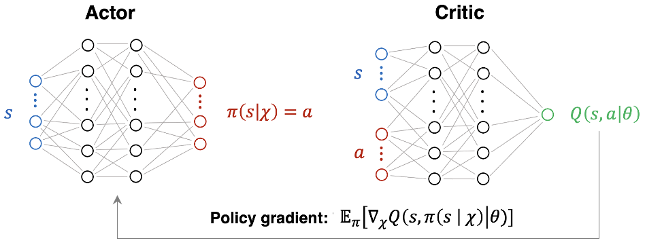
Actor Critic Schemes
Combines value-based and policy-based approaches.
Key idea: train two separate networks simultaneously
The actor selects actions (=policy)
The critic evaluates them (=value function estimator).
The actor updates parameters through the policy gradient
The critic (Q-Net) updates parameters through the TD rule (as in Q-learning)
Will be featured in next lecture and the exercise session!
Handle continuous spaces, sample efficient, more stable than pure Q-learning!
thematic CSC on Machine Learning 2024, M. Schenk
Notes:
V_\pi (s)=\mathbb{E}_\pi[G_t|s_t=s]
Q_* (s,a)=\underset{\pi}{\max}~\mathbb{E}_\pi[G_t|s_t=s, A_t=a]

Slide 56
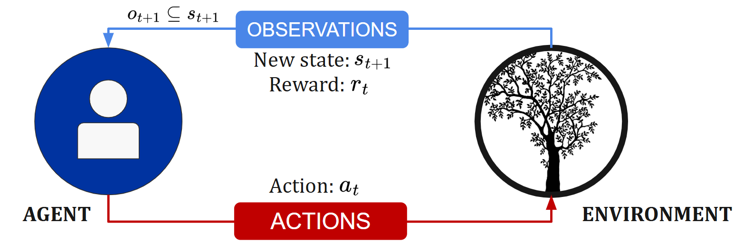
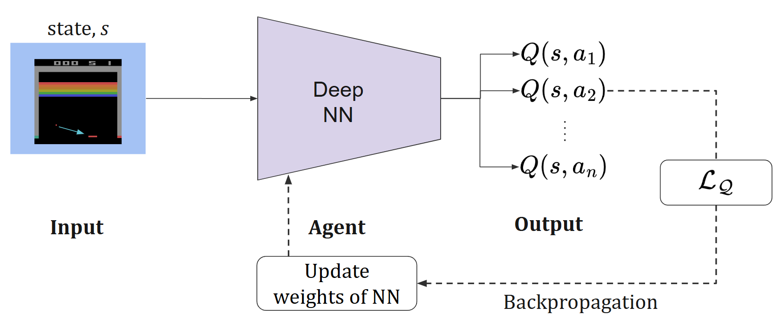
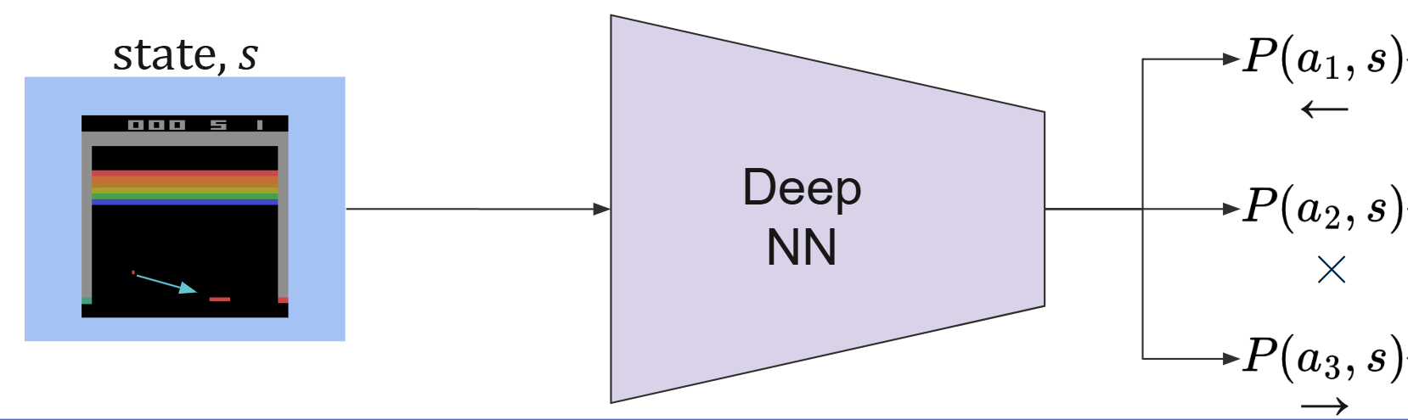
Reinforcement Learning: recap
Defined key terminology…
Learned basic idea of Q-learning…
… and policy gradient
In the total field of RL, we have only scratched the surface
Notes:
V_\pi (s)=\mathbb{E}_\pi[G_t|s_t=s]
Q_* (s,a)=\underset{\pi}{\max}~\mathbb{E}_\pi[G_t|s_t=s, A_t=a]

Slide 57
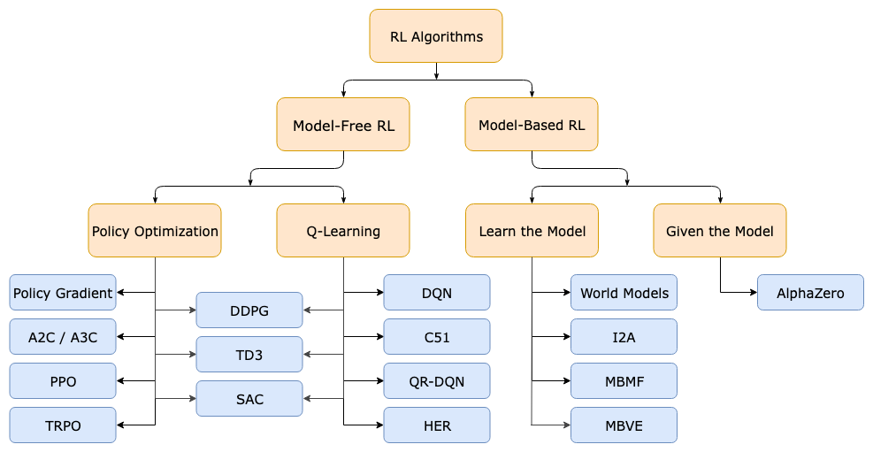
Reinforcement Learning taxonomy
Discussed so far
Actor-critic methods
Policy-based methods
Value-based methods
OpenAI – spinning up
Notes:
V_\pi (s)=\mathbb{E}_\pi[G_t|s_t=s]
Q_* (s,a)=\underset{\pi}{\max}~\mathbb{E}_\pi[G_t|s_t=s, A_t=a]

Slide 58
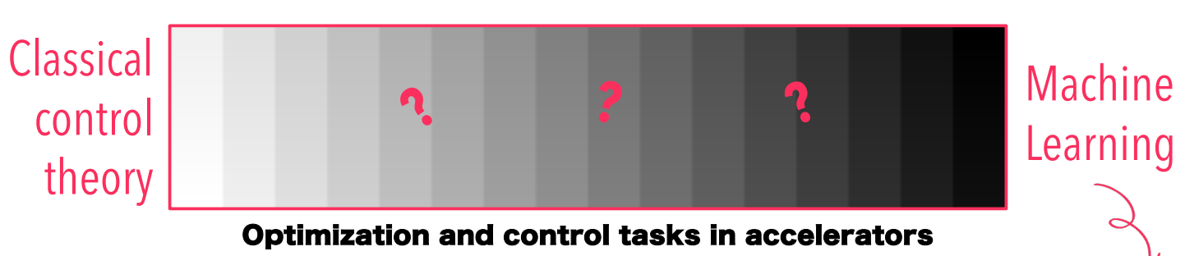
Reinforcement Learning in accelerators
We have a lot of control and optimization problems…
Trajectory steering, RF manipulations, injection matching, etc…
Could we solve them with RL? Should we?
Sometimes, performance improvements motivate trying RL!
Andrea Santamaria Garcia, KIT, Reinforcement learning and its application in particle accelerators
Notes:
V_\pi (s)=\mathbb{E}_\pi[G_t|s_t=s]
Q_* (s,a)=\underset{\pi}{\max}~\mathbb{E}_\pi[G_t|s_t=s, A_t=a]

Slide 59
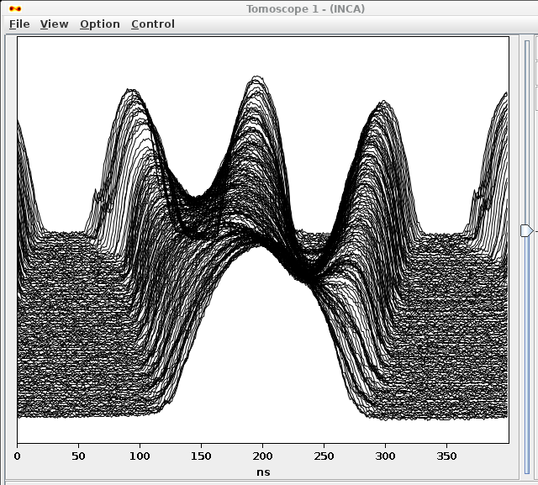
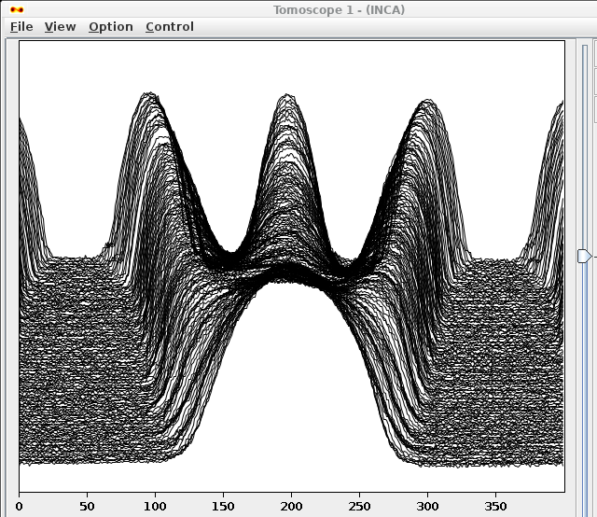
Reinforcement Learning in accelerators
A practical example: the RF triple splitting in the PS
A routine operation
Requires manual tuning any time intensity changes, or machine settings drift
Has not been automated before
Slow repetition rate: needs to optimize in few steps
Deployed prototype using Deep Reinforcement Learning agents (Actor-Critic) to optimize machine settings
In the next lecture, we will go through the steps and considerations taken to define and train this model!
Notes:
V_\pi (s)=\mathbb{E}_\pi[G_t|s_t=s]
Q_* (s,a)=\underset{\pi}{\max}~\mathbb{E}_\pi[G_t|s_t=s, A_t=a]

Slide 60
Sources and further reading
A. Amini, “Deep Reinforcement Learning” Lecture, MIT 2023. Part of MITs Intro to deeplearning.
R.S. Sutton and A.G. Barto, "Reinforcement learning - an introduction", Book, 2nd edition, 2020.
A. Santamaria Garcia, “Reinforcement learning and its application in particle accelerators”, Lecture, 2022
M. Schenk and V. Kain, “Introduction to Reinforcement Learning”, Lecture in thematic Cern School of Computing on machine learning, 2024
Notes:
V_\pi (s)=\mathbb{E}_\pi[G_t|s_t=s]
Q_* (s,a)=\underset{\pi}{\max}~\mathbb{E}_\pi[G_t|s_t=s, A_t=a]

Slide 61
Thank you for listening! Questions?

Slide 62
Extra: Model-free vs. model-based
Model-free
Model-based
Agent relies on trial-and-error experience for action selection
Does not learn transition dynamics directly
Can’t “plan ahead”
Keeps an internal model of the environment (transitions and rewards)
Can plan ahead by simulating future actions
For beginners of RL: if no accurate model is already provided or can be easily defined → explore going model-free first*
*For advanced users: Model-based and hybrid methods gaining traction in state-of-the-art. Combining model-free learning algorithms with learned predictive models show great promise for control tasks
Notes:
V_\pi (s)=\mathbb{E}_\pi[G_t|s_t=s]
Q_* (s,a)=\underset{\pi}{\max}~\mathbb{E}_\pi[G_t|s_t=s, A_t=a]

Slide 63

Extra: Why use RL for optimization?
The RL advantage
Optimize!
Explore + optimize
Optimized Beam
Optimize!
Start training!
Explore (train)
Trained Agent
Optimize
skips exploration at inference
→ Faster convergence (assuming well-trained agent)
Can capitalize on experience

Slide 64
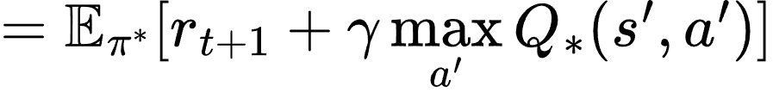
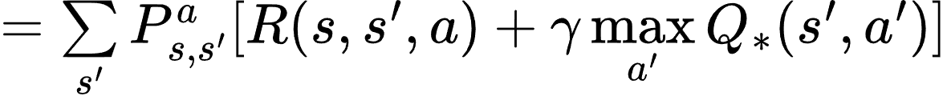

Extra: Solving the Bellman Optimality Equation
The return
Bellman Optimality Equation: Expand definition of optimal Q-function using expanded return…
Expand expected return using value and Q-functions:
Weighted sum over all possible successor states s’ under action a
Assume deterministic env.,
→ for transition from state s to s’, 0 for all other states
Can use to define an iterative way for estimating the optimal Q-function,
Notes:
Q_*(s,a) = \mathbb{E}_\pi^*[G_t]
Q_* (s,a)=\underset{\pi}{\max}~\mathbb{E}_\pi[G_t|s_t=s, A_t=a]

Slide 65
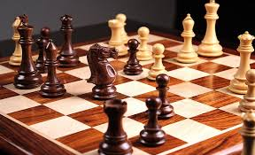
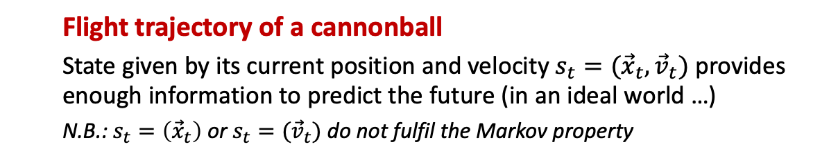
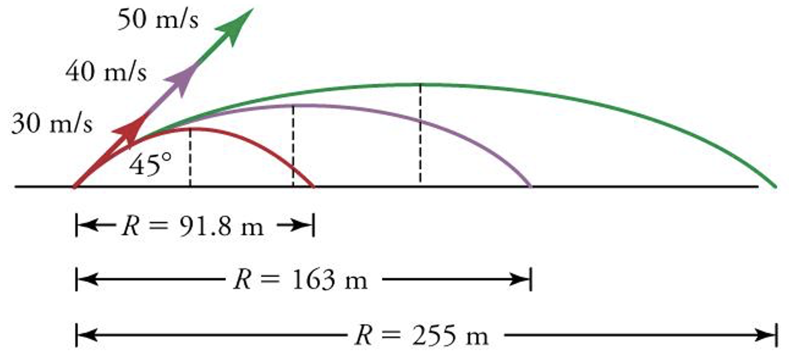
Extra: Markov Decision Process
Examples of memoryless states
  Chess
  Arrangement of pieces on the board fully defines current state.
  There may be many ways to arrive at that particular state, but this is irrelevant for deciding the next move and the future progression of the game.
Shamelessly stolen from thematic CSC on Machine Learning 2024, M. Schenk
Highly recommended!

