Slide 1

We’ll start at 09:00

Slide 2

Welcome …
16th Inverted CERN School of Computing
24 – 27 March 2025
CERN, Geneva, Switzerland
Alberto Pace, alberto.pace@cern.ch, school director

Slide 3
The CERN School of Computing
Aims at creating a common culture in scientific computing among young scientists and engineers involved in particle physics or other sciences, as a strategic direction to favor mobility and to facilitate the development of large computing-oriented transnational projects.
  http://cern.ch/csc
Participants come from worldwide laboratories and universities with typically of 15 to 30 different nationalities (>60 different nationalities over the past 10 years).
  http://cern.ch/csc/alumni

Slide 4
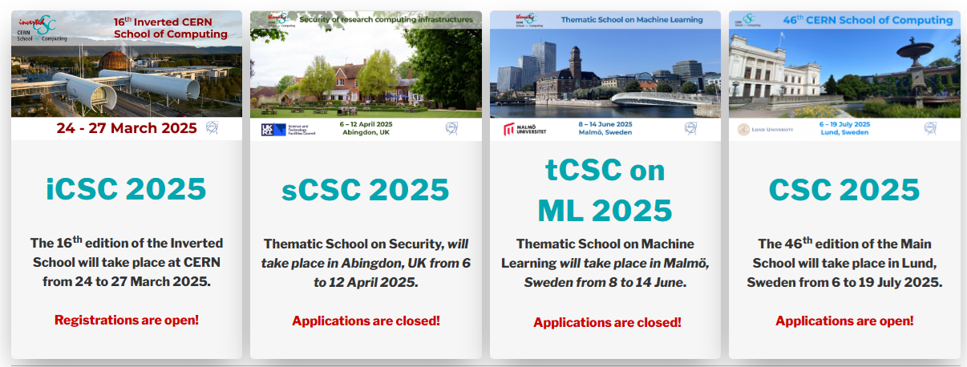
Upcoming CSC schools …
TODAY
Registration closes
Wednesday 9 April

Slide 5
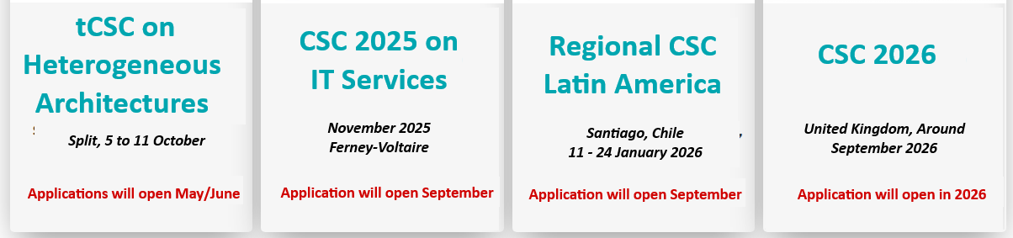
but wait… there’s more
Registration
opens soon
NEW!

Slide 6
Involving former CSC participants to deliver advanced education
"Where students turn into teachers"
i = inverted

Slide 7
Why an inverted CSC?
At every CERN School, the sum of the knowledge of the students exceeds the one of lecturers, and that it is frequent to find in the room real experts on particular topics. This is the idea behind iCSC.
Reversing the roles
CSC n
tCSC m
CSC n+1
tCSC m+1
iCSC

Slide 8

The inverted CSC
At the end of each main school, we call students present to make proposals. When we receive sufficient proposals of appropriate quality, we organize an inverted school.
The students combine their skills and elaborate on CSC related subjects.

Slide 9
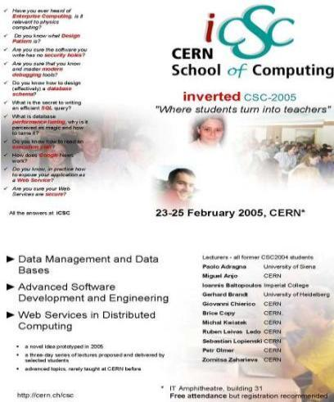
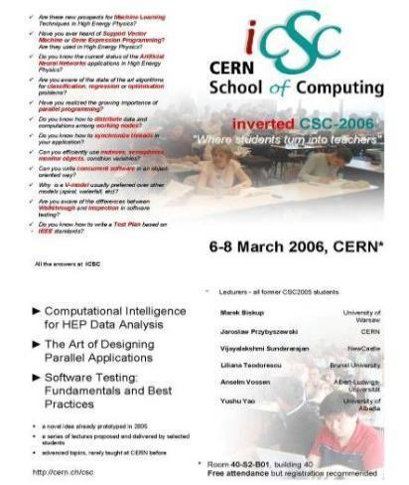
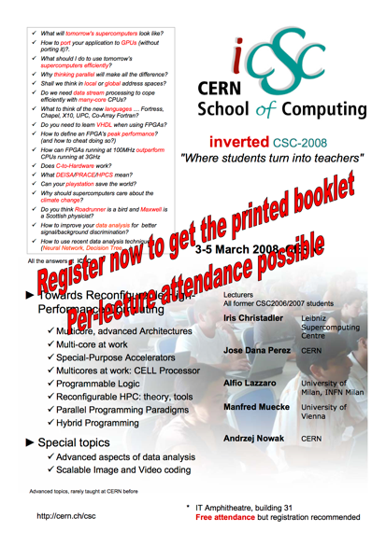
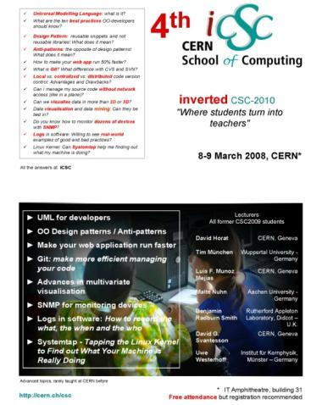
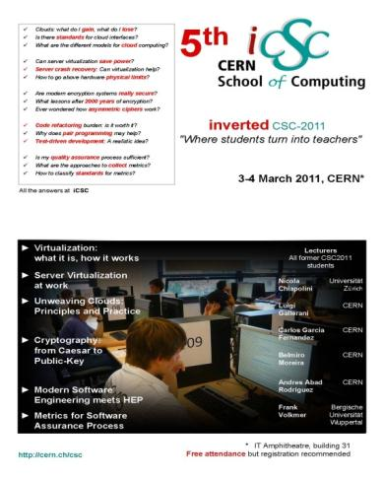
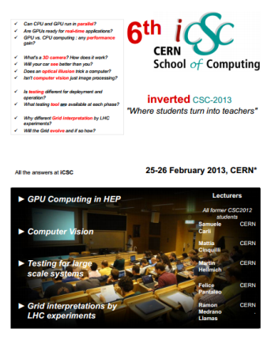
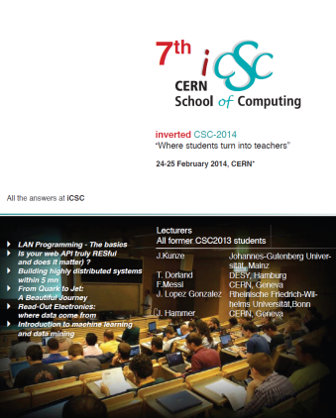
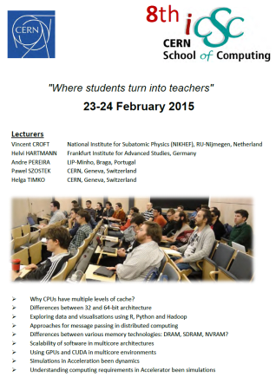
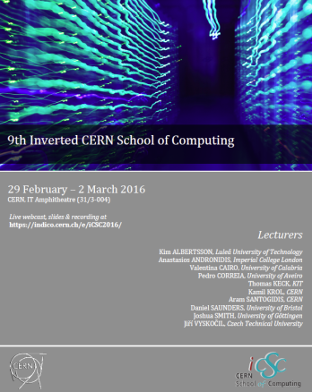
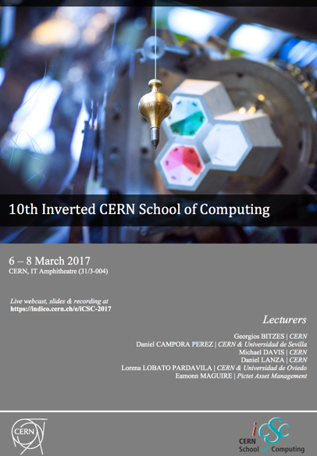
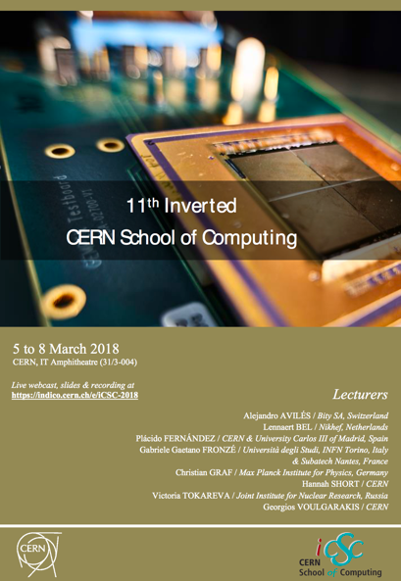
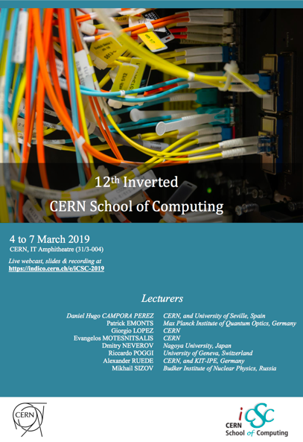
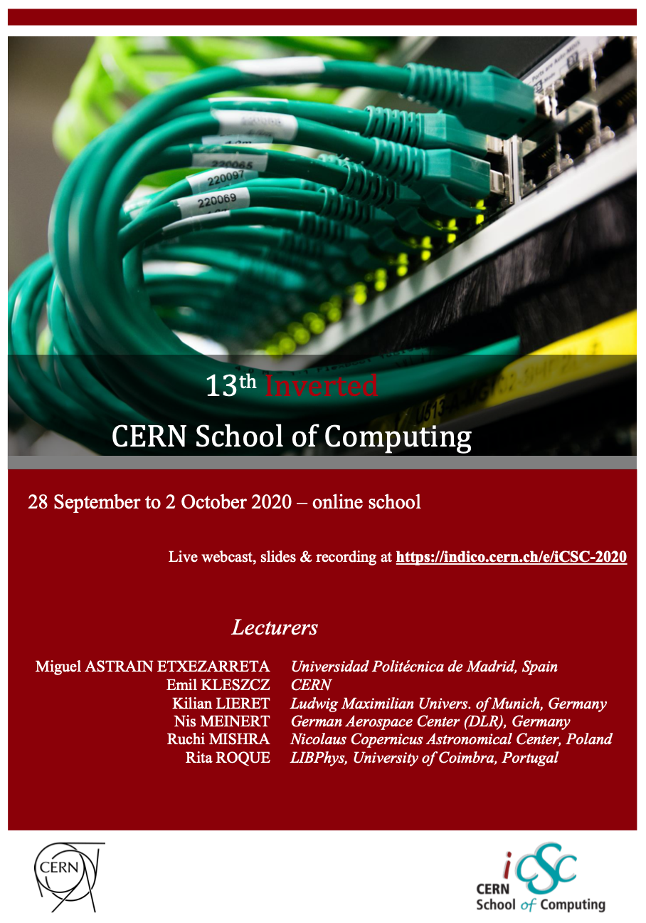

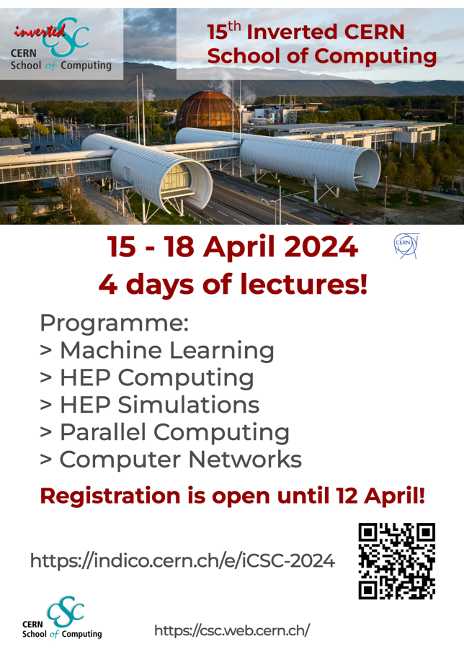
2025: the 16th edition of the iCSC
2005
2006
2008
2010
2011
2013
2014
2015
2016
2017
2018
2019
2020
2023
2024

Slide 10
Lecturers at the iCSC:
Where students turns into teachers ….
Many iCSC lecturers have become lecturers at various CSC schools
  Sebastian Lopienski (2005)
  Brice Copy (2005)
  Zornitsa Zaharieva (2005)
  Andrzej Nowak (2008)
  Benjamin Radburn-Smith (2010)
  Thomas Keck (2016)
  Daniel Campora (2017)
  Eamonn Maguire (2017)
  Hannah Short (2018)
  Francesco Vaselli (2024)
... and one of them became director of the school

Slide 11
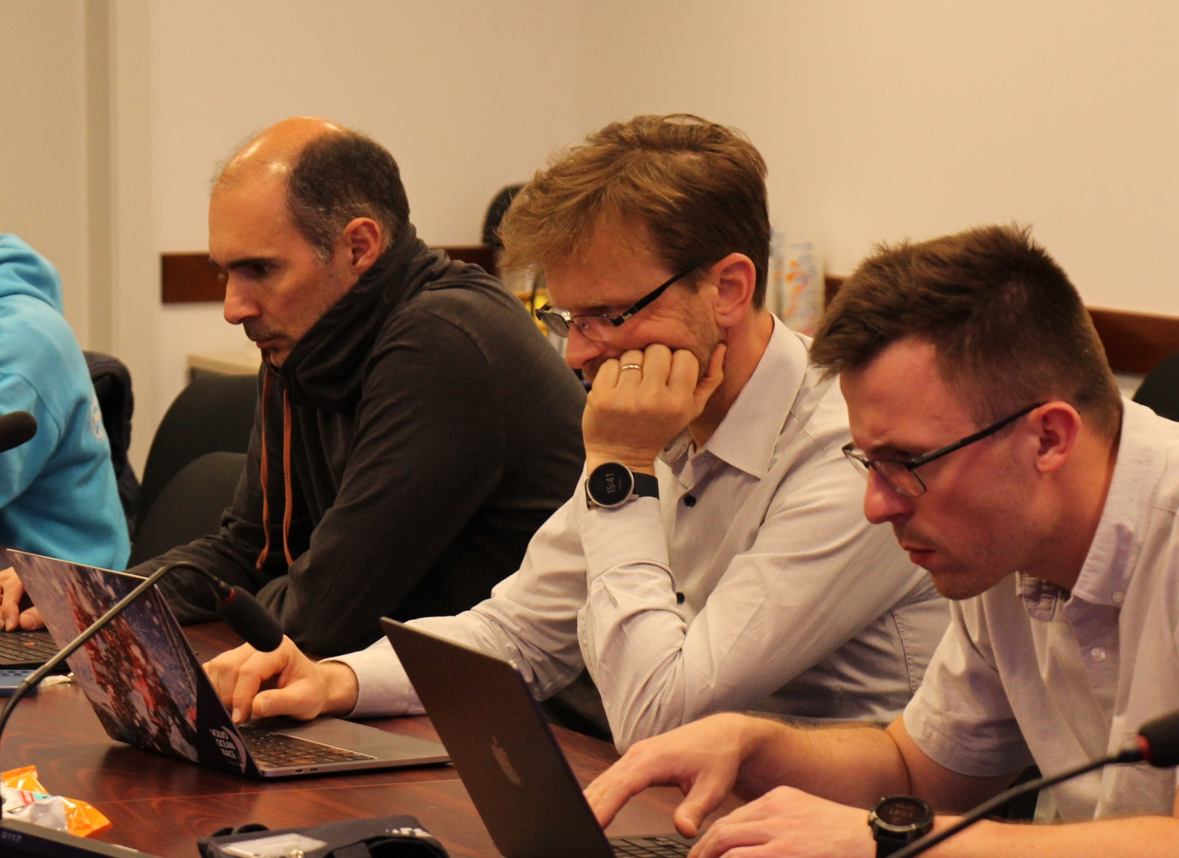
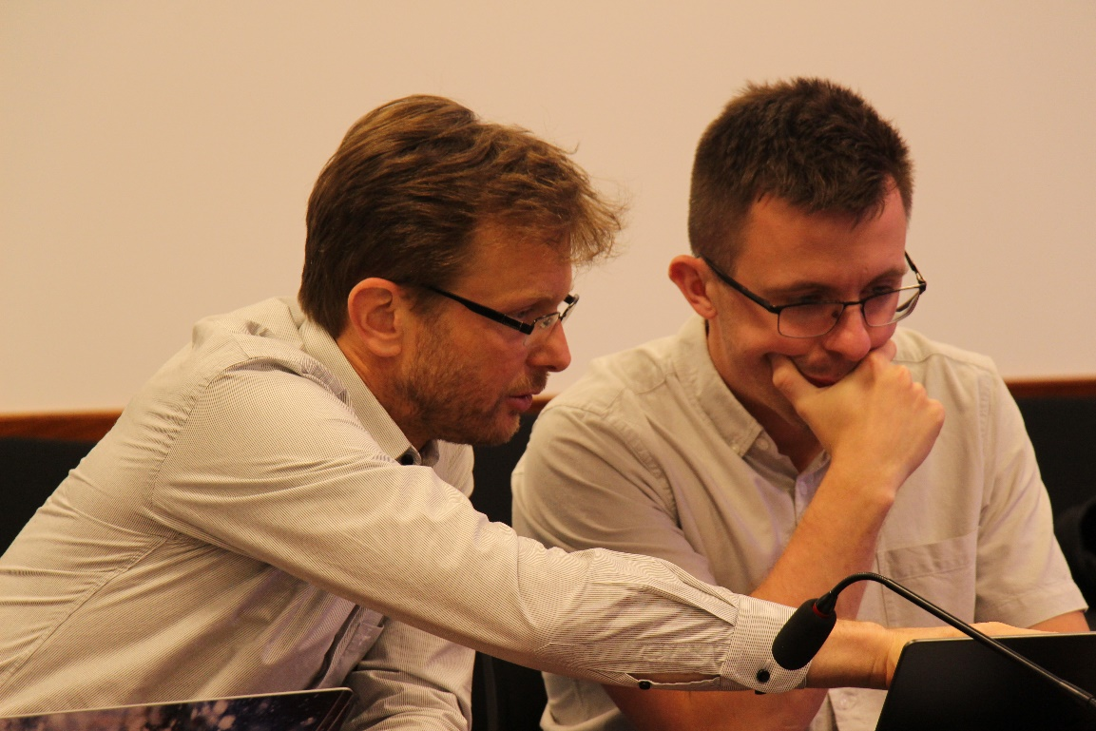
Side effect: Where teachers turns into students ….

Slide 12
The iCSC lectures selection process
A tough competition
  We have received 28 (+4 compared to 2024) outstanding proposals
  A total of 57 hours of lectures (was 48 in 2024)
  Hard choices had to be made
This should provide you with an excellent school content!

Slide 13
2025 Proposals
Submitted for tracks | Title | Lecture hours | Exercise hours
Computer Science, Engineering, IoT, Accelerator Controls | Automate All the Things: CI/CD for the Bold and the Brave | 1 | 1
Computer Science, Engineering, IoT, Accelerator Controls | Building Blocks of Cloud Computing | 2 | 0
Computer Science, Engineering, IoT, Accelerator Controls | Code with Confidence: an Introduction to Continuous Integration | 1 | 1
Computer Science, Engineering, IoT, Accelerator Controls | Code you won't regret: principles for maintainable code | 2 | 0
Computer Science, Engineering, IoT, Accelerator Controls | Do You Need Kubernetes? Yes! | 1 | 1
Computer Science, Engineering, IoT, Accelerator Controls | How to Automate Annoying Repetitive Taks in the Lab with Modern IoT Principles | 1 | 2
Computer Science, Engineering, IoT, Accelerator Controls | Reinforcement Learning in Particle Accelerators: a practical example | 2 | 1
Computer Science, Engineering, IoT, Accelerator Controls | Under the Hood of the Snake: Behind the scenes of Python | 2 | 1
Computer Science, Engineering, IoT, Accelerator Controls | Vector processing in RISC-V CPUs | 1 | 0
Computer Science, Engineering, IoT, Accelerator Controls | Web for the win! A crash course in building web apps | 1 | 1
Computing Architectures for Experiment Online Triggers and Event Filters | Data Processing with FPGAs: Parallel Computing on Compact Configurable Logic | 1 | 0
Data Science, Machine Learning, and AI | Applications with SciML (Scientific Machine Learning) - Open Source Scientific Machine Learning | 2 | 0
Data Science, Machine Learning, and AI | Best practices in modern Deep Learning (for High Energy Physics) | 2 | 2
Data Science, Machine Learning, and AI | Federated Learning with CAFEIN for Decentralized, Privacy preserving and Secure AI development | 1 | 0
Data Science, Machine Learning, and AI | Hidden in plain Script: Machine Learning for Anomaly Detection in Command-Line and User-Input Tools | 1 | 0
Data Science, Machine Learning, and AI | LLMs in Production: RAG pipelines and beyond | 1 | 0
Data Science, Machine Learning, and AI | On equivariance and explainability | 1 | 0
Data Science, Machine Learning, and AI | Understanding Large Language Models and their Applications in Code Generation | 1 | 1
Performance Tuning, Accelerated Computing, GPU-based architectures | Concurrency on the Back of an Envelope | 1 | 1
Performance Tuning, Accelerated Computing, GPU-based architectures | The Algorithm Advantage: Outperforming Hardware with Smarter Code | 1 | 1
Performance Tuning, Accelerated Computing, GPU-based architectures | WASM: the future of computing | 1 | 1
Physics Computing and Data analysis | Bayesian inference in particle physics | 1 | 1
Physics Computing and Data analysis | Efficient Workflow Management in High-Energy Physics | 1 | 1
Physics Computing and Data analysis | Maximum Likelihood Fitting | 1 | 1
Physics Computing and Data analysis | Scientific Computing in fusion energy and plasma research | 1 | 1
Quantum Computing | Breaking RSA and picking up the pieces | 1 | 0
Quantum Computing | Introduction to Quantum Computing and How It Can Level Up Your Research | 2 | 1
Quantum Computing | Quantum Error Mitigation (QEM) and its Integration in HEP Applications | 2 | 2

Slide 14
Remember: Selection process for lectures
Discussions at the main / thematic school
Lightning talks at the school
Proposal after the school
Review and selection by the CSC Advisory committee and CSC lecturers
Lecture preparation and development with mentors
  (1-2 mentors for each lecturer) (December, January)
Finally, the presentation at the school
TODAY,
TOMORROW,
WEDNESDAY,
THURSDAY

Slide 15
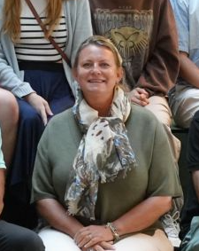
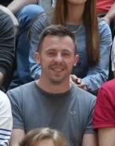
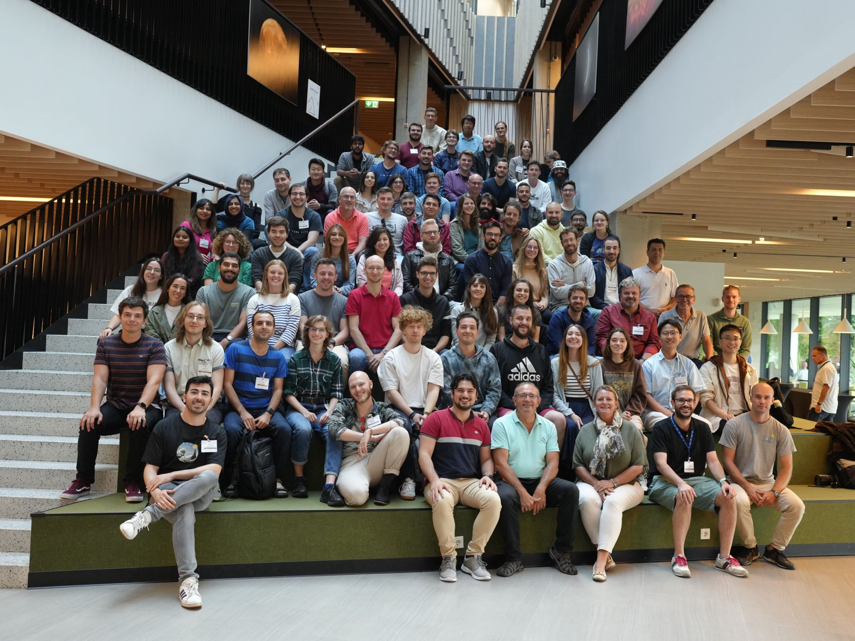
This school is brought to you by…
Kristina GUNNE
Administrative Manager
Andrzej NOWICKI
Technical Manager
Alberto PACE
School Director

Slide 16
... And this year’s 16 lecturers (12 in 2024)
Sten Astrand | CSC 2024 (Hamburg)
Niels Alexander Buegel | CSC 2024 (Hamburg)
George Coldstream | CSC 2024 (Hamburg)
Kaare Endrup | CSC 2024 (Hamburg)
Lorenz Gartner | CSC 2024 (Hamburg)
Andrea Germinario | CSC 2024 (Hamburg)
Peter Hinderberger | tCSC 2024 (Belgrade)
Elizabeth Mamtsits | CSC 2023 (Tartu)
Jack Charlie Munday | tCSC 2024 ML (Split)
Alberto Pimpo | CSC 2023 (Tartu) / tCSC 2024 ML (Split)
Diogo Reis Santos | tCSC 2023 (Split)
Vasvi Sharma | tCSC on Security 2023 (Split)
Simon Thiele | CSC 2023 (Tartu) / tCSC 2024 ML (Split)
Andrea Valenzuela Ramirez | CSC 2023 (Tartu)
Cedric Verstege | tCSC 2024 (Belgrade)
Joel Axel Wulf | tCSC 2024 (Split)

Slide 17
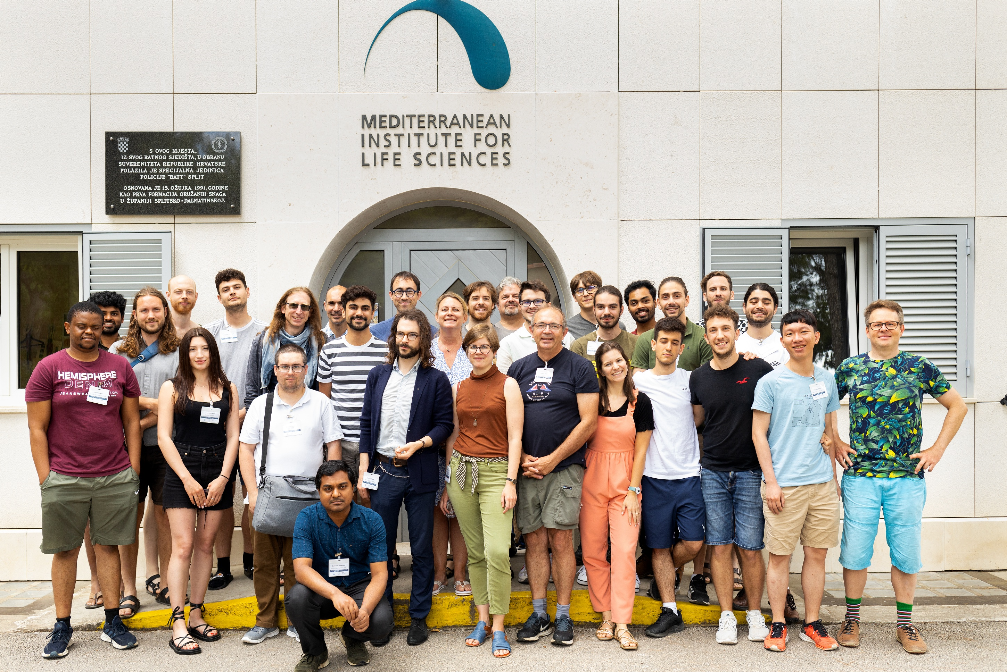
Sten Astrand
George Coldstream
Simon Thiele
Diogo Reis
Andrea Germinario
Lorenz Gartner
Niels Buegel
Kaare Endrup
Peter Hinderberger
Elizabeth Mamtsits
Alberto Pimpo
Vasvi Sharma
Andrea Valenzuela
Jack Munday
Joel Wulf
Cedric Verstege

Slide 18
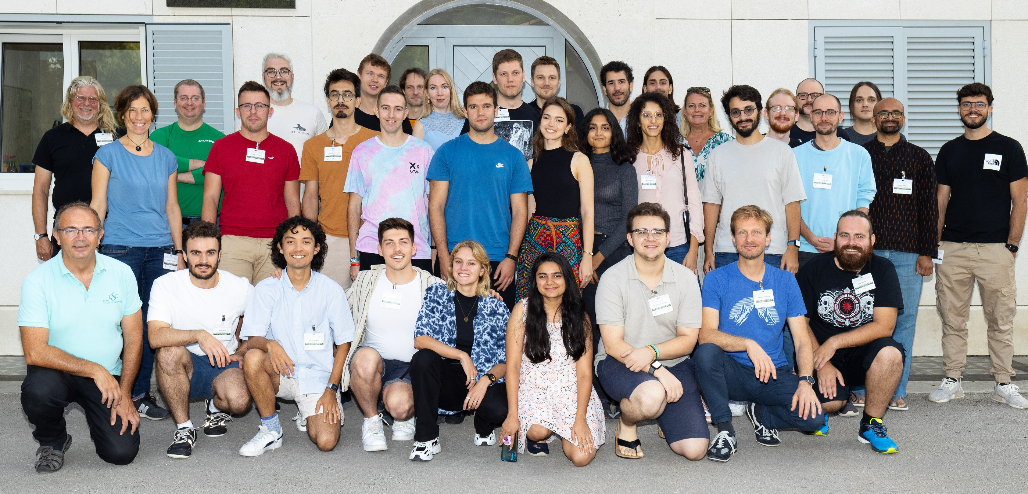
tCSC 2023 – Security (Split)
Diogo
Vasvi

Slide 19
CSC 2023 (Tartu)
Andrea
Simon
Alberto
Elizabeth

Slide 20
tCSC 2023 – Heterogeneous Architectures (Split)
Kaare
Sten

Slide 21
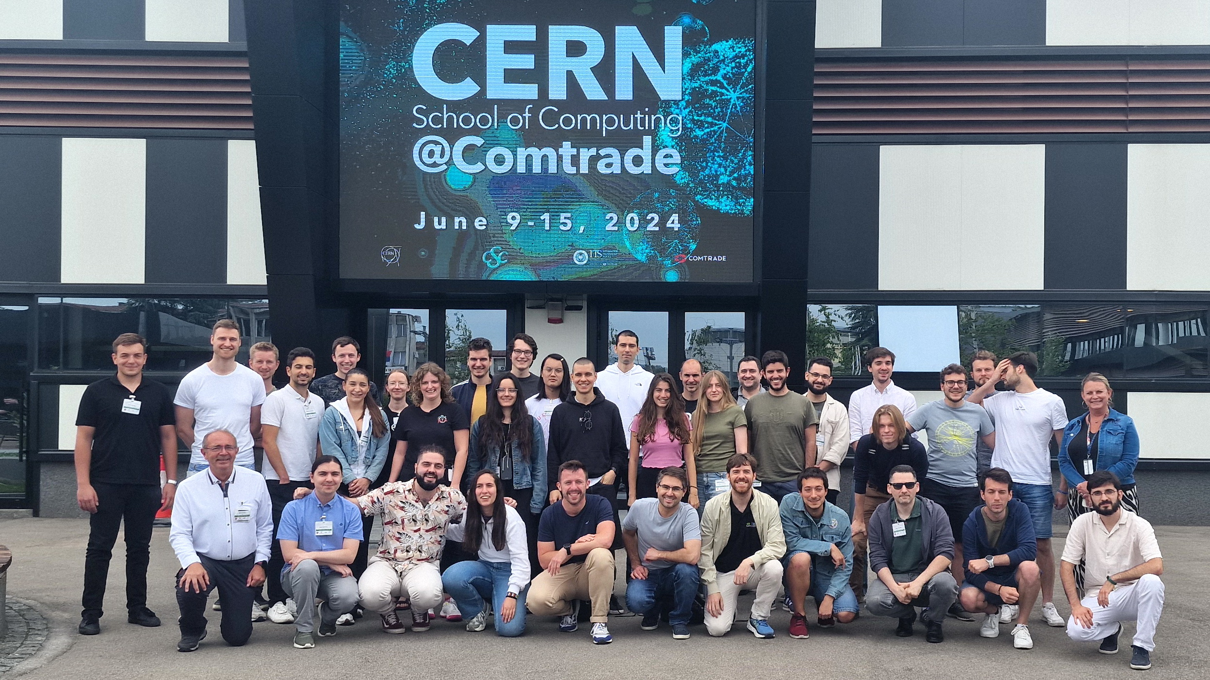
tCSC 2024 – Heterogeneous Architectures (Belgrade)
Cedric
Peter

Slide 22
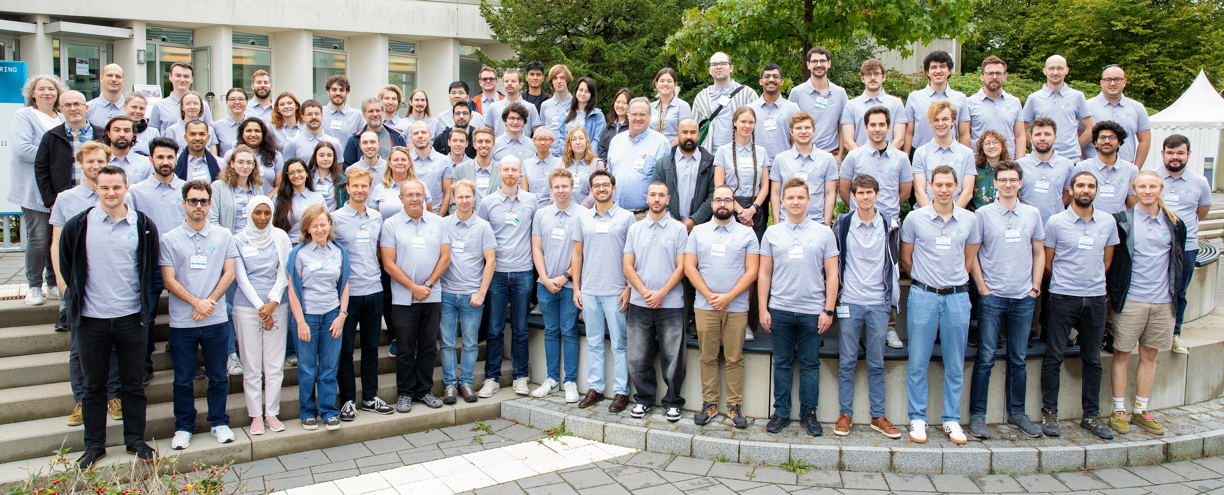
CSC 2024 (Hamburg)
Lorenz
George
Sten
Andrea
Kaare
Niels

Slide 23
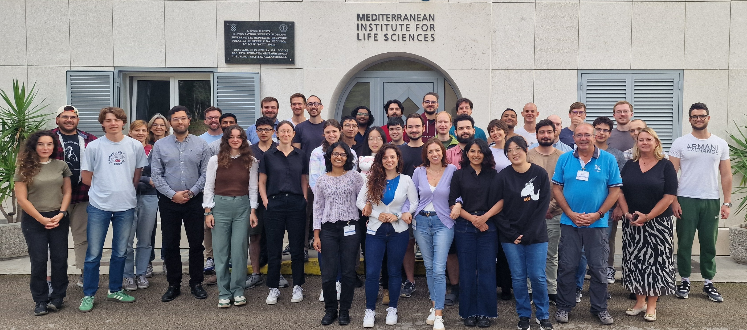
tCSC 2024 – Machine Learning (Split)
Jack
Simon
Joel
Alberto

Slide 24
Every presentation is supervised by mentors
This year’s mentors:
  Guilherme Amadio
  Aurindo Barros
  Francisco Borges
  Bob Jacobsen
  Verena Kain
  Judith Katzy
  Sebastian Lopienski
  Andrzej Nowicki
  Alberto Pace
  Danilo Piparo
  Sebastien Ponce
  Toni Sculac
  Michael Schenk
  Sofia Vallecorsa
  Francesco Vaselli
THANK YOU !

Slide 25
This year’s topics
Computer Science, Engineering, IoT, Accelerator Controls
  Automate All the Things: CI/CD for the Bold and the Brave
  Code you won't regret: principles for maintainable code
  Reinforcement Learning in Particle Accelerators: a practical example
  Under the Hood of the Snake: Behind the scenes of Python
  Web for the win! A crash course in building web apps
Computing Architectures for Experiment Online Triggers and Event Filters
  Data Processing with FPGAs: Parallel Computing on Compact Configurable Logic
Data Science, Machine Learning, and AI
  Federated Learning with CAFEIN for Decentralized, Privacy preserving and Secure AI development
  LLMs in Production: RAG pipelines and beyond
  On equivariance and explainability
  Understanding Large Language Models and their Applications in Code Generation
Performance Tuning, Accelerated Computing, GPU-based architectures
  The Algorithm Advantage: Outperforming Hardware with Smarter Code
  WASM: the future of computing
Physics Computing and Data analysis
  Bayesian inference in particle physics
  Efficient Workflow Management in High-Energy Physics
  Maximum Likelihood Fitting
Quantum Computing
  Breaking RSA and picking up the pieces

Slide 26
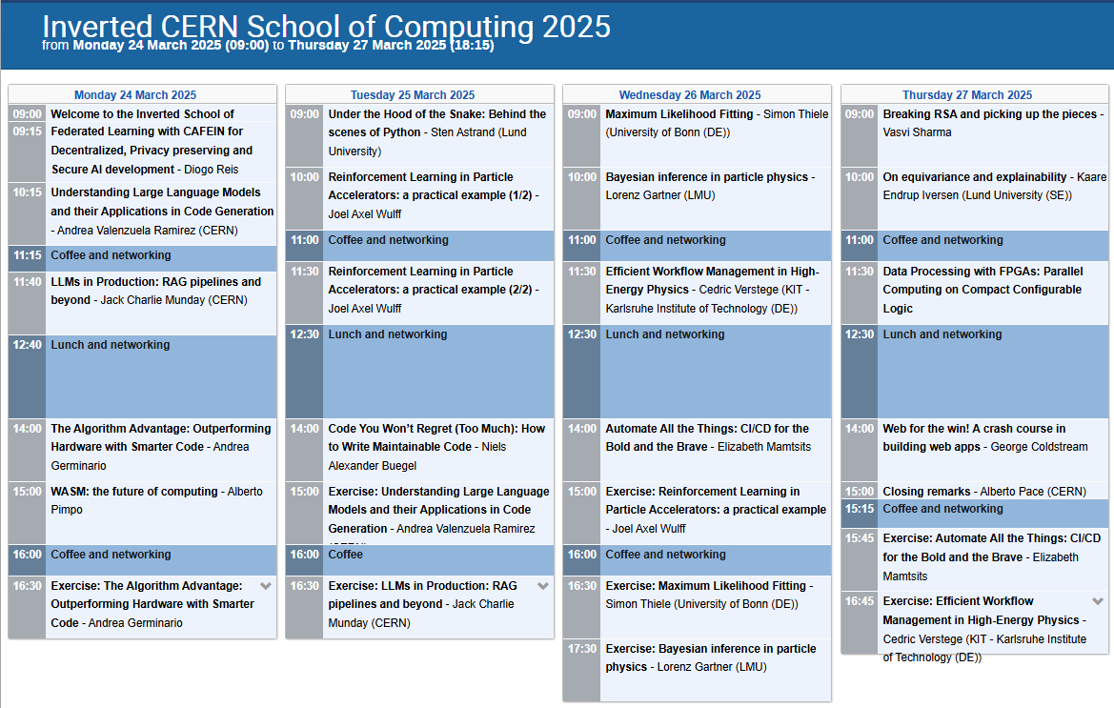
Beware of paralell sessions !

Slide 27
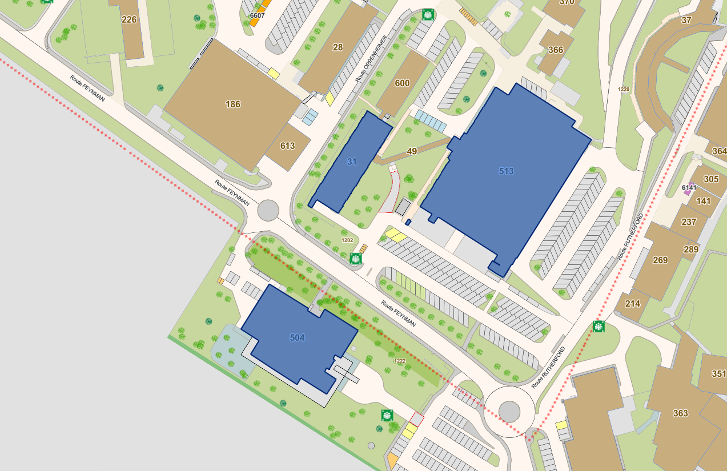



Locations
Lectures in
IT Amphitheatre
(and zoom)
Exercises in
513/1-024
(no zoom)
Lunch ❤️

Slide 28
School rules
Normal School rules #1, #2, and #3 still applies !
Additional rules for iCSC lecturers
  55 minute lectures + 5 minutes for Q&A
  Please socialise during the coffee breaks

Slide 29
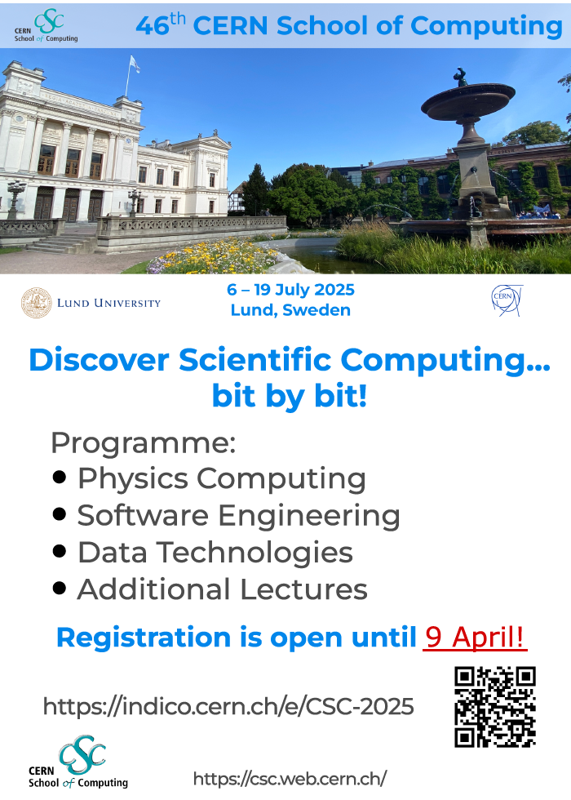
The next Main School
CSC 2025
6 – 19 July 2025
Lund University
Lund, Sweden
http://cern.ch/csc

Slide 30
Now ...
Let’s start !

Slide 31
We’ll start at 09:00

Slide 32
We’re on a coffee break!
We’ll resume at 11:30

Slide 33
We’re on a lunch break!
We’ll resume at 14:00

Slide 34
Closing remarks
16th Inverted CERN School of Computing
24 – 27 March 2025
CERN, Geneva, Switzerland
Alberto Pace, alberto.pace@cern.ch, school director

Slide 35
Involving former CSC participants to deliver advanced education
"Where students turn into teachers"
i = inverted

Slide 36
Why an inverted CSC?
At every CERN School, the sum of the knowledge of the students exceeds the one of lecturers, and that it is frequent to find in the room real experts on particular topics. This is the idea behind iCSC.
Reversing the roles
CSC n
tCSC m
CSC n+1
tCSC m+1
iCSC

Slide 37
2025: the 16th edition of the iCSC
2005
2006
2008
2010
2011
2013
2014
2015
2016
2017
2018
2019
2020
2023
2024

Slide 38
This year’s topics
Computer Science, Engineering, IoT, Accelerator Controls
  Automate All the Things: CI/CD for the Bold and the Brave
  Code you won't regret: principles for maintainable code
  Reinforcement Learning in Particle Accelerators: a practical example
  Under the Hood of the Snake: Behind the scenes of Python
  Web for the win! A crash course in building web apps
Computing Architectures for Experiment Online Triggers and Event Filters
  Data Processing with FPGAs: Parallel Computing on Compact Configurable Logic
Data Science, Machine Learning, and AI
  Federated Learning with CAFEIN for Decentralized, Privacy preserving and Secure AI development
  LLMs in Production: RAG pipelines and beyond
  On equivariance and explainability
  Understanding Large Language Models and their Applications in Code Generation
Performance Tuning, Accelerated Computing, GPU-based architectures
  The Algorithm Advantage: Outperforming Hardware with Smarter Code
  WASM: the future of computing
Physics Computing and Data analysis
  Bayesian inference in particle physics
  Efficient Workflow Management in High-Energy Physics
  Maximum Likelihood Fitting
Quantum Computing
  Breaking RSA and picking up the pieces

Slide 39
! parallel sessions !

Slide 40
How good was the school ?
There will be an online survey
Please let us know
  What was good
  What will need to be improved
Registered participants will receive an e-mail from Kristina to fill up the survey

Slide 41
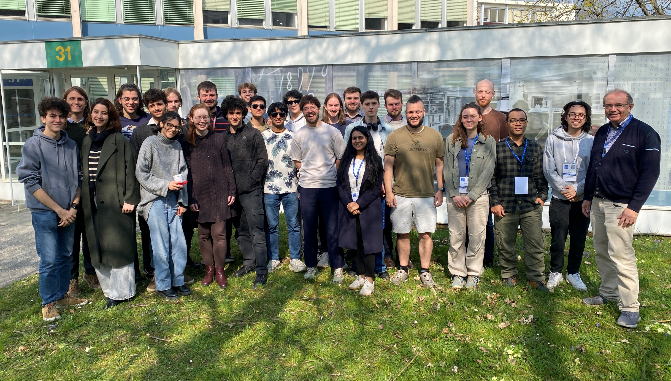

Slide 42
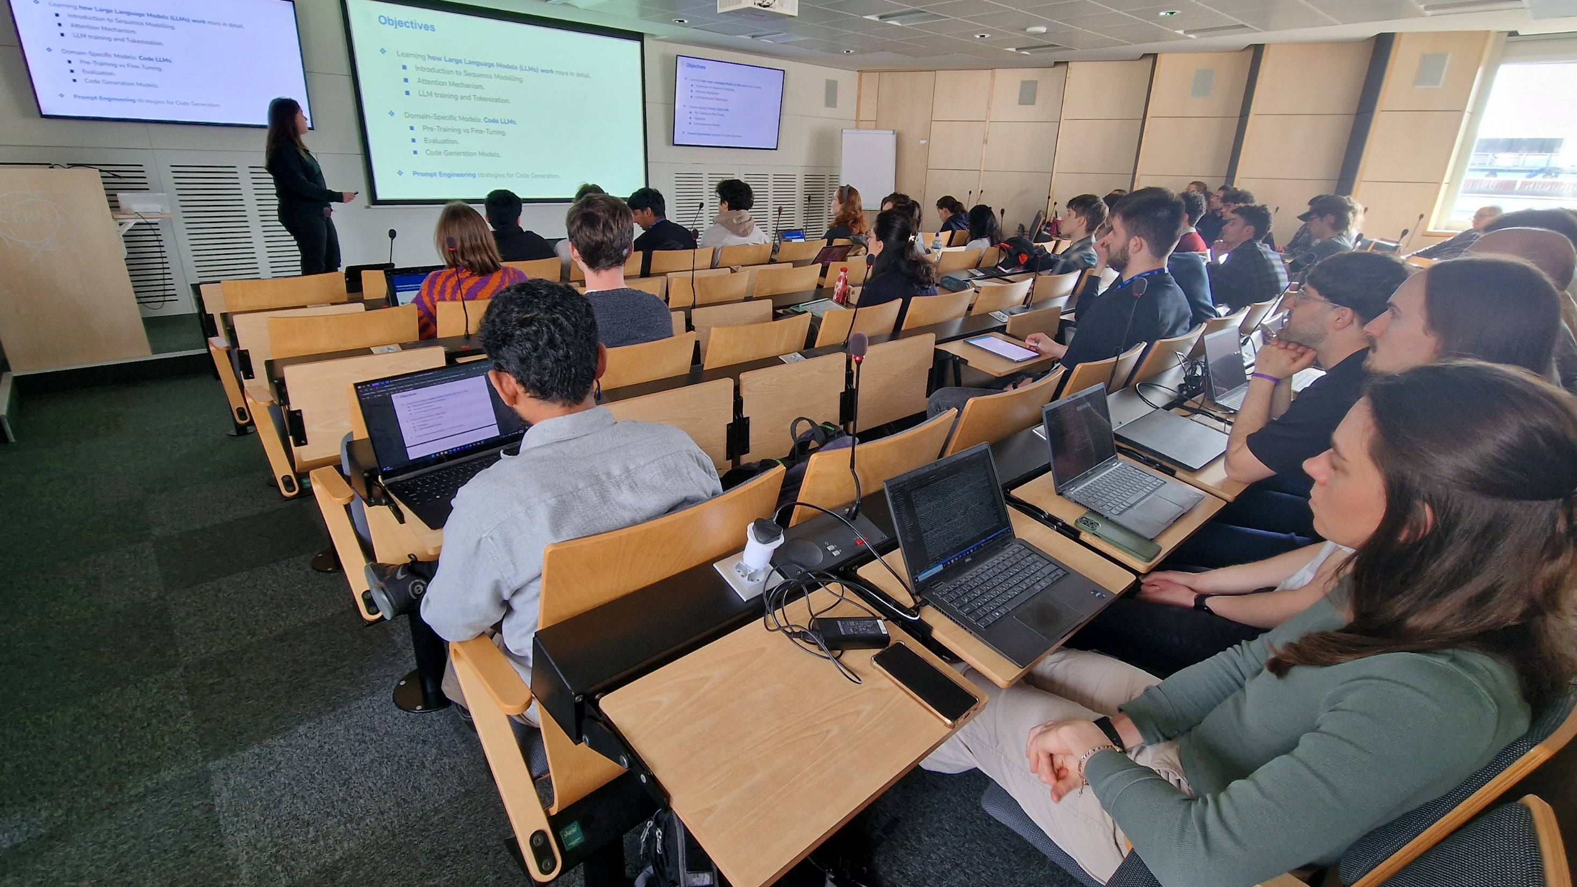

Slide 43
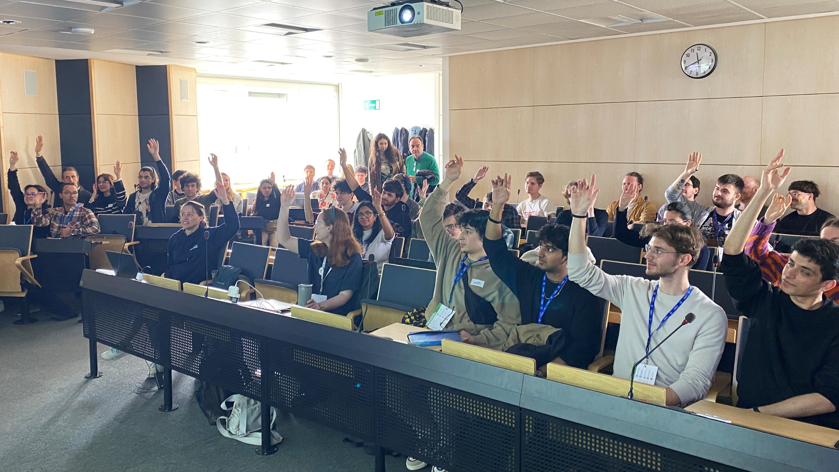

Slide 44
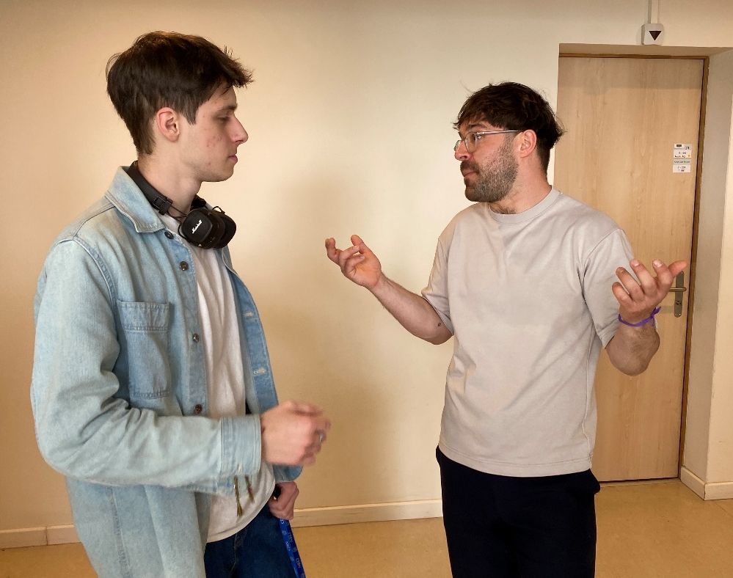
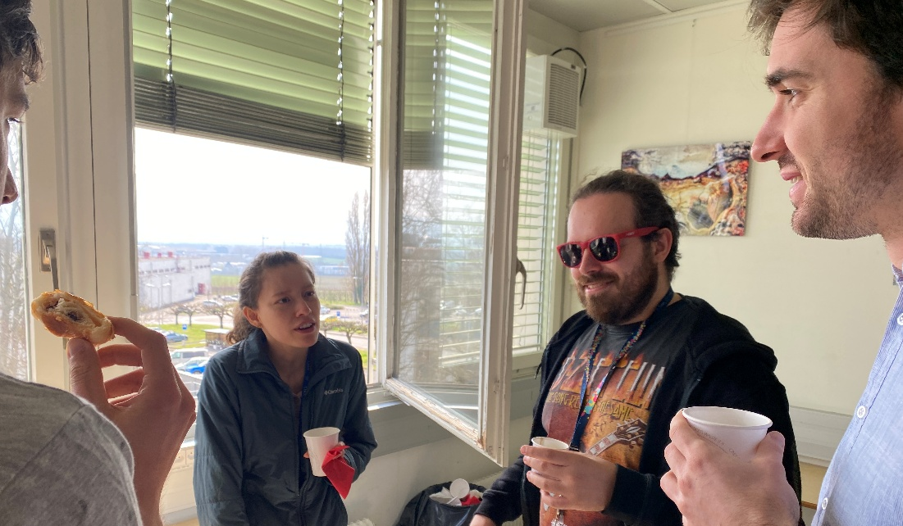
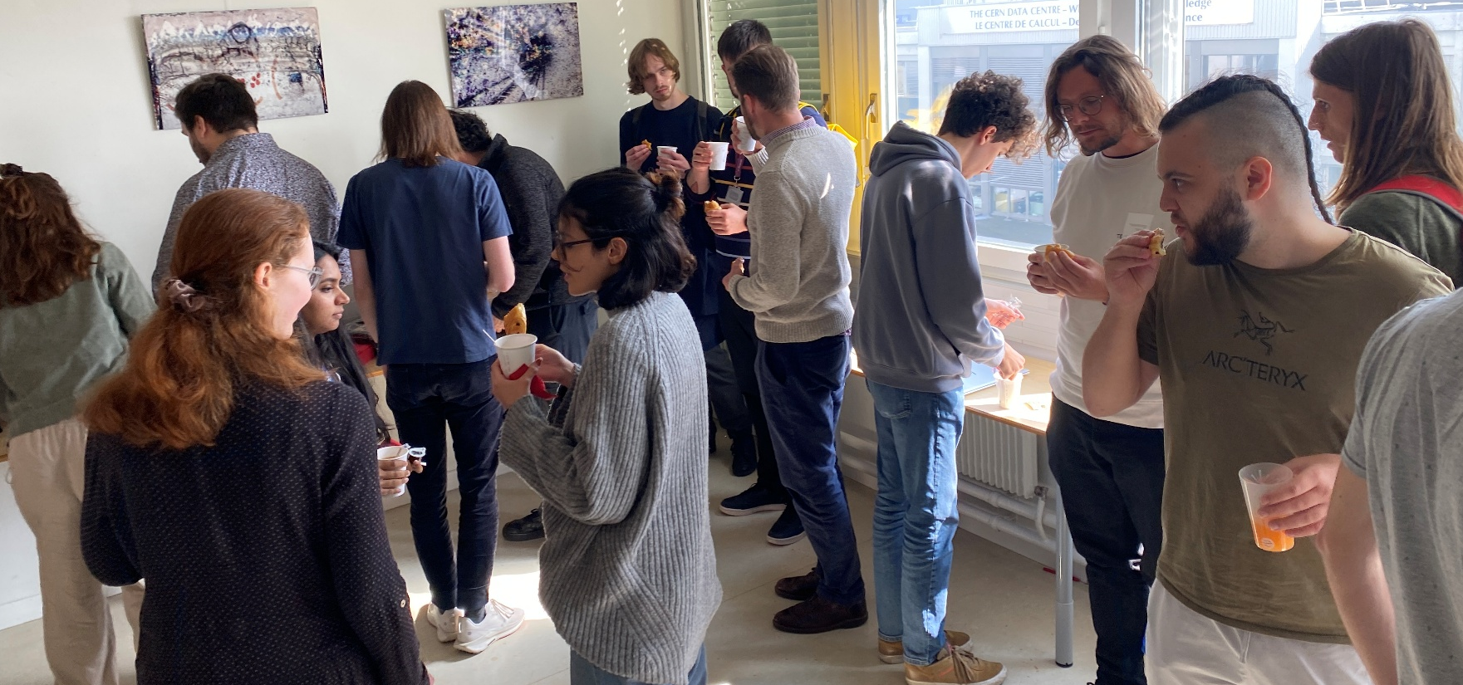
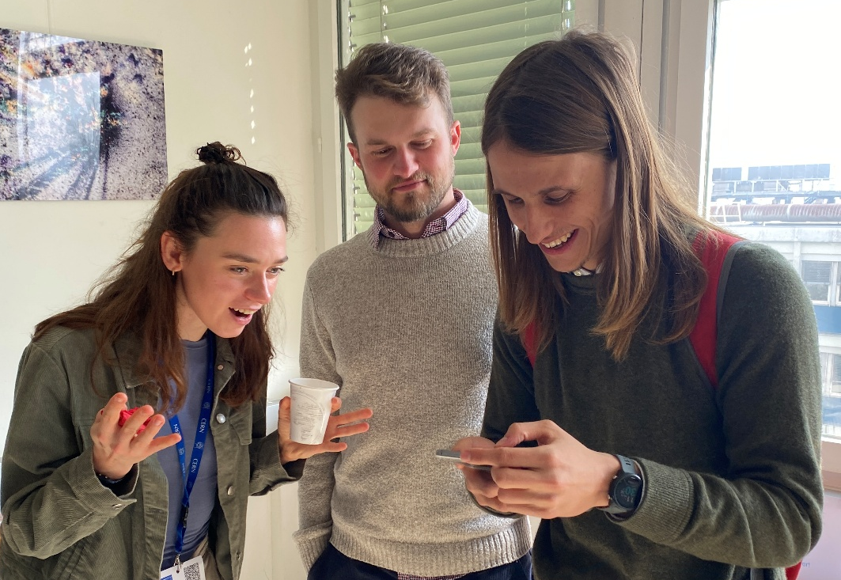
Coffee breaks !

Slide 45
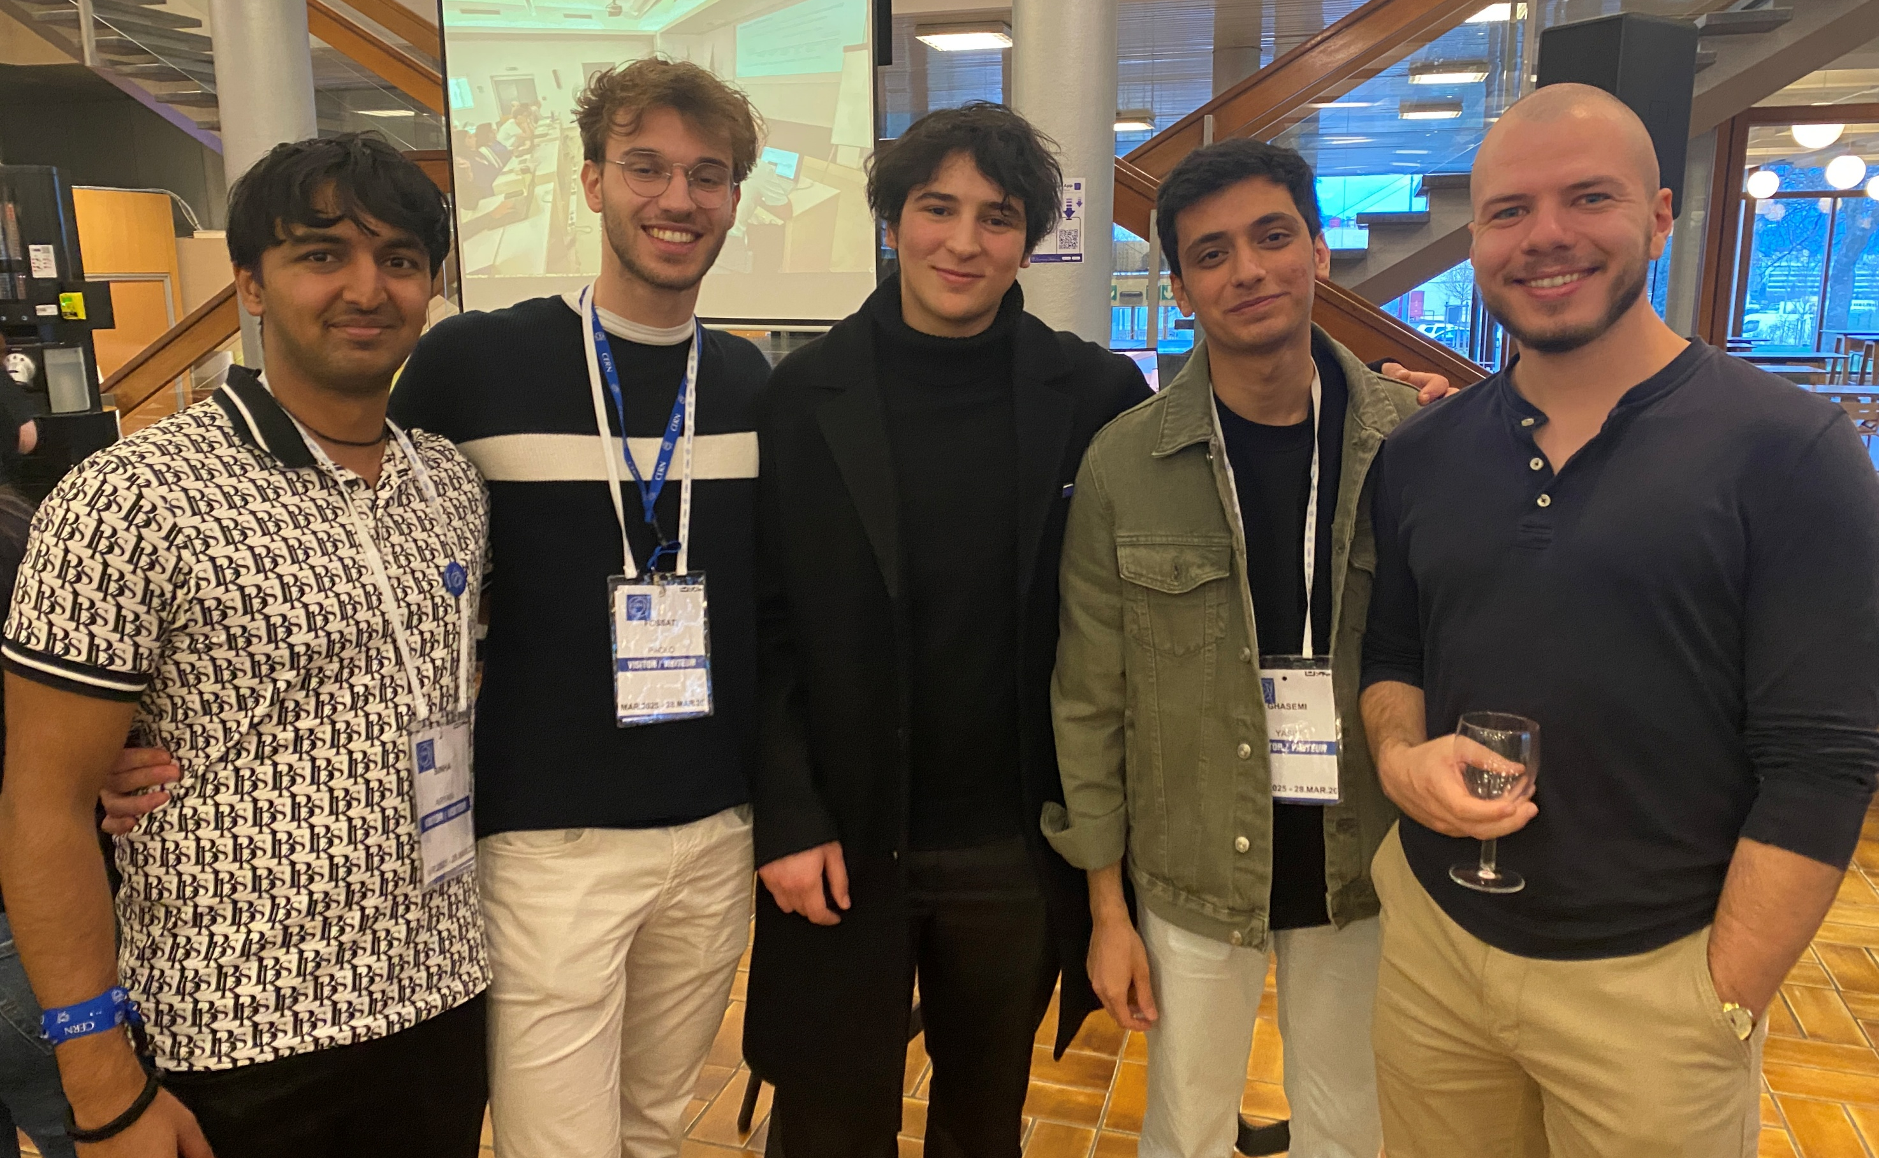

Slide 46
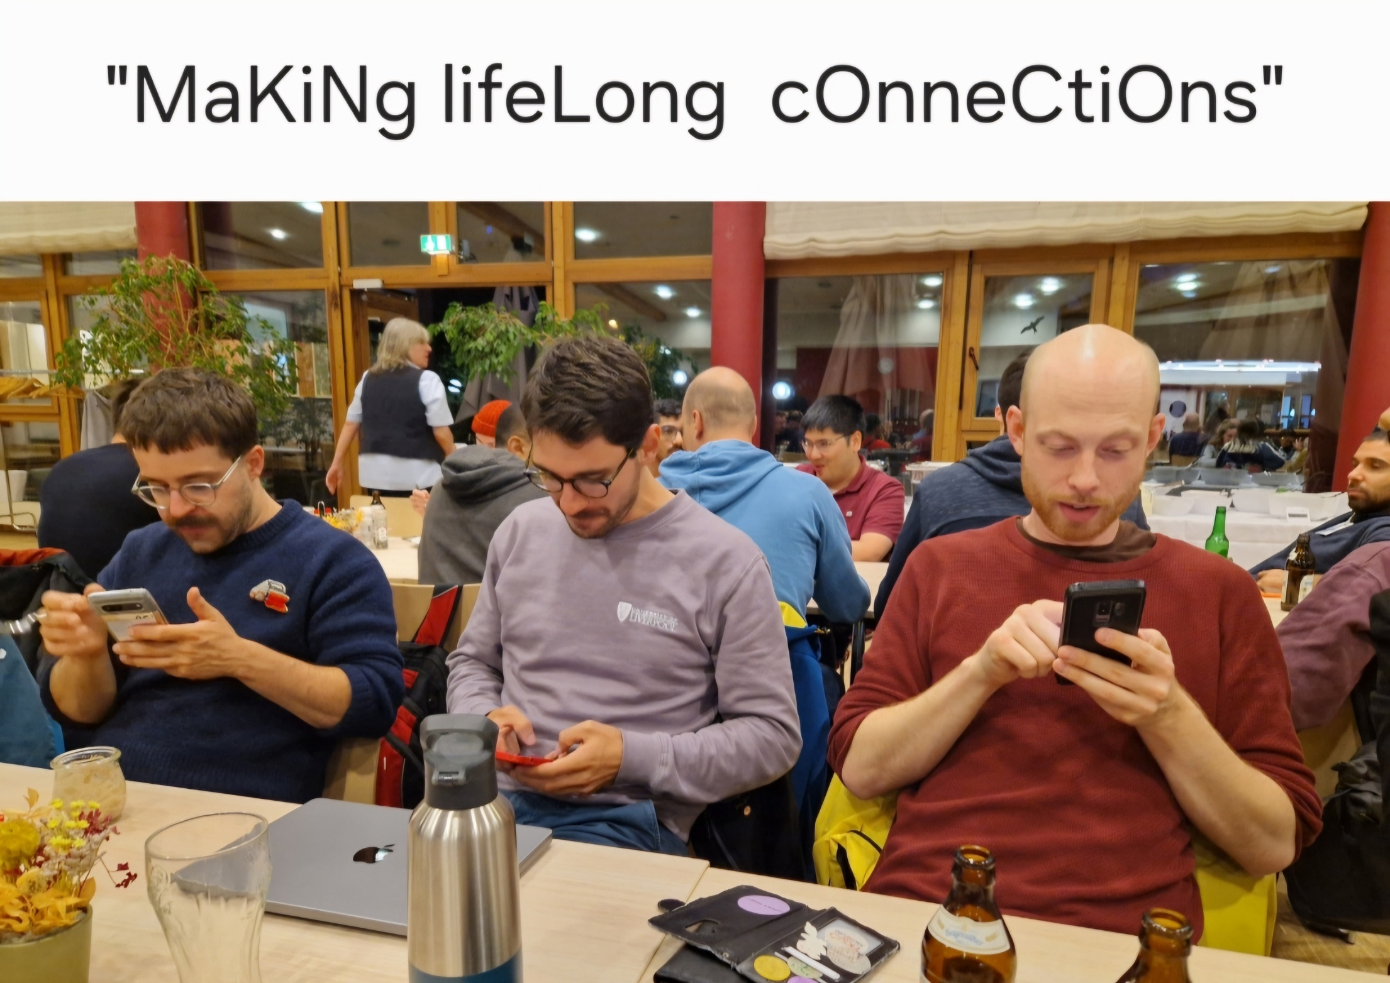

Slide 47
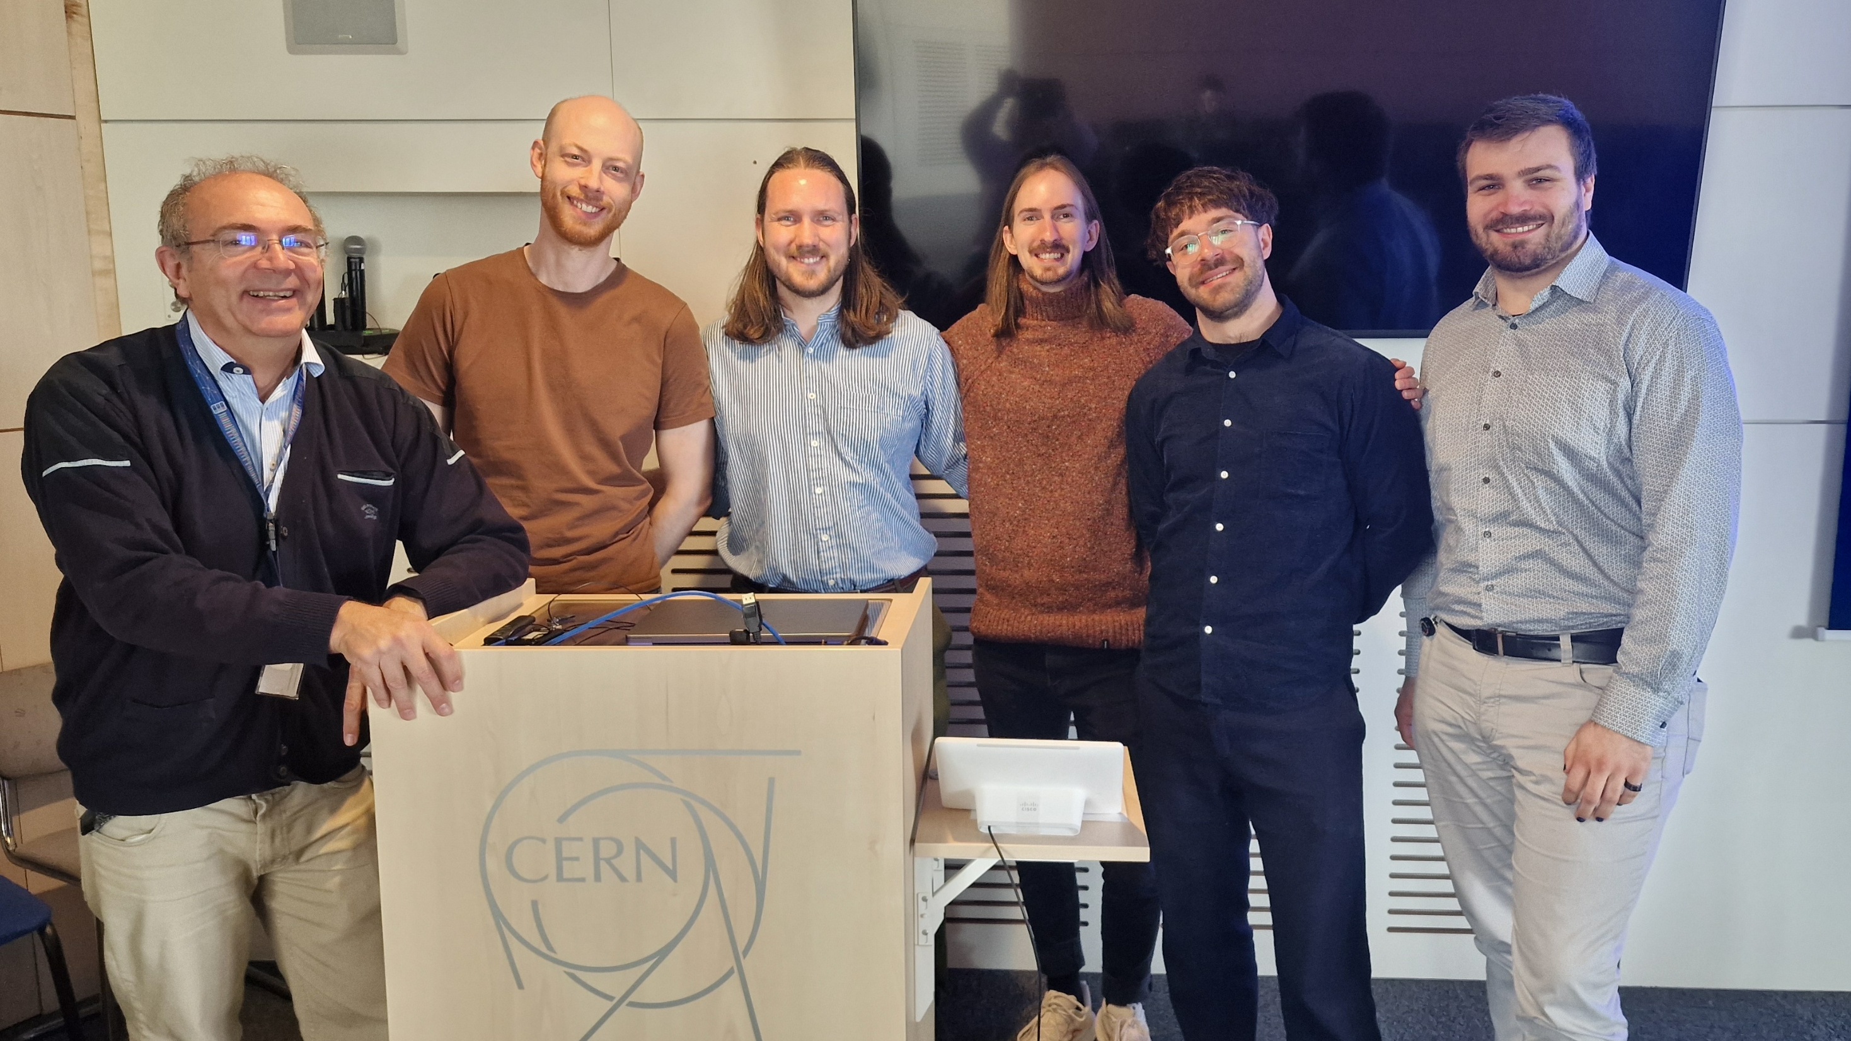

Slide 48
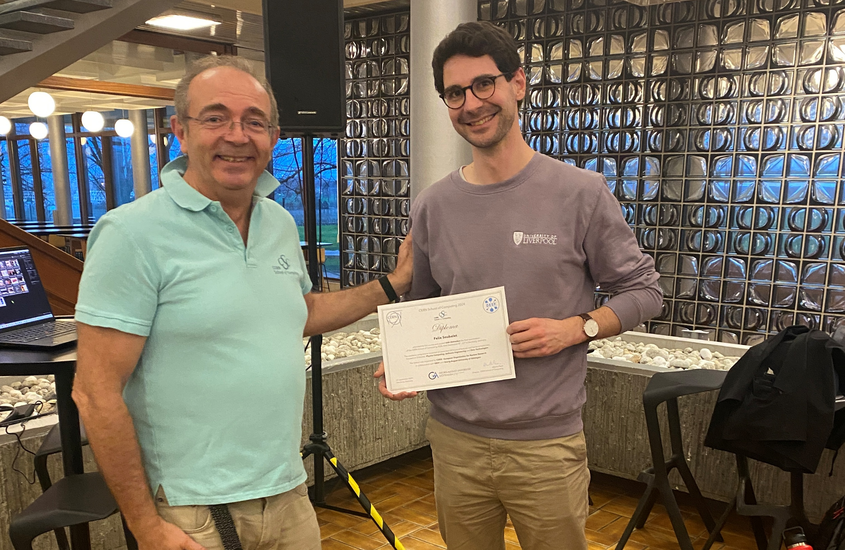

Slide 49
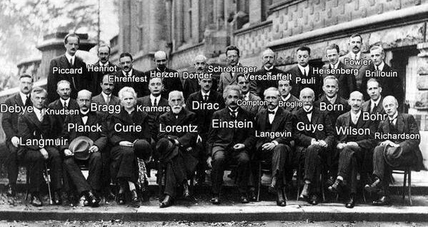
It is a small world …
All top scientists knows each other very well

Slide 50
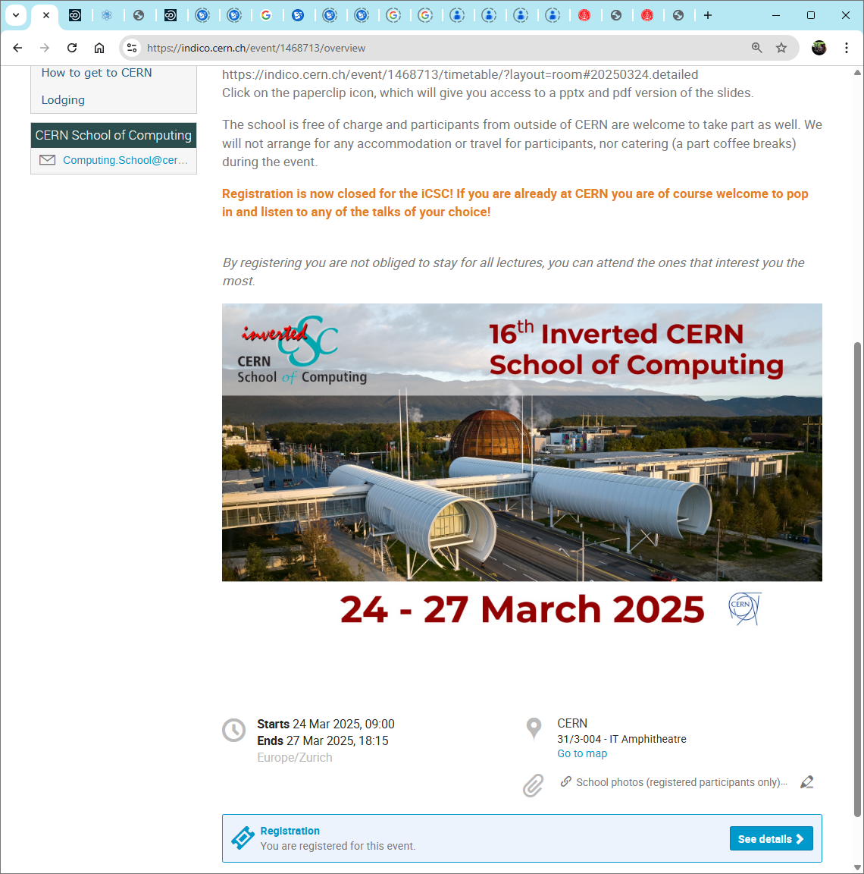

Slide 51
This school was brought to you by…
Kristina GUNNE
Administrative Manager
Andrzej NOWICKI
Technical Manager
Alberto PACE
School Director

Slide 52
... And this year’s 16 lecturers (12 in 2024)
Sten Astrand | CSC 2024 (Hamburg)
Niels Alexander Buegel | CSC 2024 (Hamburg)
George Coldstream | CSC 2024 (Hamburg)
Kaare Endrup | CSC 2024 (Hamburg)
Lorenz Gartner | CSC 2024 (Hamburg)
Andrea Germinario | CSC 2024 (Hamburg)
Peter Hinderberger | tCSC 2024 (Belgrade)
Elizabeth Mamtsits | CSC 2023 (Tartu)
Jack Charlie Munday | tCSC 2024 ML (Split)
Alberto Pimpo | CSC 2023 (Tartu) / tCSC 2024 ML (Split)
Diogo Reis Santos | tCSC 2023 (Split)
Vasvi Sharma | tCSC on Security 2023 (Split)
Simon Thiele | CSC 2023 (Tartu) / tCSC 2024 ML (Split)
Andrea Valenzuela Ramirez | CSC 2023 (Tartu)
Cedric Verstege | tCSC 2024 (Belgrade)
Joel Axel Wulf | tCSC 2024 (Split)

Slide 53
Sten Astrand
George Coldstream
Simon Thiele
Diogo Reis
Andrea Germinario
Lorenz Gartner
Niels Buegel
Kaare Endrup
Peter Hinderberger
Elizabeth Mamtsits
Alberto Pimpo
Vasvi Sharma
Andrea Valenzuela
Jack Munday
Joel Wulf
Cedric Verstege

Slide 54
tCSC 2023 – Security (Split)
Diogo
Vasvi

Slide 55
CSC 2023 (Tartu)
Andrea
Simon
Alberto
Elizabeth

Slide 56
tCSC 2023 – Heterogeneous Architectures (Split)
Kaare
Sten

Slide 57
tCSC 2024 – Heterogeneous Architectures (Belgrade)
Cedric
Peter

Slide 58
CSC 2024 (Hamburg)
Lorenz
George
Sten
Andrea
Kaare
Niels

Slide 59
tCSC 2024 – Machine Learning (Split)
Jack
Simon
Joel
Alberto

Slide 60
Every presentation is supervised by mentors
This year’s mentors:
  Guilherme Amadio
  Aurindo Barros
  Francisco Borges
  Bob Jacobsen
  Verena Kain
  Judith Katzy
  Sebastian Lopienski
  Andrzej Nowicki
  Alberto Pace
  Danilo Piparo
  Sebastien Ponce
  Toni Sculac
  Michael Schenk
  Sofia Vallecorsa
  Francesco Vaselli
THANK YOU !

Slide 61
Upcoming CSC schools …
TODAY
Registration closes
Wednesday 9 April

Slide 62
but wait… there’s more
Registration
opens soon
NEW!

Slide 63
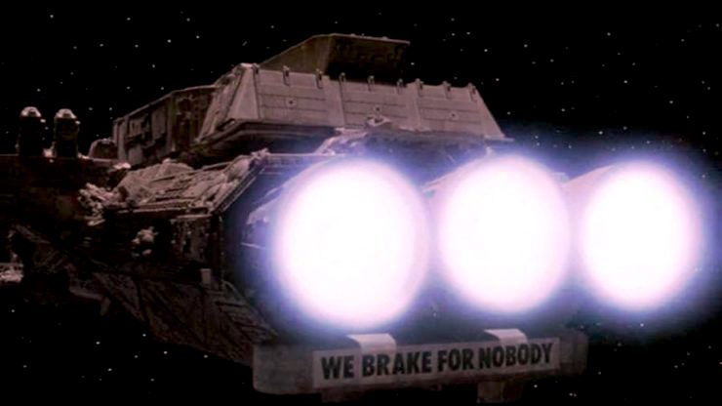
It is not over yet !
Spaceballs, Mel Brooks, 1987
https://www.youtube.com/watch?v=1dZveoBfiww

Slide 64
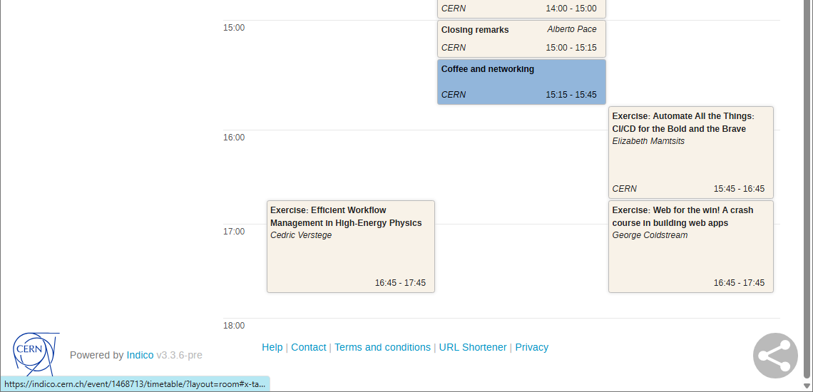
It is not over yet !

