Slide 1
BDF applications for advanced nuclear systems and other potential uses
Vicente Bécares
vicente.becares@ciemat.es
Unidad de Innovación Nuclear
Departamento de Fisión Nuclear
CIEMAT
Avda. Complutense 40, 28040 Madrid – España

Slide 2
Introduction
Some basic facts to begin with…
CERN BDF can be considered a 350 kW neutron spallation source → among the most powerful spallation targets in the world
400 GeV protons are not efficient for neutron production → still ~10¹² n/cm²/s can be achieved
Long operating periods → suitable for an irradiation facility
Neutron production is a secondary application: neutrons can be obtained “for free”
Potential applications of BDF neutrons
Nuclear data measurements
Radiation effects in electronics
Material testing for advanced nuclear systems
  Fast reactors & ADS
  Fusion
Fast Neutron Activation Analysis (FNAA)

Slide 3
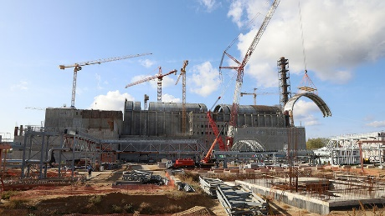
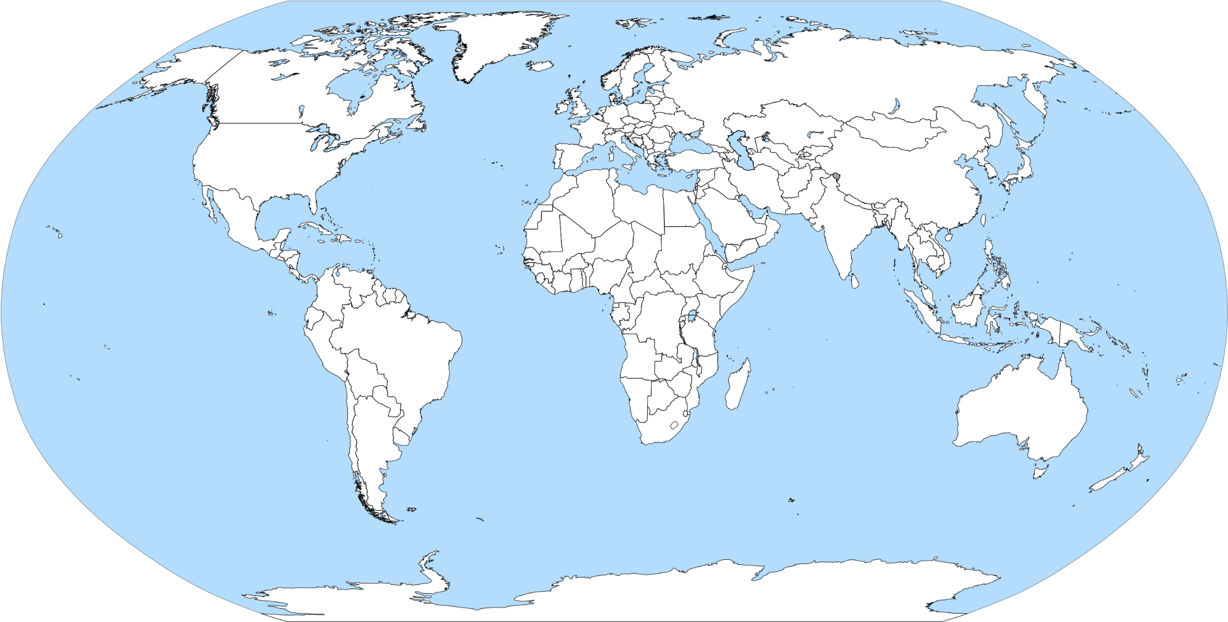
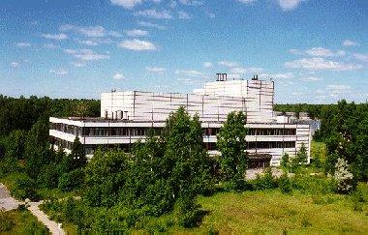
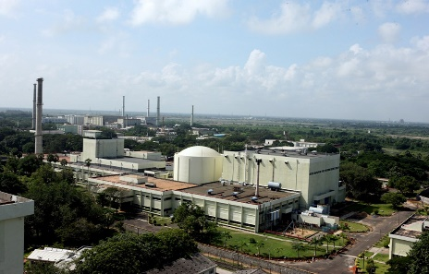
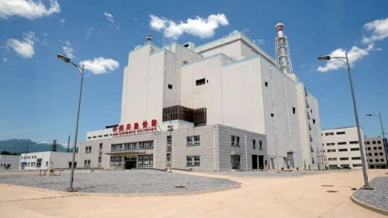
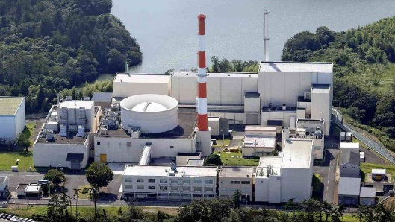
Fast spectrum irradiation facilities
MYRRHA (2036?)
~100 MW_{th}
Up to ~10¹⁵ n/cm²/s
(t.b. approved)
MBIR (2027)
150 MW_{th}
5.3×10¹⁵ n/cm²/s
VTR (suspended 2022)
~300 MW_{th}
>4.0×10¹⁵ n/cm²/s
BOR-60 (1968)
60 MW_{th}
3.7×10¹⁵ n/cm²/s
FBTR (1985)
40 MW_{th}
3.3×10¹⁵ n/cm²/s
CEFR (2010)
65 MW_{th}
3.7×10¹⁵ n/cm²/s
Joyo (1977)
140 MW_{th}
3.0×10¹⁵ n/cm²/s
To restart in 2026

Slide 4
Fast flux in thermal MTRs
No dedicated fast spectrum irradiation facility available to western countries (at lest until JOYO restart scheduled for 2016).
Fast neutron fluxes can be achieved in thermal MTRs through thermal neutron absorbers.
  Lower fluxes and DPA’s than in dedicated fast reactors.
  Major impact in reactor performance (depression in the flux).
None implemented (as far as I know).
  Plans to set up in JHR devices for material testing for SFR (RISHI loop) and fusion (FUSERO device), but without neutron absorbers.
Reactor irradiations are very expensive (~M€ range).
Reactor (power) | Peak fast neutron flux (n/cm²/s, E>0.1 MeV) | Max. dpa/yr
BOR-60 | 2.04E+15 (E>0.4 MeV) | 25
JOYO | 4.0E+15 | >15 (36)
VTR | >4.0E+15 | >30
MYRRHA (v1.6) | 1.0E+15 (E>0.75 MeV) | 31
JHR (U₃Si₂, 70 MW_{th}) | 7.5E+14 | 9 (270 days)
JHR (UMo, 100 MW_{th}) | 1.0E+15 | 16 (270 days)
ATR (110 MW_{th}) | 5.5E+14 | 6 (250 days)
ATR (250 MW_{th}) | 1.3E+15 | 10 (180 days)
HFIR (85 MW_{th}) | 1.3E+15 | 14 (161 days)
  M. Worrall et al., Fast neutron irradiation capability in existing thermal test reactors. Annals of Nuclear Energy 207 (2024) 110731.
  J. Roglands-Ribas et al., The Versatile Test Reactor Project: Mission, Requirements, and Description. NSE 196 sup. 1 (2022) 1-10.
  G. J. Youinou, Preliminary Options Assessment of Versatile Irradiation Test Reactor: Neutron Fluxes in Test Reactors. INL/EXT-17-40962, January 2017.
  G. Van der Eynde et al., MYRRHA design revision 1.6 and the phase approach. In TCADS-3, Mito (Japan) 6-10 September 2016.
  E. J. Pitcher, The materials test station: A fast-spectrum irradiation facility, Journal of Nuclear Materials 37 (2008) 17-20.
  W. F. Skerjanc and G. R. Longhurst, Gas Test Loop Facilities Alternatives Assessment Report. INL/EXT-05-00263 rev. 1, July 2005.

Slide 5
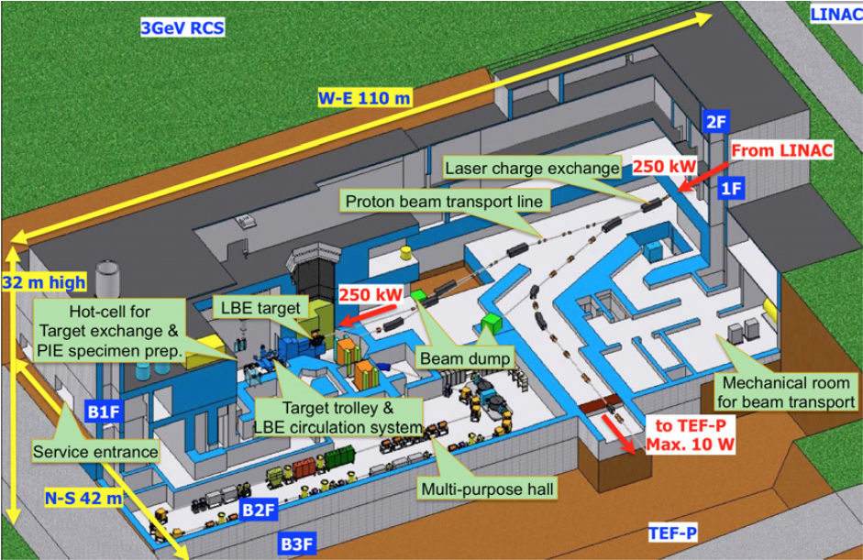
Spallation sources for material irradiation
Transmutation Experimental Facility – Target (TEF-T) at J-PARC
Liquid Pb-Bi target, 400 MeV/250 kW proton LINAC
Material irradiation for ADS (beam window).
Up to 7 dpa/yr.
Project suspended after the Fukushima accident.
  F. Maekawa et al., J-PARC Transmutation Experimental Facility Program. Plasma and Fusion Research 13 (2018) 2505045. DOI: 10.1585/pfr.13.2505045.
  T. Sasa, Design of J-PARC Transmutation Experimental Facility. Progress in Nuclear Energy 82 (2015) 64-68. DOI: 10.1016/j.pnucene.2014.07.031.
Materials Testing Station (MTS) at Los Alamos National Laboratory
Solid W spallation target, water cooled, 800 MeV/1MW proton LINAC
Fuel irradiation for fast reactors
1.4×10¹⁵ n/cm²/s (E > 0.1 MeV) and 17 dpa/yr (or ~8 considering availability)
Estimated cost (2008): US$ 73M
Reflector (W)
Spallation target (W)
Beam
dump
Proton beam
Fuel rods
  E. J. Pitcher, The materials test station: A fast-spectrum irradiation facility, Journal of Nuclear Materials 37 (2008) 17-20.
  W. F. Skerjanc and G. R. Longhurst, Gas Test Loop Facilities Alternatives Assessment Report. INL/EXT-05-00263 rev. 1, July 2005.
Irradiation samples

Slide 6
Material testing for fusion
IFMIF-DONES (2033?)
  Up to 5×10¹⁴ n/cm²/s and ~15 dpa/yr
  Max. 32 irradiation capsules × 46 cm³ each = 1472 cm³.
  A. Ibarra et al., The European approach to the fusion-like neutron source: the IFMIF-DONES project. Nuclear Fusion 59 (2019) 065002
Proposed NG-based facilities (none built)
  New Sorgentina (ENEA): ~10¹⁵ n/s, 2.5×10¹³ n/cm²/s, ~2 dpa/yr
  A. Pietropaolo et al., The New Sorgentina Fusion Source-NSFS: 14 MeV neutrons for fusion and beyond. Journal of Physics: Conference Series 746 (2016) 012037.
  University of Wisconsin/PNL: 12-16 × ~10¹⁴ n/s, ~4 dpa/yr, 21 M$
  G. L. Kulcinski et al., Near term, low cost, 14 MeV fusion neutron irradiation facility for testing the viability of fusion structural materials. Fusion Engineering and Design 109–111 (2016) 1072–1076. .
  HINEG-II (Chinese Academy of Sciences): 10¹⁴-10¹⁵ n/s
  Y. Wu, Development of high intensity D–T fusion neutron generator HINEG. International Journal of Energy Research 42 (2018) 68–72.
FLARE (Shine Technologies, Janesville, Wisconsin, USA)
  Up to 4×10⁹ n/cm²/s
  Commercial irradiation services for RHT
  https://www.shinefusion.com/flare

Slide 7
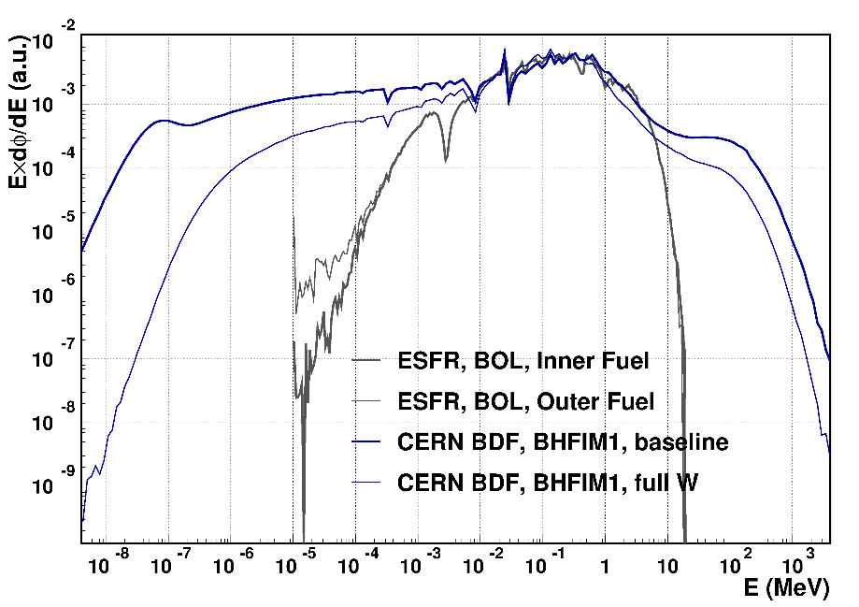
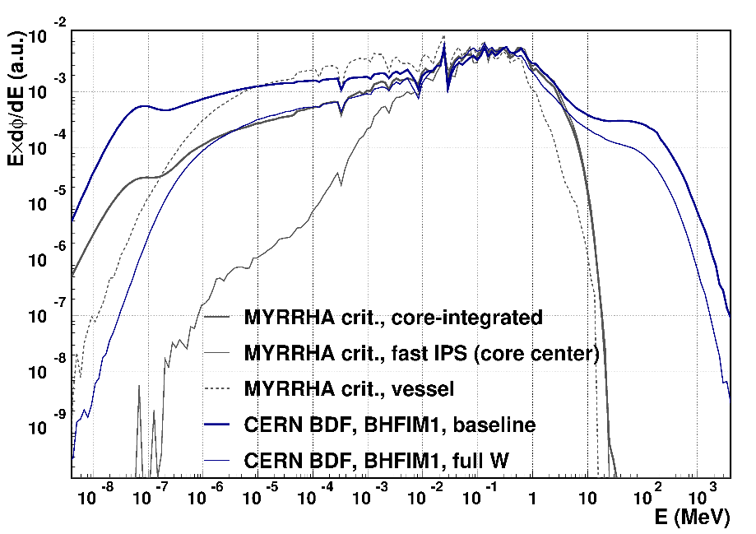
BDF flux & spectrum vs fast reactors
Average neutron fluxes and dpa’s in several BOR-60 components
Component | Av. neutron flux (n/cm²/s) | dpa/yr
Basket | 5.24E+13 | 0.36
Vessel | 2.62E+13 | 0.18
Jacket | 2.10E+13 | 0.14
Collector | 4.51E+13 | 0.33
Pins of SRP plates | 6.60E+13 | 0.51
Pins of LRP plates | 4.61E+13 | 0.36
Outlet sleeve | 2.62E+12 | 0.020
Inlet sleeve | 9.64E+10 | 0.0011
Reactor support | 7.23E+12 | 0.051
A. I. Izhutov et al., Prolongation of the BOR-60 reactor operation. Nuclear Engineering and Technology 47 (2015) 253-259
Neutron fluxes in CERN BDF
Component | Baseline | Full W
BHFIM1 | 1.4E+12 | 4.2E+12
BHFIM2 | 5.9E+11 | 2.0E+12
BIAS | 4.9E+11 | 1.5E+12
BRIS | 1.5E+11 | 4.4E+11
BEAS | 4.0E+09 | 1.4E+10
Fast spectrum in BDF favours a higher DPA number (estimates required)

Slide 8
Material irradiation at BDF: SWOT
Strenghts
  Low cost / easy licensing procedures (?)
  Large space available → many samples simultaneously and/or other instruments
  Irradiation facility: long irradiation times (required to achieve many DPAs)
  Only fast spectrum irradiation facility in the world this within its intensity range
  Existing infrastructure at CERN
Weaknesses
  Relatively low flux → low DPAs
  Neutron spectrum not representative of fast reactors or fusion facilities (not a problem for basic studies)
  Likely presence of many particles other tan neutrons (may be an advantage).
  Target accessibility (not a major issue since long irradiations required to achieve high DPA values)
  Accelerator downtime → reduced irradiation time
Opportunities
  High cost of reactor irradiations (not accessible for fundamental research or academic researchers)
  Neutron flux typical of reactor vessel or externals → useful for material rather than fuel testing (easier licensing)
  Low flux → low activation → easy handling and transport
Threats
  New fast neutron irradiation facilities: JOYO reactor (2026) in Japan is the only planned before 2030 (to my knowledge)

Slide 9
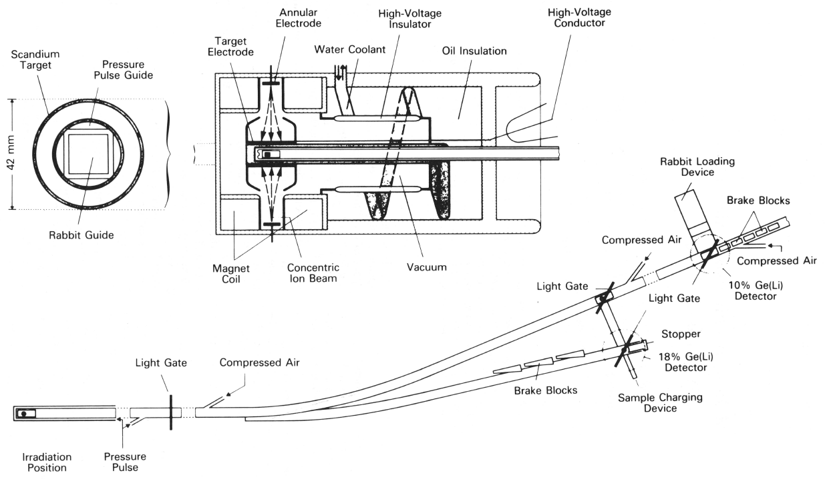
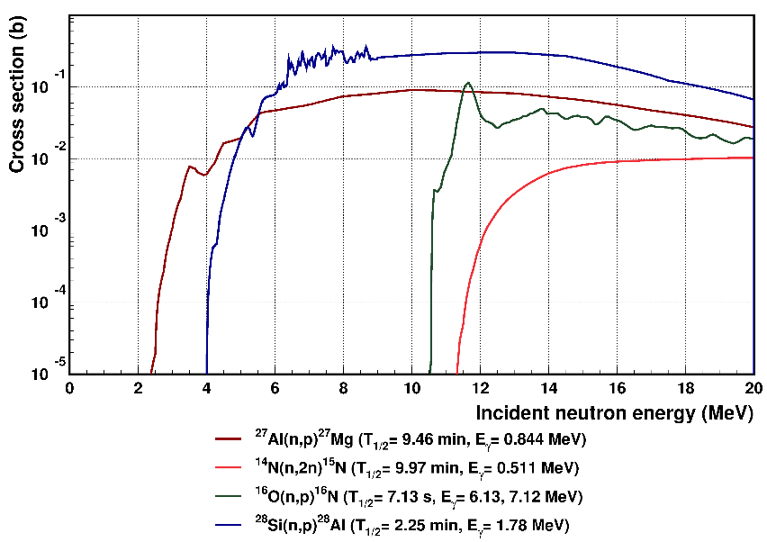
Fast Neutron Activation Analysis (FNAA)
KORONA (GKSS Geeshacht, 1981)
  5×10¹² n/s, 5×10¹⁰ n/cm²/s
  14 MeV neutrons
  Rabbit system
  FNAA (primary use), cross section measurements
  R. Pepelnik et al., KORONA, An Intense Sealed-Tube 14-MeV Neutron Generator. Nuclear Science and Engineering 106 (1990) 243–248.
  Commercial NG-based facility: 5×10¹⁰ n/s, 3×10⁸ n/cm²/s
  J. D. Simpson et al., The A-711 high yield neutron generator and automated pneumatic transfer system for fast neutron activation analysis. NIMB 241 (2005) 228–231
  Neutron Generators for Analytical Purposes, IAEA Radiation Technology Reports Series No. 1 (2012)
Advantages of CERN’s BDF for FNAA
  Higher fluxes than NG-based facilities (>10¹¹ n/cm²/s)
  High neutron energies → new reaction channels for FNAA
  Availability of a Rabbit system, no major infrastructure required
  Service for external users: archaeology, environmental science…

Slide 10
Summary & future work
Summary: material irradiation
  BDF can be of interest for material irradiation.
  Major limitation is the low neutron flux.
  The shortage of fast neutron irradiation facilities and the high cost of irradiations at MTRs opens a window of opportunity for BDF
Summary: FNAA
  A FNAA should be easy to implement and has the potential of being the most intense such facility in the world.
Suggested actions & key points
  Calculating achievable DPAs in the facility
  Assess other available experimental facilities at CERN for sample handling (e.g hot cells)
  Radiation damage modelling (neutrons and other particles) to assess representativity → reach out for experts in the field
  Sample temperature monitoring is critical. Temperature control and/or sample heating (up to a few hundred ºC) desirable
  More complex equipment to be evaluated at a later stage. E.g. Na or Pb loops (require oxygen control)
  Possibility to irradiate nuclear fuel (fissile material)?

Slide 11
Acknowledgements
This work has been supported by the ENRESA-CIEMAT agreement “Tecnologías Disponibles para la Transmutación de Radionucleidos de Vida Larga’’.
I would also like to thank Mercedes Hernández-Mayoral of the Unit of Microstructural Characterization and Microanalysis of CIEMAT for her valuable comments.

