Slide 1
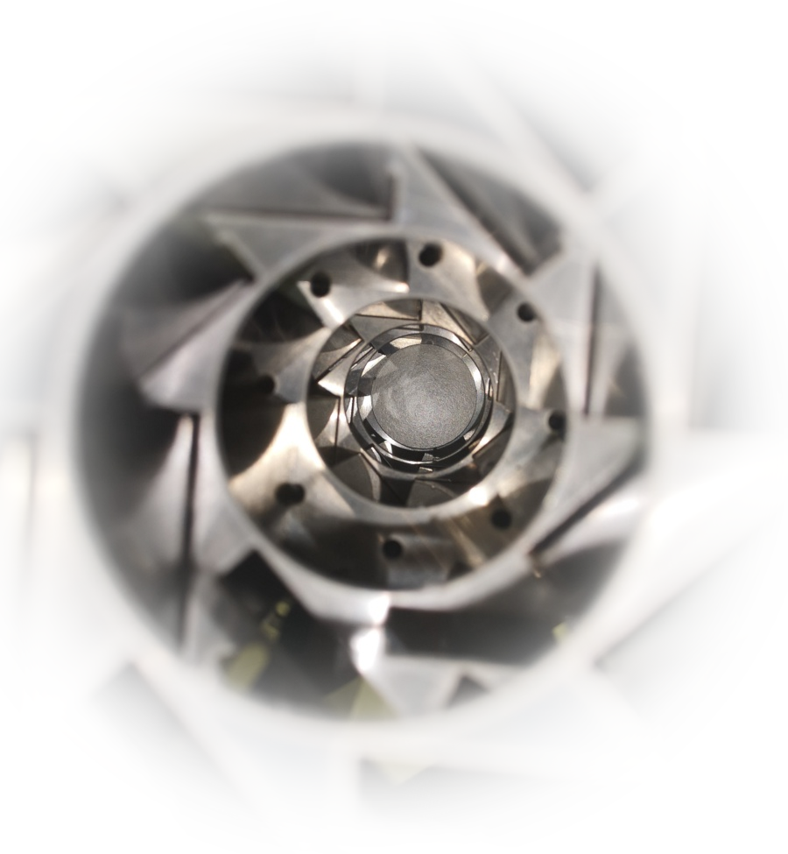
Future challenges for radiation hard materials in HEP experiments
Nicola Pacifico

Slide 2
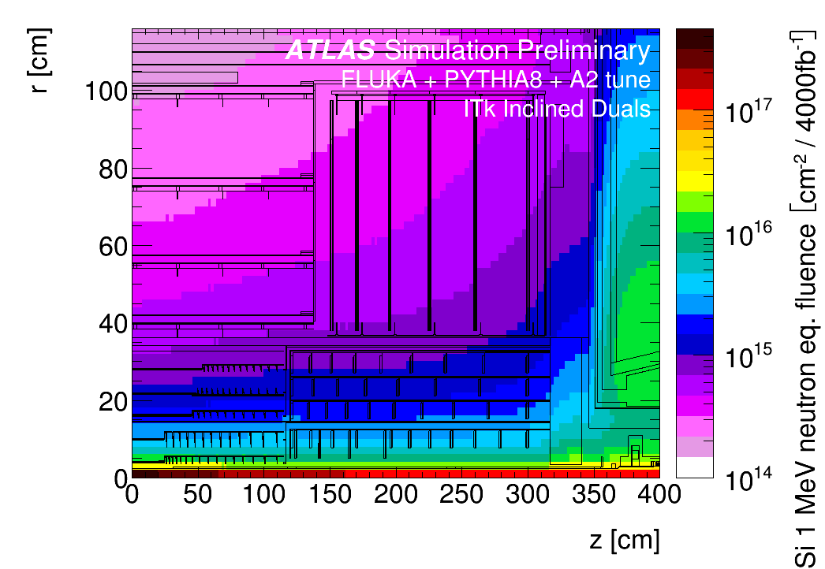
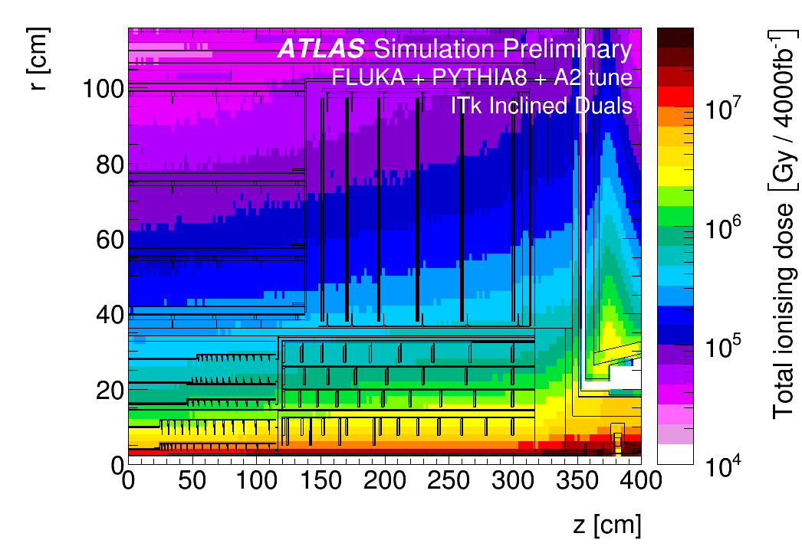
[Old] Motivation: the HL-LHC radiation environment
Outer Tracker:
~ 0.1 MGy, 10¹⁴ n_{eq}/cm²
Outer Pix:~ 1 MGy, 10¹⁶ n_{eq}/cm²
Inner Pix:~ 10 MGy, 10¹⁷ n_{eq}/cm²
An unprecedented radiation level for HEP experiments
Significant performance degradation expected from radiation damage for
  Sensors
  Electronics
  Mechanics / services
Inadequate existing data con radiation performance of many custom or commercial materials => new tests were required on many materials.

Slide 3
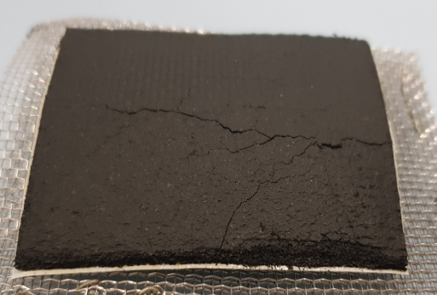
Motivation: radiation damage in materials
Radiation damage mechanisms
Ionization damage | Displacement damage
Conductors/semiconductors: | All materials:
Totally recoverable | Typically not recoverable at room temperature Macroscopic effects on structural properties are usually noticeable at relatively high fluences (~>10¹⁸ n/cm²) Electrical properties in semiconductors affected at doping concentration levels (~>10¹⁰ n/cm²)
Insulators:
Not recoverable In polymers: degradation of polymeric chains Charging up of passivations

Slide 4
Present rationale
In current (LS3) scenarios
Logistic limitations in destructive
testing of activated materials
(after hadron irradiation)
Ionization damage
overwhelming in polymers
Gamma irradiation only
viable option (for systematic
testing)

Slide 5
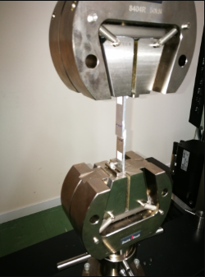
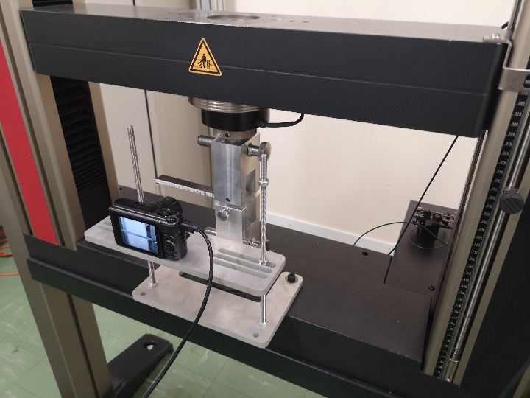
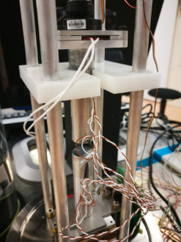
Common test standards
Standard | Test structure | Quantity
ASTM D1002 | Single lap joints | Apparent lap shear strength
ISO 25217 | Double cantilever beams | Mode 1 fracture energy
ASTM D638 | Dogbones | Tensile properties
ASTM D5740 | Cast discs/ sandwiches | Apparent thermal conductivity

Slide 6
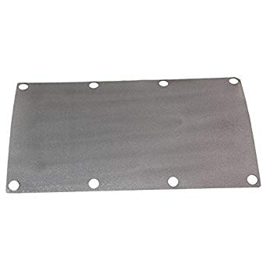
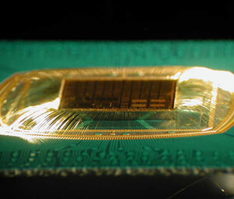
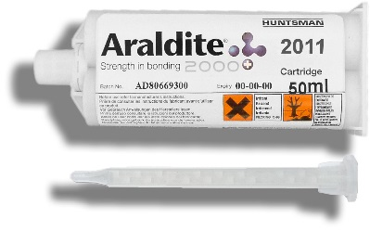
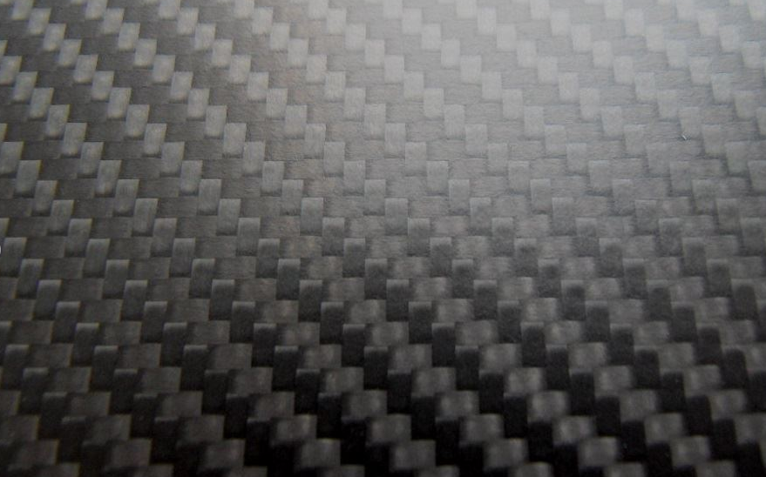
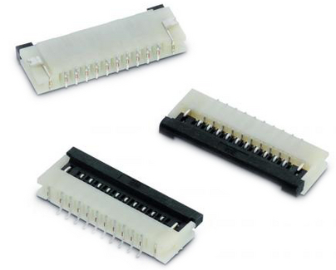
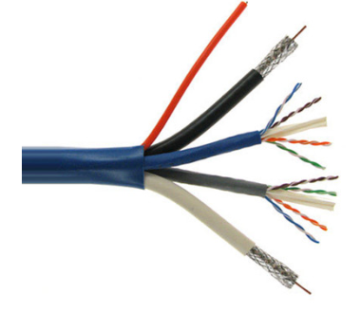
Materials of interest (categories):
Adhesives (epoxies, impregnations glues, thermally conductive glues, tapes)
Encapsulants
Thermally conductive interfaces
Connectors
Cables
CFRP or Carbon Foam structure
… and more as they come…

Slide 7
Testing materials:
Irradiation facilities

Slide 8
Aging/irradiation tests: some considerations
Most reliable scenario: irradiation in “free spots” in experimental caverns
Pros: - radiation field reflects the “real” one
- comes for “free”
Cons: - long irradiation times (years) – planning often doesn’t allow this
- environment can be tricky (standard atmosphere, no humidity control)
- samples can be accessed only during shutdowns
Realistically achievable scenario: irradiation in dedicated high rate facilities
Pros: - short irradiation turn-over times (suitable e.g. for R&D)
possibility
Cons: - accelerated aging can be not fully representative of “real” aging
(there is evidence of dose rate dependence of degradation
on some materials)
- necessary to control temperature and ozone formation
- can be expensive

Slide 9
Specialized irradiation facilities
(examples, mentioned for completeness, but not pertinent to this talk)
Type | Field characteristics | Application
> GeV protons | High dose rate, small sample size (~cm^2) or scanning table (with lower effective dose rate). Close approximation of “real” usage conditions in HEP. Significant sample activation. | Small material samples, active and passive electronics, small prototypes (up to 10x10 cm2).
~100 MeV Pions | Medium dose rate, small sample size or scanning table. Close approximation of “real” usage conditions in HEP. Significant sample activation, limited availability (no specialized facility, mostly piggybacking on HEP experiments) | Small material samples, active and passive electronics, small prototypes (up to 10x10 cm2).
Synchrotron light sources | Extremely high instantaneous dose rate, on small volumes. No activation. Suitable for specialized detector irradiation studies. | Small detectors, active and passive electronics. Highly localized irradiation (beam size ~10 um)

Slide 10
Standard irradiation facilities
Type | Field characteristics | Application
~20-70 MeV protons (cyclotrons, synchrotrons) | High dose rate, small sample size (~cm^2) or scanning table (with lower effective dose rate). Significant bragg peak – dose tuning difficult for different samples. Combination of displacement and ionization damage | Active and passive electronics, small prototypes (up to 10x10 cm2).
~10 MeV neutrons | High dose rate, medium sample size, good irradiation uniformity, no direct ionizing energy loss. | Material samples, active and passive electronics, small prototypes (up to 10x10 cm2).
Gamma (60Co or 137Cs) | High instantaneous dose rate, on large volumes. No activation. Very good radiation uniformity. | Material samples, active and passive electronics.
~5-10 MeV electrons | Very high instantaneous dose rate, large areas can be scanned quickly, limited penetration depth. | Small (thin) samples, active and passive electronics
Comprehensive list of irradiation facilities at https://irradiation-facilities.web.cern.ch/

Slide 11
Choice of the irradiation facility
TANSTAAFL: “There ain’t no such thing as a free lunch” (R. A. Heinlein)
TANSTAAIIF: There ain’t no such thing as an “ideal” irradiation facility.
Field | Gamma | Protons * | Neutrons | Electrons | Mixed
Large volume irradiation
Reasonable irradiation time
Representative radiation field
Lack of material activation
Irradiation depth uniformity
* Note: only 20-70 MeV proton sources are considered – the few (worldwide) GeV proton sources cannot handle a material characterization campaign.

Slide 12
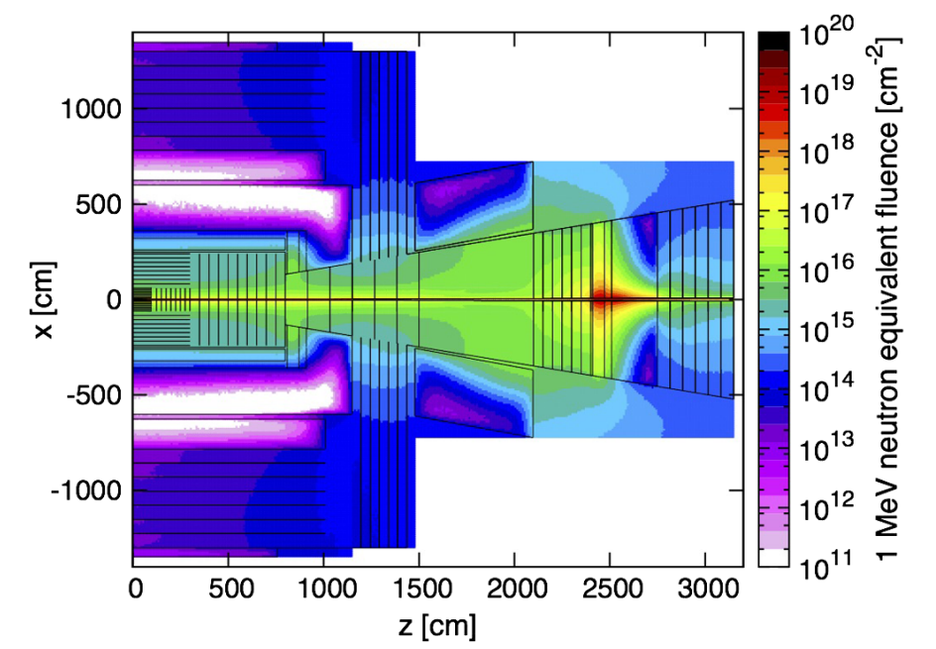
FCC & Future Scenarios

Slide 13
Future needs - fields
FCC enter the hadron fluence range where displacement damage cannot be overlooked anymore (approaching the dpa range)
Solutions:
  2-stage campaigns (e.g. gamma + neutrons)
  Mixed field irradiations
  BUT
  Displacement damage from neutrons is different from charged hadrons (damage cluster topology)
  ⇒Mixed field irradiations preferred

Slide 14
Future needs - infrastructures
(charged) hadrons irradiation ⇒ significant activation
Destructive tests will produce atmospheric contaminants (radioactive particles)
Tests can only be performed without major overhead if an on-site facility is available
Requirements:
  Hot cell with:
    Tensile / compression test stations (+ manpower)
    Climate control
    Radioactive waste disposal direct access

Slide 15
Conclusions
Irradiation needs will likely be shifting towards mixed field irradiation facilities for most exposed components.
A major point of concern is the availability of testing infrastructure (+ specialized manpower allocated) at the mixed field facility itself
This represents a major change in paradigm from the previous net separation between irradiation facilities and testing facilities.

