Slide 2
HI-ECN3 Target station and target complex design
HI-ECN3 Irradiation Opportunities Workshop
J-L. Grenard, M. Calviani (CERN) – on behalf of HI-ECN3 WP4 Target Complex

Slide 3
Content
Target complex overview
Target station design
Service building integration
Irradiation stations opportunities
Impact and timeline for implementation
Summary

Slide 4
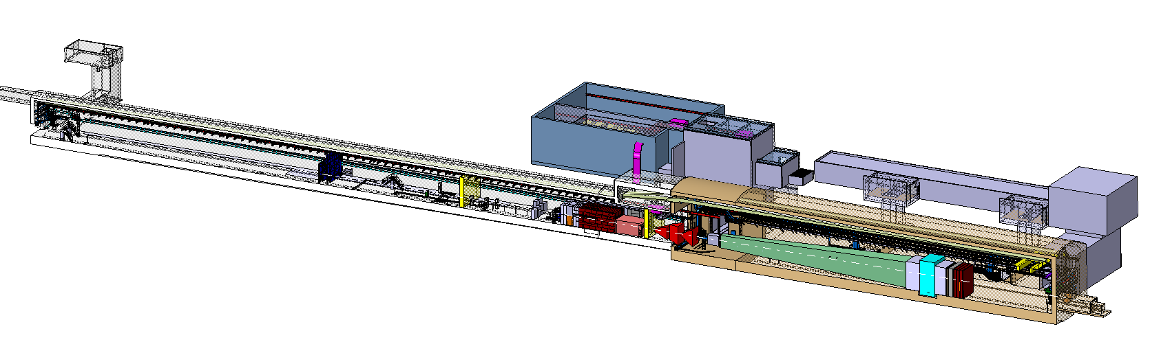
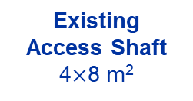
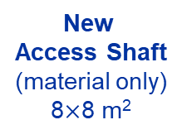
BDF/SHiP Target & Complex
New
Service Building
~ 700-1000 m²
New
Access Shaft
(material only)
8$×$8 m²
Existing
Access Shaft
4$×$8 m²
B911
B918
Beam Dilution System
TCC8
New Target Complex
containing the Beam Dump Target
ECN3

Slide 5
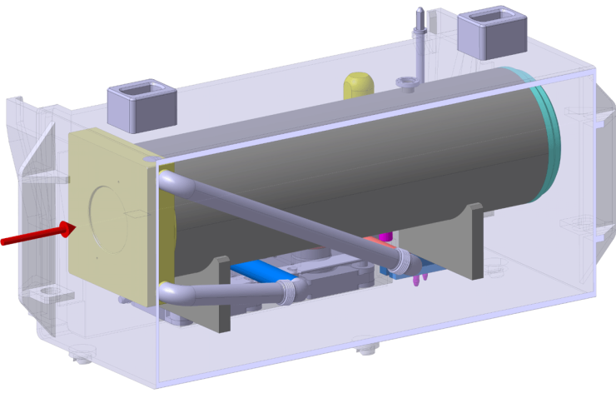
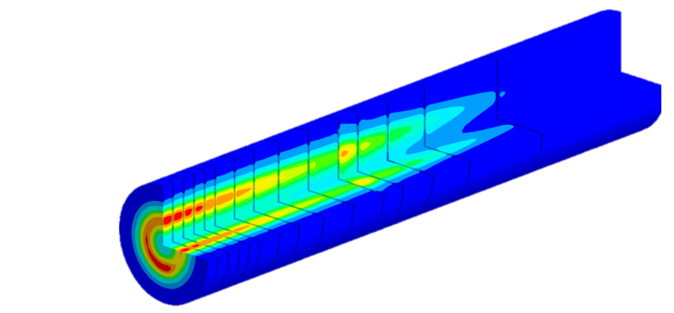
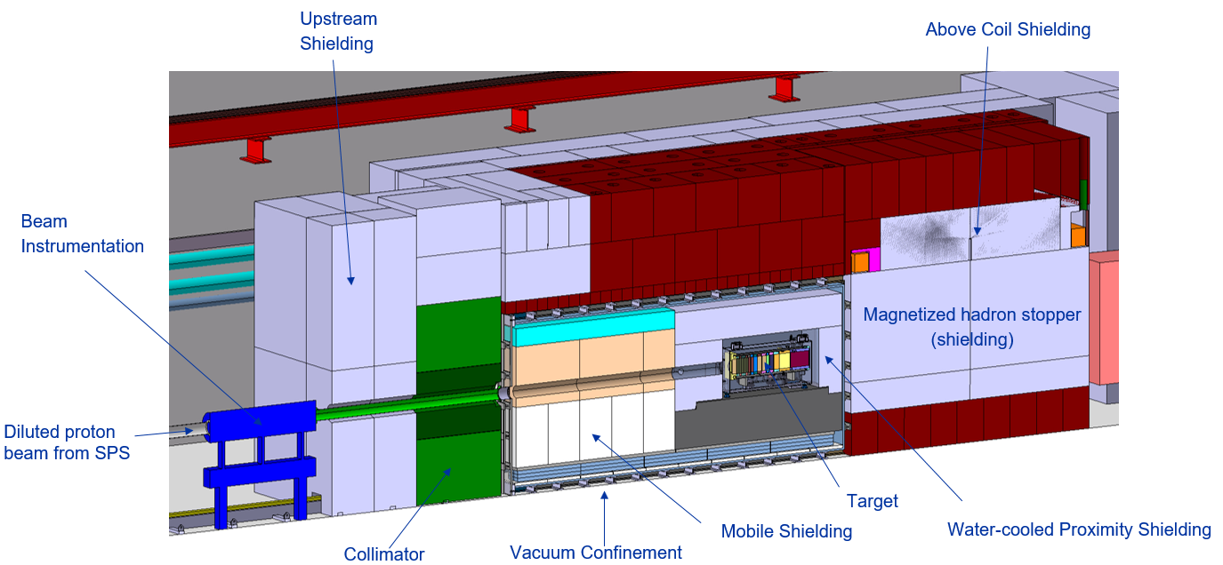
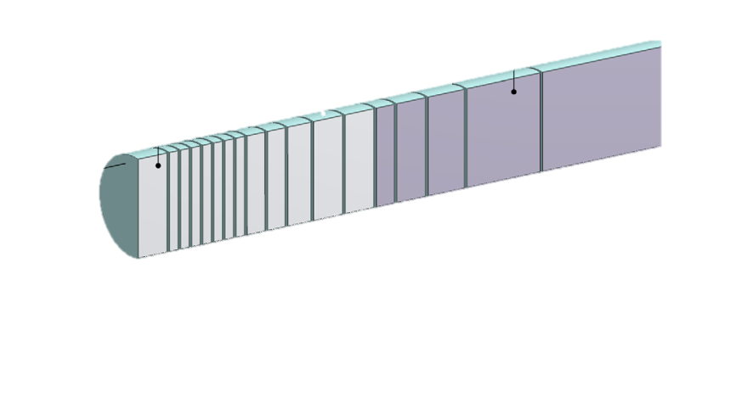
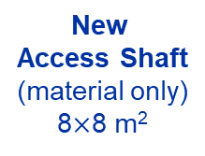
BDF/SHiP Target
Baseline Design → To be improved during TDR
WP4
WP3
13 x TZM blocks (580 mm)
5x W blocks (780 mm)
New
Service Building
~ 700 – 1000 m²
New
Access Shaft
(material only)
8$×$8 m²
Existing
Access Shaft
4$×$8 m²
WP4
B911
B918
Beam Dilution System
TCC8
WP2
WP4
ECN3
WP6,WP7 +al.
New Target Complex
containing the Beam Dump Target
WP5+SHiP

Slide 6
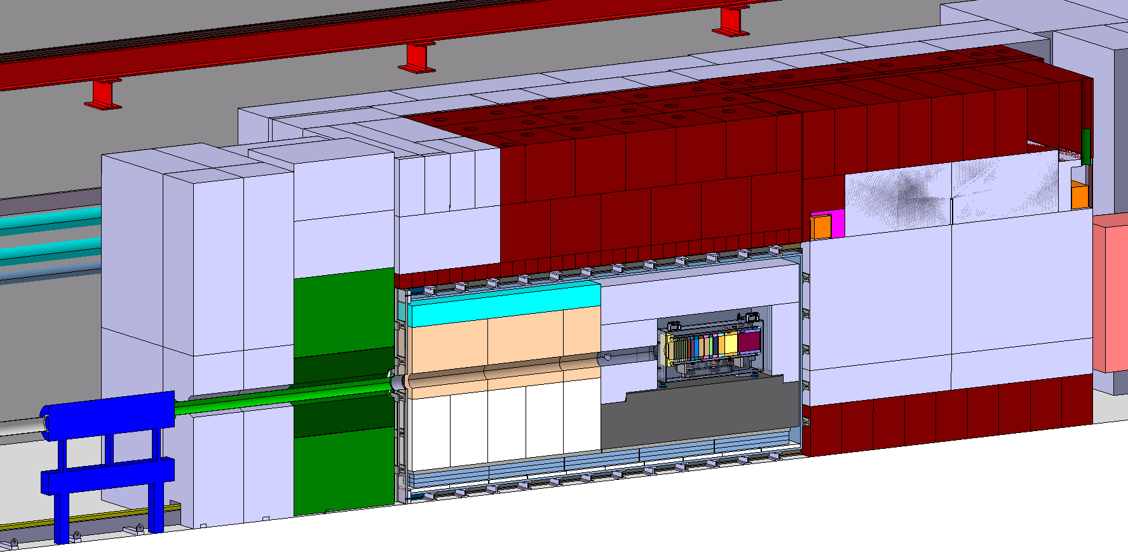
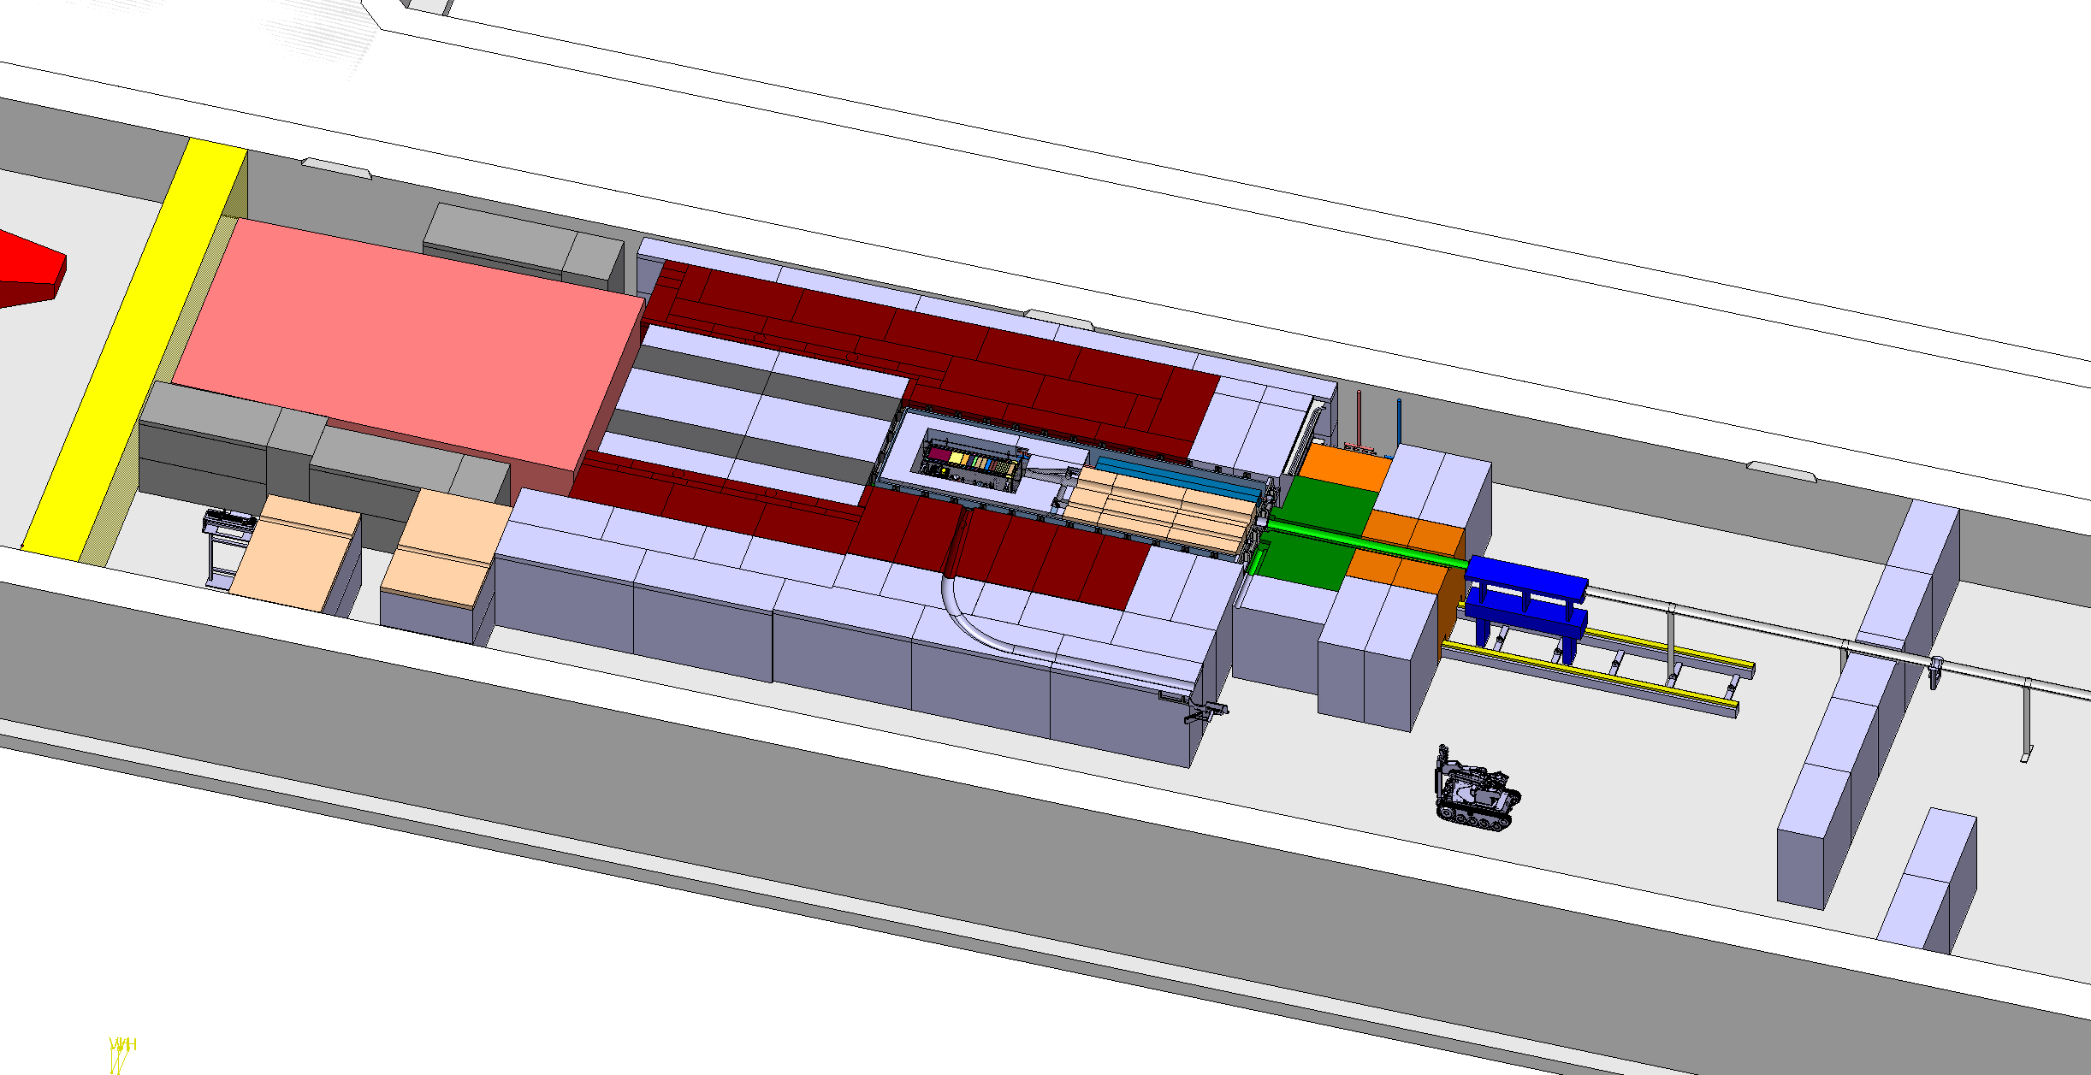
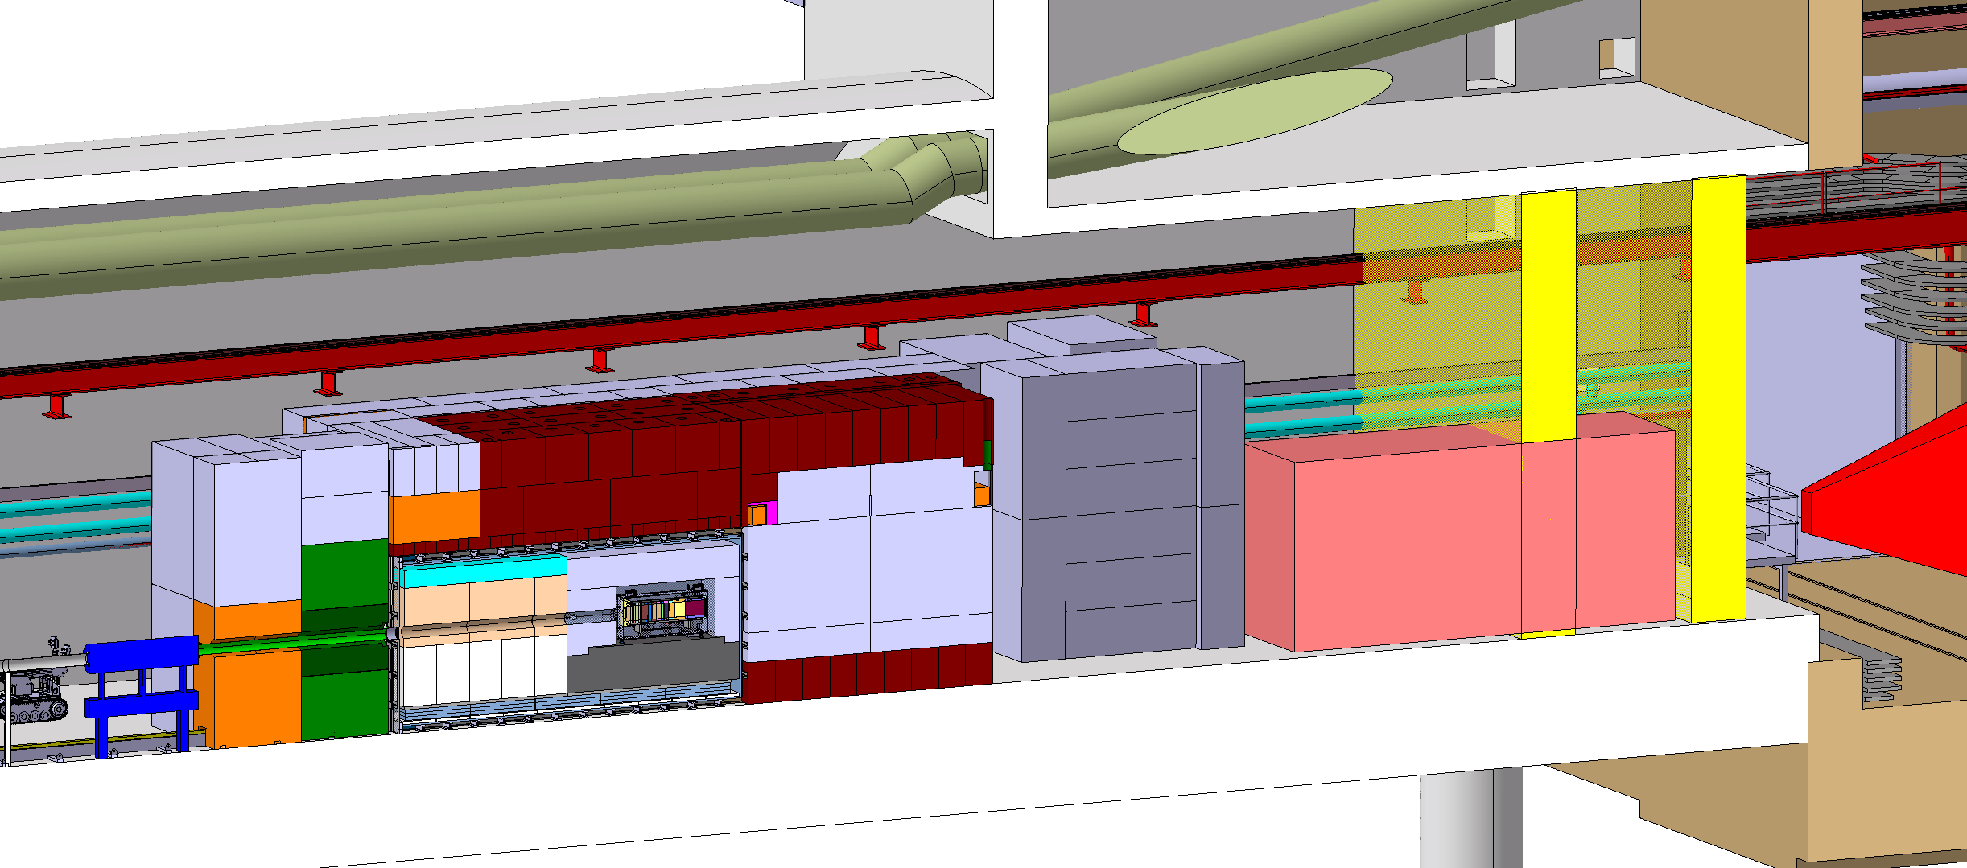
BDF Target complex integration
Upstream Shielding
Above Coil Shielding
Target area
Confinement wall
Magnetized
shielding
Beam instrumentation
Diluted Proton beam from SPS
Water cooled proximity shielding
Mobile Shielding
Vacuum confinement
Target
Collimator
Target station
SHIP experiment
Muon shield magnet
Access chicane
Space for shielding temporary storage

Slide 7
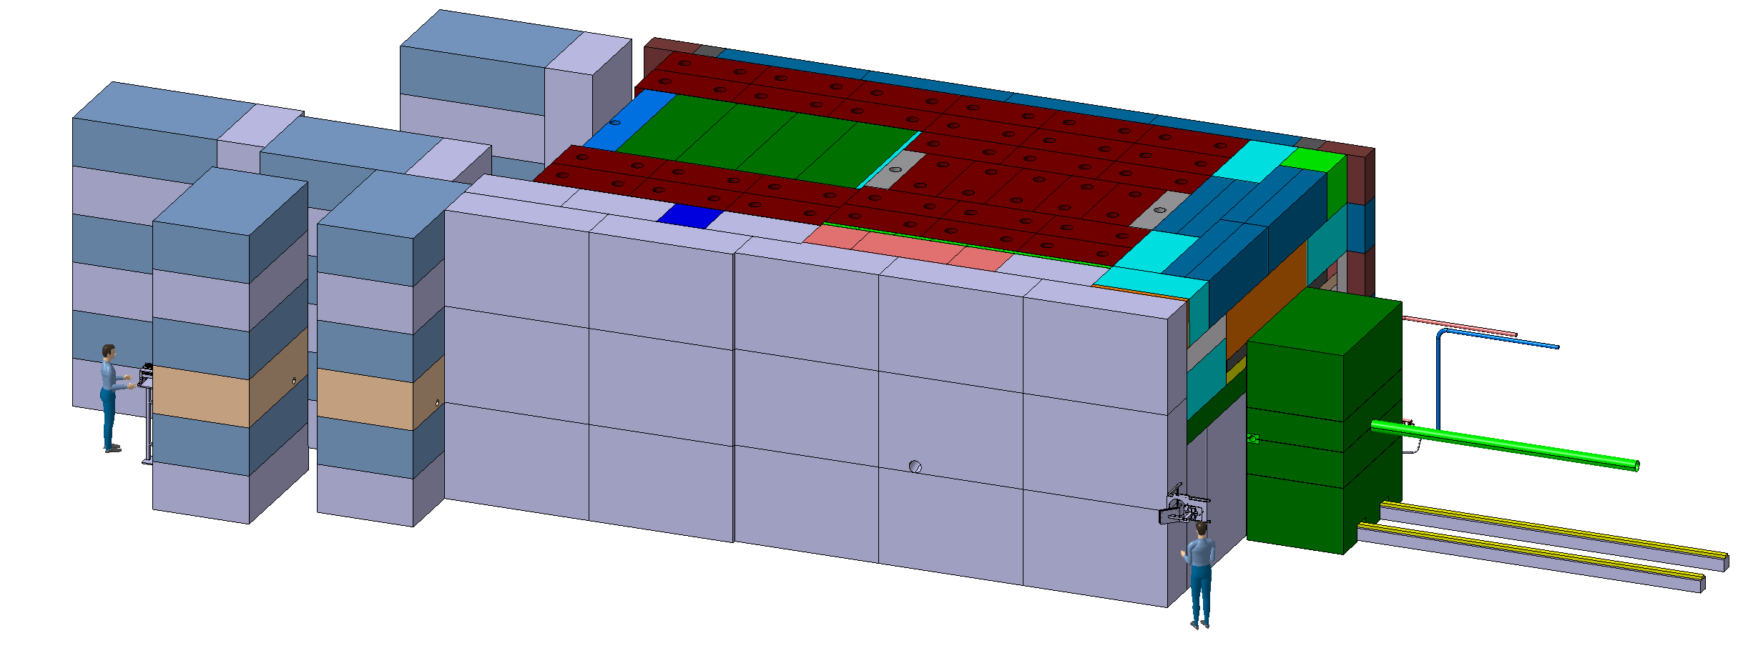
BDF Target complex integration - shielding
~4.8 m
~8 m
~12 m
~ 180 m³ (~1400 t) of cast iron + US1010
~ 360 m³ (~800 t) of concrete / marble
Most of the shielding blocks recovered from other CERN facilities
Design of the target station will need to be frozen in Q3 2025

Slide 8
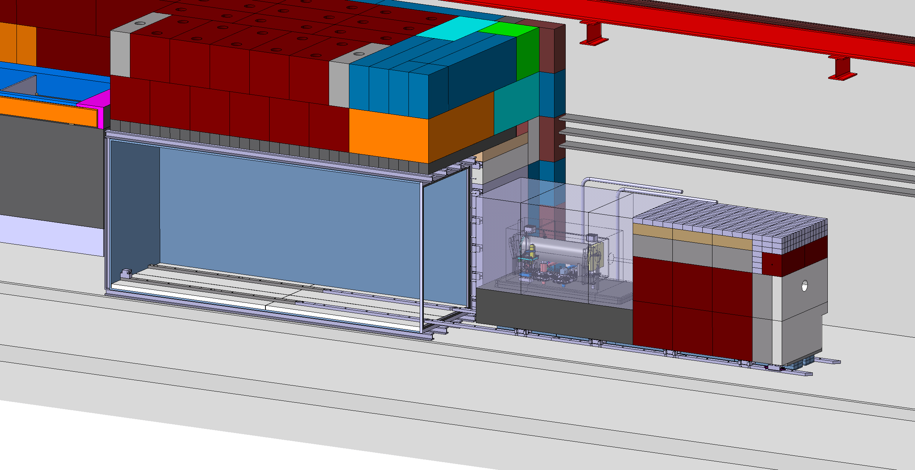
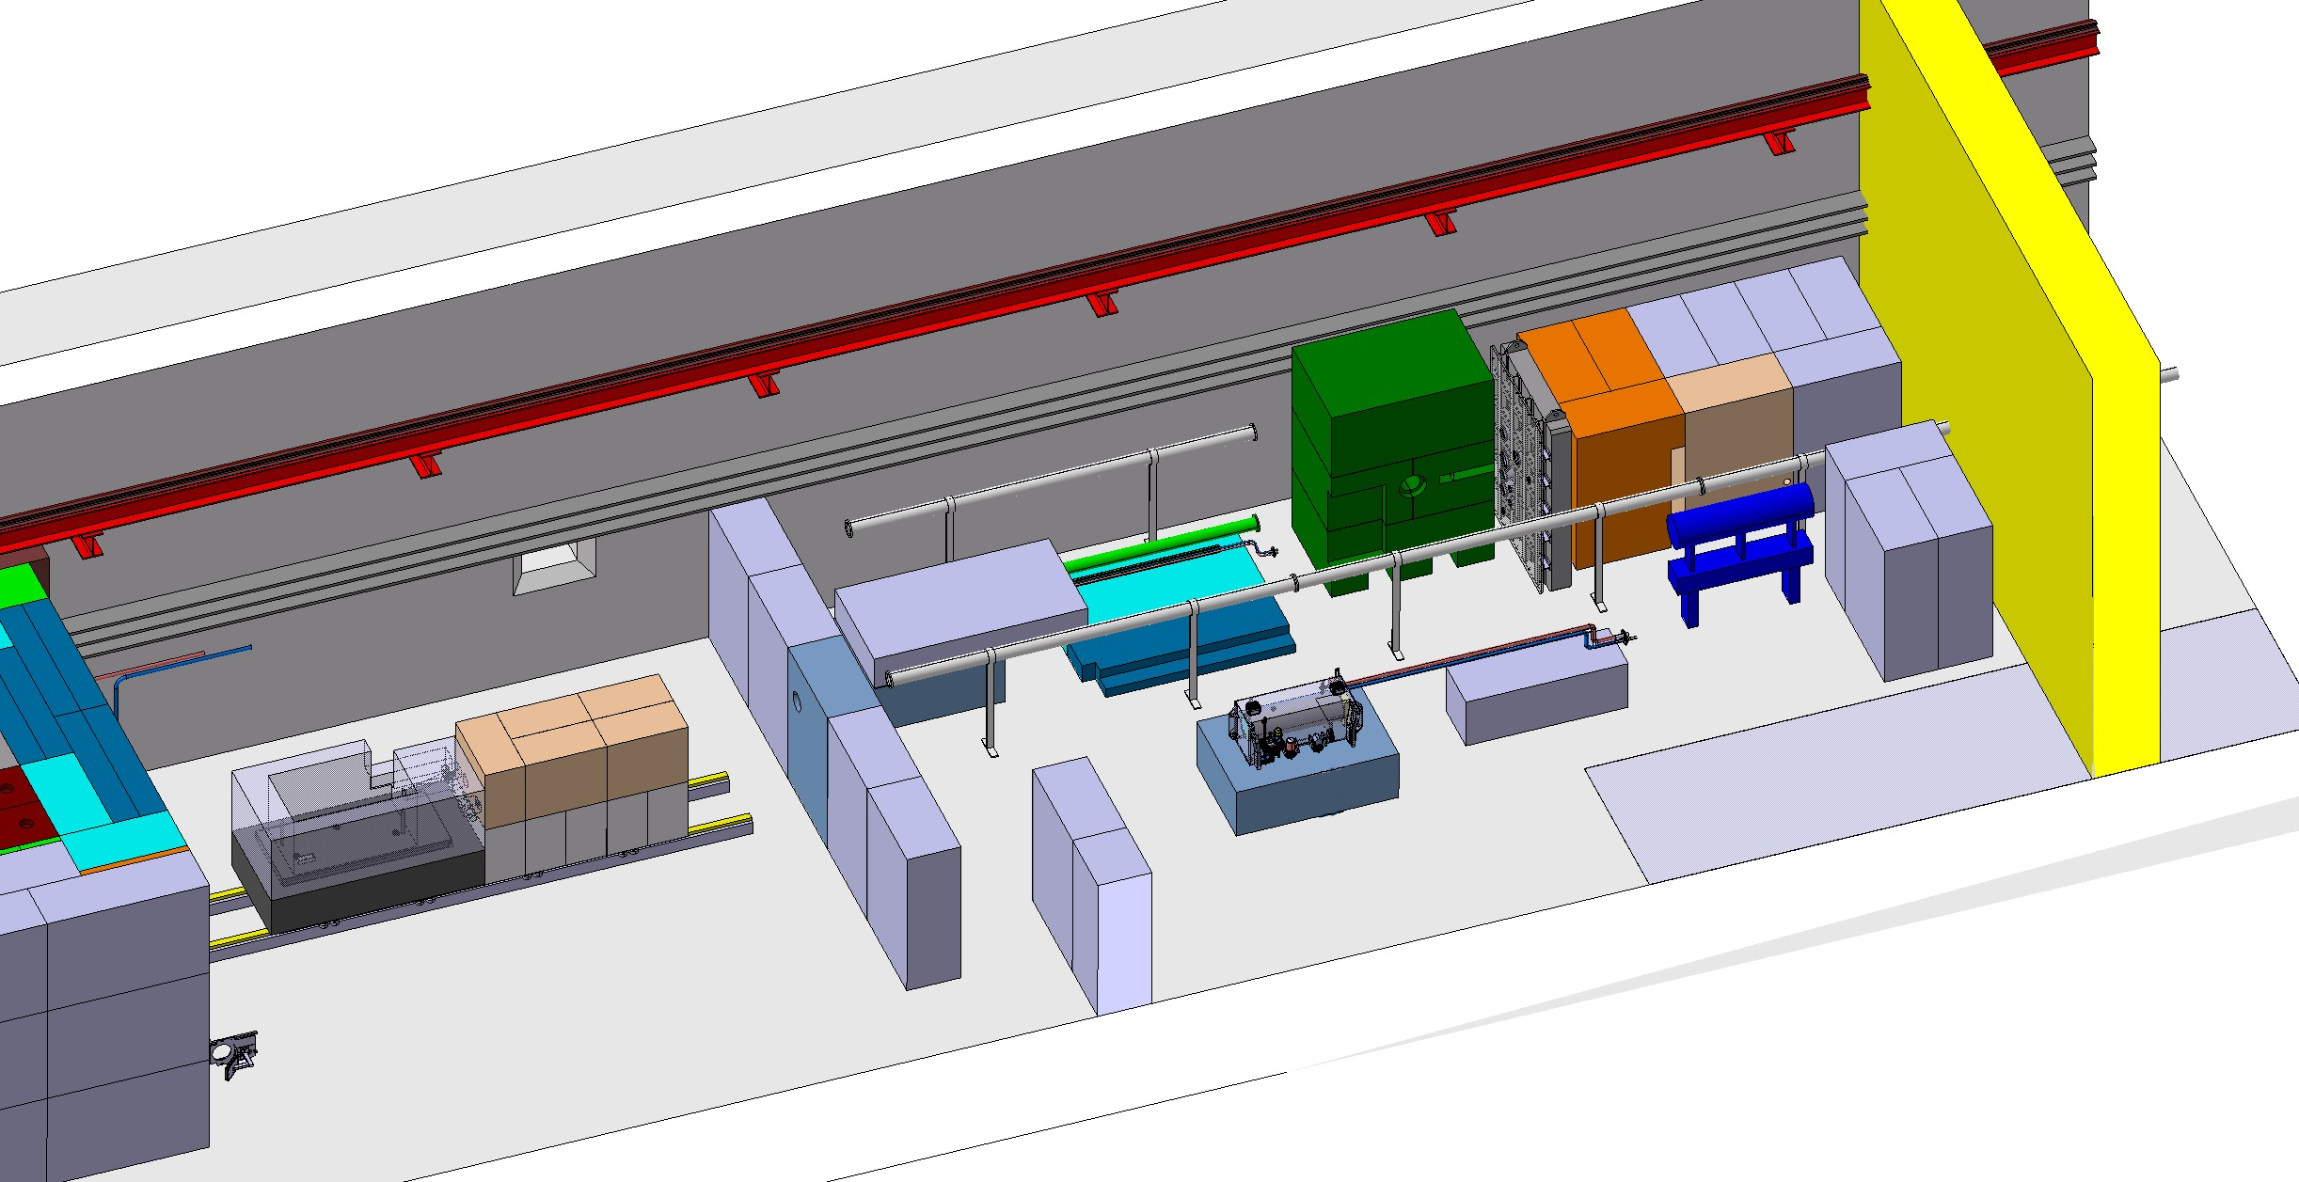
BDF Target complex integration - extraction
~30m
Trolley mounted on stainless steel chain action rollers
Extraction towards the upstream side of the facility
The extraction of the target trolley would require a significant effort (~2 months to open and close the vessel)
Can only be performed during a YETS

Slide 9
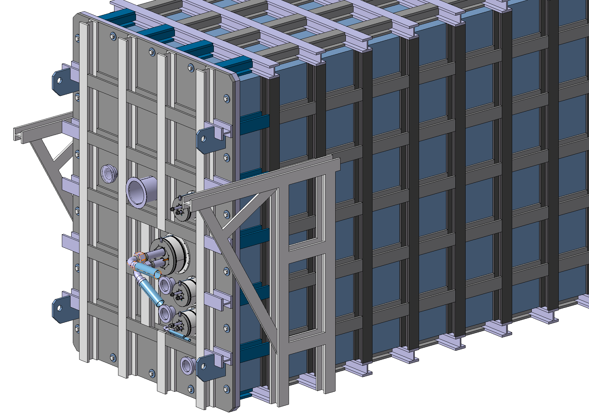
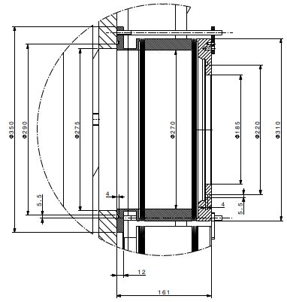
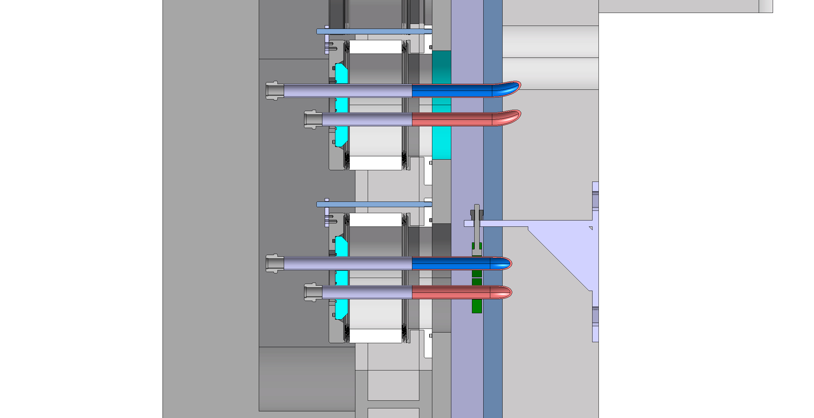
Target station vacuum confinement
Utilities feedthroughs (cooling, target instrumentation)
Mechanical design ready to build a prototype
Design of radiation tolerant gaskets
Decommissioning plan
Overall dimensions: ~6.36 x 2.05 x 2.95 m
Can be fully fabricated and tested at a contractor premises
Primary vacuum to optimize air activation around target
(Water containment in case of water leak)

Slide 10
Opportunities for parasitic irradiation
BDF/SHiP offers the unique opportunity to access unprecedented radiation levels in mixed field – allowed due to the specific feature of the experiment
Priority is given to SHiP, so irradiation opportunities will have to be parasitic to the operation of the complex
Current budget does not include/foresee the addition of these items
Any irradiation station require an associated manipulation space for highly activated samples
None of the irradiation capabilities shown in the next slides are part of the target station baseline, but are intended as realistic possibilities
Input required by beginning of 2025 to act on the design

Slide 11
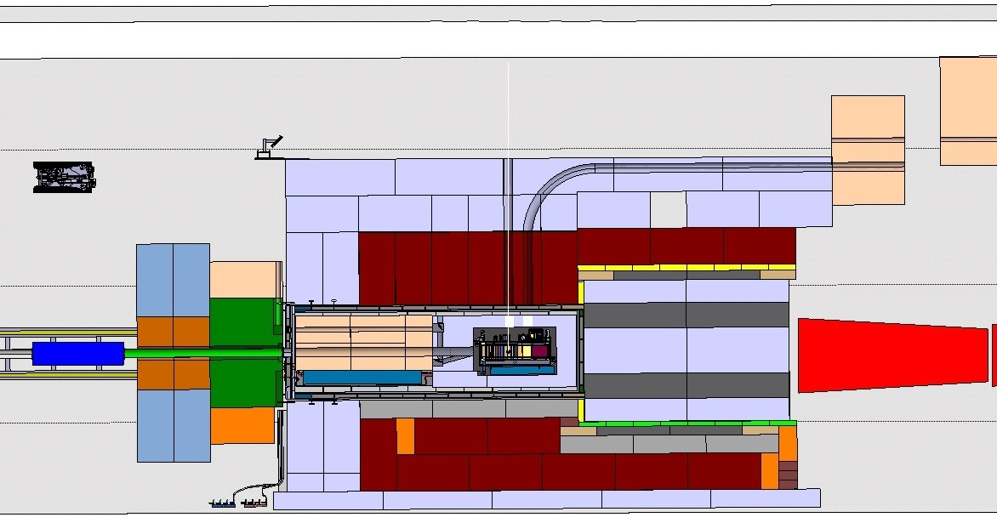
Irradiations stations opportunities
External activation station (BEAS, R2E@4m)
12 m
Rabbit irradiation station (BRIS)
Internal activation/irradiation station (BIAS)
High-fluence, in-vessel, irradiation module (BHFIM)

Slide 12
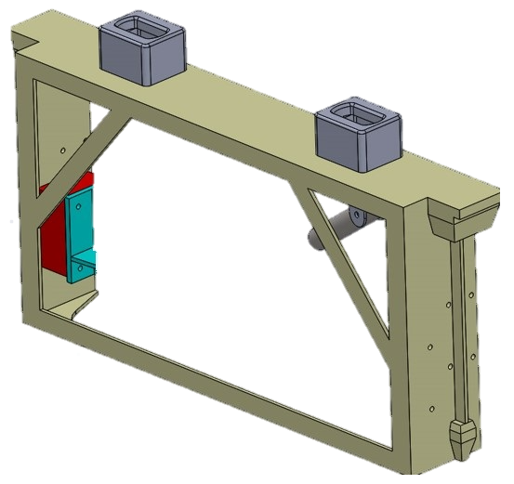
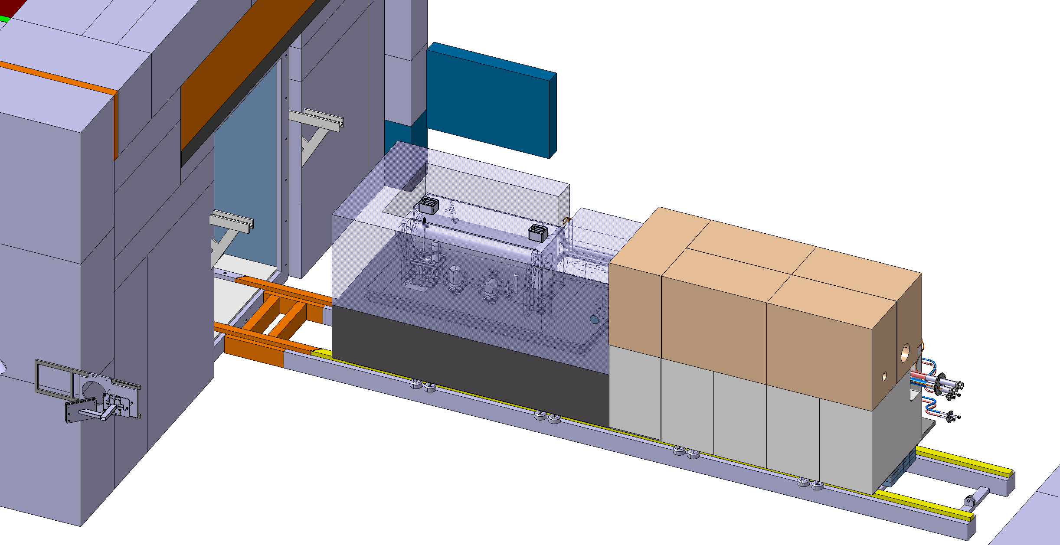
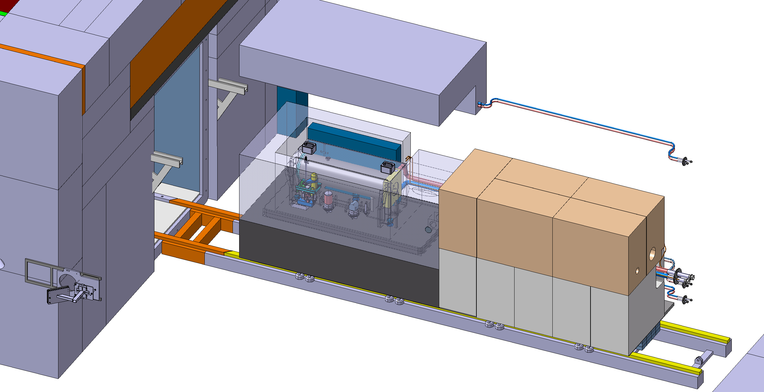
High-fluence, in-vessel, irradiation module (BHFIM)
In vessel module approximate overall size: 1 m (L) 150 mm (W) 900 mm (H)
Possible utilities could be connected via vacuum vessel door
Accessibility once a year during a YETS ~1month to extract the module
Samples could be handled in the surface target building hot/service-cell
Need a shielded cask for handling from underground to surface building

Slide 13
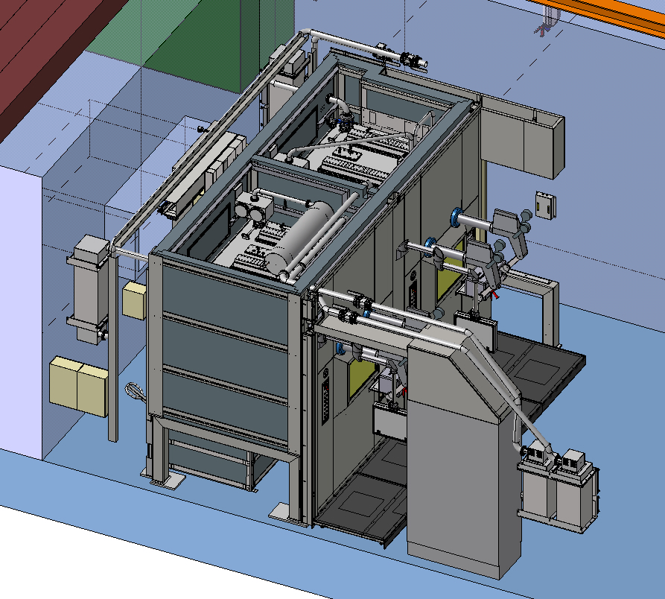
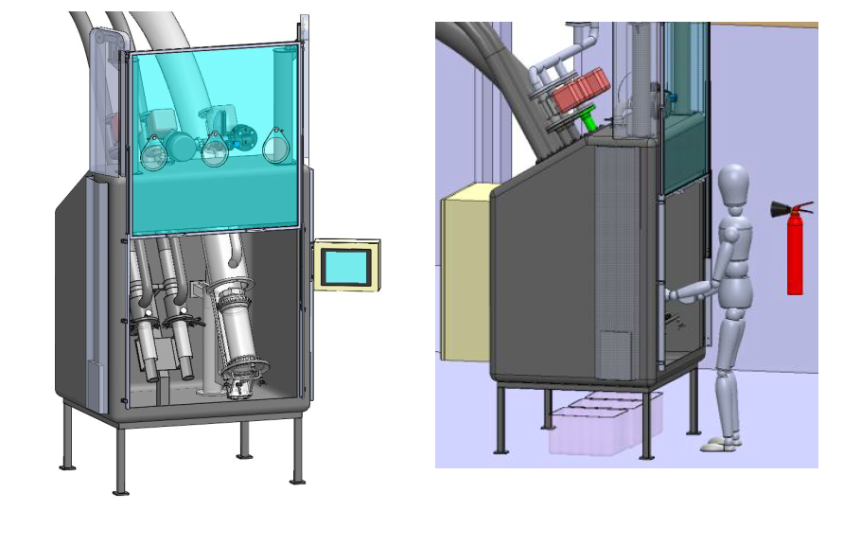
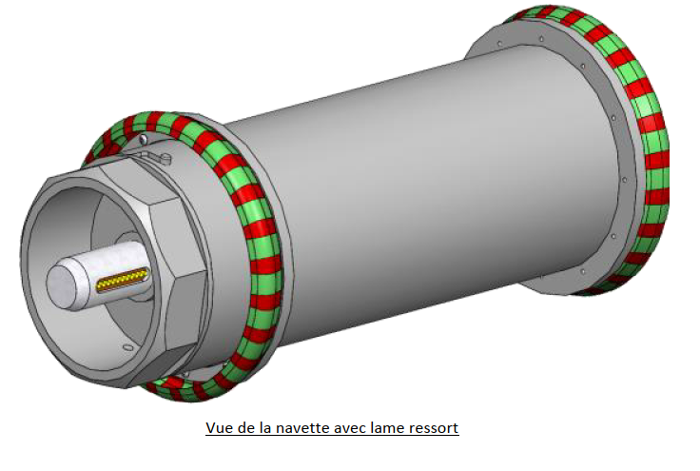
Rabbit irradiation station (BRIS)
Rabbit D200mm connected to glove box / hot cell
Handling of ‘’small’’ samples (D150mm x L385mm)
Utilities could be connected on capsule
Accessibility all the time ~10 mins to recover a sample

Slide 14
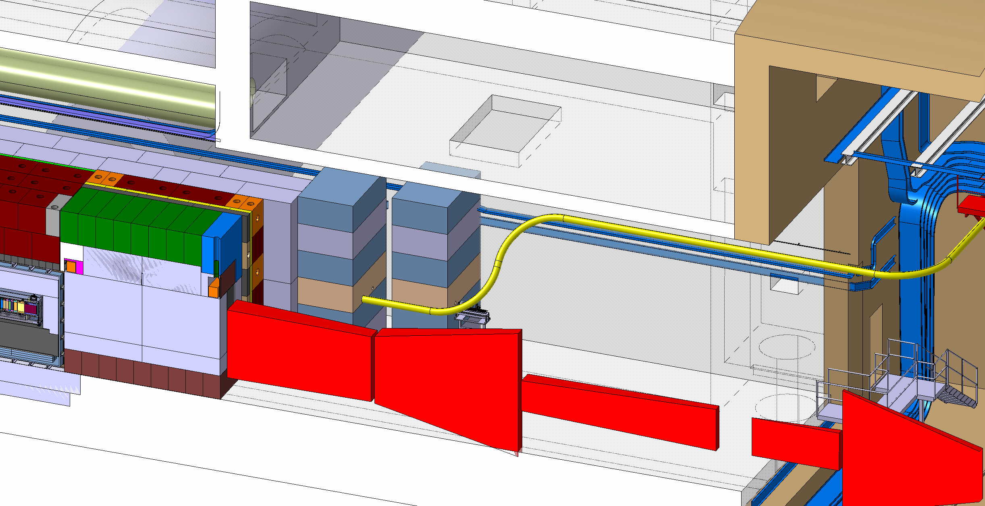
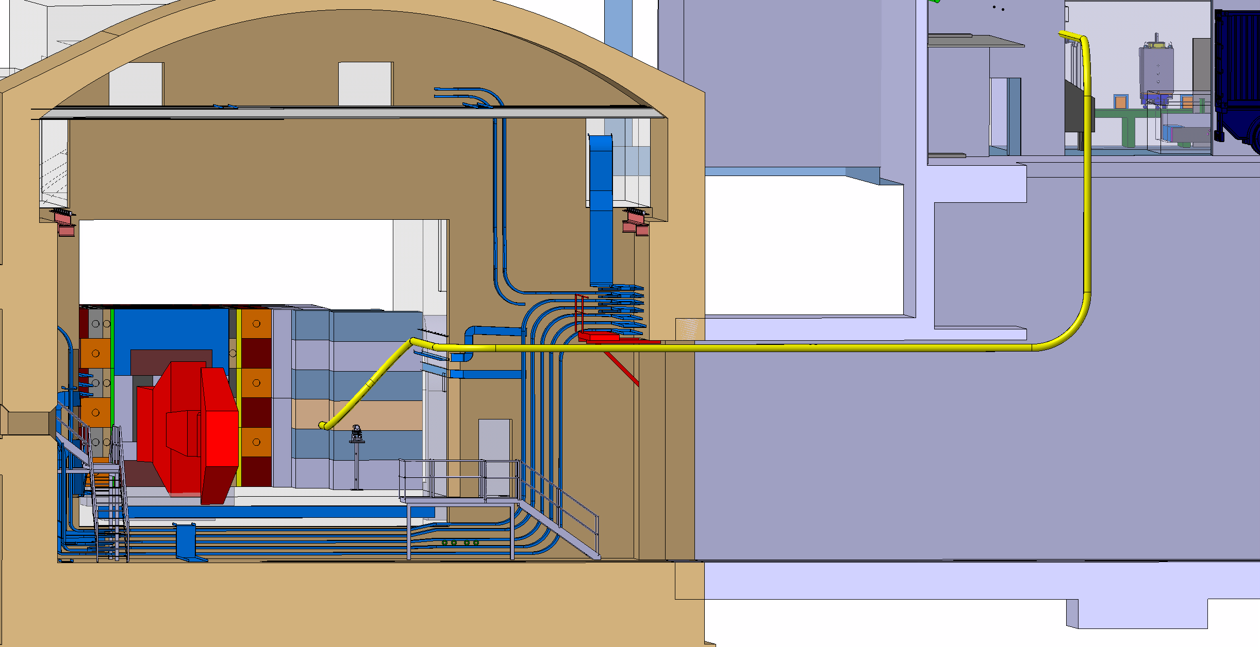
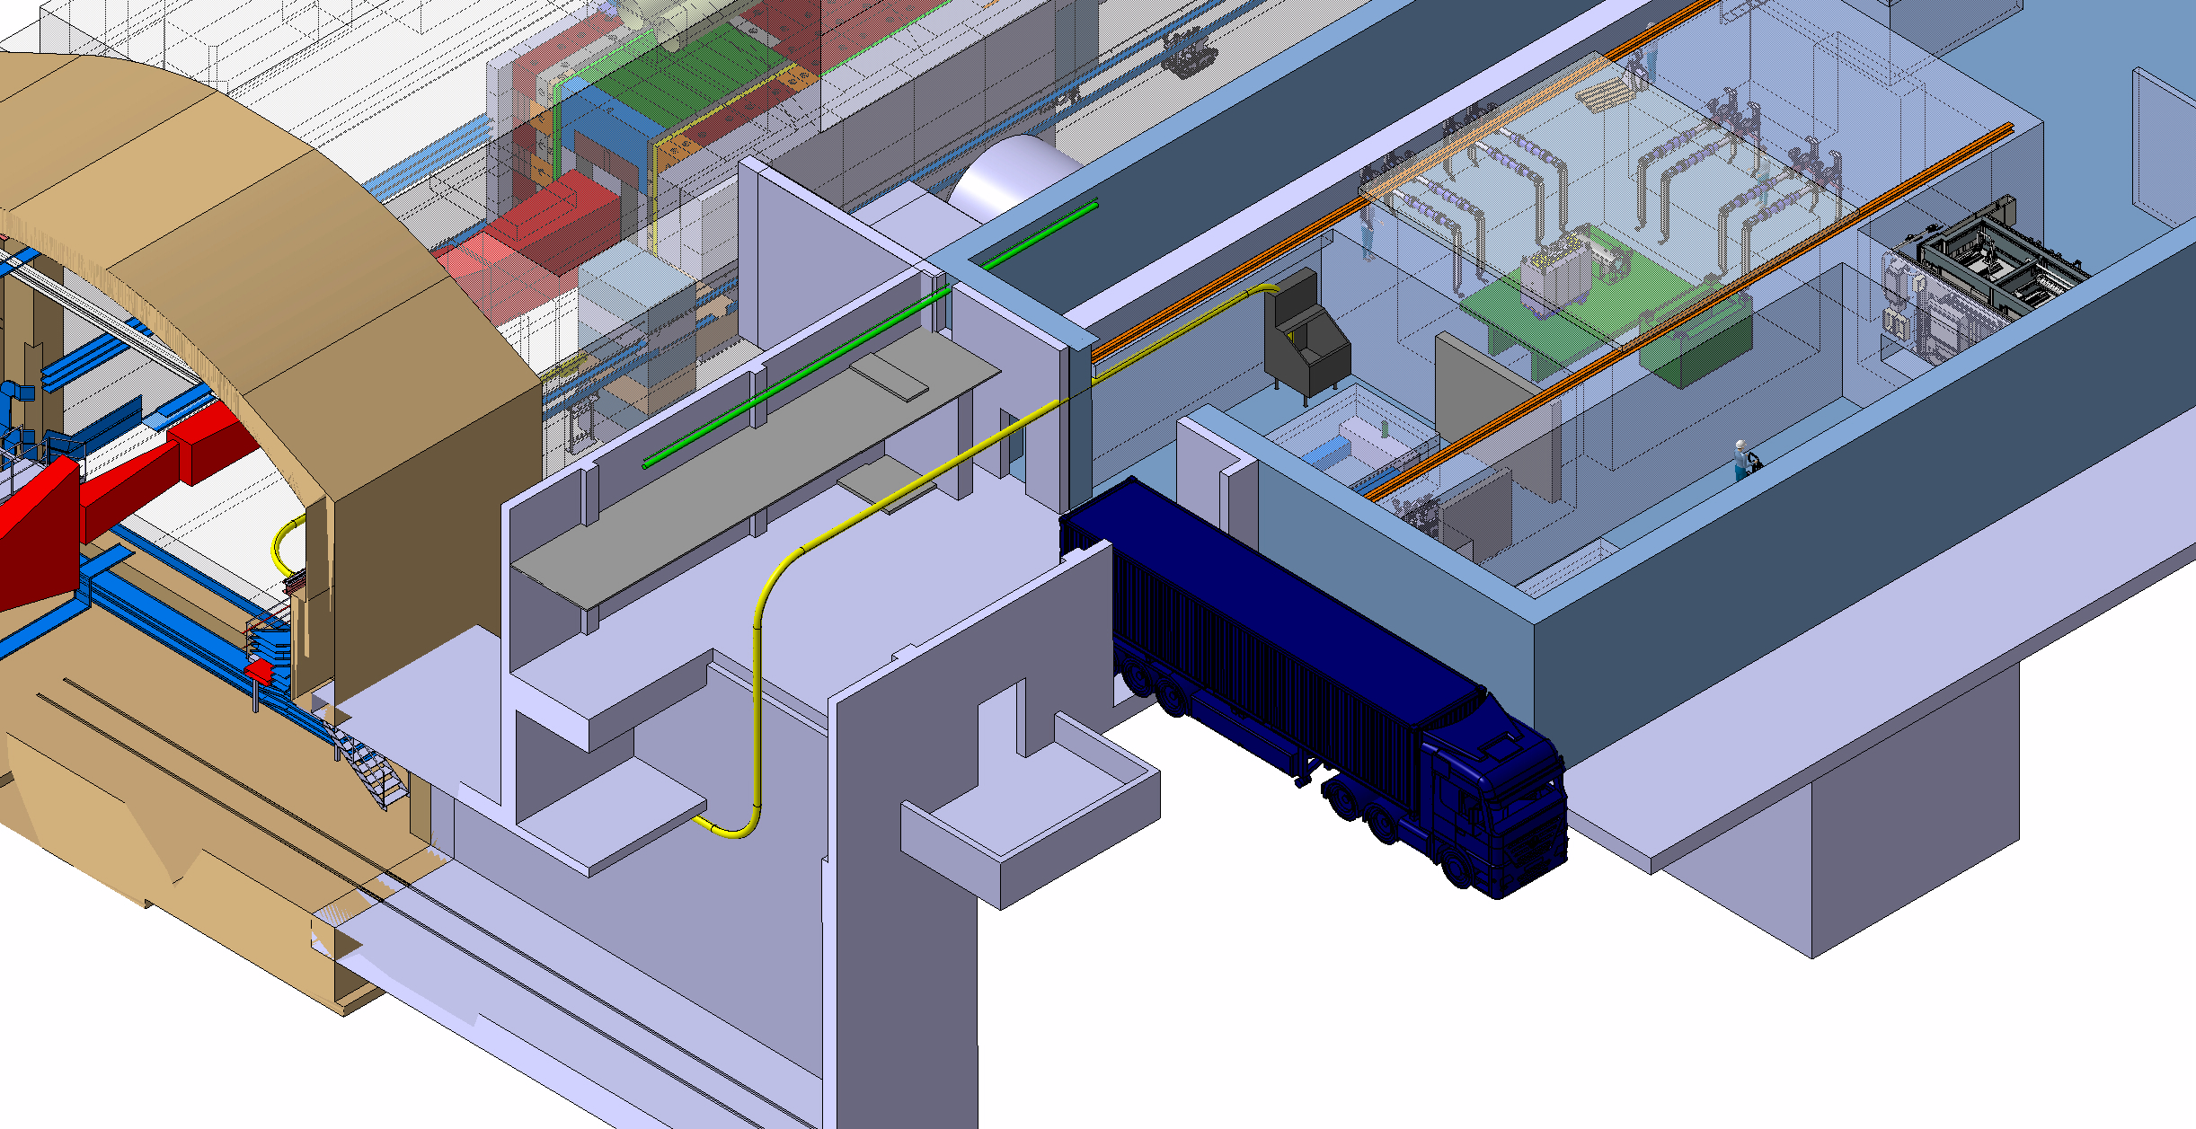
Rabbit irradiation station (BRIS)
Start in target area
Transition to shaft & target building
Reception station not included in the Project baseline, but building is foreseen to host it
Reception in target service building

Slide 15
External activation station (BEAS, R2E@4m)
Maximum thickness including shielding station 1.2 m
Utilities
Accessibility every MD when no beam delivered in ECN3
Configuration change possible during TS

Slide 16
Internal activation/irradiation station (BIAS)
Size limited to diameter ~200 mm
Could be located up to the edge of the vacuum vessel
Utilities
Accessibility every MD when no beam delivered in ECN3
Configuration change possible during TS

Slide 17
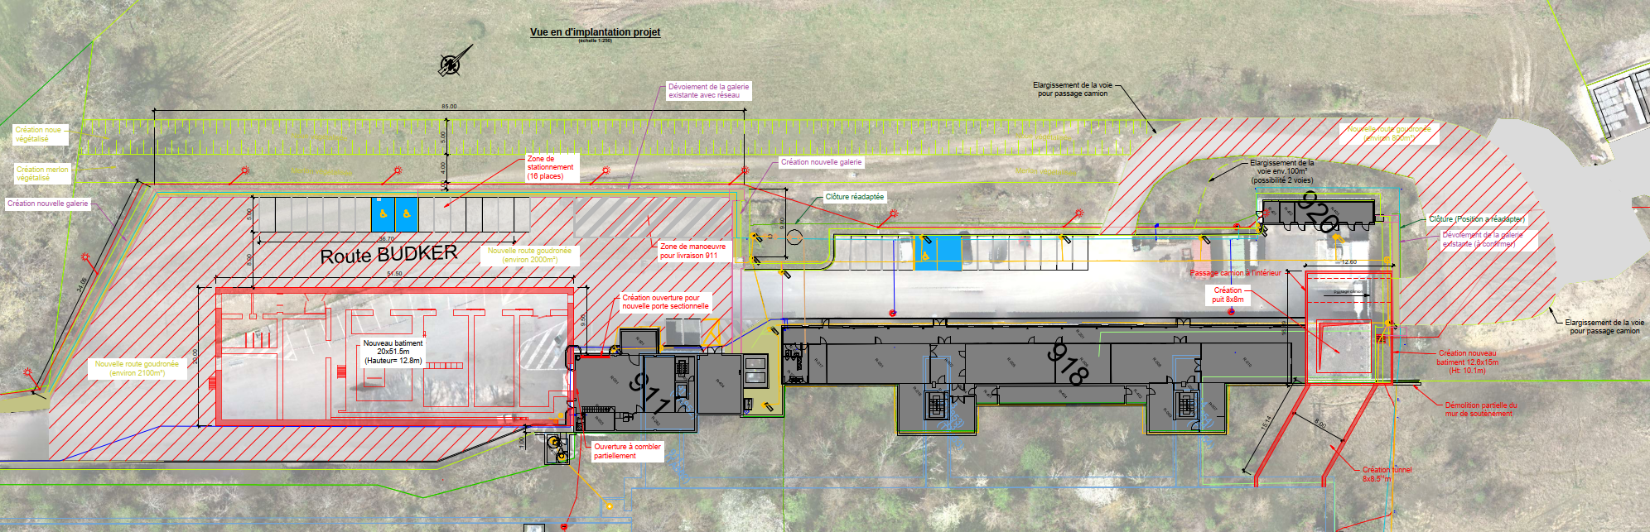
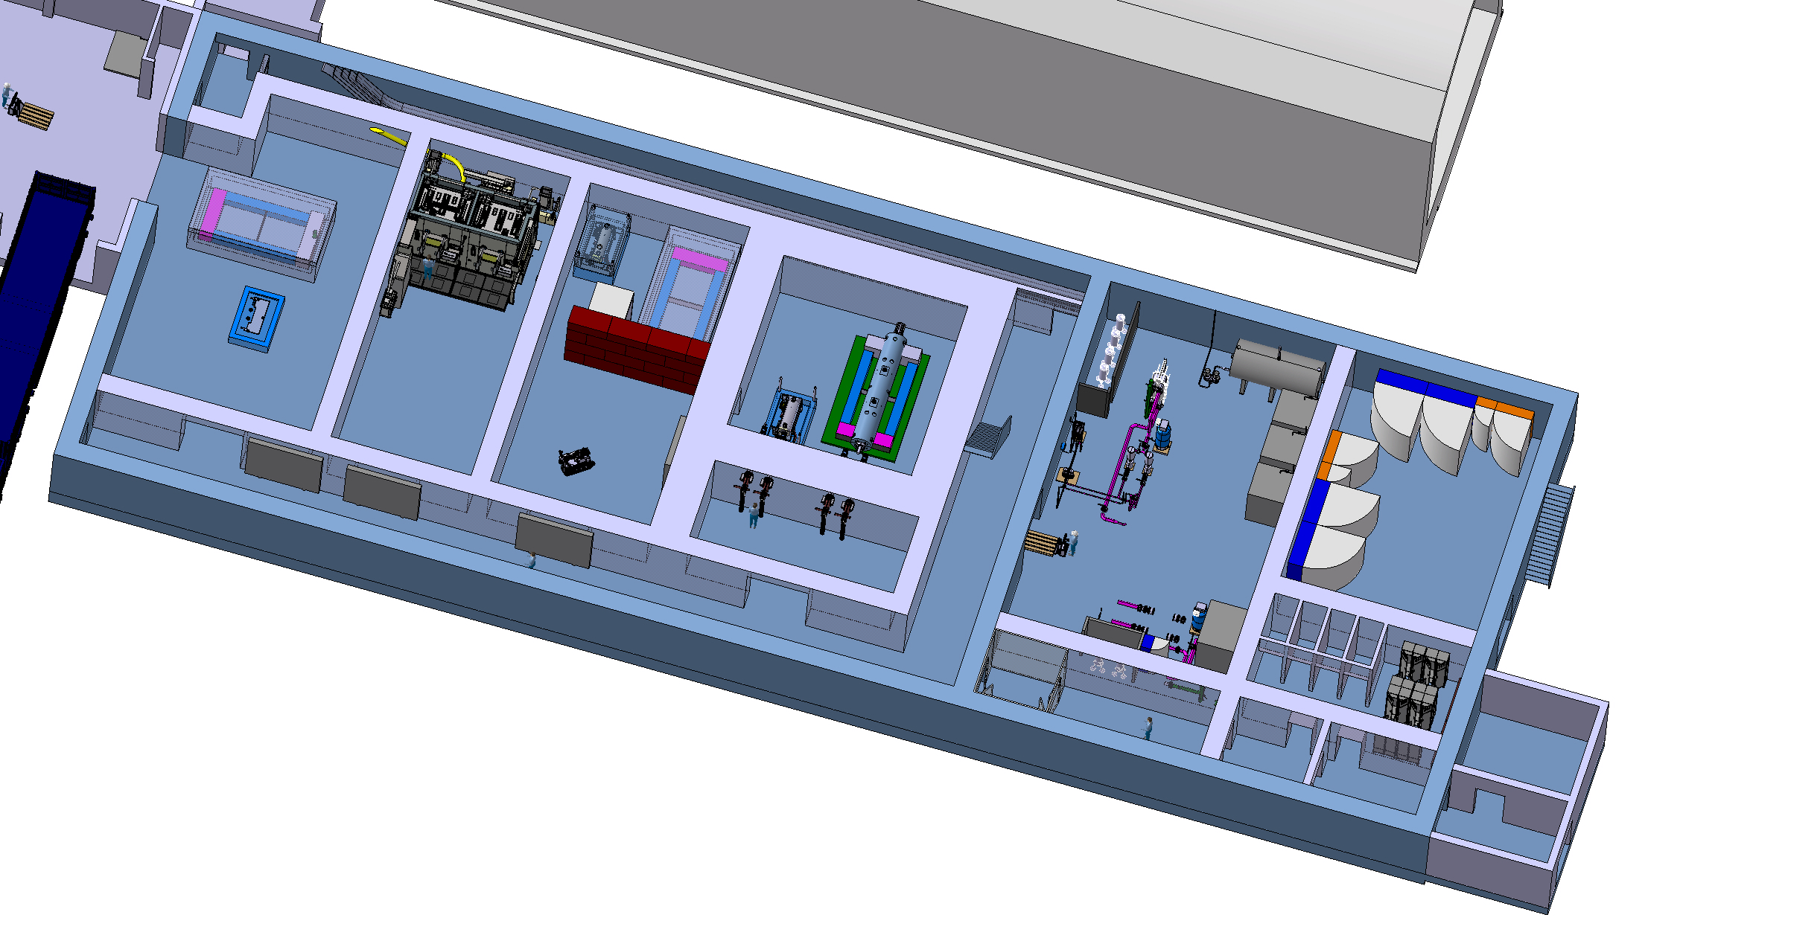
Target service building
Building to support target station operation
Direct connection to the TCC8-ECN3 caverns
Cooling and ventilation systems of the target complex
Service cell to prepare the target station equipment for final disposal (part of baseline)
Space reservation for the potential material testing
~700-1000 m²
Work in progress
Optimization of volumes and process

Slide 18
Irradiations stations opportunities - Summary
Name | Distance from target | Accessibility to recover the module | Size of module | Utilities capabilities
BEAS (R2E@4m) | ~4 m | SPS MD (when no beam for ECN3) | Max thickness 1.2 m | Yes (almost unlimited)
BIAS | ~1 m | TS | D200 mm | Yes (almost unlimited)
BRIS | ~1 m | Operation | D150xL385 mm | Yes (1 power circuit + 8 control signals)
BHFIM | ~5-10 cm | YETS | 1000x150x900 mm | Yes (limited)

Slide 19
What would mean to add a longer distance irradiation station?
Major change for the civil engineering (new access shaft, access tunnel) and would have consequence on design of the foundations of the target service building
Any large CE structure would have to be included in the current design, since doing that a posteriori will be hardly implementable or will be very costly
Would likely have a significant impact on the ventilation system
Major radiation protection aspects would have to be taken in consideration (shielding, access system)
The HI-ECN3 timeline for design and construction of the current new CE structure is already tight and doesn't allow contingency the additional large new CE structure(s) unless a decision by management and budget & resources are made available immediately.
A consequent additional resources would be required to design properly this new facility

Slide 20
Impact and timeline for implementation
Should be implemented as part of baseline target station construction
Could be implemented later post target station installation (during an EYETS, or LS)
As per expected residual dose rates of equipment (up to hundreds mSv/h) any changes (mechanical, electrical, shielding…) in the ‘’red box’’ can be foreseen
The design of the irradiation station shall take in consideration residual dose rates aspects in view of their maintenance

Slide 21
Conclusions
We are still on time to implement a certain number of features to make the BDF target station compatible with future implementation of irradiations station(s)
Any large civil engineering modification need to be evaluated by end 2024, as IRP board is foreseen in mid 2025
Any interfaces part of the target station for the irradiation station(s) need to be implemented before end 2025
Any change in the shielding to implement the irradiation station(s) need to be implement before end 2025
The existing infrastructure should be ready and compatible with the handling of any highly activated equipment
External funding are required to implement interfaces for the future irradiations station(s)

Slide 22
Thank you

Slide 23
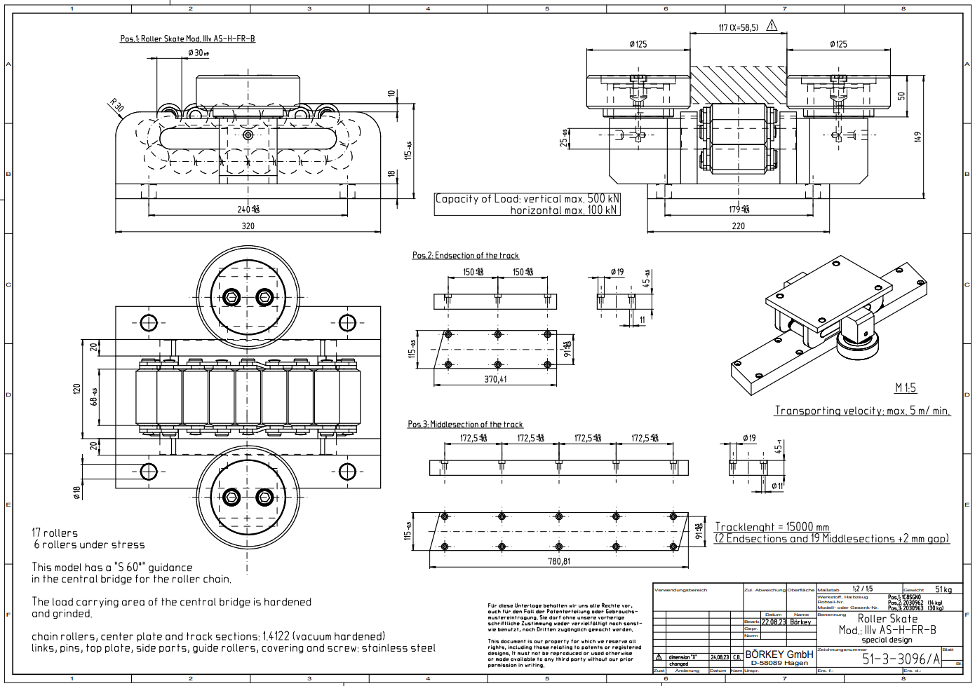
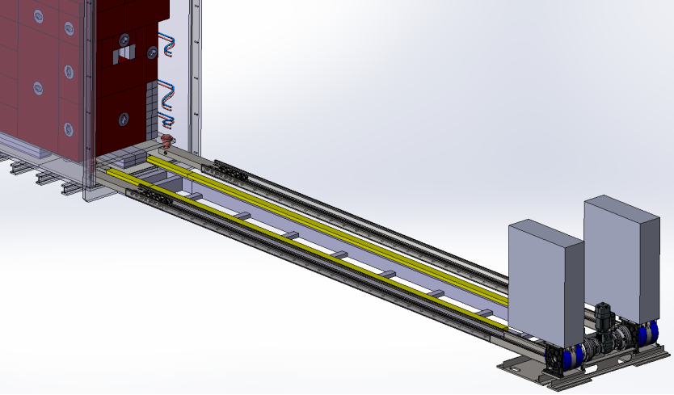
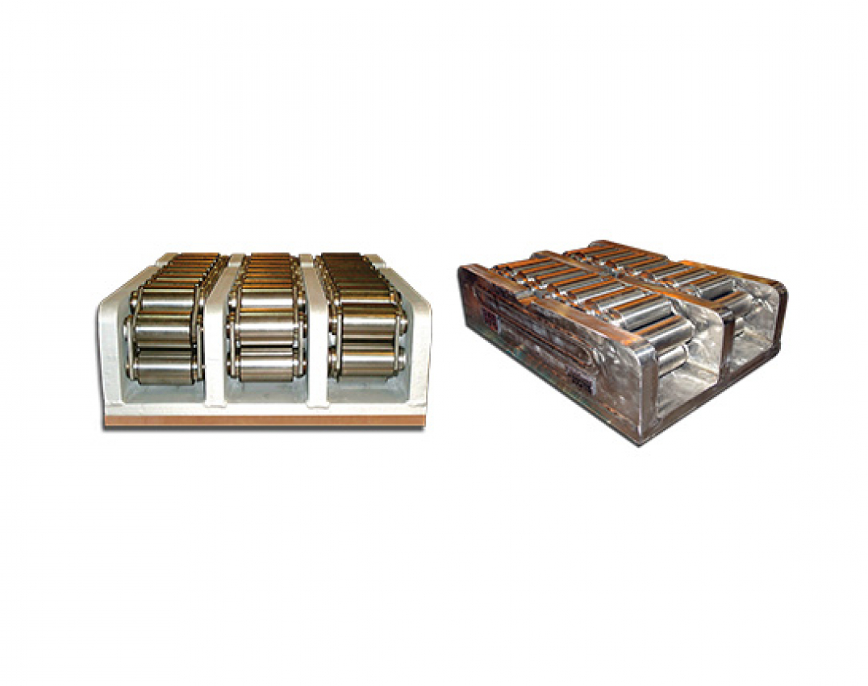
BDF Target complex integration extraction devlopment
Trolley mounted on full stainless steel chain action rollers
Extraction / insertion mechanism based on a motorized rigid chain

Slide 24
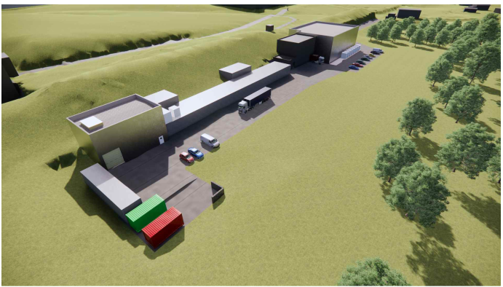
Service building within the BDF/SHiP complex

Slide 25
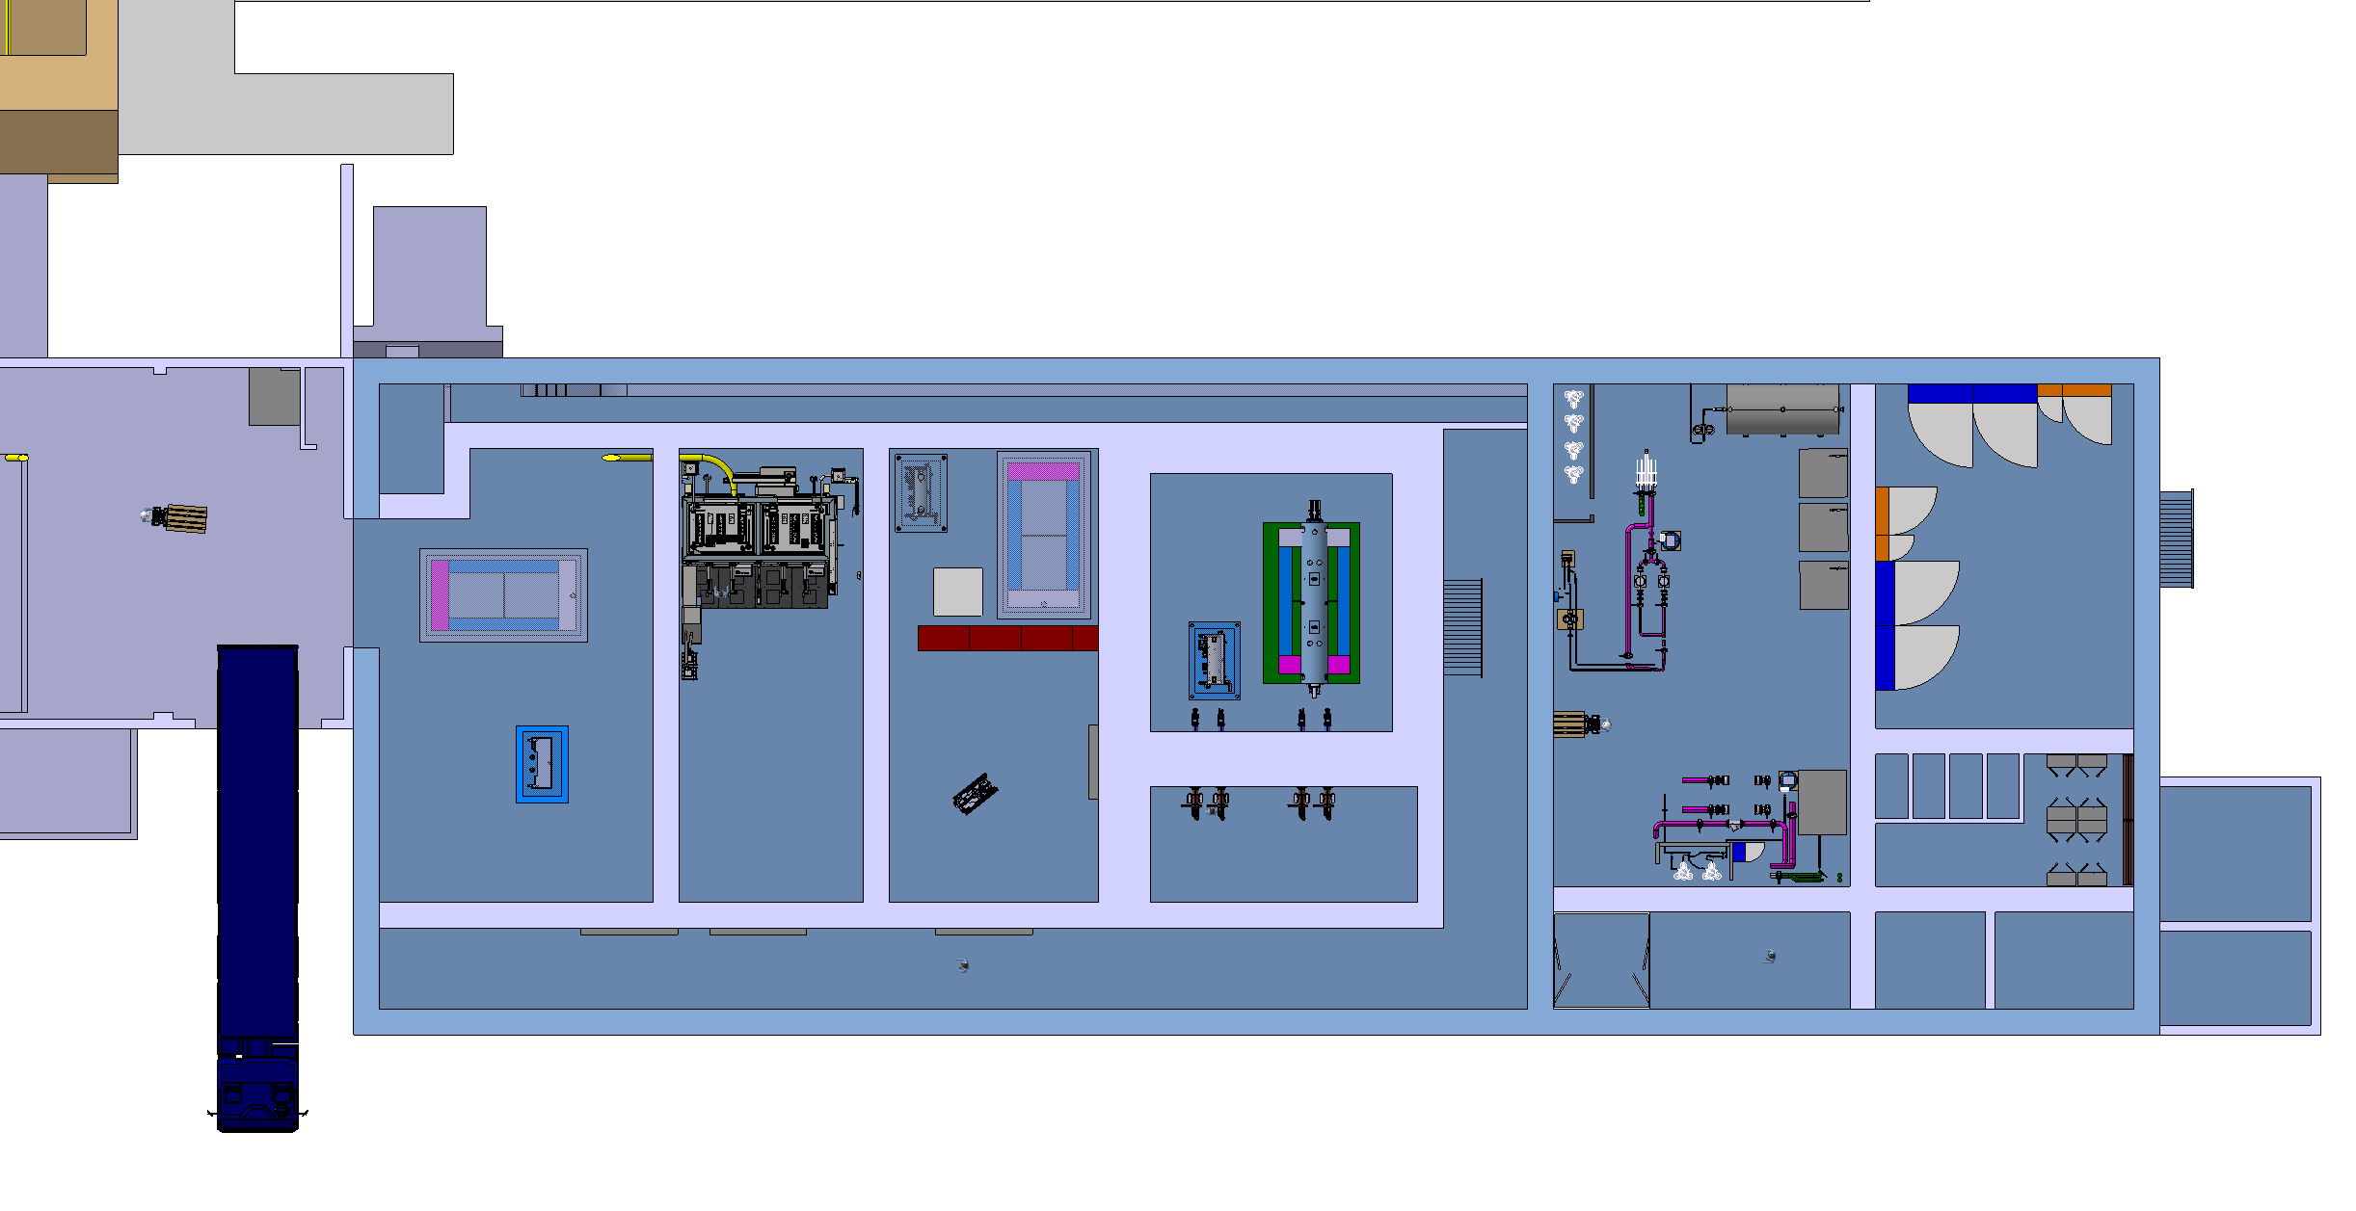
Service building – ground floor
Cooling equipment
Power room
Material access
Access shaft
New lorry access
Personnel access
HotCell
Service cell
with a movable roof
Shielded buffer zone

Slide 26
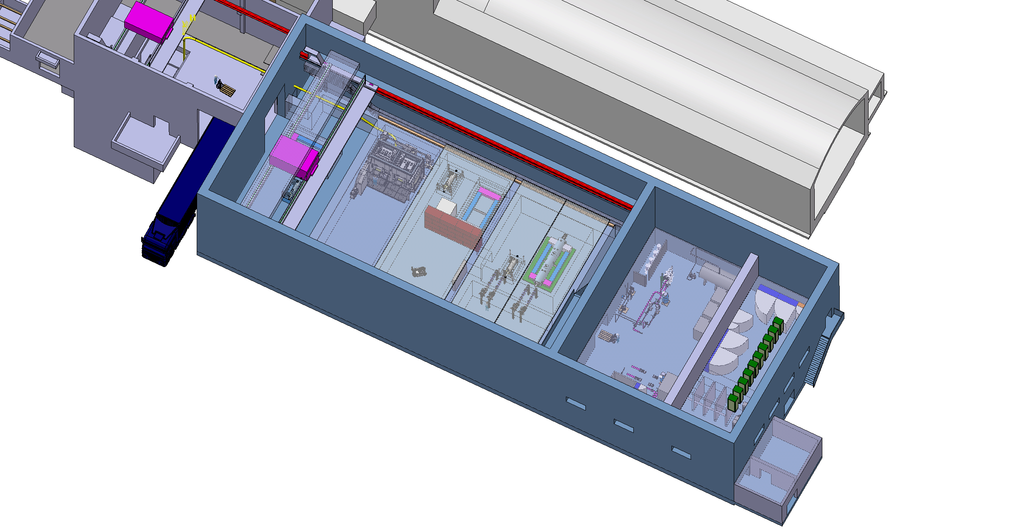
Service building – 1rst level
30t overhead traveling crane
Control racks
Mobile shielded hatches
Definition of the envelops by end of 2024
Filter room

