Slide 1
FLUKA simulations and radiation field in potential irradiation locations
G. Mazzola, M. Cecchetto, L. S. Esposito, R. Garcia Alia (SY-STI-BMI), M. Calviani, J-L. Grenard (SY-STI-TCD), P. Pelissou, F. Ravotti (EP-DT-DD)
HI-ECN3 Irradiation Opportunities Workshop - Nov 6, 2024

Slide 2
Outlook
Baseline target case
Radiation field for potential irradiation stations
  In-vessel irradiation stations (BHFIM1/2)
  Rabbit channel irradiation station (BRIS)
  Atmospheric-neutron channel (R2E@4m/10m/20m)
Full Tungsten target case
Beryllium reflector case

Slide 3
Baseline target

Slide 4
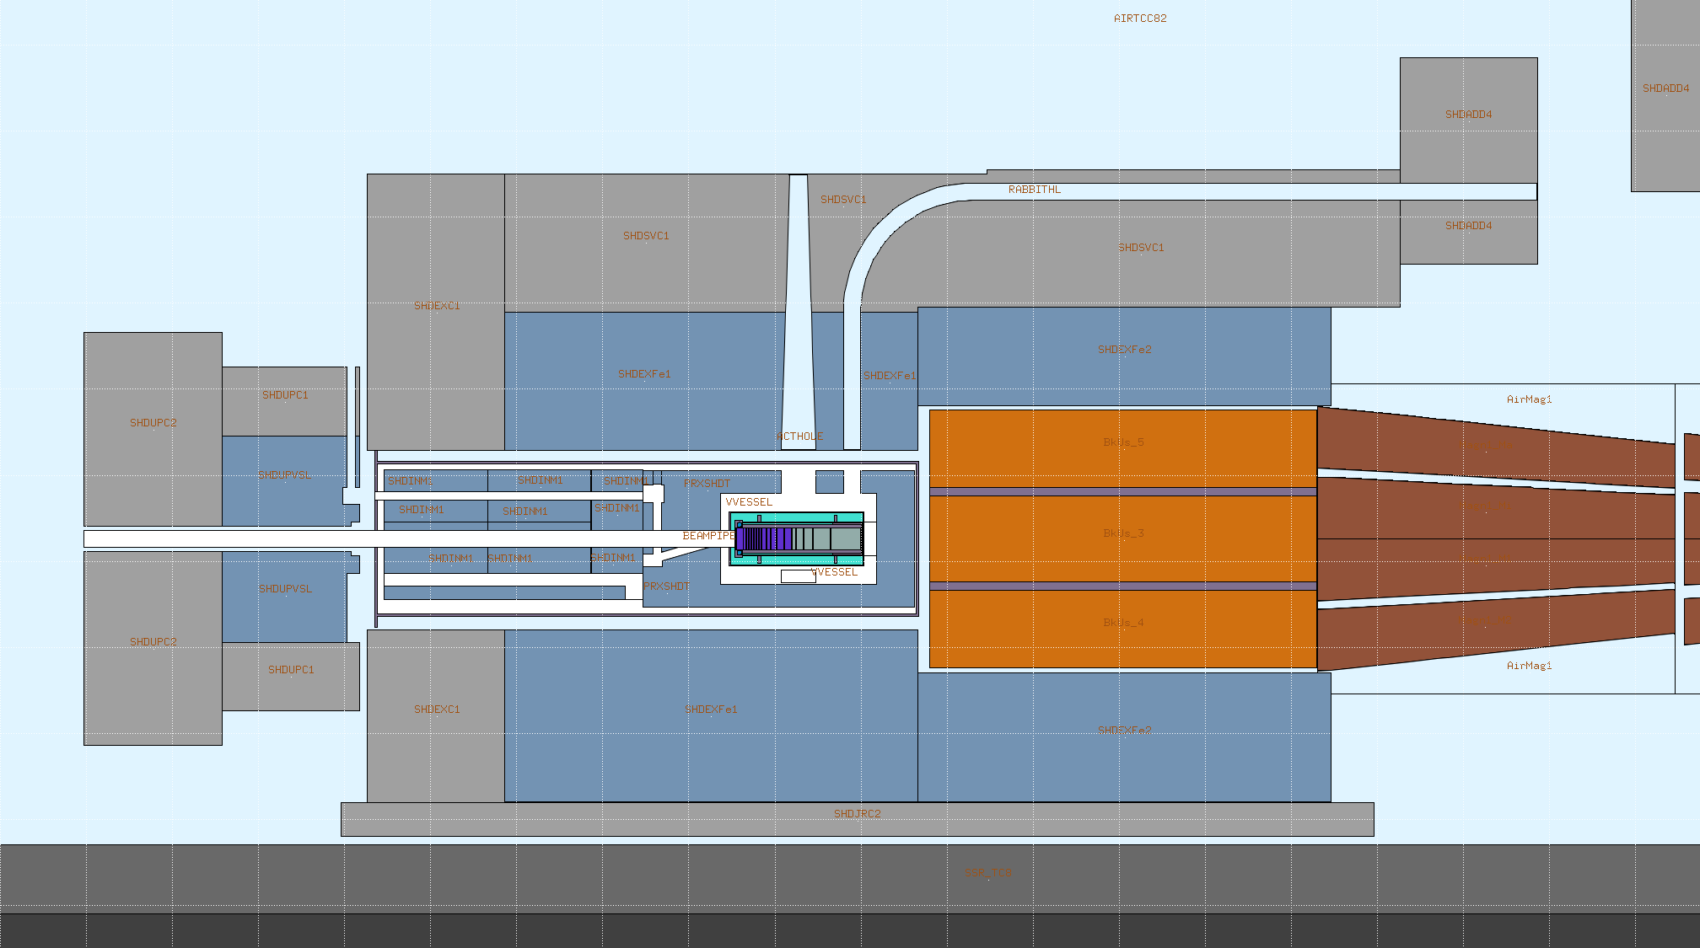
Baseline target case - Geometry
(BEAS)
R2E@4m
Rabbit channel
Vacuum-vessel
BRIS
BHFIM2
BHFIM1
X
Z

Slide 5
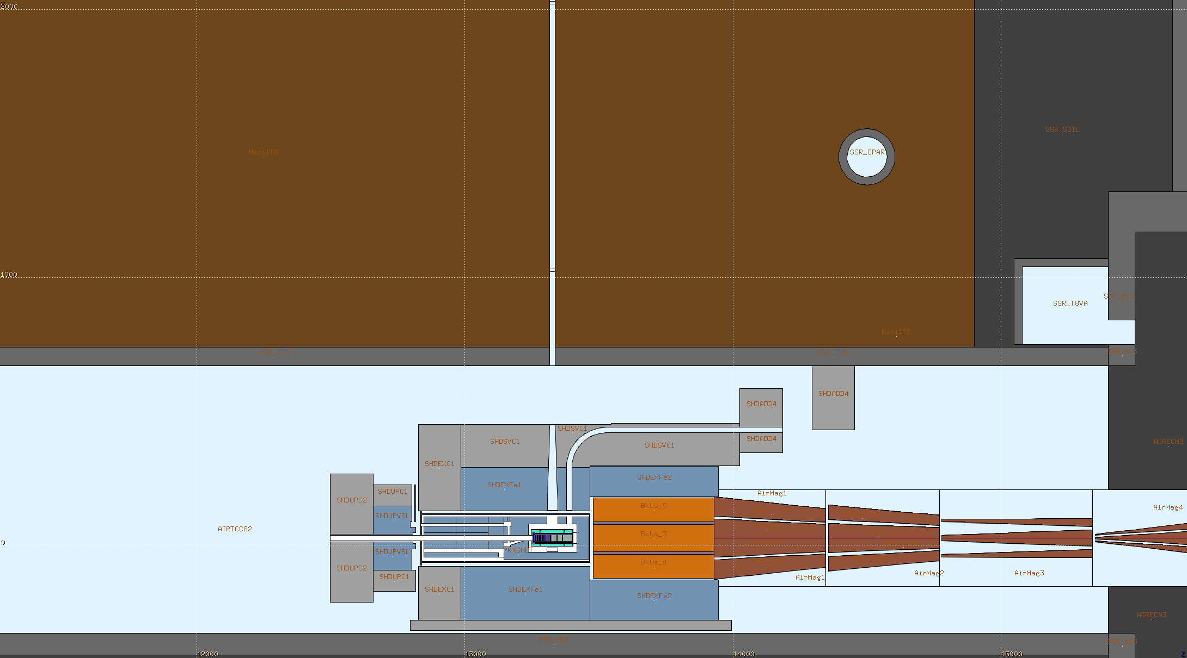
Baseline target case - Geometry
R2E@20m
R2E@10m
Atmospheric-neutron channel
R2E@4m
X
Z

Slide 6

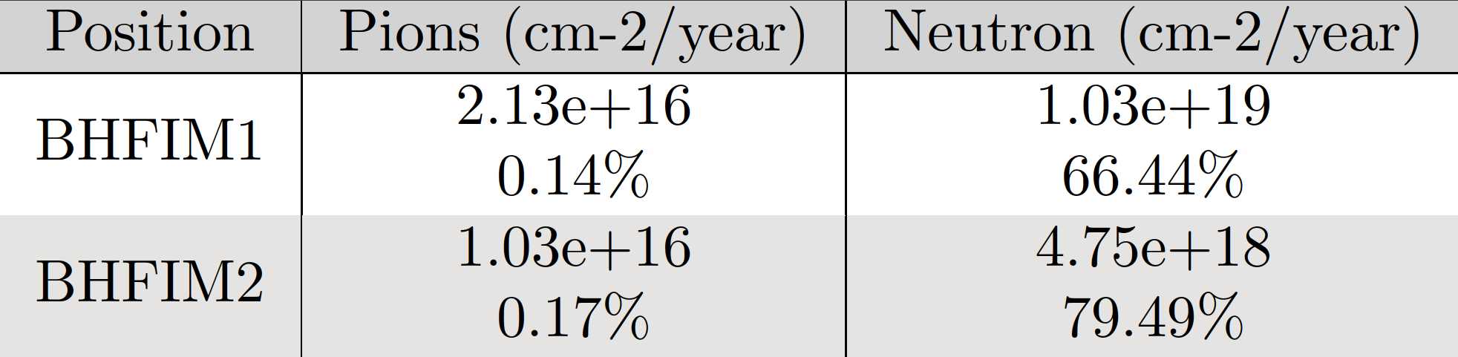
In-vessel irradiation stations – integral values
Irradiation stations inside BDF vacuum vessel → irradiated sample must remain in position for ~ 1 year
High-Fluence, in-vessel, Irradiation Module (BHFIM):
  BHFIM1 at the side of target
  BHFIM2 downstream of target
Normalization
  BDF: 4e19 POT/year

Slide 7
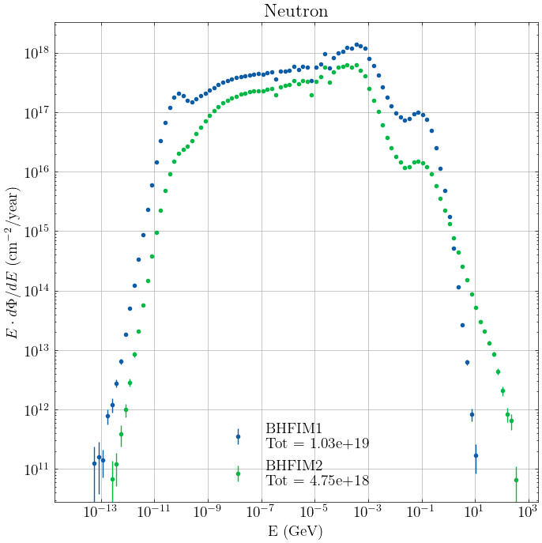
In-vessel irradiation stations – neutron spectra
Irradiation stations inside BDF vacuum vessel → irradiated sample must remain in position for ~ 1 year
High-Fluence, in-vessel, Irradiation Module (BHFIM):
  BHFIM1 at the side of target
  BHFIM2 downstream of target
Normalization
  BDF: 4e19 POT/year

Slide 8
Rabbit channel irradiation station – integral values
Irradiation station at the end of rabbit channel, closest to the target → ideally possible to easily change sample
Rabbit Irradiation System (BRIS), reaching the end of target
Normalization
  BDF: 4e13 POT/cycle with 7.2 s/cycle

Slide 9
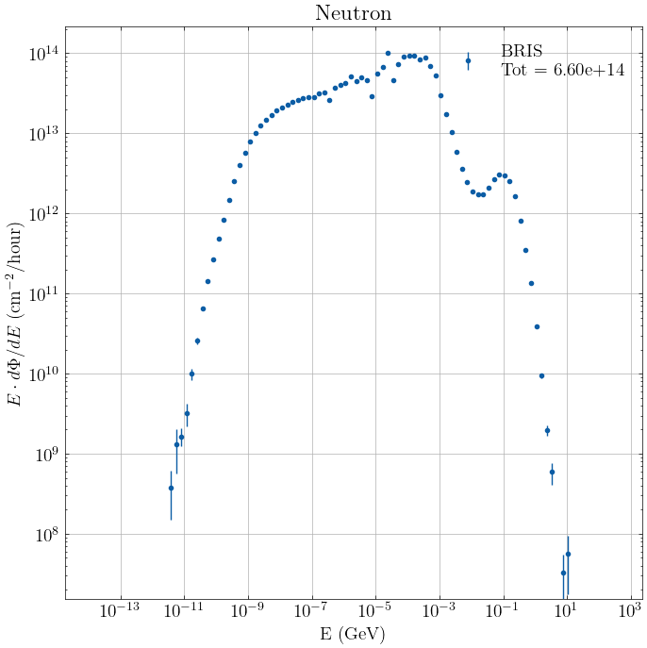
Rabbit channel irradiation station – neutron spectra
Irradiation station at the end of rabbit channel, closest to the target → ideally possible to easily change sample
Rabbit Irradiation System (BRIS), reaching the end of target
Normalization
  BDF: 4e13 POT/cycle with 7.2 s/cycle

Slide 10
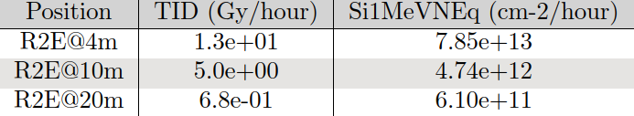
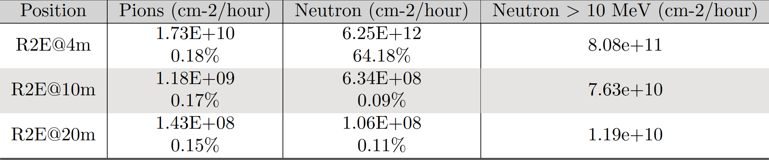
Atmospheric-neutron channel – integral values
Irradiation stations along R2E channel → ideally possible to easily access/change sample
R2E@4m/10m/20m from the target center
Normalization
  BDF: 4e13 POT/cycle with 7.2 s/cycle

Slide 11
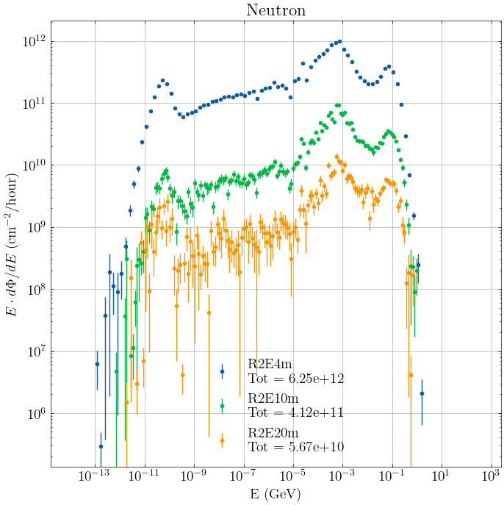
Atmospheric-neutron channel – neutron spectra
Irradiation stations along R2E channel → ideally possible to easily access/change sample
R2E@4m/10m/20m from the target center
Normalization
  BDF: 4e13 POT/cycle with 7.2 s/cycle

Slide 12
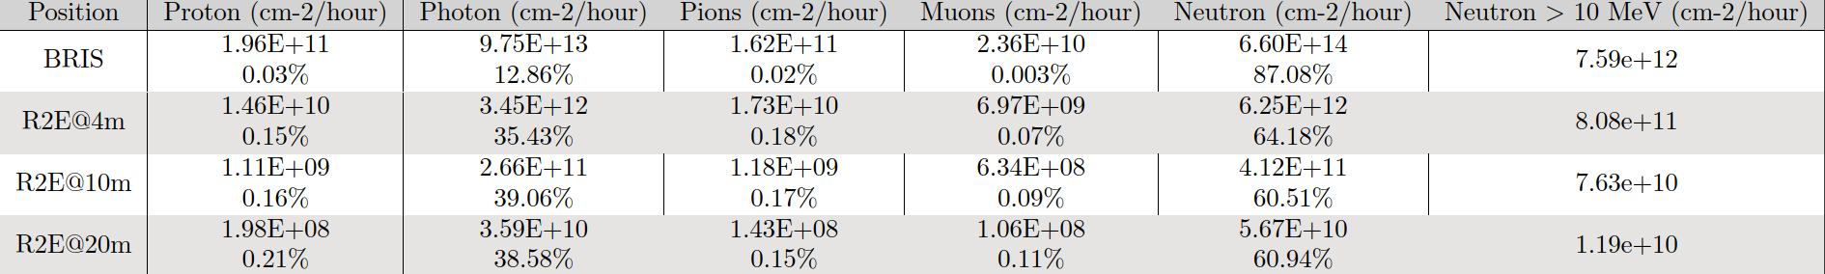
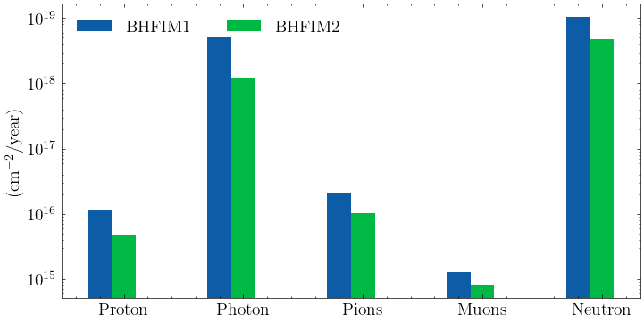
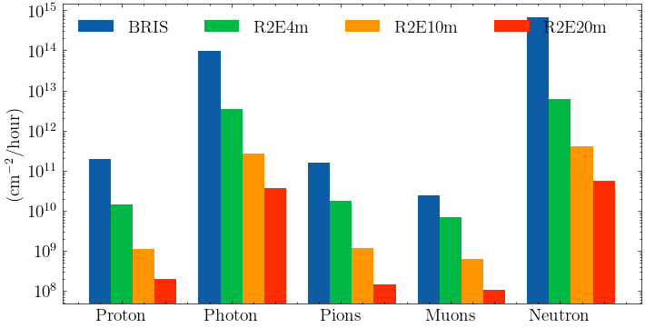
Summary – integral values particles

Slide 13
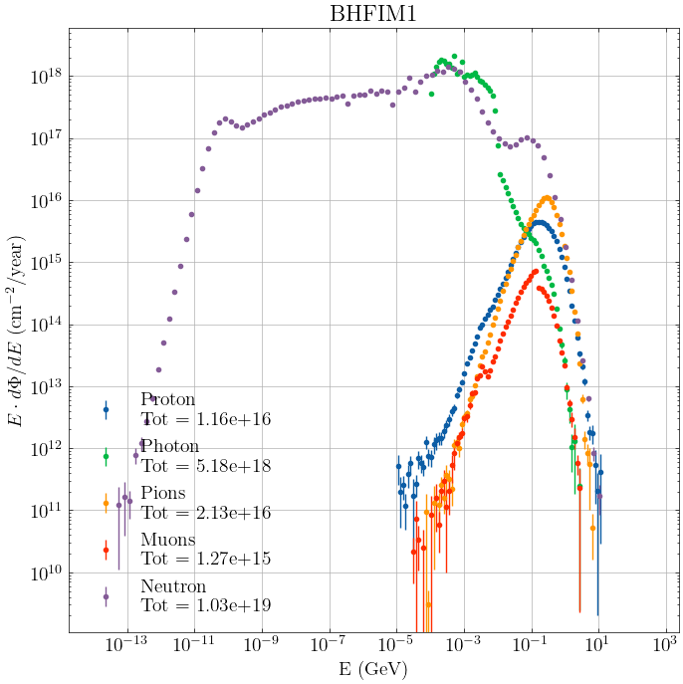
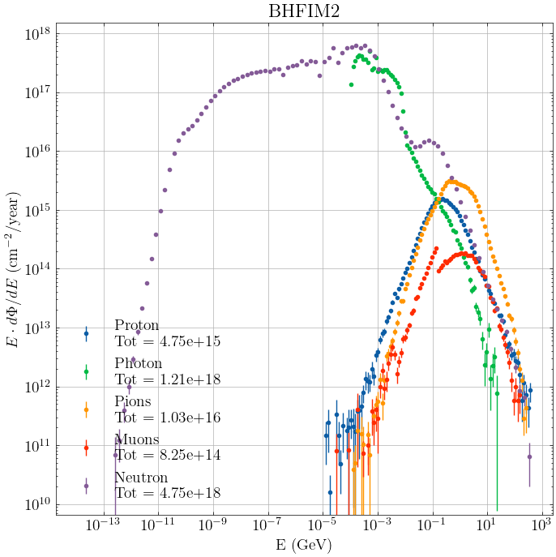
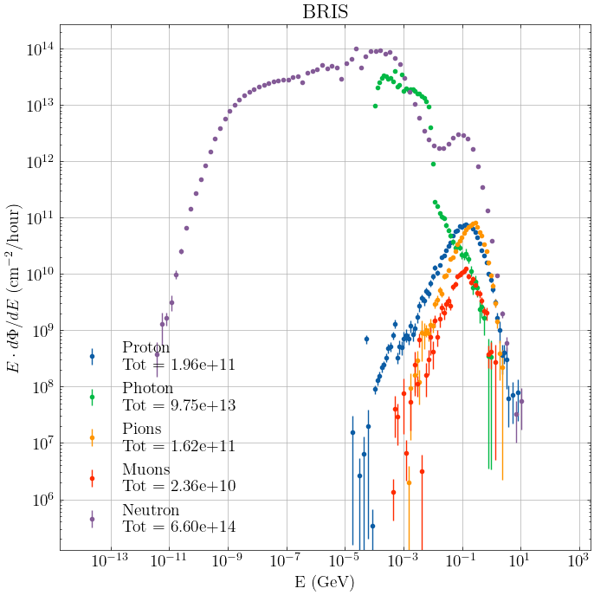
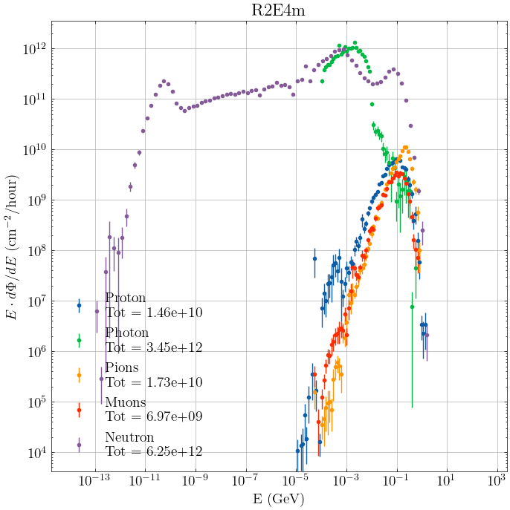
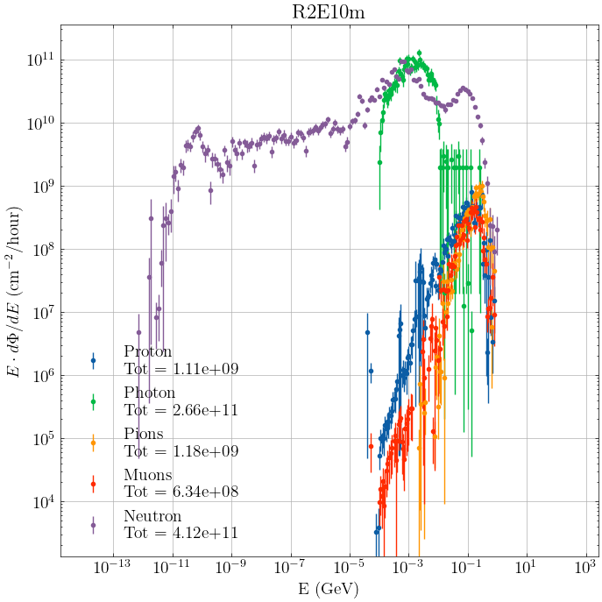
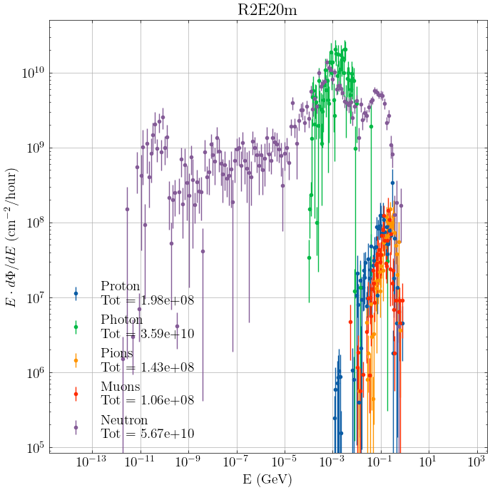
Summary – particles spectra

Slide 14
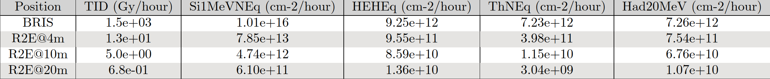
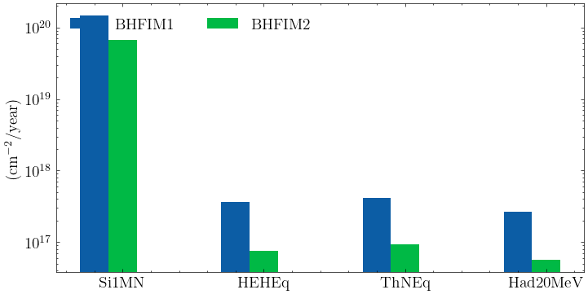
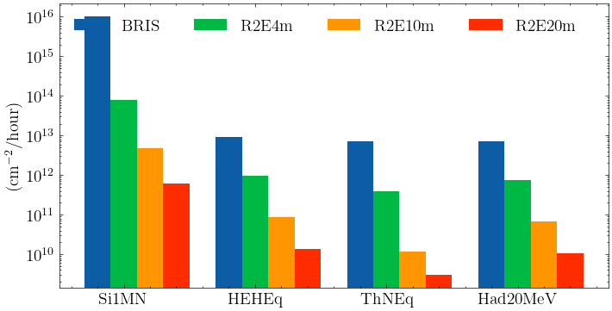
Summary – integral values R2E quantities

Slide 15
Full W target

Slide 16
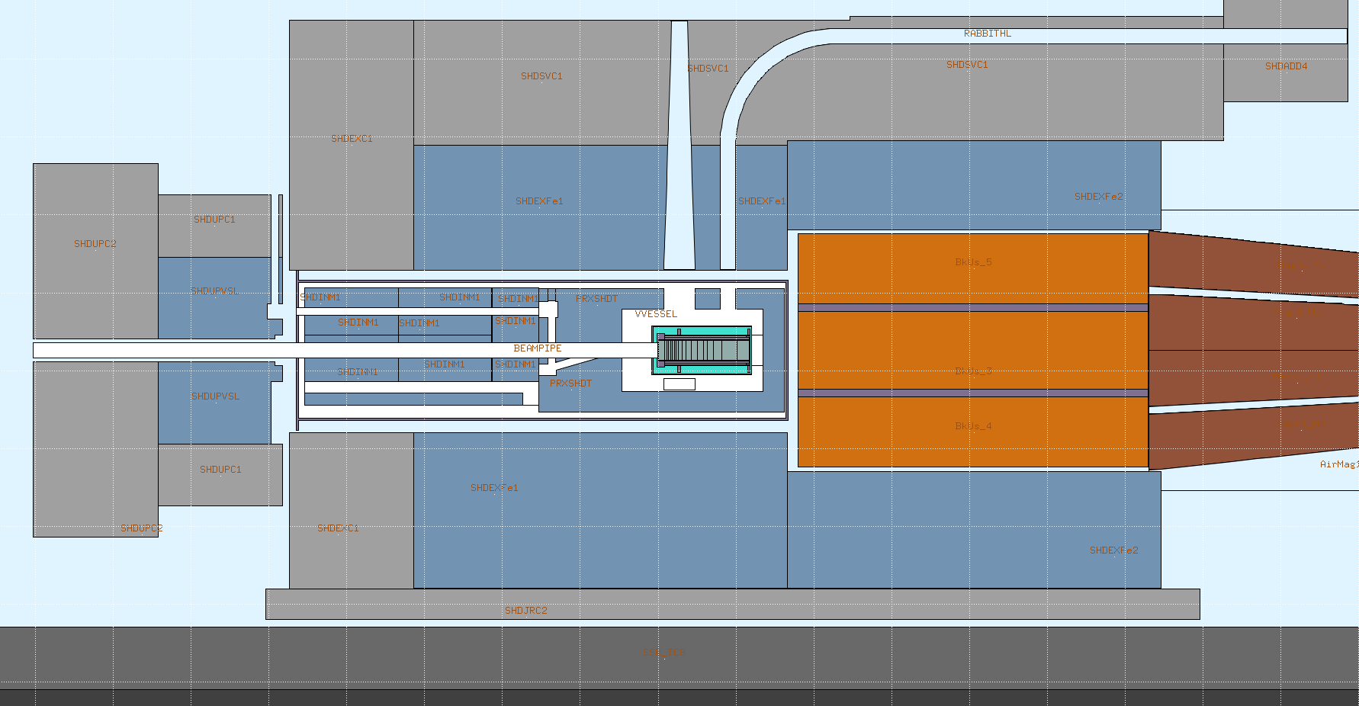
Geometry – Full W target
(BEAS)
R2E@4m
Rabbit channel
BRIS
BHFIM2
BHFIM1
X
Z

Slide 17
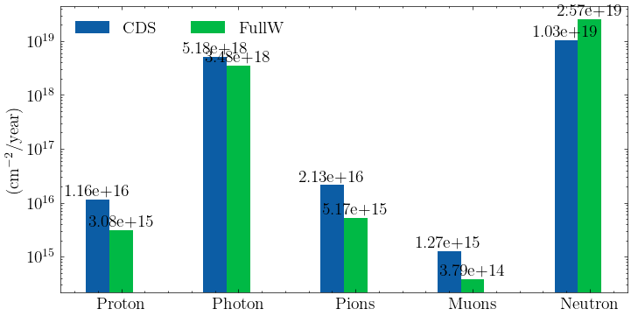
In-vessel irradiation stations – Full W target
CDS target replaced with a full tungsten target → kept same number of lambdas but higher density
Expected some differences in the particles ratio for the irradiation stations on the side of the target
Optimized target design ongoing
BHFM1

Slide 18
Be reflector

Slide 19
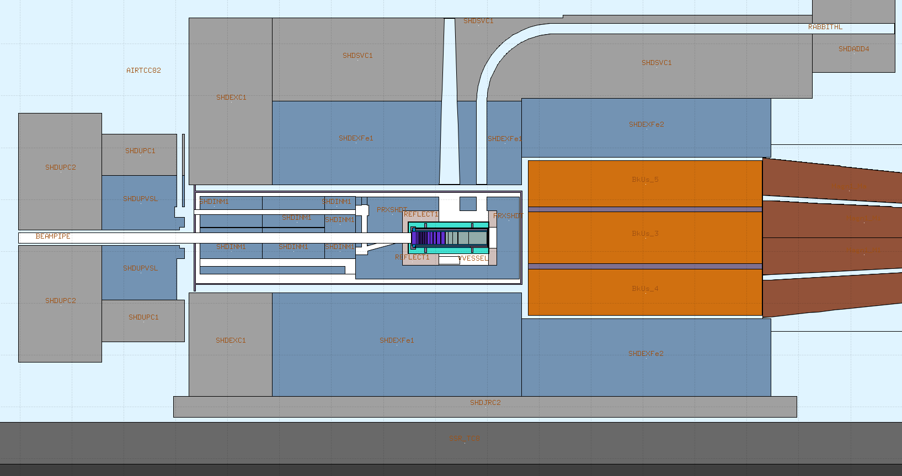
Geometry – CDS target + Be reflector
(BEAS)
R2E@4m
Rabbit channel
BRIS
BHFIM2
BHFIM1
X
Z

Slide 20
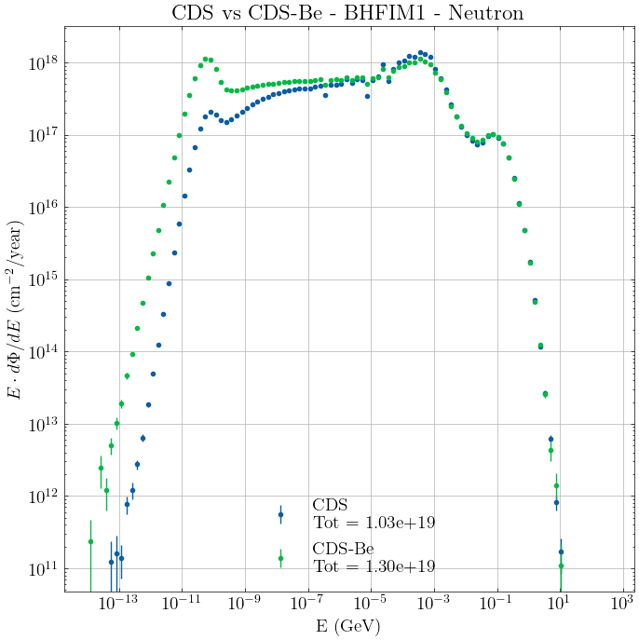
In-vessel irradiation stations – CDS + Be reflector
Be placed all around proton and neutron channels as reflector → expected an increase in thermal neutron peak
Differences visible in the neutron spectra for the in-vessel irradiation stations
Optimization for reflector might be foreseen

Slide 22
Backup

Slide 23

FLUKA - Scoring
Scoring quantities:
  Total Ionizing Dose $[Gy/Year]$
  Proton fluence $[\frac{1}{{cm}^{2}∗Year}]$
  Photon fluence $[\frac{1}{{cm}^{2}∗Year}]$
  Muons fluence $[\frac{1}{{cm}^{2}∗Year}]$
  Neutron fluence $[\frac{1}{{cm}^{2}∗Year}]$
  R2E quantities, generally fluences [$\frac{1}{{cm}^{2}∗Year}$]
R2E quantities [1][2] :
  Silicon 1 MeV-neutron Equivalent Fluence = fluence weighted by a damage function
  High Energy Hadron Equivalent Fluence = proportional to the number of SEU (Single Event Upset) due to hadrons of energy > 20MeV. Neutron of lower energies are weighted according to the ratio of their SEU cross section to the one of > 20 MeV hadrons
  Thermal Neutron Equivalent Fluence = proportional to the number of SEU's due to thermal neutrons. Neutrons of higher energies are weighted according to the ratio of their capture cross section to the one of thermal neutrons (following the 1/v law)
  Hadrons with energy greater than 20 MeV

Slide 24
References
[1] K. Roeed, M. Brugger and C. Pignard
PTB irridiation tests of the LHC radiation monitor (RadMon)
CERN ATS Note 2011-012, 2011 http://cds.cern.ch/record/1329478?ln=es
[2] K. Roeed, M. Brugger, D. Kramer et al.
Method for measuring mixed field radiation levels relevant for SEEs at the LHC
IEEE Transactions on Nuclear Science, vol. 59, no. 4, pp. 1040-1047, 2012.

Slide 25
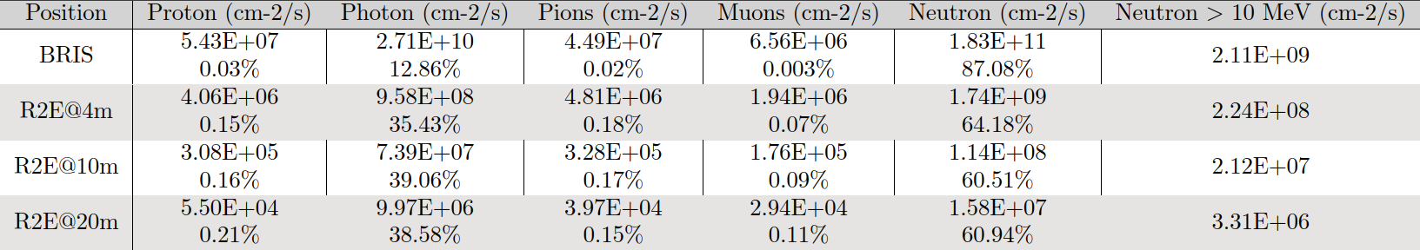

Summary – integral values particles

Slide 26
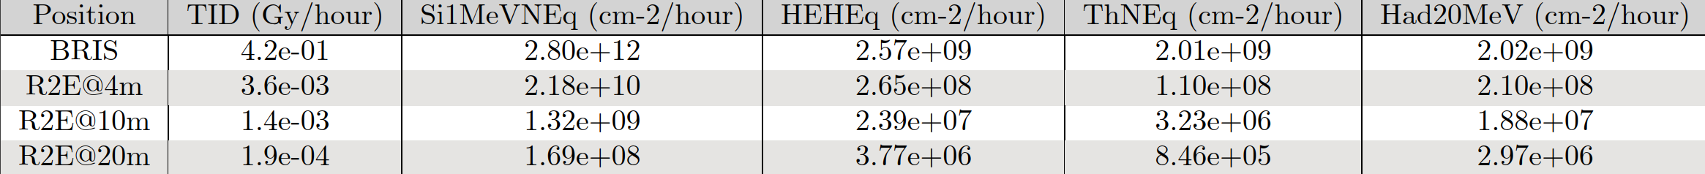
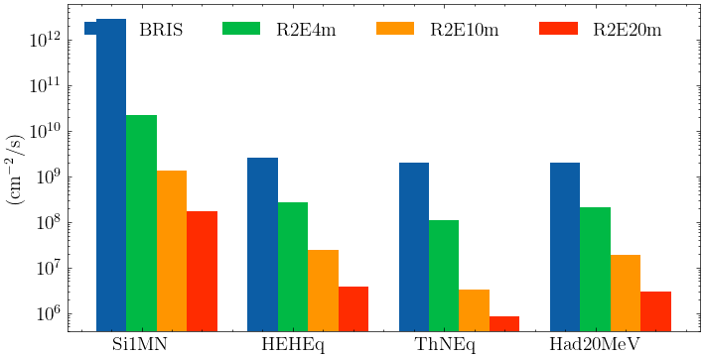
Summary – integral values R2E quantities

