Slide 1


WP 2, Communication, Dissemination, Exploitation and Training
Ennio Capria (ESRF)
RADNEXT 4th Annual Meeting – 12 and 13 May 2025
https://indico.cern.ch/e/radnext-2025

Slide 2
Outline
Main achievements (milestones and deliverables)
WP2 activities
  Exploitation and link to industry
  Communication and dissemination
  Training activities
Future plans

Slide 3
Milestones and deliverables
Work Package 2

Slide 4
Deliverables
Status | ID | Title | Deadline | Responsible (s)
Completed | D2.1 | Communication and dissemination plan | 31/08/2021 | KU Leuven
Completed | D2.2 | Exploitation and data management plan | 30/09/2021 | ESRF
Completed | D2.3 | Intermediate report on the coordination of Communication, Dissemination, Exploitation and training | 31/05/2023 | KU Leuven
TBD | D2.4 | Final Preferred Parts List | 31/05/2026 | KU Leuven
TBD | D2.5 | Final report on the coordination of Communication, Dissemination, Exploitation and training | 31/05/2026 | KU Leuven
No new deliverables to report since previous Annual Meeting

Slide 5
Milestones
Status | ID | Title | Deadline | Responsible (s)
Completed | MS08 | Project Website launched | 31/08/2021 | KU Leuven / CERN
Completed | MS09 | Appointing the Industrial Advisory Panel (IAP) | 30/11/2021 | ESRF
Completed | MS10 | List of commercial components of interest | 31/05/2022 | KU Leuven
Completed | MS11 | First RADNEXT-to-Industry event finished | 31/05/2022 | ESRF
Completed | MS12 | Second RADNEXT-to-Industry event finished | 30/11/2023 | ESRF
Completed | MS13 | Third RADNEXT-to-Industry event finished | 31/05/2025 | ESRF

Slide 6
Exploitation and link to industry

Slide 7
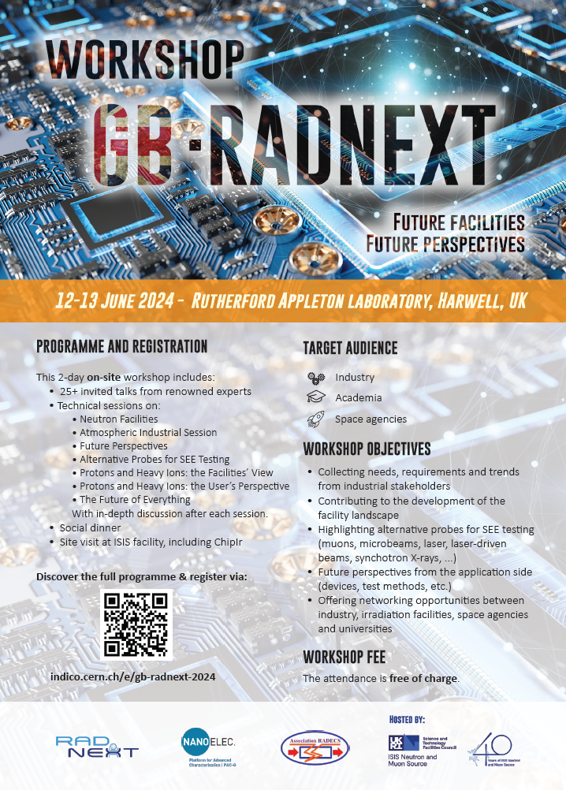
GB-RADNEXT 2024
Workshop dedicated to industry, 12-13 June 2024
Organised by RADNEXT in collaboration with the Platform for Advanced Characterisation (PAC-G), RADECS association and RAL
Aim: To increase the level of engagement from industry and to stimulate discussion
between industry and academia
2-day hybrid event at RAL (+Zoom)

Slide 8

G-RADNEXT 2025

Slide 9
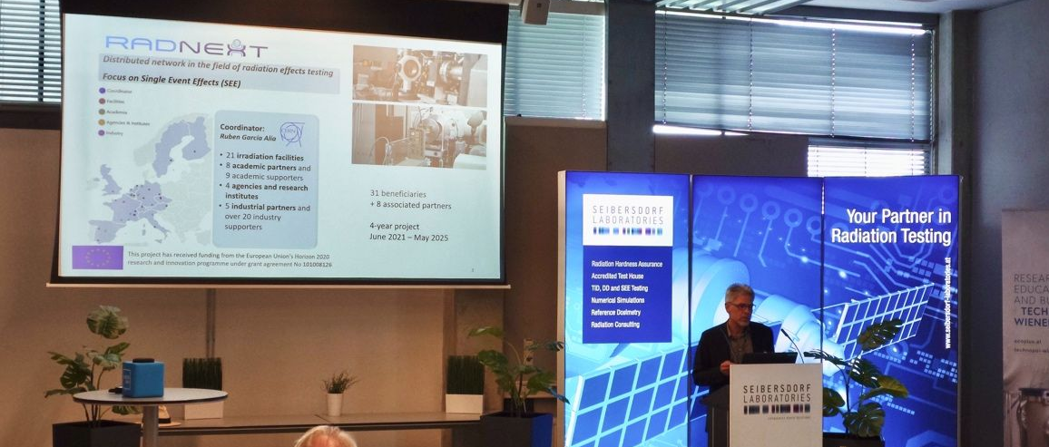
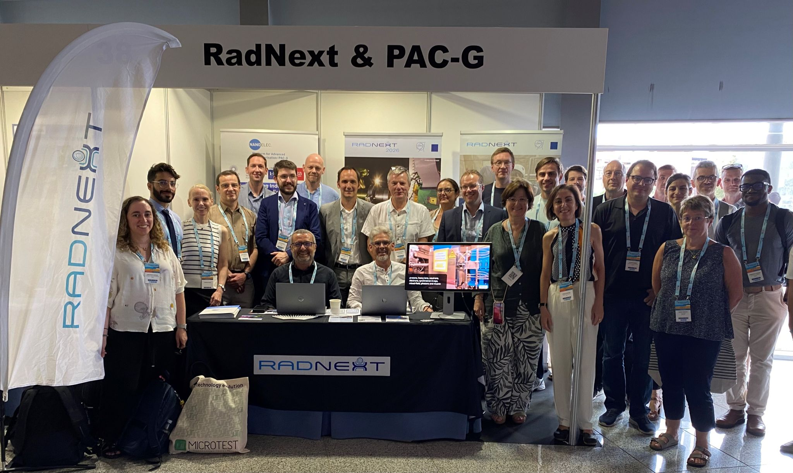
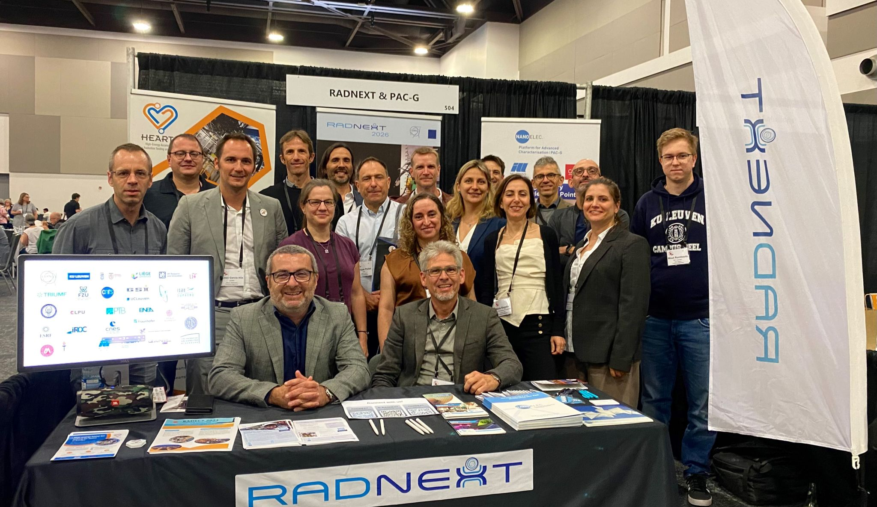
Communication and dissemination
Conferences and events
In 2024, RADNEXT was present at the following conferences
(booths or invited talks):
RADHARD Symposium (7-8 May, Seibersdorf)
GB-RADNEXT Workshop (12-13 June, Harwell)
NSREC (22-26 July, Ottawa)
RADECS (16-20 September, Maspalomas)
For 2025, we are planning to have a booth at:
RADECS (29 September-3 October, Antwerp)

Slide 10
Communication and dissemination
Ongoing activities: website, LinkedIn, newsletter, …

Slide 11
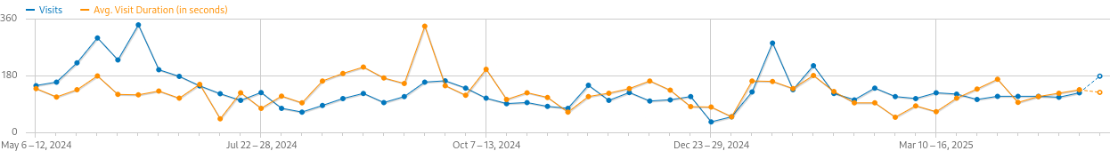
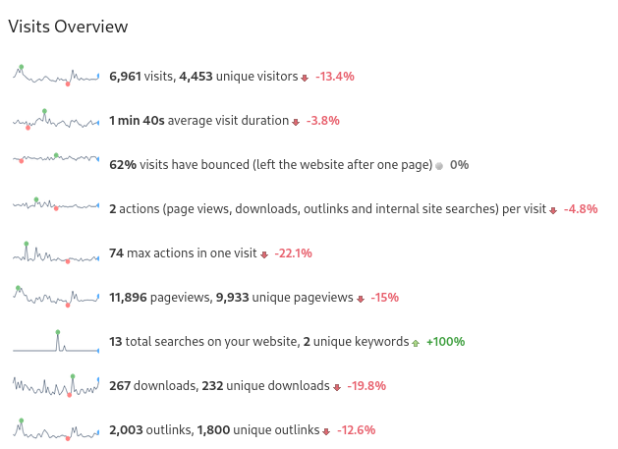
Communication and dissemination
Website statistics
Website remains primary gateway for information distribution
Useful pop-ups (for webinars, TA calls etc.)
May 2024- May 2025
G-RADNEXT and Annual Meeting 2024
RADECS 2024
Launch January
TA call

Slide 12
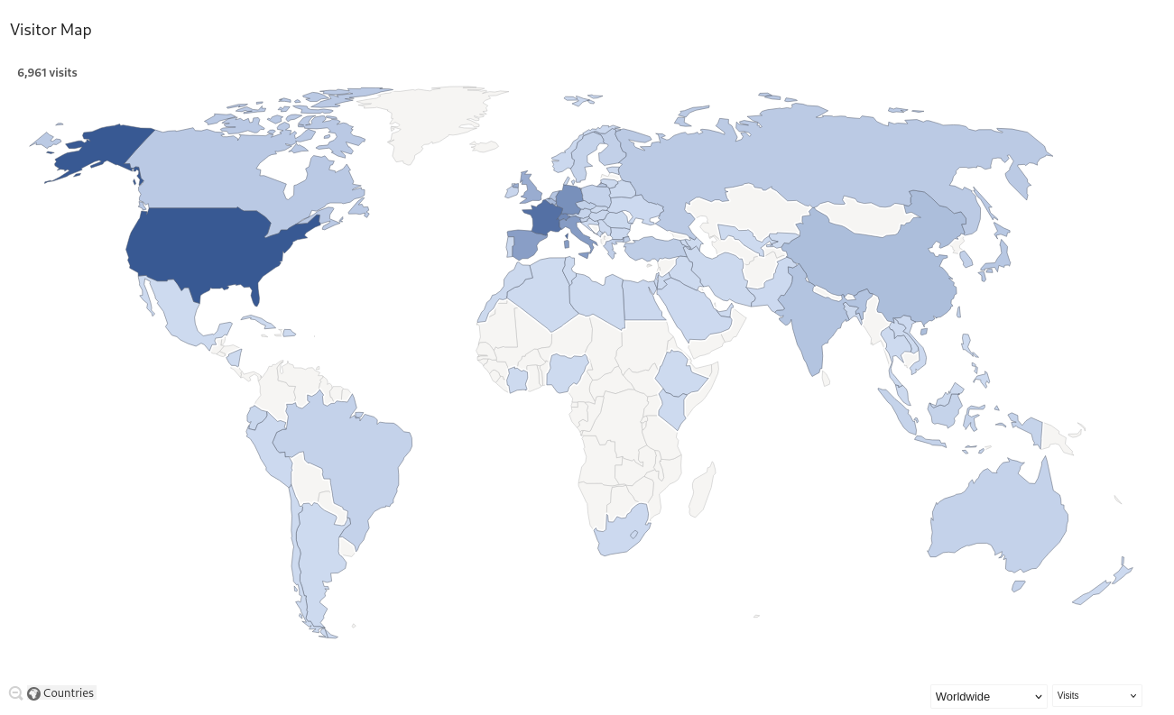
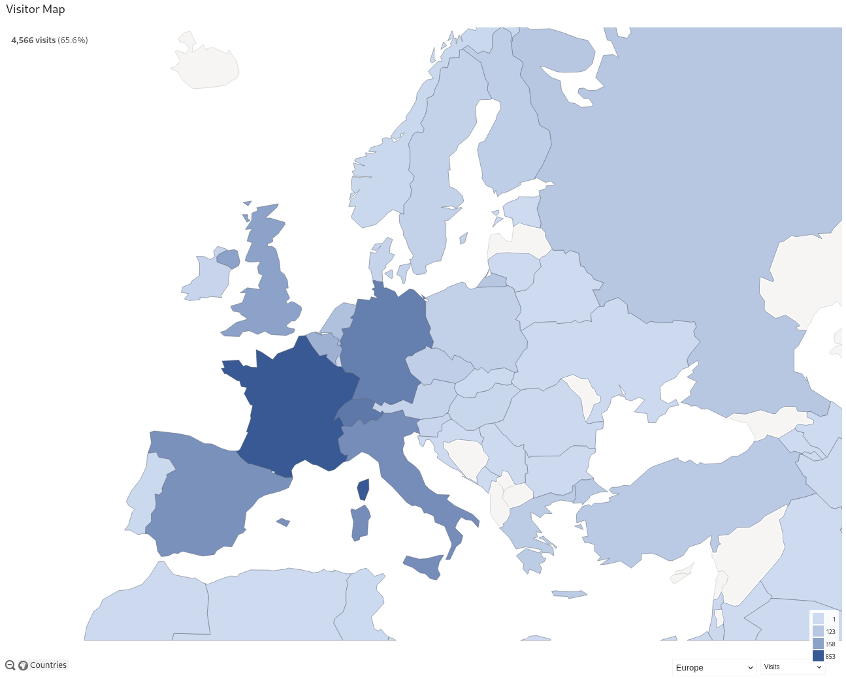
Communication and dissemination
Website statistics
Visitor distribution
Worldwide Europe

Slide 13
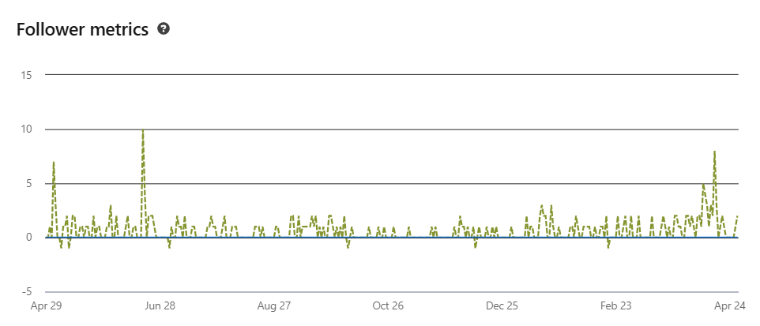
Communication and dissemination
LinkedIn
Currently 1510 followers!
(+250 since previous Annual Meeting)
And a lot of activity on LinkedIn
  Regular posts about events (G-RADNEXT, webinars, conferences, …)
  Posts about calls for beam time proposals & RADNEXT research in the spotlight
  A lot of posts/tags by facility users after their irradiation experiments
TA call launch
GB-RADNEXT 2024
Intensive activity for
G-RADNEXT 2025

Slide 14
Communication and dissemination
RADNEXT newsletter
10 newsletters sent via Spotler platform
  Topics: updates and interesting news on the project, research results, TA calls, webinars, workshops, conferences …
Newsletter sign-up button added as pop-up on website + archive available
Current mailing list: 320 contacts
  103 signed up via subscription form!
➔ Any ideas or input for the newsletter is always welcome via radnext.network@communication.cern.ch!

Slide 15
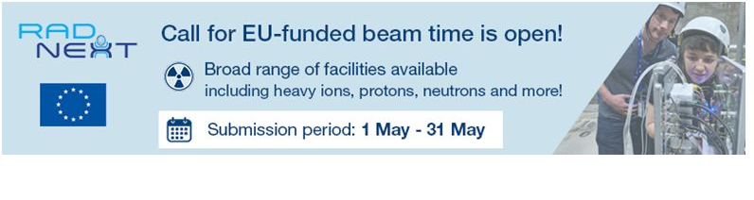
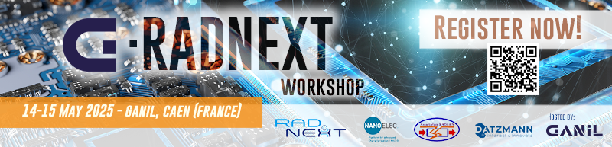

Communication and dissemination
Email signatures
Easy way to spread the word about RADNEXT TA calls and other activities
Thanks for also adding them to your own email signature!

Slide 16
Training activities
Online and in-person

Slide 17
Training activities
WP2 also has a focus on training activities in the radiation effects domain with the main goals to :
  educate people on the fundamentals related to radiation effects in electronics
  attract more engineers and scientists to the field
WP2 focuses on two important training modalities:
  Online training activities via webinars and a dedicated Massive Online Open Course (MOOC) on Radiation Effects in Electronics
  In-person training opportunities via the organisation of international schools and workshops

Slide 18
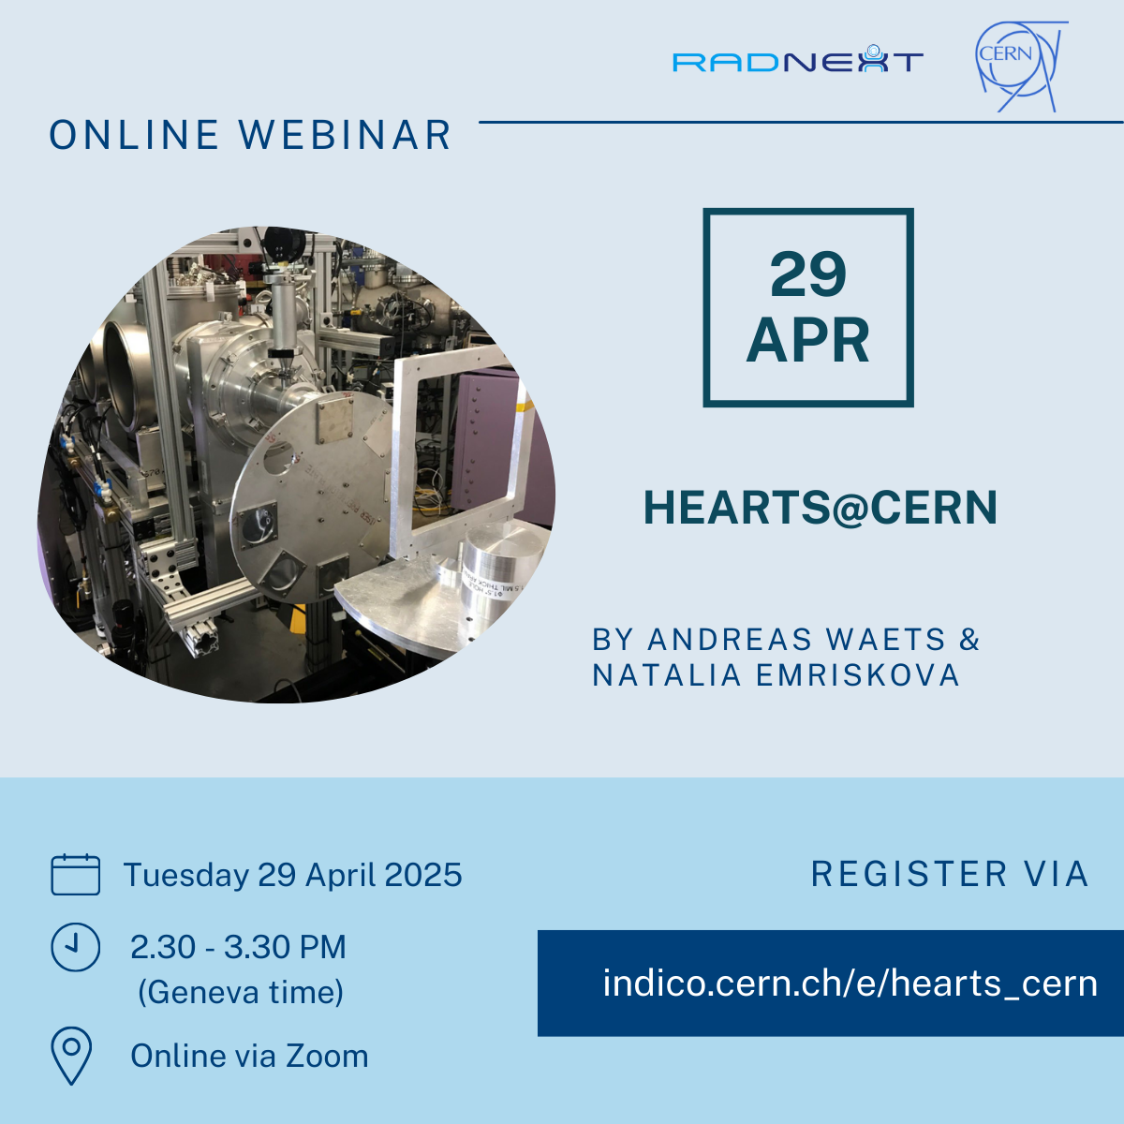
Online training activities
Webinars
Webinar series on present and future irradiation facilities around the world:
  29 April 2025 | HEARTS@CERN: High-Energy Heavy Ions for Space Electronics Testing – by Andreas Waets & Natalia Emriskova
  20 May 2025 | SEE Testing at Texas A&M University Cyclotron – by Dr. Henry L. Clark
  17 June 2025 | Heavy Ion SEE Facility Development at Michigan State University - by Dr. Steve Lidia
  All recorded videos available on
  RADNEXT YouTube Channel

Slide 19
Online training activities
MOOC: RadiationX
Radiation Effects on Electronics: from Accelerators to Space
Massive Open Online Course, hosted on Edx platform
  Duration: 5 weeks (self-paced), 6-8 hours/week
  Target audience: undergraduate and graduate students in Physics or Electrical/Electronics Engineering + young professionals and researchers
Developed with support from MOOC team of the KU Leuven Learning Lab
Quite challenging and difficult process - currently still in development phase of the learning materials (video lectures, screencasts, interactive quizzes, exercises, discussion forums, texts, …)
Expected launch date: Second semester 2025

Slide 20
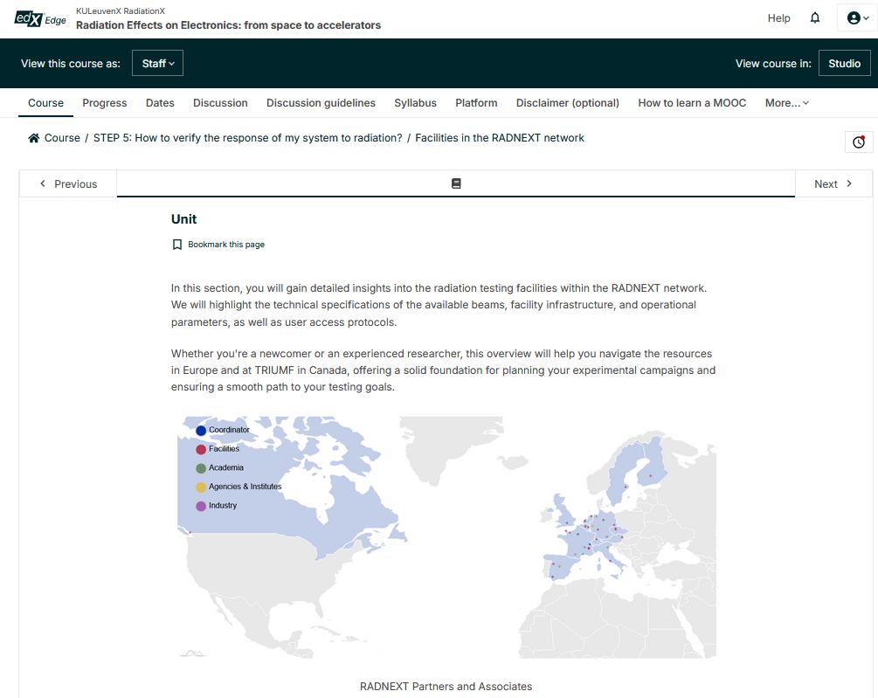

Online training activities
MOOC: RadiationX
Action on Facility responsibles:
Module 5 – Radiation Testing Methodologies and Facilities
  Input from each facility of the network to be included in the module:
Fill out this online form with your facility general information!

Slide 21
Plans for the final year
Continue our ongoing communication and dissemination activities
Finalise MOOC
Two more deliverables:
  D2.4 Final Preferred Parts List
  D2.5 Final report on the coordination of Communication, Dissemination, Exploitation and training
G-RADNEXT 2026?

Slide 22
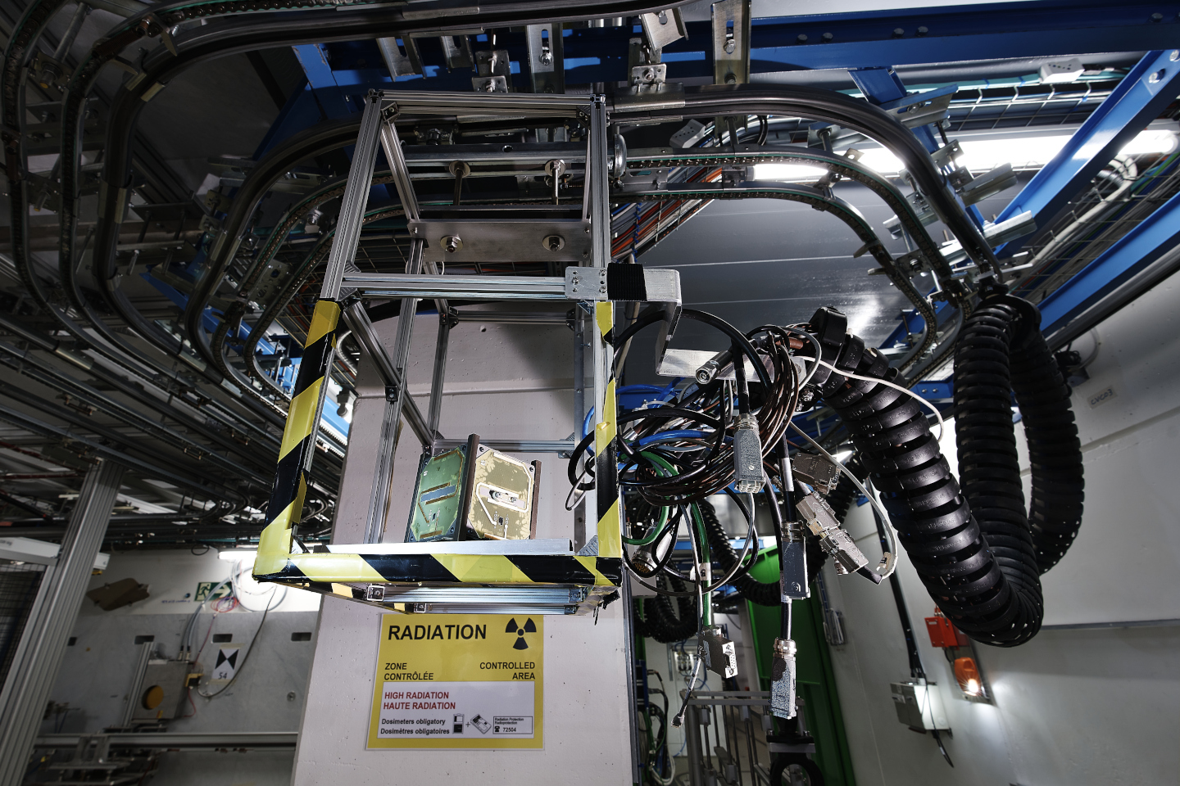
Thanks for your attention!
Image Source: CERN

